Slide 1
Treatment plan

Slide 2
The plan should encompass
Immediate
Intermediate
Long-term Goals.

Slide 3
After the diagnosis and prognosis have been established, the treatment is planned. The treatment plan is the blueprint for case management. It includes all procedures required for the establishment and maintenance of oral health and involves the following decisions:

Slide 4
Emergency treatment (pain, acute infections)
Removal of nonfunctional and diseased teeth, and possibly strategic extraction of healthy teeth to facilitate the prosthetic reconstruction of the patient
Treatment of periodontal diseases (surgical or nonsurgical, regenerative or resective).
Endodontic therapy (necessary and intentional)
Caries removal and placement of temporary and Final restorations
Occlusal adjustment and orthodontic therapy
Replacement of missing teeth with removable or Fixed dental prostheses or dental implants
Aesthetic demands
Sequence of therapy

Slide 5
Extracting or Preserving a Tooth
Treatment is directed to establishing and maintaining the health of the periodontium throughout the mouth rather than attempting spectacular efforts to “tighten loose teeth.”
Removal, retention, or temporary (interim) retention of one or more teeth is an important part of the overall treatment plan.

Slide 6
A tooth should be extracted under the following conditions:
It is so mobile that function becomes painful.
It can cause acute abscesses during therapy.
There is no use for it in the overall treatment plan.

Slide 7
In some cases, a tooth can be retained temporarily, postponing the decision to extract until after treatment is completed. A tooth in this category can be retained under the following conditions:
It maintains posterior stops and may be functional after implant placement in adjacent areas. When the implant is restored, these teeth can be extracted.
In the anterior aesthetic zone, a tooth can be retained during periodontal therapy and removed when treatment is completed and a permanent restorative procedure can be performed.

Slide 8
In the formulation of the treatment plan, in addition to the proper function of the dentition, aesthetic considerations play an important role.
In complex cases, interdisciplinary consultation with other specialty areas is necessary before a Final plan can be made.

Slide 9
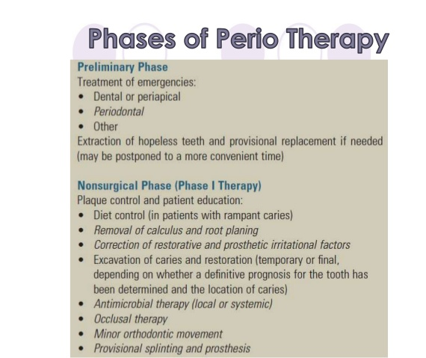
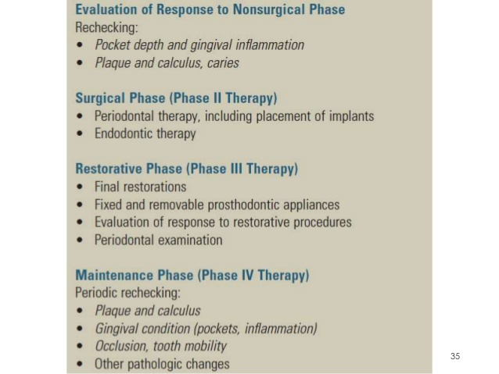
Phases of Periodontal Therapy

Slide 10
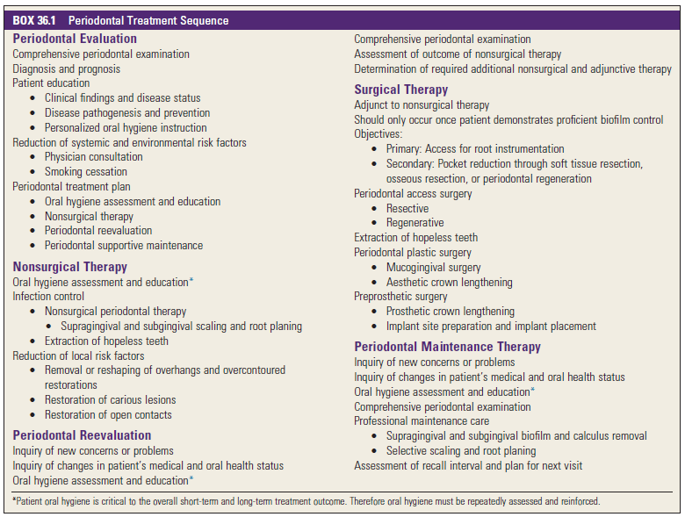

Slide 11
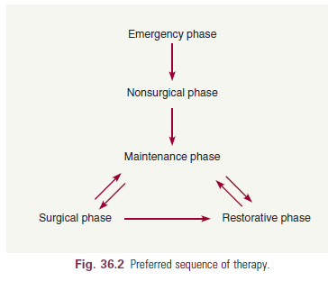
Sequence of Therapy

Slide 12
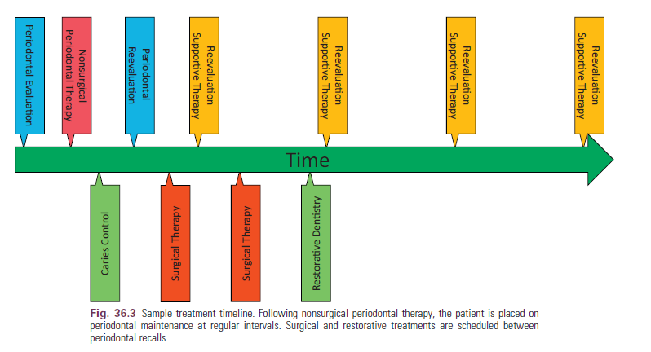

Slide 13
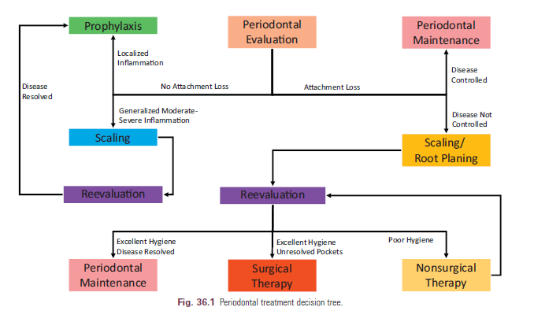

Slide 14
Explaining the Treatment Plan to the Patient
The following discussion includes suggestions for explaining the treatment plan to the patient.
Be specific.
Avoid vague statements.
Begin your discussion on a positive note
Present the entire treatment plan as a unit.

Slide 15
Patients often seek guidance from the dentist with questions such as the following:
“Are my teeth worth treating?”
“Would you have them treated if you had my problem?”
“Why don’t I just go along the way I am until the teeth really bother me and then have them all extracted?”

Slide 16
Conclusion
A treatment plan is a plan for therapy formulated only after a thorough examination has been completed, diagnosis and prognosis have been determined, and the needs and desires of the patient have been taken into consideration. A properly formulated treatment plan is paramount to treating periodontal disease, and obtaining long-term health.

