Slide 1
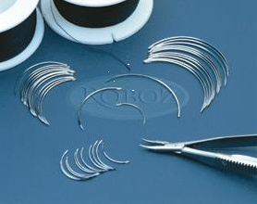
SUTURE MATERIALS
&
SUTURING TECHNIQUES

Slide 2
DEFINITIONS
Definition: suture material is an artificial fiber used to keep wound together until they hold sufficiently well by themselves by natural fibre (collagen) which is synthesized and woven into a stronger scar

Slide 3
        GOALS OF SUTURING
        Suturing is performed to
        Provide adequate tension
        Maintain hemostasis
        Provide support for tissue margins
        Reduce post-op pain
        Prevent bone exposure
        Permit proper flap position

Slide 4
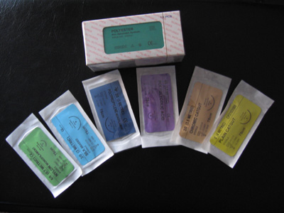
SUTURE
MATERIALS

Slide 5
REQUISITES OF AN IDEAL SUTURE
Tensile st: adequate material strength will prevent suture breakdown.
Tissue biocompatibility: sutures made from organic material will evoke a higher tissue response than synthetic sutures.
Low cost

Slide 6
Low capillarity: multifilament type soak up tissue fluid by capillary action providing a rich medium for microbes increasing chances of inflammation & infection.
Good handling & knotting properties: ease of tying & minimal knot slippage
Sterilization without deterioration of properties: sterilized by dry heat & ethylene oxide gas.

Slide 7
It should be readily visualized , should not shrink & should not be extruded from the wound.
On break down ,it should not release toxic agents.
It should disappear without excessive reaction once its task is completed.

Slide 8
CLASSIFICATION OF SUTURE MATERIALS
According to source:
1. Natural
2. Synthetic
3. Metallic

Slide 9
According to structure 1. Monofilament
2. Multifilament
According to fate:
1. Absorbable (undergo degradation and lose T.S. < 60 days)
2. Non absorbable ( maintain T.S > 60 days)
According to coating: 1. Coated
2. Uncoated

Slide 10
NATURAL
Absorbable
Catgut
Chromic catgut
Collagen
Fascia lata
kangaroo tendon
Beef tendon
Non Absorbable
Silk
Silk worm gut
Linen
Cotton
Ramie
Horse hair

Slide 11
SYNTHETIC
Absorbable
Polyglycolic Acid
Polyglactic Acid
Polyglactin 910 (Vicryl)
Polydioxanone(PDS)
Polyglecaprone 25
Non Absorbable
Nylon/ polyamide
PolyPropylene
Polyesters
Polyethelene
Polybutester

Slide 12
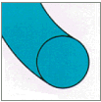
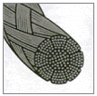
Monofilament
Multifilament

Slide 13
MONOFILAMENT
Advantages
Smooth surface
Less tissue trauma
No bacterial harbours
No capillarity
Disadvantages
Handling and knotting
Stretch
Any nick or crimp in the material leads to breakage.

Slide 14
MONOFILAMENT
Absorbable
Surgical Gut- Plain, Chromic
Polydiaxanone
Polyglactin 910
Non Absorbable
Polypropylene
Polyester
Nylon/polyamide
Polyvinylidene fluoride / PVDF Sutures

Slide 15
MULTI FILAMENT
Advantages
Strength
Soft and pliable
Good handling
Good knotting
Disadvantages
Bacterial harbors
Capillary action
Tissue trauma

Slide 16
MULTIFILAMENT
Absorbable
Polyglactin 910
Polyglycolic Acid
Non Absorbable
Silk
Cotton
Linen

Slide 17
Metallic
SS
Tantalum
Gold
Silver
Aluminium

Slide 18
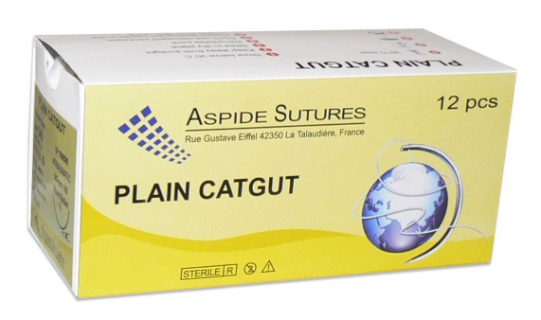
Absorbable -Natural
Gut / cat gut
Oldest known absorbable suture.
Derived from sheep intestinal sub mucosa or bovine intestinal serosa.
It is monofilament.
It should not be boiled or autoclaved as heat destroys its tensile strength.

Slide 19
Catgut is sterilized during preparation and kept in a preservative solution (isopropyl alcohol) inside foils. Unused and reusable catgut is hygroscopic so, catgut will swell due to water absorption and its tensile strength will be reduced .
Absorption :40-60 days
T.S lasts for 3-5days.

Slide 20
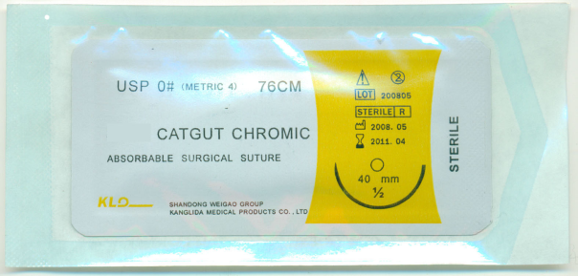
CHROMIC CATGUT
Coated with thin layer of chromium salt solution to minimize tissue reaction, increase TS, slow the absorption rate, better knot security, and ease of handling.
TS – 10-14 days
Absorbed in 90 days
Uses:Opthalmic surgery (6-0)
Oral surgery
Suture subcutaneous tissues

Slide 22
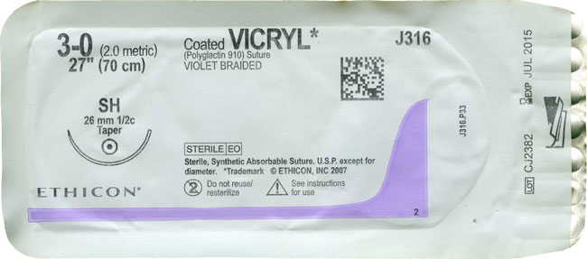
POLYGLACTIN 910 (VICRYL) Polyglactic acid
SYNTHETIC ABSORBABLE
Coated and uncoated
Synthetic suture
Monofilament/multifilament
It has hydrophobic qualities→delaying loss of TS
TS - 14 – 21 days.
Absorption – 56-70 days.

Slide 23
Minimal tissue reactivity and can be used in infected tissues
Coated with polyglactin 370 and calcium stearate which allows easy passage through tissues as well as easier knot placement.
On skin wounds, associated with delayed absorption as well as increased inflammation.

Slide 24
Non absorbable sutures
Natural – silk, silk worm gut, cotton , ramie,linen
Synthetic-polyester, polyamide, poly propylene, polyethelene
Metals : SS
Tantalum
platinum
silver wires
gold
aluminium

Slide 25
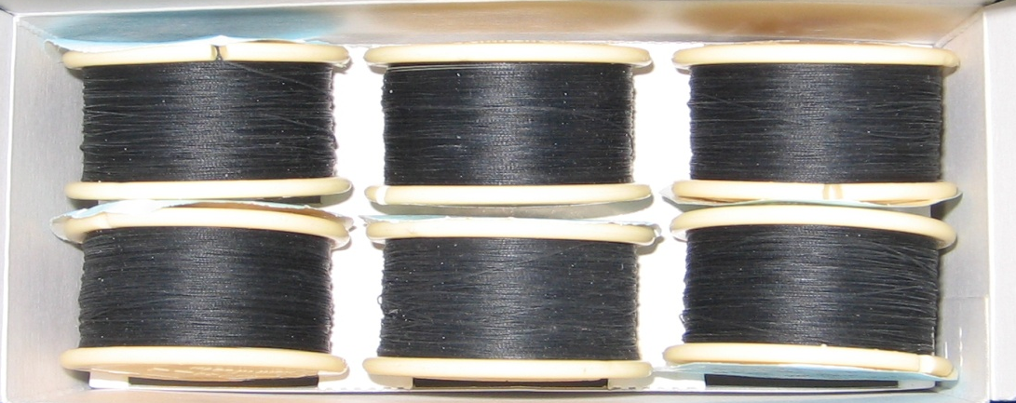
SURGICAL SILK
NATURAL NON-ABSORBABLE
-Braided or twisted
-Made from the filament spun by silkworm larva to form its cocoon. Each filament is processed to remove the natural waxes and sericin gum. After braiding, the strands are dyed, stretched and impregnated with a mixture of waxes and silicone. Dry silk suture is stronger than wet silk suture.

Slide 26
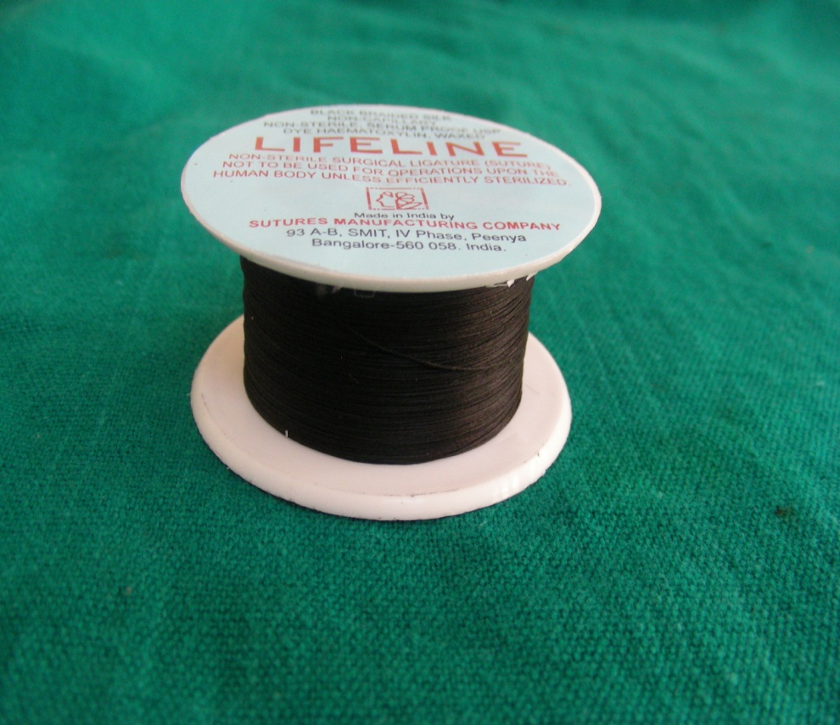
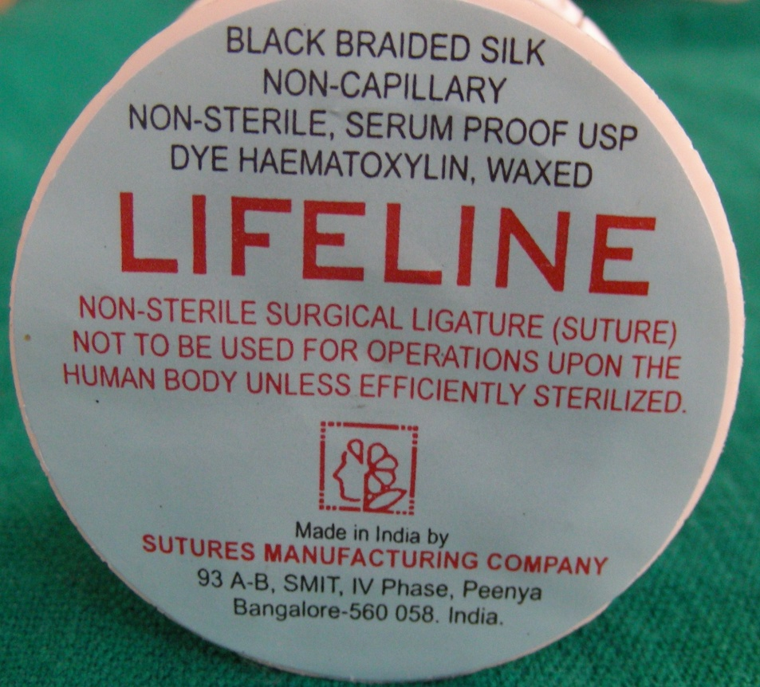
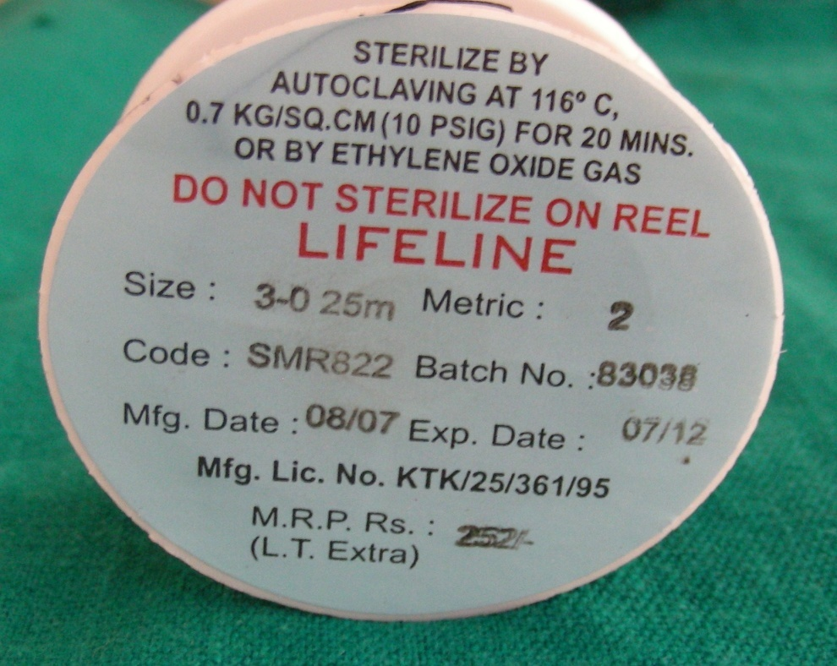

Slide 27
Advantage:
Ease of handling
Good knot security
made non capillary in order to withstand action of body fluids & moisture.(wax or silicon coated)
Cost effective
Contraindications:
Should not be used in presence of infection

Slide 28
Uses:
Plastic surgery, ophthalmic and general surgeries, ligating vessels.
studies show that it loses most of their TS after 1 yr. and cannot be detected in tissues after 2 yrs.

Slide 29
POLYPROPYLENE (PROLENE)
SYNTHETIC NON-ABSORBABLE
-Polymer of propylene.
-Inert and TS for 2 yrs
-Holds knots better than other synthetic sutures.
Advantages
-Minimal suture reaction and so used in infected and contaminated wounds.
-Do not adhere to tissues and is flexible. So used for ‘pull-out’ type of sutures.
Uses:
General, plastic, cardiovascular surgery, skin closure, ophthalmology.

Slide 30
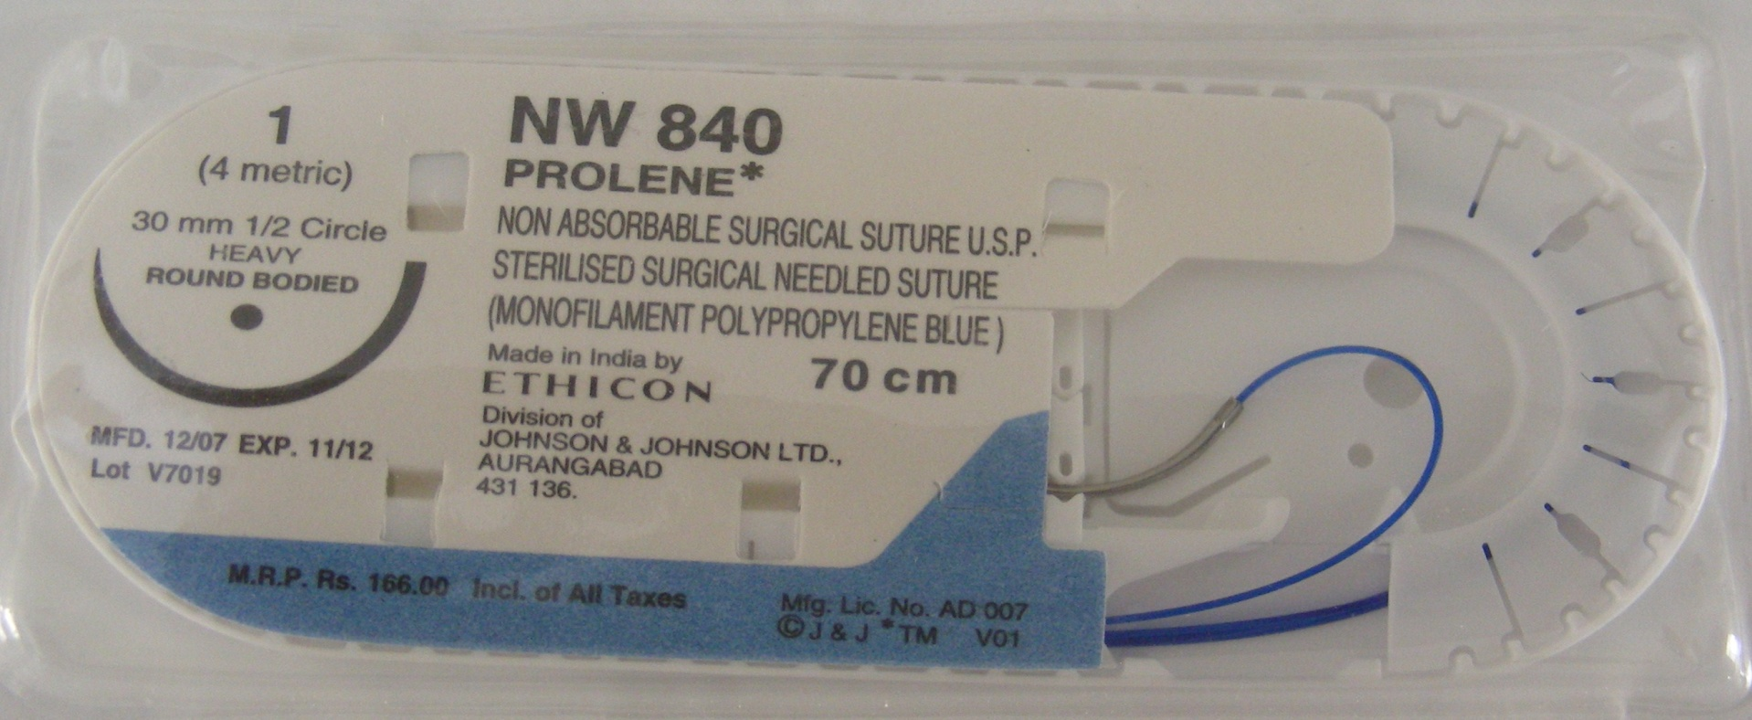

Slide 31
SUTURE SIZES
Sutures are available in different sizes.
Largest size 1-0 to extremely fine 11-0. Increasing number of zeroes correlates with decreasing suture diameter and strength.
Thicker sutures are used for approximation of deeper layers, wounds in tension prone areas and for ligation of blood vessels.
Thin sutures are used for closing delicate tissues like conjunctiva and skin incisions of the face.

Slide 32
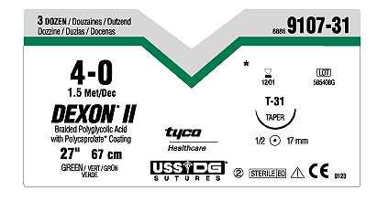
The Suture Packaging
PRODUCT CODE
STRAND SIZE
NEEDLE CODE WITH LIFE SIZE PICTURE OF NEEDLE
MATERIAL
STRAND LENGTH
NEEDLE CIRCLE
POINT TYPE
NEEDLE LENGTH
COLOUR

Slide 33
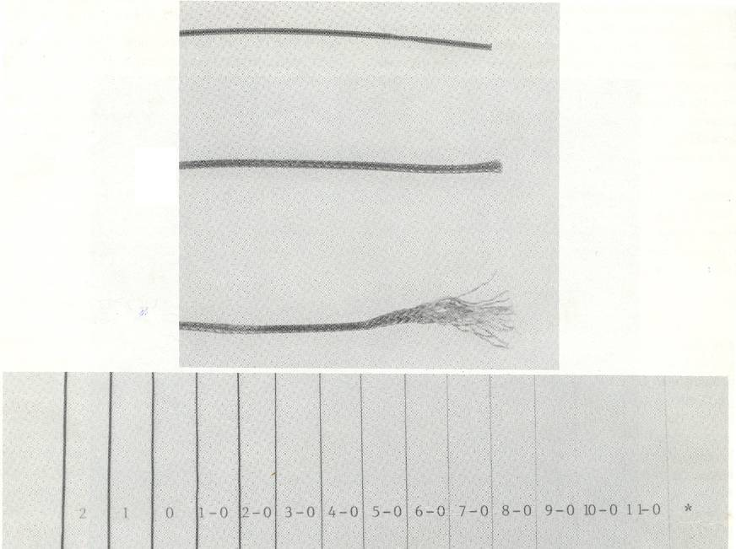
3-0 or 4-0 OMFS, muscle, deep skin
5-0 or 6-0 facial skin closure
9-0 or 10-0 microsurgery

Slide 34
SUTURE NEEDLES
Surgical needles are designed to lead suture material through tissue with minimal injury.
Made up of either SS or carbon steel.

Slide 35
CLASSIFICATION OF SURGICAL NEEDLES
1.According to eye -eye less needles
-needles with eye
2.According to shape -straight needles
-curved needles
3.According to cutting edge
a) round body
b) cutting -conventional
-reverse cutting

Slide 36
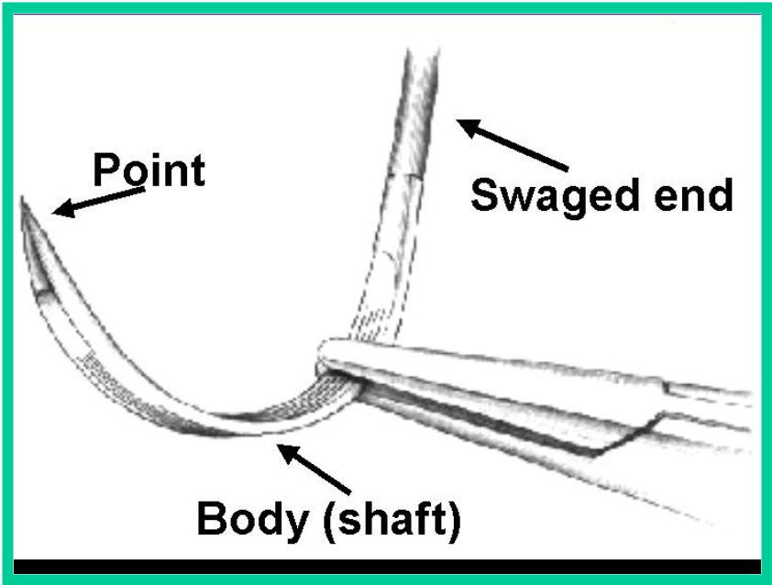
Needles
Surgical needles have three basic components
Eye or swaged end
Body
Point

Slide 37
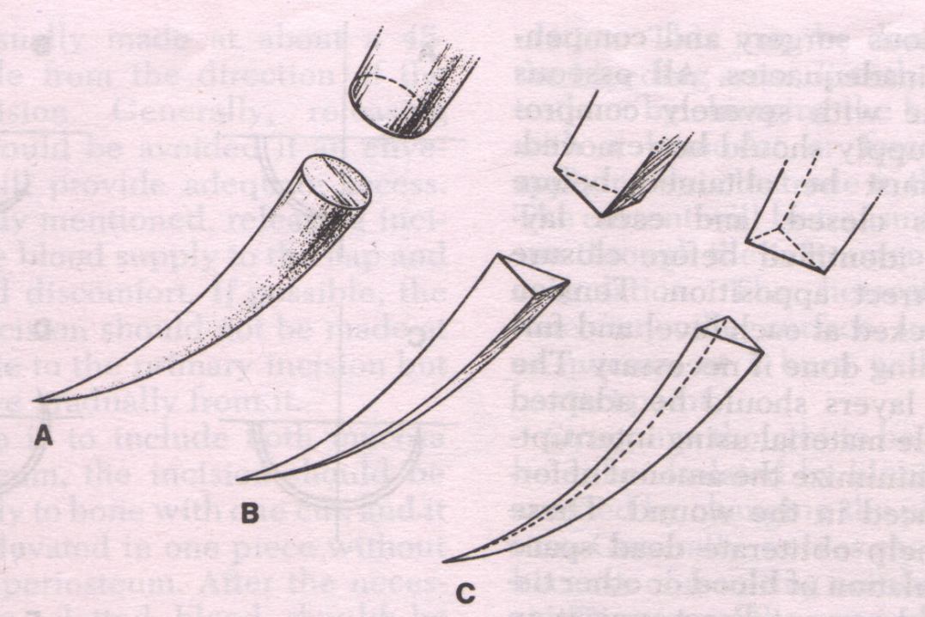
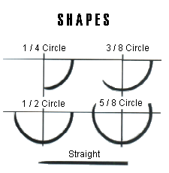
Round body
Cutting
Reverse cutting

Slide 38
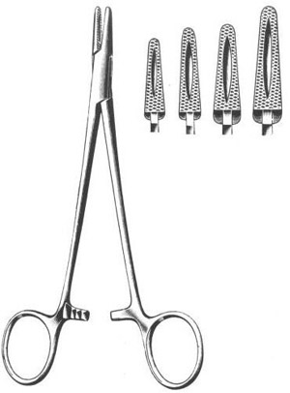
NEEDLE HOLDER
The needle holder is used to handle the suture needle and thread while suturing the surgical wound.
If used properly it enables the surgeon to perform procedures correctly and with great precision.

Slide 39
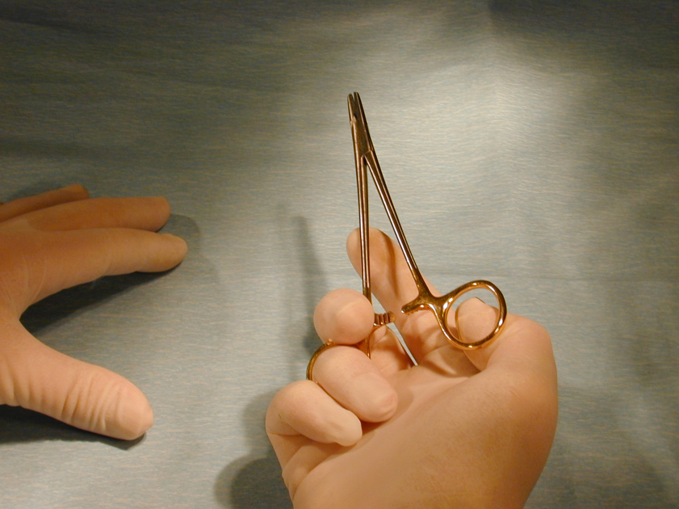
Gripping needle holder
Remember!!! Thumb & ring finger into needle holder’s rings (NOT your middle finger!)

Slide 40
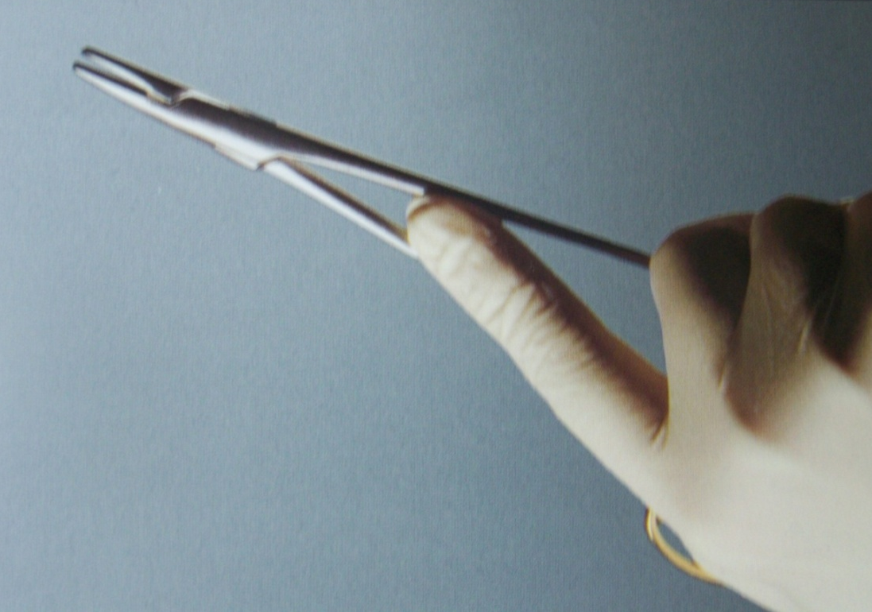
The scissor grip
The instrument is stabilized with the index finger

Slide 41
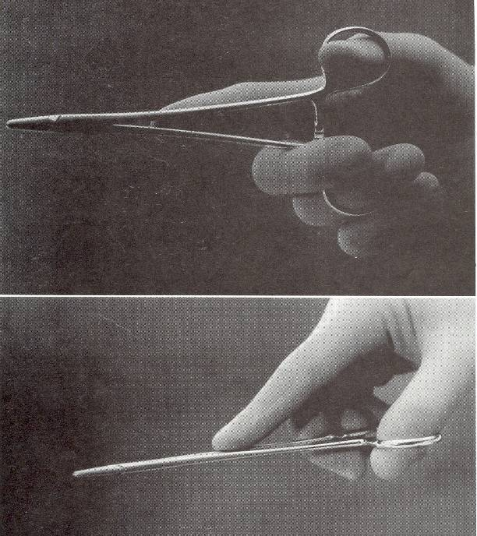

Slide 42
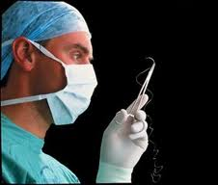
PRINCIPLES
OF
SUTURING

Slide 43
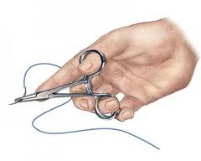
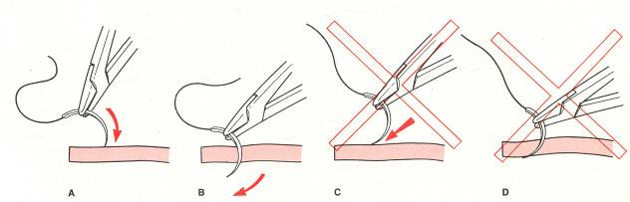
PRINCIPLES OF SUTURING
1.Needle grasped at 1/4th to half the distance from eye.
2.Needle should enter perpendicular to tissue surface

Slide 44
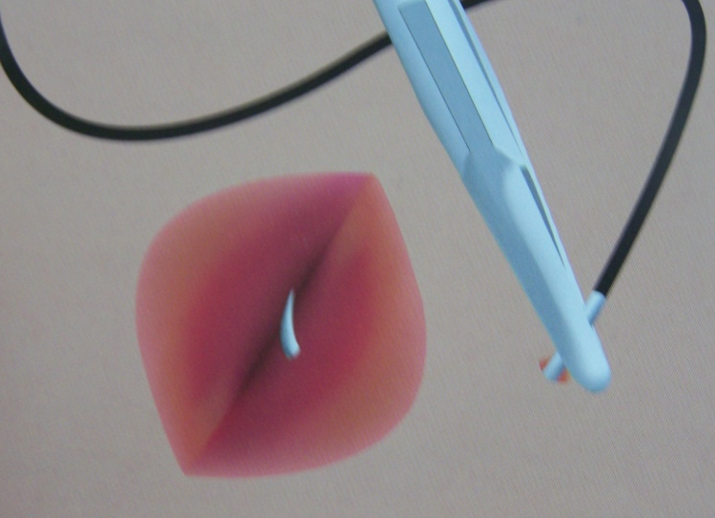
3.Needle passed along its curve
4.The bite should be equal on both sides of the wound margin.
5.The bite should be about 2-3 mm from the wound margin of the flap because after wound closure the edge of the wound softens due to collagenolysis and the holding power is impaired.

Slide 45
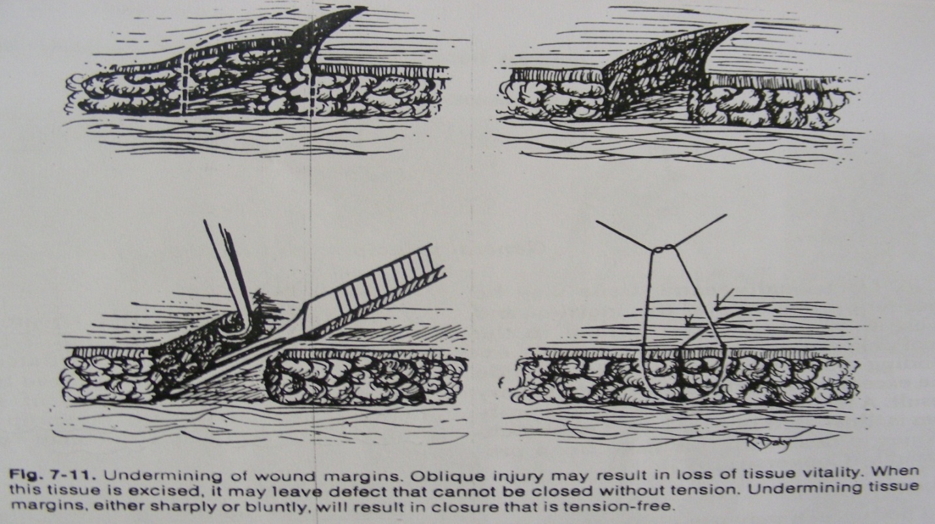
6. Needle should be passed from mobile side to the fixed side.
7.The tissues should not be closed under tension , since they will either tear or necrose around the suture

Slide 46
8.Tie to approximate; not to blanch
9.Knot must not lie on incision line
10.The distance b/w one suture to another should be about 3-4 mm apart to allow escape of the serum or inflammatory exudate.

Slide 47
11.Sutures placed at a greater depth than distance from the incision to evert wound margins
12.Close deep wounds in layers
13.Avoid retrieving needle by tip
14.Adequate tissue bite to prevent tearing

Slide 48
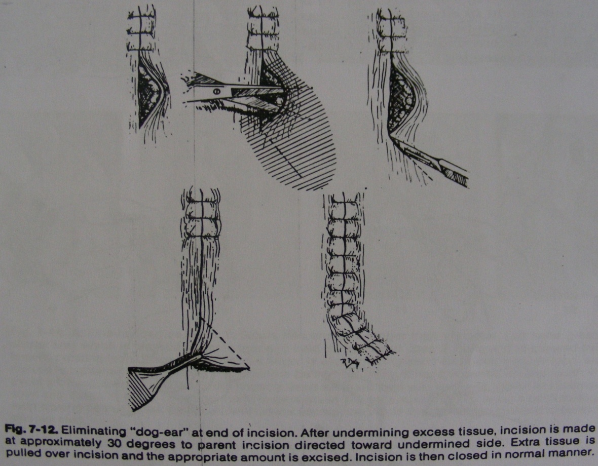
16.Occasionally extra tissue may be present on one side of incision and cause DOG EAR to be formed in the final phase of wound closure.

Slide 49
SUTURING
TECHNIQUES

Slide 50
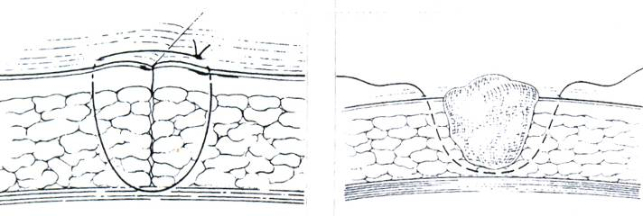
1.INTERRUPTED SIMPLE SUTURE
Most commonly used. Inserted singly through side of the wound and tied with a surgeon’s knot.

Slide 51
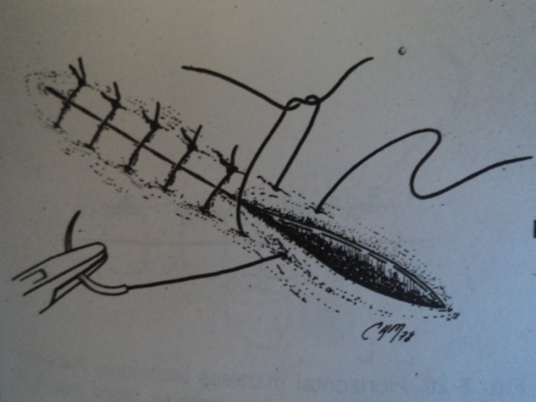
Advantages
Strong and can be used in areas of stress
Placed 4-8 mm apart to close large wounds, so that tension is shared
Each is independent and loosening one will not produce loosening of the other
In infection or hematoma, removal of few sutures.
easy to clean b/w each stitch.

Slide 52
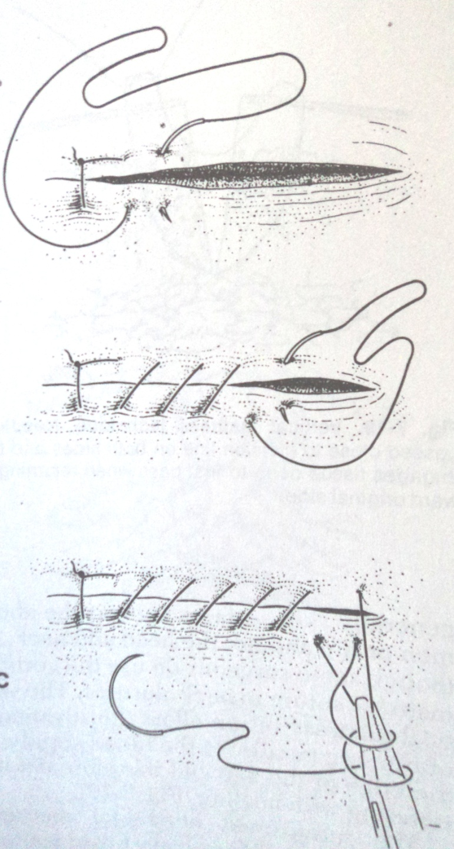
2. SIMPLE CONTINUOUS / RUNNING
A simple interrupted suture placed and needle reinserted in a continuous fashion such that the suture passes perpendicular to the incision line below and obliquely above. Ended by passing a knot over the untightened end of the suture.

Slide 53
Advantages
Rapid technique and distributes tension uniformly
More water tight closure (Shoen, 1975)
Only 2 knots with associated tags
Disadvantages
If cut at one point, suture slackens along the whole length of the wound which will then gape open.

Slide 54
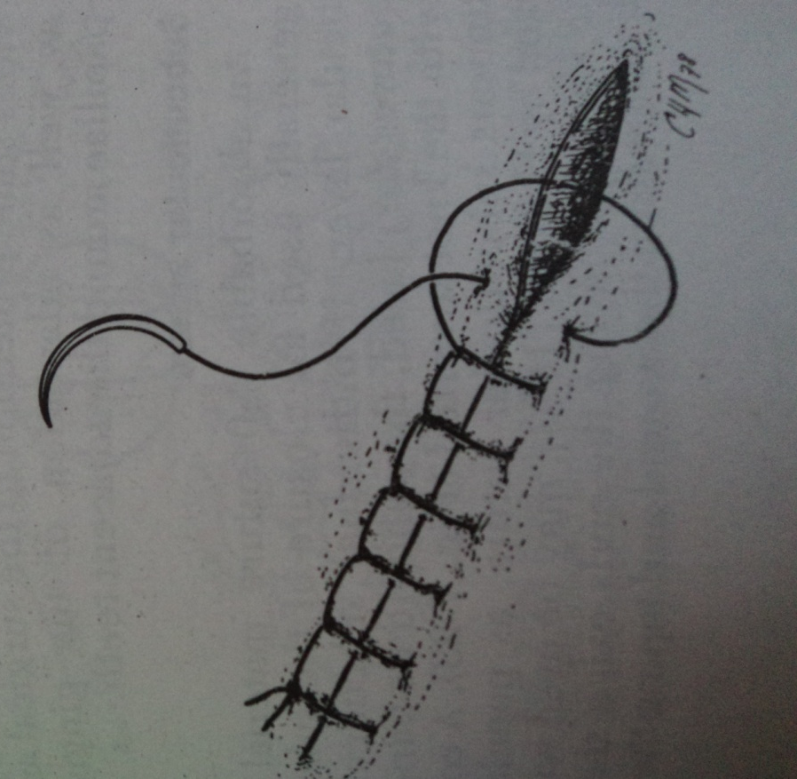
3.CONTINUOUS LOCKING/BLANKET
Similar to continuous but locking provided by withdrawing the suture through its own loop. Indicated in long edentulous areas, tuberosities or retromolar area.
Advantages
Will avoid multiple knots
Distributes tension uniformly
Water tight closure
Prevents excessive tightening.
Disadvantage :prevents adjustment of tension over suture line as tissue swelling occurs.

Slide 55
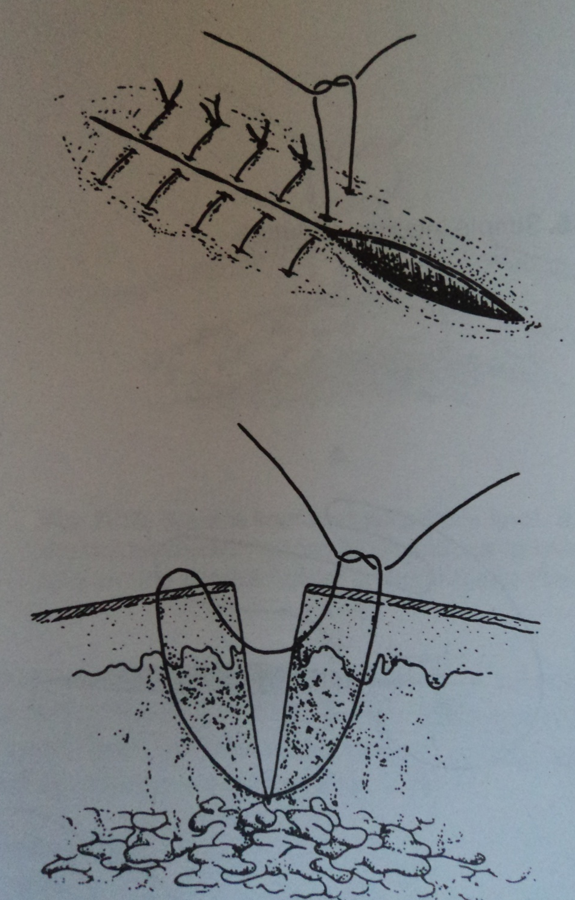
4.VERTICAL MATTRESS
Specially designed for use in skin. It passes at 2 levels, one deep to provide support and adduction of wound surfaces at a depth and one superficial to draw the edges together and evert them.
Used for closing deep wounds
This approximates subcutaneous and skin edges

Slide 56
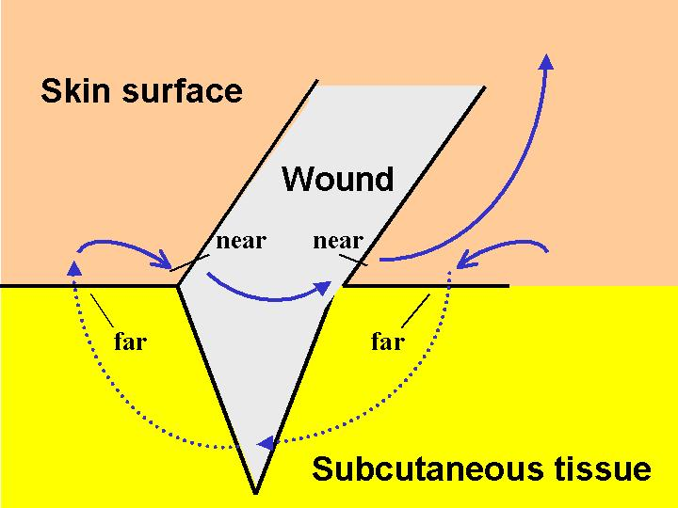
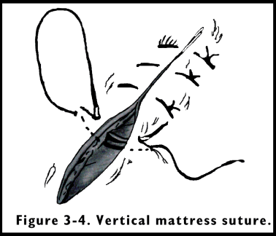
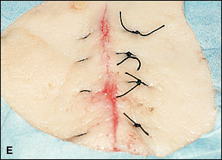
VERTICAL MATTRESS
suture

Slide 57
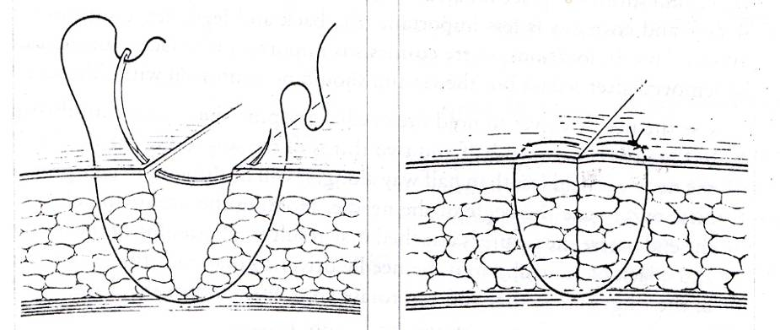
Needle passed from one edge to the other and again from latter edge to the fist and knot tied.
When needle is brought back from second flap to the first, depth of penetration is more superficial.

Slide 58
Advantages :
for better adaptation and maximum tissue approximation
To get eversion of wound margins slightly
Where healing is expected to be delayed for any reason, it is better to give wound added support by vertical mattress.
Used to control soft tissue hemorrhage.
Runs parallel to the blood supply of the edge of the flap and therefore not interfering with healing.
Uses: abdominal surgeries & closure of skin wounds.

Slide 59
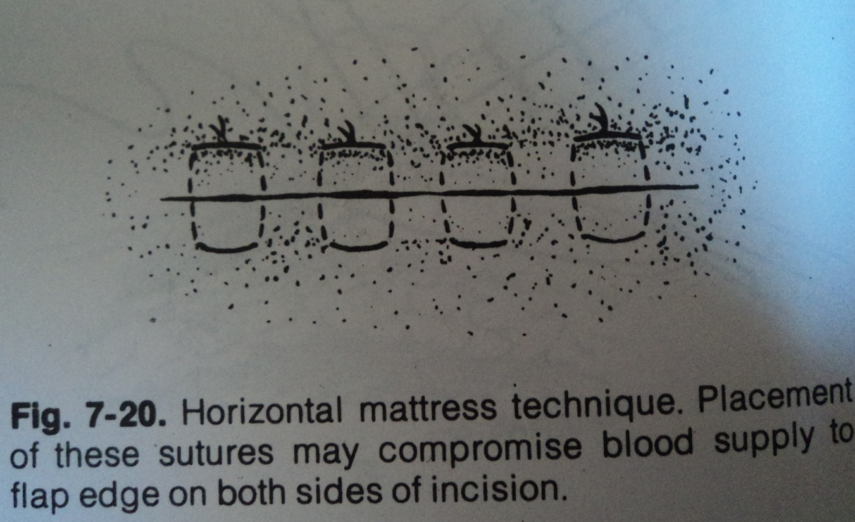
5.HORIZONTAL MATTRESS
It everts mucosal or skin margins, bringing greater areas of raw tissue into contact. So used for closing bony deficiencies such as oro-antral fistula or cystic cavities.
Disadvantage: constricts the blood supply to edges of incision.

Slide 60
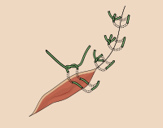
Horizontal mattress suture

Slide 61
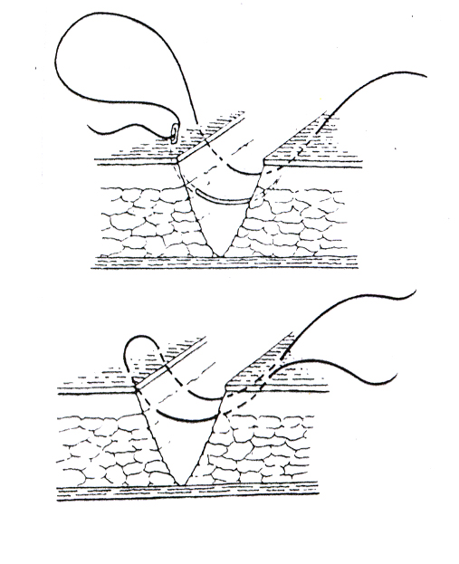
Needle passed from one edge to the other and again from the latter to the first and a knot is tied.
Distance of needle penetration and depth of penetration is same for each entry point, but horizontal distance of the points of penetration on the same side of the flap differs.

Slide 62
Advantages:
Will evert mucosal or skin margins, bringing greater areas of raw tissue into contact.
So used for closing bony deficiencies such as oro-antral fistula or cystic cavities, extraction socket wounds.
Prevents the flap from being inverted into the cavity.
To control post-operative hemorrhage from gingiva around the tooth socket.

Slide 63
Disadvantages:
More trouble to insert
Constricts the blood supply to the incision if improperly used, cause wound necrosis and dehiscence

Slide 64
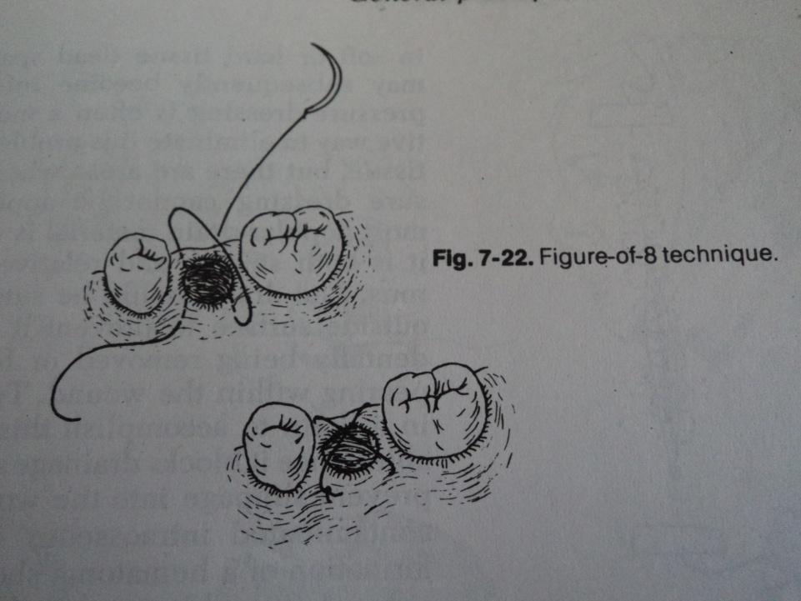
6. FIGURE OF 8 SUTURE
Used for extraction socket closure and for adaption of gingival papilla around the tooth
Suturing begun on buccal surface 3-4mm from the tip of the papilla so as to prevent tearing of papilla.
Needle first inserted into the outer surface of the buccal flap and then the lingual flap. Needle again inserted in same fashion at a horizontal distance and then both ends tied.

Slide 65
7. SUBCUTICULAR SUTURE
Used to close deep wounds in layers. Knots will be inverted or buried, so that the knot does not lie between the skin margin and cause inflammation or infection.
To bury the knot, first pass of the needle should be from within the wound and through the lower portion of the dermal layer. Needle then passed through the dermal layer and emerge through subcutaneous tissue and knot tied

Slide 66
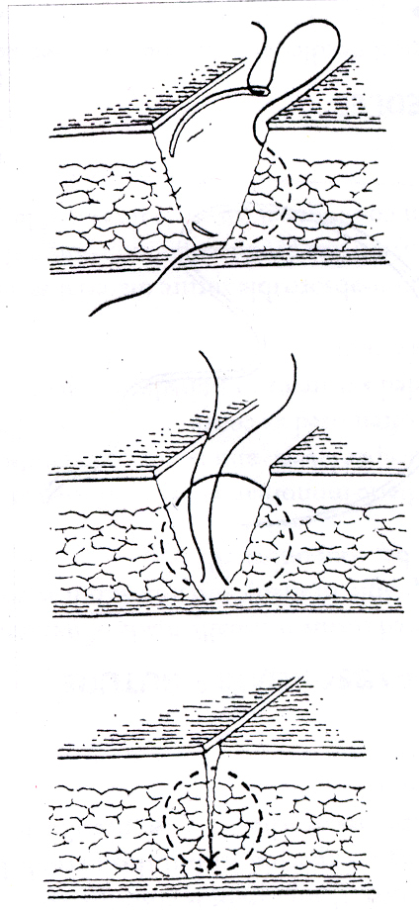

Slide 67
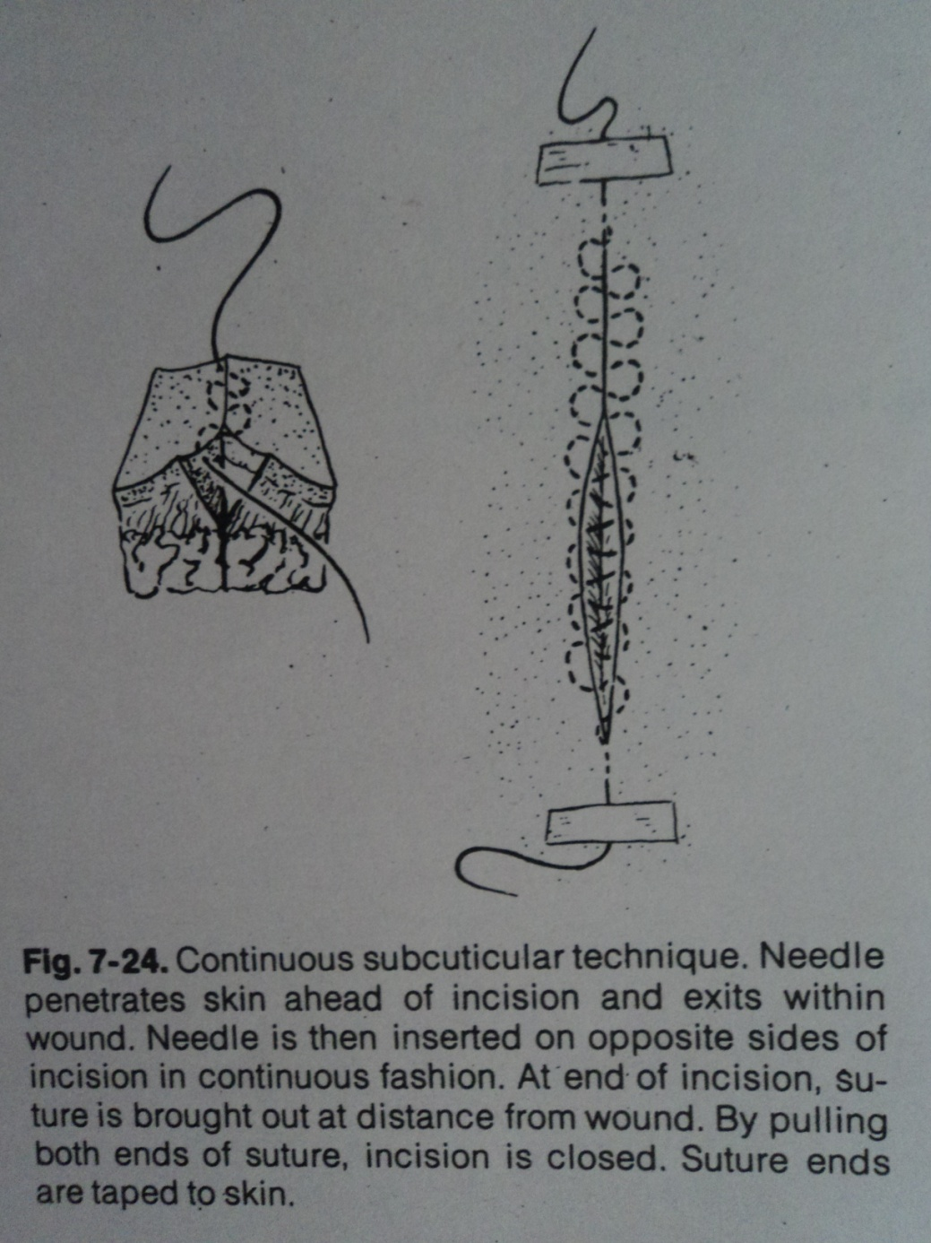
8.CONTINUOUS SUBCUTICULAR SUTURE
Continuous short lateral stitches are taken beneath the epithelial layer of the skin. The ends of the suture come out at each end of the incision and are knotted.

Slide 68
Advantages
Excellent cosmetic result
Useful for patients prone to keloid formation.
Anchor suture in wound and, from apex, take bites below the dermal-epidermal layer
Start next stitch directly opposite the one that precedes it.

Slide 69
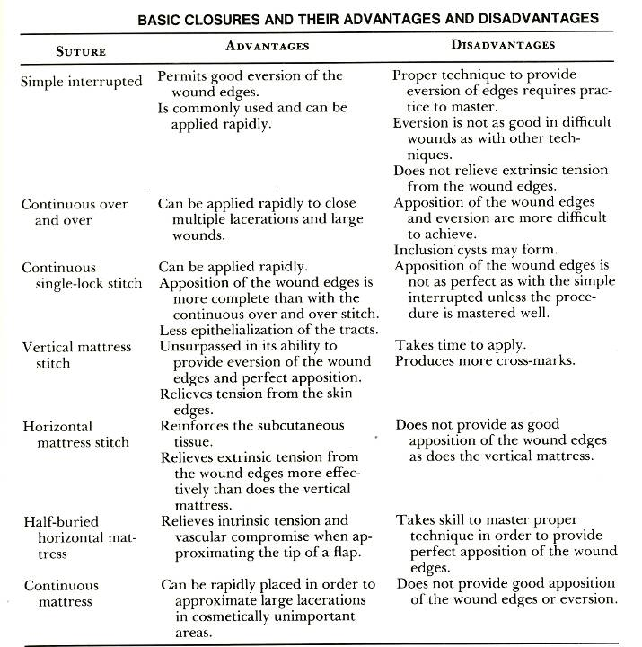

Slide 70
SUTURE
REMOVAL

Slide 71
Intra oral
- Mucoperiosteal closure (without tension)
5-7 days
- Where there is tension on the suture
eg : Oro-antral fistula- 7-10 days
Back and legs where cosmesis is less important – 10-14 days.
Continuous subcuticular can be left for 3-4 weeks without formation of suture tracks
A good guide is that as soon as they begin to get loose they should be taken out.

Slide 72
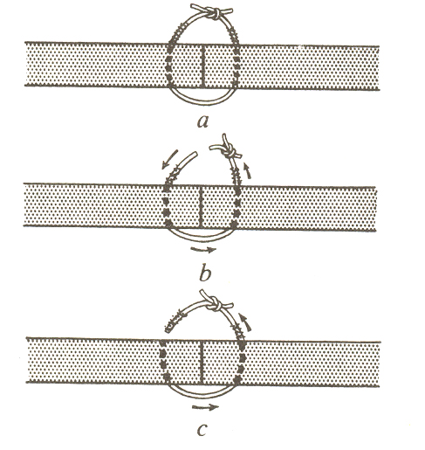
INCORRECT
CORRECT

Slide 73
Possible Complication Of Leaving Suture For Many Days :
1.Sutural abscess.
2.Suture scarring or stitch mark
3.Implanted dermoid cyst

Slide 74
SUTURE MARKS
Suture marks are caused by 3 factors
1.Skin sutures left in place longer than 7 days, resulting in epithelialisation of suture track
2.Tissue necrosis from sutures that were tied too tightly or became tight due to tissue edema
3.Use of reactive sutures in the skin.

Slide 75
Other Methods of Wound Closure
Ligating clips
Skin staples
Surgical tape
Surgical adhesives

Slide 76
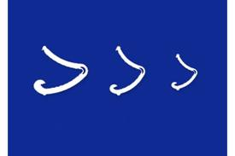
Mechanical wound closure devices
Ligating clips :
can be resorbable or non resorbable.
Made up of SS,tantalum or titanium or pidioxanone.
Designed for the ligation of tubular structures.

Slide 77
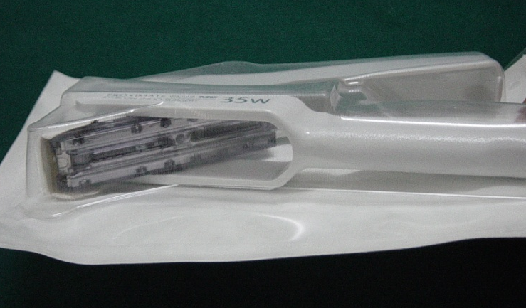
Surgical staples:
Used for skin closure .
Made up of SS.
They are placed uniformly to span the incision line.
They have minimal tissue reaction .
Can be used for routine skin closure any where in the body.

Slide 78
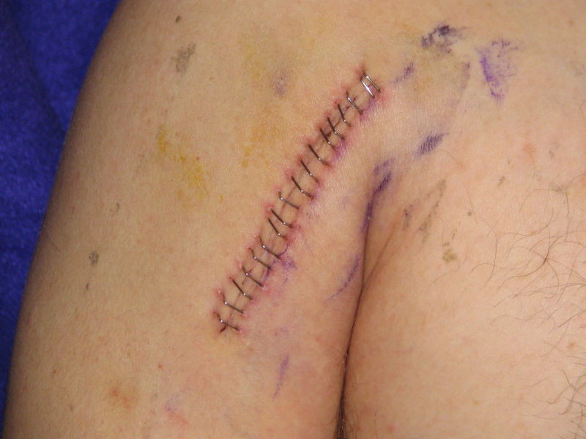
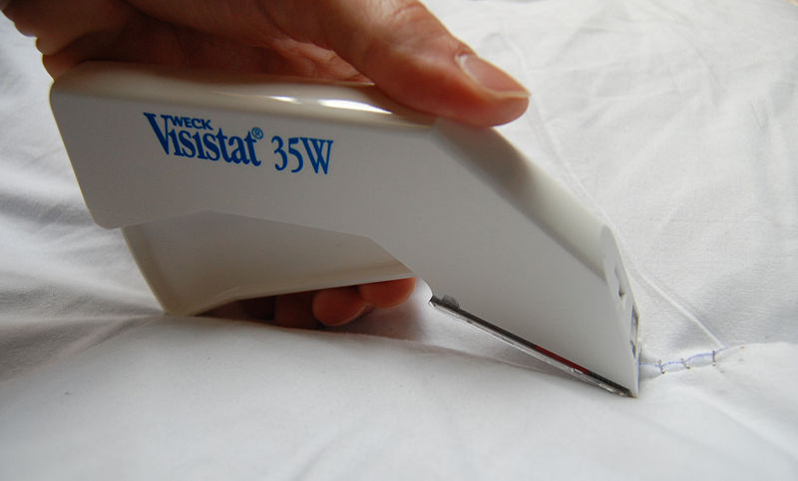

Slide 79
Advantages
As the clips do not penetrate skin, yet give apposition, the cosmetic result is excellent.
Speed and efficacy of stapling is more compared to sutures.
Suturing causes more necrosis than stapling in myocutaneous flaps.
Most significant advance is the introduction of absorbable staples (Lactomer).

Slide 80
Contra indicated when it is not possible to maintain atleast 5mm distance from the stapled skin to the underlying bone and blood vessels.

Slide 81
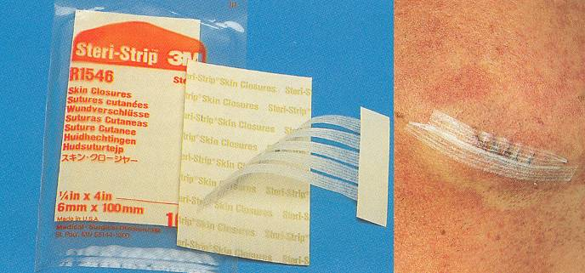
SURGICAL TAPE
Microporous tape is used alone or in conjugation with skin sutures to decrease tension at the wound margins.
The surgical tapes have a backing of viscous rayon fibers coated with an adhesive copolymer and they are pervious to sweat but not to blood or purulent material.
Comes in 1/8, 1/4, and 1/2 inch wide strips. Skin margin is prepared with tincture of benzoin to provide better adhesiveness for tape.
Used to decrease skin tension on cheek,forehead,chin.

Slide 82
Advantages
Minimizes wound dehiscence and allows earlier suture removal
Provides continuous support for the wound and minimizes scar expansion
Avoids the ordeal of suture replacement and removal in children
Less inflammatory reaction, lower rate of wound infection, greater TS and better cosmetic results.
No needle puncture marks and suture canals
Strangulation and necrosis of tissue are eliminated
Sterile paper tape is non expensive

Slide 83
Disadvantage
Do not evert edges of the wound, and readily loosen when wet by blood or serum.
Prior to placement, a thin coat of antibiotic ointment is placed on wound margin to protect wound from skin oils and bacteria.
While removing, to avoid epithelial margin separation, the ends should be lifted equally towards the wound margin and then lifted evenly from the wound.

Slide 84
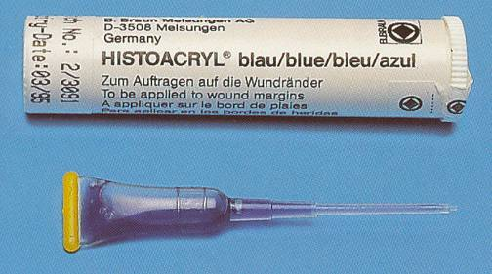
Cyanoacrylates
n-butyl cyanoacrylate is the active ingredient.
Advantages :
Strong bonding to tissues in presence of moisture
Biodegradable, bacteriostatic & hemostatic.
Reduced post operative pain & facilitates healing.
Good shelf life.
Produces little or no heat during polymerisation.
Bonding is by secondary intermolecular forces aided by mechanical interlocking of irregular forces.

Slide 85
Quick, atraumatic and cost effective with good cosmesis
No injection, suturing and post-op suture removal.
Disadvantages
1.When applied for skin closure, the polymer acts as barrier, prevents wound apposition, delays healing, and increases the infection rate.
2.Should not be allowed to come in contact with tissue under skin as it causes necrosis.

Slide 86

REFERENCE
Suturing techniques in oral surgery –Sandro Siervo
Atlas of Minor Oral Surgery- Harry Dym
Laskin vol-1
Oral & Maxillofacial Surgery Vol 1- W. Harry Archer
Textbook of oral & maxillofacial surgery- Neelima Anil Malik
Minor Oral Surgery- Goeffrey L.Howe
Text book of surgery: Sabiston
Periodontology-Caranza.

Slide 87

THANK YOU
THANK YOU

