Slide 1

GOOD AFTERNOON

Slide 2

SURVEY

Slide 3

Reseachers Want to know something about group of people

Slide 4
What is a SURVEY?
Non experimental investigation where the information is collected Systematically from a population of interest.

Slide 5
Survey is a non-experimental type of research that attempts to gather information about the status quo for a large number of people by describing present conditions without directly analyzing their causes.

Slide 6
Uses of survey
To monitor the trends in oral health and disease.
Need assessment
To develop the strategies
Program evaluation
Policy development
Visibility to dental issues

Slide 7
Based on the collection of data…..survey can be
Health interview survey
Health examination survey
Health records survey
Questionnaire survey.

Slide 8


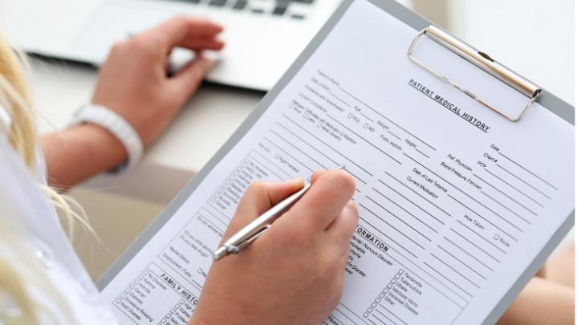
DATA COLLECTION
Health interview survey (face to face survey)

Slide 9
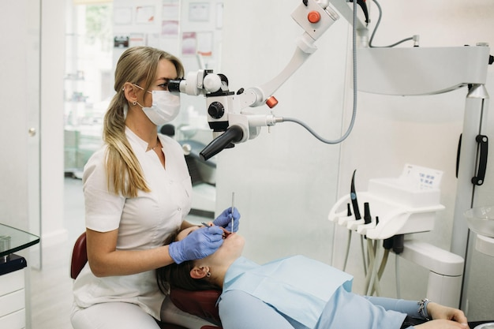
DATA COLLECTION
Health Examination survey

Slide 10
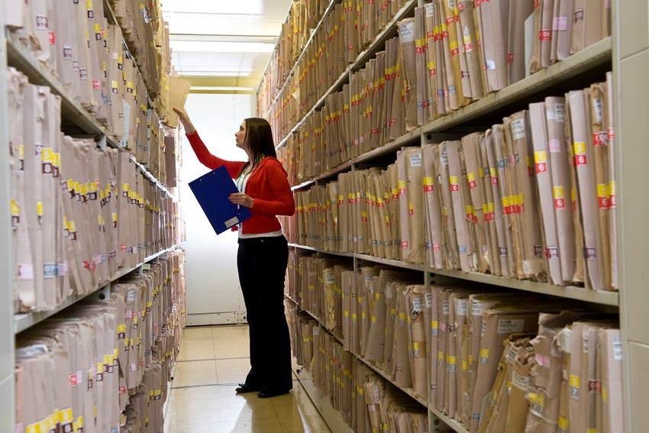
DATA COLLECTION
Health Records survey

Slide 11
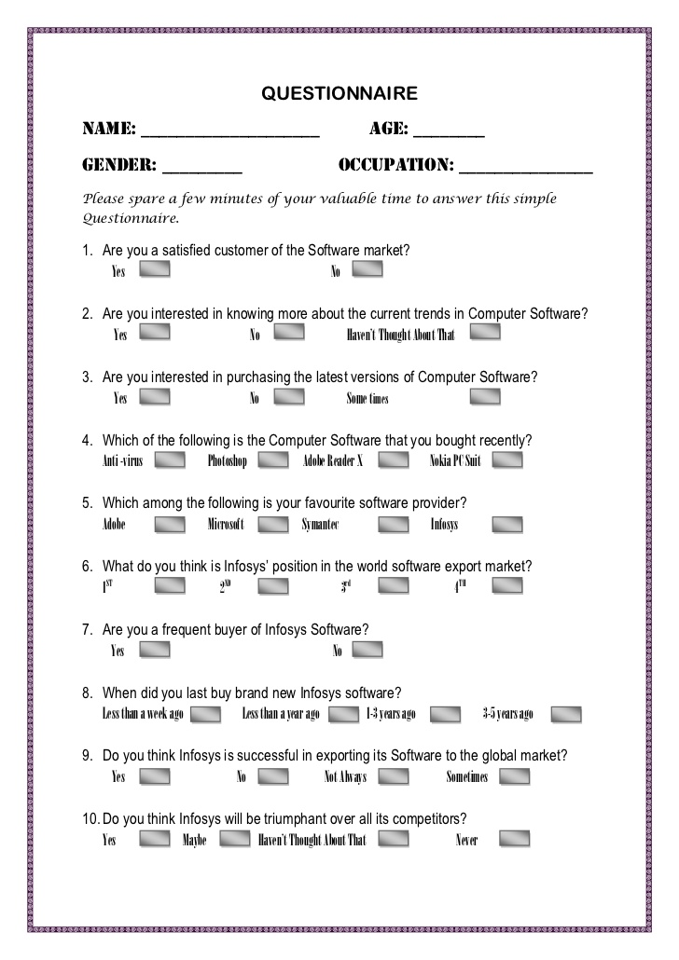
DATA COLLECTION
Questionnaire survey

Slide 12


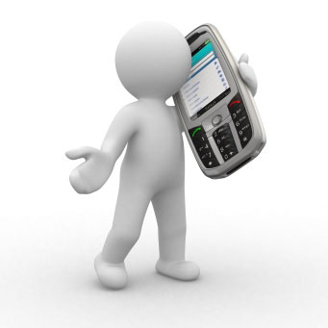



ADMINISTRATION OF QUESTIONNAIRES
Face-to-Face interviews
Telephonic method
Mailing
Web based online surveys
www.surveymonkey.com

Slide 13
Questions may be ………
Open ended question
Eg: how many times you brush?
Closed ended question
Eg: how many times you brush?
a) once daily
b) twice daily
C) more than two times
d) never

Slide 14
Scales in collecting data
Likert scale: used commonly to quantify the
attitudes and behaviour
5point Likert scale
7 point Likert scale

Slide 15
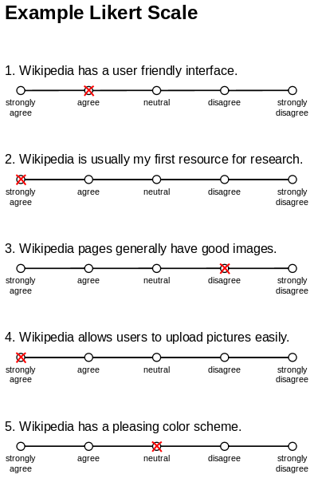

Slide 16
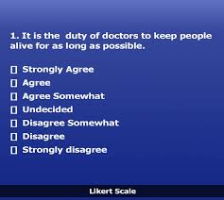

Slide 17
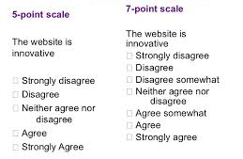

Slide 18
Guttman scale:
Increasing intensity of characteristics can be assessed using this scale

Slide 19
I believe that this country should allow more immigrants in.
I would be comfortable if a new immigrant moved next door to me.
I would be comfortable with new immigrants moving into my community.
It would be fine with me if new immigrants moved onto my block.
I would be comfortable if my child dated a new immigrant.
I would permit a child of mine to marry an immigrant.
Agree or Disagree

Slide 20
STEPS IN SURVEYING
Establishing
Establishing the objectives
Designing
Designing the investigation
Selecting
Selecting the sample
Conducting
Conducting the examinations
Analyzing
Analyzing the data
Drawing
Drawing the conclusions
Publishing
Publishing the results

Slide 21

ESTABLISHING THE OBJECTIVES
Objective of the investigation should be clear.
It can be stated in the form of….
  Hypothesis which is to be tested
  Stated by describing what is to be measured

Slide 22
Hypothesis testing
Null hypothesis or alternate hypothesis
Eg:
  There is no difference in the periodontal status of males and females aged 35-44 years in Rajahmundry.

Slide 23
Stating what is to be measured
Eg:
  To determine the prevalence of dental caries among 12 year old school children in Rajahmundry

Slide 24
DESIGNING THE INVESTIGATION
Survey protocol
  Main objective and purpose of the survey
  Type of information and methods to be used
  Sampling methods description
  Personnel and physical arrangements
  Statistical methods
  A provisional budget
  Time table of activities

Slide 25
DESIGNING THE INVESTIGATION
Obtaining approval from authorities
Budgeting
Emergency care and referral

Slide 26
SELECTING THE SAMPLE
A sample is a part of a population called the Universe or Parent population
Sampling frame is a listing of the members of the universe from which the sample is drawn.
Sampling is the process or technique of selecting a sample of appropriate characteristics and adequate size.

Slide 27
What is Sampling
What we want
to talk about What we actually
observe in the data
Sampling Sampling process
frame
Inference
Population Sample

Slide 28
SAMPLING TECHNIQUES
PROBABILITY SAMPLING
NON PROBABILITY SAMPLING

Slide 29
PROBABILITY SAMPLING
NON PROBABILITY
SAMPLING
Simple random
Systematic
Stratified
Multistage
Multiphase
Cluster & Area
Purposive
Convenience
Quota
Saturation

Slide 30
PROBABILITY SAMPLING
Every member in the population have a equal chance or an opportunities of being selected

Slide 31
SIMPLE RANDOM SAMPLING
Each and every unit of the population has equal and known chance of being selected.

Slide 32
Example….
To assess knowledge level of this class students about my previous class

Slide 33

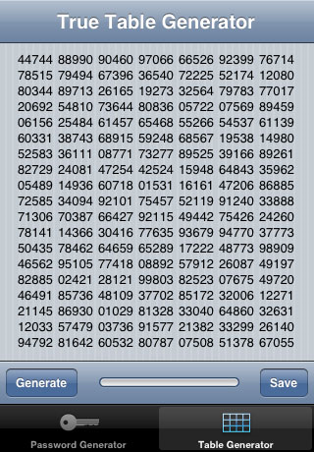
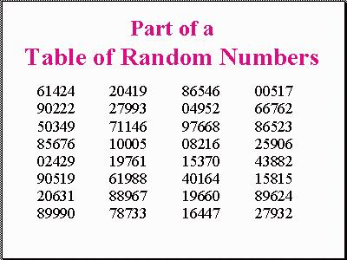
THREE WAYS OF SELECTING THE SRS…..
Computer Assisted
Software
Lottery Method

Slide 34
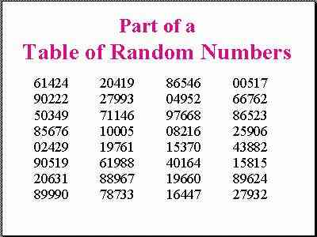
b) Table of Random numbers:
As the lottery method cannot be used, when the population is infinite, the alternative method is that of using the table of random numbers.

Slide 35

c) Random number selections using calculators or
computers:
Random number can be generated through scientific calculator or computers. The ways of selection of sample is similar to that of using random number table.

Slide 36
SIMPLE RANDOM SAMPLING
Applicable when
a) The population is small.
b) The population is readily available.
c) Homogeneous.
Cannot be used when
a) Population is large.
b) Population is scattered.

Slide 37
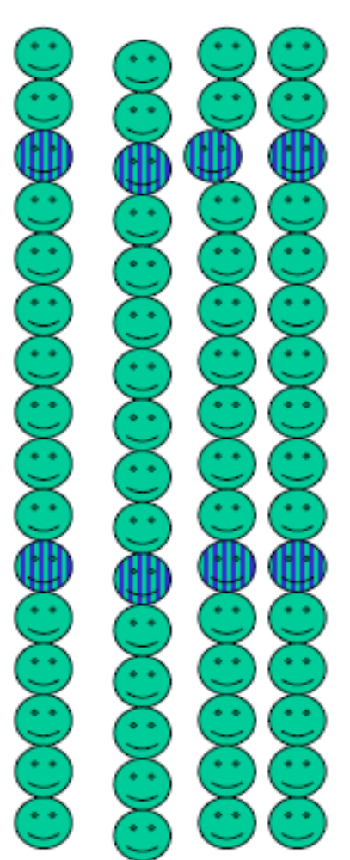
SYSTEMATIC RANDOM SAMPLING
Selecting one unit at random & additional units at evenly spaced intervals .

Slide 38
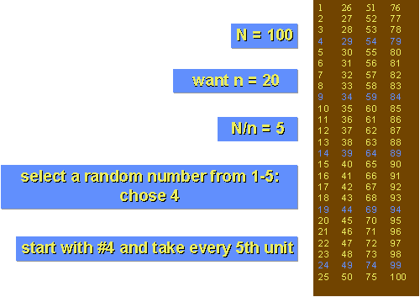
Systematic Random Sampling
Example
TOTAL POPULATION
SAMPLE SIZE
SAMPLING INTERVAL

Slide 39
Advantages:
  Less expensive…faster than SRS.
Disadvantages:
  Potential “periodicity” problems

Slide 40
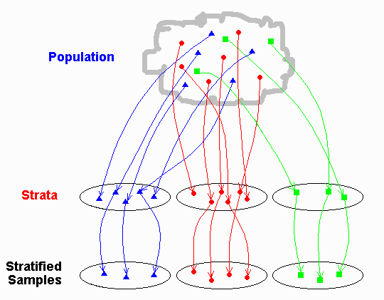
STRATIFIED RANDOM SAMPLING
Divide the population into various strata and then select a suitable sample from it.

Slide 41


STRATIFIED RANDOM SAMPLING
Applicable
For non homogenous population.
Merit
Representative sample from each strata has greater accuracy.

Slide 42
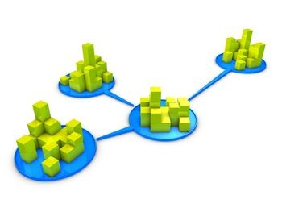
CLUSTER SAMPLING
Used when the population is heterogeneous, vast and scattered over a wide area & forms natural groups or clusters such as villages, wards, school children etc
AREA SAMPLING
When clusters happen to be some
geographic subdivisions it is called area sampling.

Slide 43
Example: Cluster sampling
Section 1
Section 2
Section 3
Section 5
Section 4

Slide 44
Advantages
  Economic efficiency… faster and less expensive than SRS.
  Does not require a list of all members of the universe.
Disadvantage:
  Cluster specification error… the more homogeneous the cluster chosen, the more imprecise the sample results

Slide 45
Multistage sampling
MULTI STAGE SAMPLING
Applicable for large scale surveys.
Sampling procedures carried out in several stages using random sampling techniques.

Slide 46
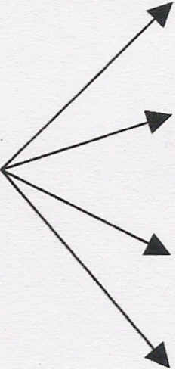
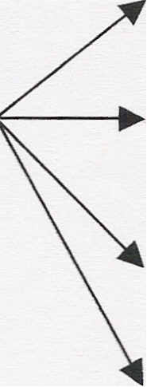
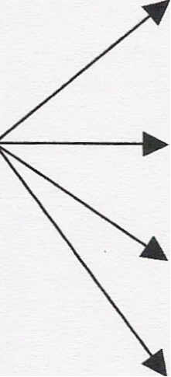
Multistage sampling
Prevalence of precancerous oral lesions among rural population of India
state 1
state 2
state 3
state 4
dist 1
dist 2
dist 3
dist 4
village 1
village 2
village 3
village 4
India
Stage 1 Stage 2 Stage 3

Slide 47
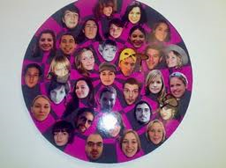
MULTIPHASE SAMPLING
Part of information is collected from the whole sample
and a part from the sub sample.
Less costly, less laborious & more purposeful.

Slide 48
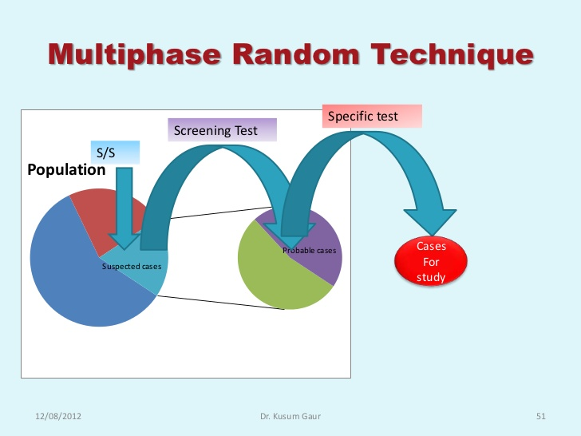
Effectiveness of a antidiabetic therapy among uncontrolled diabetic patients in a village

Slide 49
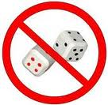
NON PROBABILITY SAMPLING

Slide 50
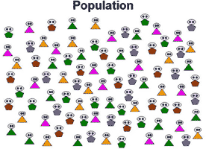
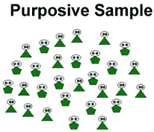
PURPOSIVE SAMPLING
[DELIBERATE, JUDGEMENT SAMPLING]
Sampling with “a purpose” in mind, sample is thus selected to include people of interest and exclude those who do not suit the purpose.
Researcher picks subjects based on specific characteristics that is required for his study
Nature of research requires small sample size.

Slide 51
Advantages of purposive sampling:
Chance to choose volunteers who are interested to participate
Disadvantage of purposive sampling:
Researcher bias
Difficulties in defining the population

Slide 52

QUOTA SAMPLING
Part of Judgment sampling.
Preplanned number of subjects in specified categories are sampled.
[E.g.,100 Men & 100 Women]
Used in public opinion studies.

Slide 53
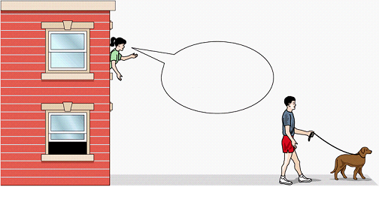
CONVENIENCE (CHUNK) SAMPLING
Selection of whichever individuals are easiest to reach. It is done at the “convenience” of the researcher
Used in pilot studies mainly in qualitative research.

Slide 54

SATURATION SAMPLING
Part of Judgment sampling where in the sample size is not fixed prior to the study but is decided by the investigator as the study progresses.
once the sufficient number has been met or no more new data is generated, the study is concluded.

Slide 55
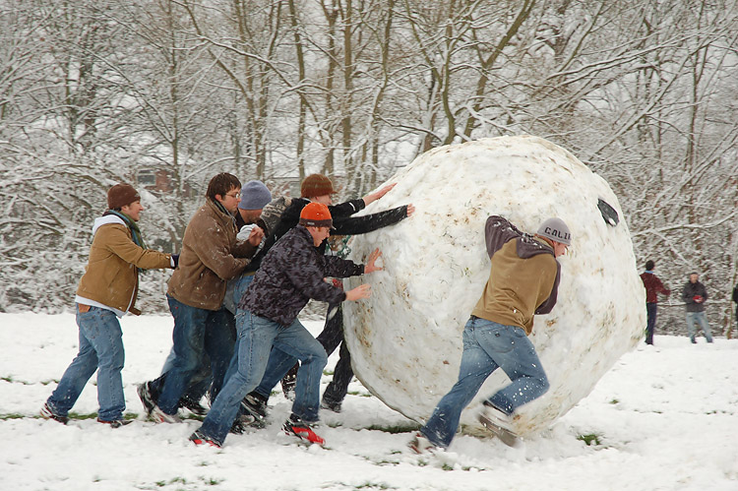
SNOWBALL SAMPLING

Slide 56
SNOWBALL SAMPLING
Sampling technique that is used by researchers to identify potential subjects in studies where subjects are hard to locate.
This type of sampling technique works like chain referral.
After observing the initial subject, the researcher asks for assistance from the subject to help identify people with a similar trait of interest.

Slide 57
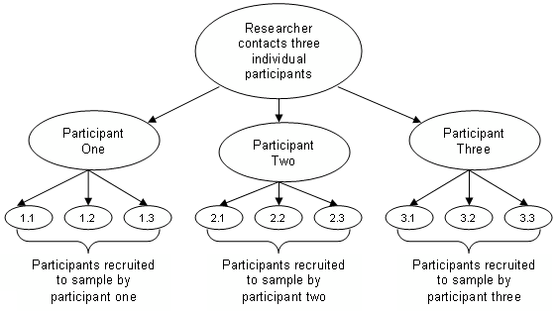
SNOWBALL SAMPLING

Slide 58
Advantages of snowball technique…
Easy to reach populations that are difficult to sample
The process is cheap, simple and cost-efficient.
Needs little planning compared to other sampling techniques.

Slide 59
Limitations of snowball technique…
Representativeness of the sample is not guaranteed.
Initial subjects tend to nominate people that they know well..

Slide 60

BIAS IN SAMPLING

Slide 61
BIAS IN SAMPLING
Selection bias:
This may be due to
deliberate selection of sampling units
deliberate substitution of sampling units

Slide 62

MERITS OF SAMPLING
Less expensive.
Less time consuming.
More reliable results.
More detailed information.

Slide 63

LIMITATIONS
Misleading if not properly planned &
executed
Cannot be relied upon in the absence
of qualified and expert persons.
Not suitable if the information is required from each and every unit.
If the sample size is overlarge, it may be
expensive and more time consuming.

Slide 64
Errors
Three types
  Observer error
    Subjective error (untrained investigator)
    Objective error (faulty recording without proper positioning)
  Instrumental error
    Use of faulty instruments
  Sampling error
    Biased, non random sample or too small sample

Slide 65
CONDUCTING THE EXAMINATIONS
Scheduling:
Orderly schedule to be prepared
Oral health examination of child – 5-10 min
Oral health examination of adult – 15-20 min
Maximum children to be examined in an hour - 15

Slide 66
Instruments and supplies
Plane mouth mirrors – 30 per examiner
Periodontal probes – 30 per examiner
Several pair of tweezers
Wash basin
Cloth or paper hand towels
Gauze

Slide 67
Infection control
National recommendations and standards
Use of disposable masks and gloves.
Wearing of protective glasses

Slide 68
Examination area
Basic requirements:
A chair with head rest or bench or table
A source of illumination (torch light or natural light)
Adequate supply of assessment forms
A recorder – live or tape
A clerk for organization and maintenance of records

Slide 69
Training and calibration of examiners
Objectives of standardization and calibration
To ensure uniform interpretation, understanding and application by all examiners of the codes and criteria for the various diseases and conditions to be observed
To ensure that each examiner can examine consistently

Slide 70
KAPPA STATISTIC
Calculation of intra and inter examiner reproducibility
Index which compares agreement against that which might be expected by chance
Values range from -1 to +1
  - 1 (complete disagreement)
  0 (no agreement)
  +1 (complete disagreement)

Slide 71
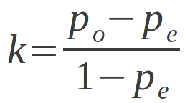
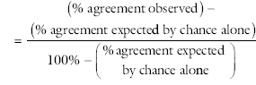
Kappa Statistic formula

Slide 72
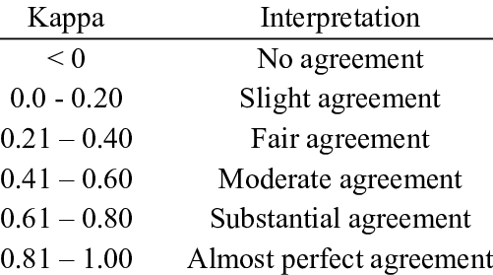
Kappa statistic interpretation

Slide 73
Classification of types of inspection and examination
Given by ADA
  Type 1 (Complete examination)
  Type 2 (Limited examination)
  Type 3 (Inspection)
  Type 4 (Screening)

Slide 74
Type 1 (complete examination)
Mouth mirror
Explorer
Adequate illumination
X-rays
Percussion, pulp vitality tests
Study models
Lab tests
Rarely used in Public health work

Slide 75
Type 2 (Limited Examination)
Mouth mirror and explorer
Adequate illumination
Posterior bite-wing x rays
Used in Public health works where ample time and adequate money is present

Slide 76
Type 3
(Inspection)
Mouth mirror
Explorer
Adequate illumination
Most used method in Public health surveying

Slide 77
Type 4 (Screening)
Tongue depressor
Available illumination
Unreliable method for Public Health surveying

Slide 78

ANALYZING THE DATA

Slide 79
ANALYZING THE DATA
Data processing
Interpretation of results

Slide 80

DRAWING CONCLUSIONS AND PUBLISHING THE REPORT

Slide 81
REPORT
Statement of the purposes of survey
Material and methods
Results
Discussion and conclusions
Summary

Slide 82
BASIC ORAL HEALTH SURVEYS
Information about the oral health status and treatment needs of a population.
Monitors changes in levels and pattern of disease.

Slide 83



Slide 84
PATHFINDER SURVEY
Stratified cluster sampling technique.
Aims to include most important population groups
Notes:
Pathfinder survey is the practical, economical and results are stratically significant.

Slide 85

Pathfinder survey
Pilot study
National pathfinder survey

Slide 86
PILOT SURVEY
Important sub groups in the population
12 years and any one other age group

Slide 87
NATIONAL PATHFINDER SURVEY
Index age groups
Index ages:
  5 years
  12 years
  15 years
  35-44 years
  65-74 years

Slide 88
5 YEARS
Relation to levels of caries in the primary dentition
Children examined between 5th and 6th birthdays
Age at which children begin primary school

Slide 89
12 YEARS
Age at which all permanent teeth except third molars have erupted.
Global monitoring age for caries for international comparisons and monitoring of disease trends

Slide 90
15 YEARS
Permanent teeth exposed to oral environment for 3-9 years
Assessment of caries prevalence
Assessment of periodontal disease indicators in adolescents

Slide 91
35-44 YEARS
Standard monitoring group for health conditions of adults.
Assessment of full effect of dental caries.
Assessment of periodontal diseases

Slide 92
65-74 YEARS
Planning appropriate care for elderly.
Monitoring overall effects of oral care services in a population.

Slide 93
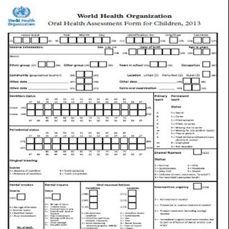
WHO ORAL HEALTH PROFORMA

Slide 94
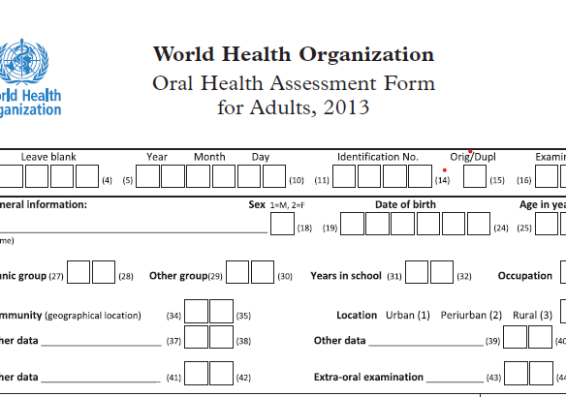

Slide 95
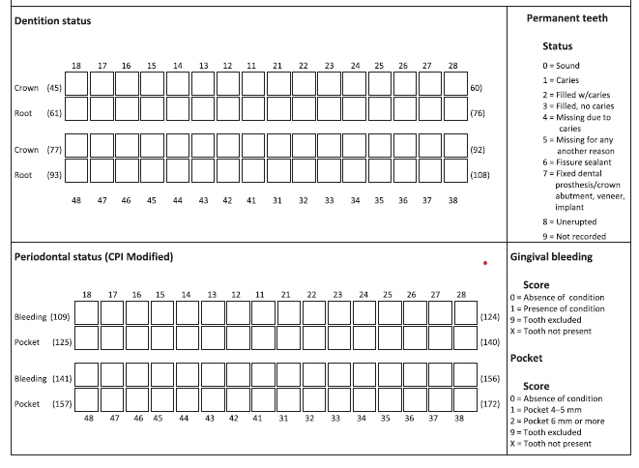

Slide 96
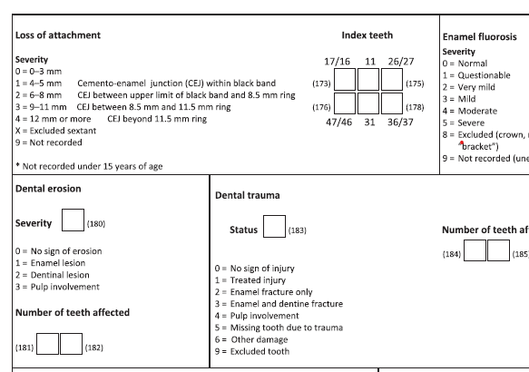

Slide 97
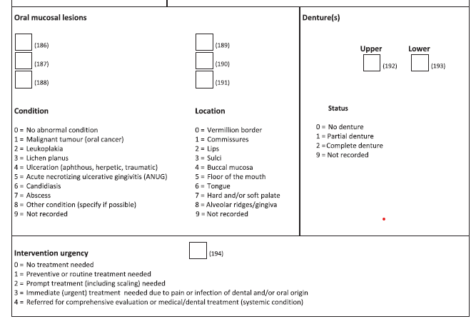

Slide 98


Slide 99


