Slide 1
GINGIVA – MICROSCOPIC LEVEL

Slide 2
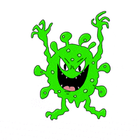
Understanding periodontal pathogenesis is key to improving management strategies for this common, complex disease.
According to Merriam Webster’s Collegiate Dictionary, the word pathogenesis is defined as “the origination and development of a disease.”
Essentially, this refers to the step-by-step processes that
lead to the development of a disease and that result in a series of changes in the structure and function of, in this case, the periodontium.
In broad terms, the pathogenesis of a disease is the mechanism by which a causative factor (or factors) causes the disease.

Slide 3

During the late 1800s, Willoughby D. Miller (an eminent
dental researcher who established the important causal role of oral bacteria for dental caries) asserted that
“during the last few years the conviction has grown continually stronger, among physicians as well as dentists, that the human mouth, as a gathering-place and incubator of diverse pathogenic germs, performs a significant role in the production of varied disorders of the body, and that if many diseases whose origin is enveloped in mystery could be traced to their source, they would be found to have originated in the oral cavity.”
This statement marked the beginning of an era of dental
treatment strategies that aimed to treat systemic diseases by eliminating the so-called “foci of infection” in the mouth

Slide 4
Periodontal disease is therefore a unique clinical entity.
It is not an infection in the classic sense of the word.
With many infections, a single infective organism causes the disease (e.g., human immunodeficiency virus, syphilis, tuberculosis), and the identification of that organism can provide the basis for the diagnosis.
With periodontal disease, many species are identifiable in the periodontal pocket, and it is impossible to conclude that a single species or even a group of
species causes periodontal disease.
Many of the species that are considered important in periodontal pathogenesis may predominate in deep pockets because the pocket is a favorable environment in which they can survive (i.e., it is warm, moist, and anaerobic, with a ready supply of nutrients).

Slide 5
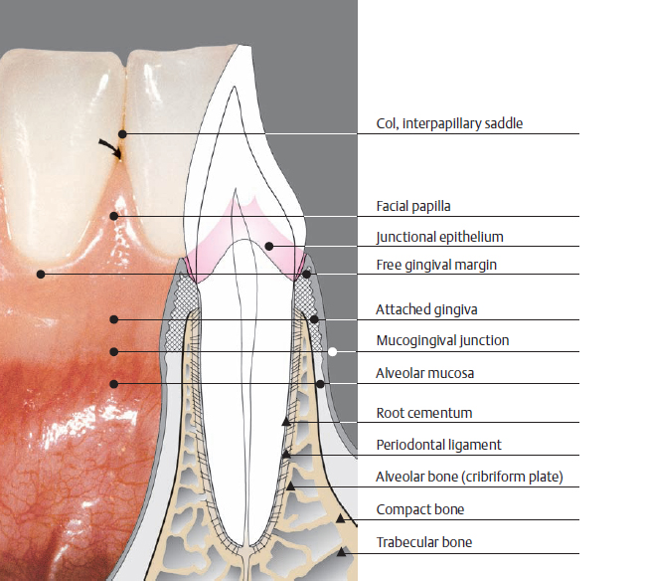
Many of the unique features of periodontitis are derived from the anatomy of the periodontium, in which
a hard, nonshedding surface (the tooth) is partly embedded within the body (within connective tissue), crosses an epithelial surface, and is partly exposed to the outside world (within the confines of the mouth).
The bacteria that colonize this surface are effectively outside of the body (although they are in the gingival crevice or pocket), yet the inflammatory response that develops is located within the body (i.e., within the tissues).
These factors add complexity to our understanding of the role of the biofilm and the immune–inflammatory responses that are part of periodontal tissue breakdown.

Slide 6
Clinically Healthy Gingival Tissues

Slide 7
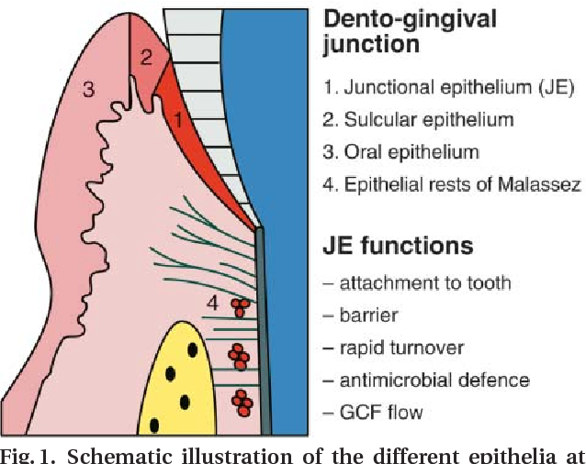
The dentogingival junction is a unique anatomic feature that functions to attach the gingiva to the tooth.
It has an epithelial portion and a connective tissue portion,
both of which are of fundamental importance for periodontal pathogenesis.
The epithelial portion can be divided into three distinct epithelial structures:
the gingival epithelium, the sulcular epithelium, and the junctional epithelium

Slide 8
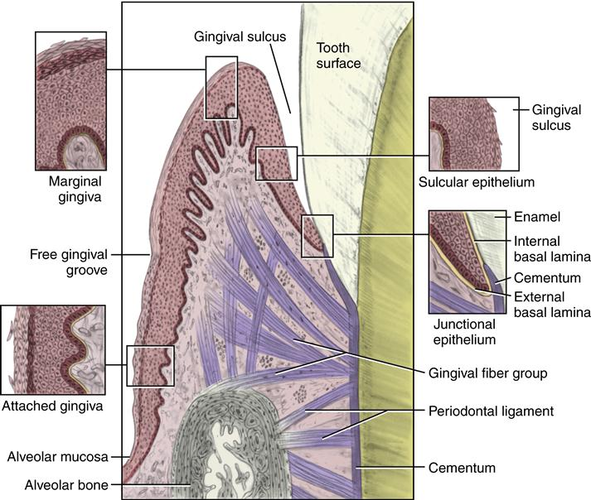
The junctional epithelium is a unique epithelial structure because the surface cells are specialized for the purpose of attachment to the tooth.
Therefore, unlike other epithelial tissues elsewhere in the body, no opportunity exists for the sloughing of cells from the surface.
Instead, cells at the basal layer continually divide and move to within two or three cell layers of the tooth surface and then migrate coronally and parallel to the tooth surface to reach the floor of the sulcus eventually and then be sloughed off into the gingival crevice.

Slide 9
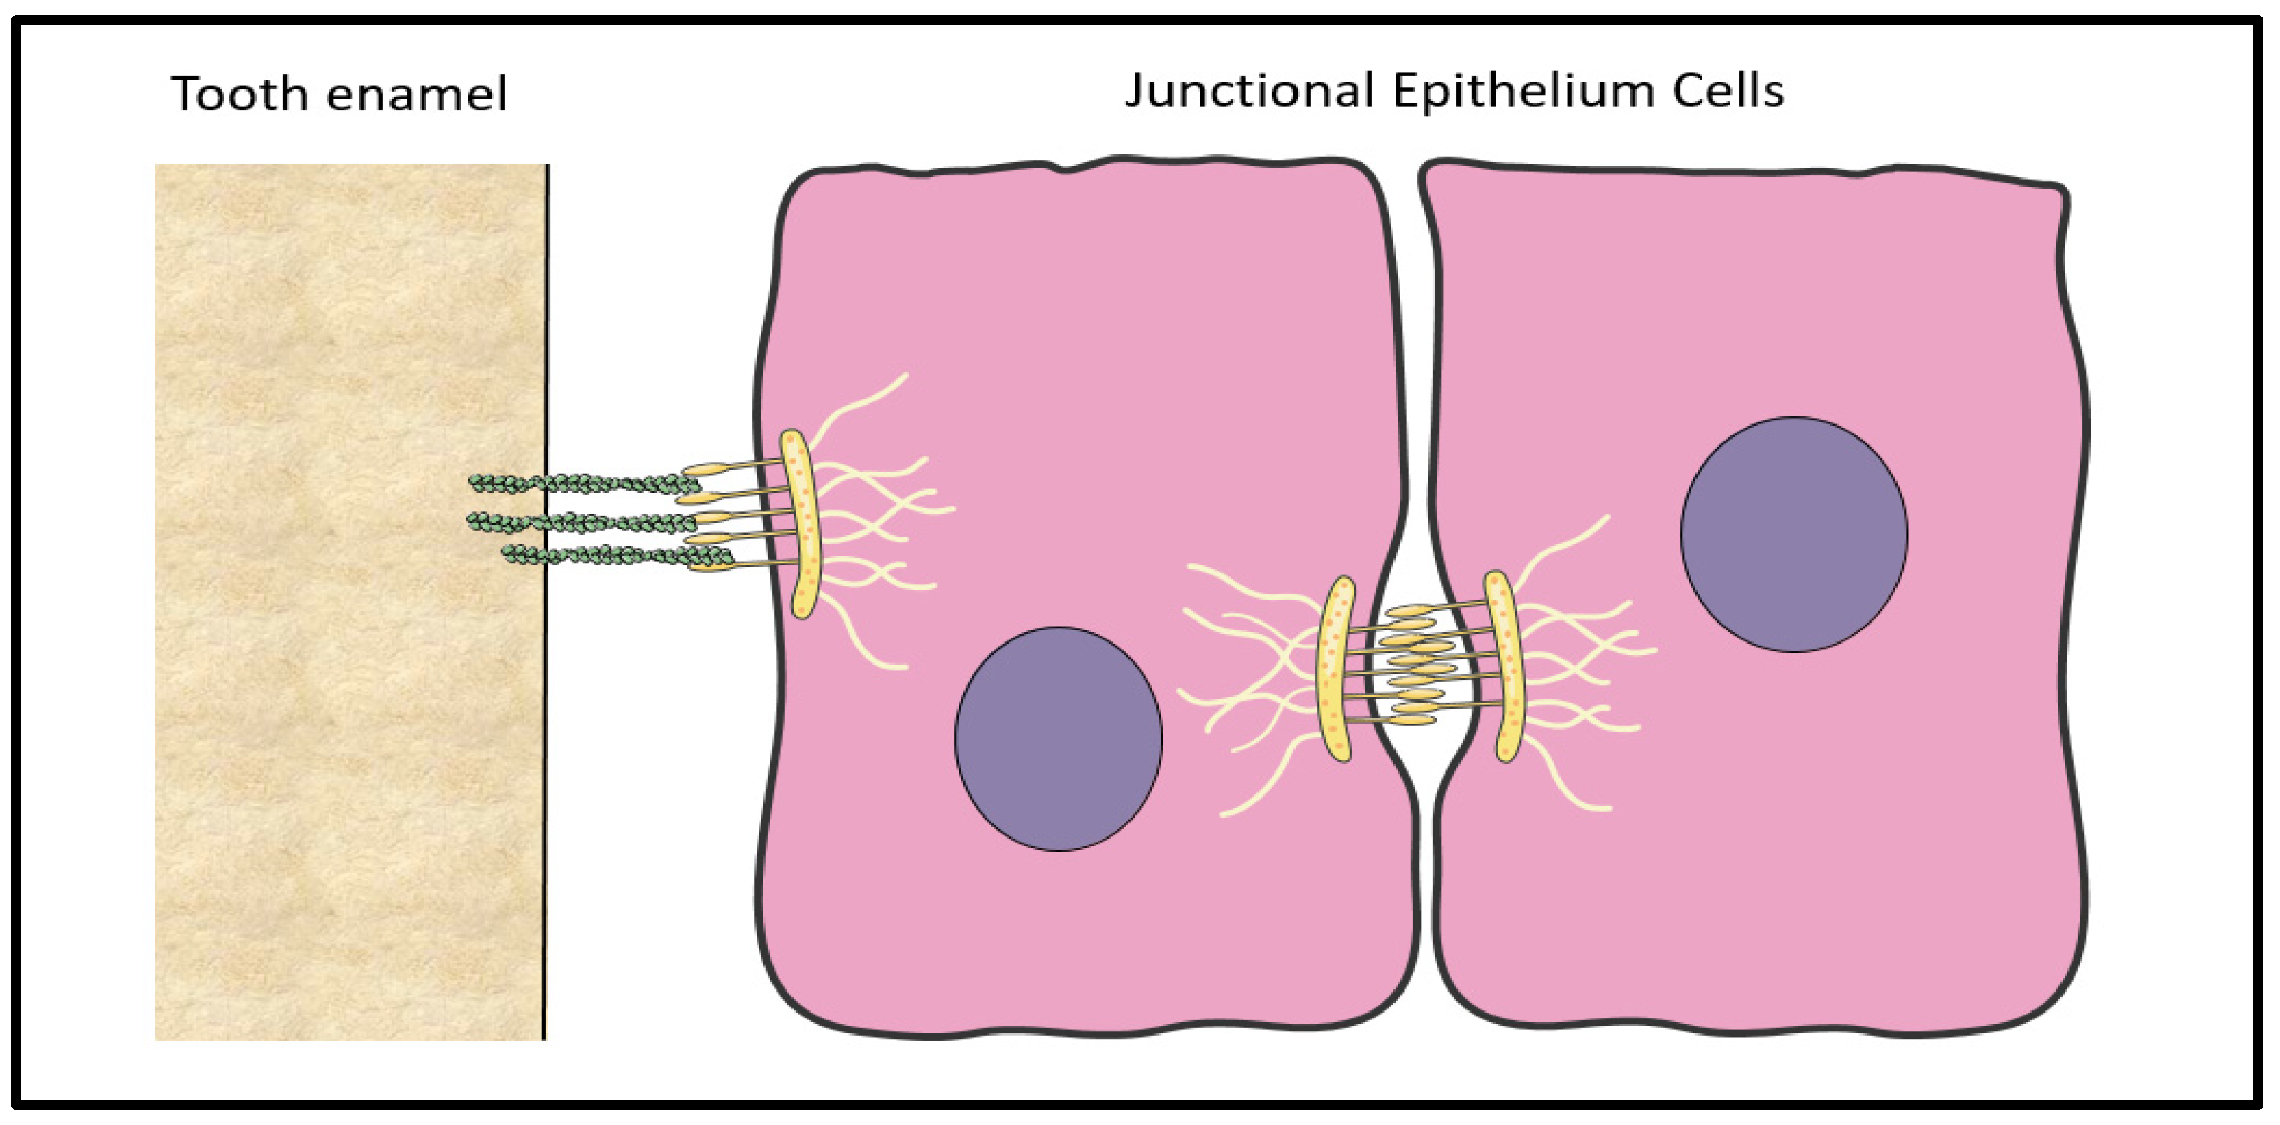
The spaces between cells of the junctional epithelium are also greater than those seen with other epithelial tissues, with the intercellular spaces comprising approximately 18% of the volume of the epithelium.
This configuration is a result of a lower density of desmosomes in the junctional epithelium as compared with the gingival epithelium;
the junctional epithelium is therefore intrinsically “leaky.”
The connective tissue component of the dentogingival unit contains densely packed collagen fiber bundles (a mixture of type I and III collagen fibers) that are arranged in distinct patterns that maintain the functional integrity of the tissues and the tight adaptation of the soft tissues to the teeth

Slide 10
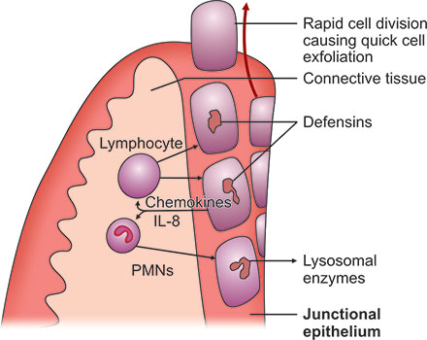
This situation has great relevance for periodontal pathogenesis because the
widened intercellular spaces in the junctional epithelium permit the migration of neutrophils (polymorphonuclear leukocytes); they also allow macrophages from the gingival connective tissues to enter the sulcus to phagocytose bacteria, and the ingress of bacterial products and antigens occurs as well.

Slide 11
NORMAL CLINICAL FEATURES OF GINGIVA

Slide 12
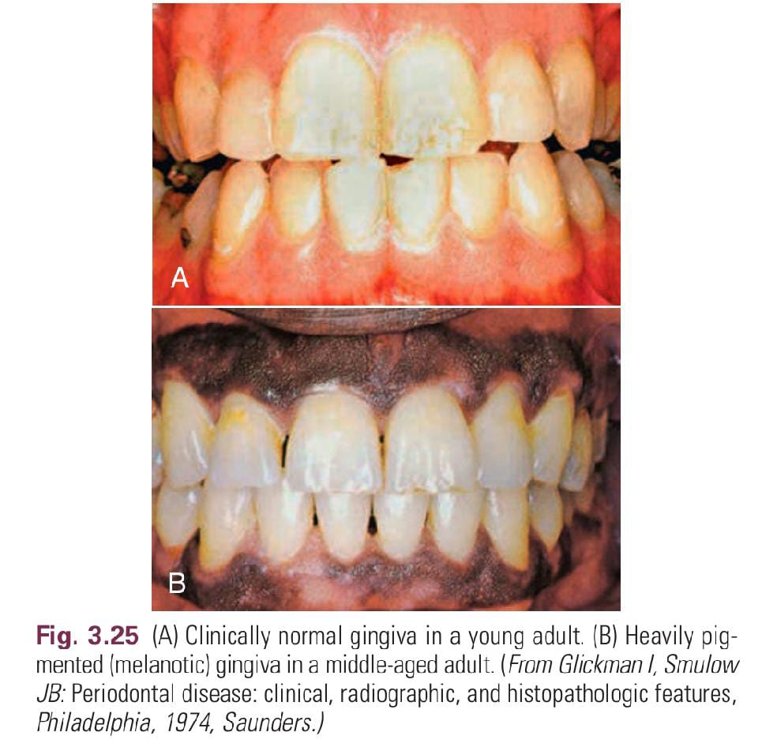
The color of the attached and marginal gingiva is generally described as “coral pink”; Influenced By Degree Of Keratinisation, Vasculature, Thickness, Presence Of Pigment Containg Cells, And Other Factors Like Physical, chemical, thermal, pharmacologic Or Idiopathic Factors.
COLOR

Slide 13
Physiologic Pigmentation (Melanin)
Melanin is a non–hemoglobin-derived brown pigment
Ascorbic acid directly down-regulates melanin pigmentation in gingival tissues

Slide 14
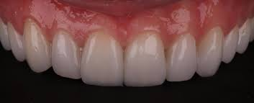
Sum Total Of Cellular, acellular elements, and their Vascular Supply.
SIZE:C
CONTOUR
Shape And Alignment Of Teeth,
Dimensions Of Proximal Contact Area And Gingival Embrasures.
The marginal gingiva envelops the teeth in collar-like fashion and follows a scalloped outline on the facial and lingual surfaces.

Slide 15
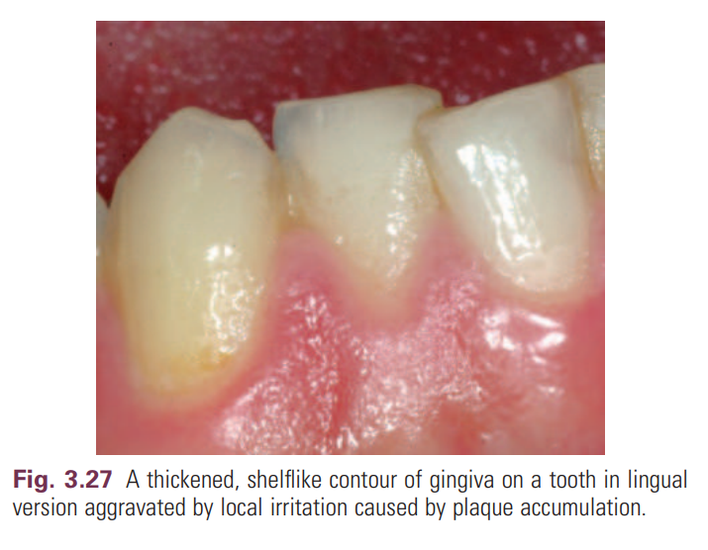
On teeth with pronounced mesiodistal convexity (e.g., maxillary canines) or teeth in labial version, the normal accuate contour is accentuated, and the gingiva is located farther apically.
On teeth in lingual version, the gingiva is horizontal and thickened

Slide 16
A thin and clear gingiva is found in one-third of the population and primarily in females with slender teeth with a narrow zone of keratinized tissue,
whereas a clear, thick gingiva with a broad zone of keratinized tissue is present in two-thirds of the population and primarily in males.

Slide 17
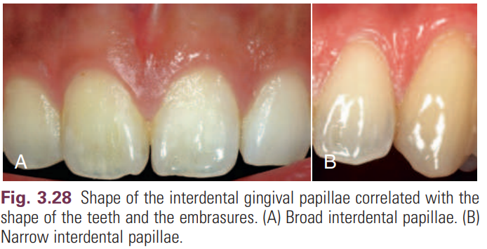
The shape of the interdental gingiva is governed by the contour of the proximal tooth surfaces and the location and shape of the gingival embrasures.
The height of the interdental gingiva varies with the location of the proximal contact
Anterior – Pyramidal ,
Posterior – Broad And Flat.
Shape

Slide 18
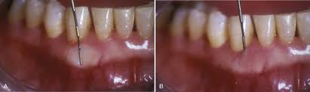
Consistency:
Firm and resilient.
Firmness of AG is due to collagen of GCT and that of MG is due to gingival fibers.

Slide 19
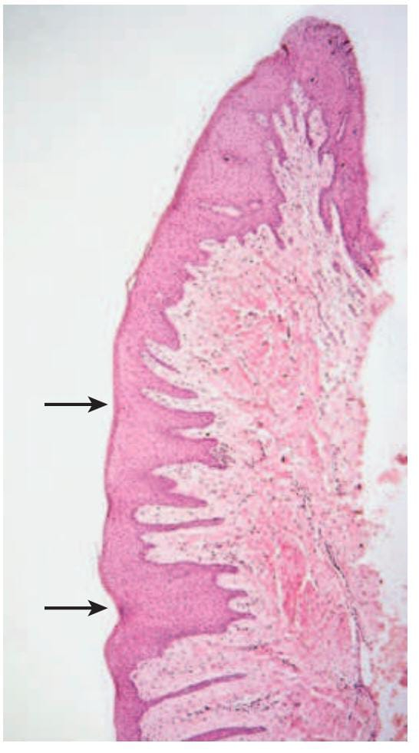
Microscopically, Stippling Is Produced By Alternate Rounded Protuberances And Depressions In The Gingival Surface.
The Papillary Layer Of The Connective Tissue Projects Into The Elevations, And
The Elevated And Depressed Areas Are Covered By Stratified Squamous Epithelium.
Surface texture:

Slide 20
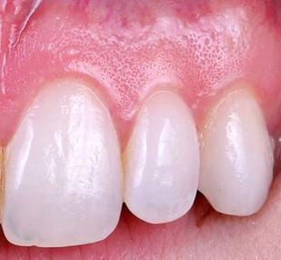
stippling

Slide 21
Level At Which Gingival Margin Is Attached To The Tooth.
During Eruption Stage- At The Tip Of The Crown
As The Eruption Continuous- Gingival Margin Gets Closer To The Root.
Position:

Slide 22
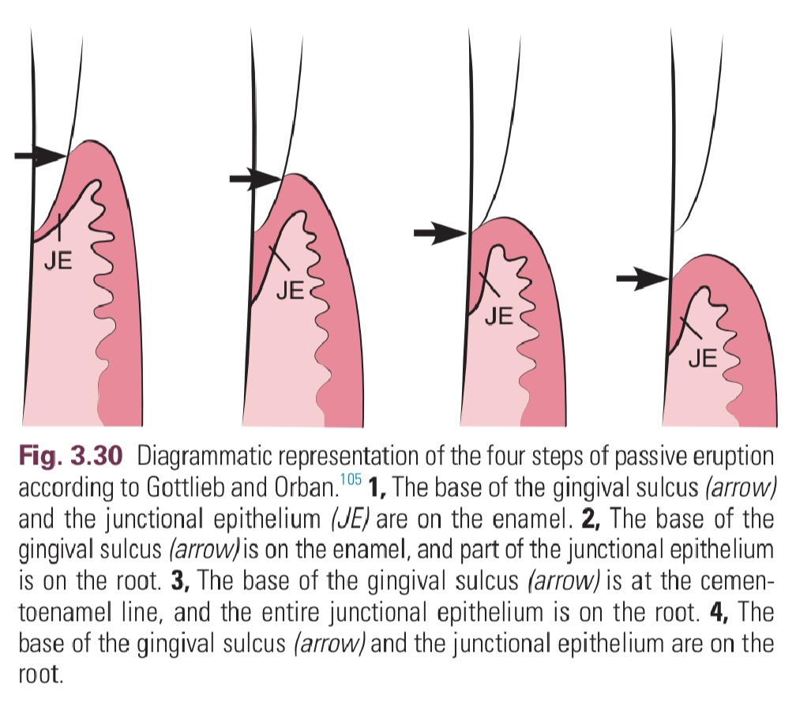
Continuous Tooth Eruption:
Active eruption is the movement of the teeth in the direction of the occlusal plane, whereas passive eruption is
the exposure of the teeth via apical migration of the gingiva.

Slide 23


Slide 24
STAGES
OF
GINGIVITIS

Slide 25
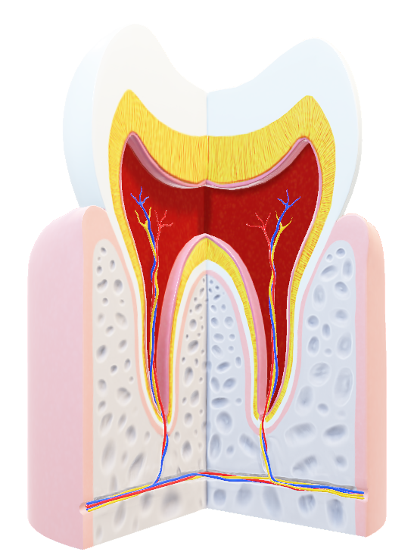
The landmark studies of Page and Schroeder described the
histologic changes that occur in the gingival tissues as the initial, early, established, and advanced gingival lesions .
In broad terms, the initial lesion corresponds with clinically healthy tissues (but nonetheless with transmigrating defense cells such as neutrophils if examined histologically),
the early lesion corresponds with the early stages of (clinically evident) gingivitis,
the established lesion corresponds with chronic gingivitis, and
the advanced lesion marks the transition to periodontitis, with attachment loss and bone resorption

Slide 26
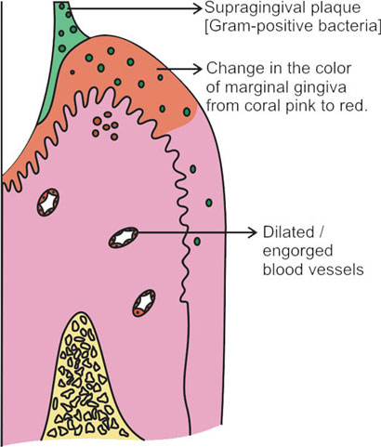
The initial lesion was reported to develop within 2 to 4 days of the accumulation of plaque at a site that was otherwise free of plaque and at which no inflammation was evident microscopically.
In other words, the initial lesion corresponds to the histologic picture that is evident in clinically healthy gingival tissues.
This low-grade inflammation is characterized by dilation of the vascular network and increased vascular permeability, thus permitting the neutrophils and monocytes from the gingival vasculature to migrate through the connective tissues toward the source of the chemotactic stimulus: the bacterial products in the gingival sulcus.
The Initial Lesion

Slide 27
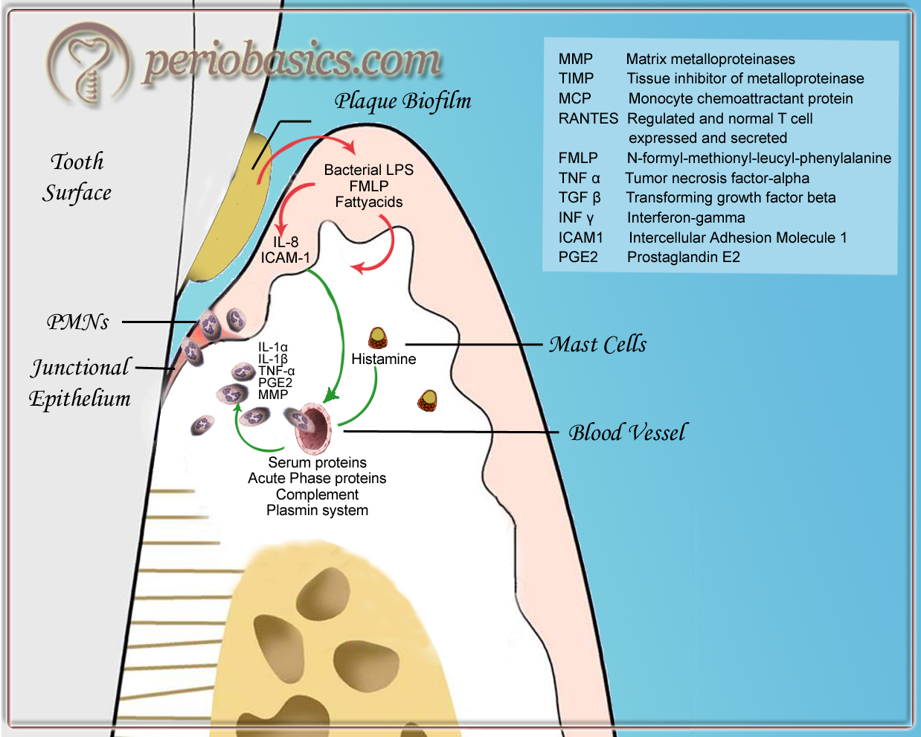
The upregulation of adhesion molecules such as intercellular adhesion molecule-1 (ICAM-1) and E-selectin in the gingival vasculature facilitates the migration of neutrophils from the capillaries into the connective tissues.
The increased leakage of fluid from the vessels increases the hydrostatic pressure in the local microcirculation, and, as a result, GCF flow increases.
Increased GCF flow has an effect of diluting bacterial products, and it also potentially has a flushing action to remove bacteria and their products from the crevice.

Slide 28
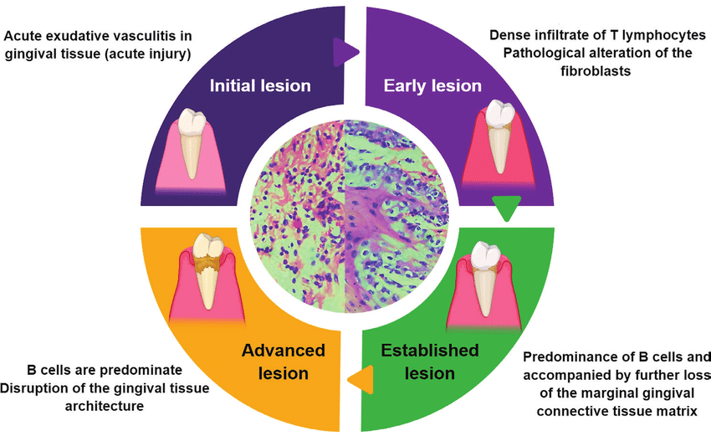
The early lesion was said to develop after about 1 week of continued plaque accumulation and corresponds to the early clinical signs of gingivitis.
The gingiva are erythematous in appearance as a result of the proliferation of capillaries, the opening up of microvascular beds, and continued vasodilation.
Increasing vascular permeability leads to increased GCF flow, and transmigrating neutrophils increase significantly in number.
Fibroblasts degenerate, primarily by apoptosis (programmed cell death), which increases the space available for infiltrating leukocytes.
Collagen destruction occurs, which results in collagen depletion in the areas apical and lateral to the junctional and sulcular epithelium.
The predominant infiltrating cell types are neutrophils and lymphocytes (primarily thymic lymphocytes [T-cells]),and the neutrophils migrate through the tissues to the sulcus and phagocytose bacteria.
The Early Lesion

Slide 29
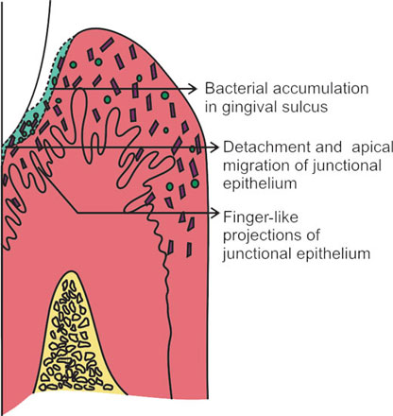
The basal cells of these epithelial structures begin to proliferate to maintain an intact barrier against the bacteria and their products and the epithelium can then be seen proliferating into the collagen-depleted areas of the connective tissues.
As a result of edema of the gingival tissues, the gingiva may appear slightly swollen, and, accordingly, the gingival sulcus becomes slightly deeper.
The subgingival biofilm exploits this ecologic niche and proliferates apically (thereby rendering effective plaque control more difficult).
The early gingival lesion may persist indefinitely, or it may progress further.

Slide 30
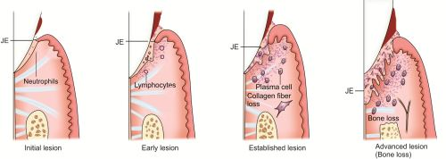
The established lesion roughly corresponds to what clinicians would refer to as “chronic gingivitis.” The progression from the early lesion to the established lesion depends on many factors, including the plaque challenge (the composition and quantity of the biofilm), host susceptibility factors, and risk factors (both local and systemic).
In the initial work by Page and Schroeder, the established lesion was defined as being dominated by plasma cells, and a significant inflammatory cell infiltrate in established gingivitis occupies a considerable volume of the inflamed connective tissues.
Large numbers of infiltrating cells can be identified adjacent and lateral to the junctional and sulcular epithelium, around blood vessels, and between collagen fiber bundles.
Collagen depletion continues, with further proliferation of the epithelium into the connective tissue spaces.
The Established Lesion

Slide 31
Neutrophils accumulate in the tissues and release their lysosomal contents extracellularly (in an attempt to kill bacteria that are not phagocytosed), thereby resulting in further tissue destruction.
Neutrophils are also a major source of matrix metalloproteinase-8 (MMP-8; neutrophil collagenase) and MMP-9 (gelatinase B), and these enzymes are produced in large quantities in the inflamed gingival tissues as the neutrophils migrate through the densely packed collagen fiber bundles to enter the sulcus.
The junctional epithelium and sulcular epithelium form a pocket epithelium that is not firmly attached to the tooth surface, that contains large numbers of neutrophils, and that is more permeable to the passage of substances into or out of the underlying connective tissue.
The pocket epithelium may be ulcerated and less able to resist the passage of the periodontal probe, so bleeding on probing is a common feature of chronic gingivitis.
These inflammatory changes are still completely reversible if effective plaque control is reinstituted.

Slide 32
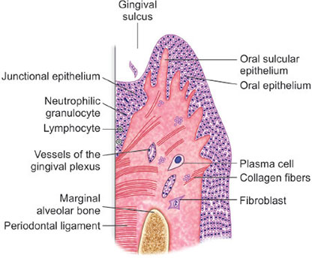
The advanced lesion, as described by Page and Schroeder, marks the transition from gingivitis to periodontitis.
This transition is determined by many factors, the relative importance of which is currently unknown but which includes the bacterial challenge (both the composition and the quantity of the biofilm), the host inflammatory response, and susceptibility factors, including environmental and genetic risk factors.
Neutrophils predominate in the pocket epithelium and the periodontal pocket, and plasma cells dominate in the connective tissues.
The junctional epithelium migrates apically along the root surface into the collagen-depleted areas to maintain an intact epithelial barrier
Histologic examination reveals continued evidence of collagen destruction that extends into the periodontal ligament and the alveolar bone.
The Advanced Lesion

Slide 33
Osteoclastic bone resorption commences, and the bone retreats from the advancing inflammatory front as a defense mechanism to the prevent spread of bacteria into the bone.
As the pocket deepens, plaque bacteria proliferate apically into a niche, which is very favorable for many of the species that are regarded as periodontal pathogens.
The pocket presents a protected, warm, moist, and anaerobic environment with a ready nutrient supply, and because the bacteria are effectively outside of the body (even though they are in the periodontal pocket), they are not significantly eliminated by the inflammatory response.
Thus a cycle develops in which chronic inflammation and associated tissue damage continue.
The tissue damage is mainly caused by the inflammatory response, yet the initiating factor—the biofilm—is not eliminated.
The destruction of collagen fibers in the periodontal ligament continues, bone resorption progresses, the junctional epithelium migrates apically to maintain an intact barrier, and as a result, the pocket deepens fractionally.
This makes it even more dificult to remove the bacteria and to disrupt the biofilm through oral hygiene techniques, and thus the cycle is perpetuated

Slide 34
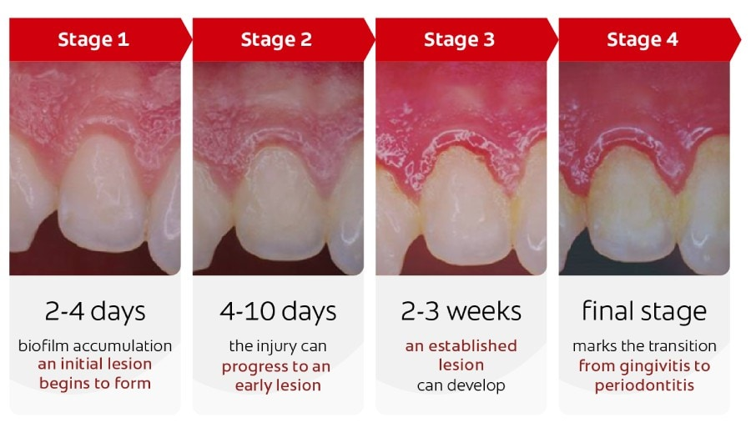

Slide 35


Slide 36
