Slide 1

Good Morning

Slide 2
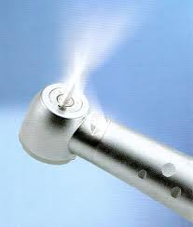
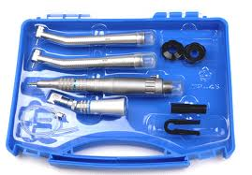
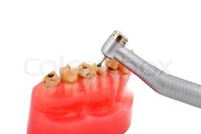
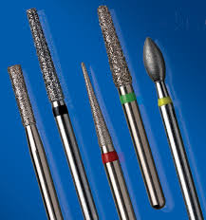
ROLE OF
SPEED
IN OPERATIVE DENTISTRY

Slide 3
CONTENTS
INTRODUCTION
HISTORY
HANDPIECE
Types of handpieces-Based on design
Based on driving mechanism
ROTARY SPEED RANGES
Low speed
Intermediate speed
High speed
DENTAL BURS AND THEIR SPEED RANGES
Steel burs
Tungsten carbide burs
Diamond burs

Slide 4
CONTENTS
CHARACTERISTICS OF ROTARY INSTRUMENTATION THAT ARE INFLUENCED BY SPEED-
Pressure
Heat production
Vibration
Patient reaction
Operator fatigue
CUTTING EFFICACY
HAZARDS WITH ROTARY INSTRUMENTATION-
Pulpal precautions
Soft tissue precautions
Eye precautions
Ear precautions
Inhalational precautions

Slide 5
CONTENTS
ALTERNATIVES TO HIGH SPEED ROTARY INSTRUMENTATION Sonic instrumentation Ultrasonic instrumentation Air abrasive system Air-polishing Laser equipment
CONCLUSION
REFERENCES

Slide 6
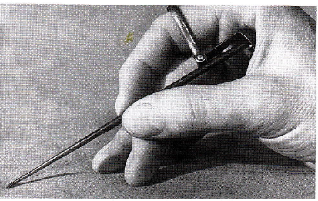
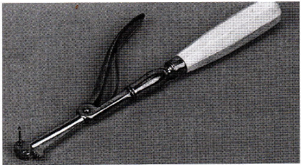
INTRODUCTION
Archeological evidence of dental treatment dates from 5000 B.C., but little is known about the equipment and methods used then.
Hand instruments – time consuming, ineffective, and do not produce defined cavity margins.
Early drills were powered by hand.

Slide 7
HISTORY
Most of the development of methods for preparing teeth - last 100 years.
1947- equipment for removal of enamel (speeds of 10,000 RPM, carbide burs and diamond instruments).
1953- continued improvements in the design and materials of construction for hand pieces and instruments (efficient and sterilizable).

Slide 8
HISTORY
1874- introduction of the electric motor as a power source.
1914- it was incorporated into a dental unit.
The initial hand piece equipment and operating speeds (maximum of 5000 RPM) remained virtually unchanged until 1946.

Slide 9
HISTORY
1935- Diamond cutting instruments were developed in Germany, (scarce until after World War II).
1946- diamond instruments and tungsten carbide burs.
Both performed best at the highest speeds available.
Resulted in need for higher speeds.

Slide 10
HISTORY
Obtaining speeds of 10,000 to 15,000 RPM - simple matter of modifying existing equipment by – enlarging the drive pulleys on the dental engine.
1950- speeds of 60,000 RPM and greater - newly designed equipment employing speed - multiplying internal belt drives.
They were more effective for cutting tooth structure and for reducing perceived vibration.

Slide 11
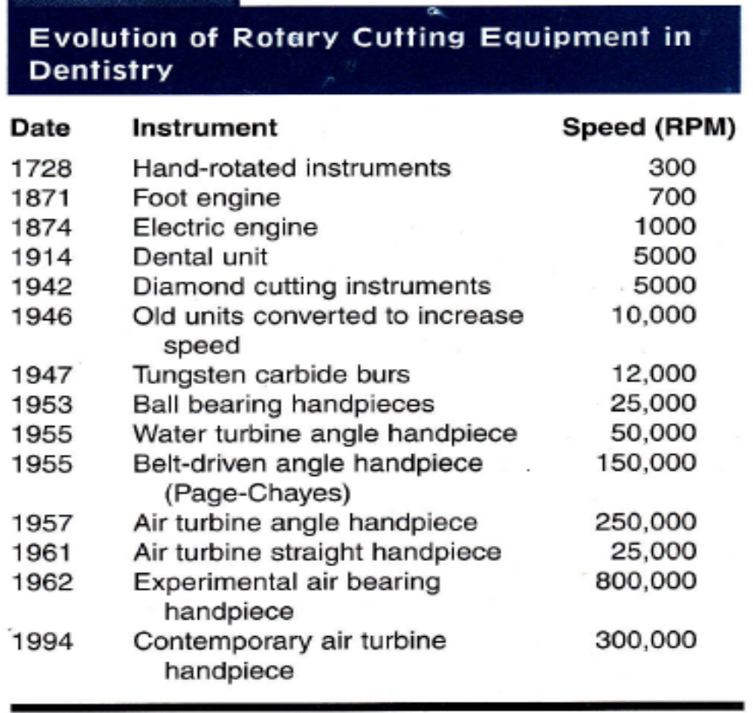
HISTORY
The major breakthrough in the development of high speed rotary equipment- introduction of contra-angled hand pieces.
Early units- water driven, but subsequent units were air driven.
Most current air-turbine hand pieces have free-running speeds of approximately 300,000 RPM.

Slide 12
HANDPIECE
A hand piece is a device for holding rotating instruments, transmitting power to them, and for positioning them intraorally.
Rotary instruments in dentistry refers to a group of instruments that turn on an axis to perform work such as cutting, abrading, burnishing, finishing or polishing tooth tissues or a restoration.

Slide 13
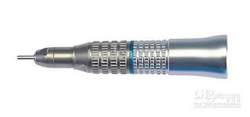
HANDPIECE
TYPES OF HANDPIECES
BASED ON DESIGN:
1. STRAIGHT HANDPIECE
The long axis of the bur is the same as that of the handpiece.
The design of the straight hand piece turbine provided the desirable high torque for low-speed operation.
Used more frequently for laboratory work and surgical procedures.

Slide 14
HANDPIECE
2. CONTRA-ANGLE HANDPIECE
The primary handpiece used in the mouth.
The head of the handpiece is angled first away from and then back toward, the long axis of the handle.
Design is intended to bring the working point (the head of the bur) to within a few millimeters of the long axis of the handle of the handpiece to provide balance.

Slide 15
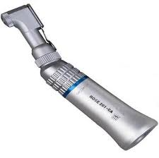
HANDPIECE
There are two types of contra-angled handpieces, which are classified by their speed potential.
LOW SPEED CONTRA-ANGLED HANDPIECE
500 to 15000 RPM.
These handpieces have either a friction grip chuck or a latch type chuck.

Slide 16
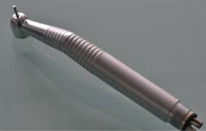
HANDPIECE
HIGH SPEED CONTRA-ANGLED HANDPIECE-
160,000 rpm to 500,000 RPM.
The speed of these handpieces during tooth preparation is 180,000 RPM and lower, depending on the application of pressure and the power of handpiece.
These receive only the friction grip burs.

Slide 17
HANDPIECE
BASED ON DRIVING MECHANISM
1. GEAR-DRIVEN HAND PIECE
<5000 RPM.
Rotary power is transferred to the straight headpiece by a belt that runs from an electric engine over a series of pulleys and a three piece extension cord arm.

Slide 18

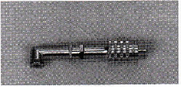
HANDPIECE
Rotary power is transferred from the straight hand piece by a shaft and gears inside the angle section.
Several speed increasing transmissions - speeds of 100,000 RPM with a gear-driven angle that has an automatic lubricating system.

Slide 19
HANDPIECE
ADVANTAGES
Very versatile, capable of a wide speed range and use.
All operative procedures can be accomplished.
Function best at low speed because of so many moving parts with metal to metal contact.
High torque is available at all speeds.
DISADVANTAGES
Proper maintenance - utmost importance to prevent excessive heat, vibration and wear within the hand piece.

Slide 20
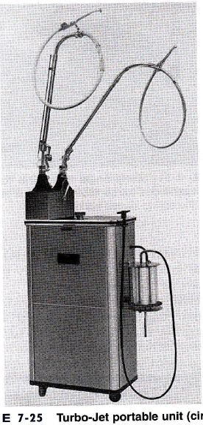
HANDPIECE
2. WATER-DRIVEN HAND PIECE
In 1953, a hydraulic driven turbine hand piece was reported to operate satisfactorily at 60,000 RPM.
2 years later, the 1st commercial model- TURBOJET.
The Turbojet is designed as a compact mobile unit, only electricity is needed to operate it.

Slide 21
HANDPIECE
The sound-proof cabinet contains a motor, water pump, water reservoir and the necessary plumbing for circulating the water.
Water is conveyed to and from the hand piece by a co-axial type tubing (tube inside a tube).

Slide 22
HANDPIECE
Small inner tube- carries water under high pressure to rotate a turbine in the handpiece head.
Larger outer tube - returns the water to the reservoir.
Re-circulated over and over.
ADVANTAGES
The handpiece is extremely quiet and has highest torque of any turbine angle hand piece.

Slide 23
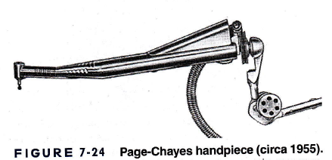
HANDPIECE
3. BELT-DRIVEN HAND PIECES
A belt-driven angle hand piece called the Page-Chayes became available in 1955.
1st angle hand piece- operate at speeds above 100,000 rpm.
All gears were eliminated by having a small belt run inside the handpiece sheath over ball-bearing pulleys in the angle sections.

Slide 24
HANDPIECE
The rotary cutting instrument has a 1/6 inch shank held in the hand piece by friction grip.
Improved models - Page-Chayes 909 and the Twin 909.
ADVANTAGES
Relatively free of maintenance problems because the bearings have factory-sealed lubrication.
History of excellent performance and great versatility.

Slide 25
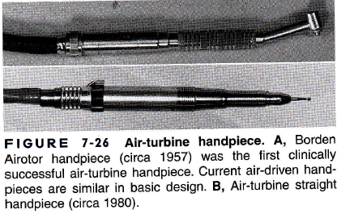
HANDPIECE
4. AIR-DRIVEN HAND PIECES
In 1957, 1st clinically successful air-driven turbine hand piece (BORDON) became available - 300,000 rpm.
A small compact unit consists of a handpiece, control box, foot control and various connector hoses.

Slide 26
HANDPIECE
When the foot control is activated, compressed air flows through the control box and is carried by a flexible hose to the back of the hand piece.
From here the air is directed to the head of the hand piece and is blown against the blades of a small turbine to produce rotation while the greater part is exhausted at the back of the handpiece or returned to the control box.

Slide 27
HANDPIECE
ADVANTAGES
The speeds drop from 300,000 rpm to 160,000 rpm with a lateral workload.
The reason is that air turbines have low torque and will stall at lateral workloads of 4½ – 5½ ounces- Excellent safety feature since excessive pressure cannot be applied to rotary instrument.

Slide 28
HANDPIECE
Different handpieces and their identification-
500-10,000 RPM. - green band handpiece
10,000-25,000 RPM - blue band handpiece
20,000-80,000 RPM - red band handpiece
80,000-120,000 RPM - orange band handpiece
250,000-400,000 RPM - air turbine only

Slide 29
ROTARY SPEED RANGES
Speed refers not only to the revolutions per minute, but also to the surface feet per unit time of contact that the tool has with the work to be cut.
Surface feet per minute is controlled by
RPM
size of the revolving tool (length and diameter),

Slide 30
ROTARY SPEED RANGES
A rotary tool should be large in diameter when used with low speeds to approach the optimum surface feet per unit time.
In the ultra-high speed range - diameter of a cutting tool should be reduced.

Slide 31
ROTARY SPEED RANGES
For dental purposes we classify speeds as follow:
ACCORDING TO MARZOUCK
Ultra-low speed - 300-3,000 RPM
Low speed - 3,000-6,000 RPM
Medium high speed - 20,000-45,000 RPM
High speed - 45,000-100,000 RPM
Ultra-high speed -100,000 RPM and more.

Slide 32
ROTARY SPEED RANGES
ACCORDING TO STURDEVENT
Lower or slow speeds- below 12,000 RPM
Medium or intermediate speeds- 12,000- 200,000 RPM
High or ultrahigh speeds- above 200,000 RPM

Slide 33
ROTARY SPEED RANGES
ACCORDING TO CHARBEANU
Conventional or low speed- below 10,000 RPM
Increased or high speed- 10,000- 150,000 RPM
Ultra speed- above 150,000 RPM

Slide 34
ROTARY SPEED RANGES
LOW SPEED
<12,000 RPM
Intact tooth structure can be removed.
USES
Cleaning teeth,
Occasional caries excavation, and
Finishing and polishing procedures that used abrasive disks, points and cups.

Slide 35
ROTARY SPEED RANGES
ADVATAGES
Tactile sensation is better.
Less chance for overcutting tooth structure.
Valuable adjunct for many dental procedures.

Slide 36
ROTARY SPEED RANGES
DISADVANTAGES
Traumatic experience for the patient and the dentist.
Cutting is ineffective.
Time-consuming.
Requires heavy force application (2-5 pounds).
Heat production at the operating site.
Produces vibrations of low frequency and high amplitude.

Slide 37
ROTARY SPEED RANGES
Patient discomfort (heat and vibration).
Burs have a tendency to roll out of the tooth preparation.
Carbide burs do not last long because their brittle blades are easily broken at low speeds.
Many of these disadvantages of low-speed operation do not apply when the objective is some procedure other than cutting tooth structure.

Slide 38
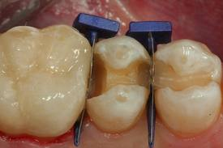
ROTARY SPEED RANGES
INTERMEDIATE SPEED
12,000-150,000RPM
USES
Cavity preparations (not as effectively as high speeds)- a large selection of specifically shaped instruments is required.
Finishing procedures (placement of retentive grooves and bevels)

Slide 39
ROTARY SPEED RANGES
ADVANTAGES
Used where vision is poor.
More positive sense of touch.
Less force is required (1 pound).

Slide 40
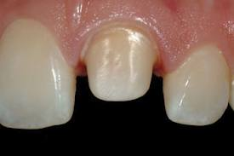
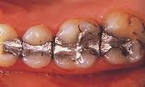
ROTARY SPEED RANGES
HIGH SPEED
>150,000 RPM
USES
Tooth preparation.
Removing old restorations.

Slide 41
ROTARY SPEED RANGES
ADVANTAGES
Speed needed for efficient cutting can be attained with smaller and more versatile cutting instruments.
Less pressure.
Less vibration and heat generation.
Less force is required (1-4 ounces).
The number of rotary cutting instruments needed is reduced (smaller sizes are more universal in application).

Slide 42
ROTARY SPEED RANGES
The operator has better control and greater ease of operation.
Instruments last longer.
Diamond and carbide cutting instruments remove tooth structure faster.
Patients are generally less apprehensive.
Several teeth in the same arch can be treated at the same appointment.

Slide 43
ROTARY SPEED RANGES
DISADVANTAGES
Desiccation of dentinal tubules.
Impaired visibility due to water spray.
Mechanical injury to soft tissue.
Overcutting of tooth.

Slide 44
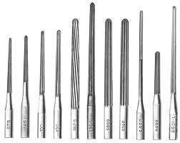
DENTAL BURS AND THEIR SPEED RANGES
STEEL BURS
<5000 RPM.
Used when rotary cutting instruments were first developed, over 100 years ago.
Each bur usually has 8 blades.
The use of air- water spray during cutting - increase efficiency, but is not essential.

Slide 45
DENTAL BURS AND THEIR SPEED RANGES
Shanks are designed for latch-type handpieces.
Now burs with friction-grip shanks- maintain concentricity, thereby reducing vibration.
USES
Removal of caries.
Development of retentive elements in dentine.

Slide 46
DENTAL BURS AND THEIR SPEED RANGES
ADVANTAGES
Positive rake angle - ease the cutting of dentine.
DISADVANTAGES
Fragile and easily chipped along the leading edge.
Low speeds - high annoyance factor.

Slide 47
DENTAL BURS AND THEIR SPEED RANGES
PRECAUTIONS
A good tactile sense is essential for the operator to avoid over-cutting.
Therefore, burs must always be in good condition and visibility must be excellent at all times.

Slide 48
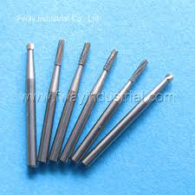
DENTAL BURS AND THEIR SPEED RANGES
TUNGSTEN CARBIDE BURS
>100,000 R.P.M.
They only cut efficiently at greatly increased speeds.
Best used at speeds beyond 300 000 R.P.M.
Friction-grip handpieces because concentricity is essential.

Slide 49
DENTAL BURS AND THEIR SPEED RANGES
USES
Cut metal and dentine well.
Tungsten carbide bur with 12 or more blades- efficient for polishing enamel margins and dentine surfaces.

Slide 50
DENTAL BURS AND THEIR SPEED RANGES
ADVANTAGES
The annoyance factor with a new bur is very low.
DISADVANTAGES
Prone to produce microcracks in enamel,- weakening cavosurface margin.
PRECAUTIONS
Air-water spray is mandatory for the removal of debris and for temperature control.

Slide 51
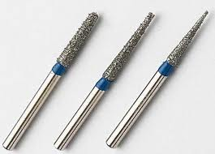
DENTAL BURS AND THEIR SPEED RANGES
DIAMOND BURS OR STONES
More efficient over a greater range of speeds.
Diamonds abrade tooth structure rather than cut or chip.
USES
Most efficient when used against hard materials such as enamel or porcelain.

Slide 52
DENTAL BURS AND THEIR SPEED RANGES
ADVANTAGES
Also less likely to chip or break, either themselves or the tooth.
Very fine diamonds - reducing dentine to a fine finish.
Diamond burs will cut efficiently over a wide range of speeds.
Annoyance factor will be least with the finer grain size if lower speeds are to be utilized.
PRECAUTIONS
Air-water spray is mandatory to enhance clearance and to control heat development.

Slide 53
CHARACTERISTICS OF ROTARY INSTRUMENTATION THAT ARE INFLUENCED BY SPEED
PRESSURE (P)
Pressure is a resultant effect of 2 factors under the control of the dentist.
Force (F): The gripping of the hand piece and its positioning and application to the tooth.
Area (A): The amount of surface area of the cutting tool in contact with the tooth surface during a cutting operation.
Pressure relates as follows:
P = F/A

Slide 54
PRESSURE
Using the same force F - smaller tools (burs or stones) will apply more pressure to the point of contact.
To have both small and large tools cut at the same pressure, it is necessary to reduce the force applied with the smaller ones.

Slide 55
PRESSURE
If the force is reduced on the smaller tool so that there is equal pressure on the tooth, obviously the larger tool will remove more tooth structure, since there is more surface feet per minute contact.
To have the smaller tool remove the same amount of tooth structure as the large one, it is necessary to increase the surface feet per minute contact of the smaller tool by increasing the RPM.

Slide 56
PRESSURE
The net result obtained is a cutting tool smaller in size with less force required by the operator and running at greater RPM.
It has been observed clinically that
low speed - 2-5 pounds force.
high speed - 1 pound.
ultra-high speed - l-4 ounces

Slide 57
PRESSURE
High speed rotary operation - less fatigue on the part of the operator, and greater patient comfort.
All these are due to reduction of forces on the tool and more efficient removal of tooth structure.

Slide 58
HEAT PRODUCTION
HEAT PRODUCTION
Heat is directly proportional to:
Pressure
RPM
Area of tooth in contact with the tool.

Slide 59
HEAT PRODUCTION
At l30° F- pulps of teeth- permanently damaged.
Even a temperature of 113° F within the pulp can produce inflammatory responses pulpitis pulp necrosis.
When speed of rotation is increased- various coolants such as flowing water, a water-air spray, or air.

Slide 60
HEAT PRODUCTION
A coolant –
Reduces the temperature rise
Increases the cutting rate by acting as a lubricant.
Cutting dentine with no lubricant - temperature rise up to 136°C in only 2 seconds.

Slide 61
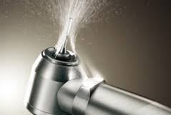
HEAT PRODUCTION
Air alone- low temperature but - dehydrate the tooth and damage the pulp.
Air-water spray - with a water flow rate of 35-50 ml/min, the temperature rise can be limited to 20-30°C.
Water alone - even more effective- temperature rise can be limited to 10°C with a flow of only 10 ml/min, ensuring that the bur head is adequately bathed with the water.

Slide 62
HEAT PRODUCTION
Because pressure is a result of applied force, a reduction of force minimize heat production.
Since higher speeds - less force - heat production could be minimized.

Slide 63
VIBRATION
VIBRATION
Major annoying factor for the patient,
Fatigue for the operator,
Excessive wear of instruments
Destructive reaction in the tooth and supporting tissues.

Slide 64
VIBRATION
Vibration - product of the equipment used and the speed of rotation.
The deleterious effects of vibration are 2-fold in origin;
Amplitude
Undesirable modulating frequencies
Minimizing or eliminating these factors - reduce the undesirable effects of vibration.

Slide 65
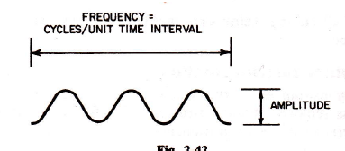
VIBRATION
1. AMPLITUDE:
A wave of vibration consists of frequency and amplitude.
At low speed - amplitude is large but the frequency is small.
At higher speeds - the reverse is true.
The greater harm is caused by the amplitude.

Slide 66
VIBRATION
Increasing the operating speed - amplitude is reduced.
Vibration waves - measured in cycles per second (CPS)
6,000 RPM - vibrational wave of 100 CPS - annoying to the patient and the dentist.
100,000 RPM - vibration of 1,600 CPS.
Over 1,300 CPS - vibrations are practically imperceptible to the patient.

Slide 67
VIBRATION
This is due to the fact that stimulations occur during the refractory period of recovery of the perception mechanism.
Higher RPMs - less amplitude and greater frequency of vibrations.
Perception will be lost in the ultra high speed ranges of 100,000 RPM or more.

Slide 68
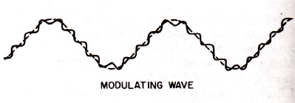
VIBRATION
2. UNDESIRABLE MODULATING FREQUENCY
The second deleterious effect of vibration - improperly designed, or poorly maintained equipment.
This allows modulating frequencies to be established so that a series of vibrations (in different directions) are perceived by the patient and the dentist.

Slide 69
VIBRATION
The end result is again
Apprehension in the patient,
Fatigue for dentist
Accelerated wear of cutting instruments.

Slide 70
VIBRATION
The fundamental vibration wave is set up when the hand piece turbine is running.
Each piece of the remaining attachment (hand piece) will vibrate, depending upon the amount of wear or eccentricity in its moving parts.
Each will set up a modulating frequency, or "overtone", accompanying the fundamental vibrational wave.
Patient and the dentist are subjected not only to the basic wave but also to other accompanying vibrations.

Slide 71
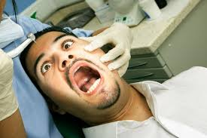
PATIENT REACTION
PATIENT REACTION
The factors that cause patient apprehension are-
Heat production,
Vibrational sensation,
Length of operating time, and
Number of visits.

Slide 72
PATIENT REACTION
The proper understanding of the instrument being used and the speed at which it is being used - allows the operator to counteract these potentially irritating stimuli.
The use of coolants- greatly in minimizing both patient discomfort and unnecessary irritation to the oral structures.

Slide 73
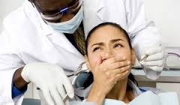
PATIENT REACTION
Annoyance factor - The term 'annoyance factor' is used rather loosely to describe the patient's subjective reaction to cavity preparation.
It is a combination of the
Pressure applied to the tooth,
Vibrations and noise recorded through the bones of the skull,
Heat and smell generated at the interface between tooth and bur
Time taken to perform a given task.

Slide 74
PATIENT REACTION
Vibration and noise generation - coarseness of the cutting instrument and the speed of rotation.
Use of higher speeds and smaller instruments- reduces vibration.
The generation of heat and smell - adequacy of lubrication and the efficiency of the instrument in removing shavings from the tooth.

Slide 75
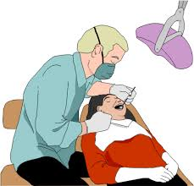
OPERATOR FATIGUE
OPERATOR FATIGUE
The major causes for fatigue are:
Duration of operation,
Vibration produced in the hand piece,
Forces needed to control the rotating instrument,
Apprehension on the part of the dentist regarding the possibility of producing a pulp exposure or injuring adjacent oral, intra- and paraoral tissues, and
Lack of patient cooperation.

Slide 76
OPERATOR FATIGUE
High speed rotary instrumentation- minimizes fatigue by decreasing vibrations and the time of the operation.
Operator confidence and patient co-operation can be enhanced only by proper training and experience on the part of the operator.

Slide 77
CUTTING EFFICACY
With a given load the rate of cutting increases with speed.
But this increase is not in direct proportion.
Cutting rate is increased above 30,000 RPM than that below this speed.
At very high speed, 150, 000 and above - time required for the removal of the same weight of tooth structure is very nearly the same as at still higher speed.

Slide 78
CUTTING EFFICACY
It indicates that no time is saved by the dentist when rotation speeds are employed higher than 150,000 RPM.
There is, however, a minimum rotation speed for a given load below which the tool will not cut.
The greater the load, the lower this minimum rotational speed.

Slide 79
CUTTING EFFICACY
The correlation between the load and the minimum rotation speed depends upon whether enamel or dentin is being cut, the design and composition of bur.
Here, again, the tactile sense of the dentist, acquired by the experience, is the controlling factor.

Slide 80
HAZARDS WITH ROTARY INSTRUMENTATION
There are pulpal dangers from the tooth preparation and restoration procedures.
There also are soft tissue dangers.
Careful adherence to normal precautions - eliminate or minimize most risks associated with cutting instrument use.

Slide 81
PULPAL PRECAUTIONS
PULPAL PRECAUTIONS
The use of cutting instruments - harm the pulp by
Exposure to mechanical vibration,
Heat generation and
Loss of dentinal tubule fluid.
As the thickness of remaining dentin decreases, the pulpal insult (and response) from heat or desiccation increases.

Slide 82
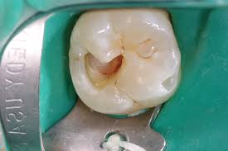
PULPAL PRECAUTIONS
Slight to moderate injury - localized, protective pulpal response in the region of the cut tubules.
Severe injury - destruction extends beyond the cut tubule - pulpal abscess and death of the pulp.
These pulpal sequelae - take 2 weeks to 6 months or longer.
Young pulp is more prone to injury - it recovers more effectively compared with an older pulp.

Slide 83
PULPAL PRECAUTIONS
Enamel and dentin - good thermal insulators - protect the pulp if the quantity of heat is not too great and the remaining thickness of tissue is adequate.
The longer the time of cutting - higher the local temperature produced- the greater is the thermal trauma.
The remaining tissue is effective in protecting the pulp in proportion to the square of its thickness.

Slide 84
PULPAL PRECAUTIONS
Steel burs - produce more heat than carbide burs because of inefficient cutting.
Burs and diamond instruments that are dull or plugged with debris - do not cut efficiently - heat production.
When used without coolant diamond instruments generate more damaging heat than carbide burs.

Slide 85
PULPAL PRECAUTIONS
Air-water spray is universally used- lubricates, cleans, and cools the cutting instrument.
Helps keep the gingival crevice open for better vision when gingival extension is necessary.

Slide 86
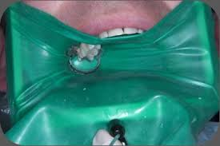
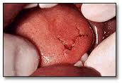
SOFT TISSUE PRECAUTIONS
The lips, tongue, and cheeks of the patient - most frequent areas of soft tissue injury.
The handpiece should never be operated unless there is good access and vision to the cutting site.
A rubber dam - isolating the operating site.

Slide 87
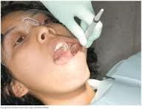
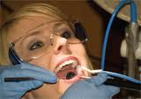
SOFT TISSUE PRECAUTIONS
Dental assistant can retract the soft tissue on one side with a mouth mirror, cotton roll or evacuator tip.
Dentist usually can manage the other side with a mirror or cotton roll or both.
If the dentist must work alone, the patient can help by holding a retraction-type saliva ejector evacuator tip, after it is positioned in the mouth.

Slide 88
SOFT TISSUE PRECAUTIONS
With air-turbine handpieces, the rotating instrument does not stop immediately when the foot control is released.
Operator must wait for the instrument to stop or be extremely careful when removing the handpiece.

Slide 89
SOFT TISSUE PRECAUTIONS
The dentist and the assistant always must be aware of the patient's response during the cutting procedures.
A sudden reflex movement by the patient such as gagging swallowing or coughing, could result in serious injury.

Slide 90
SOFT TISSUE PRECAUTIONS
If an accident does occur in which soft tissue is damaged, the operator should remain calm and control any hemorrhage with a pressure pack.
The patient should be told what has happened, and medical assistance should be obtained if needed.

Slide 91
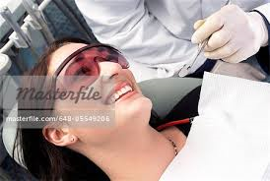
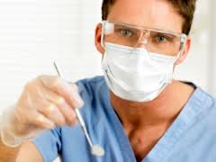
EYE PRECAUTIONS
The operator, assistant, and patient should wear glasses with side shields to prevent eye damage from air-borne particles.
When using high speeds, particles of old restorations, tooth structure, bacteria and other debris are discharged.

Slide 92
EYE PRECAUTIONS
High-volume evacuation applied by the dental assistant near the operating site helps alleviate this problem.
If an eye is injured, it should be covered by a clean gauze pad until medical attention can be obtained.

Slide 93
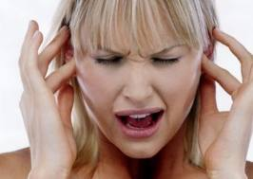
EAR PRECAUTIONS
Various sounds are known to affect people in different ways.
Soft music or random sounds such as rain fall - relaxing or sedative effect.
Loud noises - mental and physical distress.
A noisy environment - decreases the ability to concentrate, increases accident proneness, and reduces overall efficiency.

Slide 94
EAR PRECAUTIONS
An objectionable high-pitched whine is produced by some air-turbine handpieces at high speeds.
Aside from the annoying aspect of this noise, there is some possibility that hearing loss can result from continued exposure.

Slide 95
EAR PRECAUTIONS
Potential damage to hearing from noise depends on
Intensity or loudness (decibels [db])
Frequency (cycles per second [cps]) of the noise,
Duration (time) of the noise,
Susceptibility of the individual.
Increased age, existing ear damage, disease, and medications are other factors that can accelerate hearing loss.

Slide 96
EAR PRECAUTIONS
Auditory threshold is that the intensity of sound a normal ear require to reach a certain minimal level.
It can vary with frequency and exposure to other sounds.
When subjected to a loud noise of short duration a protective mechanism of the ear causes it to lose some sensitivity temporarily.
This is described as a temporary threshold shift.

Slide 97
EAR PRECAUTIONS
Turbine handpieces with ball bearings, free running at 30 lb air pressure - 70 to 94 db at high frequencies.
Noise levels greater than 75 db - hearing damage.

Slide 98
EAR PRECAUTIONS
Noise levels vary among handpieces produced by the same manufacturer.
Handpiece wear and eccentric rotating instruments can cause increased noise.
Protective measures - recommended when the noise level reaches 85 db.
Protection mandatory - 95 db.

Slide 99
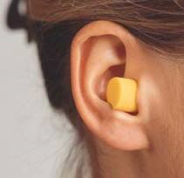
EAR PRECAUTIONS
Earplugs can be used to reduce the level of exposure.
Room soundproofing helps and can be accomplished with absorbing materials used on walls and floors.

Slide 100
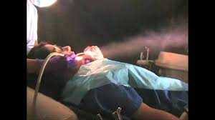
INHALATION PRECAUTIONS
Aerosols and vapors are created by cutting tooth structure and restorative materials.
Aerosols and vapors are a health hazard to all present.
The aerosols are fine dispersions in air of water, tooth debris, microorganisms, or restorative materials.
Cutting amalgams or composites produce submicron particles and vapor.

Slide 101
INHALATION PRECAUTIONS
The particles that may be inadvertently inhaled - alveolar irritation and tissue reactions.
Vapor from cutting amalgams is predominantly mercury and should be eliminated by evacuation.

Slide 102
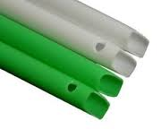
INHALATION PRECAUTIONS
The vapors generated during cutting or polishing by thermal decomposition of polymeric restorative materials (sealants, acrylic resin; composites) - predominantly monomers.
They may be eliminated efficiently by careful intraoral evacuation during the cutting or polishing procedures.

Slide 103
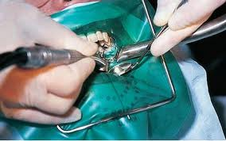
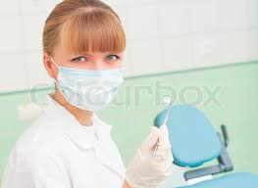
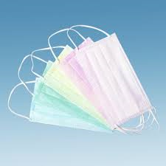
INHALATION PRECAUTIONS
A rubber dam protects the patient against oral inhalation of aerosols or vapors, but nasal inhalation of vapor and finer aerosol still may occur.
Disposable masks worn by dental office personnel filter out bacteria and all but the finest particulate matter.
Masks do not filter out mercury or monomer vapors.

Slide 104
ALTERNATIVES TO HIGH SPEED ROTARY INSTRUMENTATION
Even though the rotary instrumentation is in universal use, there are still problems that need to be overcome.
Five factors are potentially responsible for the discomfort and pain that is associated with cavity preparation:
  The sensitivity of vital dentine
  Pressure on the tooth (i.e. mechanical stimulation),
  Bone-conducted noise and vibration
  The high-pitched noise of the air-turbine hand piece, and
  Development of high temperatures at the cutting surface (i.e. thermal stimulation).

Slide 105
SONIC INSTRUMENTATION
Sonic system uses highly frequent oscillating preparation instruments in an air-driven oscillating handpiece.
The preparation instruments transfer their negative form to the tooth.

Slide 106
SONIC INSTRUMENTATION
Air pressure during preparation is 2.5-4 bars.
Frequency of the sonic waves is 6.0 kHz.
Operating pressure during preparation is about 0.1 N.
For finishing, the frequency and operating pressure are reduced.
The sonic instrumentation allows proximal beveling with limited risk of damage to the adjacent tooth surfaces.

Slide 107
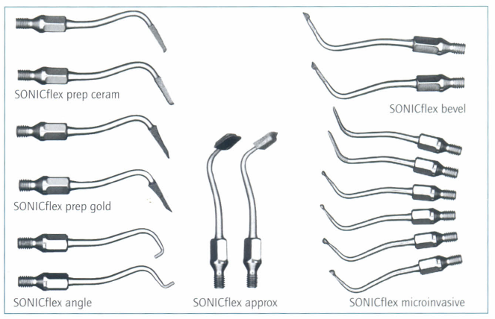
SONIC INSTRUMENTATION
Different tips are available, each in a mesial and a distal form.
SONICflex micro and SONICflex bevel tips - cutting and finishing of cavities in all localizations.
SONICflex angle instruments – where access is difficult.
SONICflex PrepGold- interventive gold
SONICflex PrepCeram - ceramic inlay preparations.
SONICflex Approx - use in the restoration of proximal lesions with preformed inlays.

Slide 108
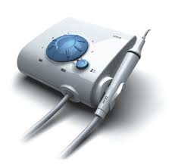
ULTRASONIC INSTRUMENTATION
Consists of an ultrasonic generator separate from a magnetostrictive transducer located within the handpiece.
The generator delivers the energy to the transducer which in turn creates vibrations used to remove hard substances.
A water cooling system is incorporated into the equipment for controlling heat generated in the handpiece.

Slide 109
ULTRASONIC INSTRUMENTATION
Another type of system directs a water-borne abrasive or slurry against the working point while providing an additional water jet for irrigation.
Energy used for removal of enamel and dentin - generated within the handpiece.
Electric current causes the transducer of the handpiece to slightly contract and expand.
Frequency- 25-30 kHz.

Slide 110
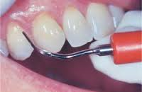
ULTRASONIC INSTRUMENTATION
These are not universally used for cavity preparations, they are mostly used for calculus and stain removal from teeth and restoration surfaces.
Soft, carious dentine apparently could not be removed, but the harder, leathery, deeper layer was more susceptible.

Slide 111
ULTRASONIC INSTRUMENTATION
Vanderlie et al conducted a study to analyze pulpal temperature increase, and time required by an ultrasonic device, and high-speed handpiece with a diamond rotary cutting instrument.
Thermocouples were positioned in the pulp chamber of 20 extracted human third molars.
Vanderlie, Aleska Dias, Borges, Alexander, Cavalcanti, Bruno Neves, Rode, J of prosthetic dentistry, Aug2008, Vol. 100 Issue 2, p107-109. 3p.

Slide 112
ULTRASONIC INSTRUMENTATION
Slot-type cavities (3 × 3 × 2 mm) were prepared on the buccal and the lingual surfaces of each tooth.
The average pulpal temperature increases were 4.3°C for the high-speed preparation and 3.8°C for the ultrasonic preparation.
Time required was 3.3 minutes for the high-speed bur and 13.77 minutes for the ultrasound device.

Slide 113
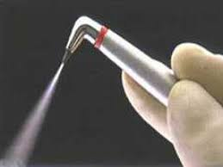
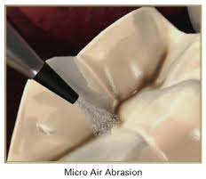
AIR ABRASIVE SYSTEM
Air-abrasion was developed by RB Black in 1945.
Air-abrasion is essentially a pseudo-mechanical, non-rotary method of cutting dental hard tissues utilizing the transfer of kinetic energy from a stream of desiccated abrasive particles bombarding the tooth surface at high velocity.

Slide 114
AIR ABRASIVE SYSTEM
The abrasive employed for cutting tooth structure is aluminium oxide (Al₂O₃₋ α alumina)
Average particle size of 27.5um and possessing a hardness of 9 on Mohs’ scale. (US FDA approval).
It is stable, non-toxic and relatively inexpensive.

Slide 115
AIR ABRASIVE SYSTEM
The exit pressure - between 60-120 pounds per square inch (p.s.i.) - velocity in excess of 1000 feet per second.
It depends on the diameter of the nozzle tip.
The alumina escapes from the nozzle tip in a cone-shaped stream, the walls of which diverge from its long axis at an angle of approximately 3.5⁰.

Slide 116
AIR ABRASIVE SYSTEM
The dimensions of the cutting cone increase in proportion to the distance between the nozzle tip and the tooth surface due to the increase in particle scatter.
The abrasion provided by the peripheral portion of the stream- less efficient (lower velocity and concentration of the alumina particles).
This phenomenon causes internal line angles to be rounded;

Slide 117
AIR ABRASIVE SYSTEM
These effects are minimized if the nozzle tip is placed less than 1.0mm from, the tooth, where the fanning is negligible.
Beveled cavosurface margin - the instrument tip placed up to 5 mm from the tooth surface.
Butt joint - the nozzle should be placed closer, 1mm from the tooth.

Slide 118
AIR ABRASIVE SYSTEM
USES
Stain removal,
Debriding pits and fissures before sealing,
Micromechanical roughening of surfaces to be bonded (enamel, cast metal alloys, or porcelain).

Slide 119
AIR ABRASIVE SYSTEM
DISADVANTAGES
It is important to note that air-abrasion is an end-cutting instrument.
This results in small diameter access, but deeper cavities.
Risk exists in over-preparing cavities into healthy dental tissues at the depths of the cavity.

Slide 120
AIR ABRASIVE SYSTEM
Cannot produce well-defined preparation wall and margin.
Lack of tactile feedback - cut cavities in healthy tissue.
α-alumina particles do not cut so efficiently through softer carious tissue.
Abrasive dust interfered with visibility.
Preventing the patient or office personnel from inhaling abrasive dust posed an additional difficulty.

Slide 121
AIR ABRASIVE SYSTEM
Indeed, recent advances in micro-abrasive technology allow a
Metered flow of alumina particles,
Higher operating pressures and
Instantaneous initiation and termination
Rubber dam isolation
Face mask protection
High volume suction
reducing the dust cloud produced.
minimize the risks of particle inhalation.

Slide 122
AIR ABRASIVE SYSTEM
Rafique S et al conducted a study to investigate whether caries removal with air-abrasion/Carisolv gel is an acceptable and viable alternative in the treatment of dental patients.
22 patients were treated with conventional methods (local anaesthetic injection/drill) followed by alternative treatment (air-abrasion and Carisolv gel) in a general practice setting, by the same operator.
Fiske J, Banerjee A. Clinical Trial of an Air-Abrasion/Chemomechanical Operative Procedure for the Restorative Treatment of Dental Patients, Caries Res 2003;37:360–364 (DOI:10.1159/000072168)

Slide 123
AIR ABRASIVE SYSTEM
The participants’ pre-operative anxiety levels were measured using the Modified Dental Anxiety Scale.
Their postoperative levels of anxiety/dislike for aspects of both conventional and alternative treatments were assessed using a visual analogue scale.

Slide 124
AIR ABRASIVE SYSTEM
Results showed 100% of subjects were concerned about several aspects of conventional treatment including pain/discomfort on injection, taste of anesthetic, length of time tissues remained numb, noise of the drill, its sensory vibrations and water coolant.
75% of the study population were happy with all aspects of the air-abrasion technique including dust, pain/discomfort and vibrations produced.

Slide 125
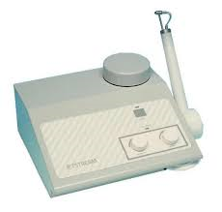
AIR-POLISHING
The process by which water soluble particles of sodium bicarbonate, tricalcium phosphate (0.08% by weight) to improve the flow characteristics, are applied onto a tooth surface using air pressure, shrouded in a concentric water jet.
The abrasive is water soluble means it does not escape too far from the operating field.

Slide 126
AIR-POLISHING
The bombardment of the hard tooth surfaces by these particles - continuous mechanical abrasive action which removes surface deposits.
USES
Remove surface enamel stains, plaque and calculus well away from the gingival margins of healthy teeth.
Removal of carious dentine at the end of cavity preparation.

Slide 127
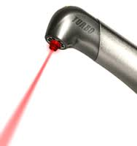
LASER EQUIPMENT
Acronym for light amplification by stimulated emission of radiation.
Lasers are devices - produce beams of coherent and very high intensity light.
Lasers - treatment of soft tissues and the modification of hard tooth structures.
A crystal or gas is excited to emit light photons of a characteristic wavelength that are amplified and filtered to make a coherent light beam.

Slide 128
LASER EQUIPMENT
The collimated beam is directed via a flexible glass fiber optic light pipe or mirror train (in a hollow tube) to the point of application.
Longer wavelength lasers are more difficult to push through fiber optic light pipes.

Slide 129
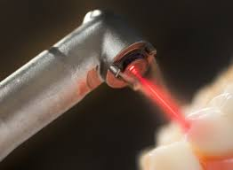
LASER EQUIPMENT
Dental lasers produce photo thermal effects.
Low temperatures (<100⁰C) - denature proteins, produce hemolysis, coagulation and shrinkage.
High temperatures (>100⁰C) - water in soft or hard tissues boils, producing explosive expansion.
Extremely high temperatures (>400ºC) - carbonization of organic materials is completed with the onset of some inorganic changes.

Slide 130
LASER EQUIPMENT
As the temperature increases from 400ºC to 1400ºC - inorganic constituents change in chemistry (melt or recrystallize or vaporize).
The actual temperatures depend on the initial composition of the tissue involved.
When the laser and tissue are well matched, such as the infrared lasers and enamel - energy can be absorbed rapidly.

Slide 131
LASER EQUIPMENT
Low energy densities for short times - cause enamel to melt and recrystallize.
High energy densities or longer times - vaporization with drilling or cutting of the surface.
For dentin the same effects occur at even lower energy densities.

Slide 132
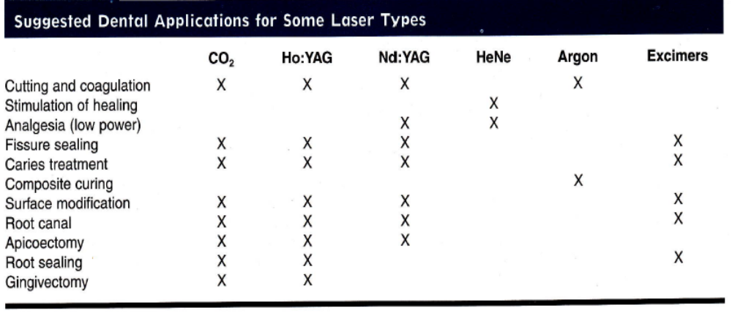
LASER EQUIPMENT
The ones of most current interest to dentistry are
Nd: YAG - wavelength 1.064 um
Er: YAG - wavelength 2.94um
CO2 - maximum wavelength 10.6 um
Er, Cr: YSGG - wavelength 2.78 um = 2780 nm

Slide 133
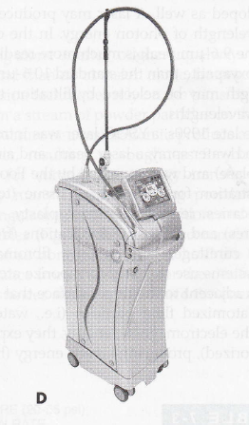
LASER EQUIPMENT
In the late 1990s, a YSGG laser was introduced that used
water spray,
laser beam, and
air (Waterlase unit; Biolase)
It was approved by the Food and Drug Administration.

Slide 134
LASER EQUIPMENT
USES
Cutting hard tissue- tooth preparation, caries removal enameloplasty, endodontic procedures and
Soft tissue applications- frenectomies, gingival curettage, gingivectomy, fibroma removal.

Slide 135
LASER EQUIPMENT
DISADVANTAGES
Lasers- not used for tooth preparations - difficult to generate a defined margin.
Lasers are inefficient for removing large amounts of enamel or dentin, (generate intolerable amounts of heat).
No single laser type is suitable for all potential laser applications.

Slide 136

LASER EQUIPMENT
PRECAUTIONS
A door is required to close off the room
Eye protection is required for the operator, assistant, and patient.
There are always potential fire and explosion hazards owing to the high-energy beams.

Slide 137
LASER EQUIPMENT
Aoki A et al conducted a study to evaluate the effectiveness of caries removal by using an Er:YAG laser in vitro was compared with that of conventional mechanical treatment.
31 extracted human teeth with root caries were used.
Half of the caries in each tooth was treated with the Er:YAG laser
And the other was removed with a conventional bur.
Aoki, I. Ishikawa, T. Yamada. M. Otsuki, H. Watanabe, J. Tagami, Y. Ando, H. Yamamoto Comparison between R. YAG Laser and Conventional Technique for root Caries Treatment in vitro-journal of dental research June 1998 vol. 77 no. 6 1404-1404
.

Slide 138
LASER EQUIPMENT
Measurements of the time required for caries removal, histopathological observations, SEM evaluation and hardness measurements of dentin were performed for each treatment.

Slide 139
LASER EQUIPMENT
Due to the careful irradiation technique, a longer treatment time was required for Er:YAG laser.
Laser ablated carious dentin effectively with minimal thermal damage to the surrounding intact dentin, and removed carious dentin to the same degree as the bur treatment.
In addition, a lower degree of vibration was noted with the Er:YAG laser treatment
The SEM examination revealed characteristic micro-irregularities of the lased dentin surface.

Slide 140

ALTERNATIVES TO HIGH SPEED ROTARY INSTRUMENTATION
Banerjee et al in a review discussed various methods of caries excavation and evaluated their ability in removing caries.
Dentine caries excavation: a review of current clinical techniques A. Banerjee,1 T. F. Watson,2 and E. A. M. Kidd, british dental journal volume 188. no.9 may 13 2000

Slide 141
CONCLUSION
However, despite of all the recent advancements of removal of carious tooth structure, air-driven HIGH SPEED hand pieces continue to be the most popular type of hand piece equipment because of the
Overall simplicity of design,
Ease of control,
Versatility, and
Patient acceptance.

Slide 142
REFERENCES
Art & sciences of Operative dentistry - Sturdevant 5th edition.
Fundamental of operative dentistry - James B.Summit
Operative dentistry – Charbenau 3rd edition.
Operative dentistry modern theory and practice –M.A.Marzouk
Textbook of operative dentistry Vimal K Sikri
Operative dentistry –Graham J Mount
Minimally invasive dentistry- Wilson

Slide 143
REFERENCES
R. Sarmadi E Hedman, P Gabre, Laser in caries treatment – patients’ experiences and opinions, International journal of dental hygiene, 2013.
Aoki, I. Ishikawa, T. Yamada. M. Otsuki, H. Watanabe, J. Tagami, Y. Ando, H. Yamamoto Comparison between R. YAG Laser and Conventional Technique for root Caries Treatment in vitro-journal of dental research June 1998 vol. 77 no. 6 1404-1404

Slide 144
REFERENCES
Rafique S,Fiske J,Benerjee A.Clinical trail of an air-abrasion/chemomechanical Operative Procedure for the Restorative Treatment of Dental Patients, Caries Res 2003;37:360-364 (DOI:10.1159/000072168).
Vanderlie, Aleska Dias, Borges, Alexander, Cavalcanti, Bruno Neves, Rode, J of prosthetic dentistry, Aug2008, Vol. 100 Issue 2, p107-109. 3p.

Slide 145
REFERENCES
Dentine caries excavation: a review of current clinical techniques A. Benerjee
T.F.Watson, 2 and E. A. M. Kidd, British dental journal volume 188. no.9 May 13 2000.
Walmsly AD, Williams AR, Laird WRE. The air-powder dental abrasive unit - an evolution using a model system. J Oral rehab 1987; 14: 43-50

