Slide 1
SMOKING

Slide 2
Introduction
Global estimated daily tobacco smoking prevalence rates (in individuals >15 years old) reduced from 41.2% in 1980 to 31.1% in 2012
Developed countries had their highest prevalence rates in those aged 30 to 34 years, whereas in developing countries the greatest prevalence was among those aged 45 to 49 years

Slide 3
As many as 6.25 trillion cigarettes are smoked annually across the globe.
Tobacco kills 6 million people each year
Smoking is associated with multiple diseases that reduce life expectancy and quality of life.
Diseases associated with smoking include lung cancer, heart disease, stroke, emphysema, bronchitis, and cancers of the oral cavity, bladder, kidney, stomach, liver, and cervix.

Slide 4
Tobacco smoke contains thousands of noxious chemicals, and it comprises a gaseous phase and a solid (particulate) phase.
Smokeless Tobacco
Swedish snuff

Slide 5
Current Smokers
Ask about current smoking and past smoking. It can also be useful to calculate the number of pack-years:
Pack-years Number of packs smoked per day Number of years = × of smoking In other words, 1 pack-year is the cumulative exposure that corresponds with the smoking of 1 pack of 20 cigarettes per day for 1 year.
For example, a smoker who has smoked 20 cigarettes per day for 15 years has 15 pack-years of smoking.

Slide 6
Current smokers
Former smokers
Non smokers

Slide 7
Biochemical tests can also be used to assess smoking status, including exhaled carbon monoxide and the measurement of cotinine (the major metabolite of nicotine) in serum, saliva, or urine.
Cotinine is measured in preference to nicotine because the half-life of nicotine is short (≈1 to 2 hours), whereas that of cotinine is approximately 20 hours

Slide 8
Plasma and saliva cotinine concentrations in smokers are approximately 100 ng/mL and the urine concentration is approximately 1200 ng/mL.
Non smokers usually have plasma and saliva cotinine concentrations of less than 2 ng/mL, unless they are passive smokers.
Biochemical validation of nonsmoking uses cotinine levels of 1 to 6 ng/mL to confirm nonsmoking status

Slide 9
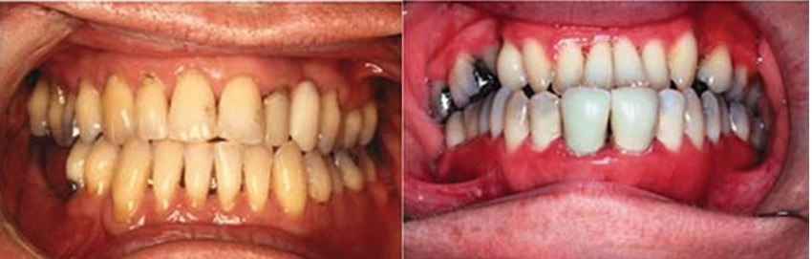
EFFECTS OF SMOKING
Gingivitis
Smokers present with less gingival inflammation than nonsmokers.

Slide 10
Periodontitis
↑Prevalence and severity of periodontal destruction
↑Pocket depth, attachment loss, and bone loss
↑Rate of periodontal destruction
↑Prevalence of severe periodontitis
↑Tooth loss
↑Prevalence with increased number of cigarettes smoked per day
↓Prevalence and severity with smoking cessation

Slide 11
Prevalence
Smokers were four times as likely to have periodontitis as persons who had never smoked.
Former smokers were 1.68 times more likely to have periodontitis than persons who had never smoked.

Slide 12
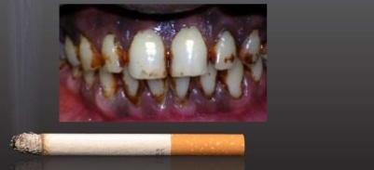
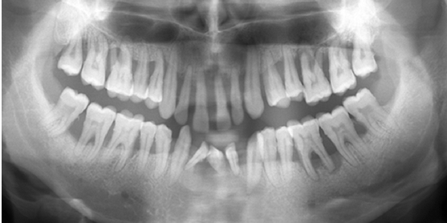
In subjects smoking nine or fewer cigarettes per day, the odds for having periodontitis was 2.79.
Whereas subjects smoking 31 or more cigarettes per day were almost six times more likely to have periodontitis.

Slide 13
These data indicated that approxi-mately 42% of periodontitis cases (6.4 million cases) in the U.S. adult population were attributable to current smoking, and approximately 11% (1.7 million cases) were attributable to former smoking.

Slide 14
1.5 to as high as 7.3.
Older-adult smokers are approximately three times more likely to have severe periodontal disease and the number of years of tobacco use is a significant factor in tooth loss, coronal root caries, and periodontal diseases.

Slide 15
Smoking also has been shown to affect periodontal disease severity in younger individuals.
Cigarette smoking is associated with increased severity of generalized aggressive periodontitis (formerly termed "early-onset periodontitis") in young adults," and those age 19 to 30 years who smoke are 3.8 times more likely to have periodontitis than nonsmokers.

Slide 16

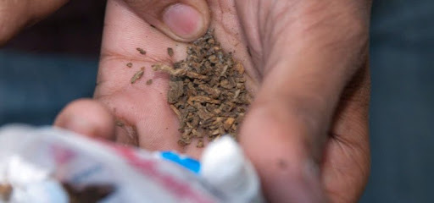
Cigar and pipe smokers showed a severity of disease intermediate between the current cigarette smokers and nonsmokers.
Smokeless tobacco use has been associated with oral leukoplakia and carcinoma

Slide 17
Former smokers have less risk for periodontitis than current smokers but more risk than nonsmokers, and the risk for periodontitis decreases with the increasing number of years since quitting smoking.
This suggests that the negative effects of smoking on the host are reversible with smoking cessation and therefore that smoking cessation programs must be an integral component of periodontal education and therapy

Slide 18
Nicotine withdrawal symptoms and the psychological factors associated with smoking cessation ,Electronic cigarettes have also emerged and are being used by many smokers to help them quit.

Slide 19
E-Cigarettes The popularity of e-cigarettes took most people by surprise.
“Heat-Not-Burn” Tobacco Products These products heat tobacco to ~500°C, producing an inhalable aerosol.
Water Pipes (Hookah, Shisha) Popular in some communities, these are likely to carry significant negative health risks.
Nicotine Gels These gels allow nicotine to be absorbed through the skin. Currently they are not very popular

Slide 20
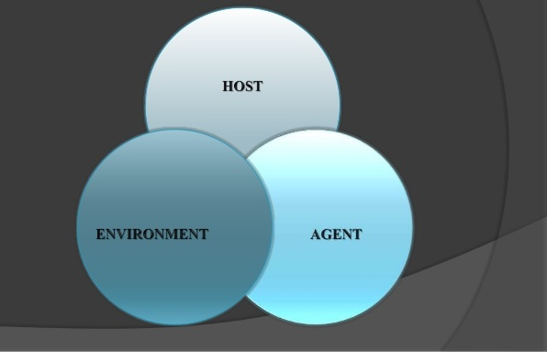
Effects of Smoking on Etiology and Pathogenesis
Alteration in host-bacterial interactions normally seen in chronic periodontitis are altered, resulting in more aggressive periodontal breakdown
It is caused by changes in the composition of the subgingival plaque, with increases in the numbers and virulence of pathogenic organisms, changes in the host response to the bacterial challenge, or a combination of both.

Slide 21
Microbiology
It results from a qualitative rather than quantitative alteration in the plaque.
T. forsythia
actinomycetemcomitans
P. gingivalis
Smokers do not respond to mechanical therapy as well as nonsmokers.

Slide 22
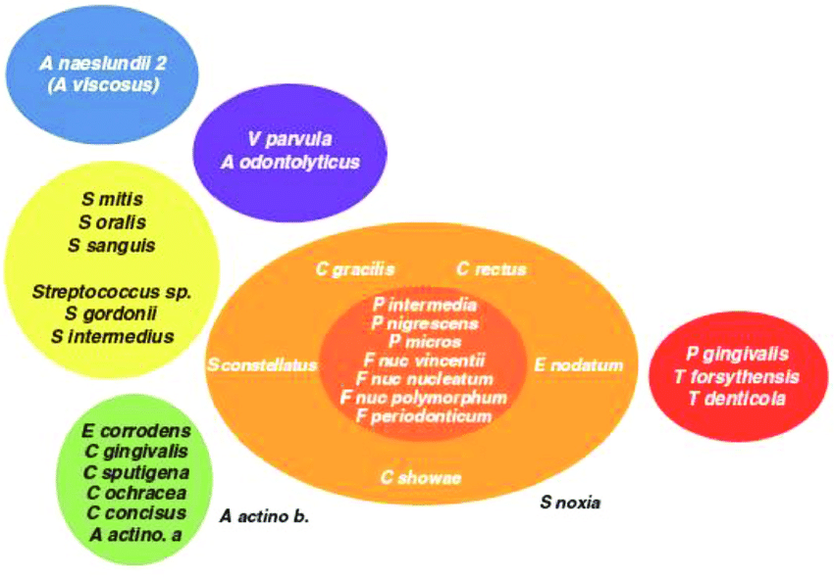
Orange and red complexes.

Slide 23
The increased prevalence of these periodontal pathogens was caused by an increased colonization of shallow sites (pocket depth ≤4 mm), with no differences among smokers, former smokers, and nonsmokers in pockets 4 mm or greater.
These pathogenic bacteria were more prevalent in the maxilla than the mandible.

Slide 24
No effect on rate of plaque accumulation
↑Colonization of shallow periodontal pockets by periodontal pathogens
↑Levels of periodontal pathogens in deep periodontal pockets

Slide 25
Host
Downregulation of the immune response to bacterial challenge.
Alterations in neutrophil number or function
Chemotaxis
Phagoctosis
Killing

Slide 26
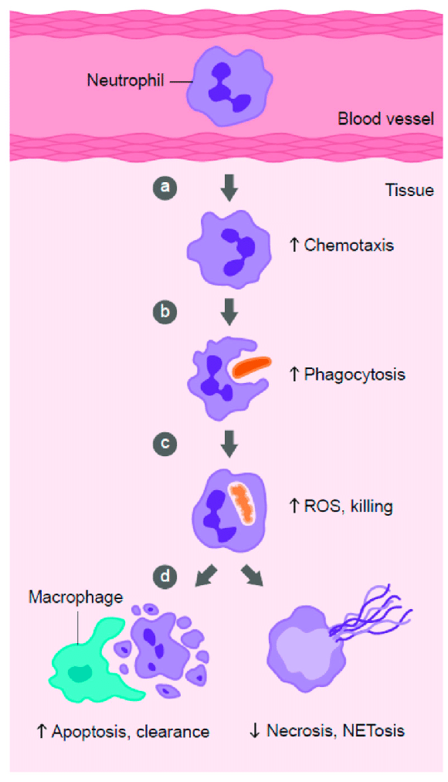

Slide 27
(IgG2)
TNF-α
Prostaglandin E2 (PGE2),
Neutrophil elastase,
Matrix metalloproteinase-8 (MMP-8)

Slide 28
Immunology
Altered neutrophil chemotaxis, phagocytosis, and oxidative burst
↑TNF–α and PGE2 in gingival crevicular fluid (GCF)
↑Neutrophil collagenase and elastase in GCF
↑Production of PGE2 by monocytes in response to LPS

Slide 29
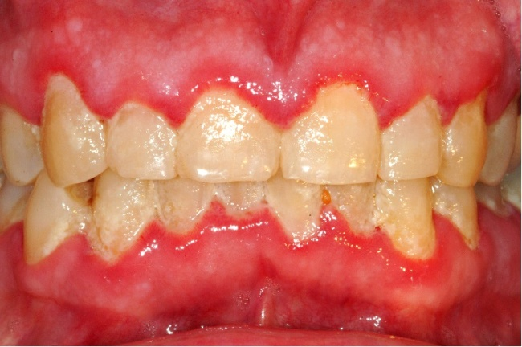
Physiology
Clinical signs of inflammation are less pronounced in smokers than in non smokers.
This may result from alterations in the inflammatory response in smokers or from alterations in the vascular response of the gingival tissues.
Increases in GCF flow, bleeding on probing,and gingival blood vessels were less in smokers than non smokers.

Slide 30
Oxygen concentration.
Subgingival temperatures .
Recovery from the vasoconstriction caused by local anaesthetic administration takes longer in smokers.
Clinicians must be focused in their assessment of periodontal disease in smokers because the appearance of healthy-appearing, non bleeding gingiva often is accompanied by deep pockets and advanced bone loss.

Slide 31
Cigarette smoking reduces the favourable outcomes of periodontal therapy.
It is recommended that smoking patients should be following a successful smoking cessation program before these surgical procedures are implemented.

Slide 32
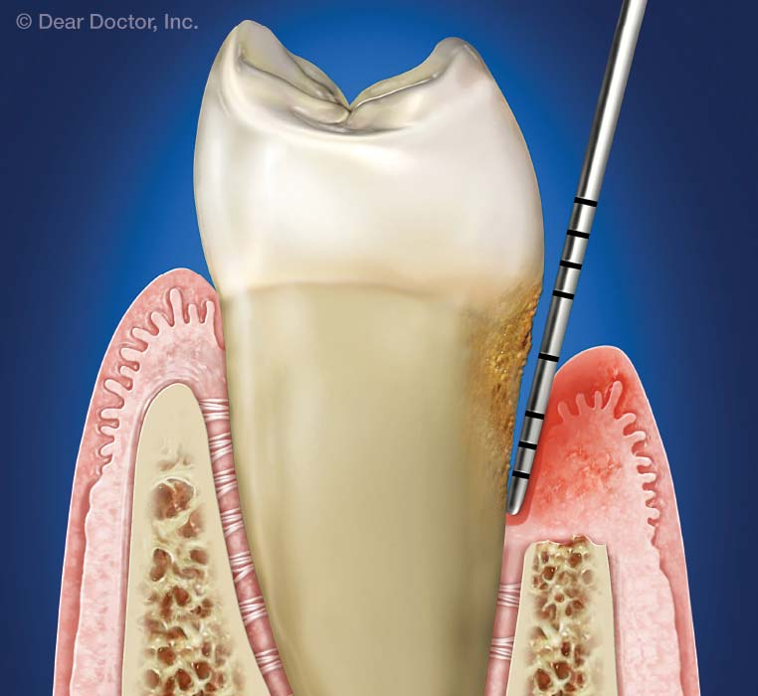
EFFECTS OF SMOKING ON RESPONSE TO PERIODONTAL THERAPY
Nonsurgical Therapy
Pocket depth reduction is more effective in nonsmokers than in smokers after nonsurgical periodontal therapy.

Slide 33
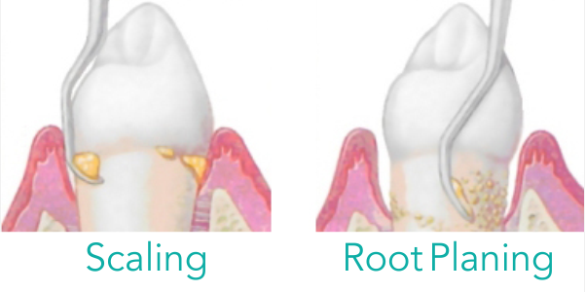

Slide 34
Gain in clinical attachment as a result of scaling and root planing are less pronounced in smokers than in nonsmokers.
Average pocket reductions of 2.5 mm for nonsmokers and 1.9 mm for smokers were observed in pockets that averaged 7 mm before treatment

Slide 35
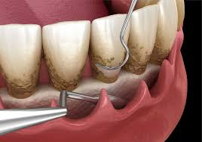

Slide 36
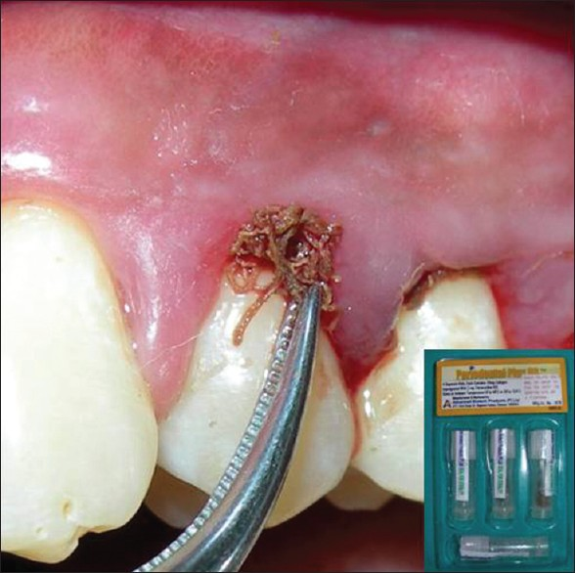
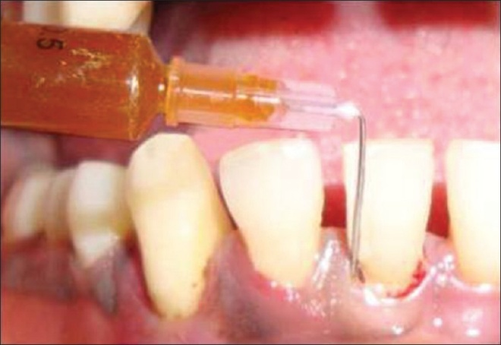
Topical antimicrobial therapy
Topical subgingivally placed tetracycline fibers.
Subgingival minocycline gel.
Subgingival metronidazole gel.
Smokers continue to show less pocket reduction than nonsmokers.

Slide 37
It can be concluded that smokers respond less well to nonsurgical therapy than nonsmokers. With excellent plaque control, however, these differences may be minimized.
Nonsurgical
↓Clinical response to scaling and root planing.
↓Reduction in pocket depth.
↓Gain in clinical attachment levels.
↓Negative impact of smoking with ↑level of plaque control.

Slide 38
Surgical Therapy and Implants
The less favorable response of the periodontal tissues to nonsurgical therapy that is observed in current smokers also appears to apply to surgical therapy.

Slide 40

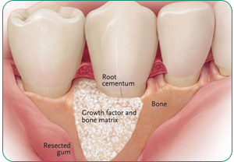
↓Pocket depth reduction after surgery
↑Deterioration of furcations after surgery
↓Gain in clinical attachment levels, ↓ bone fill, ↑ recession, and
↑ membrane exposure after GTR
↓Pocket depth reduction after DFDBA

Slide 41
↓Pocket depth reduction and gain in clinical attachment levels after open flap debridement
Conflicting data on the impact of smoking on implant success. Smoking cessation should be recommended before implants.
Maxillaryimplats.

Slide 42
Maintenance therapy
Smokers consistently had deeper pockets than nonsmokers and less gain in attachment when evaluated each year for the 7-year period.
Heavy smokers (≥20 cigarettes/day) had more plaque than light smokers, former smokers, and nonsmokers.
Even with more intensive maintenance therapy given every month for 6 months after flap surgery, smokers had deeper and more residual pockets than nonsmoker.

Slide 43
These data suggest that the effects of smoking on the quality of subgingival plaque, the host response, and the healing characteristics of the periodontal tissues may have a long-term effect on pocket resolution in smokers that may not be managed by conventional periodontal therapy.

Slide 44
More studies are needed to examine the effects of antimicrobial agents combined with host-modulating agents in an attempt to control periodontal disease in smokers.
In studies of patients who failed to respond to conventional therapy, including different combinations of oral hygiene instruction, scaling and root planing, surgery, and antibiotics, approximately 90% of these “refractory” patients were smokers.

Slide 45
It is clear from these studies that smokers
(1) may present with periodontal disease at an early age.
(2) may be difficult to treat with conventional therapy.
(3) may continue to have progressive or recurrent periodontitis leading to tooth loss.

Slide 46
Effects of Smoking Cessation on Periodontal Treatment Outcomes
Quitters demonstrated signiicantly divergent proiles; changes in bacterial levels contributed to this shift. These data suggest a critical role for smoking cessation in the alteration of the subgingival bioilm.

Slide 47
ASK
Ask the patient about his or her smoking status
ADVISE
Advise smokers of the associations between oral disease and smoking.
Be informative, honest, and helpful but not judgmental.
The patient’s response to this information will reveal his or her interest in quitting.
.

Slide 48
ASSESS
Assess the patient’s interest in and readiness to attempt
smoking cessation.
Patients may not yet be in an action phase when it comes to quitting smoking, which is why it is always important to make these assessments every time you see the patient.
ASSIST
Assist the patient with his or her quit attempt.
If you are trained, there are many techniques that can be used Alternatively, assist the patient with seeking the help that he or she needs.

Slide 49
ARRANGE
Arrange for a follow-up visit or a referral to professional
smoking cessation services.
The most important aspect of this is to keep in regular contact, particularly around the quit date and during the immediate period after the patient quits.

Slide 50
ASK Ask the patient about his or her smoking status.
ADVISE Advise smokers of the associations between oral disease and smoking.
REFER Refer the patient to a professional smoking cessation program.

Slide 51
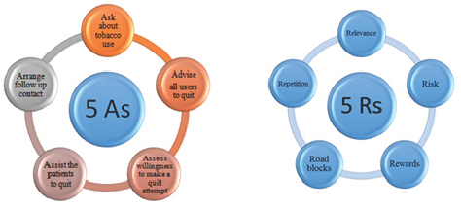

Slide 52
Nicotine Replacement Therapy
NRT products do contain nicotine, they do not contain the toxic products such as tar and carbon monoxide that are found in cigarette smoke.
Patches (available in different doses and worn for 16 to 24 hours per day)
Lozenges and gum (available in different flavors; should be chewed slowly to allow the nicotine to be absorbed through the mouth).

Slide 53
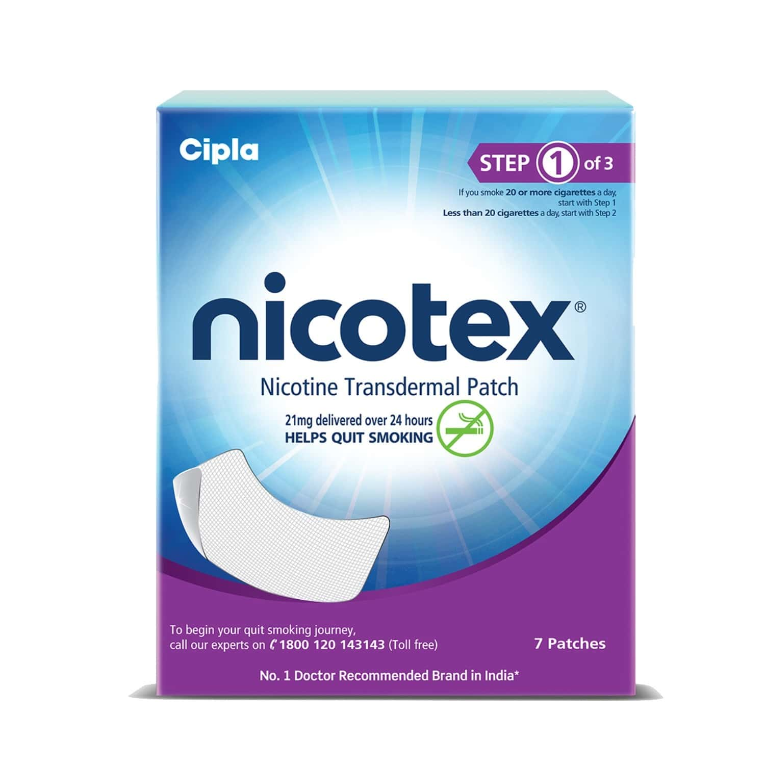
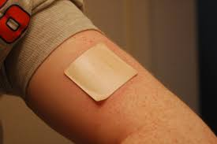


Slide 54
• Nasal spray (delivers nicotine solution via the nasal passages).
• Inhalator (a plastic mouthpiece with a supply of nicotine cartridges that fit on the end; nicotine is absorbed in the mouth by drawing on the inhalator like a cigarette).

Slide 55
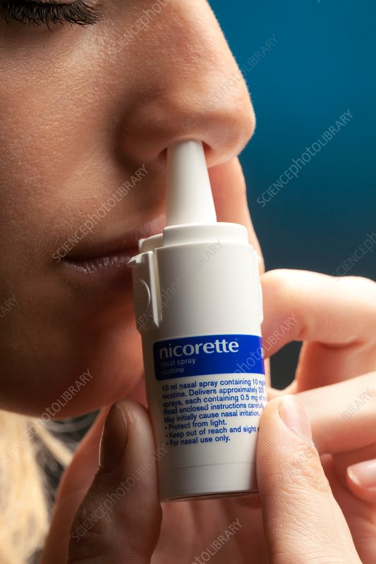
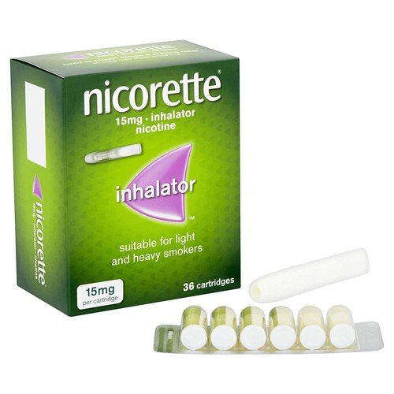

Slide 56
Bupropion
Success rate at 12 months is 20% to 30%.
This medication is used as an antidepressant at higher doses, but it is effective for smoking cessation at lower doses.
It is usually prescribed to be started 1 to 2 weeks before the quit date, initially at 150 mg once per day for 6 days then 150 mg twice per day for 7 to 9 weeks.

Slide 57
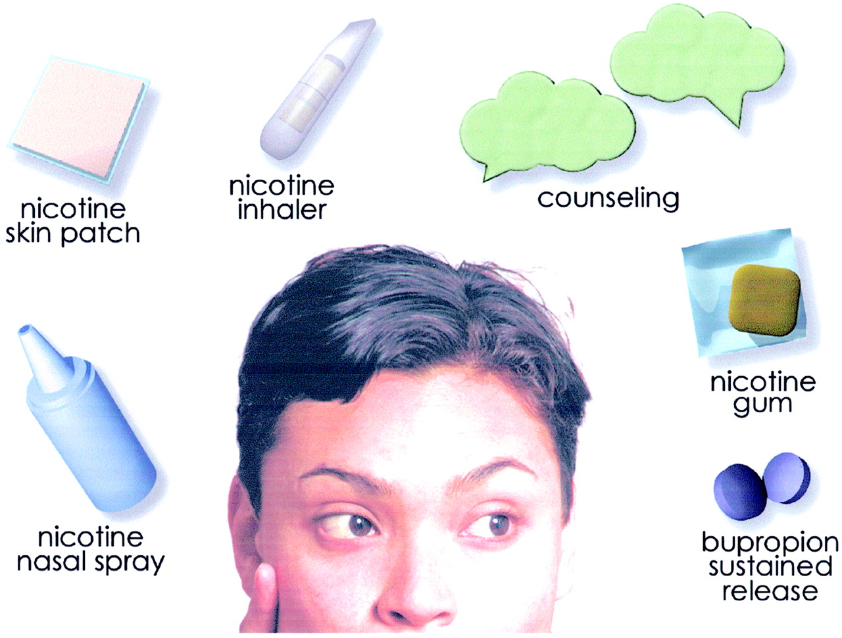

Slide 58
Electronic Cigarettes

