Slide 1

GOOD MORNING

Slide 2

SAMPLING TECHNIQUES
Dr.T.Prasanth
Sr. Lecturer, SJDC

Slide 3
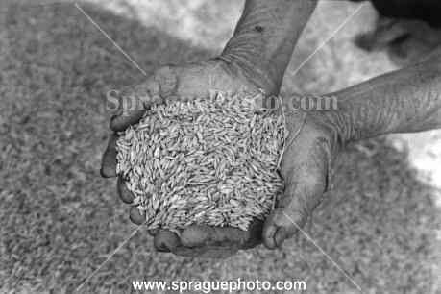
How do you check the quality of food grains ?
while purchasing food grains from a shop we usually examine a small amount of grains from the bag to assess the quality of the commodity.

Slide 4
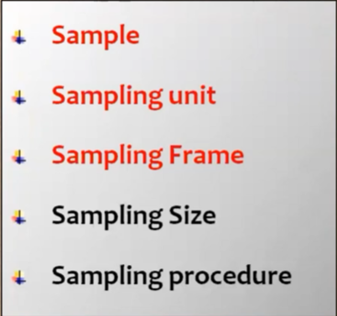
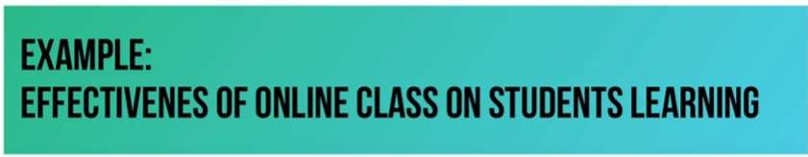
Sampling Terminology

Slide 5
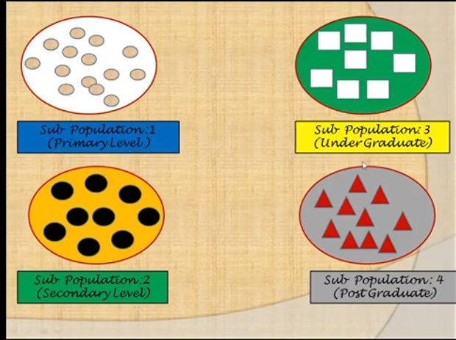
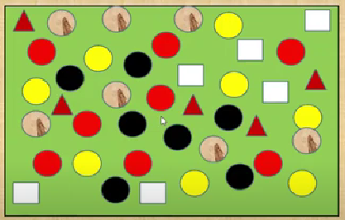
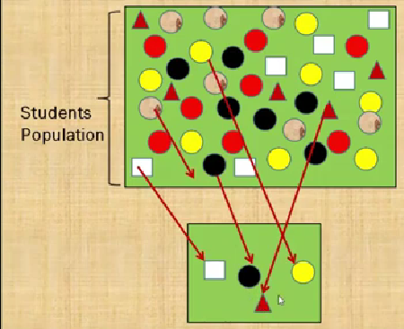
Target population
Sampling Frame
Sample

Slide 6
What is Sampling
What we want
to talk about What we actually
observe in the data
Sampling Sampling process
frame
Inference
Population Sample

Slide 7
SAMPLING TECHNIQUES
PROBABILITY SAMPLING
NON PROBABILITY SAMPLING

Slide 8
PROBABILITY SAMPLING
NON PROBABILITY
SAMPLING
Simple random
Systematic
Stratified
Multistage
Multiphase
Cluster & Area
Purposive
Convenience
Quota
Saturation
Notes:
PROBABILITY SAMPLING
Every member in the population have a equal chance or an opportunities of being selected

Slide 9
SIMPLE RANDOM SAMPLING
Each and every unit of the population has equal and known chance of being selected.

Slide 10
Example….
To assess knowledge level of this class students about my previous class

Slide 11
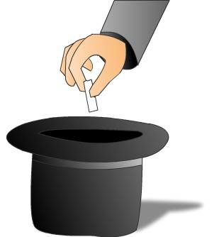
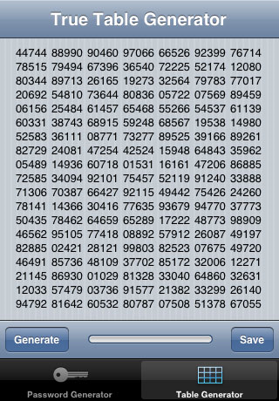
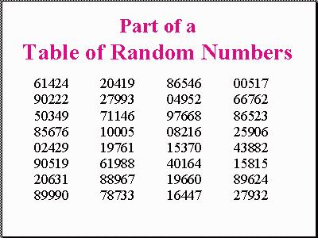
THREE WAYS OF SELECTING THE SRS…..
Computer Assisted
Software
Lottery Method
Notes:
As the lottery method cannot be used, when the population is infinite, the alternative method is that of using the table of random numbers.
Random number can be generated through scientific calculator or computers. The ways of selection of sample is similar to that of using random number table.

Slide 12
SIMPLE RANDOM SAMPLING
Applicable when
a) The population is small.
b) The population is readily available.
c) Homogeneous.
Cannot be used when
a) Population is large.
b) Population is scattered.

Slide 13
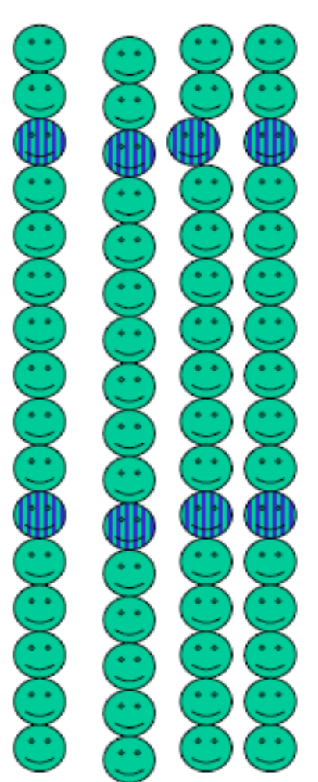
SYSTEMATIC RANDOM SAMPLING
Selecting one unit at random & additional units at evenly spaced intervals .

Slide 14
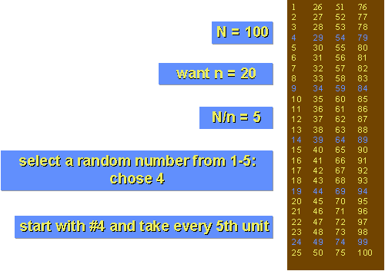
Systematic Random Sampling
Example
TOTAL POPULATION
SAMPLE SIZE
SAMPLING INTERVAL
Notes:
Advantages:
Less expensive…faster than SRS.
Disadvantages:
Potential “periodicity” problems

Slide 15
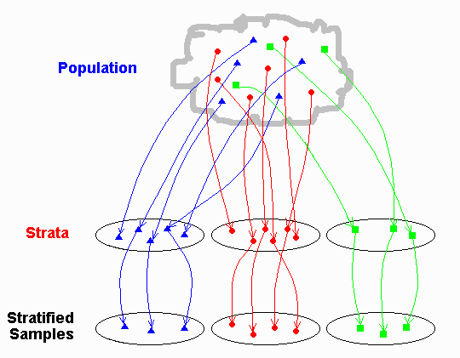
STRATIFIED RANDOM SAMPLING
Divide the population into various strata and then select a suitable sample from it.
Notes:
To find out DMFT from different age groups

Slide 16


STRATIFIED RANDOM SAMPLING
Applicable
For non homogenous population.
Merit
Representative sample from each strata has greater accuracy.

Slide 17
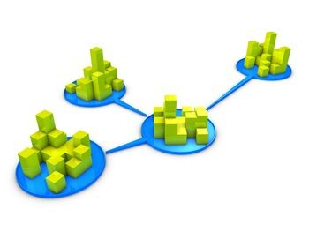
CLUSTER SAMPLING
Used when the population is heterogeneous, vast and scattered over a wide area & forms natural groups or clusters such as villages, wards, school children etc
AREA SAMPLING
When clusters happen to be some
geographic subdivisions it is called area sampling.

Slide 18
Example: Cluster sampling
Section 1
Section 2
Section 3
Section 5
Section 4
Notes:
Cluster sampling is commonly used in public health research to study the prevalence of diseases and health behaviors. For example, a study on the prevalence of diabetes in a city may randomly select clusters of neighborhoods and survey individuals within those neighborhoods

Slide 19
Advantages
  Economic efficiency… faster and less expensive than SRS.
  Does not require a list of all members of the universe.
Disadvantage:
If cluster contain similar persons, the findings cannot be generalized to the parent population.

Slide 20
Multistage sampling
MULTI STAGE SAMPLING
Applicable for large scale surveys.
Sampling procedures carried out in several stages using random sampling techniques.

Slide 21
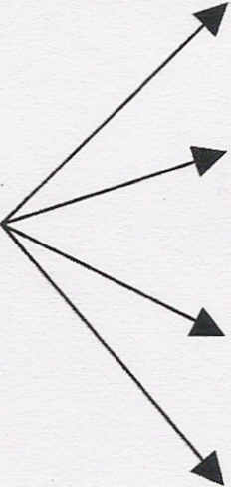
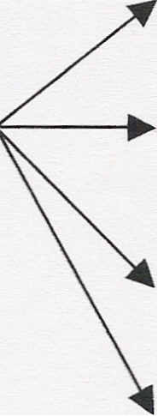
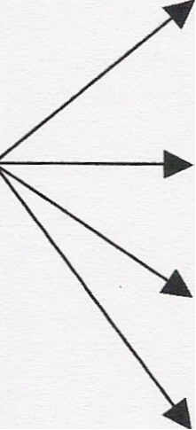
Multistage sampling
Prevalence of precancerous oral lesions among rural population of India
state 1
state 2
state 3
state 4
dist 1
dist 2
dist 3
dist 4
village 1
village 2
village 3
village 4
India
Stage 1 Stage 2 Stage 3

Slide 22
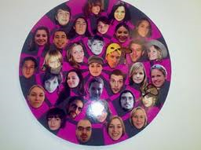
MULTIPHASE SAMPLING
Part of information is collected from the whole sample
and a part from the sub sample.
Less costly, less laborious & more purposeful.

Slide 23
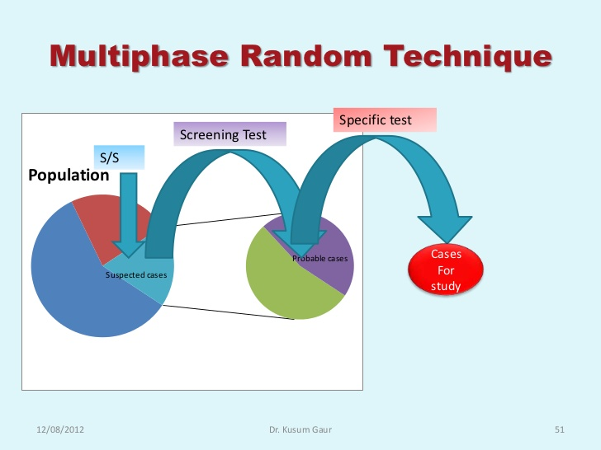
Ex:- To find out how many students have caries involving pulp in a college

Slide 24
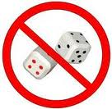
NON PROBABILITY SAMPLING

Slide 25
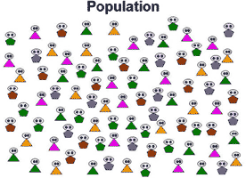
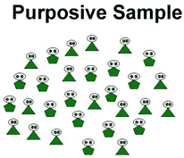
PURPOSIVE SAMPLING
[DELIBERATE, JUDGEMENT SAMPLING]
Sampling with “a purpose” in mind, sample is thus selected to include people of interest and exclude those who do not suit the purpose.
Researcher picks subjects based on specific characteristics that is required for his study
Nature of research requires small sample size.

Slide 26
Advantages of purposive sampling:
Chance to choose volunteers who are interested to participate
Disadvantage of purposive sampling:
Researcher bias
Difficulties in defining the population

Slide 27

QUOTA SAMPLING
Part of Judgment sampling.
Preplanned number of subjects in specified categories are sampled.
[E.g.,100 Men & 100 Women]
Used in public opinion studies.

Slide 28
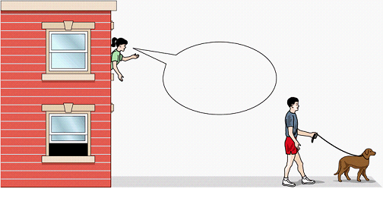
CONVENIENCE (CHUNK) SAMPLING
Selection of whichever individuals are easiest to reach. It is done at the “convenience” of the researcher
Used in pilot studies mainly in qualitative research.

Slide 29

SATURATION SAMPLING
Part of Judgment sampling where in the sample size is not fixed prior to the study but is decided by the investigator as the study progresses.
once the sufficient number has been met or no more new data is generated, the study is concluded.

Slide 30
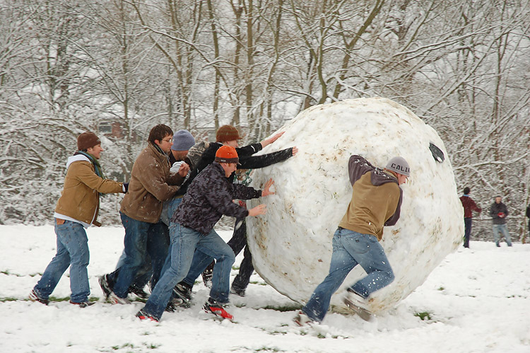
SNOWBALL SAMPLING

Slide 31
SNOWBALL SAMPLING
Sampling technique that is used by researchers to identify potential subjects in studies where subjects are hard to locate.
This type of sampling technique works like chain referral.
After observing the initial subject, the researcher asks for assistance from the subject to help identify people with a similar trait of interest.

Slide 32
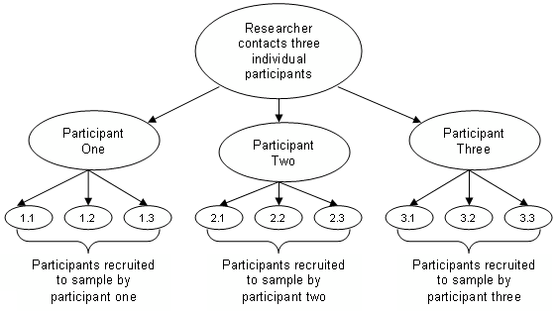
SNOWBALL SAMPLING

Slide 33
Advantages of snowball technique…
Easy to reach populations that are difficult to sample
The process is cheap, simple and cost-efficient.
Needs little planning compared to other sampling techniques.

Slide 34
Limitations of snowball technique…
Representativeness of the sample is not guaranteed.
Initial subjects tend to nominate people that they know well..

Slide 35

BIAS IN SAMPLING

Slide 36
BIAS IN SAMPLING
Selection bias:
This may be due to
Deliberate selection of sampling units
Deliberate substitution of sampling units
Notes:
DELIBERATE= INTENTIONALLY

Slide 37

MERITS OF SAMPLING
Less expensive.
Less time consuming.
More reliable results.
More detailed information.

Slide 38

LIMITATIONS
Misleading if not properly planned &
executed
Cannot be relied upon in the absence
of qualified and expert persons.
Not suitable if the information is required from each and every unit.
If the sample size is overlarge, it may be
expensive and more time consuming.

Slide 39

ERRORS IN SAMPLING
THERE ARE TWO TYPES OF ERRORS IN THE SAMPLING INVESTIGATIONS.
1) SAMPLING ERRORS –
IT MAY ARISE DUE TO FAULTY SAMPLING DESIGN OR DUE TO SMALL SAMPLE SIZE.
2) NON SAMPLING ERRORS. IT MAY BE DUE TO
A) COVERAGE ERROR – DUE TO NON CO- OPERATION OF INFORMANT .
B) OBSERVATIONAL ERROR: DUE TO INTERVIEWERS BIAS OR IMPERFECT EXPERIMENTAL TECHNIQUE OR INTERACTION OF BOTH.

Slide 40
A carefully selected sample and sampling technique plays a very important role in determining the validity of any study.

Slide 41


Slide 48
SELECTING THE SAMPLE
A sample is a part of a population called the Universe or Parent population
Sampling frame is a listing of the members of the universe from which the sample is drawn.
Sampling is the process or technique of selecting a sample of appropriate characteristics and adequate size.
Sampling is a process of selecting a no of individual for a study in such a way that the individuals represent the larger group from which they were selected

Slide 49


INTRODUCTION

Slide 50
APPLICATION IN DENTISTRY
TO EVALUATE THE ORAL HEALTH STATUS OF A COMMUNITY.
EVALUTION OF HEALTH EDUCATION ON ORAL HYGINE
STUDIES ON SERVICES LIKE AVAILABILITY AND UTILIZATION OF ORAL HEALTH FACILITY IN THE COMMUNITY
ADVANCE DATA FROM SURVEYS.
TO TEST THE HYPOTHESIS ABOUT THE POPULATION FROM WHICH THE SAMPLE OR SAMPLES ARE DRAWN.

Slide 51
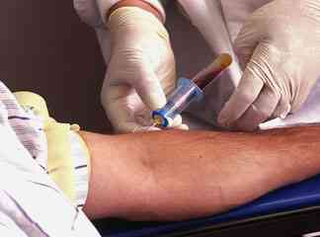
Blood investigation?
"A doctor only needs to test a few drops of blood to understand the overall health of a person's blood.

Slide 52
Errors
Three types
  Observer error
    Subjective error (untrained investigator)
    Objective error (faulty recording without proper positioning)
  Instrumental error
    Use of faulty instruments
  Sampling error
    Biased, non random sample or too small sample

