Slide 1
SALIVARY GLANDS
Dr. M. S. RAJU
PROF & HOD
DEPT OF ORAL MEDICINE & RADIOLOGY

Slide 2
INTRODUCTION
Salivary glands and saliva play a major role in maintenance of oral and systemic health. Saliva from the major salivary glands help in speech, deglutition , supported with minor salivary gland .They are the most important part of the exocrine system. The saliva that is produced by these glands is brought to the oral cavity through ductal system.

Slide 3
SALIVARY GLAND
Total salivary glands in the body are classified as:-
Major salivary gland | Minor salivary glands
parotid glands | Labial & buccal glands
submandibular glands | Glossopalatine glands
sublingual glands | Palatine glands
 | Lingual glands(anterior glands of blandid and nuhn, posterior glands of von Ebner.)

Slide 4
BASED ON THE TYPE OF SECRETORY CELLS PRESENT
Serous gland | Mucous gland | Mixed gland
Parotid gland | All Minor salivary glands except von ebner glands. | Sub mandibular gland (predominantly serous)
Von ebner’s glands. |  | Sub lingual gland (predominantly mucous)

Slide 5
SALIVA SECRETION :-
  Average volume of saliva secreted:1 – 1.5 liters \ day
  UNSTIMULATED SALIVA :
    Submandibular G. = 69%
    Parotid G. = 26%
    Sublingual = 5%
  STIMULATED SALIVA :
    Parotid G. = 69%
    Submandibular G. = 26%
    Sublingual G. = 5%

Slide 6
FUNCTIONS OF SALIVA
Moistens oral mucosa. In fact, the mucin layer on the oral mucosa is thought to be the most important nonimmune defense mechanism in the oral cavity.
Moistens dry food and cools hot food.
Provides a medium for dissolved foods to stimulate the taste buds.
Buffers:-
  oral cavity contents. Saliva has a high concentration of bicarbonate ions.
Digestion:-
  . Alpha-amylase, contained in saliva, breaks 1-4 glycoside bonds, while lingual lipase helps break down fats.

Slide 7
Antibacterial:-
  Lysozyme, Secretory IgA, and Salivary Peroxidase play important roles in saliva’s antibacterial actions. Lysozyme agglutinates bacteria and activates autolysins.
Caries prevention:-
  Mineralization of new teeth and repair of precarious enamel lesions. Saliva is high in calcium and phosphate.
  Protects the teeth by forming a “Protective Pellicle

Slide 8
Immunological:-
  IgA interferes with the adherence of microorganisms to host tissue. Peroxidase breaks down salivary thiocyanate which, in turn, oxidizes the enzymes involved in bacterial glycolysis.
Mucin:-
  Mucins contain sialic acid which agglutinates bacteria and prevents its adherence to host tissue.

Slide 9
EXAMINATION OF SALIVARY GLANDS

Slide 10
Clinical examination:- inspection
Extraoral examination:-
  Assymetry, colour, pulsations, sinus discharges noted.
  Preauricular swellings:- parotid gland
  Swelling of inferomedial region of angle of mandible – submandibular gland.
  Neurological involvement like facial nerve involvement – malignancies.
Intra oral examination:-
  Ductal orifice symmetry seen in ductal obliteration.
  openings of stenson’s and warthin’s duct .
  Dry the mucosa at orifice region to view the flow of saliva.

Slide 11
palpation
Extra oral:-
  Patients head in inclined position for palpation of parotid and submandibular gland.
  Palpate for consistency, mobility.
Intraoral :-
  Bimanual palpation of the excretory duct, and salivary gland substance with intra oral fingers and support provided by extraorally placed hand.(sialoliths, nodules).
  Roll the fingers over the substance of the gland intraorally and extra orally for any masses.
  Neck palpation for any lymphadenopathy.

Slide 12
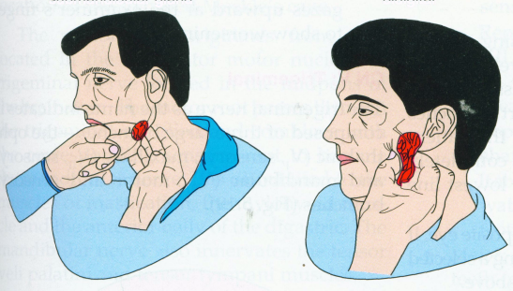

Slide 13
Radiographic evaluation

Slide 14
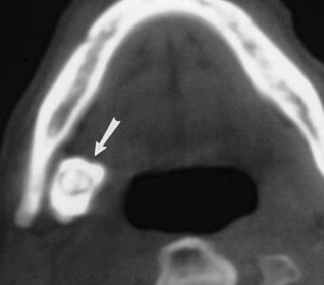
CONTRAST CT:
The salivary glands appears more opaque than surrounding fat tissue and less radiopaque than adjacent muscle tissue .
Best to diagonise sialoliths,
But insensitive to give exact borders of salivary gland (soft tissues)
Ct image showing large sialolith in submandibular gland duct.

Slide 15
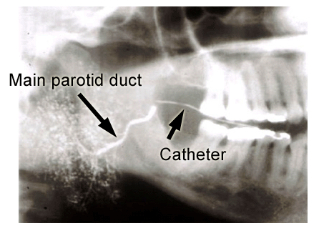
SIALOGRAPHY
Ethiodol (fat soluble radiopaque dye) or sinografin (non lipid radiopaque dye ) are used.
Indicated in cases if ductal pathologies.
Contraindicated in acute infections, known sensitivity to dye.
The dye in the ductal system appear as tree limb . dye entering into the acini appear as tree in bloom stage.

Slide 16
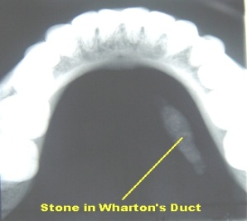
Occlusal radiographs
Mainly used to detect submandibular sialoliths.

Slide 17
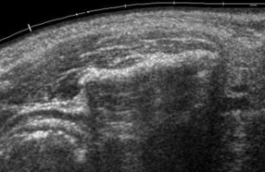
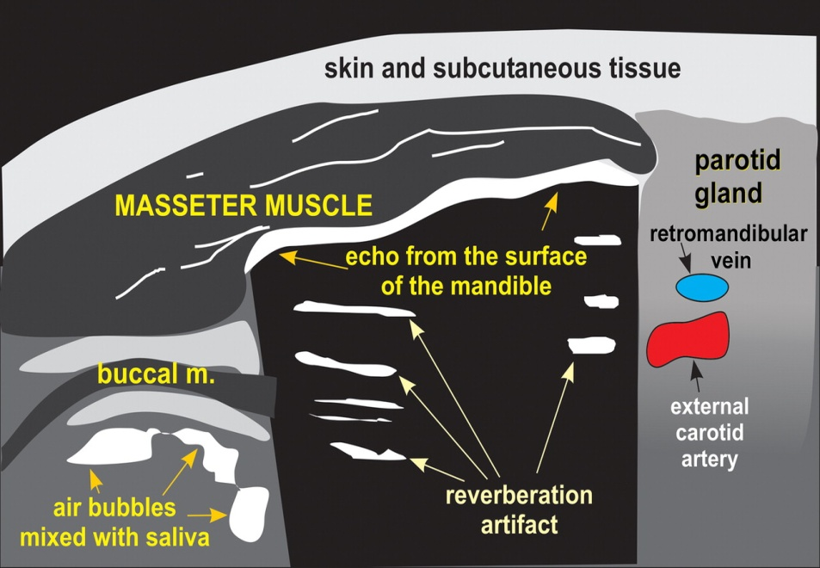
ULTRASOUND:
relatively cheaper, non invasive,painless procedure.mainly used to differentiate solid masses from cystic masses.
Ultra sound showing Normal parotid and cheek region.

Slide 18
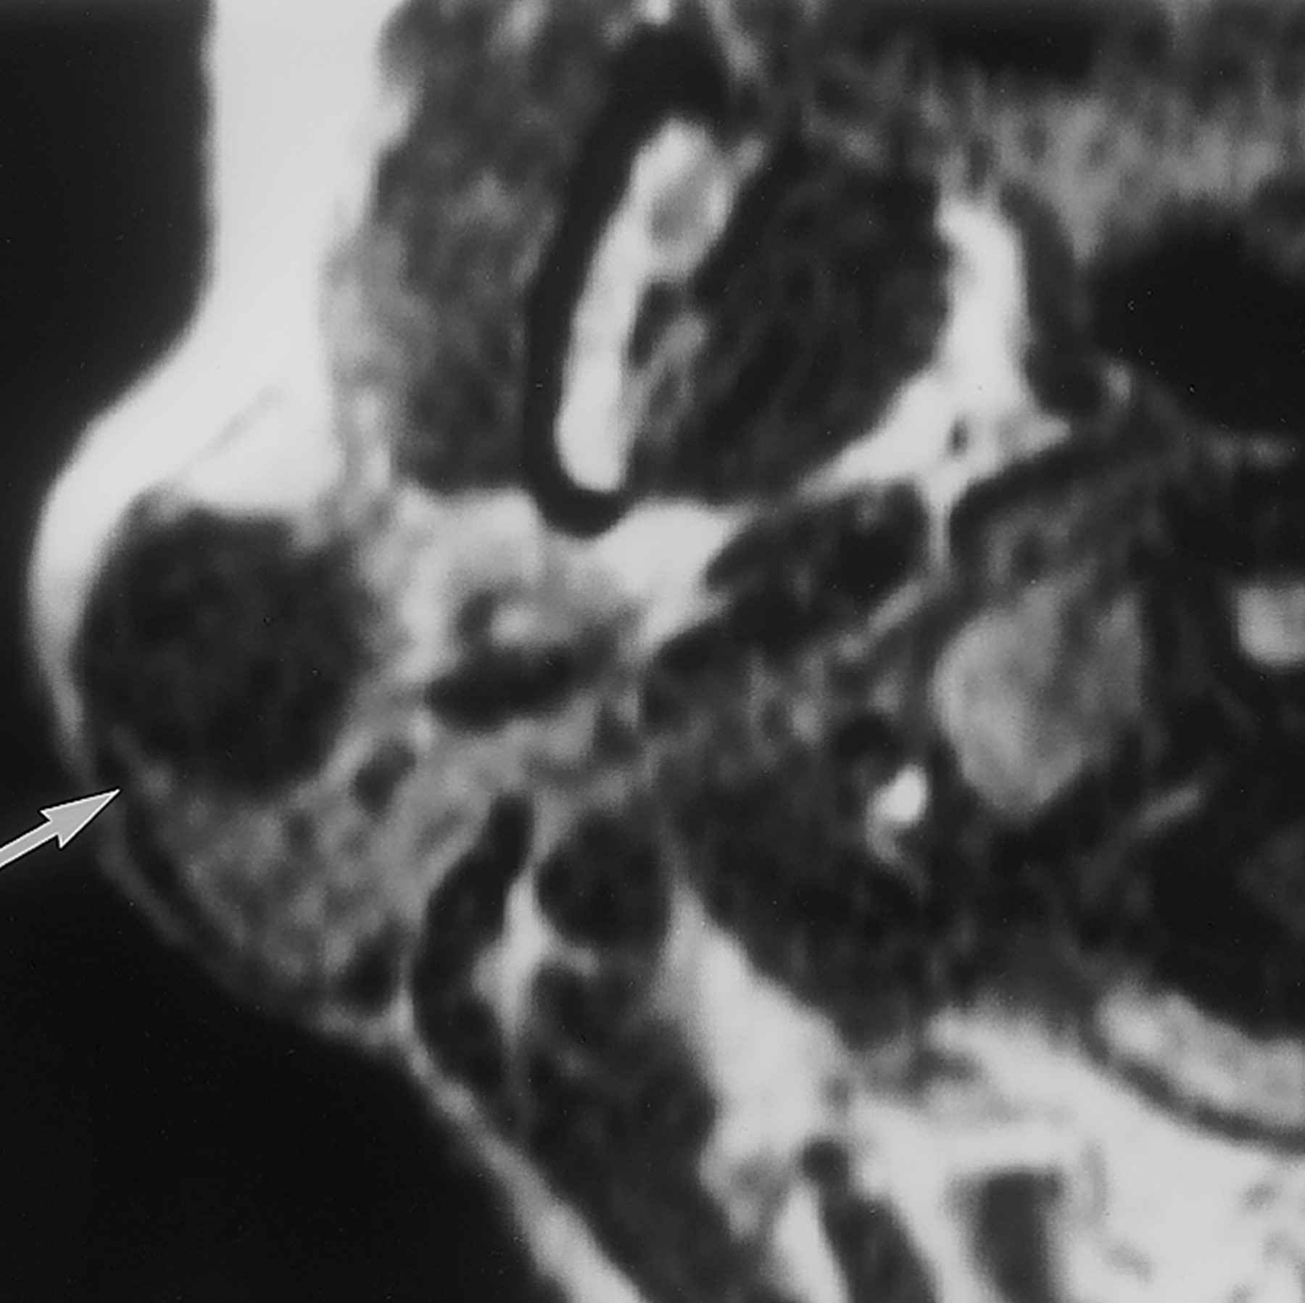
MRI
T1 weighed MRI image of right parotid pleomorphic adenoma showing a well defined mass in gland.

Slide 19
FUNCTIONAL ABNORMALITIES OF SALIVARY GLANDS
  Xerostomia:
  ptyalism

Slide 20
XEROSTOMIA:-
Xerostomia is a subjective sensation of dry mouth determined by questioning the patient about the perception of oral dryness. Salivary hypofunction is an objective sensation of the patient of having too little saliva in his mouth.

Slide 21
Salivary gland hypofunction can be diagonised by
Xerostomia can be diagonised by
Lack of saliva pooling in floor of mouth.
Cracker’s sign:- patient cannot eat cracker without drinking water.
Lip stick sign:- patients have lipstick adhered to incisal edges of anterior teeth.
Mouth mirror test:- mirrored surface of mouth mirror and attempt to move cause difficulty in moving.
Unstimulated whole salivary flow <0.15 ml/min.
  Need to sip water while eating dry food.
  Difficulty in swallowing food without water.
  Feeling of little saliva

Slide 22
Etiology:- medications
  Radiation >60 gysi.
  Systemic diseases like sjogren’s syndrome, primiary biliary cirrhosis.
  Viral infections like HIV, HEP-C.
  Habits like smoking , mouth breathing, alcohol, bevarages containing caffeine.
Treatment:-
  Water, ice chips in mouth, sugar free fluids, sugar free chewing gums, lip balm to protect lips from dryness, artificial saliva.

Slide 23
PTYALISM:-
Excessive saliva production. / decreased clearence of saliva produced.
Etiology:-
  Conditions:-
    Pregnancy
    Gastroesophageal reflux disease
    Pancreatitis
    Liver disease
    Mouth ulcers
    Oral infections
  Medications:-
    Pilocarpine
    ketamine
  Toxins:-
    Mercury, copper, arsenic, organophosphates.
Notes:
Gastroesophageal reflux disease, in such cases specifically called a water brash, and is characterized by a sour fluid or almost tasteless saliva in the mouth[8]
Commonly seen in women during pregnancy, in gastritis.
Women with hyperemesis gravidarum (severe form of morning sickness) also complain of ptylism.

Slide 24
Decreased clearence:-
  Infections
    tonsillitis, retropharyngeal and peritonsillar abscesses, epiglottitis and mumps.
  fracture or dislocation of jaws.
  Neurologic disorders
    myasthenia gravis, Parkinson's disease, rabies, bulbar paralysis, bilateral facial nerve palsy and hypoglossal nerve palsy.
Treatment:-
  avoid sour candies or substances that induce excess salivation, good oral hygine, drugs like scopolamine to decrease salivary secretions.

Slide 25
REACTIVE LESIONS
  Mucous extravasation cyst
  Mucous retention cyst
  Necrotizing sailometaplasia
  Adenamatoid hyperplasia
  Pneumopatoritis
INFECTIOUS SIALEDENITIS
  Mumps
  Bacterial sialedenitis
  Sarcoidosis
  Sjogren’s syndrome
  Salivary lymphoepithelial lesion.
SIALEDENOSIS
BENIGN NEOPLASM
  Mixed tumor/pleomorphic adenoma
  Basal cell adenoma
  Canalicular adenoma
  Oncocytoma
  Warthin’s tumor
Ductal papillomas
  Inverted ductal papilloma
  Sialadenoma papilliferum
  Intraductal papilloma.
MALIGNANT NEOPLASM
  Mucoepidermoid carcinoma
  Polymorphus low grade adenocarcinoma
  Adenocystic carcinoma
RARE TUMORS
  Metastasizing mixed tumor
  Epimyoepithelial carcinoma.
  Squamous cell carcinoma

Slide 26
MUCOCELE
Muco:- mucous
Coele:- cavity.
Mucoceles are cavities filled with mucus clinically characterized by single or multiple, spherical, fluctuant nodules which are generally asymptomatic.
2types:-
  Mucus extravasation type:-
    (Extra:- outside, vasa- vessel)
  Mucus retention type:-

Slide 27
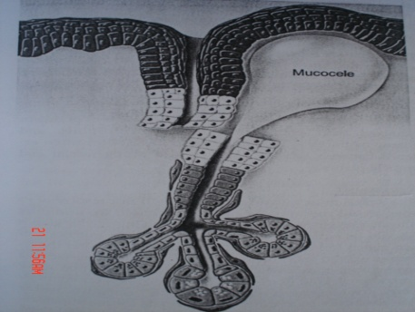
Mucus extravasation cyst:-
The trauma to the excretory duct of salivary gland , results in mucus escape or extravasation into the surrounding connective tissue. The granulation tissue forms a wall around the mucin pool .
Common site:- lower lip. Also seen in anterior ventral surface of tongue(Blandin and nuhn glands), buccal mucosa, floor of the mouth, retromolar region.
Notes:
Extravasation type most common than retention type. Most common site:- palatae and floor of the mouth.

Slide 28
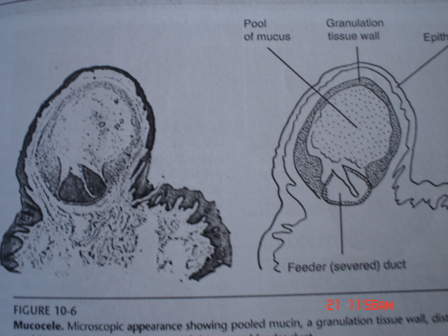
Appearance:-
  relatively painless smooth surfaced mass ranging in size from few millimeters to 2cm in diameter.
  .Bluish in colour
  Viscous material is found on aspiration.
Treatment :-
  surgical removal of involved salivary gland along with the pooled mucus .
Notes:
Appearance:- relatively painless smooth surfaced mass ranging in size from few millimeters to 2cm in diameter .Bluish in colour when mucin is superficially located.continued production of mucin causes recurrence. Viscous material is found on aspiration.
Differential diagnosis:- salivary neoplasm like mucoepidermoid carcinoma, vascular malformations, venous varix, soft tissue neoplasm such as neurofibroma or lipoma.
Treatment :- surgical removal of involved salivary gland along with the pooled mucus .

Slide 29
mucus retention cyst (obstructive sialedenitis):-
Etiology:-
  obstruction by salivary stone that are formed by accumulation of calcium salts around nicus within salivary duct. Nidus consists of desquamated cells , inspissated mucin and bacteria.
clinical features:-
  asymptomatic
  2:1 (male: female.)
  always unilateral. 80%- submandibular gland
  20% parotid
  1-15% - minor salivary glands( commonly seen in upper lip)
  In some cases Intermittent pain and swelling

Slide 30
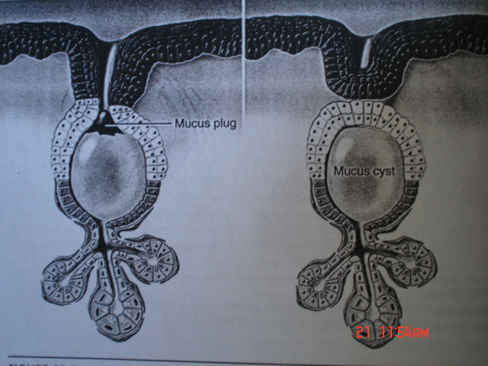
.
HISTOLOGY:-
  Commonly lined by cuboidal/columnar/atrophied squamous epithelium.
  Some cases show oncocytic metaplasia.
Treatment:-
  surgical removal of gland along with mucocele, or sialolith removal through ductal incision.

Slide 31
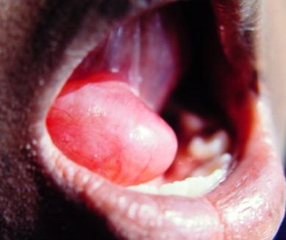
Ranula:-
Is a term used for mucoceles that occur in the floor of the mouth.
The name is derived form the word rana, because the swelling may resemble the translucent underbelly of the frog.
Although the source is usually the sublingual gland, may also arise from the submandibular duct or possibly the minor salivary glands in the floor of the mouth.
Notes:
Common in females.

Slide 32
Clinical features:-
  Presents as a blue dome shaped swelling in the floor of mouth (FOM).
  They tend to be larger than mucoceles & can fill the FOM & elevate tongue.
Differential diagnosis:-
  dermoid cyst which is usually present in the mid line, but ranula is present only unilaterally on one side only.
Treatment:-
  Marsupialisation, intralesional corticosteroids.

Slide 33
Plunging or Cervical Ranula:-
Occurs due to spilled mucin dissects through the mylohyoid muscle and produces swelling in the neck. Swelling of the floor of the mouth may be evident or not.
Tail sign:- CT and MRI images of ranula show slight extension of the lesion into the sublingual space, seen only when sublingual gland is involved.
Notes:
But absent in ranula involving sub mandibular gland.

Slide 34
Sialolithiasis:-
Sialoliths are the calcified organic matter that forms within the secetory sysem of major salivary glands associated with acute painful episodes with intermittent swellings of salivary affected salivary glands.(BURKET)
Is the major cause of unilateral diffuse parotid or submandibular gland swelling.
Etiology:-
  mechanical obstuction of the salivary duct,
  Xerostomic medications
  Tobacco smoking,
  Gout is the only systemic disease known to cause salivary calculi and these are composed of uric acid
  More common in submandibular duct because (80-90%)
    Saliva more alkaline
    Higher concentration of calcium and phosphate in the saliva,
    Longer duct , Anti-gravity flow.
Notes:
Xerostomic medications like ephedrine, terbutaline (bronchodilator), opioids, anticholinergic and adrenergic, diagepam.
Parotid 5-15%. Sublingual 2-5%.

Slide 35
Composition:-
  Organic; often predominate in the center
    Glycoproteins
    Mucopolysaccarides
    Bacteria!
    Cellular debris
  Inorganic; often in the periphery
    Calcium carbonates & calcium phosphates in the form of hydroxyapatite with trace elements of magnesium, potassium chloride, ammonium.

Slide 36
Clinical features :-
  Episodes of spasmidic pain and swelling – salivary colic ,
  trismus.
Diagnosis:-
  Bidigital palpation along the path of duct .
  ultrasound, CT, sialography, PA puffy cheek for parotid sialoliths.
DD:-
  Pleboliths appear in blood vessels , i.e out side the salivary system.
Treatment:-
  antibiotics, antiinflamatory drugs,
  stone exicision by lithotripsy, gland exicision.
Notes:
Cf:- eating initiates salivary gland swelling.
Treatment :- stasis of salivary flow can lead to infection, hence antibiotics used. Lithotripsy is disintigration of sialoliths into pieces using laser or shock wave.

Slide 37
Necrotizing sialometaplasia:-
Benign selflimiting, reactive inflamatory condition typically effecting palate , and rarely other sites containing salivary glands.
mimics malignancy both clinically and histologically.
Etiology:-
  salivary gland ischemia precipitated by local trauma, surgical manipulation, local anesthesia causing infarction of the salivary gland. This causes focal vascular compression leading to tissues necrosis of salivary gland.

Slide 38
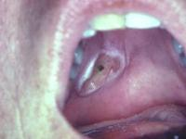
Clinical features:-
  Found at the junction of hard and soft palates
  Initially appears as a tender swelling.
  Subsequently the mucosa breaks down with the formation of a sharply demarcated deep ulcer with a yellowish grey lobular base.
  unilateral or bilateral.

Slide 39
Histology:-
  necrosis of salivary glands,
  squamous metaplasia of salivary duct.but the lobular structure is preserved which is not seen in neoplasm.
Differential diagnosis:-
  squamous cell carcinoma and malignant minor salivary gland neoplasm , syphilitic gumma (punched out ulcers).
Treatment:-
  Heal with in 6 weks by secondary intention.
subacute necrotizing sialedenitis (inflammatory condition of minor salivary glands of unknown etiology, with abrupt onset of pain and localized swelling of hard and soft palate, but self limiting without an ulcer, and no metaplasia)
Treatment:- surgical exicision.

Slide 40
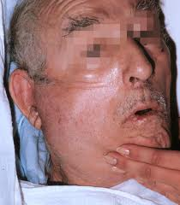
Pneumoparotitis:-
Gas in the parotid duct or gland due to the reflux of pressurized air from the mouth into Stensen’s duct.May occur with episodes of increased intrabuccal pressure like in Glass blowers, trumpet players.

Slide 41
Mumps:-
Derived from the Danish word “mompen”
Means mumbling
characteristic muffled speech that patients demonstrate because of glandular inflammation and trismus.
Acute viral sialedenitis effecting the parotid gland. Most common in late winter and spring season.
Etiology:-
  para myxo virus,
  2-3 week incubation period producing viremia of the whole body, then localizes in a biologically active tissues like salivary glands, germinal tissues and the CNS.

Slide 42
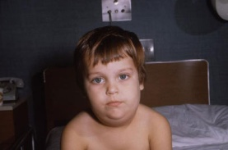
Spread by direct contact , salivary droplets etc.
Clinical features:-
  The onset of salivary gland involvement is warned by earache, gland pain while moving jaws, dysphagia and trismus.
  partially occluded stensen’s duct, pain on stimulation of salivary secretion by food,
  After 10 days decrease in swelling noted
  complications of oophorotis, orchitis seen
Notes:
, liver, pancreas , kidney and nervous system are effected (viral encephalitis, myocarditis, nephritis, deafness, bilateral testicular atrophy).

Slide 43
Diagnosis:-
  Leukocytopenia, with relative lymphocytosis
  Increased serum amylase (normal by 2- 3 week of disease)
  presence of S antibodies (recent infection) in serum.
  Presence of V antibodies (past infection /vaccination) in serum.
Differntial diagnosis:-
  coxsachie A virus., cytomegalo virus,
Treatment:- symptomatic, bed rest, analgesics, corticosteroids,
Notes:
soluble antibodies (S antibodies) directed against the nucleoprotein core of the virus appear within the first week of infection, peak in 2 weeks. They disappear in 8-9 months and are therefore associated with active or recent infection.
Viral antibodies (V antibodies) directed against the outer surface hemagglutinin, appear several weeks after the S antibodies and persist at low levels for about 5 years following exposure. Hence they are associated with past infection or prior vacciniation.

Slide 44
Bacterial sialedenitis:-
etiology:-
  microbial overgrowth with reduced salivary flow.dehydration seen. Common postoperative complication after surgery.
  hematogenous spread of the infection from other areas.
  Bacteria like penicillin resistant staphylococcus aureus, streptococcus pneumonia,

Slide 45
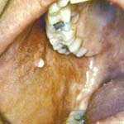
clinical features:-
  parotid glands.
  Painful swelling,
  lowgrade fever, elevated ESR, leukocytosis,
  gland extremely tender on palpation
  trismus,
  purulence at the ductal orifice on application of pressure on gland.
Treatment:-
  Antibiotic theraphy after culture sensitivity.
Notes:
:- elimination of causative organism, rehydration, use of antibiotic culture sensitivity test, biosy is avoided as it may cause sinus tract formation, sialography is avoided as it may cause spread of infection.

Slide 46
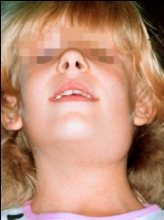
sialedenosis/ sialosis:-
Non inflammatory, non neoplastic , often recurrent condition which most commonly manifests as unilateral/bilateral enlargment of parotid or submandibular gland.
Etiology:-
  chronic alcoholism, dietary deficiency, obesity, diabetes mellitus, hypertension, hyperlipedemia.
Clinical features:-
  asymptomatic enlargement of salivary gland.

Slide 47
  diabetes:-
    reduced salivary flow, bilateral parotid gland enlargment, acinar cell hypertrophy.
  Type 1 hyperlipoprotenemia :-
    sicca like syndrome with parotid enlargement with mild oral and ocular symptoms ( xerostomia, xeropthalmia). Fatty replacement of fuctional salivary gland parenchyma.
  Acromegaly :-
    endocrine related salivary gland enlargment.
  Pancreatitis:-
    acinar cell hypertrophy with increased levels of salivary flow in parotid gland are seen.

Slide 48
Sjogren’s syndrome:-
Autoimmune process resulting in dry eyes, dry mouth , lymphocytic destruction of lacrymal and salivary gland parenchyma and rheumatoid arthritis.
Monograph on the diease published in 1933 by Sjögren, a Swedish ophthalmologist.
Etiology:-
  polyclonal B cell hyperactivity reflecting a lack of regulation by T-cells .
Primary sjogren’s syndrome:-
  involvement of exocrine glands , xerostomia, xeropthalmia.
Secondary sjogren’s syndrome:-
  xerostomia, xerophthalmia, autoimmune connective tissue disorder like rheumatoid arthritis, SLE, sleroderma, primary biliary cirrhosis, polymyositis, vasculitis, parotitis and chronic active hepatitis.

Slide 49
Clinical features:-
  more common in women at 50 years. Children and teenagers more commonly effected.
  Increased incidence of lymphoreticular malignancy in primary sjogren’s.
  Xerostomia causing eating and speaking difficulties, with caries and periodontitis, candidial infections, recurrent symmetrical parotid gland enlargement.
  Arthralgia, myalgia, fatigue are seen.
Diagnosis:- minor salivary gland biopsy, scintigraphy( nuclear imaging of salivary gland),
  Labial salivary gland biopsy is used to know the severity of sjogrens by grading it. An area containing 50 or more lymphocytes is designated as a focus in biosy. More than `1 focus in an area of 4mm²is diagnostic of sjogren’s syndrome.

Slide 50

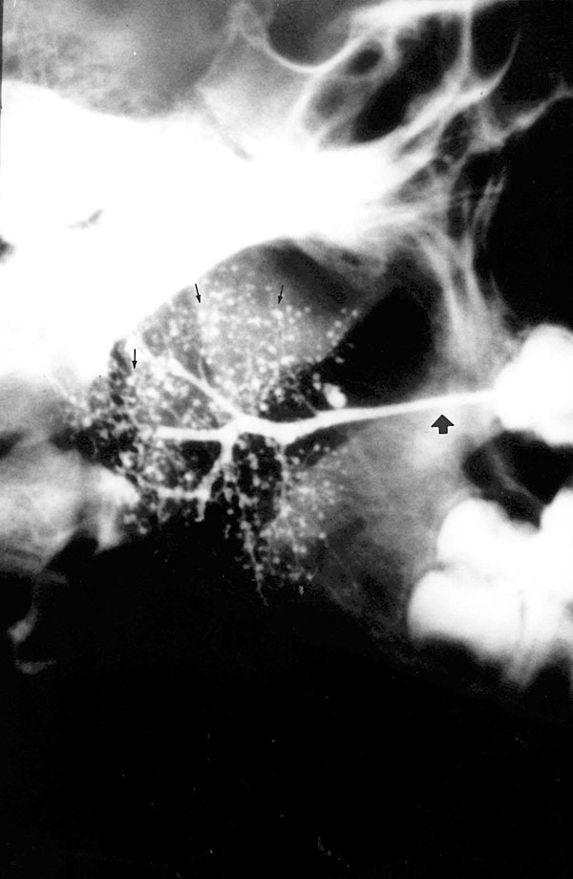
  Evaluate with Schirmer test
    Two 5 x 35mm strips of red litmus paper placed in inferior fornix, left for 5 minutes. A positive finiding is lacrimation of 5mm or less.
  contrast sialography :
    early stages shows a punctate sialectesia(dilation of salivary duct, characterstic of sjogren’s) <1mm,

Slide 51
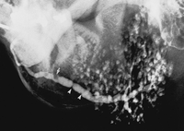
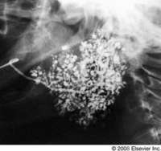
  next stage shows a globular sialectesia (<2mm),
    later stages show cavitary sialectesia (>2mm).
    It indicates ductal and acinal cell damage with intact interlobular ducts. Further ductal damage in later stages cause stenosis of even the larger duct.

Slide 52
European American consensus - | Group criteria for sjogren’s syndrome 2002
Ocular symptoms | Daily dry eyes >3months Recurrent sand or gravel sensation in eye. Use of tear substitutes more than 3 times per day
Oral symptoms | Feeling of dry mouth >3months Persistant swollen salivary glands Liquids to aid in swallowing dry food.
Ocular signs | Schimmer’s test without anesthesia (<5mm in 5 minutes) Rose Bengal score >4mm according to van blijsterveld scoring system.
Histopathology in minor salivary glands | Focal lymphocytic sialedenitis with focus >1 (1 focus > 50 lymphocytes per 4mm² tissue adjacent to normally appearing mucous acini.
Salivary gland involvement | Unstimulated whole salivary flow <1.5ml/15 minutes. Parotid sialography showing the presence of diffuse sialectiasis (punctate, cavitary, destructive pattern), without the evidence of obstructing the duct. Salivary scintigraohy showing delayed uptake and excretion of tracer.
Auto antibodies | Antibodies to SS-A/Ro , SS-B/La.

Slide 53
For primary sjogren’s syndrome:-
Any 4 out of 6 must be positive, in them either factor 4 or factor 6 must be present. (OR)
Any 3 factors out of factors 3,4,5,6 must be present.
For secondary sjogren’s syndrome:-
Any connective tissue disorder must be present, along with it
Any one factor between 1, 2 must be present along with
Any 2 factors between 3, 4, 5 must be present.

Slide 54
Treatment:-
  artificial saliva, tears. Oral hygine maintainance, sialogogues like pilocarpine and cevimeline .

Slide 55
Benign lymphoepithelia lesion (BELE)/ salivary lymphoepithelial lesion/ immunosialedenitis / mikulicz disease:-
Described by john van mikulicz radecki in 1800.
Uncommon persistant, nonpainful, firm, unilateral/ bilateral salivary gland enlargement ,along with lacrimal gland swellings. most commonly occurs along with sjogren’s syndrome.
Histology:-
  dense infiltration of lymphocytes and plasma cells into salivary tissue along with proliferation of ductal component to produce irregular islands of epithelial cells and myoepithelial cells together called as epimyoepithelial islands. Early these islands were considered benign, but recently it was diagonised that they represent a low grade salivary lymphomas of MALT (mucosally associated lymphoid tissue).
Treatment :- surgical removal of MALT tissue along with salivary gland.

Slide 56
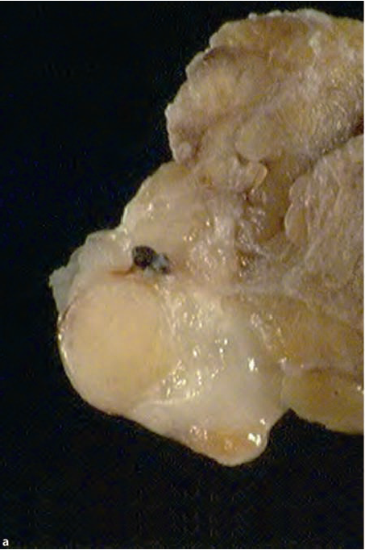
Mixed tumor/pleomorphic adenoma
It is called pleomorphic because of dual proliferation of cells (some with ductal cell features and some cells with myoepithelial features).
Most common tumor.85% in parotid, 8% in submandibular, 7% in minor salivary glands.
Males= females, 4-6th decades.
The intraoral minor salivary gland tumors are mobile (but immobile firm painless swelling when involving palate), normal overlying mucosa without any ulcerations.

Slide 57
Patotid tumors are painless and slow growing.located below the ear and posterior to the mandible. They range from few mm to several cm i.e capable of reaching gaint sizes in major salivary glands.
Histology:-
  The tumors are typically capsulated in a pseudo capsule and enclosed with in connective tissue .
  Approx one third of tumors show equal ratios of epithelial and myoepithelial elements. The epithelial components appear as ducts, tubules, ribbons, solid sheets . the myoepithelial cell derived mesenchymal component appear as a myxoid hyalinized connective tissue . infrequently fat/bone/cartilage may be seen.
  The myoepithelial cells may appear as plasmacytoid cells which is a characterstic feature of pleomorphic adenoma and is not seen in any other salivary tumors.

Slide 58
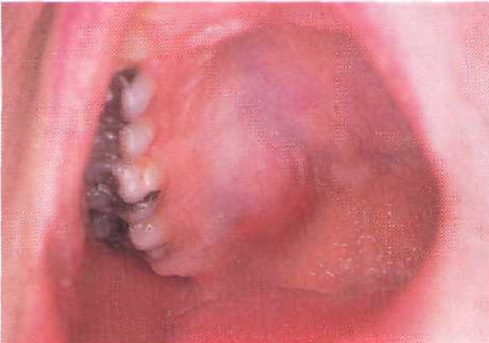
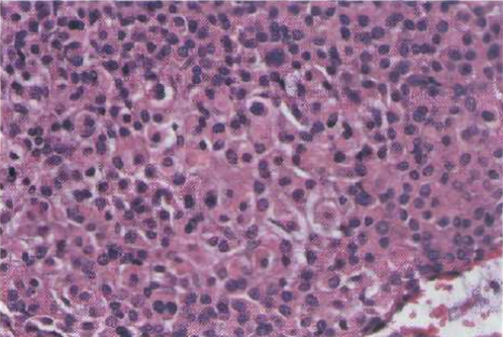
Pleomorphic adenoma of palate.
Histological picture showing plasmacytoid features of myoepithelial cells.
Notes:
A specialized cell of the lymphoid reticuloendothelial system that presents antigens for detection by lymphocytes.-plasma cytoid.

Slide 59
Diagnosis:- gland biosy, sialography(shows displacement of duct around the tumor), CT, MRI, ultrasound.
Treatment:-
  for superficial tumors:- exicision of tumor, superficial parotidectomy with preservation of facial nerve.
  For deep tumors:- total removal of gland with tumor in parotid and submandibular.
  Malignant transformation in longstanding untreated cases called as carcinoma EX pleomorphic adenoma.

Slide 60
Canalicular adenoma:-
Occurs most exclusively in minor salivary glands, marked predilction for upper lip.
Older people more common, females>males.
Clinical features:- a slowly growing painless multiple mass that ranging from several millimeters to 2 cms , firm /fluctuant on palpation on upper lip/buccal mucosa. Normal overlying mucosa.
Histology:- uniform columnar or cuboidal cells forming canal like ductal structures. Inbetween these rows eosinophilic coagulam is present.
Treatment :- surgical exicision of the gland.
Notes:
Occurs most exclusively in minor salivary glands, marked predilction for upper lip.
Older people more common, females>males.
Clinical features:- a slowly growing painless multiple mass that ranging from several millimeters to 2 cms , firm /fluctuant on palpation on upper lip/buccal mucosa. Normal overlying mucosa.
Histology:- uniform clolumnar or cuboidal cells forming canal like ductal structures. Inbetween these rows eosinophilic coagulam is present.
Treatment :- surgical exicision of the gland.

Slide 61
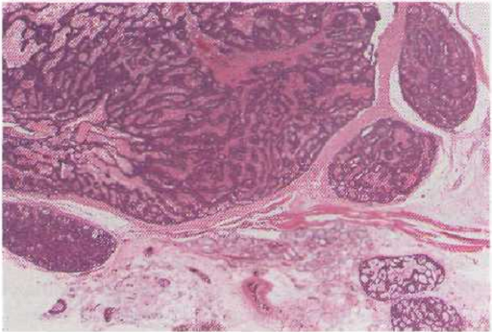
Cells forming tubular structures.
Eosinophilic coagulam inbetween.

Slide 62
Basal cell adenoma
Firm mobile slow growing mass clinically appearing as plemorphic adenoma
Occurs primarily in parotid gland.upper lip and buccal mucosa second most common sites. most common in older females.
Histology:- basioloid appearance of tumor cells is characterstic.tumor is capsulated. Based on the arrangement of cells they can be subclassified as trabacular type and solid type, tubular type..
Treatment:- surgical removal of gland.
Notes:
Basaloid cell
a cell, usually of the epidermis, resembling a basal cell.

Slide 63
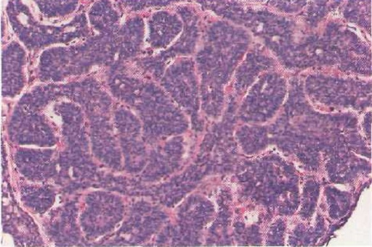
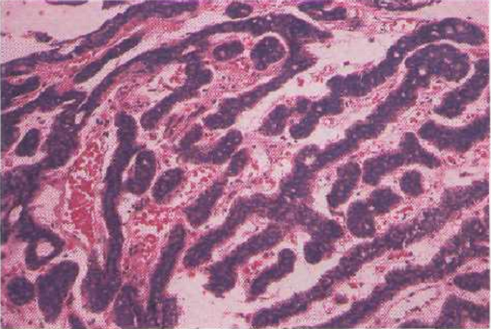
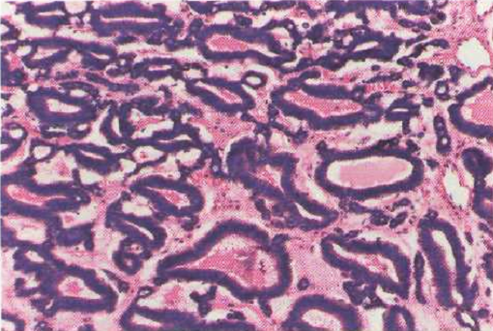
Solid type
Trabacular type
Tubular type.
Notes:
Solid/membranous type:- islands of tumor cells surrounded by thick pas positive hyaline material;
Trabacular chords of cells
Tubular arrangment of tumor cells;

Slide 64
Papillar cystadenoma lymphomatosum/ warthin’s tumor:-
Occurs exclusively in parotid gland. Second most common benign parotid tumor.
Warthin's tumor is thought to arise within lymph nodes as a result of entrapment of salivary gland elements early in development
Slow growing , painless, nodular mass of the parotid , and firm or doughy on palpation. More common in men above 6-7th decade of life.
Kotwall etal reported smokers have 8times grater chance of developing this tumor.
Notes:
n oncocyte is an epithelial cell characterized by an excessive amount of mitochondria, resulting in an abundant acidophilic, granular cytoplasm. Oncocytes can be benign or can undergo malignant transformation.

Slide 65
Diagnosis:- CT shows a well defined homogenous non calcifying mass with a well defined wall
Histology:- the ductal epithelium show double row of oncocytes with their projections into the surrounding cystic spaces. the epithelium is supported by lymphoid stroma.
Treatment :- surgical exicision.

Slide 66
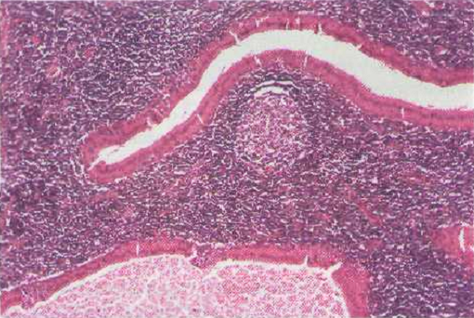
Double rows of oncocytes
Lymphoid tissue.

Slide 67
Oncocytoma (oxyphil adenoma)
Rare salivary gland tumor occurring in parotid gland. Asymptomatic encapsulated mass. Resemblance of the cells to the normal oncocytes seen in salivary glands, respiratory tract, breast, thyroid, pancreas, parathyroid, pituitary, liver and stomach.
More common in women.
Histology:- tumor cells are from ductal origin having numerous mitochondria , with swollen eosinophilic appearance.
Treatment:- surgical exicision
Notes:
on·co·cyte (ngk-st)n.A large granular acidophilic tumor cell having numerous mitochondria.

Slide 68
Mucoepidermoid carcinoma:-
Most common malignant salivary gland tumor. First described in 1945 by stewart etal.
2-7th decade,-- children,.
Clinically 3 types :-
  low grade(limited potential to metastize to regional lymphnodes),
  medium,
  high grade( tend to be solid rather than cystic and behave aggressively like a squamous cell carcinoma ).
Common site :-
  palate, buccal mucosa, retromolar area, and base of tongue
  .seen initially as a painless swelling, slowly enlarging, simulating mucocele when present in retromolar area.
  High grade tumors grow rapidly and produce pain, infiltrate to surrounding tissue causing paralysis of facial nerve , and metastasize to regional lymphnodes.
Notes:
Most common in children,

Slide 69
Histology:-
  contain stratified squamous epithelial cells along with mucous cells and a third type of intermediate cells (basiloid cells). Hence the name mucoepidermoid . the mucous cells contain abundant cytoplasm that stain positively with mucicaramine stain. Lymphocytic infiltration is seen.
  Low grade tumors show all cell types with cystic features.
  High grade tumors show solid islands of squamous epithelial cells and intermediate cells , similar to squamous cell carcinoma.
Treatment:- low grade- surgical removal, high grade tumors- wide resection with radical neck dissection.

Slide 70
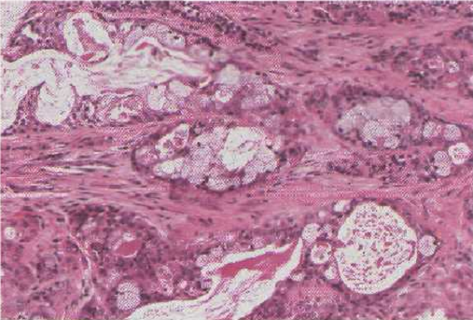
Cystic spaces
Mucus cells
Low grade mucoepidermoid carcinoma.

Slide 71
Acinic cell adenocarcinoma:-
malignant salivary gland tumor characterized histologically by the appearance of serous acini at various degrees of differentiation.
Commonly seen in parotid, 3rd decade, slowly growing with pain.
4 growth patterns seen histologically:- solid, cystic, follicular, microcystic(more common).

Slide 72
DUCTAL PAPILLOMAS
SIALEDENOMA PAPILLIFERUM | INVERTED DUCTAL PAPILLOMA | INTRADUCTAL PAPILLOMA
Reported in 1960 Commonly seen in buccal mucosa and palate of major or minor salivary glands. | Rare entity with equal gender prediliction. | Rare lesion arising from a greater depth.
Painless exophytic papillary lesion of 5th to 8th decades of life. | Nodular submucosal mass resembling fibroma or lipoma | Produces an endophytic growth into the lumen of salivary duct causing obstruction.
Originated from superficial portion of excretory duct of salivary gland. | Proliferation of ductal epithelium cells with intact mucosa. | Single or double layerded cuboidal to columnar epithelium covers papillary projections into the lumen of duct.

Slide 73
Each papillary projection lined by 2-3 cell layered squamous epithelium in superficial portions, and by cuboidal or columnar cells in deeper portions. | Papillary projections lined by columnar cells with POLARISED NUCLEI, interspersed GLOBLET CELLS, and cell transition from squamous to cuboid is seen.
exicision | exicision | exicision

Slide 74
Malignant mixed tumor /carcinoma ex pleomorphic adenoma:-
Clinically indistinguishable with pleomorphic adenoma , commonly seen in parotid followed by sub mandibular gland.
Also seen in minor salivary glands .
Clinical features:-
  age 50-70 years,
  clinically presented as a rapid expansion of longstanding asymptomatic mass, with onset of pain ,paresthesia, fixation to skin.
Histology:-
  normally a malignant transformed benign tumors show a large area of benign area with small areas of malignant changes. But here a large area of malignant cells found with small area of benign tumor. The tumor cells show anaplastic features.
Treatment:- wide exicision, lymphnode dissection, radiation theraphy.

Slide 75
Adenoid cystic carcinoma
Well defined malignant features are seen.
Common site:- palatal minor salivary gland.
  5,6,7th decade of life.
  Equal gender predeliction.
  Slowly growing , ulcerated, with pain, involvement of facial nerve, .
  perinueral invasion is characterstic feature.
Histology:-
  Deeply basophillic tumor cells arranged in the form of swiss cheese.
  The other patterns include tubular form, solid form(poor prognosis).
Treatment:-
  Surgical exicision.
Notes:
Polymorphus low grade adenocarcinoma.

Slide 76
Oral medicine – burket’s.
Oral diagnosis, oral medicine and treatment planning- bricker.
Salivary gland disorders – mayer’s.
Salivary diagnostics- amerogeun.
Oral pathology and clinical pathological correlation- regezi.
Atlas of oral pathology- nevellie.

