Slide 1
Salivary gland Disorders
Classification, Diagnosis, Sailoliths & Cysts

Slide 2
The salivary glands, major and minor, comprise a complex anatomic and physiologic organ system producing enzyme, mixing agent and immune factors.
The salivary glands respond to physical (food and drink) and emotional (flight, exhilaration and exhaustion) stimuli.

Slide 3
CLASSIFICATION
1.Developmental
  Aplasia – absence of the gland
  Atresia – absence of the duct
  Aberrancy – ectopic gland
2. Enlargement of the gland
A. Inflammatory. (Sialadenitis)
1. Viral : Mumps, coxsackie A,CMV etc..
2. Bacterial
3. Allergic
4. Sarcoidosis
5. Obstructive

Slide 4
B. Non inflamatory
  1. Autoimmune: sjogrens syndrome, mickulicz’s disease.
  2. Alcoholic cirrhosis
  3.Diabetis milletus
  4. Nutritional deficiency
  5. HIV associated
3. Cysts
  a. Extravasation cysts
  b. Retention cysts
  c. Ranula

Slide 5
4. Tumours of salivary glands
a. Benign tumours
  Pleomorphic adenoma
  Warthins tumour
  Basal cell adenoma
  Myoepithelioma
  Canalicular adenoma
  Ductal papilloma
b. Malignant tumours
  Mucoepidermoid carcinoma
  Adenoid cystic carcinoma
  Malignant pleomorphic adenoma

Slide 6
5. Necrotizing sailometaplasia
6. Salivary gland dysfunction
a. Xerostomia
b. Sialorrhea

Slide 7
Developmental anomalies
Aberrant salivary gland
An aberrant (ectopic) salivary gland - that develops at a site where it is not normally found.
It is reported as an single anomaly or in combination with other facial anomalies.
Commonly seen in the cervical region near the parotid gland or the body of the mandible and posterior to the 1st molar and often has a communication with a major salivary gland.

Slide 8
Aplasia and hypoplasia
Aplasia of the major salivary glands is rare
It may occur in combination with other congenital anomalies like cleft palate.
The major symptom is severe xerostomia.
Hypoplasia of parotid glands has been reported in patients with Melkerson-Rosenthal syndrome, which presents as a classical triad of orofacial granulomas, facial paralysis and fissure tongue.

Slide 9
Accessory glands
This is a common condition, found in more than half the people.
It is usually found superior and anterior to the normal Stensson’s duct orifice.
Diverticuli
These are small pouches or outpocketings of the ductal system of one of the major salivary glands, and these lead to repeated episodes of acute parotitis.

Slide 10
Obstructive
Salivary Gland Disorders
Sialolithiasis
Mucous retention/extravasation

Slide 11
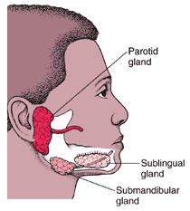
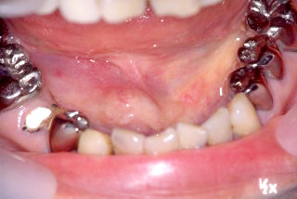
Sialolithiasis/ salivary stone/ salivary caliculi
Obstrucitve salivary gland disorder.
Calcified organic matter.
Invovled in major and minor salivary glands.

Slide 12
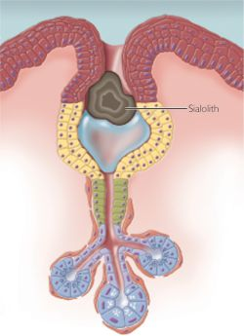
Pathology
Deposition of Ca salts around the central nidus – desquamated epithelial cells, bacteria, foreign body, products of bacterial decomposition.

Slide 13
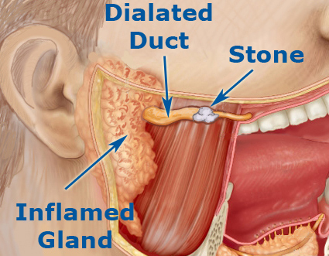
Etiology
Unknown
Chronic sialedenitis
Inflammation
Irregularities
Local irritants
Anti cholinergic drugs
Smoking

Slide 14
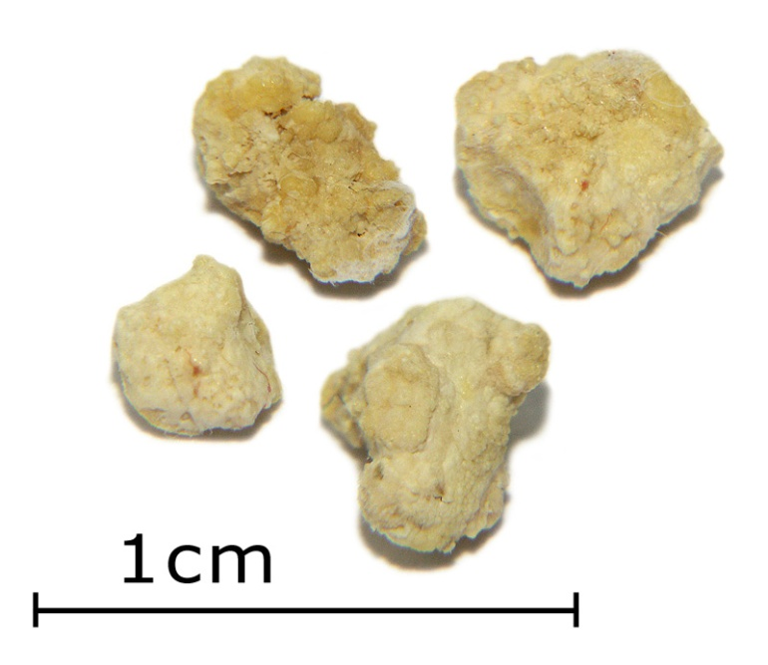
Structure
Crystalline
Yellow
Composed of
Hydroxyapatite

Slide 15
Prevalence
Middle aged
Men
Most common - submandibular – 80 – 90%
Parotid – 5 – 15%
Sublingual – 2 – 5%.

Slide 16
Clinical features
Painful & intermittent swelling during eating, which resolves after meals.
Obstruction to the flow of saliva – salivary glands enlarged and painful
Stasis of sailva – infection, fibrosis, gland atrophy.
Fistulae, ulceration – over stone – chronic cases.
Suppurative/ non suppurative retrograde infection.

Slide 17
Examination
Edema and inflammation around the duct.
Bidigital palpation - tenderness and enlargement.
Complications
  Acute sialadenitis
  Ductal stricture
  Ductal dilatation
  Recurrence of stones
  Fibrosis of the gland

Slide 18
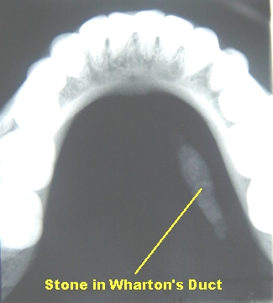
Investigations
SMG – occlusal
Parotid – AP view
occlusal film placed intraorally adjacent to duct.
Ultrasonography – can detect stones of > 2mm.

Slide 19
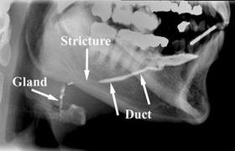
Sialography – injection of radiopaque dyes into salivary ducts.
Radionuclide salivary imaging – scintigraphy with technetiuim 99m pertechnetate – to determine abnormalties in gland uptake and excretion.

Slide 20
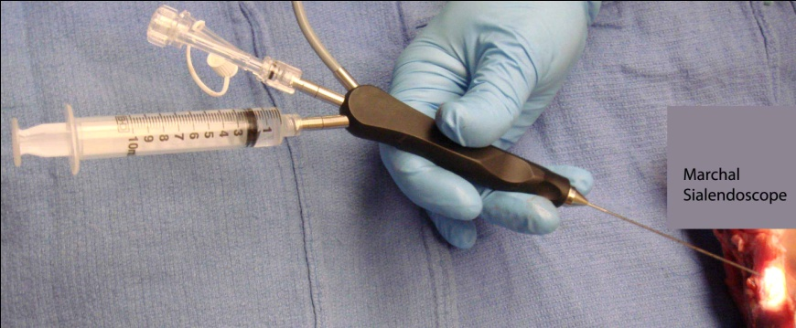
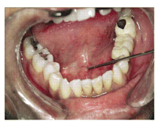
CT & MRI – used to detect sialolith.
Sialoendoscopy – to visualise and removal of sialolith.

Slide 21
Preventive measures
Drink plenty of water
Avoid
High sources of calcium diets –
Citrus fruits like orange, lemon, tomato, etc. – increase saliva production - can cause swelling and pain in the blocked gland.

Slide 22
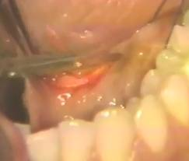
Treatment
Supportive therapy – analgesics, hydration, antibiotics, antipyretics.
Varies depending on size and location of the stone.
Small stones near orifice – milking of gland.
Sialolithotomy (removal of salivary calculus).

Slide 23
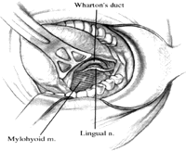
Sialolithectomy – total removal of gland.
Multiple stones
Recurrent infections.
Location of stone – intraglandular.

Slide 24
Lithotripsy ( shock wave)-
  Extra-corporeal shock-wave lithotripsy
  Intra-corporeal shock-wave lithotripsy

Slide 25
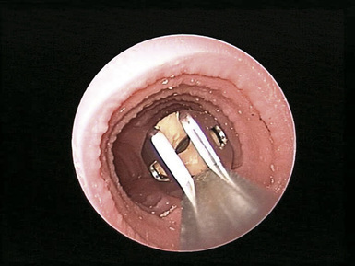
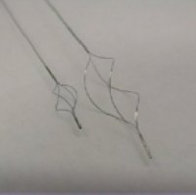
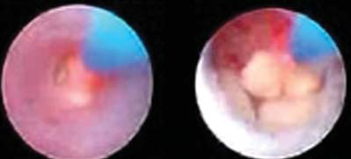
Sialoendoscopy –
Explorative procedurae
Removal of stones
Soft tissue biopsies

Slide 26
Mucocele
Muco: mucus , coele: cavity.
Mucus is the exclusive secretory product of the accessory minor salivary glands and the most prominent product of the sublingual gland.
The mechanism for mucus cavity development is extravasation or retention .
Mucoceles are most common of the benign soft tissue masses in the oral cavity.
When in the oral floor, they are called ranula.

Slide 27
Extravasation is the leakage of fluid from the ducts or acini into the surrounding tissue.
Extra: outside, vasa: vessel
Retention: narrowed ductal opening that cannot adequately accommodate the exit of saliva produced, leading to ductal dilation and surface swelling. Less common phenomenon
Consist of a circumscribed cavity in the connective tissue and submucosa producing an obvious elevation in the mucosa

Slide 28
The majority of the mucoceles result from an extravasation of fluid into the surrounding tissue after traumatic break in the continuity of their ducts.
Lacks a true epithelial lining.

Slide 29
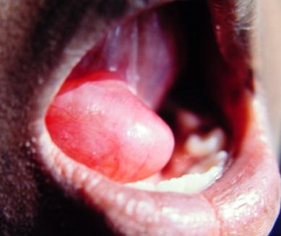
Ranula
Is a term used for mucoceles that occur in the floor of the mouth.
The name is derived from the word rana, because the swelling may resemble the translucent underbelly of the frog.

Slide 30

Although the source is usually the sublingual gland,
  may also arise from the submandibular duct
  or possibly the minor salivary glands in the floor of the mouth.
Presents as a blue dome shaped swelling in the floor of mouth (FOM).
They tend to be larger than mucoceles & can fill the FOM & elevate tongue.
Located lateral to the midline, helping to distinguish it from a midline dermoid cyst.

Slide 31
Plunging or Cervical Ranula
Occurs when spilled mucin dissects through the mylohyoid muscle and produces swelling in the neck.
Concomitant FOM swelling may or may not be visible.

Slide 32
Treatment of Mucoceles
in Lip or Buccal mucosa
Excision with strict removal of any projecting peripheral salivary glands
Avoid injury to other glands during primary wound closure

Slide 33
Ranula Treatment
Marsupialization - excessive recurrence rate of 60-90%
Sublingual gland removal via intraoral approach

Slide 34
Salivary Gland Infections
Acute bacterial sialdenitis
Chronic bacterial sialdenitis
Viral infections

Slide 35
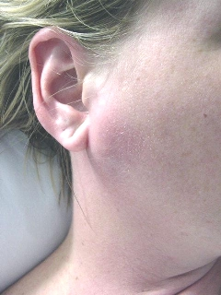
Sialadenitis
Sialadenitis :-represents inflammation mainly involving the acinoparenchyma of the gland.
Acute infection more often affects the major glands than the minor glands¹

Slide 36
Pathogenesis
Retrograde contamination of the salivary ducts and parenchymal tissues by bacteria inhabiting the oral cavity.
2. Stasis of salivary flow through the ducts and parenchyma promotes acute suppurative infection.

Slide 37
Acute Suppurative
More common in parotid gland.
Suppurative parotitis, surgical parotitis, post-operative parotitis, surgical mumps, and pyogenic parotitis.
The etiologic factor - retrograde infection from the mouth.
20% cases are bilateral

Slide 38
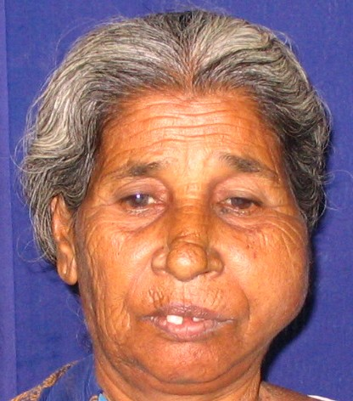
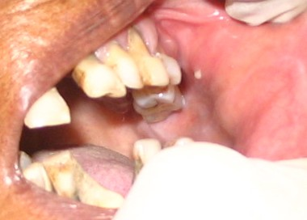
SIALADENITIS – BACTERIAL (PAROTID ABSCESS)
INTRAORAL
EXTRAORAL

Slide 39
Risk Factors for Sialadenitis¹
Systemic dehydration (salivary stasis)
Chronic disease and/or immunocompromise
  Liver failure
  Renal failure
  DM, hypothyroid
  Malnutrition
  HIV
  Sjögren’s syndrome

Slide 40
Neoplasms (pressure occlusion of duct)
Sialectasis (salivary duct dilation) increases the risk for retrograde contamination.
Extremes of age
Poor oral hygiene
Sialolithiasis

Slide 41
Clinically, the condition is characterised by the sudden onset of firm, erythematous swelling of parotid region, pain and tenderness.
Body temperature rises and purulent discharge from Stensson’s duct.
If untreated, it leads to a markedly toxic and life-threatening situation.
It is bilateral in 20%.

Slide 42
Lab Testing
Purulent saliva should be sent for culture.
Elevated white blood cell count
If no response to antibiotics in 48 hrs can perform MRI, CT or ultrasound to exclude abscess formation
Can perform needle aspiration of abscess

Slide 43
Treatment
Warm compresses, maximize OH, give sialogogues (lemon drops)
External salivary gland massage if tolerated
Antibiotics.
70% of organisms produce B-lactamase or penicillinase.
Need B-lactamase inhibitor like Augmentin or second generation cephalosporin.
Can also consider adding metronidazole or clindamycin to broaden coverage.

Slide 44
Failure to respond after 48 hours
Consider adding a third generation ceph
Possibly add an aminoglycoside
Limited role for surgery
When a discrete abscess is identified, surgical drainage is undertaken

Slide 45
Complications of Acute Parotitis
Direct extension
  Abscess ruptures into external auditory canal and TMJ have been reported
Hematogenous spread
Thrombophlebitis of the retromandibular or facial veins are rare complications
Extension of an abscess into the parapharyngeal space may result in airway obstruction, mediastinitis, internal jugular thrombosis and carotid artery erosion.

Slide 46
Chronic Sialadenitis
Causative event is thought to be a lowered secretion rate with subsequent salivary stasis.
More common in parotid gland.
Damage from bouts of acute sialadenitis over time leads to sialectasis, ductal ectasia and progressive acinar destruction combined with a lymphocyte infiltrate.
The clinician should look for a treatable predisposing factor such as a calculus or a stricture.

Slide 47
No treatable cause found
Initial management should be conservative and includes the use of sialogogues, massage and antibiotics for acute exacerbations.
Should conservative measures fail, consider removing the gland.

Slide 48
Acute viral infection (AVI)
Mumps classically designates a viral parotitis caused by the paramyxovirus.
Derived from the Danish word “mompen”.
Means mumbling, the name given to describe the characteristic muffled speech that patients demonstrate because of glandular inflammation and trismus.

Slide 49
Mumps is a non-suppurative acute sialadenitis
Is endemic in the community and spread by airborne droplets
Communicable disease
Enters through upper respiratory tract, 2-3 week incubation after exposure (the virus multiplies in the URI or parotid gland)
3-5day viremia
Then localizes to biologically active tissues like salivary glands, germinal tissues and the CNS.

Slide 50
Classic mumps syndrome is caused by paramyxovirus, an RNA virus.
Others can cause acute viral parotitis:
  Coxsackie A & B, cytomegalovirus and adenovirus.

Slide 51
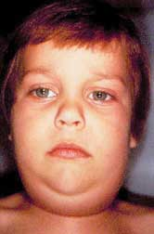
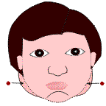
VIRAL SIALADENITIS - MUMPS

Slide 52
C/F
30% experience prodromal symptoms prior to development of parotitis.
Headache, myalgias, anorexia, malaise. Low grade fever.
earache, gland pain, dysphagia and trismus.
Glandular swelling (tense, firm) Parotid gland involved frequently, SMG & SLG can also be affected.
May displace ispilateral pinna
75% cases involve bilateral parotids, may not begin bilaterally (within 1-5 days may become bilateral)….25% unilateral

Slide 53
Treatment
Supportive
Fluid
Anti-inflammatories and analgesics

Slide 54
Prevention
The live attenuated vaccine became available in 1967
Commonly combined with the measles and rubella vaccines, the mumps vaccine is administered in a single subcutaneous dose after 12 months of age. Booster at 4-6yr

Slide 55
Complications
Orchitis, testicular atrophy and sterility in approximately 20% of young men
Oophoritis in 5% females
Aseptic meningitis in 10%
Pancreatitis in 5%
Sensorineural hearing loss <5%
  Usually permanent
  80% cases are unilateral

Slide 56
Immunologic Disease
Sjögren’s Syndrome
Most common immunologic disorder associated with salivary gland disease.
Characterized by a lymphocyte-mediated destruction of the exocrine glands leading to xerostomia and keratoconjunctivitis sicca
90% cases occur in women
Average age of onset is 50y
Classic monograph on the disease published in 1933 by Sjögren, a Swedish ophthalmologist

Slide 57
Two forms:
Primary: involves the exocrine glands only.
Secondary: associated with a definable autoimmune disease, usually rheumatoid arthritis.
  80% of primary and 30-40% of secondary involves unilateral or bilateral salivary glands swelling
Unilateral or bilateral salivary gland swelling occurs, may be permanent or intermittent.
Rule out lymphoma

Slide 58

Keratoconjuntivitis sicca: diminished tear production caused by lymphocytic cell replacement of the lacrimal gland parenchyma.
Evaluate with Schirmer test.
Two 5 x 35mm strips of red litmus paper placed in inferior fornix, left for 5 minutes. A positive finiding is lacrimation of 5mm or less.
Approximately 85% specific & sensitive

Slide 59
Sjögren’s Lip Biopsy
  Biopsy of SG mainly used to aid in the diagnosis.
  Can also be helpful to confirm sarcoidosis.
  Single 1.5 to 2cm horizontal incision labial mucosa.
  Not in midline, fewer glands there.
  Include 5+ glands for identification
  Glands assessed semi-quantitatively to determine the number of foci of lymphocytes per 4mm²/gland

Slide 60
Sjögren’s Treatment
Avoid xerostomic medications if possible
Avoid alcohol, tobacco (accentuates xerostomia)
Salivary substitutes/sprays

Slide 61
Necrotizing Sialometaplasia
Reaction to ischemia or injury
Manifests as mucosal ulceration, most commonly found on hard palate.
Pain is not a common complaint

Slide 62
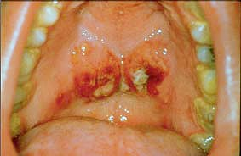

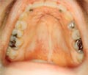
Self limiting lesion, heals by secondary intention over 6-8 weeks
Histologically may be mistaken for SCC

Slide 63
Imaging in salivary gland diseases
Multiple imaging techniques may be used in the diagnostic evaluation of salivary gland. These range from plain radiographic examination to the most complex magnetic resonance imaging (MRI).

Slide 64
Plain radiography
Plain radiography still serves an important function in the examination of the salivary glands.
It is indicated to identify any radio-opaque sialoliths, phleboliths or dystrophic calcification present in the gland or duct.
For evaluation of parotid gland, PA view, true lateral and lateral oblique views with the chin extended and mouth open, should be performed.

Slide 65
For evaluation of submandibular gland, the lateral view radiograph should be taken with index finger pressing the tongue down. In addition, an intra-oral occlusal view may be helpful.
About 80% of salivary calculi can be visualised with plain radiography. They appear as focal calcific densites, most commonly associated with submandibular gland.

Slide 66
Nuclear medicine (radionuclide imaging)
The findings of nuclear medicine techniques are less specific than sialography, CT or MRI. But this may be useful as an adjunct to these techniques.
Intravenous injection of Tc-99m pertechnate, gamma camera images obtained every 2 minutes.
Abnormalities may be defined as increased, decreased or absent uptake of radionuclide.
Increased uptake is seen in sialadenitis and granulomatous diseases and in oncocytoma and Warthin’s tumour.
Decreased uptake is seen in ageing, viral infections and most tumours.

Slide 67
Ultrasonography
This provides a non-invasive means for examination of the salivary glands, with the exception of the deep lobe of parotid.
The differentiation between cystic and solid compartments can easily be made.
Fluid-filled structures with no tissue interfaces, such as an abscess or cyst, appear echo-free on ultrasound studies.
Solid structures, such as heterogeneous tumour, appear filled with multiple echoes and various shades of grey.

Slide 68
High frequency transducers in the order of 7.5 MHz are used.
Sequential images in transverse and longitudinal planes are performed.
Ultrasonography may be used in the evaluation of all types of pathology within the salivary glands.
In the case of inflammatory lesions, the chronicity of the process determines the sonographic pattern.

Slide 69
Sialography
Sialography is the direct radiographic demonstration of the salivary gland and duct system by injection of radio-opaque contrast material into the ductal orifice.
The three main indications for the performance of sialography are
sudden acute swelling of a gland possibly secondary to ductal obstruction by a stone or stricture.
progressive glandular enlargement or symptoms suggesting recurrent inflammation.
palpable salivary gland masses.

Slide 70
Technique:
Prior to canulation of the duct, conventional radiographic examination is indicated to determine the radiographic view.
No premedication or local anaesthesia is required for sialography.
After placement of cannula in the duct, an oily contrast material such as ethiodol is introduced by either hydrostatic pressure or gentle intermittent manual injection.
Contrast injection is performed under fluoroscopic guidance.
The gland should be visualised during ductal filling, acinar filling, evacuation and post-evacuation stages.

Slide 71
Findings:
In chronic inflammatory sialadenitis, focal dilatation of peripheral ducts and globular or sacular collections of contrast are noted in an irregular pattern throughout the gland. Delayed contrast evacuation is noted.
In auto-immune diseases, punctate or globular collections of contrast material is homogeneously seen throughout the gland, and these do not disappear during evacuation.
Sjögren’s syndrome is characterised by a ‘cherry-blossom’ (branchless fruit-laden tree) appearance.

Slide 72
In evaluation of calculi, plain radiography is superior to sialography since most calculi are radio-opaque, and the contrast may obscure it.
Granulomatous diseases and lymphoma has a similar sialographic appearance.
The findings have a progressive nature depending on the course of the disease.
Sialography may also be used to evaluate lacerations or haematoma formations.

Slide 73
Sialography is contra-indicated in cases of
  acute infection and
  history of allergy to the contrast medium.

Slide 74
Computed tomography (CT)
The primary indications of CT evaluation include masses or generalised enlargements of one or more glands, acute inflammatory processes or abscesses.
This technique is helpful in diagnosis, treatment planning and in evaluating response to the treatment.
Routine CT may be performed with or without intravenous contrast administration.

Slide 75
The CT has a 10-fold advantage over conventional radiographs in the detection of calcifications within the glands.
Acute and chronic inflammation, benign and malignant tumours and cysts can be visualised.
In the case of malignant tumours, infiltration to surrounding tissues may be seen.
Also, facial nerve and other associated structures may be visualised, and this aid in treatment planning.

Slide 76
Magnetic resonance imaging (MRI)
The indications for CT and MRI overlap.
MRI is the examination of choice for the evaluation of neoplastic lesions.
The advantages of MRI include increased soft tissue contrast at the margins of the tumour.
The major disadvantages include the high cost, limited availability of facilities and increased technical complexity.

Slide 77
MRI examination of salivary glands uses a superconducting magnet with a field-strength of 1.5 T.
Routine examination includes slice thickenings of 5 mm or less.
The MR appearance of pleomorphic adenoma and Warthin’s tumour is inhomogeneous with low signal intensity compared to the normal gland.
In Warthin’s tumour, cystic components are encountered.
Fibrosis or calcifications appear as areas of low signal or signal void.

Slide 78
Malignant tumours show a lower intensity signal than that of benign tumours.
Haemorrhagic spots appear as high intensity images.
The use of MRI in salivary gland disease is limited because many diseases show similar patterns.
The contra-indications to MRI include pacemakers, ferromagnetic valvular clips and implanted neurostimulation devices.

Slide 79
References
A Textbook of Oral Pathology: Shafer, Hine and Levy: 4th edition 1993.
Burket’s Oral Medicine: Edited by Lynch: 9th edition 1994.
Differential Diagnosis of Oral Lesions: Wood and Goaz: 3rd edition 1985.
Management of Salivary Gland Lesions: Granick and Hanna: 1993.

Slide 80
Kruger’s Textbook of Oral and Maxillofacial Surgery: Gustav O. Kruger :1990.
Basic Pathology: Kumar, Cotran and Robbins: 5th edition: 1992.
The diagnosis and surgical management of salivary gland disorders. S. E. Feinberg. In Basic Principles of Oral and Maxillofacial Surgery. Peterson, Marciani, Indresano (eds). 1994.

Slide 81
THANK YOU

