Slide 1

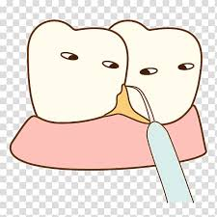
The Role of Dental Calculus and Other Local
Predisposing Factors

Slide 2
CONTENTS
Introduction
Definition
Synonyms
Classification & composition
Structure & formation of calculus
Theories of calculus formation
Calculus microbiology
Assesment & evaluation of dental calculus
Etological significance of calculus in periodontal dieases

Slide 3
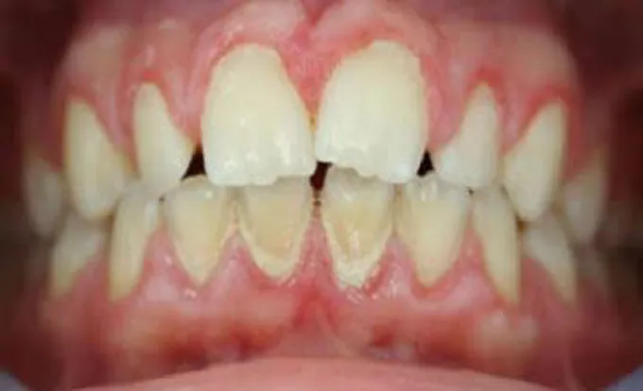
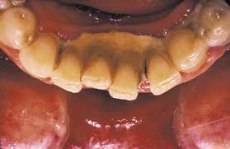
Introduction
Once the tooth erupts various materials get accumulated on tooth surfaces known as “ tooth accumulated deposits/materials”
Materia alba is an accumulation of microorganisms, desquamated epithelial cells, leukocytes, and a mixture of salivary proteins and lipids, with few or no food particles; it lacks the regular internal pattern observed in plaque. It is a yellow or grayish-white, soft, sticky deposit, and it is somewhat less adherent than dental plaque.
Soft deposits
Hard deposits
Acquired pellicle
Food debris
Materia alba
Microbial plaque
calculus
Pigmented deposits on the tooth surface are called dental stains.

Slide 4
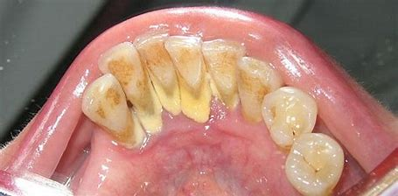
Definition
Calculus is a hard deposit that consists of mineralized bacterial plaque, that forms on the surfaces of natural teeth and dental prostheses.- Carranza
Dental calculus is defined as a mineralized dental plaque that is permeated with crystals of various calcium phosphates.- Schroeder
Calculus is a hard concretion that forms on teeth or dental prosthesis through calcification of bacterial plaque- glossary of periodontal terms
Dental calculus is a deposit of inorganic salts composed primarily of calcium carbonate and phosphate mixed with food debris & bacteria and desquamated epithelial cells.- greene

Slide 5
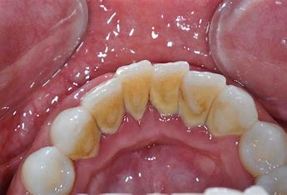
Synonyms
Tartar
Disambiguation
Calcis
Odontolithiais
Fossilized plaque

Slide 6
Classification
According to the location on tooth surface as related to adjacent free gingival margin
Supra gingival calculus
Sub gingival calculus
According to source of mineralization
Salivary calculus
Serumal calculus
According to initiation and rate of accumulation, calculus formers are classified as
Non-calculus formers
Slight calculus formers
Moderate calculus formers
Heavy calculus formers

Slide 7
Supragingival and Subgingival Calculus
Supragingival calculus is located coronal to the gingival margin and therefore is visible in the oral cavity.
It is usually white or whitish yellow in color; hard, with a claylike consistency; and easily detached
from the tooth surface.
After removal, it may rapidly recur, especially in the lingual area of the mandibular incisors.
The color is influenced by contact with substances such as tobacco and food pigments.
The two most common locations for the development of supragingival Calculus are the buccal surfaces of the maxillary molars and the lingual surfaces of the mandibular anterior teeth
Subgingival calculus is located below the crest of the marginal gingiva and therefore is not visible on routine clinical examination.
The location and the extent of subgingival calculus may be evaluated by careful tactile perception with a delicate dental instrument such as an explorer

Slide 8
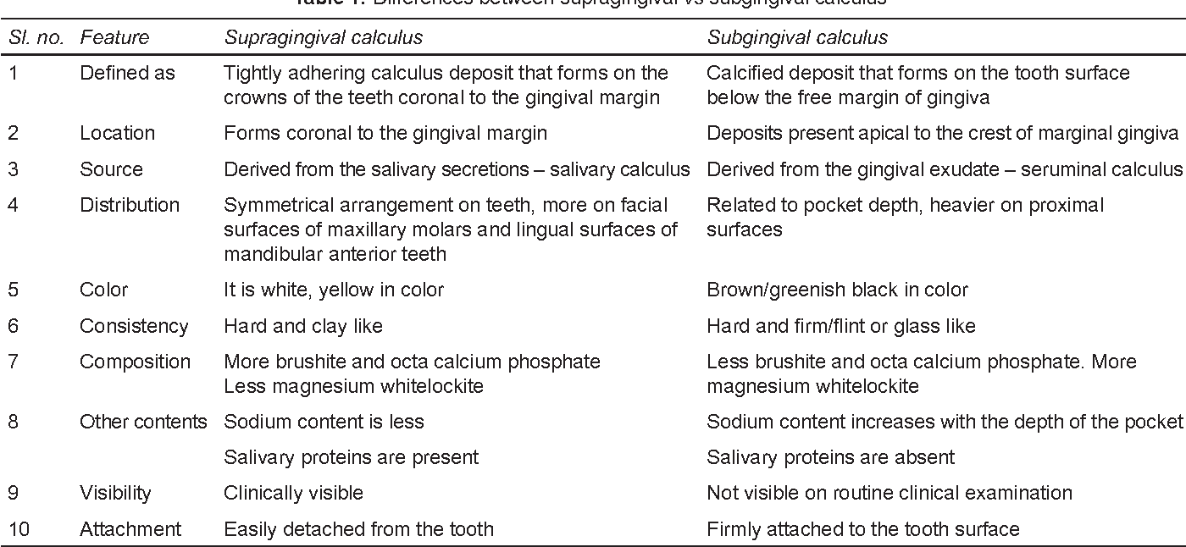

Slide 9

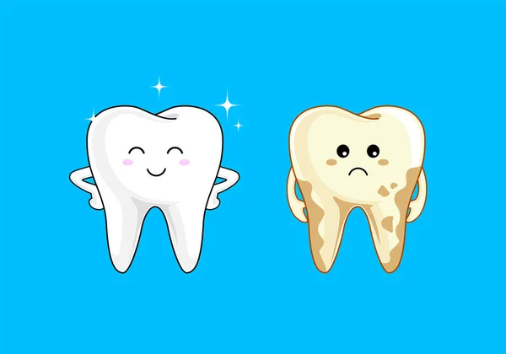
Inorganic Content
Dental calculus is primarily composed of inorganic components (70% to 90%) and the organic components constitute the rest.
The major inorganic proportions of calculus are approximately 76% calcium phosphate (Ca3[PO4]2), 3% calcium carbonate (CaCO3), 4% magnesium phosphate (Mg3[PO4]2), 2% carbon dioxide, and traces of other elements such as sodium, zinc, strontium, bromine, copper, manganese, tungsten, gold, aluminum, silicon, iron, and luorine.
At least two-thirds of the inorganic component is crystalline in structure.
The four main crystal forms and their approximate percentages are as follows: hydroxyapatite, 58%;
magnesium whitlockite, 21%;
octacalcium phosphate, 12%; and
brushite, 9%.
Two or more crystal forms are typically found in a sample of calculus. Hydroxyapatite and octacalcium phosphate are detected

Slide 10
Organic Content
The organic component of calculus consists of a mixture of protein–polysaccharide complexes, desquamated epithelial cells, leukocytes, and various types of microorganisms
Carbohydrates
1.9 to 9.1%
Salivary proteins 5.9to 8.2%
Amino acids
Lipids 0.2%
Free fatty acids, neutral fats, phospholipids,choloestrol
galactose, glucose, rhamnose, mannose, glucuronic acid, galactosamine, and sometimes arabinose, galacturonic acid,and glucosamine
The composition of subgingival calculus is similar to that of supragingival calculus, with some differences. It has the same hydroxyapatite content but more magnesium whitlockite and less brushite and octacalcium phosphate.
The ratio of calcium to phosphate is higher in subgingival calculus, and the sodium content increases with the depth of periodontal pockets.
These altered compositions may be attributed to fact that the origin of subgingival calculus is plasma, whereas supragingival calculus is partially composed of salivary constituents

Slide 11
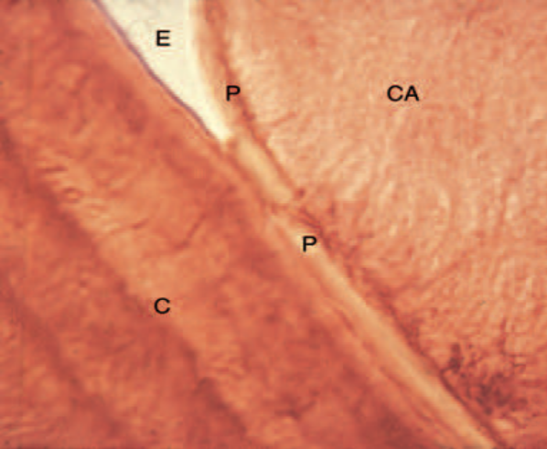
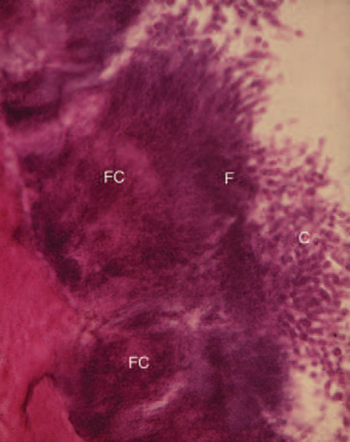
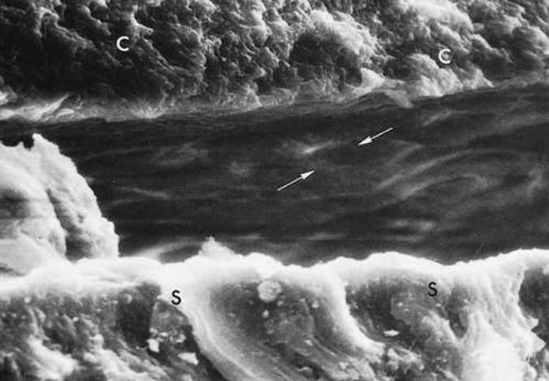
Attachment to the Tooth Surface
. Four modes of attachment have been described.
(1) Attachment by means of an organic pellicle on cementum is depicted in, and attachment on enamel
(2) Mechanical locking into surface irregularities, such as caries lesions or resorption lacunae,
(3) Close adaptation of the undersurface of calculus to depressions or gently sloping mounds of the unaltered cementum surface
(4) Penetration of bacterial calculus into cementum

Slide 12
FORMATION
Calculus is mineralized dental plaque. The soft plaque is hardened by the precipitation of mineral salts, which usually starts between the 1st and 14th days of plaque formation.
Calcification has been reported to occur within as little as 4 to 8 hours. Calcifying plaques may become 50% mineralized in 2 days and 60% to 90% mineralized in 12 days.
Early plaque contains a small amount of inorganic material, which increases as the plaque develops into calculus.
Plaque that does not develop into calculus reaches a plateau of maximal mineral content within 2 days. Microorganisms are not always essential in calculus formation,
Saliva is the primary source of mineralization for supragingival calculus, whereas the serum transudate called gingival crevicular fluid furnishes the minerals for subgingival calculus
The calcium concentration or content in plaque is 2 to 20 times higher than in saliva.
Early plaque of heavy calculus formers contains more calcium, three times more phosphorus, and less potassium than that of noncalculus formers, suggesting that phosphorus may be more critical than calcium for plaque mineralization.

Slide 13
Calcification entails the binding of calcium ions to the carbohydrate-protein complexes of the organic matrix and the precipitation of crystalline calcium phosphate salts.
Crystals form initially in the intercellular matrix and on the bacterial surfaces and finally within the bacteria.
The calcification of supragingival plaque and the attached component of subgingival plaque begins along the inner surface adjacent to the tooth structure.
For the initial mineralization process to occur, calcium phosphate supersaturation, certain membrane-associated components, and regulation of nuclear inhibitors are required
As calcification progresses, the number of filamentous bacteria increases, and the foci of calcification change from basophilic to eosinophilic
Separate foci of calcification increase in size and coalesce to form solid masses of calculus

Slide 14
Theories Regarding the Mineralization of Calculus
Booster mechanism
Epitactic theory
Inhibition theory
Bacterial theory
Enzymatic theory

Slide 15
The theoretical mechanisms by which plaque becomes mineralized can be stratified into two categories
1. Mineral precipitation results from a local rise in the degree of saturation of calcium and phosphate ions, which may be brought about in several ways:
A rise in the pH of the saliva causes the precipitation of calcium phosphate salts by lowering the precipitation constant.
The pH may be elevated by the loss of carbon dioxide and the formation of ammonia by dental plaque bacteria or by protein degradation during stagnation
Colloidal proteins in saliva bind calcium and phosphate ions and maintain a supersaturated solution with respect to calcium phosphate salts.
With the stagnation of saliva, colloids settle out, and the supersaturated state is no longer maintained, thereby leading to the precipitation of calcium phosphate salts
Phosphatase liberated from dental plaque, desquamated epithelial cells, or bacteria precipitates calcium phosphate by hydrolyzing organic phosphates in saliva, thereby increasing the concentration of free phosphate ions.

Slide 16
Esterase is another enzyme that is present in the cocci and filamentous organisms, leukocytes, macrophages, and desquamated epithelial cells of dental plaque.
Esterase may initiate calcification by hydrolyzing fatty esters into free fatty acids.
The fatty acids form soaps with calcium and magnesium that are later converted into the less-soluble calcium phosphate salts.
Seeding agents induce small foci of calcification that enlarge and coalesce to form a calcified mass.
This concept has been referred to as the epitactic concept or, more appropriately, as heterogeneous nucleation. The seeding agents in calculus formation are not known, but it is suspected that the intercellular matrix of plaque plays an active role.
The carbohydrate–protein complexes may initiate calcification by removing calcium from the saliva (chelation) and binding with it to form nuclei that induce the subsequent deposition of minerals

Slide 17
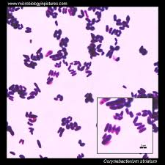
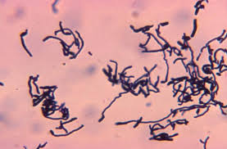
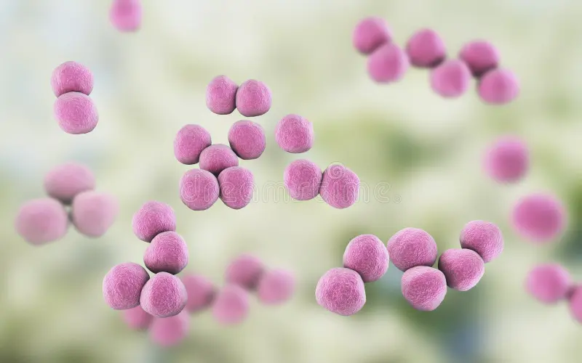
Role of Microorganisms in the Mineralization of Calculus
Mineralization of plaque generally starts extracellularly around both gram-positive and gram-negative organisms, but it may also start intracellularly.
Filamentous organisms, diphtheroids, and Bacterionema and Veillonella species have the ability to form intracellular apatite crystals
Mineralization spreads until the matrix and the bacteria are calcified.
Bacterial plaque may actively participate in the mineralization of calculus by forming phosphatases, which change the pH of the plaque and induce mineralization, but the prevalent opinion is that these bacteria are only passively involved and are simply calcified with other plaque components.

Slide 18
Etiologic Significance
The initiation of periodontal disease in young people is closely related to plaque accumulation, whereas calculus accumulation is more prevalent in chronic periodontitis found in older adults
Calculus does not contribute directly to gingival inflammation, but it provides a fixed nidus for the continued accumulation of bacterial plaque and its retention near the gingiva
Periodontal pathogens such as Aggregatibacter actinomycetemcomitans, Porphyromonas gingivalis, and Treponema denticola have been found within the structural channels and lacunae of supragingival and subgingival calculus.
Plaque initiates gingival inflammation, which leads to pocket formation, and the pocket in turn provides a sheltered area for plaque and bacterial accumulation.
The increased flow of gingival crevicular fluid associated with gingival inflammation provides the minerals that mineralize the continually accumulating plaque, resulting in the formation of subgingival calculus

Slide 19
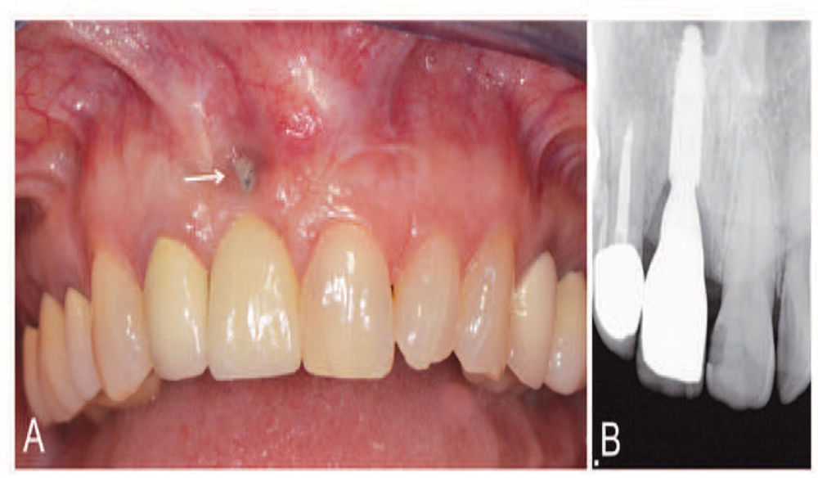
Other Predisposing Factors
Iatrogenic Factors
Deficiencies in the quality of dental restorations or prostheses are contributing factors to gingival inflammation and periodontal destruction.
Inadequate dental procedures that contribute to the deterioration of the periodontal tissues are referred to as iatrogenic factors.
Iatrogenic endodontic complications that can adversely affect the periodontium include root perforations, vertical root fractures, and endodontic failures that may necessitate tooth extraction.
Immediate implant placement in conjunction with extraction can contribute to an excessive labial and apical position of the implant, whereby the blood supply of surrounding osseous and gingival tissues is compromised, yielding to gingival fenestration or dehiscence

Slide 20
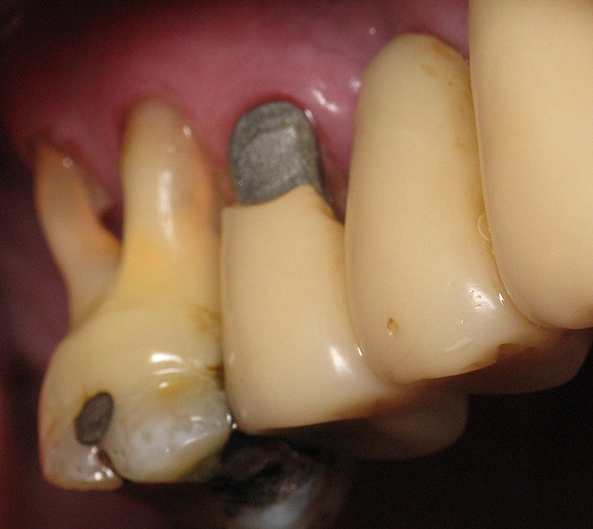
Margins of Restorations
Overhanging margins of dental restorations contribute to the development of periodontal disease by
(1) changing the ecologic balance of the gingival sulcus to an area that favors the growth of disease associated organisms (predominantly gram-negative anaerobic species and
(2) inhibiting the patient’s access to remove accumulated plaque.
A highly significant statistical relationship has been reported between marginal defects and reduced bone height.
The removal of overhangs allows for the more effective control of plaque, thereby resulting in a reduction of gingival inflammation and a small increase in radiographic alveolar bone Support
The location of the gingival margin of a restoration is directly related to the health status of the adjacent periodontal tissues.

Slide 21
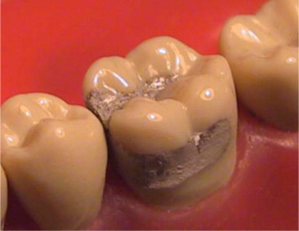
Numerous studies have shown a positive correlation between restoration margins located apical to the marginal gingiva and the presence of gingival inflammation.
Subgingival margins are associated with large amounts of plaque, more severe gingivitis, deeper pockets, and a change in the composition of the subgingival microflora that closely resembles the microflora noted in chronic periodontitis.
Sources of marginal roughness include grooves and scratches in the surface of acrylic resin, porcelain, or gold restorations separation of the restoration margin and the luting material from the cervical finish line, thereby exposing the rough surface of the prepared tooth ;
Subgingival margins typically have a gap of 20 to 40 μm between the margin of the restoration and the unprepared tooth.
Colonization of this gap by bacterial plaque undoubtedly contributes to the detrimental effect of margins placed in a subgingival environment.

Slide 22
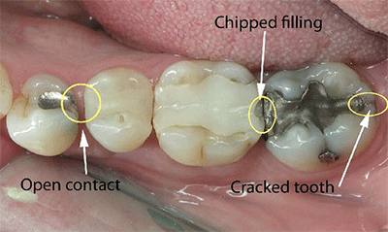
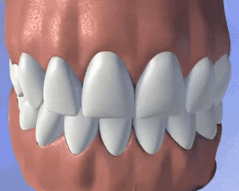
Contours and Open Contacts
Overcontoured crowns and restorations tend to accumulate plaque and handicap oral hygiene measures in addition to possibly preventing the self-cleaning mechanisms of the adjacent cheek, lips, and tongue
Restorations that fail to reestablish adequate interproximal embrasure spaces are associated with papillary inflammation.
The contour of the occlusal surface as established by the marginal ridges and related developmental grooves normally serves to deflect food away from the interproximal spaces.
The optimal cervico-occlusal location for a posterior contact is at the longest mesiodistal diameter of the tooth, which is generally just apical to the crest of the marginal ridge.
Overcontoured crowns are more detrimental to periodontal health than undercontoured crowns

Slide 23
Food impaction is the forceful wedging of food into the periodontium by occlusal forces. As the teeth wear down, their originally convex proximal surfaces become flattened, and the wedging effect of the opposing cusp is exaggerated.
Cusps that tend to forcibly wedge food into interproximal embrasures are known as plunger cusps. The interproximal plunger cusp effect may also be observed when missing teeth are not replaced and the
relationship between the proximal contacts of adjacent teeth is altered.
An intact proximal contact precludes the forceful wedging of food into the interproximal embrasure space, whereas a light or open contact is conducive to impaction
Posterior teeth with open contact and food impaction exhibit greater probing depth and clinical attachment loss than contralateral control sites without food impaction.
The classic analysis of the factors that lead to food impaction was made by Hirschfeld, who recognized the following factors:
uneven occlusal wear, opening of the contact point as a result of loss of proximal support or from extrusion, congenital morphologic abnormalities, and improperly constructed restoration

Slide 24
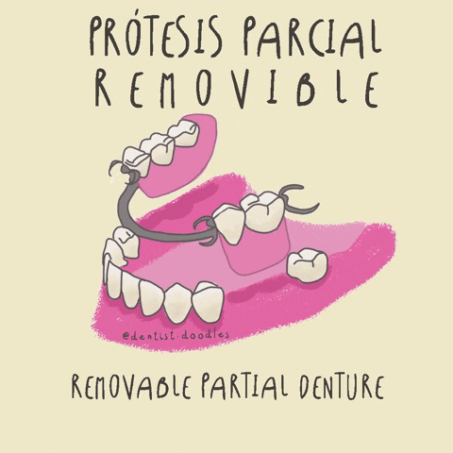
Design of Removable Partial Dentures
Several investigations have shown that, after the insertion of partial dentures, mobility of the abutment teeth, gingival inflammation, and periodontal pocket formation all increase.
This is because partial dentures favor the accumulation of plaque, particularly if they cover the gingival tissue.
Partial dentures that are worn during both night and day induce more plaque formation than those worn only during the daytime.
The presence of removable partial dentures induces not only quantitative changes in dental plaque but also qualitative changes, thereby promoting the emergence of spirochetal microorganisms

Slide 25
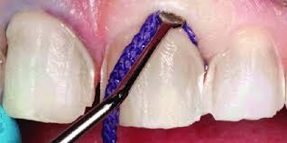
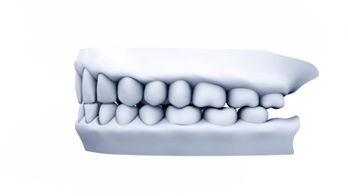
Restorative Dentistry Procedures
The use of rubber dam clamps, matrix bands, and burs in such a manner as to lacerate the gingiva results in varying degrees of mechanical trauma and inflammation.
The forceful packing of a gingival retraction cord into the sulcus to prepare the subgingival margins of a tooth or for the purpose of obtaining an impression may mechanically injure the periodontium and leave behind impacted debris that is capable of causing a foreign body reaction.
MALOCCLUSION
The irregular alignment of teeth as found in cases of malocclusion may facilitate plaque accumulation and make plaque control more difficult.
Uneven marginal ridges of contiguous posterior teeth have been found to have a low correlation with pocket depth, loss of attachment, plaque, calculus, and gingival inflammation
Roots of teeth that are prominent in the arch —such as in a buccal or lingual version or that are associated with a high frenal attachment and small quantities of attached gingiva—frequently exhibit recession

Slide 26
Periodontal Complications Associated With Orthodontic Therapy
Orthodontic therapy may affect the periodontium by favoring plaque retention, by directly injuring the gingiva as a result of overextended bands, and by creating excessive forces, unfavorable forces, or both on the tooth and its supporting structures.
Plaque Retention and Composition
excess bonding composite around the bracket base creates a critical site for plaque accumulation due to its rough surface texture and the
Presence of a distinct gap at the composite–-enamel interface. A complex community of bacterial plaque may be noted on the excess composite material within 2 to 3 weeks after bonding.
An increase in Prevotella melaninogenica, Prevotella intermedia, and Actinomyces odontolyticus and a decrease in the proportion of facultative microorganisms was detected in the gingival sulcus after the placement of orthodontic bands. More recently, A. actinomycetemcomitans was found

Slide 27
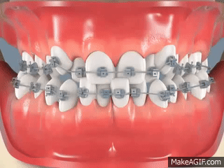
Gingival Trauma and Alveolar Bone Height
Orthodontic bands should not be forcefully placed beyond the level of attachment, because this will detach the gingiva from the tooth and result in the apical proliferation of the junctional epithelium with an increased incidence of gingival recession
The mean alveolar bone loss per patient for adolescents who underwent 2 years of orthodontic care during a 5-year observation period ranged between 0.1 and 0.5 mm
Tissue Response to Orthodontic Forces
Orthodontic tooth movement is possible because the periodontal tissues are responsive to externally applied forces. Alveolar bone is remodeled by osteoclasts that induce bone resorption in areas of pressure and by osteoblasts that form bone in areas of tension.
Although moderate orthodontic forces ordinarily result in bone remodeling and repair, excessive force may produce necrosis of the periodontal ligament and the adjacent alveolar bone.

Slide 28
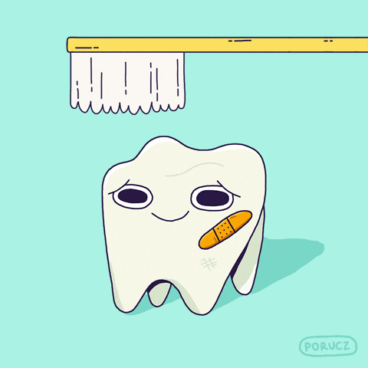
Toothbrush Trauma
Abrasions of the gingiva as well as alterations in tooth structure may result from aggressive toothbrushing in a horizontal or rotary fashion.
The deleterious effect of excessively forceful brushing is accentuated when highly abrasive dentifrices are used.
The gingival changes that are attributable to toothbrush trauma may be acute or chronic.
The acute changes vary with regard to their appearance and duration, from scuffing of the epithelial surface to denudation of the underlying connective tissue with the formation of a painful gingival ulcer
Diffuse erythema and denudation of the attached gingiva throughout the mouth may be a striking result of overzealous brushing.

Slide 29
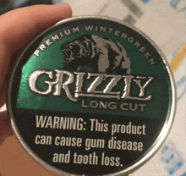
Smokeless Tobacco
Snuff and chewing tobacco constitute the two main forms of smokeless tobacco.
Snuff is a fine-cut form of tobacco that is available loosely packed or in small sachets.
Chewing tobacco is typically placed in the mandibular buccal vestibule for several hours, during which time saliva and dilute tobacco are periodically expectorated
benefits of chewing tobacco are those derived from nicotine, including improved mental alertness, diminished reaction time, muscle relaxation, and reduced anxiety and appetite.
Histologic features of oral leukoplakia associated with smokeless tobacco include
(1) a chevron-like pattern of hyperkeratosis with focal areas of inflammation and
(2) hyperplasia in the basal cell layer
can be concluded that the use of smokeless tobacco is associated with at least localized gingival recession, clinical attachment loss, leukoplakia, and possibly enhanced susceptibility to severe periodontitis

Slide 30

Radiation Therapy
Radiation therapy has cytotoxic effects on both normal cells and malignant cells. A typical total dose of radiation for head and neck tumors is in the range of 5000 to 8000 centigray (cGy);
1 cGy is equal to 1 radiation absorbed dose (rad) and equivalent to 50 to 80 Sieverts (Sv).
The total dose of radiation is usually given in partial incremental doses, and this is referred to as fractionation. Fractionation helps to minimize the adverse effects of radiation while maximizing the death rate for the tumor cells. Fractionated doses are typically administered in the range of 100 to 1000 cGy or 1 to 10 Sv per week.
Radiation treatment induces an obliterative endarteritis that results in soft tissue ischemia and fibrosis; irradiated bone becomes hypovascular and hypoxic.
Adverse effects of head and neck radiation therapy include dermatitis and mucositis of the irradiated area as well as muscle fibrosis and trismus, which may restrict access to the oral cavity. The mucositis typically develops 5 to 7 days after radiation therapy is initiated

Slide 31

The use of a chlorhexidine digluconate mouthrinse may help to reduce the mucositis.
Saliva production is permanently impaired when salivary glands that are located within the portal of radiation receive 6000 cGy (60 Sv) or more.
Xerostomia results in greater plaque accumulation and a reduced buffering capacity of saliva.
Dental and periodontal infections have the potential to be severe risks for patients who have been treated with head and neck radiation. The risk of osteoradionecrosis.
The administration of the combination of pentoxifylline with vitamin E as antioxidant therapy currently shows the greatest promise for revascularization and treatment of osteoradionecrosis sites

Slide 32
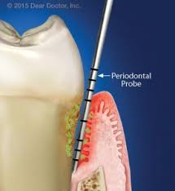
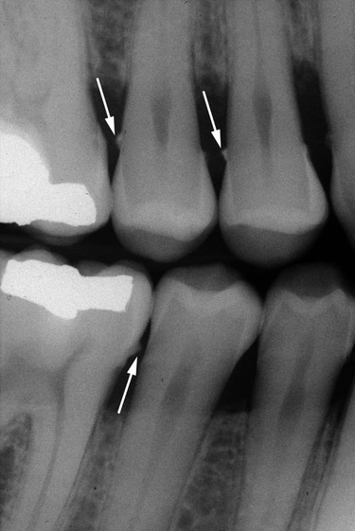
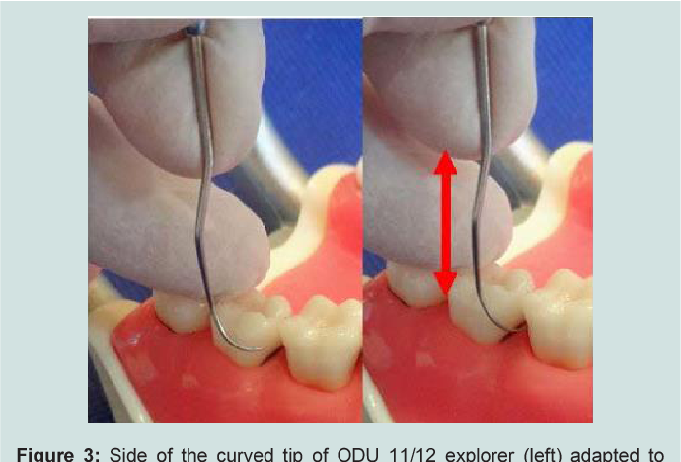
Assessment and evaluation of calculus
TACTILE EXAMINATION
RADIOGRAPHS
VISUAL EXAMINATION
Gentle air blast
Transillumination
Gingival tissue colour change
A stable, modified pen grasp held tightly to perceive the slightest vibration conducted through shank
A stable finger rest is established. instrument tip is inserted into pocket and on contact with calculus tip of the probe is advanced more apically till its termination on root surface
Interproximal calculus a highly calcified deposit, is detected as a radio opaque projections protruding into the interdental space

Slide 33
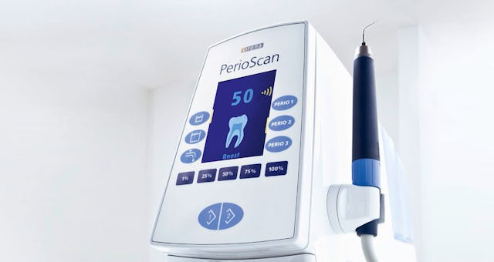
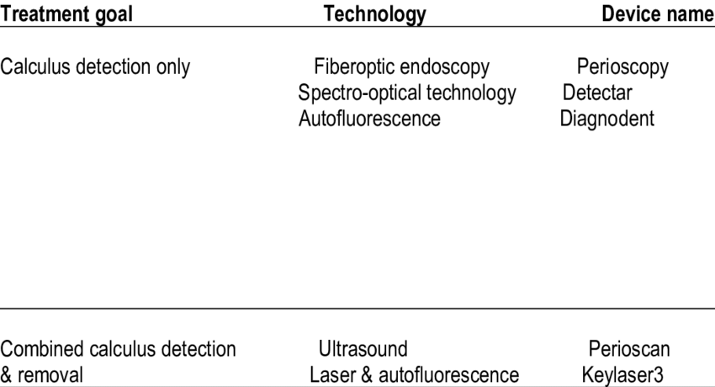
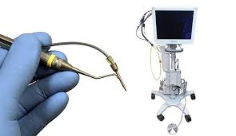
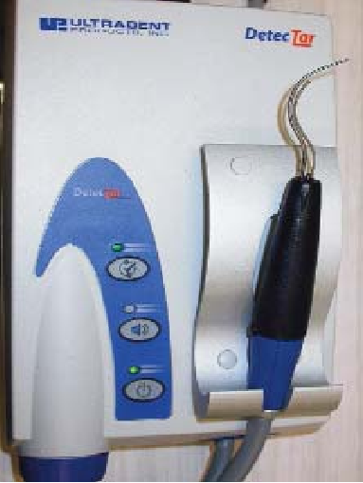
Advanced diagnostic aids

Slide 34



