Slide 1
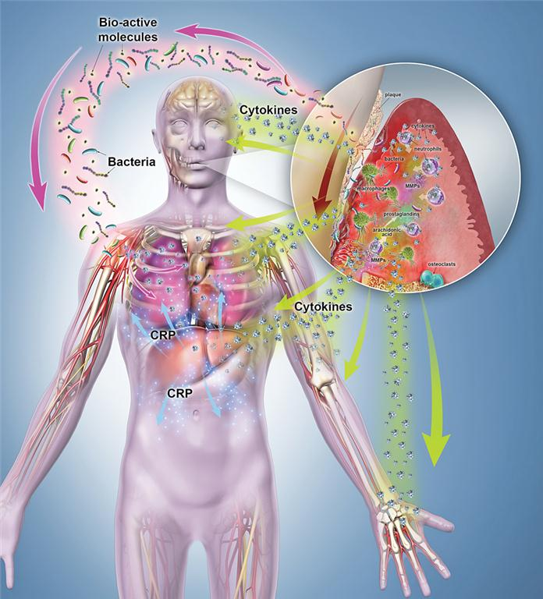
RESOLUTION
OF
INFLAMMATION

Slide 2
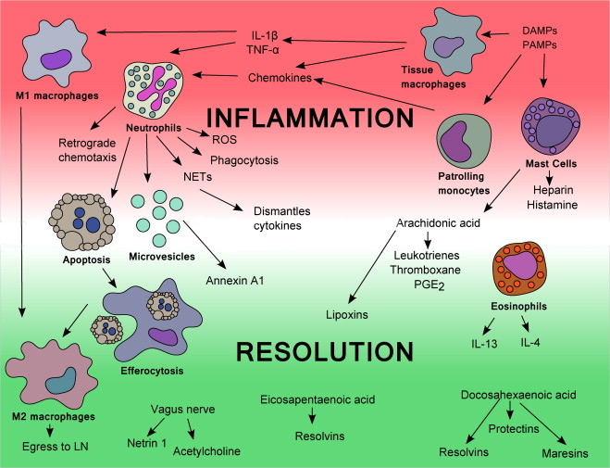
Notes:
Acute inflammation is temporally and spatially controlled to maintain
homeostasis. Four specialized lipid mediator families activate resolution
signals (lipoxins, resolvins, protectins, and maresins). Understanding
the crosstalk of resolution signals in tissue response to injury
has the potential to prevent and treat chronic diseases. The therapeutic
applications of inflammation resolution include prevention, maintenance,
and regeneration of periodontal tissues. This chapter presents
fundamental concepts of resolution as an active biochemical mechanism
regulated by endogenous/therapeutic lipid mediators

Slide 3
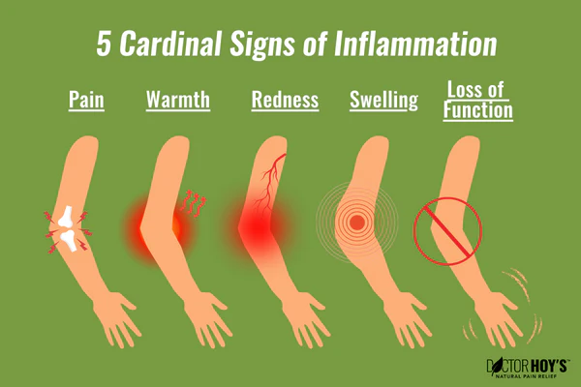
Four cardinal signs describing inflammation were identified: rubor et tumor cum calore et dolore (redness and swelling with heat and pain).
In 1958 Virchow’s investigations led to the understanding of the cellular basis of inflammation as a pathologic condition, and his observations led to the addition of a new cardinal sign, functiolaesa (loss of organ/tissue function).
The initiation of acute response is accepted to be a physiologic response occurring in vascularized tissues to defend the host and maintain homeostasis.
Inflammation, or “set on fire,” response is an active cellular and molecular response that aims to control challenge.
When activated, inflammation is protective to host tissues against stimuli, such as pathobionts, foreign bodies, toxic chemicals, and trauma

Slide 4
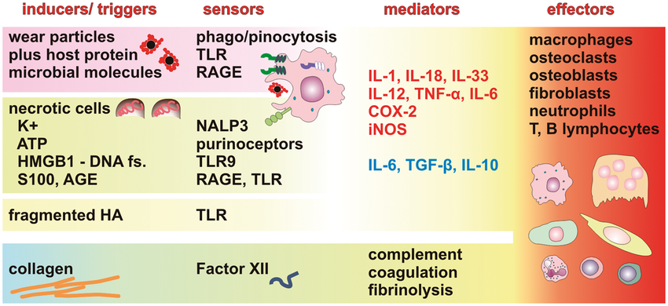
inflammation is characterized by increased blood flow, vascular dilation, increased vascular permeability, and cellular recruitment.
This response requires four biological components:
Inflammation inducers
Detecting sensors
Downstream mediators, and target tissues.
The type and degree of an inflammatory response are
dependent on the nature of the trigger (e.g., bacterial, viral, parasitic, or chemical) and its duration.
With specific cellular and molecular cues, inducers will be detected by antigen’s first line of response and activate a cascade of events that are tightly regulated.

Slide 5
The major sensors for the inflammatory response are epithelial cells and innate immune cells that migrate to the injured site
Polymorphonuclear leukocytes (PMNs) or neutrophils (named for their staining characteristics with hematoxylin and eosin) constitute the cellular arm of the first line of defense of the innate immune system.
PMNs are phagocytes with potent oxidative and nonoxidative killing mechanisms that combat bacteria.
PMN infiltration is followed by the entry of mononuclear cells, monocytes, and activated macrophages into the inflammatory site that clears cellular debris, bacteria, and apoptotic PMNs by phagocytosis without prolonging inflammation.
Together, innate cells trigger production of mediators that modulate the fate of inflammation.
Neutrophils, macrophages, dendritic cells, and mast cells produce low-molecular weight proteins called cytokines that control initiation, maintenance, and regulation of the amplitude and duration of the inflammatory response
Notes:
Mononuclear cells are found in peripheral blood,spleen,umbilical cord,bonemarrow.they include monocyres,lymphocytes,dendritic cells,nk cells

Slide 6
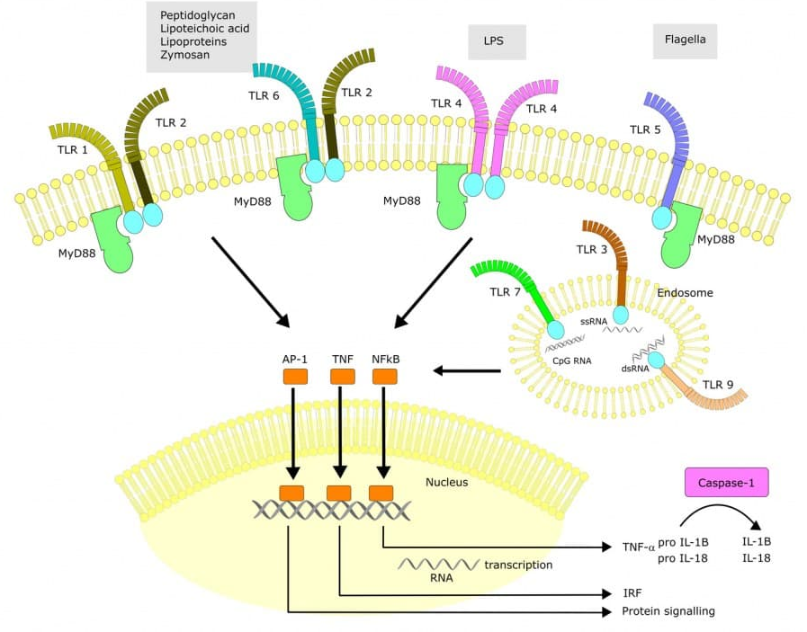
In response to bacteria conserved receptors, expressed in innate immune cells, Toll-like receptors (TLRs) sense molecules expressed on pathogens, such as pathogen-associated molecular patterns (PAMPs).
Binding of TLRs to specific pathogen molecules induces a signal that activates downstream events. In conseqence, the production of communicating molecules such as inflammatory cytokines, interleukins (ILs), chemokines (CXCs), and inflammatory lipid mediators (LMs) is key to signal an effective response.
The inflammatory mediators are communicators establishing the “language” responsible to signal bacterial clearance.
Notes:
Eg of LM’s are prostaglandins,lipoins,resolvins,maresin. They are named so because they are derived from poly unsaturated fattyacids.

Slide 7
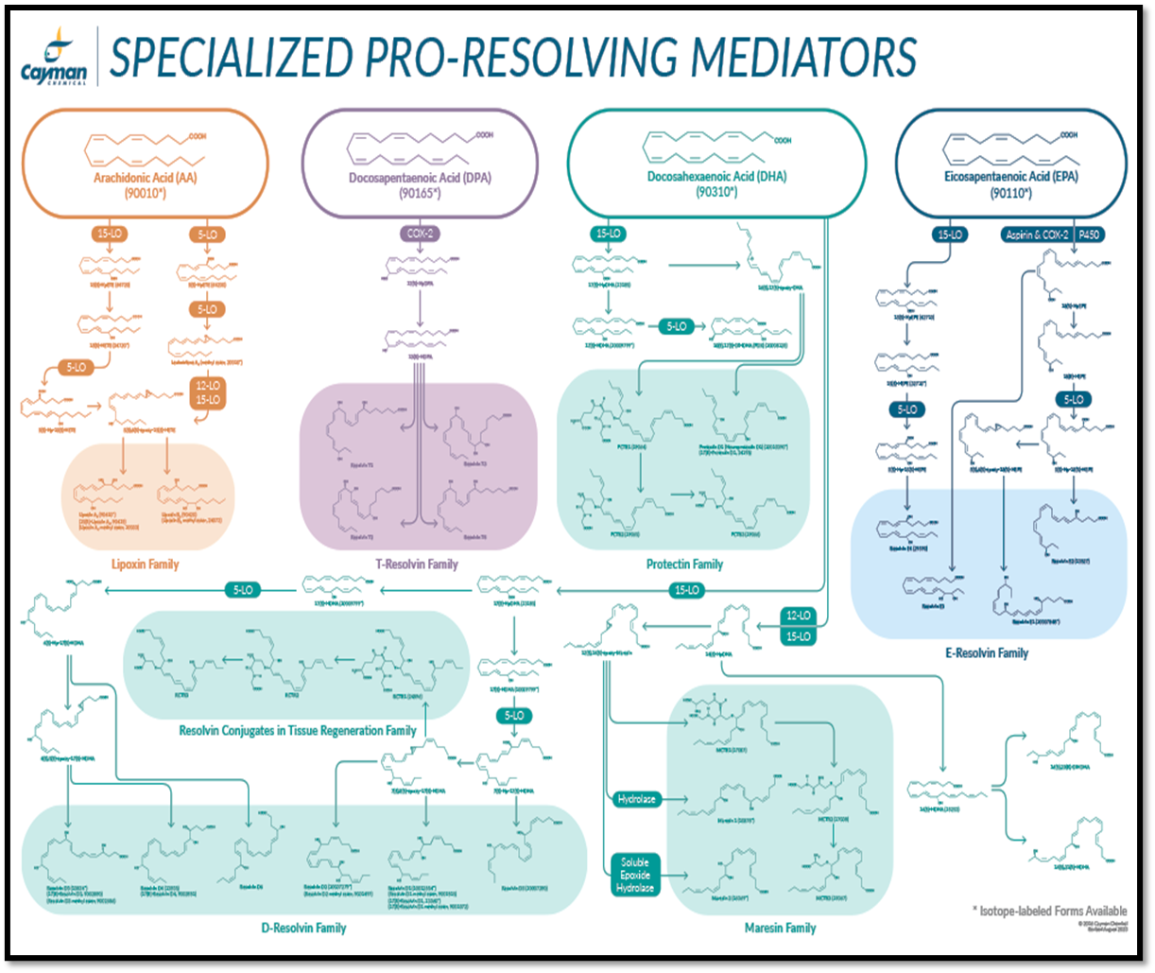
Although the inflammatory response is protective, unresolved inflammation is detrimental to tissue function, promoting dysbiosis.
Failure to resolve inflammation leads to chronic diseases including inflammatory bowel syndrome, type 2 diabetes, cardiovascular diseases, Alzheimer disease, cancer, and periodontal diseases.
Resolution of inflammation is an active biochemical mechanism regulated by mediators that switch gene expression, protein functions, and cells to return to homeostasis.
Among the mediators that regulate this process, specialized lipid mediators (SPMs) activate cells to start resolution.

Slide 8
Acute Inflammation Is Self-Limited
In the context of acute inflammation initiation, locally produced lipid mediators, such as prostaglandins, prostacyclin, leukotrienes, and thromboxanes, regulate major processes and act as autacoids
(short-lived molecules that act at the site of synthesis).
These lipid mediators are synthesized in a sequence of enzymatic activation when arachidonic acid (AA) is released from the cell membrane due to trauma or via cell-cell communication.

Slide 9
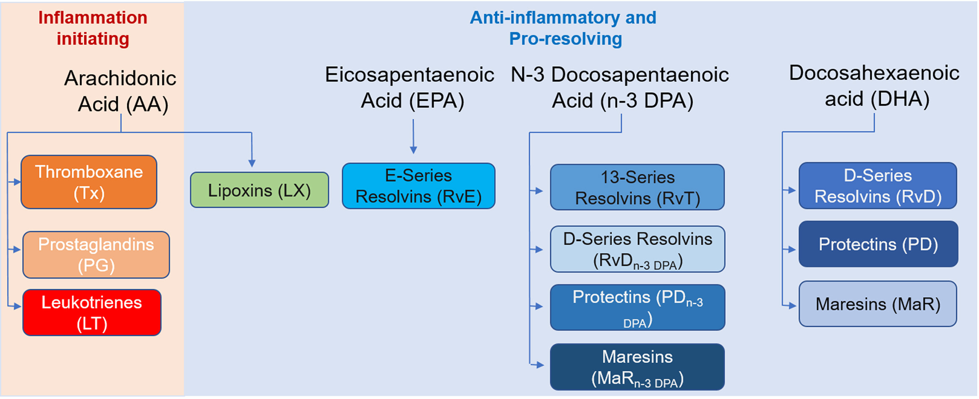
Structurally, most of the lipids of inflammation are eicosanoids (20-carbon chains) and act as endogenous precursors for biosynthesis of a chain of several molecules.
In fact, the enzyme phospholipase A2 releases AA from the phospholipid membrane.
This release constitutes the determining step in the generation of eicosanoids produced by most phagocytic and immune cells.
AA is rapidly converted into various potent lipid mediators with specific functions in a cell-specific manner by cyclooxygenases (COXs), lipoxygenases (LOs), or epoxygenases to yield prostaglandins, leukotrienes, and endoperoxides, respectively.

Slide 10
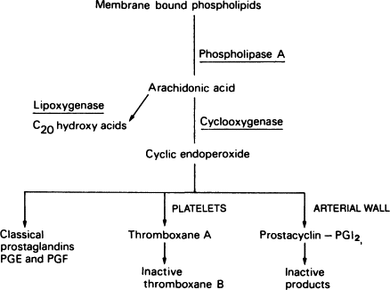
Arachidonic acids are metabolized mostly by two major enzyme pathways: COXs and LOs.
Whereas COX-1 (constitutively expressed COX) is responsible for basal levels of prostaglandin synthesis,
COX-2 (inducible COX) catalyzes the conversion of AA to lipid mediators during inflammation.
Prostaglandins have ten subclasses, of which, D, E, F G, H, and I are the most important in inflammation.
Specifically, PGE2 is generated via PGE synthase in leukocytes,
whereas PGI2 is generated by prostacyclin synthase in endothelial cells, and
thromboxanes (TXA) are generated via TXA synthase in platelets

Slide 11
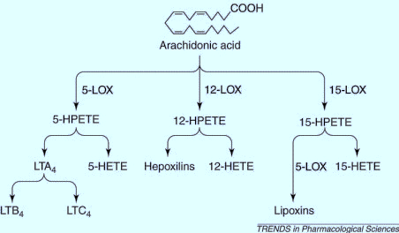
Lipoxygenases catalyze the formation of hydroxyeicosatetraenoic acids (HETEs) from AA leading to the formation of leukotrienes (LTs) and other biologically active compounds.
LTs are predominantly produced by inflammatory cells, including polymorphonuclear leukocytes, macrophages, and mast cells.
There are three distinct lipoxygenases (LOs) that are cell specific;
5-LO in myeloid cells,
12-LO in platelets, and 15-LO in epithelial/endothelial cells.
Cellular activation by pathogens and immune complexes results in activation of a sequential enzymatic reaction that includes cPLA2 and 5-LO.
5-LO converts released AA to the epoxide LTA4, which undergoes transformation by distinct pathways—one to generate LTB4, is a potent regulator of neutrophil chemotaxis and leukocyte adhesion to endothelial cells.
Notes:
and 15-LO are 12- and
15-HETE, which are further metabolized

Slide 12
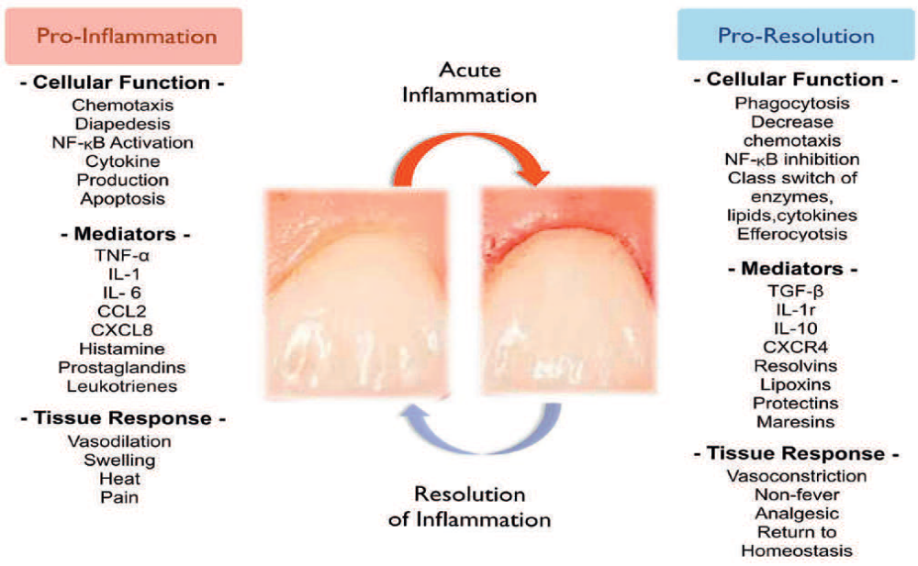
Notes:
Aspirin's antiplatelet mechanism involves irreversibly inhibiting the enzyme cyclooxygenase-1 (COX-1) in platelets, thereby preventing the production of thromboxane A2 (TXA2), a potent platelet activator, and reducing platelet aggregation.
Here's a more detailed explanation:
Aspirin and COX-1:
Aspirin works by acetylating (modifying) the COX-1 enzyme, which is crucial for synthesizing TXA2.
Thromboxane A2 (TXA2):
TXA2 is a key molecule involved in platelet activation and aggregation, meaning it helps platelets stick together and form clots.
Irreversible Inhibition:
Because platelets lack a nucleus and therefore cannot produce new enzymes, the inhibition of COX-1 by aspirin is irreversible, meaning the effect lasts for the lifespan of the platelet (about 7-10 days).
Consequences of COX-1 Inhibition:
By inhibiting COX-1 and TXA2 production, aspirin reduces the ability of platelets to clump together, thus preventing the formation of blood clots.
Other Effects:
While the primary mechanism is COX-1 inhibition, aspirin also has some anti-inflammatory effects by inhibiting COX-2, which is involved in the production of prostaglandins, another class of inflammatory molecules.

Slide 13
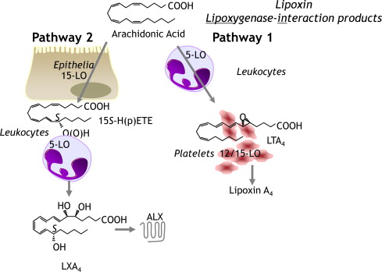
Derived from AA, lipoxins are natural pro-resolving molecules produced from endogenous fatty acids.
Lipoxins have strong dual anti-inflammatory and pro-resolution actions.
Lipoxins A4 and B4 were first isolated and identified as inhibitors of PMN infiltration and stimulators of nonphlogistic (non fever) recruitment of macrophages.
Three main pathways of lipoxin synthesis have been identified.
Lipoxins
In humans, sequential oxygenation of AA-derived lipids by 15-lipoxygenase and 5-lipoxygenase, followed by enzymatic hydrolysis, leads to LXA4, and LXB4 occurs in the mucosal tissues including the oral cavity, gastrointestinal tract, and airways.
While in blood vessels, 5-lipoxygenase biosynthesizes LXA4 and 12-lipoxygenase in platelets produce LXB4.
Lipoxin receptors are ubiquitously expressed by many cells, including neutrophils and monocytes.

Slide 14
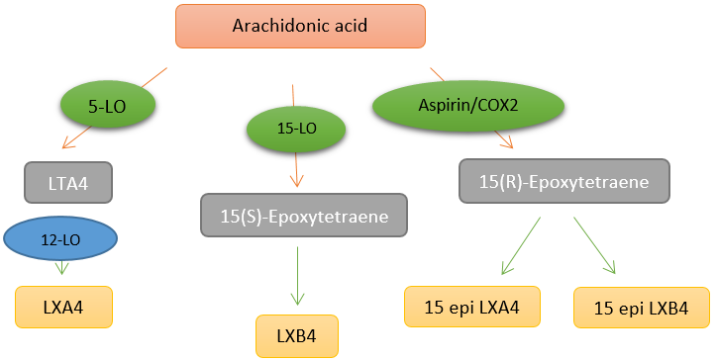
Aspirin triggers a third synthetic pathway.
Aspirin promotes acetylation of COX-2 leading to a change in COX-2 activity and the chirality of the products, which are termed aspirin triggered lipoxins (ATLs).
Cells that express COX-2 include vascular endothelial cells, epithelial cells, macrophages, and neutrophils.
In addition to the synthesis of lipoxin, aspirin also blocks prostaglandin synthesis by acetylation of COX-2 inhibiting inflammation
Notes:
ATL are a specific type of lipoxin, which are lipid mediators derived from the lipoxygenase (LO) pathway of arachidonic acid metabolism. They are also known as 15-epi-lipoxins.
How are they formed?
ATL biosynthesis requires the acetylation of cyclooxygenase-2 (COX-2) by aspirin, which then shifts the enzymatic activity from a prostaglandin endoperoxide synthase to a lipoxygenase.
What role do they play?
Lipoxins and ATL are known to be potent anti-inflammatory mediators that can help resolve inflammation. They exert their effects on leukocytes, vascular, and epithelial cells, promoting resolution of inflammation.
How do they work?
ATL are formed and released by cells expressing 5-LO, 12-LO, and 15-LO, such as leukocytes, platelets, vascular endothelium, and epithelium. They can stop inflammation and promote resolution by interacting with cells and activating specific receptors like FPR2/ALX.
What are the benefits?
ATL have shown promise in preclinical models of disease and some clinical trials, demonstrating their potential in treating various inflammatory conditions.
Examples of conditions:
ATL have shown potential in treating conditions like atherosclerosis, reperfusion injury, arthritis, gastrointestinal, renal, respiratory, and vascular inflammatory disorders, and periodontitis.
Aspirin's role:
Aspirin's ability to trigger ATL formation is an alternative mechanism of action that may contribute to its anti-inflammatory effects, distinct from its well-known antiplatelet activity.

Slide 15
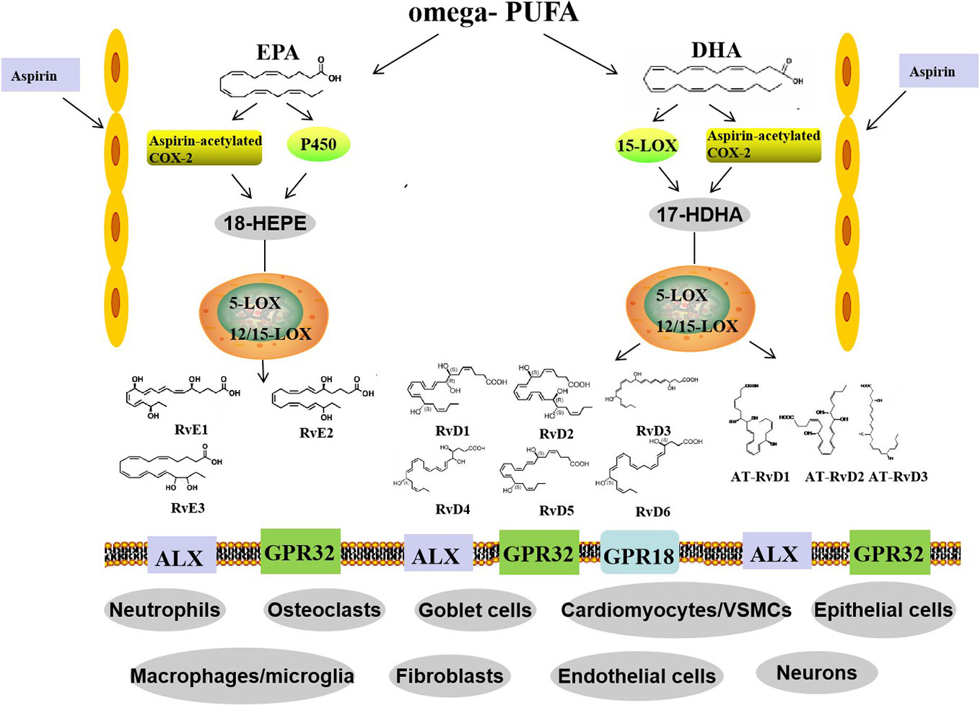
These lipid mediators are biosynthesized from the essential -3 polyunsaturated fatty acids (EPA and DHA) derived from the diet.
The two primary groups of the resolvin family have distinct chemical structures: E-series, obtained from EPA, and D-series, derived from DHA.
Vascular endothelium produces E-series resolvins via aspirin-modified COX-2 that converts EPA to 18R-hydroperoxyl eicosapentaenoic acid (18R-HPEPE) and 18S-hydroperoxyeicoapentaenoic acid (18S-HPEPE).
Neutrophils are rapidly taken up by human monocytes and metabolized to RvE1 and RvE2 by 5-lipoxygenase.
Resolvin E1 production increases in plasma of individuals taking aspirin or EPA, ameliorating clinical signs of inflammation.
Resolvins
Notes:
Resolvins are endogenous lipid mediators induced during the resolution phase of inflammation.

Slide 16
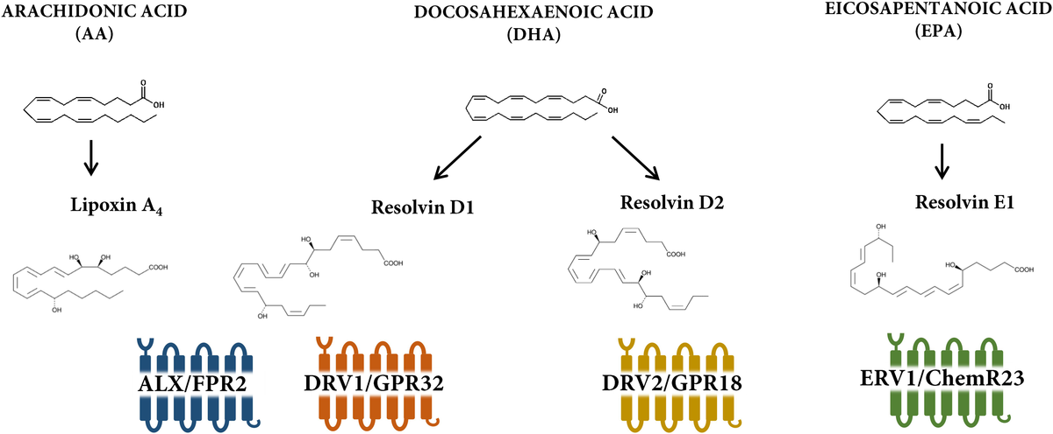
Similarly, DHA-derived D-series resolvins have been shown to reduce inflammation by decreasing platelet–leukocyte adhesion, and aspirin-triggered DHA conversion produces molecules with dual anti-inflammatory and pro-resolution function.
The interaction between resolvins and specific receptors modulates the fate of innate immune cells and counter regulates active inflammation.
Selective target sites for resolvins are G-protein coupled receptors (GPCRs).
ERV1 receptor (also known as ChemR23 or CMKLR1) is a GPCR expressed on monocytes and dendritic cells.
BLT1, a leukotriene receptor, is the resolvin E1 receptor on neutrophils.
Upon selective binding to the receptors, RvE1 attenuates NF-B signaling and production of pro-inflammatory cytokines including TNF-.α
D-series resolvins target GPR32 and ALX receptors expressed on platelets and PMN.

Slide 17
Activation of CB2 leads
to inhibition of P-selectin expression, decreasing PMN chemotaxis.
Resolvins induce hallmark functions of resolution of inflammation
including decreasing neutrophil migration, phagocytosis of apoptotic cells, and
increasing clearance of infection to activate tissue healing

Slide 18

Notes:
Here's a more detailed explanation:
PBMCs:
These are white blood cells (lymphocytes) isolated from the blood, primarily consisting of T cells, B cells, and monocytes.
T helper cells (CD4+ T cells):
A type of T cell that plays a crucial role in coordinating the immune response by interacting with other immune cells.
Th1 vs. Th2:
T helper cells can differentiate into two main subtypes, Th1 and Th2, each with distinct functions and cytokine profiles.
Th2 Phenotype:
Th2 cells are characterized by producing cytokines like IL-4, IL-10, and IL-13, which are involved in antibody production, eosinophil recruitment, and other processes associated with allergic reactions and parasitic infections.
Skewing:
When PBMCs are "skewed to the Th2 phenotype," it means that the immune response is biased towards this type of T helper cell activity, rather than a balanced Th1/Th2 response.

Slide 19
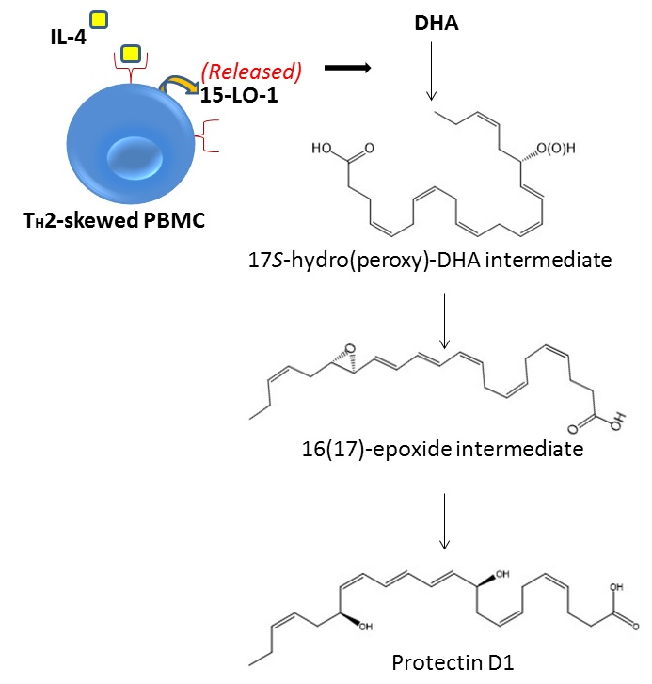
Protectins are also biosynthesized via a lipoxygenase-mediated pathway.
The pathway converts DHA into a 17S-hydroxyperoxidecontaining intermediate that is taken up by leukocytes and converted into 10,17-diHDHA, known as protectin D1 or neuroprotection.
The name accounts for the protective actions observed in neural tissues and within the immune system.
Human peripheral blood lymphocytes produce protectin D1 with a Th2 phenotype, thereby reducing TNF-α and interferon-β secretion, blocking T-cell migration, and promoting T-cell apoptosis.
Protectins reduce PMN transmigration through endothelial cells and enhance clearance (efferocytosis) of apoptotic PMN by human macrophages
Protectins
Notes:
Protectin D1 (PD1), a docosatriene produced from docosahexaenoic acid (DHA), is generated through TH2 skewing and promotes human T cell apoptosis via lipid raft clustering, suggesting a role in TH2-mediated inflammation and resolution.
Here's a more detailed explanation:
What is Protectin D1 (PD1)?
PD1 is a specialized pro-resolving lipid mediator derived from the omega-3 fatty acid DHA.
TH2 Skewing and PD1 Production:
PD1 is preferentially synthesized in peripheral blood mononuclear cells (PBMCs) that are skewed towards the TH2 phenotype, indicating that T-cell differentiation plays a role in activating the PD1 biosynthetic pathway.
Role of 15-Lipoxygenase-1 (15-LO-1):
The enzyme 15-LO-1, upregulated by TH2 cells, is crucial in the biosynthesis of PD1, adding oxygen atoms to DHA in a stereospecific manner.
Mechanism of Action:
PD1 promotes human T cell apoptosis via lipid raft clustering.

Slide 20
Macrophage mediators in resolving inflammation (maresins, or MaR) have been identified as primordial molecules produced by macrophages with homeostatic functions.
Macrophage phagocytosis of apoptotic cells triggers biosynthesis of RvE1, PD1, LXA4, and MaR1.
In sum, the local lipid mediators constitute a new genus of pro-resolving endogenous compounds with potent actions in treating immune-metabolic human diseases.
Conversion of DHA into 14-hydroxy diHA was identified via the 14-lipoxygenase cascade. MaR1 effectively stimulates efferocytosis of human cells and also has regenerative functions.
Lipoxin A4/ATL and resolving E1 have been shown to inhibit neutrophil recruitment, attenuate pro-inflammatory gene expression, and reduce the severity of colitis in a murine model.
PMN infiltration and lymphatic removal of phagocytes were observed when resolvin E1, D2, protectin D1, lipoxin, and maresin were used to ameliorate colitis.
Maresins
Notes:
Efferocytosis- the process by which apoptotic cells are recognized, engulfed, and cleared by phagocytic cells.
Essential for maintaining tissue homeostasis & preventing inflammation. done by macrophages & dendritic cells.

Slide 21
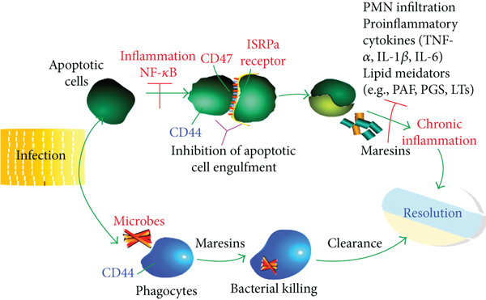
Notes:
Cd44- cell surface glycoprotein involved in cell adhesion, migration & signaling. It promotes cell proliferation, survival, and differentiation

Slide 22
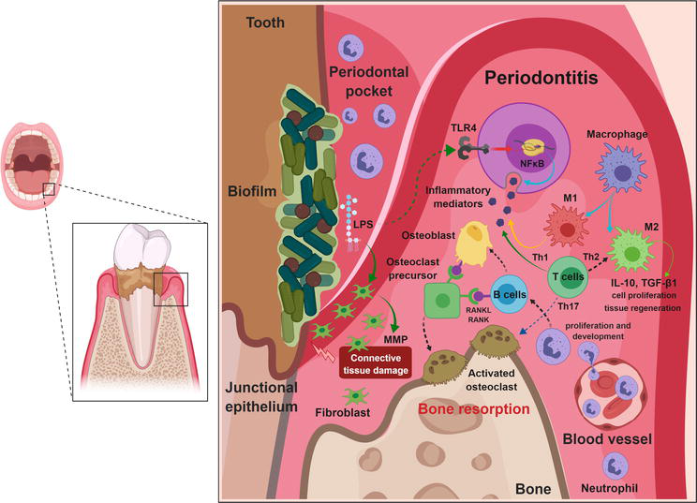
Unresolved Chronic Inflammation in Periodontal Diseases
Periodontal diseases are chronic inflammatory diseases initiated by dysbiosis and microbial biofilms.
In the case of gingivitis, acute inflammation is self-limited and reversible.
When the etiologic factor and modifiers are “removed,” the host returns to health.
When stimuli persist, unresolved inflammation causes chronic lesions, loss of attachment, disease progression, and tissue loss.
The host immune response functions as a protective mechanism, but continuous or exacerbated response risks the tissue integrity.
Notes:
M1 macrophages are induced by microbial agents (e.g., LPS) or by Th1 cytokines and show high phagocytic capacity and an increased expression of proinflammatory cytokines, costimulatory, and antimicrobial molecules. In contrast, M2 macrophages are induced by Th2 cytokines and secrete high levels of IL-10 and transforming growth factor beta 1 (TGF-β1).

Slide 23
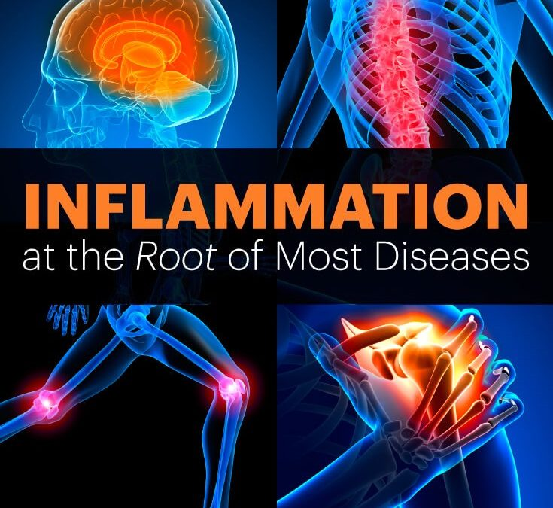
Host modifiers, including genetic, behavioral, anatomic, metabolic, and environmental, modulate the magnitude of the disease.
These factors influence the disease severity, progression, and response to therapy.
Classic studies in the 1980s showed that intake of anti-inflammatory medications prevented the progression of periodontal disease.
Instead of suppressing the system, resolution aims to enhance “good” inflammation to terminate the disease process.

Slide 24
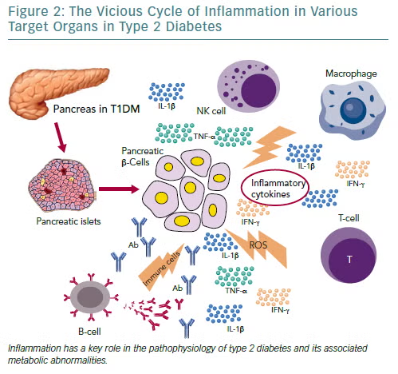
Type 2 Diabetes
Among many diseases that impact the population globally, type 2 diabetes is a major public health problem.
Inflammatory and metabolic diseases share common etiologic
factors modulating host response against antigenic challenge.
For example, inflammatory processes are shown to be exacerbated in type 2 diabetes.
Patients with diabetes are at two to three times greater risk for developing chronic periodontitis; high HbA1c levels have a significantly higher prevalence of periodontitis and more tooth loss when compared to controlled individuals.
Acute and chronic infections may adversely influence glycemic control.

Slide 25
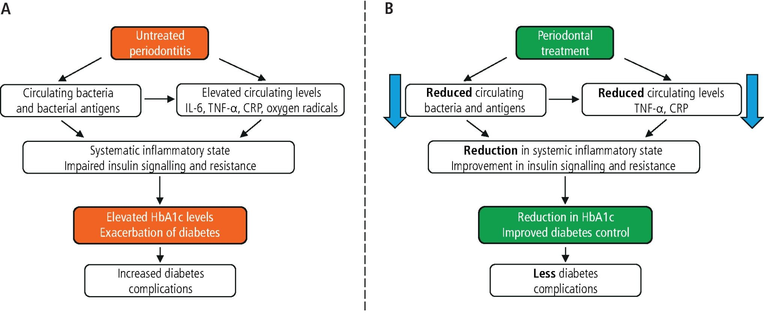
If effective treatment of periodontitis can modify glycemic control, as suggested in some studies, then periodontal therapy may play an important part in the patient management program that incorporates lifestyle changes and medications.
Among all type 2 diabetes patients, 50% of patients are treated with one or more additional drugs to achieve metabolic control.
Periodontal therapy can decrease HbA1c levels by 0.4% to 0.5% and definitely has a place in the management of diabetes due to control of inflammation.

Slide 26
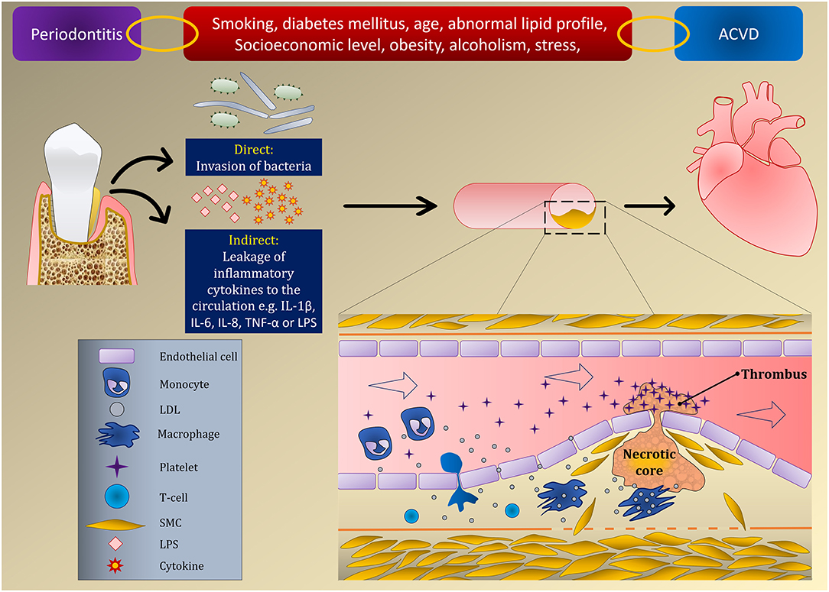
Common risk factors for cardiovascular diseases (CVDs) and periodontitis are thought to be related to increased systemic inflammation.
Diet, genetics, medications, and environmental factors influence the course of periodontal disease, and when combined they influence cardiovascular health status.
In cardiovascular diseases, active periodontal pathology was shown to be a contributing factor.7
This is partially influenced by lipid of low-density lipoproteins (LDL), which is known to initiate and propagate an inflammatory response.
Cytokines, such as INF-γ, are involved in the destabilization of the plaques because they lead to a decrease in matrix synthesis as well as matrix degradation.
In addition to cytokines, matrix metalloproteinase (MMP) enzymes are involved in controlling degradation; macrophages express MMPs, further contributing to degradation
Cardiovascular Diseases
Notes:
Cytokines and Atherosclerosis:
Cytokines are signaling molecules that play a crucial role in immune responses and inflammation, and they are also implicated in the development and progression of atherosclerosis, a condition characterized by plaque buildup in arteries.
IFN-γ and Plaque Destabilization:
Interferon-gamma (IFN-γ), a type of cytokine, is known to contribute to plaque destabilization in several ways:
Reduced Matrix Synthesis: IFN-γ can inhibit the synthesis of collagen and other extracellular matrix (ECM) components by smooth muscle cells (SMCs). The ECM provides structural support to the plaque, and its reduced synthesis weakens the plaque's stability.
Increased Matrix Degradation: IFN-γ can promote the expression of matrix metalloproteinases (MMPs), enzymes that degrade the ECM. This degradation further weakens the plaque and can lead to its rupture.
Thinning of the Fibrous Cap: The combination of reduced matrix synthesis and increased matrix degradation leads to thinning of the fibrous cap, the outer layer of the plaque that separates the lipid-rich core from the artery wall.
Consequences of Plaque Destabilization:
A weakened plaque with a thin fibrous cap is more prone to rupture, which can lead to the formation of blood clots and potentially cause a heart attack or stroke.
Other Cytokines:
Besides IFN-γ, other pro-inflammatory cytokines like TNF-α and IL-1β also contribute to plaque destabilization by promoting apoptosis (programmed cell death) of macrophages and SMCs, further weakening the plaque

Slide 27
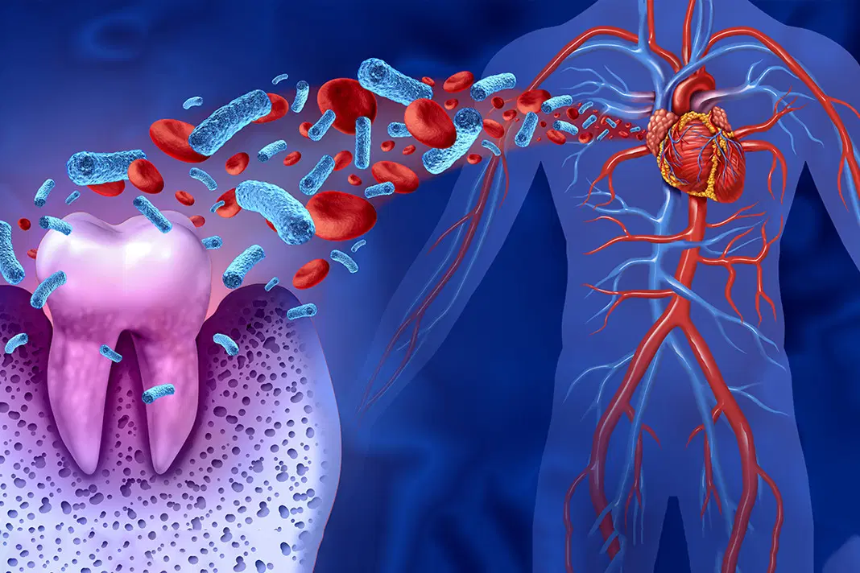
Periodontal inflammation causes a local and systemic cytokine response.
Pro-inflammatory effector molecules produced from the periodontal compartment are not only expressed locally, but they also disseminate to distant organs as noted by the increase in acute phase response (C-reactive protein and fibrinogen production) in the liver, which in turn promotes atherogenesis.
Gingival ulceration in periodontitis allows the migration of bacteria into the blood (bacteremia), which could provide a second inflammatory stimulus leading to atheroma formation.
Thus, direct actions from the pathobionts and indirect actions from inflammation aggravate the disease manifestation

Slide 28
Patients with periodontitis who have two or more known risk factors for atherosclerosis should be referred to the medical team for evaluation of atherosclerotic risk, which should include a physical examination and annual measurement of blood pressure and blood lipid profile.
Moreover, when periodontitis is newly diagnosed in patients with CVD, dentists and physicians should closely collaborate to optimize CVD risk reduction and periodontal care.
When the periodontal disease is treated/maintained, it is also notable that levels of inflammatory markers decrease, which in turn decreases vascular disease.
After adjusting for risk factors, such as smoking, diabetes, alcohol intake, obesity, and blood pressure, subjects with periodontal disease had a 1.14- to 1.59-fold greater risk of developing cardiovascular disease compared to those without periodontal disease

Slide 29
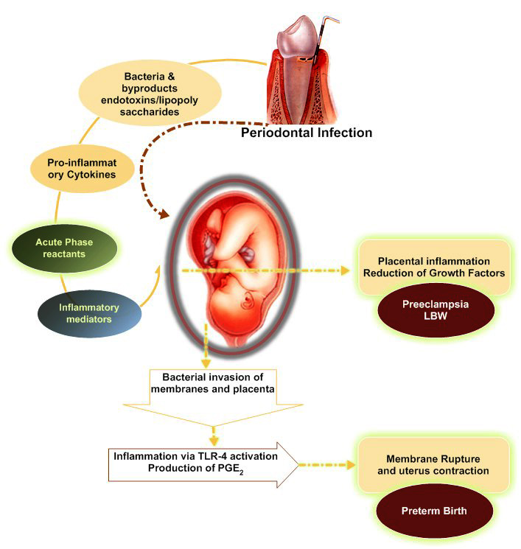
Pregnancy Outcomes
In healthy pregnancy, there is an exchange of nutrients and waste between the mother and the foetus via the umbilical cord.
Amniotic fluid levels of inflammatory mediators including prostaglandin E2 (PGE2), TNF-α, and IL-1 increase incrementally through pregnancy and reach a specific threshold that promotes uterine contraction, cervical dilation, and delivery.
Evidence suggests that periodontal pathogens interfere with homeostatic control of pregnancy.
Through DNA identification and immunodetection, both P. gingivalis and Aggregatibacter actinomycetemcomitans have been detected in the biopsies of placenta diagnosed with preeclampsia.
Most commonly, in amniotic fluids, F. nucleatum was identified in patients suffering from premature labor or low birth weight.

Slide 30
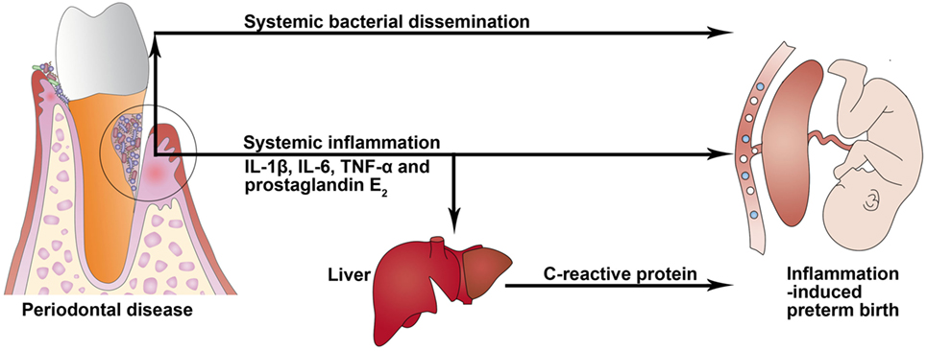
Besides the pathogens themselves, their virulent factors, including LPS, have been associated with triggering the same type of pathologic actions to the maternal placenta and fetus.
Localized elevated levels of maternal IL-1, IL-6, PGE2, and TNF- α in the amniotic fluid have been associated with pregnancy alterations, including premature birth.
Other pregnancy complications have been associated with elevated levels of CRP including intrauterine growth restriction and preeclampsia.
Notes:
Studies suggest that pathogens can gain access to the amniotic cavity by ascending from the vagina and the cervix, by hematogenous dissemination through the placenta, by the accidental inoculation at the time of invasive procedures (amniocentesis), and by retrograde spread through the fallopian tubes.

Slide 31


