Slide 1


Slide 2
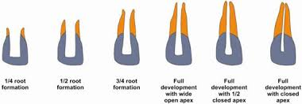
PULP THERAPY FOR YOUNG PERMANENT TEETH
Dr.Suzan Sahana
Professor
Paediatric and Preventive Dentistry

Slide 3
CONTENTS
INTRODUCTION
DIAGNOSIS AND CASE ASSESSMENT
TREATMENT MODALITIES FOR TEETH WITH OPEN APEX
APEXOGENESIS
APEXIFICATION
ONE VISIT APEXIFICATION
TOOTH RESTORATION FOLLOWING APEXIFICATION
PULP REVASCULARISATION
CONCLUSION
REFERENCES

Slide 4
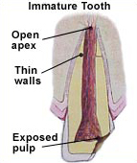
YOUNG Permanent teeth
Immature
Root & apical closure not completed
2 to 3 yrs following eruption
Mature– after apical closure

Slide 5
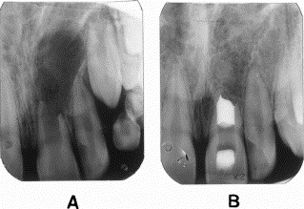
Reaction to caries and traumatic injuries
Blunderbuss canal
Conventional RCT – not possible

Slide 6
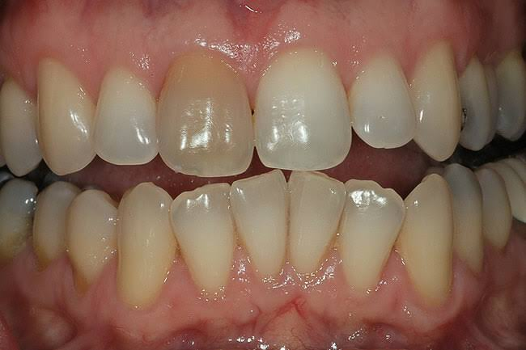
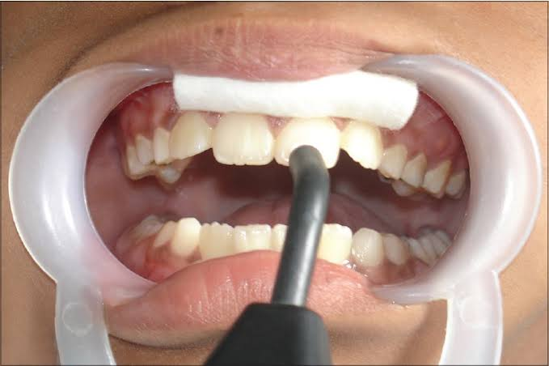
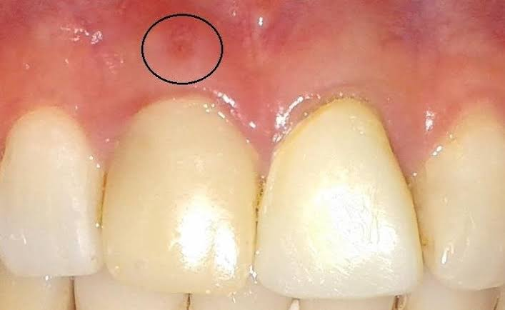
DIAGNOSIS AND CASE ASSESSMENT
History of subjective symptoms
Careful clinical and radiographic examination
Diagnostic tests

Slide 7
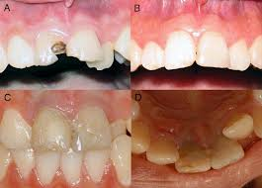
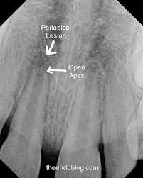
Vital teeth
Non vital teeth
Discolored
TOP
Periapical changes
Negative response to vitality test
Normal color
Not sensitive to percussion
r/g normal
Positive

Slide 8
TREATMENT MODALITIES FOR TEETH WITH OPEN APEX
vital
Non vital
Apexogenesis
Apexification
Pulp
revascularisation
IPC,DPC
PULPOTOMY
CVEK
CERVICAL
RCT

Slide 9
Apexogenesis –
Marshall
The treatment of a vital pulp by capping or
pulpotomy in order to permit continued closure of the open apex and growth of the root
Indications-
Traumatized / pulpally involved vital permanent tooth with incomplete root formation
No H/O spontaneous pain
Absence of sensitivity on percussion
No hemorrhage
Normal radiographic appearance

Slide 10
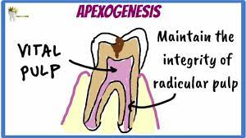
Mechanism Of Continued Root Formation
Vitality of HERS is important for continued formation of the apical portion of the root
Mesenchymal cells in the periapical region and as a result of the organizing influence of HERS may differentiate into formative cells which forms the apex

Slide 11
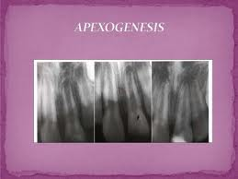
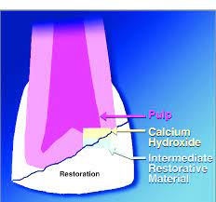
Partial pulpotomy (Cvek)
Shallow
Rationale
Preserve vital pulp
Continued normal root closure

Slide 12
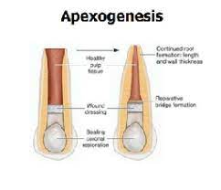
Indications
Young permanent tooth owing to its less cellular activity than the primary
Mechanical, Carious, Traumatic exposure with incomplete apical closure
Contraindications
-Diffuse inflammation
Not recommended for primary teeth
-

Slide 13
Partial pulpotomy
Mejare and Cvek 1993
To treat permanent teeth
Procedure
Anesthesia, isolation
Carious material removed and then coronal pulp amputation is performed
Hemostasis attained, temporary restoration placed
Tooth should remain asymptomatic during recall visit and radiographically secondary dentin formation to be noted

Slide 14
Harrison and Raskun (1985) - apical closure with continued root development as apexogenesis with vital pulp
It consists of the continued formation of the root in teeth with vital pulpal tissue remnants.
Rationale
Preserve vital pulp
Continued normal root closure

Slide 15
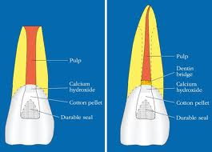
Apexogenesis
Deep pulpotomy
Ca(OH) – placed over vital pulp stumps
Radiographic and clinical follow up to predict calcific barrier formation
Barrier not observed– apexification should follow

Slide 16
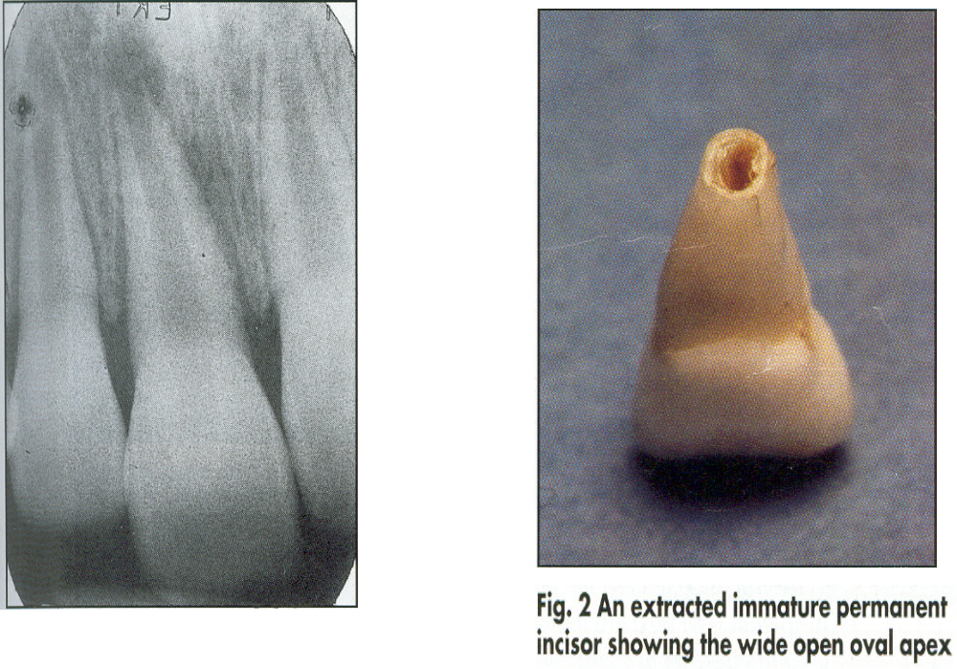
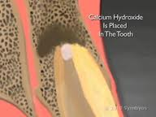
Apexification
Is a method of inducing development of the root apex of an immature pulpless tooth by formation of osteocementum / bone like tissue (COHEN)
Treatment of immature nonvital teeth either exposed or nonexposed pulps

Slide 17
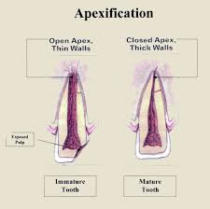
Objectives
1) Should Induce Root End Closure at the apices of immature roots,as evidenced by periodic radiographic evaluation
2) Post treatment adverse clinical signs or symptoms - prolonged sensitivity, pain / swelling should not be evident.
3) No evidence of abnormal canal calcification, internal or external root resorption, lateral root pathosis / breakdown of periradicular supporting tissues during or following therapy.

Slide 18
Indications
Non vital permanent teeth with incompletely formed roots.

Slide 19
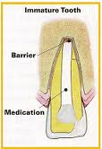
Materials used
ZOE
Tricalcium phosphate and β- tricalcium phosphate
Resorbable tricalcium phosphate
Collagen calcium phosphate gel
Ceramic
Ca(OH)2
Leaving canals empty
MTA
Iodoform containing paste

Slide 20
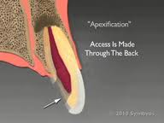
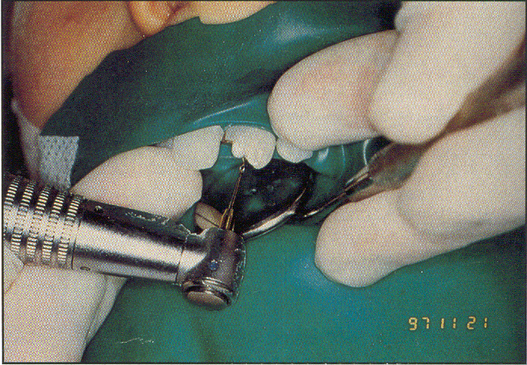
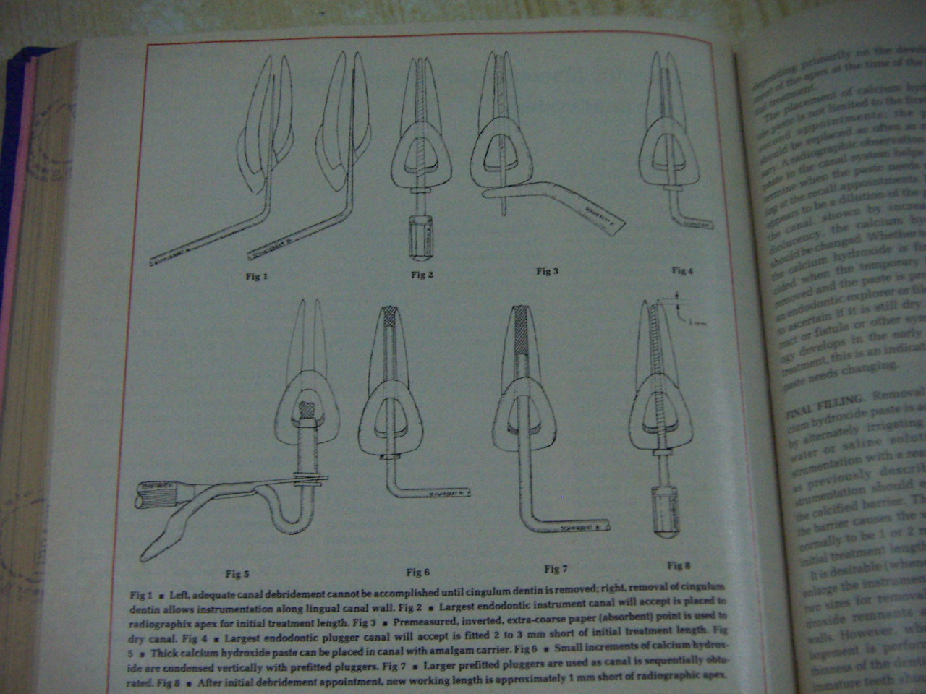
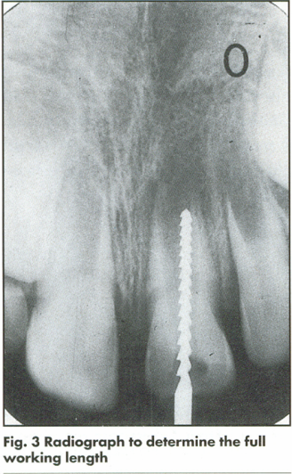
APEXIFICATTION TECHNIQUE:
Obtain anesthesia and isolation
Access:
-Straight line access
Instrumentation:
-Working length is determined
- 2mm short of radiographic apex
-Careful debridement is a primary factor to induce apical closure
- irrigation with saline
-Canals enlarged upto a size 120-140

Slide 21
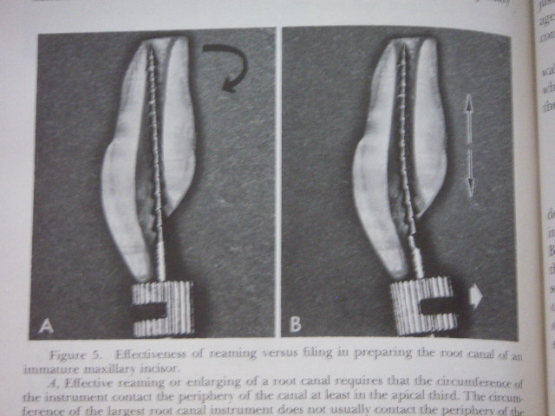
Filing motion is needed
Avoid over instrumentation

Slide 22
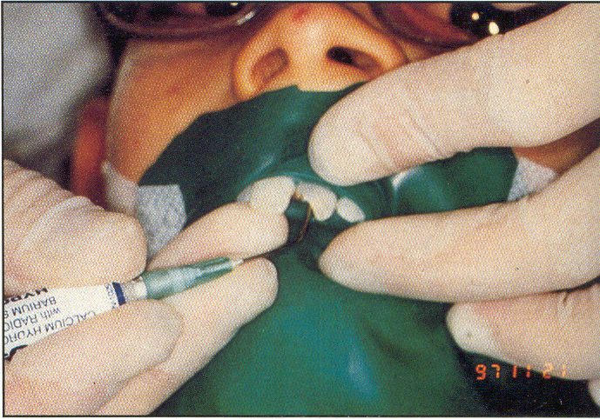
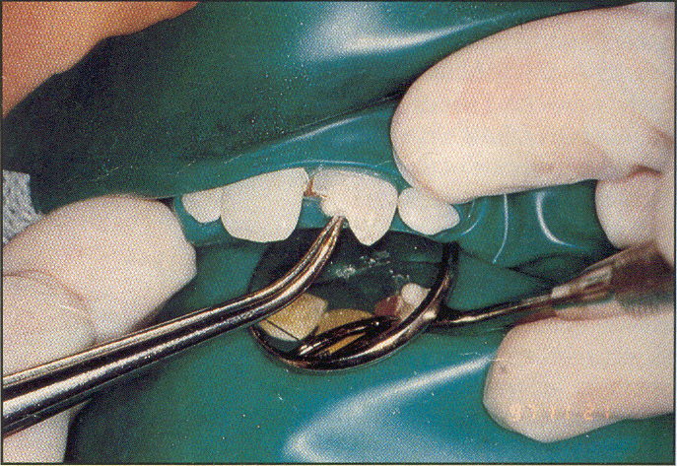
Drying of the canals:
-An inverted coarse paper point is desirable
-A dry pre fitted paper points
Introduction of pure calcium hydroxide paste:
- powder mixed with saline, barium sulphate can be added to improve opacity.
- A Carrier with a teflon or plastic sleeve is recommended

Slide 23
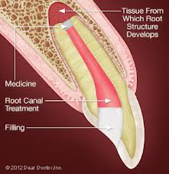
Follow up:
- ca(OH) redressed every 3-4 months
- R/g to check extent of apical development
- 6- 18 months for calcific barrier formation.
- GP point to check barrier followed by R/g evidence

Slide 24
APICAL CLOSURE INDUCTION BY Ca(OH)2:
Frank (1966) described 4 types of repair:
-Apex closure with definite , although minimal canal recession
-Apex closure without root space change
3. -Radiographically apparent bridge formation immediately coronal to apex
4. -No radiographic evidence of apical closure, however, upon instrumentation, definite apical stop

Slide 25
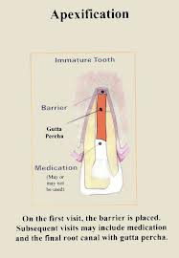
Radiographic evidence of success
Formation of calcific bridge
Continued apical development
Absence of internal resorption and periapical radiolucency

Slide 26
How often the dressing should be changed?
Chawla : Place the paste only once and wait for radiographic evidence of barrier formation
Chosak et al:Ca (OH)2 only required to initiate the healing reactions
Others:
-Should be replaced only when symptoms develop or the material appears to have washed out of the canal
Abbots :Regular replacement is advantageous

Slide 27
Time required for apical barrier formation:
Sheey and Roberts : 5- 20 mnths
Finucane and Kinirons: 34.2 weeks ( range :13-67 weeks)
Cvek : presence of infection delays the closure
Kleier and Barr : 5 – 15.9 mnths delay in the presence of infection

Slide 28
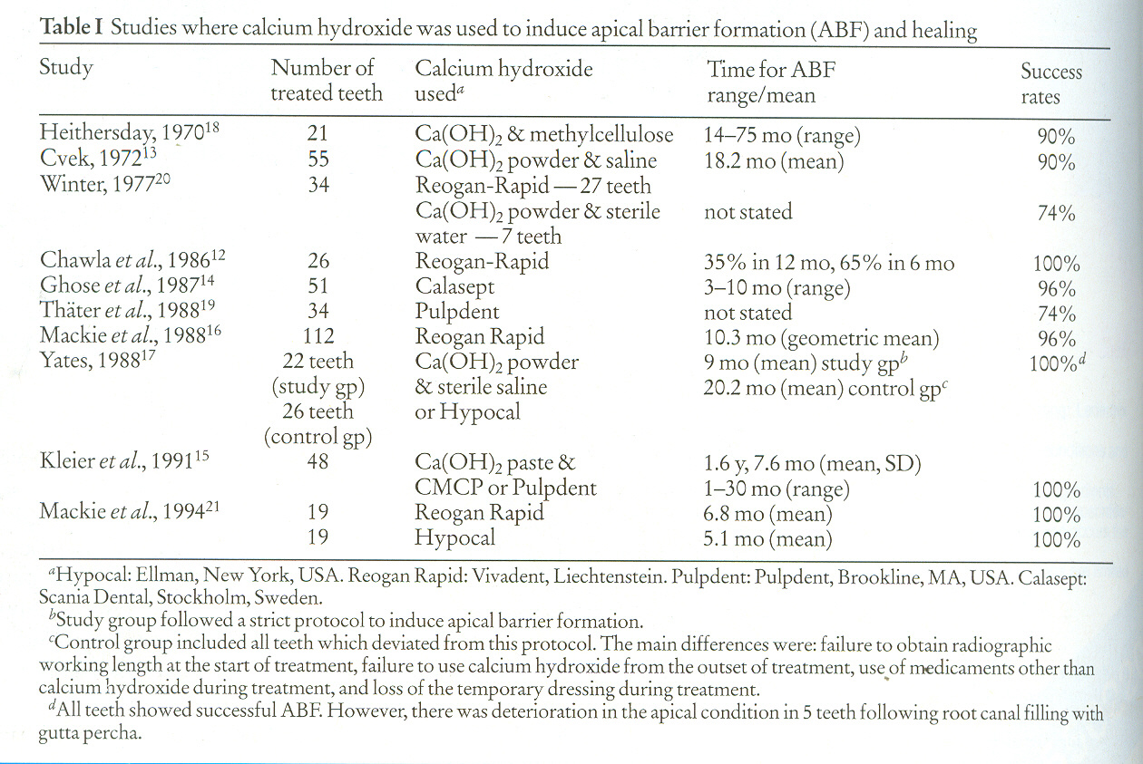

Slide 29
Composition Of Apical Barrier
Mineralized tissue / barrier formed is composed of
Osteocementum
Osteodentin
Bone
Combination
Cementum along walls of root canal even at the junction of middle and cervical 3rd (Steiner 1971).

Slide 30
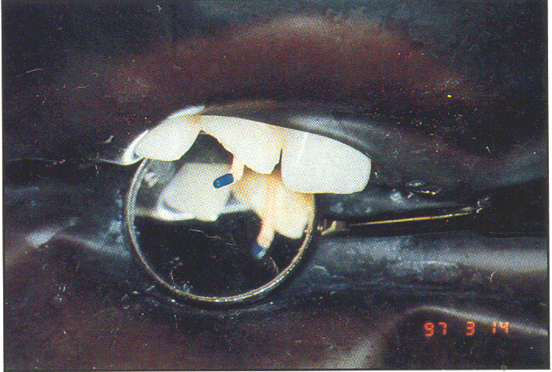
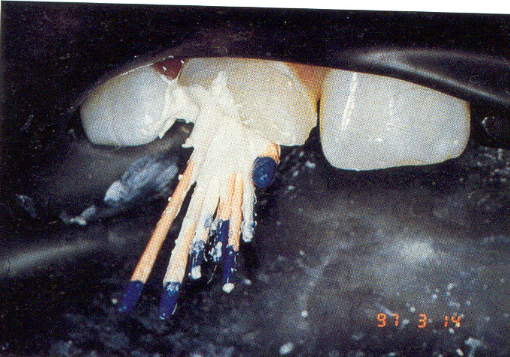
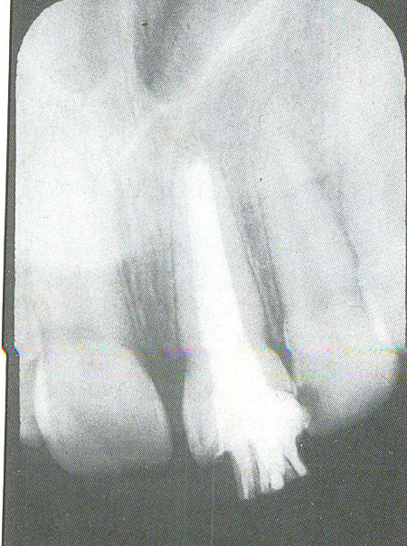
Conventional RCT following ABF

Slide 31
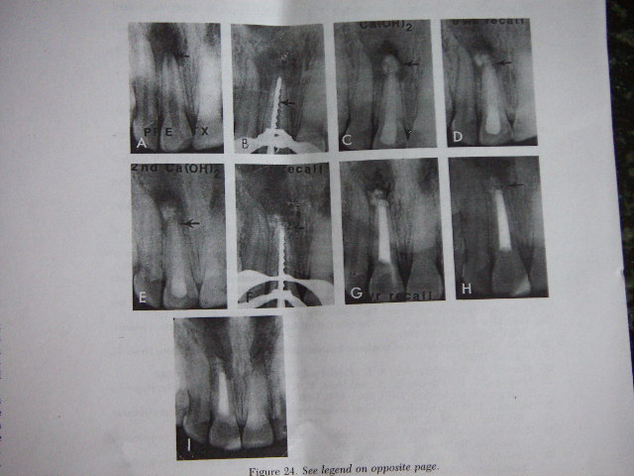

Slide 32
Disadvantages of Apexification:
- Long time span with multiple appointments
-Patient compliance may be poor
-Reinfection and prolongation or failure of treatment

Slide 33
One visit Apexification :
One visit Apexification :
-Non surgical condensation of a biocompatible material into the apical end of the root canal( Morse et al)
Materials:
-Tricalcium phosphate
-Ca (OH)2
-Freeze dried bone and Freeze dried Dentin
-A Resorbable ceramic (Ca Po4 ) Koings etal
-Matrix for invasion of blastic cells
-Allows for cellular defferentiation and proliferation
- Permits deposition of hard tissues

Slide 34
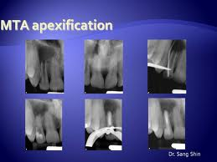
One visit Apexification
Mineral trioxide aggregate: 1993, 1998 (FDA Approval)
- Fine hydrophilic particles of Tricalcium silicate, Tri calcium aluminate,Tricalcium oxide and silicate oxide
-PH of 12.5, Antibacterial properties
-low solubility, radiopacity greater than dentin
-good sealability, biocompatibility
-Stimulate the cytokine release and the production of interleukins

Slide 35
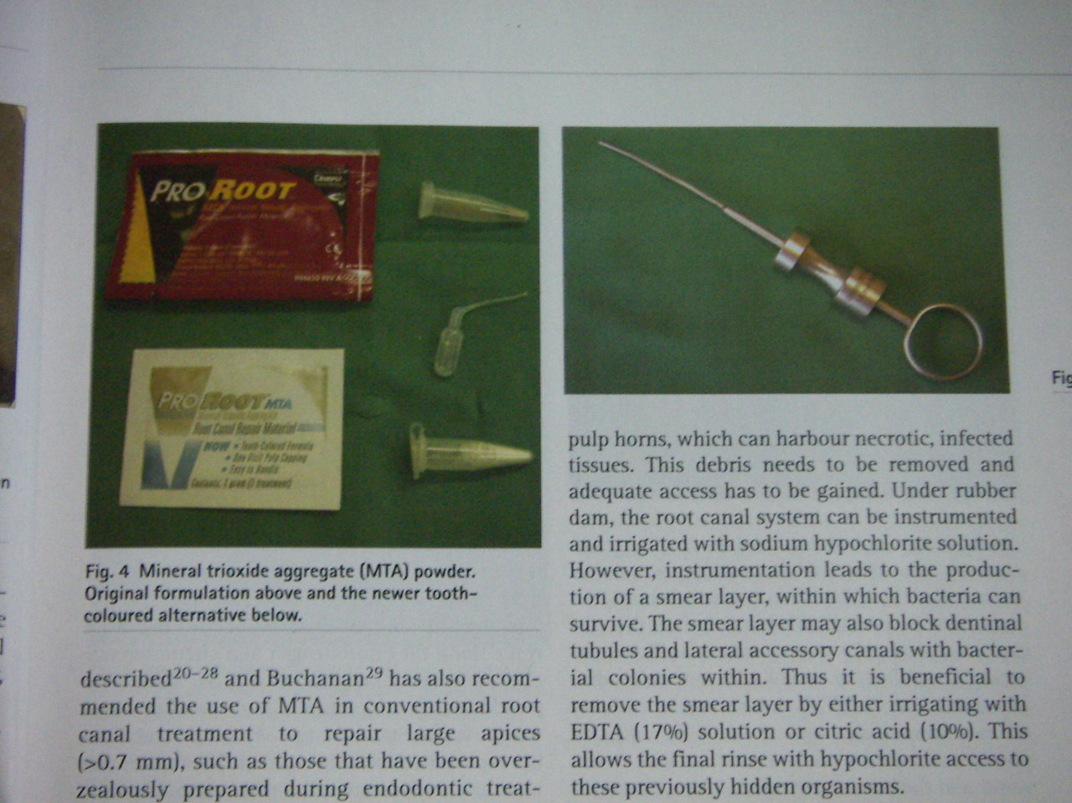
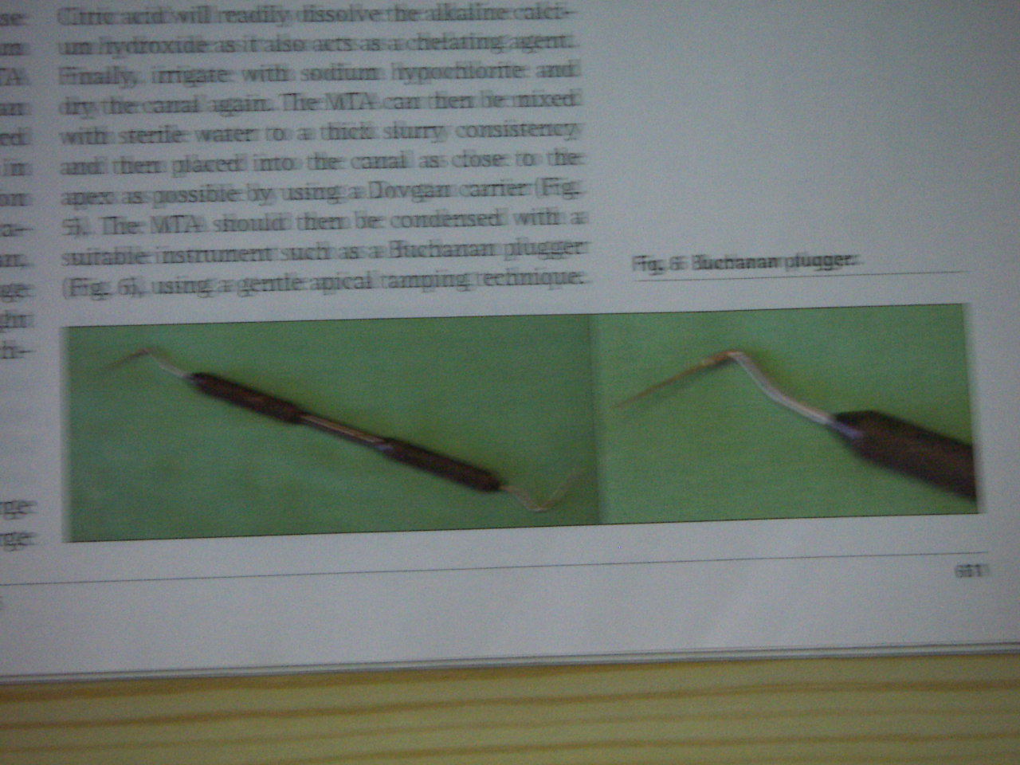
MTA KIT
Dovgan carrier
Buchanan pluggers

Slide 36
Clinical procedure:
-Access cavity preparation and irrigation with Na O Cl
EDTA(17%), Citric acid(7%)
-Working length is determined, dry the canals by using paper points
-Canal is dressed with non setting Ca (0H)2 for one to two weeks.
Re-access, Ca (OH)2 is removed
-MTA is mixed with sterile water to a thick slurry, placed and condensed into the canal

Slide 37
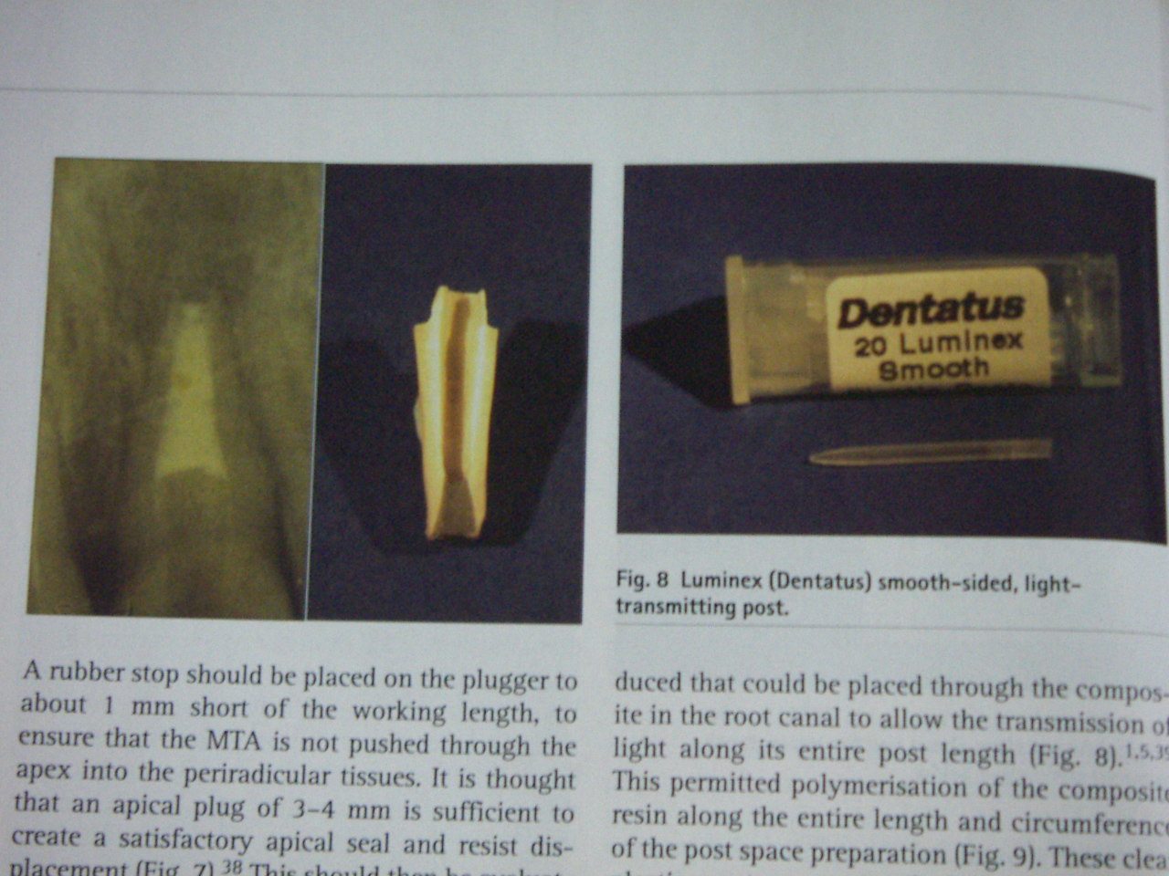
- Radiographically position of MTA is checked
-A moist cotton pellet is placed in canal,Temporary dressing is given(settin time-3-4 hr)

Slide 38
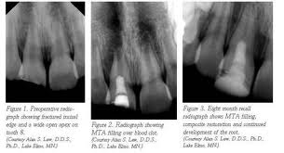
Advantages :
- Time saving
-Better apical seal, nonresorbable
-Better strengthening of the roots

Slide 39
Tooth restoration following apexification:
Strengthening the immature root by using newer dentin bonding techniques
Goldbreg et al : Reinforcing effect of RMGIC
Katebzadeth et al : Access is restored with composite restoration

Slide 40
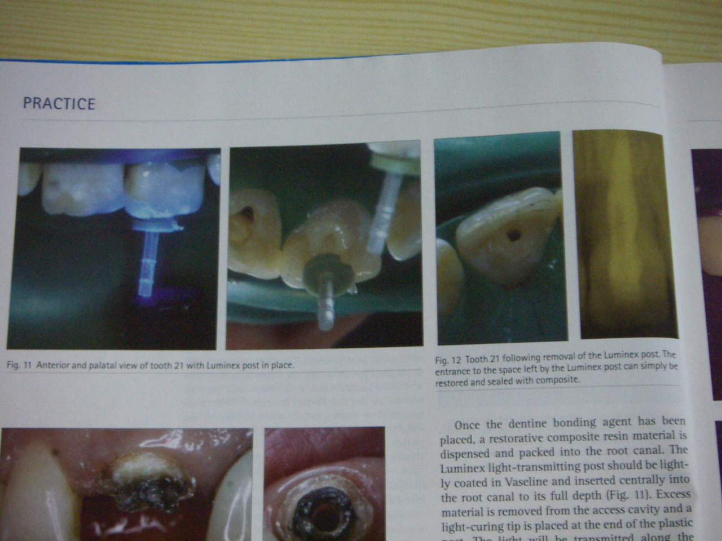
Tooth restoration following apexification
Clinical procedure for internal rehabilitation of root canal:
-Select the proper light transmitting post
- Etch, Apply DBA into root canal
- Composite resin is packed into the canal
- Post is coated with vaseline, inserted centrally
into the canal and cured

Slide 41
Complications
Prolonged treatment time
Recurrent / persistent infection = Apical surgery
Cervical root fracture

Slide 42
Pulp Revascularisation
Pulpal necrosis in immature teeth
Traditional …… Ca OH
More recent…. MTA
DISADVANTAGES????
More fragile dentinal walls
Less resistance to fracture

Slide 43
Technique
Access cavity
Hand file used to disrupt pulp tissue
Irrigate with NaOcl
Canals dried with paper points
Antiboitic mixture placed upto depth of 8mm
Access closed with cavit (4mm)
After 4 wks, canals reentered, irrigated
Explorer introduced in canal space until vital tissue is felt at a depth of 15mm---- induce bleeding
Bleeding stoped below 3mm of CEJ
Over this MTA Placed and sealed with cavit
2 weeks later if asymptomatic, cavit replaced with Bonded resin restoration

Slide 44
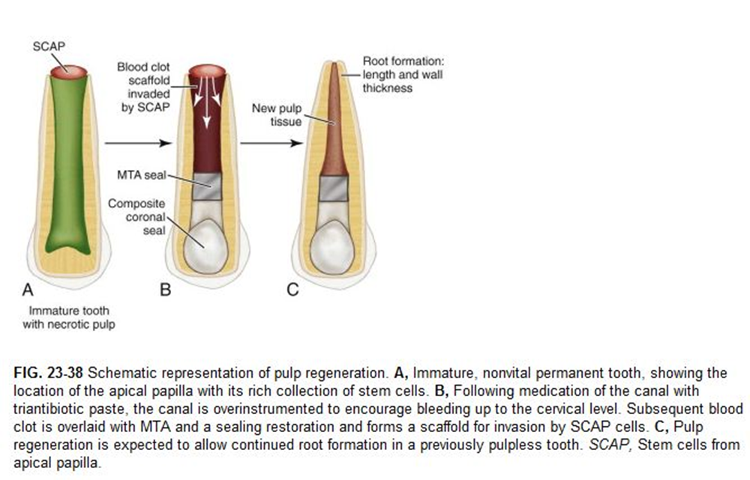

Slide 45
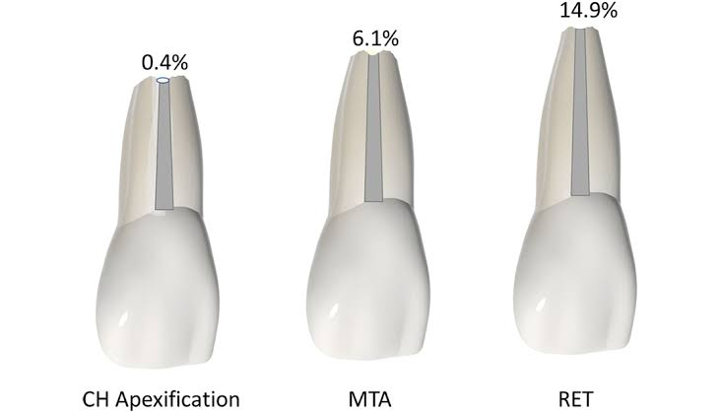

Slide 46
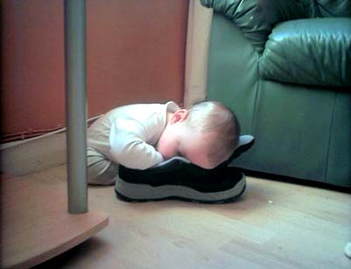
conclusion

Slide 47
TREATMENT MODALITIES FOR TEETH WITH OPEN APEX
vital
Non vital
Apexogenesis
Apexification
Pulp
revascularisation
IPC,DPC
PULPOTOMY
CVEK
CERVICAL
RCT

Slide 48
FAQs
Case 1: 7.5 year old child c/o fall and bleeding from upper front tooth. Reports within 24 hrs after injury
Case 2: 8 year old reports with discolored right upper front tooth gives history of fall one year ago
Apexogenesis vs apexification
MTA
Pulp revascularisation (RET)
Franks criteria of root closure
Young permanent teeth
Cvek pulpotomy

Slide 49
References
Fundamentals of pediatric dentistry – RJ.mathewson
Pathways of pulp – Cohen & Burn
Kennedy operative dentistry
Endodontic practice – LI.Grossman
Stewart scientific foundation
Endodontics – Ingle
Journal of dentistry 2000
International endodontic journal 2004
Pediatric dent 1994 & 1996
J dent child 199
DCNA 2000

Slide 50
THANKU

