Slide 1

Good Morning

Slide 2
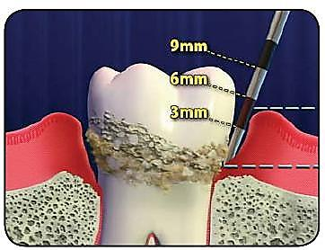
Periodontal Pocket

Slide 3
Contents
Definition
Classification
Supra bony and infra bony pocket
Pathogenesis of pocket formation
Clinical signs
Symptoms
Histopathology
Microtopography
Surface morphology of the tooth wall of periodontal pockets
Pulp changes associated with periodontal pockets
Pocket contents

Slide 4
Definition
According to Glickman
“Periodontal Pocket Is a Pathologically deepened gingival sulcus which occurs with destruction of the supporting periodontal tissues.”

Slide 5
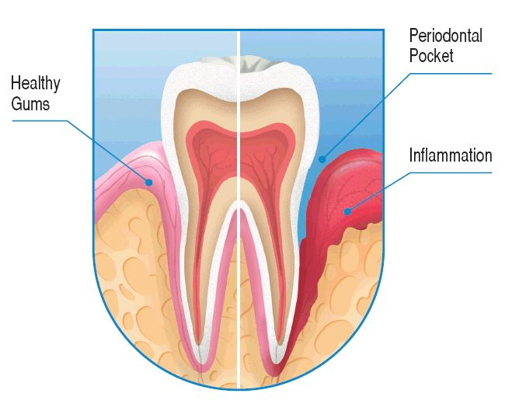
According to Carranza
    “Pocket defined as pathologically deepened gingival sulcus.”

Slide 6
According to AAP 1986
A fissure bordered on one side by the tooth and opposite site by crevicular epithelium and limited at its apex by the junctional epithelium
Abnormal apical extension of a gingival crevice caused by migration of the junctional epithelium along the root as the periodontal ligament is detached by a disease process.

Slide 7
Deepening of the gingival sulcus may occur by
  Coronal movement of the gingival margin,
  apical displacement of the gingival attachment, or
  a combination of the two processes

Slide 8
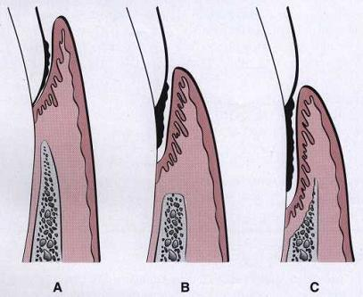
CLASSIFICATION
Gingival pocket :
Synonyms:
        Pseudo pocket
        Relative
        False
Formed by gingival enlargement without destruction of the underlying periodontal tissues.
The sulcus is deepened because of the increased bulk of the gingiva.

Slide 9
Periodontal pocket:
Synonyms:
        True
        Absolute
Formed by destruction of the supporting periodontal tissues.
Progressive pocket deepening leads to destruction of the supporting periodontal tissues and loosening and exfoliation of the teeth.

Slide 10
Two types of periodontal pockets:
Suprabony (supracrestal or supraalveolar):
Bottom of the pocket is coronal to the underlying alveolar bone.

Slide 11
Intrabony( Infrabony, Subcrestal or Intraalveolar)
Bottom of the pocket is apical to the level of the adjacent alveolar bone.
In intrabony pocket the lateral pocket wall lies between the tooth surface and the alveolar bone.

Slide 12
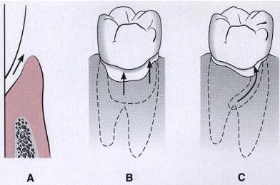
CLASSIFICATION
According the number of surfaces involved:
1.Simple pocket:
  Involves only one tooth surface.

Slide 13
2.compound pocket:
Involves two or more tooth surfaces.
Base of the pocket is in direct communication with the gingival margin, along each of the involved surface.

Slide 14
3.complex pocket:
This is a spiral type pocket. i.e ., originates on one tooth surface and twists around the tooth to involve more additional surfaces.
Only communication with the gingival margin is at the surface where pocket arises or originates.
Common in furcation areas.

Slide 15
CLASSIFICATION
Based on depth of pocket
Mild - 4 to 5mm
Moderate -6 to 8mm
Severe – more than 8mm

Slide 16
Supra bony pocket | Infra bony pocket
1. The base of the pocket is coronal to the alveolar bone | The base of the pocket is apical to the crest of the alveolar bone
2. The pattern of destruction of the underlying bone is horizontals | The bone destruction pattern is vertical (angular)
3. Interproximally the transeptal fibers are arranged horizontally in the space between the base of the pocket and the alveolar bone | Interproximally the transeptal fibers are oblique. Extending from the cementum beneath the base of the pocket along the bone and over the crest to the cementum of the adjacent tooth.
4. On the facial and lingual surface the periodontal ligament fibers beneath the pocket follow their normal horizontal – oblique course between the tooth and the bone. | On the facial and lingual surface the periodontal ligament fibers beneath the pocket follow angular pattern .

Slide 17
PATHOGENESIS OF POCKET FORMATION
Presence of bacterial plaque on tooth surface
Marginal gingiva become inflamed
Gingiva sulcus deepens due to oedematous enlargement of gingiva
Gingiva pocket
Anareobic organisms tend to colonise the subgingiva plaque
(Spirochaetes and motile rods)
(Due to anaerobic environment created in the pocket)
Large number of PMN leykocytes and macrophages migrates to the gingiva tissue in response to bacterial challenge

Slide 18
Two mechanisms of collagen loss
Lygogomal enzymes (Collagenase) released by PMN leukocytes
Fibroblast phagocytize collagen fibers by extending cytoplasmic process to the ligament cementum interface
Destruction of collagen fibers in gingival C.T.
Matrix metalloproteinases
When the collagen fibers apical to junctional epithelial get destroyed, the epithelial cells proliferate along the root surface in an apical direction until they come in contact with healthy collagen fibers.

Slide 19
At the same time – coronal portion of the junctional epithelium get detached from the tooth surface
PMN cells migrates towards the coronal portion of junctional epithelium
When volume of PMN leykocytes at the coronal portion of junctional epithelium exceeds 60%, the epithelium cells separate from the tooth surface
Pocket formation
Plaque removal is difficult or impossible from deep pocket
Favouring growth of pathogenic organism in that protected environment
Further attachment loss
Horizontal bone loss
If T.F.O. present than verticle bone loss occurs (angular bone loss)

Slide 20
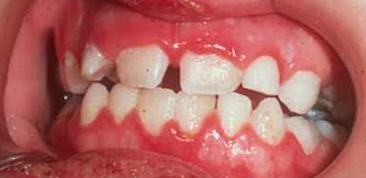
Clinical signs
Enlarged, bluish-red marginal gingiva with a rolled edge, separated from the tooth surface.
A reddish-blue vertical zone extending from the gingival margin to the attached gingiva and sometimes into the alveolar mucosa.

Slide 21
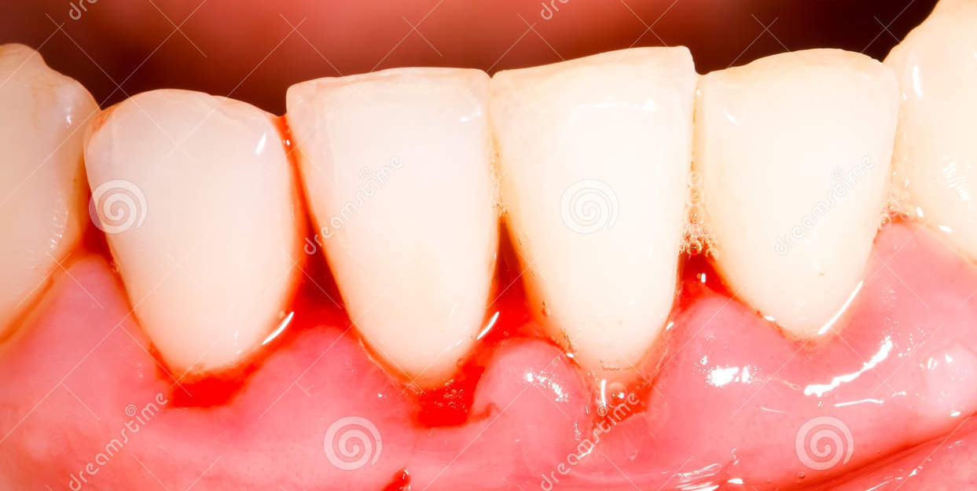
A break in the facio-lingual continuity of the interdental gingiva.
Shiny, discolored and puffy gingiva associated with exposed root surfaces.
Gingival bleeding.

Slide 22
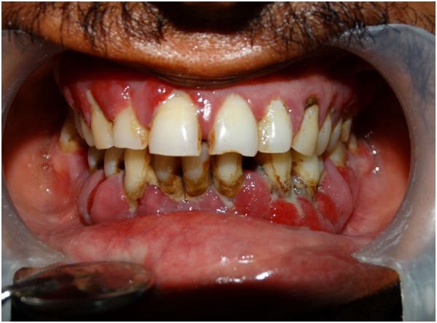
Purulent exudate of the gingival margin or its appearance in response to digital pressure on the lateral aspect of the gingival margin.
Looseness, extrusion and migration of the teeth.
The development of diastemata where none had existed.

Slide 23
Symptoms
Localized pain or sensation of pressure after eating, which gradually diminishes.
A foul taste in localized areas.
A tendency to suck material from the interproximal spaces.
Radiating pain deep in the bone.
A gnawing feeling or feeling of itchiness in the gums.

Slide 24
The urge to dig a pointed instrument into the gums with relief obtained from resultant bleeding.
Complaints that foods sticks between the teeth/the teeth feel loose/preference to eat on the other side.
Sensitivity to heat and cold, tooth ache in the absence of caries.

Slide 25
Correlation of clinical features and Histologic features
Gingival wall of pocket presents various degrees of bluish red discoloration, smooth shiny surface and pitting on pressure.
  Discoloration due to - stagnation of circulation.
  Flaccidity due to - destruction of gingival fibers.
  Shinny surface -atrophy of epithelium and edema.
  Pitting on pressure- edema and degeneration.

Slide 26
Gingival wall may be firm and pink.
In such cases fibrotic changes predominate over exudation and degeneration, particularly in relation to outer surface of pocket wall.
Bleeding on probing.
Due to increased vascularity, thinning and degeneration of epithelium and proximity of engorged vessels on inner surface.

Slide 27
Exploration with probe is painful.
Due to ulceration of inner aspect of pocket wall.
Pus expressed on digital pressure.
Pus occurs with suppurative inflammation of inner wall of the pocket

Slide 28
HISTOPATHOLOGY
Changes that occur in soft tissue wall
Connective tissue – edematous and densely infiltrated with plasma cells and PMNs.
Blood vessels increased in number, dilated and engorged.
Degenerative and exudative changes are seen.
Proliferation of endothelial cells with newly formed capillaries, fibroblasts and collagen fibers.

Slide 29
JUNCTIONAL EPITHELIUM
Junctional epithelium at the base of the pocket is much shorter than that of normal sulcus.
Coronoapical length of JE is reduced to only 50-100µm.
Cells may be well formed and in good condition or slight to marked degeneration.

Slide 30
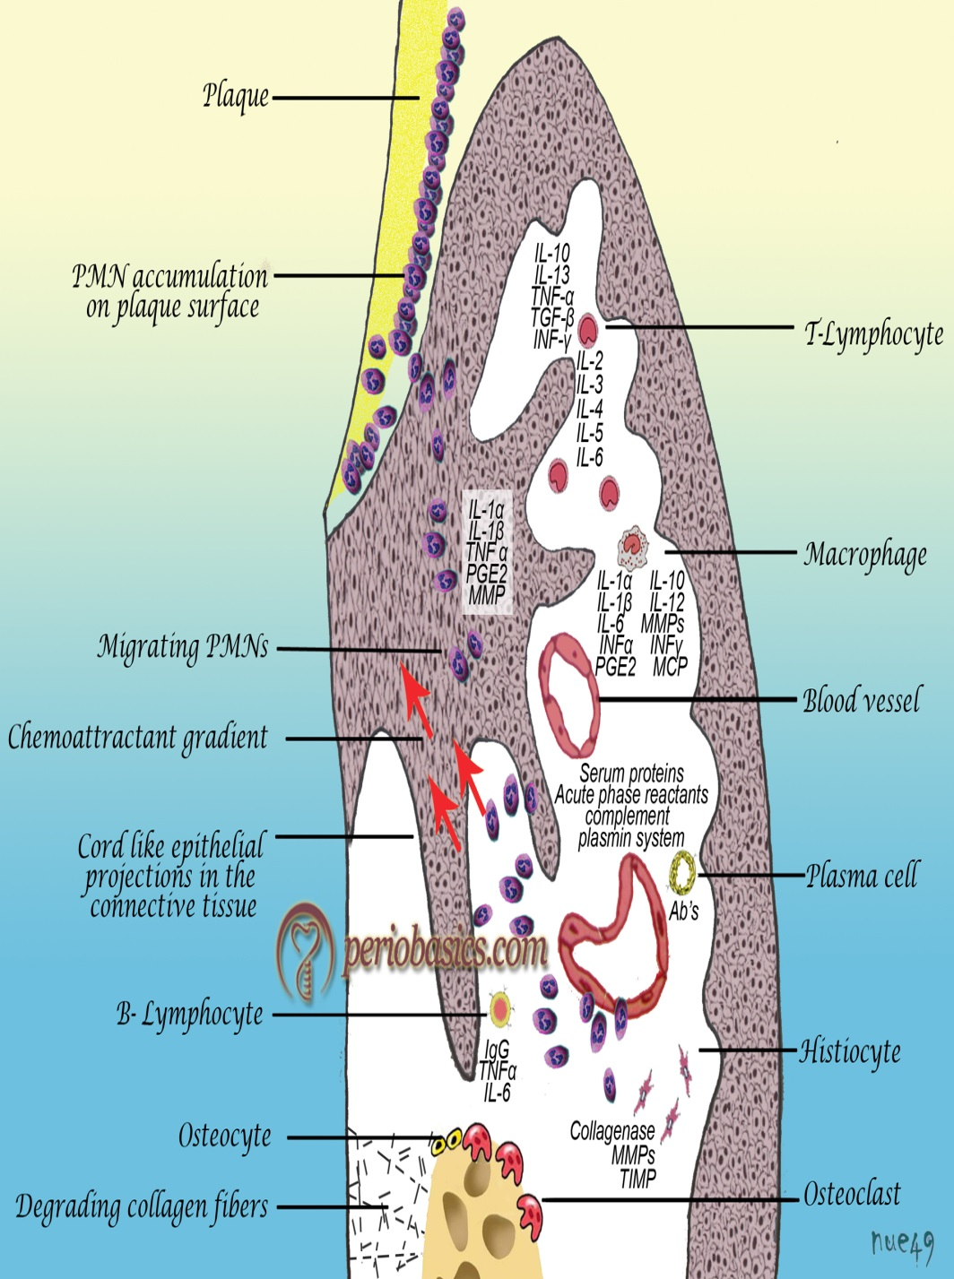
Epithelial buds and interlacing cords of epithelial cells project from the lateral wall into the adjacent inflamed connective tissue and frequently extend farther apically than the JE.
Epithelial projections – densely infiltrated by leucocytes and edema from inflamed connective tissue.

Slide 31
These cells undergo vascular degeneration and rupture to form vesicles.
Progressive degeneration and necrosis of the epithelium leads to ulceration of the lateral wall, exposure of the underlying inflamed connective tissue and suppuration.

Slide 32
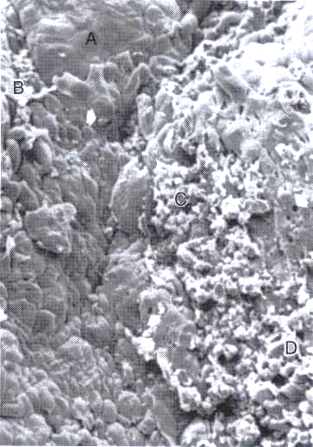
MICROTOPOGRAPHY:
Areas of relative quiescence, showing a relatively flat surface with minor depressions and mounds and occasional shedding of cells.
Areas of bacterial accumulation, which appear as depressions on the epithelial surface, with abundant debris and bacterial lumps penetrating in the enlarged intercellular spaces. These bacteria are mainly cocci, rods and filaments with a few spirochetes.

Slide 33
Areas of emergence of leukocytes, where leukocytes appear in the pocket wall through holes located in the intercellular spaces.
Areas of leukocyte-bacteria interaction, where numerous leukocytes are present and covered with bacteria in an apparent process of phagocytosis.

Slide 34
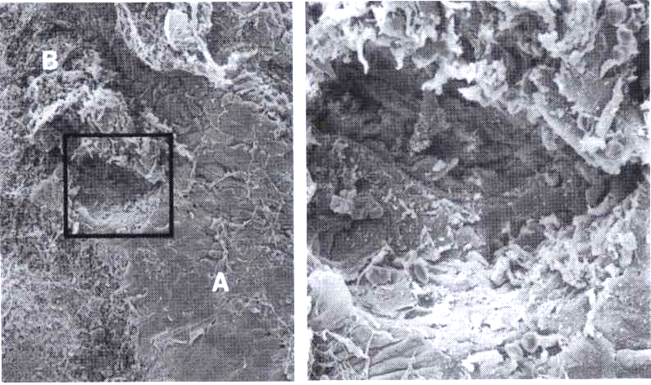
Areas of intense epithelial desquamation, which consist of semi attached and folded epithelial squames, sometimes partially covered with bacteria.
Area of ulceration, wit exposed connective tissue.
Area of hemorrhage, with numerous erythrocytes.

Slide 35
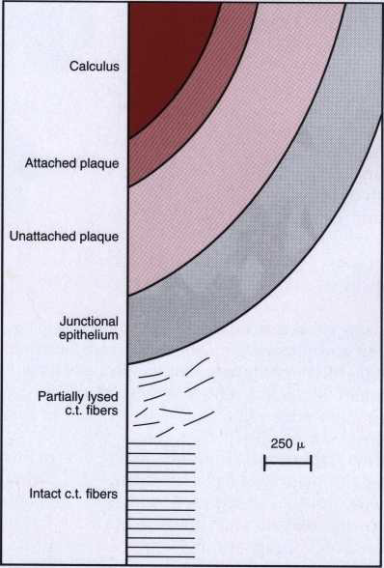
Surface morphology of the tooth wall of periodontal pockets:
Cementum covered by calculus
Attached plaque, which covers calculus and extends apically from it to a variable degree, probably 100 to 500 µm.
The zone of unattached plaque that surrounds attached plaque and extends apically to it.

Slide 36
The zone where the junctional epithelium is attached to the tooth. The extension of this zone, which in normal sulci is more than 500 µm. is usually reduced in periodontal pockets to less than 100 µm.
Apical to the junctional epithelium, there may be a zone of semi destroyed connective tissue fibers.

Slide 37
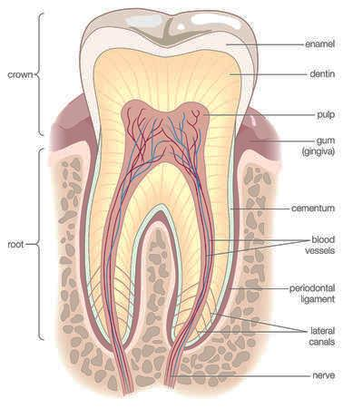
Pulp changes associated with periodontal pockets:
The spread of infection from periodontal pockets may cause pathologic changes in the pulp.
Such changes may give rise to painful symptoms or adversely affect the response of the pulp to restorative procedures.

Slide 38
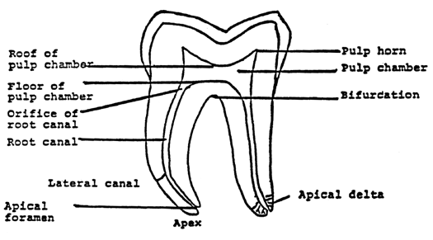
Involvement of the pulp in periodontal disease occurs through either the apical foramen or the lateral canals in the root after infection spread from the pocket through the periodontal ligament.

Slide 39
POCKET CONTENTS
Debris
Micro organisms
Gingival fluid
Food remnants
Salivary mucin
Desquamated epithelium
Leukocytes
Purulent exudate

Slide 40
To be continued
Root surface wall
Periodontal disease activity
Site specificity
Area between the base of the pocket and alveolar bone
Complications
Diagnosis/detection of pockets
Treatment

Slide 41
Beware
Periodontal pocket can empty your Pocket

