Slide 1


Slide 2
Definition
JONG “Plan is an systematic approach to defining the problem, setting the priorities, developing specific goals & objectives & determining alternative strategies, and a method of implementation’’
E. C Banfeild defined “Plan is a decision about a course of action”

Slide 3
It consists of five major elements
Objectives
Policies
Programmes
Schedules
Budget

Slide 4
Objectives- It is a planned end-point of all activities
"Policies" are the guiding principles stated as an expectation, not as a commandment.
A “programme” is the organized and systematic implementation of the actions described in the plan, according to a defined time frame and using defined resources (human, physical and financial).

Slide 5
A "schedule" is a time sequence for the work to be done.
A “budget” is an estimation of revenue and expenses over a specified future period of time and is utilized by governments, business, and individuals.
"Procedures" are a set of rules for carrying out work which, when observed by all, help to ensure the maximum use of the resources and efforts.

Slide 6
Uses of planning
To match limited resources with many problems
Eliminate wasteful expenditures or duplication of expenditure
Develop best course of action and to accomplish a defined objective

Slide 7
Plan formulation
Execution
Evaluation
In the broadest sense…..
Notes:
Planning in the broadest sense includes three steps; plan formulation, execution, evaluation

Slide 8
Types of health planning
1. Problem solving planning
2. Program planning
3. Coordination of efforts and activities planning
4. Planning for allocation of resources
5. Creation of a plan
6. Design of standard operating procedures

Slide 9
Steps in planning
Identify the problem
Determining priorities
Development of program goals, objectives and activities
Resource identification
Identifying constraints
Identify alternative strategies
Develop implementation strategy
Implementation
Monitoring
Evaluation

Slide 10
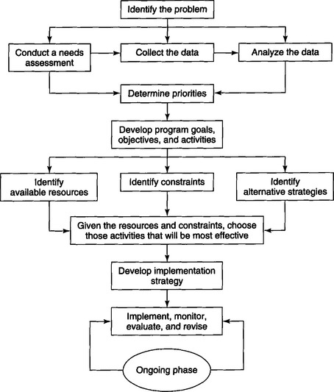

Slide 11

1. Identify the problem
Conduct a need assessment:
Needs defined as “Deficiencies in health that call for preventive, curative & eradication measures” WHO 1971
Notes:
The initial step in the planning process is to conduct needs assessment.

Slide 12
Reasons for Needs Assessment:
–Defines the problem
– Identifies the extent & severity
–Provides a profile of the community to ascertain the causes of the problem
– Helps in evaluating the effectiveness of the program
Notes:
There are several reasons why a planner should conduct a needs assessment. The primary reason is to identify its extent and severity. Second is to obtain profile. This info helps in developing appropriate goals and objectives in the prob sol. A needs

Slide 13
The information required include
Number of individuals in the population
Geographic distribution of the population
Rate of growth
Population density and degree of urbanization
Ethnic backgrounds
Diet and nutritional levels

Slide 14
Standard of living
Amount and type of public services and utilities
Public and private school system
General health profile
Patterns and distribution of dental diseases

Slide 15
Analysis of data
Once this is obtained from the needs assessment, the information must be analyzed before the priorities are determined

Slide 16

2. Determining the priorities
‘Priority determination’ is a method of imposing people’s value & judgment of what is important onto the raw data
Is used to rank the problems according to the severity & helps to utilize resources tactically
If priorities are not determined then program may not serve the people in need

Slide 17
When setting priorities for a community the planner must ask
How serious is the problem?
What percent of the population is affected by it?

Slide 18

3. Development Of Program Goals, Objectives & Activities
Program goals are broad statements on the overall purpose of a program to meet a defined problem.
Program objective are more specific and describe in a measurable way the desired end result of program activities.

Slide 19
Objectives should specify the following:
WHAT: Nature of the situation or Condition to be attained
EXTENT: Scope & Magnitude of the situation or Condition to be attained
WHO: Particular group or Portion of the environment in which the attainment is desired
WHERE: Geographic areas of the program
WHEN: Date by which the desired situation or condition is intended to exist

Slide 20
Program Activities
“How to bring about the desired results”
• Includes three components:
– What is going to be done
– Who will be doing it
– When it will be done

Slide 21

4. Resource Identification
Implies manpower, money, material, skills, knowledge,& Technique needed or available for implementation of the program
Balance has to struck with what is required & what is available

Slide 22
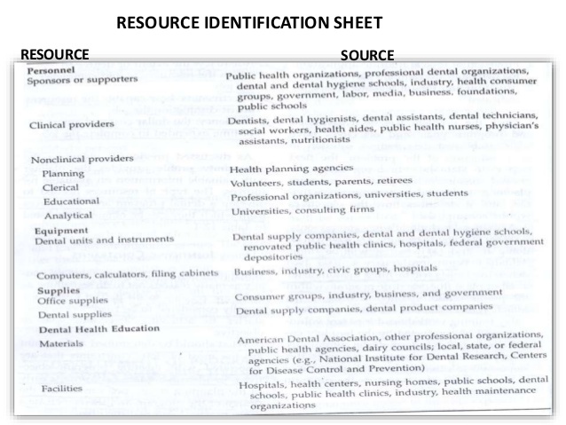

Slide 23

5. Identifying Constraints
‘Road blocks’ or ‘obstacles’
Identification of Constraints early in the planning stage:
– Can modify design of the program
– Create a more practical & realistic plan

Slide 24
Constraints may be as a result of
Organizational policies
Resource limitations
Characteristics of the community such as
- lack of funding,
- labor shortages,
- restrictive governmental policies,
- inadequate transportation systems,
- negative attitudes.

Slide 25
One of the best way to identify constraints is to bring together a group of concerned citizens who might be involved in or affected by the project.
A group that is familiar with local politics and community structures can not only identify the constraints but also offer alternative strategies and solutions for meeting the goals.
Notes:
That is they should be representative of the study or research

Slide 26

6. Identify Alternative Strategies
Presence of existing constraints & available resources Planner Should consider Alternative Strategies
Sufficient no. of alternative plans should be at hand
Should help decide the most suitable plan either individually or in combination
Which should match the limited resources & anticipated costs & effective in return to the main plan
Notes:
Cost effective and practical to implement

Slide 27

7. Develop implementation strategy
An implementation strategy for each activity is complete when the following questions are answered.
1. WHY? The effect of the objective to be achieved
2. WHAT? The activities required to achieve the objective
3. WHO? Individuals responsible for each activity
4. WHEN? Chronological sequence of activities
5. HOW? Materials, methods, techniques to be used
6. HOW MUCH? A cost estimate of materials and time

Slide 28
To develop an implementation strategy, the planner must know what specific activity he/she wants to do. The most effective method is to work backwards to identify the events that must occur prior to initiating the activity

Slide 29
8. Implementation
The process of putting the plan into operation is referred to as implementation
The implementation process involves individuals, organizations and the community. Only through team work between the individual and the environment can implementation be successful
Most health programs can be divided into four phases of implementation, which are:

Slide 30
The pilot phase: whose development proceeds on a trial and error basis
The controlled phase: where a model of a particular program strategy is run under regulated conditions to judge its effectiveness
The actualization phase: where a model of the program strategy is subjected to realistic operating conditions
The operational phase: where the program is an ongoing part of the structure

Slide 31

9. Monitoring
Monitoring refers to the maintenance of an ongoing watch over the activities of an health service.
Monitoring often denotes not only watching, but using the observation as basis for continual modification of goals, plans or activities.
The data typically collected for monitoring include:

Slide 32
Input data: Eg – financial/budgetary reports, personnel available and vacancies existing, transportation records, equipment and supplies purchased
Process data: Eg – specific activities carried out in completing the program, the sequence in which they are carried out and their timing
Out put data: Eg – services or goods provided (such as the proportion of target population served)

Slide 33

10. Evaluation
‘Evaluation measures the degree to which objectives and targets are fulfilled and the quality of the results obtained. It measures the productivity of available resources in achieving clearly defined objectives. It measures how much output or cost effectiveness is achieved. It makes possible the reallocation of priorities and of resources on the basis of changing health needs’.
- WHO 1967

Slide 34
Criteria used in the evaluation of dental services (WHO-1972)
1. Effectiveness
2. Efficiency
3. Appropriateness
4. Adequacy

Slide 35
Effectiveness : it has been defined as “ the ration between the achievement of the program activity and the desired level which, during the planning process, the planners had proposed would result from the program”.
- WHO 1974
Three variables are useful in evaluation effectiveness:
1. Resources
2. Activities
3. Objectives

Slide 36
Efficiency : It has been defined as “the result that might be achieved through expenditure of a specific amount of resources and the result that might be achieved through a minimum of expenditure.”
- WHO 1974
It is a measure of the resources spent (money, men, material and time) in the process of providing a health care program.

Slide 37
Appropriateness: the appropriateness of the program will be judged by lay decision makers. They will weigh up whether the problem defined by the program personnel is a problem for the community.
Evaluation of appropriateness can be carried out at 2 levels:
1. Whether the aim and objectives of the program are appropriate
2. Whether the strategy of the program is appropriate

Slide 38
Adequacy: a measure of adequacy is the extent to which the population in need was covered by the services or the extent to which the services covered the various aspects of the underlying problem.

Slide 39
Types of evaluation
There are different types of evaluation depending on the object being evaluated and the purpose of the evaluation.
The most important basic types of evaluation are,
Formative evaluation
Summative evaluation

Slide 40
Formative evaluation:
It refers to the internal evaluation of a program. It is an examination of the activities of a program, as they are taking place. It is usually carried out to aid in the development of a program in its early phase.
It is used primarily by the program developers as to whether they are workable or whether changes should be made to improve program activities

Slide 41
Summative evaluation:
It judges the merit or worth of a program after it has been in operation. It is an attempt to determine whether a fully operational program is meeting the goals for which it was developed.
Summative evaluation is aimed at program decision makers, who will decide as to a programs continuation or termination and also at decision makers from other programs who might be considering adoption of the program.

Slide 42
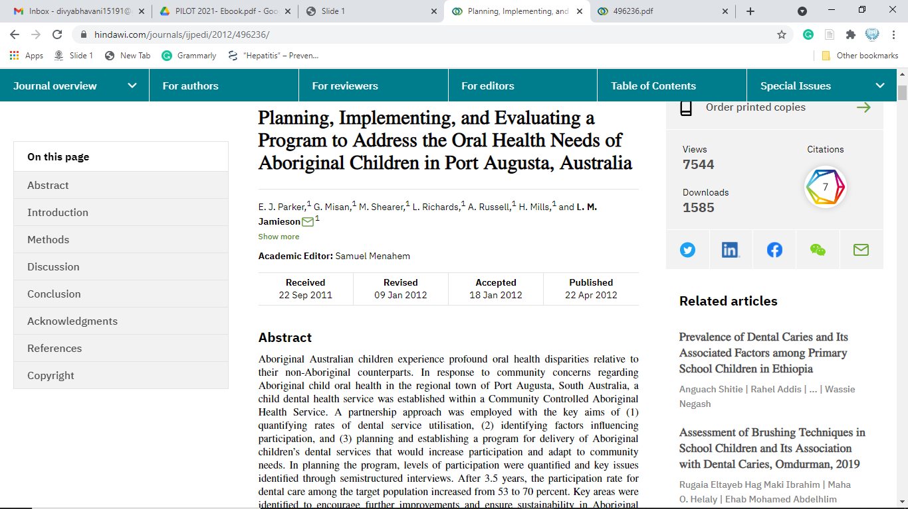
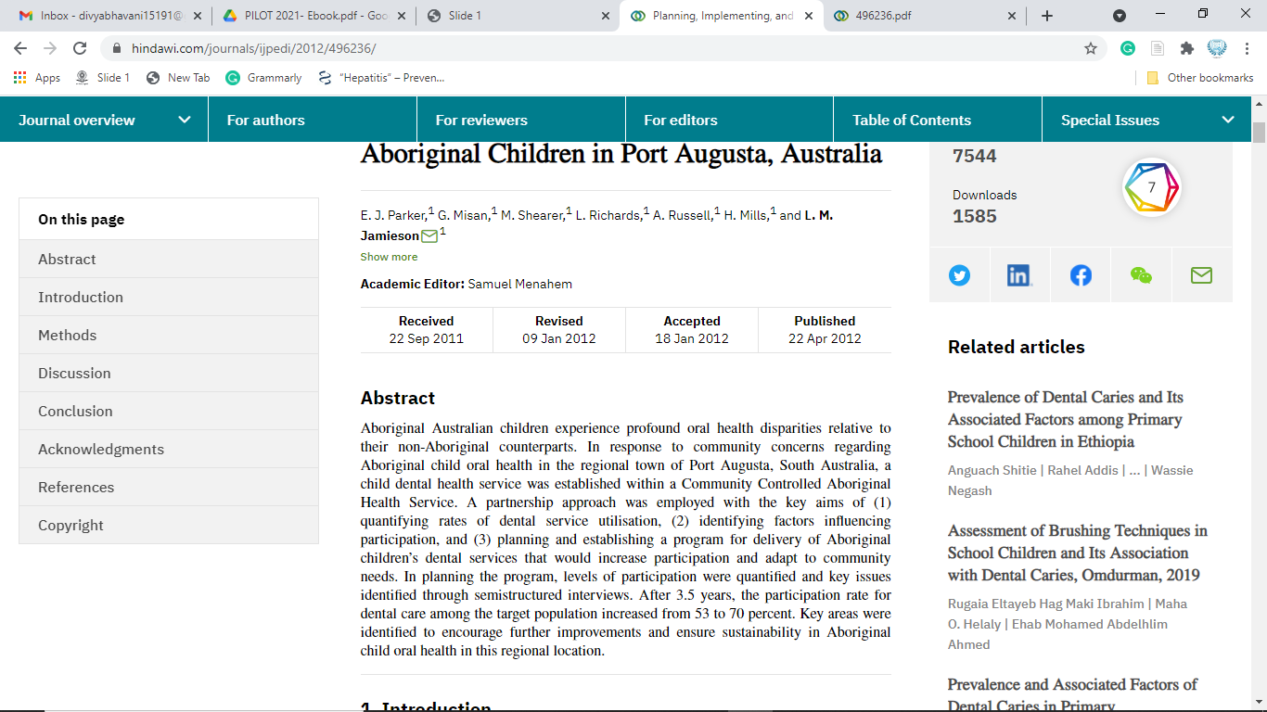

Slide 43
Conclusion
A plan can play a vital role in helping to avoid mistakes or recognize hidden opportunities. Planning helps in forecasting the future, making the future visible to some extent.
It bridges between where we are and where we want to go

Slide 44
How to develop a program to increase influenza vaccine uptake among workers in health care settings?

Slide 45
Conduct needs assessment
3 individual in-depth interviews with nursing home physicians and
two focus group sessions (one with four nursing home physicians and one with three nursing assistants and two nurses).

Slide 46
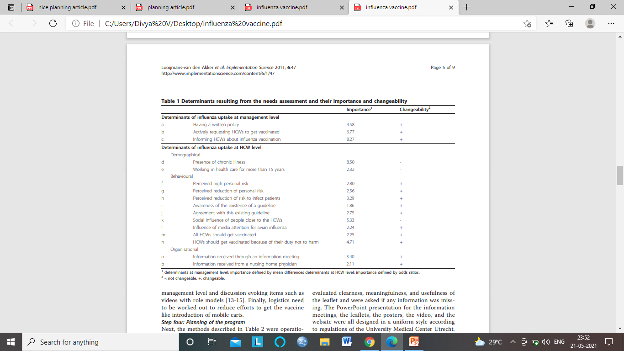
Conduct needs assessment

Slide 47
Goals and objectives
Stimulating nursing homes to develop a written policy on influenza vaccination of HCWs
Actively requesting HCWs to get vaccinated
Having HCWs informed on influenza vaccination
HCWs being convinced that vaccination is effective in reducing the personal risk for an influenza infection
HCWs being convinced that vaccination is effective in reducing the risk to infect patients with influenza

Slide 48
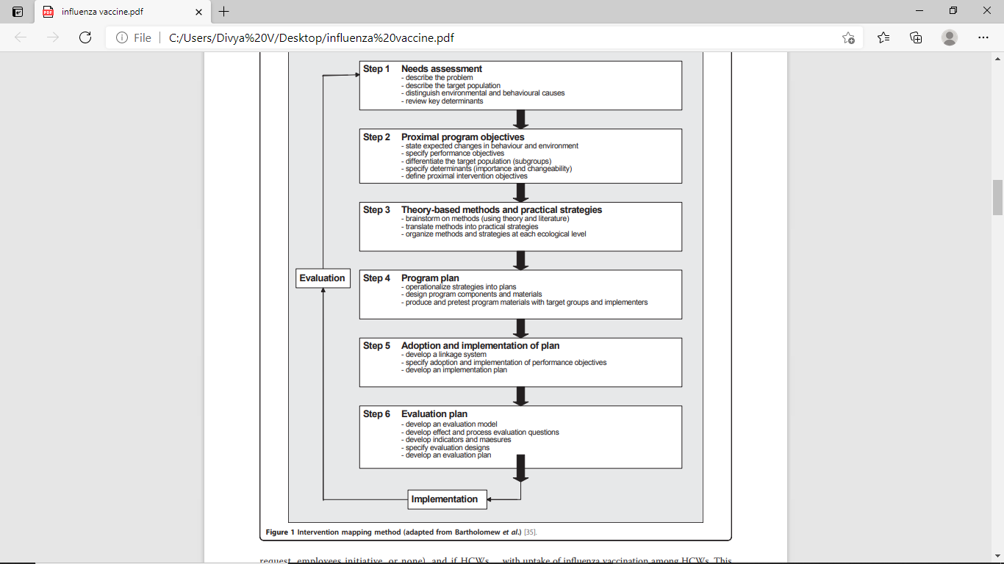
Resource identification

Slide 49
Identifying constraints
Obstacles related to care provider(knowledge/attitudes/routines)
Complications are rarely seen
No “hard” evidence on usefulness
Obstacles related to social context
None is caring and controlling
No guidelines on this topic
Management shows no interest
Obstacles related to organizational context
Costs too much time
No adequate equipment

Slide 50
Strategies
Informing management on effect of a written policy (outreach visit, written information)
Provide risk information to HCWs (plenary meeting, leaflets, website)
Evaluate own behavior in smaller groups
Show a video with role-models
Explain and discuss ethical aspects (leaflets, website)
Execute an information meeting with plenary information on influenza and influenza vaccination and discussion in smaller groups

Slide 51
Implementation
Dutch association of nursing home physicians (verenso)
and the association of nurses and nursing assistants

Slide 52
Evaluation
Cluster randomized controlled trial
Effect and process evaluation

Slide 53
References
Park K. park’s textbook of Preventive and social medicine. 25th ed. Banarsidas bhanot publishers,2019.
Gluck G, Morganstein WM. Jong's Community Dental Health. 5th ed. Elsevier Health Sciences; 2002.
E. J. Parker, G. Misan, M. Shearer, L. Richards, A. Russell, H. Mills, and L. M. Jamieson. Planning, Implementing, and Evaluating a Program to Address the Oral Health Needs of Aboriginal Children in Port Augusta, Australia; International Journal of Pediatrics;2012:1-10.

Slide 54

Thank you

