Slide 1
DIFFERENTIAL DIAGNOSIS OF PIGMENTED LESIONS OF ORAL CAVITY
Dr. B. MRUDULA
READER
DEPT OF ORAL MEDICINE & RADIOLOGY

Slide 2
CONTENTS
Introduction
Types of pigmentation
Physiology of pigmentation
Classification systems
Diagnostic approach
Differential diagnosis algoritham
Differential diagnosis of individuals lesions
Conculsion
References

Slide 3
INTRODUCTION
COLOUR
FACINATION DISCRIMINATION
ART RACIAL
DIAGNOSIS
MEDICAL SCIENCE
Notes:
It is the sensation on the eye by rays of light when resolved as by a prism in to different wavelengths
Color is used to describe many things . Some people use it in art for facination . It tries to discriminate people on racial basis . For us i.e people in medical fratentrinity it helps in diagnosis of certain conditions .

Slide 4
PIGMENT: Pigment is an organic or inorganic substance that possesses some colour of its own in its natural state.
A PIGMENTED LESION : an area of altered coloration of oral mucosa either because of physiologic or pathologic process because of deposition of endogenous or exogenous pigments or embedded foreign materials in tissues
Pigmentation is defined as the process of deposition of pigments in the tissue.
Yasin Cicek, Omit Ertas. The Normal and Pathological Pigmentation of Oral Mucous Membrane: A Review. The Journal of Contemporary Dental Practice, , 2003.

Slide 5
Cyanosis
Jaundice
Anemia
Normal oral mucosa
Inflammation and allergies
Leukoplakia
Oral melanosis
Normal color of oral mucosa – pale pink to deep bluish purple in color

Slide 6
Physiologic
Pathological
Endogenous pigmentation
pigments melanin, hemoglobin, hemosiderin
Exogenous pigmentation
foreign materials such as amalgam, graphite into the connective tissue, over growth of chromogenic bacteria, by ingestion of metals that gets deposited in oral tissues.

Slide 7
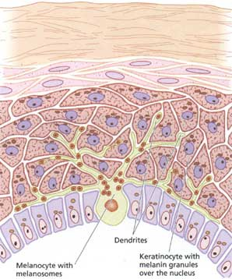
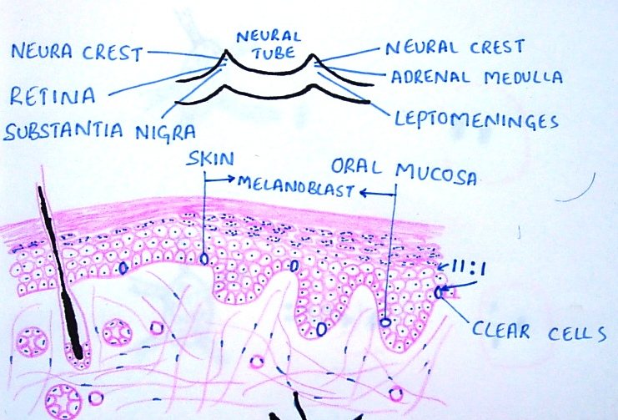
PHYSIOLOGY OF ORAL PIGMENTATION
MELANIN
MELANOBLASTS (identified by Becker in 1927 )
NEURAL CREST CELLS
Charles j. Mcdonald, clinical and laboratory diagnosis in disorders of pigmentation journal of the national medical association november, 1966

Slide 8
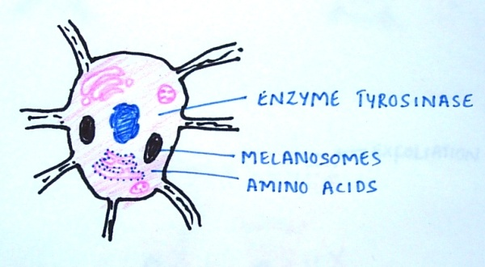
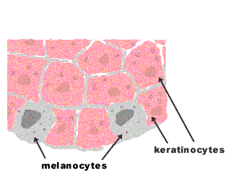
MELANOBLSTS & MELANIN SYNTHESIS
AMINO ACIDS
TYROSINE TYROSINASE
OXIDATION
DYHYDROXY PHENYL ALANINE (DOPA)
OXIDATION
QUINONE
INDOL-QUINONE
POLYMERISATION
MELANIN

Slide 9
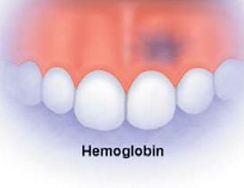
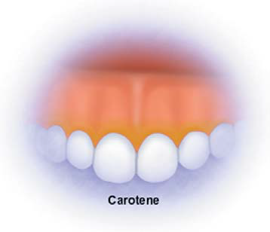
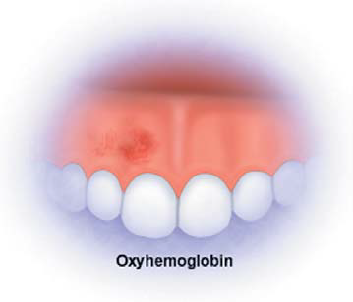
VARIOUS EXOGENOUS AND ENDOGENOUS PIGMENTS
ENDOGENOUS PIGMENTS
HEMOGLOBIN – methhemoglobin , sulphahemoglobin , carboxy hemoglobin .
HEMOSIDERIN:
HEMATIN
PORPHYRIN
BILURUBIN
EXOGENOUS PIGMENTS
Chromogenic bacteria
Caretinoids
Tradiations
Food stuffs
Yasin Cicek, Omit Ertas. The Normal and Pathological Pigmentation of Oral Mucous Membrane: A Review. The Journal of Contemporary Dental Practice, , 2003.

Slide 10
CLASSIFICATION OF PIGMENTED LESIONS
Burket (1994)
Wood and goaz ( 1997) :
Shalker gerald (1980) (from mc carthy )
NEVILLE, DAMM, ALLEN. 2004

Slide 11
BURKET’ S CLASSIFICATION
Colour | Solitary Focal Diffuse |  | Multifocal
Blue/Purple | Varix Hemangioma | Hemangioma | Kaposi’s sarcoma Hereditary – hemorrhagic telangiectasia
Brown | Melanotic macule Nevus Melanoma | Ecchymosis Melanoma Drug induced pigmentation Hairy tongue | Physiologic pigment Neurofibromatosis Hemochromatosis Lichen Planus Addison’s disease Drug induced pigmentation Peutz-Jeghers syndrome
Gray/Black | Amalgam tattoo Graphite tattoo Nevus Melanoma | Amalgam tattoo Melanoma Hairy Tongue | Heavy metal ingestion pigmentation

Slide 12
ENDOGENOUS PIGMENTATION
Pigment | Colour | Disease process
Haemoglobin | Blue, Red, Purple | Varix, hemangioma, kaposis’s sarcoma, hereditary hemorrhagic telangiectasia.
Hemosiderin | Brown | Ecchymosis, petechiae thrombosed varix. hemorrhagic mucocele, hemochromatosis.
Melanin | Brown, Black or Gray | Melanotic macule, nevus, melanoma, basilar melanosis with incontinence.
EXOGENOUS PIGMENTATION
Source | Colour | Disease Process
Silver amalgam | Gray, black | Tattoo, Iatrogenic trauma
Graphite | Gray, black | Tattoo, trauma
Lead, mercury bismuth | Gray | Ingestion of paint and medicinals.
Chromogenic bacteria | Black, brown gray | Superficial – colonization

Slide 13
WOOD AND GOAZ CLASSIFICATION (1997
Distinct circumscribed types of Brownish, Bluish or Black conditions
GENERALISED BROWN , BLUISH AND BLACK CONDITIONS
MACULES | Exophytlc lesions soft consistency | Firm lesions
1Melanoplakia | Mucocele | Amalgam fragment
2Amalgam tattoo | Ranula | Late hematoma
3Petechiae and ecchymosis | Cavernous hemangioma | Gaint cell granuloma
4. Melanotic macule | Early hematoma | Pigmented fibroma
5Superficialspreading melanoma | Superficial cyst | Intramucosal nevus
6 Junctional nevus | Lymphangioma | Compound nevus
7. Pigmentation caused by ingestion of heavy metals | Mucoepidermoid tumor | Melanoma
8 Peutz - Jegher's Syndrome | Multiple neurofibromatosis | Melanotic neurectodermal tumor of infancy
9 Albright's Syndrome | Hereditary hemorrhagic telangectasia
Cyanosis
Chloasma gravidarium
Addisons disease
Hemochromatosis
Argyria
Notes:
. Generalized Brown ,Bluish or Black conditions
Cynosis
Chloasma gravidarum
Addison's disease
Haemochromatosis
Argyria

Slide 14
NEVILLE, DAMM, ALLEN. 2004
Brown, Gray or Black lesions | Blue or purple lesions
Racial pigmentation Amalgam tattoo Black/brown hairy tongue Melanotic macule Smoker’s melanosis Melanocytic nevus Malignant melanoma Drug ingestion Peutz-Jeghers syndrome Addison’s disease Neurofibromatosis McCune-Albright syndrome Heavy metal poisoning Melanotic neuroectodermal tumor of infancy | Varicosities Sub mucosal hemorrhage Amalgam tattoo Hemangioma Kaposi’s sarcoma Blue nevus Malignant melanoma

Slide 15
McCarthy P.L., Shklar. Disturbances in pigmentation. Disease of Oral Mucosa; 1980.
ENDOGENOUS PIGMENTATION: | EXOGENOUS PIGMENTS
1 . Melanin a)Normal racial variations b)Addison’s disease c)Peutz – Jeghers syndrome d)Albright’s syndrome e)Von-Reckling hausens disease f)Pigmented nevi g)Malignant melanoma 2.Bilirubin :Jaundice 3.Iron : a)Hemochromatosis b)Ecchymosis | Pigments introduced into the body systemically Bismuth Lead Silver Mercury Gold Arsenic Antimalarials Chlorpromazine 2.Pigments introduced locally: Amalgam tattoo Industrial accidents C.Miscellaneous Black hairy tongue Stains from tobacco etc.

Slide 16
DIAGNOSTIC APPROACH
Complete and accurate history
Any lesions on the skin and perioral skin
a review of systems symptoms of underlying endocrine , neurologic , CVS , GIT , hematologic
The number , distribution , size and shape and color of intraoral pigmented lesions should be assessed
family history is to consider possible hereditary systemic disease
Previous medical and surgical history of other lesions that may be atypical or malignant
drying the area with guage , applying digital palpation fixation to the tissues , applying pressure to blanch for vascular changes
Pain assessment , color change with stretching , site of lesion , association with amalgam restoration
Biopsy , digital records diascopy , radiography and blood tests may be necessary for definitive diagnosis of oral pigmentation . Dermascopy
Craig l. Hatch. Pigmented lesions of the oral cavity. Dent Clin N Am 2005; 49: 185–201.

Slide 17
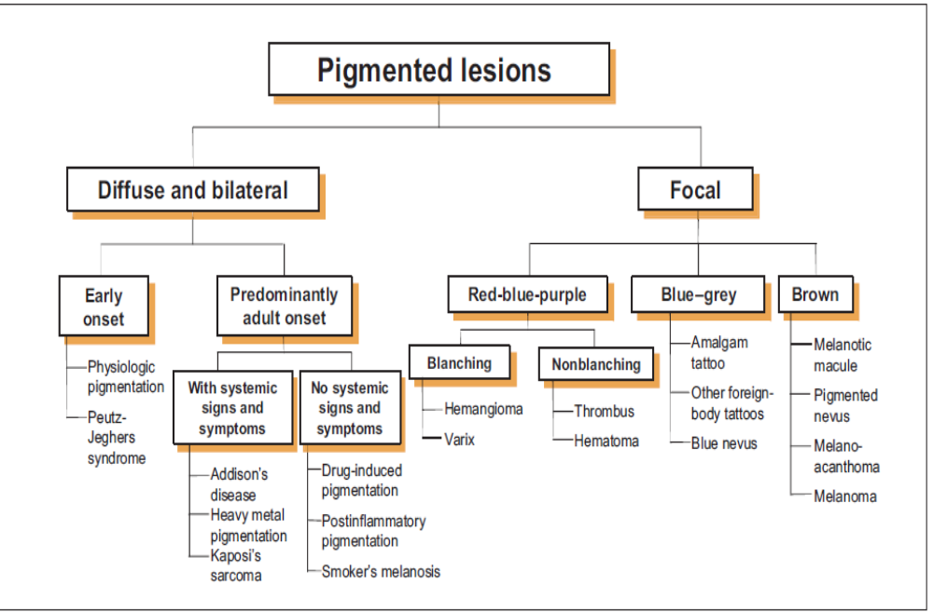
DIFFERENTIAL DIAGNOSIS
Adel Kauzman, Marisa Pavone, Nick Blanas, Grace Bradley. Pigmented Lesions of the Oral Cavity: Review, Differential Diagnosis, and Case Presentations. J Can Dent Assoc 2004; 70(10):682–3

Slide 18
PIGMENTED LESIONS OF ORAL CAVITY AND LIPS
medical history does not allow to distinguish between melanocytic and non melanocytic lesions
medical history allows to distinguish between melanocytic and non melanocytic lesions
melanocytic lesions
non melanocytic lesions
clinical suspicion of malignancy ( ABCD check list , recent history,a ge and subsite )
no or low clinical suspicion of malignancy ( ABCD check list , recent history, age and subsite
diagnosis justified on clinical grounds alone (usually no treatment follow up required )
diagnosis not possible on clinical grounds alone provisional diagnosis
biopsy or refer to specialist for further evaluation
Marco Meleti.. Pigmented lesions of the oral mucosa and perioral tissues: aflow-chart for the diagnosis and some recommendations for the management.OOOE 2008
malignant melanoma
no malignancy (treatment usually not required and follow up
Notes:
Marco Meleti.. Pigmented lesions of the oral mucosa and perioral tissues: aflow-chart for the diagnosis and some recommendations for the management. Oral Surg Oral Med Oral Pathol Oral Radiol Endod 2008; 105: 606-16.

Slide 19
DIFFERENTIAL DIAGNOSIS
FOCAL MELANOTIC PIGMENTATION
MULTIFOCAL DIFFUSE PIGMENTATION
MELANOSIS ASSOCIATED SYSTEMIC OR GENETIC DISEASE
IDIOPATHIC PIGMENTATION
HEMOGLOBIN AND IRON ASSOCIATED PIGMENT
EXOGENOUS PIGMENTATION

Slide 20
ORAL MELANOTIC MACULE
focal pigmented lesion with no cutaneous counterpart. Page & Co-workers
There is increase in melanin synthesis .
Etiology :
Clinical features :
Post traumatic or inflammatory reaction
Local factors – chronic inflammation , heat , trauma , chemicals
40 yrs , females
Lesions – oval or round with irregular < 5mm
colour may be blue, black or brown in colour
lower lip and Gingiva.
Notes:
40 years
It occurs predominantly in females .
The lesions are oval or round in shape with irregular outlines or may be demarcated and measures less than 6 to 7 mm in diameter.
The colour of the lesions may be blue, black or brown in colour
The lesions are usually focal in nature but multiple lesions also occur
They commonly occur in the lower lip and Gingiva. They also occur in hard palate, buccal mucosa, and occasionally in muco buccal fold
Oral melanotic macules may occur as solitary lesions or they may be associated with other conditions.
Melanotic macules are completely innocuous and have no malignant potential

Slide 21
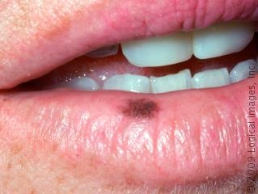
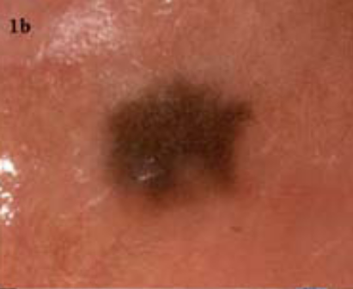
Macule on lower lip buccal mucosa
Chin-Jyh Yeh. et .al (2000)j of oral and max surg described a simple and effective cryosurgical technique to treat oral melanotic macules.
Michael A. Kahn et.al OOOE (2005) documented a case of primary oral melanoma arising from an apparent oral melanotic macule.
Román Carlos-Bregni et. al. (2006) reported 4 cases of melanoacanthoma and 4 cases of melanotic macule,with review of literature and immunohistochemical analysis.

Slide 22
Melanoplakia : presents as flat brownish to black lesion --- diffuse in nature
Amalgum Tattoo : greyish or bluish flat lesion with well circumscribed margins
Ecchymosis : It resembles macule. It usually disappears within a few days.
Superficial spreading Melanoma : macular lesion with variety of colours such as tan, brown, gray, black, blue, white or pink. The surface of lesion is indurated or invaded by surface nodules. Satellite macules or nodules of cells may develop peripherally
Nevi :Nevi presents as a brown raised lesions which is palpable, but they may be flat

Slide 23
MELANOACANTHOMA
Rare benign mixed lesion of keratinocytes and pigment laden dendritic melanocytes.
Etiology : It rare condition and appears to be reactive in origin, often arising as a result of local trauma - 40 cases reported
Clinical Features :
exclusively in Black – females – 3 to 4 decade
occur on stress bearing areas
smooth, well circumscribed flat or slightly raised lesion with varying degrees of pigmentation from dark brown to black in
rapid increase in size and occasionally reach a diameter of several centimeters within a period of few weeks
Notes:
It occurs almost exclusively in Blacks, but also reported to occur in Whites
It shows prediliction to occur in females and occurs commonly in the third and fourth decades of life.
Most oral melanoacanthomas occur on stress bearing areas such as hard palate and alveolar ridge or in common sites of trauma such as buccal mucosa. It is also occurs on gingiva, lip, soft palate and oropharynx
Clinically, it presents as smooth, well circumscribed flat or slightly raised lesion with varying degrees of pigmentation from dark brown to black in colour
The lesion often demonstrates a rapid increase in size and occasionally reach a diameter of several centimeters within a period of few weeks

Slide 24
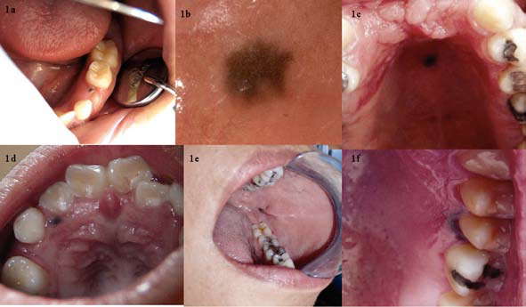
A diagnosis of oral MA can be performed solely on the basis of the histological features. Nevertheless, in order to emphasize the presence of melanin Fontana-Masson stain can be used.
The IHC profile of oral MA is essentially limited to the melanocytic markers . IHC studies generally reveal diffuse nuclear and cytoplasmic immunoreactivity of the dendritic melanocytes with S-100 protein. These cells also exhibit moderate-to-diffuse cytoplasmic reactivity for HMB-45
Oral melanoacanthoma and oral melanotic macule: a report of 8 cases,
review of the literature, and immunohistochemical analysis
Román Carlos-Bregni , Med Oral Patol Oral Cir Bucal 2007

Slide 25
Landuer DJ. et. al. ( OOOE - 1997) reported a dark brown plaque on right posterior buccal mucosa in a 30 year old Afro American woman..
Elisa Contreras et.al. ( OOOE - 2005) reported a case of melanoacanthoma on hard plate adjacent to prosthetic device, which indicating the prosthetic device which could be related in its pathogenesis.
narayanan et.al. (2009 J of medical case reports ) present a case report of oral melanoacanthoma in a 24-year-old Asian Indian man. Who presented with an intra-oral brown macular lesion on the left buccal mucosa with duration of one and a half months.

Slide 26
DIFFERENTIAL DIAGNOSIS :
Melanotic Macule : Melanotic macule appear brown or black lesion with irregular margins.
Melanoma : The early lesions of melanoma resemble melanoaceanthoma. Melanoma present as brown or black macules with irregular margins Both lesions demonstrate rapid growth should be confirmed by biopsy .

Slide 27
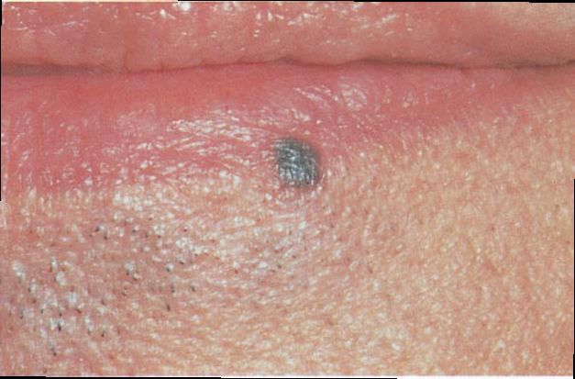
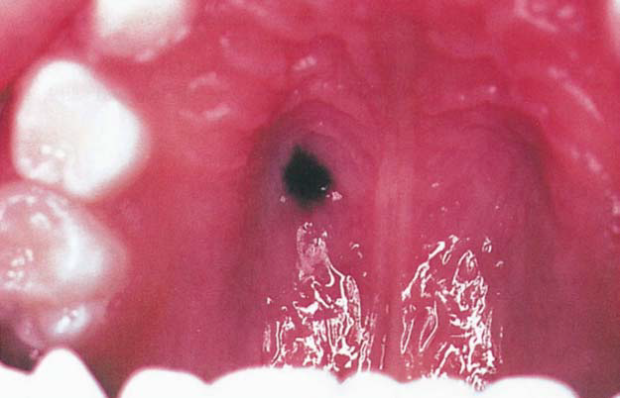
ACQUIRED MELANOCYTIC NEVUS
Benign , localised proliferation of cells from neural crest often called nevus cells .
The acquired melanocytic nevus is the most common of all human tumors
CLINICAL FEATURES :
Present during childhood occur before 35 yrs
Occur both in men and women .
Whites have more nevi
Most lesions are distributed above waist
Intraoral nevi – palate , mucobuccal fold or gingiva . some times they may lack pigmentation

Slide 28
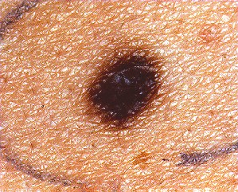
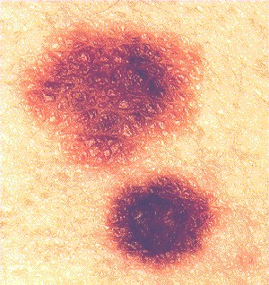
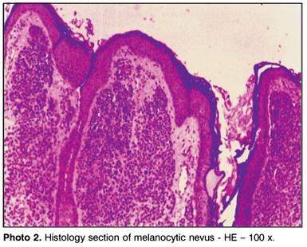
Intial presentation
Junctional nevus
Sharply demarcated brown or black macule< 6mm
Adulthood lesion
compound nevus
nevus cell proliferate and form elevated soft papule with smooth surface
Advanced stage
intradermal nevus
nevus loses its pigmentation
surface papillomatous hair grows from the centre

Slide 29
HISTOPATHOLOGICAL FEATURES :
Benign , unencapsulated proliferation of small , ovoid cells (nevus cells )
Nevus cells lack the dendritic processes that melanocytes posses
Superficial nevus cells organise in to theques (small , round aggregates )
Histopathologically according to their stage of development - Melanocytic nevi are classified as : Junctional nevus
Intradermal nevus
Compound nevus
VARIANTS : Congenital nevus , Halo nevus,Spitz nevus, Blue nevus
ORAL MELANOTIC NEVI: A CASE REPORT AND REVIEW OF LITERATURE *V.T Beena **Isha Chauhan , Oral & Maxillofacial Pathology Journal [ OMPJ ] Vol 1 No 1 Jan- Jun 2010

Slide 30
Differential Diagnosis :
Hematoma, Varix, Hemangioma:The firm nature of nevus to palpation
Amalgam Tattoo :
Foci of Hemorrhage :.
Oral Melanotic Macule :Melanotic macule presents as flat, brownish to black lesion with irregular margins where as nevus presents as brown, slightly raised lesion and is palpable¹⁸.

Slide 31
MALIGNANT MELANOMA
neoplasm of epidermal melanocytes,
biologically unpredictable and deadly of all human neoplasms.
Radical Growth Phase , Vertical Growth Phase
Predisposing Factors :
melanoma prone families have high incidence of germ line mutations in tumor suppressor genes CDKNA2 /p16 or less commonly CDK4 . Other recurrent molecular findings , including MCIR polymorphisms and alterations or loss of PTEN function
MALIGNANT MELANOMA OF ORAL CAVITY : REVIEW OF LITERATURE , indian journal of dental research , 2008

Slide 32
Clinical Features : Cutaneous melanomas four types . Superficial spreading , nodular ,lentigo maligna , acral lentigous
melanomas may develop either de novo or much less commonly existing from an existing melanocytic nevus .
In general the clinical characteristics of cutaneous melanoma are best described by ABCDE criteria : asymmetry , irregular borders , color variegation , diameter greater than 6 mm and evolution or surface elevation .

Slide 33
Oral Malignant Melanoma
it is an extremely rare condition with a poor prognosis and accounts for 0.2% to 1.8% with an average of 1.6%
malignant melanoma of oral cavity-criteria
Clinical features : common in males - effects black - mean age 55 yrs.
Common site - hard palate , gingiva
macular spot to a raised nodular mass.
  A. both clinically and histologically.
  b. presence of intra epidermal (Junctional) activity.
  c. Absence of any other primary site
early stages - macular brown or black lesions with irregular outlines.
In later stages,- diffused, nodular and tumefactive with foci or hyper and hypopigmentation.
Notes:
Clinical Features
Unlike the skin lesion, it is more common in males than in females with a ratio of 1.7:1 and appears to affect blacks more frequently than Whites .
Oral melanomas are common in Japanese than in Caucasians in whom skin melanomas are common
This tumor occurs most commonly in individuals between the age of 40 and 70 years with a mean of 55 years. It also occurs as early as 7 years and as late as 95 years
The more commonly affected sites are hard palate and gingiva, more often being maxillary gingiva. The other sites such as alveolus, buccal mucosa, tongue and floor of mouth are also affected.Clinical presentation of the lesion varies from a macular spot to a raised nodular mass. In the early stages, oral melanomas present as macular brown or black lesions with irregular outlines. In later stages, they become more diffused, nodular and tumefactive with foci or hyper and hypopigmentation.

Slide 34
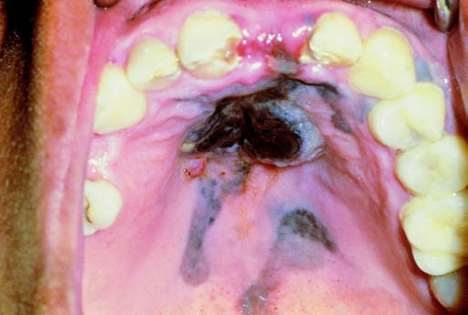
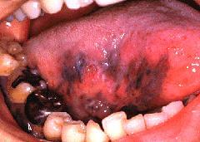
satellite lesions and are indicative of malignancy.
Foci of ulceration and lesion may be hemorrhagic which tends to progressively increase in size.
regional and distant metastasis through lymphatic and hematogenous routes to lung, liver, brain and the bones.
The histological microstaging system of Clark, used in cutaneous melanoma, cannot be applied to oral mucosa

Slide 35
Lambardi T. et al (1995 OOOE )- occuring intra - osseously in maxillary alveolus. firm, bluish expansion in maxillary right alveolus betweeen roots of incisor and canine.
Brian D. Kavanagh . et. al (2000 OOOE ) reported a case of desmoplastic malignant melanoma of the palatal alveolar mucosa of a 53 year old women
You Chan Kim . et. al (2003)immunohistochemical study of 20 cases of Acral lentiginous melanoma and proposed that S-100 protein and HMB-45 were relatively sensitive markers for recognizing .
pathology :exhibit radial or a vertical pattern of growth . the radial or superficial spreading pattern is often seen in macular lesions ,

Slide 36
Once vertical growth in to connective tissue is established the lesion may become clinically tumefactive .
Differential Diagnosis
Oral Melanotic Macule : tan to dark brown macule with irregular margins measuring less than 7cm
Amalgam Tattoo : bluish or greyish flat lesion with well defined borders
Nevi: Clinically, both are difficult to distinguish. Nevus - smoother outlines, melanoma exhibits jagged, irregular margins. Often the surface of melanoma shows ulceration and its tendency to bleed suggests malignancy. Rapid growth also favours melanoma
Ecchymosis : The early lesion of melanoma presents as macule, which resembles ecchymotic patch.
Melanoplakia presents as flat, light brown to black lesions with irregular margins.
Melanoacanthoma Clinically melanoacanthoma presents as flat macules, with papillomatous surface projections which are occasionally present,
Notes:
Oral Melanotic Macule : tan to dark brown macule with irregular margins measuring less than 7cm
Amalgam Tattoo : Amalgam tattoo presents as bluish or greyish flat lesion with well defined borders
Nevi: Clinically, Nevus and melanoma are difficult to distinguish. Nevus exhibits smoother outlines whereas melanoma exhibits jagged, irregular margins. Often the surface of melanoma shows ulceration and its tendency to bleed suggests malignancy. Rapid growth also favours melanoma
Ecchymosis : The early lesion of melanoma presents as macule, which resembles ecchymotic patch.
Melanoplakia presents as flat, light brown to black lesions with irregular margins.
Melanoacanthoma Clinically melanoacanthoma presents as flat macules, with papillomatous surface projections which are occasionally present,

Slide 37
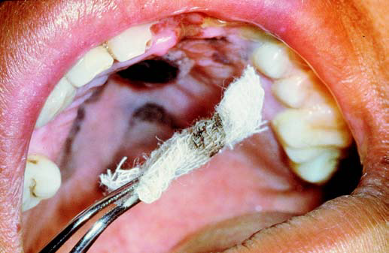
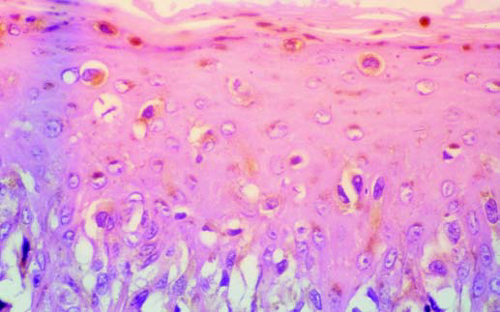
Practical and technically simple method for clinical diagnosis of oral melanomas to differentiate this neoplasm from other pigmented lesions.
13 lesions with suspected diagnosis of mucosal melanomas were submitted to a test named “rubbing with a gauze” the surface of the lesion. The test - positive when the gauze stained dark brown or black due to the presence of melanin-laden cells on the epithelial surface. In all cases definite diagnosis was confirmed by biopsy.
Positive results were obtained in 11 out of 13 cases (84.6%). In every case the final diagnosis must be established by histopathologic or immunohistochemical analysis.
DELGADO-AZAÑERO WA, A PRACTICAL METHOD FOR CLINICAL DIAGNOSIS OF ORAL MUCOSAL MELANOMAS.MED ORAL 2003;8:348-52.

Slide 38
MULTIFOCAL / DIFFUSE PIGMENTATION

Slide 39
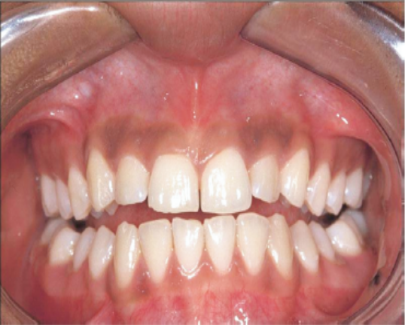
PHYSIOLOGIC PIGMENTATION ( RACIAL PIGMENTATION)
Multifocal or diffuse melanin pigmentation with variable prevalence in different ethnic groups.
Physiologic pigmentation, which is common in African, Asian and Mediterranean populations, is due to greater melanocyte activity rather than a greater number of melanocytes
Melanoplakia is a benign variation of this melanin pigment and is not associated with aggressive change.
The pigmentation of gingiva - Black gum.
Yasin Cicek, Omit Ertas. The Normal and Pathological Pigmentation of Oral Mucous Membrane: A Review. The Journal of Contemporary Dental Practice, , 2003.

Slide 40
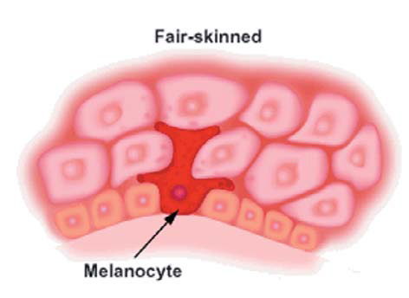
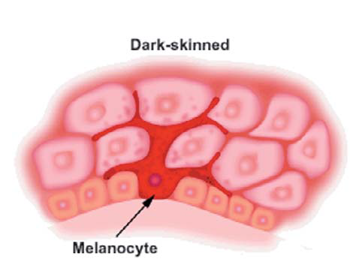
Smoker's Melanosis : flat, brown lesion with irregular outlines and some of them present as geographic or map like configuration.
Addison's Disease: , there will be deep tanning of skin and oral mucosa with deposits of melanin over pressure points.
Melanoma : early lesions of melanoma which present as flat brown or black lesions with irregular out lines resembles the physiologic pigmentation

Slide 41
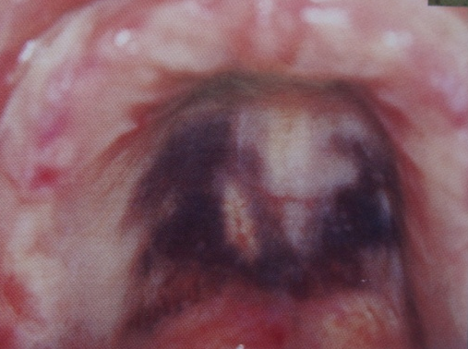
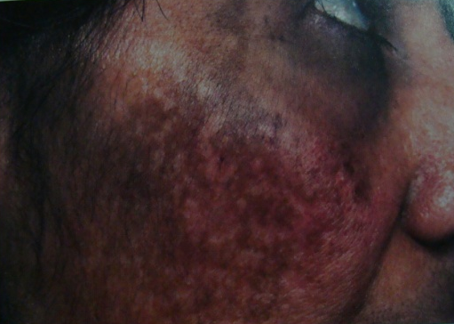
DRUG INDUCED MELANOSIS
The exact mechanism by which these drugs cause pigmentation is unknown.
The lesions are usually diffuse , mutlifocal, homogenous, macular lesions with sharp delineated borders.
The colour produced by these lesions varies depending on drug used.
Mohammad Abdollahi, Roja Rahimi, Mania Rafar. Current Opinion on Drug – induced Oral reactions. A comprehensive review. J. of Contemporary Dental Practice 2000;

Slide 42
Localized to hard palate or multifocal occurring in different sites of oral cavity ..
Lesions progress for certain period of time and disappear with discontinuity of drug
Various drugs inducing pigmentation
a)Drugs containing heavy metals - lead, bismuth, gold, mercury, arsenic
b) Antimalarial drugs chloroquinine, hydroxychloroquine, Amadioquine.
c) Quinidine, a cincona alkaloid - treatment of cardiac arrhythmias.
d) Minocycline, a synthetic tetracycline treatment of Acne vulgaris.
e) Oral contraceptives and pregnancy are also occasionally associated with pigmentation of skin in the periorbital and perioral regions the conditions commonly referred as Melasma or cholasma
Notes:
a)Drugs containing heavy metals - lead, bismuth, gold, mercury, arsenic and Bromides.
b) Antimalarial drugs - chloroquinine, hydroxychloroquine, Amadioquine.
c) Quinidine, a cincona alkaloid - treatment of cardiac arrhythmias.
d) Minocycline, a synthetic tetracycline which is used in treatment of Acne vulgaris.
e) Oral contraceptives and pregnancy are also occasionally associated with pigmentation of skin in the periorbital and perioral regions the conditions commonly referred as Melasma or cholasma

Slide 43
eZidovudine, an anti viral drug - treat AIDS mucosal pigmentation.
g) Hormones such as ACTH, progesterone
h) Anticonvulsants such as phenytoin and their related compounds
i) Phenothiazines such as chlorpromazine and related compounds
j) Others - cisplastin, busulphan gravidum, nitrogen mustard cyclophosphamide, heroin doxorubicin,
Etiopathogenisis
Minocycline – Hyper production of melanin, complex with iron, or stained bone
Antimalarials – Hyper production of melanin
Clofazamine - Chelated metabolites of medication
Tranquilizers - Medication/metabolites and/or accumulation of melanin
Hormones – Hyper production of melanin
Heavy metals - Granules of the metal distributed throughout blood vessels
Amiodorone - Increased production of lipofuscin

Slide 44
Meyerson MA et al (1995), Odell E.W. et al (1995), Anne E. Cale, Paul D . et.al.(1998), Mc Kenna et al reported minocycline induced discoloration of teeth and gingiva
Cynthia L. Kleinegger et.al. ( OOOE 2000) presented a case of oral mucosal hyperpigmentation resulting from antimalarial drug therapy
Mark A. Lerman et. al.( OOOE 2009) presented an example of quinacrine induced oral pigmentation.
The characteristic finding of slate-black pigmentation of the hard palate extending to, but without involving, the soft palate should immediately alert the clinician to the possibility of a medication-related condition.
Notes:
Meyerson MA et al (1995) reported two cases of minocycline induced pigmentation on the dorsal surface of tongue,
Odell E.W. et al (1995)⁷¹ reported a case of long term minocycline therapy which resulted in dark bone pigmentation i.e. black bone disease. The pigmentation was severe that it was visible through the alveolar and palatal mucosa.
Anne E. Cale, Paul D . et.al.(1998)⁷³ reported oral pigmentation due to minocycline hydrochloride therapy is an unusual and infrequently reported side effect of the drug. This report describes a patient on long-term minocycline therapy who presented with gingival pigmentation. Upon surgical exploration, the gingiva was noted to be normal in color, but the underlying bone was deeply pigmented. Via fluorescent microscopy, minocycline deposition within the alveolar bone was demonstrated.
Mc Kenna et al (1999)⁷⁰ in their review article reported a case of minocycline induced pigmentation of teeth and gingiva. The patient presented with a 4 year history of progressive discolouration of all her teeth and gingiva. Patient gave history of minocycliine therapy for acne vulgaris when she was about 16 years of age which was taken for a period of 6 years. They concluded that staining of teeth due to drug may be on the tooth surface rather than in dentin due to demineralization / remineralization phenomenon related to drug and also the ability of minocycline to etch the tooth surface on long term contact after initially attaching to the glycoproteins of acquired pellicle which gets oxidized on exposure to air and bacterial activity.
Cynthia L. Kleinegger et.al. (2000)⁶⁸ presented a case of oral mucosal hyperpigmentation resulting from antimalarial drug therapy
Mark A. Lerman et. al.(2009)⁶⁶ presented an example of quinacrine induced oral pigmentation. The characteristic finding of slate-black pigmentation of the hard palate extending to, but without involving, the soft palate should immediately alert the clinician to the possibility of a medication-related condition.

Slide 45
Differential Diagnosis :
When drug induced pigmentation presents as brownish macules. Addison's disease is considered.
Addison's Disease : Brown macules present in both conditions are indistinguishable. To arrive at a definite diagnosis proper history and serum laboratory studies may be required

Slide 46
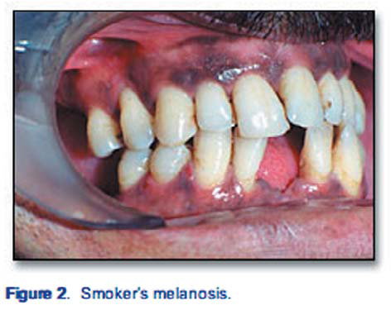
SMOKER'S MELANOSIS
Smoker's melanosis is a benign focal pigmentation
of oral mucosa caused by exposure to tobacco smoke .
Etiopathogenesis : poly cyclic amines such
as Benzopyrine, nicotine present in tobacco as well as
free radicals produced by use of tobacco .
With melanin present in tissues, these agents may be bond to melanin, and the deleterious effect on these cells is prevented. The harmless melanin-toxic complex transported within the advancing cells up through epithelial layers and finally expelled with aging cells at the surface layer.
Heat of the smoke may stimulate melanogenesis

Slide 47
Smokers melanosis is generally found in the populations of Sweden, Denmark, Germany, Japan, North America as well as in Thai, Chinese, Indian and Malaysian population.
Smoking may cause oral pigmentation in light-skinned individuals and accentuate the pigmentation of dark skinned patients.
Hedin CA. et al ( J of Oral path med 1991) conducted a study regarding smoker's meianosis in dark skinned inhabitants of South East Asia and they concluded that tobacco smoking stimulates oral melanocytes to a higher melanin production in dark skinned ethnic groups.
Hedin C and Pinborg J. (J of Oral path med(I992) have conducted histological study regarding the melanin pigmentation in the palate of Indian reverse smokers. They found that the morphology of the epithelium containing melanin in its basal part was found to be normal in smokers and non smokers in contrast to areas of depigmentation of the epithelium found in some reverse smokers.

Slide 48
Differential Diagnosis:
Physiologic Pigmentation : Physiologic pigmentation present as flat brown to black lesion which is diffuse and non palpable. Smoker's Melanosis also exhibit simliar appearance. History of smoking should be considered to rule out and smokers melanosis may disappear with the discontinuity of habit.
Treatment
These lesions are asymptomatic
Patient is advised to discontinue the smoking habit and with this improvement will be present over course of months or years.

Slide 49
POST INFLAMMATORY PIGMENTATION
It is discolouration of the skin or mucosa at the site of a healed or healing inflamed lesion. The colour tends to be more intense and persists for a longer period in dark – skinned persons, but occasionally seen in people with white skin.
The pathogenesis unclear. Histologically, there is increased production of melanin by the melanocytes and accumulation of melanin laden macrophages in the superficial connective tissue.
Patsakas et al (1982) observed that the melanophores of the epithelium increased in density as the inflammation of adjacent connective tissue in the attached gingival increased in severity.
Notes:
Tomita et al (1989 and 1992) suggested that arachidonate derived chemical mediators may be responsible for the induction of post-inflammatory hyperpigmentation .

Slide 50
PIGMENTATION ASSOCIATED WITH LICHEN PLANUS
WILSON described lichen planus as "an eruption of pimpies remarkable for their colour, their figure, their structure, their habits of isolated and aggregated development, their habitat, their local and chronic character, and for the Melasmic stains which they leave behind them when they disappear.
Etiopathogenesis- due to increased melanogenesis stimulated by infiltration of T lymphocytes into basal cell layers.
Pigmentation following oral lesions is rare. In only 11% of cases, these lesions are associated with pigmentation while the appearance of pigmentation in skin lesions is common and in these lesions it indicates resolution. Among oral lesions, erosive, reticular types are associated with pigmentation in which these may over lie or flanked by diffuse macular foci.

Slide 51
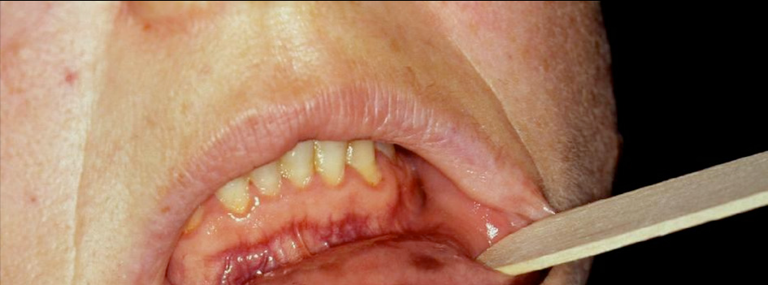
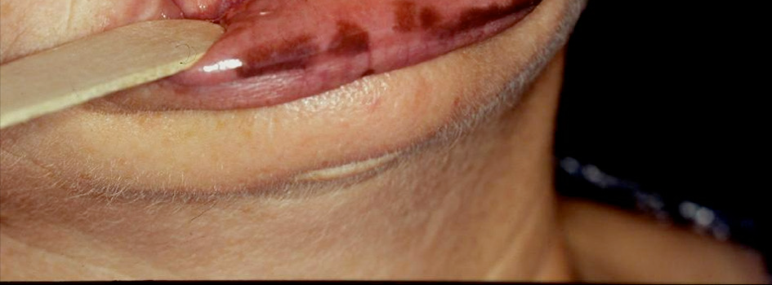
ADDISON'S DISEASE :
Addison’s disease is a primary adrenal failure caused by infiltrative or autoimmune processes.
a. Anatomic destruction of the gland
b. Metabolic destruction in hormone failure
Pathophysiology : Increasing ACTH and other proopiomelanocortin-derived peptides stimulate the melanocytes via the skin and mucosa-MSH receptor (MC1) causing skin and oral mucosa hyperpigmentation

Slide 52
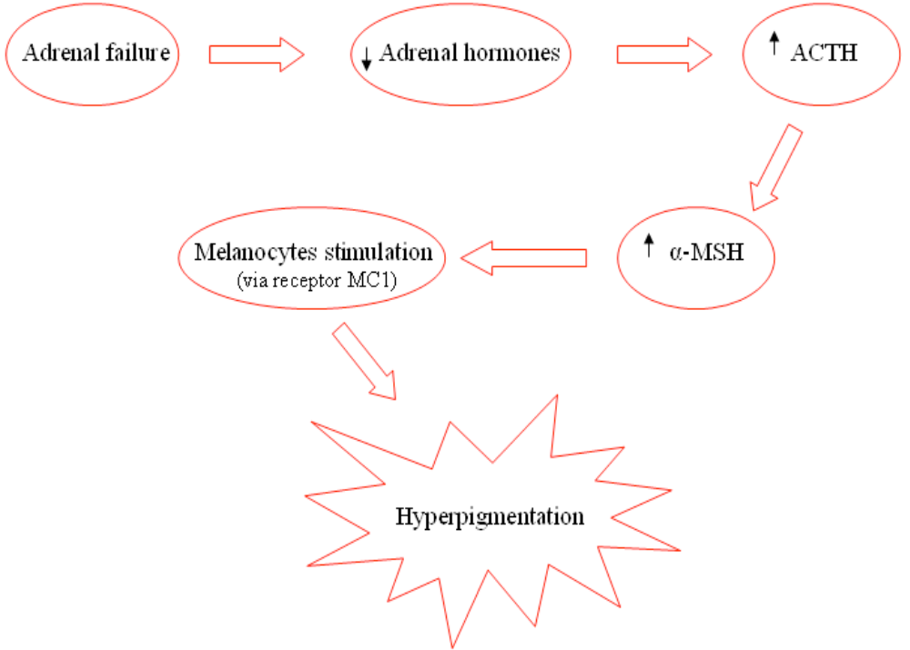
Hyper pigmentation may be a striking feature characterized by diffuse brown, tan, or bronze darkening of both exposed and unexposed areas of skin such as elbows, knees, palmar creases. Bluish black lesions are seen over the mucous membranes.
Alessandro Lanza, Oral Pigmentation as a Sign of Addison’s Disease: A Brief Reappraisal , The Open Dermatology Journal, 2009, 3, 3-6 3

Slide 53
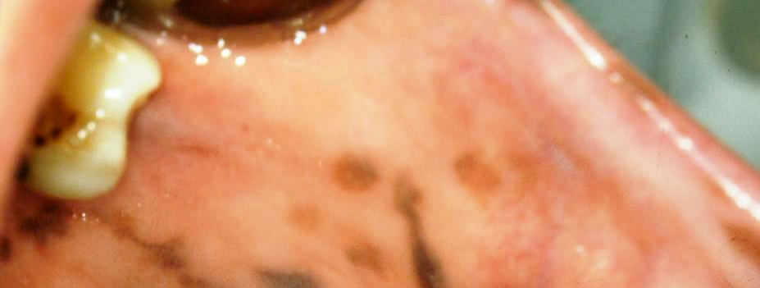
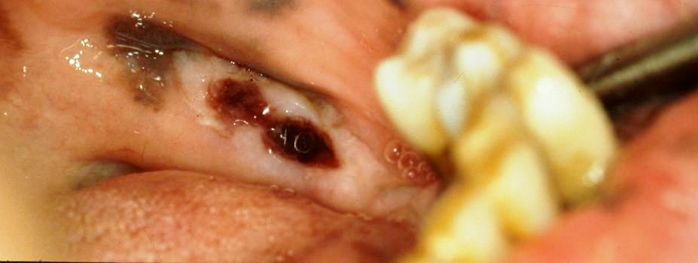
Oral Features : The Hyperpigmentation of oral mucosa is usually an early and prominent sign of Addison's disease. Pigmentation commonly occurs on buccal mucosa, labial mucosa, gingival mucosa and tongue.
The diffused pigmentation ,varies from bluish –
black to dark brown in colour which occurs in
various configurations such as streaks, blotches or spots .
Diagnosis: A critical evaluation of the patient’s medical history, intraoral and extraoral examination and laboratory tests are necessary to make a differential diagnosis; in addition a biopsy should be performed in doubtful cases

Slide 54
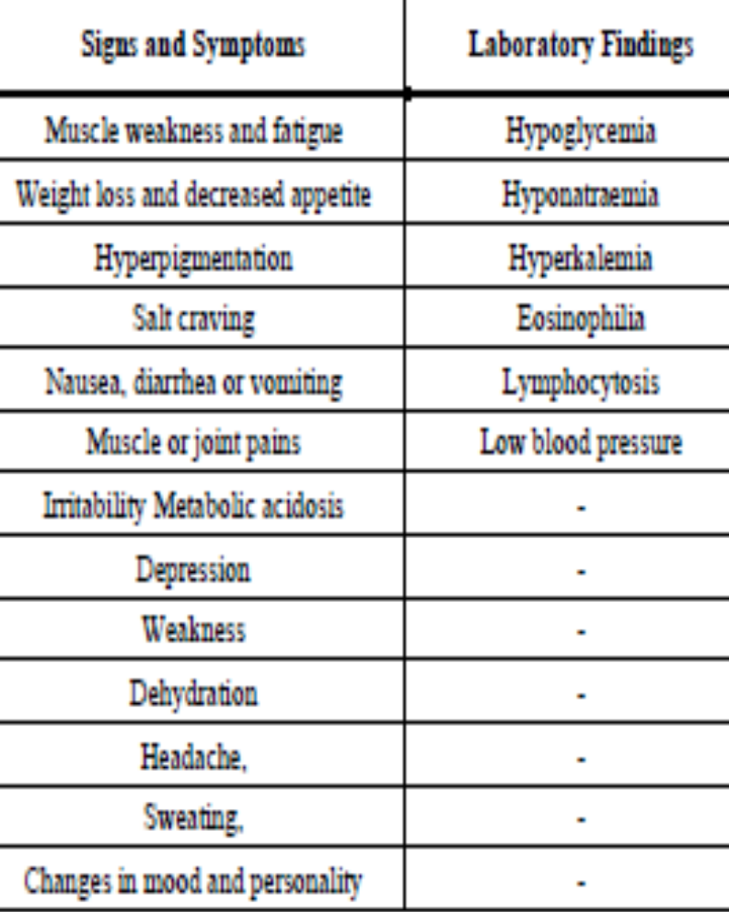
Differential diagnosis :
Physiological pigmentation
Post inflammatory healing
Smokers melanosis
Hemaochromatosis
Albrights syndrome
Neurofibromatosis
Peutz jeghers syndrome

Slide 55
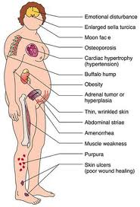
CUSHING'S SYNDROME
Cushing’s syndrome, is caused by excessive ingestion of glucocorticoid medication
Cushing's Syndrome is characterized by truncal obesity, hypertension, fatiguibility, weakness, amenorrhoea, hirsutism, purplish abnormal striae, edema, glycosuria, osteoporosis and a basophilic tumour of the pituitary gland
Pathophysiology of pigmentation :

Slide 56
Oral Features
Pigmentation commonly occurs on buccal mucosa, palate and gingiva.
The pigmented areas present as Blotchy brown or blackish areas.
Diagnosis : Serum steriod and ACTH determination will aid in the diagnosis and pigment often reslolves following appropriate surgical , radiation or medicinal therapy for the specific source of the endocrinopathy

Slide 57
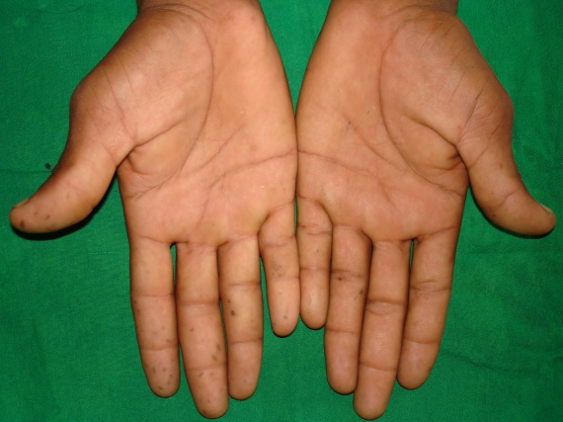
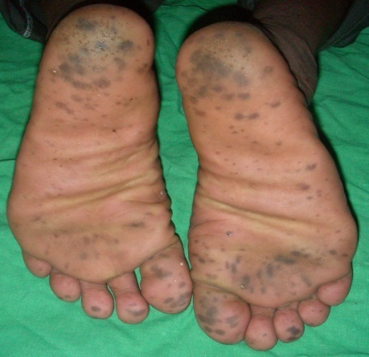
PEUTZ - JEGHER'S SYNDROME
Known as periorificial lentiginosis.
Rare, autosomal dominant genetic disorder - LKB1/ STK11 gene on chromosome 19.
Asssociated with generalised intestinal polyposis and pigmented macules on the face, oral cavity and occasionally on hands and feet.
Peutz - Jegher's Syndrome is characterized by multiple, focal, melanotic brown macules concentrated around the perioral region.

Slide 58
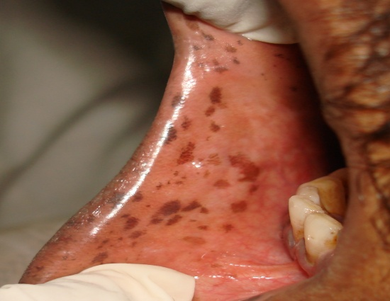
Intraorally, - buccal mucosa followed by gingiva, hard palate, lips and tongue.
The macule appears as a freckel or an ephelide measuring less than 0.5cm in diameter.
Differential diagnosis – albrights syndrome , addisons , neurofibromatosis
Peutz–Jeghers syndrome: case report and literature review E. F. GEORGESCU , Romanian Journal of Morphology and Embryology 2008, 49(2):241–245

Slide 59
CAFÉ-AU-LAIT PIGMENTATION
Café-au-Lait spots typically presents as tan or brown – colored, irregularly shaped macular lesions which manifest as common cutaneous findings and could be markers for many multisystem disease. which appear soon after birth and has a tendency to disappear with age.
They - isolated or oval shaped macules with varying size (2-20 mm).
McCune Albright syndrome, Neurofibromatosis type 1,2 , Familial cavernous malformation, Fanconi’s anemia, Tuberous sclerosis, noonans syndrome

Slide 60
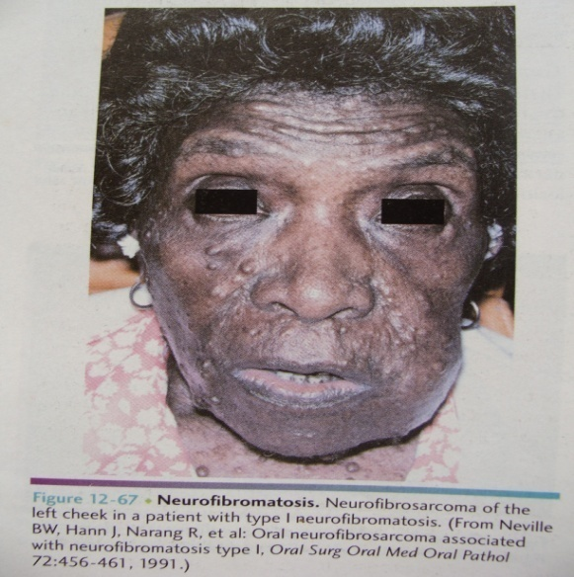
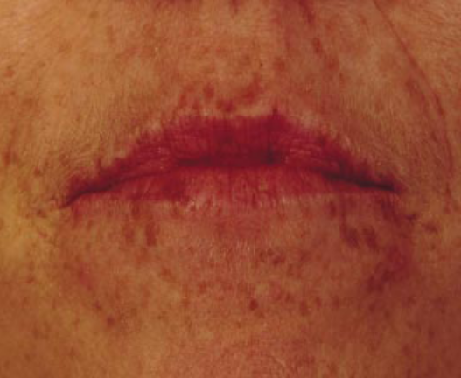
Neurofibromatosis - regular
Mccune albright – irregular
A recent study suggests that the colocalization of neurofibromin and amyloid precursor in melanosomes may be important for development of pigmented lesions in neurofibromatosis patients .

Slide 61
HIV ORAL MELANOSIS:
diffuse or multifocal mucocutaneous pigmentation has been frequently described in human immunodeficinecy virus (HIV) seropositive patients .
Langford A. et al (1989) reported that it may be related to;
a. Primary adrenocortical insufficiency
b. Due to drugs such as clofazimine, zidovudine and ketaconazole.
buccal mucosa is the most frequently affected site. The other sites such as gingiva, palate, tongue, upper lip may also be involved. Lesions appear as diffuse, multifocal macules which are brown in colour.

Slide 62
Goldstien and colleagues demonstrated a significant correlation between mucocutaneous pigment and CD 4 counts cell / micro litre <= 200 . studies also showed that the immne dysregulation with HIV / AIDS leads to increased secretion of alpha MSH form anterior pituitary gland which may also stimulate increased melanin synthesis
Differential diagnosis : addisons disease , mac cune albright , neurofibromatosis

Slide 63
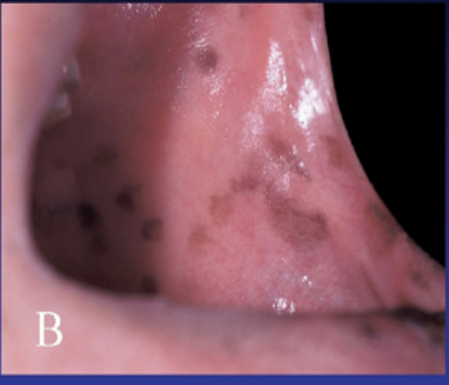
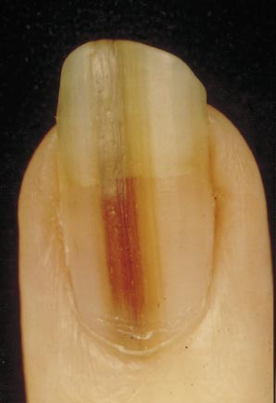
LAUGIER – HUNZIKER PIGMENTATION :
It is an acquired , idiopathic macular hyperpigmentation of the oral mucosal tissues specifically involving lips and buccal mucosae . it also involves esophageal , genital and conjuctival mucosa and acral surfaces .
60% of cases have nail involvement- longitudinal melanotic streaks and with out evidence of dystrophic changes .
clinical features : multiple discrete irregularly shaped brown or dark brown oral macules < 5mm. tances , the lesions may coalesce to produce diffuse area of involvement
A K Lampe , Laugier-Hunziker syndrome: an important differential diagnosis for Peutz-Jeghers syndrome , J Med Genet 2003

Slide 64
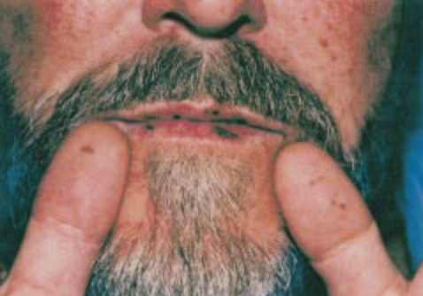
Diagnosis : a differential diagnosis may include physiologic , drug or heavy metal induced pigmentation ,endocrinopathic disease , peutz jeghers syndrome .
T. Sabesan .et. al. ( 2004) reported a case of Laugier-Hunziker Syndrome in a 80-year-old white woman who presented with painless brown pigmentation of the lower lip and patchy freckling in her nails, of 7 years’ duration.
Kaori Yago. et. al.(2008) presented present a histopathologic analysis of the syndrome in 2 cases.

Slide 65
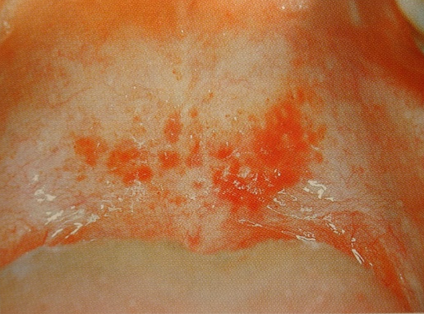
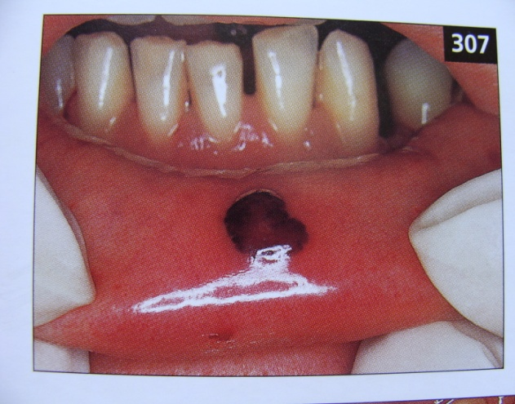
HEMOGLOBIN AND IRON ASSOCIATED PIGMENT
Echymosis : traumatic ecchymosis is common on lips
ecchymosis of oral mucosa - with liver cirrhosis , leukemia , end stage renal disease - dialysis treatment .
laboratory tests including :BT , PTT and INR should be obtained in instances of spontaneous ecchymoses
PURPURA / PETECHIAE : oral purpura/ petechiae may develop as a consequence of trauma / viral / systemic disease / platelet deficiencies .

Slide 66
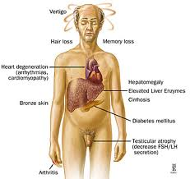
HEMOCHROMATOSIS (BRONZE DIABETES)
Haemochromatosis is an iron storage disease in which excess amounts of iron deposited in body tissues and organs
Etiology :
a. idiopathic hemochromatiosis.
b. Erythropoietic hemochromatosis.
c. In alcoholics with liver disease.
Due to excessive intake of iron.
The pigmentation of skin and oral mucous membrane may be due to combining of melanin with iron pigmentation resulting in a characteristic bronze colour which is an important characteristic feature of the disease.

Slide 67
Differential diagnosis : addisons disease , argyria
To arrive at a definitive diagnosis ;
A careful examination and history should be taken
Skin, oral,bone marrow and liver biopsies are also valuable
The tissue can be stained for iron by using Prussian blue
Determination of iron content and iron binding capacity are also helpful² .

Slide 68
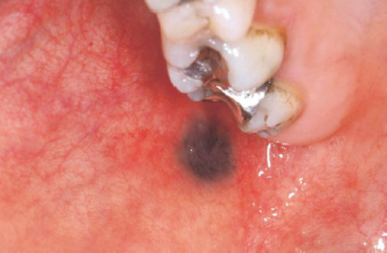
EXOGENOUS PIGMENTATION
TATTOO : Tatto is tissue stained by a pigmented foreign material.
Common material - amalgam , others – graphite from pencils , dyes , inks , charcoal dentirifice .
Pathogenesis of amalgam tatoo :
The lesions of amalgam tattoo are usually present as flat macules and occasionally it presents as a slightly raised lesion. The margins of these lesions may be well defined or irregular or diffuse in nature

Slide 69
HEAVY METAL PIGMENTATION
Heavy metal pigmentation is caused by ingestion or inhalation of materials containing lead, bismuth and mercury ,arsenic,silver and gold.
copper, zinc, phosphorous, copper, manganese rarely cause pigmentation
Identification and treatment of cause to avoid severe systemic side effects
Etiology : - It may be an occupational hazard.
By ingestion of medication containing heayy metals as their components.
Pathogenesis :
Adel Kauzman, Marisa Pavone, Nick Blanas, Grace Bradley. Pigmented Lesions of the Oral Cavity: Review, Differential Diagnosis, and Case Presentations. J Can Dent Assoc 2004; 70(10):682–3

Slide 70
Clinical Features
free gingival margin which outlines the gingival cuff like a cylinder.
pigmentation is gray to black. buccal mucosa, lips, the ventral surface of tongue or in any localized areas of inflammation.
Heavy metal pigmentation may occassionally be associated with systemic symptoms such as burning sensation, metallic taste, increased salivation, tremors .
Symptoms of toxicity such as behavioural changes, neurologic disorders and intestinal pain may occur which are rare.

Slide 71
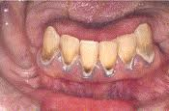
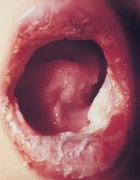
Bismuth - bismuth line – black line
Lead – burtonians line – bluish line
Mercury – blue –gray line
Silver – bluish green
Acrodynia / swift disease

Slide 72
CONCLUSION
Proper and timely identification and diagnosis of any mucosal colour change is essential so that patient is not alarmed unnecessarily nor is something alarming missed out.
As oral physicians we play a prime role in the early detection of colour changes and thus save more lives.

Slide 73
REFERENCES
Martin S. Greenberg, Michael Glick. Burkit’s text book of Oral Medicine 2003. 10th Edition. Elsevier India.
Cotran R.S, Kumar V, Robbin. Pathologic basis of disease 2003 ; 7th Edition W.B. Saunders and Company : 22 – 26.
Yasin Cicek, Omit Ertas. The Normal and Pathological Pigmentation of Oral Mucous Membrane: A Review. The Journal of Contemporary Dental Practice, Volume 4, No. 3, August 15, 2003.
McCarthy P.L., Shklar. Disturbances in pigmentation. Disease of Oral Mucosa; 1980 Lea ad Febeger : 365-375.
Wood and Goaz. "Differential Diagnosis of Oral and Maxillofacial Lesions". 5th Edition, Mosby Co.1997.
Regezi J.i. and Sculba. "Oral Pathology: Clinical - Pathologic correlations”.Chapter5, 3rd Edition, W.B. Saunders Co.

Slide 74
Neville, Damm, Allen. Oral and Maxillofacial Pathology 2004; 2nd Edition Elsevier; 269 – 275 and 791 – 793.
Adel Kauzman, Marisa Pavone, Nick Blanas, Grace Bradley. Pigmented Lesions of the Oral Cavity: Review, Differential Diagnosis, and Case Presentations. J Can Dent Assoc 2004; 70(10):682–3
Shafer, Levy, Hine A. “Textbook Of Oral Pathology”. 4th Edition, W.B.Saunders Co., 2000.
Craig l. Hatch. Pigmented lesions of the oral cavity. Dent Clin N Am 2005; 49: 185–201.
Marco Meleti. Paolo Vescovi, A wolter J. Mooiisaäc Van der Waal. Pigmented lesions of the oral mucosa and perioral tissues: aflow-chart for the diagnosis and some recommendations for the management. Oral Surg Oral Med Oral Pathol Oral Radiol Endod 2008; 105: 606-16.
Masahiro Umeda, Hideki Komatsuba, Takashi Shigeta, Yasutaka Ojima, Tsutomu Minamikawa. Treatment and prognosis of malignant melanoma of the oral cavity: preoperative surgical procedure increases risk of distant metastasis. Oral Surg Oral Med Oral Pathol Oral Radiol Endod 2008; 106: 51-7.
Mollaglu N. "Oral Lichen Planus - A review". Jr Oral & Maxillofac Surg., 2000; 38: 370-377.

Slide 75
Mark a. Lerman, Nadeem Karimbux, Kevin A. Guze, Sook-Bin Woo. Pigmentation of the hard palate. Oral Surg Oral Med Oral Pathol Oral Radiol Endod 2009;107:8-12.
Mohammad Abdollahi, Roja Rahimi, Mania Rafar. Current Opinion on Drug – induced Oral reactions. A comprehensive review. J. of Contemporary Dental Practice 2000; 9(3): 1-32.
Cynthia L. Kleinegger, Harold L. Hammond, Michael W. Finkelstein. Oral mucosal hyperpigmentation secondary to antimalarial drug therapy Oral Surg. Oral Med. Oral Pathol. Oral Radiol .Endod 2000; 90: 189-94.
Jones and Mason. Oral Manifestations of Systemic Disease". Pg 464 -468, W.B. Saunders Co., 1980.
Chuong R. and Goldberg H.M. "Oral hyper pigmentation associated with Addison's Disease". J. Oral & Maxillofac. Surg., 1983; 41: 680 – 682.
Maria Siponen. Laugier – Hunziker Syndrome – A report of a case. Oral Surg Oral Med Oral Pathol Oral Radiol Endod 2003; 96: 288 – 292.

Slide 76
Brian D. Kavanagh, Robert L. Campbell, Vjames W. Patterson. Roberts. Laugier- Hunziker syndrome: A rare cause of mucocutaneous pigmentation. British journal of oral and maxillofacial surgery 2006; 44(4): 320-321.
Kaori Yagoyoichi Tanaka, Soichiro Asanami. Laugier Hunziker-Baran syndrome. Oral Surg Oral Med Oral Pathol Oral Radiol Endod 2008;106: e20-e25.

