Slide 1
PHYSIOLOGY OF TASTE

Slide 2
INTRODUCTION
Taste is a complex contact sensation involving various sensory stimuli which involves chemo-receptors of gustation & olfaction it arises from the interactions of five basic tastes of food SWEET, SOUR,SALTY, BITTER AND UMAMI
Oral fluids and contacts over the taste receptors in the taste buds
Olfactory receptors of the mucosa in the roof of nasal cavity
Taste sensation based on temperature touch texture pain
Bitter and sweet are better when they are warm
Sour and salty ___cold

Slide 3
Taste (Gustation)
Present in oral cavity and throat
Taste bud consists of
  Taste pore
    Opening through which fluids in mouth come into
contact with surface of receptor cells
  Taste receptor cells
    Modified epithelial cells with surface folds called microvilli
    Plasma membrane of microvilli contain receptor sites
that bind selectively with chemical molecules

Slide 4
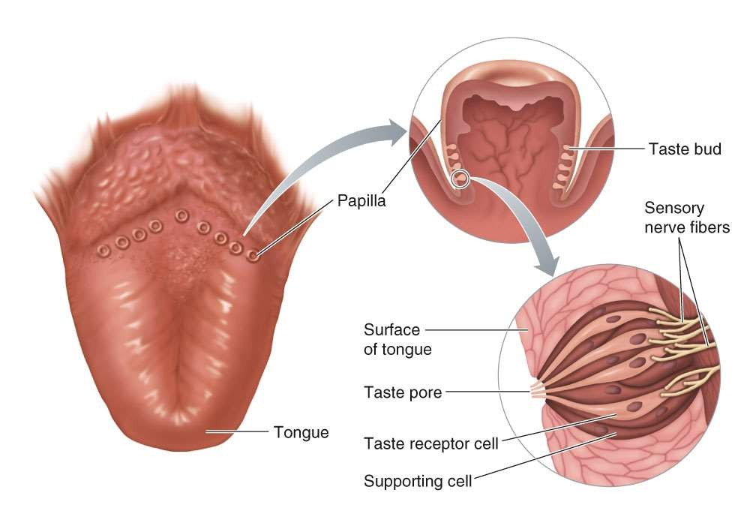
Location and Structure of Taste
Buds
2k to 10k

Slide 5
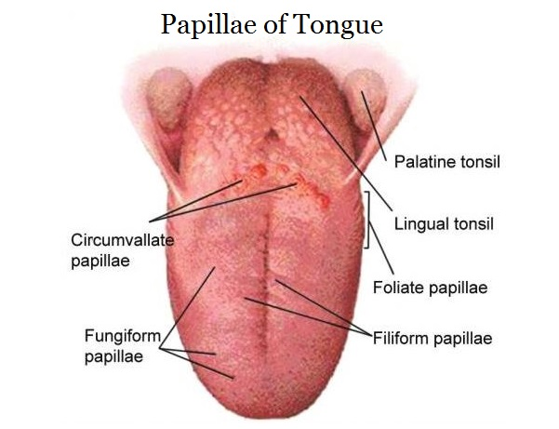
Anterior 2/3rd of the dorsum of tongue ----taste buds are found 3 types of papillae
circumvallet papillae that form v line in the posterior part of anterior 2/3rd of the dorsum.
Mushroom shaped fungiform papillae in the anterior border
leaf like foliate papillae present in the lateral border
taste buds are also found in soft palate, tonsillar pillars, epiglottis, pharynx, and initial segments of esophagus

Slide 6
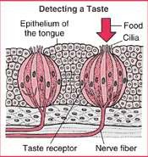
Taste Buds

Slide 7
Sensation of Taste –
Located in taste buds in:
  Tongue
  Epiglottis
  Soft Palate
  Pharynx

Slide 8
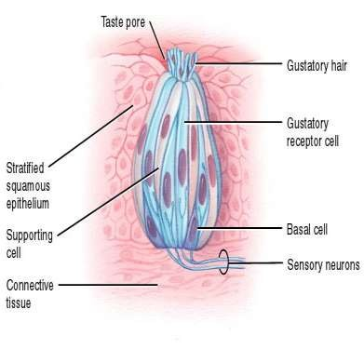
Anatomy of Taste Buds.
10,000 taste buds found on tongue, soft palate & pharynx
Taste buds consist of:
  ~50 receptor cells (type 3)
surrounded by supporting cells
  Basal cells (type 1 &2) develop into supporting cells then receptor cells

Slide 9
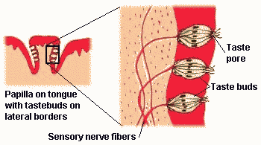
Anatomy of Taste Buds – cont.

Slide 10
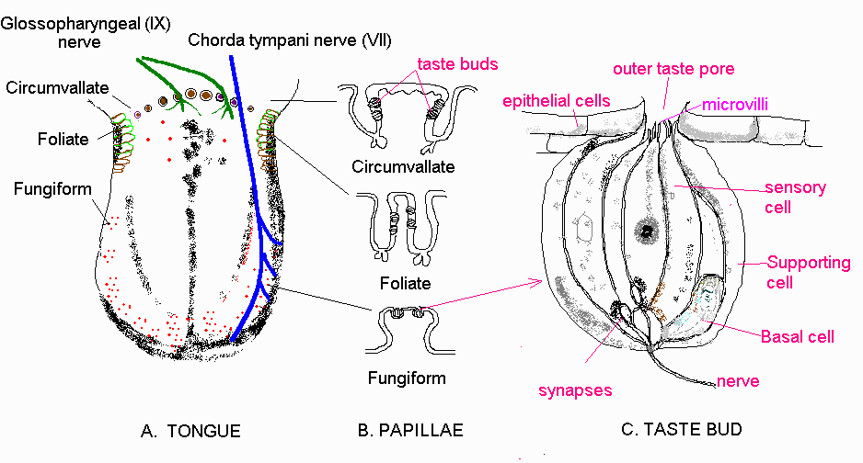

Slide 11
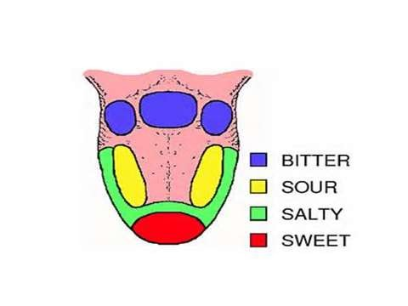
Taste modalities over tongue

Slide 12
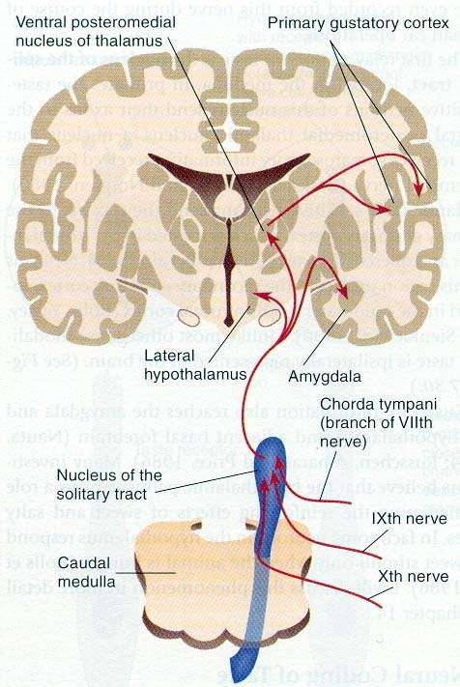
Taste Pathway
Taste information is send to the CNS by the cranial nerves # 7, 9 and 10 the taste nucleus (n. tractus
thalamus
solitarius)
primary gustatory cortex insular cortex

Slide 13
TASTE PATHWAY
Cell bodies in the geniculate ganglion
(sensory ganglion of cranial nerve VII)
FIRST ORDER NEURONS: carrying taste sensation from the taste buds located in the anterior 2/3rd of tongue
Chorda tympani branches of facial nerve
Cell bodies located in the inferior ganglion
(sensory ganglion cranial nerve IX)
Glossopharyngeal nerve (cranial nerve IX) carrying sensatioin from the posterior 1/3rd of tongue
circumvallate papilla and vallecula region

Slide 14
Vagus nerve carry taste sensation from epiglottis and pharynx has their cell bodies located in the inferior ganglion cranial nerve X
First order neurons end in the nucleus tractus solitarius (NTS) in the medulla
Second order neurons arise from NTS cross the mid line and ascends in the medial lemnsicus to end in the ventral posterior medial of the thalamus
From the VPM nucleus the third order neuron arises and terminates in the taste area of cerebral vortex the post central gyrus of the parietal lobe

Slide 15
Physiology of Taste
Dissolution in Saliva
Attachment to Receptors Generator Potential Action Potential

Slide 16
Primary modalities of taste
:
Responses of Taste buds:
Each taste bud responds strongly to one type of taste
But they also respond to other tastes as well

Slide 17
Taste
5 primary tastes
  Salty
    Stimulated by chemical salts, especially NaCl
  Sour
    Caused by acids which contain a free hydrogen ion, H⁺
  Sweet
    Evoked by configuration of glucose
  Bitter
    Brought about by more chemically diverse group of taste substances
    Examples – alkaloids, toxic plant derivatives, poisonous substances
  Umami
    Meaty or savory taste/ pleasant taste

Slide 18
Physiology of taste
Sour ... Acidity by {H⁺} – HCL
Salt …
Sodium chloride
Sweet ..Sucrose
glucose
Saccharin
Bitter .. hydrochloride
Quinine sulphate, alkaloids

Slide 19
Mechanism of stimulation of taste sensations:-
By sodium and hydrogen ions respectively.
The transduction process for sweetness and bitterness involve second messengers.

Slide 20
s

Slide 21
THE 4 “BASIC” TASTES ARE SALTY, SOUR, SWEET AND BITTER,
Different ions, different receptors for different tastes

Slide 22
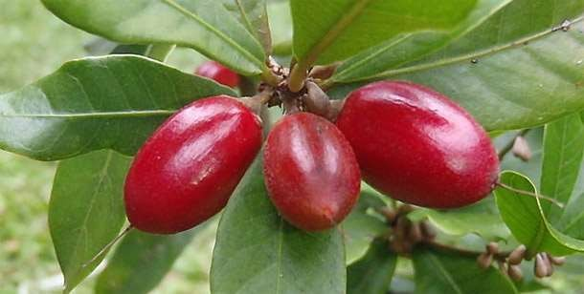
Sensation of Taste.
Taste modifier Miraculin (a glycoprotein extracxted from miracle fruit):
  When applied to tongue makes acids taste sweet
The Miracle fruit-origin
of miraculin

Slide 23
Clinical considerations
Ageusia: Absence of sense of taste
Dysgeusia: Disturbed sense of taste
Hypogeusia: Diminshed sense of taste
Hypergeusia: increased sense of taste

