Slide 1



PERIODONTAL MEDICINE
Presentor
Dr.P.D.L.Haneesha

Slide 2
Periodontal Disease, Coronary Heart Disease, and Atherosclerosis
Periodontal Disease and Stroke
CONTENTS
Periodontal Disease and Pregnancy
Outcome
Periodontal Disease and Chronic Obstructive Pulmonary Disease
Periodontal Disease and Diabetes Mellitus
Periodontal Disease and Acute Respiratory Infections

Slide 3
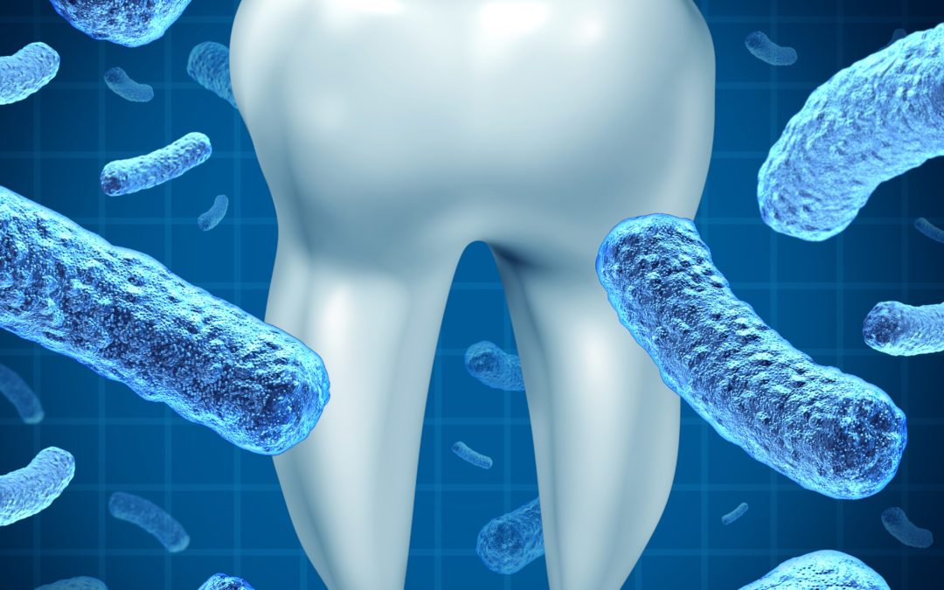
Introduction
Pathogenic bacteria are necessary for periodontal disease, but bacteria alone are not sufficient to cause disease.
A susceptible host is imperative.
In a host with relatively low susceptibility, bacterial pathogens may have little or no clinical effect.
Conditions in which the influences of periodontal infection are well documented include coronary heart disease (CHD) and CHD-related events such as angina, infarction, atherosclerosis, and other vascular conditions;
stroke; diabetes mellitus; preterm labor, low-birth-weight delivery,
and preeclampsia; and respiratory conditions such as chronic obstructive pulmonary disease
3

Slide 4

In 1900, British physician William Hunter first developed the idea that oral microorganisms were responsible for a wide range of systemic conditions that were not easily recognized as being infectious in nature.
He claimed that restoration of carious teeth, instead of extraction, resulted in the trapping of infectious agents under restorations.
Hunter identified gingivitis and periodontitis as foci of infection.
He advocated the extraction of teeth with these conditions to eliminate the source of sepsis.
Hunter thought that teeth were prone to septic infection primarily because of their structure and their relationship to alveolar bone.
He stated that the degree of systemic effect produced by oral sepsis depended on the virulence of the oral infection and the individual’s degree of resistance.
Focal infection theory revisited

Slide 5

Finally, Hunter thought that the connection between oral sepsis and resulting systemic conditions could be shown via removal of the causative sepsis through tooth extraction and observation of the improvement in systemic health
The focal infection theory fell into disrepute during the 1940s and
1950s, when widespread extraction—often of the entire dentition—
failed to reduce or eliminate the systemic conditions to which the
supposedly infected dentition had been linked.
The theory, while offering a possible explanation for perplexing systemic disorders, had been based on very little (if any) scientific evidence.
Hunter and other advocates of the theory were unable to explain how focal oral sepsis produced these systemic maladies.
They were also unable to elucidate possible interactive mechanisms between oral and systemic health.

Slide 6
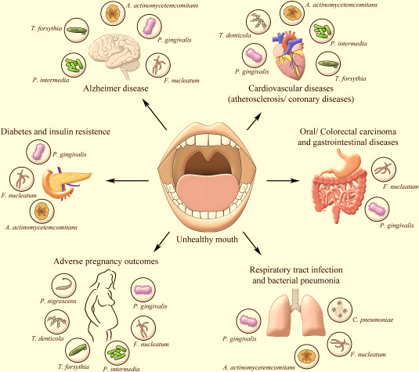
The subgingival microbiota in patients with periodontitis provides a significant and persistent gram-negative bacterial challenge to the host that is met with a potent immunoinflammatory response.
These organisms and their products, such as lipopolysaccharides
(LPSs), have ready access to the periodontal tissues and to the circulation via the sulcular epithelium, which is frequently ulcerated and discontinuous.
Even with treatment, complete eradication of these organisms is difficult, and their reemergence is often rapid.
The total surface area of pocket epithelium in contact with subgingival bacteria and their products in a patient with generalized moderate periodontitis has been estimated to be approximately the size of the palm of an adult hand.
Bacteremias are common after mechanical periodontal therapy,

Slide 7
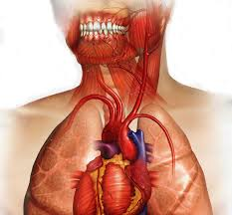
Periodontal disease, coronary heart Disease, and atherosclerosis
There are numerous mechanisms—both direct and indirect—through which periodontal infection may affect the onset or progression of atherosclerosis and CHD.
Periodontitis and atherosclerosis
both have complex etiologic factors that combine genetic and environmental influences.
In addition to smoking, the diseases share many risk factors and have distinct similarities concerning their basic pathogenic mechanisms

Slide 8
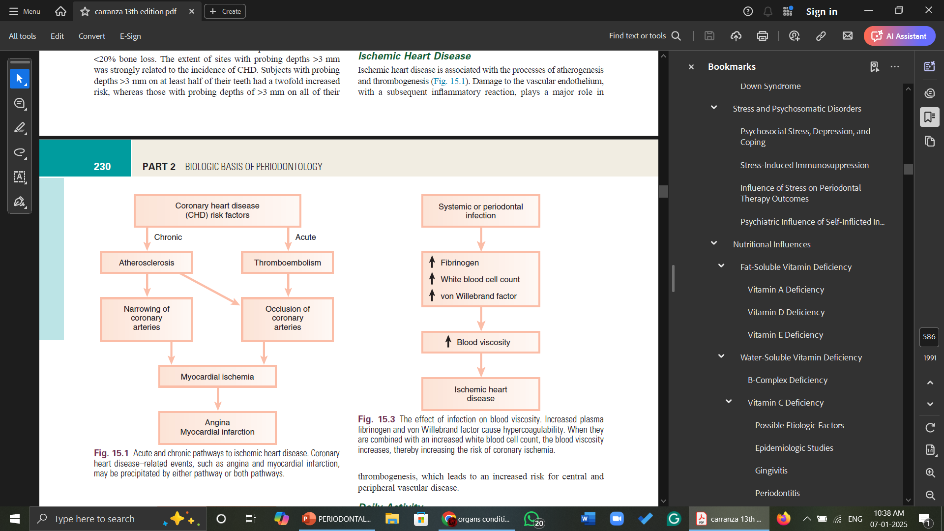
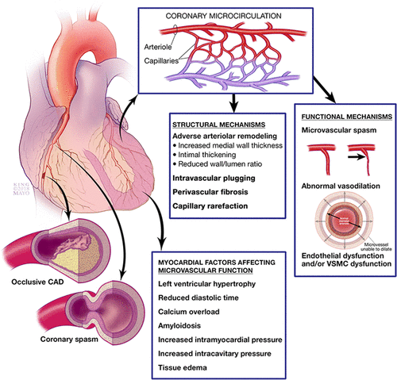

Slide 9
Increased viscosity of blood may promote major ischemic heart disease and cerebrovascular accident (stroke) by increasing the risk of thrombus formation.
Fibrinogen is a major factor in the promotion of this is the precursor to fibrin, and hypercoagulable state.
increased fibrinogen levels increase blood viscosity.
Increased plasma fibrinogen is a recognized risk factor for cardiovascular events and peripheral vascular disease.
An elevated white blood cell count is also a predictor of heart disease and stroke, and circulating leukocytes may promote the occlusion of blood vessels.
Coagulation factor VIII (von Willebrand factor) has likewise been associated with a risk of ischemic heart disease.
Systemic or periodontal infection
Fibrinogen
Wbc
Von Willebrand factor
Blood viscosity
Ischaemic heart disease
Notes:
Fibrinogen levels are increased due to physical activity, cholesterol, diet rich in iron,cholesterol and fatty acids, inflammation, age,BMI,, smoking, diabetes, pregnancy, genetic factors. Low density lipoproteins bind to blood vessel walls & can increase the density of clots by making them stiffer and less permeable.

Slide 10
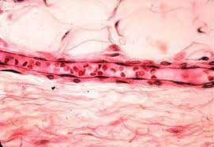
Thrombogenesis
Platelet aggregation plays a major role in thrombogenesis, and most cases of acute MI are precipitated by thromboembolism. Oral organisms may be involved in coronary thrombogenesis. Platelets selectively bind some strains of Streptococcus sanguinis, which is a common component of supragingival plaque, and Porphyromonas gingivalis, which is a pathogen closely associated with periodontitis.
The aggregation of platelets is induced by the platelet aggregation–associated protein (PAAP) expressed on some strains of these bacteria.

Slide 11
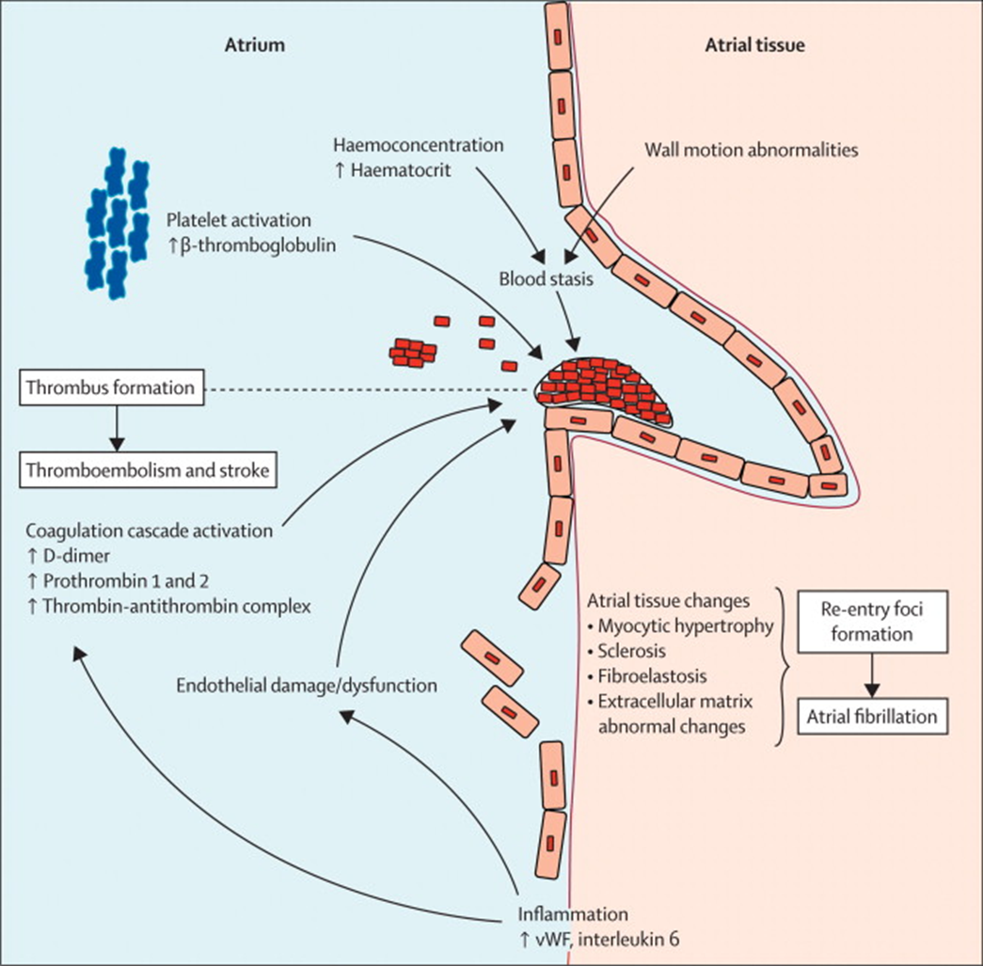
Atherosclerosis
Atherosclerosis is a focal thickening of the arterial intima, the
innermost layer lining the vessel lumen, and the media, the thick
layer under the intima that consists of smooth muscle, collagen, and elastic fibers .
The formation of atherosclerotic plaques is precipitated by damage to vascular endothelium that results in an inflammatory response in which circulating monocytes adhere to the vascular endothelium.
Damage to vascular endothelium can occur because of the presence of intravascular microorganisms and their products; and increased shear force along the vascular lining, such as that occurring in hypertension.

Slide 12
The adherence of monocytes to the damaged vascular endothelium is mediated by several adhesion molecules on the endothelial cell surface, including intercellular adhesion molecule-1 (ICAM-1), endothelial leukocyte adhesion molecule-1 (ELAM-1), and vascular cell adhesion molecule-1 (VCAM-1).
These adhesion molecules are up-regulated by a number of factors, including bacterial LPSs, prostaglandins, and
Pro-inflammatory cytokines.
After binding to the endothelial cell lining, monocytes penetrate the endothelium and migrate under the arterial intima.
The monocytes ingest circulating low-density lipoprotein in its oxidized state and become engorged, thereby forming the foam cells that are characteristic of atheromatous plaque.

Slide 13
After entering the arterial media, monocytes may also transform to macrophages.
A host of pro-inflammatory cytokines such as interleukin-1 (IL-1),tumor necrosis factor alpha (TNF-α), and prostaglandin E2 (PGE2) are then produced, and they propagate the atheromatous lesion.
Mitogenic factors such as fibroblast growth factor and platelet-derived growth factor stimulate smooth muscle and collagen proliferation within the media, thereby thickening the arterial wall.
Atheromatous plaque formation and thickening of the vessel wall narrow the lumen and dramatically decrease blood low through the vessel.
Arterial thrombosis often occurs after an atheromatous plaque ruptures.
Plaque rupture exposes circulating blood to arterial collagen and tissue factor from monocytes and macrophages that activate platelets and the coagulation pathway.
Platelet and fibrin accumulation forms a thrombus that may occlude the vessel and result in an ischemic event such as angina or MI.
The thrombus may separate from the vessel wall and form an embolus, which may also occlude vessels, again leading to an acute event such as MI or cerebral infarction (stroke).

Slide 14
Role of Periodontal Disease in Atherosclerotic Myocardial or Cerebral Ischemia
In animal models, gram-negative bacteria and associated LPSs cause infiltration of inflammatory cells into the arterial wall, proliferation of arterial smooth muscle, and intravascular coagulation.
These changes are identical to those seen with naturally occurring atheromatosis.
There is strong evidence that periodontal bacteria disseminate from the oral cavity to the systemic vasculature, can be found within distant tissues, and can live within those affected tissues.
Patients with periodontitis are at increased risk for thickening of the walls of the major coronary arteries.
In several studies of atheromas obtained from humans during endarterectomy, more than half of the lesions contained periodontal pathogens, and many atheromas contained multiple different periodontal species.
Periodontal diseases result in chronic systemic exposure to products of these organisms.
Low-level bacteremia may initiate host responses that alter coagulability, endothelial and vessel wall integrity, and platelet function, thereby resulting in atherogenic changes and possible thromboembolic events

Slide 15
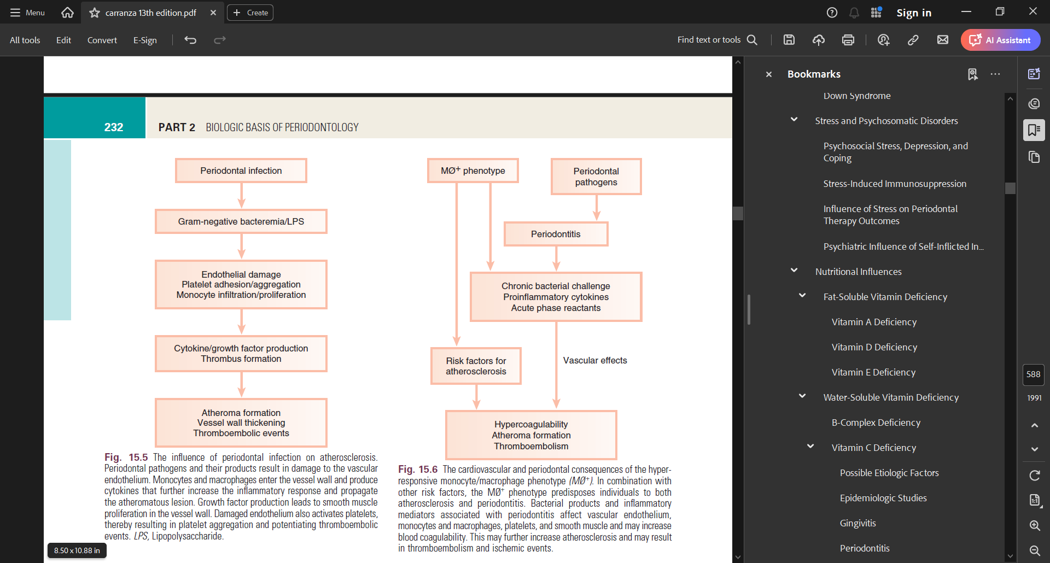
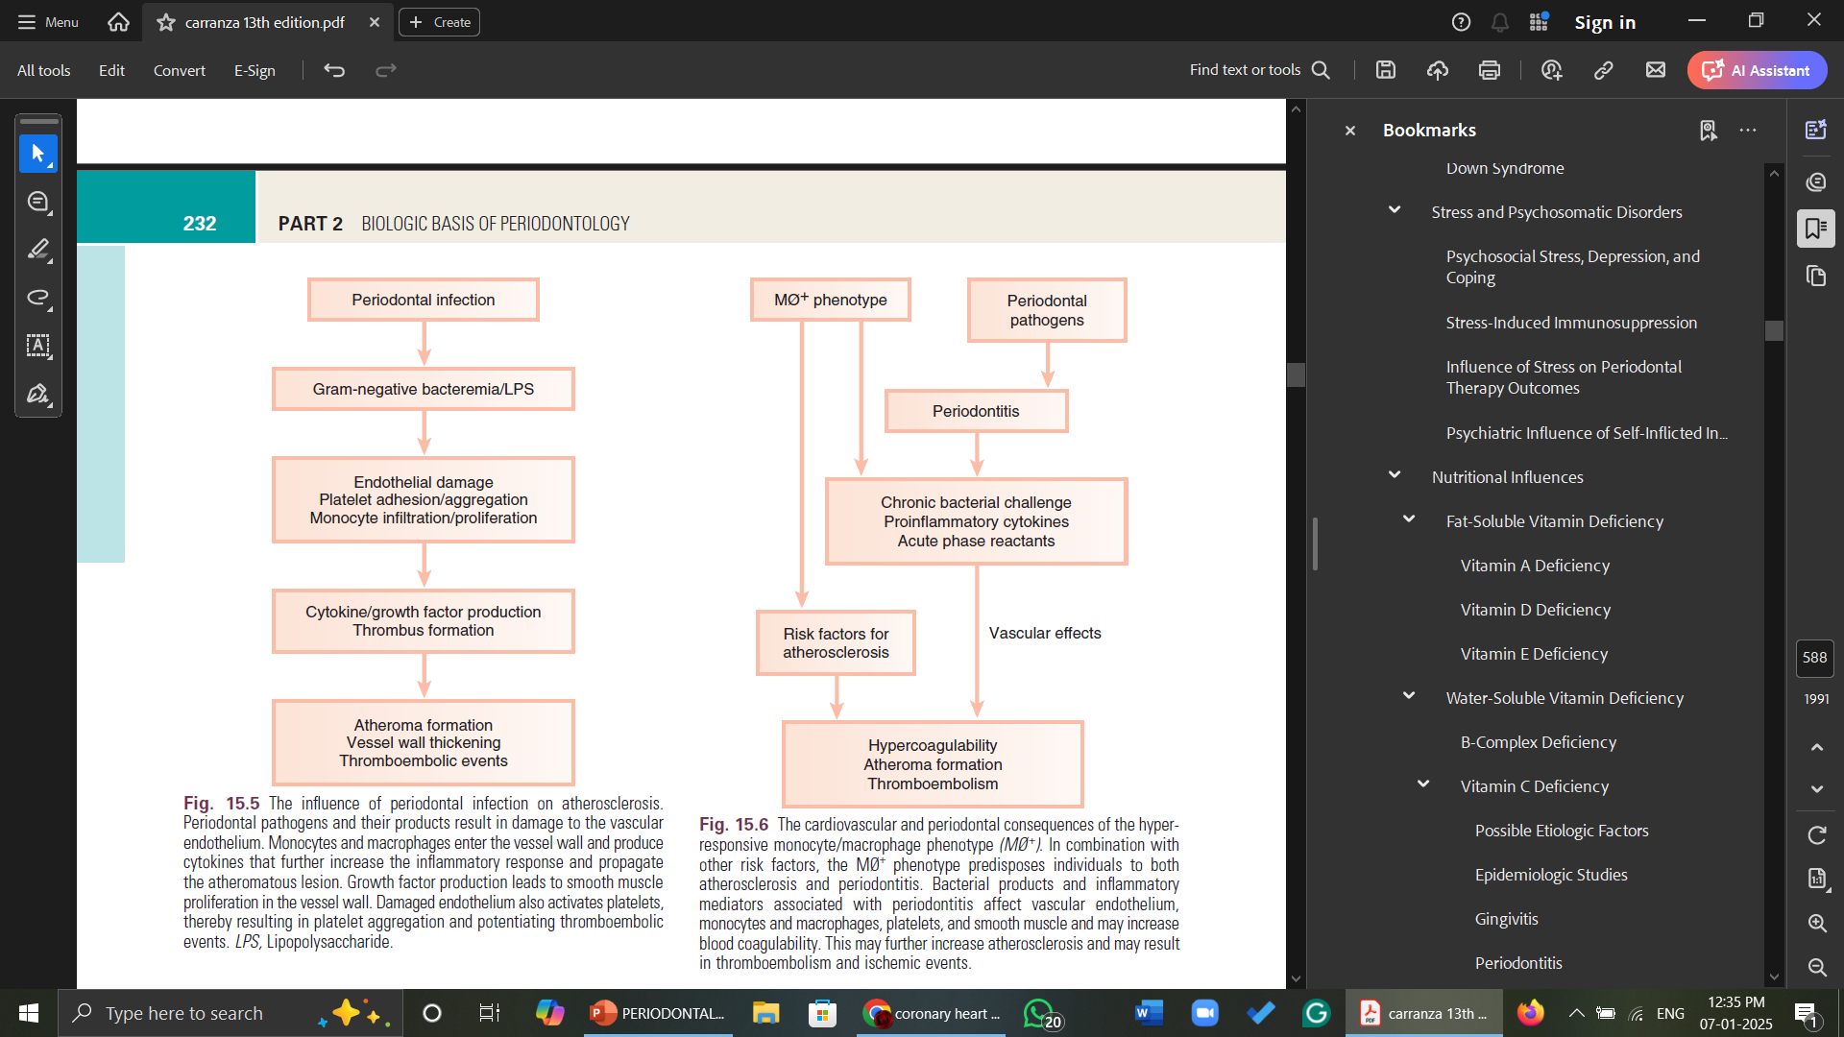
Notes:
Patients with an abnormally
exuberant inlammatory response often have a hyperinlammatory
monocyte and macrophage phenotype (MØ+). Monocytes and
macrophages from these individuals secrete signiicantly increased
levels of proinlammatory mediators (e.g., IL-1, TNF-, PGE2) in
response to bacterial LPSs compared with patients with a normal
monocyte and macrophage phenotype. Patients with aggressive
periodontitis, refractory periodontitis, and type 1 diabetes mellitus

Slide 16
The monocyte and macrophage cell line is intimately involved in the pathogenesis of both periodontal disease and atherosclerosis.
Diet-induced elevations in serum low-density lipoprotein levels up-regulate monocyte and macrophage responsiveness to bacterial LPSs.
Thus, elevated low-density lipoprotein levels, which is a known risk factor for atherosclerosis and CHD, may increase the secretion of destructive and inflammatory cytokines by monocytes and macrophages.
This may result not only in the propagation of atheromatous lesions, but also in enhanced periodontal destruction in the presence of pathogenic organisms.
Periodontal infections may contribute to atherosclerosis and thromboembolic events by repeatedly challenging the vascular endothelium and arterial wall with bacterial LPSs and proinflammatory cytokines.
Vascular monocytes and macrophages in patients with an MØ+ phenotype meet this challenge with an abnormally elevated inflammatory response that may directly contribute to atherosclerosis and may precipitate thromboembolic events
Notes:
The presence of an MØ+ phenotype may place patients at risk for both CHD and periodontitis

Slide 17
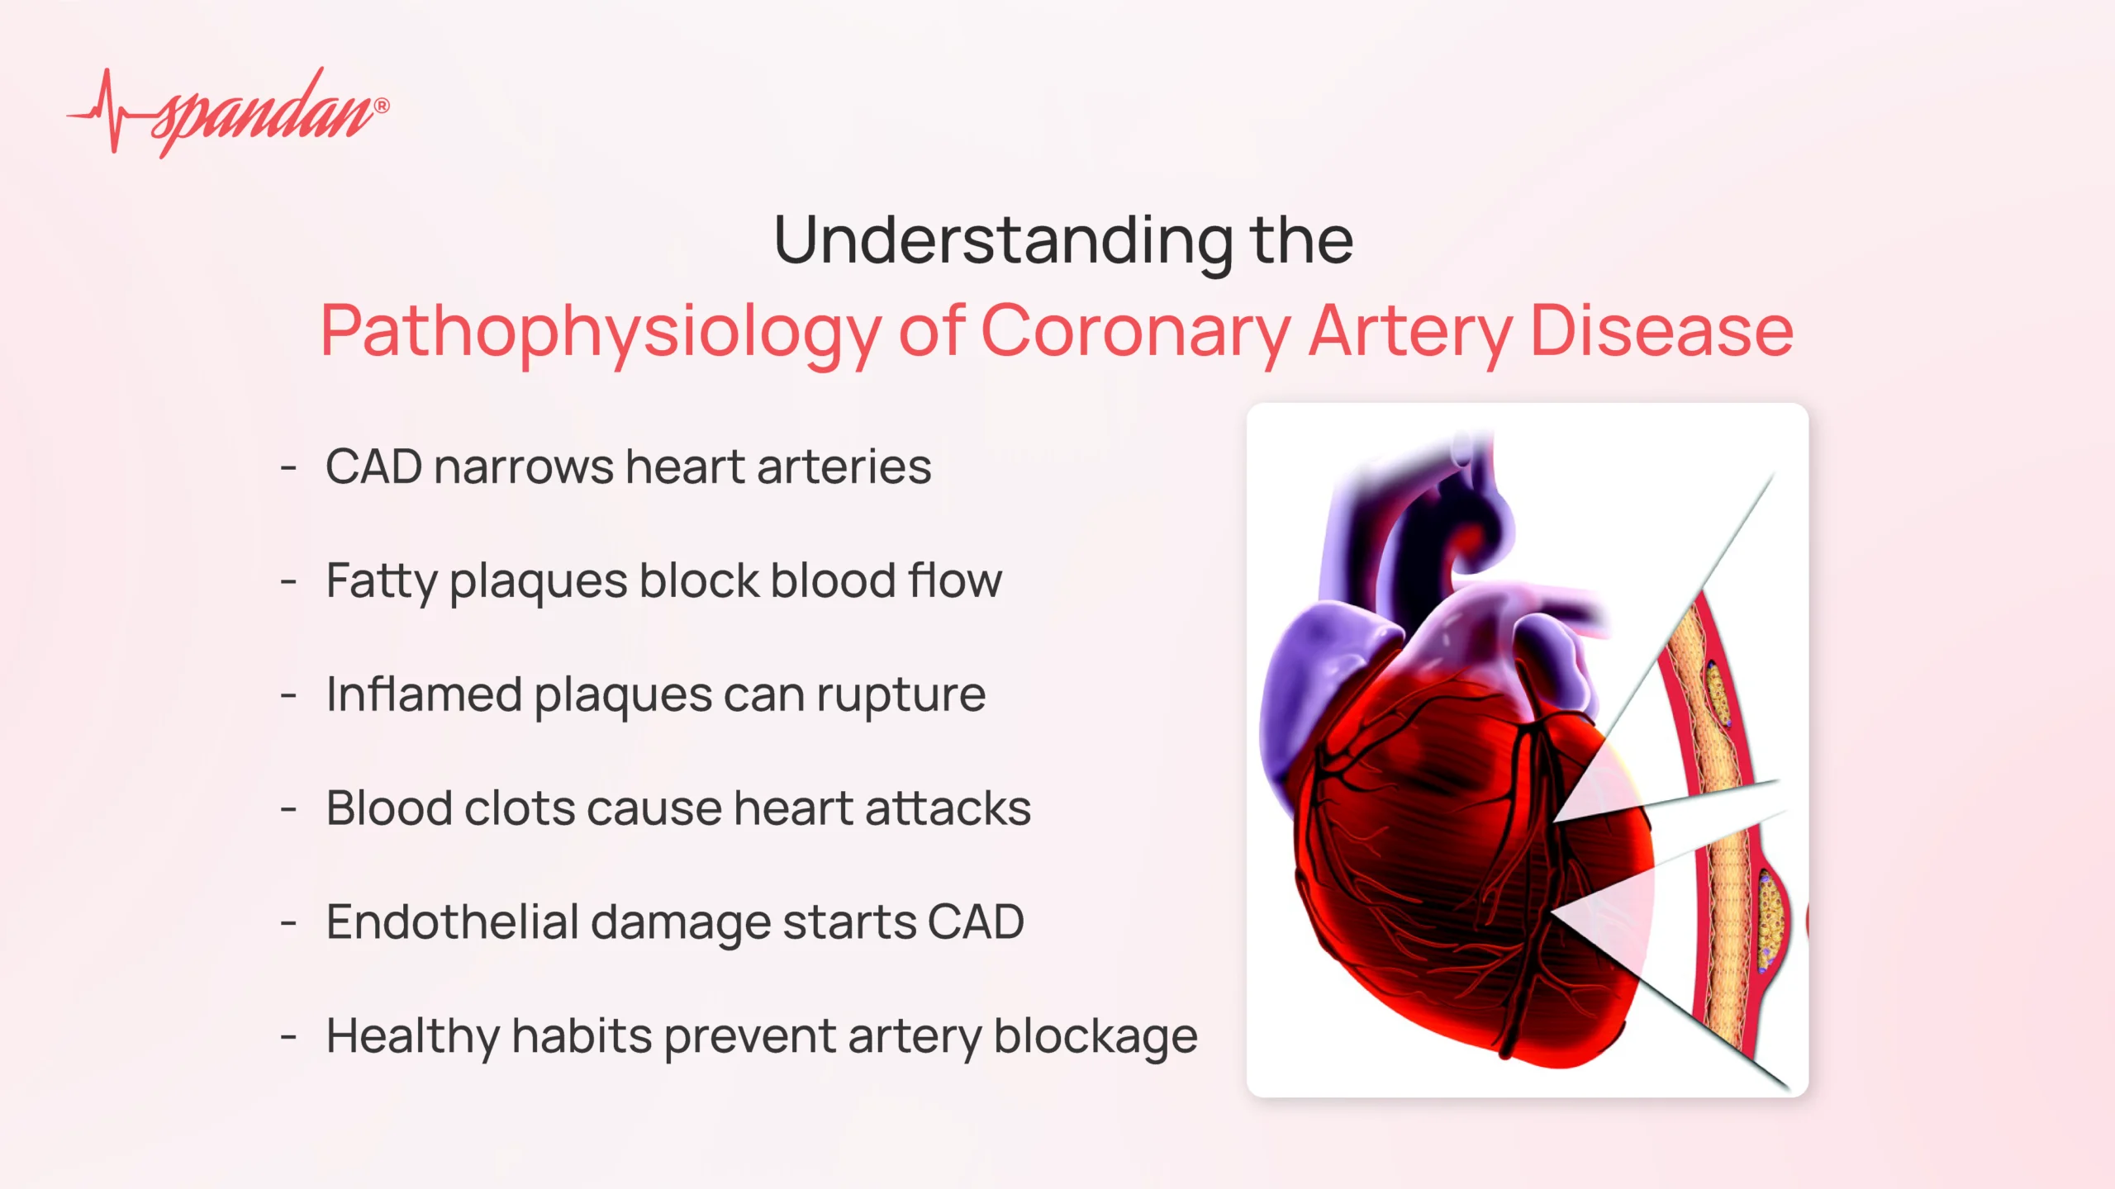
Notes:
systemic inlammatory markers plays an increasingly
important role in risk assessment for vascular events such as MI and
cerebral infarction. Acute-phase proteins such as C-reactive protein
(CRP) and ibrinogen are produced in the liver in response to inlammatory
or infectious stimuli and act as inlammatory markers.
CRP induces monocytes and macrophages to produce tissue factor,
which stimulates the coagulation pathway and increases blood
coagulability. Increased ibrinogen levels may contribute to this
process. CRP also stimulates the complement cascade, further
exacerbating inlammation.

Slide 18
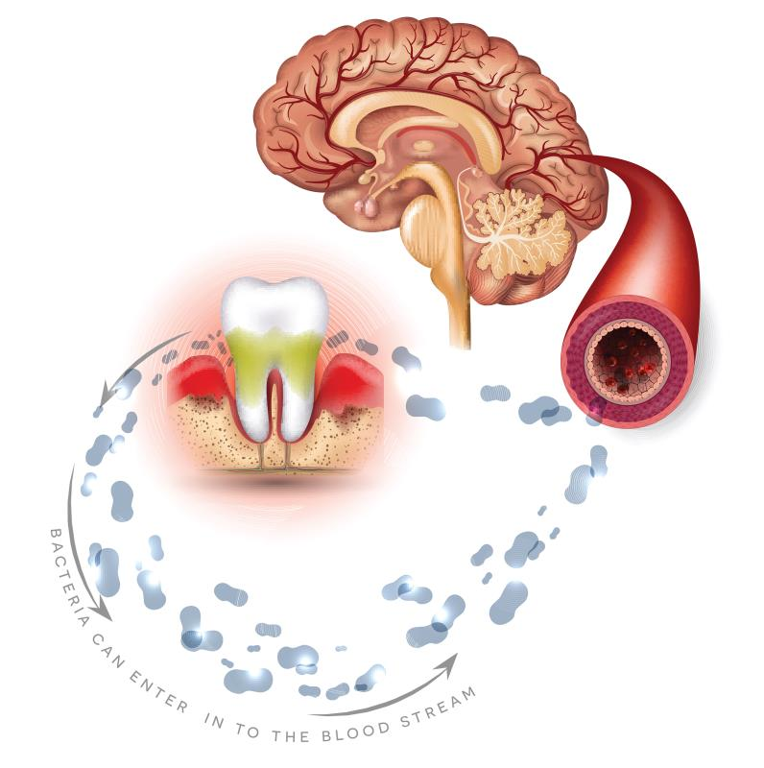
Periodontal Disease and Stroke

Slide 19
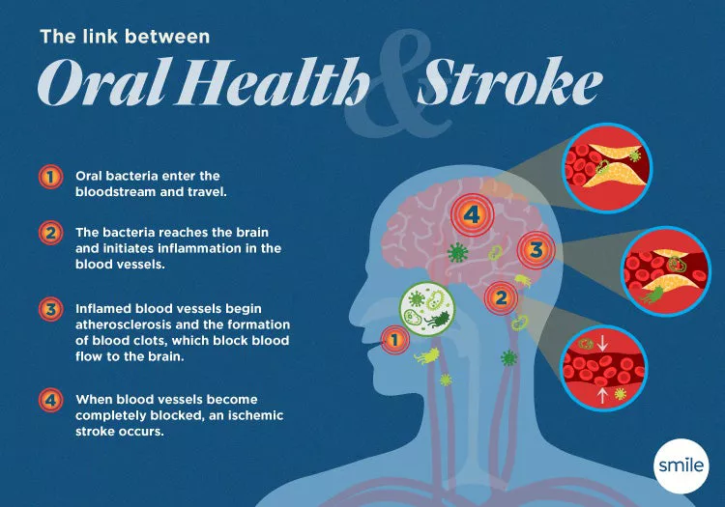
Stroke is classified as either hemorrhagic or non-hemorrhagic.
Non-hemorrhagic stroke, or ischemic stroke, is usually caused by thromboembolic events and cerebrovascular atherosclerosis, whereas
hemorrhagic stroke often results from a vascular bleed such as an aneurysm.
Periodontal disease has been associated primarily with an increased risk of non-hemorrhagic stroke.
In a case–control study, subjects with severe periodontitis had a 4.3 times higher risk of stroke than subjects with mild or no periodontitis.
Severe periodontitis was a risk factor in men but not women and in those younger but not older than 65 years of age
Notes:
Ischemic cerebral infarction, or stroke, is often preceded by systemic
bacterial or viral infection.
Furthermore,
periodontal infection may stimulate a series of indirect systemic
effects, such as elevated production of ibrinogen and CRP, which
increases the risk of stroke (see Figs. 15.5 and 15.6). Finally, bacteremia
with PAAP-positive bacterial strains from supragingival and
subgingival plaque can increase platelet aggregation, thereby contributing
to thrombus formation and subsequent thromboembolism, which
is the leading cause of stroke

Slide 20


Slide 21
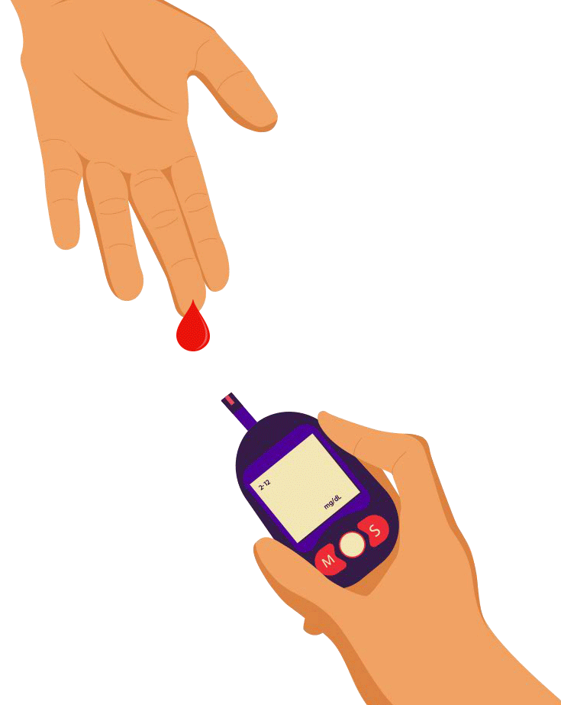
Periodontal Disease and Diabetes Mellitus

Slide 22
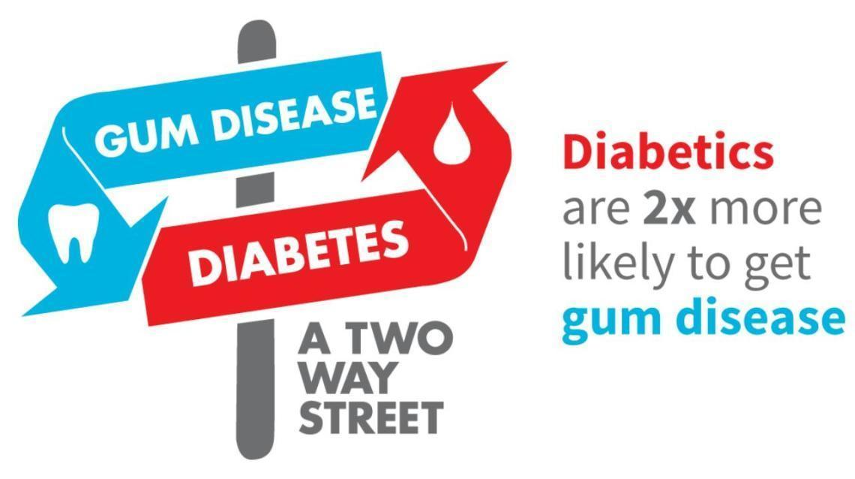
The increased prevalence and severity of periodontitis typically seen in patients with diabetes— especially those with poor metabolic control—has led to the designation of periodontal disease as the “sixth complication” of diabetes.99
In addition to the five “classic” complications of diabetes.
The incidence of type 2 diabetes (i.e., new diagnoses) was
significantly greater in individuals with periodontal disease than in those without periodontal disease.
In a longitudinal study of patients with type 2 diabetes, severe periodontitis was associated with the significant worsening of glycemic control over time
Among diabetic patients with periodontitis, periodontal therapy may have beneficial effects on glycemic control

Slide 23
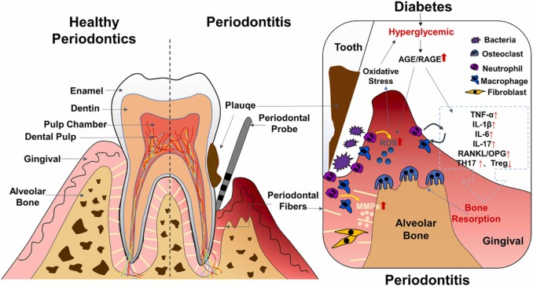
It is well known that systemic inflammation plays a major role in insulin sensitivity and glucose dynamics
periodontal diseases can induce or perpetuate an elevated systemic chronic inflammatory state, which is reflected in increased serum CRP, IL-6, and fibrinogen levels seen in many people with periodontitis.
Inflammation induces insulin resistance and such resistance often accompanies systemic infections.
Systemic infections increase tissue resistance to insulin through a variety of mechanisms, thereby preventing glucose from entering target cells, causing elevated blood glucose levels, and requiring increased pancreatic insulin production to maintain normoglycemia.

Slide 24
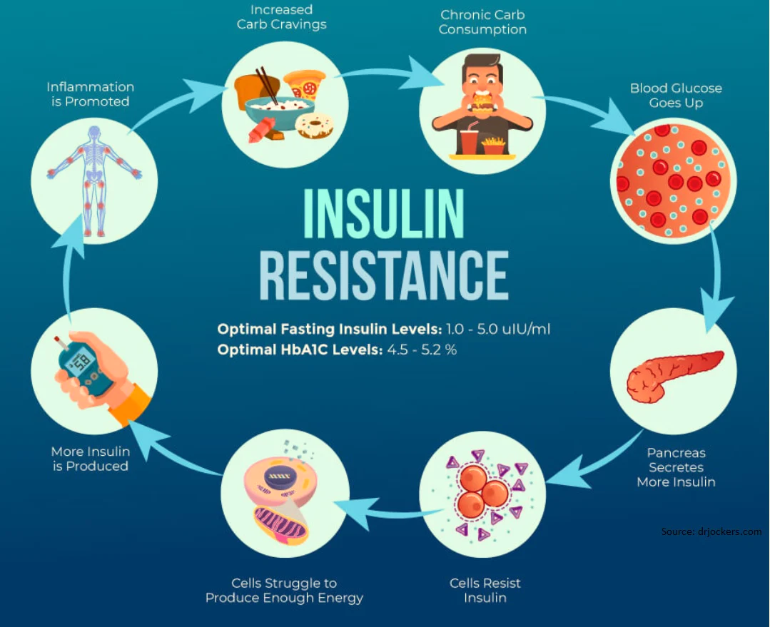
Insulin resistance may persist for weeks or even months after the patient has recovered clinically from the illness.
In an individual with type2 diabetes who already has significant insulin resistance, further tissue resistance to insulin as a result of infection may considerably exacerbate poor glycemic control
It is possible that chronic gram-negative periodontal infections
may also result in increased insulin resistance and poor glycemic control.
In patients with periodontitis, persistent systemic challenge
with periodontopathic bacteria and their products results in an upregulation of the immunoinflammatory response, with elevation in serum levels of proinflammatory mediators such as IL-1, TNF-α, and IL-6.
Increased serum levels of several cytokines, including TNF- and IL-6, are associated with increased insulin resistance

Slide 25
Gram-negative periodontal infection
Increased insulin resistance
Worsened glycemic control
Periodontal treatment
Decreased inflammation
Improved insulin sensitivity
Improved glycemic control
Periodontal treatment is designed to decrease bacterial insult and reduce inflammation may result in decreased systemic inflammation, restoring insulin sensitivity over time and thereby resulting in improved metabolic control

Slide 26
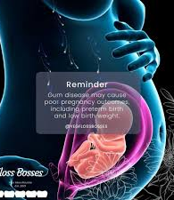
Periodontal Disease and Pregnancy
Outcome

Slide 27
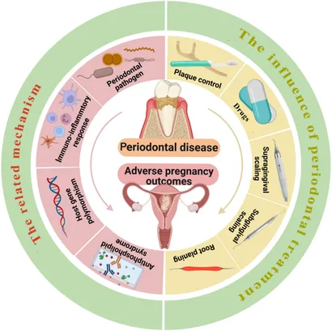
The primary cause of LBW deliveries is preterm labor or premature rupture of membranes (PROM).
Factors such as smoking, alcohol or drug use during pregnancy; inadequate prenatal care; race;
low socioeconomic status; hypertension; old or young maternal age; diabetes; and genitourinary tract infections increase the risk of preterm LBW delivery
Women with bacteriuria have increased rates of preterm delivery, and the antibiotic treatment of bacteriuria has resulted in a significant decrease in preterm delivery rates.
Vaginal colonization with group B streptococci or Bacteroides species increases the risk of PROM, preterm delivery, and LBW infants.
Notes:
Low-birth-weight (LBW) infants (i.e., those weighing <2500 g at
birth) are 40 times more likely to die during the neonatal period
than normal-birth-weight (NBW) infants.107 LBW infants who survive
the neonatal period are at increased risk for congenital anomalies,
respiratory disorders, and neurodevelopmental disabilities.

Slide 28
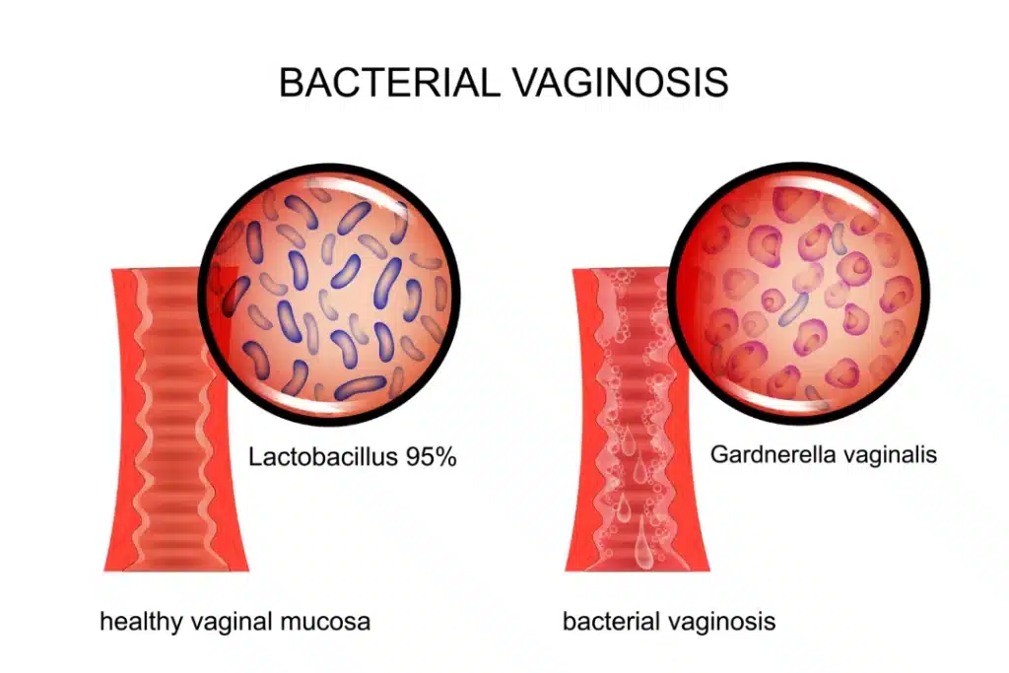
Bacterial Vaginosis
Bacterial vaginosis is the most common vaginal disorder in women of reproductive age.
Changes in the vaginal microflora cause in which normally predominant facultative lactobacilli are replaced
by Gardnerella vaginalis; anaerobic organisms, including species of Prevotella, Bacteroides, Peptostreptococcus, Porphyromonas, and Mobiluncus.
Bacterial vaginosis is a known risk factor for preterm labor, PROM, and LBW delivery.
The incidence of preterm birth is approximately three times greater among women with bacterial vaginosis

Slide 29
The primary mechanism has traditionally been thought to be ascending infection from the vagina and the endocervix.
Endotoxins (LPSs) and bioactive enzymes produced by many organisms associated with vaginosis may directly injure tissues and induce the release of proinflammatory cytokines and prostaglandins.
Throughout normal gestation, amniotic prostaglandin levels rise steadily until a sufficeint threshold is reached that induces labor and delivery.
Maternal infection may cause increased amniotic prostaglandin production, and it may also result in labor-inducing levels being reached before full gestation.
In addition to prostaglandins, various proinflammatory cytokines (e.g., IL-1, IL-6, TNF-) have been found in the amniotic fluid of women with preterm labour.

Slide 30
F. nucleatum is a common oral species that is highly prevalent in patients with periodontitis, and it could reach the amniotic fluid via hematogenous spread from the oral cavity.
This route is also suggested by the occasional isolation of Capnocytophaga species in the amniotic fluid of women with preterm labor; this is an organism that is rarely isolated from the vagina but is common in the oral cavity.
Bacterial infection
Bacteria and products in amnion
Inflammatory response with cytokine production in amnion
Increased amniotic prostaglandin production
Preterm labor
Women with preterm labor often have culture-positive amniotic fluid, even in the absence of clinical infection.
Among culture-positive patients, the species that is most often isolated is Fusobacterium nucleatum

Slide 31
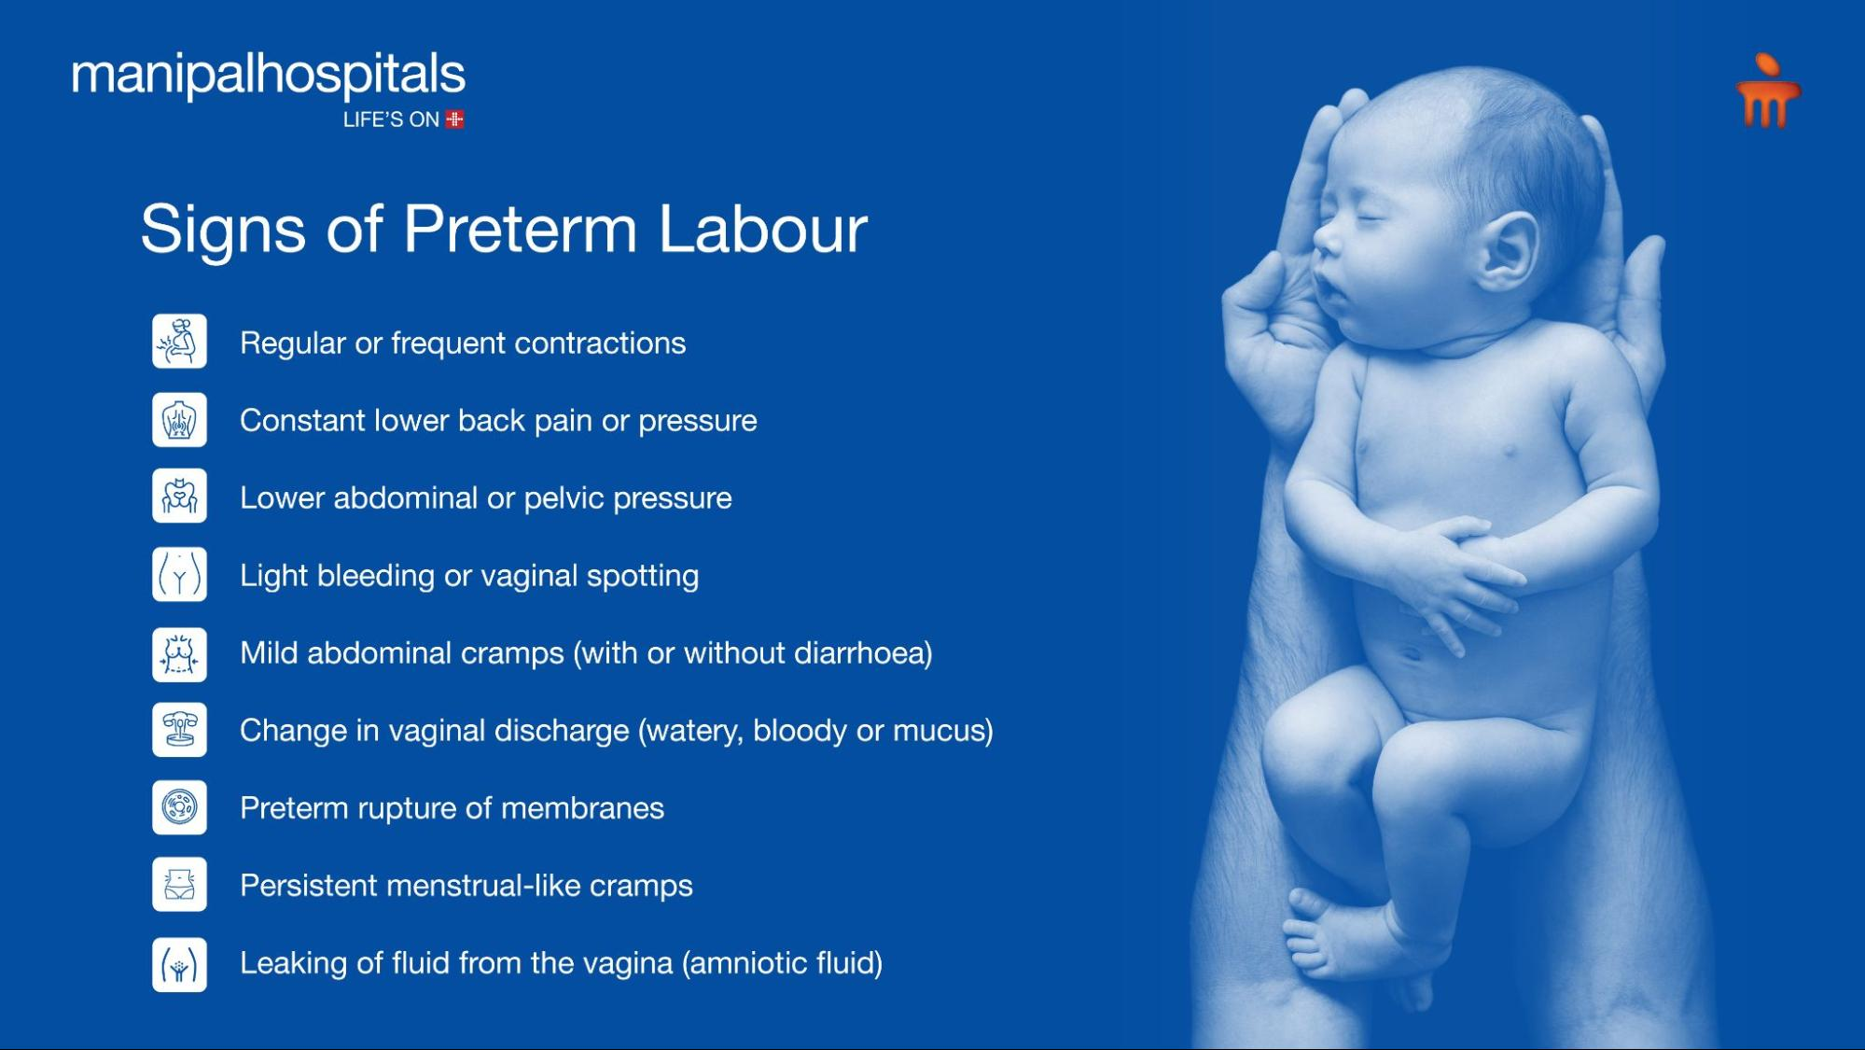
It is likely that an indirect mechanism may be active in which the cascade of host products produced in response to infection is often responsible for preterm labor.
Maternal infection may lead to the presence of amniotic bacterial products, such as LPSs from gram-negative organisms, which stimulate the production of host-derived cytokines in the amnion and the decidua.
These cytokines, including IL-1, TNF-, and IL-6, stimulate increased prostaglandin production from the amnion and the decidua, which leads to the onset of preterm labor.
A premature rise in PGE2 and PGF2 is characteristic of preterm labor.

Slide 32
Role of Periodontitis
There are two major pathways by which periodontal diseases may be associated with increased adverse pregnancy outcomes:
(2) an indirect pathway in which elevated inflammatory mediators from the periodontal tissues reach the fetal-placental unit directly through the systemic vasculature or reach the liver and stimulate hepatic production of even more proinflammatory cytokines, which subsequently affects the fetal-placental unit.
(1) a direct pathway in which oral microorganisms disseminate to the fetal-placental unit either through a hematogenous route from the oral cavity or by an ascending route via the genitourinary tract, or

Slide 33
In a cross-sectional study, women who had LBW infants had significantly higher levels of Aggregatibacter (formerly Actinobacillus) actinomycetemcomitans, Tannerella forsythia, P. gingivalis, and Treponema denticola in their subgingival plaque
Periodontal disease may also increase the risk for preeclampsia.
This hypertensive disorder affects about 5% to 10% of pregnancies, and it is a major cause of perinatal and maternal morbidity and mortality.
Preeclampsia has multiple potential etiologies, several of which involve vascular changes in the placenta that are similar to those seen with atherosclerosis.
The presence of periodontitis during pregnancy or a worsening of periodontal disease during pregnancy is associated with a twofold to 2.5-fold increased risk for preeclampsia.
Studies of fetal immunoglobulin M (IgM) antibody levels have found remarkably high fetal antibody seropositivity to oral bacteria.
This indicates that the fetal immune response is activated in utero by bacterial antigens derived from the oral cavity.
Women who had LBW infants also had higher levels of gingival crevicular fluid (GCF), PGE2, and IL-1

Slide 34
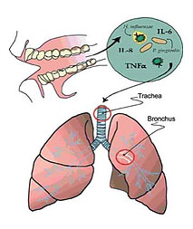
Periodontal Disease and Chronic Obstructive
Pulmonary Disease

Slide 35
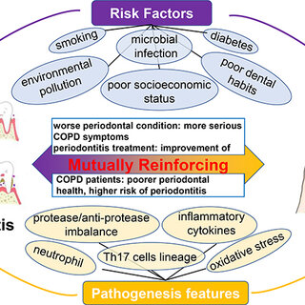
Chronic obstructive pulmonary disease (COPD) is characterized by airflow obstruction that results from chronic bronchitis or emphysema.
Bronchial mucous glands enlarge, and an inflammatory process occurs during which neutrophils and mononuclear inflammatory cells accumulate within the lung tissue.
The resulting neutrophil influx leads to the release of oxidative and hydrolytic enzymes that cause tissue destruction directly. The recruitment of monocytes and macrophages leads to further release of pro-inflammatory mediators.
In controlled clinical trials, scaling and root planing was associated with a decrease in the frequency of COPD exacerbations compared with nontreatment
Notes:
COPD shares similar pathogenic mechanisms with periodontal
disease. With both diseases, a host inlammatory response is mounte d
in response to chronic challenge by bacteria in periodontal disease
and by factors such as cigarette smoking in COPD.

Slide 36
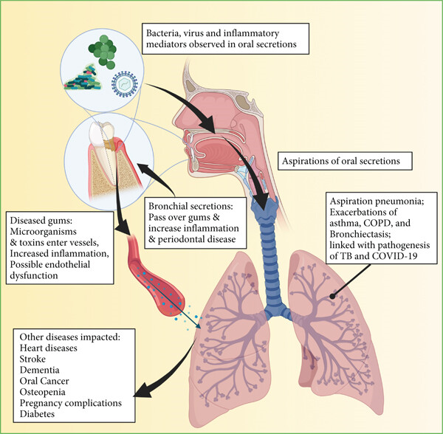
Periodontal Disease and Acute Respiratory
Infections

Slide 37
Pneumonia is an infection of the lungs that is caused by bacteria, viruses, fungi, or mycoplasma and is broadly categorized as either community-acquired or hospital-acquired
nosocomial pneumonia is most often caused by gram-negative aerobic organisms, including those that are typically found in the subgingival environment
The incidence of nosocomial pneumonia is highest among severely ill patients, such as those in intensive care units or on ventilatory support.
Hospital-acquired (nosocomial) bacterial pneumonia has a very high morbidity and mortality rate.
Community-acquired bacterial pneumonia is caused primarily by the inhalation of infectious aerosols
Streptococcus pneumoniae and Haemophilus influenzae are the most common,
Antibiotic therapy is highly successful for the resolution of community acquired bacterial pneumonia.
or the aspiration of oropharyngeal organisms.
Notes:
The upper respiratory passages are often contaminated with
organisms derived from the oral, nasal, and pharyngeal regions.
Conversely, the lower airways, in which gas exchange occurs, are
generally maintained free of microorganisms by a combination of
host immune factors and mechanical clearance through the cough
relex, the ciliary transport of aspirated contaminants, and the
movement of secretions from the lower airways into the trachea

Slide 38
Hospital-acquired pneumonia is usually caused by the aspiration of oropharyngeal contents.
The longer the hospital stay, the greater the prevalence of PRPs.
PRPs are found predominantly in the gastrointestinal tract, and they may be passed via esophageal reflux into the oropharynx, where they colonize.
Dental plaque has been shown to serve as a reservoir of PRPs; such colonization in plaque results in a persistent source of potential aspiration
Oropharyngeal colonization with potential respiratory pathogens (PRPs) is generally a transient phenomenon; however, such colonization increases during hospitalization.
Subsequent aspiration may lead to pneumonia.
Patients whose posterior oropharynx becomes colonized with PRPs have a significantly increased risk of developing nosocomial pneumonia as compared with those without oropharyngeal colonization by PRPs

Slide 39
The technique is used primarily for patients who are intubated and on mechanical ventilators.
Selective decontamination significantly decreases the incidence of nosocomial pneumonia
and thereby minimize the risk of nosocomial respiratory infections.
Selective decontamination is a technique that combines systemic antibiotics with orally administered nonabsorbable antibiotics in an attempt to eradicate PRPs from the digestive tract and the oropharynx
Notes:
Decontamination
of only the digestive tract does not reduce the incidence of pneumonia,
but decontamination of the oropharynx alone does. This provides
further evidence that the oropharynx is the primary site of PRP
colonization, with the subsequent aspiration of causative organisms
leading to pneumonia

Slide 40
Conclusion
Does periodontal disease cause CHD, COPD, or adverse pregnancy outcomes?
This question may be answered only by use of the evidence that is currently available, with the full knowledge that conclusions may change as future evidence dictates.
Periodontal disease may increase the risk for many systemic disorders.

Slide 41


