Slide 1
OSTEOMYELITIS

Slide 2
CONTENTS
INTRODUCTION
CLASSIFICATION
PREDISPOSING FACTORS
ETIOLOGY AND PATHOGENESIS
PROCESS OF OSTEOMYELITIS
MICROBIOLOGY OF OSTEMYELITIS
CLINICAL FINDINGS
RADIOGRAPHIC FINDINGS
DIAGNOSTIC IMAGING
TREATMENT
-ANTIBIOTIC THERAPY
-SURGICAL MANAGEMENT

Slide 3
INTRODUCTION
Word “osseous” in latin means bony
“osteon” in greek means bone
“myelos” means marrow
“itis” means inflammation
Defined as an inflammatory condition of bone that usually begins as an infection of the medullary cavity, rapidly involves the haversian systems and quickly extends to the periosteum of the area.

Slide 4
CLASSIFICATION
BASED ON CLINICAL PICTURE AND RADIOLOGY
1. Acute forms of osteomyelitis (suppurative or nonsuppurative)
2. Chronic forms of osteomyelitis
A. Recurrent multifocal
B. Garrè's
C. Suppurative or nonsuppurative
D. Diffuse sclerosing
-

Slide 5
CLASSIFICATION BASED ON CLINICAL PICTURE, RADIOLOGY, PATHOLOGY, AND ETIOLOGY
1. Acute suppurative osteomyelitis
2. Chronic suppurative osteomyelitis
3. Chronic focal sclerosing osteomyelitis (pseudo- paget, condensing osteomyelitis)
4. Chronic diffuse sclerosing osteomyelitis 5. Chronic osteomyelitis with proliferative periostitis
(Garre's chronic nonsuppurative sclerosing
osteitis, ossifying periostitis)
6. Specific osteomyelitis
A. Tuberculous osteomyelitis
B. Syphilitic osteomyelitis
C. Actinomycotic osteomyelitis
CLASSIFICATION

Slide 6
CLASSIFICATION BASED ON CLINICAL PICTURE,RADIOLOGY, AND ETIOLOGY
1. Suppurative osteomyelitis
1. Acute suppurative osteomyelitis
2. Chronic suppurative osteomyelitis
– Primary chronic suppurative
– Secondary chronic suppurative
3. Infantile osteomyelitis
2. Nonsuppurative osteomyelitis
A. Chronic sclerosing osteomyelitis
– Focal sclerosing osteomyelitis
– Diffuse sclerosing osteomyelitis
- Garre`s osteomyelitis
B. Radiation osteomyelitis and necrosis
CLASSIFICATION

Slide 7
PREDISPOSING FACTORS
Condition affecting the Host resistance
1) Diabetes Mellitus
2) Tuberculosis
3) Severe anemia
4) Leukeamia
5) Agranulocytosis
6)Acuteinfection-Scarletfever,influenza
7) Typhoid
8) Sickel cell anemia
9) Malnutrition
10) Chronic alcholism
Condition affecting the Jaw vascularity
1) Metastasis from area of infection such as another bony site & kidney
2) Radiation
3) Osteoporosis
4) Osteopetrosis
5) Fibrous dysplasia
6)Peripheralvascular disease

Slide 8
ETIOLOGY
Odontogenic infection
Infection from infected dental cyst
Compound fracture of Jaw.
Traumatic injury
Middle ear infection & upper respiratory tract infection through haematogenous route.
Furuncle of chin by lymphatic route
Peritonsillar abscess

Slide 9
PROCESS OF OSTEOMYELITIS
Acute inflammation following infection
⇃
Hyperemia
⇃
Capillary permeability ↑and infiltration of granulocytes
⇃
Tissue necrosis
⇃
Destruction of bacteria, vascular thrombosis & Pus forms
⇃
Intramedullary pressure ↑ as pus accumulates -> anesthesia compression
⇃
Vascular collapse, venous stasis and ischemia

Slide 10
⇃
Pus accumulates with Stripping of periosteum
⇃
Vascular supply reduced
⇃
Periosteum penetration and mucosal fistulas
⇃
Chronic Inflammation - >granulation tissue & lysis of bone
⇃
Separation of necrotic bone (sequestra)
⇃
Sheath of new bone (involucrum)
⇃
Penetrated through channels (cloacae)

Slide 11
MICROBIOLOGY
 | FACULTATIVE ANAEROBIC | ANAEROBIC
Gram-positive cocci | Staphylococcus aureus Coagulase-negative staphylococci Streptococcus spp Abiotrophia spp Granulicatella spp | Peptostreptococcus spp
Gram-positive rods | Actinomyces spp Corynebacterium spp Lactobacillus spp Propionibacterium spp Rothia dentocariosa | Actinomyces israelii Eubacterium lentum Bifidobacterium spp.
Gram-negative cocci | Neisseria spp | Veillonella spp
Gram-negative rods | Actinobacillus actinomycetemcomitans Capnocytophaga spp. Haemophilus spp Eikenella corrodens Leptotrichia buccalis | Fusobacterium spp Porphyromonas spp Prevotella spp

Slide 12
Clinical features
Early:
  DEEP INTENSE PAIN
  HIGH INTERMITTENT FEVER
  PARESTHESIA OR ANESTHESIA OF
  LOWER LIP ( IAN)
  CLEARLY IDENTIFIABLE CAUSE,
DEEP CARIOUS TOOTH
Slight leucocytosis
conventional radiographs doesn’t show changes
Positive radionuclide scan with above c|f support the diagnosis

Slide 13
Sub acute :
If the disease is not controlled in 10-14 days, pus extends through the haversian canals to accumulate under the periosteum and then may penetrate and extend in to the soft tissues.
DEEP PAIN
MALAISE,FEVER, ANOREXIA, REG.LYMPHADENOPATHY.
TEETH BEGIN TO LOOSE AND SENSITIVE TO PERCUSSION
PUS EXUDES AROUND GINGIVAL SULCUS AND THROUGH MUCOSAL / CUTANEOUS FISTULAS
FIRM CELLULITS OF THE CHEEK
LEUCOCYTOSIS , INCREASED ESR

Slide 14
Chronic :
PRIMARY–
  insidious in onset and is not preceded by
episode of acute symptoms
  slight pain, slow increase in jaw size, gradual development of sequestra, often with out fistulas.
SECONDARY
  induration of soft tissues
  Thickened and wooden character of the
affected area with pain and tenderness on
palpation
  Fistulas

Slide 15
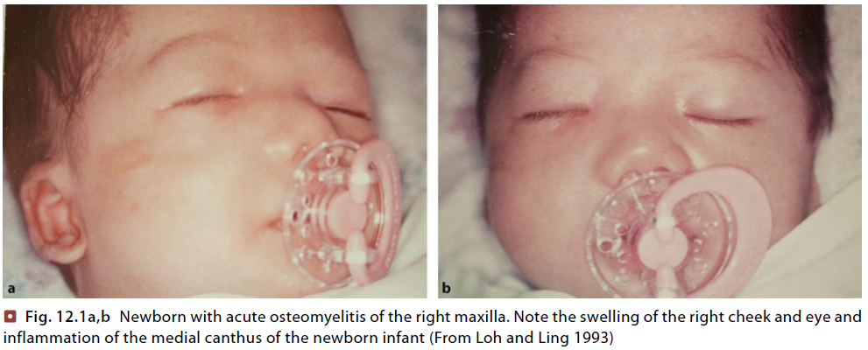
INFANTILE OSTEOMYELITIS
Few weeks after birth and usually involves maxilla
Occur via hematogenous route or from perinatal trauma of the oral mucosa from the obstetrician’s finger or the mucosa suction bulb
SOURCES OF INFECTION
-Infections involving the maxillary sinus and infected human or artificial nipples
CLINICAL FEATURES
- Facial cellulitis centered about the orbit
- Irritability and malaise
- Hyperpyrexia, anorexia and dehydration
- Intra-orally, the maxilla on the affected side is swollen both bucally and palatally, especially in the molar region
- Fistulas
TYPES OF OSTEOMYELITIS

Slide 16
In early acute phase, little radiographic changes and leucocytosis are noted.
Antibiotic treatment is started after culture and sensitivity of samples taken.
Cloxacillin 200mg/kg IV
In Streptococcal or Pneumococcal infections Benzyl penicillin can be given.
For penicillin-hypersensitivity Cephalosporins or Erythromycin or Fusidic acid may be given.
Ampicillin is effective against Hemophilus influenza infection.
Drainage
Sequestrectomy delayed until the inflammation has subsided and must be as conservative as possible.
Adequate fluid intake and nutrition are maintained by a fine nasogastric tube

Slide 17
CHRONIC non suppurative SCLEROSING OSTEOMYELITIS- (FOCAL & DIFFUSE)
FOCAL: condensing osteitis
Occurs in cases of extremely high tissue resistance or in cases of low grade medullary infection
Young persons below 20yrs.
Tooth most commonly involved is lower first molar
No signs or symptoms of the disease
Periapical radiograph shows well-circumscribed radio-opaque mass of sclerotic bone surrounding and extending below the apex of involved tooth
Histologically there is dense mass of bony trabeculation with little interstitial marrow tissue.
Treatment consists of endodontic therapy or extraction of involved tooth

Slide 18
Diffuse : proliferative reaction of bone to low grade infection
Unilateral involvement of basal bone and alveolar process of the mandible.
In addition to body, ramus and condyle may also be involved.
Usually adults in 3rd decade
Episodes of reccurent swelling and pain.
Fever and leucocytosis do not occur, ESR may raise

Slide 19
Cause is controversial- infec or non infec
Extensive radio opaque lesion . May mimick paget`s disease when its bilateral
High doses of prolonged antibiotics, decortication, resection and reconstruction, HBO therapy

Slide 20
GARRE’S CHRONIC NONSUPPURATIVE SCLEROSING OSTEOMYELITIS / PERIOSTEITIS OSSIFICANS:
Described by Carl Garre in 1893 in long bones
In 1955 Pell reported the first case involving jaws
In children and young adults
Pt c/o tooth ache or jaw pain and hard swelling in the outer surface
Clinically it is characterised by a localized, hard, non-tender swelling of lateral and inferior aspect of the mandible.
Overlying skin appears normal
Lymphadenopathy, fever and leucocytosis doesn’t occur
Commonly associated with a carious lower
first molar tooth.

Slide 21
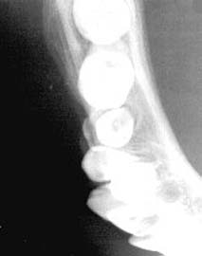
IOPA will often reveal a carious tooth opposite the bony mass
Occlusal view shows a focal overgrowth of bone on the outer surface of the cortex, which may be described as a duplication of the cortical layer of bone ( laminated or onoin skin)
Treatment is by removal of the involved tooth or endodontic therapy
Biopsy – if the lesion is not subsided
If the deformity remains static – surgical
recontouring

Slide 22
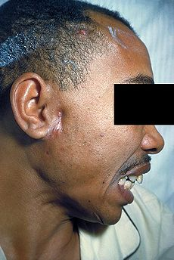
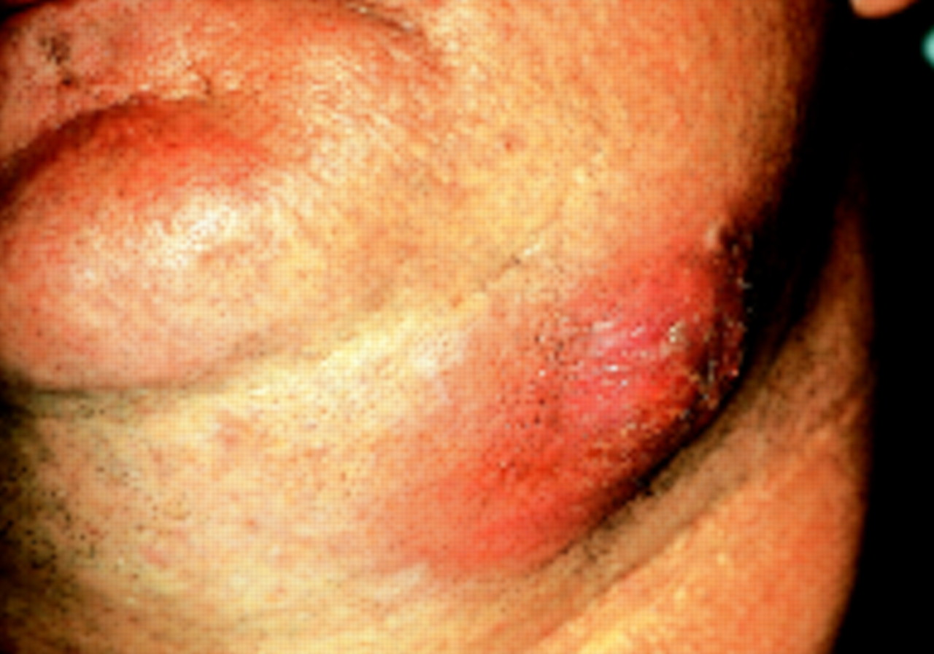
ACTINOMYCOTIC OSTEOMYELITIS
Rare but may present as a periosteitis as a result of the involvement of the adjacent soft tissues.
Mandible is thickened and the micro-organisms are embedded in granulation tissue. Eventually sequestration of the bone occurs.
Chronic cases fracture of the jaw bone and produce chronic facial sinus.
Diagnosis is by microscopic examination of the pus. Sulphur granules are present
Antibiotic therapy with penicillin 500mg 6th hourly or amoxycillin 500mg 8th hourly for 6-8 weeks or for several months.
Surgical intervention will be required to remove any sequestra, which have formed.

Slide 23
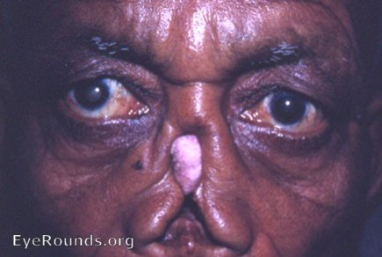
SYPHILITIC OSTEOMYELITIS
There is a chronic, inflammatory granulomatous and necrotising periarterial infiltrate accompanied by partial destruction of bone.
Vascularity of the area become diminished and the bone tends to become sclerosed.
Osteosclerosis with new bone formation is more common
Gummatous destruction of the nasal septum and hard palate are common.
This result in saddle shaped nose and perforations of the palate.

Slide 24
TUBERCULOUS OSTEOMYELITIS
This condition of the jaws is rare.
It may follow tooth extraction in tuberculous patient.
The infected socket is painless, fails to heal and there is continuous discharge of pus.
Later bone destruction occurs to produce a granulation tissue filled bone cavity submucosally at the site of the socket.
The diagnosis is confirmed on biopsy. If the infection of mandible is left untreated it may spread into soft tissues and form chronic facial sinus.
Treatment consists of local surgery and anti-tuberculous therapy.

Slide 25
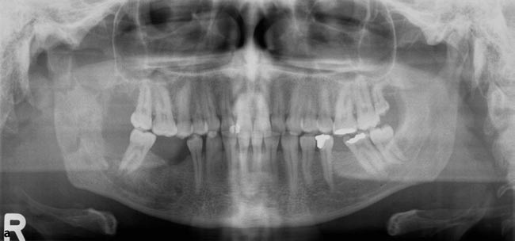
RADIOGRAPHIC FINDINGS
Bone destruction cannot be determined radiographically until 3 weeks after initiation of osteomyelitic process
Scattered areas of bone destruction varied in size and number
Moth-eaten appearance
Widening of volkman`s canals
Sequestra
Involucrum

Slide 26
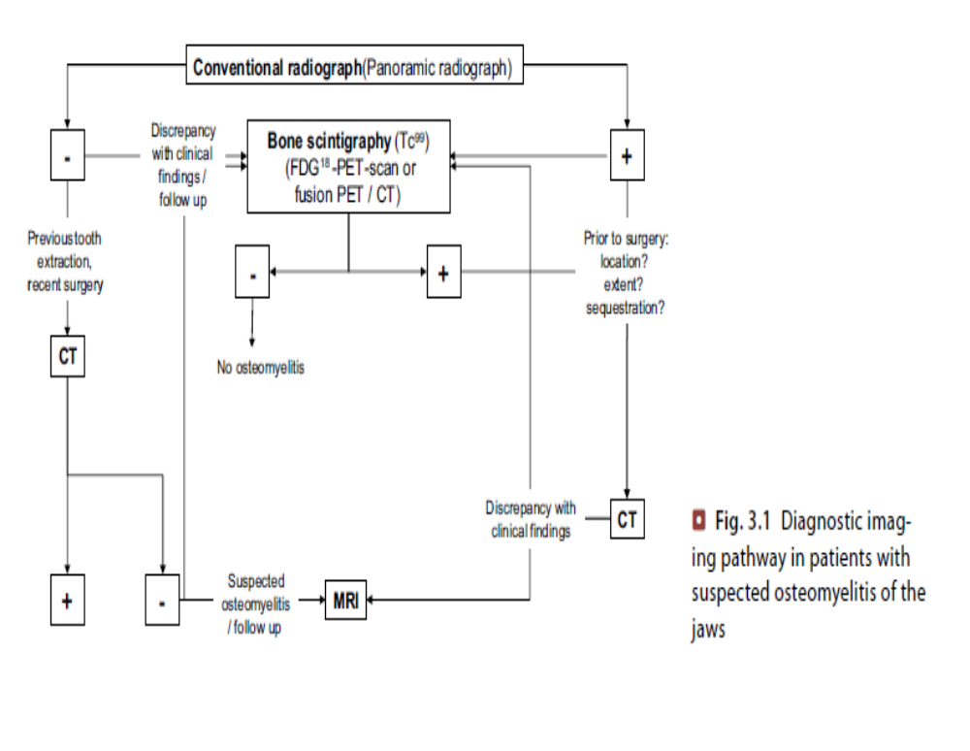
TYPES OF DIAGNOSTIC IMAGING

Slide 27
Conventional Radiology
Orthopanoramic view depicts the status of the dentition, displays the osseous confines and internal osseous structure of the jaws, and is the adequate basis for a follow-up examination.
Occasionally supplemented by intraoral radiographs.
Additional radiographs may be required to focus on certain anatomical areas:
Mandibular oblique view for mandibular body, the occlusal view to depict the symphysis and maxilla area.
The posteroanterior view of the mandible (Clementschitsch) for mandibular condyles and Waters view to assess the maxillary sinuses.

Slide 28
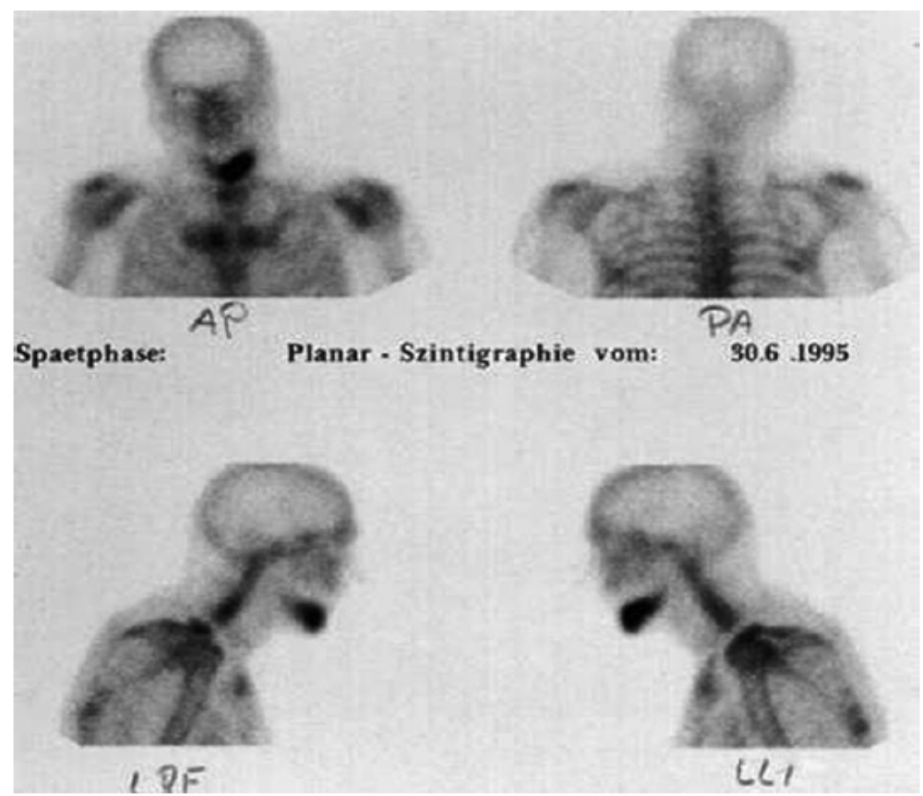
SCINTIGRAPHY / BONE IMAGING
Presence of reactive bone
Technetium (Tc^{99m}) labeled methylenediphosphonates
Rectilinear scanner or a scintillation camera
basic principle consists of injecting a radioactive tracer into the circulation system.
Radiopharmaceuticals that are absorbed by bone provide particularly useful information
The complete 99mTc bone scanconsists of three phases.
The first phase (flow study) consists of serial 3- to 4-s images taken during the first 1−2 min after injection of the radionuclide.
The second phase (blood-pool study) consists of a single image obtained 5−10 min after injection.
The third phase (delayed study or bone study) includes multiple views obtained 2−4 h after injection (Gold 1991).

Slide 29
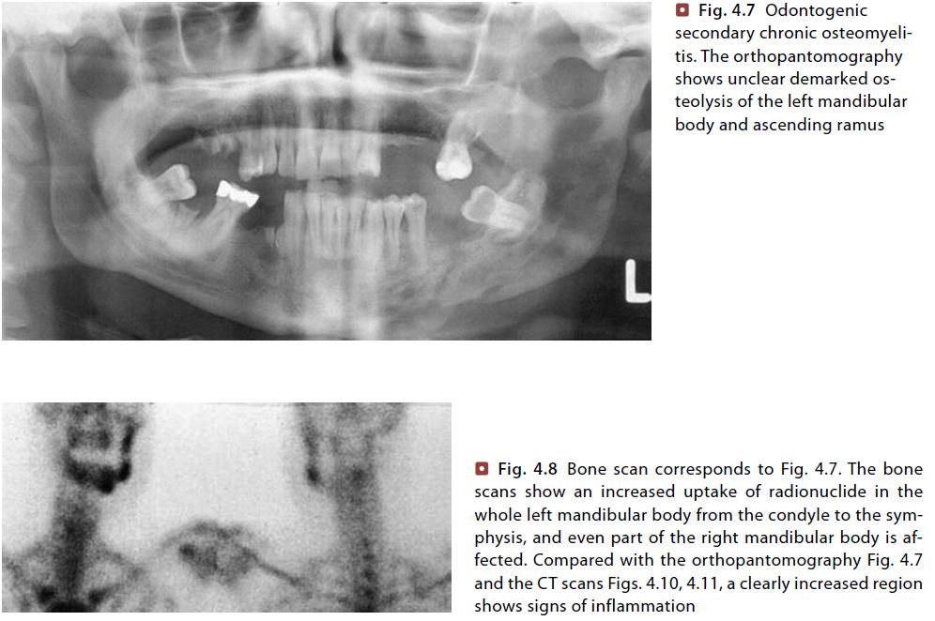
SCINTIGRAPHY / BONE IMAGING
In the facial skeleton the uptake is slightly higher in the maxilla and mandible compared with the rest of the skull.
The following criteria must always be addressed:
Look for symmetrical uptake within the corresponding skeletal regions
Regions with increased or decreased uptake compared with surrounding and corresponding bones are suspicious and may need further radiological investigation
Increased uptake is a sign of increased metabolic activity
A physiological or decreased uptake indicates a normal osteoblastic bone activity or may be the result of a very aggressive lesion with failure of local bone repair

Slide 30
COMPUTED TOMOGRAPHY
Proper, well-aligned positioning of the head facilitates reconstruction of the axially acquired image data set into axial oblique and coronal planes.
The reconstructions are performed with a slice thickness of 2 mm
Curved or sagittal oblique reconstructions along the mandibular body provide information similar to an orthopanoramic radiograph.
Recognition and differentiation of facial and masticator space inflammation requires intravenous application of iodine-containing contrast material which is performed with 100 ml at a flow rate of 2 ml/s.
The soft tissue images which are reconstructed from the axial data set are displayed as coronal and axial oblique 3-mm slices with a window/level setting of W/L 300/100.

Slide 31
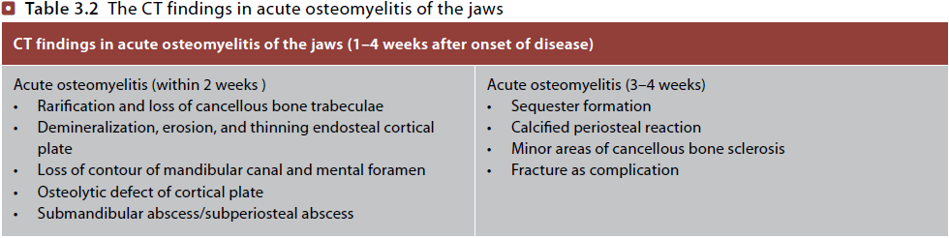
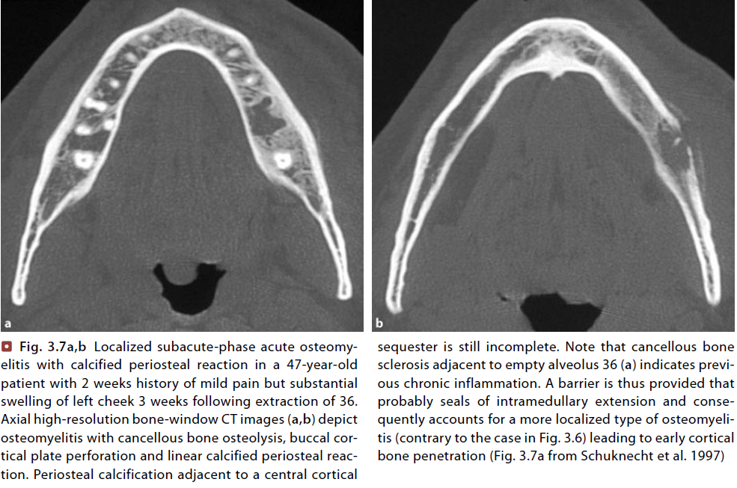
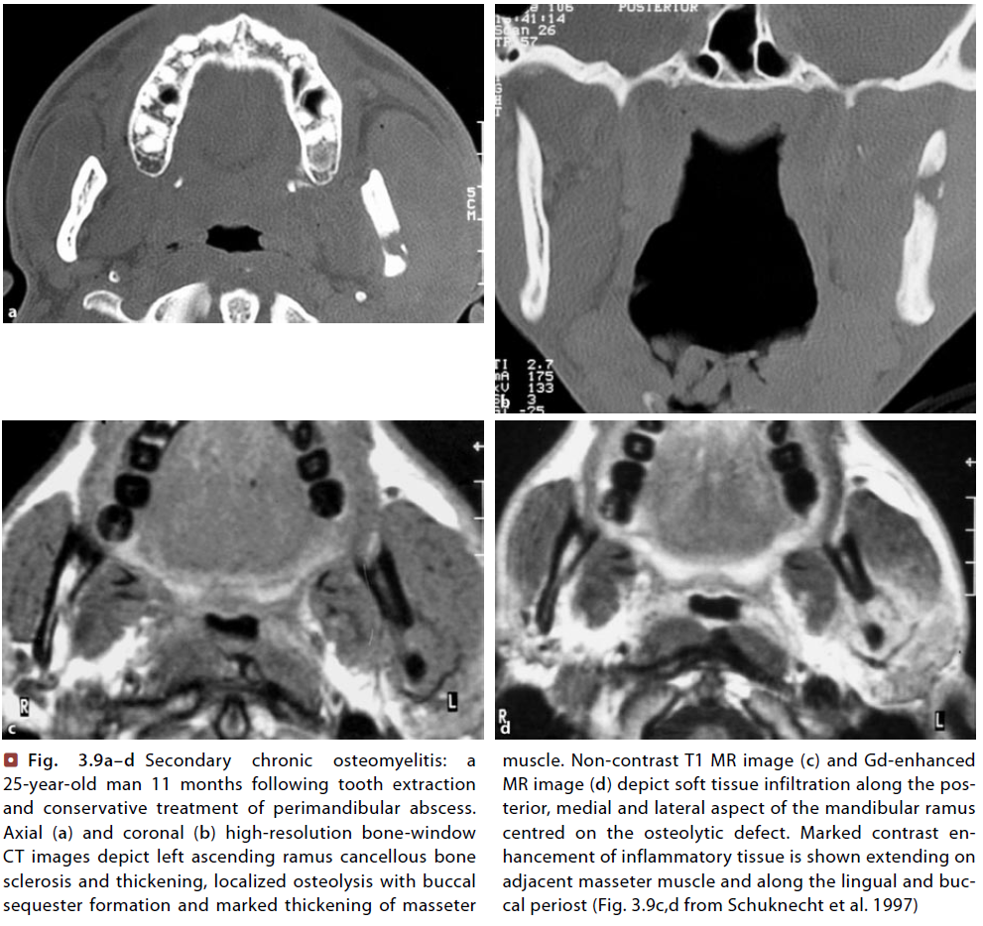
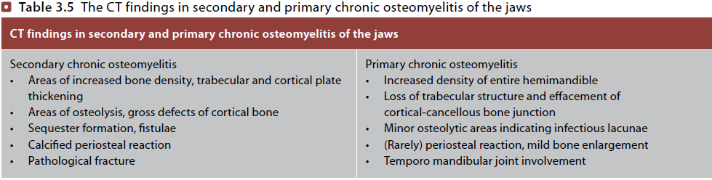

Slide 32
MAGNETIC RESONANCE IMAGING
The MRI examination protocol consists of a coronal and axial fast T2-weighted series that covers the upper and lower jaw, slice thickness is 3.5 mm.
Axial and coronal T1-weighted series without and with gadolinium as contrast agent are additionally performed.
The coronal T1-weighted series is replaced by a T1-weighted sagittal oblique series in case of positive findings within the mandibular body or ramus on axial noncontrast images.
The contrast-enhanced series requires fat-suppression technique in order to facilitate recognition of pathological contrast enhancement within medullary bone and soft tissue.

Slide 33
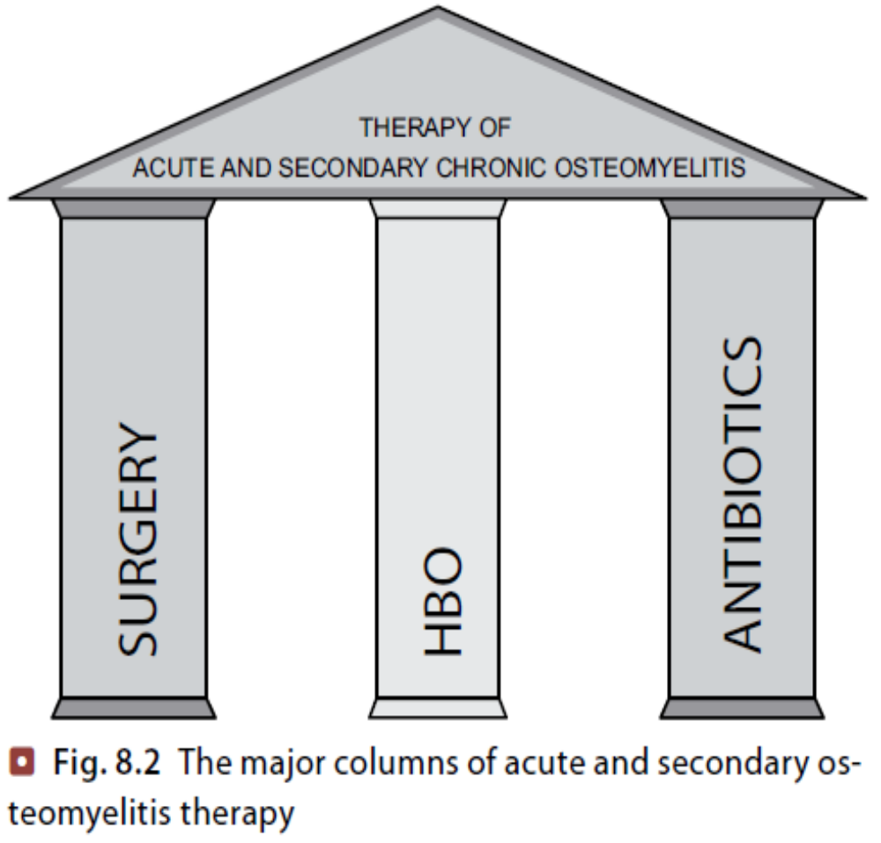
TREATMENT
Successful treatment for osteomyelitis is based on
Early diagnosis
Drainage of pus
Bacteriological culture and sensitivity
Appropriate antibiotic therapy
Supportive therapy
Surgical debridement
Reconstruction when indicated
Adjunct Hyper Baric Oxygen therapy

Slide 34
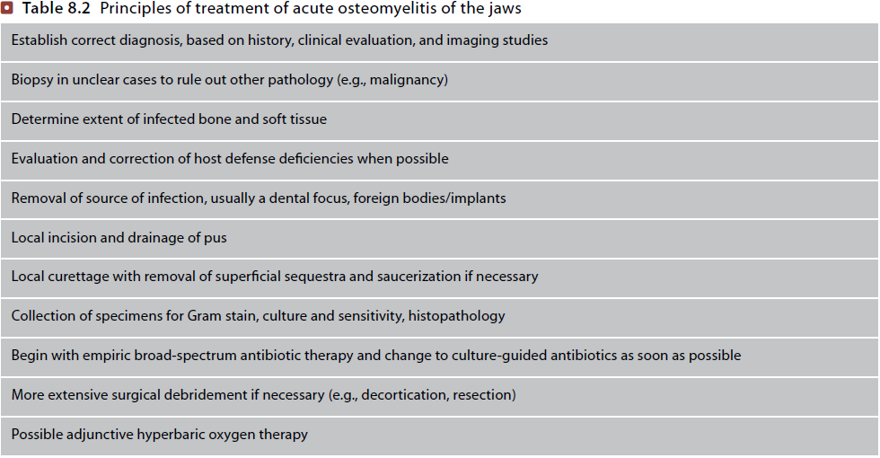

Slide 35
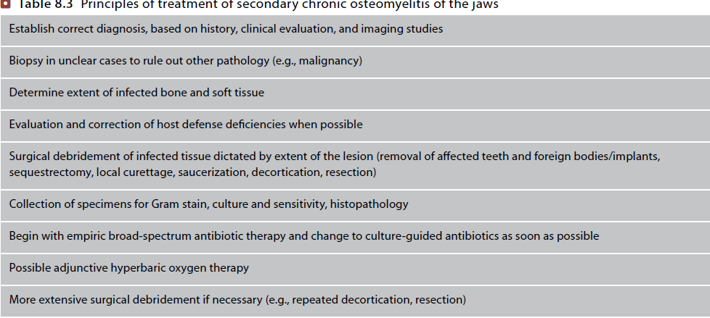

Slide 36
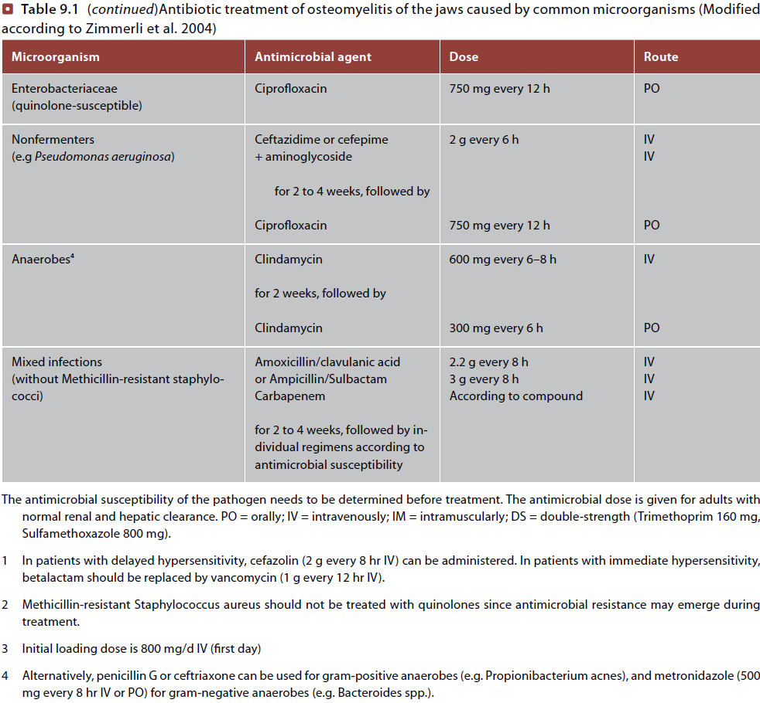
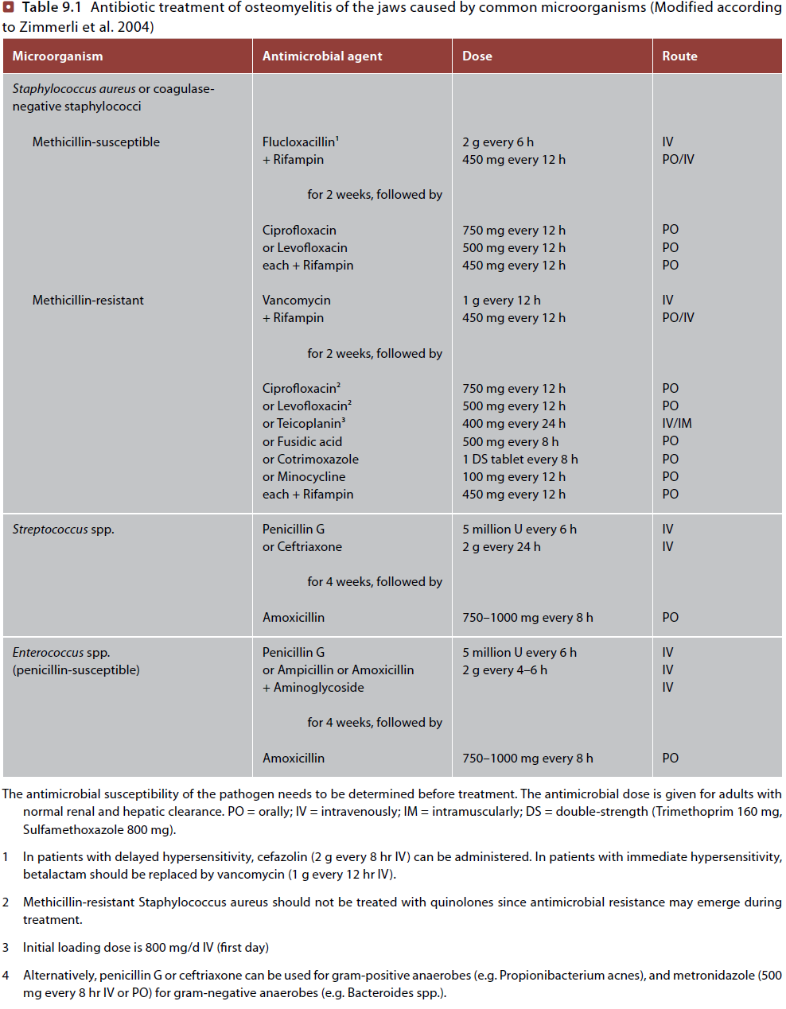
ANTIBIOTIC THERAPY

Slide 37
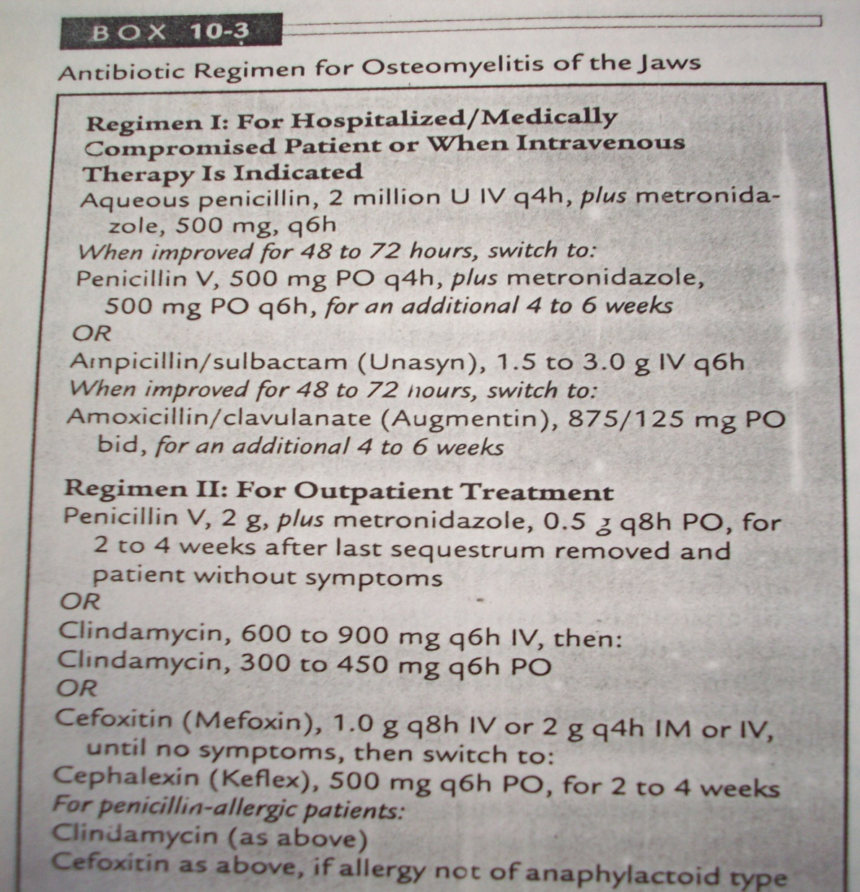
Antibiotic regimen

Slide 38
LOCAL ANTIBIOTICS
(i) Closed wound irrigation – suction
To achieve the desired effect locally it may be required to give very high doses of antibiotic systematically which on other hand will produce unwanted side effects.
To overcome this problem, local application of the antibiotic may be effective.
After intra oral debridement, saucerization or decortication two small pediatric naso gastric are perforated along a distance of 3-4 cm from the tip and placed in the wound. Tight wound closure.
One tube is connected to the i.v bottle ( afferent ) and other is connected to low pressure suction (efferent )

Slide 39
Neosporin, clindamycin etc drug solutions are introduced thru afferent tube & left in place for 3 hrs (1-2lit )
Evacuation is done thru efferent tube connected to low pressure suction for 9hrs and procedure is repeated untill sterile culture is obtained from efferent tube

Slide 40
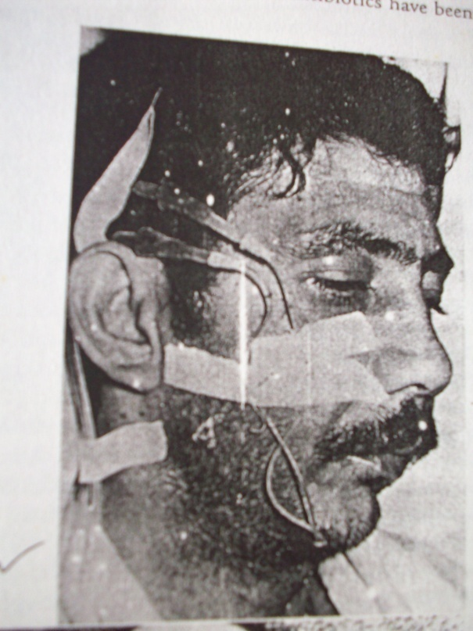
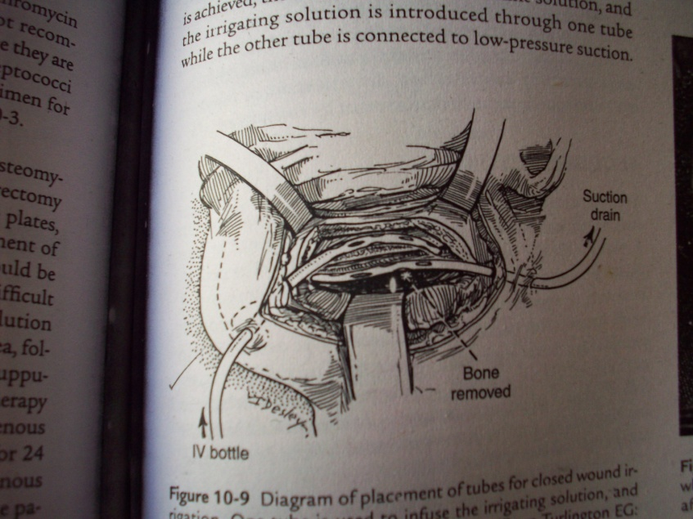

Slide 41
(ii) Antibiotic impregnated beads:
PMMA (Poly methyl methacrylate) beads impregnated with antibiotics may be placed into the disease bone.
leaching of antibiotics produce high local concentrations ( low systemic toxicity )
clindamycin, tobramycin and gentamycin

Slide 42
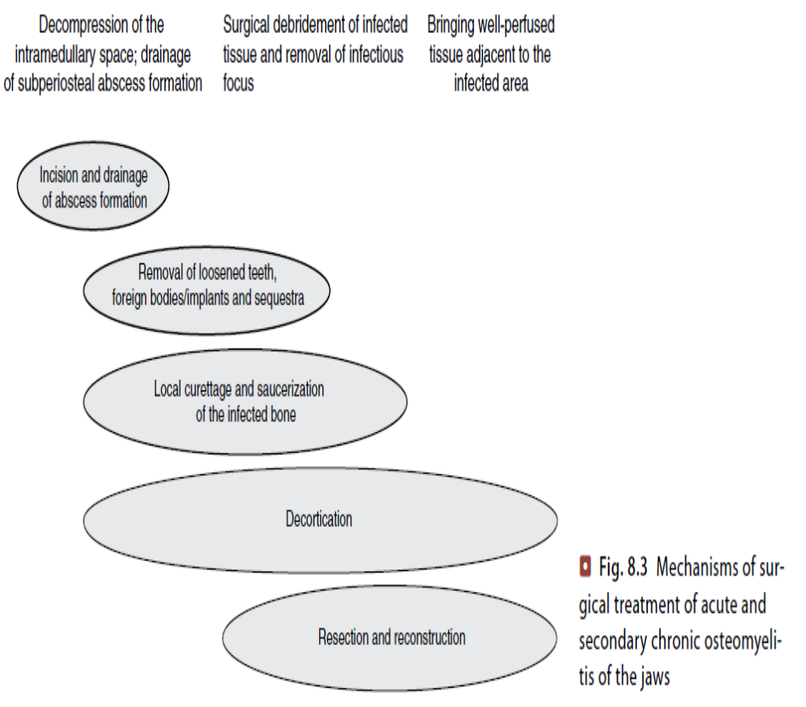
SURGICAL MANAGEMENT

Slide 43
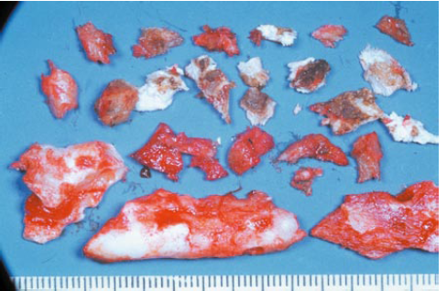
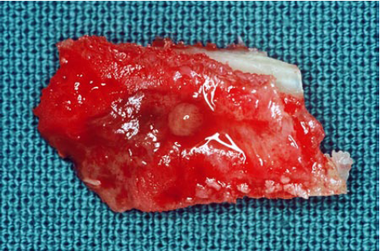
SEQUESTRECTOMY
is the removal of sequestrum.
Sequestra usually cortical may be cancellous
Fully formed sequestra persist for several months before they are resorbed , removed or spontaneously expelled through the mucosa or skin.
Resorption occurs by lytic activity of osteoclasts in granulation tissue ingrowing sequestra.
In chronic state the involucrum or shell of bone produced by the periosteum may be perforated by tracts(cloacae) through which pus escapes to epithelial surfaces.
Avascular and poorly penetrated by antibiotics.
Sterile abscesses (brodie’s abscess) commonly to long bones occur in the jaws.
Once the sequestra are completely formed it can be removed with minimal surgical trauma.
This method prevents the spread of infection and minimizes tooth and bone loss

Slide 44
SAUCERIZATION
Access to the bone by creating a muco periosteal flap usually using a gingival crest incision
Reflection of flap should be as limited as possible to preserve local blood supply
Affected teeth (loosened and other dental foci within the affected area) are extracted
Lateral cortex of the mandible is reduced using burs or rongeurs until the sufficient bleeding bone is encountered at all margins, approximately to the level of the unattached mucosa, thus producing a saucerlike defect
Local debridement is performed by removing granulation tissue and loose bone fragments from the bone bed

Slide 45
Debrided area is thoroughly irrigated with sterile saline solution with or without additional antibiotic such as Neomycin
Local bleeding due to hyperemia caused by the inflammatory process, a medicated pack may be placed and serve as local compression device
Buccal flap is trimmed and a medicated pack such as iodoform gauze lightly covered with antibiotic and local steroid ointment is placed for hemostasis. pack is placed firmly without pressure and retained by
Several nonresorbable sutures, extending over the pack from the lingual to the buccal flap
Pack is remained in situ for several days up to 2 weeks or even more in some instances and may be replaced several times until the surface of the bed of granulation tissue is epithelialized and healed margins

Slide 46
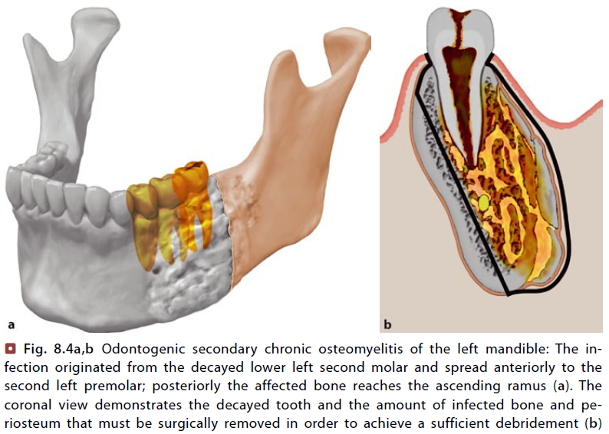
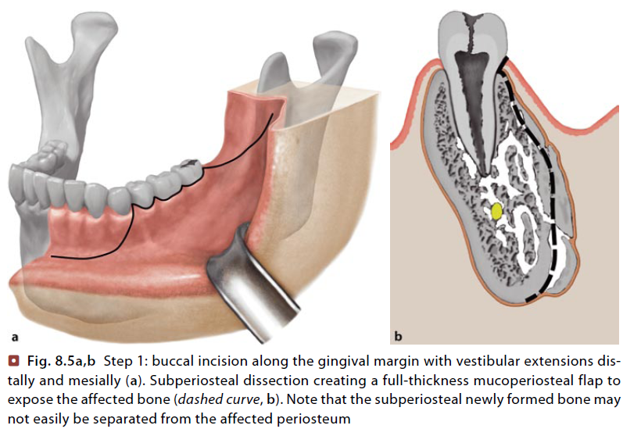
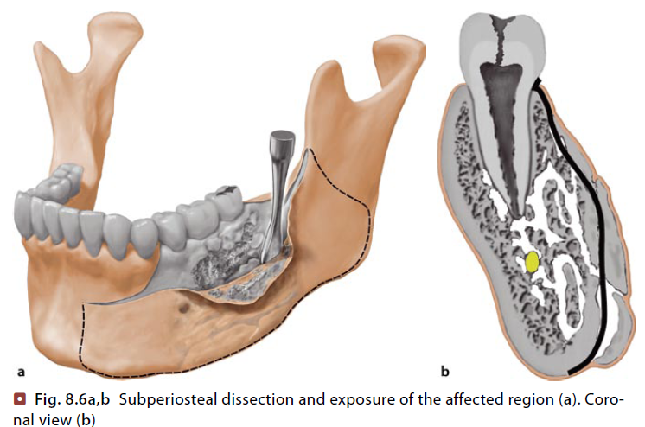
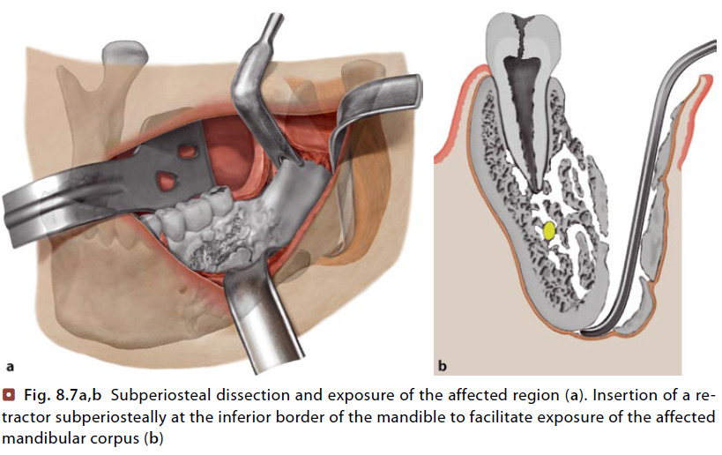
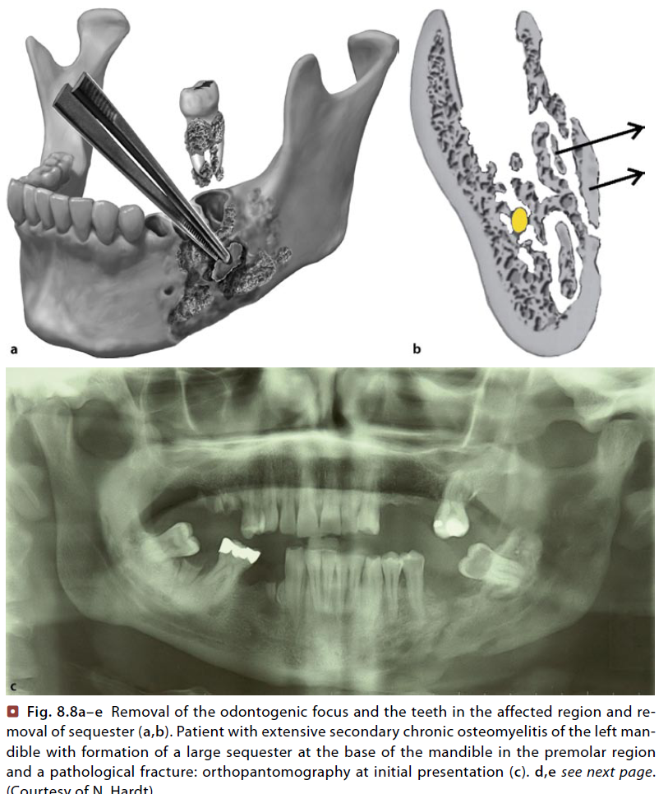
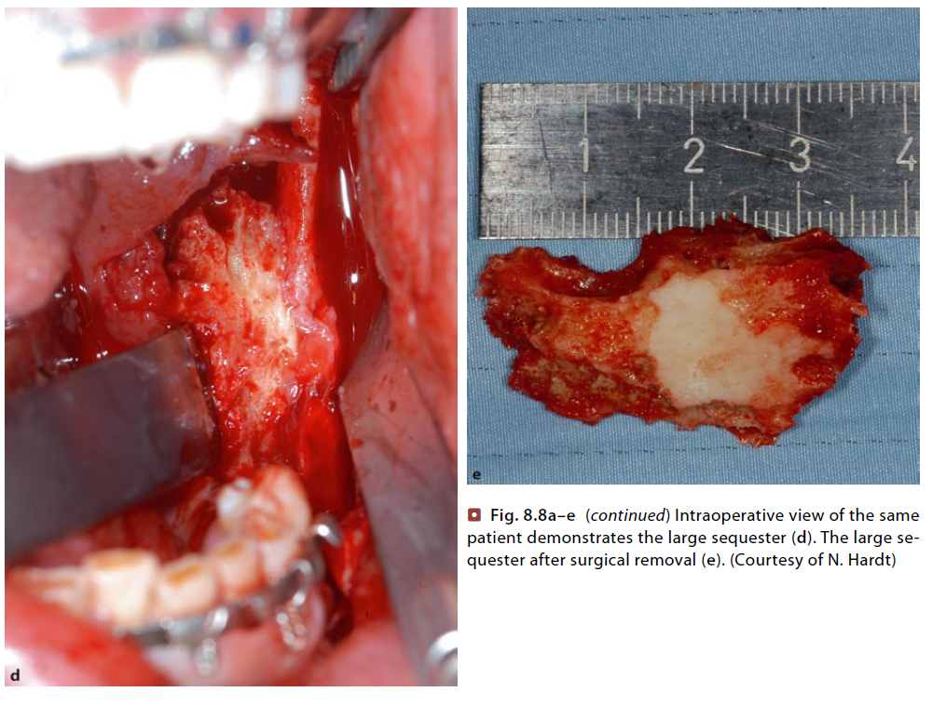

Slide 47
DECORTICATION
Raising the buccal flap with reflection of the mucoperiosteum upto the inferior border, removal of teeth in the involved area along with removal of the lateral cortical plate and the inferior border with the chisels preferably in one piece.
Bone must be cut back to the uninvolved areas as evidenced by bleeding points in bone margins.
The bony bed is thoroughly debrided and the flap is closed primarily and the dead space is eliminated by applying pressure bandage. Irrigation tubes may be placed.
In secondary chronic osteomyelitis, removal of lateral cortical plate reveals a medullary cavity occupied by granulation tissue, pus and sequestra.
In primary chronic osteomyelitis, cavities are not usually found instead areas of dense sclerotic bone are present with occasional small areas of granulation tissue.

Slide 48
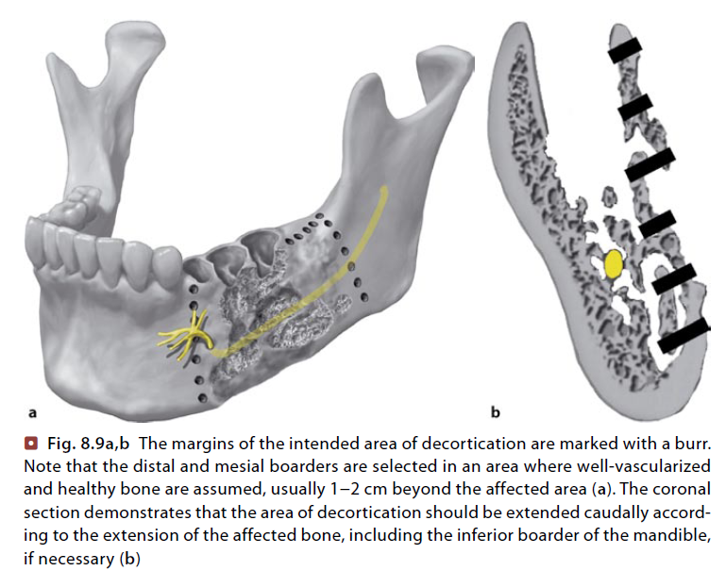
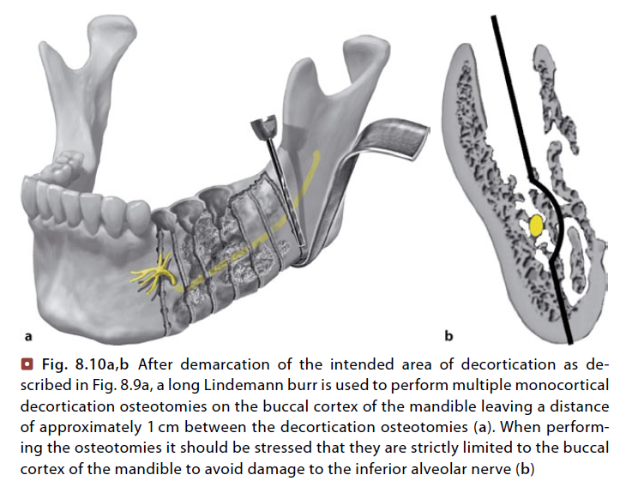
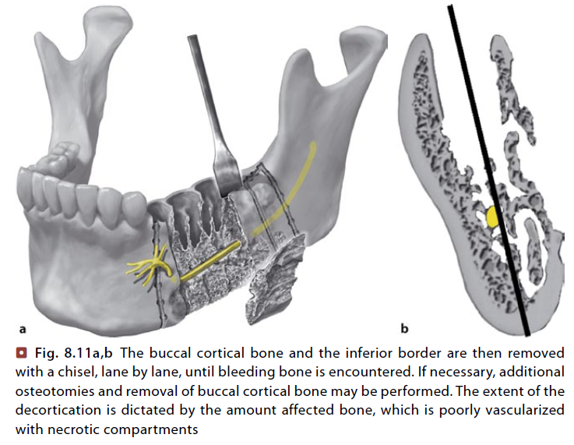
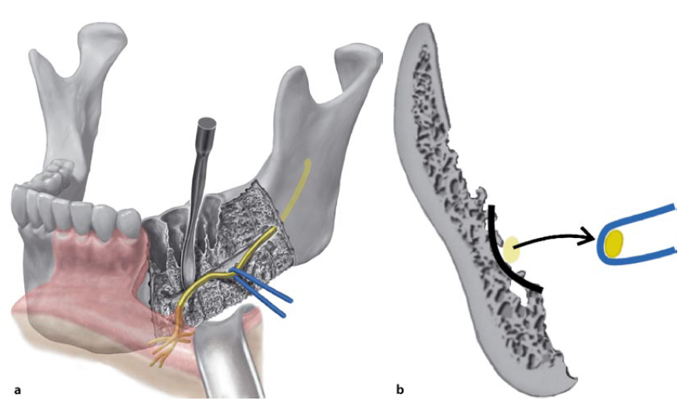
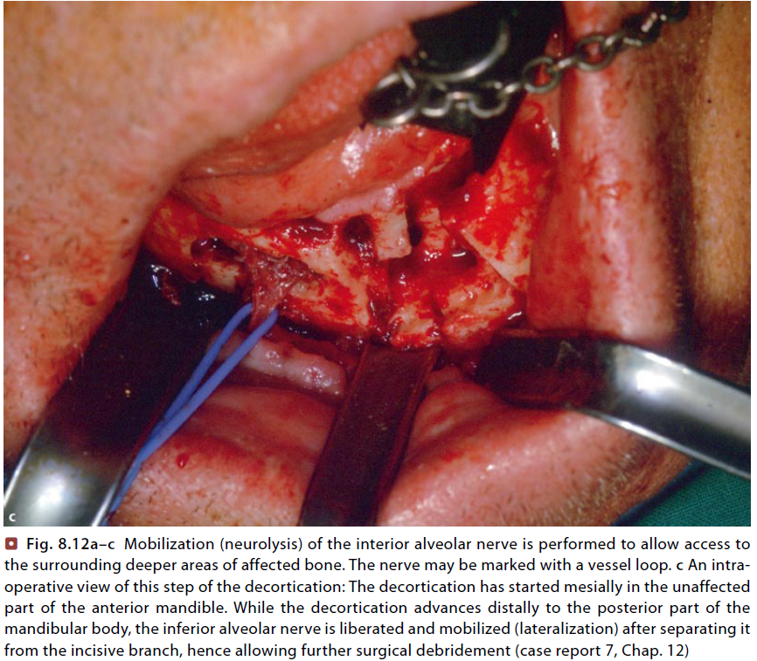
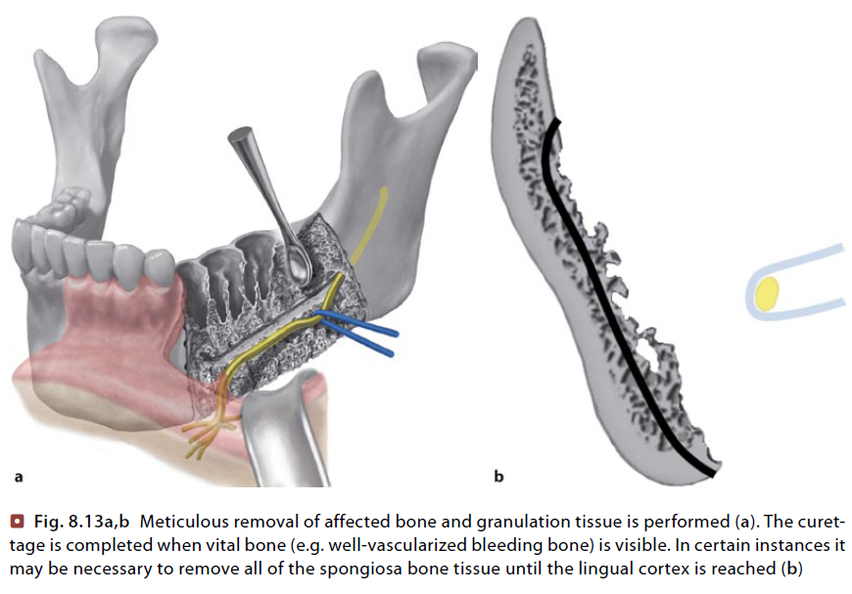
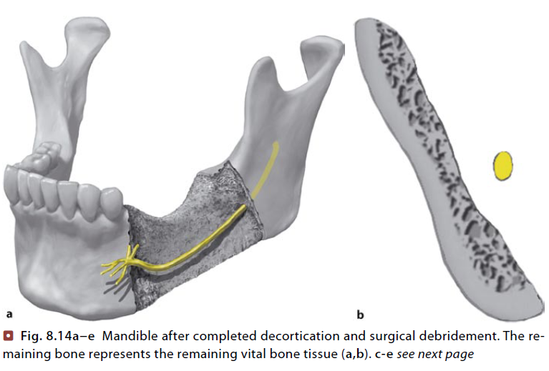
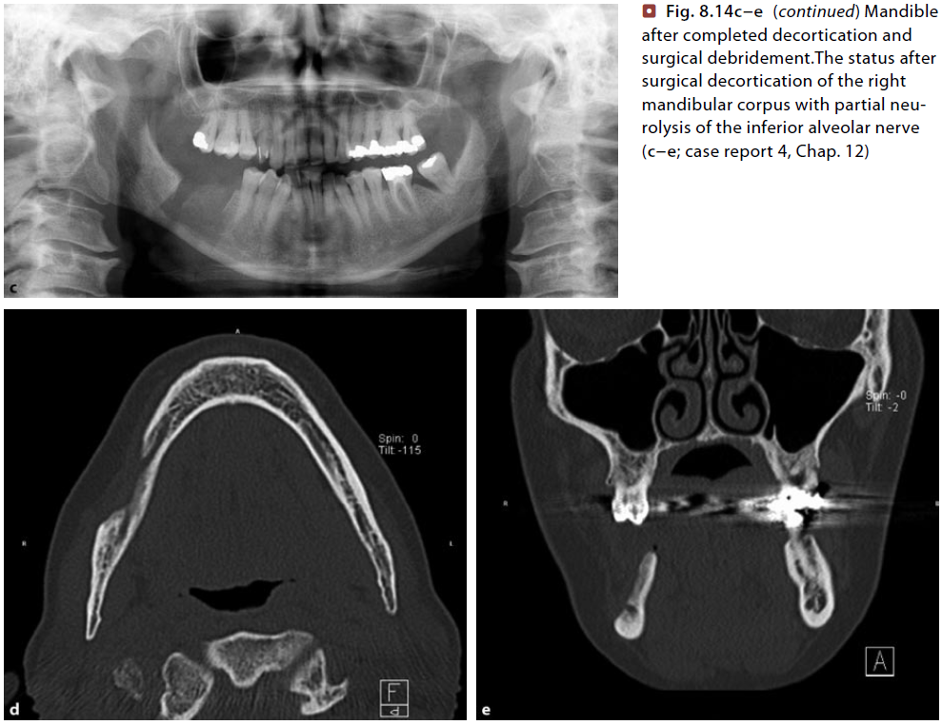

Slide 49
RESECTION AND IMMEDIATE RECONSTRUCTION
Osteotomy is performed mostly through intra-oral approach.
The wound is extensively and repeatedly irrigated.
A block of cancellous iliac crest bone or cancellous marrow is the most desirable graft material.
Stabilization may be achieved by vitalium or titanium mesh.
Immediate reconstruction offers the obvious advantage of shortening the period of illness and speeding rehabilitation.

Slide 50
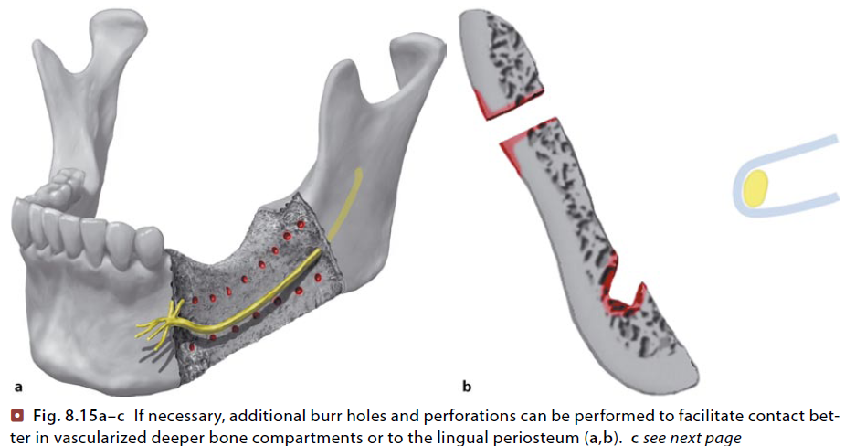
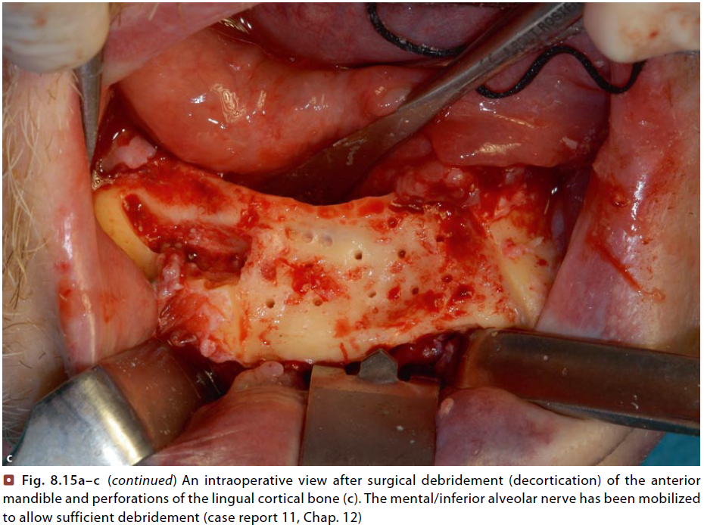
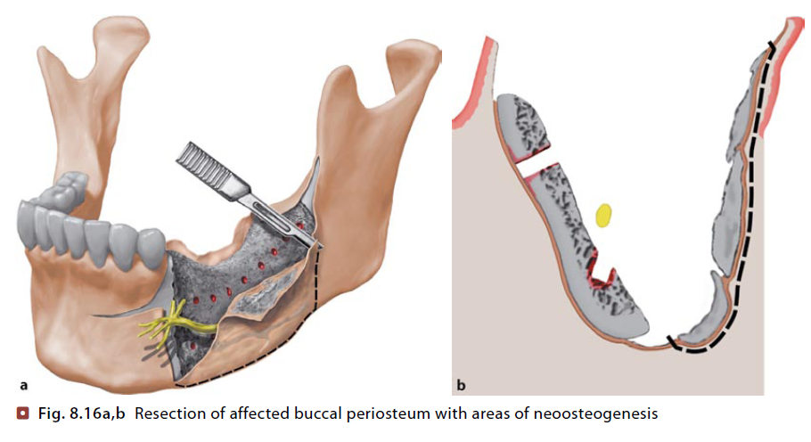
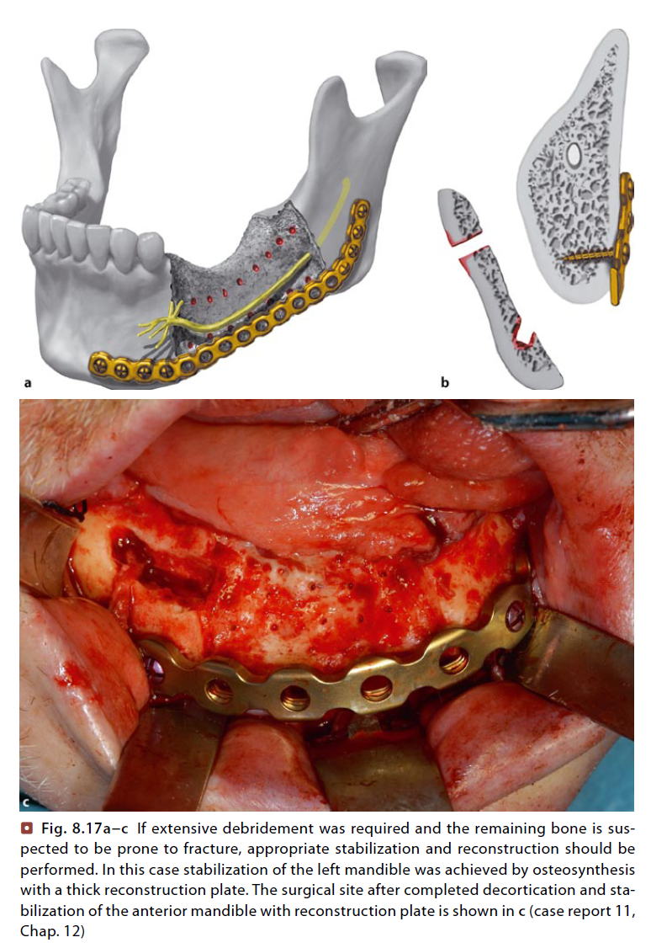
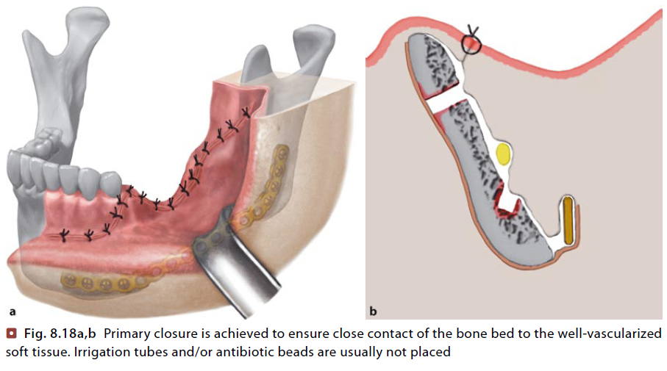
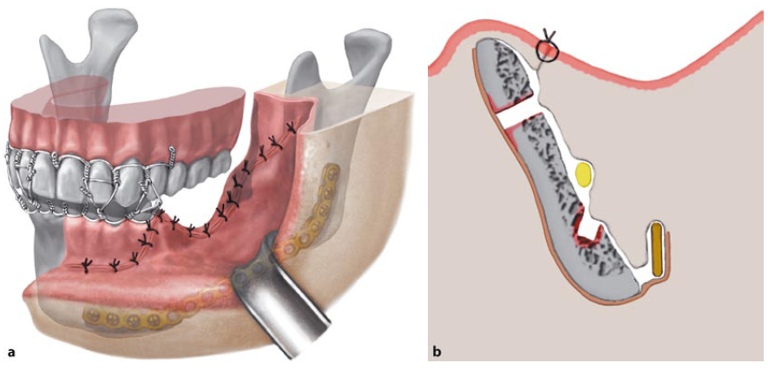
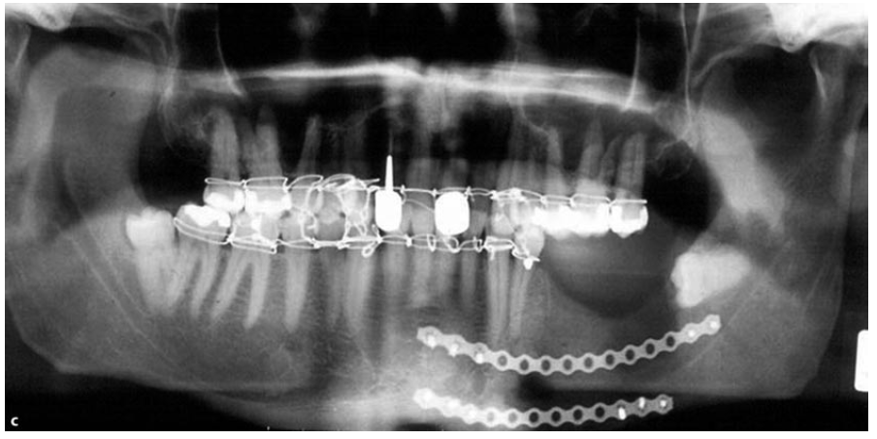

Slide 51
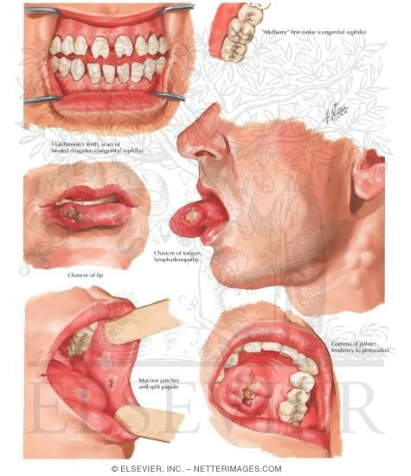
In the cranium there may be a diffuse osteitis or multiple periosteal nodes, usually around the anterior fontanel.
Radiologically, the cranium has a worm-eaten appearance due to subperiosteal gummas.
In acquired syphilis bony changes are seldom seen before tertiary stage. The palate, nose, skull and tibia are the bone most commonly affected.
The changes seen are in the form of periosteal or central gumma. Bone is resorbed at the site of the gumma producing radiolucency with a poorly defined margin.
More extensive bone necrosis and sequestrum formation.
Diagnosis may be missed, unless a gumma is seen or evidence of tertiary syphilis is found elsewhere in the body or a serological test to show presence of syphilis.
The condition rapidly improves with use of penicillin or erythromycin.
SYPHILITIC OSTEOMYELITIS

Slide 52
OSTEORADIONECROSIS
Is an exposure of non viable, non healing, non septic lesion in the irradiated bone which fails to heal without intervention
It is a sequale of irradiation induced tissue injury due to hypo vascularity, hypo cellularity and hypoxia. ( Marx hypothesis )

Slide 53
PATHOPHYSIOLOGY
In the 1983, Marx presented the pathophysiology for osteoradionecrosis,
He stated the following sequence for development of ORN
Irradiation.
Development of hypocellular, hypovascular and hypoxic tissue.
Tissue breakdown (Trauma induced or spontaneously)

Slide 54
Clinical features
Severe, deep, boring pain
Swelling of face
Soft tissue abscesses
Trismus
Fetid odour
Pyrexia
Pathological fracture
Exposed bone with a gray to yellowish colour is seen
Intra and extra-oral fistulas.
The tissues surrounding the exposed bone may be indurated or ulcerated from infection or recurrent tumor.
Formation of sequestra or involucrum occurs late or not at all seen in irradiated bone because of the severely compromised blood supply.

Slide 55
TYPES
Marx et al in 1983 defined three types of osteoradionecrosis based on the time of occurrence since radiation and also based on traumatic episodes.
Type I : Develops shortly after radiation; is due to synergistic effects of surgical trauma and radiation closely coupled in time.
Type II: Develops years after radiation and follows a traumatic event; occurs 6 years after treatment; due to progressive endarteritis and vascular occlusion of the nutrient vessels in the bone.
Type III:(Spontaneous ORN) Occurs spontaneously without a preceding traumatic event; usually occurs between 6 months and 3 years after radiation. ; due to immediate cellular damage and death due to radiation treatment. This occurs when the radiation dose exceeds 7000 Rads or the fraction doses are greater than 200 Rads per day.

Slide 56
PREVENTION
Teeth in the line of primary radiation therapy are to be extracted.
Tooth requires extraction on a previously irradiated part of the jaws, the following precaution to be taken
Metronidazole 400mg preoperatively.
Prophylactic HBO therapy should be considered before dental procedures. The recommended protocol is 20 dives of pre surgical HBO treatments of 90minutes at 2.4 atmospheric pressure. This is to be followed up with 10 dives of postsurgical HBO treatments.
Local anesthetic without vasoconstrictor should be chosen.
Extraction with least amount of trauma.
Flaps aren’t to be raised.
Metronidazole is continued for 10 days or until if the wound has healed.

Slide 57
Topicail fluoride application
Maintenance of good oral hygiene
Daily use of fluoride mouth washes

Slide 58
MANAGEMENT
Require hospitalization for parental antibiotics and fluids.
Penicillin+ metronidazole or clindamycin is the antibiotic of choice,
Difficulty in obtaining cultures is due to contamination of the necrosed tissue by indigenous flora
Aerobic and anaerobic cultures should be taken for sensitivity testing.
Supportive treatment with fluids and liquid or semi-liquid diet rich in protein and vitamins are desirable.
Exposing the patients to a pure oxygen environment (hyperbaric oxygen therapy) at 2.4 atmospheric pressure for 90 min for 4-8 weeks will increase concentration of oxygen in the plasma and tissue fluids.

Slide 59
MANAGEMENT
Encourages granulation tissue and leukocytes to migrate into the zone of necrosis, facilitating the separation of sequestra and enhancing bone healing.
conservative management is effective in small areas of osteoradionecrosis but not suitable for cases of extensive lesions.
Several alternative surgical treatments
Surgical resection
Trimming away exposed and necrotic bone until the line of attached soft tissues is reached and bringing a simple vascular flap to cover and revascularise the area.
Resection of the segment and reconstruction with free bone grafting of the defect.
Reconstruction with a composite flap.

Slide 60
HYPERBARIC OXYGEN THERAPY
Hyperbaric oxygen(HBO is defined in the European Code of Good Practice as the inhalation of pure oxygen under a pressure above the ambient pressure. Pressure is indicated in kilo Pascal (kPa) or in atmosphere absolute (ATA).
In a chamber oxygen is given by mask or hood
Dive – 100% oxygen at 2.4 ATA for 90 min

Slide 61
Hyperbaric Chambers
MULTIPLACE, ICU COMPATIBLE HBO CHAMBER
Multiplace HBO chambers have at least two compartments.Larger ones may harbor space for several patients
MONOPLACE HBO CHAMBER
Single-compartment vessels designed for a single patient
Due to their limited space, they do not allow direct access to the patient during the treatment but can allow distance intensive care monitoring and respiratory assistance
BREATHING SYSTEMS
To breathe the pure oxygen through a tight face mask
- In maxillofacial, ENT, and facial plastic surgery some patients are not able to wear such a mask specially designed and comfortable hoods have been created

Slide 62
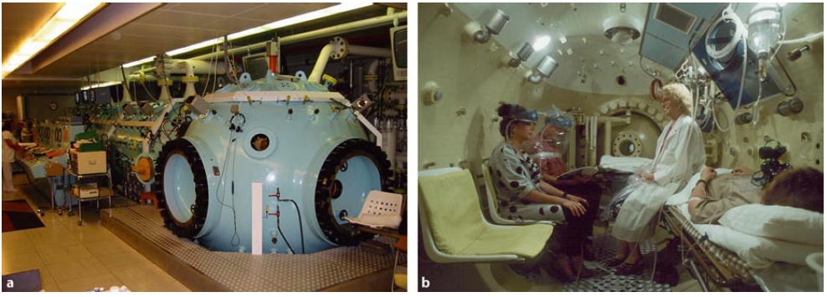
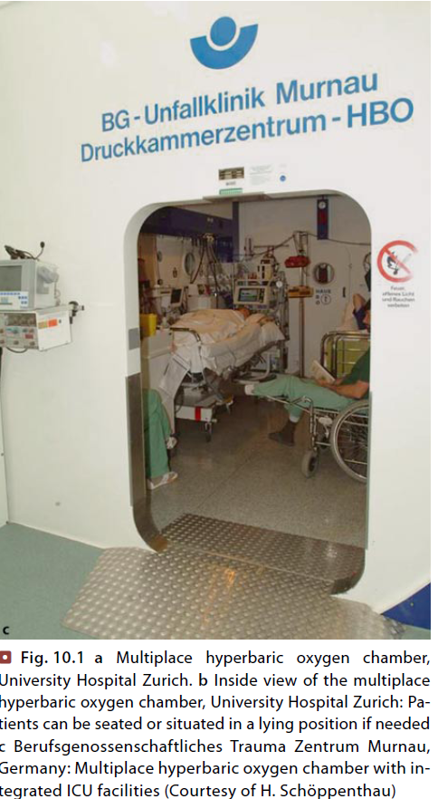
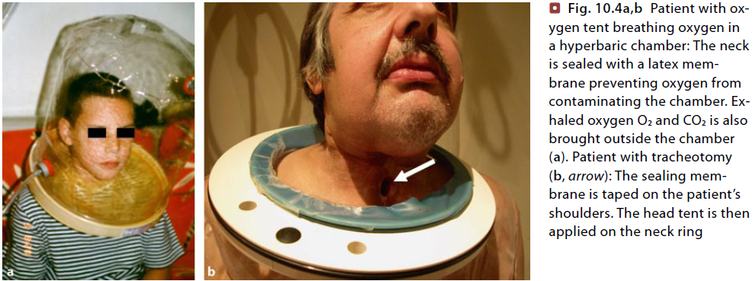
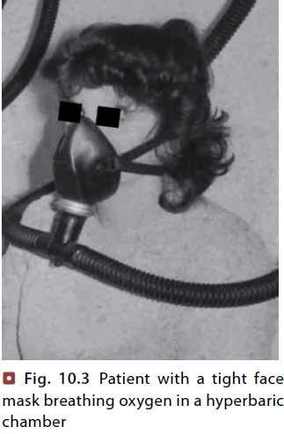


Slide 63
BENEFICIAL ACTION OF HBO
Enhancement of lysosomal degradation potential of polymorphonuclear leucocytes and oxygen radicals
Free oxygen radicals are bactericidal
Exotoxins liberated are rendered inert by exposure to elevated partial pressure of oxygen
Tissue hypoxia is reversed by HBO therapy
Positive enhancement of neoangiogenesis

Slide 64
CLINICAL EFFECTS
Healing of draining sinus
Improves osteogenesis in lytic areas
Reduces destruction of bone and soft tissues
Sequestra undergo rapid dissolution without suppuration
Healing frequently

Slide 65
THE MARX-UNIVERSITY OF MIAMI PROTOCOL
Marx et al in 1983 has proposed a protocol for the management of ORN based on surgical and HBO therapy.
Three treatment stages
STAGE I TREATMENT:
30 dives of HBO treatment therapy at 2.4 atmospheric pressure for 90 minutes each.
Wound care is maintained with irrigation and antibiotics are usually discontinued. After 30 treatments wound is re-evaluated.
If there is clinical improvement such as decrease in exposed bone, resorption, spontaneous sequestration, or softening of exposed bone, the patients receive 10 more treatments of HBO.
If there is no clinical improvement the treatment is advanced to stage II.
.

Slide 66
THE MARX-UNIVERSITY OF MIAMI PROTOCOL
STAGE II TREATMENT:
Here after 30 treatments of HBO exposure, a transoral alveolar sequestrectomy is accomplished by saw with minimal periosteal reflection.
Only cases of cortical or superficial bone involvement and in those cases who do not require jaw resection.
All necrotic bone is removed back to the bleeding bone with minimal periosteal reflection.
The mucoperiosteum is closed in layered fashion.
If healing progresses well 10 additional treatment of HBO are given. If the wound breakdown, leaving a larger area of exposed non-healing bone, the patient is identified as non-responder and is advanced to stage III

Slide 67
THE MARX-UNIVERSITY OF MIAMI PROTOCOL
STAGE III TREATMENT:
This is indicated in non-responders to stage II treatment or in case where there is extensive dead bone, or pathologic fractures, fistulas.
After 30 treatments of HBO, the patients undergo a transoral partial jaw resection, the margins of which are determined by the presence of bleeding bone.
The segments of mandible are stabilized for later reconstruction. HBO is continued for 10 postoperative treatments.
The reconstruction is usually done 10 to 12 weeks after resection. The patients are given 10 treatments of HBO after reconstruction.

Slide 68


Slide 69
contraindications
Pneumothorax
Severe COPD
Optic neuritis
Upper respiratory tract infection
Malignant disease
Psychiatric problems
H/o prior thoracic or ear surgery
Acute viral infection

Slide 70
complications
Eustachian tube dysfunction
Tympanic membrane rupture
Decompression sickness
Changes in vision
claustrophobia

Slide 71


