Slide 1


Slide 2
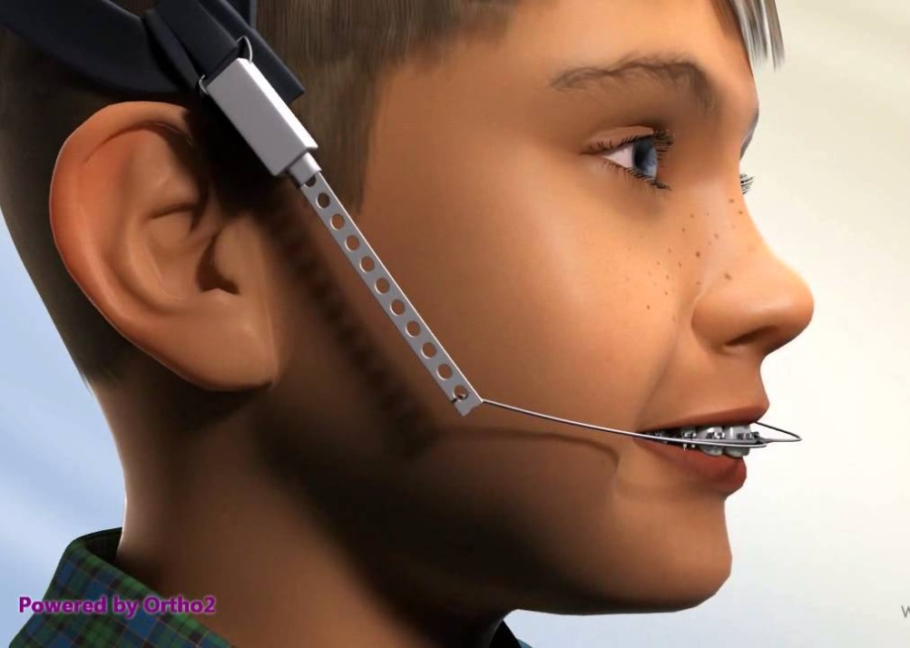
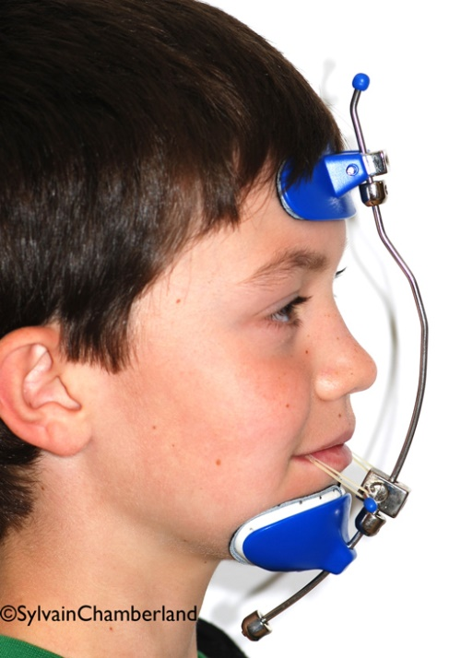
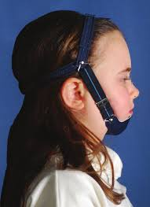
Orthopaedic appliances

Slide 3
Introduction
ORTHODONTICS
ORTHODONTIC FORCE
Tooth moving forces
Light forces
50-100gm
ORTHOPEDIC FORCE
Heavy forces
>400gms
Cranio facial skeleton

Slide 4
Definition
Any appliance used to prevent, intercept and/or correct improper relationship between maxilla and mandible as well as various functional deviations, by influencing growth, development and function are orthopedic appliances.

Slide 5
Basis For Orthopedic Appliance
Appliance make use of teeth as a handle to transmit forces to the underlying skeletal structures.

Slide 6
Factors Controlling Skeletal Changes:
Amount of force:
Heavier forces >400gms
Hyalinization & undermining resorption
Duration of force:
Intermittent forces
12-14hrs/day
more of skeletal effect than dental effects

Slide 7
Commonly Used Orthopedic Appliances
Headgear
Facemask
Chin cup

Slide 8
HEADGEAR

Slide 9
Components
Molar tube
Face bow
Force module
Head strap

Slide 10
Components of Head-gear assembly
Molar tube
Face-bow
Inner bow
- Outer bow
Head strap
Force module

Slide 11
Molar Tube
Fixed appliance
Removable appliance
0.045 inch
0.045 inch

Slide 12
Facebow – Types
Inner-outer bow type
J-hook type
Soldered
joint
Inner bow
Outer bow

Slide 13
Soldered
joint
Inner-outer bow type Facebow :
The force is delivered to the first molar by the face bow which is engaged in the buccal tube. It can be attached to removable appliances also.
The facebow has an inner and an outer bow.
Inner bow
Outer bow

Slide 14
The Inner Bow
Inner bow is available in either:
  0.045 inch
  0.051 inch
Proper adjustment of the inner bow will allow the wire to slide in and out of the headgear tubes easily.
Inner bow

Slide 15
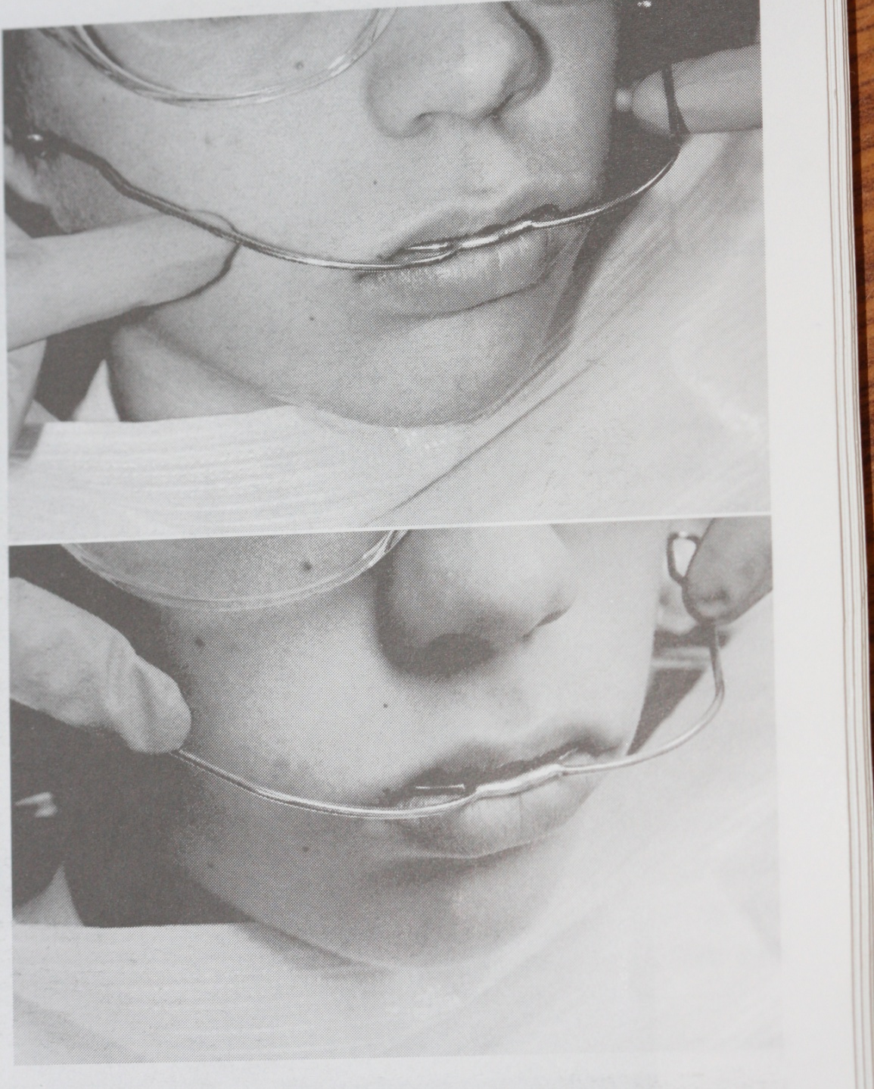
The Outer Bow
Outer bow diameter is :
  0.072 inch
The outer bow must be adjusted to
fit the face of the patient.
Should be 5 to 10mm away from cheeks.

Slide 16
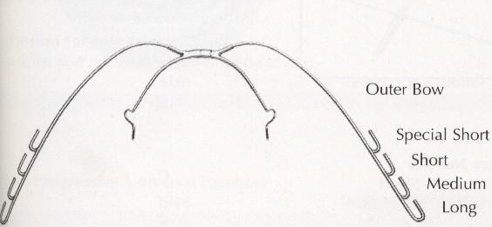
Outer bows:

Slide 17
J-hook type
An alternative method of applying extra-oral forces to a fixed appliance.
The hooks are termed ‘J’ hook on account of their shape and are attached directly to the arch wire usually in the incisor region.

Slide 18
Each J-hook consists of a 0.072 inch wire contoured so as to fit over a small soldered stop on the arch wire.
1
3
1
2
1
1
1
3
1
2
1
1

Slide 19
Force Modules
Heavy force module
Light force module

Slide 20
Head cap/Neck strap

Slide 21
Classification of Head-gears
Cervical headgears
Occipital headgears
Combination headgears
Vertical pull/high pull headgears
Asymmetric headgear

Slide 22
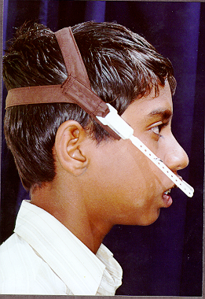
High Pull Head-gear

Slide 23
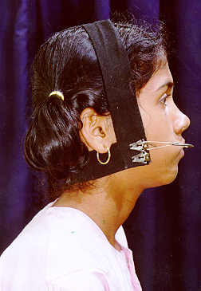
Combi-Pull Head-gear

Slide 24
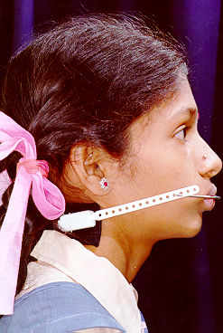
Low Pull Head-gear

Slide 25
Center of Resistance
Applying a force through the center of resistance will lead to a pure translatory movement along the force vector.
Unless the force direction is parallel with the occlusal plane, tooth will also move vertically (intrusion & extrusion).

Slide 26
Applying a force away from the center of resistance will lead to a combination of translatory and rotational movement.
The amount of rotational effect will depend on the distance of the force vector at right angle from the center of resistance.

Slide 27
The relative amounts of angular change and translation are determined by the length of the shortest distance between the line of force and the center of resistance.

Slide 28
According to observed clinical reactions the location of the center of resistance of the maxillary complex must be somewhere in the area of the postero-superior aspect of the zygomatico-maxillary suture.

Slide 29
A force vector would have to pass through the center of resistance of the dentition and through the center of resistance of the maxilla if no rotational effects are to be induced.

Slide 30
Uses of headgear
Orthopaedic effect
Anchorage
Distalization of molars
Molar rotation
Space maintenance

Slide 31

Facemask/Reverse pull headgear

Slide 32
Class III Skeletal cases – maxillary retrognathism
Hickham(1972) claims the patron, but popularised by Delaire
Principle – disarticulate the sutures and pulling the maxilla forward
Anchor unit – forehead, chin or commonly both

Slide 33
Indications
1. Used in growing patient with mild to moderate class II skeletal malocclusion due to maxillary retrusion
2. Correction of post surgical relapse after osteotomies.
3. Selective rearrangement of palatal shelves in the cleft patients.

Slide 34
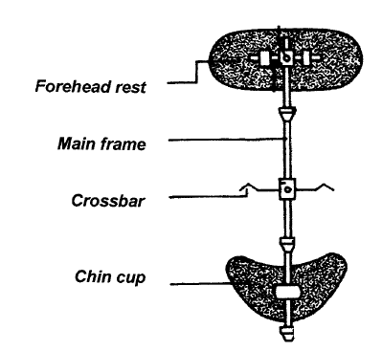
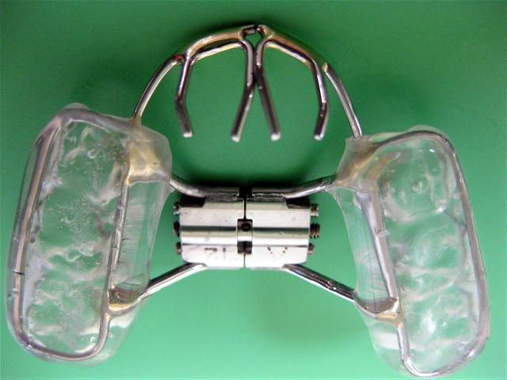
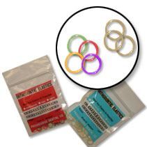
Parts of a facemask :
1.Metalframe
2.Chin Cup/Pad
3.Forehead Cap
4.Cross Bar.
5.Intraoral Appliance
6.Heavy Elastics.

Slide 35
Types of reverse pull headgear
Delaire’s Facemask
Petit type of face mask
Tubinger model
Other modifications
35

Slide 36
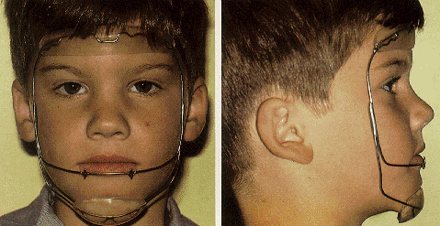
Delaire’s Facemask
36

Slide 37
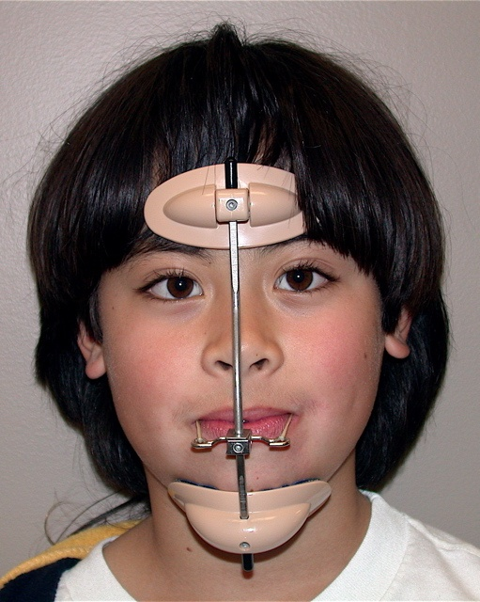
Petit type of face mask
37

Slide 38
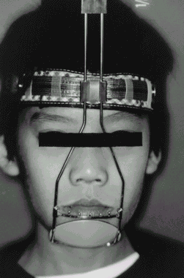
Tubinger model

Slide 39
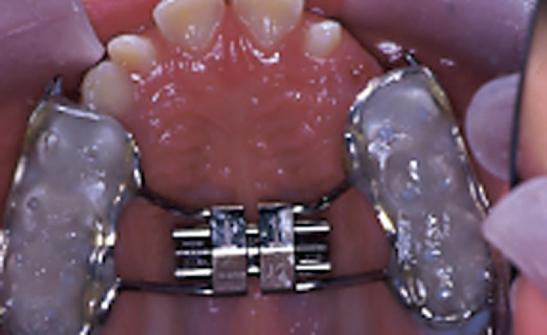
Bonded palatal expansion appliance
39

Slide 40

40

Slide 41
BIOMECHANICAL CONSIDERATIONS
The amount of maxillary movement is influenced by:
1. Amount of force (300-500gms/side)
2. Direction of force (15-20 degrees downward)
3. Duration of force (8-12 months)
4. Frequency of use (12-14 hrs/day)
5. Age of patient (early mixed dentition)
6. Anchorage systems (palatal arches/expansion appliances)

Slide 42
Chin cup
The chin cup assembly

Slide 43
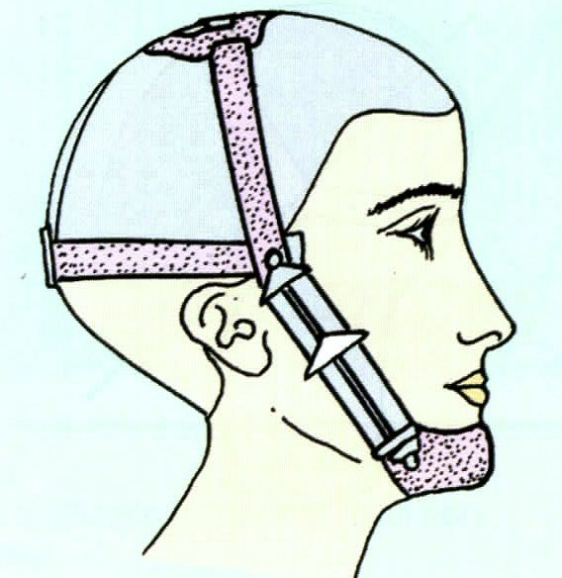
Chin cup
Chin cup is an extra oral appliance that utilizes a head cap.
Used to restrict the forward and downward growth of the mandible.
Custom made or prefabricated ,
hard or soft.

Slide 44
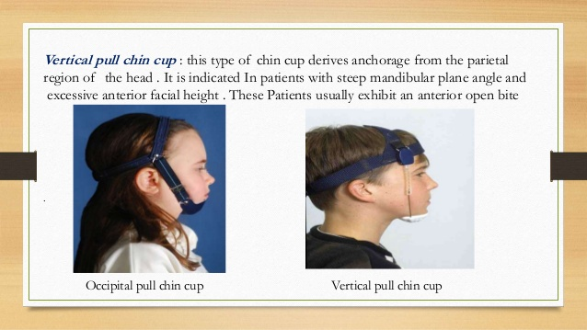
Types of chin cup
1)Occipital chin cup
2)Vertical pull chin cup
Occipital chin cup
It derives anchorage from the occipital region.
This is used in case of class III cases with mild to moderate prognathism.
Vertical pull chin cup
Derives anchorage from the parietal region .
Indicated in high angle patients or long face patients .

Slide 45
Magnitude of force :
A force of 300 – 600 gm/side is recommended.
Initially lower force of 150 gm recommended.
Duration of wear :
A maximum of 12-14 hours/day

Slide 46
THANK YOU

