Slide 1
ORTHODONTIC PRACTICALS CLASS

Slide 2
Basics
Angles classification
Wire bendings
Case history discussion

Slide 3
Basics
Definition :
In 1922, Th e British Society of Orthodontists proposed that “Orthodontics includes the study of growth and development of jaws and face particularly and the body generally, as infl uencing the position of the teeth; the study of action and reaction of internal and external influences on the development, and the prevention and correction of arrested and perverted development”

Slide 4
Orthodontics is the branch of dentistry concerned with the growth of the face, development of occlusion and the prevention and correction of occlusal anomalies/ abnormalities.
The term “orthodontics” comes from Greek: “orthos” meaning right or correct and “odontos” meaning tooth.
The term ‘orthodontics’ was first coined by Le Felon in 1839

Slide 5
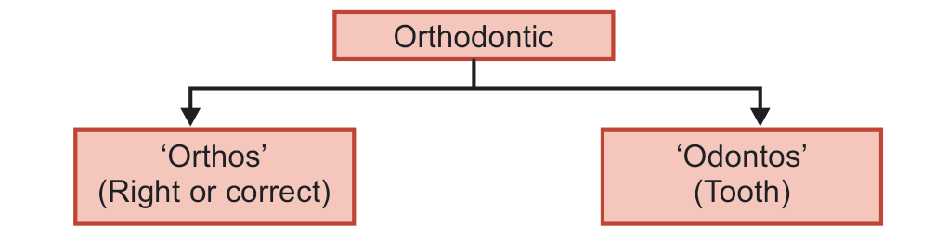

Slide 6
WHAT IS MALOCCLUSION?
The term ‘malocclusion’ was first coined by Guilford and it refers to any irregularities in occlusion beyond the accepted range of normal category.
Malocclusion can be presented in a number of ways.
Some of the common characteristics of malocclusion include:
 Overcrowded teeth
 Spacing between the teeth
 Improper “bite” between maxillary and mandibular teeth
 Disproportion in the size and the alignment between the maxillary and the mandibular jaws

Slide 7
AIMS OF ORTHODONTIC TREATMENT
Although orthodontic treatment improves facial appearance and is occasionally performed for cosmetic reasons, it should be aimed at restoration of overall dental health.
Jackson has summarized the aims of orthodontic treatment.
Jackson’s Triad
i. Functional efficiency
ii. Structural balance
iii. Esthetic harmony

Slide 8
BRANCHES OF ORTHODONTICS
Preventive orthodontics
Interceptive orthodontics
Corrective orthodontics

Slide 9
ORTHODONTIC APPLIANCES
Orthodontic appliance
Orthodontic appliances are appliances by means of which pressure can be applied to a teeth or group of teeth in a predetermined direction.

Slide 10
There are basically four types of orthodontic appliances, which can either be used individually or in combination to treat malocclusions.
i. Removable orthodontic appliances
ii. Fixed orthodontic appliances
iii. Functional appliances
iv. Orthopedic appliances/Extra-oral force appliances

Slide 11
Definitions
Removable appliance
The term removable appliance is used to indicate an appliance which can be removed for cleaning by patient or for adjustment by the orthodontist.
Fixed appliance
Fixed appliance is rigidly attached to the teeth by means of bands or rings of metal which are closely adapted and cemented to the teeth or bonded to the teeth. patient can’t remove the appliance by himself/herself.

Slide 12
Functional appliance :a functional appliance is a harmless natural force and transmits them to the teeth and alveolar bone in a predetermined direction.
Myofunctional appliances are loose fitting appliances generally removable and some times fixed which are designed to change the neuromuscular surroundings of orofacial area.they also improve the occlusal development and the relation,along with craniofacial growth.

Slide 13


Slide 14
Removable Appliances
INDICATIONS:
Use of removable orthodontic appliances requires careful selection.
They should not be used in circumstances where fixed orthodontic appliance therapy would be more appropriate.
May be used as an adjunct to fixed orthodontic appliance treatment.

Slide 15
CONTRAINDICATIONS:
Removable orthodontic appliances are contraindicated in case where bodily movements of the teeth are required.

Slide 16
Advantages of removable appliance
Allow growth guidance
Aesthetically better accepted than fixed appliance.
Bite planes can be incorporated with removable appliance.
Can be treated for simple tipping /tilting
Control is less complex. Simple tooth movement.
Can be removed on socially sensitive occasions for short period of time.
Can be removed by patient. If there is any damage or problem, appliance.
Can be used as muscle exerciser.
Dental practitioner can handle these removable appliances.
Easy to brush and clean the appliance.
Excessive force cant be applied as it leads to displaCement of appliance.
Less chair-side time.
Less expensive for doctor and the patient.

Slide 17
Disadvantages
Only simple malocclusion can be corrected.
Need more time for correcting multiple tooth movement ,only few movements can be treated at a time.
Bodily movement can’t be done
Multiple rotations can’t be corrected.
Root movements can’t be corrected.
Cases other than first premolar extraction can’t be treated.
Posterior segment can’t bring forward for closing extraction space.
If not adjusted carefully, it brings about uncontrolled tipping.
Final alignment of teeth is not possible.
Difficulty of speech in initial stages.
Patients can be uncooperative.
Easily damaged or broken if care is not taken.
Not well tolerated.
Not useful in in class II and class III cases.

Slide 18
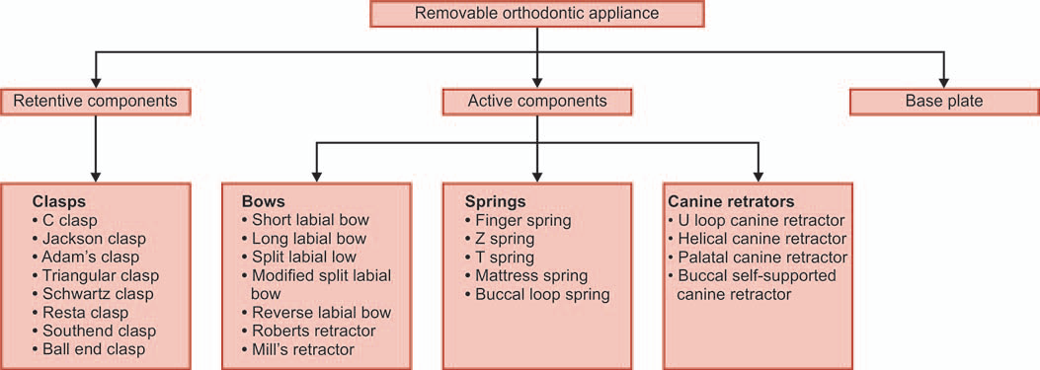

Slide 19
BASIC BENDS
There are four basic types of bends that are used to fabricate
orthodontic appliances.
I. Right-angled bend.
II. Loops and helices.
III. Curves.
IV. Control of plane in space

Slide 20
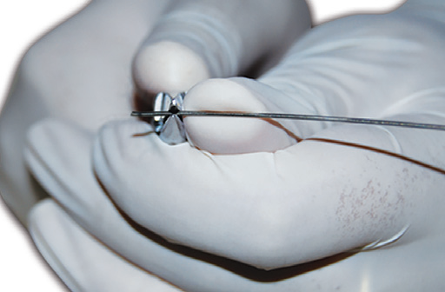
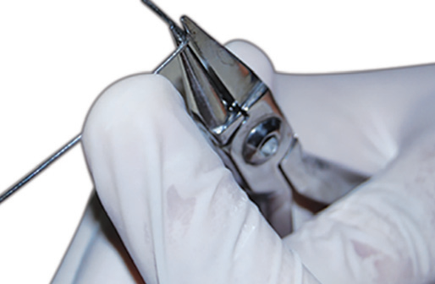
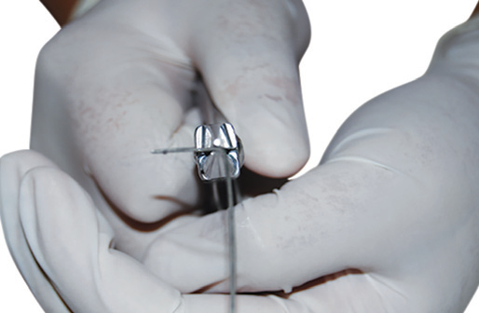
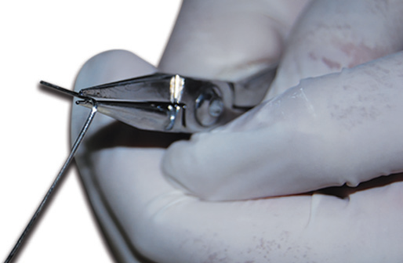

Slide 21
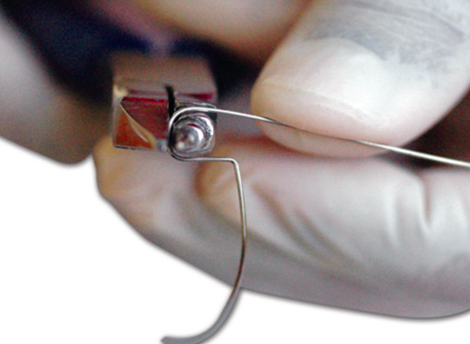
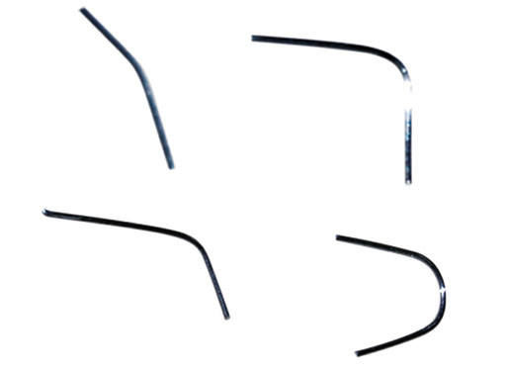

Slide 23
BASIC ARMAMENTARIUM
Universal pliers
Adam’s pliers
Hard wire cutter

Slide 24
UNIVERSAL PLIERS
so called, because it can be used for fabricating many of the wire components.
Parts
1. Working end
a. Looped beak portion
b. Non-looped beak portion
2. Hinge
3. Handle.
Looped Beak Portion
Small-sized loop
Medium-sized loop
Large-sized loop

Slide 25
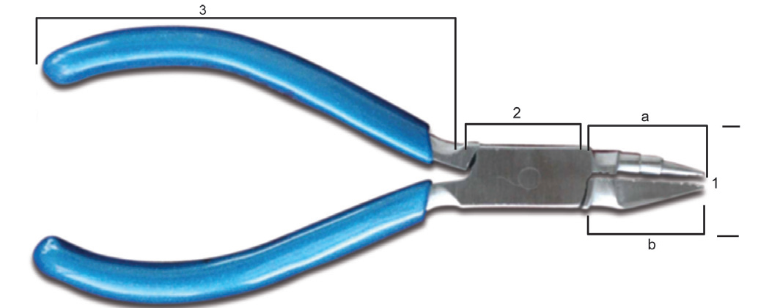
Working end, a—Looped beak portion,
b—Non-looped beak portion
(2) Hinge,
(3) Handle

Slide 26
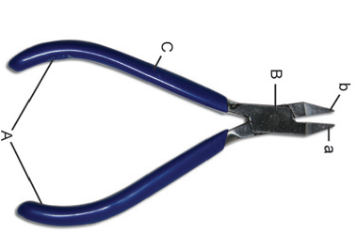
ADAM’S PLIERS
Adam’s pliers was developed by Philip C Adam.
He also designed one of the most versatile clasps used in orthodontic appliance, the Adam’s clasp.
1. Working end.
a. Right half/right beak
b. Left half/left beak
2. Hinge
3. Handle

Slide 27
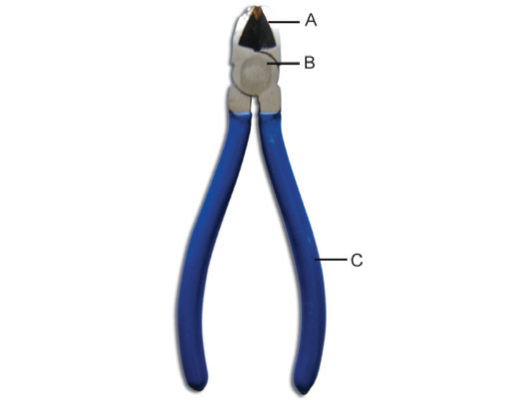
HARD WIRE CUTTER
1. Working end
2. Hinge
3. Handle

Slide 28
‘C’ Clasp
Circumferential clasp, also known as “three-quarter clasp” or ‘C’ clasp
1 mm wire
Advantages:
1. Simplicity in design.
2. Easy to fabricate.
3. Less occlusal interference.
4. Provides adequate retention.
5. Having squash loop in the clasp helps in preventing soft tissue trauma and injury while cleaning the appliance.

Slide 29
Disadvantages:
1. It does not provide adequate retention when used for an active removable orthodontic appliance.
2. It should be considered only as a supporting clasp.
3. It is not comparable to Adam’s clasp in retention ability, as it engages only one undercut area of the clasped tooth.
4. It cannot be used in teeth that are partially erupted, as the cervical undercut cannot be seen.
5. It cannot be fabricated on deciduous molar.
6. It can be easily distorted during insertion or removal of the appliance by the patient.

Slide 30
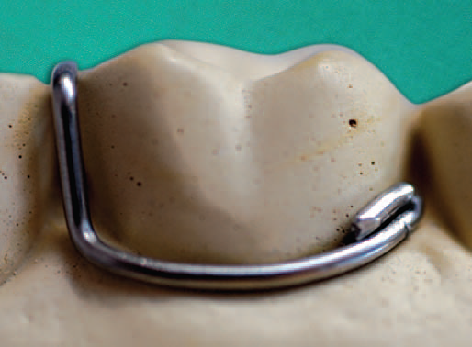
Design
Utilizes buccocervical undercut of the teeth
The wire is extended circumferentially from one proximal undercut along the cervical margin, to reach the other proximal side
Then brought occlusally over the embrasure to end lingually as retentive arm and tag.
The retentive arm and tag later
get embedded in the acrylic base material
Incorporation of a squash loop
at the beginning of ‘C’ prevents soft tissue
trauma and injury while cleaning the appliance

Slide 31
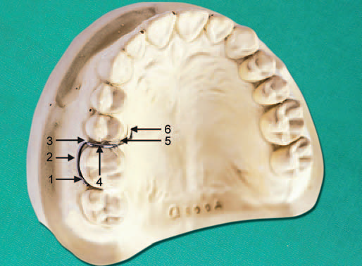
1—Squash loop;
2—Circumferential arm;
3—Buccal interdental arm;
4—Occlusal interdental arm;
5—Retentive arm;
6—Retentive tag

Slide 32
Uses
1. Circumferential clasp is often used on first permanent molar or second permanent molars.
2. Circumferential clasp is occasionally used on permanent canines

Slide 33
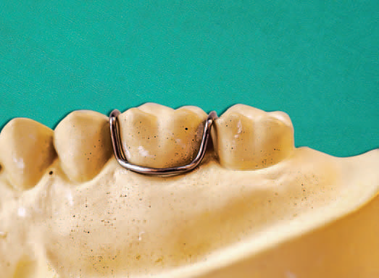
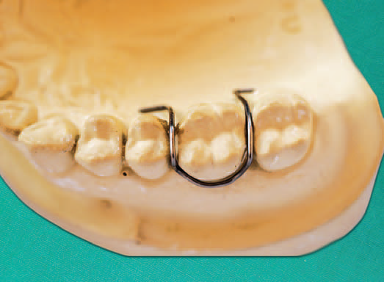
Jackson Clasp/Full Clasp
full clasp” or “U” clasp
This clasp is adapted along the buccal cervical margin and extends along the mesial and distal undercuts over the occlusal embrasure to end in two retentive arms on either side of the teeth

Slide 34
Triangular Clasp
Triangular clasp is so called because it acquires the shape of a triangle
Parts
Parts of triangular clasp are:
1. Base of triangle: Away from embrasure
2. Apex of triangle: Faces embrasure
3. Retentive arm: Long
4. Retentive tag.

Slide 35
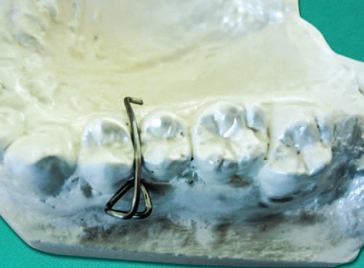

Slide 36
Uses
1. Triangular clasps are used as accessory clasps.
2. They are used to provide additional retention.
Advantages
1. They are small-sized clasps thus do not interfere with the maintenance of oral hygiene.
2. Easy to fabricate.
3. They can be fabricated between two adjacent teeth, mainly between two adjacent posterior teeth.
4. They engage proximal undercuts between two adjacent teeth.

Slide 37
Disadvantages
Triangular clasp cannot provide adequate retention when used alone

Slide 38
ACTIVE COMPONENTS
BOWS:
Short Labial Bow:
constructed from canine to canine
Parts:
a bow,
two “U” loops,
two retentive arms

Slide 39
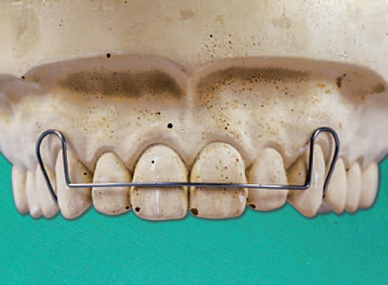
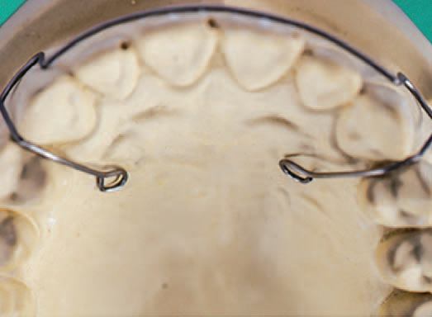

Slide 40
Bow:
1. It contacts with the most prominent labial surface of
the anterior teeth.
2. Bow should be exactly in the center of the crown on
labial surface of the anterior teeth.
3. There should not be any bends in the bow.
.

Slide 41
“U” Loops:
1. There are two U-shaped loops, one on right canine another one on left canine.
2. The bow terminates just mesial to labial ridges of canines on either side, where the wire is bent to form “U” loops.
3. The distal leg of “U” loop passes interdentally between canine and first premolar to end lingually as retentive arm

Slide 42
Retentive Arms
1. Short labial bow has two retentive arms—mesial and distal.
2. The retentive arms should follow the anatomy of palate and lingual mandibular area in respective jaws.
3. A clearance of 0.5 mm between the tissue surface and retentive arm is needed for acrylization
Indications
1. Minor overjet reduction.
2. Anterior space closure.
3. For the purpose of retention at the termination of active orthodontic therapy.

Slide 43
Activation
It is activated by compressing the “U” loop by 1 to 2 mm.

