Slide 1
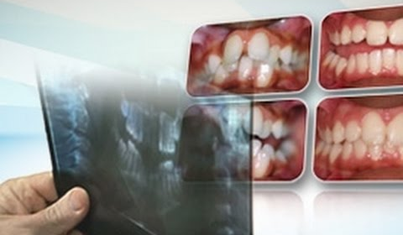
ORTHODONTIC DIAGNOSTIC AIDS

Slide 2
CONTENTS
Introduction
Essential diagnostic aids
Supplemental diagnostic aids
Conclusion

Slide 3
INTRODUCTION
◆ Orthodontic diagnosis deals with recognition of the various characteristics of the malocclusion.
◆ Diagnosis include case history, clinical examination and other diagnostic aids such as study casts, radiographs and photographs.

Slide 4
Comprehensive orthodontic diagnosis is established by clinical implementation called diagnostic aids.
Orthodontic diagnostic aids are of two types namely.
Essential diagnostic aids
Supplemental diagnostic aids

Slide 5
Essential diagnostic aids
Case history
Clinical examination
Study models
Certain radiographs;
    ◆ Periapical
    ◆ Bitewing
    ◆ Panoramic
  Facial photographs

Slide 6
Supplemental diagnostic aids
They are certain aids that are not essential in all cases. They may require specialized equipments that an average dentist may not possess.

Slide 7
The supplemental diagnostic aids include
1-Specialized radiographs
2. EMG
Hand wrist radiographs to assess bone age or maturation age
Endocrine tests
Estimation of basal metabolic rate
Diagnostic set-up
7.Occlusograms

Slide 8
Orthodontic study models
Orthodontic study models are accurate plaster reproductions of teeth and their surrounding soft tissues, that are essential diagnostic aid that make it possible to study the arrangement of teeth and the occlusion from all directions .
Uses of study model include:
  Study of occlusion from all aspect
  Accurate measurements to be made in dental arch.
  arch length, arch width , and tooth size

Slide 9
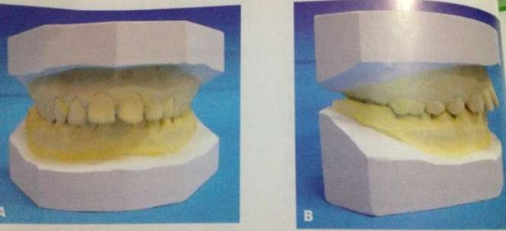
  Nature and severity of malocclusion
  Motivation of patient and to explain the treatment
  Progress to patient and parent
  Mock surgery
  Transfer records

Slide 10
Plaster and digital models
Plaster | Digital
Less expensive | More
Laboratory | Virtual
Large space | Negligible
Fast and efficient retrieval (single location) | Fast and efficient retrieval (multiple)
Physical damage | No physical damage
Shipping | Digital file
Not integrated to Office management software | Integrated to Office management software
Patient education | Patient education

Slide 11
Gnathostatic models
They are orthodontic study models where the base of the maxillary cast is trimmed to correspond to the Frankfort horizontal plane.

Slide 12
Diagnostic set up
It was first propose by H.D. kesling
  Diagnostic set up is made from an extra set of trimmed and polished study models.the individual teeth and their associated alveolar processes are sectioned off and replaced on the model base in the desired positions. the diagnostic set up thus help in simulating the various tooth movement s that are planned for patients.

Slide 13
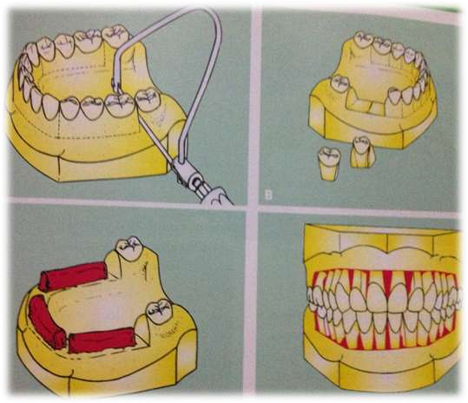
Useful in visualizing and testing the effect of complex tooth
movements and extractions on the occlusion
Patient can be motivated by simulating the various corrective
procedures in the cast
Tooth size- arch length discrepancies can be visualized

Slide 14
Facial photographs
Facial photographs offers a lot of information on the soft tissue morphology and facial expression.
  Three extra-oral views are routinely taken:
  Frontal view
  Profile view
  Oblique facial view
Extra-oral photograph are taken by positioning the patient in such a manner that the F.H.plane is parallel to the floor

Slide 15
The intra-oral photograph taken include:
  Left and right lateral view.
  Frontal view.
  Maxillary and mandibular occlusal view.
Uses of photographs
Useful in assessment of facial symmetry ,facial type and profile
Serve as a diagnostic records
Help in assessing the progress of the treatment

Slide 16
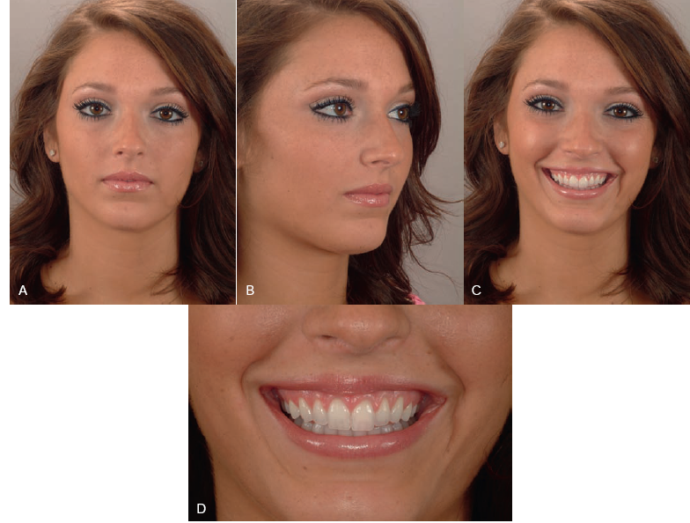
Frontal

Slide 17
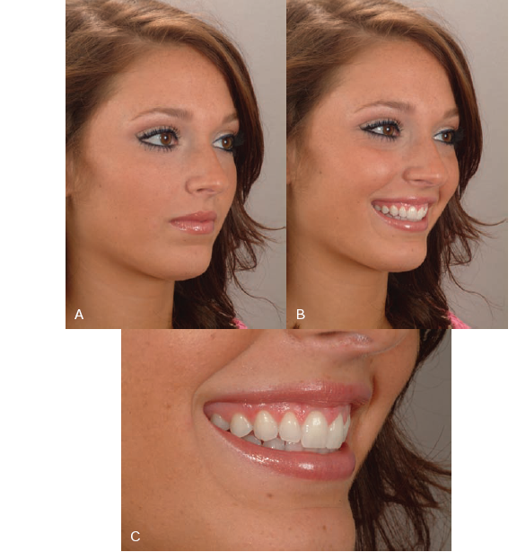
Oblique

Slide 18
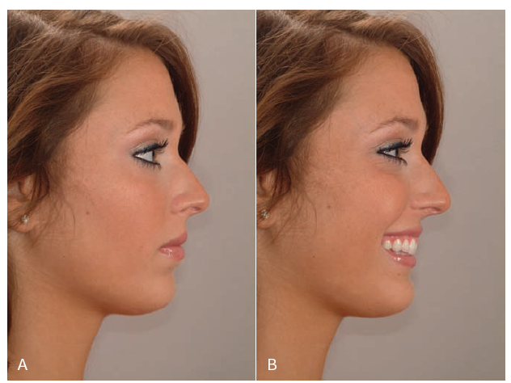
Profile

Slide 19
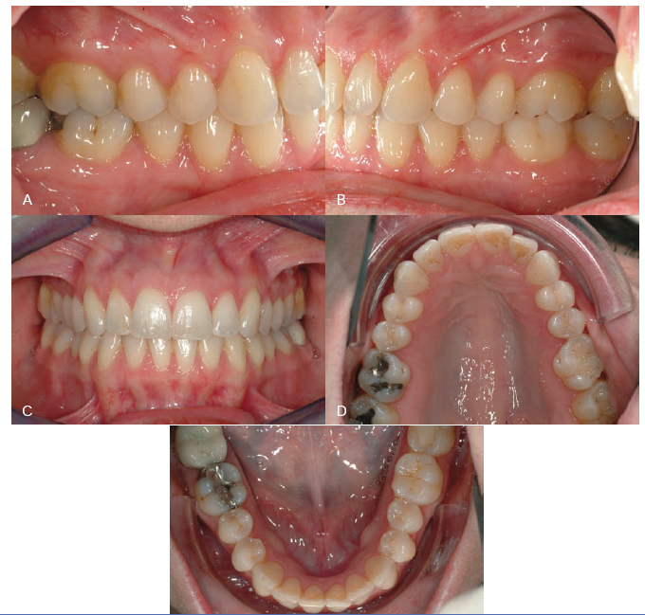
Intraoral

Slide 20
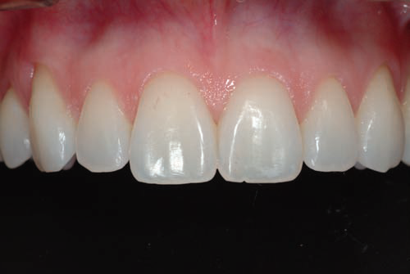
Closeup image with black background

Slide 21
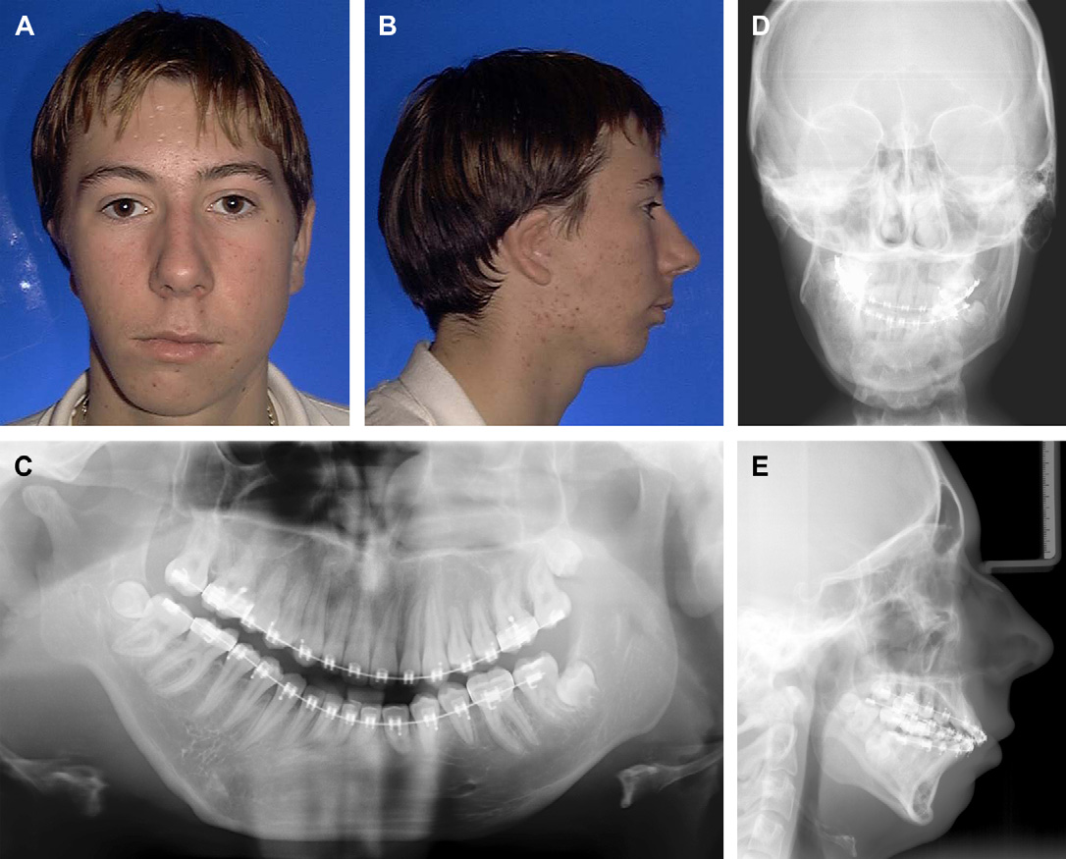
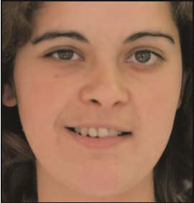
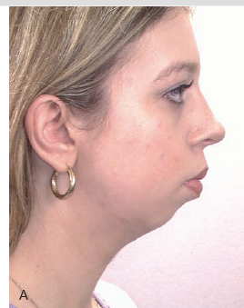
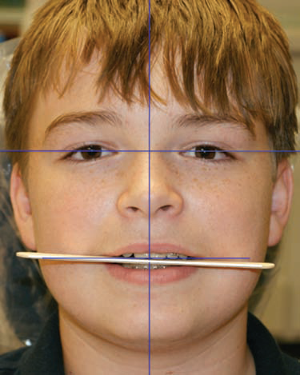
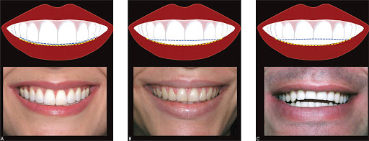
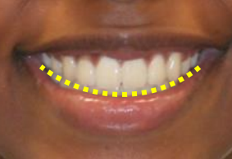
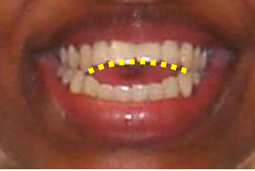

Slide 22
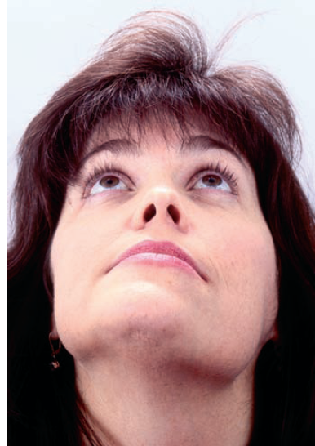
Submental

Slide 23
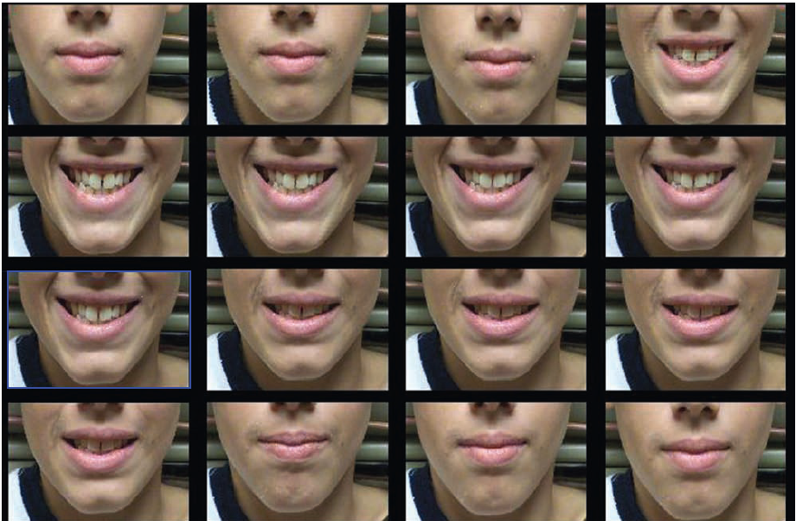
Digital Video Technology

Slide 24
EMG
Electromyography is a procedure used for recording the electrical activity of muscles the resting potential of a muscle fiber is 85-90mV
  Electromyograph is a machine used to receive , amplify
  and record the action potential during muscle activity.
  Electromyogram is the record
  The action potential picked up by the electrodes are of
  two types

Slide 25
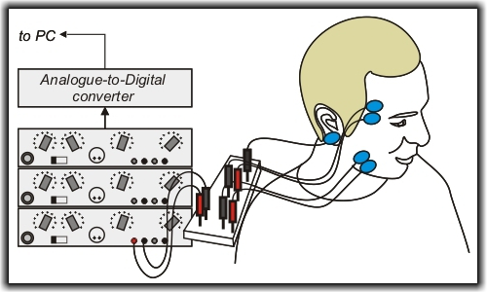
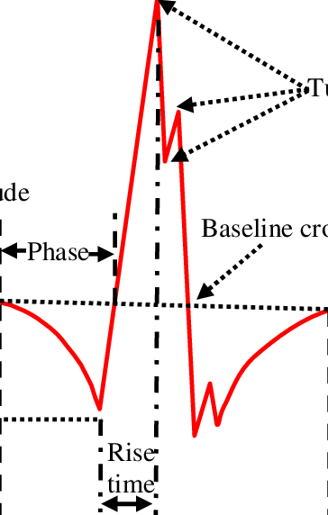
Needle electrodes: used when muscles are placed deep inside
e.g. pterygoid muscle
Surface electrodes :used when muscle is superficially placed
just below the skin
The action potential is recorded either with a moving pen in form of a graph or recorded in form of sound with help of a magnetic tape recorder

Slide 26
Electromyography is used to detect abnormal muscle activity associated with certain forms of malocclusion
In severe classII ,division1 malocclusion the upper lip is hypofunuctionl, strong mentalis activity is seen .E.M.G can be used to study such a condition.
Abnormal buccinator activity in classII ,division1
Over closure of jaw associated with accentuated temporalis muscle activity
Children with cerebral palsy
E.M.G . Can be carried out after orthodontic therapy to see if muscle balance is achieved

Slide 27
RADIOGRAPHS
Radiograph routinely used for diagnosis in orthodontics are classified into two groups
Intra-oral radiograph
Extra-oral radiograph

Slide 28
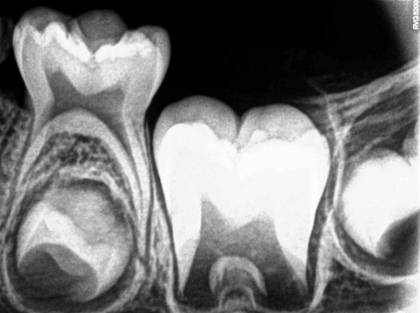
IOPA
They are radiographs that are used to view the teeth and their
supporting structures.
Two intra oral techniques are used for periapical radiography.
  PARELLEING TECHNIQUE
  BISECTING ANGLE TECHNIQUE
USES
  To confirm presence or absence of teeth
  To establish presence or absence of supernumerary teeth
  Extend of calcification and root formation of teeth
  To study alveolar bone & PDL
  To determine size and shape of unerupted teeth
  To assess axial inclination of roots

Slide 29
Disadvantages
◆ Assessment of entire dentition requires too many radiographs.
◆ They cannot be used in patients with high gag reflex and trismus
Advantages
◆ Low radiation dose
◆ Excellent clarity of teeth and their supporting structure
◆ Possible to obtain localized view of area of interest.

Slide 30
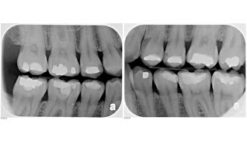
BITEWING RADIOGRAPHS
◆ It records the coronal part of upper and lower dentition along with their supporting structure.
  Used to detect proximal caries
  Height and contour of inter alveolar bone
  To detect periodontal changes
  To detect secondary caries below restorations.
  To determine inter proximal calculus

Slide 31
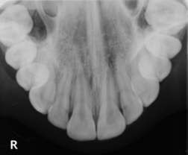
Occlusal radiographs
Occlusal radiographs are used in patients who are unable to open their mouth wide enough for periapical radiographs.
Uses
To locate impacted or unerupted teeth
To locate supernumerary teeth
To locate foreign bodies in the jaw
To diagnose the presence and extend of fractures

Slide 32

SLOB

Slide 33
Extraoral radiographs
They are useful when large areas of face and skull are to be visualized
Panoramic radiograph
It enables viewing of both maxillary and mandibular arches with their supporting structures
USES:
Studying deciduous root resorption
Root development of permanent teeth
To study the path of eruption of the teeth
Used to view ankylosed and impacted teeth
To diagnose presence and extend of pathology and fractures of jaw

Slide 34
ADVANTAGES
Broad anatomic area can be visualized
Radiation exposure is low
Can be used in patient who are unable to tolerate intra oral films or unable to open the mouth
DISADVANTAGES
Expensive equipment
Inclination of anterior teeth cannot be visualized
Less clear images as in periapical films
Distortion, magnification and overlapping of the structures
occur

Slide 35
CEPHALOMETRIC RADIOGRAPHS
Specialized skull radiograph in which the head is positioned in a specially designed head holder cephalostat.
It is of two types
  Lateral cephalogram
  Postero-anterior cephalogram

Slide 37
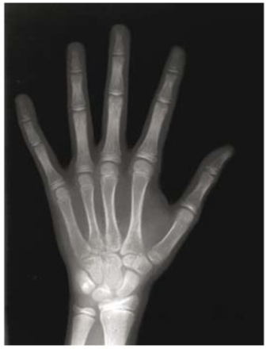
HAND-WRIST RADIOGRAPH
Radiograph of hand and wrist are useful in estimating the skeletal age of a person.
This enables skeletal age of a person they are useful in assessing growth for planning growth modification procedures and surgical respective procedures

Slide 38
Recent advances
Some of the recently evolved diagnostic aids are :
XERO RADIOGRAPHY
It was invented by Chester f Carlson in 1937
It’s a completely dry non chemical process which makes use
of electrostatic process as in Xerox machines.
Xeroradiography makes use of a aluminium plate that is
coated with layer of vitreous selenium
The selenium particles are given a uniform electrostatic charge
The charge plate is placed in a light tight, air tight cassette

Slide 39
◆ When the film is exposed it causes a selective discharge of selenium depending up on the amount of radiation used and relative density of objects
◆ This pattern of electric discharge on the plate is called latent
image
◆ The latent image is converted into visible image by a process called development in a unit called processor
◆ the plate is exposed to charged particle called toner
◆ This particles adhere to the charged areas in amount
proportional to the quantity of the charge present
◆ The image is now transferred on to a special kind of paper called Xerox opaque paper

Slide 40
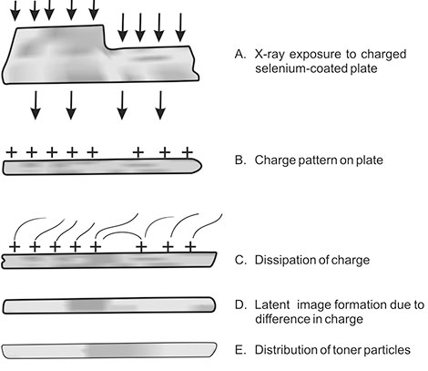
Xero radiography

Slide 41
◆ The unique feature of xero radiography is that its possible to have both positive and negative image
◆ Once latent image is converted into real image on to a paper. The selenium plates can be discharged cleaned and used again.

Slide 42
Difference of xero radiographic image from conventional
radiographic image.
Exhibit high edge contrast due to a phenomenon called edge enhancement
No special illumination is needed for viewing of Xerox radiographic image
Choice of negative or positive image is possible

Slide 43
Advantages of Xerox radiographic are:
Reduction in exposure time
Ease in manipulation
Ease of viewing
Edge enhancement effect
Cephalometric landmarks are easily identified

Slide 44
DIGI GRAPH
It enables clinician to perform non invasive and non radiographic cephalometric analysis.
◆ Features of digi graph system includes
A landmark can be identified as a point in 3d
A cephalometric analysis can be made independently of head position
Parallelism of x ray in mid sagittal plane and symmetry of anatomic morphology between left and right side is not necessary.

Slide 45
Digi graph allows all patients model radiographs, photographs cephalograms and tracing to be stored on one small disk- reducing storage requirements

Slide 46
Digi graph

Slide 47
MRI
◆ MRI makes use of two fundamental properties of proton ie spin and small magnetic movement
◆ The proton of hydrogen ion which is in water is utilized in MRI
The proton behave like small spinning magnets and when placed in a magnetic field they tend to move parallel to the field.
◆ Because of the spin the proton differently within their axis progressing about the direction of the magnetic field.

Slide 48
MRI

Slide 49
Advantages
MRI does not have hazards as it uses non ionising
electromagnetic radiation
Anatomical details are as good as in ct scan
Greater tissue characterisation is possible
Imaging of blood vessel, blood flow, visualisation of thrombus is possible
Disadvantages of MRI
Time taken is more
Not used in patients with cardiac pacemaker
Non visualisation of bone makes it useless in bony lesions

Slide 50
Tomography
◆ Tomography can be used to visualize a section or a slice of the object and there by eliminate undesirable overlap.
◆ Tomographic can be conventional or computed tomography
Conventional tomography :
◆ This is process by which a layer of a image with in the body is produced while the images of structure above and below that layer are made invisible by blurring.
◆ Blurring of the image outside the plane of interest is accomplished by simultaneous movement of x ray tube and film during the exposure.

Slide 51
The tube and the film are connected so that movements occur around a point or fulcrum.
◆ As the distance from the point of rotation increases , amount of image blurring also increases .
As the angle between the source/ film and tissue increases thickness of the image is reduced.

Slide 52
Principles of tomography can be mechanically implemented in
two ways
The x ray tube and film can move synchronously in opposite direction in parallel planes
The x ray tube and film can move synchronously and in opposite direction in parallel planes but with motions other than straight lines that is circular spiral etc

Slide 53
Computed tomography
This is also called CT or CAT (computed axial tomography)
Ct systems are mainly complex imaging systems which use thin beams of x ray that moves in asynchronous manner with an array of detectors which calculates and attenuate the x ray beam at different angles and in different planes
This data is spread in to computer which perform numerous calculations as per the program and constructs accurate image in the coronal axial plane

Slide 54
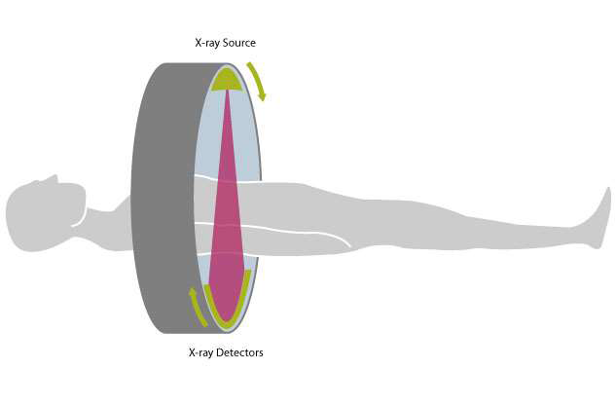
Advantages
Accurate visualization
Computer programming makes to view images in different shapes and densities.

Slide 55
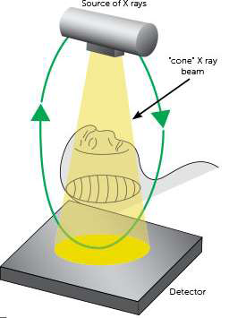
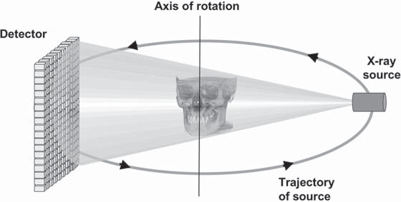
CBCT

Slide 56
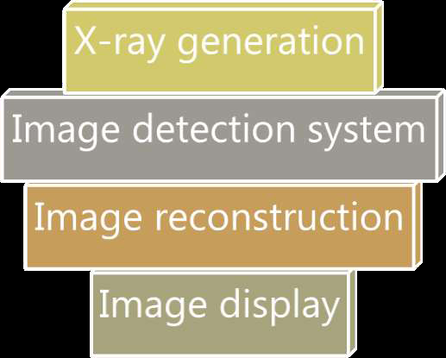

Slide 57
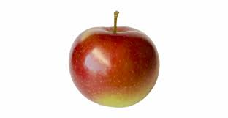
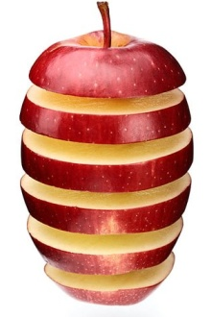
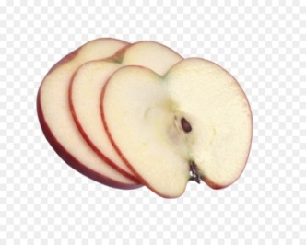
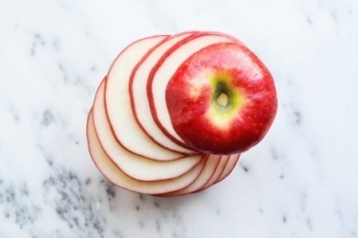
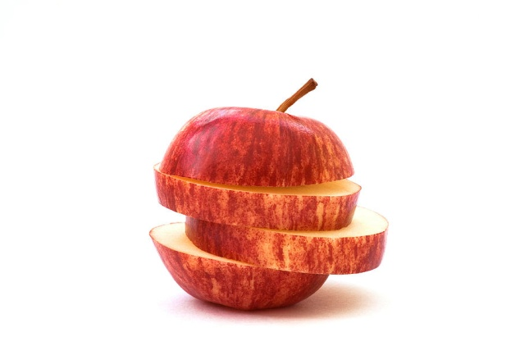

Slide 58
Advantages of CBCT over conventional CT
  1. It is less expensive and involves a smaller system.
  2. The X-ray beam is limited.
  3. Accurate images are obtained.
  4. The scan time is rapid.
  5. A lower radiation dose is used.
  6. The display modes are exclusive to dento facial imaging.
  7. There are fewer imaging artifacts.

Slide 59
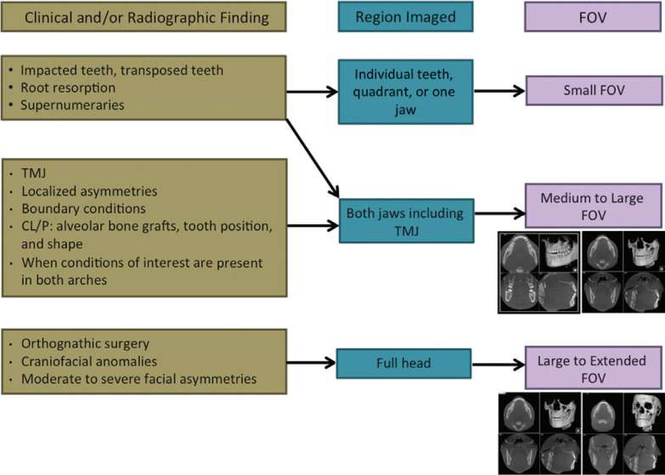
FOV
Small( 5x5)
Medium
single arch –(10x5)
inter arch –(10x 10/8x8)
Large
maxillofacial (17x11)
mandible and extending to nose
craniofacial (>17)

Slide 60
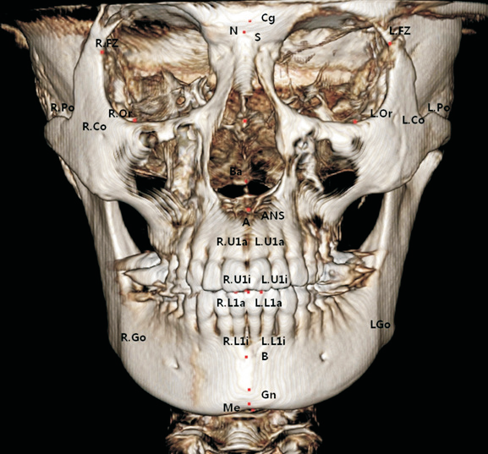
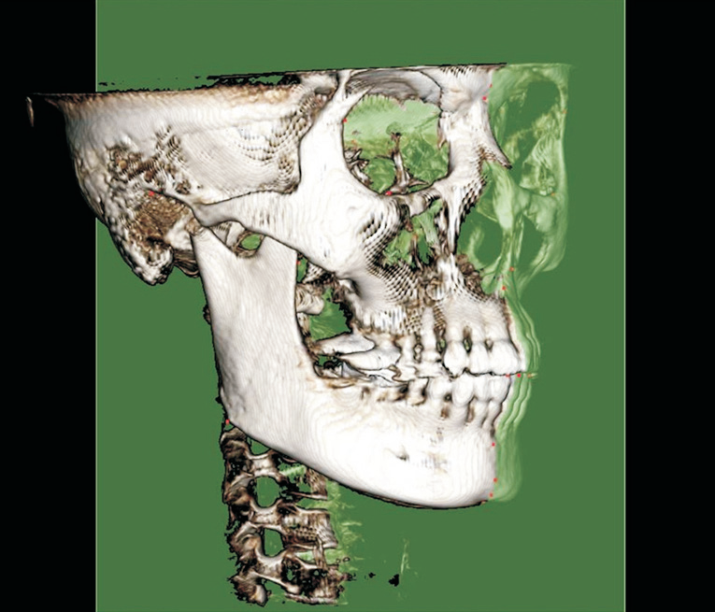
APPLICATIONS OF CBCT
According to Van Vlijmen et al. CBCT scans gave more accurate measurements than conventional ones

Slide 61
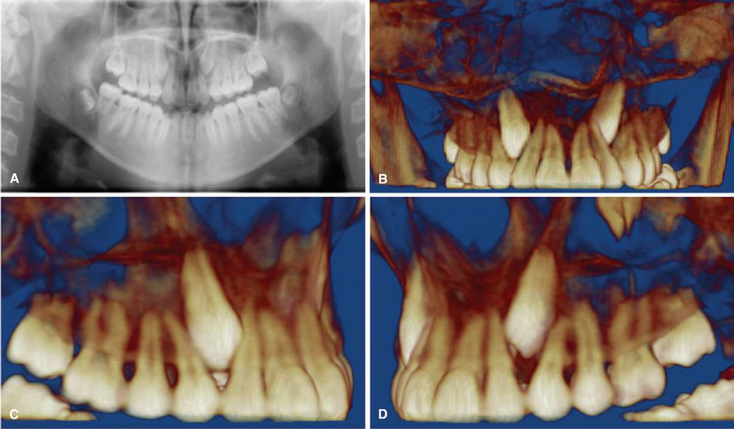
Impacted and transposed teeth

Slide 62
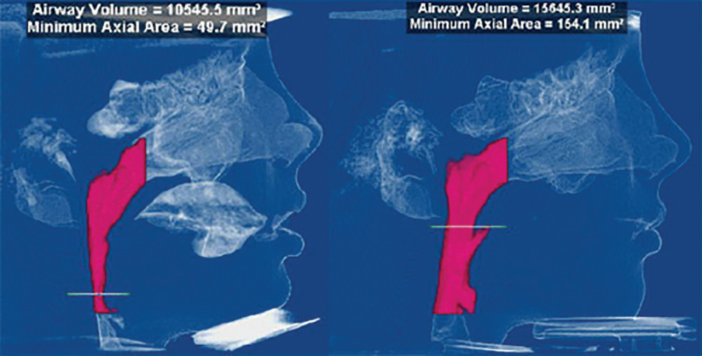

Slide 63
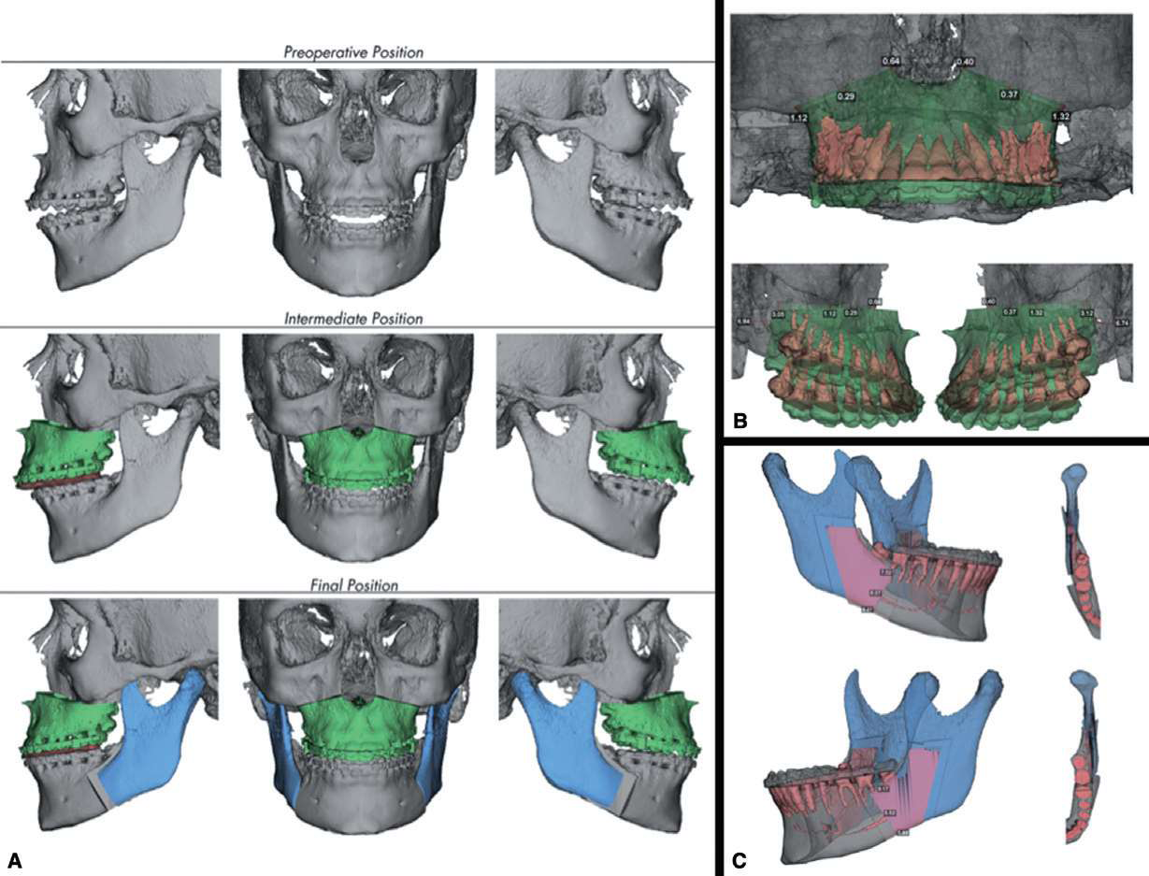
ORTHOGNATHIC SURGERY

Slide 64
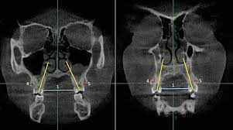
RME

Slide 65
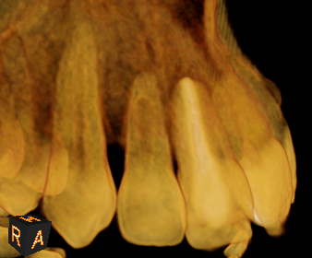
ROOT RESORPTION

Slide 66
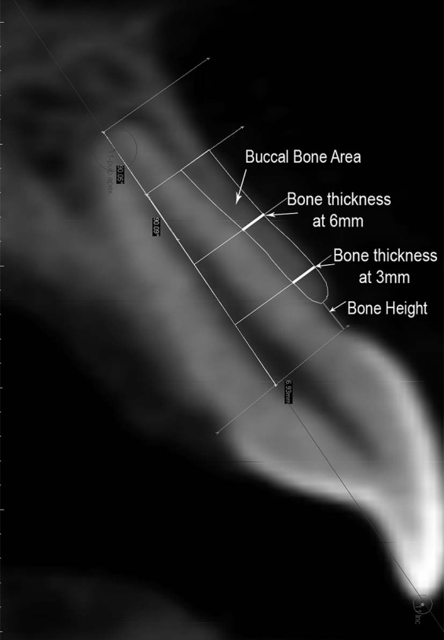
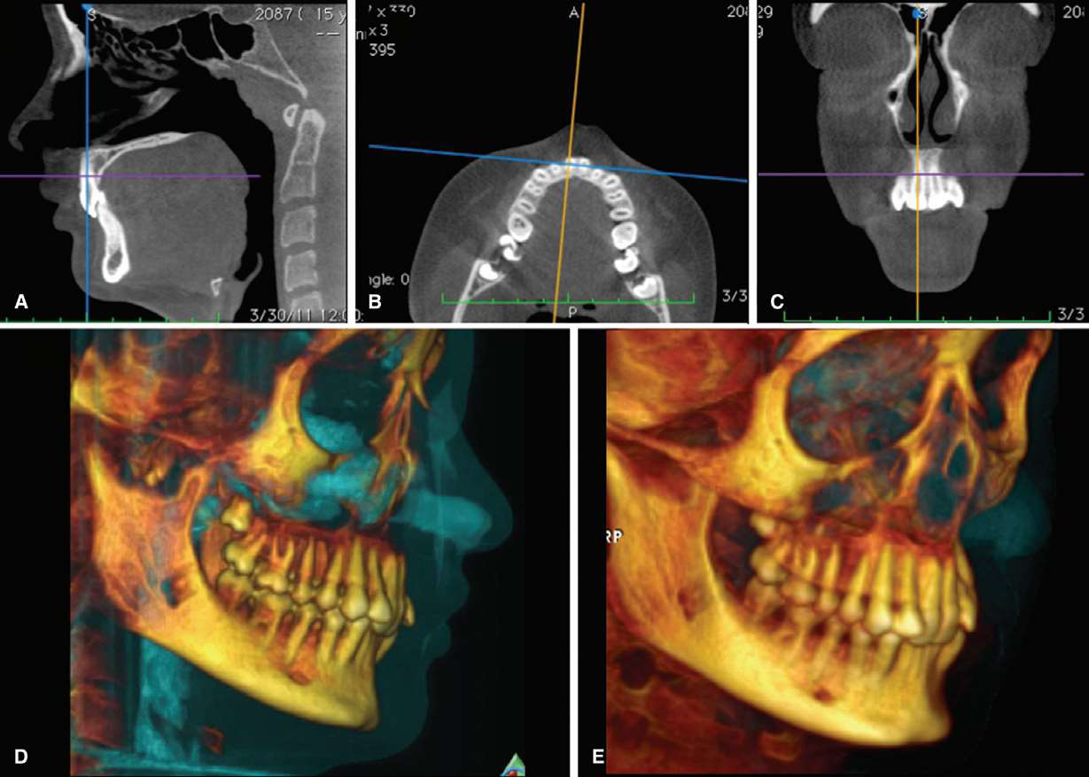
ALVEOLAR BONE CHANGES

Slide 67
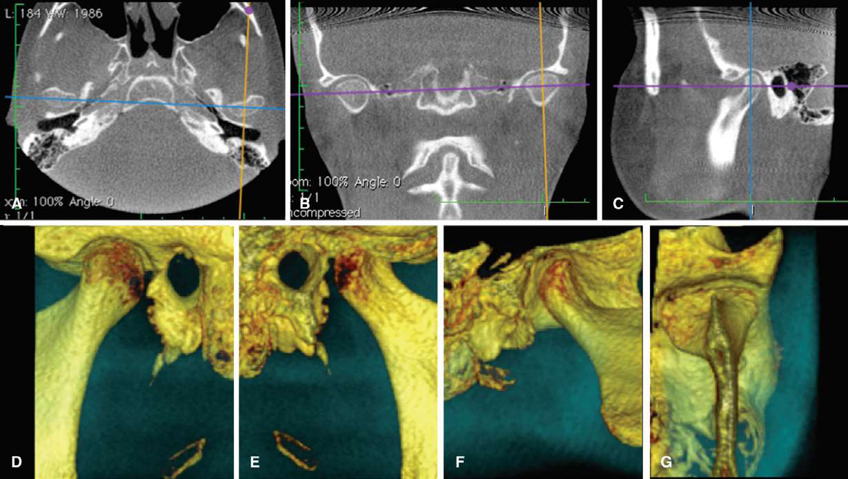
TMJ degeneration, progressive bite changes functional shifts, and
responses to therapy

Slide 68
Future
Alginate impressions
Study models
Customized brackets and archwires
Aligners
Rapid prototype

Slide 69
Occlusograms
It is a tracing of photograph or a photocopy of a dental arch .
To estimate occlusal relationships
To estimate arch length and width
To estimate the tooth movements required in all 3 planes of
space
To estimate anchorage requirements

Slide 70
Recording
The occlusal surfaces of the upper and lower dental casts are photographed in a 1:1 ratio and a tracing of the photograph is made.
The cast are photocopied on a Xerox machine and the occlusal photocopy is used to obtain a tracing.

Slide 72
Digital subtraction radiography
Comparatively this decrease the amount of distracting background information and by allowing the eye to focus on the actual change that has occurred between two images.
Technically this is a image enhancement method that remove the structured noise from the images

Slide 74
Holography
◆ Holography is photographic technique for recording and reconstructing images in such way that 3d aspect object can be obtain recorded image is called hologram
◆ Laser is light amplification by stimulated emission of radiation
◆ Holography is a wave front reconstruction process in which two coherent beams converge to produce a constructive and distractive interference pattern which is recorded on film

Slide 75
Orthodontic applications of laser holography:
  ◆ Storage of study model images
  ◆ Measurement of incisor intrusion
  To determine the centers of rotation produced by orthodontic
  process
  ◆ Lower incisor space analysis
  ◆ to access facial and dental arch symmetry

Slide 76
Holography

Slide 77
Photocephalometry
◆ Thomas in 1978 developed photocephalometry to better visualize soft tissues of patient
◆ Three radiopaque metallic markers with holes are placed on patients skin with adhesives and standard lateral and anterior posterior cephlograms are taken
◆ Using the same position lateral and frontal photographs are taken
◆ The photographs are printed to same size as the radiographs and are superimposed over the radiographic tracing taking the metallic markers as the guide

Slide 78
Cineradiography
◆ Basically radiographic motion picture
◆ The subject is oriented properly and stabilized in modified cephalostat
◆ An x ray motion picture is obtained using a cine camera which runs at 240 frames per sec
◆ It is used to visualize swallowing pattern of patient
◆ The x ray motion picture is studied using a movie projector

Slide 79
Conclusion
The development and rapid commercialization of technology for maxillofacial region will undoubtedly increase access to general and specialist practitioner for better imaging .
They are capable of providing accurate, submillimeter-resolution images in formats allowing 2D,3D visualization of the complexity of the maxillofacial region.

