Slide 1
ORAL MANIFESTATIONS OF SYSTEMIC DISEASE
Dr. B. MRUDULA
READER
DEPT OF ORAL MEDICINE & RADIOLOGY

Slide 2
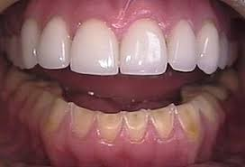
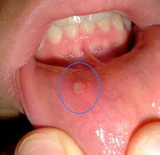
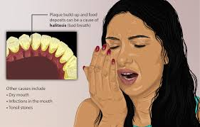
GASTROINTESTINAL SYSTEM
GERD: gastro eosophageal reflux disease
Oral ulcerations
Erosions of teeth
Xerostomia
Halitosis
dysgeusia(foul taste),

Slide 3
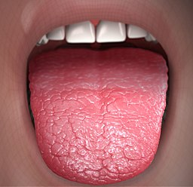
PEPTIC ULCERS AND DUODENAL ULCERS
Dental erosion, typically of the palatal aspect of the maxillary teeth.
Vascular malformations of the lip have been reported.
recurrent aphthous stomatitis (RAS)
dry mouth (xerostomia)
thrombocytopenia

Slide 4
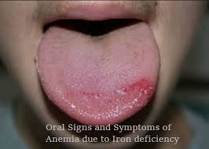
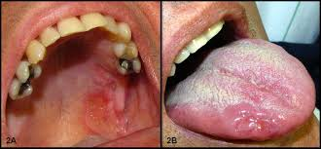
INFLAMMATORY BOWEL DISEASE
ULCERATIVE COLITIS
Anemia - delayed healing
Aphthous stomatitis of the major and minor
Pyoderma gangrenosum may occur in the form of deep ulcers that sometimes ulcerate through the tonsillar pillar.

Slide 5
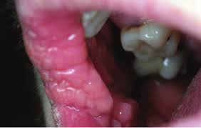
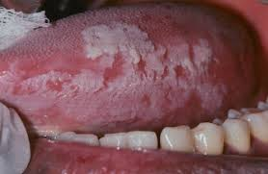
Pyostomatitis vegetans, a purulent inflammation of the mouth, may also occur. These oral lesions are characterized by deep tissue vegetating or proliferative lesions that undergo ulceration and then suppuration.
hairy leukoplakia.

Slide 6
CHRON’S DISEASE
Recurrent aphthous ulcers. Biopsy specimens of these multiple small nonhealing aphthous ulcers reveal granulomatous inflammation.
Pyostomatitis vegetans, cobblestone mucosal architecture, and minor salivary gland duct pathology represent granulomatous changes that constitute the hallmark of Crohn’s disease.

Slide 7
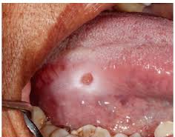
diffuse swelling of the lips and face, inflammatory hyperplasias of the oral mucosa.
indurated polypoid tag-like lesions in the vestibule and retromolar pad area, and persistent deep linear ulcerations with hyperplastic margins.

Slide 8
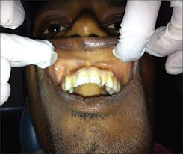
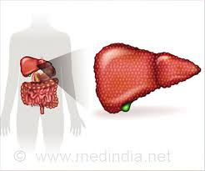
JAUNDICE
Jaundice (yellow pigmentation) may be observed on the mucosa and may be accompanied by cutaneous and scleral jaundice.
Jaundice usually occurs when total serum bilirubin reaches levels ≥3 mg/dL.
There may be extraoral and/or intraoral petechiae and ecchymosis, gingival crevicular hemorrhage due to the deficient clotting factors associated with dysfunctioning hepatocytes, and thrombocytopenia associated with alcohol.
Sweet ketone breath, indicative of liver gluconeogenesis, should raise the suspicion of hepatotoxicity.

Slide 9

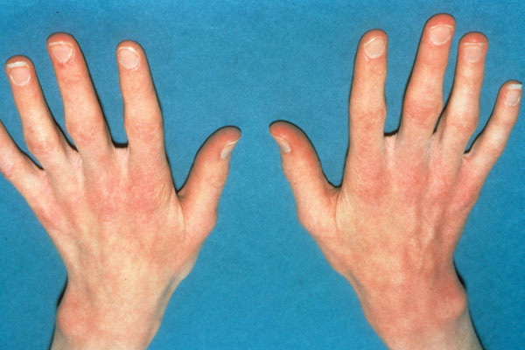
EATING DISORDERS: ANOREXIA AND BULIMIA
The cardinal oral manifestation of eating disorders is severe erosion of the enamel on the lingual surfaces of the maxillary teeth. Acids from chronic vomiting are the cause.
Examination of the patient’s fingernails may disclose abnormalities related to the use of fingers to initiate purging.
Mandibular teeth may be affected but not as severely as the maxillary teeth.
Parotid enlargement may develop as a sequela of starvation.

Slide 10
HEMATOLOGIC DISORDERS-BLEEDING AND CLOTTING DISORDERS

Slide 11
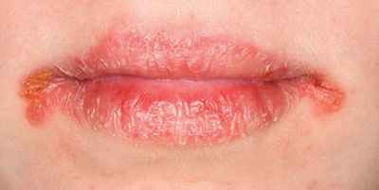
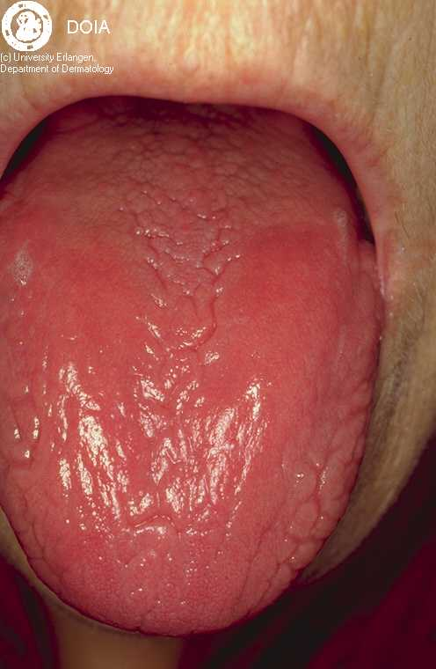
Oral Manifestations
Angular cheilitis,
Glossitis with different degrees of atrophy of fungiform and filliform papillae
Pale oral mucosa
Oral candidiasis
Recurrent aphthous stomatitis
Erythematous mucositis
Burning mouth

Slide 12
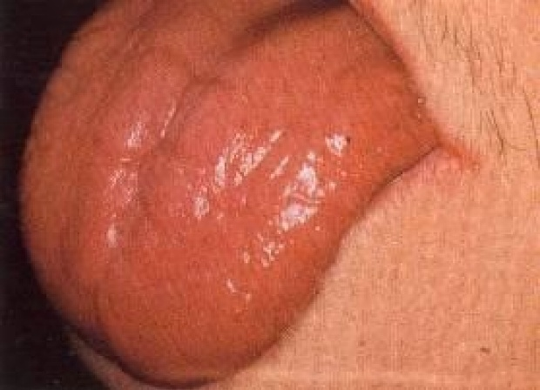
Oral Manifestations of megaloblastic anemia
Burning sensation in the tongue, lips, buccal mucosa, and other mucosal sites.
The tongue is generally inflammed often described as ‘beefy red’in color.
Characteristically with the glossitis, glossodynia and glossopyrosis there is gradual atrophy of the papillae tongue that eventuates in a smooth or bald tongue → Hunter’s glossitis or Moeller’s glossitis.
Fiery red appearance of the tongue may undergo periods of remission, recurrent attacks are common.
Dysphagia and taste alterations have been reported.

Slide 13
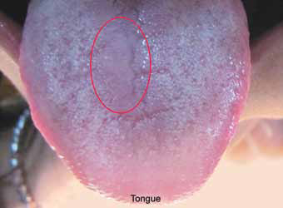
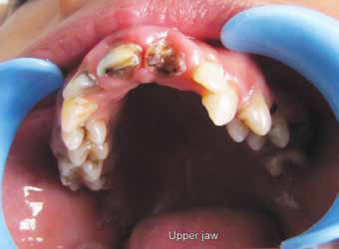
Oral Manifestations of sickle cell anemia.
Significant bone change in dental radiograph
Mild to severe generalized osteoporosis
Loss of trabeculation of the jaw bone
Enamel hypomineralization
Increased overjet and overbite
Pallor of the oral mucosa
Delayed eruption of the teeth
Pulpal necrosis
Smooth tongue

Slide 14
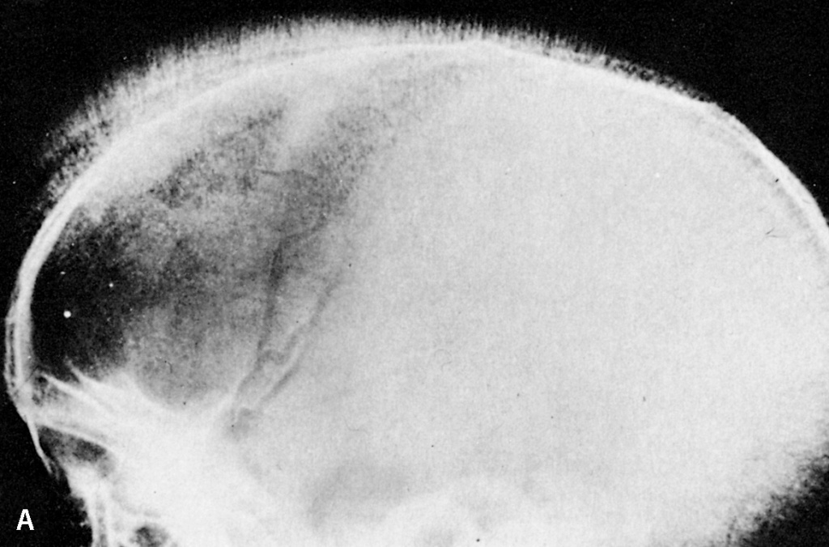
Radiographic features
HAIR – ON – END: perpendicular trabeculations radiating outward from the inner table.
Outer table of bone may appear absent and the dipole thickened.
Generalized osteoporosis
Enlarged medullary cavities with thin cortices

Slide 15
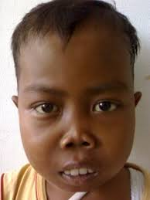
Oral Manifestations of thalassemia
RODENT FACIES- develops mongoloid features due to prominence of the cheeks, protrusion of the maxillary anterior teeth, depression of the bridge of the nose.

Slide 16
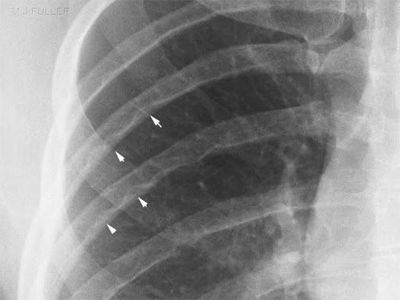
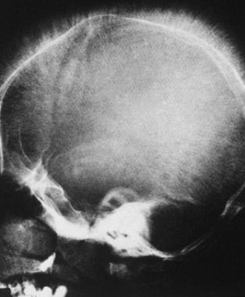
Radiographic findings
RIB- WITHIN- A- RIB: noted in middle and anterior portion of the ribs. Long linear density within or overlapping the medullary space of the rib and running parallel to its long axis.
HAIR- ON- END appearance.
SALT AND PEPPER EFFECT: peculiar trabeculae pattern of maxilla and mandible, apparent coarsening of some trabeculae and the blurring and disappearance of others.

Slide 17
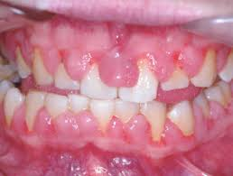
Non hodgkins lymphoma IN THE ORAL CAVITY
Primary NHL of the oral region is rare and may present as a gingival or mucosal tissue swelling or mass.
Intrabony involvement characterized by osseous rarefaction around the roots of the symptomatic teeth, mimicking toothache. In such a case, extraction of the associated tooth is followed by rapid growth of the tumor from the nonhealing extraction site.

Slide 18
Nerve invasion can lead to paresthesia or anesthesia of related oral mucosal tissue.
Nonhealing mucosal ulceration with ill-defined borders, a benign-appearing gingival lesion, and a mucosal lesion resembling a vesiculobullous disease.
Involvement of the oral mucosa in cutaneous T-cell lymphoma (mycosis fungoides) is uncommon

Slide 19
Oral manifestations of Burkits Lymphoma
clinically evident jaw tumors that may result in tooth mobility and pain, intraoral swelling of the mandible and maxilla, and anterior open bite.
Mobile teeth may be present

Slide 20
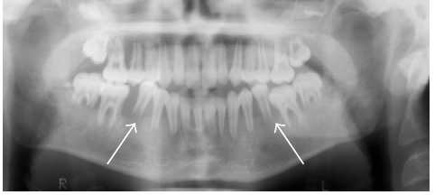
Radiographic features on panoramic images include
resorption of alveolar bone;
loss of lamina dura;
enlargement of tooth follicles;
destruction of the cortex around tooth crypts;
displacement of teeth and tooth buds by the enlarging tumor, resulting in the impression of “teeth floating in air;” and sun-ray spicules as bone forms perpendicular to the mandible from subperiosteal growth.

Slide 21
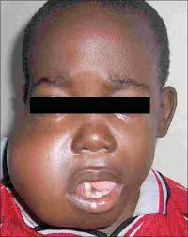
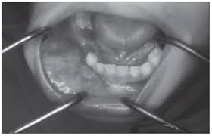
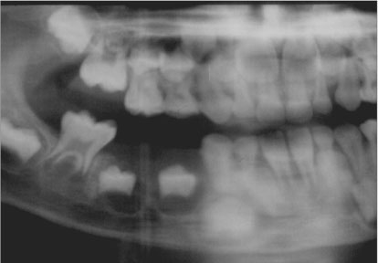

Slide 22
MULTIPLE MYELOMA
oro-facial lesions can mimic common dental pathologies such
as periapical or periodontal abscess,
gingivitis, periodontitis, or other gingival enlargement or masses.
Initial signs and symptoms of MM may involve pain, paresthesia of the inferior alveolar and mental nerves, swelling, tooth mobility, and radiolucency.
Radiographic changes in patients with MM include typical “punched-out” lesions in the skull from the focal proliferation of plasma cells inside the bone marrow and jaw bone (mandible > maxilla) involvement, ranging from asymptomatic osteolytic lesions to pathologic fracture.

Slide 23
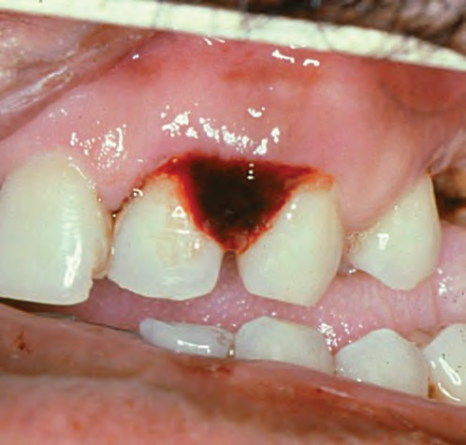
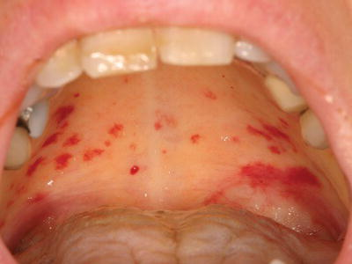
Oral manifestations of platelet disorders
Severe and profuse gingival bleeding
Hemorrhage may be spontaneous
Petechiae- palate
Ecchymosis

Slide 24
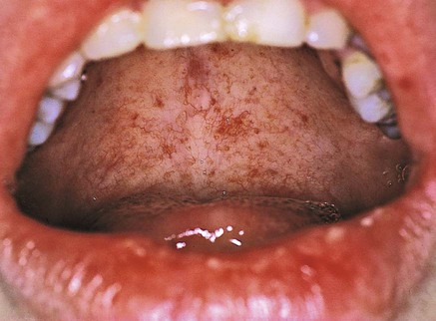
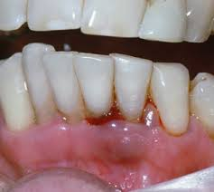
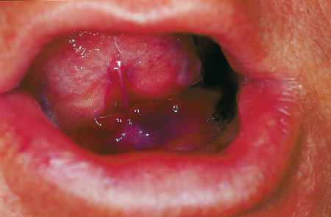
Oral manifestations of bleeding and clotting disorders
Ecchymoses
Spontaneous gingival bleeding
PETECHIAE
SPONTANEOUS GINGIVAL BLEEDING
ECCHYMOSIS

Slide 25
Brown colored teeth due to deposits of hemosiderin as a result of continous long term bleeding.
Hemarthrosis (rarely)

Slide 26
ORAL MANIFESTATIONS OF NEUROLOGICAL DISORDERS
CARDIOVASCULAR ACCIDENT
Following stroke, patients may experience several oral problems, including masticatory and facial muscle paralysis, impaired or lost touch and taste sensation, diminished protective gag reflex, and dysphagia.
These problems can lead to impairment of food intake, poor nutrition, and weight loss due to diminished taste satisfaction, chewing capacity, and swallowing; choking; and gagging.
Diminished motor function of masticatory and facial muscles may also reduce food clearance from the mouth and teeth and alone or combined with the presence of diminished dexterity of the arms or hands may adversely affect oral hygiene and increase the risk for caries and periodontal disease.

Slide 27
MULTIPLE SCLEROSIS
Bilateral Trigeminal neuralgia (TGN), which is characterized by electric shock–like pain, may be an initial manifestation of MS in up to 5% of cases. Features of MS-related TGN include possible absence of trigger zones and continuous pain with lower intensity.
Patients with MS may also demonstrate neuropathy of the maxillary (V2) and mandibular branches (V3) of the trigeminal nerve, which may include burning, tingling, and/ or reduced sensation.
Neuropathy of the mental nerve can cause numbness of the lower lip and chin.
Myokymia may be seen in patients with MS and consists of rapid, flickering contractions of the facial musculature secondary to MS lesions affecting the facial nerve.
Facial weakness and paralysis may also be evident in MS patients.

Slide 28
Other orofacial pain conditions that may be present at higher frequency in patients with MS compared to the general population include temporomandibular disorder and headache.

Slide 29
SEIZURE DISORDERS
Important features for the clinician to assess include the type of seizures, etiology of seizures, frequency of seizures, known triggers of seizure activity, presence of aura prior to seizure activity, and history of injuries related to seizure activity.
Higher rate of physical injuries, including dental and facial trauma, compared to healthy subjects.
AEDs, including phenytoin, carbamazepine, and valproic acid can cause bone marrow suppression, leukopenia, thrombocytopenia, and secondary platelet dysfunction, possibly resulting in an increased incidence of microbial infection, delayed healing, and both gingival and postoperative bleeding.

Slide 30
The anterior labial surfaces of the maxillary and mandibular gingiva are most commonly affected and may be seen within 2 to 18 months after starting the medication.

Slide 31
Development of intraoral lesions that clinically resemble lupus lesions and lip enlargement.
Reduced salivary flow may result from the use of AEDs and increased dental caries and oral candidiasis in patients using these agents are often seen.
PARKINSON DISEASE
Resting tremors and drug-related dyskinesia.
Dysphagia and impaired gag reflex increase the risk for aspiration of oral and irrigation fluids, and high-speed evacuation of fluids is important in reducing the risk for aspiration pneumonia.
Sialorrhea.

Slide 32
ORAL MANIFESTATIONS OF CARDIOVASCULAR DISEASES
ARTERIAL HYPERTENSION
Antihypertensive drugs can cause xerostomia, lichenoid reactions, burning mouth sensation, loss of taste sensation or gingival hyperplasia, as well as extraoral manifestations such as sialadenosis.
ISCHEMIC HEART DISEASE
If the patient is under anticoagulant or antiplatelet treatment, bleeding may occur, manifesting as hematomas, petechiae or gingival bleeding.

Slide 33
ARRHYTHMIAS
Many antiarrhythmic drugs have side effects such as gingival hyperplasia or xerostomia.
HEART FAILURE
Due to the drug treatments used by patients with heart failure, a series of oral manifestations can be observed.
In this context, ACEIs (captopril, enalapril) can produce lichenoid reactions, burning mouth sensation and a loss of taste sensation, while diuretics (furosemide) can produce xerostomia.

Slide 34
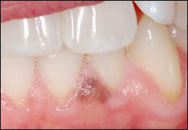
ORAL MANIFESTATIONS OF RESPIRATORY DISEASES
VIRAL UPPER RESPIRATORY TRACT DISEASES
presence of small round erythematous macular lesions on the soft palate.
These lesions may be caused directly by the viral infection, or they may represent a response of lymphoid tissue.
Individuals with excessive lingual tonsillar tissue also experience enlargement of these foci of lymphoid tissue, particularly at the lateral borders at the base of the tongue.

Slide 35
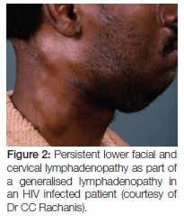
LARYNGITIS,BRONCHITIS,PHARYNGITIS, TONSILLITIS
Severe sore throat,
Orofacial lymphadenopathy.

Slide 36
ALLERGIC RHINITIS AND CONJUCTIVITIS
The use of decongestants and first-generation antihistamines may be associated with oral dryness.
An increased incidence of oral candidiasis in long-term users of topical corticosteroid-containing sprays.
SINUSITIS
Patients with sinus infections who present with a complaint of a toothache are commonly encountered in a dental office.
On history, sinus infections usually present with pain involving more than one tooth in the same maxillary quadrant, whereas a toothache usually involves only a single tooth.
Chronic sinus infections are often accompanied by mouth breathing.

Slide 37
LOWER AIRWAY DISORDERS
Bronchitis, pneumonia
Aspiration
ASTHMA
Oral manifestations of asthma include candidiasis, decreased salivary flow, increased calculus, increased gingivitis, increased periodontal disease, increased incidence of caries, and adverse effects of orthodontic therapy.

Slide 38
ORAL MANIFESTAIONS IN PATIENTS WITH TRANSPLANTS
Oral infections- oppurtinistic
Dental caries
Oral ulcerations
Medication induced gingival overgrowths.
GVHD
Mucositis
Xerostomia
Decreased salivary pH and Ig A levels.

Slide 39
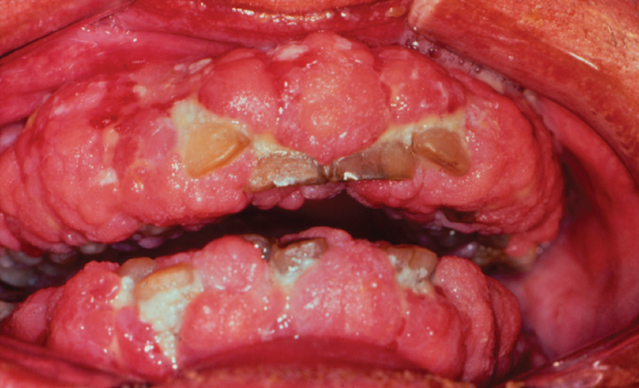
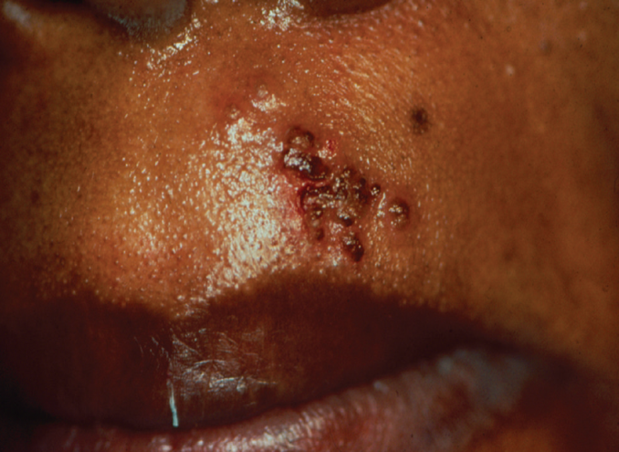
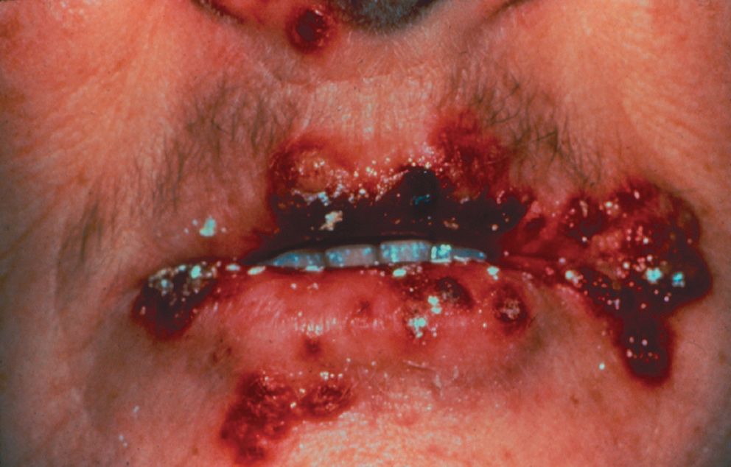
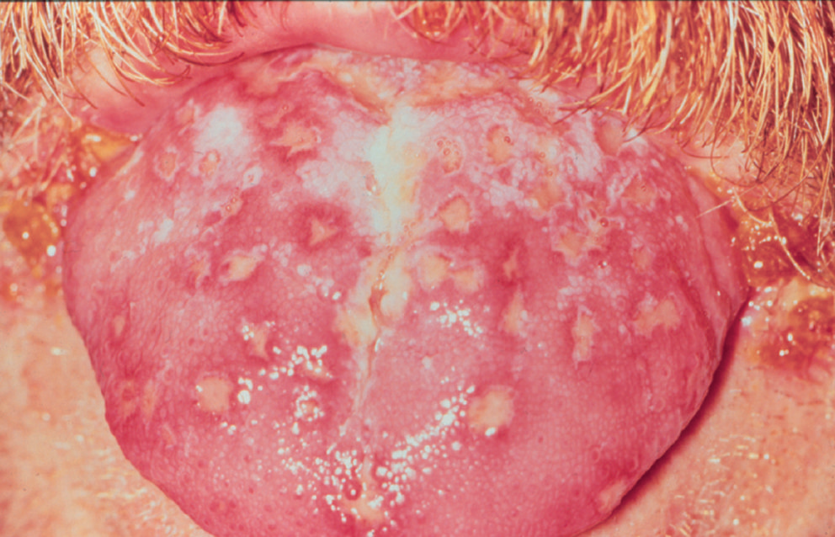

Slide 40
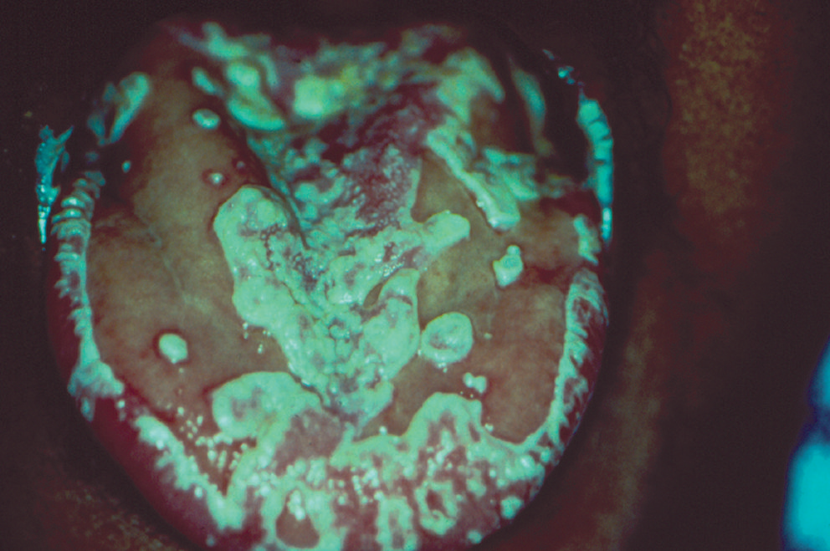
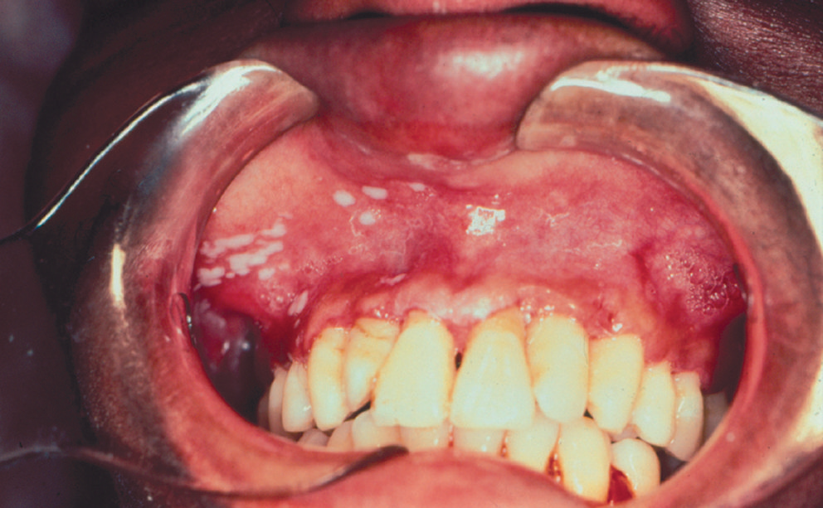
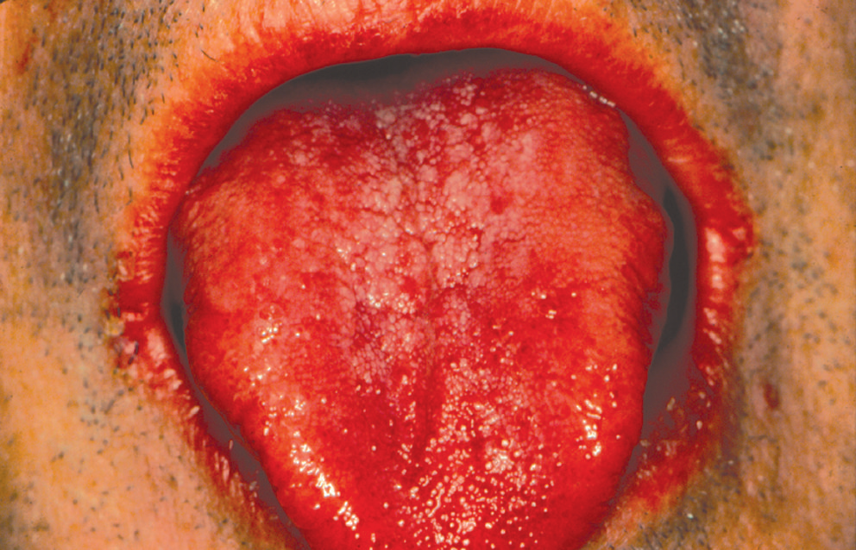
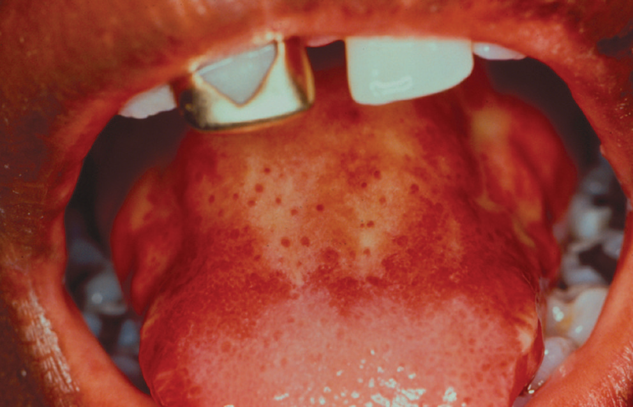

Slide 41
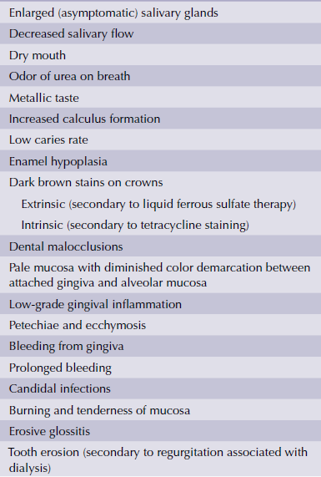
ORAL MANIFESTATIONS OF RENAL DISEASES

Slide 42
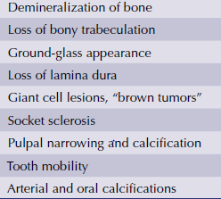
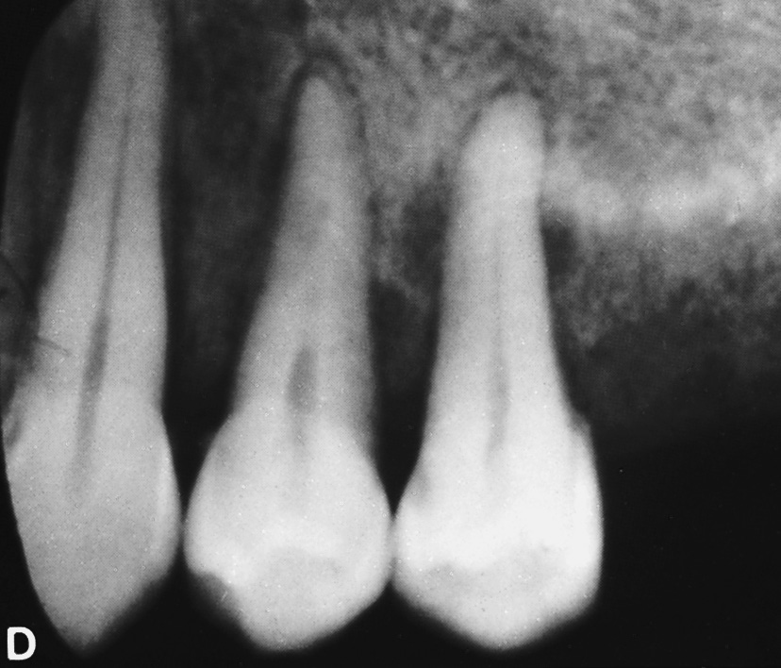

Slide 43
ORAL MANIFESTATIONS OF ENDOCRINAL DISEASES
Diabetes
Oral manifestations and complications of DM are related to the impaired immune response.
Mycotic (candidiasis) and bacterial infections (periodontal disease) are frequent and severe.
The sensory and autonomic neuropathies characteristic of DM, together with associated impaired renal function, result in dehydration and hyposalivation.
The consequences of hyposalivation are increased dental caries, particularly smooth surfaces caries, oral dryness, atrophy of the oral mucosa, and increased frequency and severity in all clinical forms of candida infection.
The range of the oral manifestations secondary to DM directly correlates with the degree of glycemic control.

Slide 44
oral dysesthesia, such as burning mouth syndrome and
bilateral sialosis (especially of the parotid glands)
Drug induced lichenoid reactions of the oral mucosa.

Slide 45
Growth hormone excess
GH excess leads to gigantism if it occurs before the completion of linear growth.
GH excess results in acromegaly if it occurs after the growth plates have fused.
Acral overgrowth is manifested with a classic facial appearance of coarse facies, macrognathia, macroglossia, large diastemas and enlargement of the nose and frontal bones(frontal bossing).
Soft tissue edema, due to a direct effect of GH on sodium retention, leads to a “doughy” feel to the hands and feet, as well as an increase in shoe, hat, glove, and ring sizes.

Slide 46
Acromegaly has many features, including increased sweating, deepening of the voice due to enlargement of the thyroid cartilage and vocal cords, enlargement of the synovium and cartilages with hypertrophic arthropathy (knees, ankles, hips, spine, and other joints), skin tags, nerve compression (causing paresthesia of the hands, as in carpal tunnel syndrome),
Enlargement of the soft tissues of the pharynx and larynx (which can lead to obstructive sleep apnea), increased risk of colonic polyps, and organomegaly (including the thyroid, heart, liver, kidneys, and prostate).

Slide 47
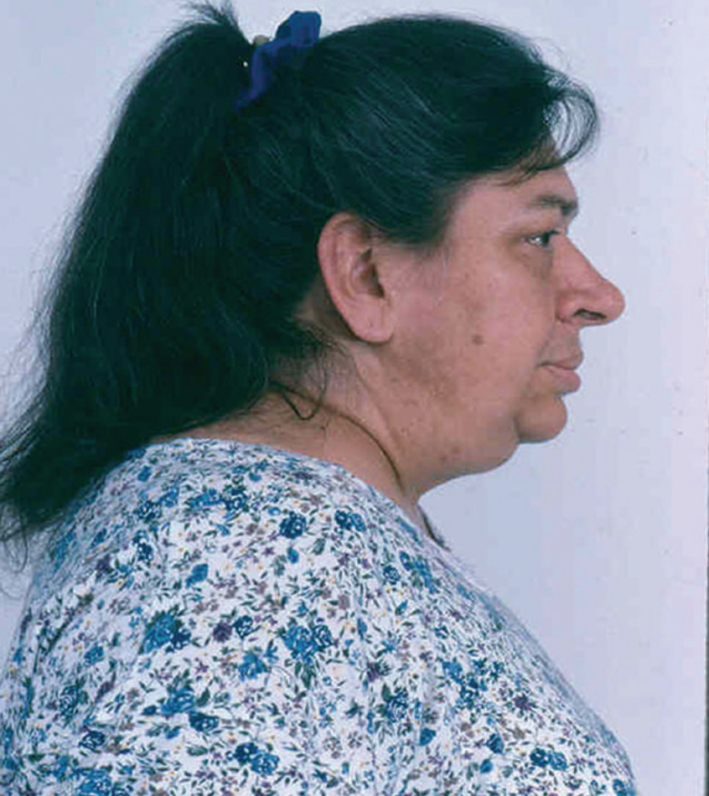
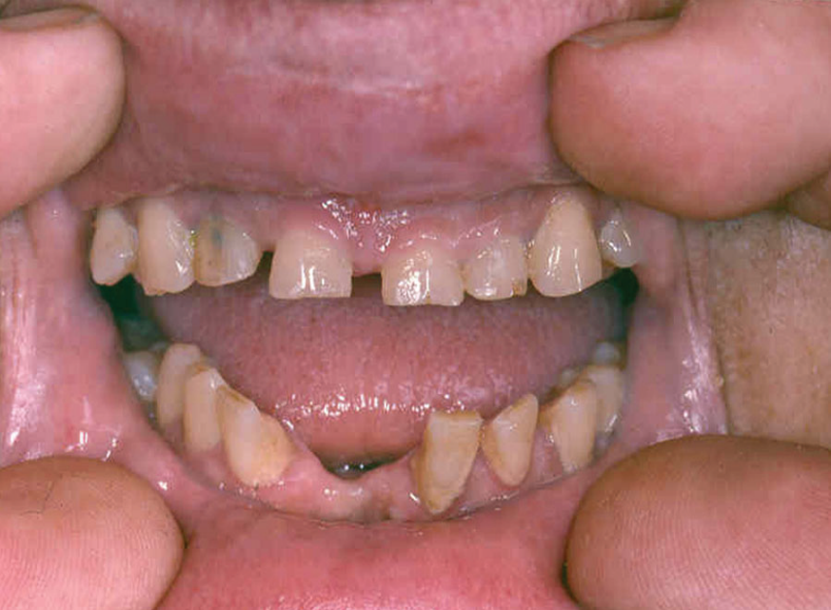

Slide 48
ORAL MANIFESTATIONS OF THYROID
GLAND DISORDERS
GOITER/ THYROID ENLARGEMENT
The majority are painless, but pain or discomfort can occur in acute varieties.
Large goiters can produce dysphagia and difficulty in breathing, from esophageal or tracheal compression.
Small goiters are more readily detected visibly (on swallowing) than by palpation.
There are two major aspects of any goiter: its pathological nature and the patient’s thyroid status.

Slide 49
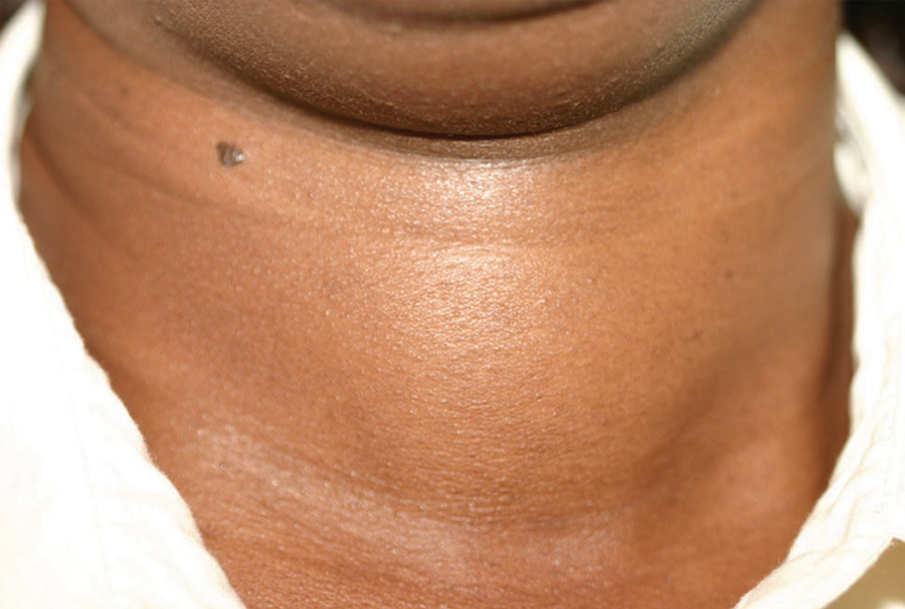

Slide 50
Diffuse goiter:
Simple Goiter: no cause is found for the generalised enlargement of the thyroid, which is usually smooth and soft.
Firm diffuse goiter of variable size is usually associated with Hashimoto’s thyroiditis and thyrotoxicosis.
Painful, tender goiter with diffuse swelling of the thyroid gland, sometimes with severe pain, is suggestive of an acute viral thyroiditis (de Quervain’s thyroiditis).
It can produce transient clinical features of hyperthyroidism and serological changes, with an increase in the serum T4.
• Nodular goiter:
Multinodular goiter
Solitary nodular goiter
Fibrotic goiter (Riedel’s thyroiditis)

Slide 51
Hypothyroidism
myxedema of the skin,
an enlarged tongue (macroglossia),
compromised periodontal health,
delayed tooth eruption,
delayed wound healing, and a hoarse voice.
Salivary gland enlargement,
changes in taste, and burning mouth symptoms
Hyperthyroidism
oculomotor function, protrusion of the eyes,
excess sweating,
enlargement of the thyroid or the tongue,
lingual thyroid tissue, and
difficulty in swallowing.

Slide 52
Oral manifestations of adrenal gland
Hyperadrenocorticism (Glucocorticoid Excess of Cushing’s Syndrome)
round, moon face due to muscle wasting and accumulation of fat.
Surface capillaries in the face and other skin regions become fragile, rendering them readily susceptible to hematomas after mild trauma.
acne and excessive facial hair (hirsutism) are also commonly seen.
Long-standing Cushing’s syndrome produces delayed growth and development, including of the skeletal and dental structures.
Many of the systemic findings of Cushing’s syndrome are similar to those seen in patients on moderate- to high-dose glucocorticoid therapy, and these patients are considered to be immunosuppressed.
oral candidiasis,
recurrent herpes labialis and herpes zoster infections,
Gingival and periodontal diseases, and
impaired wound healing.

Slide 53
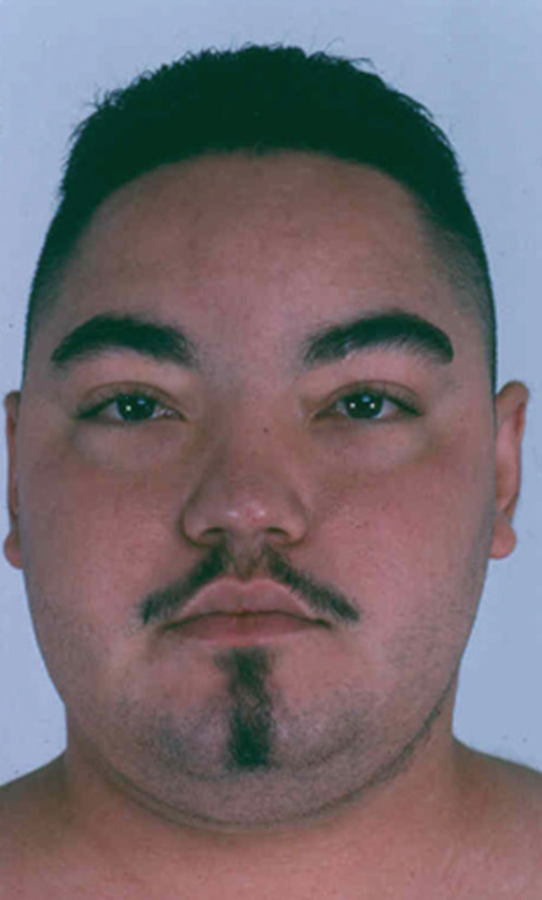
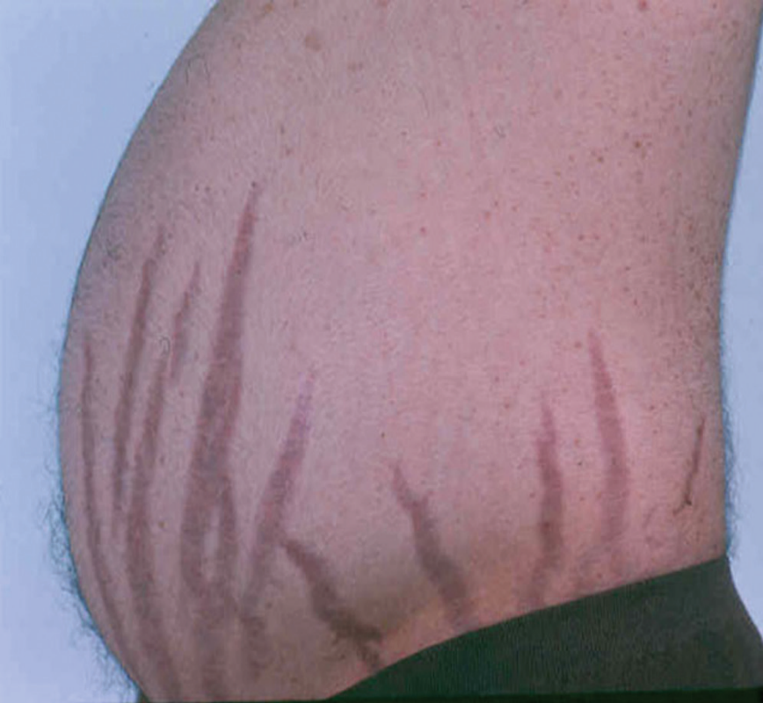

Slide 54
Hypoadrenocorticism (Glucocorticoid Deficiency or Addison’s Disease)
Unusual skin pigmentation, most intensely of the sun exposed areas.
On the face, freckles and moles become darker, as well as the appearance of a tan-like complexion (“bronzing” of the skin and sometimes of the oral mucosa), except that the increased pigmentation does not fade on cessation of sunlight exposure.
The mucocutaneous junctions undergo increased pigmentation, including the lips, but hyperpigmentation can also involve the intraoral mucosal surfaces, such as the gingival margins, buccal mucosa, palate, and lingual surface of the tongue.
The oral pigmentations appear as irregular spots that range from pale brown to gray or black.

Slide 55
ORAL MANIFESTATIONS OF PARATHYROID
GLAND DISORDERS AND IMPAIRED CALCIUM
HOMEOSTASIS
HYPERPARATHYROIDIDSM
The primary clinical orofacial signs and symptoms of hyperparathyroidism are reflections of the systemic effects of hypercalcemia.
Long-standing hypercalcemia causes generalized osteoporosis, which is visible on dental radiographs.
Patients develop cortical resorption and rarefactions, loss of trabeculation presenting as “ground-glass” appearance, partial or total loss of lamina dura, lytic lesions, and metastatic calcifications.
The rarefactions occur secondary to generalized osteoporosis when fine trabeculae disappear later in the disease process, leaving a coarse pattern.
Alveolar bone is particularly sensitive to increased levels of PTH from either primary or secondary hyperparathyroidism.
Thinning and eventual loss of the cortical bone of the maxilla and mandible may occur, especially on the lower border of the mandible. Severe cases may result in spontaneous mandibular fracture.

Slide 56
The lytic jaw lesions or brown tumors can increase in size, causing the bony cortex to expand, ultimately becoming destroyed.
These tumors rarely expand into the periosteum but can produce gingival swelling.
Biopsy of the lytic lesion is necessary for definitive diagnosis; however, they are histologically similar to central giant cell tumors and giant cell reparative granulomas.
Fully developed teeth are not affected except that they appear more radiopaque.
Due to bony changes, the teeth become mobile, drift, and cause malocclusion.
With gradual loosening of the dentition, periradicular radiolucencies develop, with increased periodontal pocketing, root resorption, and dental pain.

Slide 57
Hypoparathyroidism
Painful muscular spasms affect oral and laryngeal muscles.
Despite low serum calcium levels, the maxilla and mandible are abnormally dense, with well-calcified trabeculae.
If the hypoparathyroidism is part of an autoimmune polyendocrinopathy syndrome, oral mucocutaneous candidiasis may be readily evident clinically.
If hypoparathyroidism occurs when teeth are still developing, there will be abnormalities in the appearance and eruption pattern.
There may be enamel hypoplasia, single or parallel horizontal bands on the enamel, and poorly mineralized dentin.
Other dental findings include malformed teeth, anodontia, short blunt root apices, elongated pulp chambers (some occluded by pulp stones, even in the primary dentition), impacted teeth, and mandibular exostoses.
If hypoparathyroidism occurs after dental development, there are no abnormalities seen in the erupted teeth.

