Slide 1


Slide 2


Slide 3
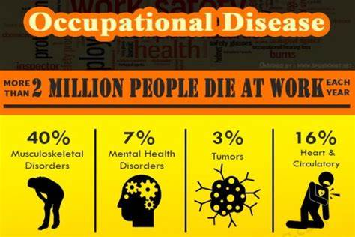

Slide 4
OCCUPATIONAL HAZARD
Is defined as a risk to a person usually arising out of employment
Accident or disease
caused at a work place due to mismanagement or mishandling or lack of awareness about the use of materials , substances , technical processes, etc.
Notes:
Dental professionals are predisposed to a number of occupational hazards.
These hazards may be mild, self curable like influenza , mental stress etc……
To more serious and incurable like AIDS.

Slide 5

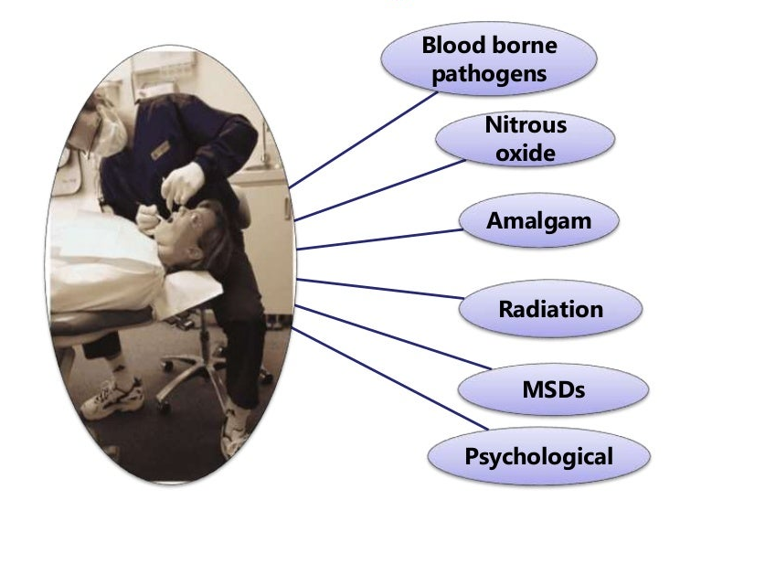

Slide 6

HISTORY ………
Awareness of occupational hazards can be traced back to the 18th century
BERNADINO RAMAZZINI---- father of occupational medicine recognized the role of occupation in the dynamics of health and disease.

Slide 7
MAJOR OCCUPATIONAL HAZARDS ARE
Biological health hazards
Physical hazards
Chemical hazards
Musculoskeletal disorders
Psychosocial hazards
Legal hazards

Slide 8
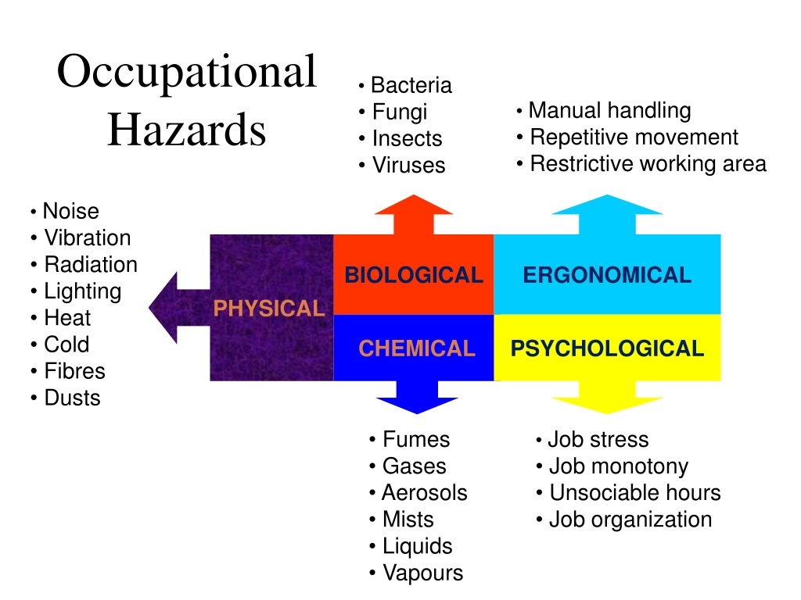

Slide 9

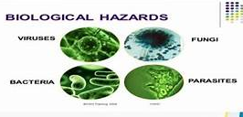
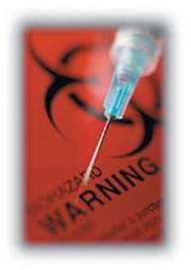
BIOLOGICAL HEALTH HAZARDS
Notes:
Cross infection……….traumatized tissues
Improper management of biomedical waste
Exposure to Infectious agents including virus, bacteria and fungi……..directly or indirectly
Through cut wounds , needle stick injury [percutaneous exposure incidents], aerosols of saliva, gingival fluid etc….

Slide 10
BIOLOGICAL HEALTH HAZARDS
Entry of infection may be from epidermis of hands, oral epithelium , nasal epithelium , conjunctival epithelium.
Notes:
Cross infection……….traumatized tissues

Slide 11
TRANSMISSIBLE DISEASES
Hepatitis B
Hepatitis C
Tuberculosis
HIV/AIDS
Lengionella [immunological reactions due to proliferation of microorganisms generated through aerosols within dental unit water lines
Other type of communicable infections
Notes:
Pathogenic gram negetive bacterium

Slide 12

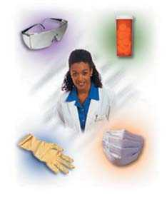
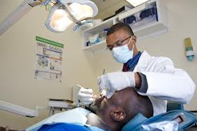
PREVENTION
Wash hands with bactericidal soap
Wash hands before gloving
Change gloves between patient
Proper waste disposal
Use eye glasses
Protective face masks
Ensure proper sterilization of instruments and equipments

Slide 13
PHYSICAL HAZARDS
HEAT ELECTRICAL HAZARDS
Lack of maintenance of any electrical equipments
Lack of understanding of the equipment
Can cause painful shocks, burns etc
Prevented by having sufficient knowledge about maintenance and the operation of the equipement or instrument

Slide 14
PHYSICAL HAZARDS
LIGHT
Poor illumination or excessive brightness
Cause fatigue , pain in eyes , headache
Discomfort , annoyance
Use sufficient and suitable lighting

Slide 15
PHYSICAL HAZARDS
NOISE
Use high speed ultrasonic scalar, rotary instruments, compressor, suction, any high speed electronics
May cause temporary or permanent hearing loss
Non auditory problems like fatigue, interference in communication and decreased efficiency

Slide 16
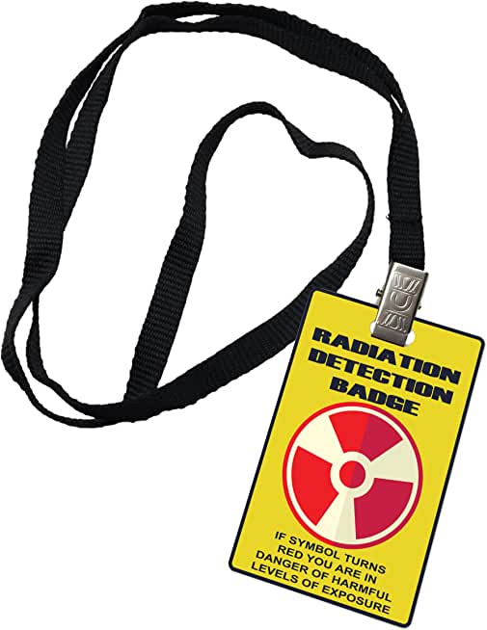
PHYSICAL HAZARDS
UV RADIATIONS, COMPUTERS , LASERS
Conjunctivitis and keratitis
Radiation effects are cumulative……they are painless yet life threatening
Erythema, dermatitis, skin cancer, bone marrow suppression , genetic effects leading congenital defects in the employee’s offspring's
International commission for radiological protection the maximum permissible level of occupational exposure is 5 rem per year to the whole body.

Slide 17
PHYSICAL HAZARDS
Glass wares, sharp needles , lancets , BP Blades , broken ampoules ,test tubes……lading to cut wounds , scratches , abrasions……..potential for infections.
Handle with care
Manage and dispose such items as per the biomedical waste management and handling rules 1998

Slide 18
CHEMICAL HAZARDS
Exposure to various chemicals are hazardous while providing care.
Mercury, beryllium , silica, latex etc…….
Irritation to skin , eyes , mucous membrane , allergic dermatitis, asthma and disturbances to central nervous system such as head ache , nausea , fatigue, loss of memory etc…

Slide 19
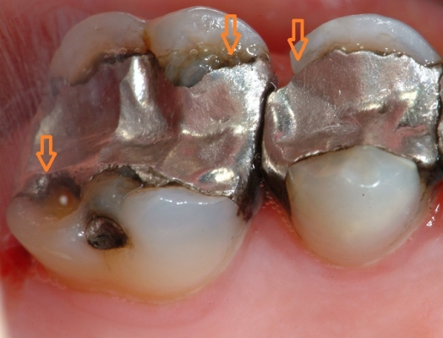

CHEMICAL HAZARDS
Mercury poisoning
Notes:
As per OSHA maximum of 2 micro grams of beryllium per cubic metre of air for an 8 hour time is average

Slide 20
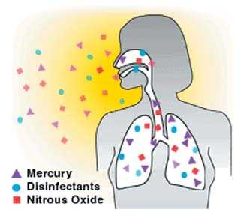
CHEMICAL HAZARDS
understand the manufacturers instruction, components or contents
use encapsulated alloys
good ventilation
excess and spilled mercury should be collected in fixer containing break resistant bottles
Notes:
As per OSHA maximum of 2 micro grams of beryllium per cubic metre of air for an 8 hour time is average

Slide 21
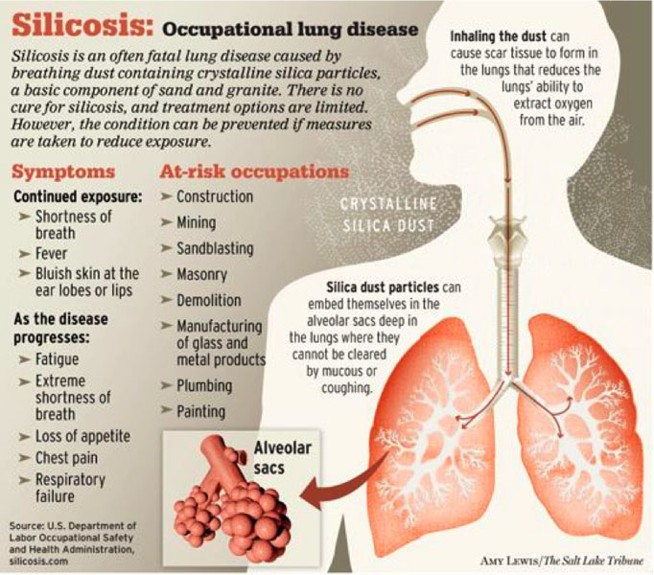
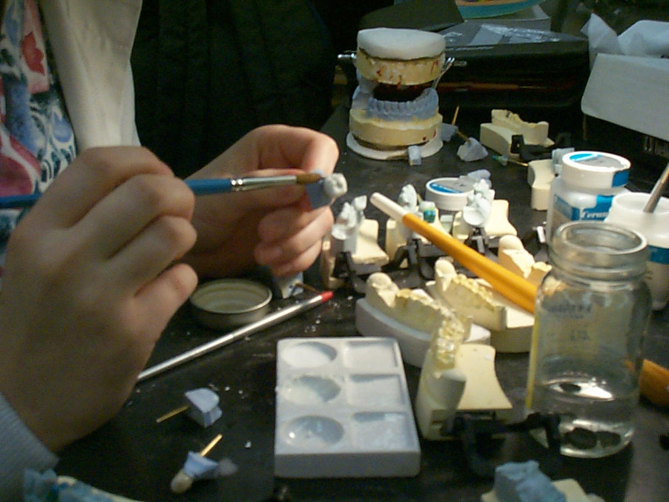
CHEMICAL HAZARDS
Inhalation of dust of silica in ceramic laboratories leads to Silicosis
Notes:
As per OSHA maximum of 2 micro grams of beryllium per cubic metre of air for an 8 hour time is average

Slide 22
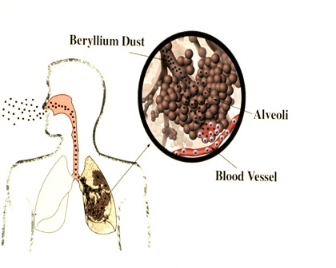
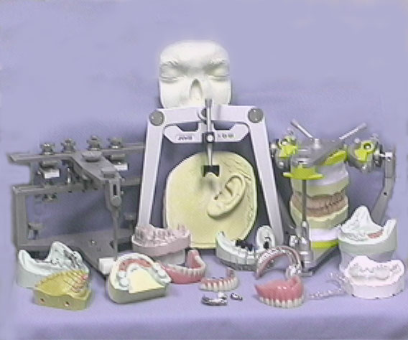
CHEMICAL HAZARDS
Inhalation of beryllium dust in prosthodontics laboratories develop chronic beryllium disease
Notes:
As per OSHA maximum of 2 micro grams of beryllium per cubic metre of air for an 8 hour time is average

Slide 23
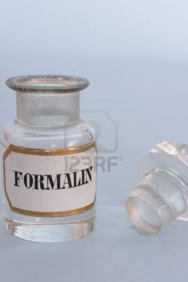

CHEMICAL HAZARDS
Commonly used disinfectant formaldehyde……..
Acute eye and respiratory irritation from the liquid and vapour form.
chronic like laryngitis , bronchitis
Notes:
As per OSHA maximum of 2 micro grams of beryllium per cubic metre of air for an 8 hour time is average

Slide 24
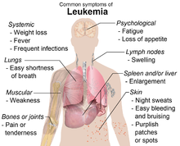

CHEMICAL HAZARDS
Chemical agent used for sterilization like xylene causes dizziness, head ache , mental confusion
It also contains benzene as an impurity…..
repeated breathing of the vapours over a long
period of time may cause leukemia
Notes:
As per OSHA maximum of 2 micro grams of beryllium per cubic metre of air for an 8 hour time is average

Slide 25
CHEMICAL HAZARDS
Latex gloves are often dusted with cornstarch powder are more commonly used……it forms an efficient barrier against most pathogens and a good barrier against viruses
  Unfortunately few professionals are allergic to this product…….urticaria and other causes like abdominal pain , nausea, vomiting
Vinyl or nitril gloves are of choice

Slide 26
PSYCHOSOCIAL HAZARDS
Stress can lead to other problems like……...
tension
High blood pressure
TirednessLeadin
Depression
Sleeplessness
Due to busy schedule….will deprived of social interaction , spending less time with family leading to burn out syndrome.

Slide 27
PREVENT PSYCHOLOGICAL HAZARD
Give enough time for relaxation
Group practice
Allot time for social interaction and family
To over come the stress----yoga, art of living , meditation etc……..

Slide 28
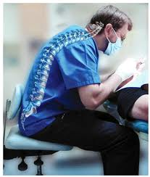
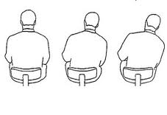
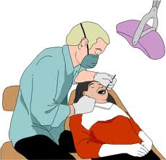
MUSCULOSKELETAL DISORDERS
Musculoskeletal disorders (MSDs) are described as disorders of the muscles, nerves, tendons, ligaments, joints, cartilage, or spinal discs.

Slide 29
MUSCULOSKELETAL DISORDERS
Dentists are among the workers who are more often susceptible to MSDs.
Their work may lead pathologies such as tendinitis, synovitis , tenosynovitis, and bursitis
Tenosynovitis is the inflammation of the fluid-filled sheath that surrounds a tendon
Bursitis is the inflammation of small sacs of synovial fluid in the body
Notes:
Tenosynovitis is the inflammation of the fluid-filled sheath (called the synovium) that surrounds a tendon

Slide 30
TYPES OF MSDS
Neck and Shoulder Disorders
  Myofascial Pain Disorder
  Cervical Spondylolysis
  Thoracic Outlet Syndrome
  Rotator Cuff Tendinitis/Tears
Back Disorders
  Herniated Spinal Disc
  Lower Back Pain
  Sciatica
Hand and Wrist Disorders
  Trigger Finger
  Carpal Tunnel Syndrome
  Cubital Tunnel Syndrome
  Hand-Arm Vibration Syndrome
  Raynaud’s Phenomenon

Slide 31
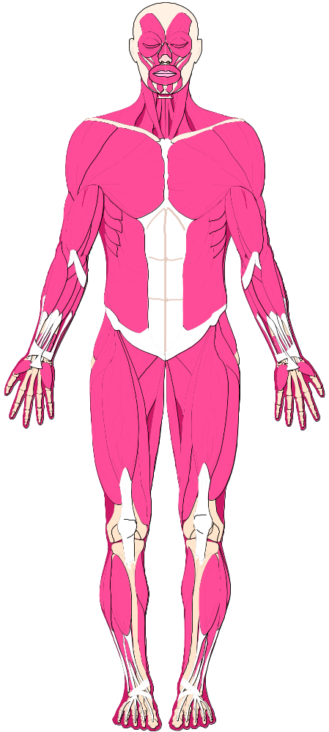
  MSDS origins are complex with a broad range of symptoms
  Signs Symptoms
Decreased range of motion
Deformity
Decreased grip strength
Loss of muscle function
Pain
Numbness
Tingling
Burning
Cramping
Stiffness

Slide 32
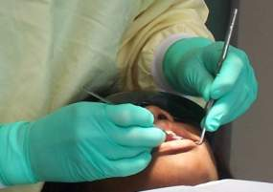
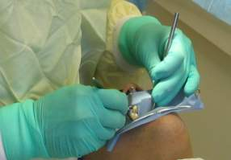
WHAT FACTORS CONTRIBUTE TO MSDS?
Forceful hand exertions
  Grasping small instruments for prolonged periods
  Forceful squeezing/release of instruments
Repetitive movements—e.g., scaling, root planing, polishing

Slide 33
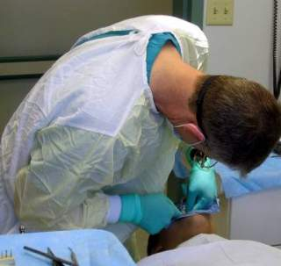
What Factors Contribute to MSDs?
Fixed or awkward postures
  Neck, back, shoulder posture
  Hand/wrist positions
  Standing/sitting
  Operatory organization
  Patient positioning

Slide 34
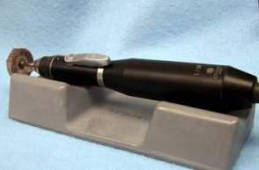
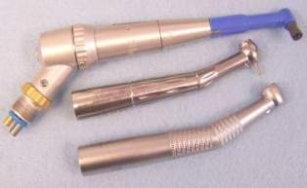
What Factors Contribute to MSDs?
Prolonged use of vibrating hand tools—dental handpieces, laboratory equipment

Slide 35

Treatment and Management of MSDs
Obtain an accurate diagnosis from a qualified health-care provider
  Early intervention is key
Self-diagnosis is not recommended
  MSD origins are complex with a broad range of symptoms

Slide 36
Treatment and Management of MSDs
Diagnostic tests may include physical exams, provocative tests, and electromyography
Treatment may range from pain-relief medications and rest to surgery, and ergonomic interventions both at work and home

Slide 37

ERGONOMICS

Slide 38
What is Ergonomics?
“Ergo” means work
“Nomos” means natural laws or systems
The study of peoples efficiency in their working places
Ergonomics is the science of work
Ergonomics is much broader than preventing work-related musculoskeletal disorders
Ergonomics plays an important role in preventing injury and illness

Slide 39
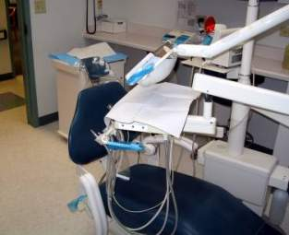
Applying Ergonomics to Dentistry
Provide Sufficient Space
Awkward bending, twisting, and reaching places stress on the musculoskeletal system and can lead to discomfort

Slide 40
Applying Ergonomics to Dentistry
Provide Sufficient Space
Permanently place equipment used in every clinical procedure within comfortable reach (within 20 inches of the front of the body)
Provide a clear line of sight to the oral cavity and all required equipment

Slide 41
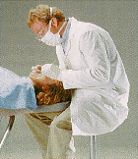
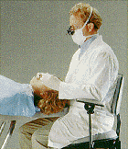
Applying Ergonomics to Dentistry
Reduce Physical Effort
Avoid bent or unnatural postures
Ideally, equipment should allow work in a relaxed and well-balanced position
  Position the patient to allow easy access from the desired position

Slide 42
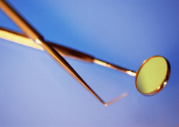
Applying Ergonomics to Dentistry
Instrument Design
Goal: reduce force exertion; maintain hand/wrist in neutral position (no wrist bend)
Considerations
  Overall shape/size
  Handle shape/size
  Weight
  Balance
  Ease of operation
  Ease of maintenance

Slide 43
Applying Ergonomics to Dentistry
Hand Instruments
When selecting instruments, look for
  Hollow or resin handles
  Round, textured/grooves, or compressible handles
  Carbon-steel construction
  Color-coding may make instrument identification easier

Slide 44
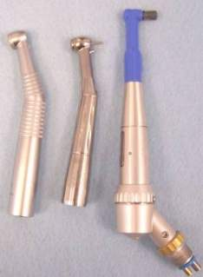
Applying Ergonomics to Dentistry
Dental Handpieces
When selecting handpieces, look for
  Lightweight, balanced models
  Sufficient power
  Built-in light sources
  Angled vs. straight-shank
  Pliable
  Easy activation
  Easy maintenance

Slide 45

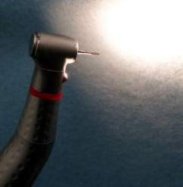
Applying Ergonomics to Dentistry
Lighting
Goal: produce even, shadow-free, color-corrected illumination concentrated on operating field
Overhead light switch readily accessible
Hand mirrors can be used to provide light intraoral

Slide 46
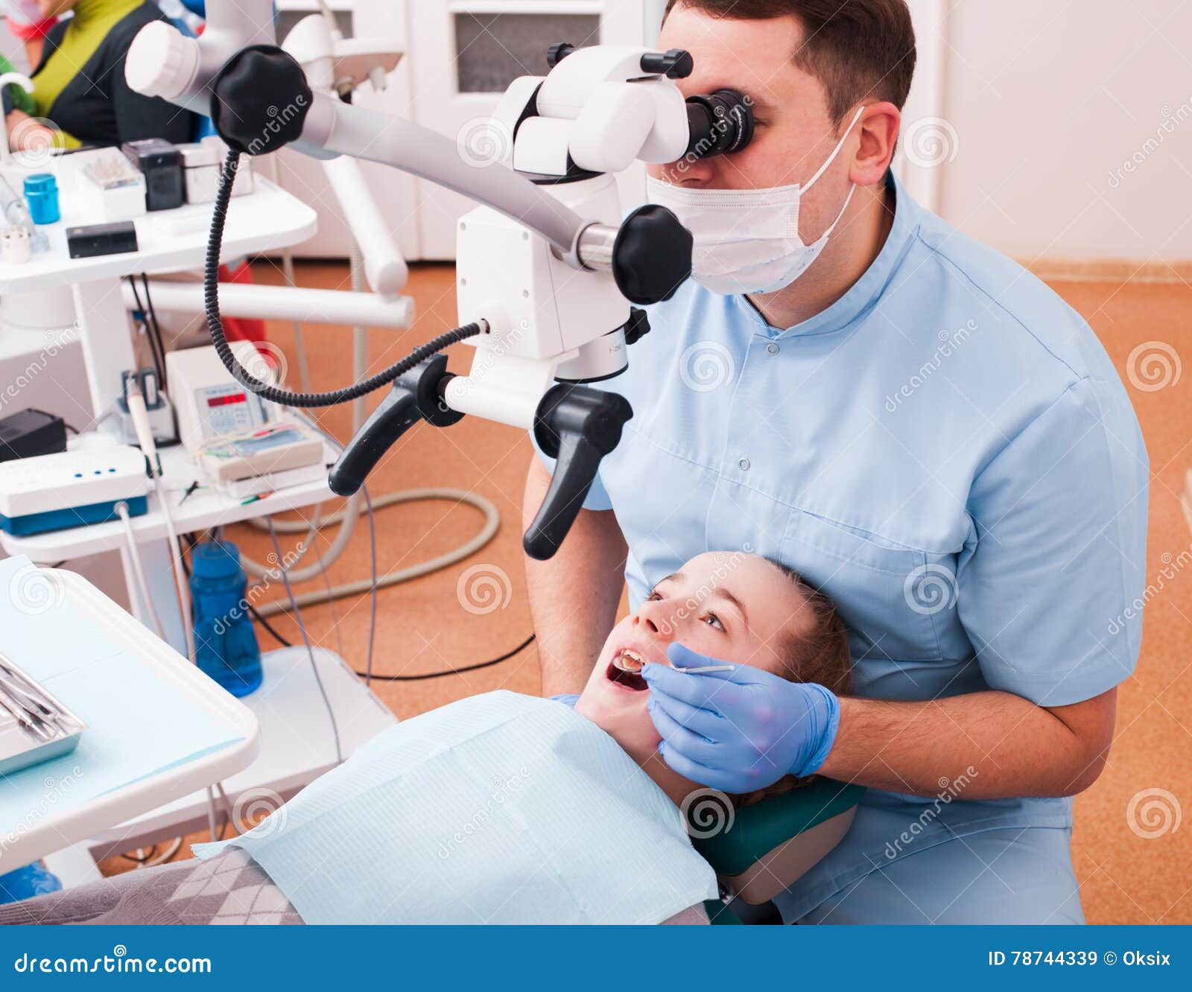
Applying Ergonomics to Dentistry
Magnification
Goal: improve neck posture; provide clearer vision
Select the magnification systems considering
  Working distance
  Depth of field
  Magnification factor
  Lighting needs

Slide 47
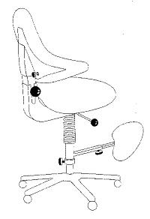
Applying Ergonomics to Dentistry
Operator Chair
Goal: promote mobility and patient access; accommodate different body sizes
Look for:
  Stability
  Lumbar support
  Hands-free seat height
  adjustment
  Fully adjustable

Slide 48
Applying Ergonomics to Dentistry
Posture/Positioning
Goal: avoid static and/or awkward positions
Potential strategies
  Position patient so that operator’s elbows are elevated no more than 30 degrees
  Adjust patient chair when accessing different quadrants
  Alternate between standing and sitting

Slide 49
Applying Ergonomics to Dentistry
Personal Protective Equipment
Glasses
  Lightweight, clean, well-fitted
  Magnifying lenses and head lamps are encouraged
Clothing
  Fit loosely, lightweight, pliable

Slide 50
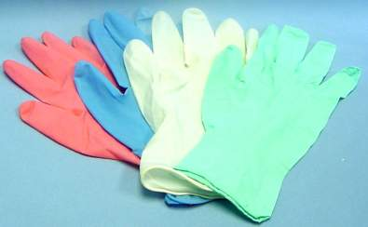
Applying Ergonomics to Dentistry
Personal Protective Equipment
Gloves
  Be of proper size, lightweight, and pliable
  Should fit hands and fingers snugly
  Should not fit tightly across wrist/forearm

Slide 51
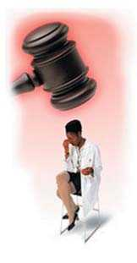
LEGAL HAZARDS
Every nation has its relevant rules and regulations which apply to the practice of dentistry
Contravention of any of these rule and regulations may warrant legal actions against the professional
Adopt a safe work environment, have awareness of possible hazards
Prevention of legal risk should be known to all workers in the clinic or hospital

Slide 52
PREVENTION
OF
OCCUPATIONAL HAZARDS

Slide 53
Awareness and protection from potential occupational risks is important,
Appropriate occupational health and safety measures need to be adopted and adhere to it
Focus mainly on infection control and proper handling of potentially infected materials

Slide 54
Use of proper barrier techniques……
Include gloves , masks, protective eye wear, high power suction and good ventilation to reduce aerosols and vapor
Non latex gloves, lead aprons, periodic maintenance of x-ray machine and radiation level sensors
Healthy professional is essential for healthy patients.

