Slide 1
Occlusion
– basic concepts
Dr. Madhu bhaskar MDS
Dept of orthodontics

Slide 2
CONTENTS
INTRODUCTION
TERMINOLOGY
TYPES OF CUSPS
ARRANGEMENT OF TEETH IN HUMANS
IMAGINARY OCCLUSAL PLANES & CURVES
CENTRIC RELATION & CENTRIC OCCLUSION
CENTRIC CONTACTS
ECCENTRIC OCCLUSION
DISCLUSION
ANDREWS SIX KEYS TO NORMAL OCCLUSION
CONCLUSION

Slide 3
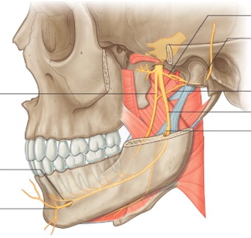
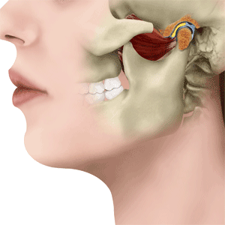
INTRODUCTION
Need to study occlusion
Static occlusion
(form, alignment, articulation)
Dynamic occlusion
(stomatognathic system, tmj, neuromuscular and nutritive
system)
Angle defined occlusion: relation of occlusal inclined planes

Slide 4
Terminology
Ideal occlusion : preconceived theoretical concept of occlusal structural & functional
relationships, principles and characteristics
Physiologic occlusion : occlusion deviated in one or more ways from ideal occlusion
but well adapted to that particular environment.
Balanced occlusion: balanced and equal contacts are maintained during excursion of
mandible
Functional occlusion: provides highest efficiency during all excursive movements.
Therapeutic occlusion: modified by appropriate therapeutic modalities
Trauma from occlusion: periodontal tissue injury caused by occlusal forces

Slide 5
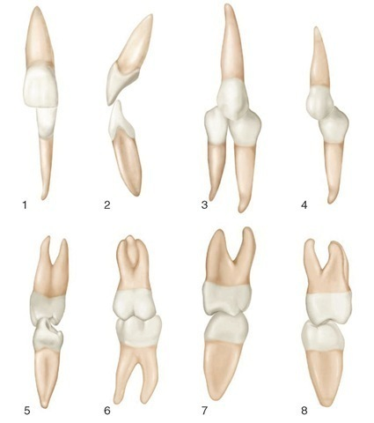
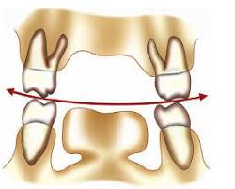
Types of cusps centric holding cusps non supporting cusps

Slide 6
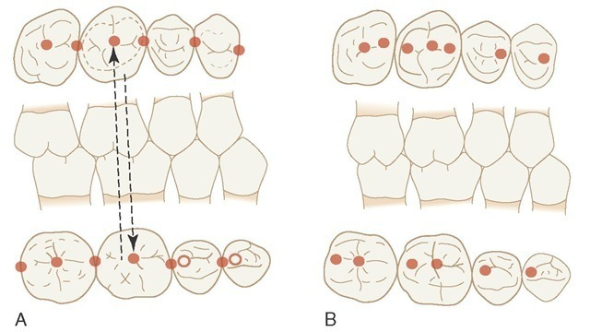
Arrangement of teeth in humans
1.Cusp-fossa occlusion
2.Cusp-embrasure occlusion

Slide 7
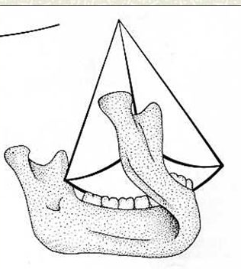
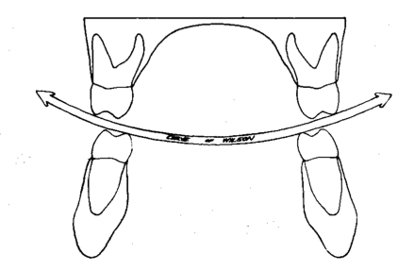
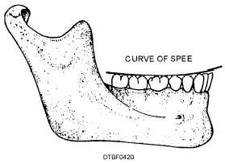
Compensating curves
Curve of Spee
Curve of Wilson
Curve of Monson

Slide 8
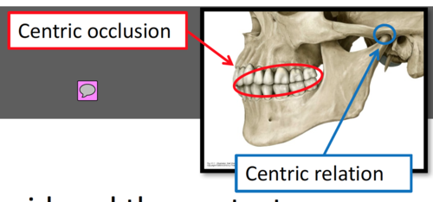
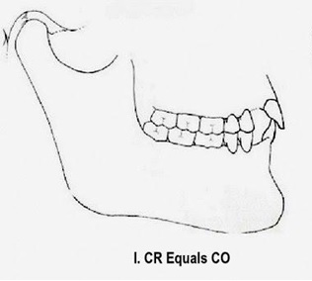
Centric relation & centric occlusion
Centric relation is the most retruded, unstrained position of the mandibular condyle within the temporomandibular joint (TMJ).
Centric occlusion refers to a position of maximal, bilateral, balanced contact between the cusps of the maxillary and mandibular arches.

Slide 9
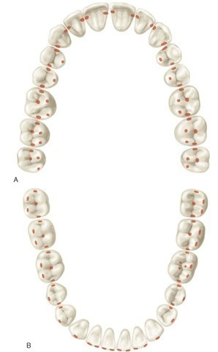
Centric contacts
They are areas of the teeth that contact the opposing teeth.
  Anterior centric contacts
  Posterior centric contacts
Contact between inclines
  Bipode contact
  Tripode contact
  quadrapoded

Slide 10
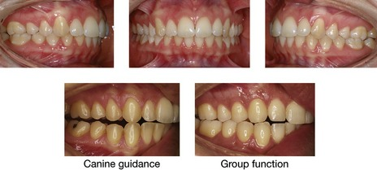
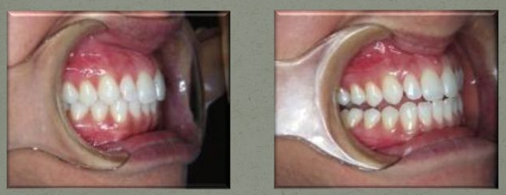
Eccentric occlusion
Functional occlusion (working side)
  lateral functional occlusion
    Canine guided
    Group lateral
  Protrusive functional occlusion
Non functional occlusion
Disclusion

Slide 11
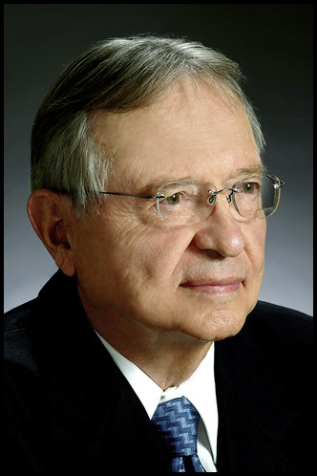
Andrews six keys of normal occlusion
1.Molar inter-arch relation
2.Mesiodistal crown angulation
3.Labiolingual crown inclination
4.Absence of rotation
5.Tight contact
6.Curve of spee

Slide 12

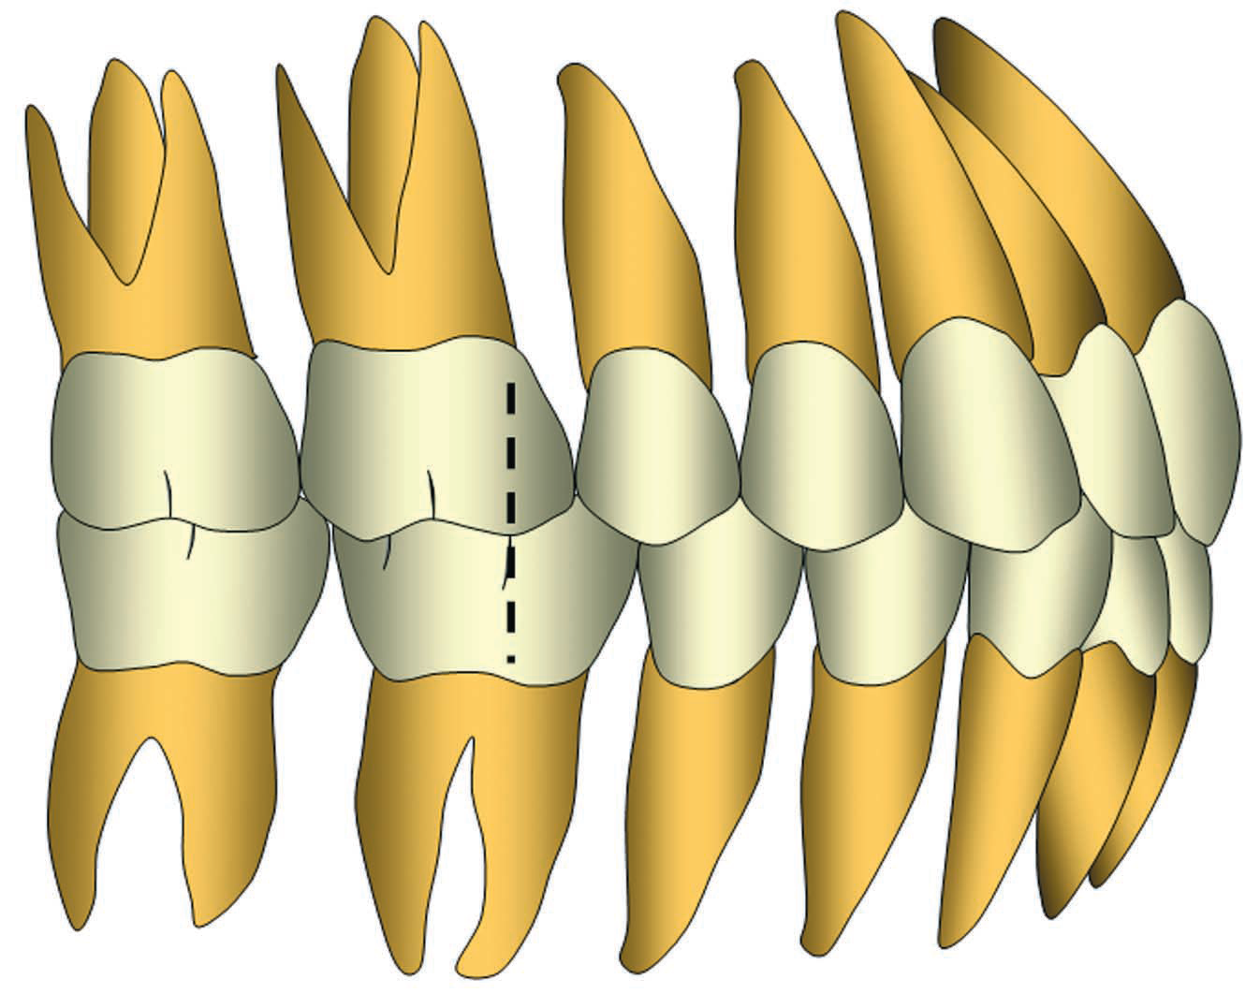
1.Molar interarch relation
Mesiobuccal cusp-groove
Mesiolingual cusp-fossa
Distal marginal ridge- mesial marginal ridge

Slide 13
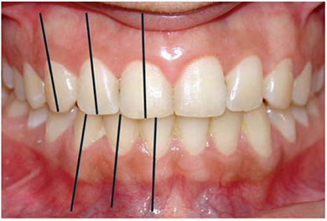
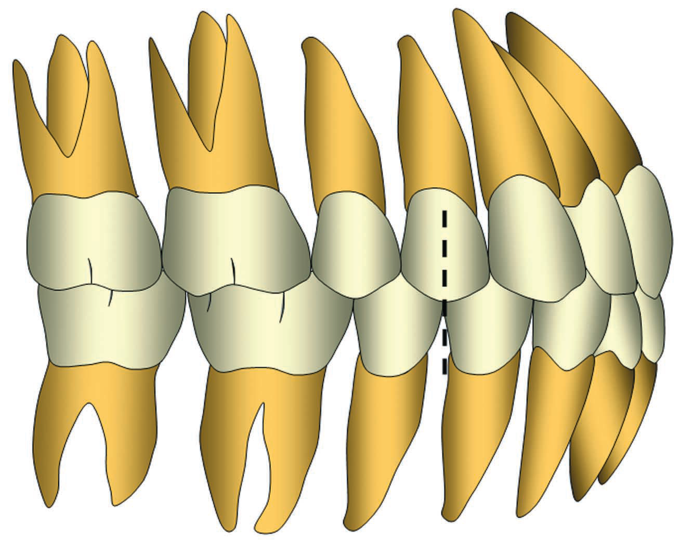
2.Mesio-distal crown angulation
Gingival part of long axis of the crown must be distal to occlusal part of line

Slide 14
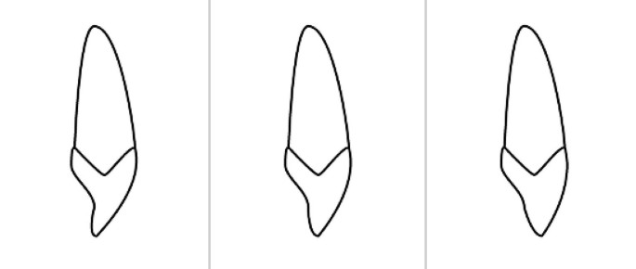
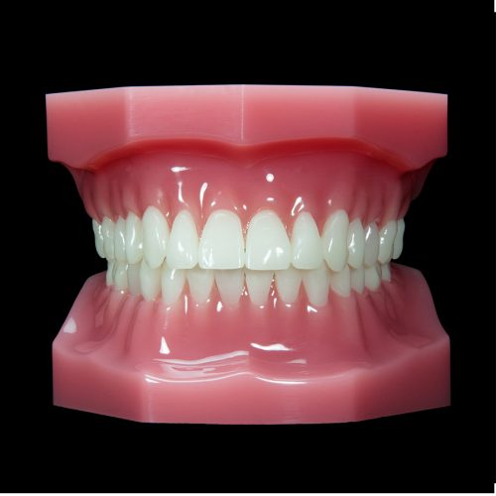
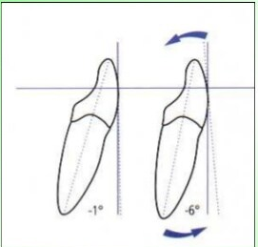
3.Labio-lingual crown inclination
Determined from a mesial or distal view.
  Positive crown inclination
  Very mild negative crown inclination
  Negative crown inclination

Slide 15
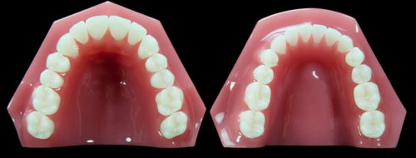
4.Absence of rotation
Rotated posterior teeth occupy more space in dental arch than anteriors

Slide 16
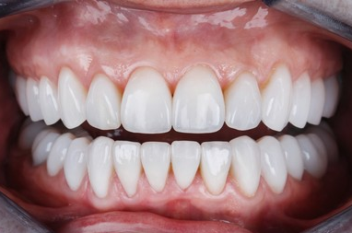
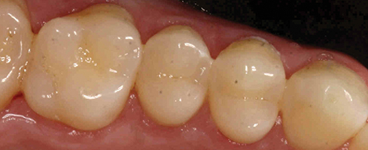
5.Tight contacts
Tight contact between adjacent teeth

Slide 17
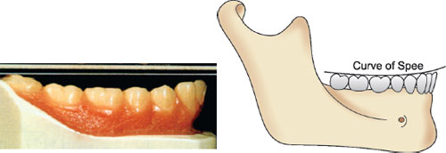
6.Curve of spee
Not exceeding 1.5mm

Slide 18
Conclusion

Slide 19

Reference
THANK YOU
1.Orthodontics the art and science -7 edition S.I.BHALAJHI
2.TEXTBOOK OF ORTHODONTICS -GURKEERAT SINGH

