Slide 1
OBJECTIVES AND PRINCIPLES OF IMPRESSION MAKING, THEORIES AND TECHNIQUES.
Dr. Yarlagadda Siva Kiran Babu

Slide 2
Contents
Introduction
Principles of impression making
Objectives of impression making
Theories of impression making
Conclusion

Slide 3
Introduction
“Ideal impression must be in the mind of the dentist before it is in his hand. He must literally make the impression rather than take it.”
- M.M.DEVAN

Slide 4
Impression -A negative likeness or copy in reverse of the surface of an object; an imprint of the teeth and adjacent structures for use in dentistry.
– GPT 10
Preliminary impression - a negative likeness made for the purpose of diagnosis, treatment planning, and/or the fabrication of a custom impression tray.
– GPT 10
Final impression:- The impression that represents the completion of the registration of the surface or object.
– GPT 10

Slide 5
Basic Requirements:
Knowledge of facial & oral anatomy.
Knowledge of basic and reliable technique.
Knowledge and understanding of materials.
Skill and Patient management

Slide 6
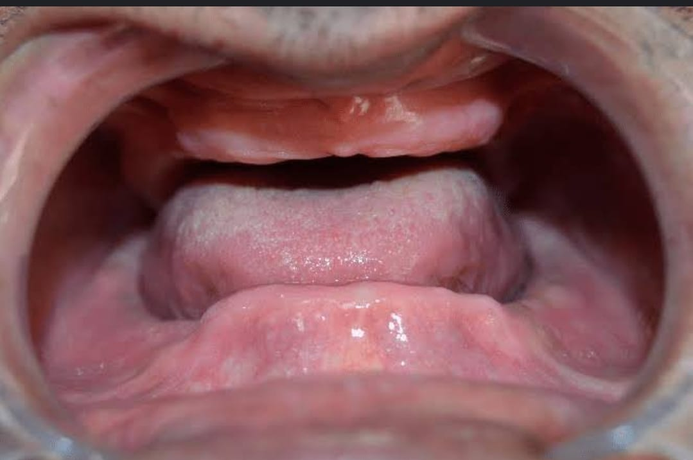
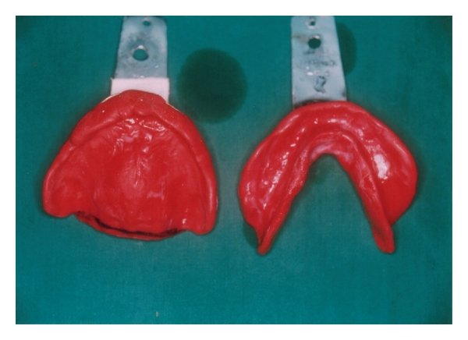
Principles of Impression Making:
Healthy oral mucosa
Include all basal seat area
Borders are within anatomical limits

Slide 7
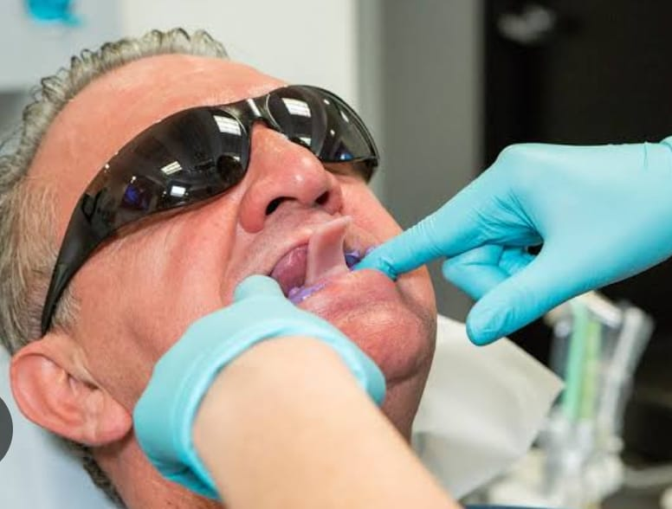
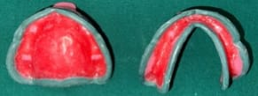
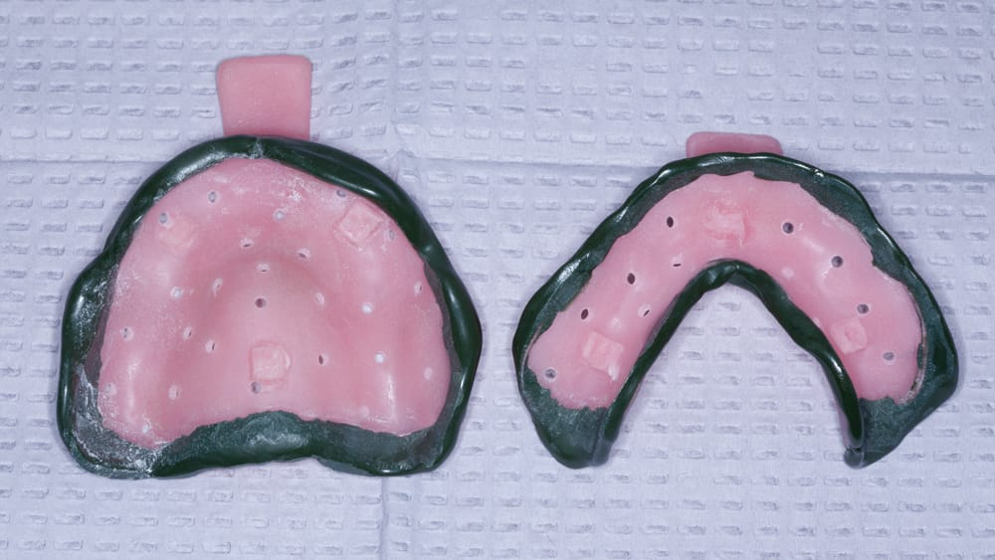
.Physiological type of border moulding
Sufficient space for the selected impression material

Slide 8
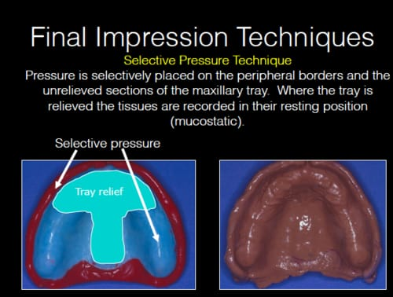
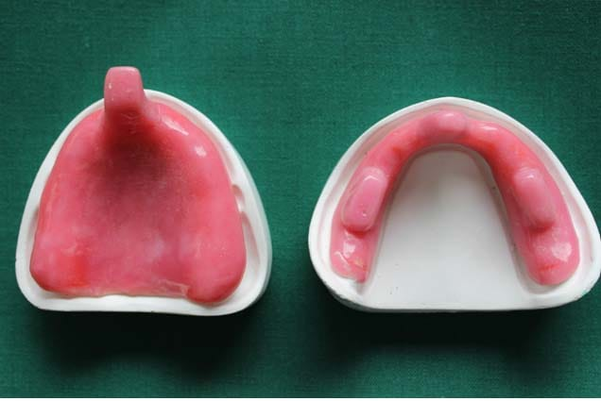
Dimensionally stable
Correct positioning of tray

Slide 9
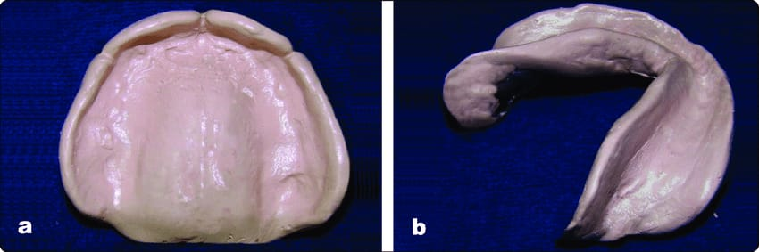
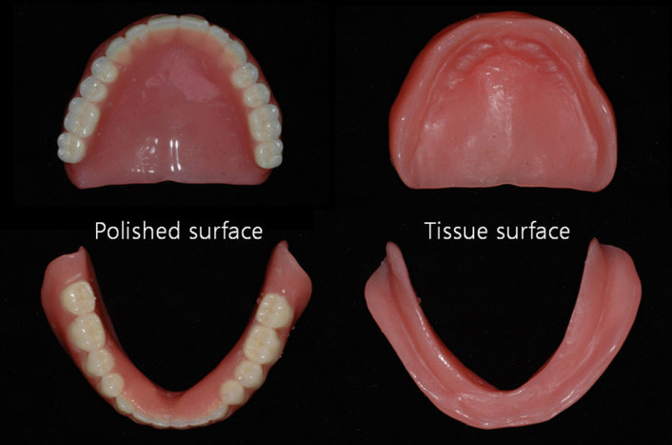
removed without damaging the mucosa.
external shape of the impression should be similar to the external form of complete denture.

Slide 10
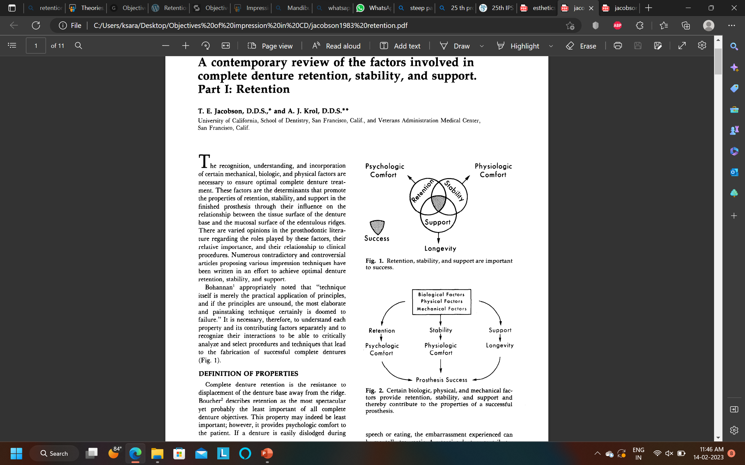
OBJECTIVES OF IMPRESSION MAKING
Preservation of the alveolar ridges
Retention
Esthetics
Stability
Support

Slide 11
PRESERVATION OF THE ALVEOLAR RIDGES
M.M. De Van’s dictum
“Perpetual preservation of what is remaining is more important than
meticulous replacement of what is lost”
Not to use heavy pressure.
Covering as much of the supporting areas as possible - minimize the possibility of soft tissue abuse and bone resorption.

Slide 12
RETENTION
It is defined as “That quality inherent in the prosthesis which resists the force of gravity, adhesiveness of foods and the forces associated with the opening of the jaws”- GPT 10
Retention is the ability of the denture to withstand displacement against its path of insertion.

Slide 13
PHYSICAL
Adhesion
cohesion
interfacial surface tension
capillarity
atmospheric pressure
gravity
PHYSIOLOGICAL saliva
ANATOMICAL
SIZE OF DENTURE BEARING AREA
QUALITY OF DENTURE BEARING AREA
PARALLEL RIDGE WALLS
RETENTION
MECHANICAL
Undercuts
Retentive springs
Magnetic forces
Denture adhesives
Suction chambers
Palatal implants
MUSCULAR
Oral musculature
Facial musculature

Slide 14
History
Fish’ was first to discuss the determinants of retention and differentiate between the tissue, polished, and occlusal surfaces of a complete denture. He emphasized that each of the three surfaces plays a role in retention.
Craddock’ described the “gripping” action of the buccinator muscle on the buccal flange of a mandibular complete denture..

Slide 15
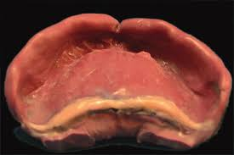
ANATOMIC INFLUENCES ON MAXILLARY DENTURE RETENTION
The posterior palatal seal maintains tissue contact during base movement or soft palate function and compensates for processing changes.
This critical area extends between the hamular notches along the flexure line of the soft palate.

Slide 16
ANATOMIC INFLUENCES ON MANDIBULAR DENTURE RETENTION
Triangularis muscle and the mentalis muscle should accompany any border-molding procedure.
The border seal of the entire facial flange of the denture depends on accurate border molding and is enhanced by the draping effect of the lips and cheek

Slide 17
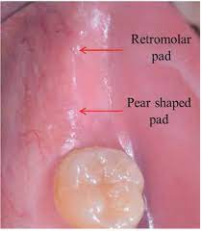
The denture base should cover the posterior extension of the firmly bound, keratinized tissue of the pear-shaped pad.
Craddock coined the term “pear shaped pad”.

Slide 18
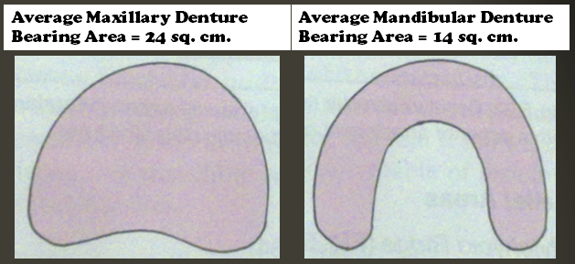
1)Anatomical factors:
Size of denture bearing area - Retentive force is directly proportional to the area covered.
Quality of the denture bearing area - Displaceability of tissues.
2)Physiological factors:
Saliva and its quality

Slide 19
3)Physical factors
Adhesion
Cohesion
Interfacial surface tension
Capillarity and capillary attraction
Atmospheric pressure and peripheral seal

Slide 20
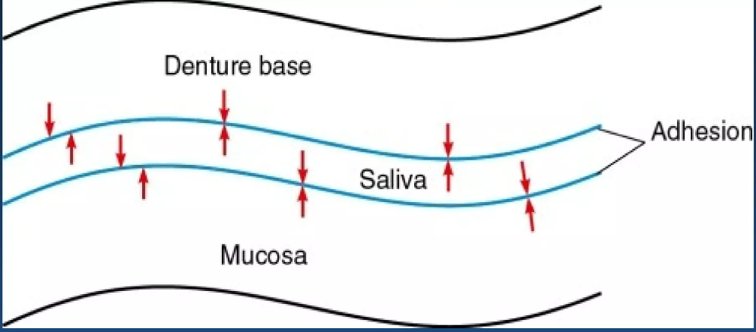
ADHESION:
Adhesion is the force of attraction between dissimilar molecules such as saliva and acrylic resin or saliva and mucosa, which promotes the wetting of the denture and mucosal surfaces

Slide 21
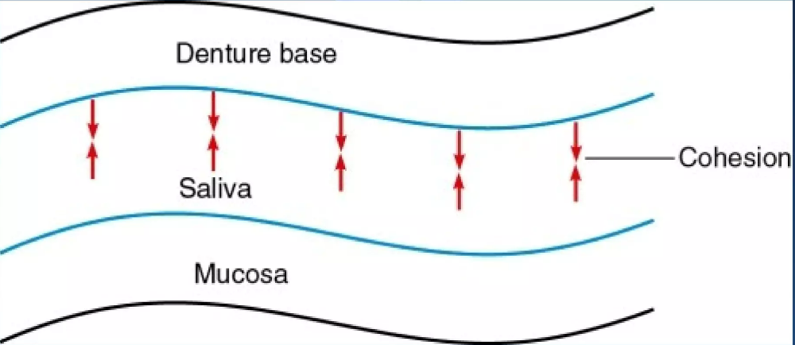
COHESION:
Cohesion is the force of attraction between like molecules, which maintains the integrity of the saliva film. These intermolecular forces of adhesion and cohesion may be thought of forming a chain between the denture and the mucosa

Slide 22
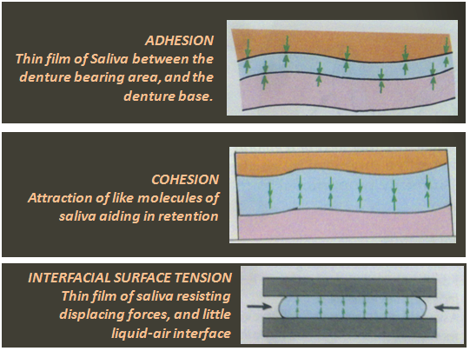
INTERFACIAL SURFACE TENSION:
It is defined as “The tension or resistance to separation possessed by
the film of liquid between two well-adapted surfaces”- GPT 10
It results from a thin layer of fluid that is present between two parallel planes of rigid material.

Slide 23
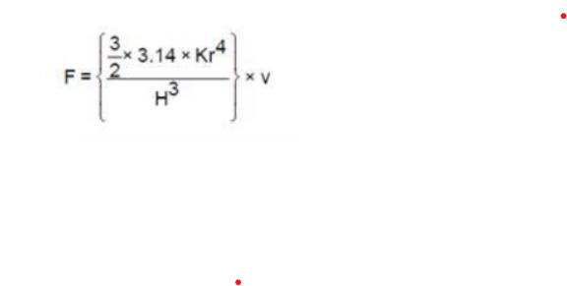
According to Stefan’s law:
F - interfacial surface tension.
k - viscosity of the interposed liquid (saliva).
r - denture surface area
H- the width of the space between the denture base and the mucosa.
V - the velocity of the displacing force

Slide 24
To obtain maximum interfacial surface tension:
• Saliva should be thin and even.
• Perfect adaptation should be present between the tissues and the denture base.
• The denture base should cover a large area.
• There should be good adhesive and cohesive forces, which aid to enhance interfacial surface tension

Slide 25
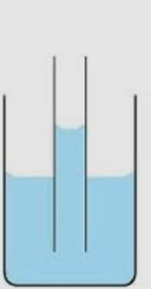
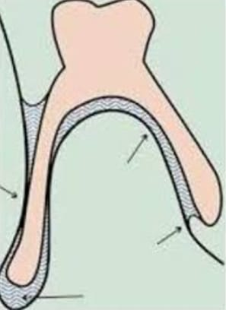
Capillarity or capillary attraction:
It is defined as, “That quality or state, because of surface tension causes elevation or depression of the surface of a liquid that is in contact with a solid” – GPT 10

Slide 26
Factors that aid to improve capillary attraction:
- Closeness of adaptation of denture base to soft tissue.
- Greater surface of the denture-bearing area.
- Thin film of saliva should be present.

Slide 27
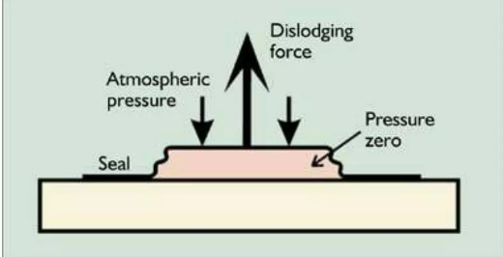
ATMOSPHERIC PRESSURE
When displacing forces act on a denture, a partial vacuum is produced between the denture and soft tissues, which aid in retention.
This is called natural suction of a denture.
Hence it is referred to as emergency retentive force or temporary restraining force.

Slide 28
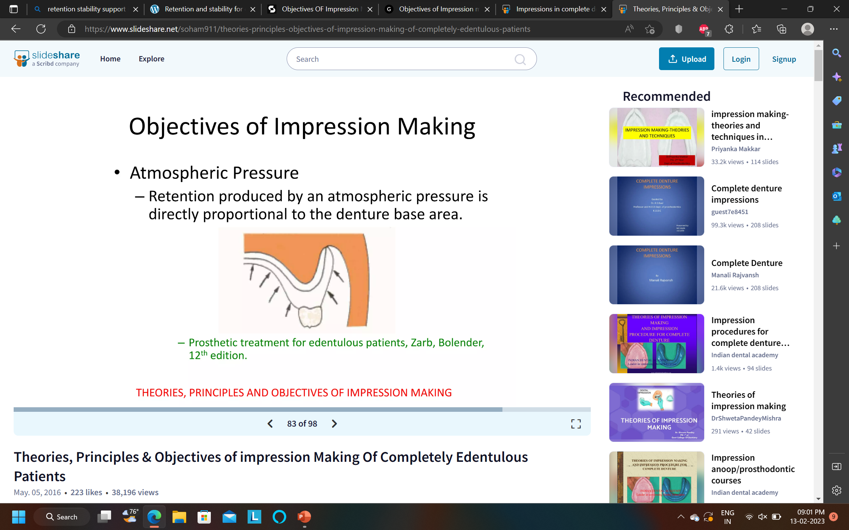
Retention produced by an atmospheric pressure is directly proportional to denture base area.

Slide 29
GRAVITY:
Weight of a denture acts as an important factor.
When a person is in upright posture, gravity acts as a retentive force for mandibular denture and a displacive force for maxillary denture.

Slide 30
INTIMATE TISSUE CONTACT:
The close adaptation of denture base to the underlying tissue.
Impression technique will determine the degree of intimate contact obtained with the tissues at rest and during function.

Slide 31
OPTIMUM PHYSICAL RETENTION:
The aspects of complete dentures that influence the amount of physical retention obtained are:
border seal
area of impression surface
accuracy of fit

Slide 32
AREA OF IMPRESSION SURFACE:
Physical retention is proportional to the area of the impression surface.

Slide 33
ACCURACY OF FIT:
Thinner the saliva film between the denture and underlying mucosa
Greater the forces of retention

Slide 34
Poor fit
Increase the thickness of the saliva film and increase the likelihood of air bubbles
Reduce retention of the denture.

Slide 35
MECHANICAL FACTORS:
Retentive springs
Undercuts
Magnetic forces
Denture adhesive
Suction chambers and suction discs

Slide 36
UNDERCUTS :
It is that portion of surface of an object that is beyond the height of contour in relationship to the path of placement.
maxillary-distobuccal vestibule area
premolar area anteriorly
mandibular-distolingual vestibule
lingual areas

Slide 37
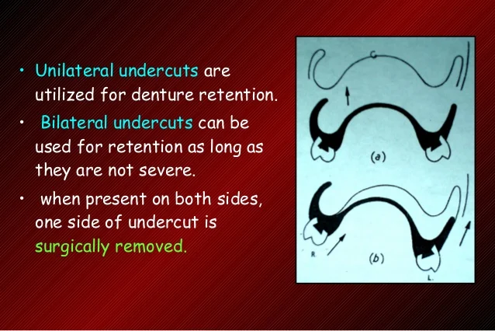
Types
Unilateral undercuts
Bilateral undercuts
When present on both sides one side of undercut is surgically removed.

Slide 38
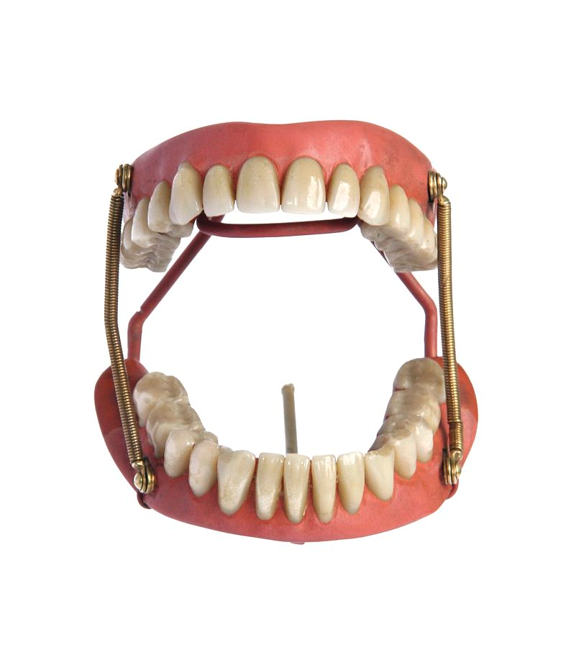
RETENTIVE SPRINGS:
Made of coiled stainless steel or gold plated base metal.
Their ends attached to swivels in the premolar area on both sides of upper and lower dentures.
As soon as they are released the dentures are forced apart by the action of springs and held in place.

Slide 39
Disadvantages of springs:
Mucous membrane cannot tolerate constant pressure.
Constant pressure causes excessive resorption.
The inner surfaces of cheeks frequently become sore from friction with the springs.
Lateral movements of mandible restricted hence efficiency of dentures is impaired.

Slide 40
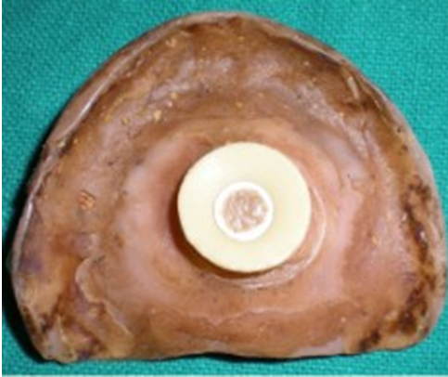
RUBBER SUCTION DISCS:
They consists of a rubber disc which is buttoned on to a stud sunk into the fitting surface of the denture.
The partial vacuum created within the perimeter of this disc holds the upper denture suspended from the hard palate.

Slide 41
Disadvantages:
Unhygienic - the soft tissue disc is porous and it swells and becomes very foul.
It causes constant irritation and damage to soft tissue and even epithelioma.
On prolonged use causes perforation of palate.

Slide 42
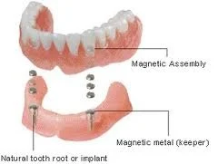
MAGNETS:
Use of small steel magnets beneath the molar and premolar teeth have been advocated.
They are arranged such that similar poles oppose each other.

Slide 43
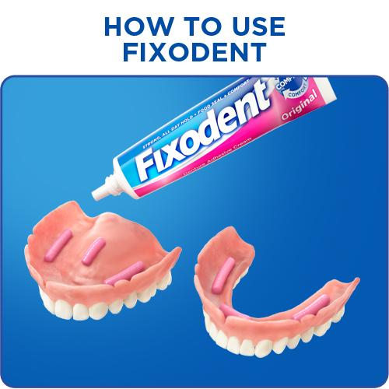
ADHESIVES:
Denture adhesives refers to nontoxic, soluble material that is applied to the tissue surface of denture to enhance denture retention and stability.
Composition:
Prior to early 1960s- based on vegetable gums-karaya, tragacanth, xanthan, acacia.

Slide 44
Presently available synthetic adhesives:
Carboxymethylcellulose (CMC)-short acting
Poly (vinyl methyl ether maleate) or gantrez-long acting
Polyvinylpyrrolidone (povidone)-short acting
Binding agent- petrolatum, mineral oil, polyethylene oxide
Anti clumping agents- silicon dioxide, calcium stearate
Flavouring agent, color, preservatives.

Slide 45
Mechanism of action:
Adhesives increase retention by optimizing interfacial forces by
-Increasing the adhesive and cohesive properties and viscosity of the saliva between denture base and underlying tissue.
-Eliminating voids between the denture bases and its basal seat.

Slide 46
Indications:
To enhance retention.
Xerostomia
Cerebrovascular accidents
Resective surgeries
Contraindications:
Improperly fabricated or poorly fitting prosthesis.

Slide 47
PSYCHOLOGICAL FACTORS:
The process whereby an edentulous patient can accept and use complete denture is complex.
The patients ability and willingness to accept and learn to use the dentures ultimately determines the degree of success of clinical treatment.

Slide 48
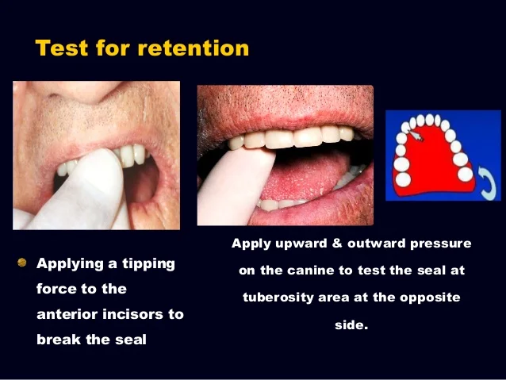
Clinical evaluation for retention:
Maxilla
- Upward anterior force on palatal aspect of anterior teeth –posterior border seal.
- Buccal force on palatal aspect on one side- opposite side.

Slide 49
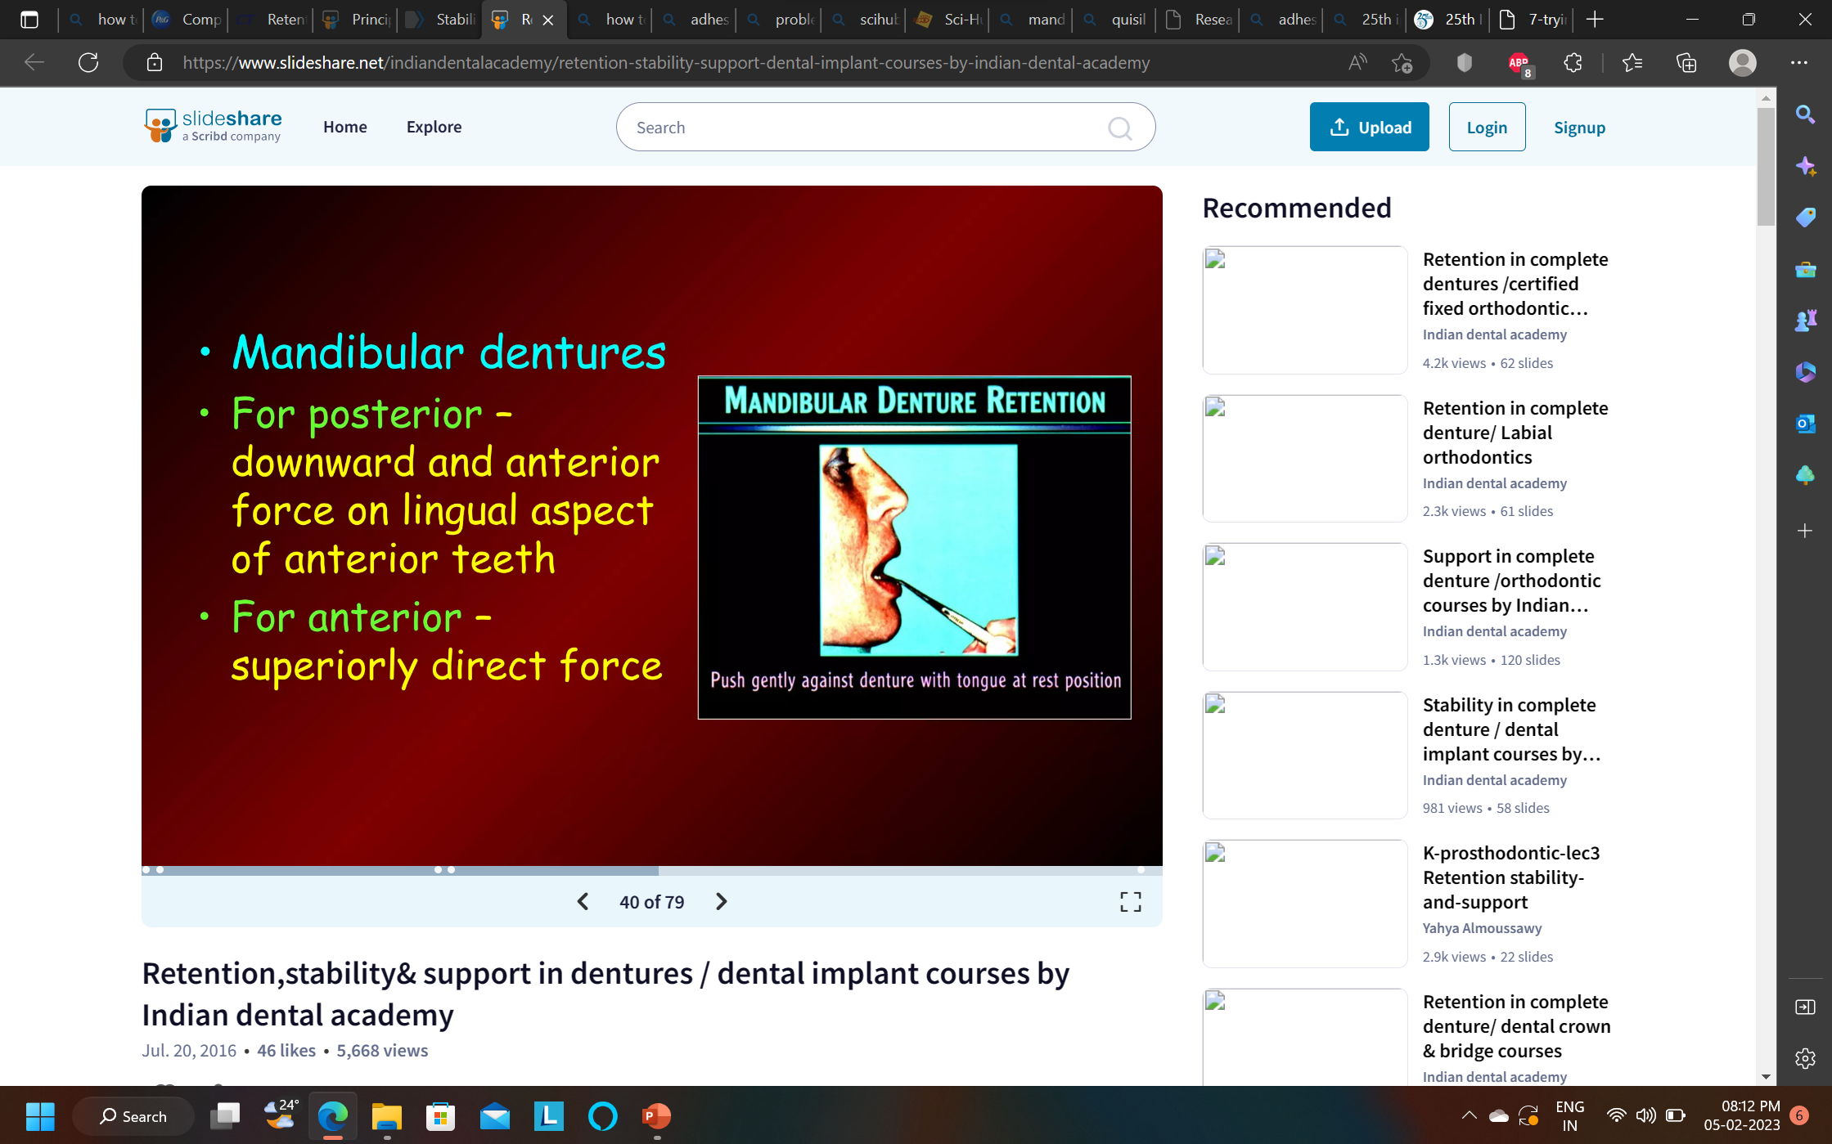
Mandible
- Posterior- downward and anterior force on lingual aspect of anterior teeth.
- Anterior- superiorly direct force.

Slide 50
Causes of poor retention:
When opening mouth wide
- over/under extension
- tight lips
- tongue cramp
- lack of peripheral seal
- lack of saliva
When coughing or sneezing
- normal due to sudden rise of soft palate

Slide 51
STABILITY:
The quality of a dental prosthesis to be firm, steady or constant, to resist displacement by functional horizontal or rotational stresses. (GPT-10)
Relationship of the denture base to the underlying bone.

Slide 52
Factors affecting stability:
Vertical height of residual alveolar ridge.
Quality of soft tissue covering the ridge.
Adaptation of denture base to the tissues.
Occlusal plane.
Teeth arrangement.
Contour of polished surfaces

Slide 53
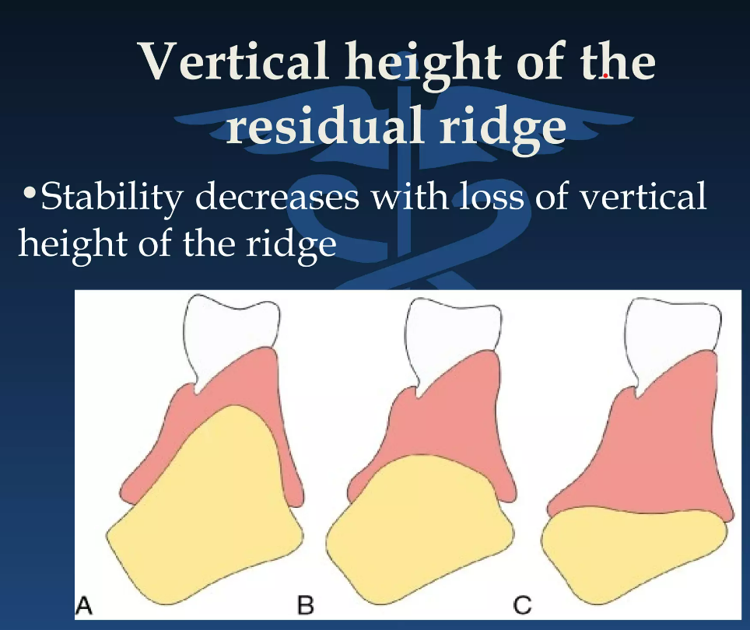
Vertical height of residual ridge:
Stability decreases with loss of vertical height.

Slide 54
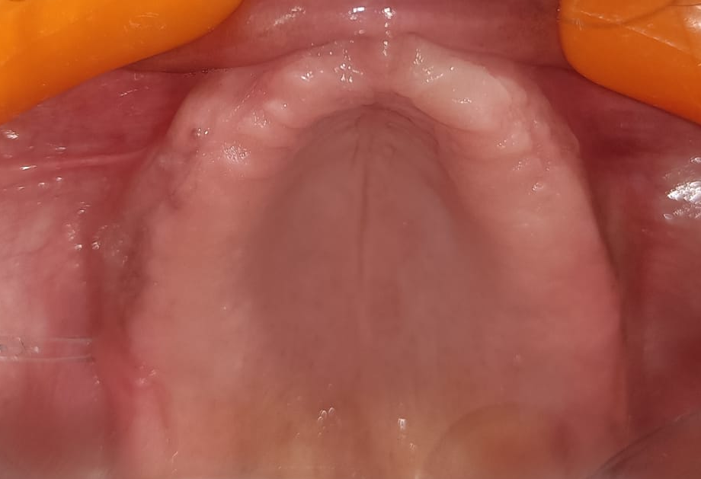
Quality of soft tissue covering ridge:
Flabby ridge provide poor stability.

Slide 55
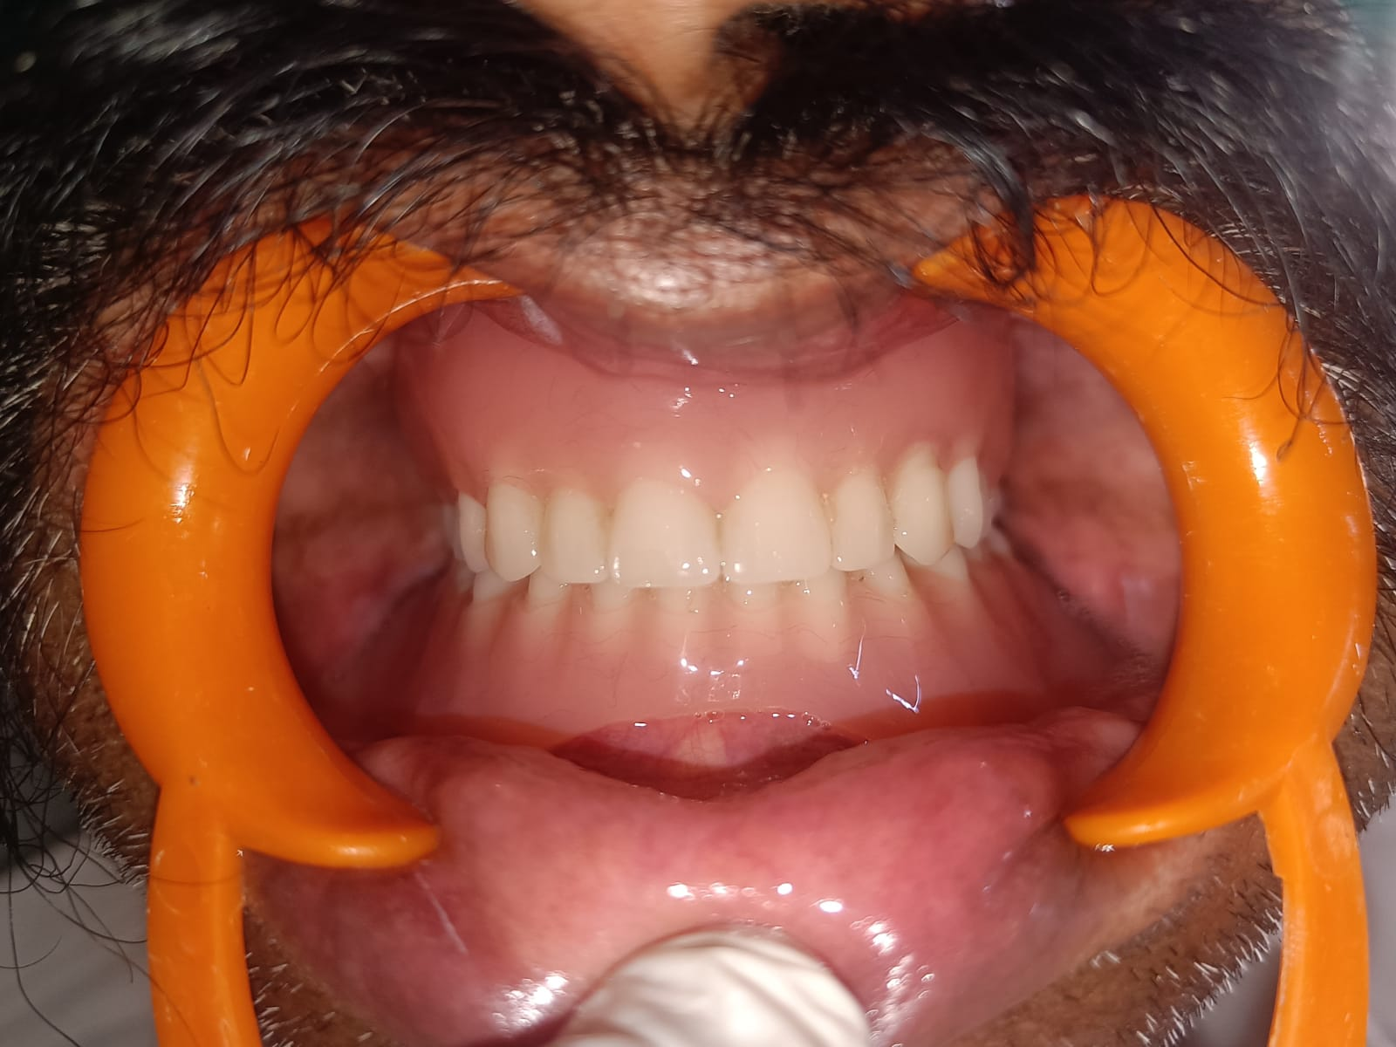
Adaptation of denture base to the tissues:
Close adaptation of denture to the basal seat tissues ensure proper stability.
An accurate impression is essential to achieve this.

Slide 56
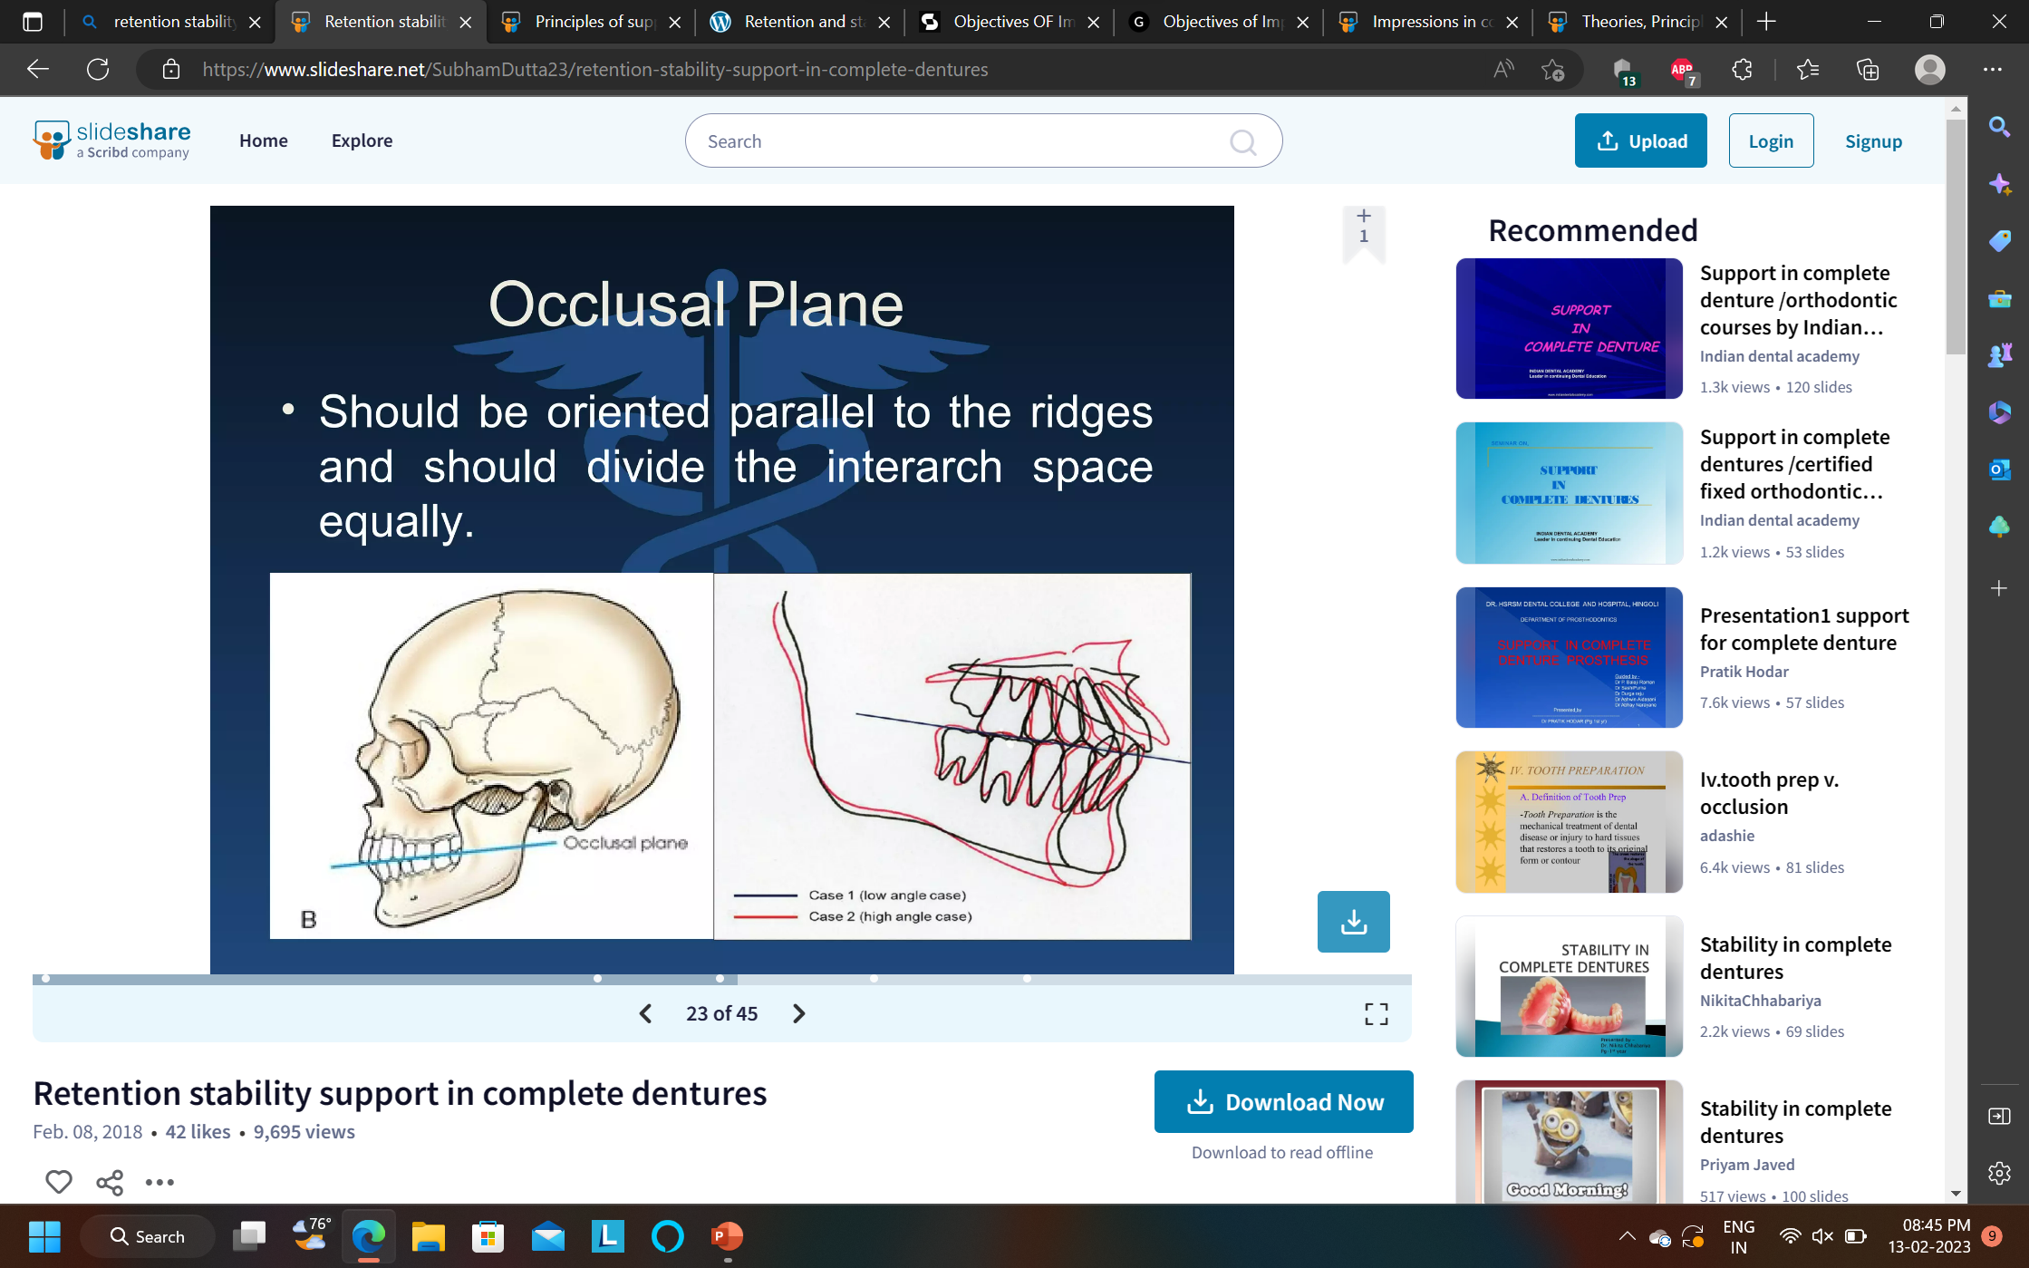
Occlusal plane:
Should be parallel to the ridges and interarch space should be divided equally.

Slide 57
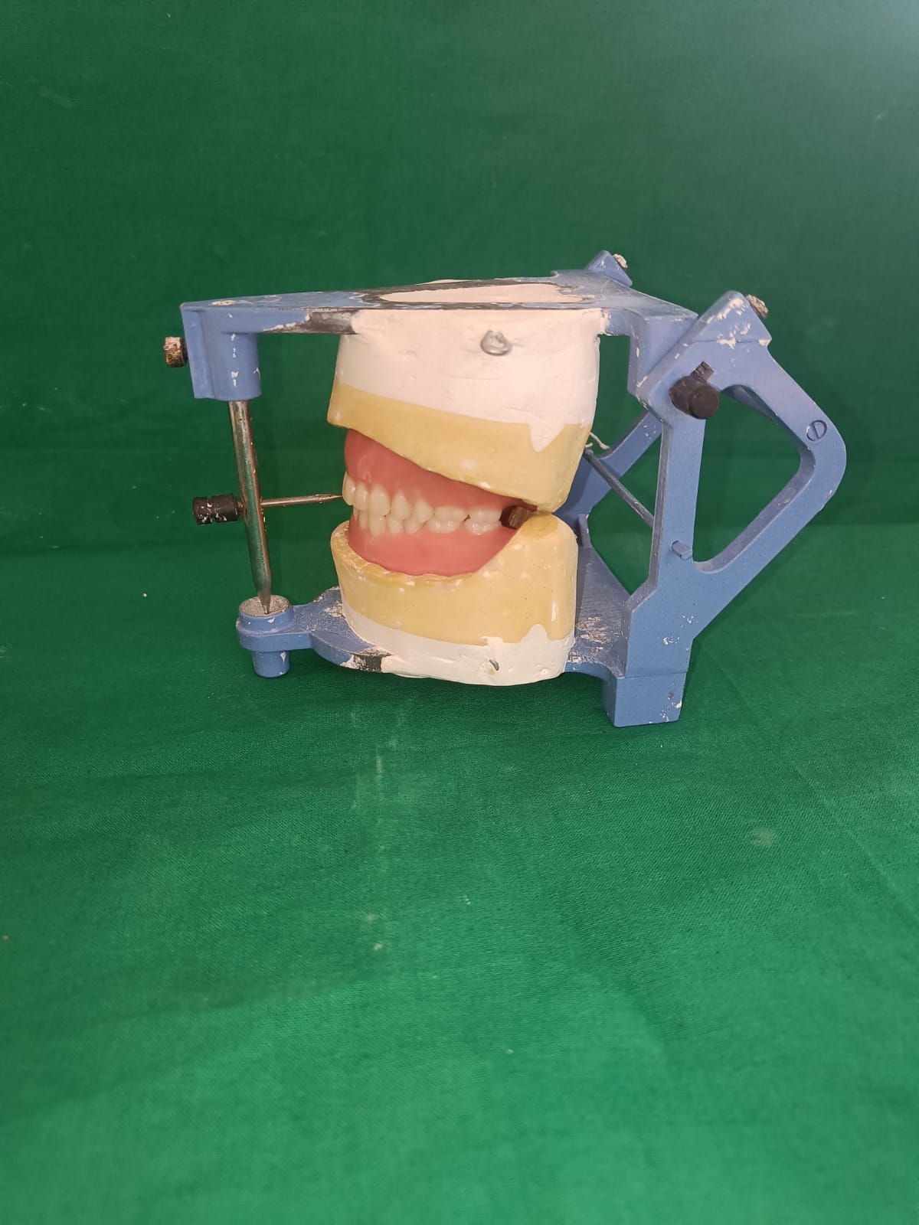
Teeth arrangement:
Setting the teeth in balanced occlusion and in neutral zone promotes stability.

Slide 58
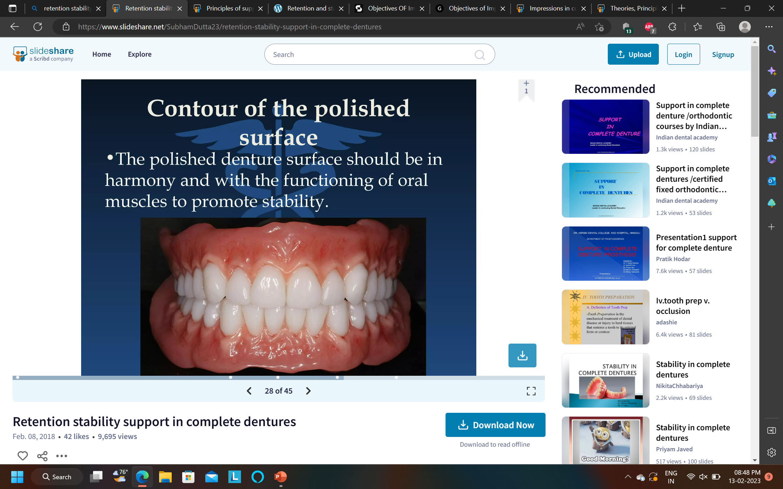
Contour of polished surface:
Polished denture surface should be in harmony with the functioning of oral muscles to promote stability.

Slide 59
Factors Contributing Stability
1. The Intaglio surface.
2. The Cameo surface and surrounding musculature.
3. The Occlusal surfaces.

Slide 60
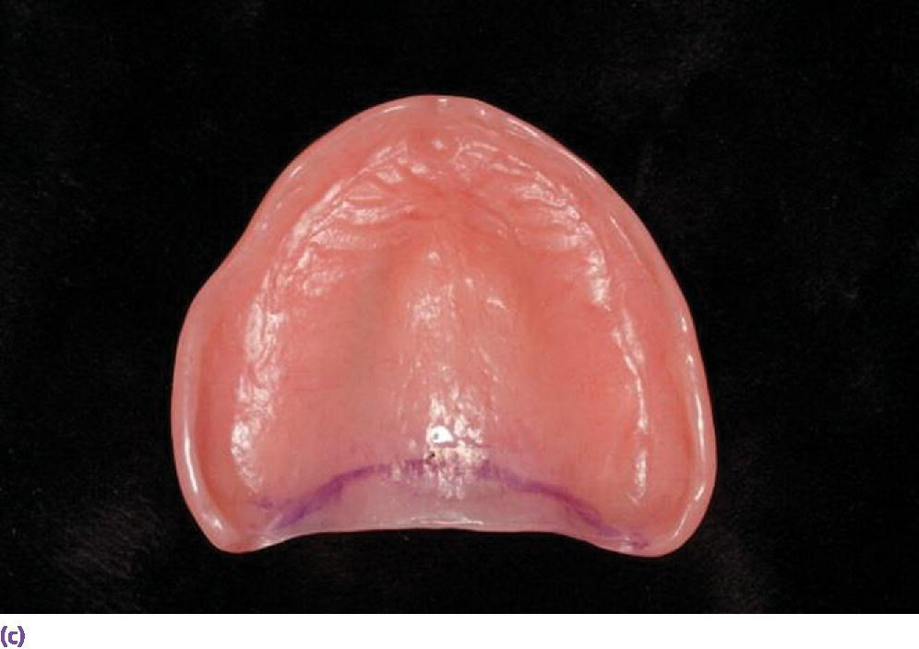
1.The Intaglio Surface:
Denture Base Adaptation:
Contacting of the flanges with the ridge slopes is a critical factor contributing to stability as given by Friedman.
Maximum contact between the tissue and denture borders must be limited by movable tissue.

Slide 61
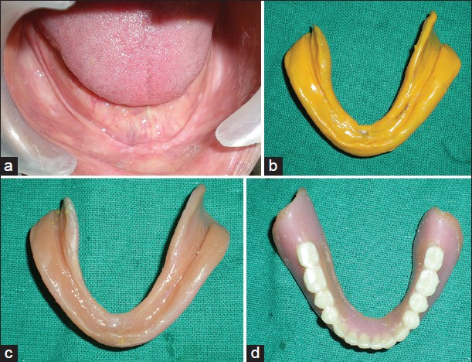
Importance of mandibular lingual flange:
Most desirable feature of mandibular lingual flange is that it is perpendicular to the occlusal plane and it bears the horizontal forces well.
The extension of the lingual flange is dictated by the attachment of the mylohyoid muscle to the internal oblique ridge,

Slide 62
Anatomical considerations:
Factors | Good stability | Poor stability
Height | More height | Less height
Conformation | Large, square, broad | Small, narrow, tapered
Arch form | Square and tapered | ovoid
Shape of palatal vault | Steep | Shallow

Slide 63
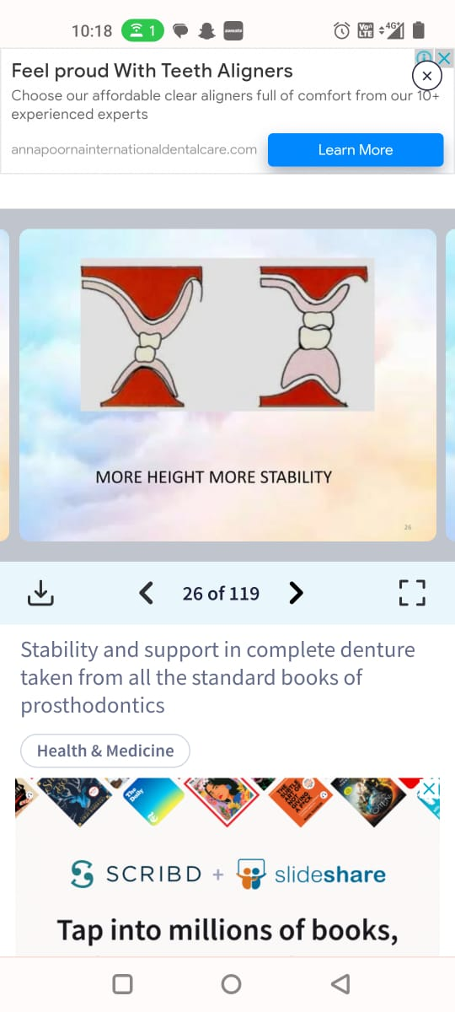
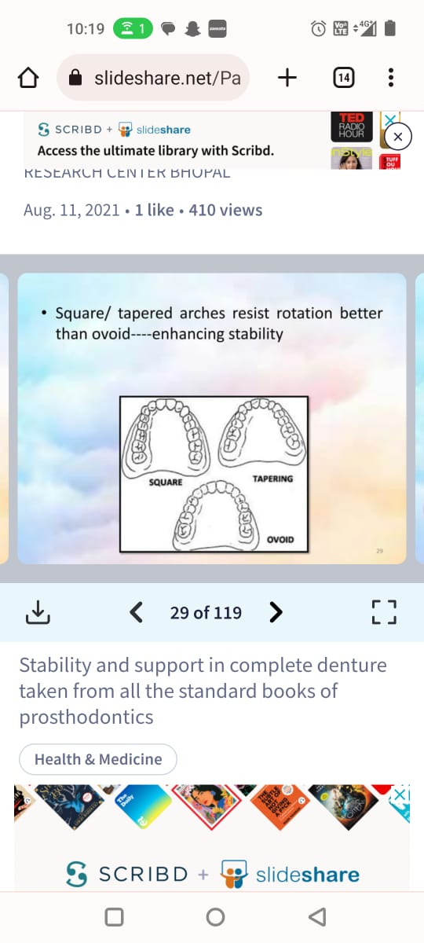
Notes:
More height more stability, large square broad ridges offer resistance to lateral forces, steep vault enchances stability by providing greater surface contact area , square tapered resist rotation better than ovoid.

Slide 64
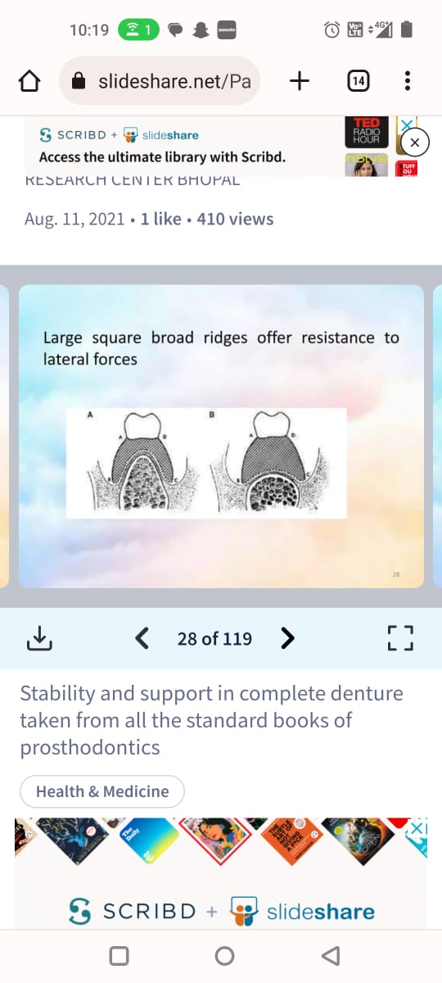
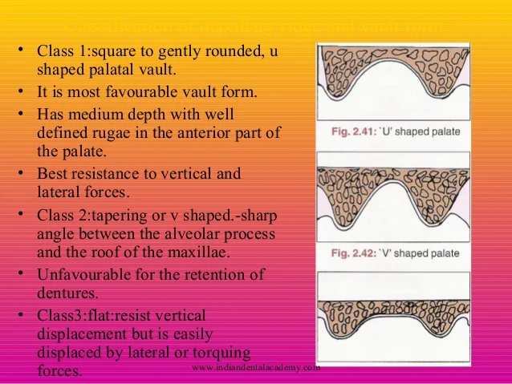

Slide 65
Cameo surface:
Determined by orofacial musculature.
Denture bases must be properly extended to cover the maximum area possible.
The occlusal plane must be at the correct level.
The arch form of the teeth must be in the Neutral zone.

Slide 66
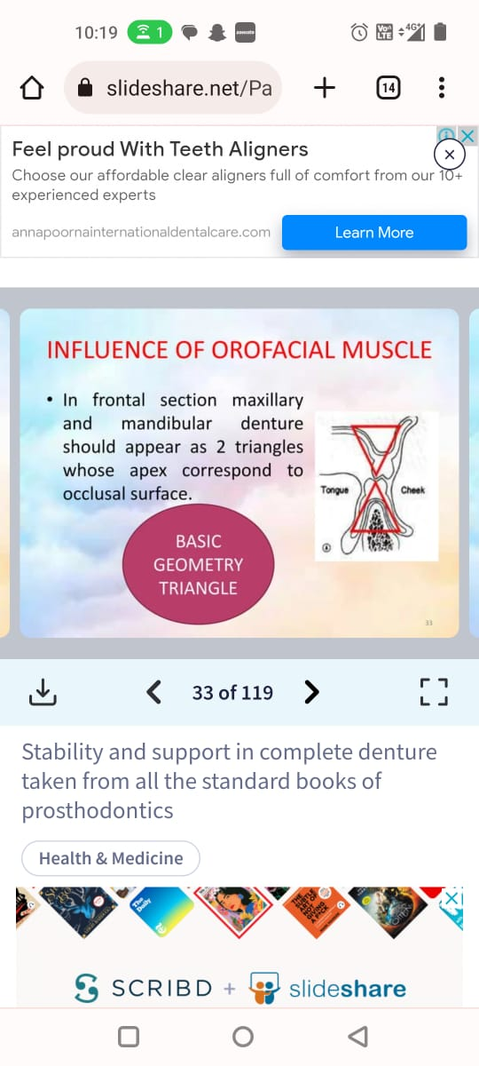
Influence of orofacial muscle:
-In frontal section maxillary and mandibular denture should appear as 2 triangles whose apex correspond to occlusal surface.

Slide 67
Occlusal surfaces:
Opposing occlusal surfaces also contributes stability.
Occlusion must be free of interferences which may produce unwanted forces resulting in lateral and torquing forces that adversely affect the stability

Slide 68
Tooth position and occlusal plane
Teeth should be arranged as close as possible to the position once occupied by natural teeth.
occlusal plane too high
force the tongue into new position i.e higher position
loss of tongue accuracy

Slide 69
causes raise of floor of mouth
undue pressure on the border of the lingual flange
partial loss of border seal

Slide 70
occlusal plane is too low
destabilizes the denture

Slide 71
SUPPORT
The resistance to vertical forces of mastication and to occlusal or other forces applied in a direction toward the basal seat.
Enhanced by selective placement of pressures that are in harmony with the resiliency of the tissues that make up the basal seat.

Slide 72
Denture base should cover as much denture bearing area as possible
Distribution of forces over a larger area.
Snow-shoe effect.

Slide 73
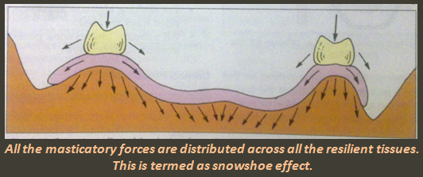
Snow shoe principle:
The basic snow shoe principle of maximal extension is applied for support.
It states that, at a given constant occlusal force, a broader denture-bearing area decreases the stress/unit area under the denture base.

Slide 74
Factors responsible for support:
Size and consistency of tissues.
Patients general health and resistance.
Force developed by supporting muscles.
Severity and location of past periodontal diseases.
Length of edentulousness.

Slide 75
Mechanism of complete denture support:
Basic problem – edentulous – artificial replacements are attached to the supporting bone.
Masticatory loads:
Natural teeth – 44 lb(20kg)
complete denture – 13-16 lb(6-8kg)
Mucosa support

Slide 76
Mean denture bearing area
maxilla- 22.96 cm²
mandible- 12.15cm²
Periodontal ligament area – 45 cm²
Anatomy of supporting structure:
The foundation for dentures is made up of bone of the hard palate and residual ridge covered by mucous membrane.

Slide 77
Based on clinical and histologic impressions the denture bearing tissues categorize into:
- Primary stress bearing area.
- Secondary stress bearing area.
- Valve producing areas.
- Relief areas.

Slide 78
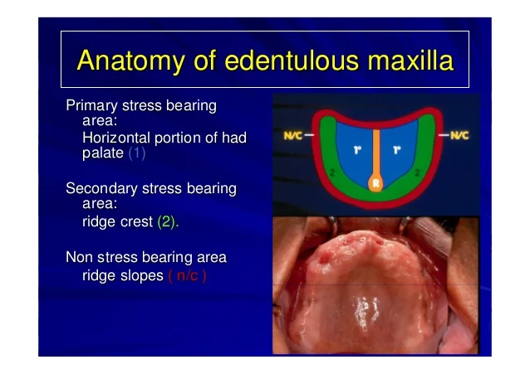
Primary support area:- area of edentulous ridge that are at right angle to occlusal forces & usually do not resorb easily.
Maxillary :-
a) posterior ridge
b) flat areas of the palate
c) Crest of residual alveolar ridge

Slide 79
Mandibular :-
a) Buccal shelf area
b) Posterior ridge
c) Pear shaped pad

Slide 80
Secondary supporting area:-
Area of edentulous ridge that are greater than at right angle to occlusal forces.
Also, the area of edentulous ridge that are at right angle to occlusal forces but tend to resorb under load.
Maxillary :- anterior ridge, rugae, ridge slopes, tuberosity.
  Mandibular :- anterior ridge & ridge slopes.

Slide 81
Valve producing area:
The mucosa of labial , buccal vestibule between residual alveolar ridge and the lips and cheeks is called valve producing area.
The tissues of the oral vestibule and soft palate are ideally suited to provide a valve seal.
The adaptation of posterior palatine border of maxillary denture does not differ from other peripheral contacts.

Slide 82
Relief areas:
Relief regions fall into three categories.
Tissues that are susceptible to resorption should not be subjected to functional pressure - some maxillary and most mandibular ridge crests.
Those regions that have a thin mucosa directly over hard cortical bone-palatal midline raphe, tori and exostoses, and the lingual surface of the mandible, especially the mylohyoid ridge.
Regions of mucosa overlying neurovascular bundles- incisive papilla , mental foramen

Slide 83
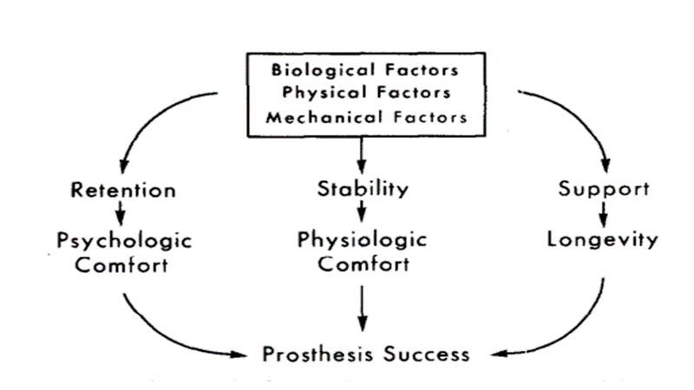

Slide 84
Aesthetics:
Prime concern of patients.
Impression should perfectly reproduce the width and height of the entire sulcus for the proper fabrication of the flanges.
The role of aesthetics in impression making refers to the development of the labial and buccal borders so that they are not only retentive but also support the lips and cheeks properly.
Thicker denture flanges are preferred in long- term edentulous patients - labial fullness.

Slide 85
THEORIES OF IMPRESSION MAKING
HISTORY
1845-1900
Basic principles of complete denture impression making were introduced in the middle of nineteenth century which were
a. Concepts of atmospheric pressure.
b. Maximum extension of denture bearing area.
c. Equal distribution of pressure.
d. Adaptation of denture bearing tissues

Slide 86
1900-1929
Closed mouth impression technique was introduced .
Proper denture extension through various methods of border molding to capture/record the anatomy of tissues contiguous to denture borders was introduced

Slide 87
1930-1950
New impression materials were introduced like,
a. Reversible hydrocolloid
b. Zinc oxide–Eugenol
c. Zinc oxide–oil of cloves.
Modeling compound and plaster remained the two major impression materials for primary and final impression procedures

Slide 88
1946
Minimal pressure technique based on mucostatic principle
In a Brochure published by Hary L. Page in 1946 he stated that all soft tissues were chiefly fluid and 80% or more of the tissues are composed of water..

Slide 89
1948-1964
More attention was given to esthetics in the impression techniques used greater emphasis was on flanges, border molding, posterior palatal seal and denture extension.

Slide 90
1950
Selective pressure technique based on selective pressure theory
Advocated by Boucher in 1950 it combines the principles of both pressure and minimal pressure techniques
In 1952, alginate impression technique was described, a non pressure type of impression. Dentures made from this type of impression were compared with dentures made from impressions of impression compound.

Slide 91
1966
Impression by use of sub atmospheric pressure (also called as vacustatic technique) It obtains an accurate vertical and lateral record of the tissues through the application of controlled pressure.
The difference between sub atmospheric pressure within the tray and sub atmospheric pressure outside the tray, seats the tray centrally over the basal seat which retains it in a static position

Slide 92
In 1971, a modified impression technique for hyperplastic alveolar ridges was described where surgical preparation was contraindicated. This was done in two steps where two cold cure acrylic trays were prepared on relieved primary casts.
In 1972, applied plaster impression technique for maxillary complete denture was described. It is applicable in cases of combination syndrome wherein the soft tissue of anterior part of the maxillary ridge is soft and movable and should be recorded in undistorted state.

Slide 93
In 1979, dynamic impression technique was described which is based on the assumption that every patient has a steady and characteristic oral functional pattern.
The anatomic functional reproduction of the ridge and the tissues requires the knowledge of the space to be occupied by the denture i.e. neutral zone.

Slide 94
In 2004, a study was conducted to compare the swallowing and phonetic techniques for assessing the location and shape of the neutral zone.
Study showed that the phonetic neutral zone appeared to be narrower posteriorly compared to the swallowing zone, thus limiting premolar and molar positioning .

Slide 95
CLASSIFICATION OF IMPRESSION TECHNIQUES
Based on the theories of impression making
      Definite pressure technique
      Minimum pressure technique
      Selective pressure technique
Based on the mouth positioning
      Open mouth technique
      Closed mouth technique

Slide 96
Definite pressure technique
Introduced by Greene brothers.
It is based on the theory of muco compression, assume that tissue recorded under functional pressure provide better support and retention for the denture.
Advocates of this theory believe that occlusal loading during impression making is comparable to the occlusal loading during function.

Slide 97
TECHNIQUE
Primary impression taken with impression compound
Custom tray made 1/8th shorter to periphery
With this tray another impression with compound was taken
Well fitting rinse with uniform occlusal surface were made and the height of the bite adjusted against a similar bite rim on the mandibular ridge.

Slide 98
Areas to be relieved like median raphe was softened on the impression and was again inserted in the mouth and was held under biting pressure for one / two minutes.
The peripheral margins of the impression was then softened and border molding was done by asking the patient to give various cheek and lip movement as in whistling and smiling.

Slide 99
The posterior palatal seal was obtained by swallowing movements by the patient under biting pressure.
The claims made by the advocates of this technique was that since border molding was done in their functional positions, the final dentures would retain well and cannot be dislodged during functional movements of the jaw.

Slide 100
Variations in this technique
Some used the preliminary impression itself as the tray and impression to be improved by border molding.
Some preferred to make custom trays in a more stable and stronger material than compound for better results.
Relief in hard areas was obtained by making escape holes in areas overlying the hard tissues and close adaptation provided in those areas covering the soft tissues.

Slide 101
Some use low fusing compound by softening and adapting it to the soft tissues.
Some advocate unnatural movement of the mouth along with massaging of the cheeks and lips from outside during border molding.

Slide 102
The amount of pressure applied to the tissues in the muco compressive technique was not only great but was applied to the Centre of the palate and the peripheral tissues which were not well suited to receive the maximum biting load this interferes with normal blood supply of the tissues resulting in their breakdown.
As soon as this change took place both the peripheral seal and excellent retention were lost. Hence the retention achieved by these means was transient and harmful to the health of tissues.

Slide 103
As soon as this change took place both the peripheral seal and excellent retention were lost. Hence the retention achieved by these means was transient and harmful to the health of tissues

Slide 104
Dentures made by this technique would fit well during mastication i.e. only a short period each day, but would not be closely adapted to the tissue when the patient was at rest. This is because of the rebounding of tissues.
These disadvantages indicated a need for spacer in the custom tray fabrication.

Slide 105
Advantages
Better retention and support during functional movements
Provide more tissue coverage

Slide 106
Disadvantages
Increased bone resorption
Transient ischemia
Loss of retention during rest due to tissue rebound
Pain and soreness
Denture is in function for a while through the day

Slide 107
Minimum pressure technique
Mucostatic principle was advocated by Dr. Carrol W. Jones.
Addison (1944) described the mucostatic impressions and technique is attributed to Henry Page. (1946)
According to this principle interfacial surface tension was the only significant way of retaining complete denture.

Slide 108
It is based on Pascal’s law,where the tissues are predominantly water, and liquid exert pressure in all direction equally. Only great pressure will compress the tissue and any force exerted on mucosa will be widely distributed.

Slide 109
TECHNIQUE
A compound impression was made in a suitable tray and a cast was made.
On this base plate wax was adapted which acted as a spacer according to denture outline.
Custom tray was fabricated over this spacer

Slide 110
A soft ribbon of carding wax was applied at the posterior margin of the maxillary tray and it was placed in the mouth under light pressure and patient was asked to do swallowing movements in order to obtain a posterior palatal seal.
A small amount of impression plaster mixed into a smooth consistency was placed in the tray, introduced in the mouth and was slowly raised to position and held with as little pressure as possible.

Slide 111
No border molding was advocated but the soft plaster was expected to mold itself to the relaxed vestibular tissues.
The impression was held till the impression hardened and was then removed.

Slide 112
VARIATION IN TECHNIQUES
Some techniques use compound instead of wax for obtaining post dam.
Some techniques advocate post dam over the final impression.
Zinc oxide eugenol and alginate had also been used for similar results.
Page’s application of Pascal’s law to the field of denture impressions is only partly correct because the tissues involved are not wholly incompressible and fluids may escape through the borders of the denture.

Slide 113
Page’s claim that retention is a function of surface tension alone is also objectionable because this tensile force itself is dependent upon adhesion and cohesion.
The elimination of use of separating media results in distortion of the cast.
The use of chrome cobalt as denture bases results in failure of accurate detail reproduction.

Slide 114
The mucostatic principle ignores the value of dissipating masticatory forces over as largest possible basal seat area. Further the mucostatic denture minimized the retentive role of the musculature as described by Fish in 1948.
The merit of this technique was its high regard for health and preservation of tissue.

Slide 115
Advantages :
    High regards for the tissue health and preservation
    Good stability due to close adaptation of denture bases
    Well suited for cases like sharp,thin,flat, and flabby ridges

Slide 116
Disadvantages:
    Less tissue coverage
    Reduced retention
    Lack of border-moulding reduces effective border seal
    Lack of border seal permits food lodgment
    Compromised aesthetics due to short denture flanges
    Patient with poor ridges or with deficient attached gingiva were difficult to treat.
    Recommend use of metal bases for close adaptation
    Tissue variations at the time of impression making and insertion may affect the results.

Slide 117
Selective pressure technique
Advocated by Boucher.
-The philosophy of the selective pressure technique is that certain areas of maxilla and mandible are by nature better adapted for with standing extra loads from forces of mastication. These tissues can be recorded under slight placement of pressure while other tissues must be recorded at rest or relieved with minimum pressure in a position that will record maximum coverage with the least possible interferences to health of surrounding tissues.

Slide 118
Boucher divided the basal seat areas in to different zones according to their capacity to withstand masticatory loads.
        Primary stress-bearing areas
        Secondary stress-bearing areas
        Non-stress-bearing areas
He also advocated maximum extension with in the comfort and functional limits of the surrounding muscles and tissues.

Slide 119
TECHNIQUE
A well-fitting tray with a uniform clearance of about 5mm was selected and a compound impression was obtained with little border molding done on the peripheries.
This compound impression was separated from the metal tray and its peripheral borders were trimmed 1 – 2 mm short.
The base portion of the impression was then scrapped evenly to a depth of about 2mm except in the posterior seal area where no scraping was done.

Slide 120
Variations in the technique
Most of the techniques prefer taking a preliminary impression and using a custom tray rather than use the initial compound impression for further improvement.
The preliminary impressions are usually taken in compound but materials like alginate, elastomeric impression materials are also used.

Slide 121
The amount of material, consistency of material, use of space or escape vents and the manual pressure with which the impression is made are all possible variable which have been used to advantage by different techniques
The mucoseal technique was stated by Pryor in 1948 which was introduced as a variation to the mucostatic technique.
The anterior lingual border is molded by the floor of the mouth with the tongue in repose.

Slide 122
The tray is extended horizontally backward, over the sublingual glands towards the tongue to affect a border seal.
Thus, this technique utilizes the benefit of minimal pressure and also provides maximum extension of denture borders and maximum coverage of denture bearing area.

Slide 123
Advantages :
    Technique provides maximum coverage with the least possible interferences with health of surrounding tissues.
    Technique considers the physiologic functions of the tissues of the basal seat therefore appears more sound and appealing.

Slide 124
Disadvantages:
    Some consider that it is impossible to record areas with varying degree of pressure.
    Since some areas are still recorded under functional load, the denture still faces the potential danger of rebounding and loosing retention.

Slide 125
Sub-atmospheric pressure technique based on the concept of mucostatics
    Milo V. Kubalik and Bert C. Buffington developed this technique the objective of which was to reduce the stress on any given tissue by increasing load bearing area. the form of the tissue is recorded vertically and laterally, when a controlled partial vacuum is established in impression tray specially built for the patient. It is maintained in the mouth without direct mechanical support of any kind.

Slide 126
The difference between the sub atmospheric pressure within the tray and the atmospheric pressure outside the tray is all that is needed to Centre the tray over the ridges in a static position.
A vacuum is developed between the soft tissues and the tray. A recording material in a fluid state flows from the border region into the evacuated space and develops the basal tissues. Border seal is determined by the readings remaining constant.

Slide 127
Open mouth technique
This technique is preferred over closed-mouth technique
      Visualization of the muscle trimming
      Various movements can be accomplished easily.
      Denture retention can be predicted in open as well as in closed mouth movements.
      Pressure or pressure-less technique can be employed by using this technique

Slide 128
Closed mouth technique
Supporting tissues are recorded in functional relationship.
Advantages :
      Interferences of tray handles and operator’s finger is eliminated

Slide 129
Disadvantages:
Rebound of the tissues during rest leads to denture displacement.
Tendency for over-extension or under-extension
Contraindicated in the presence of considerable amount of movable tissues.
A constant pressure is exerted over tissues, hence blood supply is compromised leading to ridge resorption

Slide 130
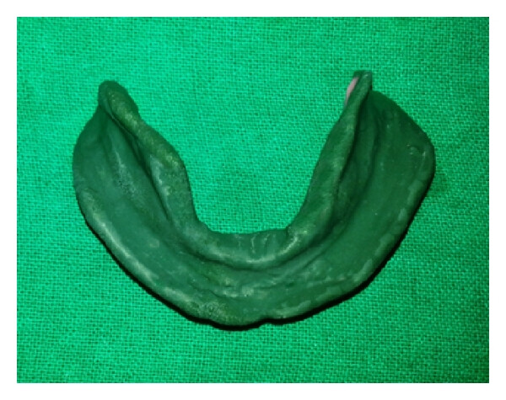
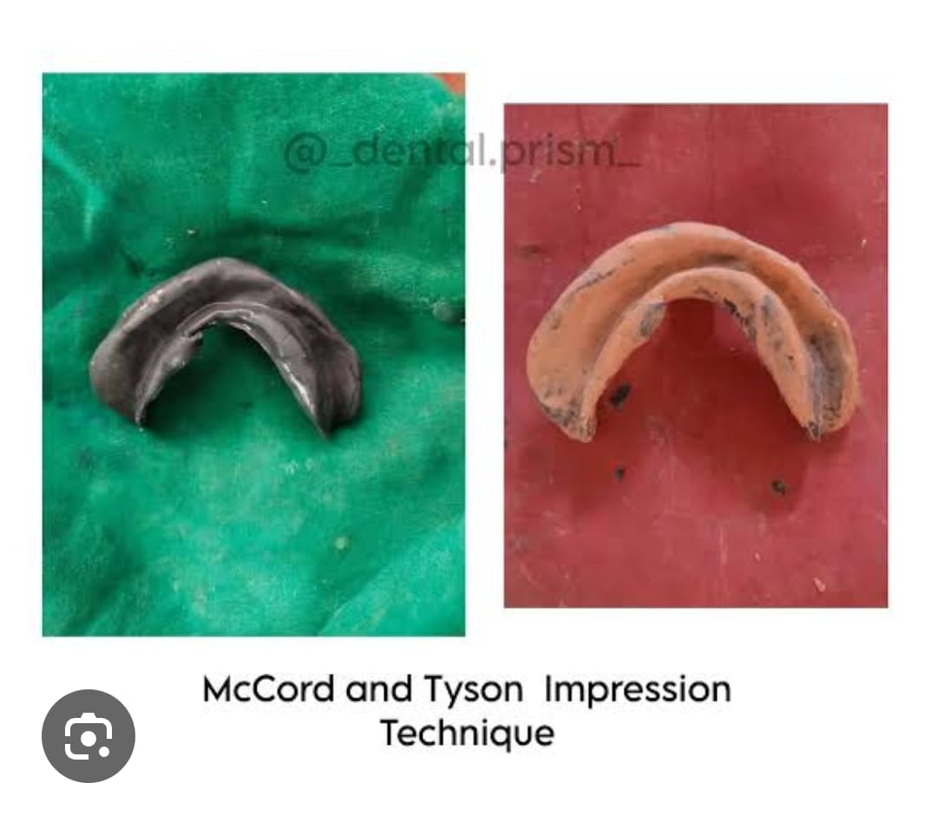
Special impression techniques
COMPLETE DENTURE IMPRESSION TECHNIQUES FOR RESORBED RIDGES
All green technique

Slide 131
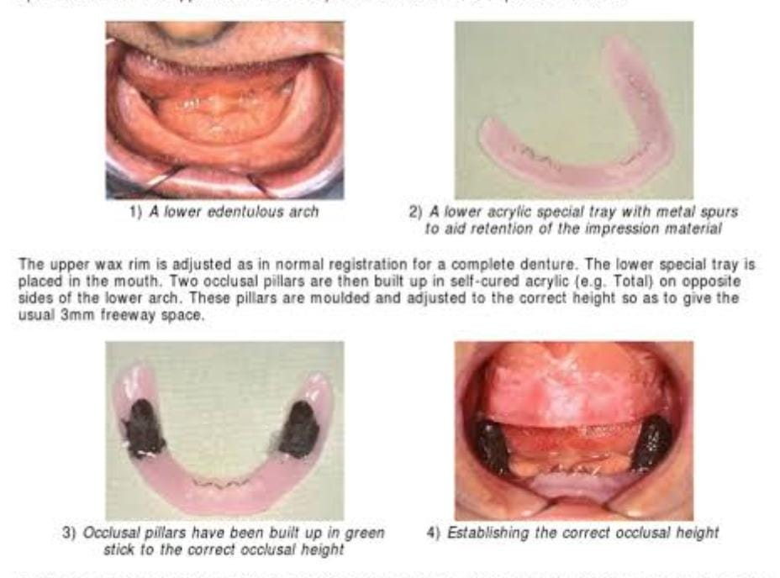
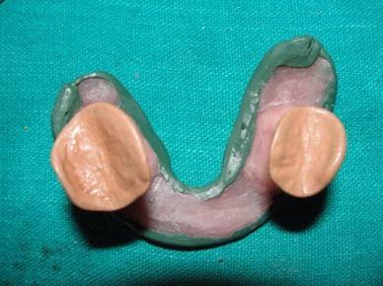
Cocktail technique
The neutral zone technique

Slide 132
Elastomeric technique
Modified fluid wax impression technique
Flange Technique
Dynamic impression technique
Kleins technique

Slide 133
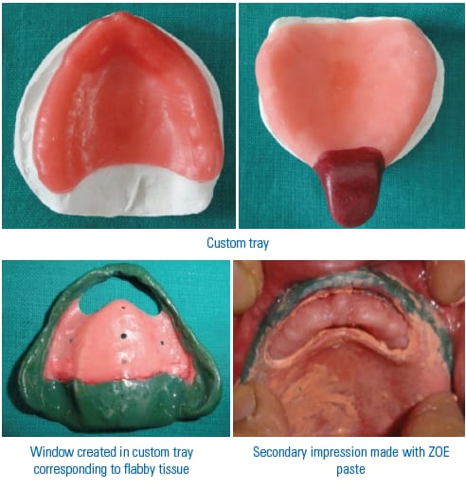
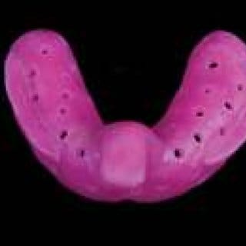
COMPLETE DENTURE IMPRESSION TECHNIQUES FOR FLABBY RIDGES

Slide 134



Palatal splinting using a two-part tray system
Hobkirk technique
Custom double tray technique

Slide 135
CONCLUSION
Although there are many techniques with varied logic, the success of the prosthodontics treatment depends on the clinical diagnostic alumen, understanding of the theories of impression making and its application by the operator.

Slide 136
REFERENCES:
Essentials of COMPLETE DENTURE PROSTHODONTICS by Sheldon Winkler , 3rd edition
Syllabus of complete dentures – Arthur O Rahn, Charles M Heartwell., 4th edition
Impressions for complete denture , Bernard and levin.
Bouchers prosthodontic treatment for edentulous patients-11th edition.
Prosthodontic treatment for edentulous patients, Zarb, Bolender, 12th edition

Slide 137
T.E. JACOBSON and J.KROLL a contemporary review of factors that involved in complete denture retention, stability, support – retention
T.E. JACOBSON and J.KROLL a contemporary review of factors that involved in complete denture- stability.
T.E. JACOBSON and J.KROLL a contemporary review of factors that involved in complete denture- support.
Basic principles in impression making M. M. Devan, DDS
Stability in Complete Dentures: An Overview ; Rohit Mistry1, Sweta Kale Pisulkar2,Anjali Bhoyar Borle3 Surekha Godbole3, Ruchika Mandhane

