Slide 1
NORMAL CLINICAL FEATURES OF GINGIVA:

Slide 2
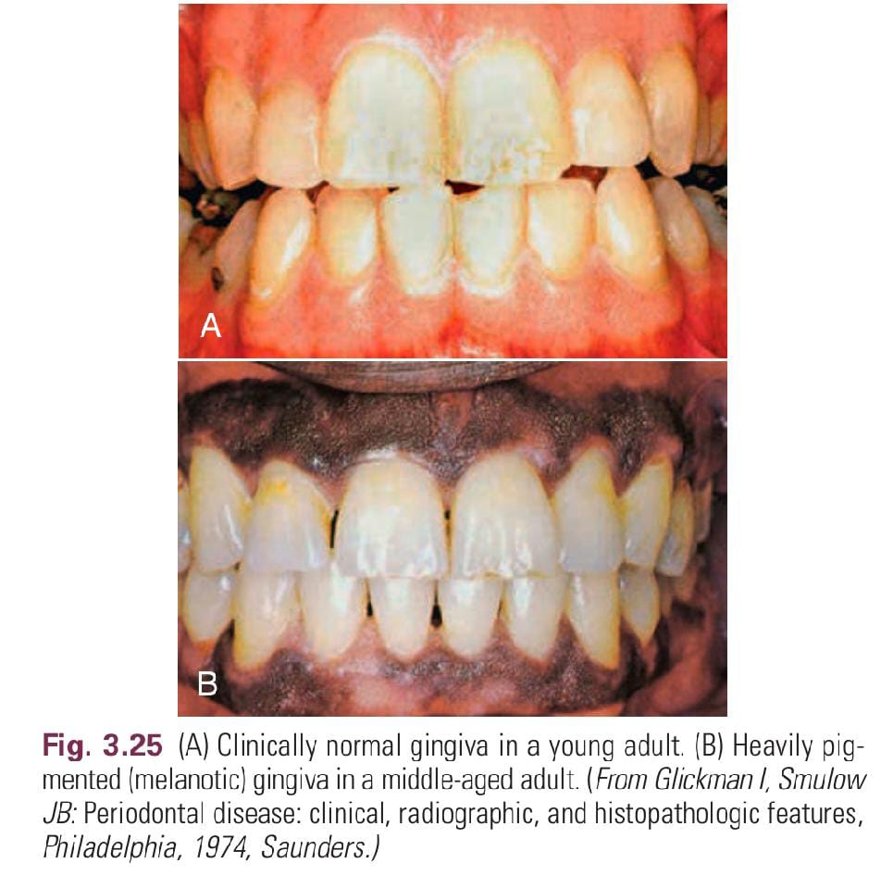
The color of the attached and marginal gingiva is generally described as “coral pink”; Influenced By Degree Of Keratinisation, Vasculature, Thickness, Presence Of Pigment Containg Cells, And Other Factors LikePhysical,chemical,thermal, pharmacologic Or Idiopathic Factors.
COLOR

Slide 3
Physiologic Pigmentation (Melanin)
Melanin is a non–hemoglobin-derived brown pigment
Ascorbic acid directly down-regulates melanin pigmentation in gingival tissues

Slide 4
Sum Total Of Cellular, acellular And Their Vascular Supply.
SIZE:C
CONTOUR
Shape And Alignment Of Teeth,
Dimensions Of Proximal Contact Area And Gingival Embrasures.
The marginal gingiva envelops the teeth in collar-like fashion and follows a scalloped outline on the facial and lingual surfaces.

Slide 5
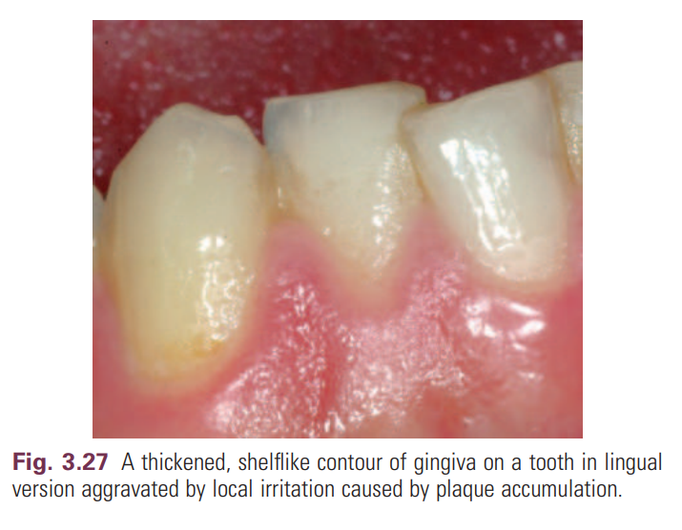
On teeth with pronounced mesiodistal convexity (e.g., maxillary canines) or teeth in labial version, the normal arcuate contour is accentuated, and the gingiva is located farther apically.
On teeth in lingual version, the gingiva is horizontal and thickened

Slide 6
A thin and clear gingiva is found in one-third of the population and primarily in females with slender teeth with a narrow zone of keratinized tissue,
whereas a clear, thick gingiva with a broad zone of keratinized tissue is present in two-thirds of the population and primarily in males.

Slide 7
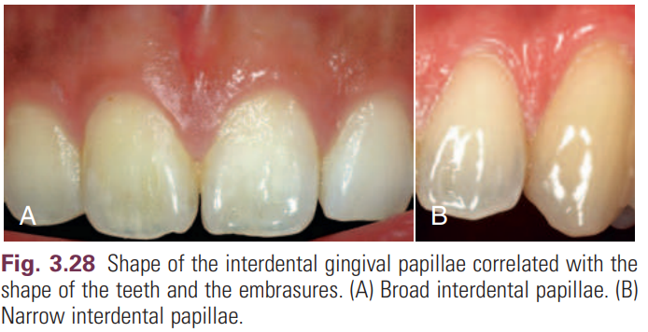
The shape of the interdental gingiva is governed by the contour of the proximal tooth surfaces and the location and shape of the gingival embrasures.
The height of the interdental gingiva varies with the location of the proximal contact
Anterior – Pyramidal , Posterior – Broad And Flat.
Shape:

Slide 8
Consistency:
Firm and resilient.
Firmness of AG is due to collagen of GCT and that of MG is due to gingival fibers.

Slide 9
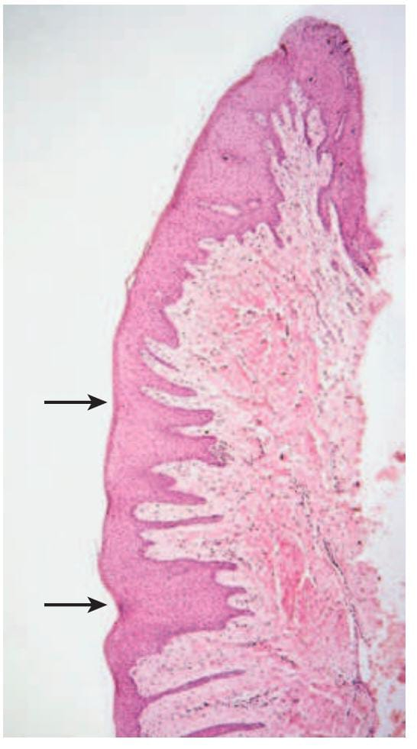
Microscopically, Stippling Is Produced By Alternate Rounded Protuberances And Depressions In The Gingival Surface.
The Papillary Layer Of The Connective Tissue Projects Into The Elevations, And
The Elevated And Depressed Areas Are Covered By Stratified Squamous Epithelium.
Surface texture:

Slide 10
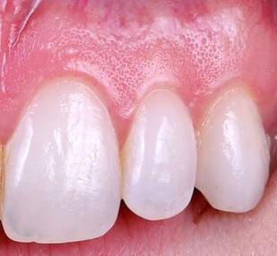
stippling

Slide 11
Level At Which Gingival Margin Is Attached To The Tooth.
During Eruption Stage- At The Tip Of The Crown
As The Eruption Continuous- Gingival Margin Gets Closer To The Root.
Position:

Slide 12
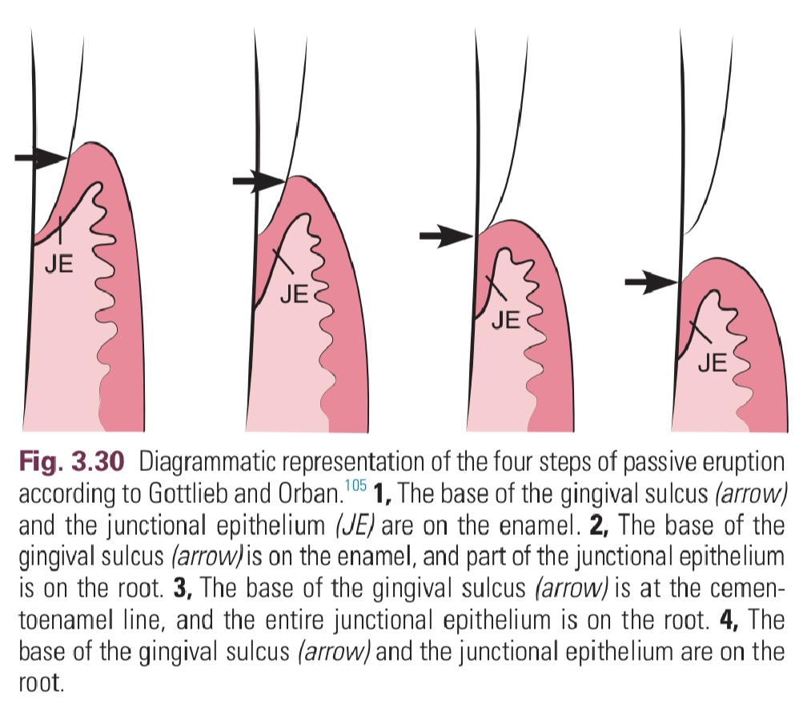
Continuous Tooth Eruption:
Active eruption is the movement of the teeth in the direction of the occlusal plane, whereas passive eruption is
the exposure of the teeth via apical migration of the gingiva.

