Slide 1


Slide 2
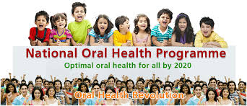
NATIONAL ORAL HEALTH POLICY

Slide 3
INTRODUCTION
According to the World Health Organisation (WHO), Oral health is a state of being free from chronic mouth and facial pain, oral and throat cancer, oral sores, birth defects such as cleft lip and palate, periodontal (gum) disease, tooth decay and tooth loss, and other diseases and disorders that affect the oral cavity.

Slide 4
As per recent data from Dental Council of India, there are about 1.5 lakh registered dentists for a population of about 1.3 billion, out of which 72% live in villages which remain deprived from dental care.
Some states have made progress in providing comprehensive oral health care through its primary care system [through the NHM umbrella]. Dental units are established even in the Primary Health Centre in some states. However, a lot still remains to be achieved in many of the other states.
Govt. of India has envisaged the National Oral Health Program [NOHP] for an affordable, accessible and equitable oral health care delivery in a well coordinated manner.

Slide 5
Burden of Oral diseases in India:
Two large scale Oral Health Surveys have been conducted in the past
(i) National Oral Health Survey & Fluoride Mapping by Dental Council of India in 2003 and
(ii) Oral Health in India: Report of multi-centric oral health survey by MoHFW in collaboration with Dental Department AIIMS in 2007.These two surveys indicate the prevalence of some oral diseases and conditions in the country [Table -1 & 2].
Notes:
Oral diseases affect both the young and the old. Some of the common diseases are dental caries, periodontal diseases, malocclusion, sub-mucosal fibrosis, oral cancer etc. Cleft lip and cleft palate also continue to affect the population. Oral lesions are also common with patients with HIV/AIDS and other debilitating systemic conditions.

Slide 6
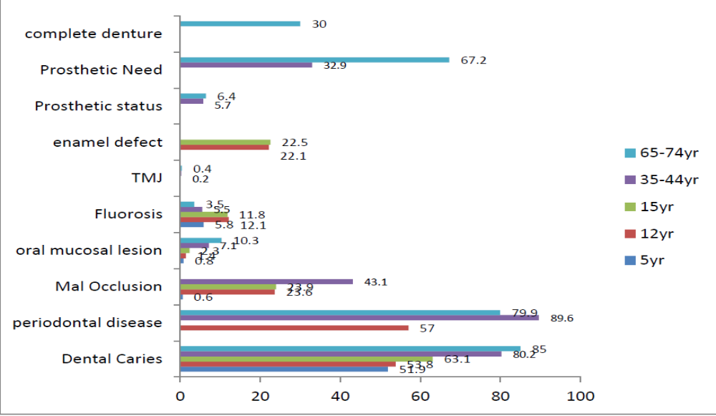
Table 1: Burden of Oral Diseases (National Oral Health Survey & Fluoride Mapping-2003)

Slide 7
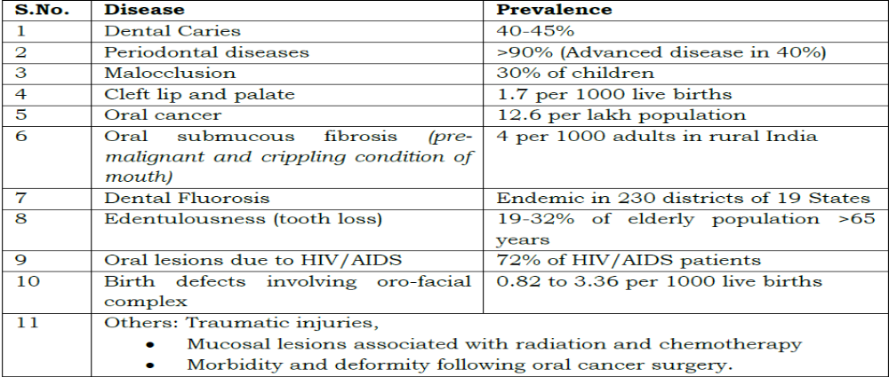
Table 2: Burden of Oral Diseases (Multi-centric survey 2007)

Slide 8
National Oral Health Programme
Health care facilities with the following objectives:
a. To improve the determinants of oral health
b. To reduce morbidity from oral diseases
c. To integrate oral health promotion and preventive services with general health care system
d. To encourage Promotion of Public Private Partnerships (PPP) model for achieving better oral health
Notes:
Taking into account the oral health situation in the country, Government of India has initiated a National Oral Health Programme to provide integrated, comprehensive oral health care in the existing health care facilities
This dental unit equipped with necessary trained manpower, equipments including dental chair and support for consumables would be provided to the states through the NOHP. These units, according to the level of saturation of state’s own dental units, may be established at district hospitals or in the health facilities below the level of district hospitals.

Slide 9
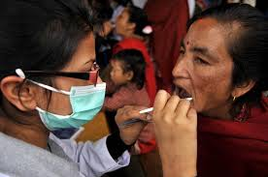
NATIONAL ORAL HEALTH POLICY
National oral health policy has been formulated by the DCI through the input of two national workshops organized way back in 1991 and 1994 at Delhi and Mysore respectively.

Slide 10
NEED FOR ORAL HEALTH POLICY
1.Increasing prevalence and severity of dental diseases.
2.Crippling nature of oral diseases.
3.Prevention of oral diseases; the only alternative
4.Impelling economic reasons for early recognition and prevention of oral diseases.
5.Dentist population ratio.

Slide 11
1.INCREASING PREVALENCE & SEVERITY OF DENTAL DISEASES
In the four decades a number of point prevalence studies on dental caries , periodontal disease, oral cancer & malocclusion have been conducted in India.
In 1940-50’s,the prevalence was 40-50% with an average DMFT of 1.5.
In 1980-90’s,the prevalence of dental caries was increased to 80% at the age of 16 years in children with the average being 5 in urban areas & 4 in rural areas.
Periodontal disease prevalence was seen to be increased in the range of 90-100% in the various age groups.

Slide 12
2.CRIPPLING NATURE OF ORAL DISEASES
85% of children & 95-100% of adult population is suffering from periodontal disease.
The pus oozing pockets of periodontal disease of adults acts as a focus of infection for other vital organs : kidney, heart, lungs, brain.
35% of all body cancers are oral cancers.

Slide 13
3.PREVENTION OF ORAL DISEASES
In India with limited resources and manpower once such a situation develops, there would be no going back.
There is no national oral health policy and the country is without any plan to provide even the minimum coverage to the rural masses.
There is an urgent need to prevent the rising of dental diseases in India.
Ministry of health and family welfare , Government of India accepted the principle National oral health policy in the year 1995 to be included in National health policy.
Oral health has been recognized as an integral part of general health.

Slide 14
4.IMPELLING ECONOMIC REASONS FOR EARLY RECOGNITION AND PREVENTION OF ORAL DISEASES.
The early recognition of these diseases is in order to be able to prevent not only the diseases but also the pain.
India is a developing country & spends approximately 1-1.5% of the total national budget on health.
There is no separate allocation for oral health, so we can’t afford to spend on the highly expensive dental restorative treatment.

Slide 15
5.Dentist population ratio
Out of these 90% are clustered in cities while 10% are in rural areas with a population of over 75%.
The dentist population ratio is 1:2.5 lakh for rural & 1:10,000 for urban population. In 2004.
In order to bring down the disease prevalence & severity, it is important to implement organized oral health preventive programmes at community level.

Slide 16
CURRENT SCENARIO
At present ,no oral health cover is being given to rural population.
It is therefore intended to introduce preventive & promotive oral health services from the village level onwards.
At the village level it is intended to give special training in oral health to anganwadi workers & village health guides
The health guides should be related to preventive infant dental care & promotion of oral health in mother and child.

Slide 17
At the primary health centre.
There is a need for the appointment of one dental surgeon to render curative aspects & also look after referrals.
There is also a need for appointment of one health assistant (dental) who would supervise the oral health component of the male & female health workers at the sub centre & village level.

Slide 18
At the community health centre
there is a need to appoint two dental specialists to deal with the vast range of dental problems.
One dental mechanic with requisite training & adequate dental laboratory facilities.

Slide 19
ORAL HEALTH SERVICES AT THE DISTRICT & STATE LEVEL

Slide 20
DISTRICT LEVEL
∆Four dental specialists with post graduate qualification in different specialties of dentistry.
∆One chief dental officer & one programme officer

Slide 21
STATE LEVEL
Sufficient number of dental colleges as per the requirement of the individual state.
1.At the directorate level, there should be a director of oral health services with an independent charge of Budget.

Slide 22
According to 2020 scenario
The dentist to population ratio in rural areas varies from 1:30,000-
1:1, 00,000
The majority of developed urban areas, the average ratio is 1:4,000.
By incorporating dentists into the primary health care system may be one possible way to balance rural-urban disparities.
https://r.search.yahoo.com/_ylt=Awr1QaiR7s1mawQAgZS7HAx.;_ylu=Y29sbwNzZzMEcG9zAzEEdnRpZAMEc2VjA3Ny/RV=2/RE=1725981586/RO=10/RU=https%3a%2f%2fwww.researchgate.net%2fpublication%2f357420829_Dental_Manpower_in_India_changing_trends_upto_2020_Running_title_Dental_Manpower_in_India_Title_Dental_Manpower_in_India_changing_trends_upto_2020_Aim_To_analyse_the_developing_trends_in_the_productio/RK=2/RS=r1nlTLTub3cGl.6VziYxq.v7vTo-

Slide 23
Ministry of Health and Family Welfare, Govt. of India accepted in principle National Oral Health Policy in the year 1995 to be included in National Health Policy.
In pursuance to National Oral Health Policy 'National Oral Health Care Programme' has been launched as "Pilot Project"
It has covered five States (Delhi, Punjab, Maharashtra, Kerala and North eastern States) for its implementation.
To begin with, one district in each of these States has been chosen to test run the strategies evolved through 2 national and 4 regional workshops organized in the country, to achieve the following goals:

Slide 24
Goals
1. Oral Health for all by the year 2020.
2. To bring down the incidence of oral and dental diseases to less than 40% from the existing prevalence of 90%.
3.To bring down the DMFT in school children between 6-12 years of age to less than 2 which is approximately 4 at present.
4.To reduce high prevalence of periodontal diseases to lower prevalence.
5. At the age of 18 years, 85% should retain all their teeth.
6. To achieve 50% reduction in edentulousness between the age of 35-44 years.
7. To achieve 25% reduction in edentulousness at the age of 65 years and above.

Slide 25
8. To achieve 50% reduction in the present level of malocclusion and dento-facial deformities.
9. To reduce the number of new cases of Oral Cancers and precancerous lesions from the existing levels.

Slide 26
ORAL HEALTH POLICY IMPLEMENTATION IN INDIA
A state level symposium on oral Health Policy Phase-I for Karnataka was organized by the departments of Public Health Dentistry of Dakshina Kannada, Udupi and Coorg districts of Karnataka on 17th February 2014.
A total of 301 delegates attended the symposium. This resulted in formulation of recommendation.

Slide 27
BARRIERS TO ORAL HEALTH POLICY
Policy makers give oral health low priority.
Treatment cost high
Lack of experts
Lack of organized oral health education
Rapidly growing population and lack of resources
Early initiation of tobacco.

Slide 28
Health, Medical & Family Welfare Department, Govt of AP, has been serving the people of Andhra Pradesh, through 7507 subcenters, 1147 PHC’s 191 CHC’s 34 Aera Hospitals, 8 District Hospitals and 11 Teaching Hospitals with bed strength of 33,217.

Slide 29


