Slide 1
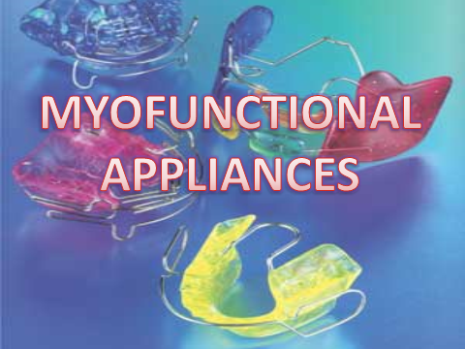

Slide 2
Contents
Definition
Classification
Treatment principles
Action of functional appliances
Case selection
Visual treatment objective
Common appliances in use
Conclusion

Slide 3
Definition
“ Loose fitting or passive appliances which harness natural forces of the oro-facial musculature that are transmitted to the teeth & alveolar bone through the medium of the appliance.”

Slide 4
Classification
Basic classification
(i) Removable -Eg: Activator, Bionator, Frankel
(ii) Fixed - Eg: Herbst, Jasper Jumper
(iii)Semi Fixed -Some components fixed, some
detachable Eg: Den Holtz, Bass Appliance

Slide 5
Classification By Profitt
(i) Tooth borne passive –no intrinsic force generating
components-Eg: Activator, Bionator
(ii) Tooth borne active – modifications of activator,
bionator
(iii)Tissue borne -Eg: Oral screen, lip bumper
Frankel’s appliances

Slide 6
Classification by Tom Graber
Group A -Teeth supported -Eg: catalan’s appliance, inclined planes
Group B -Teeth/Tissue supported- Eg: activator, bionator.
(iii) Group C -Vestibular positioned appliances with isolated support from tooth/tissue- Eg: Frankel’s appliance, lip bumpers, vestibular screen

Slide 7
Classification based on transmission of force
Group I- E.g Oral Screen, Inclined planes
Group II- E.g Activator, bionator
Group III- E.g Frankel, vestibular screen
Classification into myotonic and myodynamic appliances
Myotonic appliances
Myodynamic appliances

Slide 8
Treatment Principles
Depending on the type of force applied, 2 treatment principles can be differentiated:
Force application
Force elimination

Slide 9
Action Of Functional Appliances
Functional appliances can bring about the following changes:
(i) Orthopaedic Changes
(ii) Dento-aveolar changes
(iii) Muscular & Soft Tissue changes

Slide 10
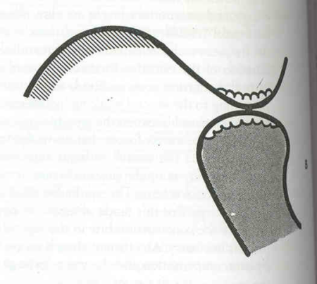
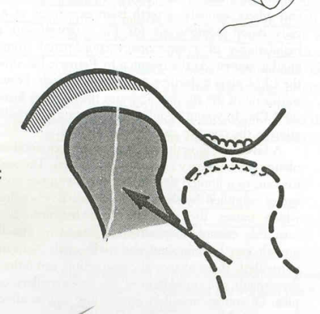
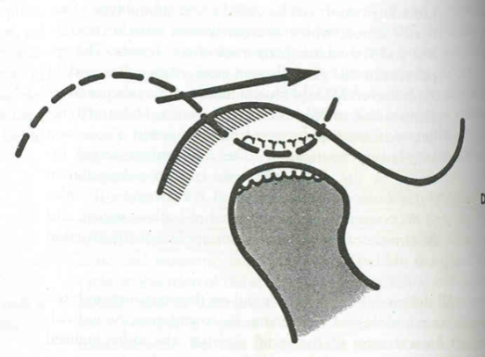
Orthopaedic Changes:
Capable of accelerating the growth in the condylar region.
Can bring about remodeling of the glenoid fossa.
Can be designed to have a restrictive influence on the growth of jaws.
Can change the direction of growth in jaws.

Slide 11
Dento-alveolar Changes:
Can bring about changes in sagittal, transverse & vertical directions.
Bring expansion of dental arches
Allow
  Retroclination of the upper incisors.
  Proclination of the lower incisor.
  Lower labial segment intrusion.

Slide 12
Muscular & Soft Tissues Changes:
Improve the tonicity of the orofacial musculature.
Removal of the lip trap & improved lip competence.
Removal of soft tissue pressures from the cheeks & lips.

Slide 13
Case selection
Age: only in growing patient. Opt. age for FA therapy ➔ b/w 10 years & pubertal growth phase
Social Considerations
Keen patient interest,Potential cooperation
Dental Considerations:
one devoid of gross local irregularities
Good mandibular arch
Flat mandible occlusal plane
No labial tipping
Moderate deep bite
No latero occlusion

Slide 14
Skeletal Considerations:
Moderate to severe Class II malocclusion cases are ideal
Mild Class III malocclusion with a reverse overjet & an average overbite
Positive VTO
Low angle cases

Slide 15
Visual Treatment Objective
An imp. diagnostic test undertaken before making a decision to use a functional appliance.
Enables us to visualize how the patient’s profile would be after FA therapy.
Performed by asking the patient to bring the mandible forward.
An improvement in profile ➔positive indication.
Profile worsens➔negative-other R_{x} modalities considered.
Photographs taken with forward mandibular posture.

Slide 16
Positive with complete mandible protrusion-mandibular deficiency.
Positive with half advancement-maxilo mandibular deficiency.
Negative –maxillary deficiency

Slide 17
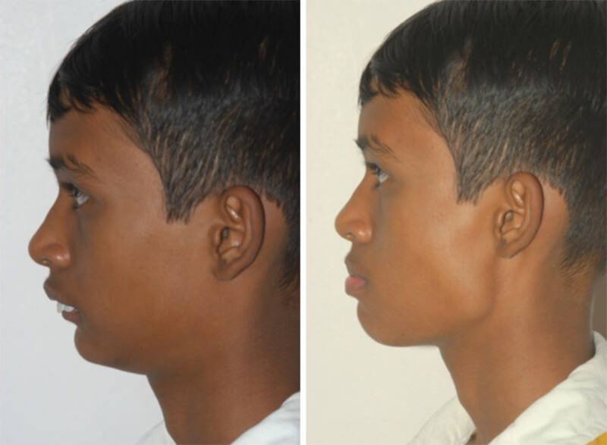

Slide 18
COMMON APPLIANCES IN USE

Slide 19
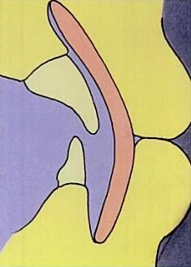
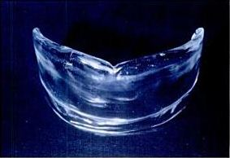
VESTIBULAR SCREEN
Introduced by Newell in 1912.
Takes the form of a curved shield of acrylic placed in the labial vestibule.
Works on the principle of both force application & elimination.

Slide 20
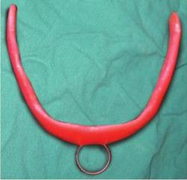
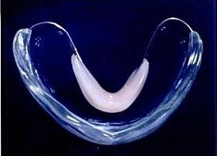
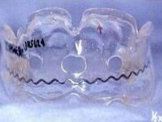
Indications:
-To intercept mouth breathing, thumb sucking, tongue thrusting
lip biting & cheek biting.
-To perform muscle exercises to help in correction of hypotonic
lip & cheek muscles.
-Mild anterior proclination.
Modifications:
DOUBLE ORAL SCREEN
(With additional tongue shield)
KRAUS MODIFICATION
HOTz MODIFICATION

Slide 21
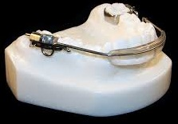
LIP BUMPER
“Combined removal-fixed appliance”
Used in both maxilla & mandible to shield the lips away from the teeth.
Maxillary appliance➔ Denholtz appliance.
Uses:
-in lip sucking patients.
-hyperactive mentalis activity.
-to augment anchorage
-distalization of first molars

Slide 22
ACTIVATOR
Introduced By Andresen In 1908
SYNONYMS:
Biomechanical working retainer
Andersen appliance
Nocturnal airway patency appliance.
Norwegian appliance.
Monobloc

Slide 23
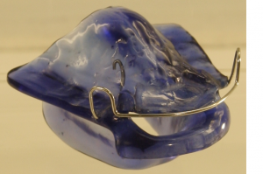
Indications:
In actively growing individuals with favorable growth patterns.
  -class II div I
  -class II div II
  -class III
  -class I open bite
  -class I deep bite
As a preliminary T/t before major fixed appliance therapy to improve skeletal jaw relations.
For post treatment retention
Children with lack of vertical development in lower facial
height.

Slide 24
Contraindications:
-Correction of class I cases with crowded teeth caused by
disharmony b/w tooth size & jaw size.
-Children with excess lower facial height.
-Children whose lower incisors are severely procumbent.
-Children with nasal stenosis
-Non-growing individuals.

Slide 25
Advantages:
-Uses existing growth of the jaws
-Minimal oral hygiene problems
-Intervals b/w appointments is long
-Appointments are short, minimal adjustments required
-Hence, more economical

Slide 26
Disadvantages:
-Requires very good patient cooperation
-Cannot produce a precise detailing & finishing of occlusion.
-May produce moderate mandibular rotation(hence contraindicated in excess lower facial height cases)

Slide 27
Mode Of Action: Acc. To Andresen & Haupl
Activator induces musculoskeletal adaptation by introducing a new pattern of mandibular closure.
The pt has to move the mandible forwards to engage the
appliance.
stretching of elevator muscles of mastication
contraction
myotactic reflex set up
Generates kinetic energy

Slide 28
kinetic energy causes:
-prevention of growth of max. dento-
alveolar process
-movement of max. dento alveolar
process distally
-reciprocal forward growth of mandible.
In addition, a condylar adaptation by backward & upward growth occurs.

Slide 29
GENERAL RULES FOR CONSTRUCTION BITE:
In a forward position of 7 – 8 mm the opening must be
slight
If forward position is not more than 3 – 5 mm the vertical
opening should be 4 – 6 mm.
If there is midline shift due to translation of mandible then
it can be corrected

Slide 30
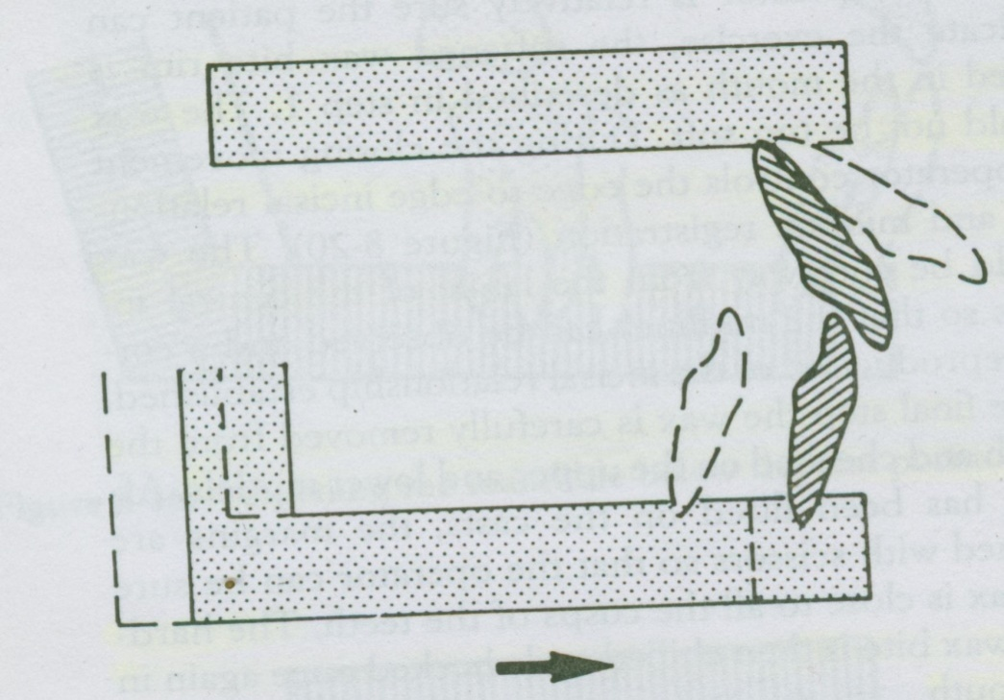
Technique for a Low Construction Bite with Markedly Forward Mandibular Positioning

Slide 31
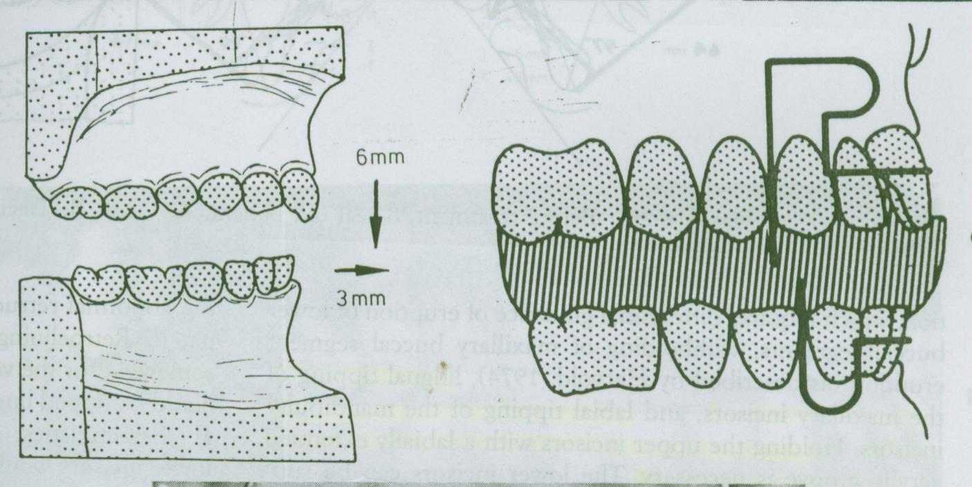
Technique for a High Construction Bite with Slightly Anterior Mandibular Positioning

Slide 32
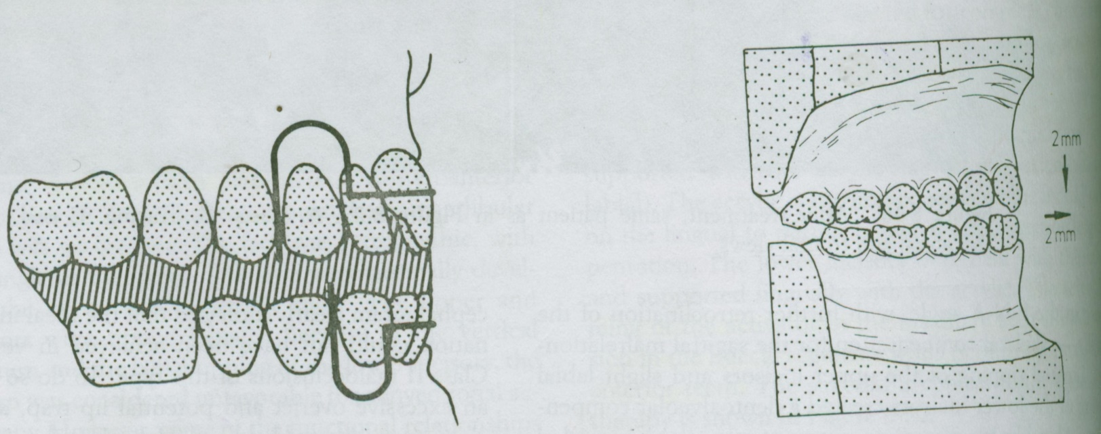
Technique for a Construction Bite without Forward Mandibular Positioning

Slide 33
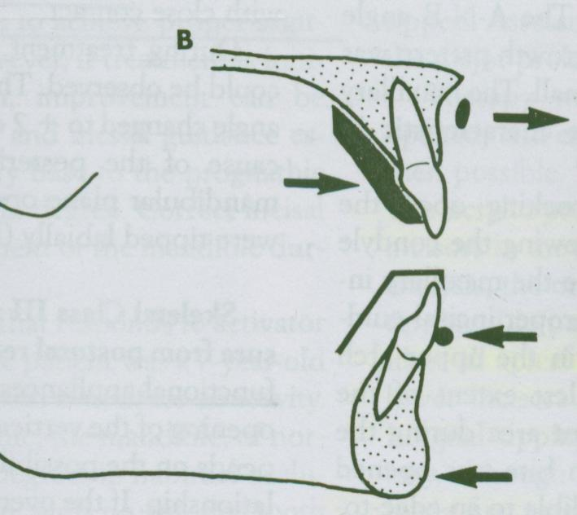
Construction Bite with Opening and Posterior Positioning of the Mandible

Slide 34
EXECUTION OF CONSTRUCTION BITE:
Horse shoe shaped wax rim is made in the proper arch form; should be 2-3mm thicker than the planned construction bite for guiding the mandible.
Wax is placed is placed in lower for treatment of class II and in the upper for treatment of class III.
Make the patient sit upright in the relaxed posture, guide the mandible into desired position without exerting force.
Wax is placed in mouth after the operator is sure the patient can replicate.
Edge to edge incisal relation is maintained.
Midline is observed for coincidence.
Wax bite is carefully removed.

Slide 35
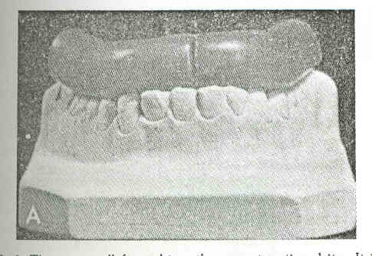
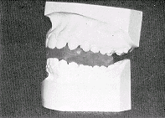
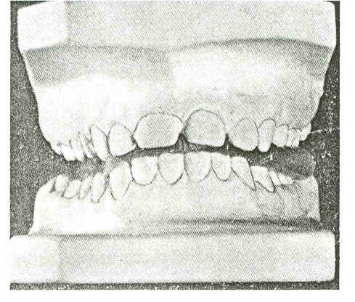
Wax placed over the cast
Casts mounted on wax after obtaining bite registration

Slide 36
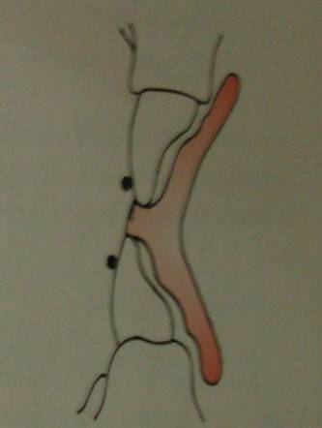
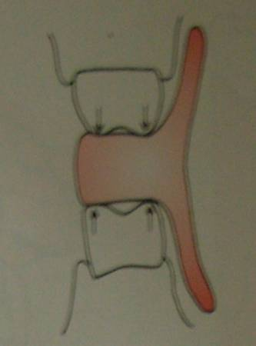
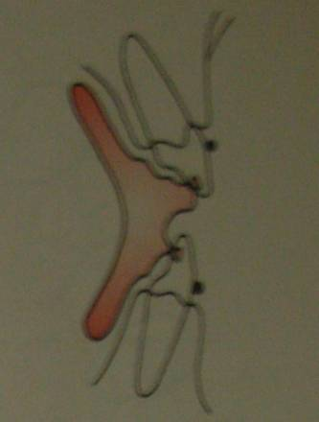
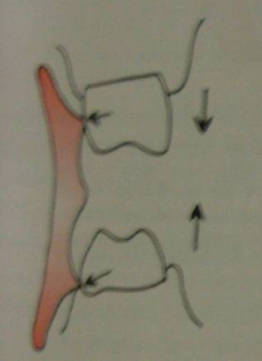
Trimming of activator
Intrusion of teeth
Extrusion of teeth

Slide 37
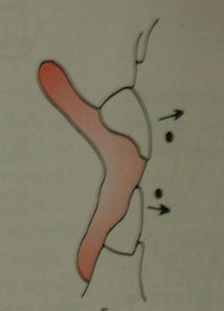
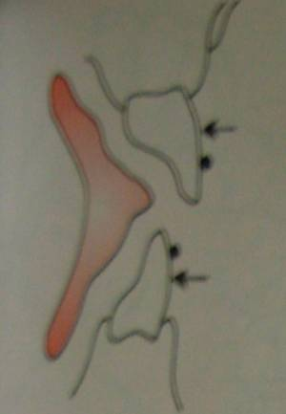
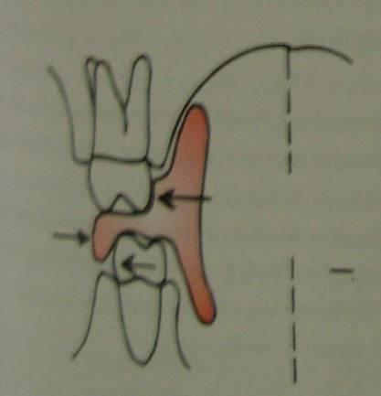
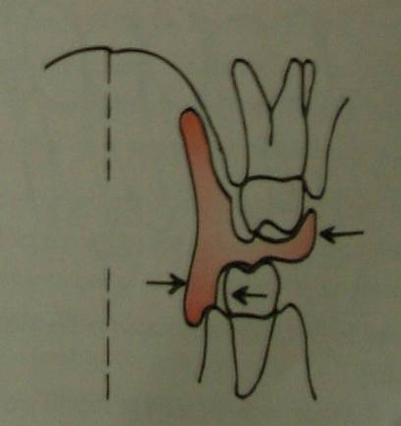
Trimming of activator
Incisor proclination
Incisor retroclination
Expansion of arch
Contraction of arch

Slide 38
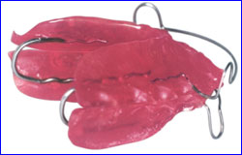
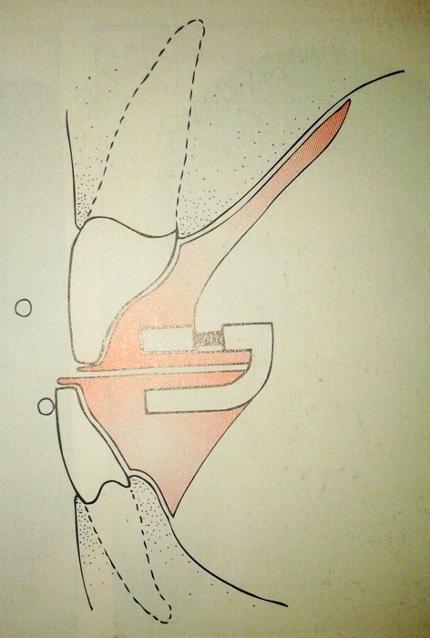
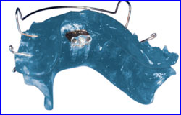
Modifications:
BOW ACTIVATOR By A.M.Schwarz
Wunderer’s modificaiton for Class III

Slide 39
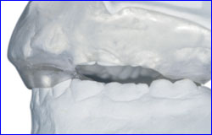
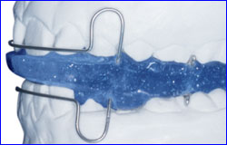
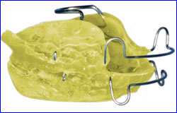
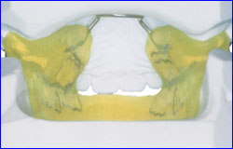
PROPULSOR by Muhlemann & Hotz
Herren’s Modification
REDUCED ACTIVATOR/CYBERNATOR By G.P.F.Schmuth

Slide 40
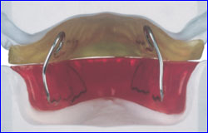
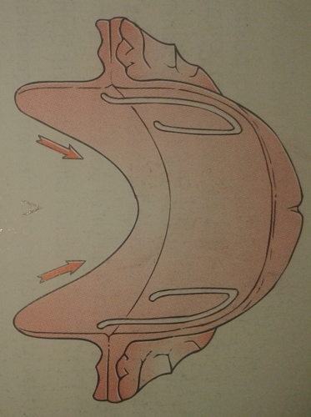
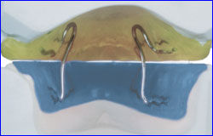
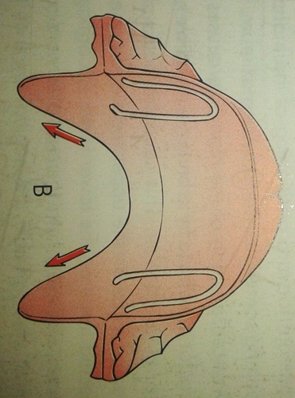
K
A
R
V
E
T
Z
K
Y
M
O
D
I
F
I
C
A
T
I
O
N
Type I - Distal Activator
Type II - Prognathism Activator

Slide 41
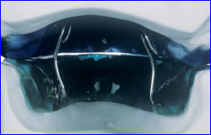
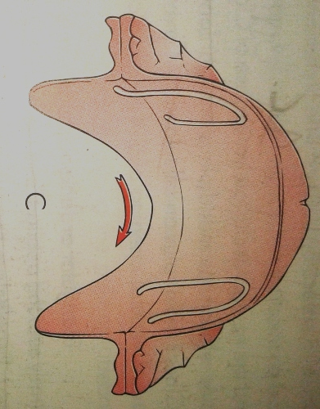
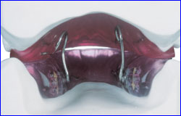
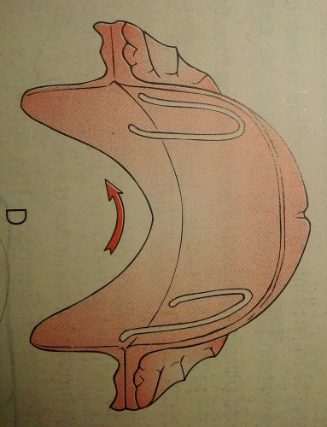
K
A
R
V
E
T
Z
K
Y
M
O
D
I
F
I
C
A
T
I
O
N
Type III a Pan Activator
Type III b Pan Activator

Slide 42
Wear Time:
1st week ➔2-3 hrs a day during day time
2nd week onwards➔ 3 hrs during day & while sleeping.

Slide 43
FRANKEL’S FUNCTION REGULATOR
Frankel appliance
Vestibular appliance
Oral gymnastic appliance
Functional regulator
2 main T/t effects:
1) Serves as a template against which craniofacial muscles function..
2) Removes the muscle forces in the labial & buccal areas thereby providing an environment which enables skeletal growth.

Slide 44
Frankel’s Philosophy
1. Vestibular arena of operation
2. Sagittal correction via tooth borne maxillary anchorage
3. Differential eruption guidance.
4. Minimum maxillary basal effect
5. Periosteal pull by buccal shields and lip pads

Slide 45
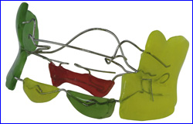
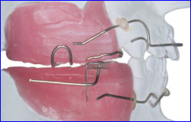
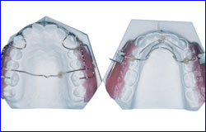
Types:
FR I-Class I & Class II Div I .
FR 1a-Class I with minor to moderate
crowding.
FR 1b-Class II div I where overjet does not
exceed 5mm
FR 1c-Class II div I ;overjet >7mm

Slide 46
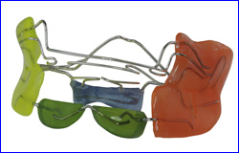
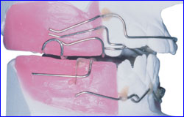
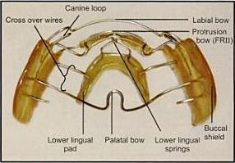
FR II- Class II div I & II

Slide 47
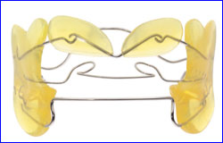
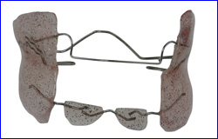
FR III-Class III
FR IV-open bite & bimaxilliary protrusion
FR V- incorporate head gear. Indicated in long face patients having high mandibular plane angle& vertical maxillary excess.
FR III
FR IV

Slide 48
BIONATOR
Developed by Balters in 1950’s.
Modified activator ➔less bulky & more elastic
3 types-
  Standard type-class II div I having narrow dental arches
  Class III Appliance
  Open bite appliance

Slide 49



Standard type
Class III Appliance
Open Bite Appliance

Slide 50
Indications
In class II div I having
  Well aligned dental arches
  Retruded mandible
  Not very severe skeletal discrepancy
  Labial tipping of upper incisors
Class III malocclusion
Openbite cases

Slide 51
TWIN BLOCK APPLIANCE
The Twin Block appliance is a removable, orthodontic functional appliance that is used to help correct jaw alignment, particularly an underdeveloped lower jaw.
Developed by Dr. William J. Clark , 1977.

Slide 52


The removable twin block is a tissue-borne functional appliance that is worn fulltime.
It helps in the advancement of the mandible.
It is a two-piece appliance composed of an upper and lower bite block.
Upper & lower bite blocks interlock at 70⁰ angle.

Slide 53

The fixed twin block is similar to the removable twin block, but can be used in non-compliant patients.

Slide 54
Advantages:
-Very good patient acceptance.
-Bite planes offer greater freedom of movement & lateral excursion.
-Less interference with normal function.
-Significant changes in patient’s appearance within 2-3 months.

Slide 55
HERBST APPLIANCE
Fixed functional appliance developed by Emil Herbst in early 1900’s.
Indications:
-Correction of class II MO due to retrognathic mandible.
-Can be used as anterior repositioning splint in patients having TMJ disorders.

Slide 56
Specific indications
Post adolescent patients: T/t completed w/in 6-8
months,hence possible to use the residual
growth in these patients.
Mouth breathers
Uncooperative patients
2 types:
-Banded Herbst
-Bonded Herbst

Slide 57


Banded Herbst Appliance
Bonded Herbst Appliance

Slide 58
Advantages:
-Continuous action
-T/t duration is short
-Less pt cooperation needed
-Can be used in pts who are at the end of their growth
-Can be used in pts with mouth breathing habit.

Slide 59
Disadvantages:
Cause minor functional disturbances.
Increased risk of development of dual bite,with TMJ dysfunction symptoms as a possible consequence.
Repeated breakage & loosening of appliance occurs,esp. in lower premolar area.
Plaque accumulation & enamel decalcification can occur
Tendency for posterior open bite.

Slide 60
JASPER JUMPER
A relatively new flexible fixed tooth borne FA.
Introduced by J.J.Jasper ,1980
Actions similar to Herbst appliance but lack rigidity.
Basically indicated in skeletal class II malocclusion with maxillary excess & mandibular deficiency.

Slide 61


Advantages:
-Produce continuous force
-Does not require patient compliance
-Allows greater degree of mandibular freedom than Herbst appliance
-Oral hygiene is easier to maintain.

Slide 62
Conclusion
The global demand for orthodontics without braces continues to grow. It's an option that many parents and patients would prefer.
Myofunctional orthodontics offers a viable alternative to traditional orthodontic methods.

