Slide 1
MUSCLES OF
MASTICATION
Dr B.RAJASEKHARORAL PATHOLOGY

Slide 2













Notes:
M of m movies the mandible during mastication and speech
These muscls develop from first arch

Slide 3




The process by which food is crushed and ground
by teeth
The first step of digestion
Increases the surface area of food to allow more efficient breakdown by enzymes
Food after swallowing is called BOLUS

Slide 4




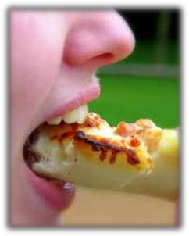
Mastication is the repetitive sequence of jaw opening and closing with a profile in the vertical plane called CHEWING CYCLE.
THREE PHASES:
1. OPENING PHASE
the mouth is opened and the mandible is depressed

Slide 5
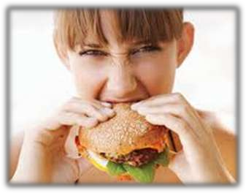
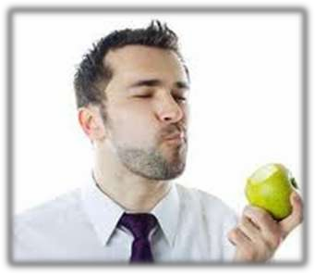
2. CLOSING PHASE
-the mandible is raised towards the maxilla
3. OCCLUSAL OR INTERCUSPAL PHASE
-the mandible is stationary and the teeth from both upper and lower arches approximate

Slide 6

COMMON CHARACTERISITICS:
All are inserted to the mandible
All are innervated by the mandibular division of the trigeminal nerve
FUNCTIONS:
To move the mandible
To secure then stabilize the mandibular
positions
To determine the direction of mandibular movements

Slide 7
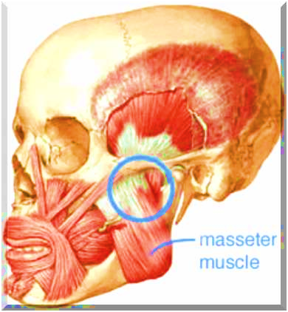
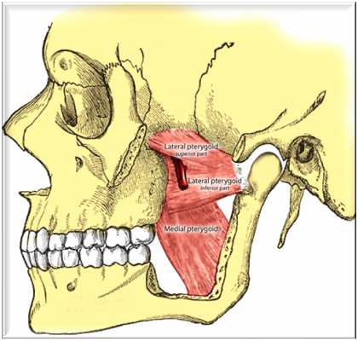
MASSETER
TEMPORALIS
MEDIAL PTERYGOID
LATERAL PTERYGOID
TEMPORALIS

Slide 8





MASSETER MUSCLE
It is a flat quadrangular muscle, partly
tendinous, partly fleshy.
It overlies the lateral surface of the mandibular ramus.

Slide 9
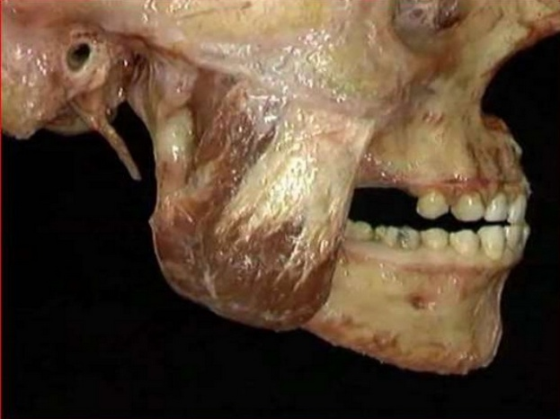

Slide 10



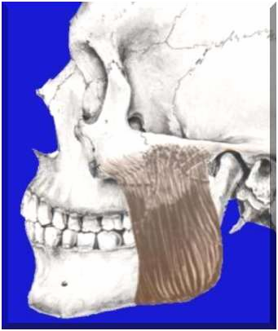






Superficial part
ORIGIN: maxillary process of zygomatic bone and anterior 2/3 of the zygomatic process of the maxilla
INSERTION: angle of the mandible and posterior part of ramus
Deep part
ORIGIN: medial aspect of the zygomatic arch
INSERTION: central and upper part of ramus as high as the coronoid
ACTION: elevate the jaw, with the superficial fibers causing protraction
Notes:
Supercifical fibers pass downwards and backwards at 45 degres
Deep fibers pass vertically downward

Slide 11
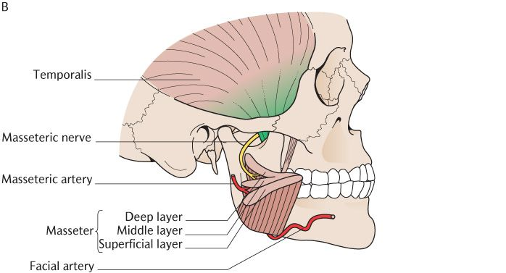
Nerve supply
A branch of anterior division of mandible

Slide 12

TEMPORALIS MUSCLE
It is a large, fan- shaped muscle at the sides of the head.

Slide 13
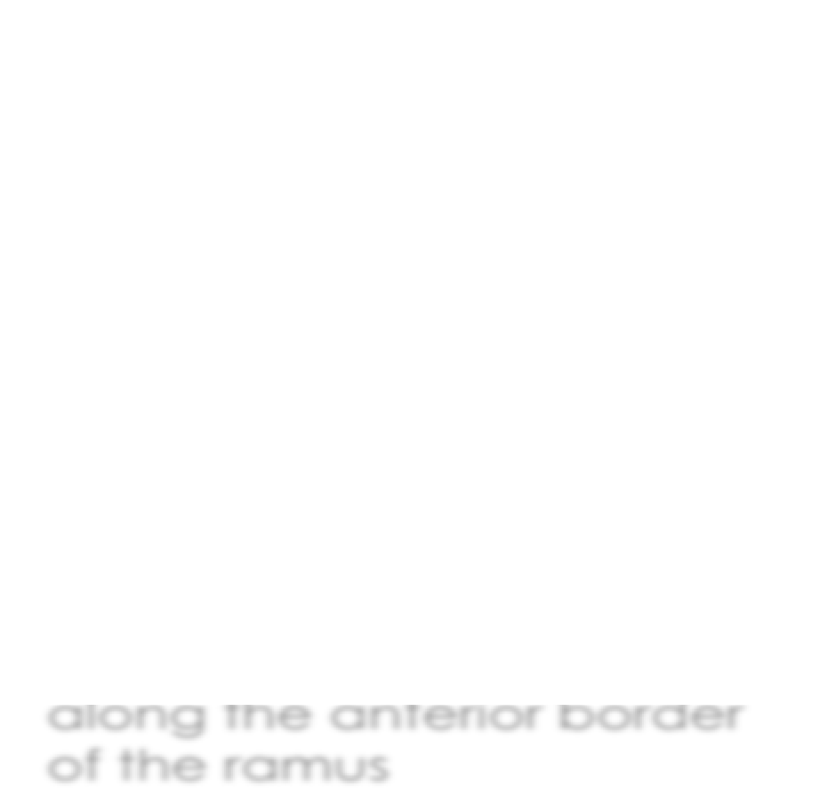

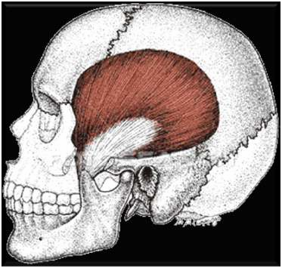




ORIGIN: the floor of temporal fossa and temporal fascia
COURSE: anterior fibers run vertically downwards while the posterior fibers are almost horizontal in position
INSERTION: the apex and deep surface of the coronoid process and along the anterior border
ACTION: anterior fibers elevate the mandible, while the posterior fibers retract the mandible
of the ramus

Slide 14
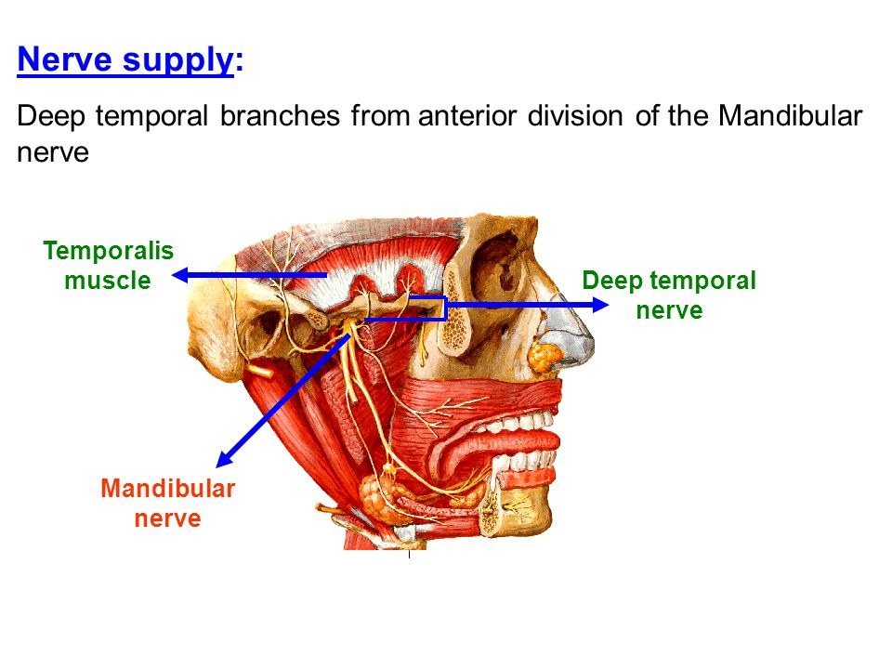

Slide 15




LATERAL (or EXTERNAL) PTERGOID MUSCLE
It is a thick and triangular muscle with two heads.
It is the muscle of mastication that occupy primarily a horizontal position.

Slide 16



ORIGIN: Superior portion – infratemporal surface of greater wing of sphenoid. Inferior portion – lateral surface of lateral pterygoid plate
INSERTION: fibers a re directed laterally and backwards into the front of the pteygoi plate
ACTION: depress, proturude and move the mandible from side to side

Slide 17




MEDIAL (or INTERNAL) PTERYGOID MUSCLE
It is almost a mirror-like image of the masseter muscle.
It is rhomboidal and runs practically in the same direction on the inner surface of the mandible

Slide 18
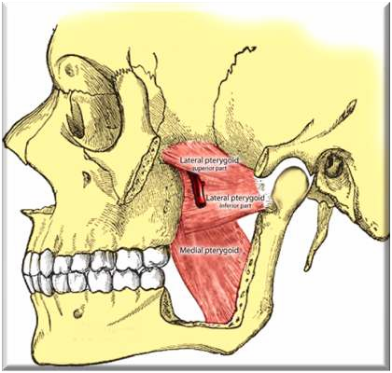

Slide 19
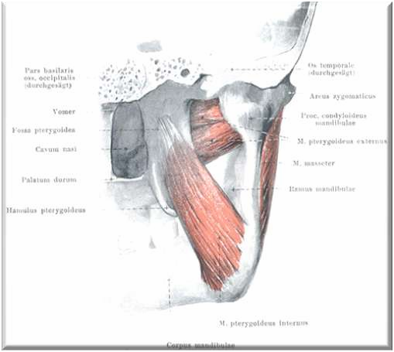






ORIGIN: medial surface of lateral pterygoid plate, the posterior surface of the tubercle of palatine bone and tuberosity of maxilla
INSERTION: pterygoid tuberosity
ACTION: elevates and protracts the mandible. It also moves the jaw from side to side

Slide 20
MOVEMENT OF JAW | MUSCLES INVOLVED
Depression of mandible | Lateral pterygoid
Elevation of jaw | Masseter Temporalis Medial pterygoid
Protrusion | Lateral pterygoid Medial pterygoid
Retraction | Posterior fibres of Temporalis Masseter
Lateral movements | Medial and lateral pterygoid acting alternatively

Slide 21
Masticatory reflexes
1
Jaw jerk reflex
2
Unloading reflex
3
Jaw opening reflexes

Slide 22
Jaw jerk reflex:
Sitting or standing upright with his or her jaw in rest position .
A sharp downward tap on the chin results in the masseter to contract suddenly and the jaw closes immediately.
this is monosynaptic reflex due to stretching of muscle spindles of the masseter
A reverse jaw jerk is however not present
An upward tap on the chin has no effect on the depressors of the mandible because these depressor muscles have very few spindles

Slide 23
UNLOADING REFLEX:
This is a protective reflex
During eating if a hard particle such as a stone or shell is suddenly encountered the closing movement of the mandible stops immediately
This occurs because of sudden inactivation of the muscles spindles of masseter.
The jaw opens the hard particle is detected and thrown out of the mouth

Slide 24
Jaw opening reflex
Jaw opens because of mechanical or electrical stimulation of the lips teeth etc
This reflex is commonly seen in children and is due to inhibition of the elevator activity

Slide 25



Slide 26
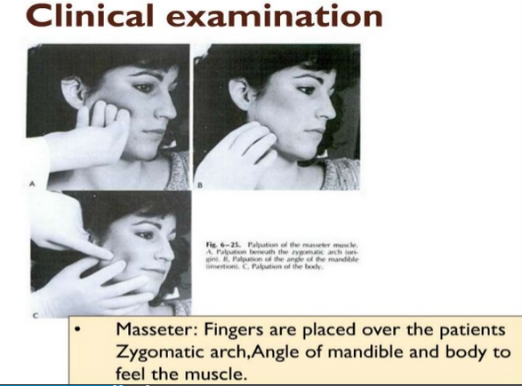
Notes:
Palpate the origen of maseter biletrally along the zygomatic arch and continue to palpate down the body of the mandible wher the masseter Is attached

Slide 27
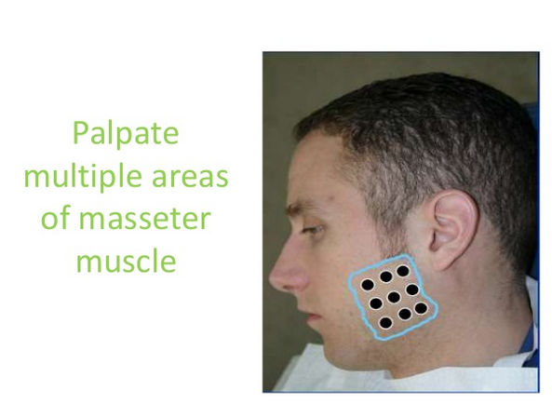

Slide 28
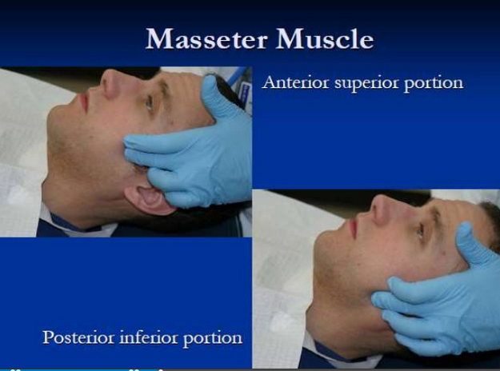
Notes:
Clinical importance : is bruxism bcz of hypertrophy of musscles

Slide 29
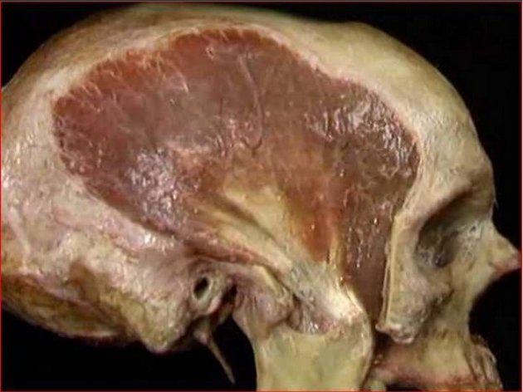

Slide 30
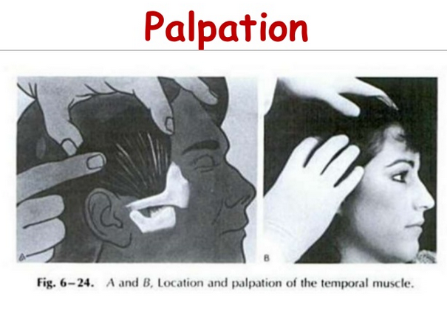

Slide 31
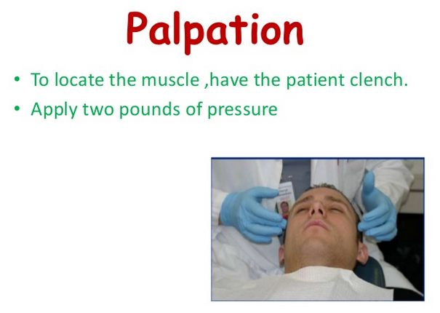

Slide 32
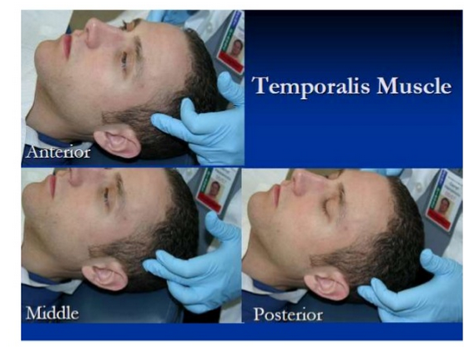

Slide 33
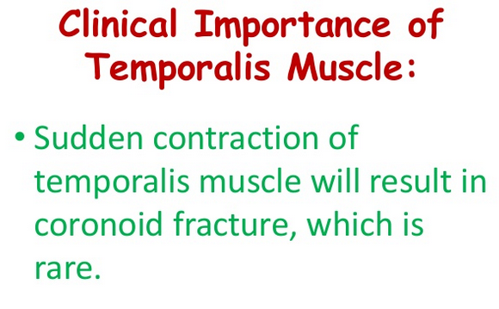

Slide 34
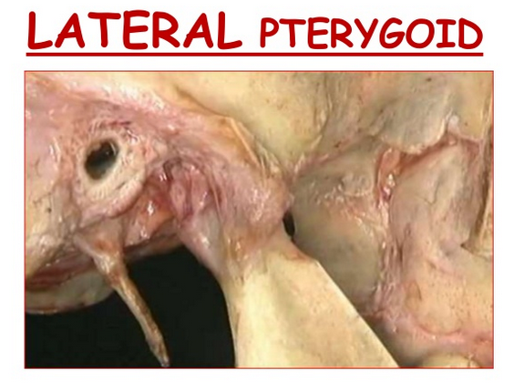

Slide 35
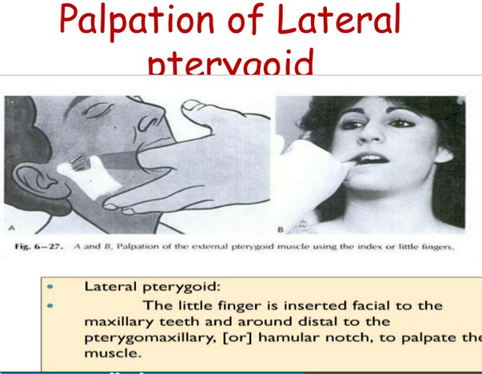

Slide 36
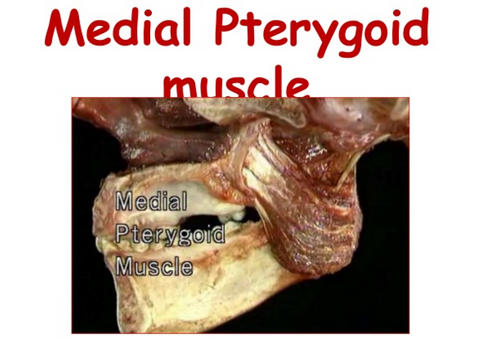

Slide 37
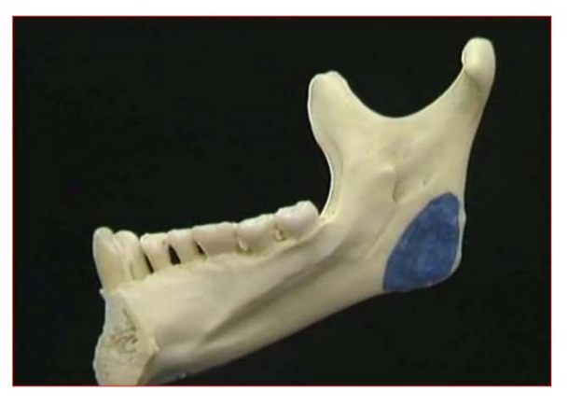
Notes:
Insertion seen on the medial angle of the mandb

Slide 38
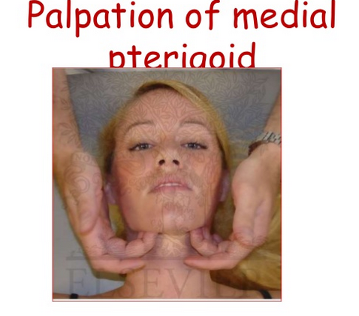

Slide 39
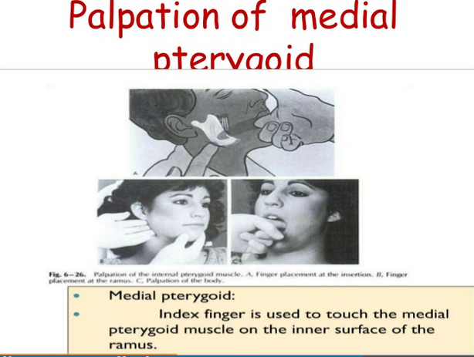

Slide 40
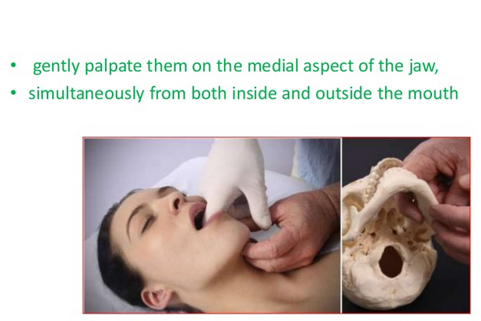

Slide 41
