Slide 1
Periodontal Treatment of Medically
Compromised Patients

Slide 2
Contents
Cardiovascular Diseases
Endocrine Disorders
Hemorrhagic Disorders
Renal Diseases
Liver Diseases
Pulmonary Diseases
Medications and Cancer Therapies
Prosthetic Joint Replacement
Pregnancy
Infectious Diseases

Slide 3
The term Medically Compromised refers to dental patients with impaired health status like pregnancy, or patients with systemic diseases like ischemic heart disease, congenital heart disease, liver disease, renal disease, asthma, patients with immunodeficiency and patients with altered immune status.

Slide 4
Cardiovascular Diseases
Cardiovascular diseases are the most prevalent category of systemic disease
Hypertension
Myocardial infarction (MI)
Cerebrovascular accident (CVA),
Angina pectoris
Cardiac bypass surgery
CVS problems
implanted cardiac pacemakers
or automatic cardioverter-defibrillators.
Infective endocarditis (IE)
Congestive heart failure (CHF)

Slide 5
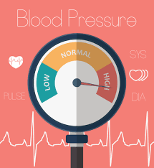
Hypertension
Systolic BP greater than 140 mm Hg is considered a greater risk factor for cardiovascular disease than elevated diastolic pressure. JNC-7 also introduced a category known as prehypertension to replace the more innocuous terms high normal and borderline hypertension
primary
HYPERTENSION
secondary

Slide 6
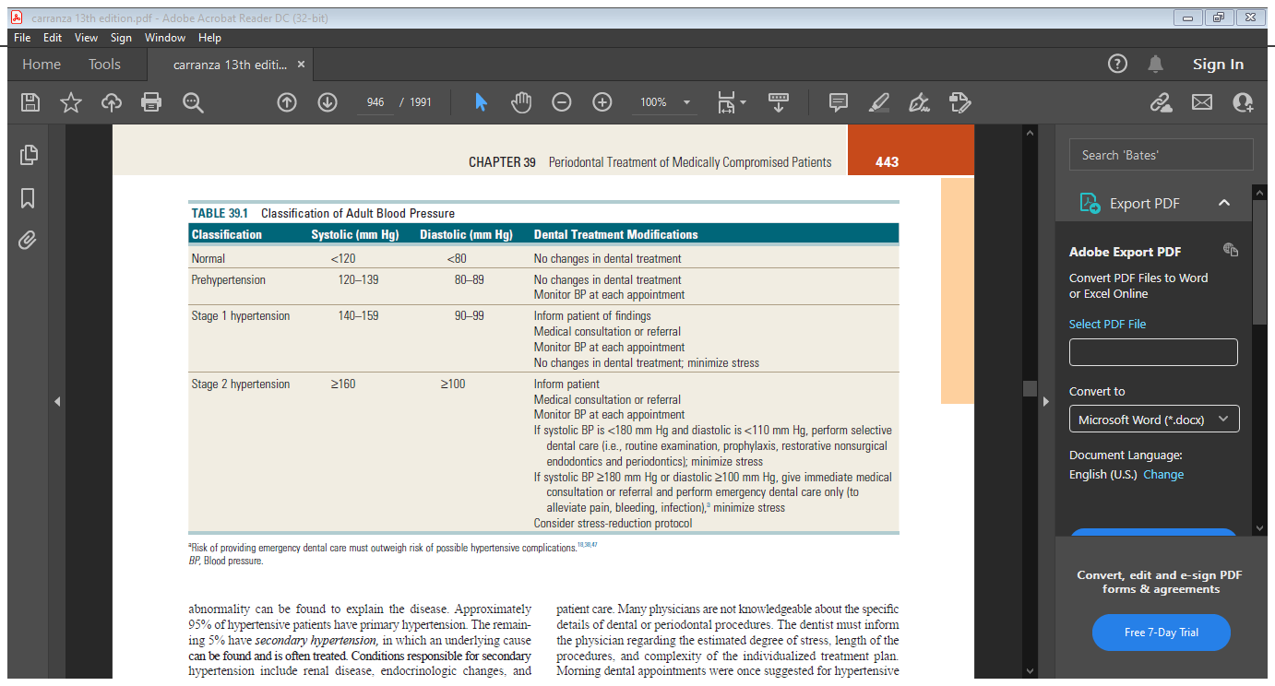

Slide 7
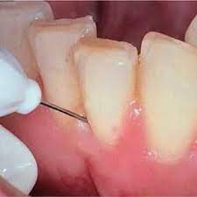

The first dental office visit should include two BP readings spaced at least 10 minutes apart, which are averaged and used as a baseline
The periodontal recall system is an ideal method for hypertension detection and monitoring.
Dental treatment for hypertensive patients is safe as long as stress is minimized.
Morning dental appointments were once suggested for hypertensive patients, but evidence indicates that BP usually increases around awakening and peaks at midmorning. Because lower BP levels occur in the afternoon, afternoon dental appointments may be preferred.
Intraligamentary injections

Slide 8
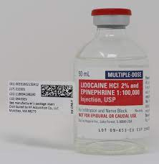
When treating hypertensive patients, the clinician should not use a local anaesthetic containing an epinephrine concentration greater than 1 : 100,000 or a vasopressor to control local bleeding.
Local anesthesia without epinephrine can be used for short procedures (<30 minutes). In a patient with hypertensive disease, it is important to minimize pain by providing profound local anaesthesia to avoid an increase in endogenous epinephrine secretion

Slide 9
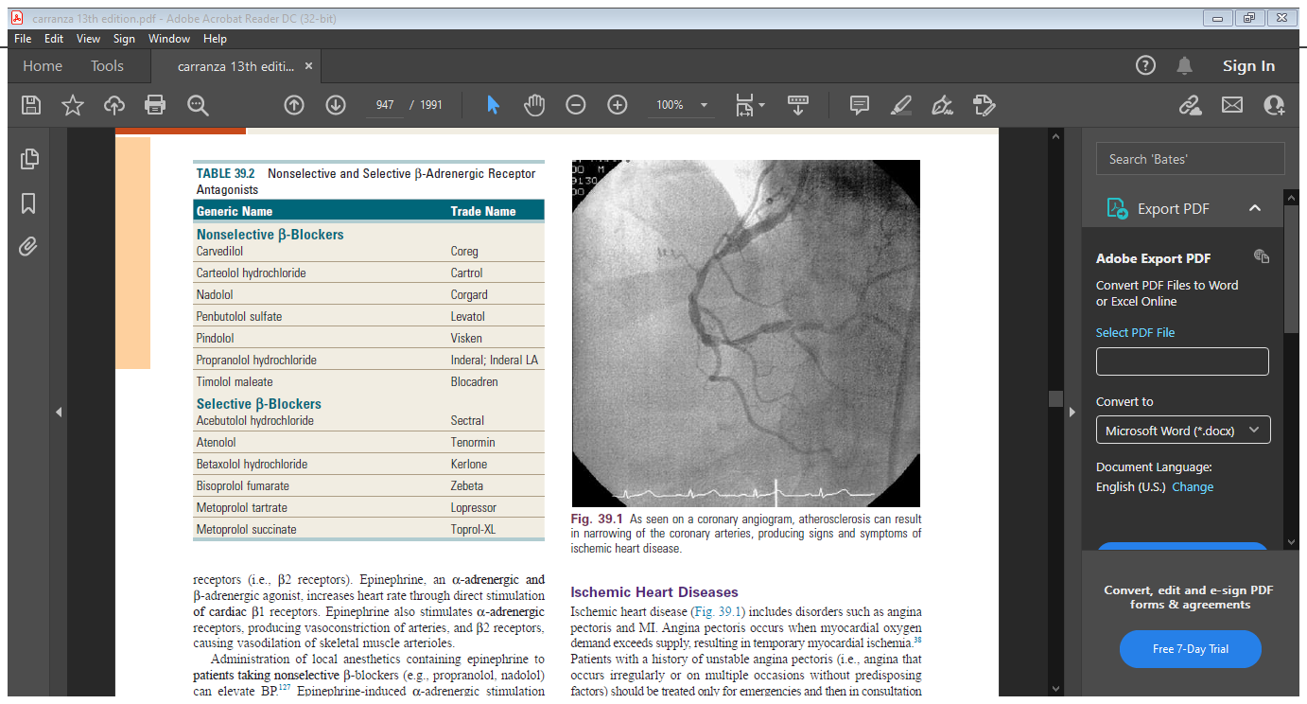
β- adrenergic receptor antagonists (i.e., βblockers) are typically used to treat hypertension

Slide 10
Epinephrine, an α-adrenergic and β -adrenergic agonist, increases heart rate through direct stimulation of cardiac β 1 receptors. Epinephrine also stimulates α –adrenergic receptors, producing vasoconstriction of arteries, and β2 receptors, causing vasodilation of skeletal muscle arterioles.
Administration of local anesthetics containing epinephrine to patients taking nonselective β -blockers (e.g., propranolol, nadolol) can elevate BP
Postural hypotension is common and can be minimized by slow positional changes in the dental chair.
Depression is a side effect of which many patients are unaware.
Nausea, sedation, oral dryness, lichenoid drug reactions, and gingival overgrowth are associated with certain classes of antihypertensive agents

Slide 11
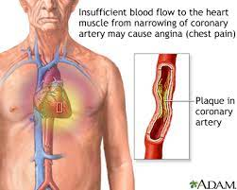
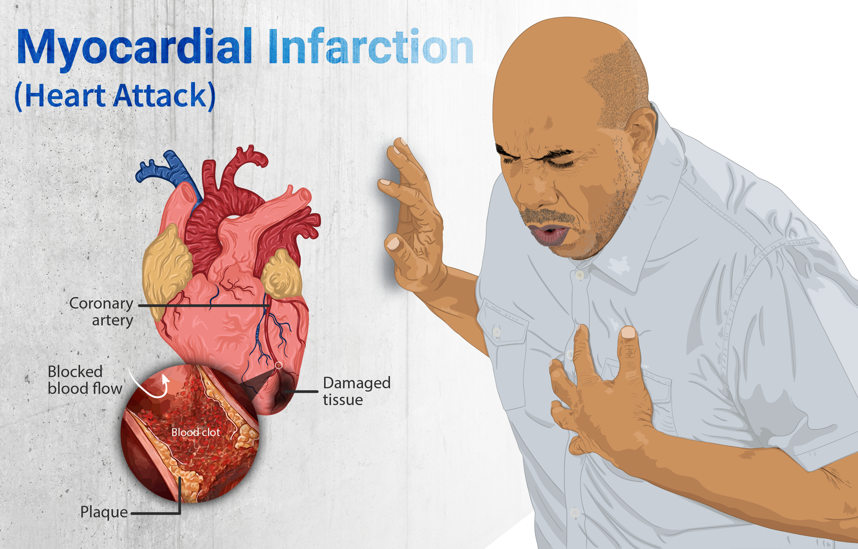
Ischemic Heart Diseases
Ischemic Heart Diseases
Angina pectoris
MI.

Slide 12
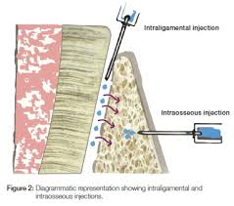
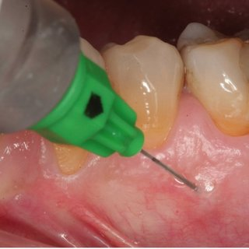
Profound local anesthesia is vital, and conscious sedation may be indicated for anxious patients
Patients who manage acute anginal attacks with nitroglycerin should be instructed to bring their medication to dental appointments
Restrictions on the use of local anesthetics containing epinephrine are similar to those for the patient with hypertension

Slide 13
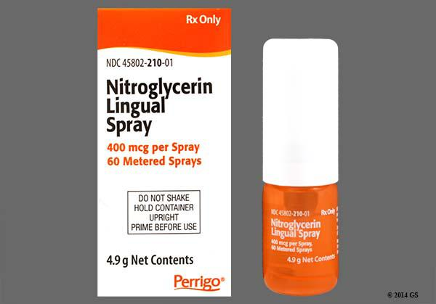
Discontinue the periodontal procedure.
2. Administer 1 tablet (0.3 to 0.6 mg) of nitroglycerin sublingually.
3. Reassure the patient, and loosen restrictive garments.
4. Administer oxygen with the patient in a reclined position.
5. If the signs and symptoms cease within 3 minutes, complete the periodontal procedure if possible, making sure that the patient is comfortable. Terminate the procedure at the earliest convenient time.
6. If the anginal signs and symptoms do not resolve with this treatment within 5 minutes, administer another dose of nitroglycerin, monitor the patient’s vital signs, call the patient’s physician, and be ready to accompany the patient to the emergency department.
7. A third nitroglycerin tablet can be given 5 minutes after the second. Chest pain that is not relieved by three tablets of nitroglycerin indicates likely MI. The patient should be transported to the nearest emergency medical facility immediately.

Slide 14
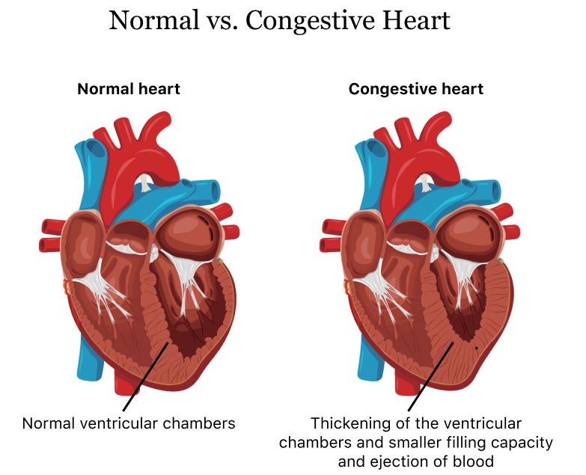
Congestive Heart Failure
CHF is a condition in which the pump function of the heart is unable to supply sufficient amounts of oxygenated blood to meet the body’s needs.
CHF usually begins with left ventricular failure caused by a disproportion between the hemodynamic load and the capacity to handle that load. CHF can be caused by a chronic increase in workload (as in hypertension or aortic, mitral, pulmonary, or tricuspid valvular disease), direct damage to the myocardium (as in MI or rheumaticfever), or an increase in the body’s oxygen requirements (as in anemia, thyrotoxicosis, or pregnancy).

Slide 15
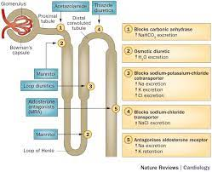
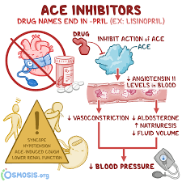
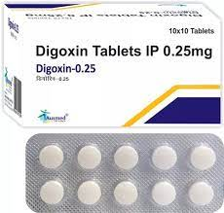
Medical management of CHF can include the use of calcium channel blockers, direct vasodilators, diuretics, angiotensin-converting enzyme (ACE) inhibitors, α-receptor blockers, or cardiotonic agents such as digoxin. Each medication has potential side effects that can affect periodontal therapy.
Because of orthopnea (i.e., inability to breathe unless in an upright position) in some CHF patients the dental chair should be adjusted to a comfortable level for the patient rather than placed in a supine position. Short appointments, stress reduction with profound local anesthesia and possibly conscious sedation, and use of supplemental oxygen should be considered.

Slide 16
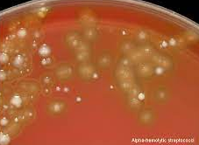

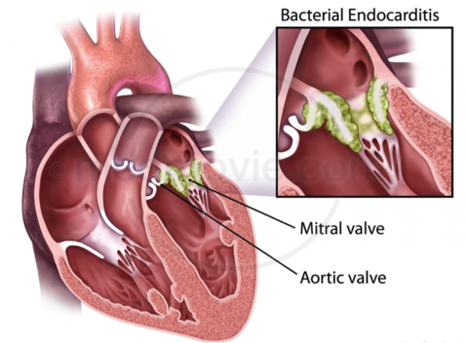
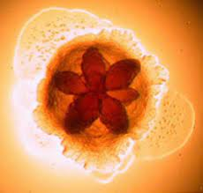
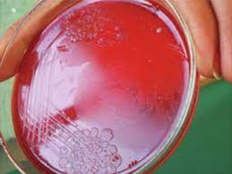
Infective Endocarditis
Infective endocarditis (IE) is a disease in which microorganisms colonize damaged endocardium or heart valves

Slide 17
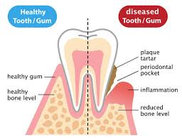
Infective endocarditis
Acute
Sub –acute
The acute form involves virulent organisms, usually nonhemolytic streptococci and strains of staphylococci, which invade normal cardiac tissue, produce septic emboli, and cause infections that run a rapid, fatal course.
Results from Colony formation on damaged endocardium or heart valves by low-grade pathogenic organisms. The classic example is rheumatic carditis from rheumatic fever
Antibiotic prophylaxis is recommended for all dental procedures that involve manipulation of the gingival or periapical tissues, or perforation of the oral mucosa. Prevention of periodontal inflammation is paramount.

Slide 18
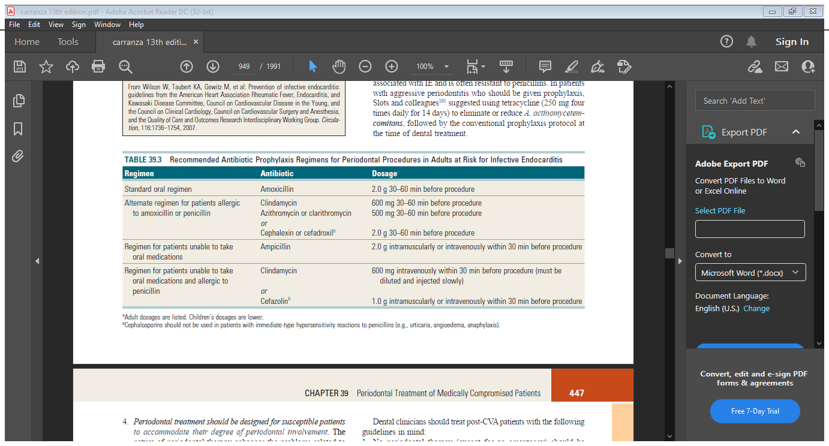

Slide 19

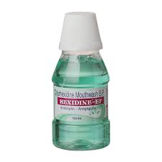
Periodontal treatment should be designed for susceptible patients to accommodate their degree of periodontal involvement. The nature of periodontal therapy enhances the problems related to the prophylaxis of subacute IE
Periodontal disease is an infection with potentially wide-ranging systemic effects. For patients at risk for IE, every effort should be made to eliminate this infection. Teeth with severe periodontitis and a poor prognosis may require extraction.
Teeth with less severe involvement in a motivated patient should be retained, treated, and maintained closely.
All periodontal treatment procedures (including probing) require antibiotic prophylaxis; gentle oral hygiene methods are excluded.
Pre treatment chlorhexidine rinses are recommended before all procedures, including periodontal probing, because these oral rinses significantly reduce the bacteria on mucosal surfaces.

Slide 20

Cerebrovascular Accident
A CVA (i.e., stroke) results from ischemic changes (e.g., cerebral thrombosis caused by an embolus) or hemorrahagic phenomena.
Hypertension and atherosclerosis are predisposing factors for CVA
To prevent a repeat stroke, active infections should be treated aggressively, because even a minor infection can alter blood coagulation and trigger thrombus formation and ensuing cerebral infarction.

Slide 21
Dental clinicians should treat post-CVA patients with the following guidelines in mind:
1. No periodontal therapy (except for an emergency) should be performed for 6 months because of the high risk of recurrence
during this period.
2. After 6 months, periodontal therapy can be performed during short appointments with an emphasis on minimizing stress.
Profound local anesthesia should be obtained, using the minimal effective dose of local anesthetic agents. Concentrations of
epinephrine greater than 1 : 100,000 are contraindicated.
3. Light conscious sedation (i.e., inhalation, oral, or parenteral) be used for anxious patients. Supplemental oxygen is indicated to maintain thorough cerebral oxygenation.
4. Stroke patients are frequently placed on oral anticoagulants. evidence regarding the risks of altering anticoagulants
therapy suggests that it may be prudent to provide treatment without changing it .Any changes in anticoagulant therapy regimens for a stroke patient should be done in consultation with the patient’s physician.
5. BP should be monitored carefully. Recurrence rates for CVAs are high, as are rates of associated functional deficits.

Slide 22

Let’s meet soon!!

Slide 23
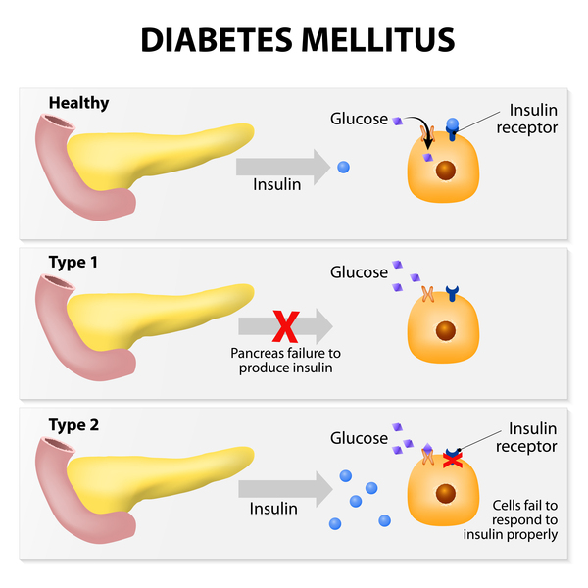
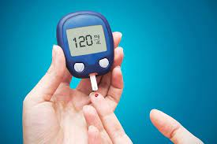
Endocrine Disorders
Diabetes

Slide 24
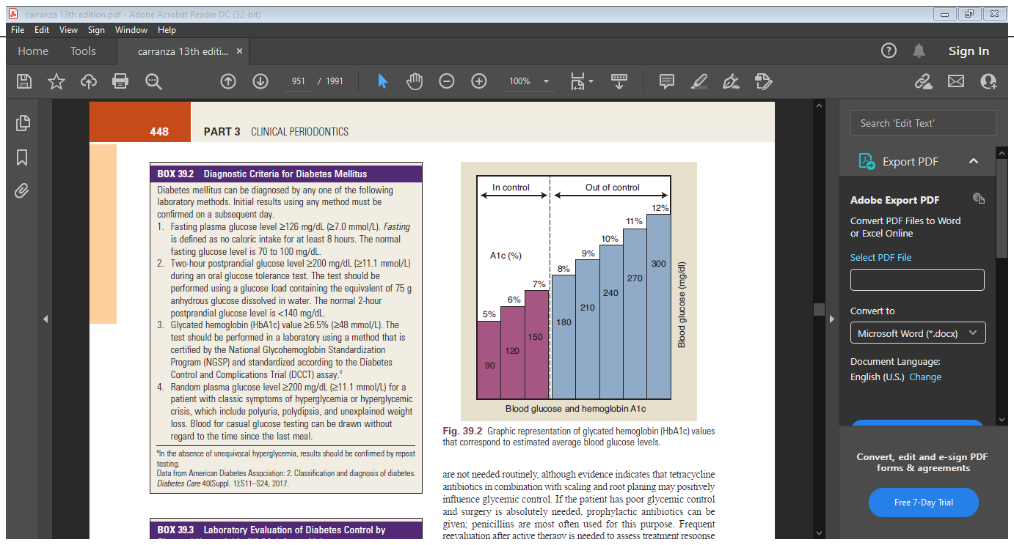
If a patient is suspected of having undiagnosed diabetes, the following procedures should be performed:
1. Consult the patient’s physician.
2. Analyze laboratory test , including fasting blood glucose and casual glucose test results.
3. Rule out acute orofacial infection or severe dental infection; if present, provide emergency care immediately
4. Establish the best possible oral health through nonsurgical debridement
of plaque and calculus.

Slide 25
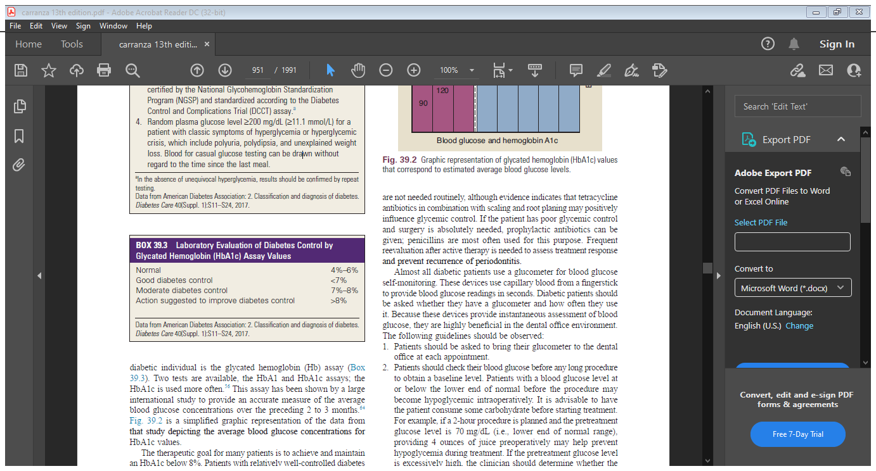
Diabetic patients with periodontitis should receive oral hygiene instructions, mechanical debridement to remove local factors, and regular maintenance.
When possible, an HbA1c of less than 10% should be established before surgical treatment is performed

Slide 26
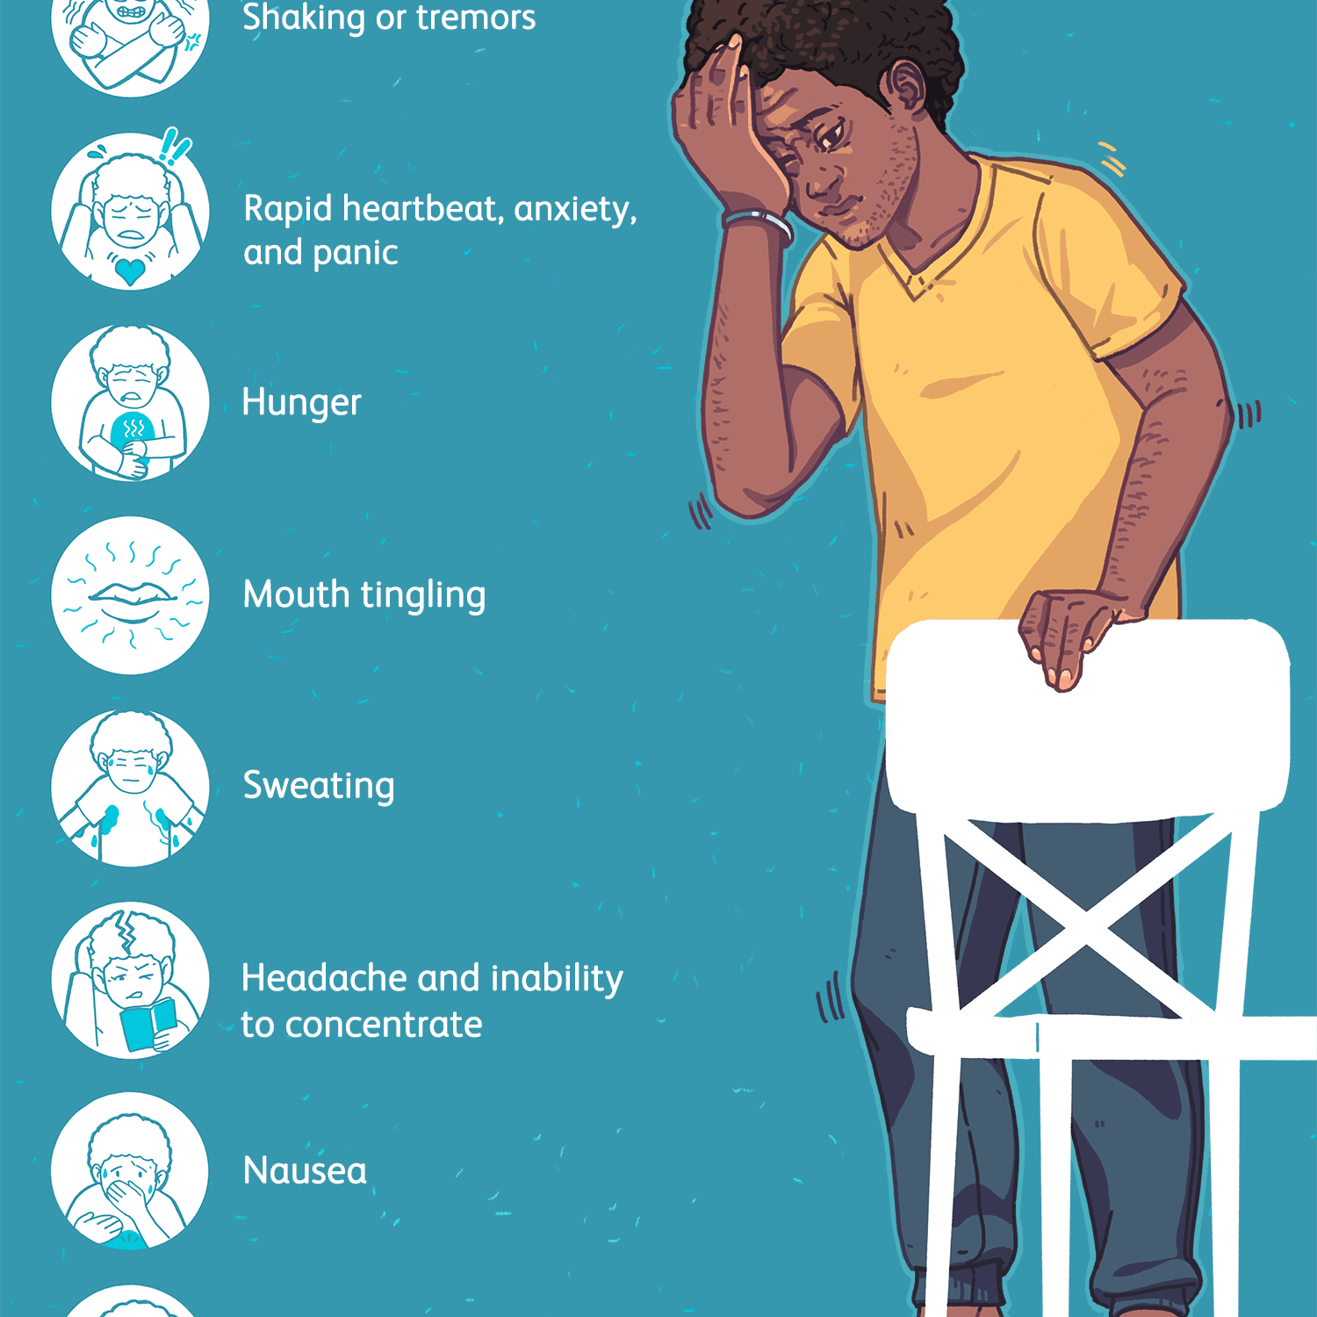
If the patient has poor glycemic control and surgery is absolutely needed, prophylactic antibiotics can be given; penicillins are most often used for this purpose.
The most common dental office complication seen in diabetic patients taking insulin is a symptomatic low blood glucose level (i.e., hypoglycemia)

Slide 27
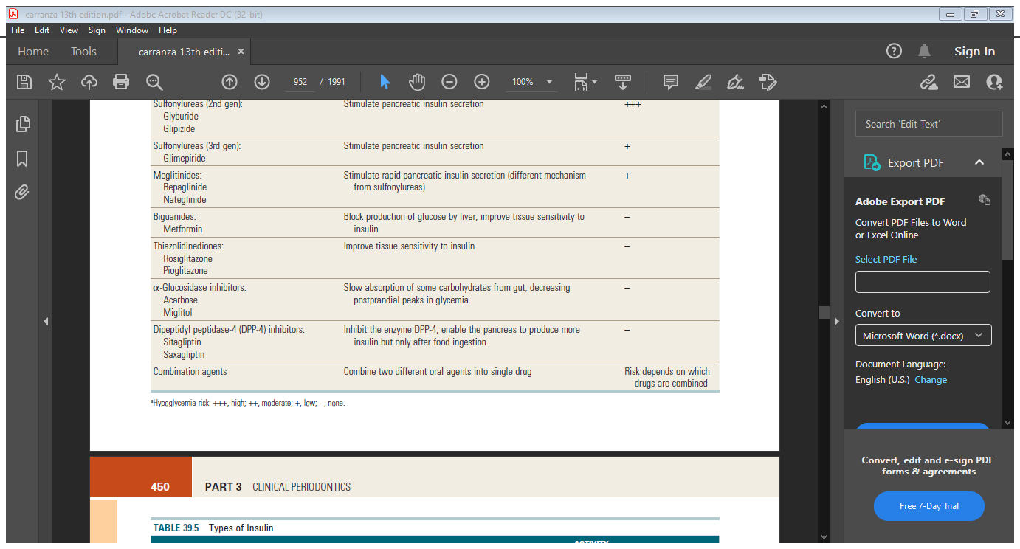
Oral agents used for management of diabetes

Slide 28
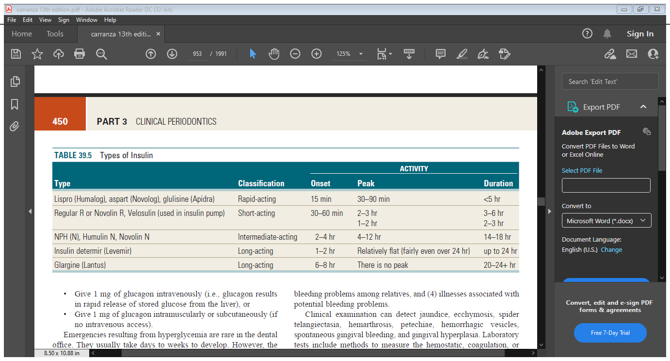
Periodontal treatment often can be timed to avoid peak insulin activity.

Slide 29
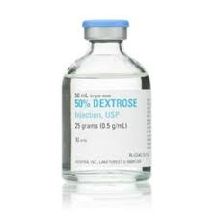
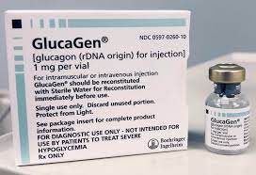

If hypoglycemia occurs during dental treatment, therapy should be immediately terminated.
If a glucometer is available, the blood glucose level should be checked.
Treatment guidelines include the following:
1. Provide approximately 15 g of oral carbohydrate to the patient
• 4 to 6 ounces of juice or soda
• 3 or 4 teaspoons of table sugar
• Hard candy with 15 g of sugar
2. If the patient is unable to take food or drink by mouth or if the patient is sedated
• Give 25 to 30 mL of 50% dextrose intravenously, which provides 12.5 to 15.0 g of dextrose, or Give 1 mg of glucagon intravenously (i.e., glucagon results in rapid release of stored glucose from the liver), or
• Give 1 mg of glucagon intramuscularly or subcutaneously

Slide 30
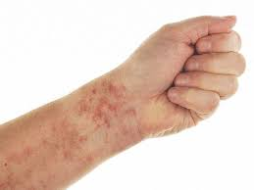
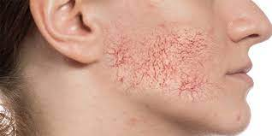
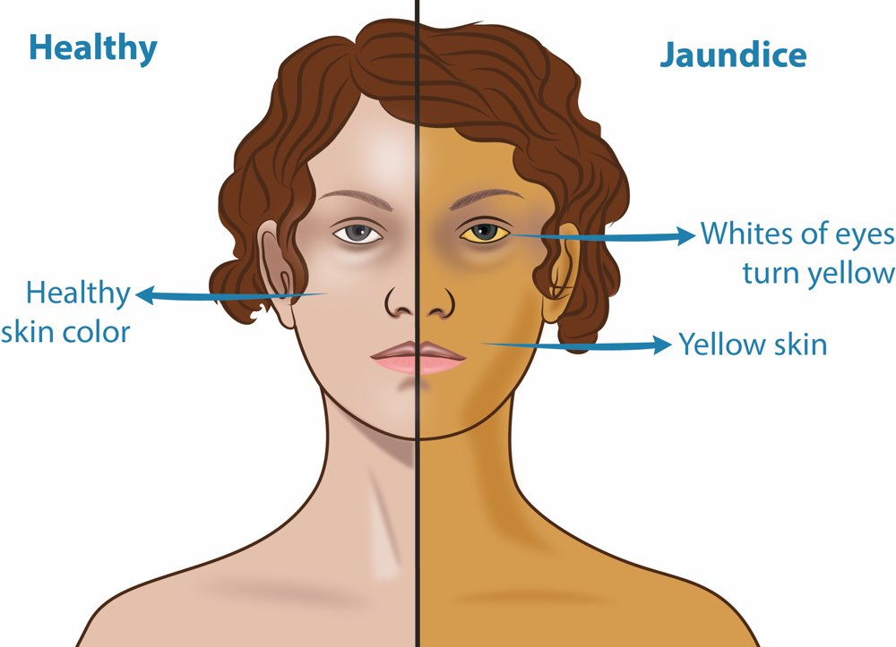
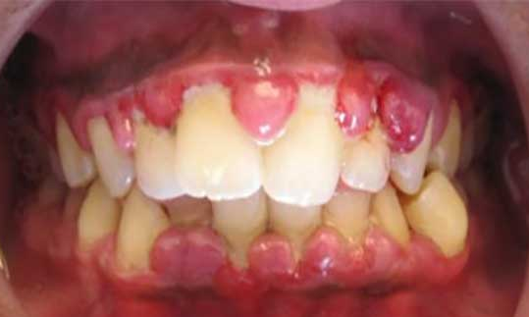
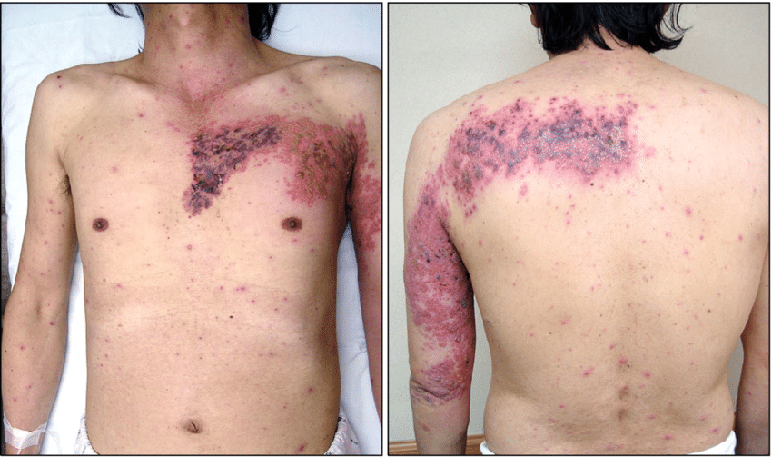
Hemorrhagic Disorders
Clinical examination can detect jaundice, ecchymosis, spider telangiectasia, hemarthrosis, petechiae, hemorrhagic vesicles, spontaneous gingival bleeding, and gingival hyperplasia.
Laboratory tests include methods to measure the hemostatic, coagulation, or lytic phase of the clotting mechanism,
These tests include bleeding time, tourniquet test, complete blood cell count, prothrombin time (PT), partial thromboplastin time (PTT), and coagulation time

Slide 31
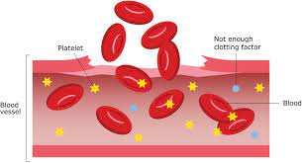
Bleeding disorders
Coagulation disorders
Thrombocytopenic purpuras
Nonthrombocytopenic purpuras.

Slide 32
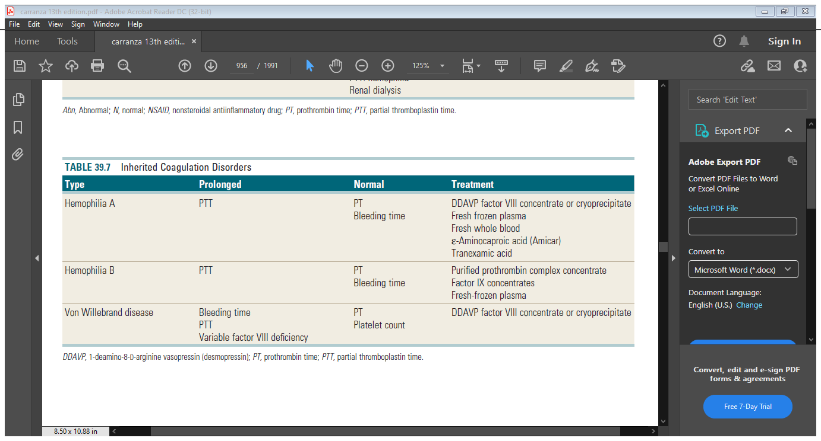

Slide 33
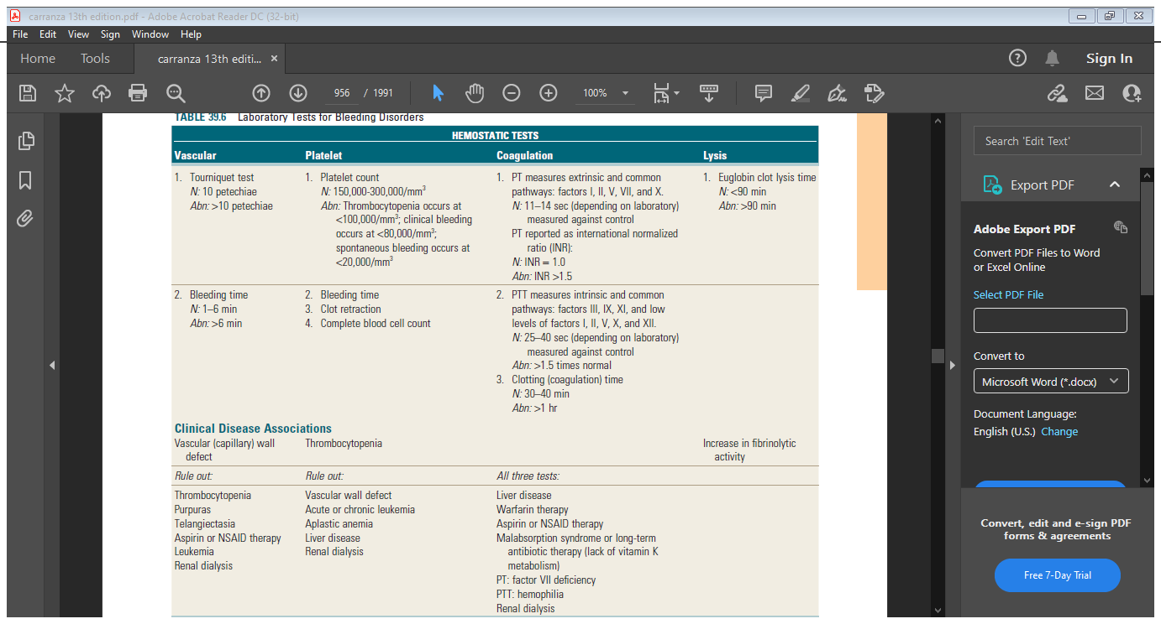

Slide 34
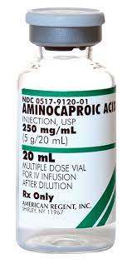
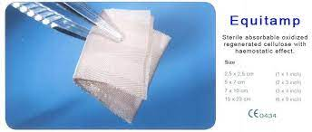
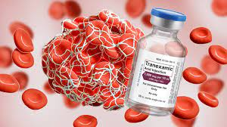
Periodontal treatment can be performed in patients with these coagulation disorders, provided that sufficient precautions are taken.
Probing, scaling, and prophylaxis can usually be done without medical modification. More invasive treatment, such as local block anesthesia, root planing, or surgery, dictates prior physician consultation.
Antihemostatic agents, such as oxidized cellulose or purified bovine collagen, can be placed over surgical sites or into extraction sockets

Slide 35
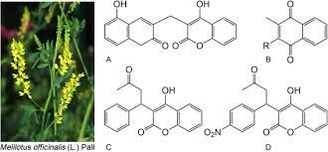
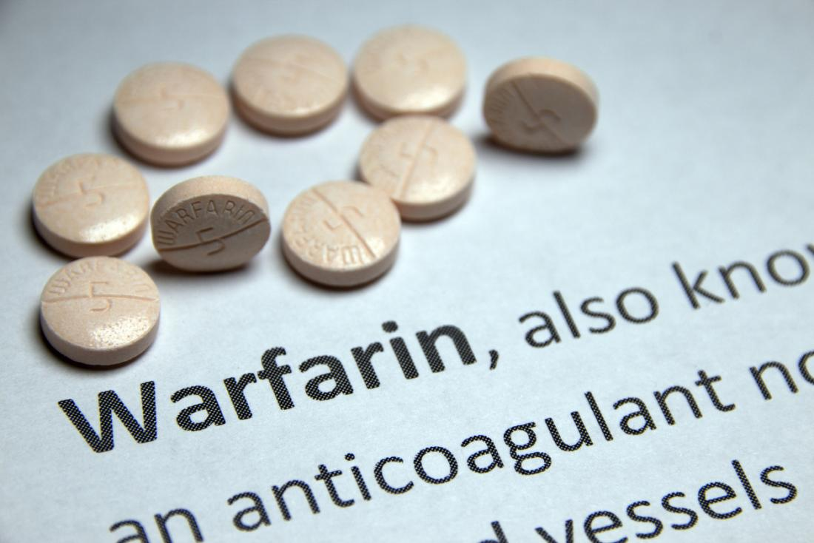
Anticoagulant Medications
Dicoumarol
The recommended level of therapeutic anticoagulation for most patients is an INR of 2.0 to 3.0
The anticoagulant is discontinued for 2 to 3 days before periodontal treatment (i.e., clearance half-life of warfarin is 36 to 42 hours), and the INR is checked On the day of therapy.

Slide 36
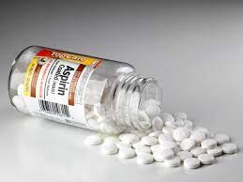
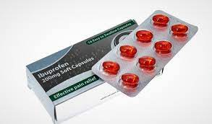
Antiplatelet Medications
Aspirin interferes with normal platelet aggregation and can result in prolonged bleeding.
Because it binds irreversibly to platelets, the effects of aspirin last at least 4 to 7 days. Aspirin typically is used in small doses of 325 mg or less per day, which usually does not alter bleeding time.
Nonsteroidal antiinlammatory drugs (NSAIDs) such as ibuprofen also inhibit platelet function. Because NSAIDs bind reversibly, the effect is transitory, lasting only a short time after the last drug dose.

Slide 37
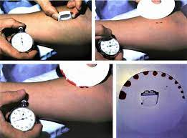
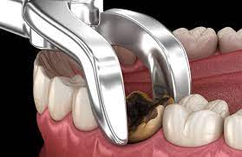
Leukaemia
Altered periodontal treatment for patients with leukemia is based on their enhanced susceptibility to infections, bleeding tendency, and effects of chemotherapy. The treatment plan for leukemia patients is as follows:
Refer the patient for medical evaluation and treatment. Close cooperation with the physician is required.
2. Before chemotherapy, a complete periodontal treatment plan should be developed with a doctor.
hematologic laboratory values daily: bleeding time, coagulation time, PT, and platelet count.
Administer antibiotic coverage before periodontal treatment because infection is a major concern.
• If systemic conditions allow, extract all hopeless, nonmaintainable, or potentially infectious teeth at least 10 days before the initiation of chemotherapy.

Slide 38
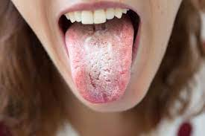
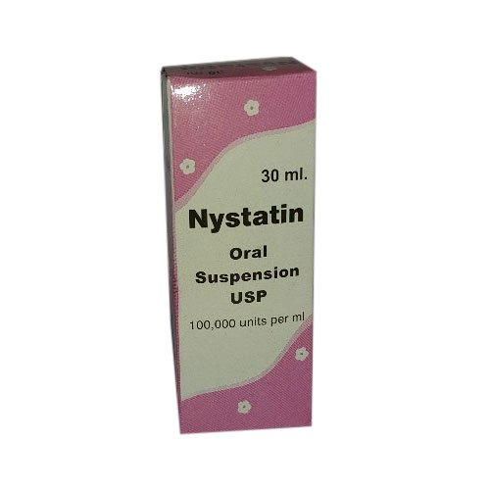
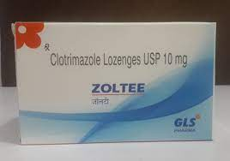
• Periodontal debridement (i.e., scaling and root planing) should be performed and thorough oral hygiene instructions given if the patient’s condition allows. Twice-daily rinsing with 0.12% chlorhexidine gluconate is recommended after oral hygiene procedures. Recognize the potential for bleeding caused by thrombocytopenia. Use pressure and topical hemostatic agents.
3. During the acute phases of leukemia, patients should receive only emergency periodontal care. Any source of potential infection must be eliminated to prevent systemic dissemination. Antibiotic therapy is frequently the treatment of choice, combined with nonsurgical or surgical debridement as indicated
4.Oral ulcerations and mucositis are treated palliatively with agents such as viscous lidocaine. Systemic antibiotics may be indicated to prevent secondary infection.
5. Oral candidiasis is common in leukemic patients and can be treated with nystatin suspension (400,000–600,000 U/mL four times daily) or clotrimazole vaginal suppositories (10 mg four or five times daily).

Slide 39


Agranulocytosis
Patients with agranulocytosis (i.e., cyclic neutropenia and granulocytopenia) have an increased susceptibility to infection. The total white blood cell count is reduced, and granular leukocytes (i.e.neutrophils, eosinophils, and basophils) are reduced in number or disappear. These disorders are often marked by early, severe periodontal
destruction

Slide 40


Thrombocytopenic Purpuras
Thrombocytopenia is deined as a platelet count of less than 100,000/mm3. Bleeding caused by thrombocytopenia can be seen with idiopathic thrombocytopenic purpuras, radiation therapy, myelosuppressive drug therapy (e.g., chemotherapy), leukemia, or infections.
Purpuras are hemorrhagic diseases characterized by extravasation of blood into the tissues under the skin or mucosa, producing spontaneous petechiae (i.e.small red patches) or ecchymoses (i.e.bruises)

Slide 41
Periodontal therapy for patients with thrombocytopenia should be directed toward reducing inlammation by removing local irritants to avoid the need for more aggressive therapy.
Scaling and root planing are usually safe unless the platelet count is less than 60,000/mm3.
No surgical procedure should be performed unless the platelet count is greater than 80,000/mm3. Platelet transfusion may be required before surgery. Surgical technique should be as atraumatic as possible, and local hemostatic measures should be applied

Slide 43

Adrenal Insufficiency
Acute adrenal insuficiency is associated with significant morbidity and mortality rates as a result of peripheral vascular collapse and cardiac arrest
Adrenal Insufficiency
Primary adrenal insufficiency
Secondary adrenal insufficiency

Slide 44

COMPLICATIONS
Alterations in glucose metabolism (i.e.steroid-induced diabetes)
Increased risk of infection,
Altered wound healing,
Osteoporosis,
Skin disorders,
Cataracts,
Glaucoma,
And suppression of the hypothalamic-pituitary-adrenal (HPA) axis
Exogenous steroids may suppress the HPA axis and impair the patient’s ability to respond to stress with increased endogenous cortisol production, leading to the potential for acute adrenal crisis

Slide 45

Most individuals with adrenal insuficiency can receive routine dental treatment without the need for supplemental glucocorticosteroids.
Patients currently taking corticosteroids usually have enough exogenous and endogenous cortisol to handle routine dental procedures if their usual dose is taken within 2 hours of the planned procedure
Management of the patient in an acute adrenal insufficiency crisis is as follows:
Terminate periodontal treatment.
Summon medical assistance.
Give oxygen.
Monitor vital signs.
Place the patient in a supine position.
Administer 100 mg of hydrocortisone sodium succinate (Solu-Cortef) intravenously over 30 seconds or intramuscularly

Slide 46


Thyroid and Parathyroid Disorders
Patients with thyrotoxicosis and those with inadequate medical management should not receive
periodontal therapy until their condition is stabilized
Routine periodontal therapy can be provided to patients with parathyroid disease after the disorder has been identified and the proper medical treatment given

Slide 47

Liver Diseases
Major causes of liver disease include drug toxicity, cirrhosis, viral infections (e.g., hepatitis B, hepatitis C), neoplasms, and biliary tract disorders
Treatment recommendations for patients with liver disease include the following:
Consultation with the physician concerning the current stage of disease, risk of bleeding, potential drugs to be prescribed during treatment, and required alterations to periodontal therapy
2. Screening for hepatitis B and C
3. Laboratory values for PT and PTT

Slide 48


Renal Diseases
electrolyte imbalance
pulmonary congestion
Renal failure
cardiac arrhythmias
CHF

Slide 49

Monitor BP; patients in end-stage renal failure are usually hypertensive
Check laboratory values: PTT, PT, bleeding time, and platelet count; hematocrit; blood urea nitrogen (do not treat if <60 mg/dL); and serum creatinine (do not treat if <1.5 mg/dL).
3. Eliminate areas of oral infection to prevent systemic infection.
• Good oral hygiene should be established.
• Periodontal treatment should aim at eliminating inflammation or infection
Questionable teeth should be extracted if medical parameters permit.
• Frequent recall appointments should be scheduled.
Excessive bleeding can occur during or after periodontal treatment because of drug-induced thrombocytopenia or anticoagulation, or both. A periodontal abscess is a potentially life-threatening situation, and a dental team approach should be used before transplantation to determine which teeth can be easily maintained

Slide 50





4. Drugs that are nephrotoxic or metabolized by the kidney should not be given (e.g., phenacetin, tetracycline, aminoglycoside antibiotics). Acetaminophen may be used for analgesia and diazepam for sedation. Local anesthetics such as lidocaine are usually safe

Slide 51





Pulmonary Diseases
The periodontal treatment of a patient with pulmonary disease may require alteration, depending on the nature and severity of the respiratory problem. Pulmonary diseases range from obstructive lung
diseases (e.g., asthma, emphysema, bronchitis, acute obstruction) to restrictive ventilatory disorders caused by muscle weakness, scarring, obesity, or any condition that can interfere with effective lung ventilation

Slide 52

Acute respiratory distress can be caused by slight airway obstruction or depression of respiratory function.

Slide 53
The following guidelines should be used during periodontal therapy:
Identify and refer patients with signs and symptoms of pulmonary disease to their physician.
2. For patients with known pulmonary disease, consult with their physician regarding medications (e.g., antibiotics, steroids, chemotherapeutic agents) and the degree and severity of pulmonary disease.
3. Avoid elicitation of respiratory depression or distress:
• Minimize the stress of a periodontal appointment. The patient with emphysema should be treated in the afternoon, several hours after sleep, to allow for airway clearance.
• Avoid medications that could cause respiratory depression (e.g., narcotics, sedatives, general anesthetics).
• Avoid bilateral mandibular block anesthesia, which could cause increased airway obstruction.
• Position the patient to allow maximal ventilatory eficiency, be careful to prevent physical airway obstruction, keep the
patient’s throat clear, and avoid excess periodontal packing.
4. For a person with a history of asthma, especially if asthma attacks are frequent, make sure the patient’s medication (inhaler) is available.
5. Patients with active fungal or bacterial respiratory diseases should not be treated unless the periodontal procedure is an emergency.

Slide 54
Medications and Cancer Therapies
Some medications prescribed to cure, manage, or prevent diseases have effects on periodontal tissues,
wound healing, or the host immune response that sometimes require modification of treatment
Bisphosphonates
Medications
Antiplatelet medications
Radiation therapy
Chemotherapy
Anticoagulation medications
Steroids

Slide 55

Bisphosphonates
Bisphosphonate medications are primarily used to treat cancer (i.e intravenous administration) and osteoporosis (i.e., oral administration).
They act by inhibiting osteoclastic activity, which leads to less bone resorption, remodeling, and turnover.83 Bisphosphonates are used in cancer treatment to prevent the often lethal imbalance of osteoclastic activity.

Slide 56







Risk factors for BRONJ

Slide 57


For individuals treated with intravenous bisphosphonates, invasive treatment, such as extractions, periodontal surgery, implant surgery, and bone augmentation procedures, should be avoided.

Slide 58

Anticoagulant or Antiplatelet Therapy
Patients at risk who may be on anticoagulant or antiplatelet therapy include
heart valve replacements
heart rhythm disorders
congenital heart defects
stroke
deep vein thrombosis
those with or a history or risk of MI

Slide 59



Corticosteroids
A stressful event, such as a dental procedure may be impaired in patients exposed to habitual corticosteroid use.
The stress response to minor general and oral surgical procedures concluded that significant increases in cortisol were usually not seen until 1 to 5 hours after surgery and appeared to be associated more with postoperative pain and the loss of local anesthesia than with the preoperative and intraoperative stress of
the procedure. Administration of adequate analgesics in the postoperative period can diminish the release (requirement) of cortisol

Slide 60





Radiation Therapy
mucositis
dysphagia
trismus,
Radiation Therapy
periodontal changes
Gustatory alteration
radiation caries
xerostomia,
temporomandibular joint degeneration

Slide 61

Periodontal disease can be a precipitating factor in ORN
surgical lap procedures are usually discouraged after radiation therapy.
Teeth that are non restorable or severely periodontally diseased should be extracted, ideally at least 2 weeks
before radiation therapy. Extractions should be performed in a manner that allows primary closure. Mucoperiosteal laps should be gently elevated; teeth should be extracted in segments; alveolectomy
should be performed, allowing no rough bony spicules to remain.
During radiation therapy, patients should receive weekly prophylaxis, oral hygiene instruction, and professionally applied fluoride treatments, unless mucositis prevents treatment. Patients should be instructed to brush daily with a 0.4% stannous or 1.0% sodium fluoride gel

Slide 62

Hepatitis

Slide 63


Slide 64

The following guidelines are offered for treating hepatitis patients:
1. If the disease, regardless of type, is active, do not provide periodontal therapy unless the situation is an emergency. In an emergency case, follow the protocol for patients testing positive
for hepatitis B surface antigen (HBsAg).
2. For patients with a history of hepatitis, consult the physician to determine the type of hepatitis, course and length of the disease, mode of transmission, and any chronic liver disease or viral carrier state.
3. For recovered HAV and HEV patients, perform routine periodontal care.
4. For recovered HBV and HDV patients, consult with the physician and order HBsAg and anti-HBs (i.e., antibody to HBV surface antigen) laboratory tests.
• If HBsAg and anti-HBs test results are negative but HBV is suspected, order another HBs determination.
• Patients who are HBsAg positive are probably infective (i.e.chronic carriers); the degree of infectivity is measured by an HBsAg determination.
• Patients who are anti-HBs positive may be treated routinely because they have antibody to HBsAg.

Slide 65

If a patient with active hepatitis, positive-HBsAg (i.e., HBVcarrier) status, or positive-HCV carrier status requires emergency treatment, use the following precautions:
Consult the patient’s physician regarding status.
• If bleeding is likely during or after treatment, measure the PT and bleeding time. Hepatitis can alter coagulation; change the treatment accordingly.
• All personnel in clinical contact with the patient should use full barrier techniques, including masks, gloves, glasses or
eye shields, and disposable gowns.
• Use as many disposable covers as possible, covering light handles, drawer handles, and bracket trays. Headrest covers
should also be used.
• All disposable items (e.g., gauze,saliva ejectors, masks, gowns, gloves) should be placed in one lined waste basket. After treatment, these items and all disposable covers should be bagged, labelled, and disposed of following proper guidelines for biohazardous waste.

Slide 66

• Aseptic technique should be followed at all times. Minimize aerosol production by not using ultrasonic instrumentation, air syringe, or high-speed handpieces; remember that saliva contains a distillate of the virus. Pre rinsing with chlorhexidine gluconate for 30 seconds is highly recommended.
• When the procedure is completed, all equipment should be scrubbed and sterilized. If an item cannot be sterilized or
disposed of, it should not be used.

Slide 67


HIV and AIDS
An awareness of oral disorders associated with HIV infection may allow the clinician to recognize previously undiagnosed disease or modify treatment protocols appropriately.

Slide 68

Tuberculosis
The patient with tuberculosis should receive only emergency care, following the guidelines
If the patient has completed chemotherapy, the patient’s physician should be consulted regarding infectivity and the results of sputum cultures for Mycobacterium tuberculosis
Adequate treatment of tuberculosis requires a minimum of 18 months, and thorough posttreatment follow-up should include chest radiographs, sputum cultures, and a review of the patient’s symptoms by the physician at least every 12 months
Oral tubercular lesions can be either, primary or, secondary to pulmonary tuberculosis, with secondary lesions being more common. Most common sites for these lesions are tongue, gingiva, floor of the mouth, buccal mucosa. Dorsum of the tongue is most favourable site with these lesions appearing as a stellate ulcer.

