Slide 1


Masticatory System Disorders that Influence the Periodontium

Slide 2

Contents
Introduction
Temporomandibular Joint
Muscles and Nerves of the Masticatory System
Centric Relation
Biomechanics of the Masticatory Dysfunction and Deterioration
Orofacial Pain

Slide 3

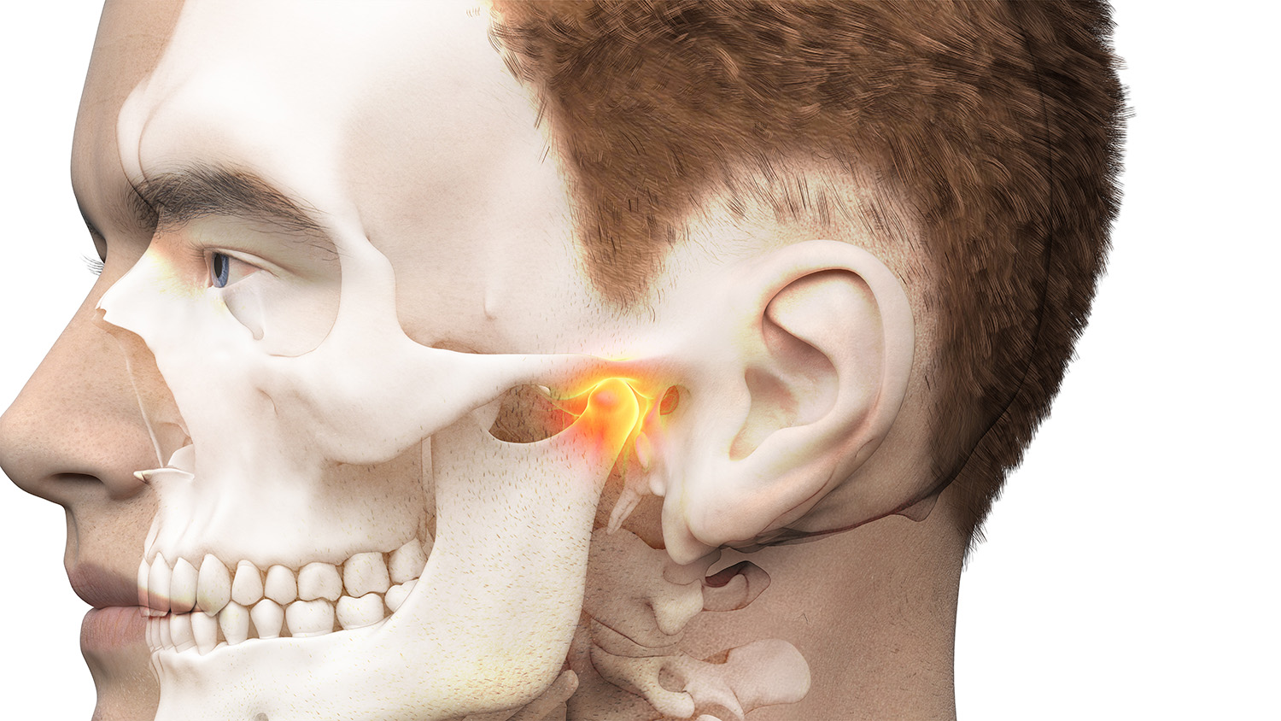
The masticatory system consists of the temporomandibular joints
(TMJs), the masticatory muscles, the teeth in occlusion, and the neurologic and vascular supplies that support all of these structures

Slide 4

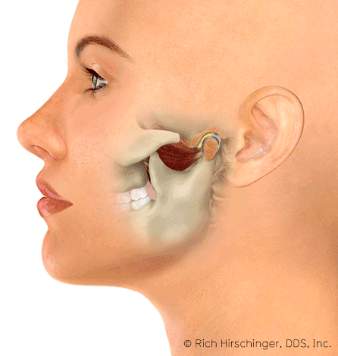
Temporomandibular Joint
The TMJ is one of the most complex joints in the human body.
It is capable of providing both hinging (rotation) and gliding (translation) movements and it is able to resist incredible forces of mastication.
The TMJ is formed by the head of the condyle of the mandible as it its into the articular fossa of the temporal bone.
The body of the mandible effectively connects both condyles so that neither condyle functions independently of the other. Interposed between the head of the condyle and the articular surface of the temporal bone is the articular disc, which consists of dense connective tissue;
this results in a compound joint with two joint cavities

Slide 5
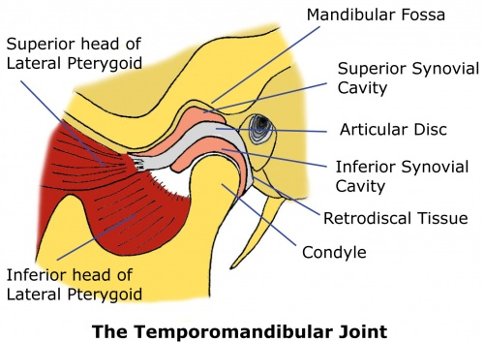
The articulating surfaces of the osseous structures are essentially convex in a healthy situation, so the biconcave configuration of the articular disc compensates for the opposing convexities.
The articular surfaces of the condyles and the temporal bones consist of fibrous connective tissue, which renders them resistant to breakdown and capable of repair.
Deep to the superficial connective tissue layer, articular cartilage provides the cellular and structural basis for the response to the functional loading and movement of the TMJs.
The discal ligaments and attachments to the capsule, along with the
disc itself, becomes the means of separating the joint into superior
and inferior joint spaces.
Synovial lubrication of the articular surfaces is a function of the production of synovial fluid by endothelial cells along the borders of each joint cavity and at the anterior extent of the retro-discal tissues.

Slide 6
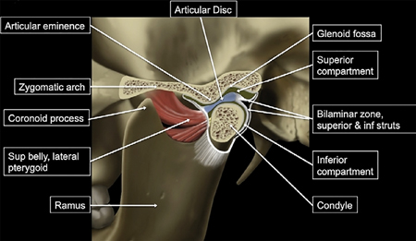
Components of TMJ
2 bones : Temporal & Mandibular bone
A disk that divides joint space into 2 spaces : upper & lower compartments
A joint capsule
Ligaments : the Lateral ligament, Sphenomandibular & Stylomandibular ligaments
4 main muscles of mastication :
Masseter,
Temporalis,
Medial pterygoid & Lateral pterygoid

Slide 7

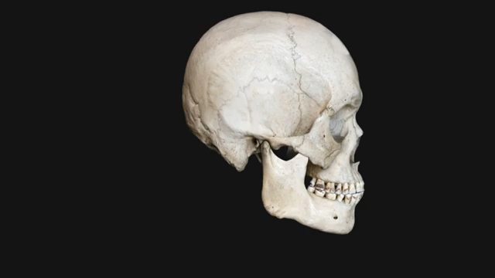
The muscles of mastication consist principally of two groups:
the elevator muscles and the depressor muscles.
The muscles responsible for elevating the mandible are the masseter, the internal pterygoid, and much of the temporal muscle
The posteriorly oriented fibers of the temporal muscle also retrude the mandible
The superficial muscle bundle of the masseter muscle may also assist with protruding the mandible whereas the deeper bundle stabilizes the condylar head against the articular eminence
Juxtaposed with the masseter muscle, the medial pterygoid forms a muscular support for the mandible at its angle.
Although its primary function is elevation of the mandible, it is also active during protrusion
The lateral pterygoid muscle is now known to function as two distinct muscles,
the inferior and superior lateral pterygoid muscles, with independent and almost opposite functions.
The inferior lateral pterygoid muscle depresses and protrudes the mandible.
The superior lateral pterygoid muscle does not contract during depression of the mandible but rather contracts along with the elevator muscles, thereby bracing the condyle anteromedially.

Slide 8
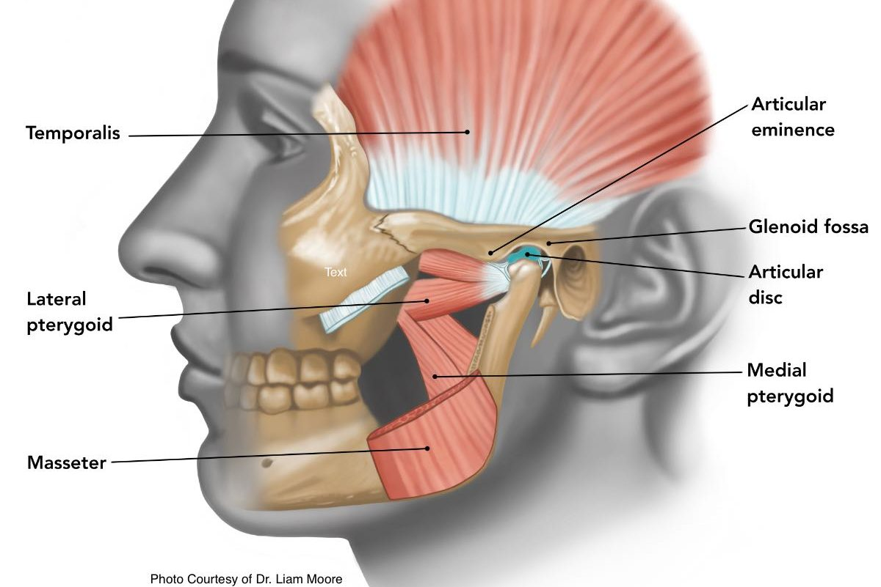
The motor and sensory innervation of the TMJs and the rest of the masticatory system are provided by structures of the trigeminal nerve.
The innervation of both the capsular ligaments and the discal ligaments provides essential proprioceptive input with regard to joint position.
Pain perception causes the nociceptive reflex to open the mouth rapidly via the contraction of depressor muscles and the suppression of elevator muscles;
Notes:
Elevator muscles : masseter, temporalis, medial pterygoid & upper head of lateral pterygoid
Depressor muscles : lower head of lateral pterygoid, geniohyoid, digastric ,mylohyoid.

Slide 9
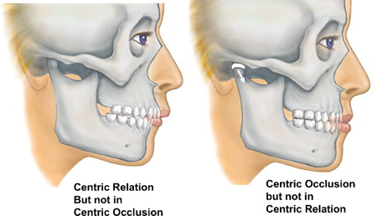
Centric Relation
The mandible is suspended from the cranial base by ligaments and
muscles.
The understanding of mandibular movement begins with an initial reference point for each condyle, which is usually referred to as centric relation;
this clinically determined relationship of the mandible to the maxilla occurs when both condyle–disc assemblies are in their most superior position in the maxillary (or glenoid) fossa and against the slope of the articular eminence of the temporal bone.
Verification of centric relation is obtained by loading the TMJs bilaterally with the teeth apart via the bimanual mandibular
manipulation technique.
When both condyles are in this relationship, rotation or hinging action
occurs around an axis defined by the medial poles of each condyle

Slide 10
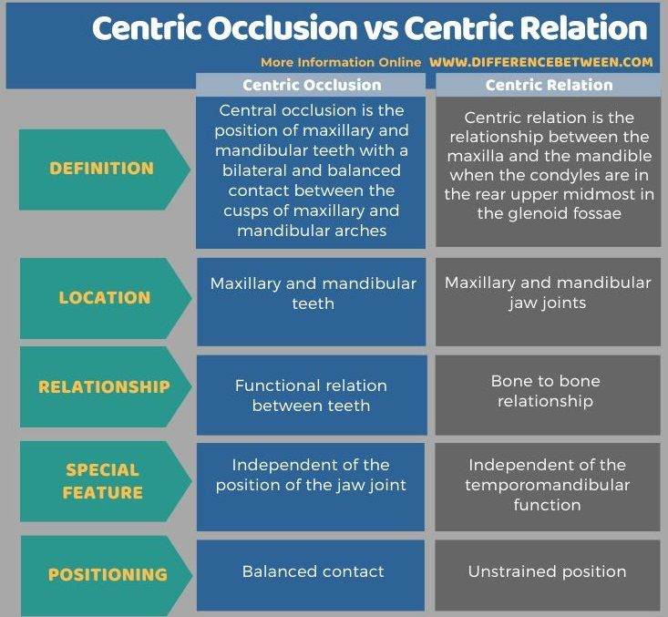
Enhancing your presentation

Slide 11

The term centric relation is limited to the rotation axis through both condyles while they are seated in their respective glenoid fossae.
The only occlusal consideration relative to centric relation occurs when rotation of the mandible initiates the first contact of opposing occlusal surfaces.
The term initial contact in centric relation can be used to define this relationship.
If the contraction of elevator muscles occurs at the point of initial occlusal contact and results in the distraction of one or both condyle–disc assemblies from their seated relationship, then centric relation is no longer occurring. For
For TMJs to maintain orthopedic stability, the condyles must remain fully seated in their respective fossae when the teeth occlude in maximal intercuspation.

Slide 12
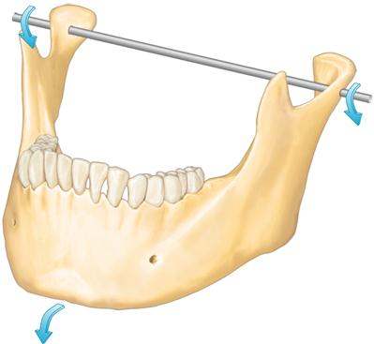
Biomechanics of the Masticatory System
Muscular action either stabilizes the condyle against the articular eminence or directs its rotational and translational movements relative to each respective temporal bone.
The position and functional movement of one condyle always depend on the status or activity of the other.
Because the maxillary teeth have a fixed relationship with the cranial base (just as mandibular teeth have a fixed relationship with the condyle), the contact of their respective occlusal surfaces may directly influence condylar position or movement.
pure rotation of up to approximately 25 mm can occur before translation of the condyle is required to continue toward the maximal opening of the jaw.
Movement of the condyle is relative to the disc, so rotation effectively occurs within the inferior joint space.
Strict translation protrudes the mandible, whereas the condyle–disc assembly moves anterior and inferior toward the articular eminence of the temporal bone.

Slide 13
the disc moves relative to the temporal bone, and movement occurs within the upper joint space .
During combination translation/rotation movement of the condyle, the axis of rotation for each condyle changes as the condyle translates down the articular eminence to a position inferior to its fossa.
Harmonious muscle function and ligament attachments keep the condyle–disc assembly properly related so that the articular disc remains loaded in its concave avascular central portion between the condyle and the articular surface of the temporal bone.
The elasticity and vascularity of the retrodiscal tissues permit anterior movement of the disc during the translation of each respective condyle.

Slide 14


Slide 15
Dysfunction and Deterioration
Clinical experience shows that the tolerance of the components of the masticatory system can be exceeded by both acute trauma and chronic trauma.
Acute trauma to the head and neck region can range from a distinct event, such as an accident or a blow to the face, to a sustained overuse experience, such as a long dental appointment. Acute trauma can serve as an initiating event that leads to a chronic condition, so accurate documentation and careful monitoring may prove extremely valuable.
Chronic trauma is defined as any experience that repeatedly exceeds the tolerances of the affected masticatory system structure.
Postural stresses and parafunctional occlusal habits, with or without occlusal discrepancies, may produce musculoskeletal disharmony and orthopedic instability of the TMJ.

Slide 16
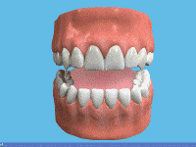
The general terms for occlusal parafunction used in this text
include bruxism, which is the grinding of the teeth, and clenching, which is when a person holds the teeth firmly together with significant force.
Bruxism is usually confirmed by the observation of excessive tooth wear.
The clenching type of parafunction can be distinguished from the grinding of the teeth, and it seems to be more often associated with masticatory system disorders than does bruxism.
Sleep bruxism may include both tooth grinding and clenching, and it seems to occur primarily during stage 1 and stage 2 (i.e., non–rapid eye movement) sleep.

Slide 17
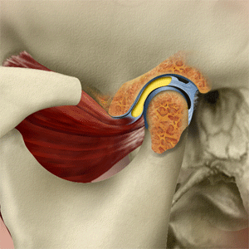
Disruption of the relationship or alignment of the condyle, the disc, and the articular surface of the temporal bone is typically called an intracapsular disorder or an internal derangement of the TMJ.
The articular disc can be displaced as a result of an acute blow to the jaw, chronic trauma, or the uncoordinated contraction of the lateral pterygoid muscle.
When the disc cannot return to its normal relationship to the condyle with full closure of the mouth, it is considered to be displaced or dislocated.

Slide 18
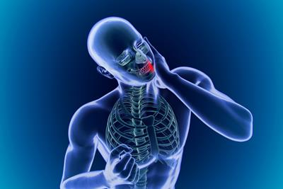
Orofacial Pain
Pain associated with TMJ dysfunction is most frequently muscular in origin, and it may be amplified by both occlusal parafunction and stress.
Headache pain is perceived primarily within the trigeminal nerve pathways, although other cranial and cervical nerves may offer painful sensory input.
Pain that originates in masticatory system structures, which are also innervated by the trigeminal nerve, requires diagnostic differentiation from headache pain.
Pain of dental and periodontal origin must be clearly defined and Differentiated from a heart attack, sinus pain, and myofascial pain.
Pain that originates in pulpal or periodontal nociceptors can be differentiated with a comprehensive clinical and radiographic evaluation.
Orofacial pain that originates in the TMJs or the muscles of mastication can result from neoplasm, macro trauma, repeated microtrauma, systemic disease, and anatomic predisposition.

Slide 19
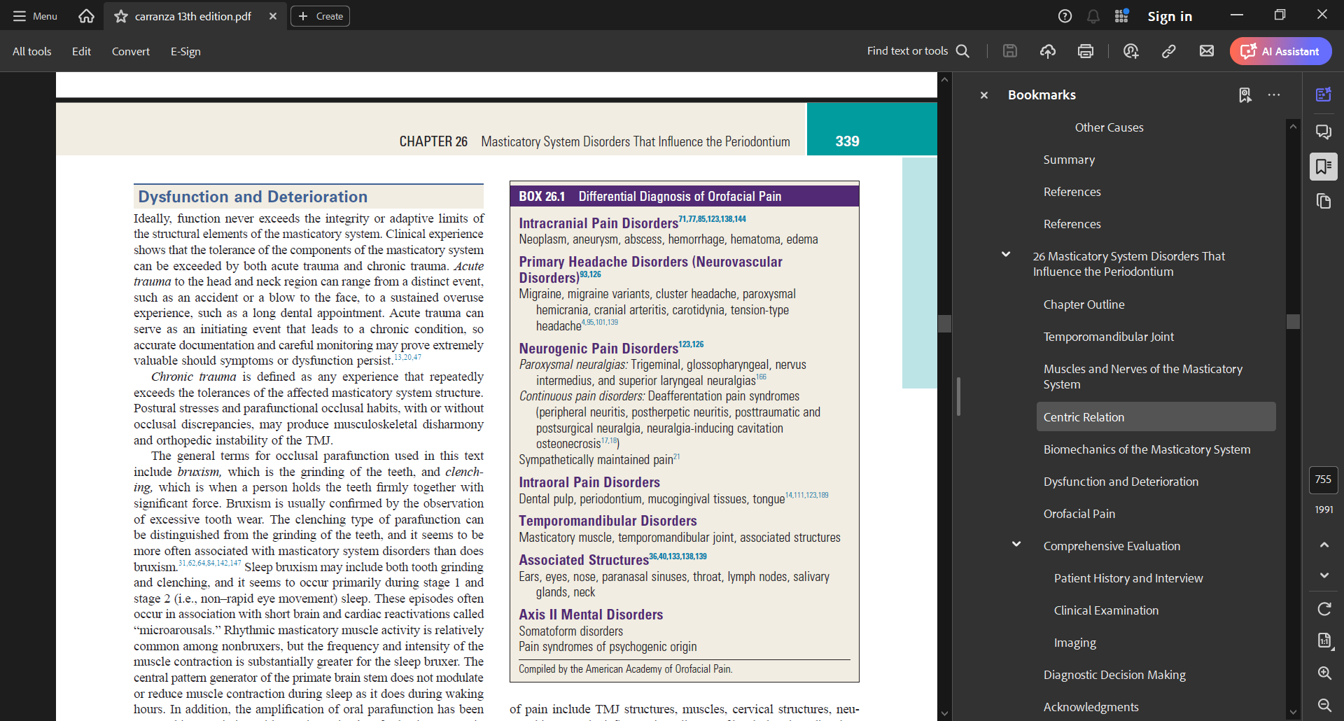

Slide 20
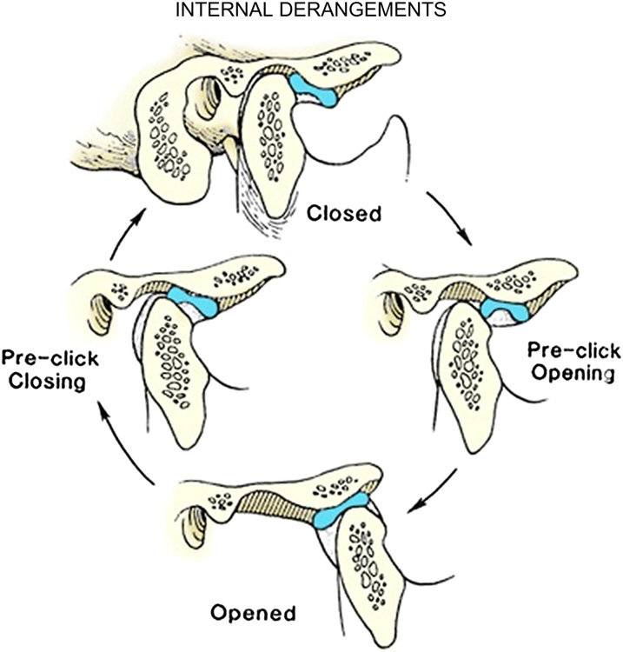
Progressive disc displacement most often begins on its lateral aspect and occurs in an anterior and medial direction as a result of the insertion of muscle fibers into the anteromedial aspect of the disc.
Stretching of the retrodiscal tissues and collateral ligaments permits the disc to be displaced and function to be limited in response to pain that results from compressive forces on the retrodiscal tissues
At some stage of opening, the remaining elasticity of the retrodiscal tissues and the tension of the capsular ligaments can pull the disc onto the head of the condyle, often with a discernible sound.
Closing then results in the disc again becoming dislocated anteriorly, which results in a common joint sound that is often referred to as a reciprocal click
Notes:
Reciprocal click. (A) Reciprocal click occurs when the condyle moves onto the articular disc from a position behind the posterior band of the
disc and then (B) clicks off the disc when the condyle moves back. This occurs as the condyle translates forward and back during the opening and closing
movements.

Slide 21
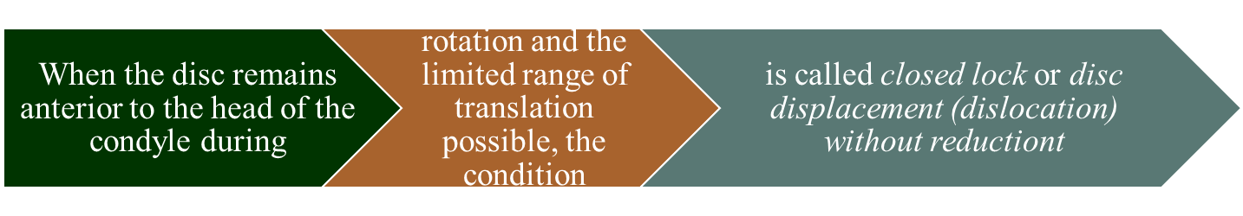
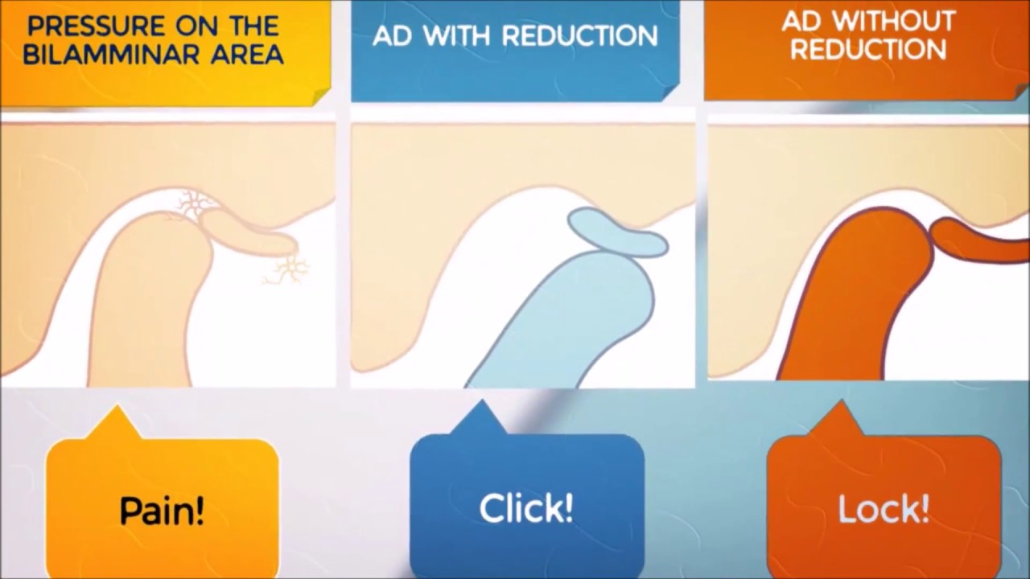
The vascular portion of the retrodiscal tissues being loaded between the condyle and the articular surface of the eminentia accounts for most current pain or a history of pain originating within the TMJ.
The adaptation of the retrodiscal tissues to completely nonvascular fibrous tissue or perforation of the disc may account for the cessation of the painful symptoms
Notes:
The retrodiscal (bilaminar) zone is located between the posterior band of the TMJ disc and the posterior portion of the TMJ capsule. The 'bilaminar' refers to the two posterior attachments of the disc:
superior layer: elastic to allow anterior translation of the disc over the articular eminence
inferior layer: inelastic collagen to maintain relationship with the mandibular condyle
It also contains a small neurovascular bundle.

Slide 22
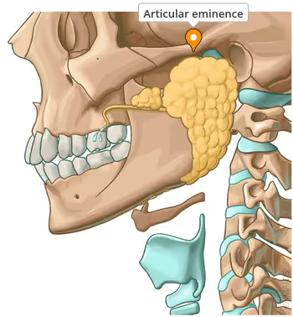
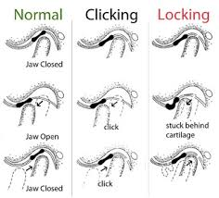
Hypermobility (subluxation) of the TMJ can permit the condyle to translate beyond the eminentia, with both the disc and the condyle located beyond its prominence.
When the condyles translate beyond the eminentia but the discs are trapped posteriorly, the combined steepness of the disc and the eminentia prevents the reduction of each condyle, and the mandible is locked open
Notes:
articular eminence (AE) and the articular tubercle are both parts of the temporomandibular joint (TMJ) in the skull, but they are different structures:
Articular eminence
Located on the temporal bone, the AE is the anterior limit of the glenoid fossa. It guides the path of the condyle, the top end of the jawbone, and controls how far the jaw can open.
Articular tubercle
A small bony projection on the lateral side of the AE, the articular tubercle is the origin of the temporomandibular ligament. The mandibular condyle moves over the articular tubercle when the jaw opens.
If the opening of mandible continues beyond 20-25mm, then translation movement occurs in upper compartment

Slide 23
Myositis of the masticatory muscles arises from direct trauma or infection close to the muscle.
Associated pain increases with mandibular movement, thereby limiting the range of motion.
Muscle spasm is the sustained involuntary contraction that results in the pain and dramatic shortening of the affected muscle.
Myospasms of the masticatory muscles greatly limits mandibular movement, and it can change that occlusion suddenly as a result of its rapid onset.
Local myalgia, which is pain that is specific to individual muscles, may result from ischemia or fatigue, and it may present as delayed-onset muscle soreness and protective co-contraction.

Slide 24
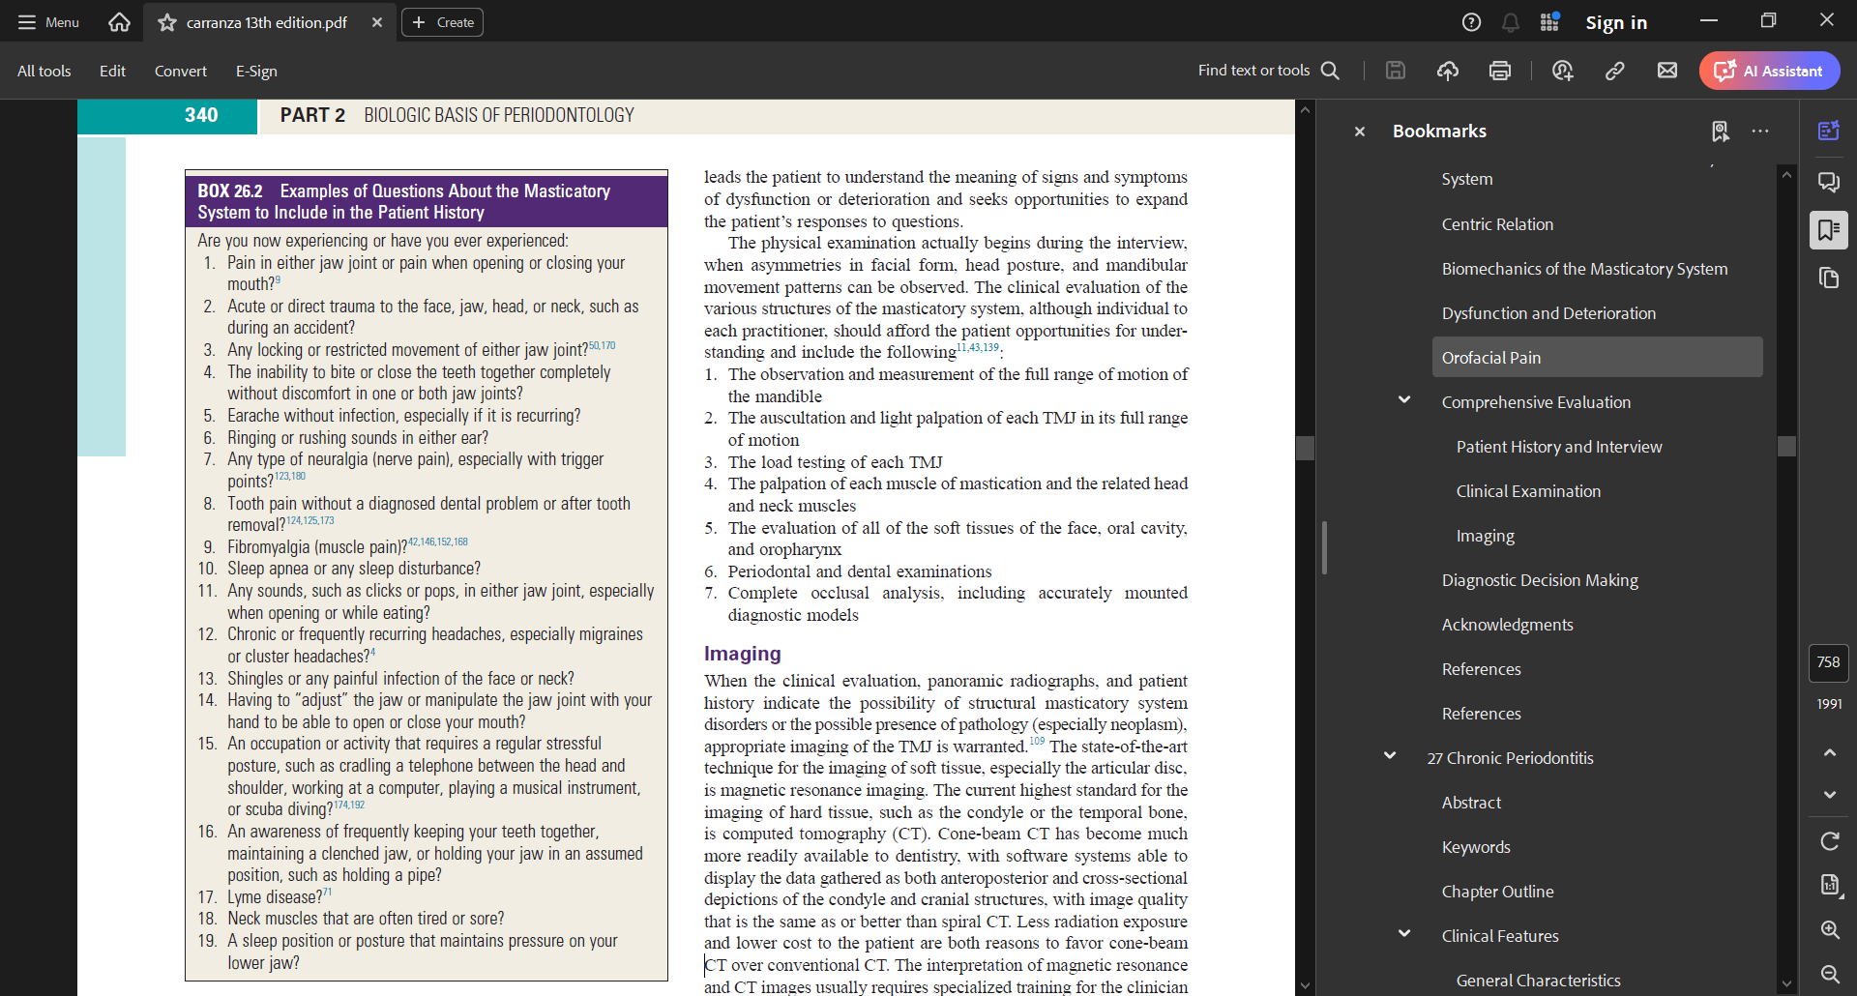
1.The observation and measurement of the full range of motion of the mandible
2. The auscultation and light palpation of each TMJ in its full range of motion
3. The load testing of each TMJ
4. The palpation of each muscle of mastication and the related head and neck muscles
5. The evaluation of all of the soft tissues of the face, oral cavity,
and oropharynx
6. Periodontal and dental examinations
7. Complete occlusal analysis, including accurately mounted
diagnostic models.

Slide 25
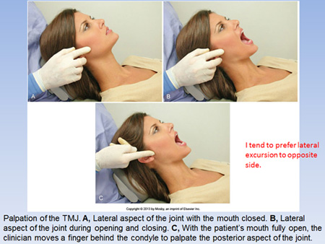
Evaluation of the TMJ begins with range-of-motion analysis.
The observation of a departure from a straight path of opening and closing the mandible suggests an intracapsular disorder or masticatory muscle incoordination.
An average maximal opening of 50 mm is common; findings of less than 40 mm of opening suggest limited opening caused by a masticatory system disorder.
The range of right and left lateral excursions is usually about 9 mm, and the protrusion of the mandible is typically 7 mm.
Auscultation of the joint by listening with a stethoscope or Doppler instrument, which amplifies joint sound for both the patient and the dentist, can reveal noises that are diagnostic for numerous conditions.
The intensity and nature of any sounds, clicks, pops, or crepitus (i.e., grinding, grating, or rubbing sounds) should be recorded accurately.

Slide 26
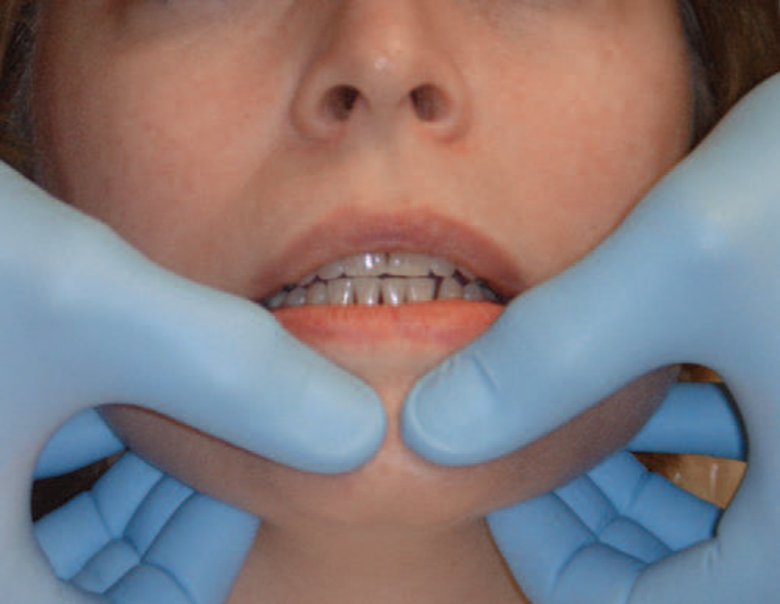
Load testing of the TMJ is essentially a means to palpate the head of the condyle, the surface of the glenoid fossa, and the tissue interposed between them, except in the case of bone-to-bone contact.
With bimanual mandibular manipulation, the dentist loads the joints equally and may detect resistance or tension on either side.
patient is in a supine position in the dental chair to minimize postural influence on muscle activity. The patient’s head is braced by the support of the chair and by being cradled against the dentist’s arm or abdomen.
The dentist’s middle fingers locate the notch in the mandible just anterior to the angle, and the thumbs are placed near the midline in the mental region of the mandible.
Initially, the dentist provides gentle guidance to the hinging action of the mandible, with a slight lifting force applied with the fingers and a slight depressing force applied with the thumbs.
If the patient remains comfortable, increasing force can be applied at both points, ultimately with enough pressure to load test the joints. With the avascular fibrous discs interposed, the condyles are in centric relation, and the loading of both joints is comfortable.

Slide 27
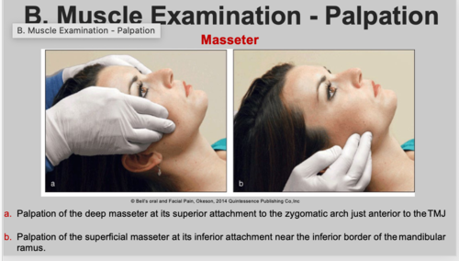
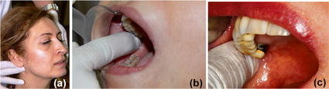
Muscle palpation is also a learned technique that requires both experience and expertise so that it may help to derive the most reliable information.
Externally, the muscles that are palpated include the anterior, middle, and posterior temporalis;
the superficial masseter; the anterior and posterior digastric; the sternocleidomastoid; the trapezius; the posterior cervical muscles; and the insertion of the medial pterygoid muscle.
Intraorally, the deep masseter is tested with moderate squeezing pressure, and the
The medial pterygoid muscle is palpated directly in the general region of the insertion point for local anesthesia with a mandibular block.
The lateral pterygoid is difficult to palpate because of the dominance of the medial pterygoid in the same region.

Slide 28


Slide 32

Speaking impact
Your ability to communicate effectively will leave a lasting impact on your audience
Effectively communicating involves not only delivering a message but also resonating with the experiences, values, and emotions of those listening

