Slide 1
MANAGEMENT OF DEEP BITE
Dr.Madhu bhaskar MDS
Dept of orthodontics
St. Joseph dental college

Slide 2
Contents
Introduction
Classification
Diagnosis
Treatment
Conclusion

Slide 3
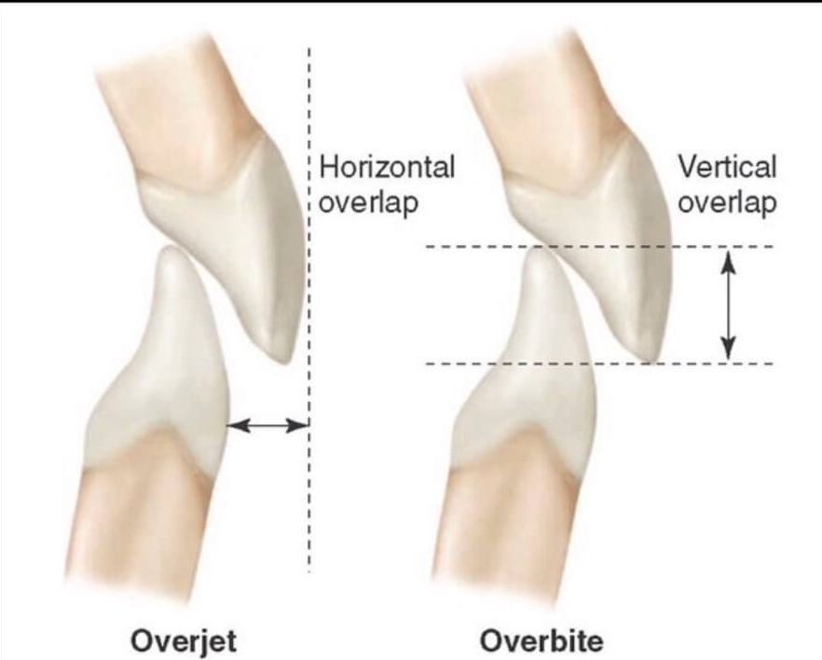
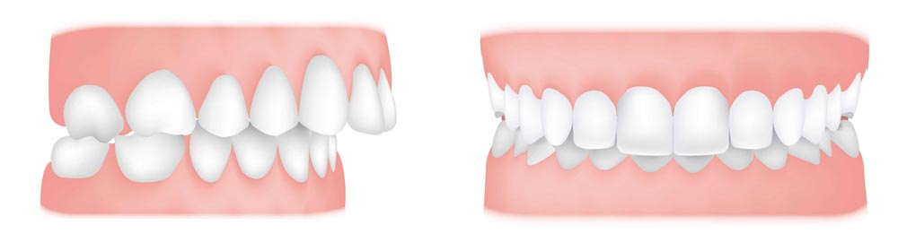
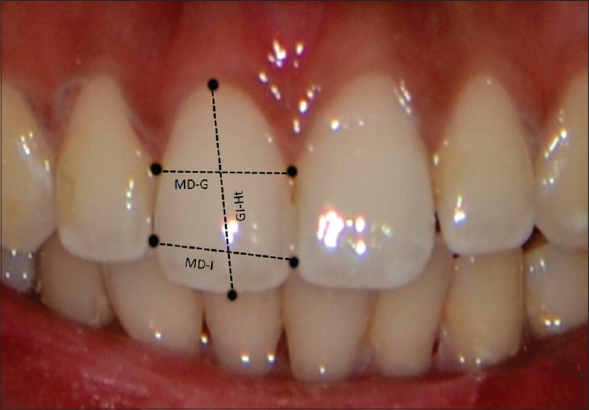
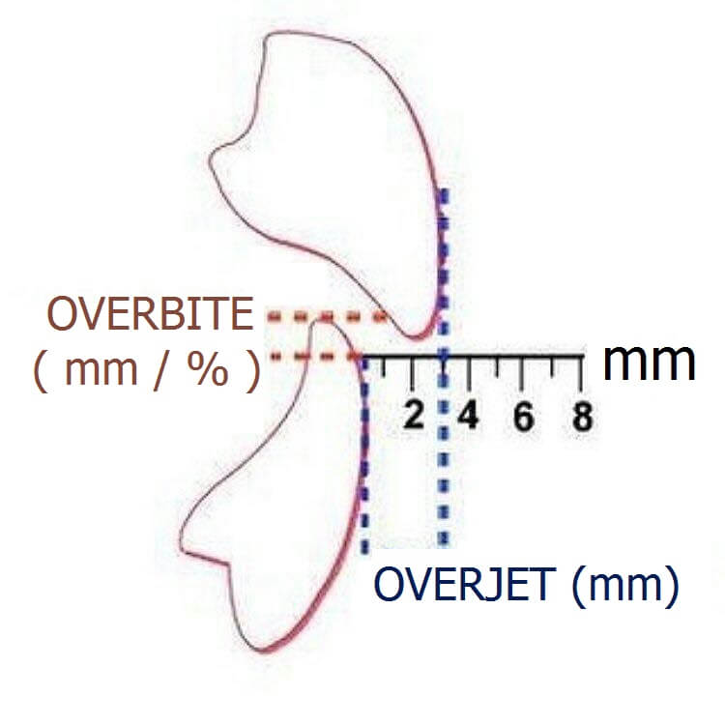
INTRODUCTION
2-4MM

Slide 4
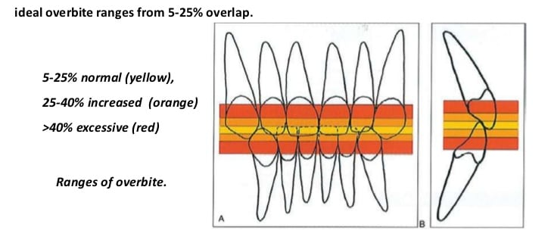
DEEP BITE IN PERCENTAGE

Slide 5
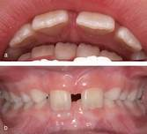
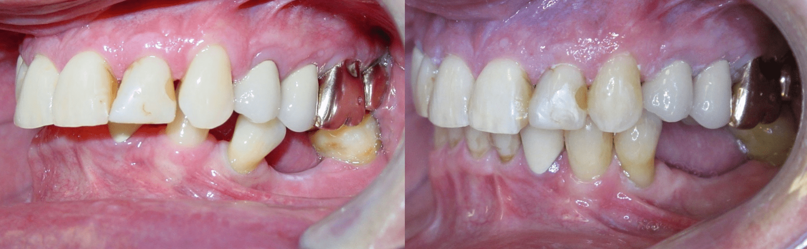
TYPES
COMPLETE
INCOMPLETE
COVERBITE
CLOSEDBITE

Slide 6
Primary
Mixed
Permanent
Deepbite
Dental
True
Pseudo
Skeletal
Origin
Functional

Slide 7
Skeletal deep bite
Horizontal grower
Dec ant facial height
Red freeway space
Horizontal planes parallel in cephalometry
Reduced mand plane angle

Slide 8
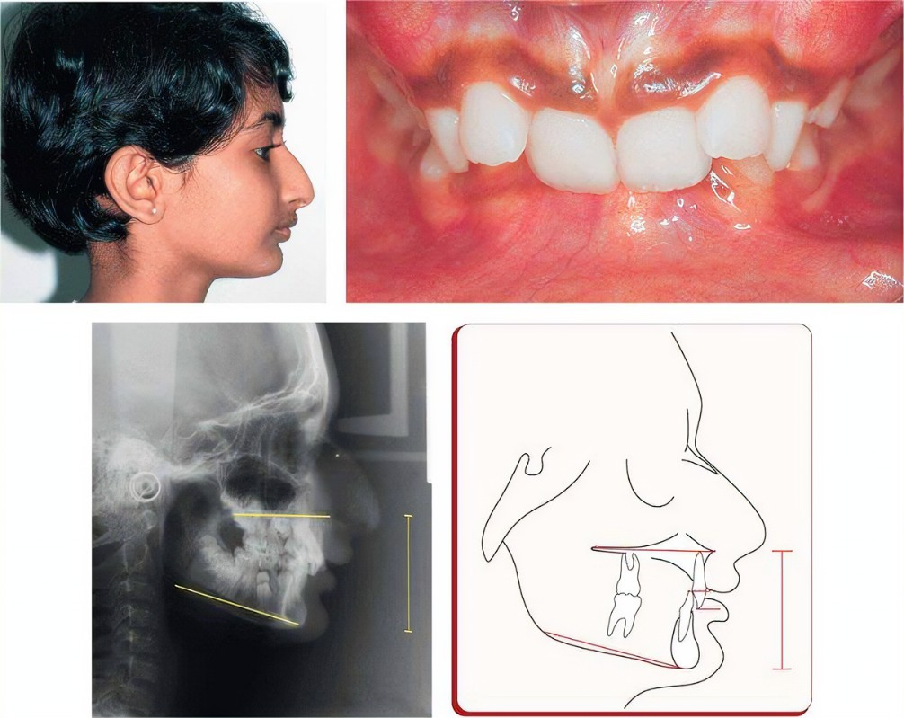

Slide 9
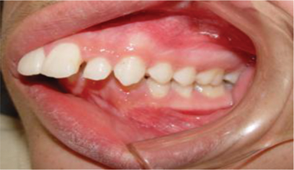
Dental deep bite
Over eruption of anteriors.
Infra occlusion of molars.

Slide 10
Diagnosis

Slide 11
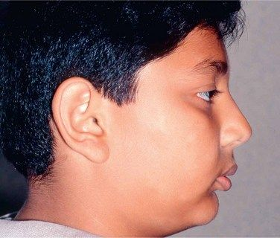
Factors to be considered in treatment of deepbite
Lip relation
  gummy smile and short upperlip
  Interlabial gap
Growth factor
Anterior facial height
Inter occlusal clearance(1-4mm)

Slide 12
Deep bite treatment
Removable
Hawleys with ant bite plane
Activator and bionator
Fixed
Anchor bends
Reverse curve
Intrusion arch
Utility arches
Fixed anterior biteplane
Implants
Treatment

Slide 13


Slide 19
Conclusion
Deep bite can be treated by intrusion of anteriors or extrusion of posteriors depending on diagnosis.

