Slide 1

INTRODUCTION TO RESEARCH METHODOLOGY
Dr. m. pavana sandya
Professor &hod
Dept of public health dentistry
St. joseph dental college

Slide 2
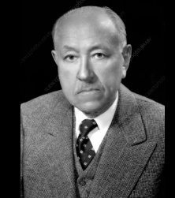
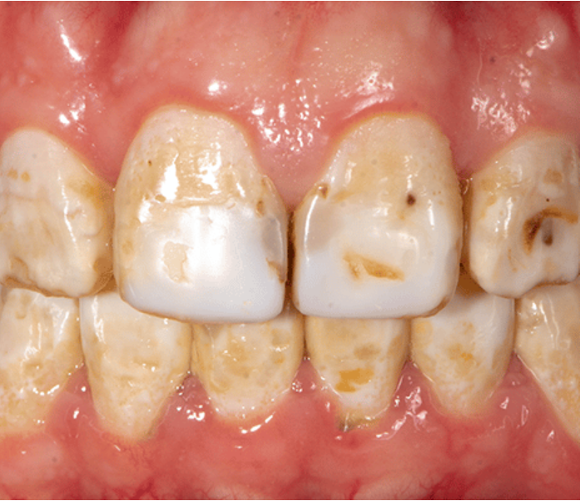
Dr. FREDERICK MC KAY DENTAL FLUOROSIS

Slide 3
contents
WHAT IS RESEARCH?
PURPOSE OF RESEARCH
AIM AND OBJECTIVES OF RESEARCH
MOTIVATION IN RESEARCH
ELEMENTS IN RESEARCH
TYPES OF RESEARCH
RESEARCH APPROACHES
HEALTH RESEARCH
SIGNIFICANCE OF HEALTH RESEARCH
RESEARCH PROCESS
PROBLEMS ENCOUNTERED BY RESEARCHERS IN INDIA
CRITERIA FOR GOOD RESEARCH
QUALITIES OF GOOD RESEARCH

Slide 4

What is research?
“A careful investigation or inquiry specially through search for new facts in any branch of knowledge.”
(The Advanced Learner’s Dictionary of Current English)
“A systematized effort to gain new knowledge.”
(Redman and Mory)

Slide 5


Some people consider research as a movement,
a movement from the known to the unknown.
It is actually a voyage(passage) of discovery.
We all possess the vital instinct or nature of inquisitiveness or, when the unknown confronts or challenges us, we wonder and our inquisitiveness makes us probe or seek and attain full and fuller understanding of the unknown.
This inquisitiveness is the mother of all knowledge and the method, which man employs for obtaining the knowledge of whatever the unknown, can be termed as research.
Notes:
Movement from known to unknown

Slide 6
What is research?
Research is an academic activity and as such the term should be used in a technical sense.
According to Clifford Woody research comprises defining and redefining problems, formulating hypothesis or suggested solutions; collecting, organizing and evaluating data; making deductions and reaching conclusions.

Slide 7
Objectives of research
PURPOSE OF RESEARCH
Is to discover answers to questions through the application of scientific procedures.
Exploratory or formulative
Descriptive
Diagnostic
Hypothesis testing
AIM OF RESEARCH
To find out the truth which is hidden and which has not discovered as yet.

Slide 8

Motivation in research
Desire to get a research degree
Desire to face the challenge in solving the unsolved problems
Desire to get intellectual joy of doing some creative work
Desire to be of service to society
Desire to get respectability

Slide 9
Elements of Research:
Investigatory, desirable mind
Specific field
Availability of information
Descriptive presumption
Scientific theory Explanation
Fruitful logical theory

Slide 10
Types of research
DESCRIPTIVE VS ANALYTICAL
QUANTITATIVE VS QUALITATIVE
APPLIED VS FUNDAMENTAL
CONCEPTUAL VS EMPIRICAL

Slide 11
DESCRIPTIVE Vs ANALYTICAL
ANALYTICAL
DESCRIPTIVE
(EX POST FACTO RESEARCH)
The researcher has to use facts or information already available, and analyze these to make a critical evaluation of the material.
Eg: Factors associated with dental caries in schoolchildren.
The researcher has no control over the variables; he can only report what has happened or what is happening.
Researchers can discover causes even when they cannot control the variables.
Eg: Prevalence of dental caries in schoolchildren in a city.

Slide 12
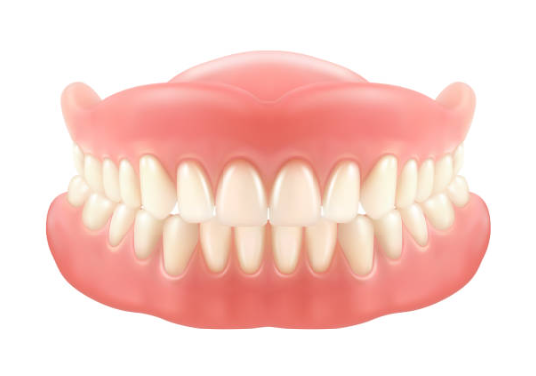

applied Vs fundamentAL
APPLIED
FUNDAMENTAL
To solve specific, practical problems or to answer real-world questions.
It is focused on applying scientific methods and knowledge to address immediate needs or challenges rather than purely expanding theoretical understanding.
Eg: Many patients with removable dentures experience discomfort and poor fit, leading to reduced usage and quality of life.
Fundamental research is mainly concerned with generalisations and with the formulation of a theory.
Basic research is directed towards finding information that has a broad base of applications and thus, adds to the already existing organized body of scientific knowledge.
Eg: Why does fluoride strengthen tooth enamel?

Slide 13
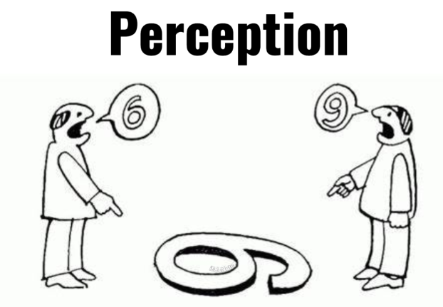
qualitaTIVE Vs quantitative
QUANTITATIVE
QUALITATIVE
on measuring and quantifying phenomena using numerical data.
Structured methods like surveys, experiments, and statistical analysis to identify patterns, relationships, or causal connections.
Eg: To measure the reduction in dental caries in patients using fluoride toothpaste versus non-fluoride toothpaste over 6 months.
Focuses on understanding human experiences, perceptions, and behaviors. It explores why and how people think, feel, and act in certain ways.
Eg: Understanding Patients’ Perceptions of Dental Anxiety

Slide 14
Conceptual Vs empirical
EMPIRICAL
CONCEPTUAL
Related to some abstract idea(s) or theory.
To develop new concepts or reinterpret existing theories.
Eg: Understanding the philosophy of patient-centered care.
Collects and analyzes data from direct observation or experimentation to answer specific questions, solve problems, or test hypotheses. It is grounded in the scientific method and is essential for validating theories and concepts with real-world evidence. (Experimental)
Eg: Effectiveness of a New Oral Hygiene Education Program

Slide 15
Research Approaches
Research approaches refer to the overall strategy and design used to conduct a study. These approaches guide the collection, analysis, and interpretation of data. There are three primary research approaches:
QUANTITATIVE
QUALITATIVE
MIXED

Slide 16
Quantitative research approach
Focuses on numerical data, measurement, and statistical analysis to answer research questions or test hypotheses.
Objective and structured.
Surveys, experiments, observational studies with numerical outcomes
Measuring the effectiveness of a new fluoride varnish in reducing dental caries using a randomized controlled trial.
To quantify relationships, measure variables, and generalize findings

Slide 17
Qualitative research approach
Explores subjective experiences, behaviors, and social phenomena in depth through non-numerical data..
Interpretive and flexible.
Interviews, focus groups, case studies,
To gain a deeper understanding of motivations, perceptions, or social dynamics.
Interviewing patients to understand their perceptions of pain management during dental procedures.

Slide 18
Mixed-Methods Approach
Combines both quantitative and qualitative approaches to provide a comprehensive understanding of a research problem..
Integrative and pragmatic.
Methods: Sequential or concurrent use of quantitative and qualitative methods.
Quantitative: Conducting a survey to measure oral hygiene behaviors.
Qualitative: Followed by interviews to explore why patients follow or neglect certain practices.
To capture the strengths of both approaches for a well-rounded analysis.

Slide 19
Health research
There are different types of health research:
Also known as medical research,
Scientific methods to learn about human diseases,
How to prevent and treat illness
How to promote health.
Behavioral research
Clinical research
Genetic research
Public health research

Slide 20
SIGNIFICANCE OF HEALTH RESEARCH
Improves Patient Care and Outcomes
  Evidence-Based Practices
  Personalized Medicine
Prevention of Diseases
  Early Detection
  Vaccines and Preventive Measures
Addresses Health Inequalities
Advances Scientific Knowledge
Supports Policy and Public Health Decisions
Combats Emerging Health Threats
Economic Benefits
Global Health Contributions

Slide 21
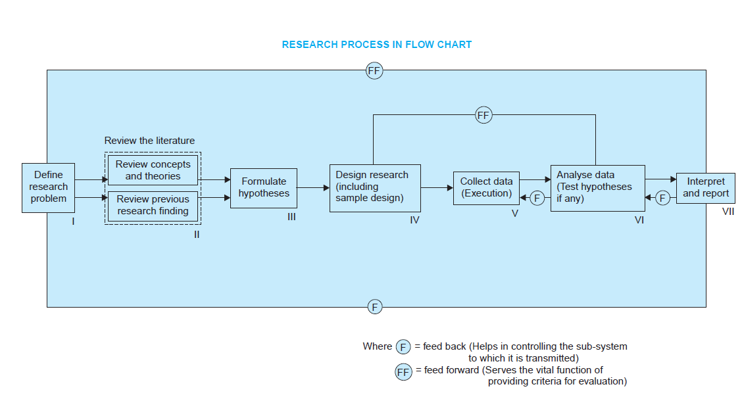
Research process

Slide 22

Formulating A research problem
Types of Research problem:
State of Nature Problems: Focus on understanding the inherent characteristics or conditions of a subject.
Relationship Problems: Explore connections or associations between variables
Selection: Identify a broad area, resolve ambiguities, and assess feasibility.
Steps:
Discuss with experts or guides.
Rephrase into specific, operational terms.

Slide 23
Formulating A research problem
Literature Review: Explore theories and past studies for context and data availability.
Definition: Clearly define the problem for relevant data and objectivity.
Refinement: Progress from general to specific formulations.
Importance: Drives data collection, analysis, and reporting.

Slide 24

Literature search
Purpose: Conduct an in-depth review to understand the research context.
Key Sources: Abstracts, indexing journals, bibliographies, academic journals, books, conference proceedings, government reports.
Approach: Follow references from one source to another.
Focus: Study similar prior research thoroughly.
Support: Utilize resources like a good library.

Slide 25
HOW TO SEARCH FOR ARTICLES?
Use Boolean operators
Boolean is a set of commands that can be used in almost every search engine, database, or online catalogue.
We can use the AND
OR
NOT
and AND NOT

Slide 26
KEYWORDS
Clinical trial
Dental caries
Longitudinal
Xylitol

Slide 27
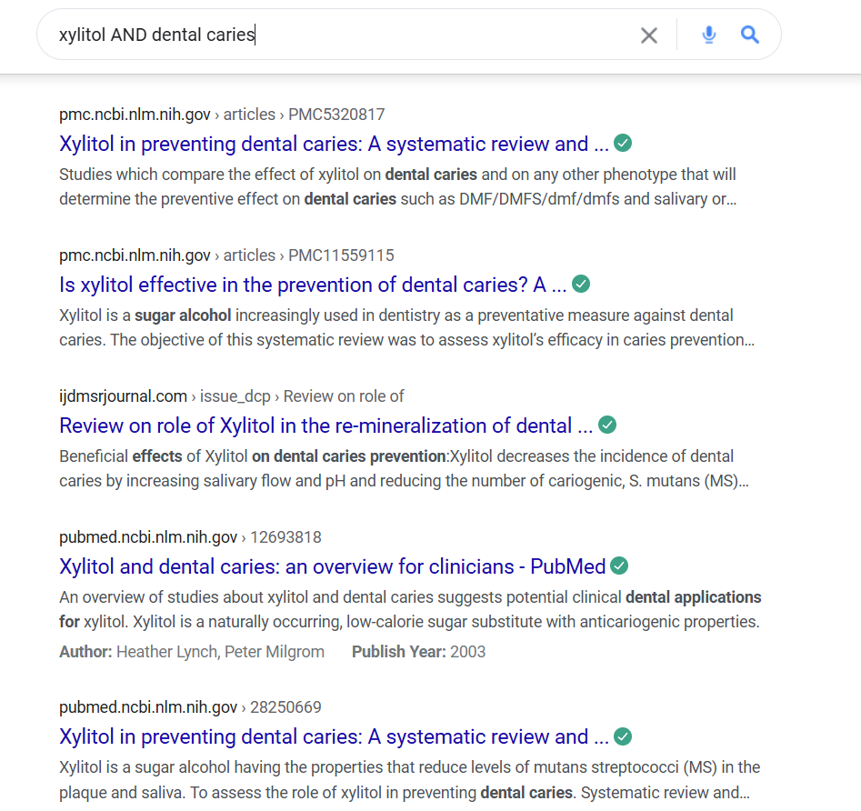

Slide 28
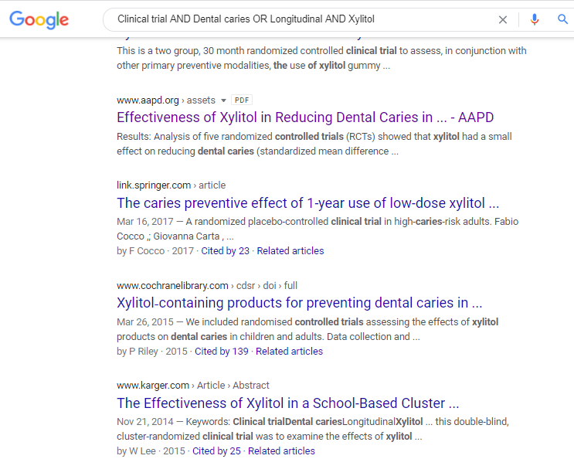

Slide 29
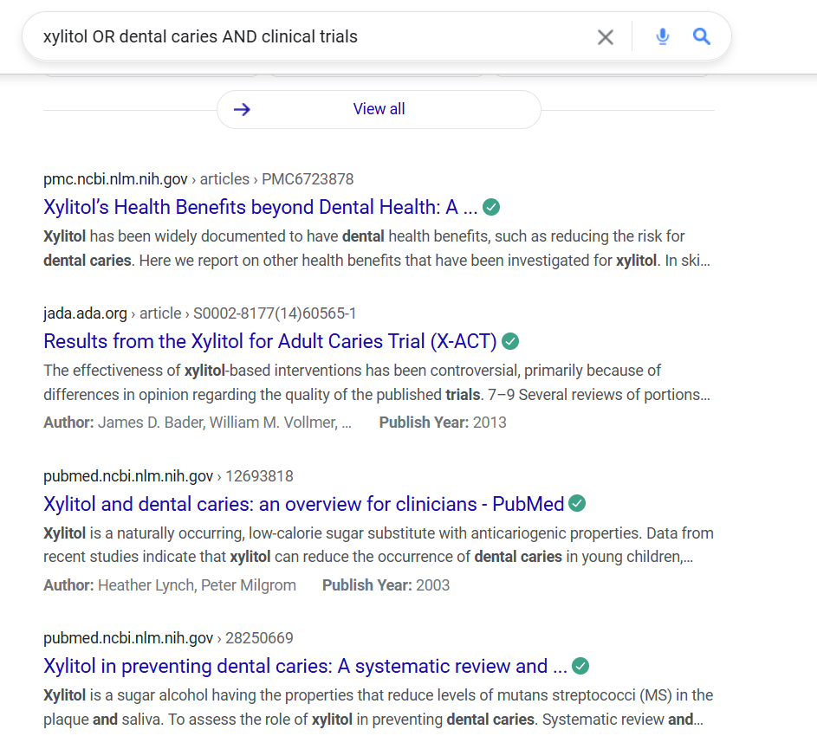
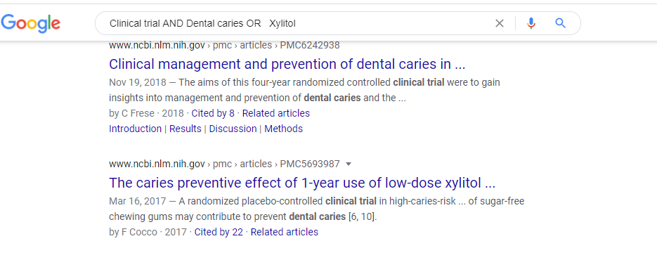

Slide 30
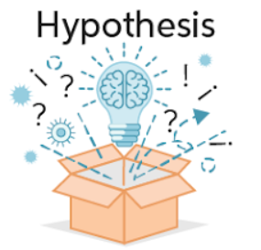
Development of working hypothesis
Working hypothesis is a tentative assumption to test logical or empirical outcomes.
Importance: Focuses research, guides data collection, and analysis methods.
Characteristics: Specific, precise, and relevant to the research.
Development Approach:
  Discussions with experts.
  Review of data, trends, and similar studies.
  Exploratory field investigations.

Slide 31

Formulation of hypothesis
It is a supposition, arrived at from observation or reflection
It should specify following:
  POPULATION- The characteristics of the persons to whom the hypothesis applies
  SPECIFIC CAUSE BEING CONSIDERED- The environmental exposure
  EXPECTED OUTCOME – the disease
  DOSE-RESPONSE RELATIONSHIP
  TIME-RESPONSE RELATIONSHIP

Slide 32
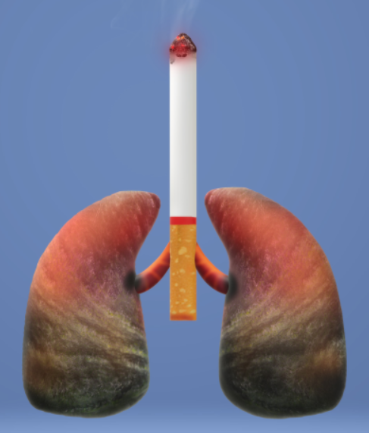
“CIGARETTE SMOKING CAUSES LUNG CANCER”
AN IMPROVED FORMULATION
“ The smoking of 30-40 cigarettes per day causes lung cancer in 10% of smokers after 20 years of exposure.”

Slide 33

Preparing the research design
Conceptual structure for conducting research efficiently with minimal effort, time, and cost.
Purpose:
Exploration
Description
Diagnosis
Experimentation
Design Types:
Experimental: Informal (e.g., before-and-after, control group) or formal (e.g., randomized designs).
Non-Experimental: For hypothesis testing and observational studies.

Slide 34
PREPARING THE RESEARCH DESIGN
Key Considerations:
Methods to obtain information.
Researcher’s skills and resources.
Time and cost constraints.
Justification for chosen methods.

Slide 35
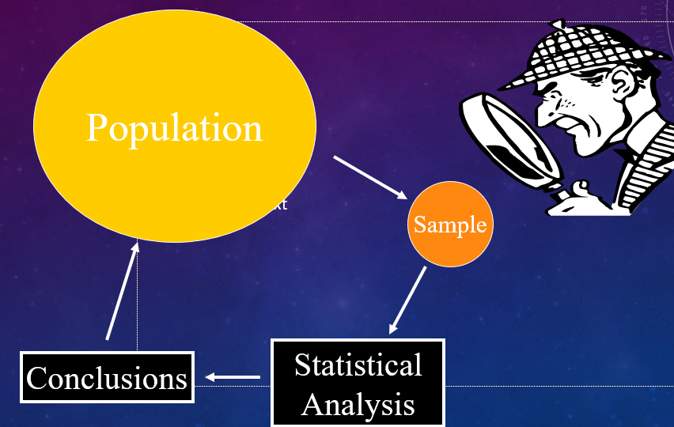
Determining the sample design
All the items under consideration in any field of inquiry constitute a ‘universe’ or ‘population’. A complete enumeration of all the items in the ‘population’ is known as a census inquiry.
Sampling Design: Plan to select a subset (sample) from the population for efficient study.

Slide 36
Sample Types:
Probability Samples:
Non-Probability Samples:
Special Designs:
Sequential Sampling: Sample size adjusts during survey progress.
Mixed Sampling: Combination of methods for flexibility.
Key Considerations: Nature of inquiry, cost, time, and bias minimization.

Slide 37

Collecting the data
Experiment: Quantitative measurements to test hypotheses.
Survey: Methods include:
  Observation: Investigator observes directly; limited scope, high cost.
  Personal Interview: Structured questions; depends on interviewer skill.
  Telephone Interview: Quick, useful in industrial surveys.
  Mailed Questionnaires: Widely used; requires pre-testing (pilot study).
  Schedules: Trained enumerators collect data via schedules; accuracy depends on enumerator capability.

Slide 38

Factors to Consider
  Nature, objective, and scope of the inquiry.
  Financial resources, time, and desired accuracy.
  Researcher's experience and judgment.

Slide 39

Execution of the project
Systematic Execution
  Ensure data collected is adequate, dependable, and timely.
  Use structured, coded questionnaires for machine processing.
Training & Monitoring
  Proper selection and training of interviewers with clear instruction manuals.
  Conduct occasional field checks to ensure efficiency and sincerity.

Slide 40

Maintaining Accuracy
  Keep the survey under statistical control to meet accuracy standards.
  Monitor and address unanticipated factors promptly.
Handling Non-Response
  List non-respondents, take a sub-sample, and secure responses with expert assistance

Slide 41

Analysis of data
Data Preparation
  Categorize raw data into manageable groups.
  Perform coding to transform categories into symbols for tabulation.
  Edit data to improve quality and ensure accuracy.
Tabulation
  Organize data into tables for analysis.
  Utilize computers for efficient tabulation, especially in large inquiries.

Slide 42

Statistical Analysis
  Compute percentages, coefficients, and apply statistical formulas.
  Use tests of significance to validate relationships or differences.
  Distinguish real differences from random fluctuations.
Drawing Conclusions
  Analyze results to confirm or reject hypotheses based on statistical evidence.

Slide 43
Hypothesis testing
Purpose
  Evaluate whether data supports or contradicts the hypotheses.
Statistical Tests
  Common tests:
    Chi-square Test
    t-Test
    F-Test
  Choice depends on the research objective and data nature.

Slide 44
3.Outcome
  Accept Hypothesis: Data supports the hypothesis.
  Reject Hypothesis: Data contradicts the hypothesis.
4.Future Scope
  If no initial hypothesis, use findings to form hypotheses for future research.

Slide 45
Generalisations and interpretations
Generalisation
  When a hypothesis is consistently upheld, it may lead to the formulation of a theory.
  Research's value lies in drawing reliable generalizations.
Interpretation
  If no hypothesis, findings are explained through existing theories.
  Interpretation often sparks new questions, prompting further research.

Slide 46
Preparation of the report or the thesis
Layout of the Report
  Preliminary Pages: Title, Date, Acknowledgements, Foreword, Table of Contents, List of Tables/Graphs.
  Main Text:
    Introduction: Objective, Methodology, Scope, Limitations.
    Summary of Findings: Non-technical language, key findings, recommendations.
    Main Report: Logical sequence, distinct sections.
    Conclusion: Final summing up of results.

Slide 47
3. End Matter : Appendices, Bibliography, Index (for published reports).
4. Writing Style:
  Concise, objective, simple language.
  Avoid vague expressions (e.g., "it seems," "there may be").
5. Charts/Illustrations:
  Use only if they clarify or enhance understanding.
6. Confidence Limits:
  Mention calculated confidence limits and research constraints.

Slide 48
Problems encountered by researchers in india
Lack of Scientific Training: Insufficient understanding of research methodology, leading to poorly executed studies.
Limited Interaction Between Academia and Industry: Lack of liaison between university research departments and business/government bodies, restricting access to valuable data.
Confidentiality Concerns: Business units reluctant to share data due to fear of misuse.

Slide 49
Duplication of Research: Overlapping research studies due to inadequate information and coordination.
Absence of Research Code of Conduct: Rivalries between researchers and lack of ethical guidelines.
Inadequate Secretarial Assistance: Delays due to insufficient support, especially in computer-related tasks.

Slide 50
Poor Library Management: Time wasted searching for materials rather than focusing on research.
Delay in Government Publications: Libraries, especially in remote areas, face delays in receiving government materials.
Data Availability Issues: Delayed and inconsistent availability of published data from various agencies.
Conceptualization and Data Collection Issues: Problems in defining research scope and data collection processes.

Slide 51
Criteria for good research
Clear Purpose & Concepts: Defined research objective and common terminology.
Detailed Procedure: Research should be replicable with enough detail for others to follow.
Objective Design: Research process should minimize bias and maximize objectivity.
Transparency: Acknowledge flaws in the design and estimate their impact on findings.
Adequate Data Analysis: Methods should be appropriate, ensuring data validity and reliability.
Valid Conclusions: Conclusions must be supported by the data and appropriately limited.
Researcher Integrity: Greater confidence in research by experienced and reputable researchers.

Slide 52
Qualities of Good Research
Systematic: Structured, following a clear sequence and rules.
Logical: Guided by logical reasoning (induction & deduction).
Empirical: Based on real situations with concrete data.
Replicable: Results can be verified through replication.

Slide 53


