Slide 1
Influence of Systemic Conditions on
periodontium

Slide 2
Contents
Endocrine Disorders and Hormonal Changes
Hematologic Disorders and Immune Deficiencies
Genetic Disorders
Stress and Psychosomatic Disorders
Nutritional Influences
Medications
Other Systemic Conditions
Conclusion

Slide 3
About us
Many systemic diseases, disorders, and conditions have been implicated as risk indicators or risk factors in periodontal disease.
The relationships between periodontal infections and host defense are complex.
A number of environmental, physical, and psychosocial factors have the potential to alter periodontal tissues and the host immune response, thereby resulting in more severe periodontal disease expression.
It is important to recognize that the systemic diseases, disorders, or conditions themselves do not cause periodontitis; rather, they may predispose, accelerate, or otherwise increase the disease’s progression.
This chapter discusses important systemic diseases, disorders, and conditions that have the potential to influence periodontal health.

Slide 4

Endocrine diseases such as diabetes and hormonal fluctuations that are associated with puberty and pregnancy are well-known examples of systemic conditions that adversely affect the condition of the periodontium.
Endocrine disturbances and hormone fluctuations affect the periodontal tissues directly, modify the tissue response to local factors, and produce anatomic changes in the gingiva that may favour plaque accumulation and disease progression.
Endocrine Disorders
And
Hormonal Changes

Slide 5


It is a complex metabolic disorder characterized by chronic hyperglycemia. Diminished insulin production, impaired insulin action, or a combination of both result in the inability of glucose to be transported from the bloodstream into the tissues, which in turn results in high blood glucose levels and the excretion of sugar in the urine.
Lipid and protein metabolism are altered in diabetes as well. Uncontrolled diabetes (chronic hyperglycemia) is associated with several long-term complications, including
microvascular diseases(retinopathy, nephropathy, or neuropathy), macrovascular diseases (cardiovascular and cerebrovascular conditions), increased susceptibility to infections, and poor wound healing.

Slide 6

There are two major types of diabetes, type 1 and type 2, with several less common secondary types.
Type 1 diabetes mellitus, which was formerly known as insulin-dependent diabetes mellitus, is caused by a cell-mediated autoimmune destruction of the insulin-producing beta cells of the islets of Langerhans in the pancreas, which results in insulin deficiency.
Type 1 diabetes accounts for 5% to 10% of all cases of diabetes and most often occurs in children and young adults.
This type of diabetes results from a lack of insulin production, and it is very unstable and difficult to control.
It has a marked tendency toward ketosis and coma, it is not preceded by obesity, and it requires the injection of insulin to be controlled.
Patients with type 1 diabetes mellitus present with the symptoms that are traditionally associated with diabetes, including polyphagia, polydipsia, polyuria, and predisposition to infections.

Slide 7

Type 2 diabetes mellitus, which was formerly known as non–insulin-dependent diabetes mellitus, is caused by peripheral resistance to insulin action, impaired insulin secretion, and increased glucose production in the liver.
The insulin-producing beta cells in the pancreas are not destroyed by cell-mediated autoimmune reaction.
It typically begins as insulin resistance, which leads to the reduced pancreas production of insulin as the demand increases.
Individuals are often not aware they have the disease until severe symptoms or complications occur.
Type 2 diabetes generally occurs in obese individuals, and it can often be controlled by diet and oral hypoglycemic agents.
Ketosis and coma are uncommon.

Slide 8

An additional category of diabetes is hyperglycemia secondary to other diseases or conditions.
A prime example of this type of hyperglycemia is gestational diabetes associated with pregnancy.
Gestational diabetes develops in 2% to 10% of all pregnancies but disappears after delivery.
Women who have had gestational diabetes are at increased risk of developing type 2 diabetes.
Other secondary types of diabetes are those associated with diseases that involve the pancreas and the destruction of the insulin-producing cells.
Endocrine diseases (e.g., acromegaly, Cushing syndrome), tumors, pancreatectomy, and drugs or chemicals that cause altered insulin levels are included in this group.

Slide 9
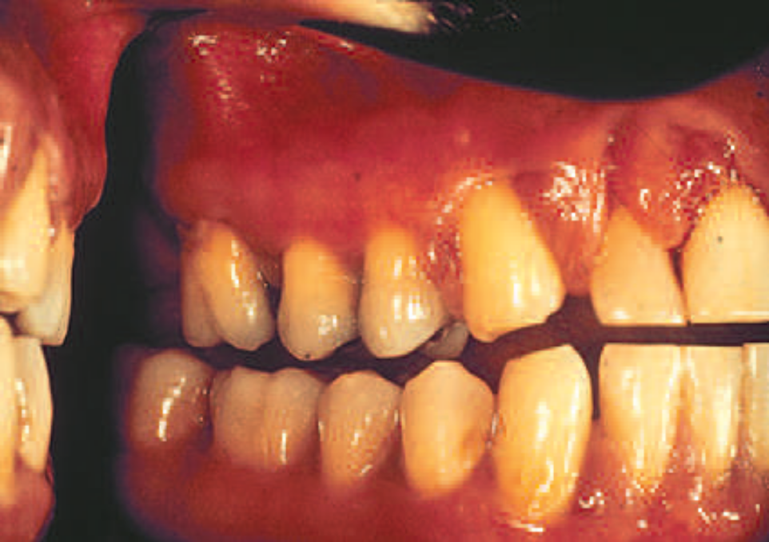
Oral Manifestations
Numerous oral changes have been described in patients with diabetes,
including cheilosis, mucosal drying and cracking, burning mouth and tongue, diminished salivary low, and alterations in the flora of the oral cavity, with greater predominance of Candida albicans, hemolytic streptococci, and staphylococci.
An increased rate of dental caries has also been observed in patients with poorly controlled diabetes.
It is important to note that these changes are not always present, that they are not specific, and that they are not pathognomonic for diabetes.
Individuals with controlled diabetes have a normal tissue response, a normally developed dentition, a normal defense against infections,
and no increase in the incidence of caries.

Slide 10
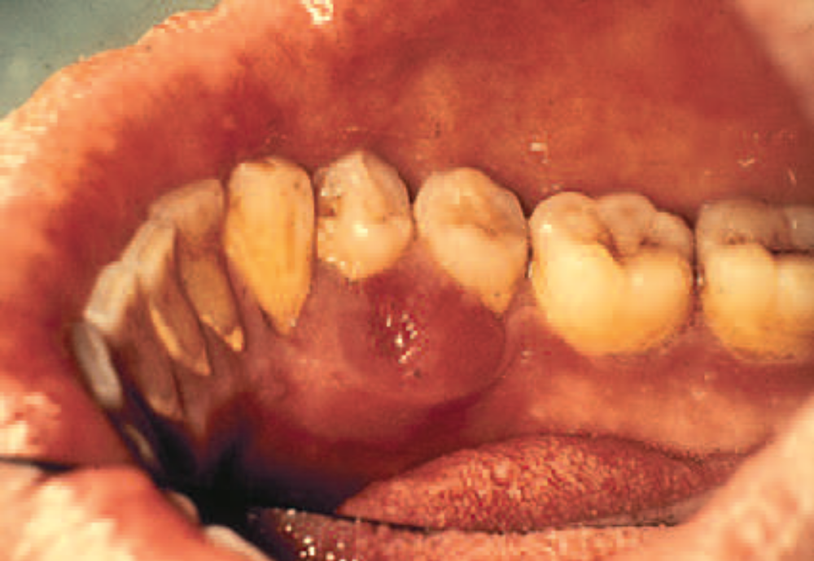
The influence of diabetes on the periodontium a variety of changes have been described, including a tendency toward
enlarged gingiva,
sessile or pedunculated gingival polyps,
Polypoid gingival proliferations,
abscess formation,
periodontitis, and loosened teeth.
the most striking changes in patients with uncontrolled diabetes are the reductions in the defense mechanisms
and the increased susceptibility to infections, which lead to destructive periodontal disease.
In fact, periodontal disease is considered to be the sixth complication of diabetes
periodontal disease in patients with diabetes follows no consistent or distinct pattern

Slide 11
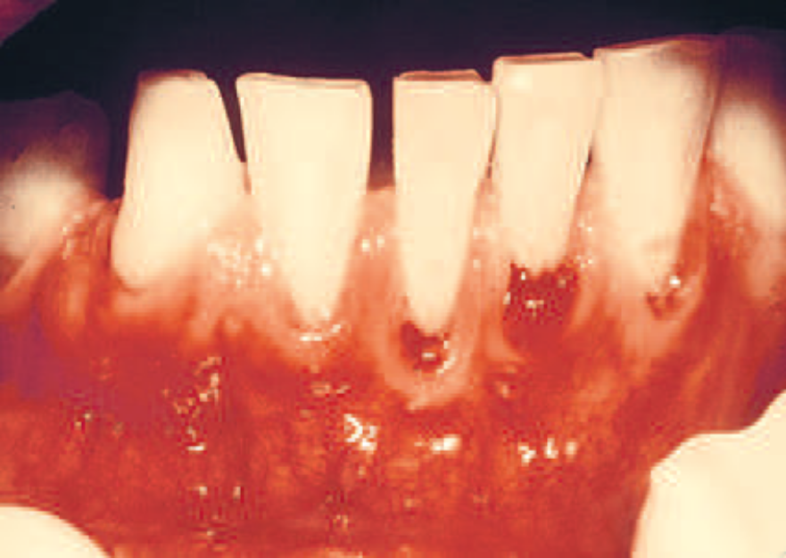
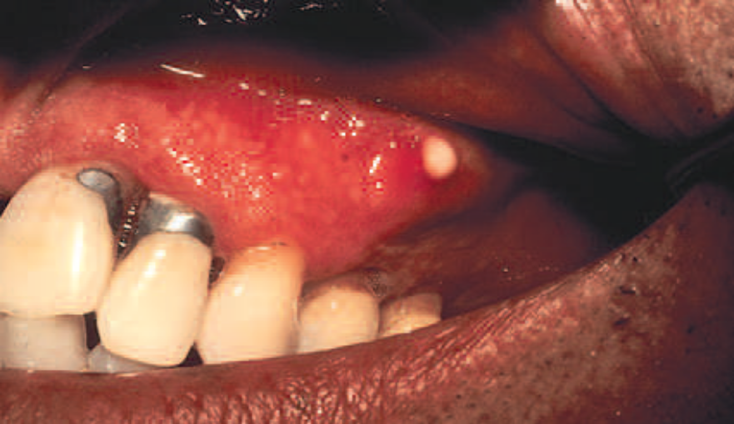
Severe gingival inflammation,
deep periodontal pockets,
rapid bone loss, and
frequent periodontal abscesses often occur in patients with poorly controlled diabetes and poor oral hygiene.
Children with type 1 diabetes tend to have more destruction around the first molars and incisors, but this destruction becomes more generalized at older ages
Adults who are 45 years of age or older with poorly controlled diabetes (i.e., with a glycated hemoglobin level >9%) were 2.9 times more likely to have severe periodontitis than those without diabetes.
The likelihood was even greater (4.6 times) among smokers with poorly controlled diabetes

Slide 12
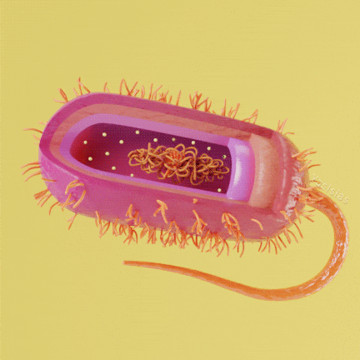
Bacterial Pathogens
Patients with type 1 diabetes mellitus and periodontitis have been reported to have a subgingival flora that is composed mainly of
Capnocytophaga, anaerobic vibrios, and Actinomyces species.
Porphyromonas gingivalis, Prevotella intermedia, and Aggregatibacteractinomycetemcomitans, which are common in periodontal lesions of individuals without diabetes, are present in low numbers in those with the disease.
Black-pigmented species—especially P. gingivalis, P. intermedia, and C. rectus—are prominent in severe periodontal lesions of Pima Indians with type2 diabetes

Slide 13
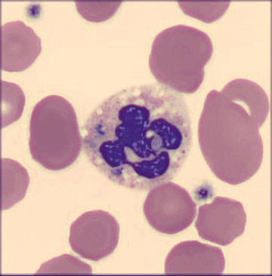
Polymorphonuclear Leukocyte Function
The increased susceptibility of patients with diabetes to infection has been hypothesized as being caused by polymorphonuclear leukocyte (PMN) deficiencies that result in impaired chemotaxis, defective phagocytosis, or impaired adherence.
In patients with poorly controlled diabetes, the functions of PMNs, monocytes, and macrophages are impaired.
As a result, the primary defense mounted by PMNs against periodontal pathogens is diminished, and bacterial
proliferation is more likely.

Slide 14

Altered Collagen Metabolism
Chronic hyperglycemia impairs collagen structure and function, which may directly impact the integrity of the periodontium.
Chronic hyperglycemia adversely affects the synthesis, maturation, and maintenance of collagen and extracellular matrix.
In the hyperglycemic state, numerous proteins and matrix molecules undergo a nonenzymatic glycosylation, thereby resulting in accumulated glycation end-products (AGEs).
The formation of AGEs occurs at normal glucose levels as well; however, in hyperglycemic environments, AGE formation is excessive.
Collagen is cross-linked by AGE formation, which makes the collagen less soluble and less likely to be normally repaired or replaced.
As a result, collagen in the tissues of patients with poorly controlled diabetes is older and more susceptible to pathogenic breakdown (i.e., less resistant to destruction by periodontal infections).
Notes:
Decreased collagen synthesis, osteoporosis, and a reduction in alveolar bone height have been demonstrated in diabetic animals.

Slide 15
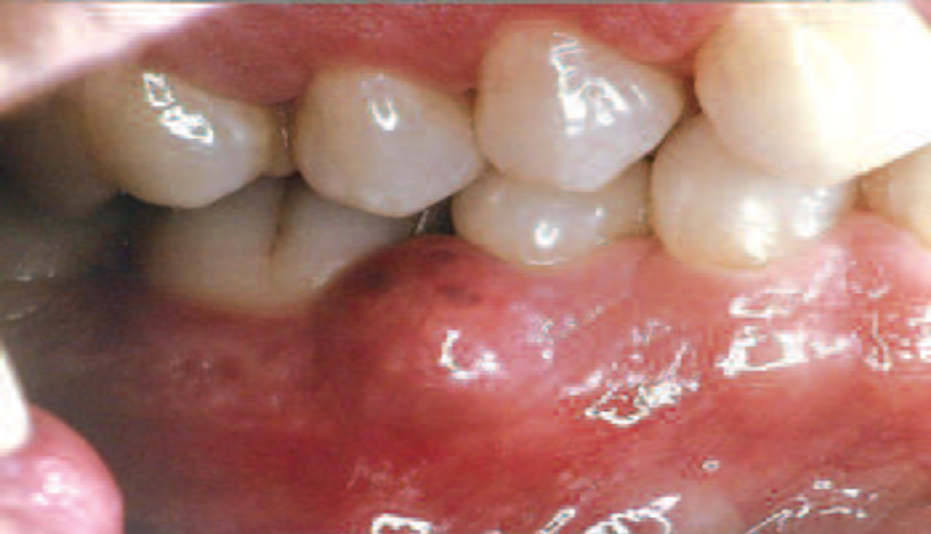
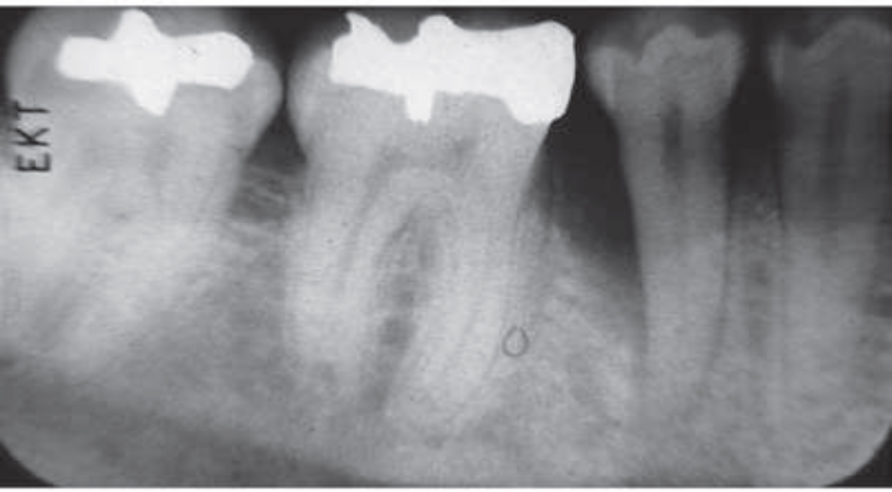
Altered cellular response to local factors
Altered collagen metabolism
Impaired tissue integrity,

Slide 16
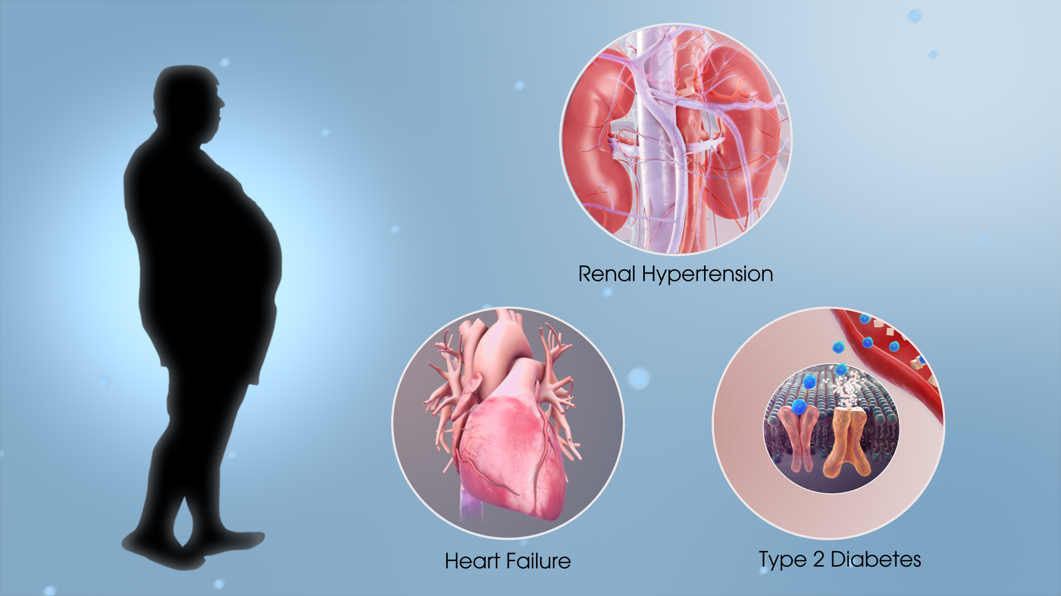
Metabolic Syndrome
It is believed that the condition of excess adipose tissue contributes to an increased systemic proinflammatory response in these individuals.
Metabolic syndrome is a term used to describe a condition of abdominal obesity combined with two or more of the following metabolic disturbances:
hypertension,
dyslipidemia, and hyperglycemia.
Individuals diagnosed with metabolic syndrome are at increased risk for developing type 2 diabetes mellitus and cardiovascular disease.

Slide 17

The association between periodontitis and metabolic syndrome is thought to be the result of systemic oxidative stress and an increased inflammatory response.
Obesity is associated with increased cytokine production as well as T-cell and monocyte/macrophage dysfunction, factors known to contribute to periodontitis.
The proinflammatory cytokines interleukin-6 (IL-6) and tumor necrosis factor alpha (TNF-α), which are elevated in obese individuals, are thought to be produced by activated macrophages that have infiltrated adipose tissue

Slide 18
Female Sex Hormones

Slide 19
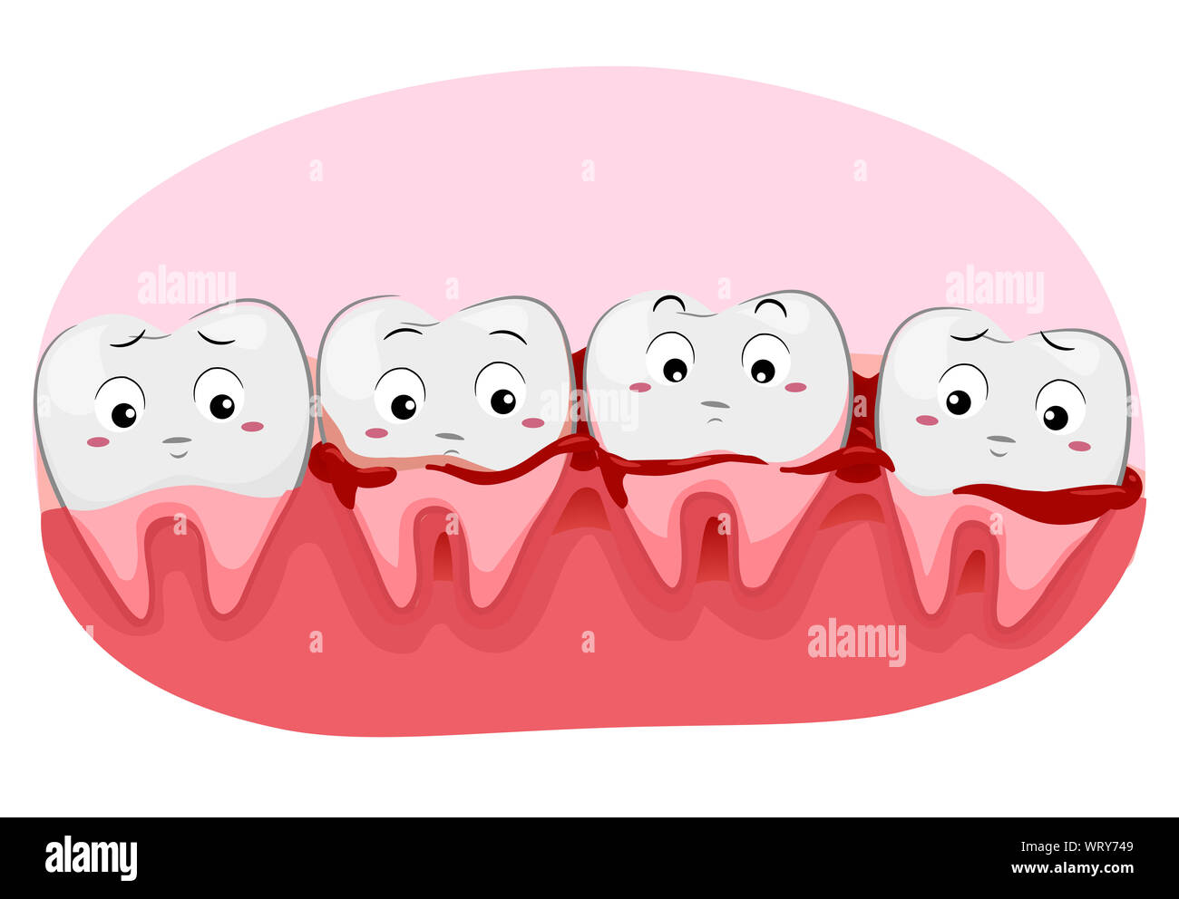
During puberty and pregnancy, these changes are characterized by non-specific inflammatory reactions with a predominant vascular component, which leads clinically to a marked hemorrhagic tendency.
Oral changes during menopause may include thinning of the oral mucosa, gingival recession, xerostomia, altered taste, and burning mouth.

Slide 20
Puberty
Puberty is often accompanied by an exaggerated response of the gingiva to plaque.
Pronounced inflammation, edema, and gingival
enlargement result from local factors that might ordinarily elicit a comparatively mild gingival response.
As adulthood approaches, the severity of the gingival reaction diminishes, even when local factors persist
Pregnancy
As with other systemic conditions, pregnancy itself does not cause gingivitis.
Gingivitis during pregnancy is caused by bacterial plaque, just as it is in nonpregnant women.
The hormonal changes of pregnancy accentuate the gingival response to plaque and modify the resultant clinical picture.
Pregnancy affects the severity of previously inflamed areas, but it does not alter healthy gingiva.
Tooth mobility, pocket depth, and gingival fluid are also increased during pregnancy.
The correlation between gingivitis and the quantity of plaque is greater after parturition than during pregnancy, which suggests that pregnancy introduces other factors that aggravate the gingival response to local factors.

Slide 21
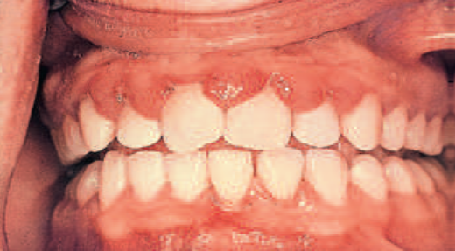
Pronounced ease of bleeding is the most striking clinical feature.
The gingiva is inflamed and varies in color from bright red to bluish red.
The marginal and interdental gingivae are edematous; they pit on pressure, appear smooth and shiny, are soft and pliable, and sometimes have a raspberry-like appearance.
The extreme redness results from marked vascularity, and there is an increased tendency to bleed.
The gingival changes are usually painless unless they are complicated by acute infection.
In some cases, the inflamed gingiva forms discrete tumor-like masses, which are referred to as pregnancy tumors

Slide 22
Microscopically, gingival disease during pregnancy appears as nonspecific, vascularizing, and proliferative inflammation1.
Marked inflammatory cellular infiltration occurs, with edema and degeneration of the gingival epithelium and connective tissue.
The epithelium is hyperplastic, with accentuated rete pegs, reduced surface keratinization, and various degrees of intracellular and extracellular edema and infiltration by leukocytes.
Newly formed, engorged capillaries are present in abundance
The aggravation of gingivitis during pregnancy has been attributed principally to the increased level of progesterone, which produces dilation and tortuosity of the gingival microvasculature, circulatory stasis, and increased susceptibility to mechanical irritation, all of which favor the leakage of fluid into the perivascular tissues

Slide 23
Menopause
During menopause, the usual rhythmic hormonal fluctuations of the female cycle are ended as estradiol ceases to be the major circulating estrogen.
As a result, women can develop a gingivostomatitis.
This condition occurs during menopause or during the postmenopausal Period.
The gingiva and the remaining oral mucosa are dry and shiny, they vary in color from abnormal paleness to redness, and they bleed easily.
Fissuring occurs in the mucobuccal fold in some women, and comparable changes may occur in the vaginal mucosa.
Microscopically, the gingiva exhibits atrophy of the germinal and prickle cell layers of the epithelium and, in some patients, areas of ulceration.
The patient complains of a dry, burning sensation throughout the oral cavity that is associated with extreme sensitivity to thermal changes; abnormal taste sensations described as “salty,” “peppery,” or “sour”; and difficulty with removable partial prostheses.

Slide 24
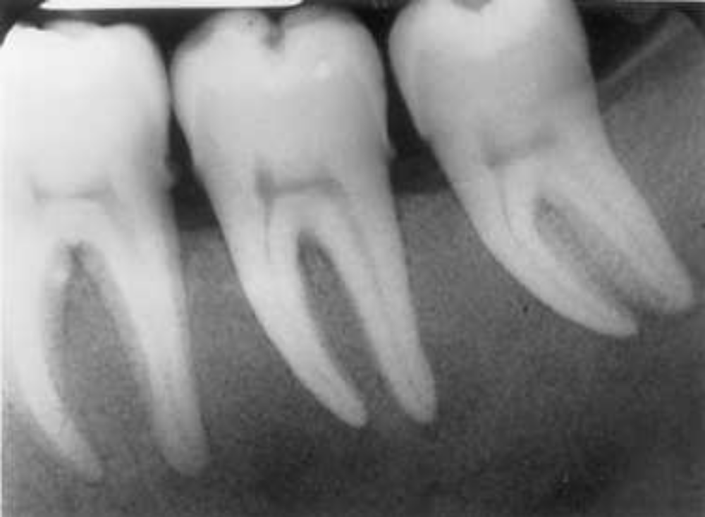
Hyperparathyroidism
Parathyroid hypersecretion produces generalized demineralization of the skeleton, increased osteoclasis with proliferation of the connective tissue in the enlarged marrow spaces, and the formation of bone cysts and giant cell tumors.
The disease is called osteitis fibrosa cystica or von Recklinghausen bone disease.
Loss of the lamina dura and giant cell tumors in the jaws are late signs of hyperparathyroid bone disease, which in itself is uncommon.
The loss of lamina dura may also occur with Paget disease, fibrous dysplasia, and osteomalacia.

Slide 25
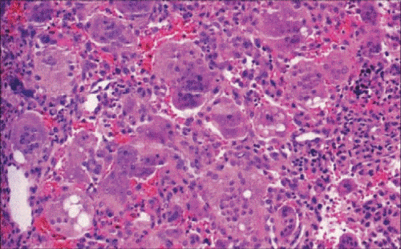
Reports have suggested that 25% to 50% of patients with hyperparathyroidism have associated oral changes.
These changes include malocclusion and tooth mobility, radiographic evidence of alveolar osteoporosis with closely meshed trabeculae, widening of the periodontal ligament space, absence of the lamina dura, and radiolucent cyst like spaces.
Bone cysts become filled with fibrous tissue with abundant hemosiderin-laden macrophages and giant cells.
These cysts have been called brown tumors, but they are not tumors. More accurately, they are reparative giant cell granulomas.

Slide 26
Hematologic Disorders
and
Immune Deficiencies

Slide 27
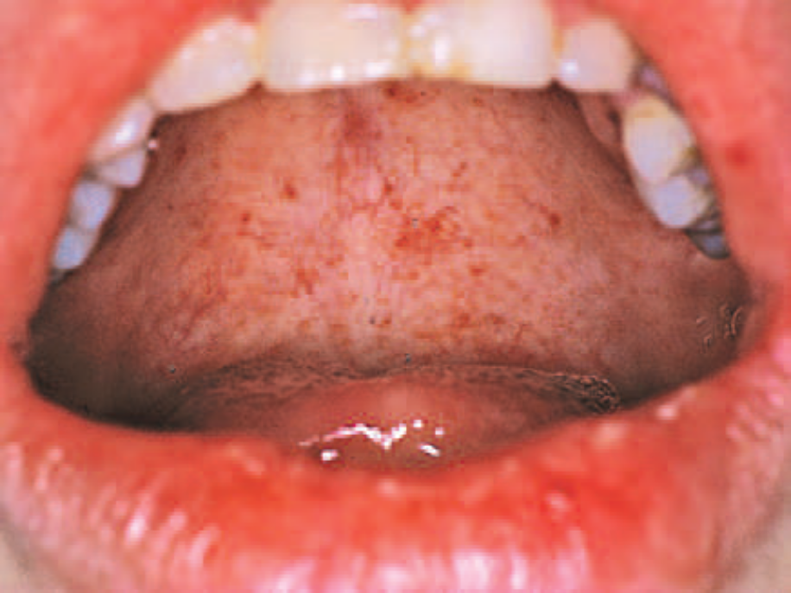
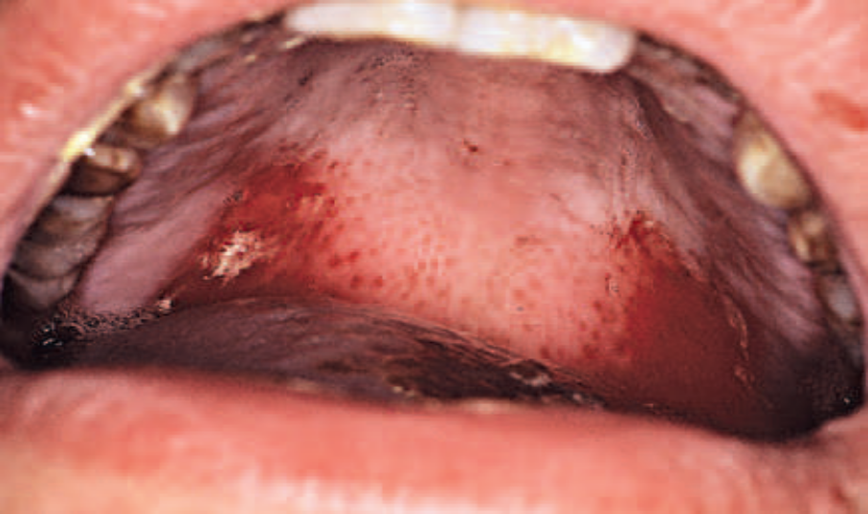
Hemorrhagic tendencies occur when the normal hemostatic mechanisms are disturbed.
Abnormal bleeding from the gingiva or other areas of the oral mucosa that is difficult to control is an important clinical sign that suggests a hematologic disorder.
Petechiae and ecchymosis , observed most often in the soft palate area, are signs of an underlying bleeding disorder.
Deficiencies in the host immune response may lead to severely destructive periodontal lesions.
These deficiencies may be primary (inherited) or secondary (acquired) and may be caused by either immunosuppressive drug therapy or the pathologic destruction of the lymphoid system.
Leukemia, Hodgkin disease, lymphomas, and multiple myeloma may result in secondary immune deficiency disorders.

Slide 28
Leukocyte (Neutrophil) Disorders

Slide 29
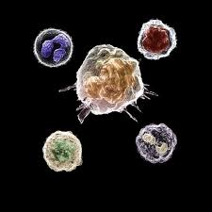
Disorders that affect the production or function of leukocytes may result in severe periodontal destruction.
PMNs (i.e., neutrophils) in particular play a critical role in bacterial infections, because PMNs are the first line of defense.
A quantitative deficiency of leukocytes (e.g., neutropenia, agranulocytosis) is typically associated with a more generalized periodontal destruction that affects all
teeth.

Slide 30
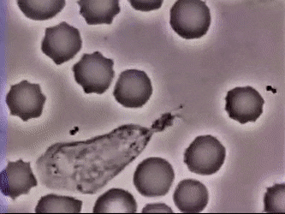
Neutropenia
Neutropenia is a blood disorder that results in low levels of circulating neutrophils.
It is a serious condition that may be caused by diseases, medications, chemicals, infections, idiopathic conditions, or hereditary disorders.
It may be chronic or cyclic and severe or benign.
It affects as many as one in three patients who are receiving chemotherapy for cancer.
An absolute neutrophil count (ANC) of 1000 to 1500 cells/μL is diagnostic for mild neutropenia.
An ANC of 500 to1000 cells/μL is considered moderate neutropenia, and
an ANC of <500 cells/μL indicates a severe neutropenia.

Slide 31
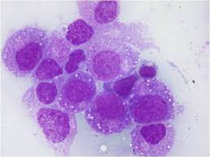
Agranulocytosis
Agranulocytosis is a more severe neutropenia that involves not only neutrophils but also basophils and eosinophils.
It is deined as an ANC of <100 cells/μL.
It is characterized by a reduction in the number of circulating granulocytes, and it results in severe infections, including ulcerative necrotizing lesions of the oral mucosa, the skin, and the gastrointestinal and genitourinary tracts.
Less severe forms of the disease are called neutropenia or granulocytopenia
Agranulocytosis has been reported after the administration of drugs such as aminopyrine, barbiturates and their derivatives, benzene ring derivatives, sulfonamides, gold salts, and arsenical agents.

Slide 32
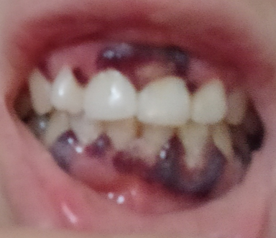
Clinical features
The onset of disease is accompanied by fever, malaise, general weakness, and sore throat.
Ulceration in the oral cavity, the oropharynx, and the throat is characteristic.
The mucosa exhibits isolated necrotic patches that are black and gray and that are sharply demarcated from the adjacent uninvolved areas.
The absence of a notable inflammatory reaction caused by a lack of granulocytes is a striking feature.
Gingival hemorrhage, necrosis, increased salivation, and fetid odor are accompanying clinical features.
With cyclic neutropenia, the gingival changes recur with recurrent exacerbation of the disease.
The occurrence of generalized aggressive periodontitis has been described in patients with cyclic neutropenia

Slide 33
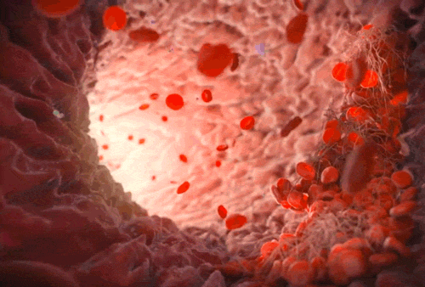
The leukemias are malignant neoplasias of WBC precursors that are characterized by the following:
(1) diffuse replacement of the bone marrow with proliferating leukemic cells;
(2) abnormal numbers and forms of immature WBCs in the circulating blood; and
(3) widespread infiltrates in the liver, spleen, lymph nodes, and other body sites.
According to the cell type involved, leukemias are classified as lymphocytic or myelogenous.
A subgroup of the myelogenous leukemias are the monocytic leukemias.
The term lymphocytic indicates that the malignant change occurs in cells that normally form lymphocytes.
The term myelogenous indicates that the malignant change occurs in cells that normally form red blood cells (RBCs), some types of WBCs, and platelets.
Leukemia
Notes:
All leukemias tend to displace normal components of the bone
marrow elements with leukemic cells, thereby resulting in the reduced
production of normal RBCs, WBCs, and platelets, which leads to
anemia, leukopenia (a reduction in the number of nonmalignant
WBCs), and thrombocytopenia

Slide 34
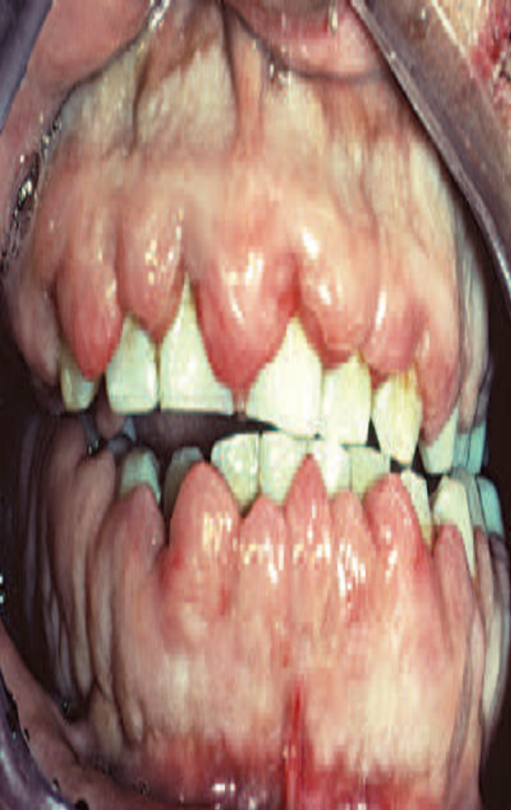
The Periodontium in Leukemic Patients
Oral and periodontal manifestations of leukemia may include leukemic infiltration, bleeding, oral ulcerations, and infections.

Slide 35
Leukemic Infiltration
Leukemic cells can infiltrate the gingiva and, less frequently, the alveolar bone. Gingival infiltration often results in leukemic gingival enlargement.
Leukemic gingival enlargement consists of a basic infiltration of the gingival corium by leukemic cells that increases the gingival thickness and creates gingival pockets in which bacterial plaque accumulates, thereby initiating a secondary inflammatory lesion that contributes to the enlargement of the gingiva.
It may be localized to the interdental papilla area , or it may expand to include the marginal gingiva and partially cover the crowns of the teeth

Slide 36
Microscopically, the gingiva exhibits a dense, diffuse infiltration of predominantly immature leukocytes in the attached and marginal gingiva.
The normal connective tissue components of the gingiva are displaced by the leukemic cells. .
The cellular accumulation is denser in the entire reticular connective tissue layer.
In almost all cases, the papillary layer contains comparatively few leukocytes.
Clinically, the gingiva appears bluish red and cyanotic, with a rounding and tenseness of the gingival margin.
The abnormal accumulation of leukemic cells in the dermal and subcutaneous connective tissue is called leukemia cutis, and it forms elevated and flat macules and papules.

Slide 37
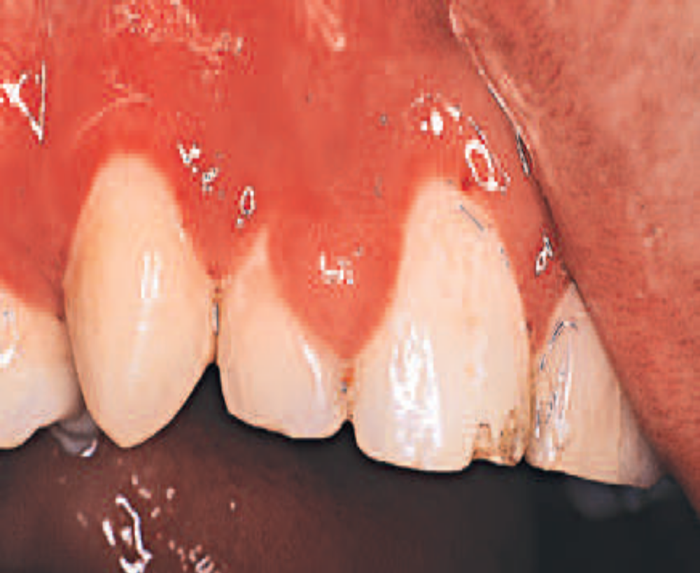
  Bleeding
Gingival hemorrhage is a common finding in leukemic patients, even in the absence of clinically detectable gingivitis.
Bleeding gingiva can be an early sign of leukemia.
It is caused by the thrombocytopenia that results from the replacement of bone marrow cells with leukemic cells and from the inhibition of normal stem cell function by leukemic cells or their products.
This bleeding tendency can also manifest in the skin and throughout the oral mucosa, where petechiae are often found, with or without leukemic infiltrates.
A more diffuse submucosal bleeding manifests as ecchymosis.
Bleeding may also be a side effect of the chemotherapeutic agents used to treat leukemia.

Slide 38
Oral Ulceration and Infection
In patients with leukemia, the response to bacterial plaque or other local irritation is altered.
The cellular component of the inflammatory exudate differs both quantitatively and qualitatively from that found in nonleukemic individuals in that there is a pronounced infiltration of immature leukemic cells in addition to the usual inflammatory cells.
As a result, the normal inflammatory response may be diminished.
Granulocytopenia (diminished WBC count) results from the displacement of normal bone marrow cells by leukemic cells, which increases the host susceptibility to opportunistic microorganism and leads to ulcerations and infections.
Discrete, punched-out ulcers that penetrate deeply into the submucosa and are covered by a firmly attached white slough can be found on the oral mucosa.
These lesions occur in sites of trauma (e.g., the buccal mucosa) in relation to the line of occlusion or on the palate.

Slide 39
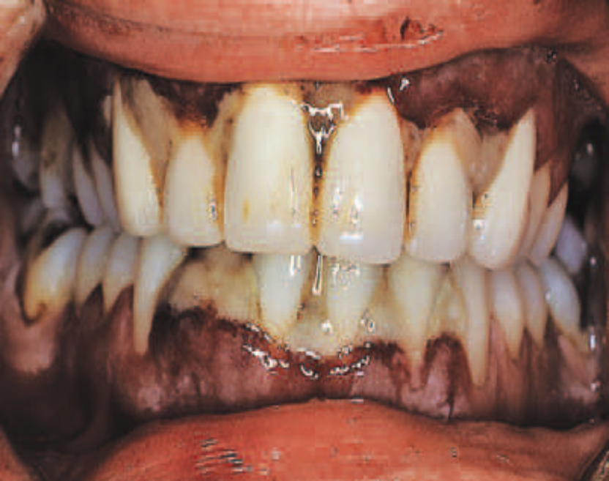
The inflamed gingiva in patients with leukemia differs clinically from that found in nonleukemic individuals.
The gingiva is a peculiar bluish red, it is spongelike and friable, and it bleeds persistently on the slightest provocation or even spontaneously in leukemic patients.
This greatly altered and degenerated tissue is extremely susceptible to bacterial infection, which can be so severe as to cause acute gingival necrosis with pseudomembrane formation
or bone exposure

Slide 40
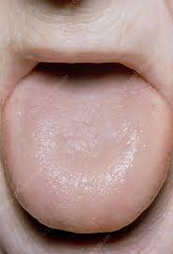
Anaemia is a deficiency in the quantity or quality of the blood as manifested by a reduction in the number of erythrocytes and in the amount of hemoglobin.
Anaemia may be the result of blood loss, defective blood formation, or increased RBC destruction.
Anaemias are classified according to cellular morphology and hemoglobin content as follows:
(1) macrocytic hyperchromic anemia (pernicious anemia);
(2) microcytic hypochromic anemia (iron deficiency anemia)
(3) sickle cell anemia; and
(4) normocytic–normochromic anemia (hemolytic or aplastic anemia).
Pernicious anemia results in tongue changes in 75% of patients.
The tongue appears red, smooth, and shiny as a result of atrophy of the papillae.
There is also marked pallor of the gingiva.
Anemia

Slide 41
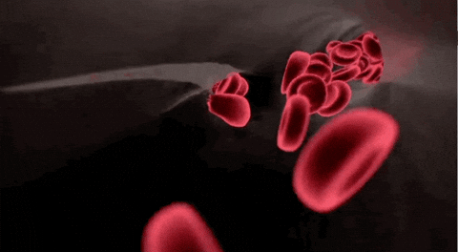
Iron deficiency anemia induces similar tongue and gingival changes.
A syndrome that consists of glossitis and ulceration of the oral mucosa and oropharynx and that induces dysphagia (Plummer–Vinson syndrome) has been described in patients with iron deficiency anemia.
Sickle cell anemia is a hereditary form of chronic hemolytic anemia that occurs almost exclusively in blacks.
It is characterized by pallor, jaundice, weakness, rheumatoid manifestations, and leg ulcers.
Oral changes include generalized osteoporosis of the jaws, with a peculiar stepladder alignment of the trabeculae of the interdental septa, along with pallor and yellowish discoloration of the oral mucosa.

Slide 42
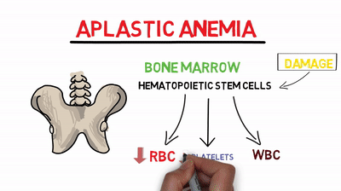
Aplastic anemia results from a failure of the bone marrow to produce erythrocytes.
The etiology is usually the effect of toxic drugs on the marrow or the displacement of RBCs by leukemic cells.
Oral changes include pale discoloration of the oral mucosa and increased susceptibility to infection because of concomitant neutropenia.

Slide 43
Thrombocytopenia
Such etiologic factors include aplasia of the marrow, displacement of the megakaryocytes in the marrow (as with leukemia), replacement of the marrow by tumor, and destruction of the marrow by irradiation or radium or by drugs such as benzene, aminopyrine, or arsenical agents.
There is spontaneous bleeding into the skin or from the mucous membranes.
Petechiae and hemorrhagic vesicles occur in the oral cavity, particularly in the palate, the tonsillar pillars, and the buccal mucosa.
The gingivae are swollen, soft, and friable. Bleeding occurs spontaneously or with the slightest provocation, and it is difficult to control.
Thrombocytopenia is a term that is used to describe a reduced platelet count condition that results from either a lack of platelet production or an increased loss of platelets
Purpura refers to the purplish appearance of the skin or mucous membranes where bleeding has occurred as a result of decreased platelets.
Thrombocytopenic purpura is characterized by a low platelet count, a prolonged clot retraction and bleeding time, and a normal or slightly prolonged clotting time

Slide 44

Let’s meet soon!!!

Slide 45
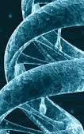
Genetic disorders affecting periodontium

Slide 46
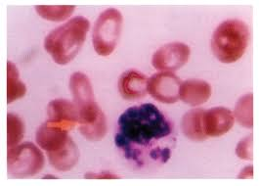
Chédiak–Higashi syndrome
Chédiak–Higashi syndrome is a rare disease that affects the production of organelles found in almost every cell.
It affects mostly the melanocytes, platelets, and phagocytes.
It causes partial albinism, mild bleeding disorders, and recurrent bacterial infections.
Neutrophils contain abnormal, giant lysosomes that can fuse with the phagosome, but their ability to release their contents is impaired.
As a result, the killing of ingested microorganisms is delayed.
Patients with Chédiak–Higashi syndrome are susceptible to repeated infections that can be serious and life-threatening.
Aggressive periodontitis has been described in these patients

Slide 47
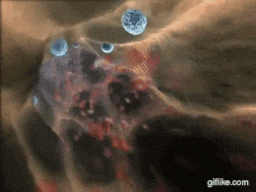
Lazy Leukocyte Syndrome
Lazy leukocyte syndrome is characterized by susceptibility to severe microbial infections, neutropenia, defective chemotactic response by neutrophils, and an abnormal inflammatory response.
Those who are diagnosed with lazy leukocyte syndrome are susceptible to aggressive periodontitis with destruction of bone and early tooth loss.

Slide 48
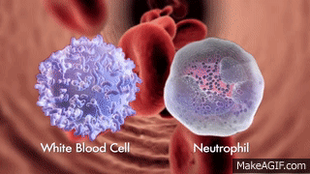
Leukocyte Adhesion Deficiency
Leukocyte adhesion deficiency (LAD) is a very rare genetic disorder.
Because LAD is an inherited disease, it is categorized as a primary immunodeficiency that is most often diagnosed at birth.
Many children with LAD do not survive.
LAD results from an inability to produce or a failure to normally express an important cell surface integrin (CD18), which is necessary
for leukocytes to adhere to the vessel wall at the site of infection.

Slide 49
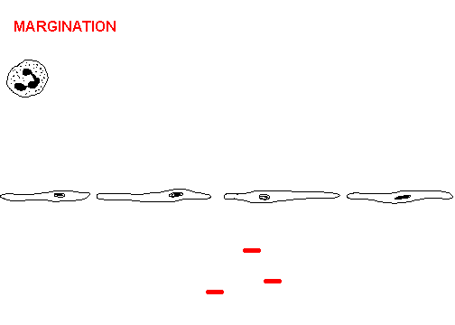
When leukocytes cannot effectively adhere to the vessel wall near the site of infection, they cannot migrate to the infection.
As a result, bacterial infections are able to continue to destroy host tissues unimpeded by the normal host immune response.
They begin during or immediately after the eruption of the primary
teeth.
Extremely acute inflammation and proliferation of the gingival tissues with rapid destruction of the bone are found.
Profound defects in peripheral blood neutrophils and monocytes and an absence of neutrophils in the gingival tissues have been noted in patients with LAD.
Both the primary and the permanent teeth are affected, often resulting in early tooth loss.

Slide 50
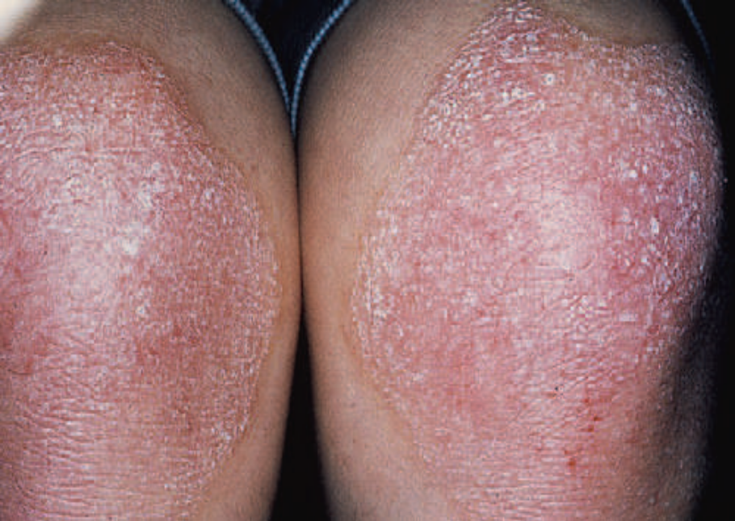
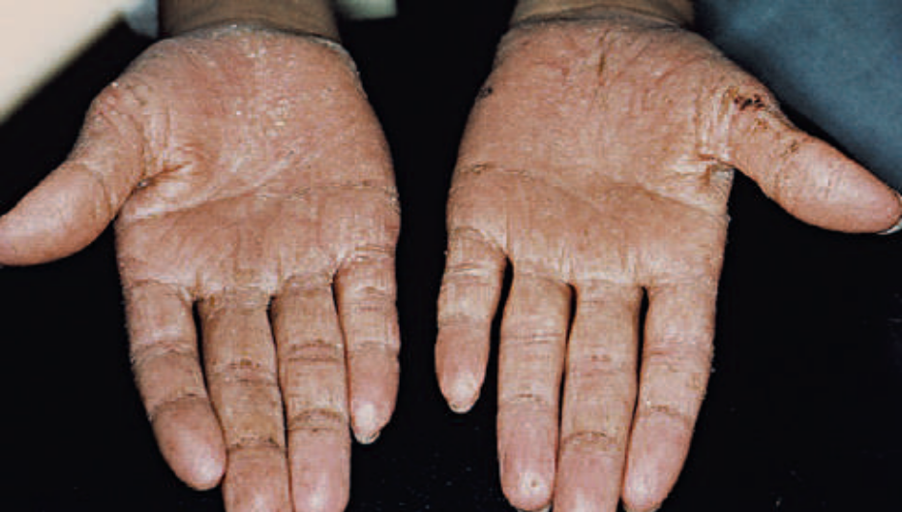
Papillon–Lefèvre Syndrome
Papillon–Lefèvre syndrome, which was first described by French physicians Papillon and Lefèvre in 1924, is a very rare inherited condition that appears to follow an autosomal-recessive pattern and it has no gender predilection.
The estimated frequency is 1 to 4 cases per 1 million individuals.
The syndrome is characterized by hyperkeratotic skin lesions, severe destruction of the periodontium, and, in some cases, calcification of the dura.
The cutaneous and periodontal changes usually appear together when the patient is between the ages of 2 and 4 years.
The skin lesions consist of hyperkeratosis and ichthyosis of localized areas on the palms, soles, knees, and elbow

Slide 51
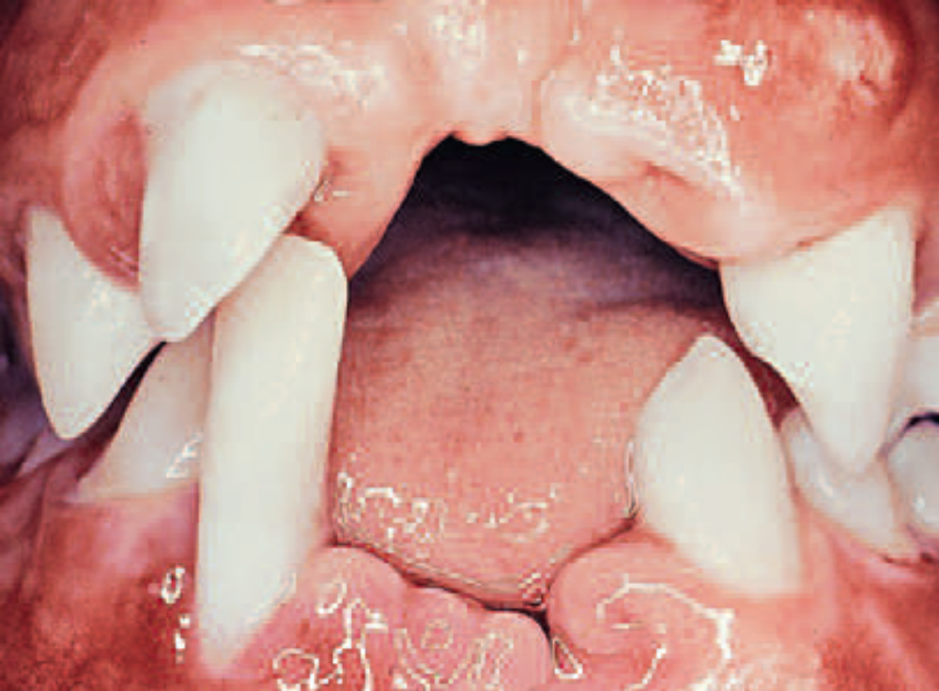
Periodontal involvement consists of early inflammatory changes that lead to bone loss and exfoliation of teeth.
The primary teeth are lost by 5 or 6 years of age.
The permanent dentition then erupts normally, but within a few years the permanent teeth are also lost as a result of destructive periodontal disease .
At a very early age (usually 15 to 20 years), patients are often edentulous except for the third molars.
The microscopic changes reported include marked chronic inflammation of the lateral wall of the pocket with a predominantly plasma cell infiltrate, considerable osteoclastic activity with an apparent lack of osteoblastic activity, and an extremely thin cementum.

Slide 52
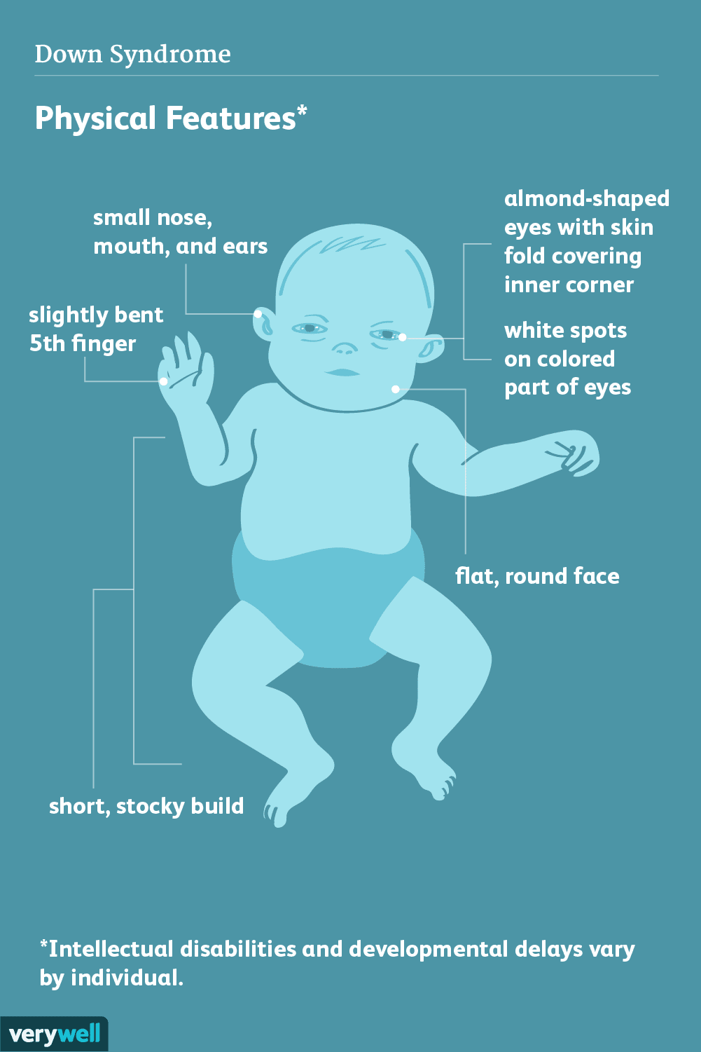
Down syndrome (mongolism, trisomy 21) is a congenital disease caused by a chromosomal abnormality and is characterized by mental deficiency and growth retardation.
The prevalence of periodontal disease in patients with Down syndrome is high, occurring in almost 100% of patients who are younger than 30 years of age.
Although plaque, calculus, and local irritants (e.g., diastemata, crowding of teeth, high frenum attachments, malocclusion) are present and oral hygiene is poor, the severity of periodontal destruction exceeds that explainable by local factors alone.
Periodontal disease in those with Down syndrome is characterized by the formation of deep periodontal pockets associated with substantial plaque accumulation and moderate gingivitis.
Down Syndrome

Slide 53
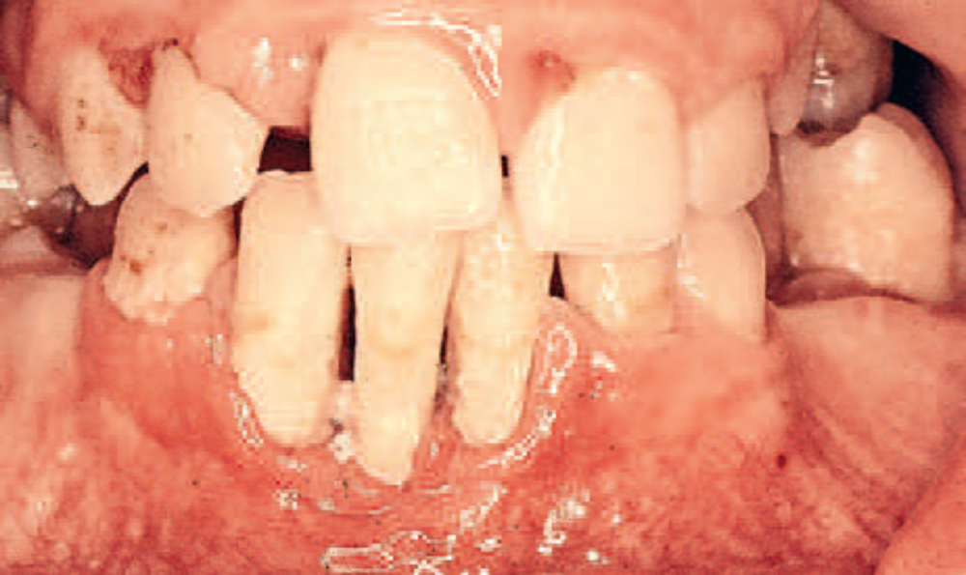
These findings are usually generalized, although they tend to be more severe in the lower anterior region.
Moderate recession is sometimes seen in this region as well.
The disease progresses rapidly.
The high prevalence and increased severity of periodontal destruction associated with Down syndrome is most likely explained by poor PMN chemotaxis, phagocytosis, and intracellular killing

Slide 54

Stress-Induced Immunosuppression

Slide 55
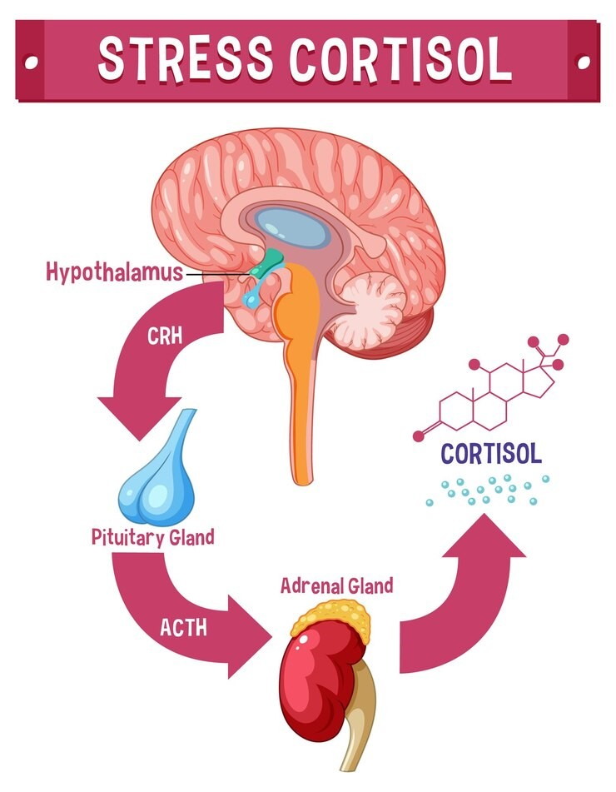
Stress and psychosomatic disorders most likely impact periodontal health via changes in the individual’s behaviour and through complex interactions among the nervous, endocrine, and immune systems.
Individuals under stress may have poorer oral hygiene; they may start or increase the clenching and grinding of their teeth; and they may smoke more frequently.
All of these behavioural changes increase their susceptibility to periodontal disease destruction.
Stress-related immune system changes clearly have the potential to affect the pathogenesis of periodontal disease as well.
One possible mechanism involves the production of cortisol

Slide 56
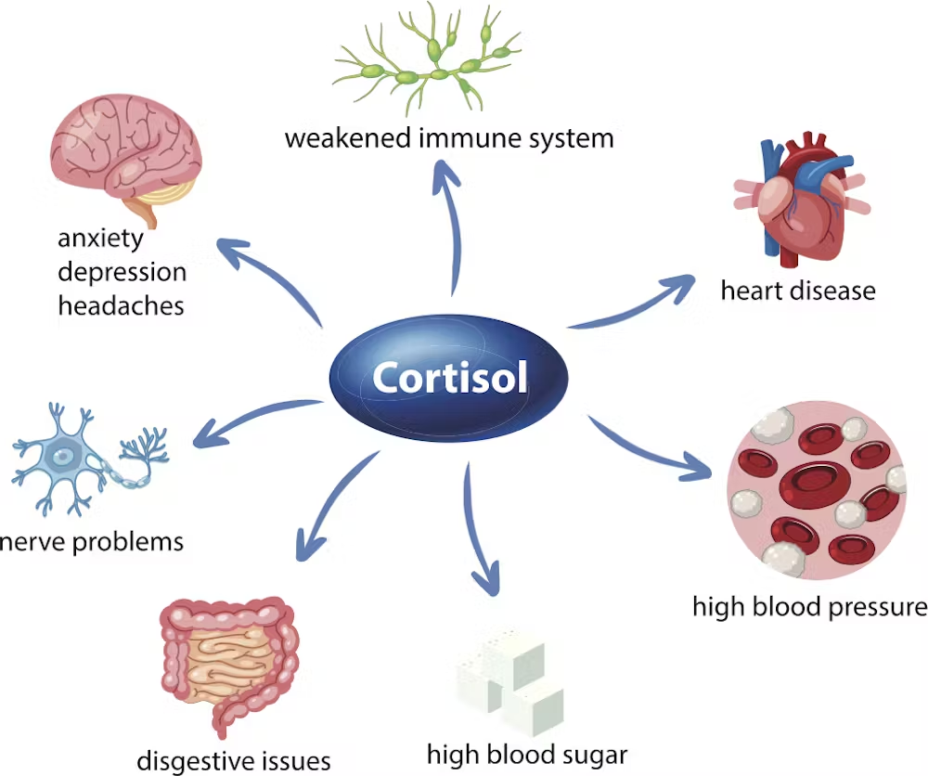
Stress increases cortisol production from the adrenal cortex by stimulating an increase in the release of adrenocorticotropic hormone from the pituitary gland.
Increased cortisol suppresses the immune response directly through the suppression of neutrophil activity, immunoglobulin G production, and salivary IgA secretion.
All of these immune responses are critical for the normal immunoinflammatory response to periodontal pathogens.
The resulting stress-induced immunosuppression increases the potential for destruction by periodontal pathogens.

Slide 57
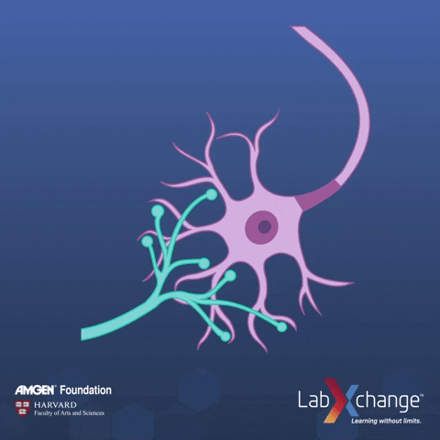
Stress may also affect the cellular immune response directly through an increased release of neurotransmitters, including epinephrine, norepinephrine, neurokinin, and substance P, which interact directly with lymphocytes, neutrophils, monocytes, and macrophages via receptors that cause an increase in their tissue-destructive function.
Thus, in a manner similar to cortisol production, the stress-induced release of these neurotransmitters results in an upregulated immune response that increases the potential for destruction by the cellular response to periodontal pathogens
In other words, stress alone does not cause or lead to periodontitis in the absence of periodontal pathogens

Slide 58

Medications

Slide 59
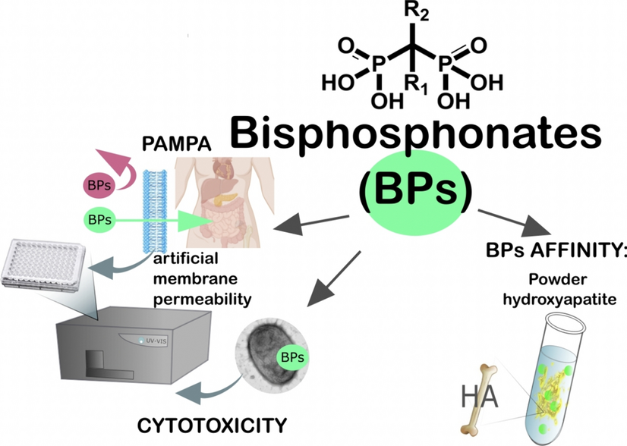
Bisphosphonate medications are primarily used to treat cancer (via intravenous [IV] administration) and osteoporosis (via oral administration).
They act by inhibiting osteoclastic activity, which leads to less bone resorption, less bone remodelling, and less bone turnover.
During the treatment of osteoporosis, the goal is simply to harness osteoclastic activity to minimize or prevent bone loss and, in many cases, to increase bone mass by creating an advantage for osteoblastic activity.
The major differences in the use of bisphosphonates for cancer versus osteoporosis are the potency and route of administration of the specific bisphosphonate medication used.
Specifically, the strength of binding and the ease of release of bisphosphonates with hydroxyapatite make these drugs more or less potent.
Bisphosphonates
Notes:
Potency is influenced by the chemical properties as well as by the binding and
release pharmacokinetic properties of these agents as they apply to
bone. The US Food and Drug Administration
approved the use of alendronate for osteoporosis in 1995.

Slide 60
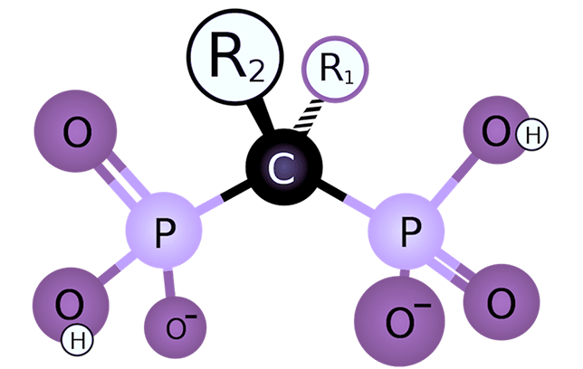
Bisphosphonates inhibit osteoclasts by two mechanisms that depend on whether the R2 side chain contains nitrogen.
Non-aminobisphosphonates are metabolized by osteoclasts to form an adenosine triphosphate analog that interferes with energy production and causes osteoclast apoptosis.
Aminobisphosphonates (i.e., risedronate, zoledronate, ibandronate, and alendronate) are more potent and have multiple effects on osteoclasts, including the following:
(1) inactivation of adenosine triphosphate;
(2) osteoclast cytoskeletal disruption;
(3) Impairment of osteoclast recruitment; and
(4) induction of osteoblasts to produce osteoclast-inhibiting factor.
Bisphosphonates also inhibit bone metabolism via antiangiogenic activity
They have recently been implicated in osteonecrosis of the jaw (ONJ), a serious condition that is characterized
by non-healing and often painful exposure of nonvital and often sequestrating bone in the jaws.
Notes:
An in vitro study by Kim and colleagues suggested
that bisphosphonates may act on oral keratinocytes to impair wound
healing by inhibiting epithelial migration and wound closure

Slide 61
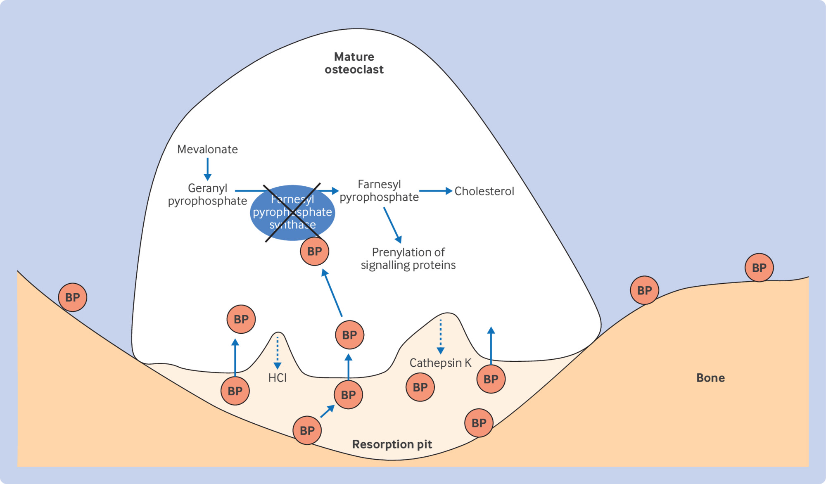
the effects of bisphosphonates on oral mucosal cells and bone cells share the common mechanism of interference with products of the mevalonate pathway, which may be more significant to the overall problem than the reported apoptosis effects on osteoclasts
The inhibition of farnesyl pyrophosphate synthase leads to inhibition of the mevalonate pathway end product, geranylgeranyl Pyrophosphate.
This bisphosphonate-inhibited pathway is required for many essential cellular functions in a variety of tissues.
In the case of soft tissues, the bisphosphonate-induced senescence of human oral keratinocytes was found to be mediated, at least in part, by inhibition of the mevalonate pathway

Slide 62
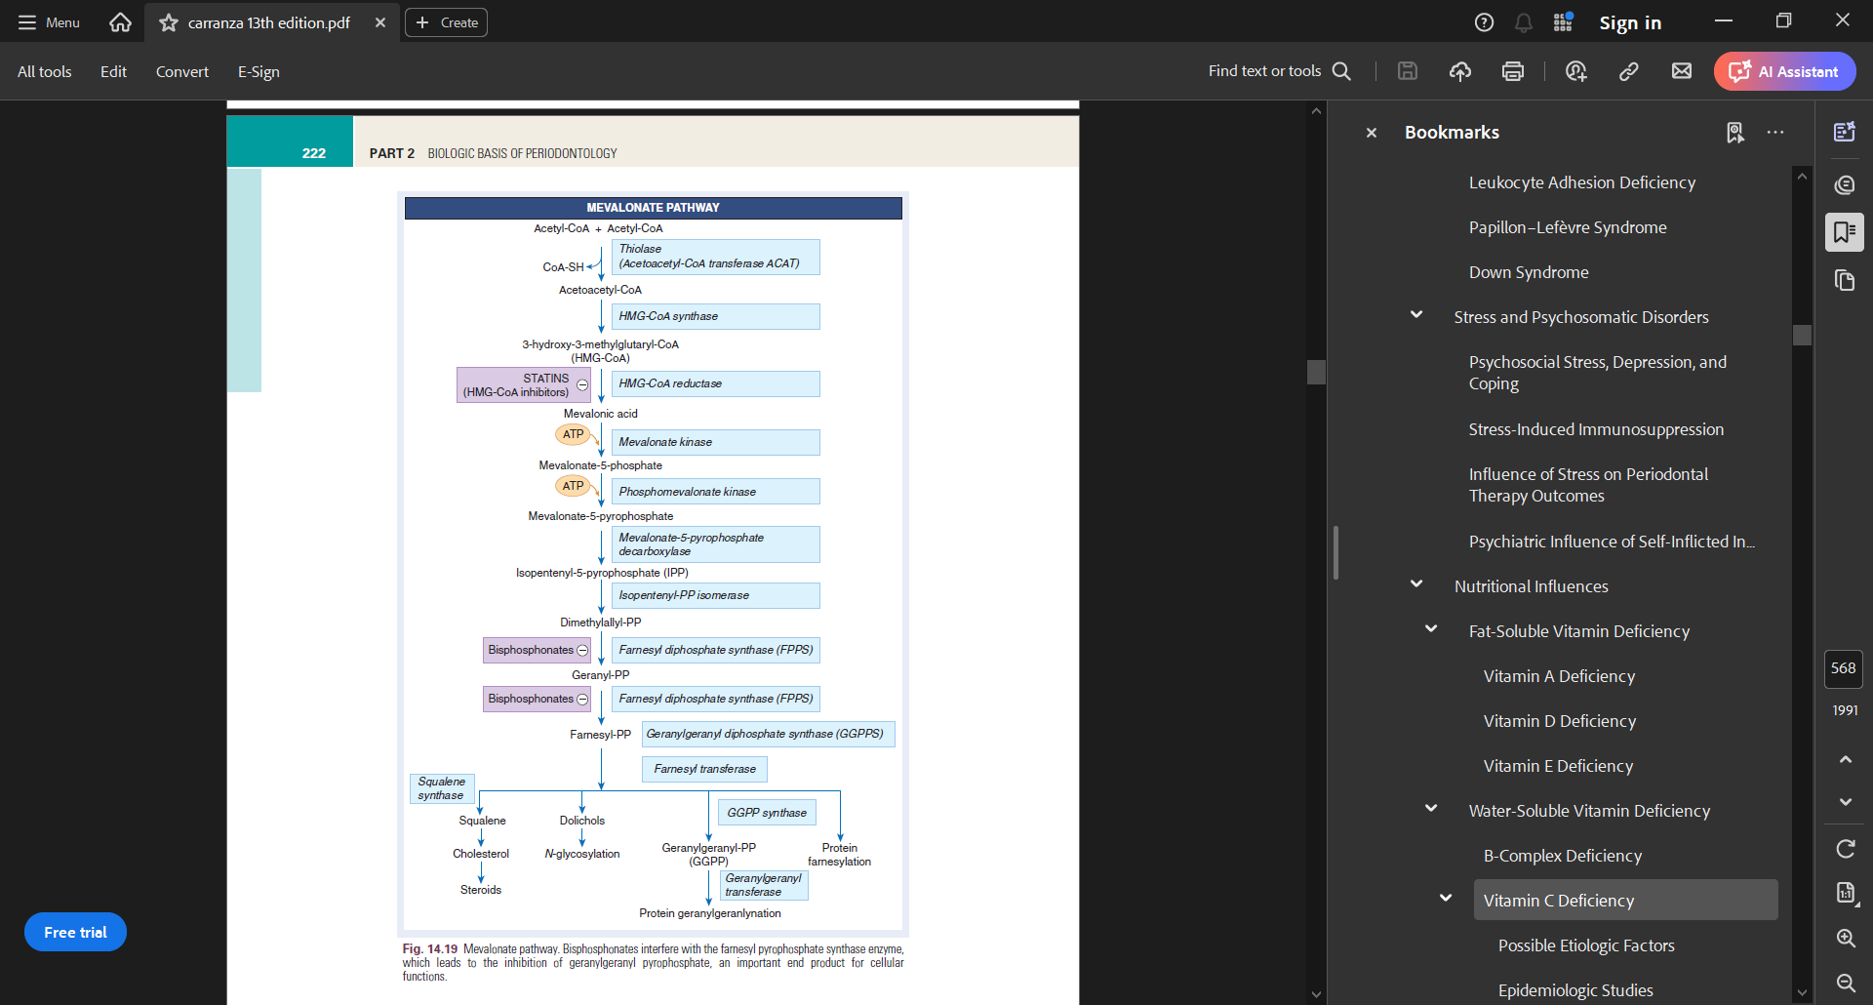

Slide 63
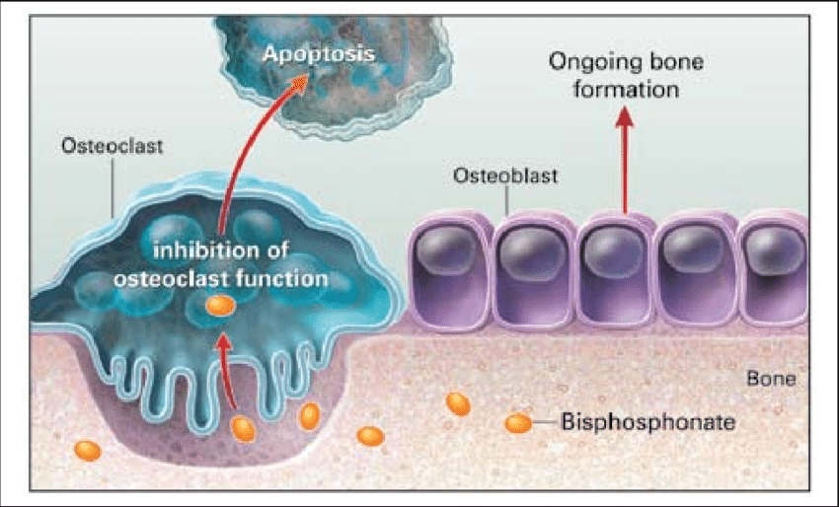
Bisphosphonates have a high affinity for hydroxyapatite. They are rapidly absorbed in bone, especially in areas of high activity, which may help to explain why bisphosphonate-induced osteonecrosis is found only in the jaws.
The bisphosphonate molecule gets incorporated into bone without being metabolized or modified.
During the osteoclastic resorption of bone, the trapped bisphosphonate is released and able to affect osteoclasts again.
As a result, the half-life of bisphosphonates in the bone is estimated to be 10 years or longer.

Slide 64
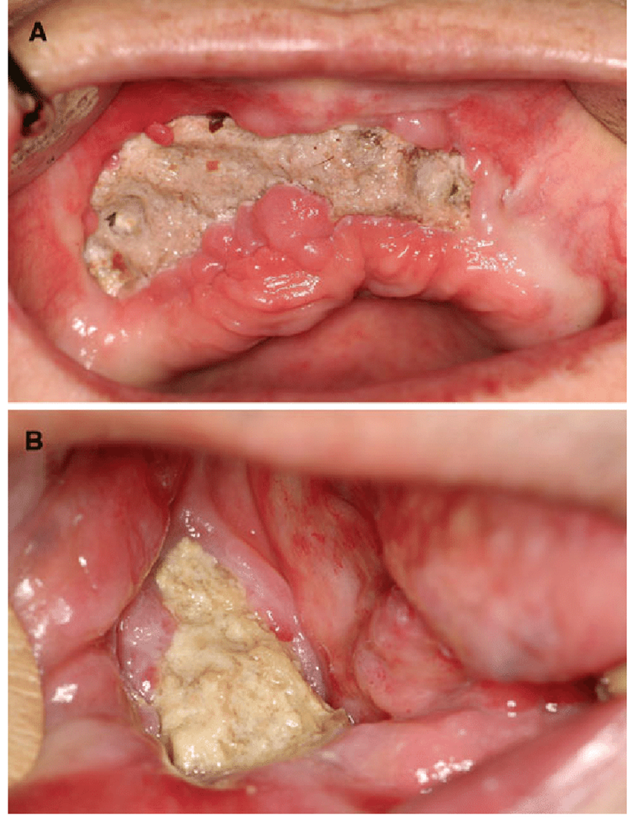
Various terms have been used to describe this type of ONJ, including
Avascular necrosis, bisphosphonate-associated ONJ
bisphosphonate-induced ONJ,
and bisphosphonate-related ONJ (BRONJ)
The condition of BRONJ has been deined as the exposure and
necrosis of portions of the jaw bone in patients who have been
exposed to bisphosphonates that has persisted for longer than
8weeks with no history of radiation therapy to the jaws.

Slide 65
BRONJ classification
Stage 0 patients are patients at risk who have been treated with IV or oral bisphosphonates but who have no apparent exposed or necrotic bone.
Stage 1 involves exposed or necrotic bone in patients who are asymptomatic with no infection.
Stage 2 involves exposed or necrotic bone in patients with pain and clinical evidence of infection.
Stage 3 involves exposed or necrotic bone in patients with pain, infection, and one or more of the following: pathologic fracture, extraoral fistula, or osteolysis that extends to the inferior border

Slide 66
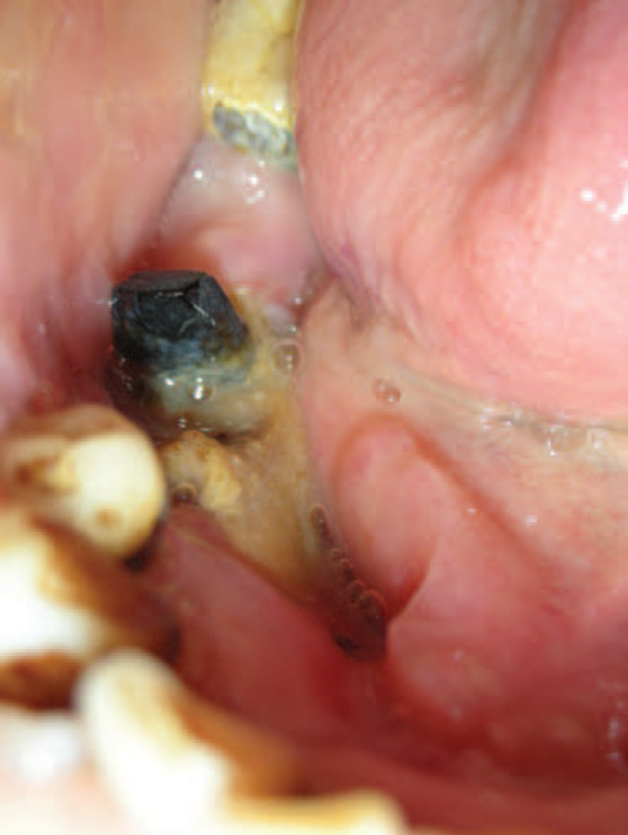
Clinically, BRONJ manifests as exposed alveolar bone that occurs spontaneously or after a traumatic event such as a dental procedure.
The sites may be painful, with surrounding soft tissue induration and inflammation.
Infection with drainage may be present.
Radiographically, lesions appear radiolucent, with sclerosis
of the lamina dura, a loss of the lamina dura, or a widening of the periodontal ligament in areas where teeth are present.
Histologically, bone appears necrotic, with empty lacunae demonstrating a lack of living osteocytes
Notes:
has been observed that BRONJ lesions occur most often in
areas with dense bone and thin overlying mucosa, such as tori, bony
exostoses, and the mylohyoid ridge.165,213,214 Lesions are found more
commonly in the mandible than in the maxilla at a 2 : 1 ratio

Slide 67

Nutritional Influences

Slide 68

Fat-Soluble Vitamin Deficiency

Slide 69


A major function of vitamin A is to maintain the health of the epithelial cells of the skin and mucous membranes.
deficiency of vitamin A results in dermatologic, mucosal, and ocular manifestations.
In the absence of vitamin A, degenerative changes occur in epithelial tissues, thereby resulting in a keratinizing metaplasia.
Because epithelial tissues provide a primary barrier function to protect against invading microorganisms, vitamin A may play an important role in protecting against microbial invasion by maintaining epithelial integrity.
The following periodontal changes have been reported in vitamin A–deficient rats:
hyperplasia and hyperkeratinization of the gingival epithelium,
with proliferation of the junctional epithelium, and retardation of gingival wound healing.

Slide 70

Vitamin D or calciferol is essential for the absorption of calcium from the gastrointestinal tract and for the maintenance of the calcium–phosphorus balance.
A deficiency of vitamin D and an imbalance in calcium–phosphorus intake result in rickets in young children and osteomalacia in adults.
Osteoid forms at a normal rate but remains uncalcified and fails to resorb, which leads to excessive accumulation.
Vitamin D Deficiency
A reduction in the width of the periodontal ligament space results from a normal rate of cementum formation coupled with defective calcification and distortion of the growth pattern of alveolar bone.
Radiographically, there is generalized partial to complete disappearance of the lamina dura and reduced density of the supporting bone, a loss of trabeculae, increased radiolucency of the trabecular interstices, and increased prominence of the remaining trabeculae
Notes:
In osteomalacic animals, there is rapid, generalized, severe
osteoclastic resorption of alveolar bone, proliferation of fibroblasts
that replace bone and marrow, and new bone formation around the
remnants of unresorbed bony trabeculae

Slide 71

Water-Soluble Vitamins Deficiency

Slide 72
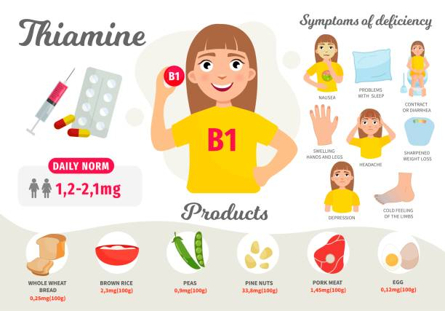
The vitamin B complex includes thiamin, riboflavin, niacin, pyridoxine (B6), biotin, folic acid, and cobalamin (B12)
The human manifestations of thiamin deficiency, called beriberi, are characterized by paralysis; cardiovascular symptoms, including edema; and loss of appetite.
Oral disturbances that have been attributed to thiamin deficiency include hypersensitivity of the oral mucosa; minute vesicles (simulating herpes) on the buccal mucosa, under the tongue, or on the palate; and erosion of the oral mucosa

Slide 73
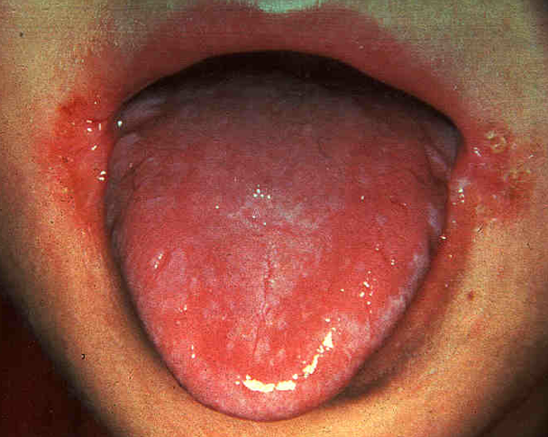
The symptoms of riboflavin deficiency (aribolavinosis) include
glossitis, angular cheilitis, seborrheic dermatitis, and a superficial vascularizing keratitis.
The glossitis is characterized by a magenta discoloration and atrophy of the papillae.
With severe deficiency, the entire dorsum is flat, with a dry and often fissured surface.

Slide 74
Niacin deficiency results in pellagra, which is characterized by symptoms of dermatitis, gastrointestinal disturbances, neurologic and mental disturbances (dermatitis, diarrhea, or dementia), glossitis, gingivitis, and generalized stomatitis.
Glossitis and stomatitis may be the earliest clinical signs of niacin deficiency.
The gingiva may be involved in aniacinosis with or without tongue changes.
The most common finding is necrotizing ulcerative gingivitis,
Folic acid deficiency results in macrocytic anemia with megaloblastic erythropoiesis accompanied by oral changes, gastrointestinal lesions, diarrhoea, and intestinal malabsorption.
Folic acid–deficient animals demonstrate necrosis of the gingiva, the periodontal ligament, and the alveolar bone without inflammation.
The absence of inflammation is the result of deficiency-induced granulocytopenia.

Slide 75
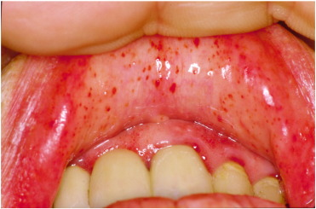
Vitamin C Deficiency
Scurvy results in the defective formation and maintenance of
collagen, the impairment or cessation of osteoid formation, and
impaired osteoblastic function.
Vitamin C deficiency is also characterized by increased capillary permeability, susceptibility to traumatic hemorrhages, and sluggishness of blood flow.
Clinical manifestations of scurvy include petechial hemorrhages, often around the hair follicles; increased susceptibility to infections; and impaired wound healing.
Bleeding, swollen gingiva, and loosened teeth are common features of scurvy

Slide 76

Ascorbic acid may play a role in periodontal disease through one or more of the following suggested mechanisms
1. Low levels of ascorbic acid influence the metabolism of collagen within the periodontium, thereby affecting the ability of the tissue to regenerate and repair itself.
2. Ascorbic acid deficiency interferes with bone formation and leads to the loss of periodontal bone.
Changes that do occur in alveolar bone and other bones as a result of failure of the osteoblasts to form osteoid take place very late in the deficiency state.

Slide 77
3. Ascorbic acid deficiency increases the permeability of the oral mucosa to tritiated endotoxin and tritiated inulin and of normal human crevicular epithelium to tritiated dextran.
4. Increasing levels of ascorbic acid enhance the chemotactic and migratory actions of leukocytes without influencing their phagocytic activity.
5. An optimal level of ascorbic acid is apparently required to maintain the integrity of the periodontal microvasculature as well as the vascular response to bacterial plaque and wound healing.
6. Depletion of vitamin C may interfere with the ecologic equilibrium of bacteria in plaque and thus increase its pathogenicity
Patients with acute or chronic vitamin C–deficient states and no plaque accumulation demonstrate minimal (if any) changes in their gingival health status
Notes:
Gingivitis with enlarged,
hemorrhagic, bluish-red gingiva is described as one of the classic
signs of vitamin C deiciency, but gingivitis is not caused by vitamin
C deiciency.

Slide 78
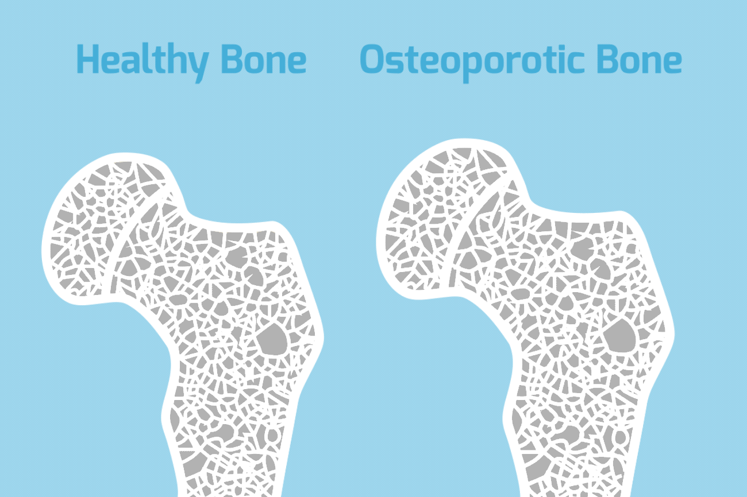

Osteoporosis is a disease that is characterized by low bone mass
and structural deterioration leading to an increased risk of bone fracture.
Osteoporosis
The loss of bone mass and the incidence of osteoporosis
increases with age for both men and women, with women being
affected earlier than men.
The rate of bone loss is greatest for women
during the perimenopausal years, when estrogen levels decrease.

Slide 79

Congenital Heart Disease
The most striking feature of congenital heart disease is cyanosis caused by the shunting of deoxygenated blood from the right to the left, which results in the return of poorly oxygenated blood to the systemic circulation
The need for prophylactic antibiotics should be evaluated before dental therapy

Slide 80


In addition to the obvious cyanosis of the lips and the oral mucosa,
oral abnormalities associated with cyanotic congenital heart disease include
delayed eruption of both primary and permanent dentitions,
increased positional abnormalities, and enamel hypoplasia.
The teeth often have a bluish-white appearance with an increased pulp vascular volume.
Gingival disease and other oral symptoms have been reported
in children with congenital heart disease

Slide 81

As its name implies, tetralogy of Fallot is characterized by four cardiac defects:
(1) ventricular septal defect, (2) pulmonary stenosis,
(3) malposition of the aorta to the right, and (4) compensatory right ventricular enlargement.
Clinical features include severe cyanosis, audible heart murmurs, and breathlessness.
Oral changes include a purplish-red discoloration of the lips and the gingiva.
Severe marginal gingivitis and periodontal destruction have been reported .
The discoloration of the lips and the gingiva corresponds to the general degree of cyanosis and returns to normal after corrective heart surgery.
The tongue appears coated, fissured, and edematous, and there is extreme reddening of the fungiform and filiform papillae
Tetralogy of Fallot

Slide 82

Metal Intoxication

Slide 83

The ingestion of metals such as mercury, lead, and bismuth in medicinal compounds and through industrial contact may result in oral manifestations caused by either intoxication or absorption without evidence of toxicity.

Slide 84

Chronic bismuth intoxication is characterized by gastrointestinal
disturbances, nausea, vomiting, and jaundice as well as by an ulcerative gingivostomatitis, generally with pigmentation and accompanied by
a metallic taste and burning sensation of the oral mucosa.
The tongue may be sore and inflamed.
Acute bismuth intoxication, which is seen less frequently, is accompanied by methemoglobin formation, cyanosis, and dyspnea.
Bismuth pigmentation in the oral cavity usually appears as a
narrow, bluish-black discoloration of the gingival margin in areas
of pre existing gingival inflammation .
Such pigmentation results from the precipitation of particles of bismuth sulfide associated with vascular changes in inflammation;
Bismuth Intoxication

Slide 85


Lead Intoxication
Lead is slowly absorbed, and toxic symptoms are not particularly definitive when they do occur.
There is a pallor of the face and lips and gastrointestinal symptoms that consist of nausea, vomiting, loss of appetite, and abdominal colic.
Peripheral neuritis, psychologic disorders, and encephalitis have been reported.
Oral signs include salivation, coated tongue, a peculiar sweetish taste, gingival pigmentation, and ulceration.
Gingival pigmentation is linear (Burtonian line), steel gray, and associated with local inflammation.

Slide 86

Mercury Intoxication
Mercury intoxication is characterized by headache, insomnia, cardiovascular symptoms, pronounced salivation (ptyalism), and a metallic taste.
Gingival pigmentation in linear form results from
the deposition of mercuric sulfide.

Slide 87


