Slide 1
IMPLANTS

Slide 2
DEFINITION
The Glossary of Prosthodontic Terms defines an implant as “a prosthetic device or alloplastic material implanted into the oral tissues beneath the mucosal or/and periosteal layer, and /or within the bone to provide retention and support for a fixed or removable prosthesis.”

Slide 3
CLASSIFICATION OF IMPLANTS
BASED ON RELATION TO BONE FORM
ENDOSTEAL
SUBPERIOSTEAL
TRANSOSSEOUS
BASED ON SHAPE
BLADE FORM
ROOT FORM
BASED ON MATERIAL USED
METALLIC
CERAMIC

Slide 4
TYPES OF DENTAL IMPLANTS
  Several types of implants have been used throughout history.
They include
Endosteal implants that are placed into the bone
Subperiosteal implants that are placed on or upon the bone
Transosteal implants that are placed through the bone

Slide 5
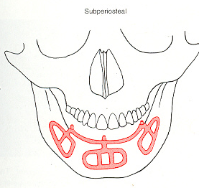
The subperiosteal implant is retained by periosteal integration In which the outer layer of periosteum provides dense fibrous envelope & anchors the implant to bone through sharpeys` fibers

Slide 6
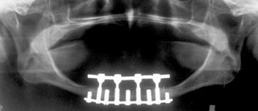
Transosteal implants
Used only in the anterior mandible
Indication :
In the very atrophic mandible
Due to the complex nature of the surgical approach this implant is not used frequently
.

Slide 7
Endosteal implants:
They are surgically placed within alveolar and basal bone
subdivided into
Root form
  Implants include those that approximate the shape and dimensions of tooth roots.
Blade form
  Those that are plates of metal.
Ramus form
  Those that are metal frameworks where only a portion of the metal is implanted into bone.

Slide 8
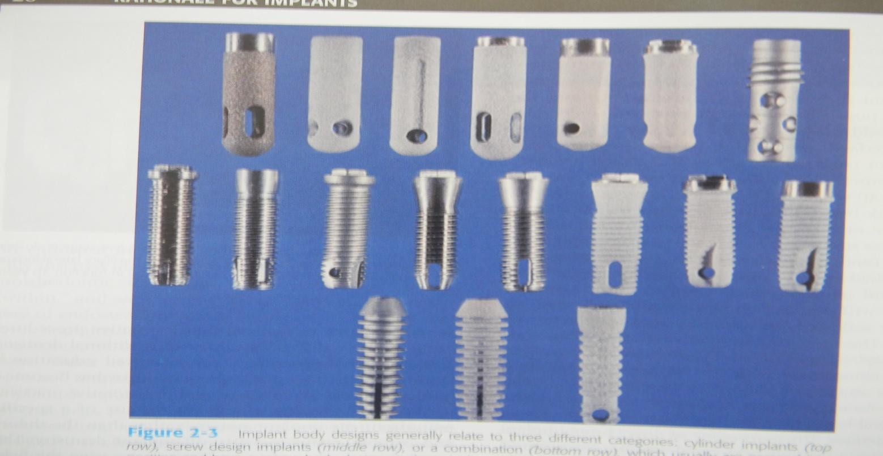
ROOT FORM
  Cylindrical
  Screw type
  combination

Slide 9
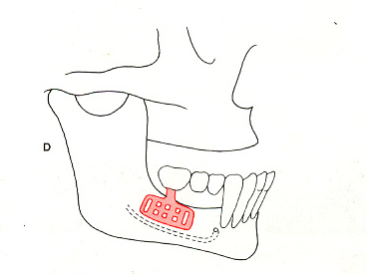
BLADE FORM
The Endosteal Blade implant was introduced in 1967 by Leonard Linkow and also by Ralph and Harold Roberts
Shape:
as the name suggests a metal / blade in cross-section
Available in 1 stage / 2 stage forms
2.5mm in width
8 to 15mm in depth
15 to 30mm in length

Slide 10
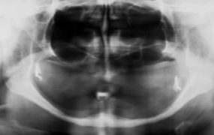
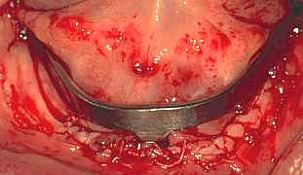
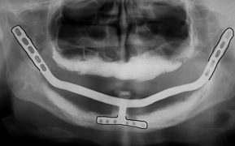
RAMUS FORM
They are technique- sensitive
They have an external attachment bar that runs from ascending ramus to ascending ramus
Posteriorly on each side they have
an endosteal extensions, inserts into available bone within ascending ramus
Anteriorly it has plate / blade extension ,is inserted into symphysis

Slide 11
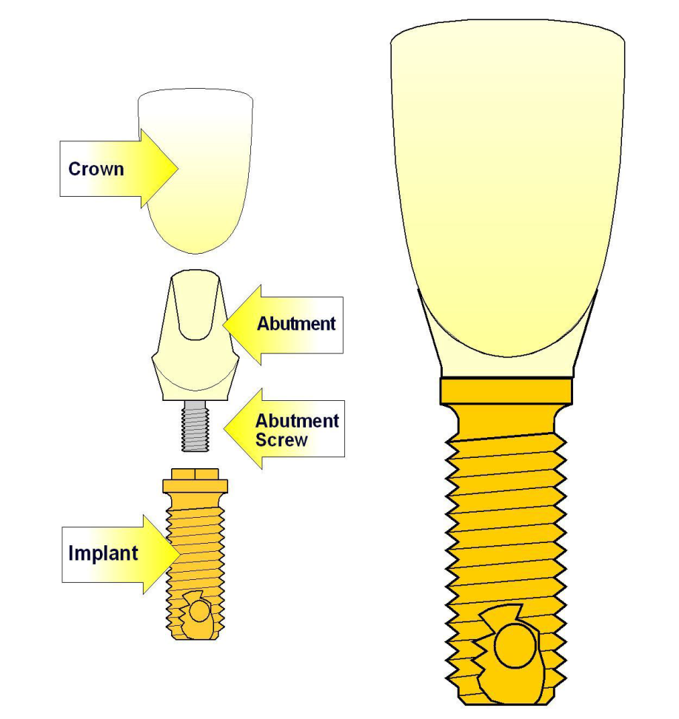
PARTS OF AN IMPLANT
BASIC PARTS

Slide 12
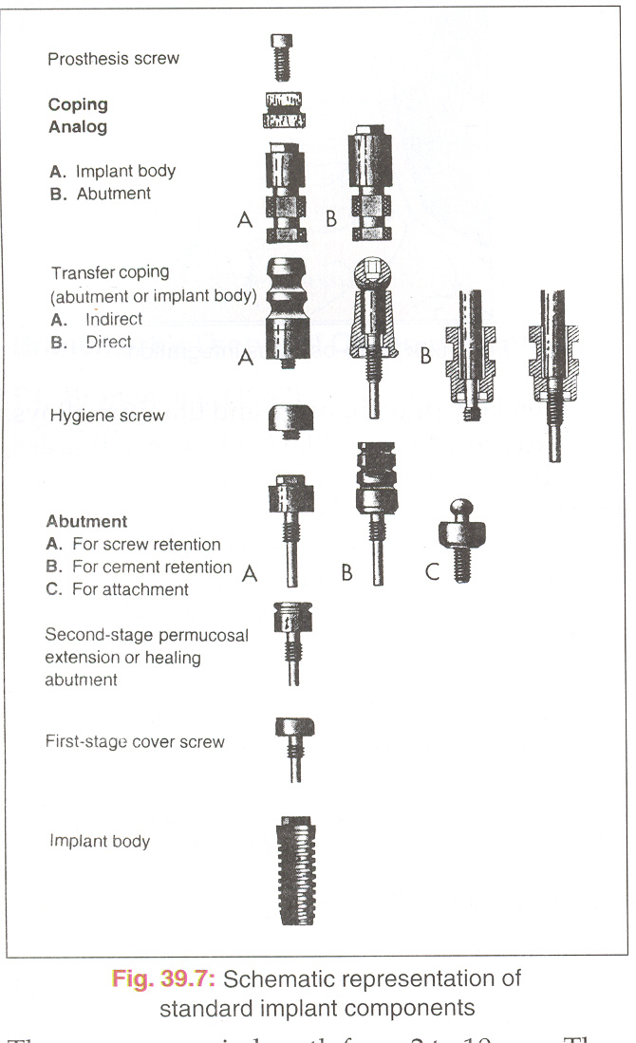
IMPLANT COMPONENTS
Implant body
Sealing screw
Healing cap
Abutement
Impression post
Laboratory analogues
Waxing sleeves
Prosthesis retaining screw
IMPLANT COMPONENTS

Slide 13
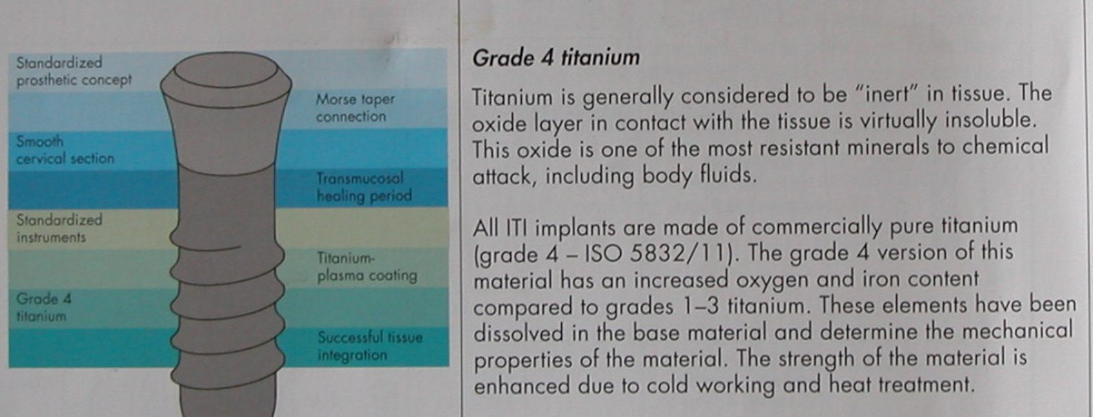
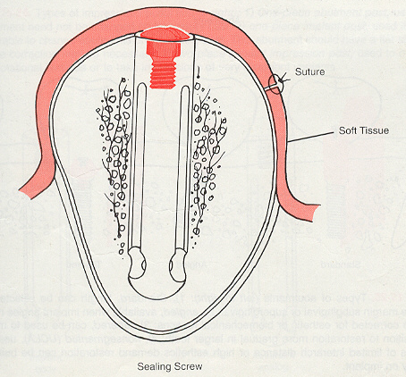
1.Implant body:
  Implant body is the endosteal dental implant that is placed within the bone during first stage surgery.
  It may be either a threaded or non threaded cylinder.
  It is either titanium alloy with or without hydroxyapatite coating.
2.Sealing screw :
  A screw is placed in the implant during the healing phase following stage –one surgery.
  Prevents the growth of the tissue over the edge of the implant.
Sealing screw

Slide 14
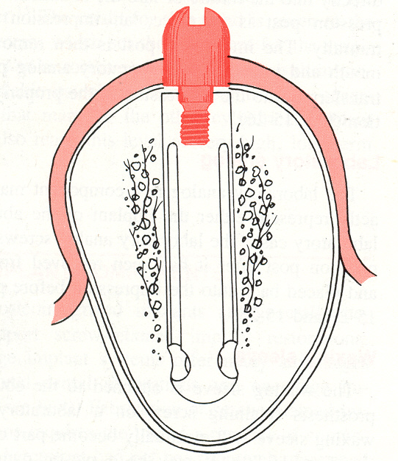
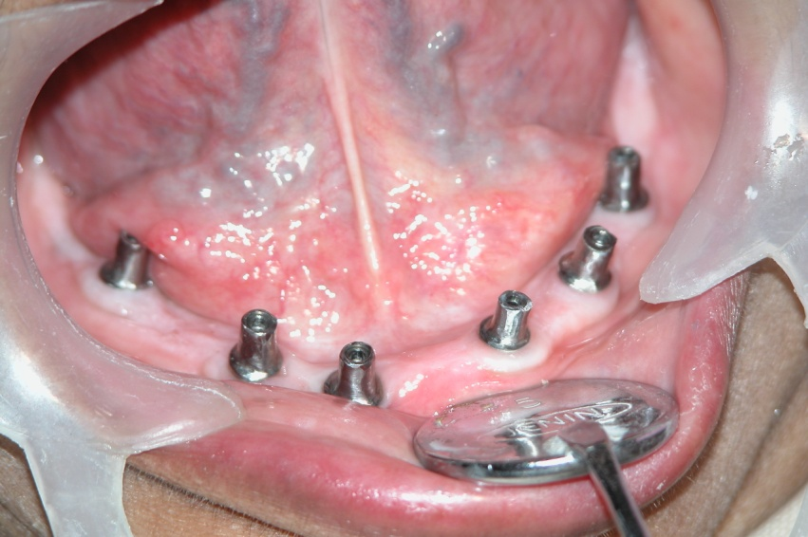
3.Healing cap
Healing cap is dome –shaped screw .
They may range in length from 2 to 10mm and projects through the soft tissue into the oral cavity.
Made up of resin such as polyoxymethyline or the titanium metals
4.Abutment:
Primary component which provides retention to the prosthesis.
Screws directly into implant support prosthesis.

Slide 15
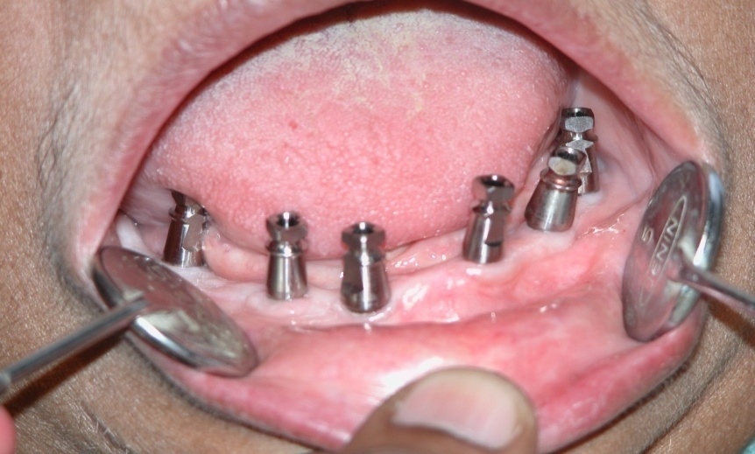
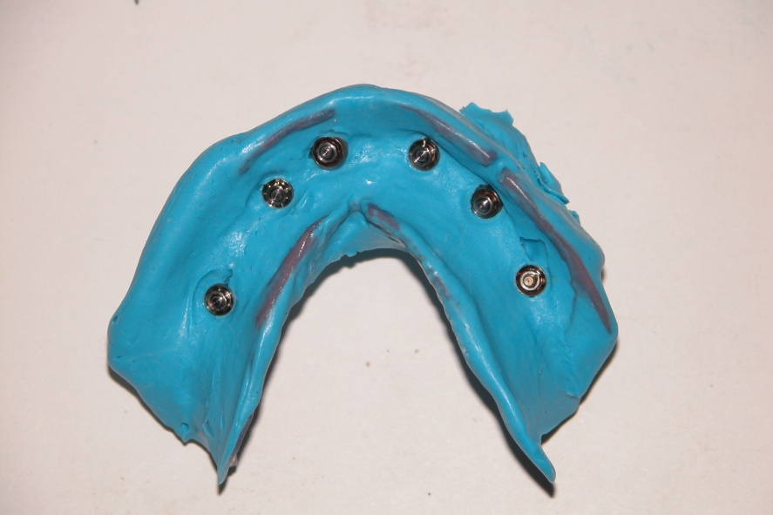
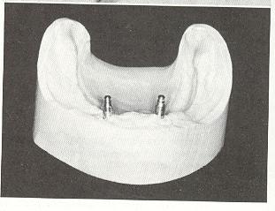
5.Impression post:
Facilitates transfer of intra oral location of abutment to similar position in laboratory cast.
It screws directly into fixture / into abutment.once impression post is in place ,an impression is made.

Slide 16
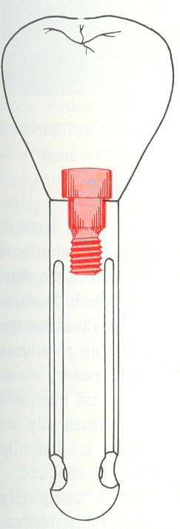
6.Laboratory analog:
Component to represent either implant or abutment in laboratory cast.
It screws onto the impression post after it has been removed from mouth & placed back into impression before pouring
7. Waxing sleeve :
Is attached to the abutment by the prosthesis retaining screw on a laboratory model.
8. Prosthesis retaining screw :
Penetrates the fixed restoration and secures to the abutment
Prosthesis retaining screw

Slide 17
Anchorage component:
that is embedded in bone (the implant).
segmented
Prosthetic component
MULTIPLE PIECES CONNECTED
TOGETHER
that attaches to the implant
non-segmented
ONE PIECE

Slide 18
Bone to implant interface
Two basic theories
  1.Fibro-osseous integration by Linkow, James & Weis
  2 Osseointegration by Branemark

Slide 19
Fibro osseous integration
Fibroosseous integration is described as ‘tissue to implant’ contact with healthy dense collagenous tissue between the implant and the bone.
Collagen fibers function similar to the periodontal fibers but are oriented in different direction i.e. parallel to implant surface.
Fibro osseous integration is associated with good initial success rates but drops off rapidly in the long term.

Slide 20
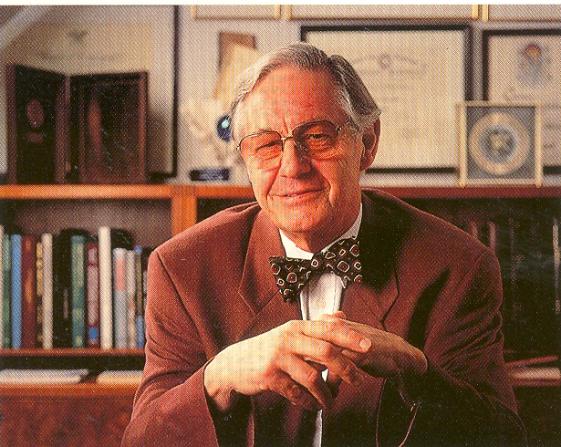
“CONCEPT OF OSSEOINTEGRATION”
Dr. Per-Ingvar Branemark
Orthopaedic surgeon
Professor University of Goteburg, Sweden.
Threaded implant design made up of pure titanium.

Slide 21
Osseo integration
Osseointegration is the process of formation of direct connection between the implant surface and bone, without an intervening fibrovascular tissue.
Branemark in 1985, defined it as “ A structural and functional connection between ordered, living bone and the surface of load bearing implant”.

Slide 22
Mechanism of osseointegration
Phase | Timing | Specific occurrence
1. Inflammatory phase/Injury phase | Day1-10 | Adsorption of plasma proteins Platelet aggregation and activation Clotting cascade activation Cytokine release Nonspecific cellular inflammatory response Specific cellular inflmmatory response Macrophage mediated inflammation.
2. Proliferative phase /Granulation phase | 2-3 weeks | Neovascularization Differentiation, Proliferation and activation of cells. Production of immature connective tissue matrix.
3.Maturation phase/callus phase | 4-16 weeks | Remodeling of the immature bone matrix with coupled resorption and deposition of bone. Bone remodeling in response to implant loading Physiological bone recession.

Slide 23
EVENTS AFTER IMPLANT PLACEMENT
Bone Necrosis
About 1 millimeter of cortical bone adjacent to the osseous wound (osteotomy site) undergoes post surgical necrosis inspite of careful surgical technique.
Three phases have been described in the development of the bone-implant interface -
1.stabilization phase
subendosteal and subperiosteal calluses form and adhere to the implant surface.

Slide 24
2.THE STERENGTH PHASE
The implant is stabilized
The process of resorption begins
Stronger, weight bearing bone is formed (lamellar bone)
Osteoclasts resorb nonvital bone and restore it with new
lamellar bone
3. THE DURABILITY PHASE
Extensive remodeling occur and additional strength is developed.
With remodeling and proper prosthodontic function, the interface bone will tend to show very mature osteonal and lamellated bone

Slide 25
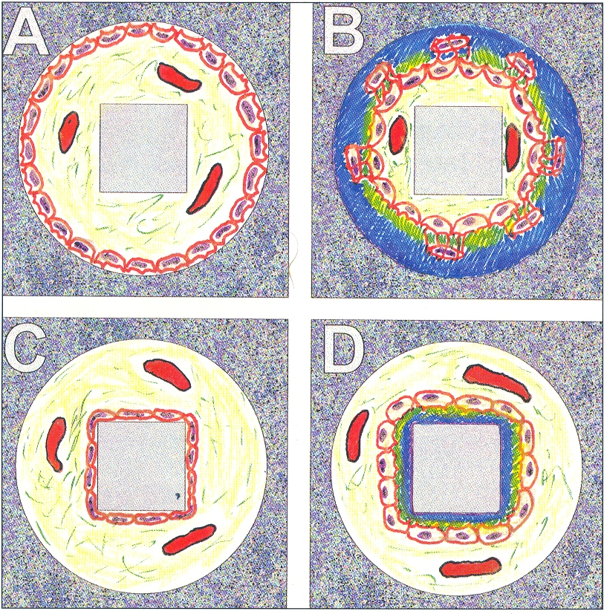
Contact osteogenesis vs distant osteogenesis :
Osborn and Newesley (1980) : Proposed 2 different phenomena
Distant osteogenesis
Contact osteogenesis

Slide 26
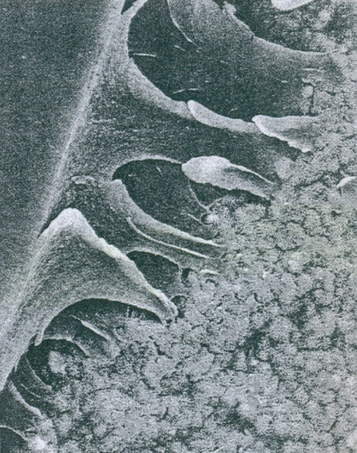
Relies on Migration of Differentiating Osteogenic cell to Implant surface
Contact Osteogenesis
Undifferentiated Perivascular connective cells
Differentiating Osteogenic cells
Osteoconduction :
Migration of differentiating osteogenic cells from the recipient host bed to implant surface where they attach and proliferate.
Fibrin

Slide 27
Destruction of Osseointegration
The main contributing factor to bone resorption are
1. local inflammation from plaque
Direct action of plaque products induces formation of osteoclasts, destroys bone through a non cellular mechanism
2.Trauma from occlusion
Stimulate gingival cells, which release mediators for osteoclast formation.

Slide 28
Factors influencing Osseointegration
  Biomaterial for dental implant
  Surface composition and structure
  Implant design
  Heat
  Contamination
  Primary stability or initial stability
  Bone quality
  Epithelial down growth
  Loading
A minimum of 3 month healing in mandible and 6 months in maxilla is necessary before load is applied

Slide 29
Ideal properties of implants
Accordind to Branemark, 1969 & Brunski, 1988 :
  Sterile
  Made of highly biocompatible material such as titanium
  Inserted with atraumatic surgical technique
  Placed with initial stability
  Not functionally loaded during the healing period of 4 to 6 months.

Slide 30
Indications
Patients with partially and fully edentulous arches as well as patients with maxillofacial deformities.
Patients who are unable to wear removable dentures and have adequate bone for replacement of dental implants.

Slide 31
General Medical Contraindications
Absolute Contraindications :
Systemic diseases such as developing cancer and Aids.
Cardiac diseases – patients with heart valve replacements and recent infarcts.
Deficient hemostasis and blood dyscrasias.
Disorders involving erythrocytes – Anemia.

Slide 32
Anticoagulant medication or any medication leading to impaired hemostasis.
Psychological diseases may carry potential risks.
Uncontrolled infections such as of the respiratory tract may negatively influence the surgical procedure or may effect the treatment result.

Slide 33
Relative Contraindications
Diabetes.
Irradiation of the Jaws. - Specifically if the jaw has been exposed to irradiation over the level of 50 Gy (Sennerby & Rasmusson 2001)
Hyperbaric oxygen treatment preceding implant therapy, the failure rate can be reduced from 60% to about 5%
(Granstrom 1992)
Reports have indicated a lower risk for failures if the pre-operative irradiation has been less than 40 Gy and carried out two years or more prior to the implant placement.

Slide 34
Chemotherapy.
If the implants are placed during medication or if the chemotherapy is given in combination with irradiation higher failure rates have been indicated. (Wolfhardt et al 1996)
Smoking.
If the patient stops smoking during the healing period, implants survival rate may improve. (Bain 1996)
Misuse of alcohol and drugs
Long standing steroid medication
patients suffering from severe osteoporosis have been treated with implants without developing any negative results in the long term. (Friberg et al 2001, Sennerby & Rasmusson 2001)

Slide 35
Intraoral Contraindications
No Pathologic conditions should be present.
All Oral lesions, including periodontal inflammation should be treated.
Unfavorable intermaxillary relationships.
Problematic occlusal and functional relationships
Pathologic conditions in alveolar bone.

Slide 36
Pathologic alterations of Oral mucosa.
  cutaneous lichen planus
  Leukoplakia
  Conditions such as pemphigus, lupus erythematosus, aphthous stomatitis, erythema multiforme, herpes zoster and herpes labialis should be handled with caution.
Xerostomia- reduced salivary flow rate is a relative contraindication for oral implantology. (Matukas 1998)
Macroglossia
Unrestored teeth and poor oral hygiene.

Slide 37
Diagnostic methods
A primary determinant for the long term success of the endosteal implants is the best possible anchorage in the bone.
Before attempting any treatment, 3 important diagnostic procedures must be performed.
Analysis of appropriate and adequate radiographs.
Measurement of mucosal thickness.
Analysis of mounted study models.

Slide 38
Anatomic prerequisites
Amount of available bone –
  Height
  Width
  Length
  shape

Slide 39
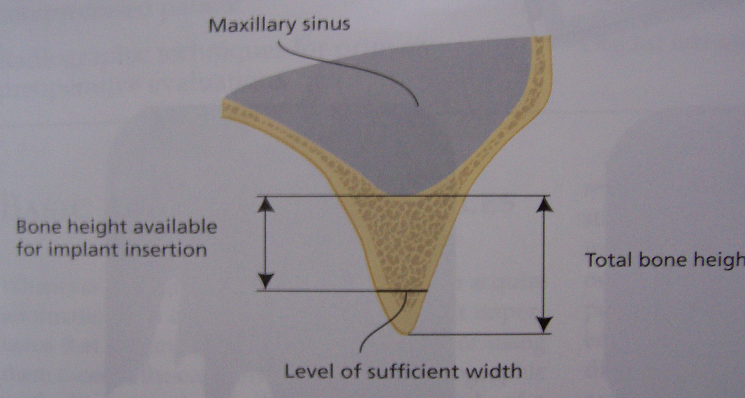

Slide 40
Minimum bone volume needed - bone height is 9-10 mm and where the width is at least 5 mm.
Less height - drills extend about 2mm deeper than the length of the implant, damaging the nerve.
Heights of 7-9mm may be accepted only when working between the mental foramina or when working in the maxilla.

Slide 41
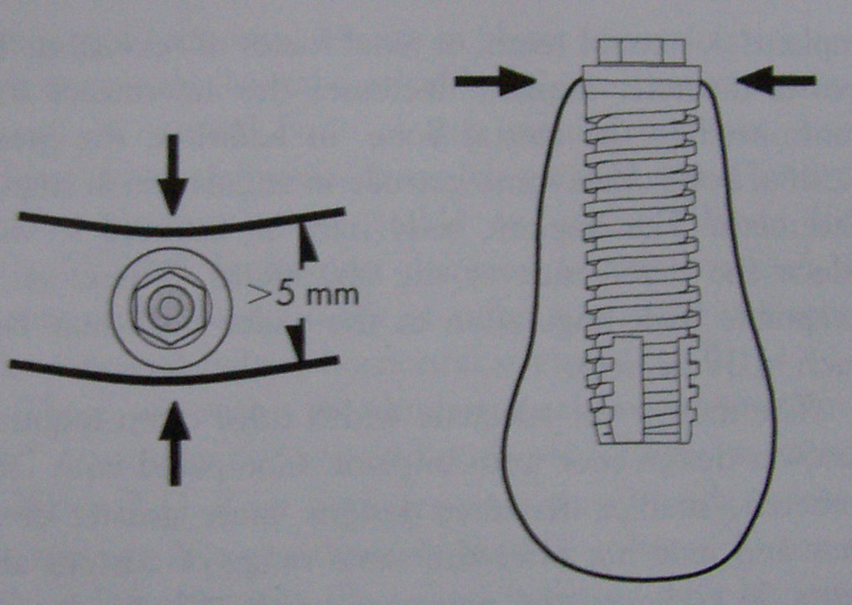

Slide 42
The length of the bone or the minimum distance required from axis to axis between two implants is 7 mm.
Depending on the implant diameter this corresponds to a minimum of 3-4mm distance between the Implants.
The minimum distance between an implant and a natural tooth should be 1.5mm.
(Ohrnell 1992)

Slide 43
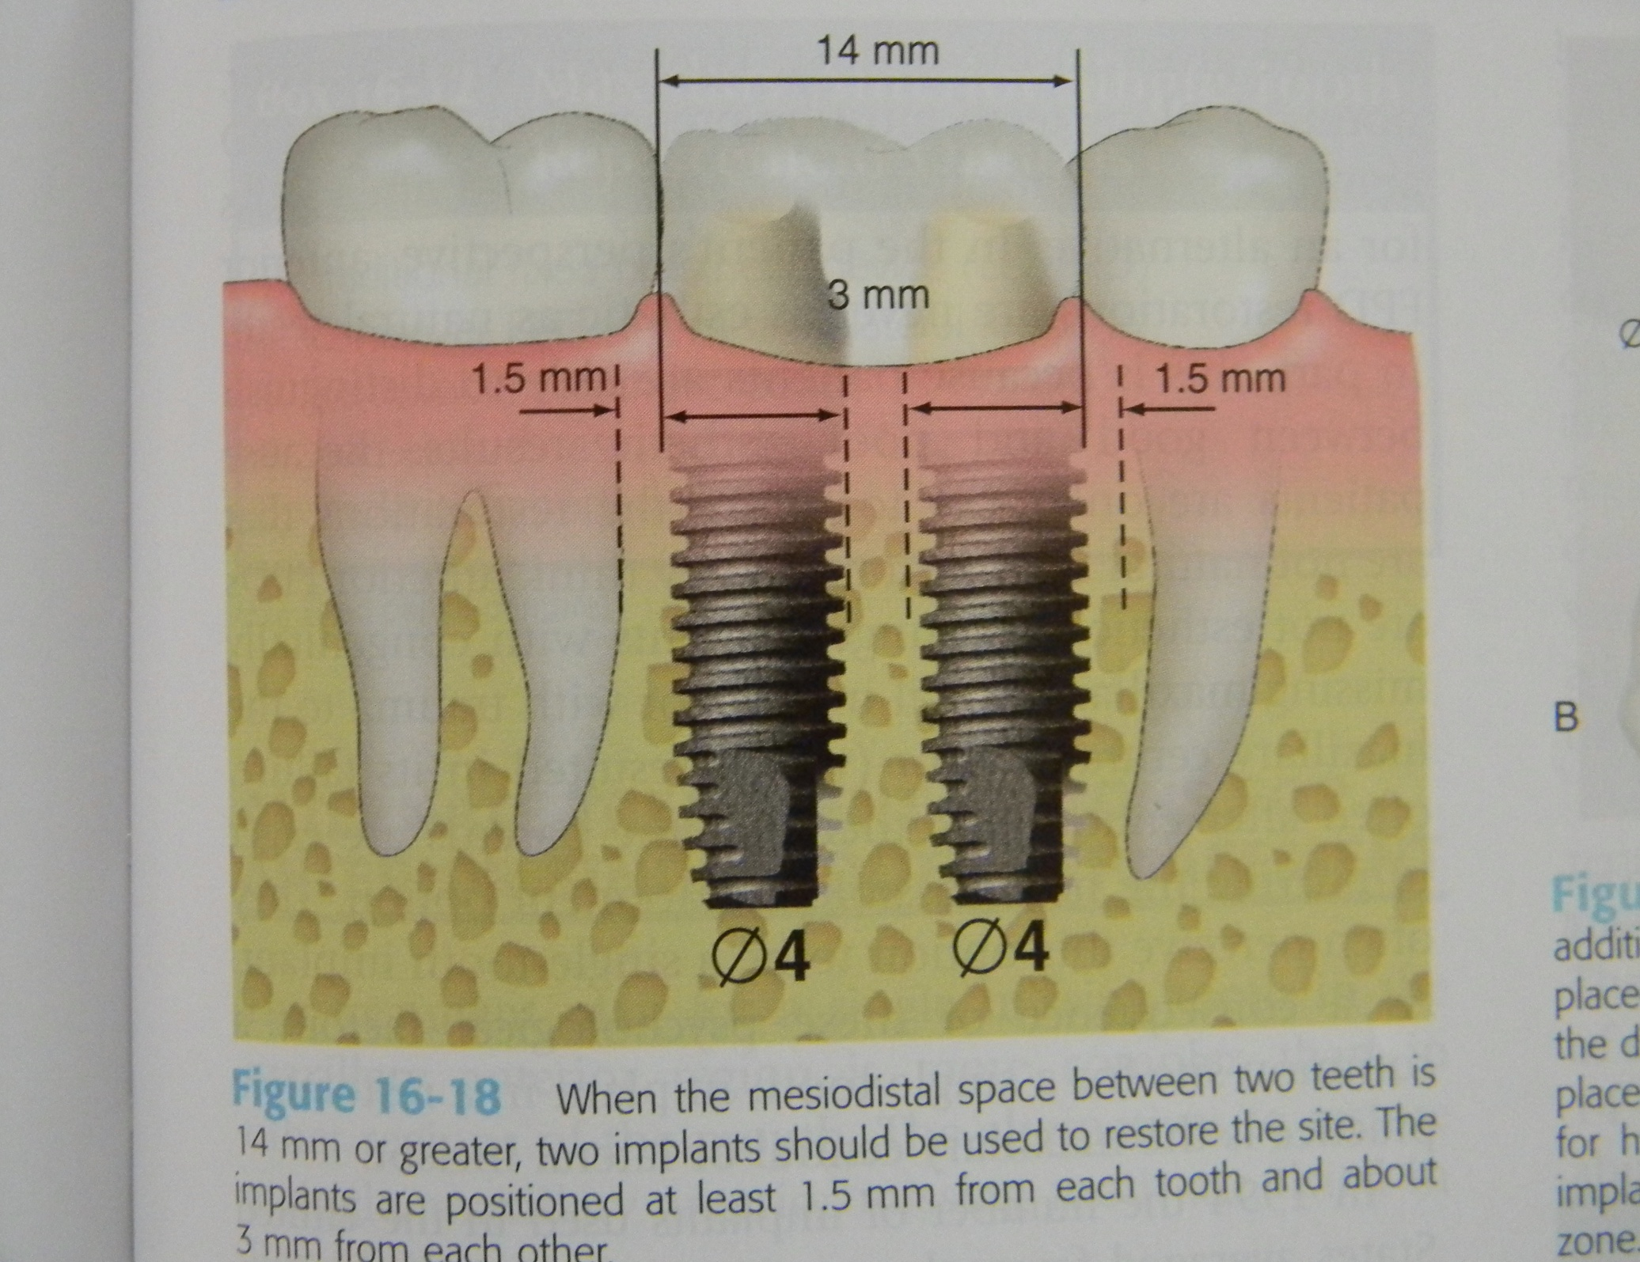

Slide 44
Maxillary sinuses
As a general rule, the implants should be placed no closer than 1-2mm from the base of the maxillary sinus.
Implant crown relationship: The crown to root implant ratio should be ideally less than 1 or close to 1:1 as possible.

Slide 45
Shape of the jaws :
Tooth extraction leads to a remodeling of the alveolar bone.
Mandible – resorption occurs lingually in premolar areas and bucally in molar areas.
Maxilla – resorption occurs mainly on the buccal aspect.
This leads to changes in the intermaxillary relationships.
Because of the atrophy of the alveolar ridge, characteristic shapes result from the resorptive process.

Slide 46
Bone density classification (Misch)

Slide 47
Classification of bone density (Misch 1990) :
  D1 - Thick, dense compact bone
  Site: Anterior segment of the atrophic edentulous mandible
  Thick lateral aspects of anterior mandible
  Advantages:
  Provides good primary stability.
  More implant bone interface approximately 80%.
  Highly mineralized and able to withstand greater loads.
  success rate - 94%.

Slide 48
  Disadvantages:
  Low Vascular supply compared with other bone categories and healing phase is longer.
  Healing time is 5 months and immediate loading can be done

Slide 49
  D2 Bone: Thick porous compact bone with coarse
  trabecular core.
  Site: Anterior and posterior segment of the mandible.
  Anterior maxillary segment ( palatal aspect).
  Advantages:
  Provides immediate stability and long term survival.
  The intrabony bleeding helps control over heating during preparation.
  The percentage of bone at bone implant interface is 70%.
  The excellent blood supply and rigid initial fixation permit adequate bone healing within 4 months.
  Progressive loading is important.

Slide 50
D3 Bone: Thin porous compact bone with coarse trabecular core.
Site: Anterior (Facial aspect) and posterior segments of the maxilla, posterior segments of the mandible.
    Condition following osteoplasty of D2 bone.
Advantages:
Good blood supply.
Disadvantages
Difficult implant bed preparation (widening). The surgeon must be extremely careful to avoid lateral perforations of the cortical bone especially on the labial portion of the maxilla.

Slide 51
2. Because of reduced implant bone interface, more number of implants may be necessary.
Time period of healing - 6 months.
Extended gradual loading should be done.

Slide 52
D4 Bone: Fine trabecular bone
Site: Maxillary tuberosity,
condition following osteoplasty of D3 Bone.
Advantages:
None.
Disadvantages:
Has very little bone density and little or no crestal cortical bone.
Difficult implant bed preparation. The bone site is easily distorted resulting in reduced initial stability of the implant.

Slide 53
Reduced implant bone interface, so optimum usage of available bone is necessary.
Number of implants to be placed is increased.
Up to 8 months of undisturbed healing is suggested.

Slide 54
Surgical guides
Partially edentulous patients:
Helps the dentist to position the implants appropriately from the prosthetic point of view.
In patients with some remaining teeth, these stents can be fabricated in the form of clasp retained partial dentures or modified bridge constructions.
Holes are drilled into the acrylic at appropriate locations with proper axis orientation.

Slide 55
Surgical guides that cover the incisal or occlusal surfaces of the remaining teeth have the advantage that they remain secure, as the pilot hole is drilled during surgery.
The ideal implant position and axis orientation are determined during analysis of the study models.
The holes in the acrylic that guide the pilot drills are ideally located in the center of the occlusal surface of the artificial acrylic teeth.

Slide 56
The acrylic stent can be hollowed out from the buccal or lingual side – a good overview of the surgical field is insured.
When implants are inserted without guidance (free hand) the danger exists that the final restoration will be less than optimal in one or more of the categories such as function, occlusion, esthetics and hygiene.

Slide 57
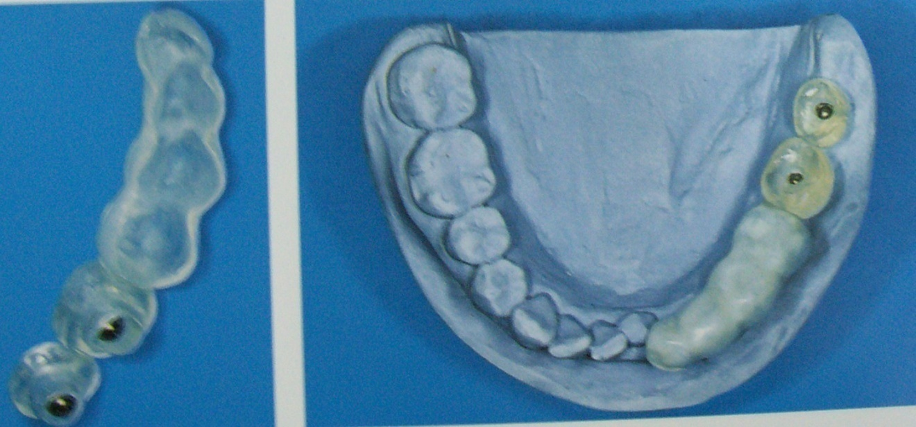
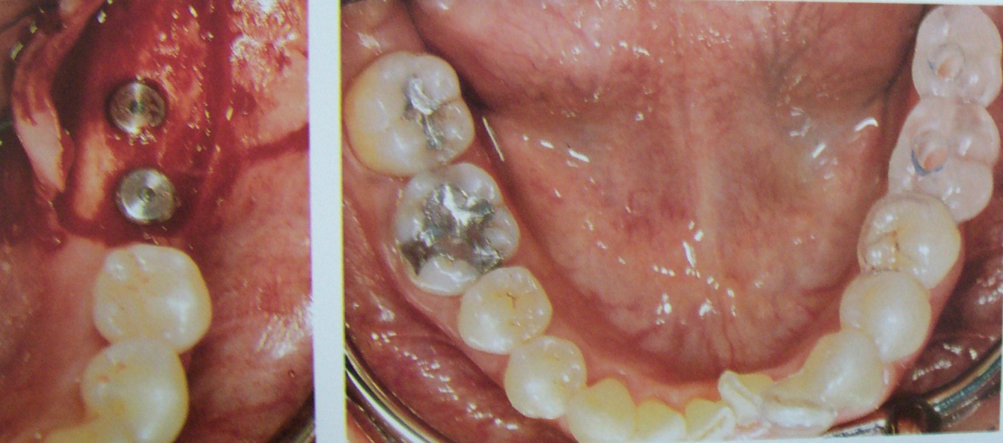

Slide 58
Edentulous patients
Surgical guide is not necessary if the treatment plan involves a complete denture retained by 2-4 implants in the anterior segment of the edentulous maxilla or mandible.
But if the therapy involves rigid screw fixation prosthesis then the use of a surgical guide is required to achieve the best possible treatment result.
The guide is prepared from clear acrylic. It could even be the patient’s own complete denture.

Slide 59
In the jaw segments, where the implants are to be placed the guide must be either completely relieved or have holes drilled in it at the proper locations.
Maxillary guides relieved from the palatal aspect and mandibular guides relieved from the lingual aspects offer practical advantages with corresponding incisions.

Slide 60
In this way the surgeon would be able to visualize the course of the dental arch and can also appreciate the inclination of the implant axes, which should be parallel to the buccal surfaces of the anterior and posterior teeth as much as possible.
The occlusal surfaces of the molars should be retained to permit intraoperative checks of the guide position in centric occlusion.
Guides must be disinfected in appropriate solutions before clinical use.

Slide 61
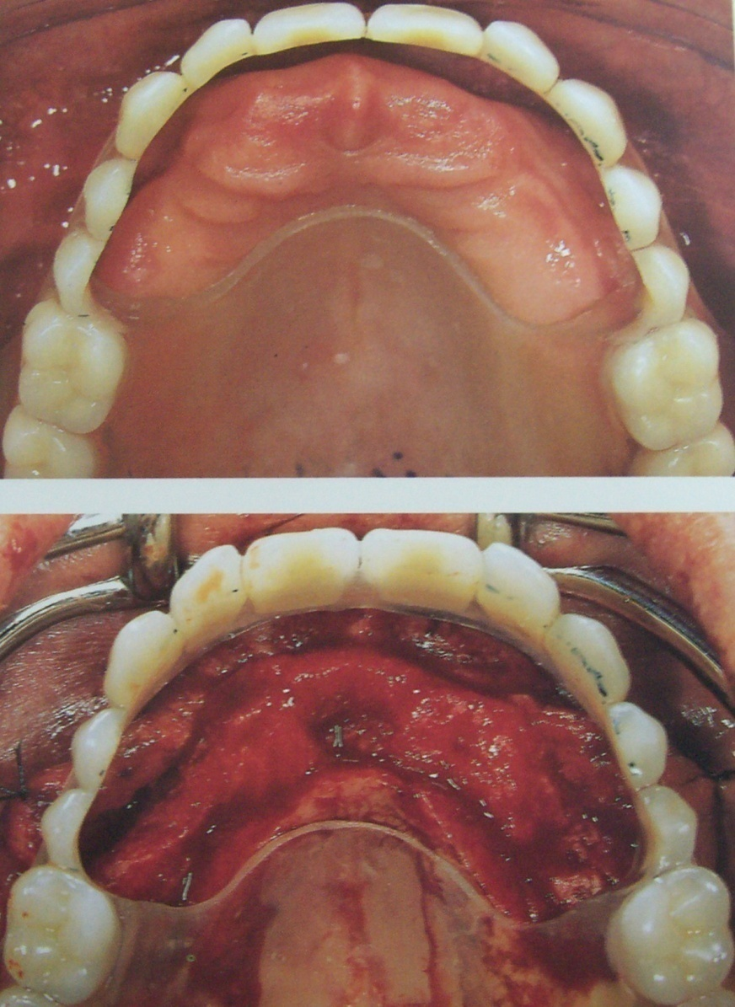
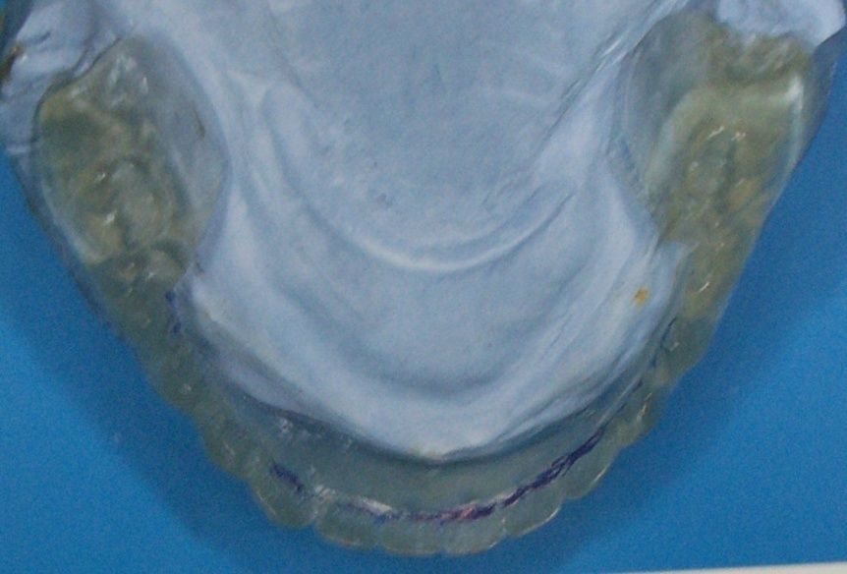

Slide 62
SURGICAL ASPECTS OF
DENTAL IMPLANTS

Slide 63
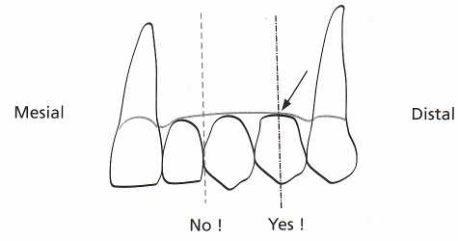
Implant position
with regard to the anatomic situation, the implant should preferably be placed in tooth position , both in a mesiodistal and in a buccolingual direction.

Slide 64
Implants should never be placed in the midline of the maxilla or the mandible, as in these positions they may either expand the suture, as between the two maxillae, and/or may compromise the esthetics.
the implants should not be placed into important structures such as nerves, tooth roots and jaw cavities either, as no damage of surrounding tissues can be accepted just because of the wish to insert implants for prosthetic anchorage

Slide 65
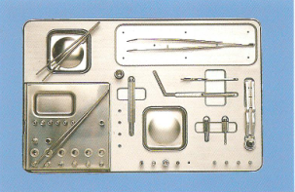
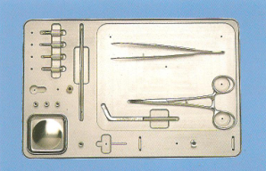
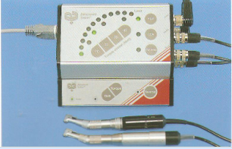
Instrument tray for implant placement
Tray for uncovering,, abutment adaptation
Controller set, drill equipment

Slide 66
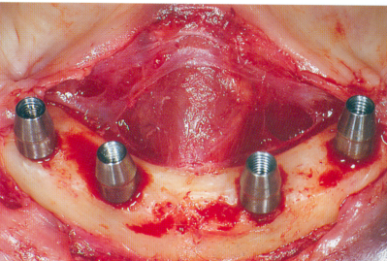
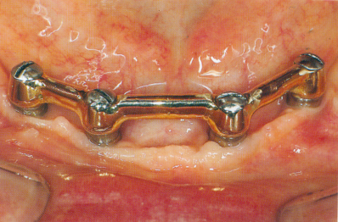
Single stage implant:
This technique involves only single surgical procedure.
The implant fixture is inserted with a prosthetic post,
immediately in the post-operative period.
The implant may be loaded in the post-operative period.

Slide 67
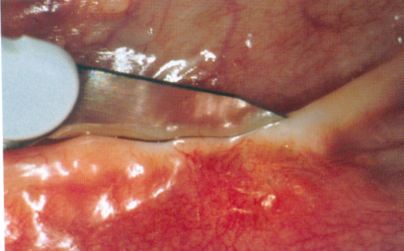
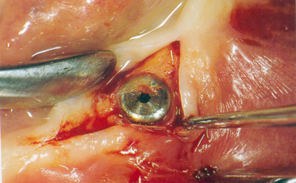
Two stage implant:
This requires two surgical procedures.
In the first surgery, the implant body is seated into bone and completely covered by mucoperiosteal flaps and allowed for healing.
In the second surgery, implants are uncovered to receive the prosthetic component.
Advantage : Allows osseous healing of the implant without any loading force

Slide 68
STEPS IN PLACEMENT OF IMPLANT
1.Incision
2.Reflection of mucoperiosteal flap
3.Preperation of osteotomy & insertion of implant
4.Uncovering of implant after healing phase
5.Prosthetic component placement
6.loading of implant

Slide 69
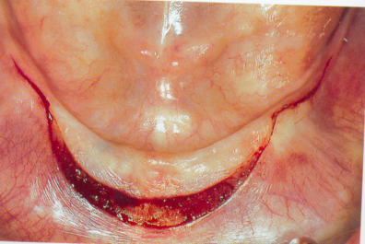
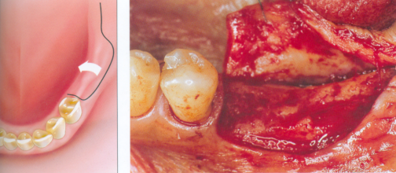
VESTIBULAR INCISION:
If the mentalis is located adjacent to alveolar crest Incision is placed 5-10mm from junction of attached & unattached gingiva
Vestibular incision with lingual reflection

Slide 70
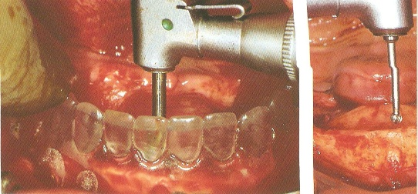
Determination of implant location
With help of Surgical guide (the transparent acrylic mandibular CD) making implant location

Slide 71
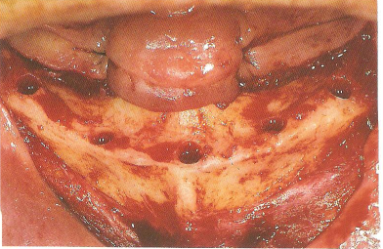
Good spatial harmony of implant placement

Slide 72
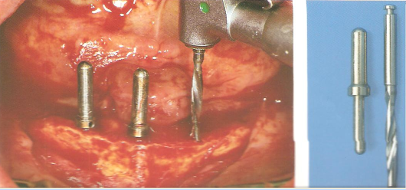
Parallelism of abutments
Guide pins, twist drill

Slide 73
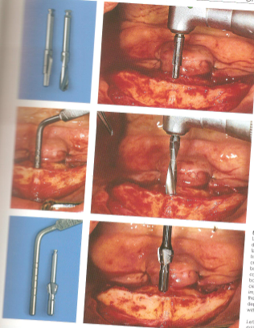
Coronal enlargement of the implant bed
Final enlargement & depth measurement
Depth gauge

Slide 74
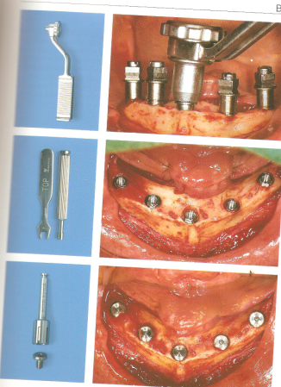
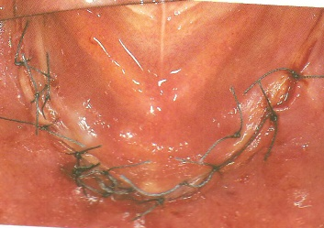
Tightening with cylinder wrench
Removing the seating posts
Placement of cover screws
Suture closure

Slide 75
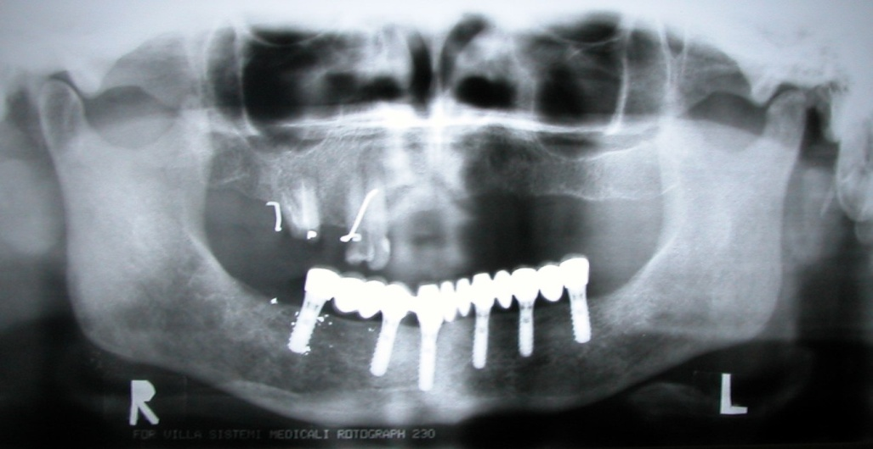
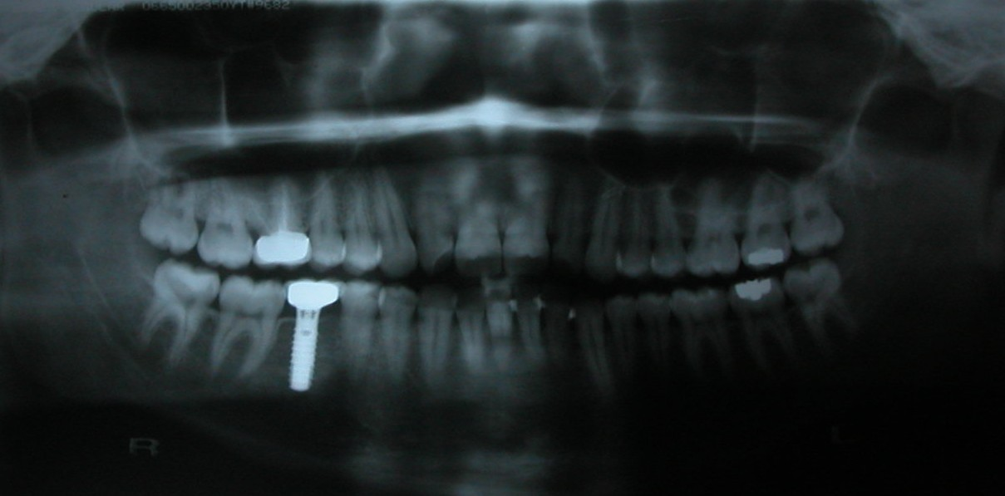
post operative radiographic evaluation
  should be taken at this time to confirm implant placement and proper seating of the healing screw.

Slide 76
Healing Time
The post-operative bone healing time depends on several factors
1.Quantity and quality of bone
2.Implant stability
3.Health of the patient
4.Clinical judgment and experience of the
surgeon.
A general guide for healing time is:
• Type I bone (3 to 4 months)
• Type II bone (4 to 5 months)
• Type III bone (5 to 6 months)
• Type IV bone (6 to 8 months)

Slide 77
UNCOVERING OF IMPLANT
In two stage implant the 2nd surgical procedure is to uncover the implant after healing phase
Usually done after--3 months in mandible
6 months in maxilla
VARIOUS TECHNIQUES USED ARE
Crestal incision
Tissue punch / Soft tissue punch
Electro surgical uncovering
Once the implant is uncovered
Osseous union of implant is checked
Peri-implant soft tissue is checked

Slide 78
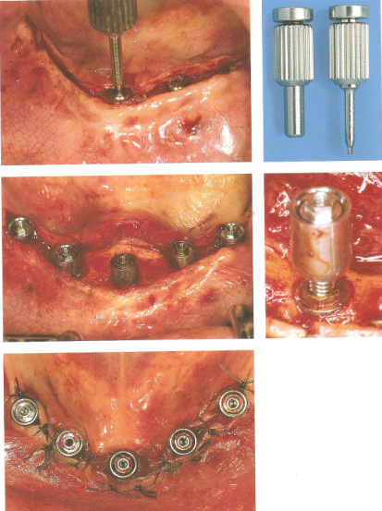
Uncovering of implant
Removal of cover screws

Slide 79
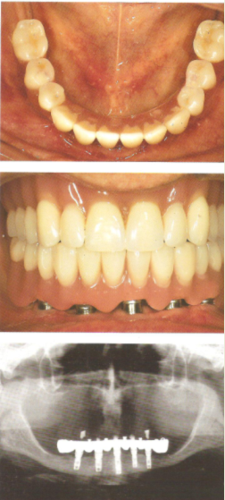

Seating of prosthesis

Slide 80
Guidelines for key implants position
  No cantilevers.
  No three adjacent pontics.
  Canine – molar rule.
  Arch dynamics.

Slide 81
Key implant positions
There are four guidelines to determine key implant positions
Cantilevers on the prosthesis should be reduced and preferably eliminated, there fore terminal abutments in the prosthesis are key implant positions.
Three adjacent pontics should not be designed in the prosthesis.
Canine and the first molar sites are key positions, especially when adjacent teeth are missing.
An arch is divided into five segments. when more than one segment of an arch is being relaced,a key implant position is at least one implant in each segment.

Slide 82
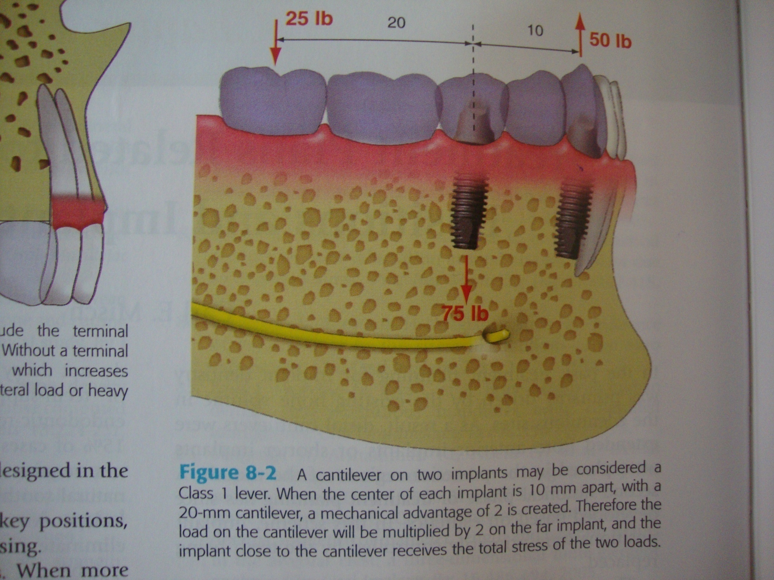

Slide 83
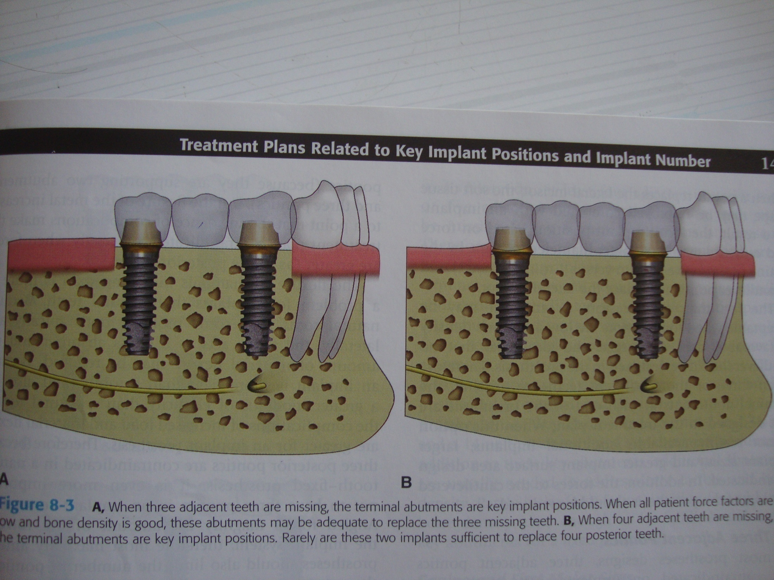

Slide 84
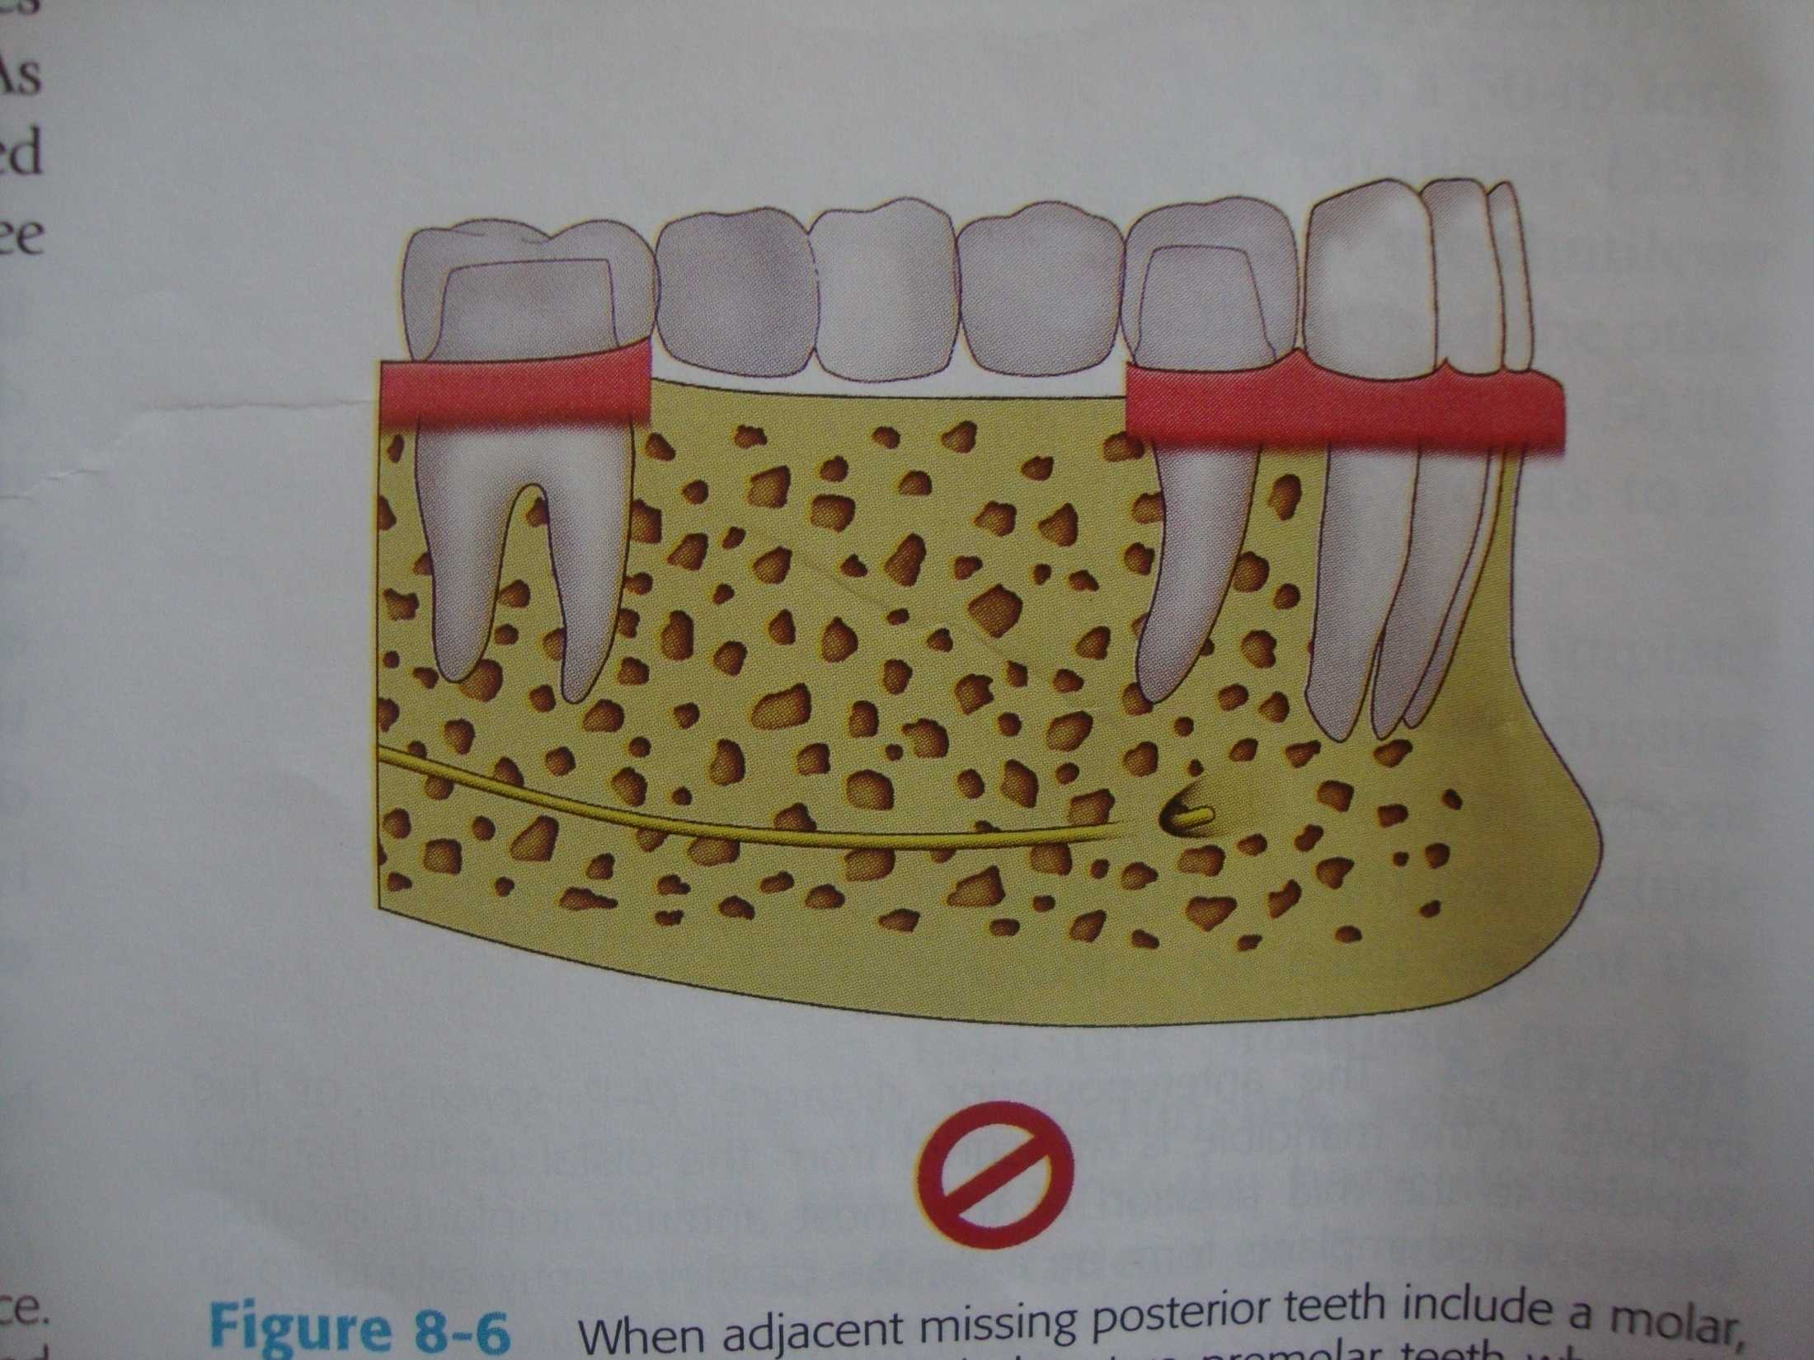

Slide 85


Slide 86
COMPLICATIONS ASSOCIATED WITH IMPLANTS

Slide 87

1.SURGICAL COMPLICATIONS
1.Hematomas/Edema/Ecchymosis
2. Nerve damage
Hematoma
3.Mandibular Fracture
4.Adjacent Tooth Devitalization
5.Life-Threatening Hemorrhage
6.Air Emboli
2.EFFECT OF IMPLANT LENGTH
Failure occurs when the implants are short (7 & 10 millimeters long).
3.EFFECT OF IMPLANT PLACEMENT IN TYPE IV BONE
Higher failure rates

Slide 88

Nerve damage( injury to inferior alveolar nerve)

Slide 89

Opening the nasal or maxillary sinuses

Slide 90

4.PROSTHETIC RELATED
Dehiscence
1.Opposing Prosthesis Fracture
2.Prosthesis Screw Loosening
3.Abutment Screw Loosening
4.Metal Framework Fracture
5.Implant Fracture
5.PERI-IMPLANT SOFT TISSUE
COMPLICATIONS
1.Implant Fenestration/Dehiscence
2.Gingival Inflammation/Proliferation
3.Fistulas
Implant Fenestration

Slide 91


Failing implants are clinically characterized by
1.Gigival inflammation
2. increased mobility
3.periimplant radiolucency
4..probing depths greater than 6mm
Implants in partially edentulous cases appear to be at greater risk for periimplantitis than implants in completely or fully edentulous cases/ patients
Healthy implant bed
Diseased implant bed

Slide 92
MANAGEMENT
The treatment involves ANTI-INFECTIVE THERAPY
1. The local removal of plaque deposits with plastic instruments
2. Polishing of all accessible surfaces with pumice
3. Subgingival irrigation of all peri­implant pockets with 0.12% chlorhexidine
4. Systemic antimicrobial therapy for 10 consecutive days
The second phase involves the surgical procedure.

Slide 93

Treatment of implant surface
Access may be gained via full thickness or split-thickness periodontal flap reflection. The peri-implant pocket epithelium and any granulation tissue are removed using conventional curettes.
Care must be taken to avoid damaging or contaminating implant surface.
plastic curettes are used to remove plaque and calculus as thoroughly as possible from the surface of the implant.
PLASTIC CURETTE

Slide 94

Prophy-Jet Device (30-60 seconds application) are used to clean the implant surface. The Device uses sodium hydrocarbonate with sterile water are indicated (Bass et al. 1992). The high pressure air powder abrasive, removes microbial deposits completely from titanium implant surfaces.
Prophy - Jet Device

Slide 95
Consideration should be given to the potential for air-emphysema when using high-pressure air spray instrumentation in the surgical site.
The spray should never be directed parallel to the implant surface into the surface, but rather at an angle of atleast 45⁰ .(Brown et al 1992)
PROPHY-JET

Slide 96

The final Step in cleaning the surface of the implant consists of detoxification using citric acid (pH 1-3) 30 – 60 seconds on a soaked gauze strip around the implant surface.
The use of citric acid provides the greatest potential to remove bacteria and endo toxins from the implant surface, in comparison with other chemical agents. (Zablowsky et al. 1992).
Before closing the flap, the entire area is rinsed again using sterile saline solution.
De-toxification with
Citric Acid

Slide 97
ROLES IN IMPLANT MAINTENANCE
`
PATIENTS `ROLE
1. Plaque control of 85%.
2. Use of interdental (ID) brushes,hand and
motorized.(Proxa-Brush,Oral-B Brush,Rota-Dent,Sonic).
3. Dip brushes in chlorhexidine,0.12% (Peridex,Periogard).
4. Use of flosses,,tapes,dipped in chlorhexidine (Super-
Floss,Perio-Floss,G-Floss)
5. If patient has tooth-colored materials,composites and so
on, use a cotton swab dipped in chlorhexidine.

Slide 98
HYGIENIST ROLE
1. Check plaque control effectiveness (85%).
2. Check for inflammatory changes
3. IF pathology is present,probe gently with plastic probe
(sensor).
4. Scale supragingivally only (or slightly subgingivally).
5. Check for problems such as loose suprastructure.
6. No need to probe if no pathology is present.

Slide 99
CLINICAL ROLE
Check every 3 or 4 months
Check for 85% plaque control effectiveness.
3. Expose radiographs every 12 to 18 months if no pathology is present.
4. If suprastructure is retrievable, remove and clean with the
ultrasonic every 10 to 24 months.
5. If implant needs it repair, degranulate, detoxify and graft with guided bone regeneration (GBR) if necessary.

Slide 100
REFERENCES
1. CONTEMPORARY IMPLANT DENTISTRY.
CARL E. MISCH; 2ND EDITION.
2.CLINICAL PERIODONTOLOGY 10TH EDITION –CARRANZA
3.CLINICAL PERIODONTOLOGY AND IMPLANTOGY 5TH EDITION-JAN LINDHE
4.GOOGLE NET SEARCH

Slide 101


T H A N K Y O U

