Slide 1
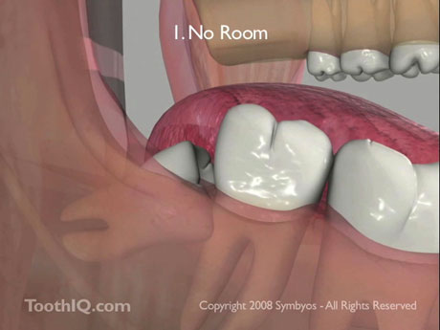
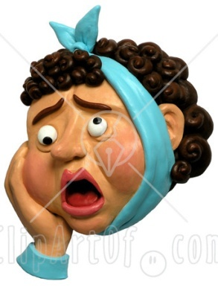
IMPACTION
BY
T.SUBBA RAJU
IIND YEAR
POST GRADUATE

Slide 2
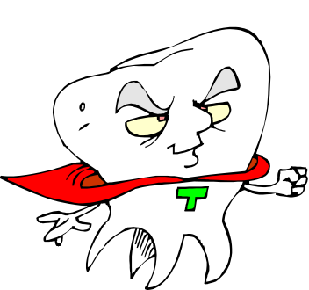

DEFINITION
Impaction is any tooth that is prevented from reaching its normal position in mouth by tissue or bone or another tooth.
- WHO
A tooth that is completely or partially unerupted and is positioned against another tooth / bone / soft tissue, so that its further eruption is unlikely, described according to its anatomical position.
- ARCHER’s

Slide 3
THEORIES OF IMPACTION
Nature & Nurture theory – John Hunter 1771
Mendelian theory.
Anthropological theory. – Begg & Kesling 1971
Endocrine theory.
Orthodontic theory.
Growth studies. – Bjork, Richardson & Broadbent.

Slide 4
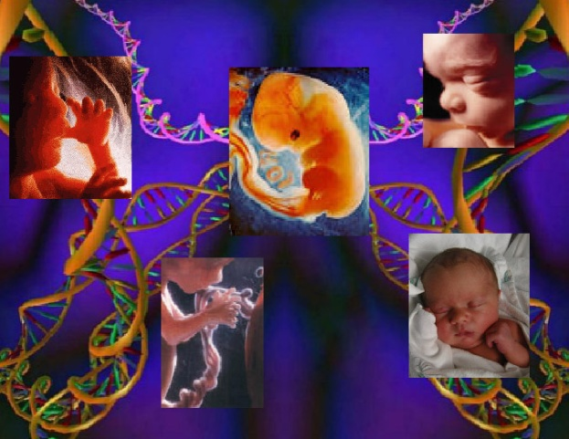
ETIOLOGY
BERGER’S CLASSIFICATION
Systemic causes:
a) Prenatal.
b) Postnatal.
c) Skeletal disturbances.
II. Local causes:
a) Irregularity in position.
b) Increased density of bone.
c) Increased density of mucosa.
d) Jaw size discrepancy.

Slide 5
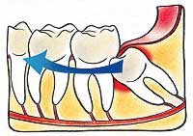
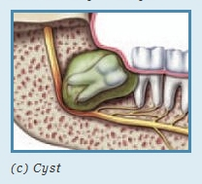
e) Premature loss of retained deciduous teeth.
f) Infection in bone or systemic causes.
III. OTHER CAUSES
Dilaceration
Any obstruction- retained, odontome, cyst ,tumor
ETIOLOGY

Slide 6
ORDER OF FREQUENCY :
Archer
Mandibular third molars
Maxillary third molars
Maxillary canines
Mandibular premolar
Mandibular canines
Maxillary premolar
Maxillary central incisors
Maxillary lateral incisors
Supernumerary teeth

Slide 7
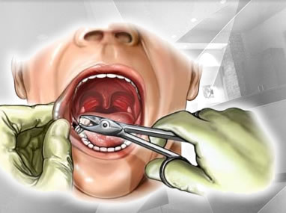
MANDIBULAR 3RD MOLAR

Slide 8
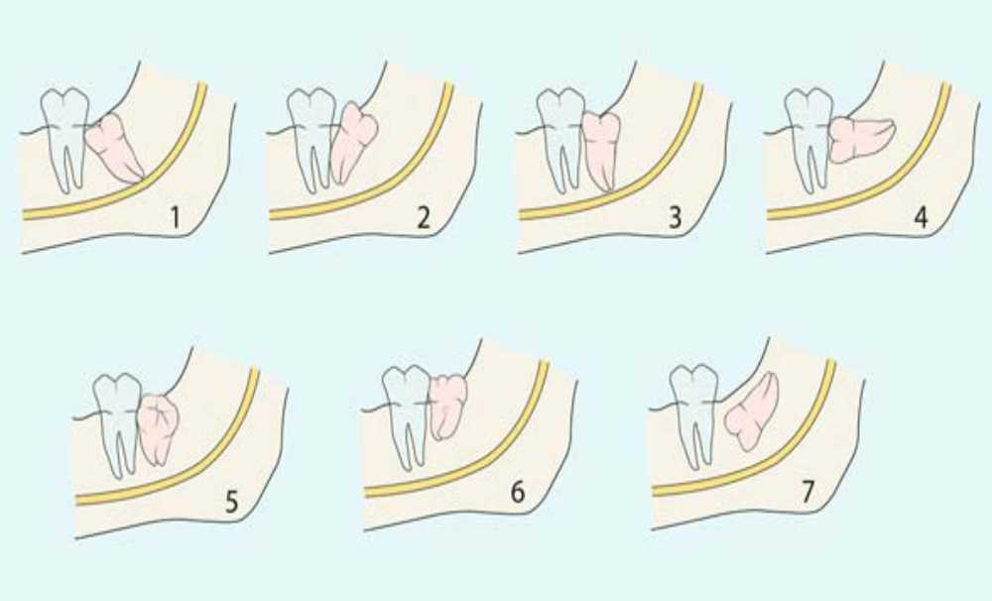
CLASSIFICATION OF IMPACTED MANDIBULAR 3rd MOLAR
GEORGE WINTER’S CLASSIFICATION
1.MESIOANGULAR 11.DISTOANGULAR 111. VERTICAL
1V. HORIZONTAL V. BUCCOVERSION VI. LINGUOVERSION
VIII. INVERTED

Slide 9
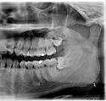
WINTER’S SUB-CLASSES :-
Angle between the longitudinal axis of 3rd molar and occlusal plane.
ANGLE | TOOTH
- ve or 0º | Inverted
0º to 30º | Horizontal
31º to 60º | Mesio-angular
61º to 90º | Vertical
>90º | Disto-angular

Slide 10
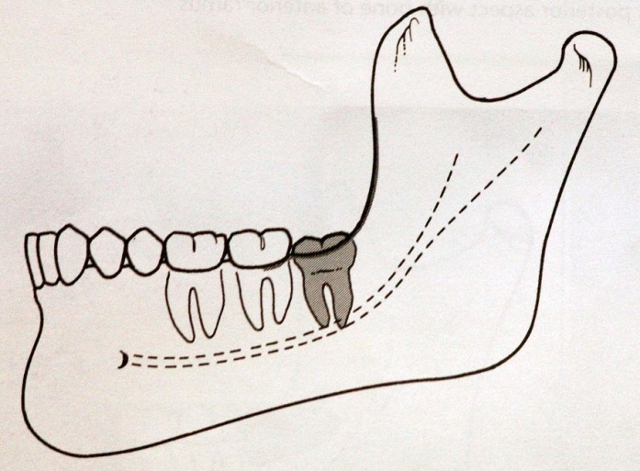
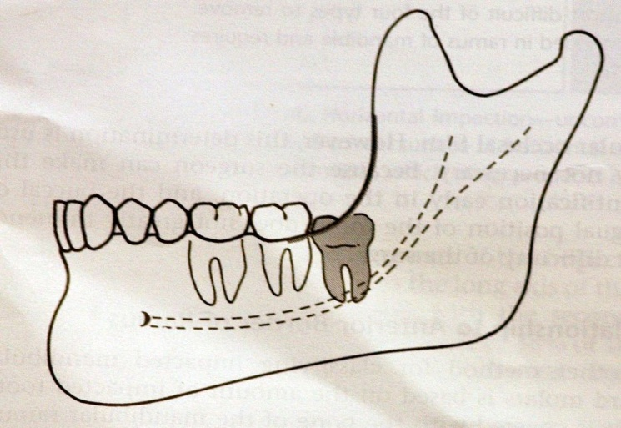
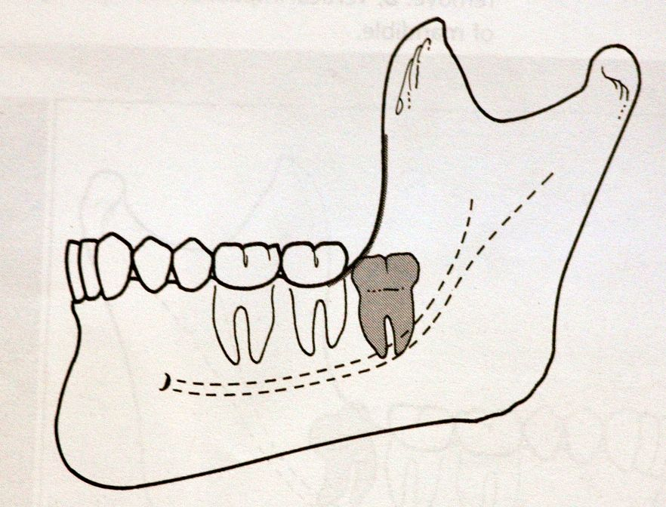
PELL AND GREGORY’S CLASSIFICATION (1933)
I) Skeletal anatomic space between posterior aspect of 2nd molar and anterior border of ramus of mandible
CLASS I
CLASS II
CLASS III

Slide 11
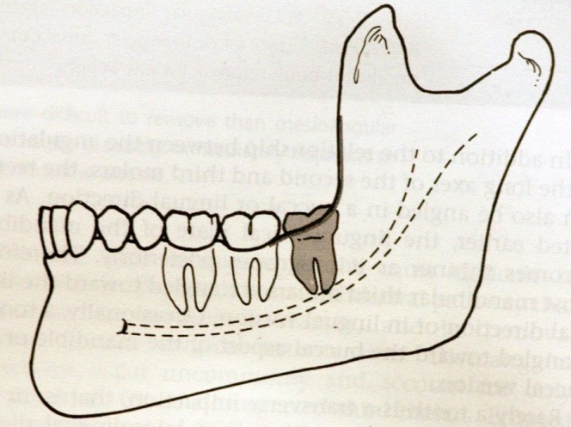
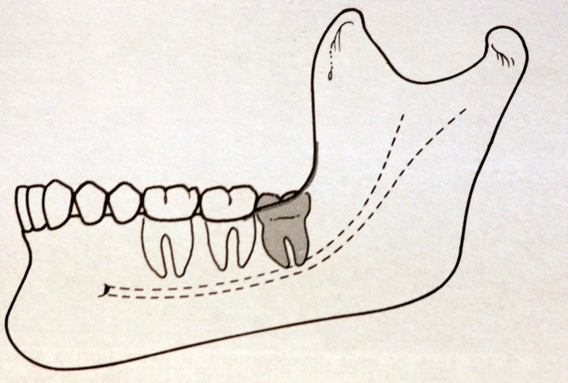
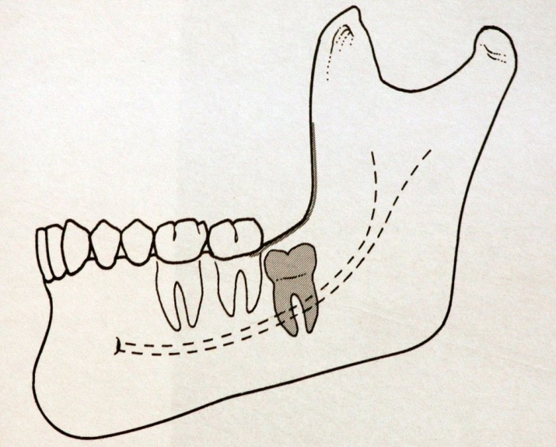
II) Relative depth of 3rd molar in bone –
POSITION - A
POSITION - B
POSITION - C

Slide 12
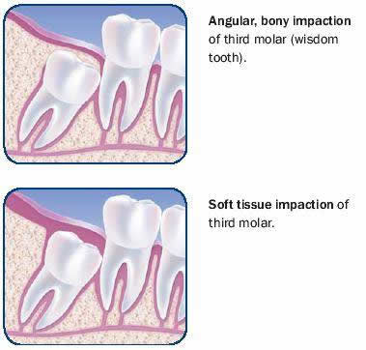
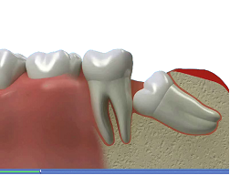
COMBINED ADA AND AAOMS CLASSIFICATION : - Alling
Based on the operation performed to remove impacted teeth.
I) D7220 – (Soft tissue impaction)
II) D7230 - (Partially bony impaction)
III) D7240 – (Complete bony impaction)
IV) D7241 – (Complete bony impaction with surgical difficulties )
OMFSCNA FEB 2007

Slide 13
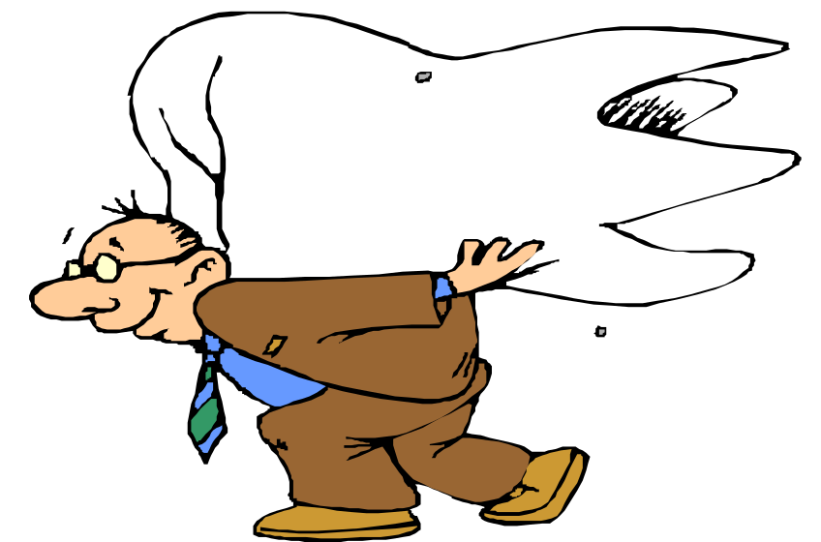
PETER TETSCH & WILFRIED WAGNER’S CLASSIFICATION
i) Vertical retention
ii) Horizontal retention
  a) Sagittal – Mesio-angular, Disto-angular
  b) Transverse – Buccoversion, Linguoversion.
iii) Inclined retention

Slide 14
THIRD MOLAR CLASSIFICATION ON OPG:-
LINE –I : Line of the Occlusal plane
LINE-II : Class A,B,C as per the PELL & GREGORY classification
LINE-III : Class- I, II, III as per the PELL & GREGORY classification
LINE-IV: Winter’s classification sub - classes

Slide 15
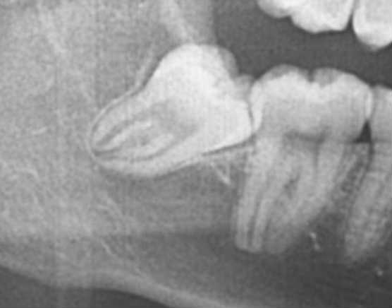
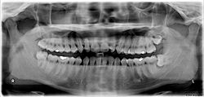
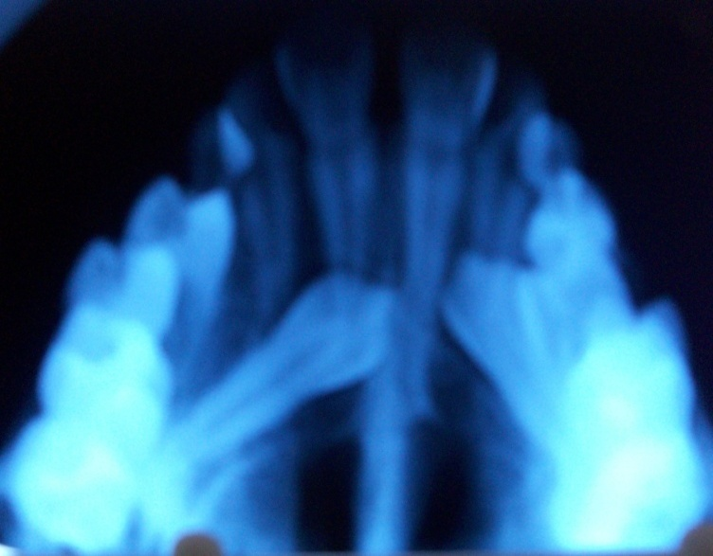
PRE-OPERATIVE ASSESSMENT
RADIOGRAPHS NEEDED:
Orthopantomographs
Intra oral periapical view.
Occlusal view.
Special technique.
Cone shift or tube shift.

Slide 16
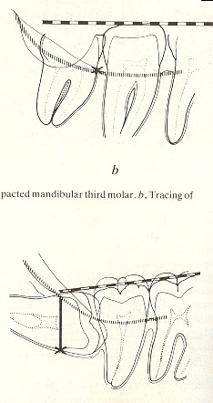
WINTER’S LINES (WAR lines)
White line.
Amber line.
Red line
RADIOLOGICAL ASSESMENT IOPA & OPG

Slide 17
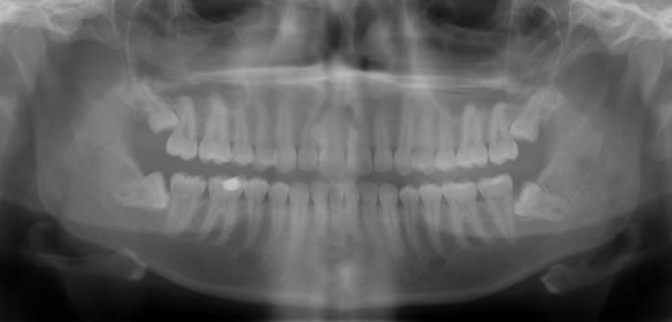
WINTER’S LINES
RADIOLOGICAL ASSESMENT IOPA & OPG

Slide 18
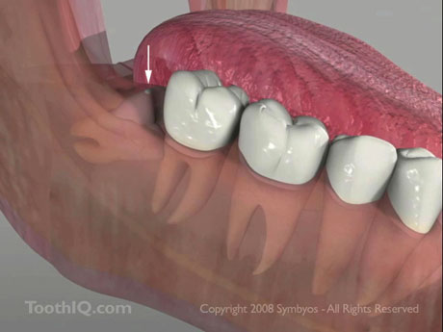
ANDERSON’S DIFFICULTY SCORE INDEX :-
CRITERIA SCORE
PELL & GREGORY
Class I 1
Class II 2
Class III 3
Position A 1
Position B 2
Position C 3
WINTER
Mesio-angular 1
Horizontal 2
Vertical 3
Disto-angular 4
INTERPRETATION :
Relatively Easy – 3 to 5
Moderate – 6 to 8
Difficult – 8 to 10.

Slide 19
WHARFE’S ASSESSMENT
CATEGORY SCORE
Winter’s classification
Horizontal 2
Disto-angular 2
Mesio-angular 1
Vertical 0
2. Height of mandible
1 – 30mm 0
31 – 34mm 1
35 – 39mm 2
3. Angulation of 3rd molar.
1º to 50º 0
60º to 69º 1
70º to 79º 2
80º to 89º 3
90º + 4

Slide 20
WHARFE’S ASSESSMENT
4. Root shape
a) < 1/3rd complete 2
b) 1/3rd to 2/3rd complete 1
c) > 2/3rd complete
i) Complex 3
ii) UnFavourable curvature 2
iii) Favourable curvature 1
5. Follicles
Normal 0
Possibly enlarged -1
Enlarged -2
Impaction relieved -3
6. Path of exit
Space available 0
Distal cusps 1
Mesial cusps covered 2
Both the covered 3
Total 33

Slide 21
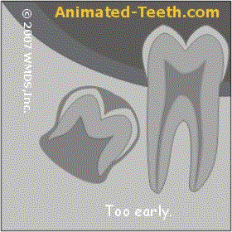
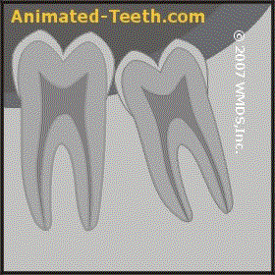
ROOT PATTERN
  Converging roots – easy to remove.
  Divergent roots – difficult to remove.
  Bulkier roots or dilacerated roots – difficult to remove.
  Tooth 1/3rd to 2/3rd development – easier to remove than
  fully formed root.
  Limited root formation – difficult to remove as the follicle
  keeps rolling.
  Roots with mesio-distal diameter that is greater than at
  the cervical line must be sectioned longitudinally
RADIOLOGICAL ASSESMENT IOPA& OPG

Slide 22
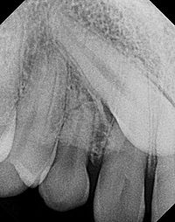
TEXTURE OF INVESTING BONE :
Bone tends to become sclerosis and less elastic as age advances.
Bone is elastic and cancellous in younger.
Dense and sclerosed in aged.
If the trabecular spaces of bone are large and bone structure is fine, then it seem to be elastic.
If the trabecular spaces are small and the bone shadow is dense, then the bone is sclerotic and brittle.

Slide 23
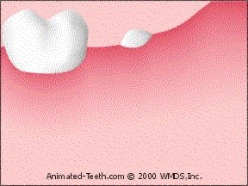
INDICATIONS FOR IMPACTED TOOTH REMOVAL
Recurrent Pericoronitis – most commonest indication
Dental caries
Food impaction
TMJ disorders
Preventive dentistry
Nonspecific pain
Foci of infection
Trauma
Orthodontic consideration
Prior to Orthognathic surgeries.
Prosthetic consideration
Pathology.
Prophylactic removal.

Slide 24
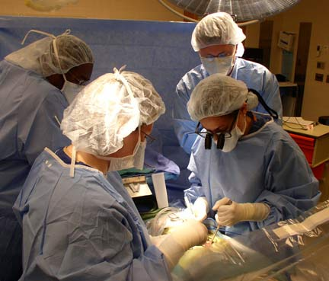
CONTRAINDICATIONS FOR TOOTH REMOVAL
Extremes of age.
Compromised medical status.
Probable extensive damage to adjacent structures
SURGICAL STEPS
1. Aseptic environment
2. Regional anesthesia
3. Access.
4. Incisions
5. Elevation of soft tissue
6. Retraction of soft tissue
7. Operations on osseous tissue
8. Sectioning
9. Removal of tooth
10. Surgical closure

Slide 25
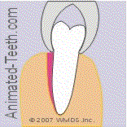
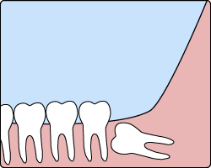
METHOD OF REMOVAL
I. Conventional method –
a) Forceps technique – Wedge, lever and fulcrum, wheel and axle.
b) Elevator technique
c) Combination of both.
II. Open method / Transalveolar extraction –
a) Odontectomy – by removal of bone
b) Odontotomy.- by division of tooth.

Slide 26
PRINCIPLES OF INCISIONS
Incision is made with sharp blade .B.P blade No.15, handle No.3 or No. 4
Continuous in one stroke & deep to bone
Incision is made at right angle to the epithelial surface
Care for vital structures
Full thickness mucoperiosteal flap
Base flap must be broad
Length of flap should not exceed base
Line of closure should rest on sound bone & not on deep surface.
Either include or exclude the papilla
Avoid sharp corners in the flap.

Slide 27
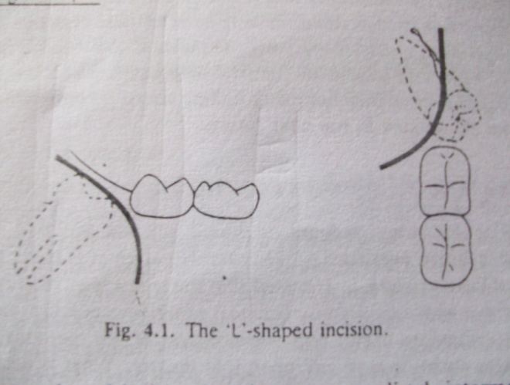
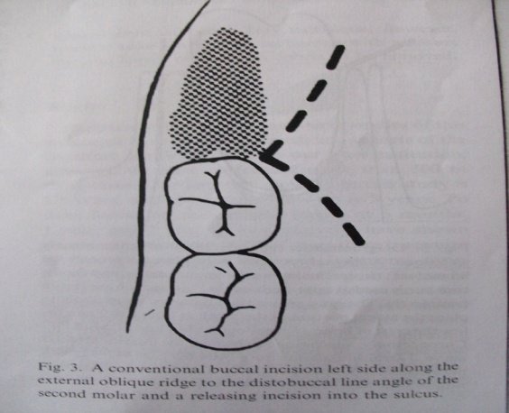
L – SHAPED FLAP OR 2ND MOLAR PARA-MARGINAL FLAP WITH VESTIBULAR EXTENSION
INCISION AND FLAP ELEVATION
Advantage : prevent the formation of periodontal pocket.
Modifications –
Shift the distal incision away from the distobuccal aspect of
2nd molar
Shifting the junction of both limbs from the distobuccal region of 2nd molar to midpoint of distal region or even to shift lingually

Slide 28
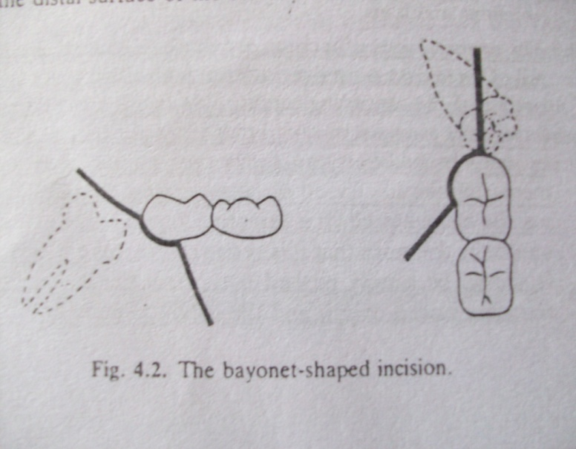
BAYONET – SHAPED FLAP
ADVANTAGE :
- Good blood supply to the flap due to broad base.
- It can be comfortably used for partially erupted tooth
INCISION AND FLAP ELEVATION

Slide 29
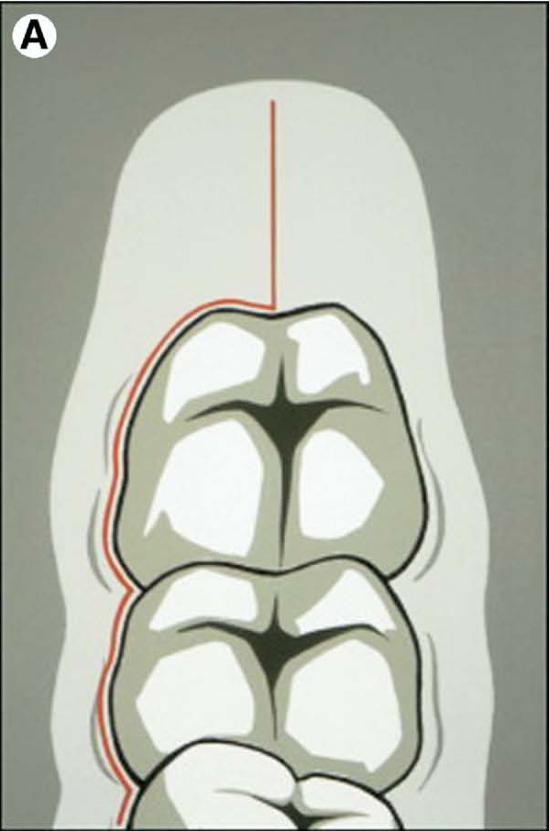
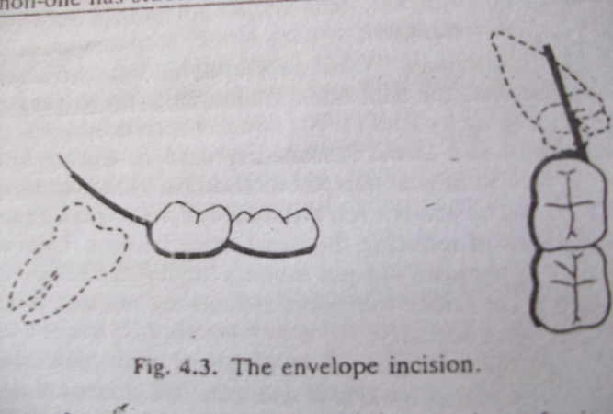
ENVELOPE FLAP
INDICATIONS:
For mesioangular impacted teeth, superficial impactions.
For distoangular teeth, length of the incision is 3/4th inch.
INCISION AND FLAP ELEVATION
Schow (1970) – identified that any incision or flap extended beyond the external oblique ridge will have high chances of dry socket formation.

Slide 30
MODIFIED ENVELOPE FLAP:
The deeper the tooth, the more anteriorly the sulcular incision given.
Indicated for better visibility and lingually inclined 3rd molar
LINGUAL FLAP :
Used with the lingual approach.
The incision starts on ascending ramus aiming at the disto-buccal corner of 2nd molar follows the distal surface of 2nd molar as a sulcular incision and then continues lingually to the first molar.
A sulcular incision is also made along the buccal aspect of 2nd molar.
Disadvantage:- Lingual nerve injury.
INCISION AND FLAP ELEVATION

Slide 31
TERENCE WARD’S INCISION :-
Used for superficial impactions.
The vertical anterior releasing incision is placed at the gingival related to the disto-buccal line angle of 2nd molar 1/3rd the way into papilla.
Followed by gingival crevicular incision.
Followed by the posterior distal incision of 3/4th inch or 2cms, angulated from the middle of the distal surface of 2nd molar laterally towards the external oblique ridge.
INCISION AND FLAP ELEVATION

Slide 32
MODIFIED TERENCE WARD’S INCISION :-
Indications:
- Used for deep impactions.
- The vertical releasing incision starts at the mesio-buccal line
angle about 1/3rd the way into papilla of 2nd molar .
- Followed by gingival crevicular incision.
Caution:
- Followed by distal limb of 3/4th inch extending laterally towards the external oblique ridge to:
a) To avoid injury to the Lingual nerve.
b) To avoid injury to the nutrient vessels.
c) To avoid the damage to temporalis muscle thereby prevention of trismus
d) To avoid the buccal pad fat to be encountered
e) Distal incision should not be extended too posteriorly
so as to prevent the damage to lingual and facial artery.
INCISION AND FLAP ELEVATION

Slide 33
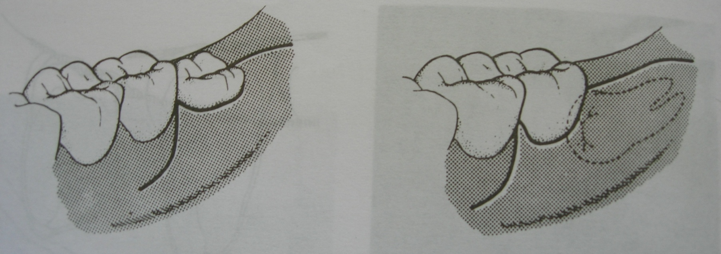
INCISION AND FLAP ELEVATION
TERENCE WARD’S INCISION & MODIFIED WARD’S INCISION

Slide 34
BONE AND TOOTH REMOVAL
Depends on:
Shape of the tooth.
Position of tooth.
Shape of surrounding bone.
Age of the patient.
A) MOORE AND GILBE COLLAR TECHNIQUE
B) CHISEL TECHNIQUE

Slide 35
CRITERIA CHISEL AND MALLET BUR
1. Technique Difficult Easy
Patient’s acceptance Not well tolerated Tolerated well
under local anesthesia. Under local anesthesia
3. Chance of fracture of bone Relatively high Less possibility.
Healing of bone Good Delayed due to over heating
and inefficient cooling
5. Postoperative edema Less More
6. Dry socket Incidence is less Very high
7. Postoperative infection Less More
Advantage/ Disadvantage Difficult to remove Relatively easy to remove
deeply buried impactions; deeply buried impactions;
impacted in edentulous impactions in edentulous
jaws and in elderly patients. jaws and in elderly patients.

Slide 36
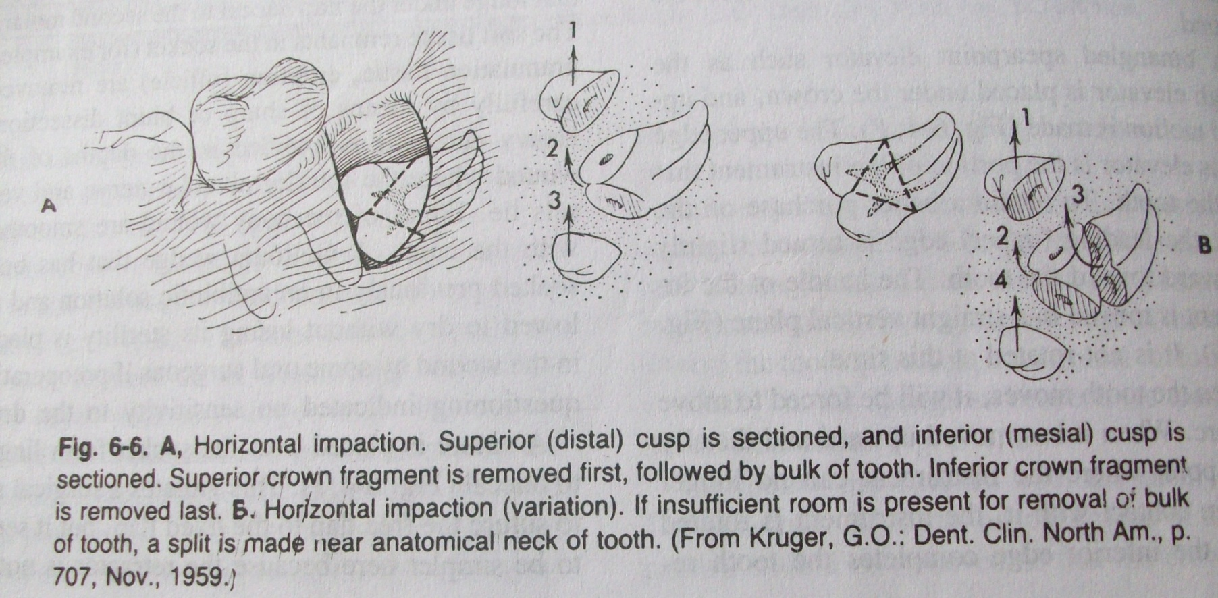
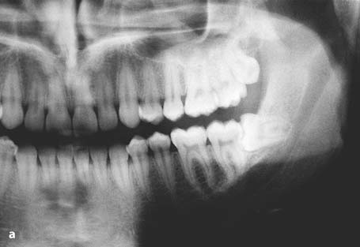
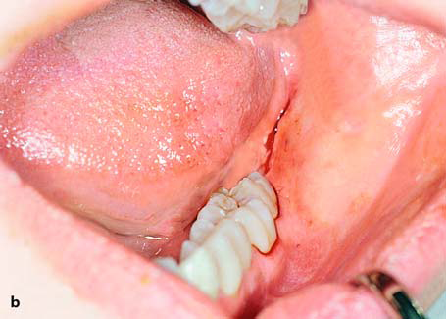
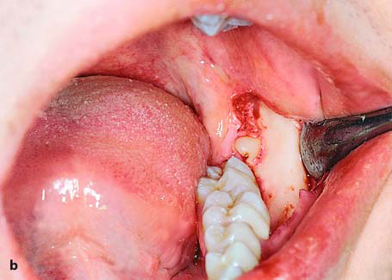
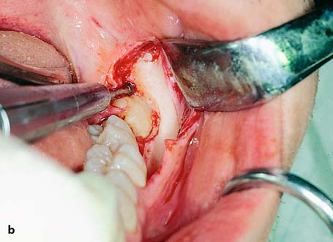
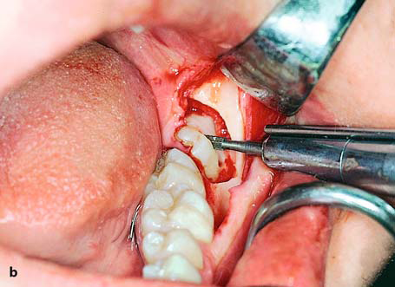
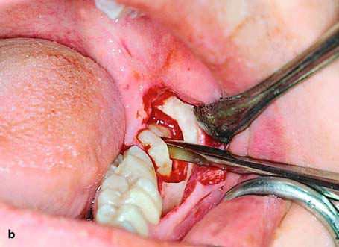
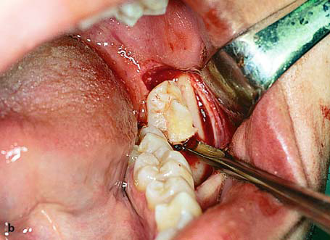
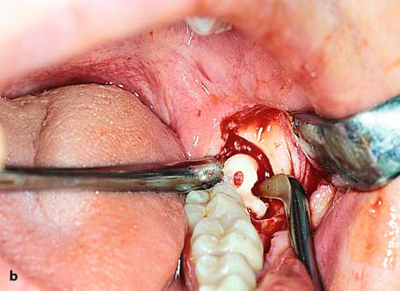
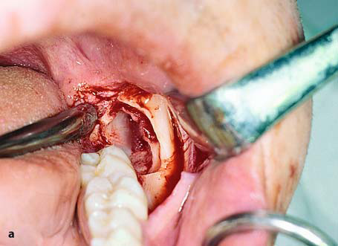
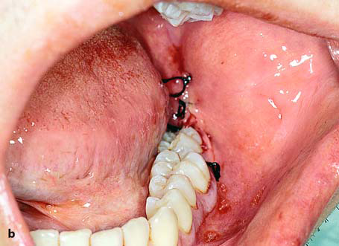
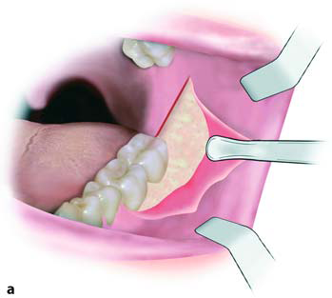
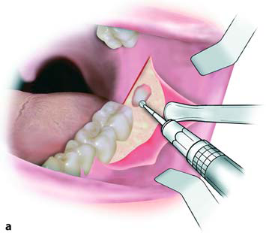




REMOVAL OF HORIZONTAL IMPACTION

Slide 37















REMOVAL OF DISTOANGULAR IMPACTION

Slide 38
















REMOVAL OF
MESIOANGULAR IMPACTION

Slide 39
ADVANTAGES OF THE TOOTH- DIVISION TECHNIQUE –
Decrease damage to adjacent teeth.
Decrease bone removal results in decrease postoperative
swelling and pain
Decreased fracture of mandible.
Danger of lingual nerve injury and inferior alveolar nerve
injury is decreased because of leverage forcing apex of
the tooth down into the canal.

Slide 40

Indicated unerupted 3rd molar in the age group 9 to 16 years.
Modified S- shaped incision is made from retromolar fossa across the external oblique ridge. It then curves down along the reflection of the mucous membrane above the vestibule, extending upto the 1st molar anteriorly.
Such an incision leaves behind 5mm cuff of attached mucosa at the distobuccal region of 2nd molar.
- The buccal cortical plate is trephined over the 3rd molar crypt.

Slide 41

LINGUAL SPLIT BONE TECHNIQUE
Sir William Kelsey Fry 1933
-Introduced by Kelsey Fry and popularized by Terence Ward.
- Indicated in the removal of impacted molars that are placed lingually

Slide 42
Advantages :-
Faster tooth removal
Less risk of inferior alveolar nerve damage.
Lessened risk of damage to the periodontium of the 2nd molar.
Lessened risk of socket healing problems.
Disadvantages :-
Risk of damage to lingual nerve.
Increased risk of post-operative infection and greater danger of spread.
Patient’s discomfort due to use of chisel and mallet for lingual bone
removal or fracture of the jaw.

Slide 43

IMPACTED MAXILLARY 3RD MOLAR

Slide 44


CLASSIFICATION OF IMPACTED MAXILLARY 3RD MOLAR – by Archer (1975)
VERTICAL DISTOANGULAR MESIOANGULAR
CLASS – A CLASS – B CLASS - C

Slide 45
Relationship of the impacted maxillary 3rd molar to the maxillary sinus :-
Sinus approximation (SA) - No bone or thin partition of bone between the impacted 3rd molar and the maxillary sinus.
No Sinus approximation (NSA) - 2mm or more of bone between maxillary 3rd molar and the maxillary sinus.

Slide 46

INCISION & FLAP ELEVATION

Slide 47













Slide 48
IMPACTED MAXILLARY CANINE
Etiology :-
  Space loss.
  Ectopic eruption of the tooth germ.
  Delayed resorption of primary canine.
  Hereditary cause.
  Cleft lip and cleft palate deformity

Slide 49
CLASSIFICATION OF IMPACTED CANINE – by Field
& Ackerman (1935)
Maxillary canines :
1. Labial position :
a. Crown in intimate relationship with the incisors
b. Crown well above the apices of incisors
2. Palatal position :
a. Crown in intimate relationship with the incisors
b. Crown deeply embeded above the apices of incisors
3. Intermediate position :
a. crown between lateral incisor and first premolar roots
b. crown above these teeth with crown labially placed and root palatally placed or vice versa
4. Unusual position :
a. In nasal or antral wall
b. In infra-orbital rim
IMPACTED MANDIBULAR CANINE

Slide 50
II. Mandibular canines :
1. Labial position : a. Vertical
b. Oblique
c. Horizontal
2. Unusual position :
a. At inferior border b. In mental protruberance
c. Migrated to opposite side
IMPACTED MANDIBULAR CANINE

Slide 51
CLASSIFICATION BY PELL & GREGORY :-
CLASS –I : Impacted cuspids located in palate
      a) Horizontal.
      b) Vertical.
      c) Semi-vertical.
CLASS-II:- Impacted cuspids located in labial or buccal suface of maxilla.
a) Horizontal.
b) Vertical.
c) Semi-vertical.
CLASS-III:- Impacted cuspids located in both the palate and buccal side.
a) Crown in palate and root in buccal side.
b) Crown in buccal and root in palate.
IMPACTED CANINE

Slide 52
CLASS-IV:- Impacted cuspids located in alveolar process usually vertically between the incisors and 1st bicuspids.
CLASS- V:- Impacted cuspids located in an edentulous maxilla.
CLASS- VI:- When the impacted canines are positioned abnormally like maxillary antral wall or infraorbital position

Slide 53












IMPACTED MAXILLARYCANINE

Slide 54














IMPACTED MANDIBULAR CANINE

Slide 55




















IMPACTED MANDIBULAR PREMOLAR

Slide 56



Slide 57


COMPLICATIONS DURING SURGERY
Dental complications.
Soft tissue complications.
Bone complications.
Nerve complications.
Instrument breakage

Slide 58
DENTAL COMPLICATIONS
i)Extraction of wrong tooth.
ii) Fracture of crown of teeth
  - Gross caries.
  - Excessive force.
  - Endodontically treated teeth.
iii) Damage to the root of teeth
- Abnormal root morphology.
- Unmonitored bone removal.
iv) Displacement of tooth or tooth fragment
  - Lingually – sublingual or submandibular space.
  - Posteriorly – Lateral pharyngeal space.
  - Inferiorly – Inferior alveolar canal.
  - Into maxillary sinus.
v) Swallowing or aspiration of teeth

Slide 59

SOFT TISSUE COMPLICATIONS
Trauma or flap tear
Hemorrhage:
a) Primary
b) Secondary
c) Teritiary
iii) Prolapse of buccal pad of fat.
iv) Surgical emphysema.
v) Trismus

Slide 60




BONE COMPLICATIONS
Hemorrhage.
Fracture of alveolar process mandible or maxilla.
TMJ dislocation.
Oro antral fistula
Post operative infections
Alveolar osteitis
Bone necrosis.

Slide 61


NERVE AND VESSEL COMPLICATIONS
Inferior alveolar nerve damage.
Lingual nerve damage.
Mylohyoid nerve damage.
Facial artery.
Internal maxillary artery.
Greater palatine artery.

Slide 62
REFERENCES
TEXT BOOKS
KILLEY & KAY’S OUTLINE OF ORAL SURGERY – VOLUME I
TEXTBOOK OF ORAL & MAXILLOFACIAL SURGERY – DANIEL LASKIN VOLUME II.
ORAL & MAXILLOFACIAL SURGERY- VOLUME 1 –W.HARRY ARCHER
COMPLICATIONS OF ORAL & MAXILLOFACIAL SURGERY – KABAN & PERROTT.
SURGERY FOR IMPACTED TEETH – ALLING & ALLING
MINOR ORAL SURGERY – GEOFFREY L. HOWE
IMPACTED TEETH – KILLEY & KAY.
PRINCIPLES OF OMFS – VOLUME – I – PETERSON
CONTEMPORARY ORAL AND MAXILLOFACIAL SURGERY – LARRY.J.PETERSON.
TEXT BOOK OF OMFS – B.SRINIVASAN.
TEXT BOOK OF OMFS – S.M.BALAJI
TEXT BOOK OF OMFS – NEELIMA. ANIL. MALIK.
JOURNALS
BRITISH JOURNAL OF ORAL & MAXILLOFACIAL SURGERY
INTERNATIONAL JOURNAL OR ORAL & MAXILLOFACIAL SURGEONS
ORAL & MAXILLOFACIAL SURGERY CLINICS OF NORTH AMERICA, MAY 2003.
ORAL & MAXILLOFACIAL SURGERY CLINICS OF NORTH AMERICA, FEB 2007.N
ORAL SURGERY, ORAL MEDICINE, ORAL PATHOLOGY, ENDODONTOLOGY
JOURNAL OF ORAL & MAXILLOFACIAL SURGERY

Slide 63

THANK YOU

