Slide 1
IMMUNOLOGY & AUTOIMMUNE DISEASES OF ORAL CAVITY
Dr. M. S. RAJU
PROF & HOD
DEPT OF ORAL MEDICINE & RADIOLOGY

Slide 2
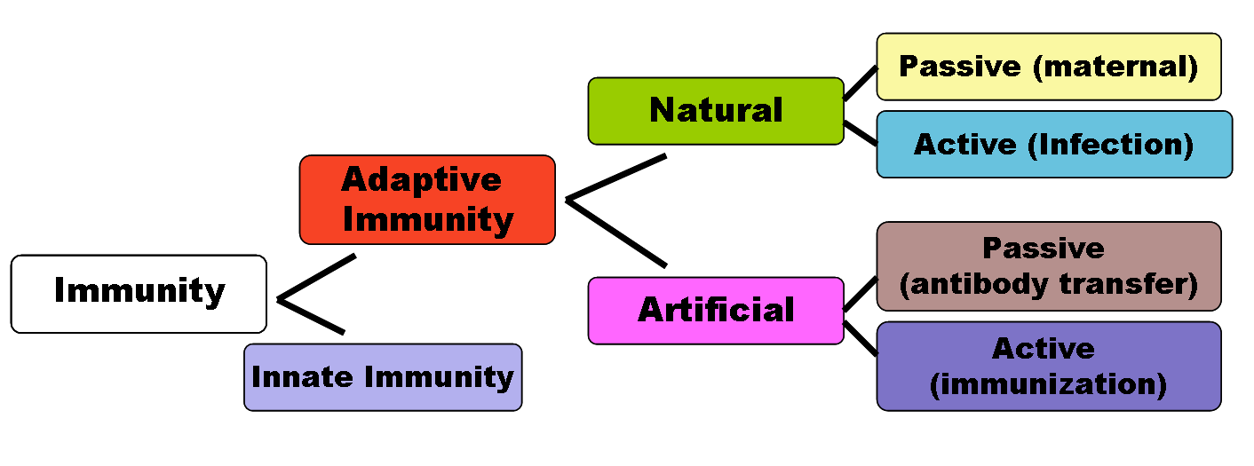
IMMUNITY CLASSIFICATION

Slide 3
IMMUNITY
PHYSICAL BARRIERS
HEAMATOLOGICAL WARRORS
HAIR, SKIN, NAILS
NASAL, ORAL, OCULAR SECRETIONS
MONO NUCLEAR PHAGOCYTES/TISUE MACROPHAGES
POLYMORPH NUCLEAR NEUTROPHILS
BASOPHILS - PARASITES
EOSINOPHILS – MAST CELLS
CONVERT IN TO APC
ACTIVATE CD4/Th CELLS
ACTIVATE CD8/TCY CELLS
ACTIVATE B CELLS
PLASMA CELLS
N-K CELLS

Slide 4
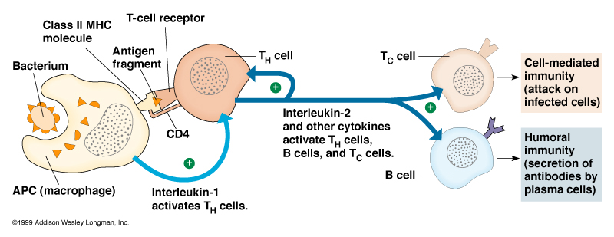

Slide 5
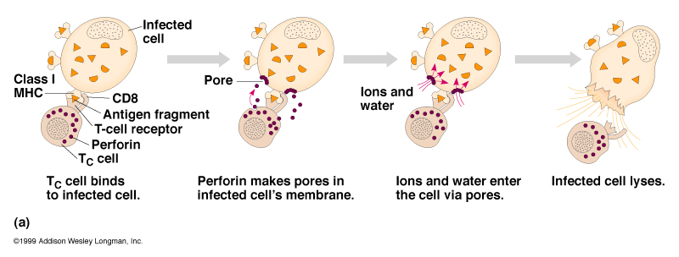

Slide 6
Hypersensitivity
It is a condition in which immune response results in excessive reactions leading to tissue damage, disease or even death in the sensitized host.

Slide 7
Type I Hypersensitivity
Immediate (anaphylactic type)
The reaction occurs within minutes after exposure to an antigen.
Plasma cells produce IgE.
IgE causes mast cells to release histamine, causing increased dilation and permeability of blood vessels and constricting smooth muscle in bronchioles of the lungs.
The reaction may range from hay fever to asthma and life-threatening anaphylaxis.
Eg: pencillin hypersensitivity, angio edema

Slide 8
Type II Hypersensitivity
  Antigen – antibody --- IgG and IgM
  Antibody combines with an antigen bound to the surface of tissue cells, usually a circulating RBC (red blood cell).
  Activated complement components, IgG and IgM antibodies in blood, participate in this type of hypersensitivity reaction.
  This destroys the tissue that has the antigens on the surface of its cells.
  Eg: lichen planus, pemphigus, pemphigoid,

Slide 9
Type III Hypersensitivity
  Immune complex type (serum sickness)
  Immune complexes are formed between microorganisms and antibody in circulating blood.
  These complexes leave the blood and are deposited in body tissues, where they cause an acute inflammatory response.
  Tissue destruction occurs following phagocytosis by neutrophils.
  Eg: SLE

Slide 10
Type IV Hypersensitivity
  Cell-mediated type (delayed)
  T lymphocytes that previously have been introduced to an antigen cause damage to tissue cells or recruit other cells.
  Responsible for the rejection of tissue grafts and transplanted organs
  Eg: lichenoid reaction

Slide 11
AUTOIMMUNITY
It is a condition in which the body produces antibodies and immunologically competent T-lymphocytes against its own tissues.
It is loss of body’s self tolerance.

Slide 12
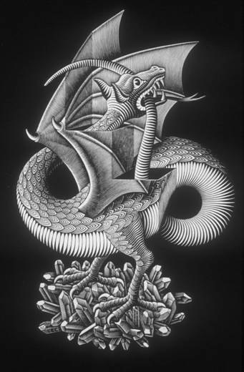
Self/Non-self Discrimination
Autoimmunity is a problem of self/non-self discrimination.

Slide 13
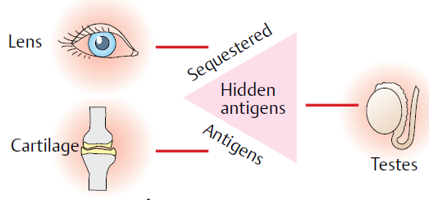
Mechanism of autoimmunity
Hidden antigens:-
  Certain antigens in the body does not come in contact to the normal immune system.
  When these antigens are released into the circulation they evoke response.
  In mumps due to damage to the seminiferous tubules of the testis by virus, the sperms leak into the blood circulation causing autoimmune reactions.
Notes:
The lens antigen, cartilage antigen, sperm are always covered in an capsule and are away from the normal immune action of body. When they come in contact with the normal immune system due to any trauma, the body may produce antigens against them.

Slide 14
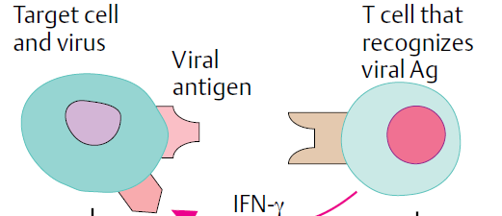
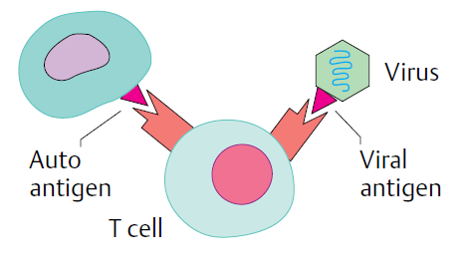
Antigen alteration
Cross reacting antigens
Viruses or other pathogens may alter the surface antigens causing prodution of autoantibodies.
Sometimes different species share same antigens causing autoimmunity.
Eg:-viral antigens may mimic native antigen, hence antibodies produced against virus may destroy own tissue

Slide 15
Immuno deficiency

Slide 16
IMMUNODEFICIENCY
The conditions where the defence mechanisms of the host are impaired, leading to repeated microbial infections and sometimes enhance susceptibility to malignancies.
They are mainly of 2 types:-
  Primary immunodeficiencies:-
    They result from abnormalities in the development of immune mechanisms.
  Secondary immunodeficiencies:-
    They are mainly due to consequence of infections malnutrition, drugs and other processes that effect the normal functioning of the mature immune system.

Slide 17
Primary immunodeficiencies
T CELL DEFECTS
Digeorge’s syndrome / thymic hypoplasia. | Defect effecting 3rd and 4th pharyngeal pouches causing hypoplasia of thymus and parathyroid glands. Deficient matured T cells in circulation. Enhanced susceptibility to viral, fungal and bacterial infections.
Purine nucleoside phosphorylase deficiency | Deficiency of PNP enzyme. Inherited defect of chromosome 14. Decreased T cell proliferation.

Slide 18
B cell defects | Description
X-linked agammaglobulinaemia | Discovered by bruton in 1952. Failure of Pre B-cells to differentiate into mature B-cells. Recurrent infections with pneumococci, streptococci. Normal level of Pre B-cells in bone marrow, but depletion of matured B cells in serum.
Transient hypogammaglobulinaemia of infancy | Abnormal delay in the initiation of IgG synthesis in some infants cause transient decrease in level of IgG in blood.
Selective immunoglobulin deficiencies | Selective Secretory IgA deficiency with respiratory and gastrointestinal infections. Selective IgM deficiency causing septicemia due to gram negative bacteria.
Immunoglobulin deficiencies with hyper IgM | IgA, IgG are deficient in this X linked autosomal recessive disease , but with malignacy of plasma cells producing IgM, cause excess production of IgM.
Transcobalamine II deficiency | Vit B12 deficiency with megaloblastic anemia, plasma cell depletion, diminished immunoglobulin level and impaired phagocytosis.

Slide 19
COMBINED T AND B CELL DEFECTS
Wiskott- Aldrich syndrome | Elevated IgE levels Abnormalities in cell mediated and humoral immunities. X linked recessive disease characterized by eczema, bleeding, recurrent infections. Unable to form antibodies against polysaccharides.
MHC class II deficiency | Autosomal recessive Failure to express MHC classII molecule on the surface of antigen presenting cells. This causes deficiency of T helper cells (CD4). Hence cause failure of stimulation of plasma cells to produce immunoglobulins.
PHAGOCYTIC CELL DISORDERS
Chediak-hagashi syndrome | Autosomal recessive The neutrophils possess large lysosomes, which donot readily fuse to the phagosome, causing diminished phagocytic activity.
Leukocyte G-6-PD deficiency | Leukocytes due to the deficiency of the enzyme 6GPD dehydrogenase causes decreased bactericidal activity.

Slide 20
SECONDARY IMMUNE DEFICIENCIES
Depression of humoral immunity | B-cells depleted Seen in chronic lymphatic leukemia, exfoliative skin diseases, multiple myeloma (where inc abnormal immunoglobulins, but not normal immunoglobulins occur)
Depression of cell mediated immunity | Occurs in AIDS (Decreases CD4:CD8 ratio), Hodgkin’s lymphoma, lepromatous leprosy, sarcoidosis.

