Slide 1


Slide 2
  Educare/Educere – to bring out and to lead.
  Education : learning process or a series of learning experiences through which an individual informs & orients himself to develop skills & intelligent action
  Health education-aims at Altering attitude & behavior.
Introduction
“Helping people to help themselves”

Slide 3
Definitions
Health:
  It is a state of complete physical, mental and social well being and not merely the absence of disease or infirmity leading a socially and economically productive life
  - WHO, 1948
Health Education:
  "Health education comprises consciously constructed opportunities for learning involving some form of communication designed to improve health literacy, including improving knowledge, and developing life skills which are conducive to individual and community health.
  - WHO, 1998

Slide 4
  Is a process which informs, motivates and helps people to adopt and maintain healthy practices and lifestyles, advocates environmental changes as needed to facilitate this goal and conducts professional training and research to the same end.
  - National conference on preventive medicine in USA

Slide 5
Aims & Objectives
  To Encourage people to adopt and sustain health promoting life style and practices
  Promote proper use of health services
  Arouse interest, provide knowledge, improve skills and change attitude
  Stimulate individual & community participation

Slide 6
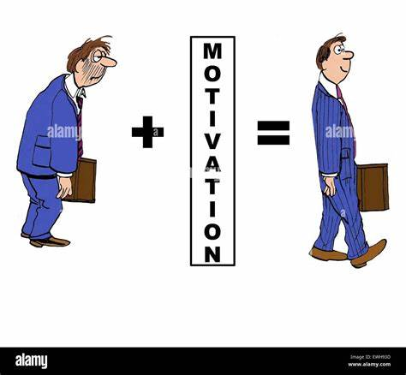

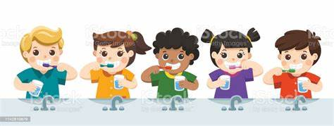
2. Motivating people
Informing people
3. Guiding into action
Notes:
Informing people: The primary objective is to inform people or provide them with the scientific knowledge about the prevention of disease and promotion of health. This creates an awareness of health needs and helps people to do away with the misconceptions and ignorance they may have about health and disease. 2. Motivating people: People must be motivated to change their habits and ways of living as many current health problems are directly related with them for example drug addiction, cigarette smoking, pollution of water, sedentary lifestyles, etc. 3. Guiding into action: The people should be encouraged to use judiciously and wisely the health services available to

Slide 7
  There are three main domains of learning:
  1. Cognitive: Understanding factual knowledge
  2. Affective: Feelings, emotions and beliefs associated with health
  3. Behavioral: Skills development
Notes:
(for example, knowledge that tobacco chewing is linked to development of oral cancer).
(for example, skills required for effective brushing and flossing of teeth).
(belief that milk teeth are not important).

Slide 8
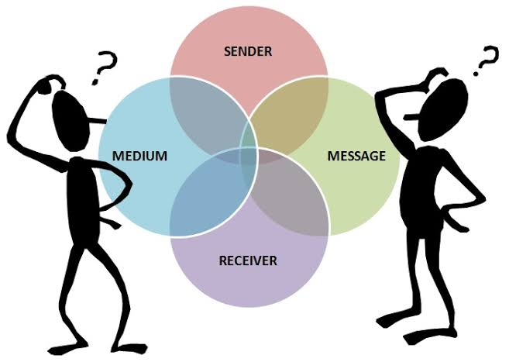
Process Of Communication In
Health Education

Slide 9
Process Of Communication In
Health Education
Sender
Message
Channel
Feed back
Receiver
Awareness Interest Evaluation Adoption

Slide 10
Sender
Sender(communicator) is the originator of the message .to be an effective communicator he must know:
  His objectives clearly defined
  His audience: it’s interests & needs
  His message
  Channels of communication
  His abilities & limitations
Receiver
  Controlled – common interest
  Uncontrolled/ free - curiosity

Slide 11
Message
a message is the information which the communicator transmits to his audience to receive,understand,accept and act upon.
A good message must be:
  In line with the objectives
  Meaningful
  Based on felt needs
  Clear & understandable
  Specific & accurate
  Timely & adequate
  Fitting the audience
  Interesting
  Culturally & socially appropriate

Slide 12

Channels of communication
Is implied the physical bridges or the media of communication between the sender and the receiver.
  Interpersonal communication
  Mass media
  Traditional/folk media
Feedback
  Reaction of the audience
  Provides opportunity to modify the message

Slide 13


Types Of Communication
One- way communication (Didaticmethod)
DRAW BACKS:
  Knowledge is imposed
  Learning is authoritative
  Little audience participation
  No feedback
  Doesn’t influence human behavior
Two – way communication (Socratic Method)
  Learning is active & democratic
  More likely to influence behavior

Slide 14
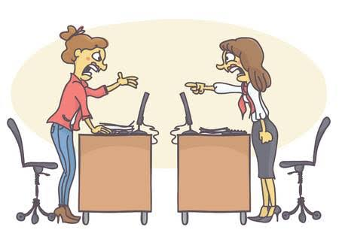
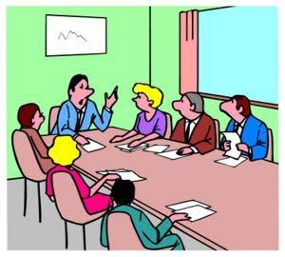



Verbal communication
  Loaded with hidden meanings
  Persuasive
  Non direct or written communication may not be persuasive as the spoken word.
Non-verbal communication
Formal & informal communication
Visual communication
  Charts, graphs, pictograms, tables, maps, posters etc.
Telecommunication & internet

Slide 15
Barriers Of Communication
Physiological | Difficulties in hearing, expression
Psychological | Emotional disturbances, neurosis, level of intelligence, language or comprehension difficulties
Environmental | Noise, invisibility, congestion
Cultural | Illiteracy, levels of knowledge & understanding, customs, beliefs, religion, attitudes, economic & social class differences, cultural difficulties b/w foreigners, b/w urban & rural population

Slide 16
Approach To Health Promotion
Legal / Regulatory/ Coercive approach
  Eg: -The child marriage restraint Act, Epidemic Diseases Act, Pollution Act, Food Adulteration Act and Environmental Act.
  Reasons for failure:
  Applicable only at certain times or in limited situations.
  They may not alter the behavior of the individual.
  These laws are not democratic since they , interfere with an individual's personal choices.
Notes:
s use of the law to protect the health of the public. The government makes laws and regulations in order to safeguard the health of its people

Slide 17

Service approach
  This approach was tried by Basic Health Services 1960
  Providing all the health services at their door step
  Failure: Not based on felt – needs
Educational approach
  The most effective means for achievement of changes in the health practices and life-styles of the community.
  Individuals should be informed, educated & encouraged to make their own choice.
  Results are slow, but they are permanent and enduring
  Behavior is easily controlled / developed in young population

Slide 18

Primary health care education
  This is an approach that involves full participation and active involvement of the people starting from the planning stage till the delivery of health services.
  This can be achieved by providing the necessary guidance to help people identify their health problems and to find solutions to these problems.

Slide 19
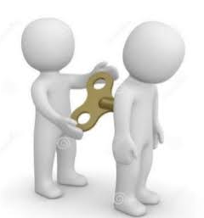
Models Of Health Education
Medical Model
  The model is concerned with the recognition and treatment of disease and technological advances to facilitate this process.
  Health information is provided to the people hoping that they will use this information to improve their health.
  Social, cultural & psychological factors were ignored
  It did not fill the gap between knowledge and behaviour.
Motivation Model
  Stage of awareness
  Stage of motivation
    Stage of interest
    Stage of evaluation
    Stage of decision making

Slide 20
  Stage of action
    Stage of trial
    Stage of adoption
Social intervention Model
  Considered the importance of social environment in shaping the behavior
  Highlights the importance of group support
  An effective health education model is based on Knowledge of ecology & understanding of cultural, biological, social environment

Slide 21
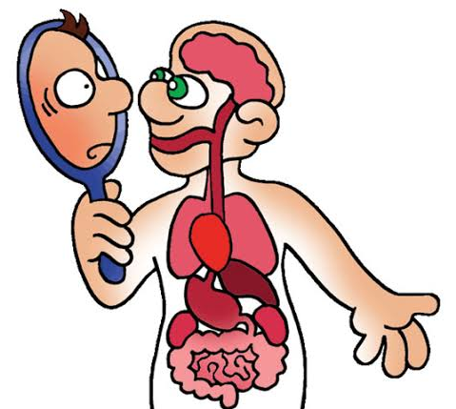
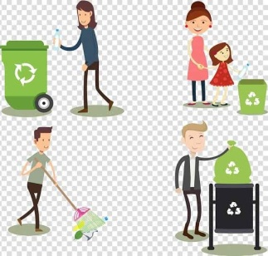

Content Of Health Education
Human Biology
Nutrition
Hygiene
Family Health
Control of communicable &
non communicable diseases
Prevention of accidents
Use of health services
Notes:
Understanding
Structure & function of the body
Need of exercise, rest, sleep
Effect of deviation from healthy life style

Slide 22


Slide 23
Principles Of HealthEducation
Credibility
  Degree to which message should be perceived as trustworthy.
  It should be scientifically proven, based on facts and should be compatible with local culture and social goals
Interest
  Should be based on felt – needs.
  Prepare a program that they can actively participate in to make it successful.

Slide 24

Participation
Motivation
  Motivation can be defined as “the fundamental desire for learning in an individual”.
  Primary motives – inborn desires and/or forces
  Secondary motives – created by outside forces
    Praise, reward, love, recognition, punishment, rivalry

Slide 25


Comprehension
It refers to the level of understanding
Reinforcement
  Repeat the message in different way
Learning by doing
  If I hear, I forget
  If I see, I remember
  If I do, I know
Notes:
It refers to the level of understanding of people who receive the health education.
Communicate in the language people understand
Never use new & strange words
Teach within the mental capacity of the audience

Slide 26
Known to unknown
  “from the particular to the general”
  “from easy to the difficult”
Setting an example
The health educator should follow what he preaches. He should set an example for other people to follow.
Good human relations
Feedback
  Can modify the contents & channels

Slide 27
  Community leaders
  Understands the need & demands of the community
  Provides proper guidance
  Takes initiative
  Receptive to the views & suggestions
  Identifies himself with the community
  Self less, honest, impartial
  Easily accessible
  Possesses skill & knowledge of eliciting cooperation , coordination

Slide 28

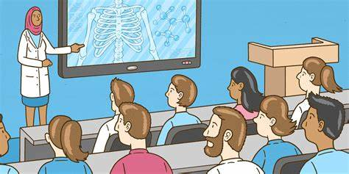
Soil,seed and sower:
soil -
seed –
sower--

Slide 29

Practice Of Health Education
Educational material
  Focus attention
  Facilitate interpersonal & group discussion
  Reinforce/ clarify prior knowledge & behavior
Audiovisual Aids
  Simplify unfamiliar concepts
  Bring about understanding
  Reinforce learning
  Avoid monotony

Slide 30
  Auditory Aids
    Radio, tape-recorder, microphones, amplifiers, earphones
  Visual Aids
    Not requiring projection: Chalk –board, leaflets, posters, charts, flannelgraph, exhibits, models, specimens
    Requiring projection : slides, film strips
  Combined
    Television, sound films, slide-tape combination

Slide 31
Methods Of Health Education
Health education
Individual approach
Personal contact
Home visits
Personal letters
Group approach
Lectures
Demonstrations
Discussion methods
Group discussion
Panel discussion
Symposium
Workshop
Conference
Seminars
Role play
Mass approach
Television
Radio
Newspaper
Printed material
Direct mailing
Posters
Health museum
Folk methods
internet

Slide 32
Methods Of Health Education
Individual approach
  On individuals visit to health center
  On health visitor’s home visit
  Advantage
    Discuss, argue & persuade the individual
    Specific interest can be discussed
  Disadvantage
    Reaches small number

Slide 33
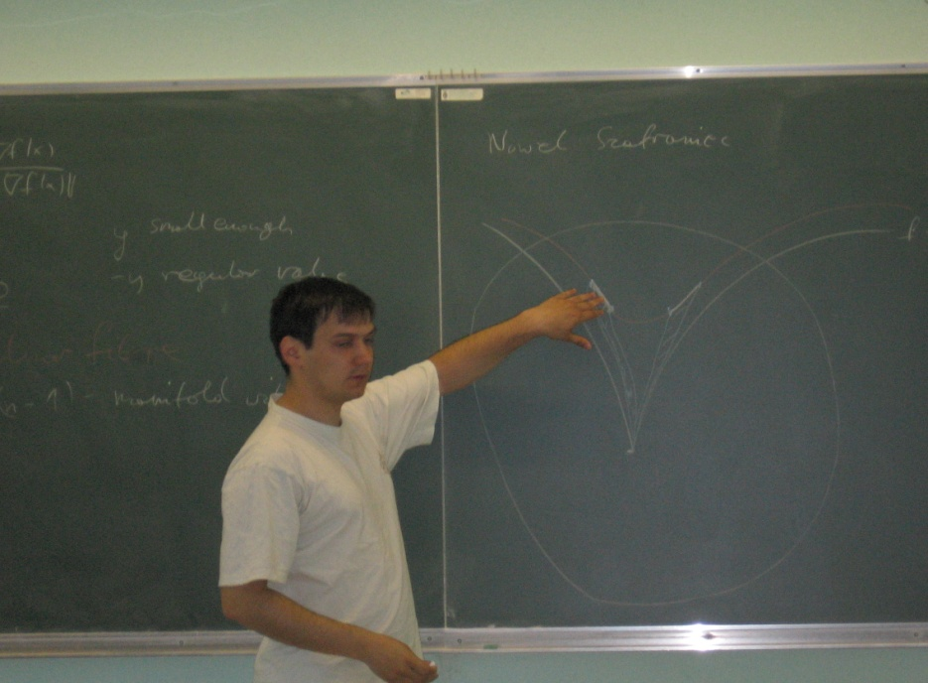
Group Approach
Lectures
A lecture is a discourse on one particular subject delivered by one person.
Number of facts and concepts can be presented in a short time to a large number of people.
Chalk & Talk
  Carefully prepared oral presentation of facts, organized thoughts and ideas by a qualified person
  Not > 30 people
  15-20min

Slide 34
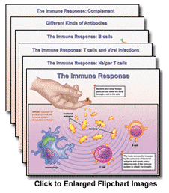
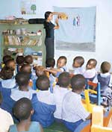
Flipcharts – 25×30cms
  Message on chart must be brief
  Help to hold the attention of the group
Flannel graph
  Maintain continuity
  A very cheap medium
  Easy to transport
  Promotes thought & critcism
Exhibits
  Objects, models, specimens etc

Slide 35
Disadvantages of lectures
  Minimal involvement of audience
  Learning is passive
  Don not stimulate thinking/problem solving capacity
  Comprehension varies with audience
  Behavior not necessarily affected

Slide 36

Symposium
Advantage: Understands the topic better if it is presented in an easy and a simple way by various speakers.
Disadvantage: Lack of participation from the audience, so no scope for either participation or feedback
Notes:
The symposium consists of a number of experts who are invited to speak on a particular topic.
Each speaker is given an opportunity to present various some aspects pertaining to selected topic.

Slide 37
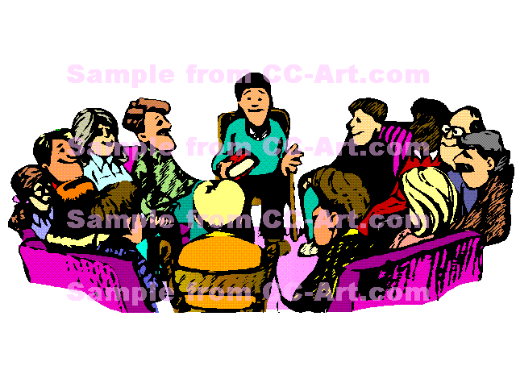
Group discussion
  Free exchange of ideas, opinion & knowledge
  Group should consist of 6-12 members.
    Express ideas clearly & consistently
    Listen what others say
    Do not interrupt
    Make only relevant remarks
    Accept criticism gracefully
    Help to reach conclusion

Slide 38
Group discussion
  Adv :
    Decision is accepted easily
  Limitations
Notes:
There may be unequal participation Some members may be shy and some may be dominating.

Slide 39
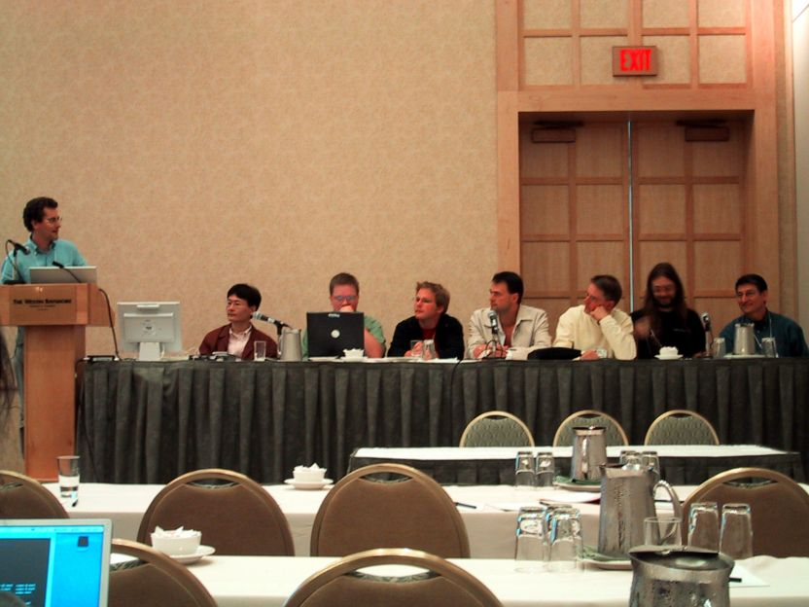
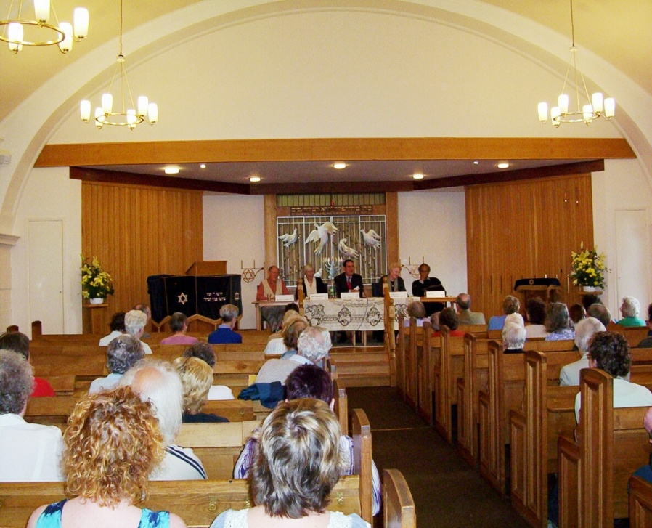
Panel discussion

Slide 40
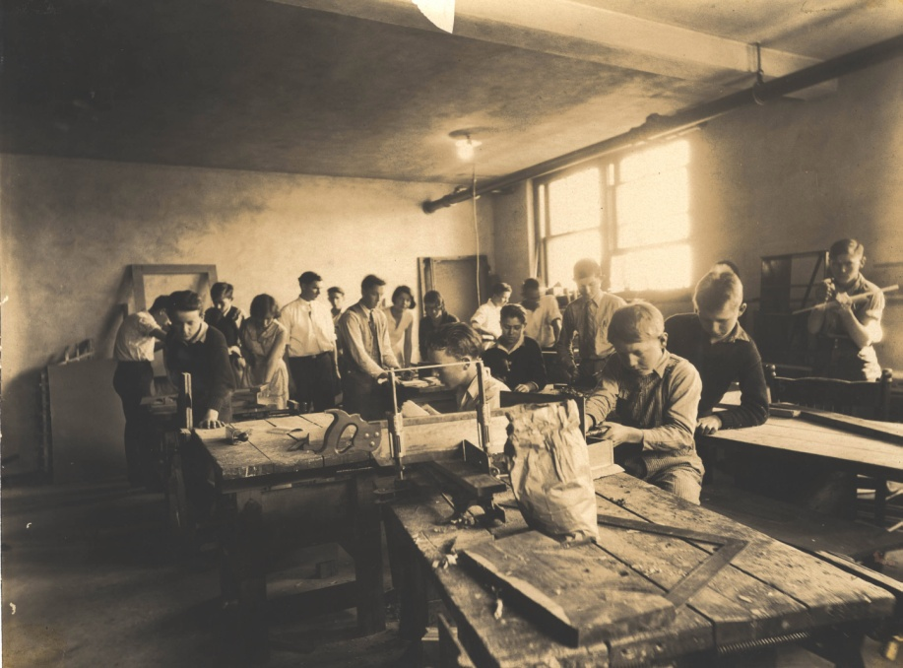
Workshop

Slide 41
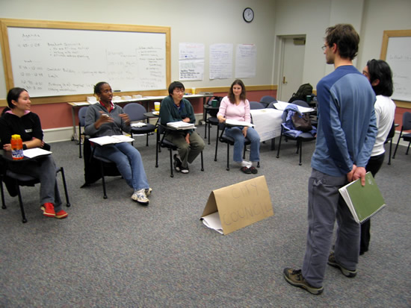
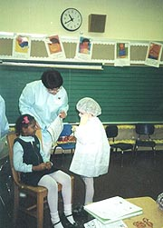
Role playing/Socio-drama
The size of the group should be about 25. The audience should take active part by suggesting alternative solutions and even by taking part in the drama.

Slide 42
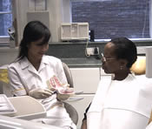
Demonstrations

Slide 43
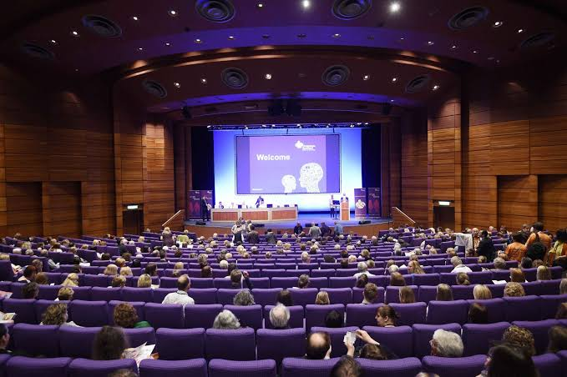
Conferences and seminars
This category contains a large component of commercialized continuing education.
May cover a single topic in depth or broadly comprehensive.

Slide 44
Mass Approach
Mass approach
  Reach remotest places, large number
  Raising health conscious
  Delivering technical messages
  Popularizing health knowledge
  One –way communication
  Not effective in changing human behavior

Slide 45
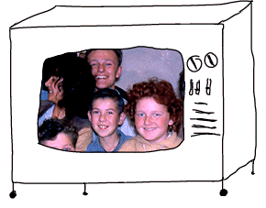
Mass Approach
Television
  The most popular media
  Influence public opinion
  Introduce new ways of life
  Raise level of understanding
  Familiarize with unknown
Radio
  Much cheaper

Slide 46
Internet
  Direct & instant communication
  Major health education tool in the future
News paper
  Factual, detailed & statistical material
  Reach only limited group
Printed materials
  Magazines, pamphlets, booklets & hand outs
  Convey detailed information

Slide 47

Posters, billboards & signs
  Catch eye & create awareness
  Not expensive
  Humor & fear are introduced in posters in order to hold the attention of the public
  Message should be simple, short, direct
  Right place & right time
  Changed frequently

Slide 48
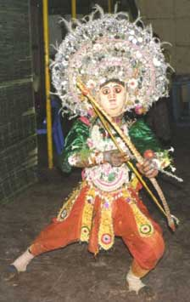
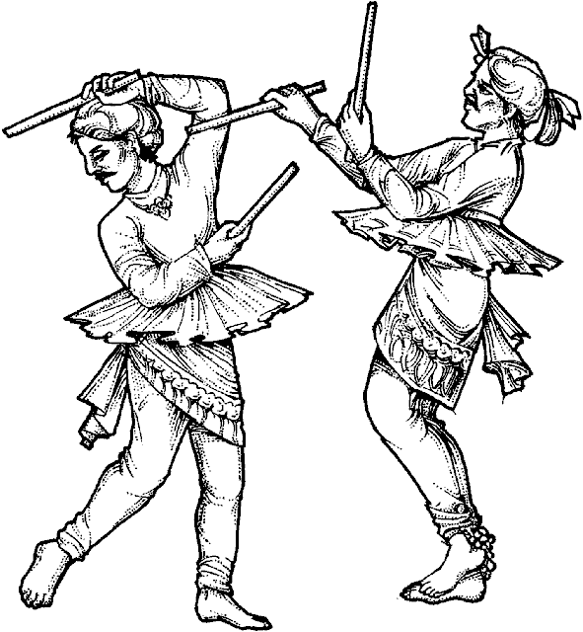
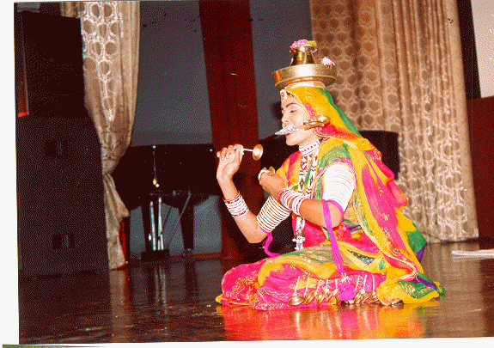
Health museum & Exhibition
  Can attract large number of people
  This is because photos give a humatized touch to the communication.
Folk media

Slide 49
Health education Vs Propaganda
Education | Propaganda
Knowledge & skills actively acquired | Knowledge instilled in the individual's minds of people
Makes people think for themselves | Prevents thinking
Disciplines primitive desires | Arouses & stimulates primitive desires
Develops reflective behavior | Develops reflexive behavior
Appeals to reason | Appeals to emotion
Develops individuality, personality & self expression | Develops a standard pattern of attitude & behavior
The process is behavior centered | Information centered

Slide 50
Essentials Of Health Education
The aim of health education is to bring about a change in health behavior
Health education should be factual
Tell only what is needed
Do not give conflicting information
Try to change only what needs to be changed

Slide 51
The educator should make himself acceptable
  He should be friendly & be sympathetic
  He should be knowledgeable
  He should talk the language of the people
Choose a proper medium of communication
Use audiovisual aids whenever possible
Health education should be provided in graded dosages

Slide 52


