Slide 1

Good Morning

Slide 2
HEALTH AND DISEASE

Slide 3
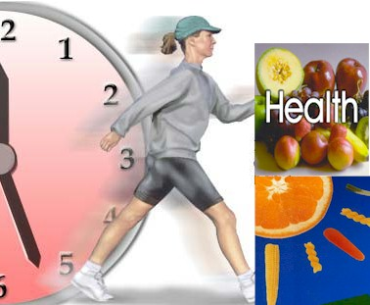

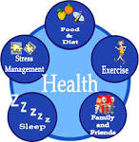



Notes:
If I ask any body over here….that r u healthy? And how do u define that you are healthy?
It is very difficult to give a convincing answer……right?

Slide 4
CHANGING CONCEPT OF HEALTH
Health is difficult term to define
Health is not perceived the same way by all members of a community including various professional groups
Various concepts have emerged
based on different thoughts
To define health

Slide 5
CHANGING CONCEPT OF HEALTH
Biomedical concept
Ecological concept
Psychosocial concept
Holistic concept
Notes:
Health is perceived in different ways………gave rise to various concepts

Slide 6
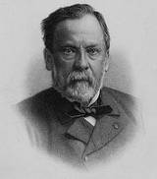
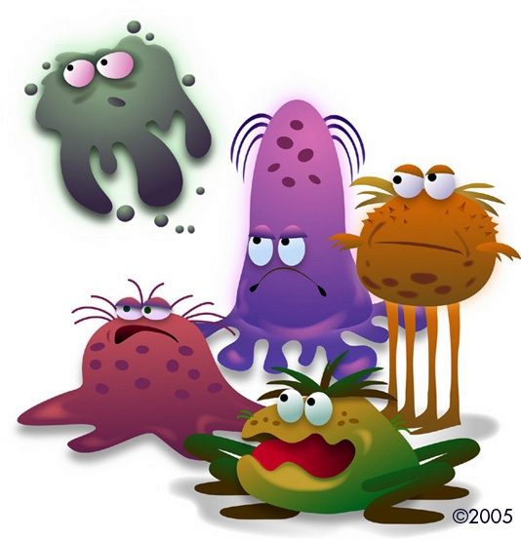
1.BIOMEDICAL CONCEPT :
“ Health is the absence of disease”-
Germ theory of disease.
Louis Pasteur
Notes:
Discovered that most infectious diseases are caused by germ……… he is also the person who introduced the concept of virus
One who is free from disease is called as healthy….

Slide 7

2. ECOLOGICAL CONCEPT:
Health is a Dynamic Equilibrium between Man and his Environment.
Notes:
ECOLOGIST VIEWED …..environmental scientist

Slide 8
2. ECOLOGICAL CONCEPT:
Adaptation of Man to his
Environment leads to
better health and longer life expectancy
even in the absence of Modern health services.
Notes:
MAL ADJUSTMENT OF THE HUMAN ORGANISM TO ENVIRONMENT ------- LEADS TO DISEASE

Slide 9
3. PSYCHOSOCIAL CONCEPT:
Health is both a biological and social phenomenon
where it is influenced by Psychological, Social, Cultural , Economic, Political factors
Notes:
ADVANCES IN THE SOCIAL SCIENCE……..or social scientist……..SHOWED THAT HEALTH IS NOT ONLY A BIOMEDICAL PHENOMENON BUT ………..

Slide 10
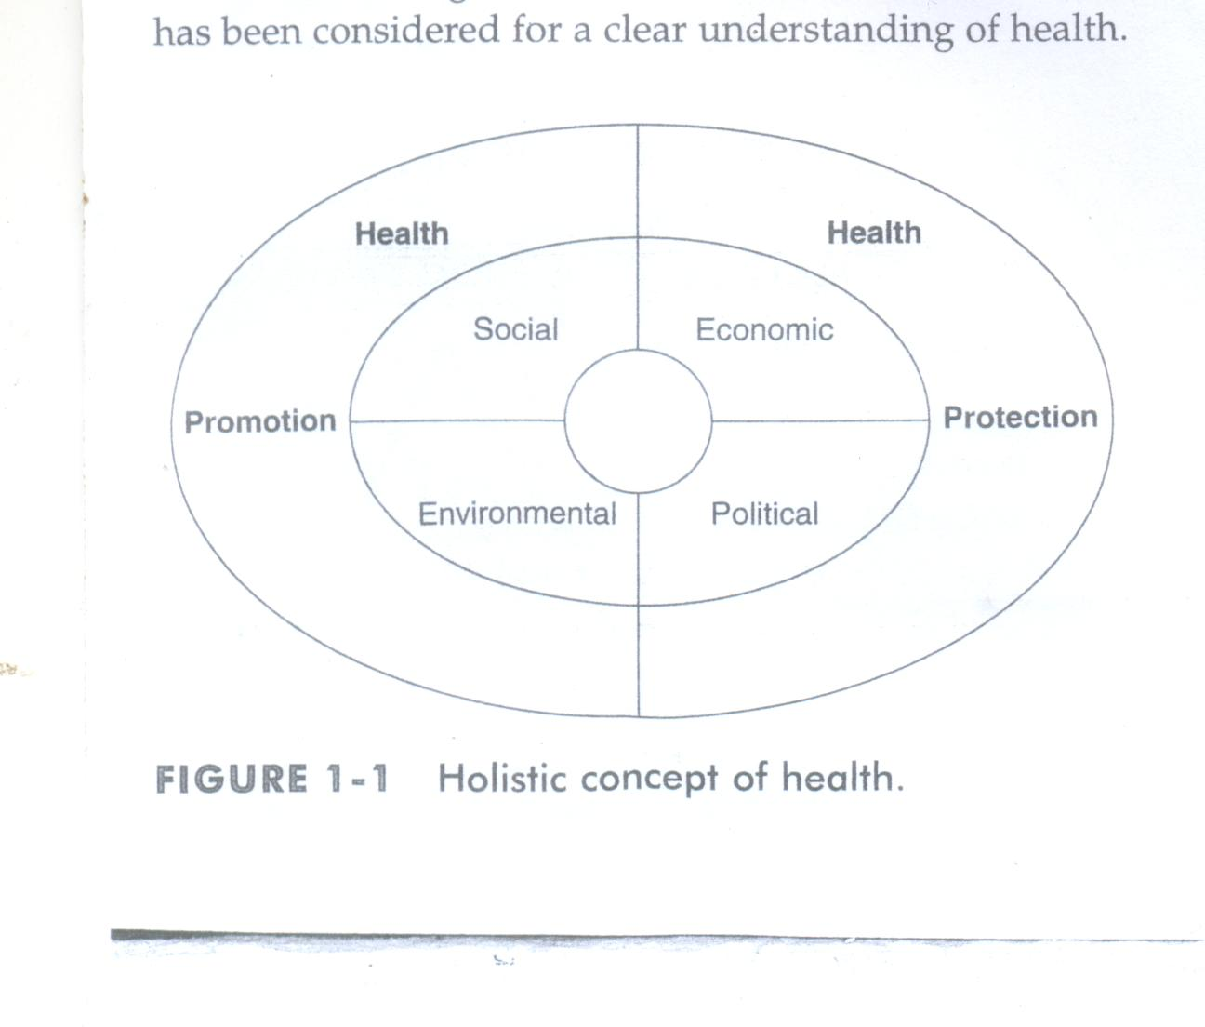
4.HOLISTIC CONCEPT:
Synthesis of all the above concepts
All the sectors of society have an effect on health.

Slide 11
4.HOLISTIC CONCEPT:
Sectors of society are…….
Economic sector
Political sector
Family sector
Religious sector
Education sector

Slide 12
DYNAMIC CONCEPT OF HEALTH-- WHO
Is defined as a state of complete physical, social and mental well being and not merely the absence of disease or infirmity.
World health organization [1948]
Later expanded to include the ability to lead a “socially and economically productive life”
World health organization[1978]
Notes:
A person needs to be or wants to be healthy …….he or she should be having healthy habits such as taking regular exercise and adequate rest , high level of personal hygiene eating nutritional diet and taking care of mental well being and developing social skills to interact in a positive manner within society.

Slide 13
WHO STUDY GROUP
OPERATIONAL DEFINITION OF HEALTH
BROAD SENSE
A condition or quality of the human organism expressing the adequate functioning of the organism in given conditions , genetics or environment
NARROW SENSE
There is no evidence of disease and that a person is functioning normally and several organs of the body are functioning adequately themselves and in relation to one another
Notes:
VIEWED HEALTH AS BEING OF TWO ORDERS

Slide 14
DIMENSIONS OF HEALTH

Slide 15
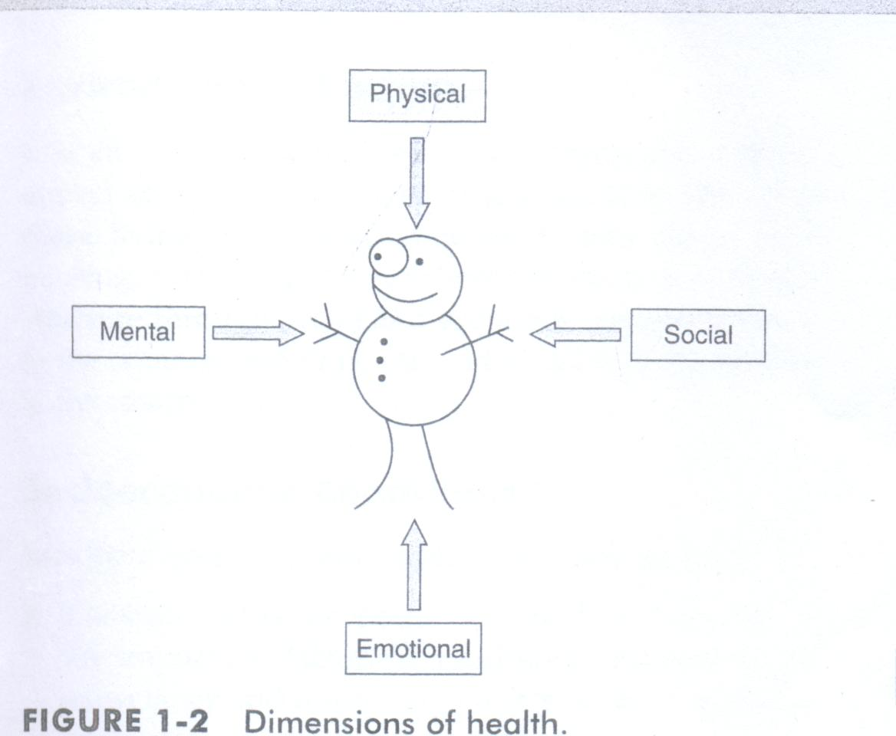
DIMENSIONS OF HEALTH

Slide 16

Sign of physical health :
A good complexion
Clean skin
bright eyes
lustrous hairs
body with firm flush
not too fat
Sweet breath …… Sign of physical health
Notes:
There are other biological factors which also helps in diagnosing the physical health of an individual.

Slide 17



SOCIAL DIMENSION
Ability to interact with other individuals
OR
Ability to create and maintain healthy relationship
with in the family, working places and in surrounding society
Notes:
Meaniningfulrelationship……

Slide 18



MENTAL DIMENSION
Ability to process information and act properly
State of balance between the individual and the surrounding world

Slide 19
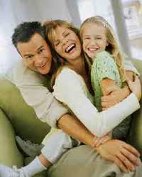

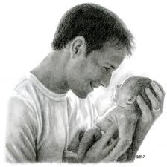
EMOTIONAL DIMENSION
Mental health can be seen as "knowing" or "cognition" while emotional health relates to "feeling".
Notes:
It reflects the emotional aspect of a person

Slide 20
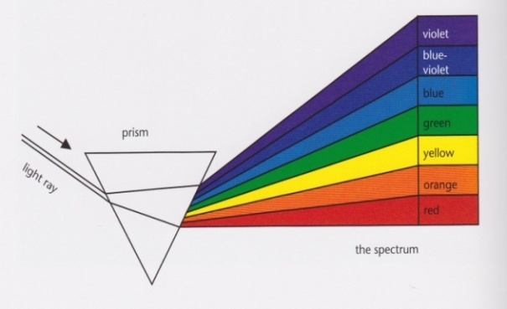
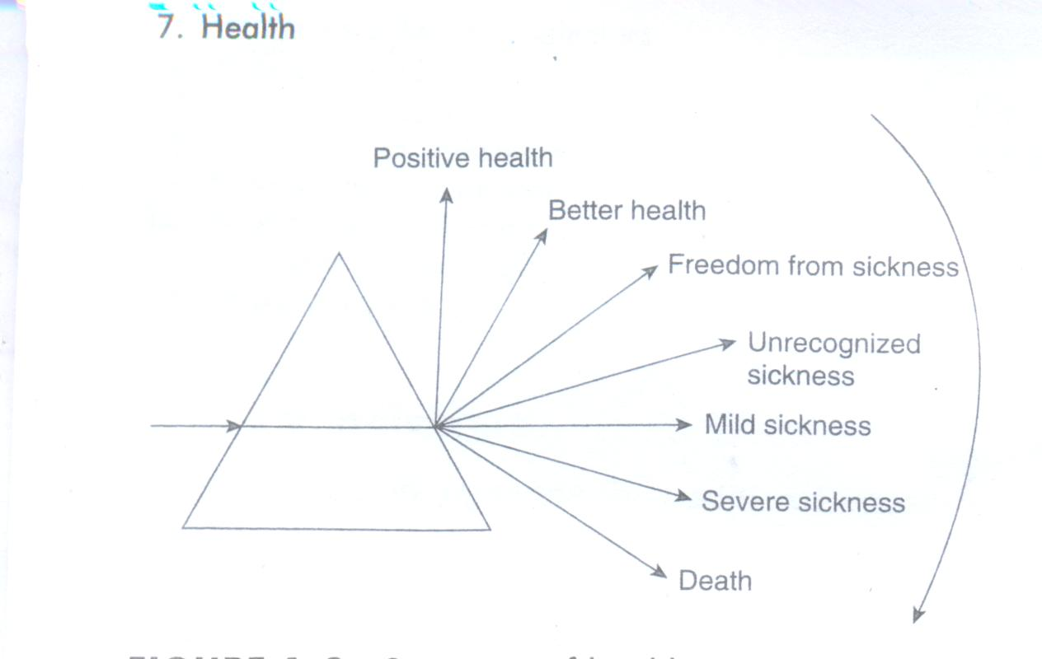
SPECTRUM OF HEALTH
Health of an individual is a dynamic phenomenon and is a process of continuous change
Transition from optimum health to ill health in gradual pattern

Slide 21
DETERMINANTS OF HEALTH
Factors which influence the Health
It may be external or internal factors
It may be direct or indirect factors
Notes:
It may be a better influence or worse influence…….. Or it may be positive and negetive influence
External like environmental factors, adverse habits adopted by a person
Internal like body’simmune system

Slide 22
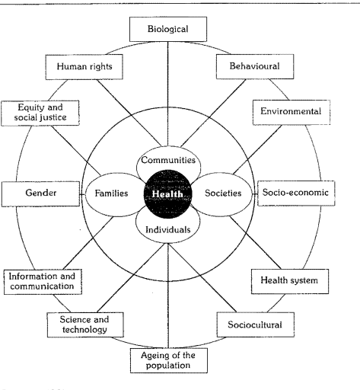
WHO - identifies 12 determinants of Health

Slide 23

  HOW HEALTHY IS A GIVEN COMMUNITY?

Slide 24

INDICATORS OF HEALTH

Slide 25
INDICATORS OF HEALTH
WHO defined indicators as variables or an index which help to measure changes in the health status directly or indirectly.

Slide 26
USES OF HEALTH INDICATORS
To measure the health status of a community
To compare the health status of one country with that of another.
To assess the health care needs of the community
To monitor and evaluate health services, activities and programs.
To measure the extent to which the objectives and targets of a program are being attained.

Slide 27
HEALTH INDICATORS ARE……
Mortality indicators
Morbidity indicators
Disability rates
Nutritional status indicators
Health care delivery indicators
Health care Utilization rates
Indicators of social and mental health
Environmental indicators
Socio-economic indicators
Health policy indicators

Slide 28
MORTALITY INDICATORS
a. CRUDE DEATH RATE
It is defined as the number of deaths per 1000 population per year in a given community.
Crude death rate = _Number of deaths (all causes)_X 1000
Estimated midyear population
Notes:
Mortality …. means “death” or describes death and
related issues

Slide 29
MORTALITY INDICATORS
b. LIFE EXPECTANCY
“The average number of years that will be lived by those born alive into a population”

Slide 30
MORTALITY INDICATORS
c. INFANT MORTALITY RATE
It is the ratio of
deaths under 1 year of age in a given year X 1000
total number of live births in the same year
It is one of the most universally accepted indicators

Slide 31
MORTALITY INDICATORS
d. CHILD MORTALITY RATE
Number of deaths at ages 1-4 years in a given year
per 1000 children in that age group

Slide 32
MORTALITY INDICATORS
e. UNDER 5 PROPORTIONATE MORTALITY RATE
Proportion of total deaths occurring in the under 5 age group

Slide 33
MORTALITY INDICATORS
f. MATERNAL MORTALITY RATE
Proportion of deaths among women of reproductive age

Slide 34
MORTALITY INDICATORS
g. DISEASE SPECIFIC MORTALITY RATE
Mortality rate computed for specific disease
Eg: cancer, cardiovascular diseases , accidents etc…

Slide 35
2.MORBIDITY INDICATORS
Reveal the burden of ill health in a community.
The following morbidity rates are used for assessing ill health in the community:
  Incidence and Prevalence
  Attendance rates at out-patient departments, health centers, etc
  Admission, Readmission and Discharge rates
  Duration of stay in hospital

Slide 36
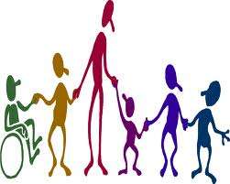
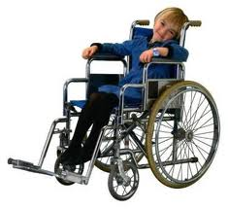
3.DISABILITY RATES
Disability rates related to illness and injury

Slide 37
DISABILITY RATES
THREE INDICES ARE USE………….
SULIVAN’S INDEX
HEALTH ADJUSTED LIFE EXPECTANCY [ HALE]
DISABILITY ADJUSTED LIFE EXPECTANCY [DALY]

Slide 38
DISABILITY RATES
SULIVAN’S INDEX
Index is calculated by subtracting from life expectancy the probable duration of bed disability and inability to perform major activities
[ life expectancy - probable duration of bed disability
and
inability to perform major activities

Slide 39
DISABILITY RATES
HEALTH ADJUSTED LIFE EXPECTANCY [ HALE]
Based on life expectancy at birth including an
+
adjustment of time spent in poor health

Slide 40
DISABILITY RATES
DISABILITY ADJUSTED LIFE EXPECTANCY [DALY]
It is a measure of burden of disease in a defined population and the effectiveness of the intervention
It measures
years of life lost to premature death
and
years lived with disability

Slide 41
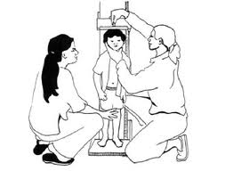
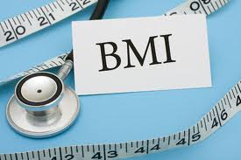
NUTRITIONAL STATUS INDICATORS
Anthropometric measurements of……….
[weight, height, mid- arm circumference]
preschool children
children at school entry
Prevalence of low birth weight (less than 2.5 kg)

Slide 42

HEALTH CARE DELIVERY INDICATORS
The frequently used indicators are………
  Doctor-population ratio
  Doctor-nurse ratio
  Population-bed ratio
  Population per health center
  Population per traditional birth attendant

Slide 43
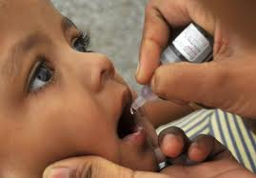
UTILIZATION RATES
Health care utilization is expressed as…….
The proportion of people in need of a service, who actually receive it in given period.
Eg: Immunization, antenatal care , utilization of inpatient facilities etc…….

Slide 44
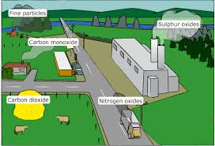
ENVIRONMENTAL INDICATORS
It measures the disease causing environmental factors like…………….
air pollution,
water pollution,
noise pollution,
radiation pollution,
ailments caused by miss management of solid waste etc…..

Slide 45
SOCIO-ECONOMIC INDICATORS
  rate of population increase
  per capita GNP
  level of unemployment
  dependency ratio
  literacy rates
  family size
  housing: the number of persons per room

Slide 46
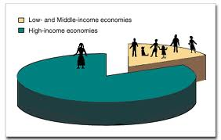

HEALTH POLICY INDICATORS
MEASURES THE ALLOCATION RESOURCES
Proportion of GNP spent on [GROSS NATIONAL PRODUCT]
Health services
Health-related activities
On primary health care

Slide 47
Concept of well being

Slide 48
  WHO definition of Health introduces the “Concept of well-being”.
  Objective component Subjective component
  Standard of living Quality of life
  OR
  Level of living

Slide 49
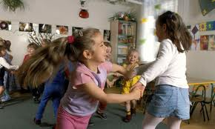
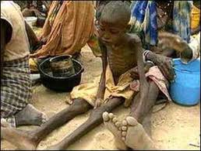
Standard of Living
According to WHO…….
Income
Occupation
Housing
Sanitation
Educational
Recreational
Other services
SOCIOECONOMIC STATUS
Standard of Living

Slide 50

QUALITY OF LIFE
The condition of life resulting from the combination of the effects of the complete range of factors such as those determining health , happiness , education , social and intellectual attainments , freedom of action , justice and freedom of expression

Slide 51
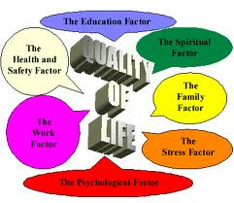
INDICES FOR MEASURING THE QUALITY OF LIFE
PHYSICAL QUALITY OF LIFE INDEX [PQLI]
HUMAN DEVELOPMENT INDEX[HDI]

Slide 52
PHYSICAL QUALITY OF LIFE INDEX
PQLI
COMPOSITE INDEX: three indicators are used :
1-Infant Mortality Rate [IMR]
2-Life Expectancy at age ONE
3-Literacy rate
Notes:
Average of three indicators are taken to interpret the PQLI and placed on a scale of 0 to 100
100 which is the Best performance and 0 the Worst performance

Slide 53
HUMAN DEVELOPMENT INDEX
HDI
COMPOSITE INDEX: three indicators are used :
1-Life Expectancy at age Birth-
(Minimum 25 Maximum 85 years)
2-Adult Literacy
3- Income ( Real Gross Domestic Product GDP per capita ).

Slide 54
CONCEPTS OF DISEASE

Slide 55

DISEASE

Slide 56
DEFINITION OF DISEASE
ACCORDING TO WEBSTER:
A condition in which body health is impaired, a departure from a state of health, an alteration of the human body interrupting the performance of vital functions.

Slide 57
CONCEPT OF CAUSATION

Slide 58
THEORIES OF DISEASE CAUSATION
Germ theory of disease.
Epidemiological triad.
Multifactorial causation.
Web of Causation.
Natural History of Disease.

Slide 59
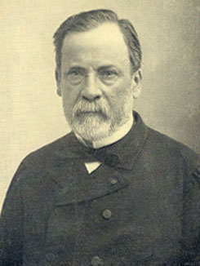
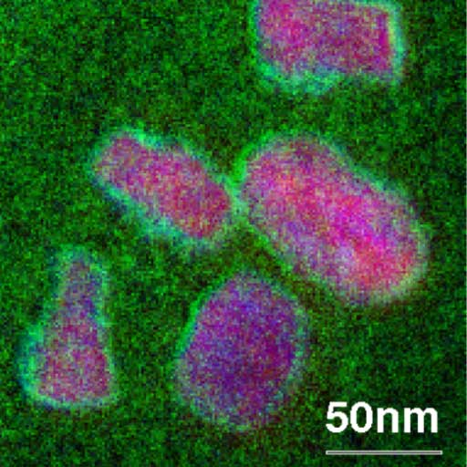
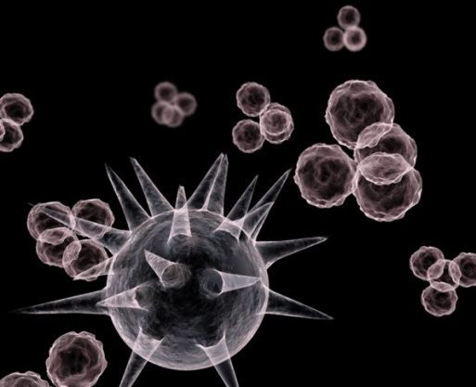
GERM THEORY OF DISEASE
19th century [1861 Louis Pasteur published ‘germ theory’]
Microbes as the sole cause of the disease.
One to one relationship between the causative agent and disease.

Slide 60
Disease agent Man Disease
EFFECT
CAUSE
CORNEBACTERIUMDIPTHERIA
DIPTHERIA

Slide 61
EPIDEMIOLOGICAL TRIAD
DISEASE
complex interaction
ENVIRONMENT
Agent
Host
Environment
AGENT
HOST

Slide 62
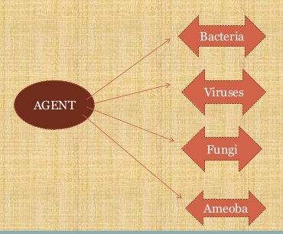

Slide 63
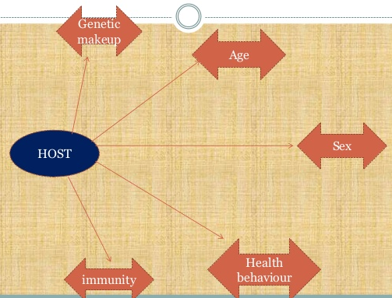

Slide 64
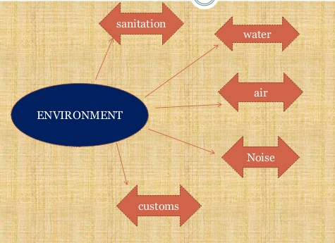

Slide 65
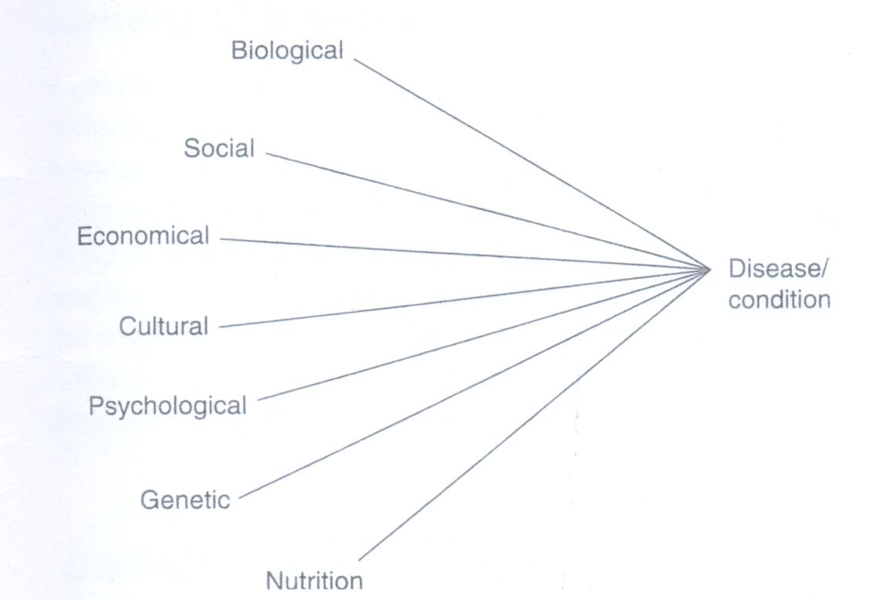
MULTIFACORIAL CAUSATION

Slide 66
MULTIFACTORIAL CAUSATION
Tubercle bacilli
Susceptible host
Tuberculosis
Access to health care
Under
nourishment
overcrowding
poverty

Slide 67
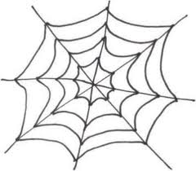
WEB OF CAUSATION
Suggested by MacMohan and Pugh
Ideally suited in the study of Chronic disease
[myocardial infarction]
Where disease agent is not known
considers all the predisposing factors of any type and their complex interrelationship with each other
DISEASE OUTCOME

Slide 68
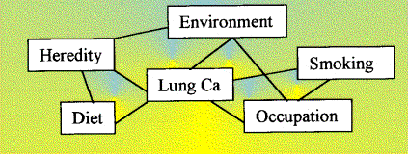
WEB OF CAUSATION FOR LUNG CANCER

Slide 69
NATURAL HISTORY OF DISEASE
Natural history of disease causation
How the disease evolves over time from the earliest stage to its termination stage
DISEASE
Prepathogenesis Phase
Absence of treatment
or
Prevention
RECOVERY
DISABILITY
DEATH

Slide 70
It consists of 2 phases:-
Prepathogenesis
Pathogenesis
[Process in the environment]
[Process in man]

Slide 71
PRE- PATHOGENESIS PHASE
Man is in the ‘Midst of the disease’ or Man exposed to the risk of disease.
Potentially we are all in the prepathogenesis phase of many diseases, both communicable and noncommunicable.

Slide 72
PATHOGENESIS PHASE
Disease Agent
Susceptible human host
ENTRY
Disease agent multiplies.
Induces tissue and physiological changes.
Disease progresses through a period of incubation and later through early and late pathogenesis stage.
Recovery
FINAL OUTCOME
Disability
Death

Slide 73
PERIOD OF PRE-PATHOGENESIS
PERIOD OF PATHOGENESIS
DISEASE PROCESS
Before man is
involved
Course in man
DEATH
Chronic State
Defect
Disability
Agent
Host
Illness
Clinical Horizon
Signs and symptoms
Tissue & physiological
changes
Environment factors
Stimulus or agent becomes
established and increases
by multiplication
RECOVERY
(Bring the agent
And host together
Or produce a disease
Provoking stimulus)
In the
Human
Host
Interaction of host
And stimulus
Host Reaction
Early
Pathogenesis
Discernible
Early lesion
Advanced
disease
Convalescence
LEVELS OF PREVENTION
PRIMARY PREVENTION
SECONDARY
PREVENTION
TERTIARY PREVENTION
MODES OF INTERVENTION
HEALTH
PROMOTION
SPECIFIC
PROTECTION
EARLY DIAGNOSIS
AND TREATMENT
DISABILITY
LIMITATION
REHABILITATION

Slide 74
RISK FACTORS OF THE DISEASE
An attribute or exposure that is significantly associated with the development of a disease.
A determinant that can be modified by intervention, thereby reducing the possiblity of occurrence of disease or other specified outcomes.

Slide 75
Risk factor may
Be causative – E.g. smoking for lung cancer
Be merely contributory to undesired outcome e.g. lack of physical exercise- coronary heart disease.
Be predictive only in a statistical sense
e.g.: illiteracy for prenatal mortality

Slide 76
Risk factors can be
Modified:
e.g. smoking, hypertension, elevated serum cholesterol, obesity etc.
Unmodifiable
e.g. age, sex, race, family history, obesity

Slide 77
RISK GROUPS
WHO developed this approach to identify the “Risk groups” or “target groups” by certain defined criteria and direct appropriate action- Risk Approach
The risk approach is a managerial device for increasing the efficiency of health care services within the limits existing resources.

Slide 78
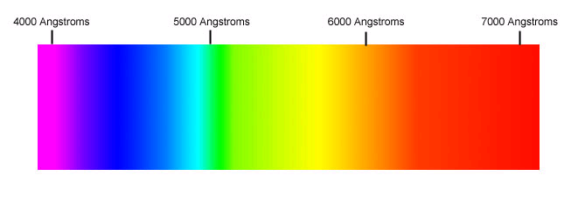
SPECTRUM OF DISEASE
variations in the manifestations of disease.
Subclinical infection
Mild infection
Severe infection
Fatal illness
Sequence of events can be interrupted by early diagnosis and treatment or by preventive measures.

Slide 79
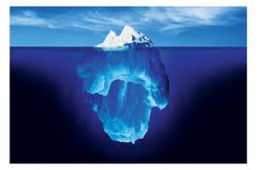
ICEBERG OF DISEASE
Disease in community may be compared with an iceberg.

Slide 80
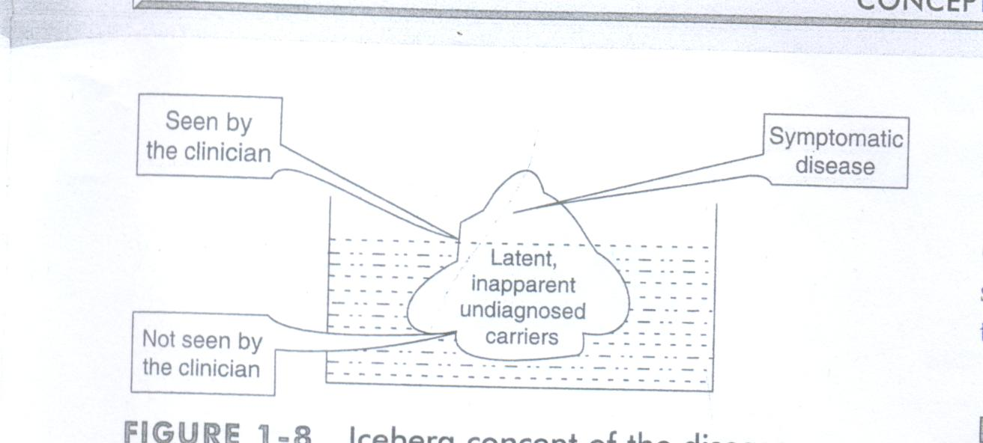
ICEBERG OF DISEASE
Notes:
Floating tip of iceberg represents what the physician sees in the community – Clinical cases
Submerged portion of the iceberg represents the hidden mass of disease- Latent, inapparent, Presymptomatic and undiagnosed cases and carriers in the community.
Waterline represents the demarcation between apparent and inapparent disease.

Slide 81
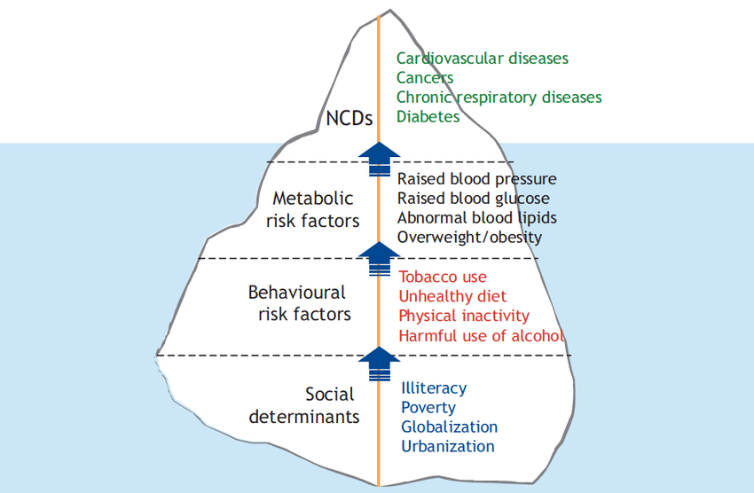
ICEBERG OF DISEASE
.
undiagnosed reservoir of infection or disease in the community
Hypertension, diabetics, malnutrition, mental illness
submerged portion will be very vast

Slide 82
Thus hidden part of the iceberg
constitutes an important, undiagnosed reservoir of infection or disease in the community
Its detection and control is a challenge to modern techniques in preventive medicine.
Major deterrents in the study of chronic diseases of unknown etiology is the absence of methods to detect the sub clinical state

Slide 83
Questions
Define health
Concepts of health
Dimensions of health
Spectrum of health
Determinants of health
Indicators of health
Mortality and Morbidity indicators of health
Sullivan’s index

Slide 86
Level of Living :
Parallel term to standard of living

Slide 87
Consists of nine components
Health,
Food consumption,
Education,
Occupation and working conditions,
Housing,
Social security,
Clothing,
Recreation ,
Leisure and Human Rights.

Slide 88
Impairment in these component
Level of living

