Slide 1
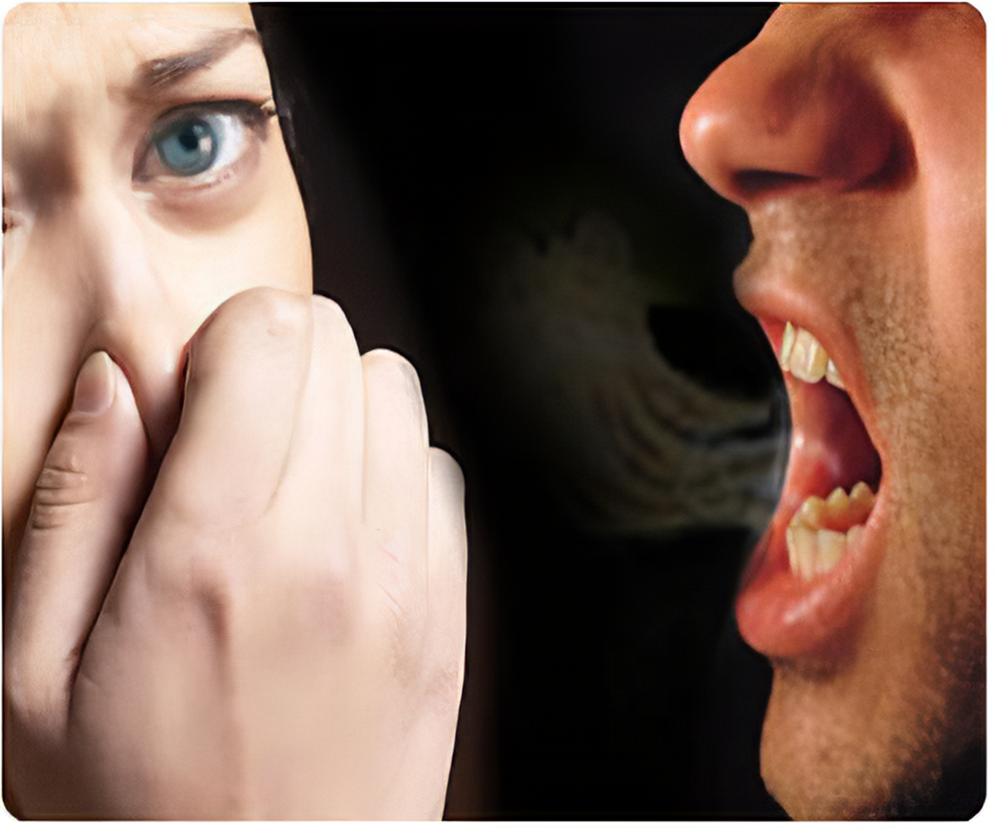
ORAL MALODOR

Slide 2
Contents
Introduction
Definition
Classification
Etiology
Intraoral causes
Extraoral causes
Physiology of malodor detection
Diagnosis of malodor
Treatment of oral malodor

Slide 3
Definition
Breath odor can be defined as the subjective perception after smelling someone’s breath. It can be pleasant, unpleasant or even disturbing. If unpleasant, the terms breath malodor, halitosis can be applied. also known as
foeter oris or foeter ex ore, stomato dysodia and commonly referred to as ``bad breathe’’.
Caused by a variety of factors including periodontal disease ,xerostomia ,bacterial ,fungal coating of tongue, dental prosthesis, systemic disorders different types of food and use of tobacco products.

Slide 4
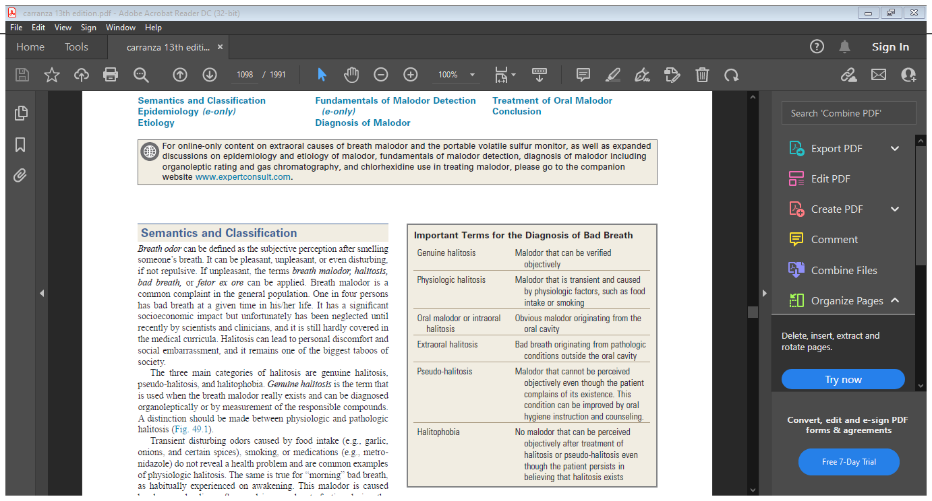
Classification
The three main categories of halitosis are genuine halitosis, pseudo-halitosis, and halitophobia.
Genuine halitosis is the term that is used when the breath malodor really exists and can be diagnosed organoleptically or by measurement of the responsible compounds
When an obvious breath malodor cannot be perceived but the patient is convinced that he or she suffers from it, this is
called pseudo-halitosis.
If the patient still believes that bad breath is present after treatment of genuine halitosis or diagnosis of pseudohalitosis,
one considers halitophobia, which is a recognized psychiatric condition

Slide 5
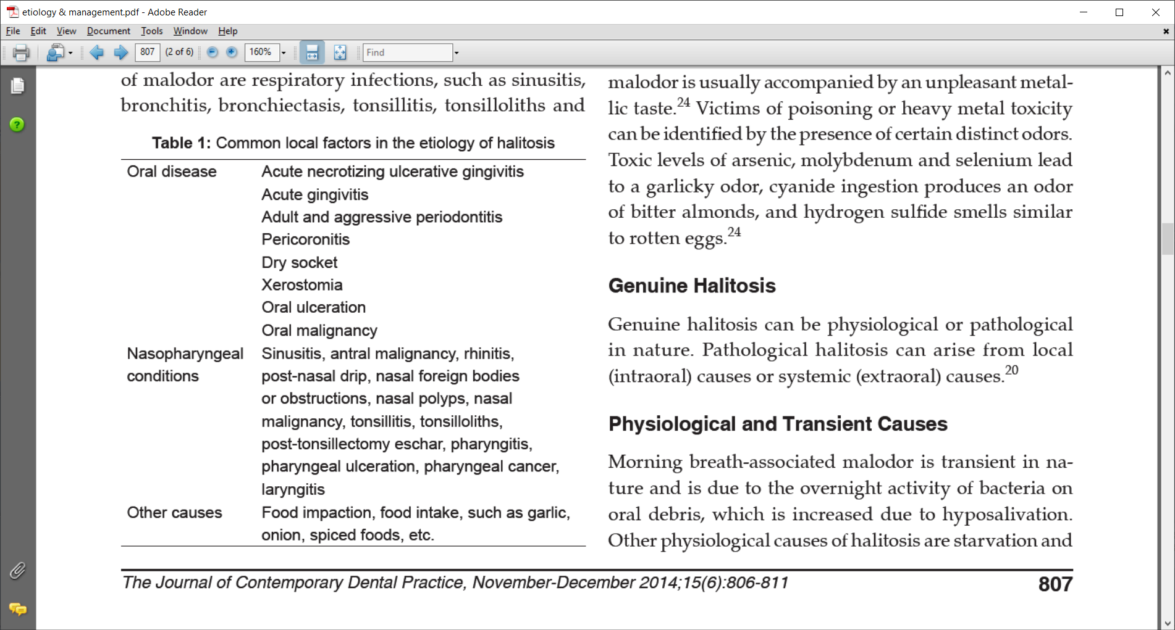
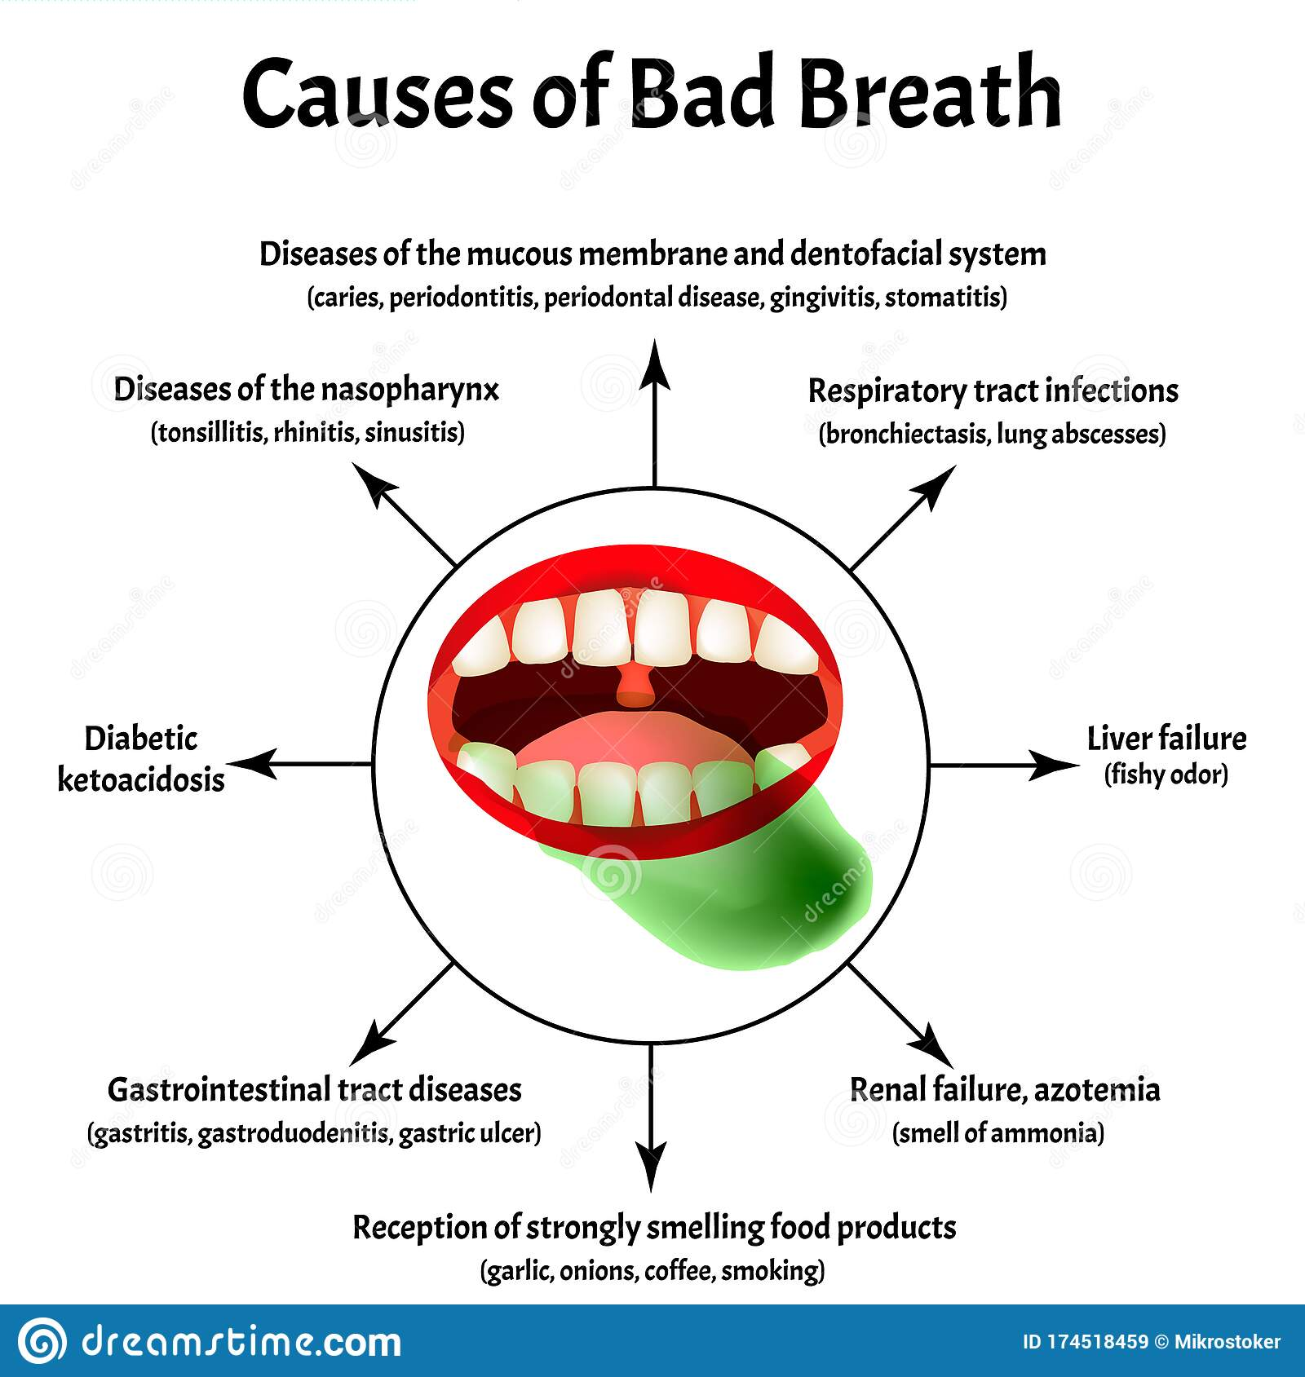
Etiology

Slide 6
Odoriferous components causing halitosis are
Family group Compound name
Volatile sulfur compounds (VSCs) Hydrogen sulfide
Methyl mercaptan
Dimethyl sulfide
Volatile aromatic compounds and amines Indole, Skatole
Pyridine, Picoline
Urea, Ammonia, Methylamine
Short chain fatty acids or organic acids Propionic acid,
Butyric acid, Acetic acid
Valeric acid, Isovaleric acid
Aldehydes and ketones Acetone, acetophenone

Slide 7
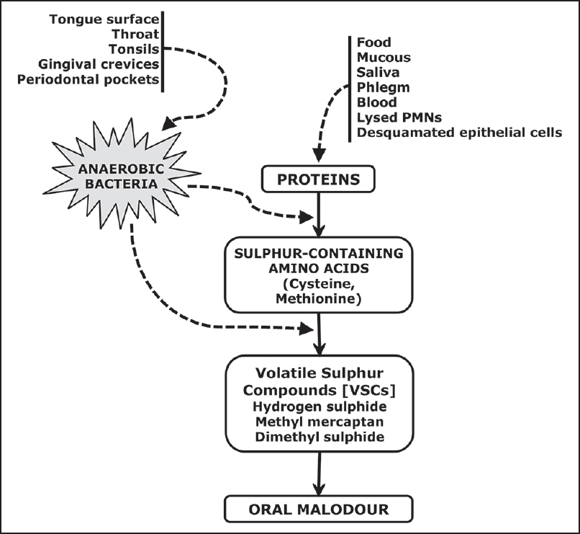
Intraoral Causes
Tongue coating, poor oral hygiene, gingivitis, and periodontitis are the predominant causative factors
Pathophysiology
It is the result of the degradation of organic substrates by anaerobic bacteria. During the process of bacterial
putrefaction, peptides and proteins present in saliva, food debris, gingival crevicular fluid, interdental plaque, shed epithelial cells and blood are hydrolyzed to sulfide-containing and non–sulfide-containing amino acids, which can be further metabolized .
The proteolytic degradation of sulfur-containing amino acids produces sulfur containing gases such as hydrogen sulfide (H2S) and methylmercaptan

Slide 8
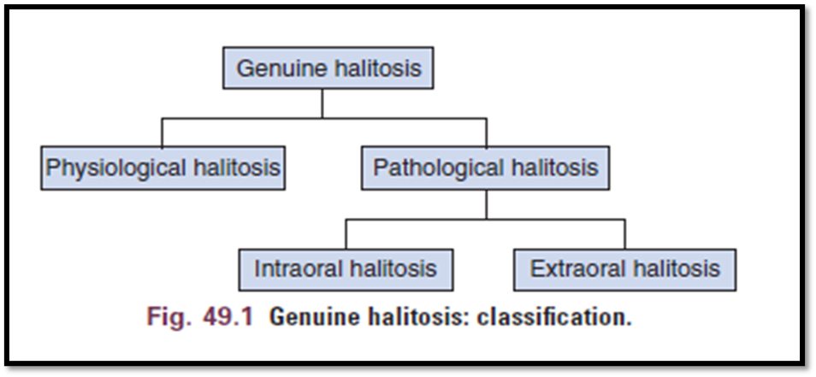

Slide 9
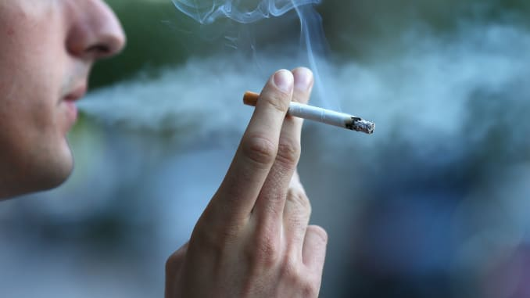
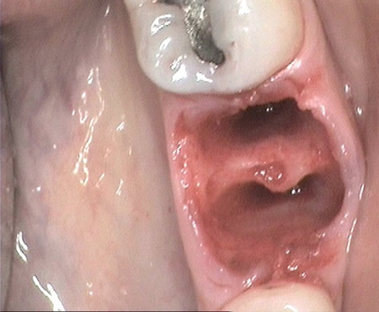
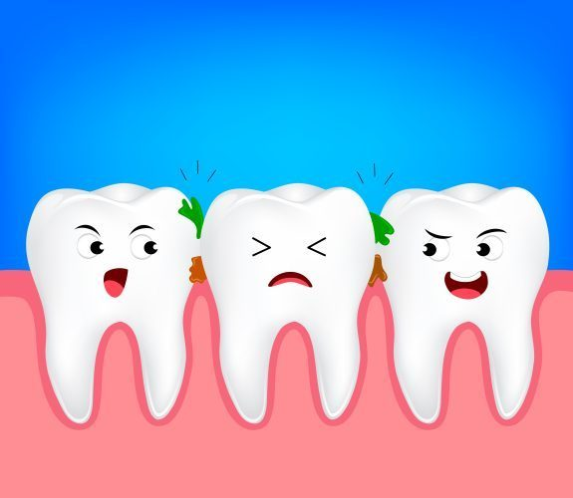
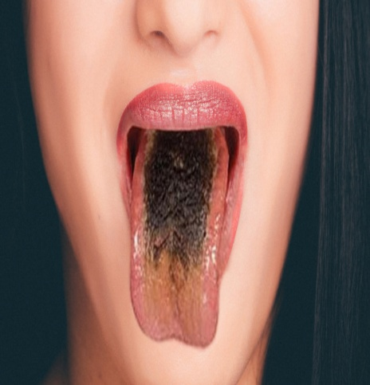
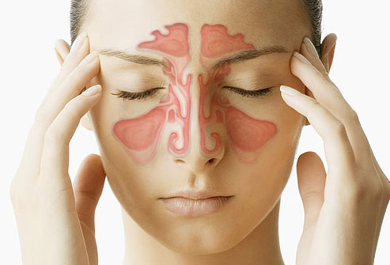
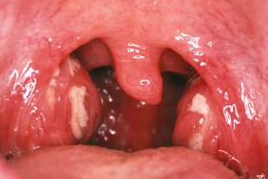
Halitosis
pathologic origin
Non pathologic origin
Halitosis due to local factors of pathologic origin:

Slide 10

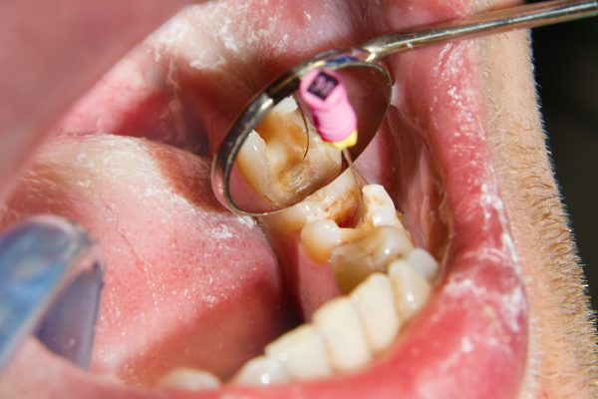

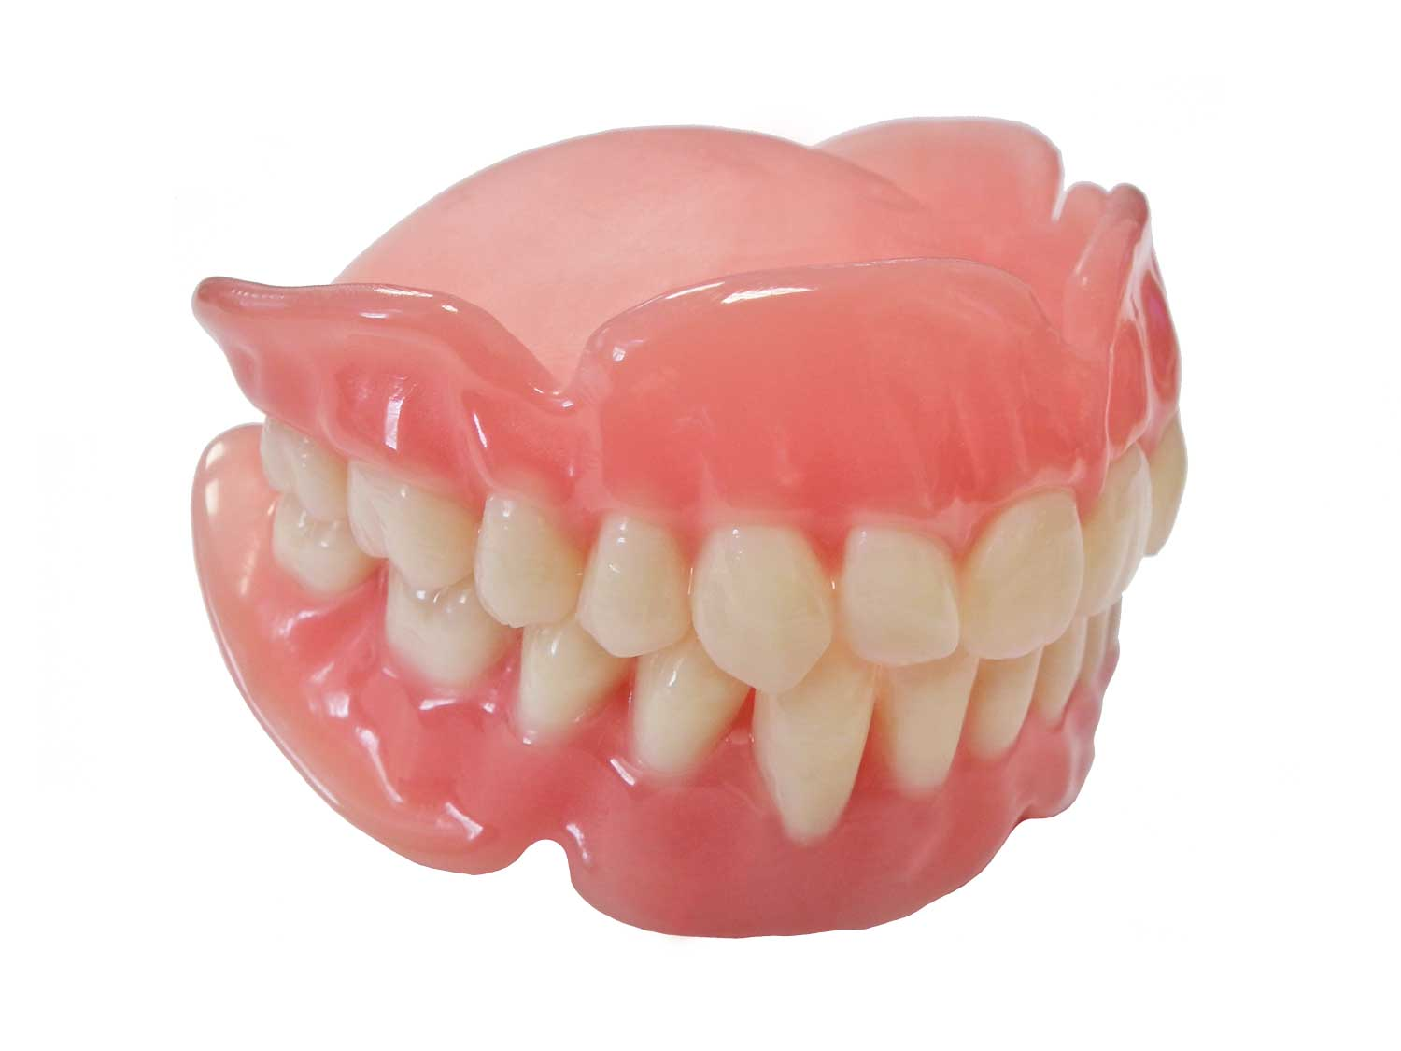
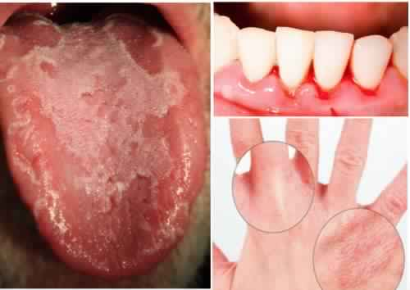

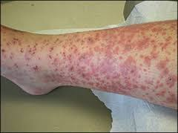
Halitosis due to local factors of non-pathologic origin
Halitosis due to systemic factors of pathologic origin
Vit.C deficiency

Slide 11
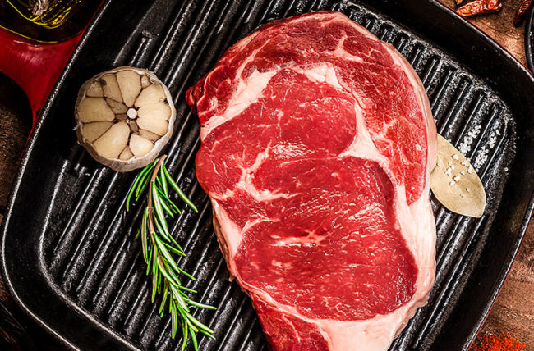
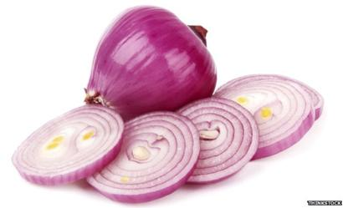
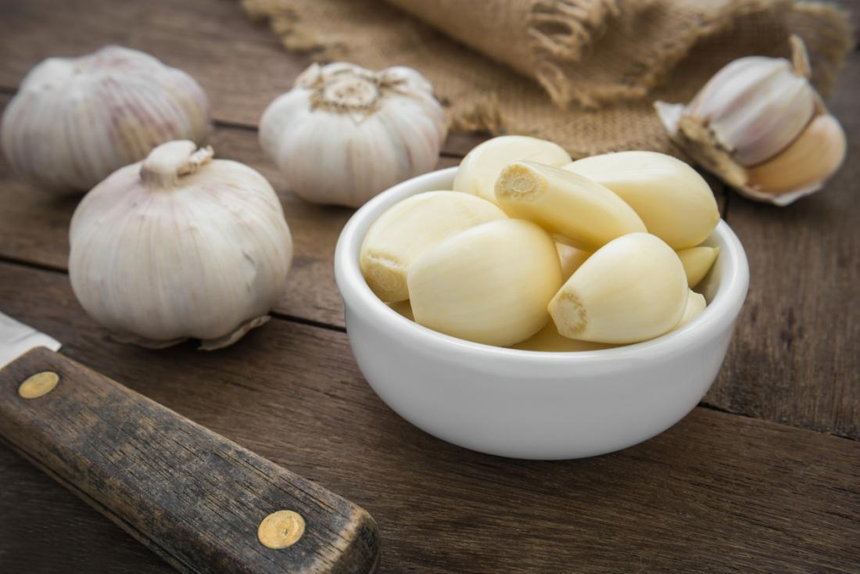
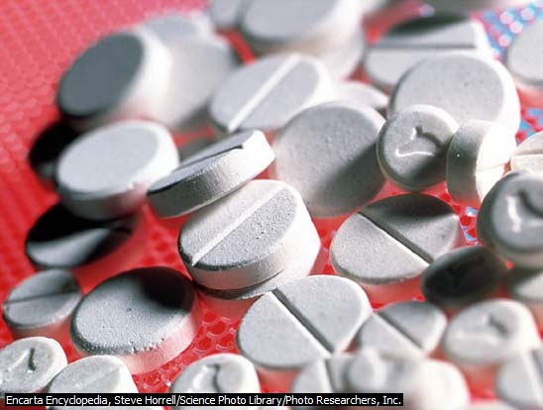

Halitosis due to systemic factors of non-pathologic origin

Slide 12
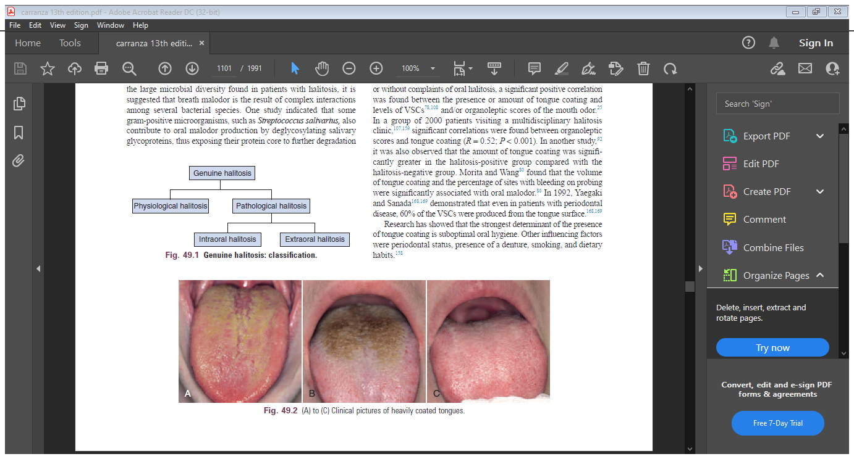
Tongue and Tongue Coating
The dorsal tongue mucosa, with an area of 25 cm3, has a very irregular surface topography.
The innumerable depressions in the tongue surface are ideal niches for bacterial adhesion and growth
fissured tongue (deep fissures on the dorsum, also called scrotal tongue or lingua plicata) and a hairy tongue (lingua villosa) have an even rougher surface
Accumulated food remnants intermingled with exfoliated cells and bacteria form a coating on the tongue dorsum. As such, the two factors essential for putrefaction (bacteria and their nutrients) are united.

Slide 13
Periodontal Infections
Several studies have shown that VSC levels in the mouth correlate positively with the depth of periodontal pockets and that the amount of VSCs in the breath increases with the number, depth, and bleeding tendency of the periodontal pockets.
VSCs aggravate the periodontitis process by increasing the permeability of the pocket and mucosal epithelium, therefore exposing the underlying connective tissues of the periodontium to bacterial metabolites.
Methylmercaptan enhances interstitial collagenase production, interleukin-1 production, further mediating connective tissue breakdown. the reaction of hydrogen sulfide with collagen can alter the protein structure, rendering the periodontal ligament and bone collagen more susceptible to destruction by proteases

Slide 14
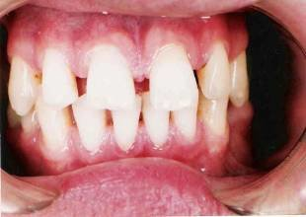
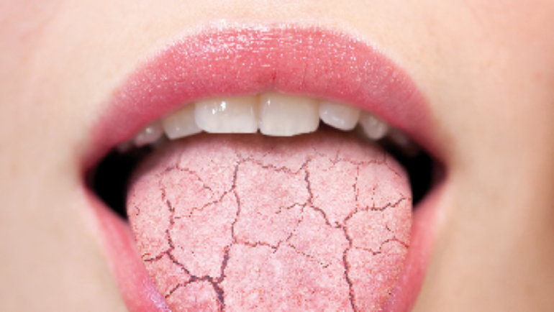
Dental Disorders
Possible causes within the dentition are deep carious lesions with food impaction and putrefaction, extraction wounds filled with blood clots, and purulent discharge leading to important putrefaction.
Dry Mouth
The implication is that when saliva dries out on oral surfaces, a range of VSC and other volatiles are released. Proteolytic degradation by oral microorganisms of four amino acids (two sulfur containing and two non-sulfur containing) to malodorous compounds.
Halitosis generally arises as a result of the bacterial decomposition of food particles, cells, blood and some chemical composition of saliva

Slide 15
Extraoral Causes
Extraoral halitosis can be subdivided into two types: non–bloodborne halitosis and blood-borne halitosis.
Blood-borne halitosis is the result of bad-smelling metabolites that can be formed or absorbed at any place in the body (e.g.liver, the gut) and transported by the bloodstream to the lungs. Exhalation of these volatiles in the alveolar air then causes halitosis.

Slide 16
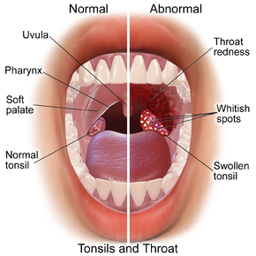
Ear, Nose, and Throat
During chronic or purulent tonsillitis, the deep crypts of the tonsils accumulate debris and bacteria, especially perio pathogens, resulting in putrefaction.
Ozena (caused by Klebsiella ozaenae) is a rare atrophic condition of the nasal mucosa, with the appearance of crusts that cause a very strong breath malodor.
Finally, a foreign body in a nasal or sinus cavity can cause local irritation, ulceration, and subsequent putrefaction

Slide 17
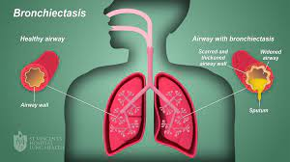
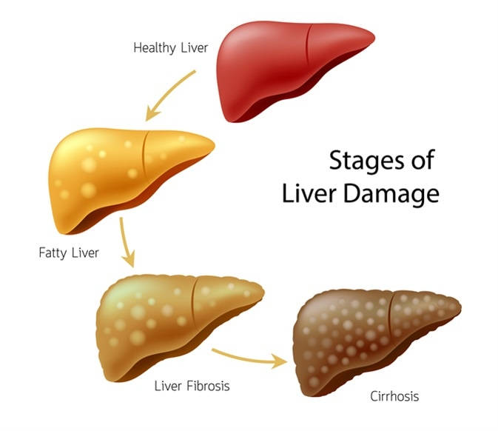
Bronchi and Lungs
Pulmonary causes include chronic bronchitis, bronchiectasis (infection of standing mucus secretion in cystic dilations through walls of bronchioles), pneumonia, pulmonary abscess, bronchial carcinoma, and carcinoma of the lung
Liver
Patients with various degrees of hepatocellular failure and/or portosystemic shunting of blood may acquire a sweet, musty, or even slightly fecal aroma of the breath, termed fetor hepaticus, which has been mainly attributed to the accumulation of dimethyl sulfide

Slide 18
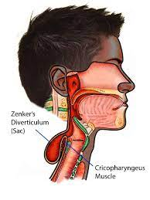
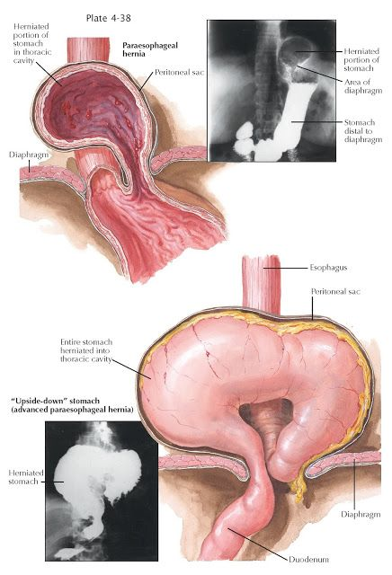
Gastrointestinal Tract
A Zenker diverticulum can cause significant breath odour because it is not separated from the oral cavity by a sphincter.
• A gastric diaphragmatic hernia can cause reflux of the gastric contents up to the oropharynx.
• Regurgitation esophagitis may be a cause.
• Intestinal gas production: Some gases (e.g., dimethyl sulfide) are absorbed but not metabolized by the intestinal endothelium and thus transported by the blood. These gases can then be exhaled through the lungs

Slide 19
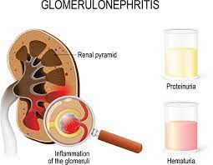

Kidney
Kidney insufficiency, primarily caused by chronic glomerulonephritis, leads to an increase of the amines dimethylamine and trimethylamine, causing a typical fishy odour of the breath
Systemic Metabolic Disorders
Uncontrolled diabetes mellitus results in the accumulation of ketones, which have a sweet smell, like the odor of rotten apples. Insulin resistance leads to an increase of triglycerides and free fatty acids, and ketones (e.g., acetone, acetoacetate, and hydroxybutyrate) are formed during lipolysis

Slide 20
Trimethylaminuria
Trimethylaminuria is a hereditary metabolic disorder that leads to a typical fishy odor of the breath, urine, sweat, and other bodily secretions.
Trimethylaminuria is an enzymatic defect that prevents the transformation of trimethylamine to trimethylamineoxide, resulting in abnormal amounts of this molecule.

Slide 21

Diagnosis of malodor
Before their first visit to the office, patients are instructed to abstain from:
Breath fresheners, and oral hygiene for 6 hours
Smoking for 12 hours
Scented cosmetics for 24 hours
Onions, garlic, and spicy foods for 48 hours and
Antibiotics for 3 weeks.

Slide 22
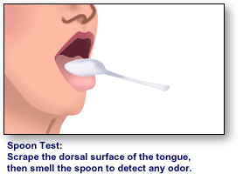

DIRECT MEASUREMENTS
Wrist lick test
Spoon test
Dental floss test
Saliva odor test
Organoleptic assessment.
Gas chromatography.
Dark field/ phase contrast microscopy

Slide 23
Indirect measurement techniques
BANA (Benzoyl-DL-arginine- 2-Naphthylamide) test
Chemical sensors
Quantifying beta-galactosidase activity
Salivary incubation test
Ammonia monitoring
Ninhydrin method
Polymerase chain reaction (PCR)

Slide 24

Medical history

Slide 25
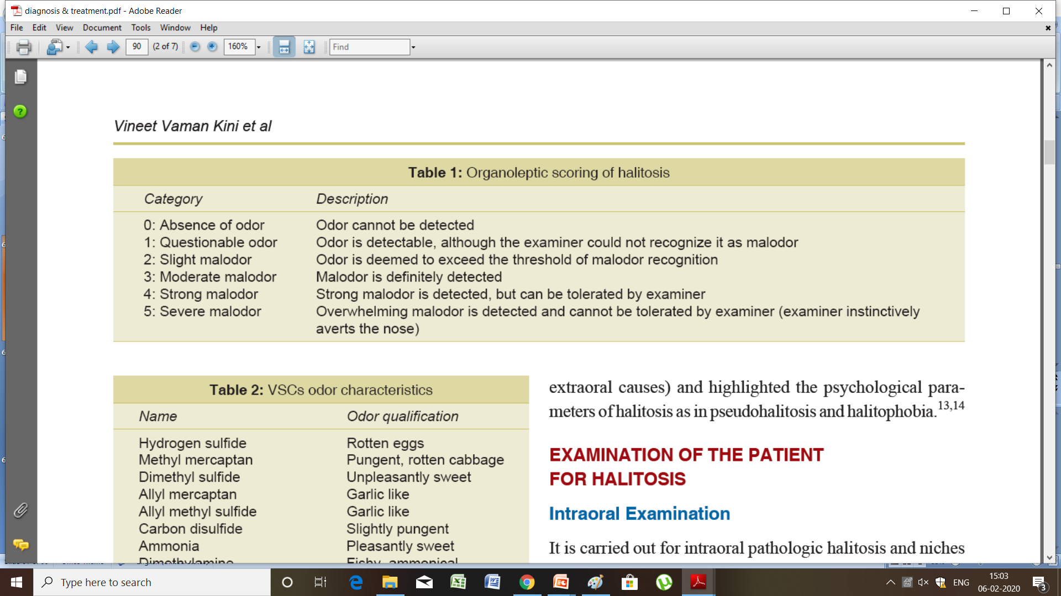
Organoleptic Rating
The human nose can smell 10,000 different odors, more than any device on the market
In an organoleptic evaluation, a trained and preferably calibrated “judge” sniffs the expired air and assesses whether it is unpleasant by using an intensity rating
By Rosenberg , Mulloch Et Al 1991.

Slide 26
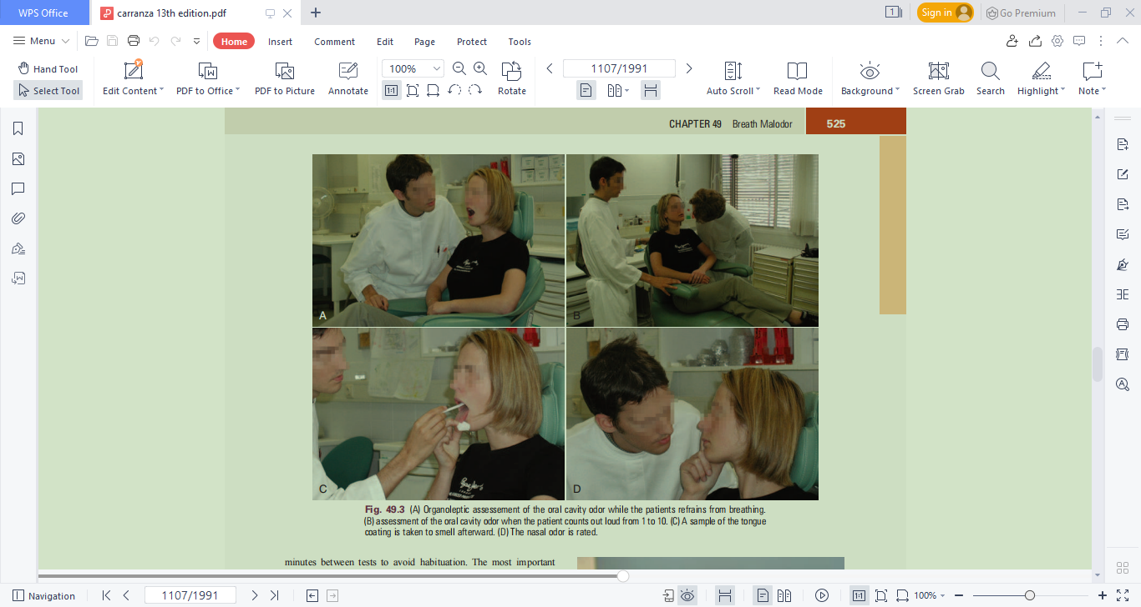
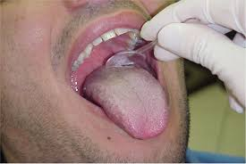
In an organoleptic assessment, the judge smells a series of air sample
Nasal breath odor
Breath odor
Oral cavity odor
Tongue coating
Saliva

Slide 27
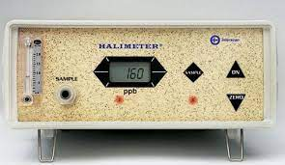
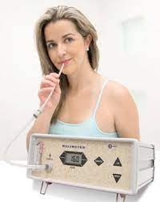
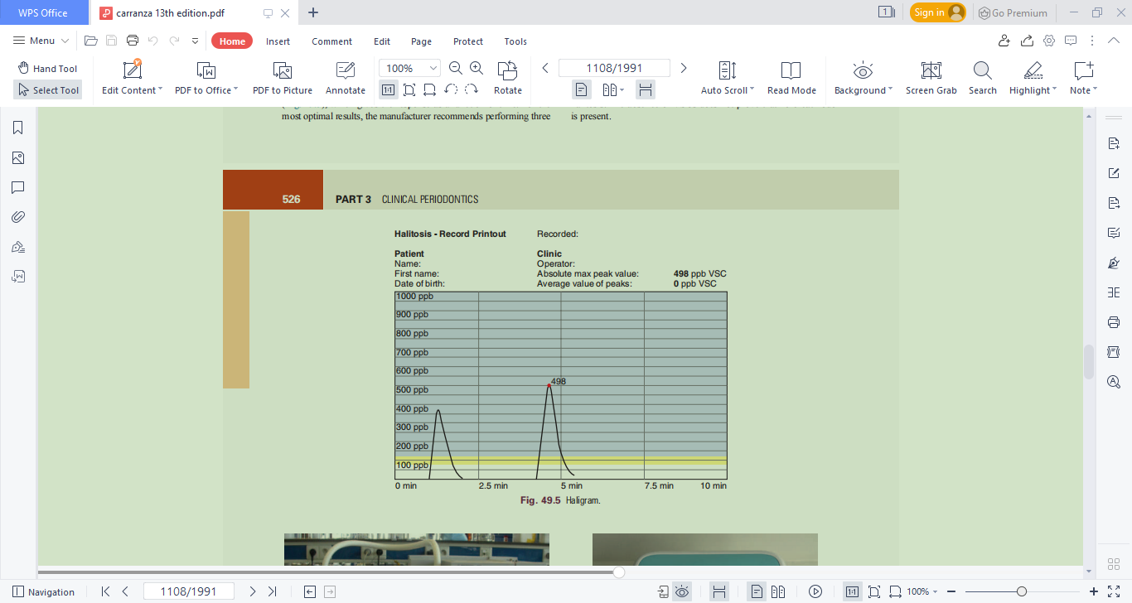
Portable Volatile Sulfur Monitor
The Halimeter is an electronic device that detects the presence of VSCs such as hydrogen sulfide and methylmercaptan in breath.
The sensitivity for methylmercaptan is five times lower than for hydrogen sulfide, and the device is almost insensitive to dimethyl sulfide.

Slide 28
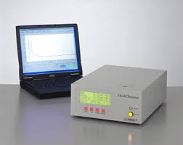
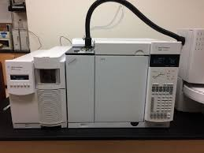
Gas Chromatography
A gas chromatograph can analyze air, saliva, or crevicular fluid
In the expired air of a person, at least 150 compounds can be found. The most important advantage of the technique is that when coupled with mass spectrometry, it can detect virtually any compound when using adequate materials and conditions.
Moreover, it has very high sensitivity and specificity.

Slide 29
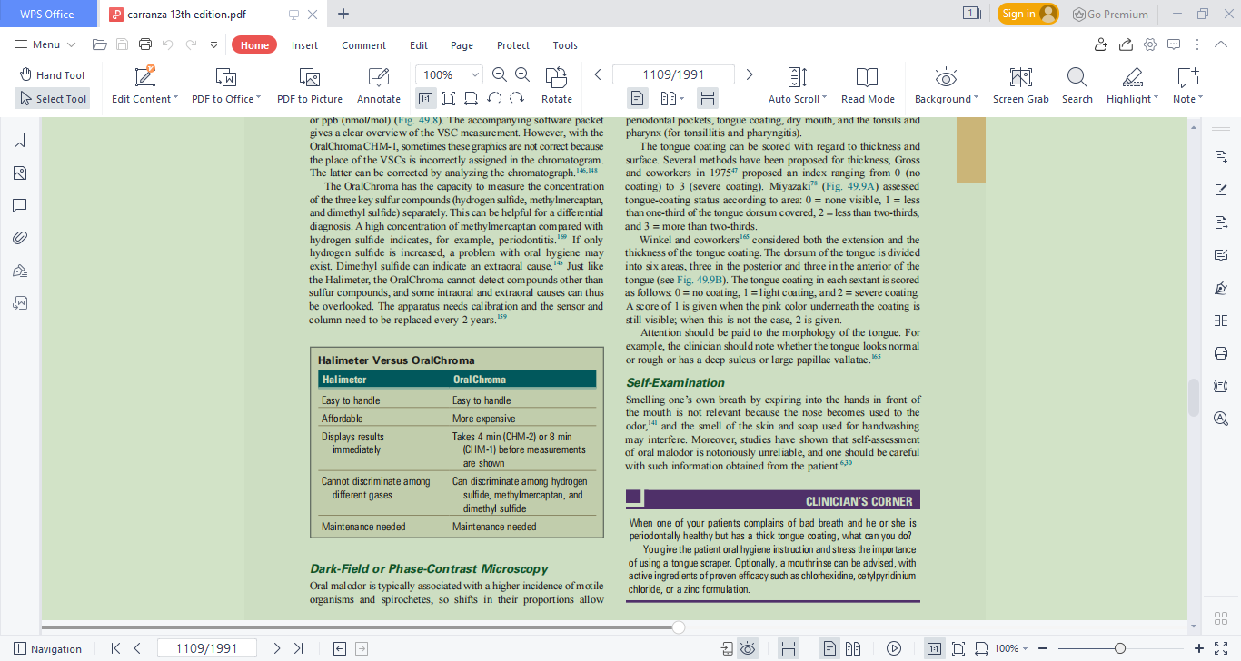

Slide 30
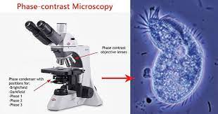
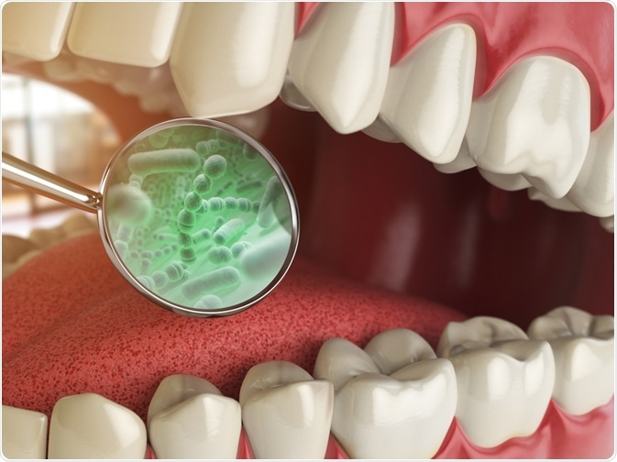
Dark-Field or Phase-Contrast Microscopy
Oral malodor is typically associated with a higher incidence of motile organisms and spirochetes, so shifts in their proportions allow monitoring of therapeutic progress.
Another advantage of direct microscopy is that the patient becomes aware of bacteria present in plaque, tongue coating, and saliva.

Slide 31
Oropharyngeal Examination
The oropharyngeal examination includes inspection of deep carious lesions, interdental food impaction, wounds, bleeding of the gums, periodontal pockets, tongue coating, dry mouth, and the tonsils and pharynx (for tonsillitis and pharyngitis).
The tongue coating can be scored with regard to thickness and surface.
Miyazaki assessed tongue-coating status according to area:
0 = none visible,
1 = less than one-third of the tongue dorsum covered,
2 = less than two-thirds,
and 3 = more than two-thirds.

Slide 32
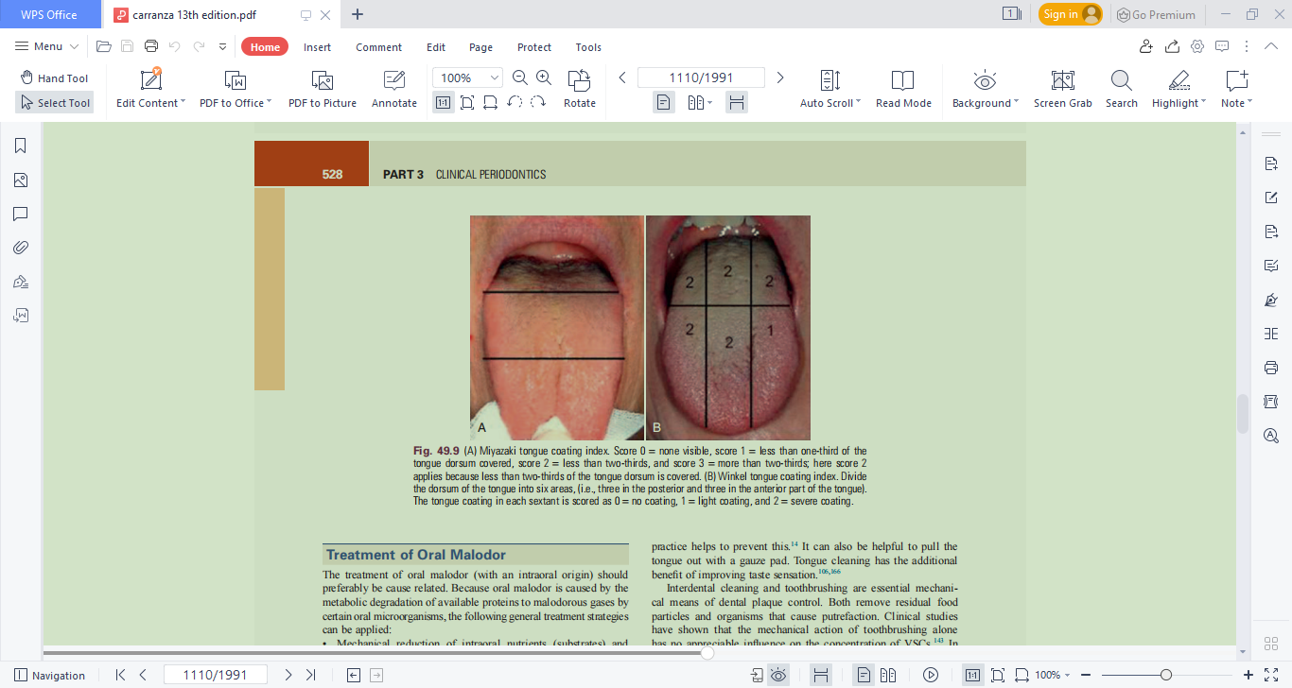
Winkel and coworkers considered both the extension and the thickness of the tongue coating.
The dorsum of the tongue is divided into six areas, three in the posterior and three in the anterior of the
tongue.
The tongue coating in each sextant is scored
as follows:
0 = no coating,
1 = light coating, and
2 = severe coating.
A score of 1 is given when the pink color underneath the coating is still visible; when this is not the case, 2 is given.

Slide 33
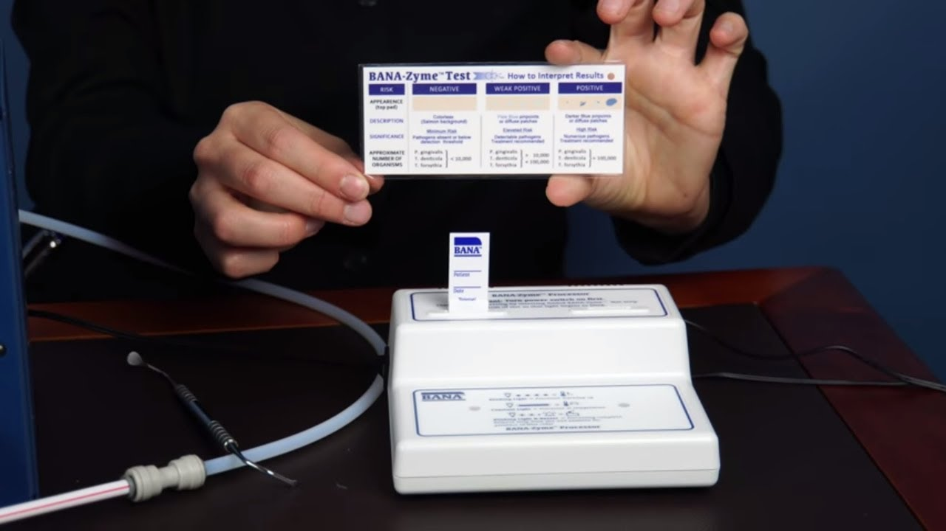
BANA (Benzoyl-DL-arginine- 2-Naphthylamide) test
Many of the anaerobic bacteria in the dorsum of the tongue and subgingival plaques can produce VSCs and malodorous volatile fatty acids.
BANA test is used to identify 3 major bacteria such as Treponema denticola, Porphyromonas gingivalis, and Bacteroides forsythia .
When these proteolytic bacteria are treated with a synthetic trypsin substrate BANA, the arginine hydrolase enzyme which is a colored compound is released. Thus, the presence of bacteria is proved and the test can be done within a 5-10 minutes

Slide 34
Treatment of Oral Malodor
The treatment of oral malodor (with an intraoral origin) should preferably be cause related.
Because oral malodor is caused by the metabolic degradation of available proteins to malodorous gases by certain oral microorganisms, the following general treatment strategies can be applied:
• Mechanical reduction of intraoral nutrients (substrates) and microorganisms
• Chemical reduction of oral microbial load
• Rendering malodorous gases nonvolatile
• Masking the malodor

Slide 35
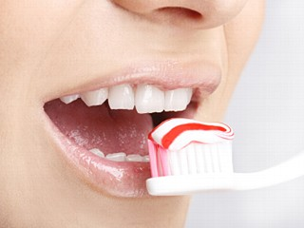
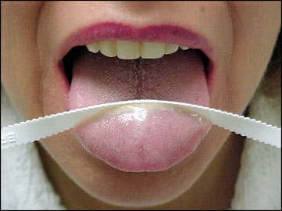

Mechanical Reduction of Intraoral Nutrients and Microorganisms
Previous investigations demonstrated that tongue cleaning reduces both the amount of coating (and thus bacterial nutrients) and the number of bacteria and thereby improves oral malodor effectively
interdental cleaning and toothbrushing are essential mechanical means of dental plaque control. Both remove residual food particles and organisms that cause putrefaction.

Slide 36
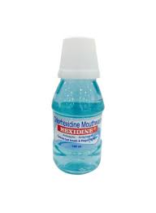
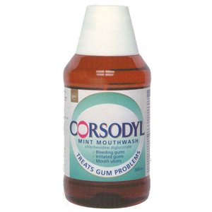
Chemical Reduction of Oral Microbial Load
The active ingredients usually include anti microbial agents such as chlorhexidine, cetyl pyridinium chloride (CPC), essential oils, chlorine dioxide, triclosan, amine fluoride and stannous fluoride, hydrogen peroxide, and baking soda.
Rosenberg et al showed that a 0.2% chlorhexidine regimen produced 43% reduction in VSC values and a greater than 50 % reduction in organoleptic mouth odor ratings
Its antibacterial action can be explained by disruption of the bacterial cell membrane by the chlorhexidine molecules, thus increasing its permeability and resulting in cell lysis and death.

Slide 37
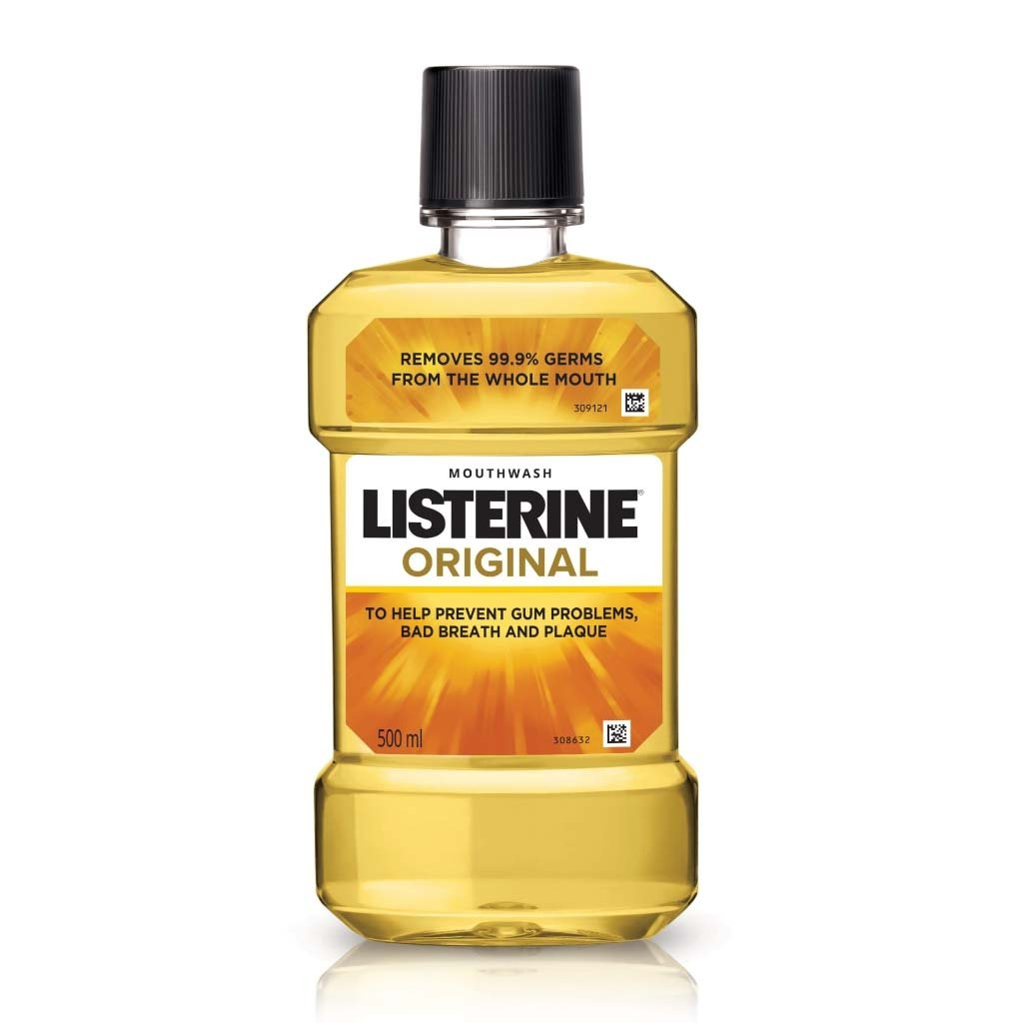
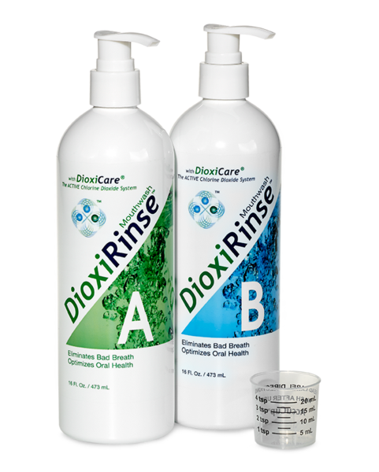
Essential Oils
Chlorine Dioxide
Chlorine dioxide (ClO₂) is a powerful oxidizing agent that can eliminate bad breath by oxidation of hydrogen sulfide, methylmercaptan, and the amino acids methionine and cysteine.

Slide 38
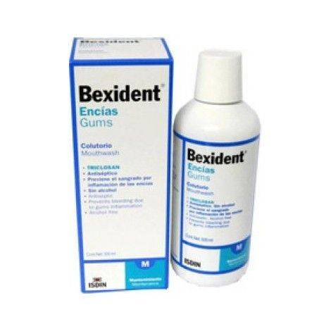
Triclosan
Triclosan, a broad-spectrum antibacterial agent, has been found to be effective against most oral bacteria and has good compatibility
The anti VSC effect of triclosan, seems strongly dependent on the solubilizing agents. Flavouring oils or anionic detergents and copolymers are added to increase the oral retention and decrease the rate of release in toothpaste formulations containing triclosan.
0.15% triclosan and 0.84% zinc

Slide 39


The association of amine fluoride with stannous fluoride resulted in encouraging reductions of morning breath odour, even when oral hygiene was insufficient
Hydrogen Peroxide
Amine Fluoride or Stannous Fluoride
3% hydrogen peroxide (H2O2) produced impressive reductions (±90%) in sulfur gases that persisted for 8 hours.

Slide 40

Oxidizing Lozenges
Greenstein and associates reported that sucking a lozenge with oxidizing properties reduced tongue dorsum malodor for 3 hours.
This antimalodor effect may be caused by the activity of dehydroascorbic acid, which is generated by peroxide-mediated oxidation of ascorbate in lozenges.

Slide 41

Conversion of Volatile Sulfur Compounds
Metal Salt Solutions
Metal ions with an affinity for sulfur are efficient in capturing the sulfur-containing gases.
Zinc is an ion with two positive charges (Zn++), which will bind to the twice-negatively loaded sulfur radicals
and thus reduce the expression of VSCs. The same applies for other metal ions such as stannous, mercury, and copper.
Clinically, the VSC inhibitory effect was copper chloride > stannous fluoride > zinc chloride (CuCl2 > SnF2 > ZnCl2).
Chewing gum

Slide 42


Slide 43


Slide 45


