Slide 1
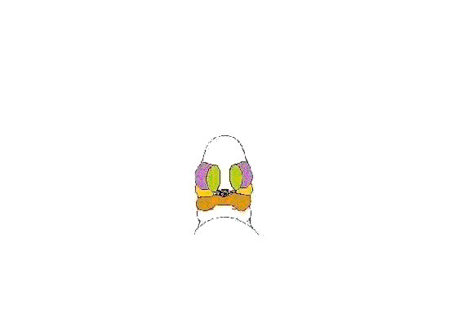
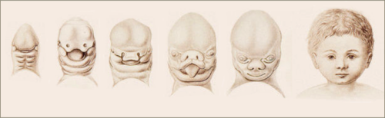
Growth and development of maxilla

Slide 2
contents
Introduction
Embryogenesis
Formation of Neural crestcells
Formation of frontonasal process
Formation and disintegration of oropharyngeal membrane
Formation of median nasal and lateral nasal process
Formation of maxillary and mandibular process

Slide 3
Development of palate
Development of gingiva,lip,teeth.
Postnatal growth of maxilla
Developmental distrubence
Orthodontic considerations,
Conclusion
Reference

Slide 4
Introduction
Knowledge of the embryology of the facial region not only allows one insight into how normal variations in facial structure arise but also provides an understanding of how congenital deformities occur when normal facial development goes awry.

Slide 5
Growth
J.S.Huxley-”The self multiplication of living substance”
Todd-”Increase in size”
Krogman-” Increase in size change in proportion&progressive
complexity”

Slide 6
Development
Todd -“Development is progress towards maturity”
Moyer –”All naturally occurining unidirectional changes in life the life of an individual from its existance as single cell to is elobaration as multifunctional unit”

Slide 7
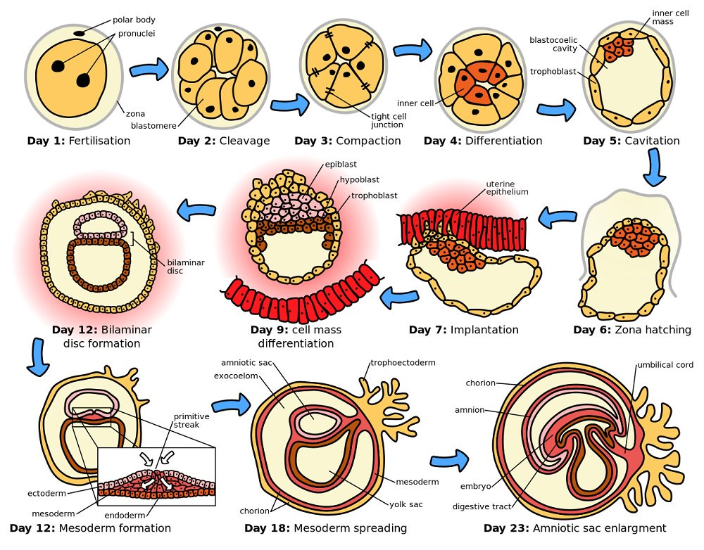
Embryogenesis

Slide 8
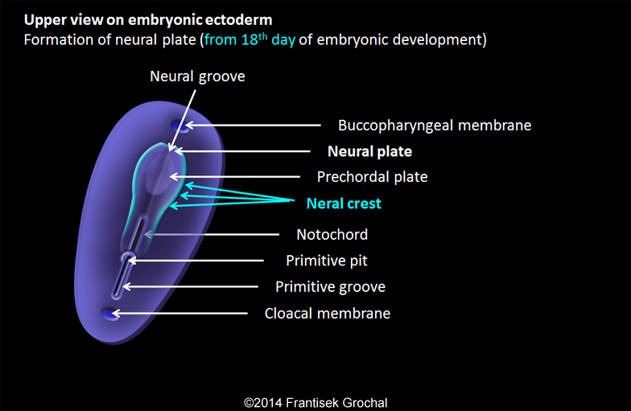
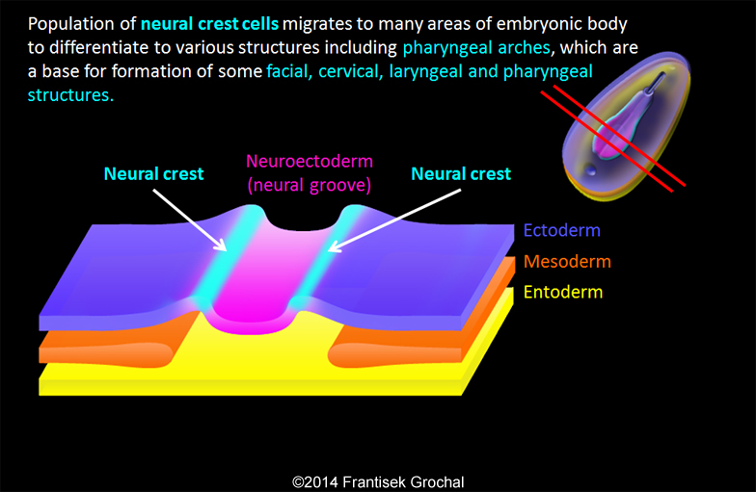
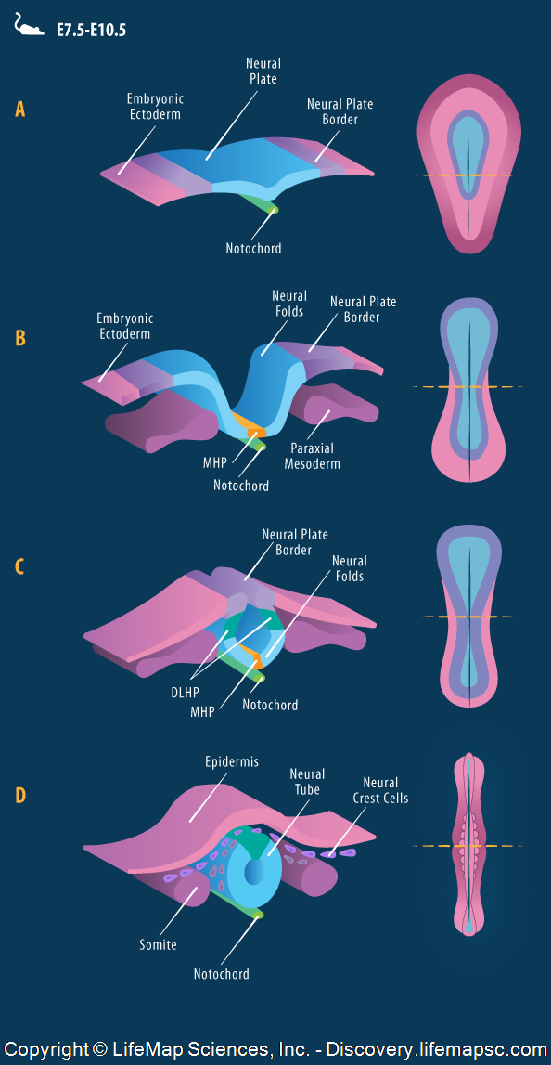

Slide 9
The major development of the facial region occurs between the
fourth and eighth embryonic weeks via a series of highly coordinated
and preprogrammed events.
This process includes contributions from the head ectoderm, which
will help form the face and oral cavity, and the neural crest
mesenchyme, which contributes to the first branchial arch and its
derivatives.

Slide 10
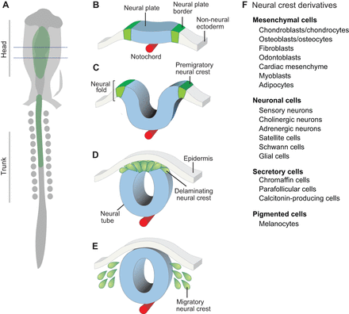
Neural crest derivatives

Slide 11
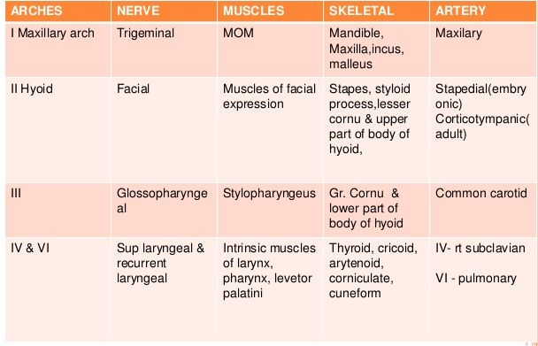
Derivatives of pharyngeal arches

Slide 12
MOLECULAR REGULATION OF FACIAL DEVELOPMENT

Slide 13
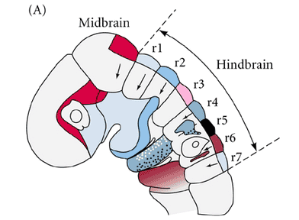
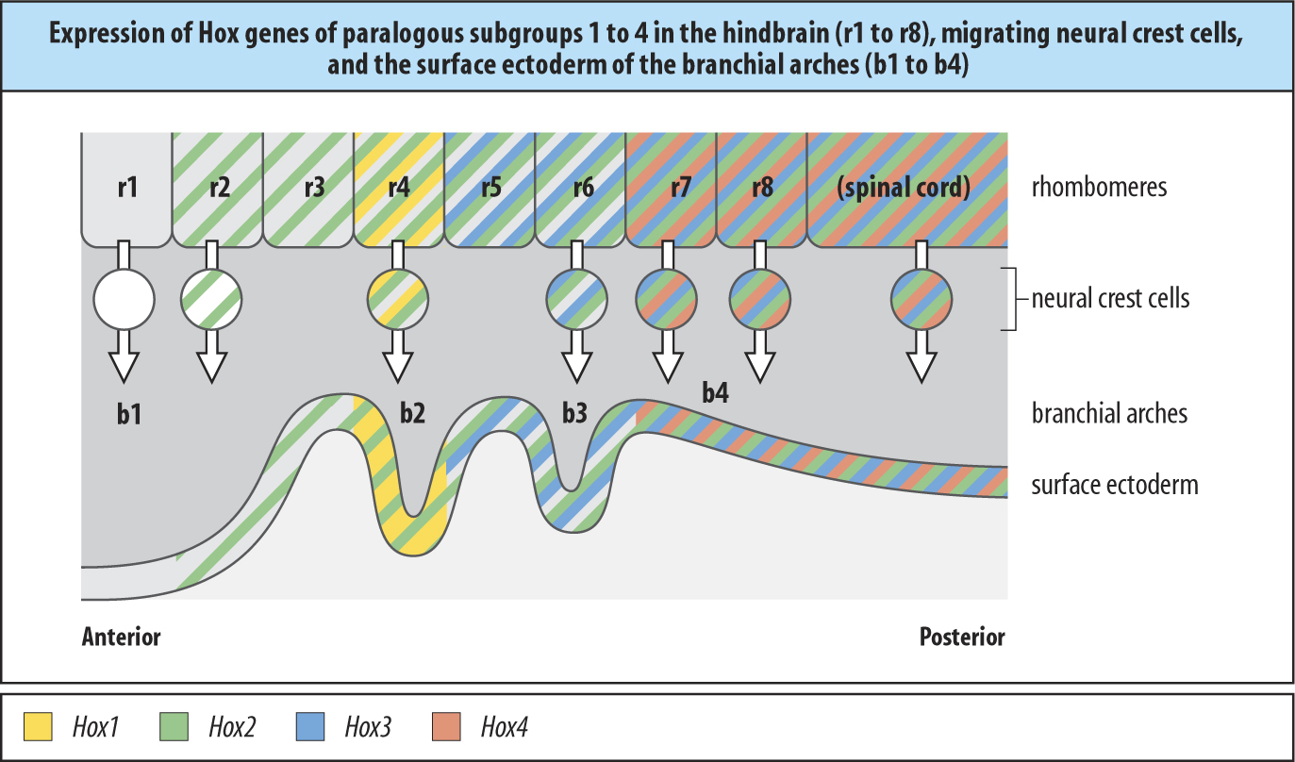
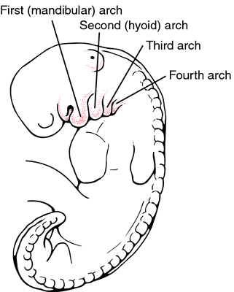
Retinoic acid receptor elements for retinoids
OTX2

Slide 14
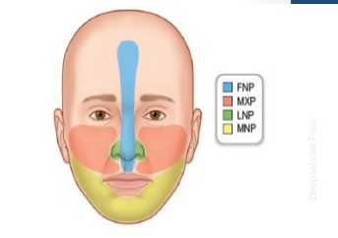
Dursey&His

Slide 15
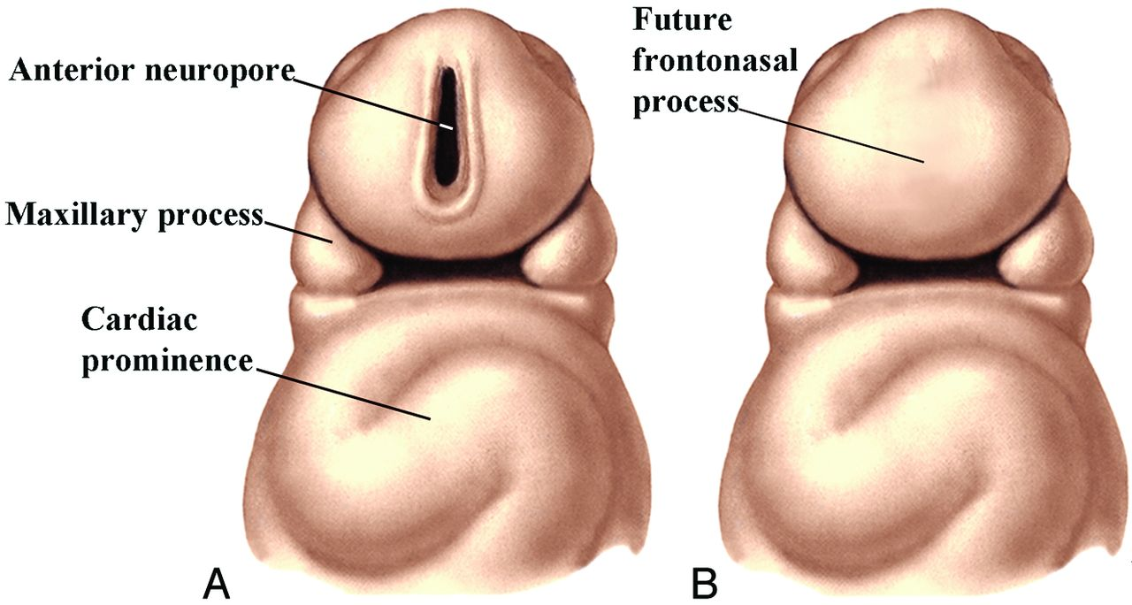
Formation of Frontonasal process
Shortly after the anterior neuropore closes in the late third to
early fourth week, the forebrain enlarges and pushes the
overlying ectoderm forward and laterally, creating the
frontonasal process.

Slide 16
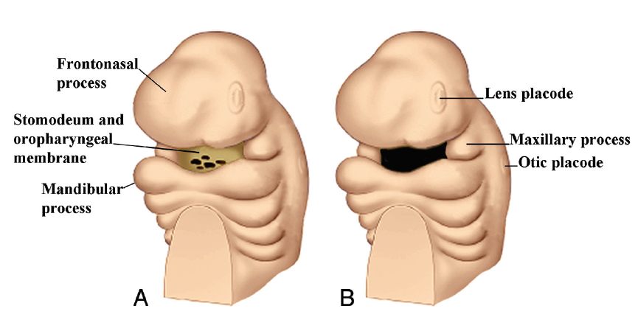
Formation & disintegration of oropharyngeal membrane
The enlarging brain and frontonasal process contribute to
an ectodermally covered invagination, the stomodeum, which develops below them in the early fourth week.
The ectoderm over the stomodeum comes to abut the endoderm of the developing foregut to form the oropharyngeal membrane.
In the fifth week, the oropharyngeal membrane disintegrates, creating communication between the foregut and the outside .

Slide 17
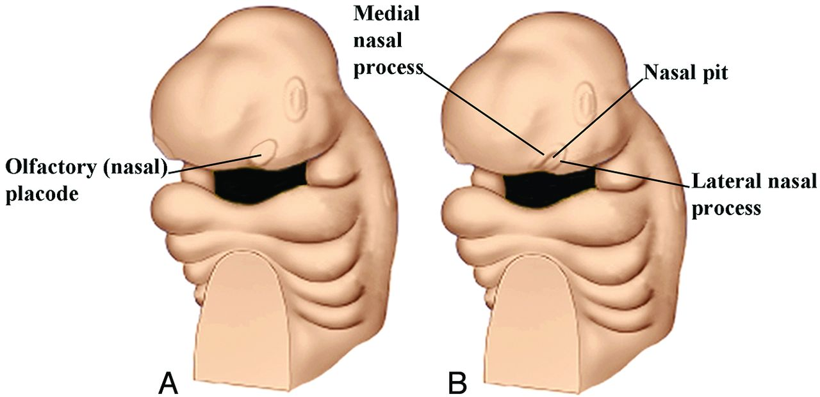
Formation of median nasal and lateral nasal process

Slide 18
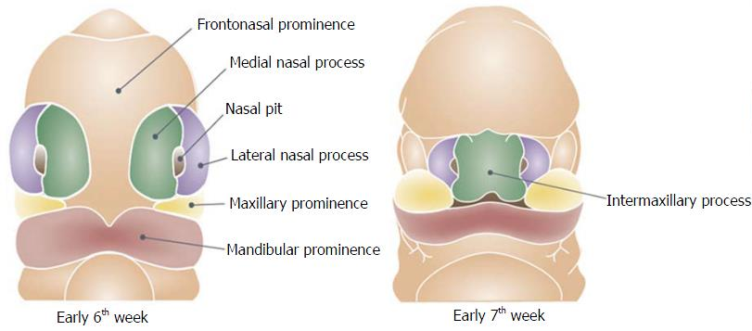
At the same time, mesenchymal growth in the first branchial arch produces first the maxillary process and then the faster growing mandibular process on each side of the future face.
The mandibular processes rapidly extend to the facial midline
and merge.

Slide 19
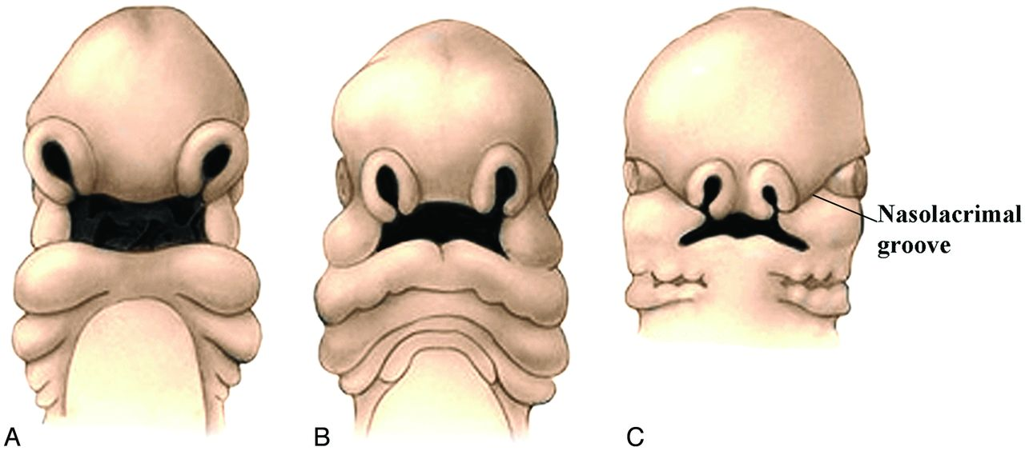
The stomodeum is now surrounded by the frontonasal process above, the paired maxillary processes on either side, and the paired mandibular processes below (future lower jaw)

Slide 20
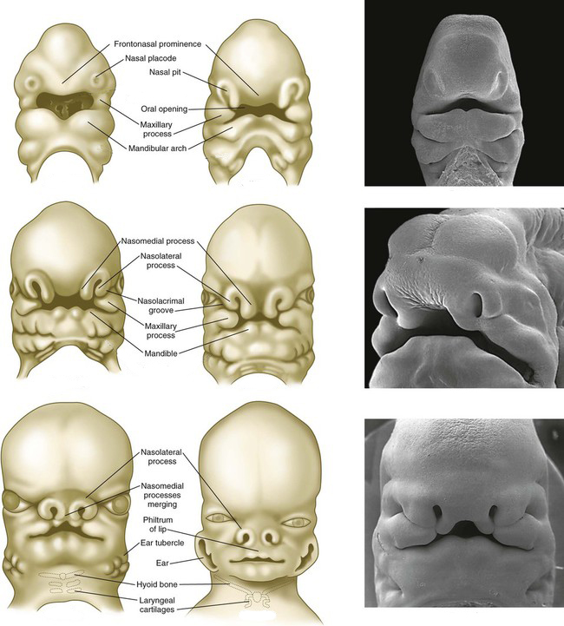

Slide 21
Formation of the Palate
Between the sixth and 12th weeks, the palate is formed from 3 primordia: a midline median palatine process and paired lateral palatine processes .
In the beginning of the sixth week, merging of the paired medial nasal processes forms the intermaxillary process.
From this, a wedge-shaped primary anterior mesenchymal mass extends posteriorly, between the internal surfaces of the developing maxillae, to form the primary palate .

Slide 22
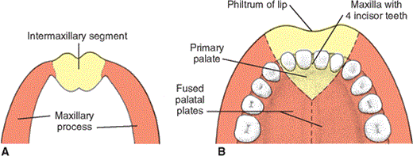
Intermaxillary segment
Formed from maxillary prominance and twomedial nasal prominence
Labial component(philtrum)
Upper jaw component(4 incisors)
Palatal component(primary palate)

Slide 23
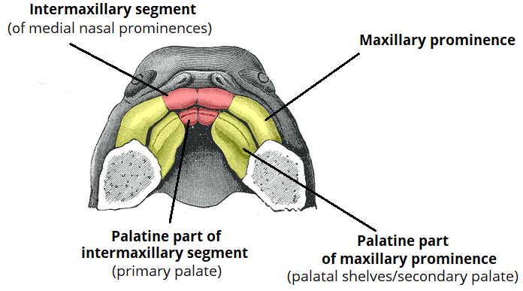

Slide 24
The secondary palate is the primordium of the remaining hard and the soft palates.
Later in the sixth week, paired lateral palatine processes arise as medial mesenchymal projections from each maxillary process .
Initially these grow inferiorly, between the developing tongue and the developing alveolus (see the sections on the mandible and teeth).
However, as the maxilla and mandible elongate, the tongue is pulled downward away from the lateral palatal processes.
During the seventh and eighth weeks , the palatal shelves elevate into a horizontal position above the tongue .

Slide 25
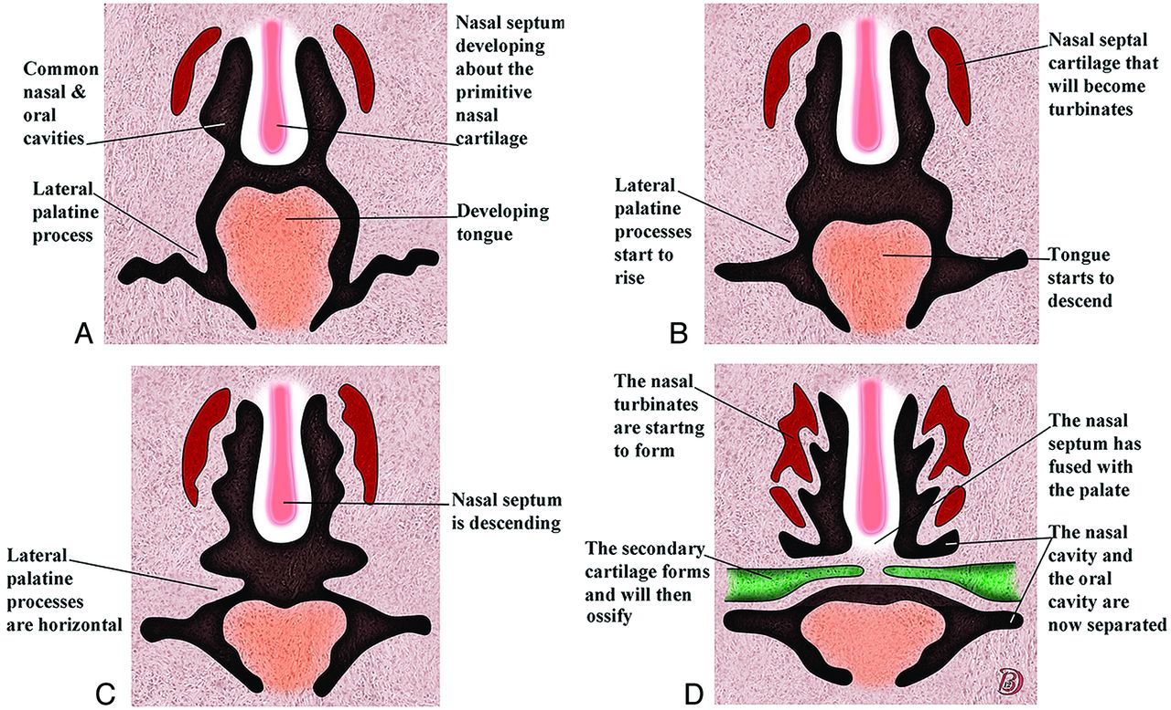

Slide 26
Transformation ??
This change in orientation is facilitated by the release of hyaluronic acid by the mesenchyme of each palatal process.
Alternation in vasculature and blood supply to palatal shelves.
Appearance of an intrinsic shelf force.
Rapid differential mitotic activity.
Muscular movements .
Withdrawal of embryonic face from heart prominence, slight jaw opening

Slide 27
When the palatal shelves first make contact, each is completely covered by a homogeneous epithelium.
A special epithelium arises at the edge of each palatal shelf, facilitating the eventual fusion of these shelves.

Slide 28
The 2 palatal shelves also fuse with the triangular primary palate anteromedially to form a y-shaped fusion line.
The point of fusion of the secondary palatal shelves with the primary palate is marked in the adult by the incisive foramen.
Ossification gradually occurs in the primary palate and then extends into the palatal processes to form the hard palate.
The posterior portions of the palatal processes do not ossify. rather they extend posteriorly to the nasal septum and fuse to form the soft palate .

Slide 29
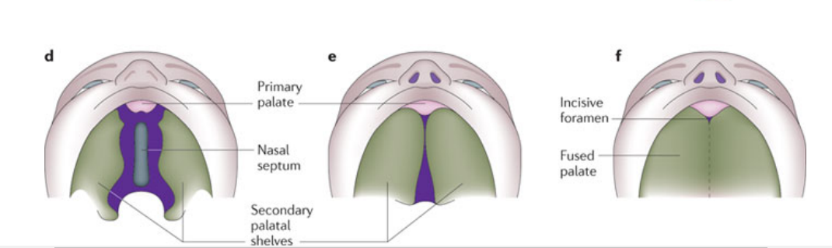

Slide 30
Gingiva, Lips, and Teeth
Until the end of the sixth week, the primordial jaws comprise only masses of mesenchymal tissue with no differentiation of the lips and gingivae.
At the end of the sixth week, a curvilinear thickening of ectoderm, the labiogingival lamina, grows into the underlying mesenchyme.
Most of this lamina degenerates, creating a labiogingival groove or sulcus between the lips and gingivae .

Slide 31
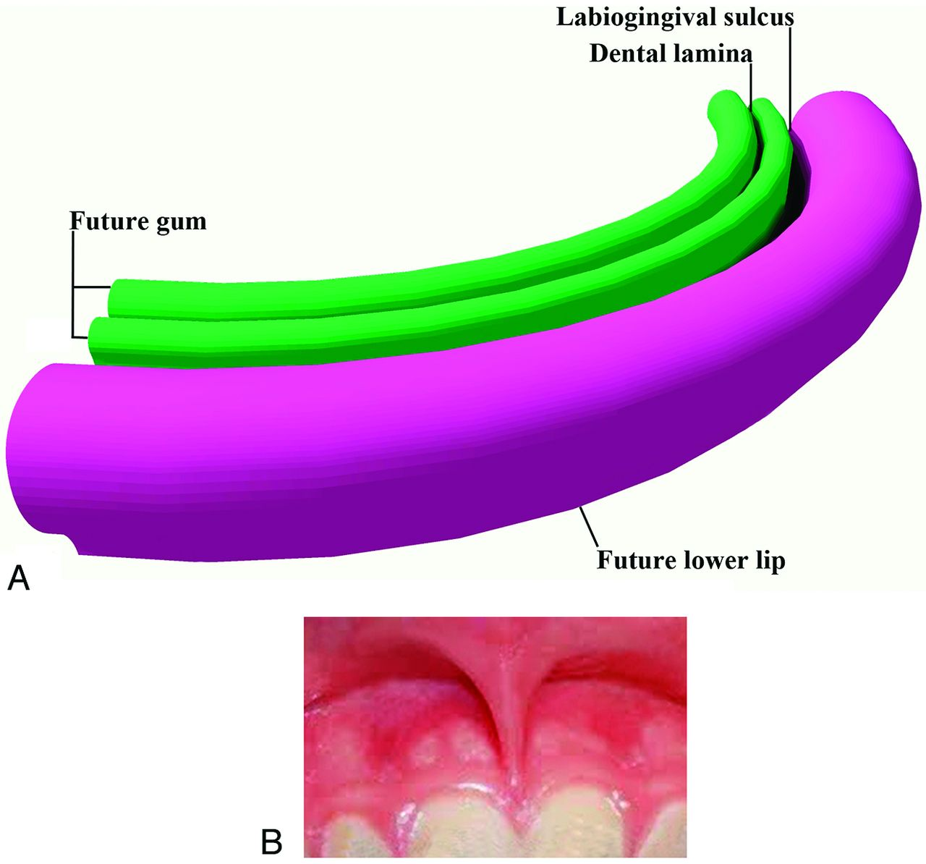
A small midline remnant of the labiogingival lamina persists as the frenulum of the upper lip

Slide 32
Shortly after in the sixth week, a second lamina, the dental lamina, arises in the more buccal margin of the developing gingiva of both jaws.
The dental lamina eventually will give rise to 10 spherical tooth buds that penetrate the mesenchyme of both jaws.
The tooth buds first appear in the anterior mandible followed by the anterior maxilla.
Budding then continues progressively posteriorly to form 10 deciduous teeth in the maxilla.

Slide 33
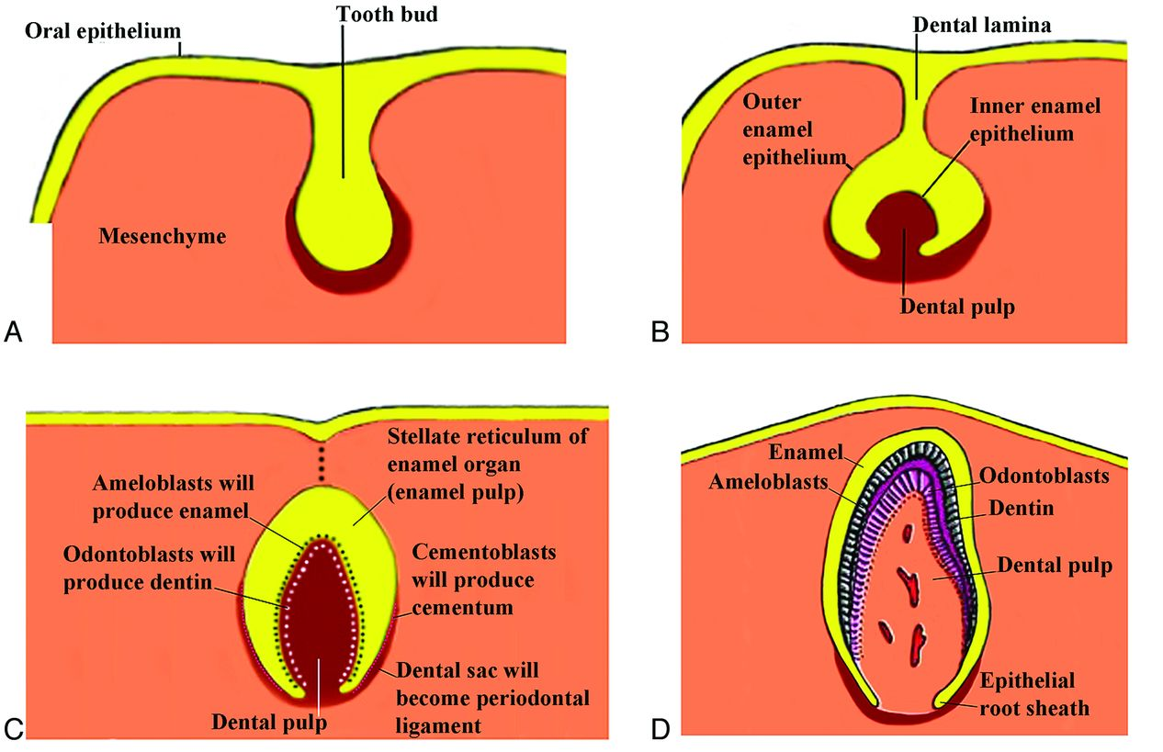
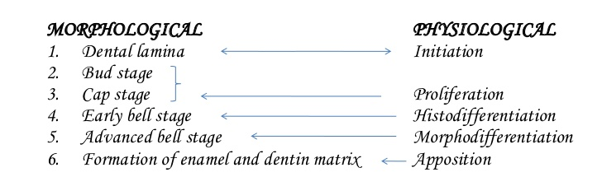

Slide 34
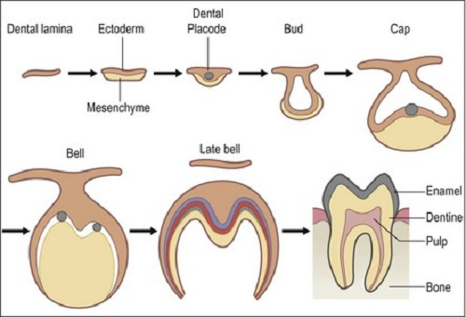
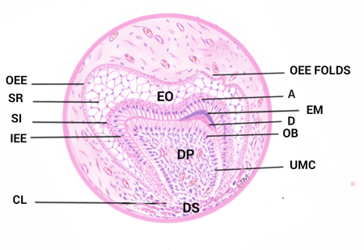
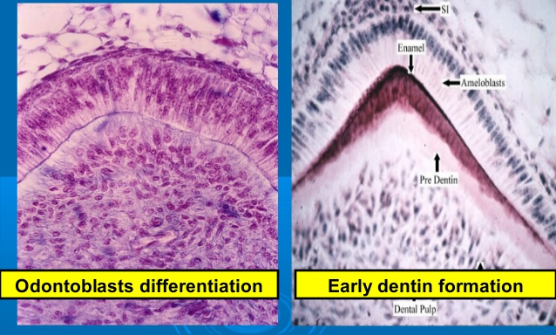

Slide 35
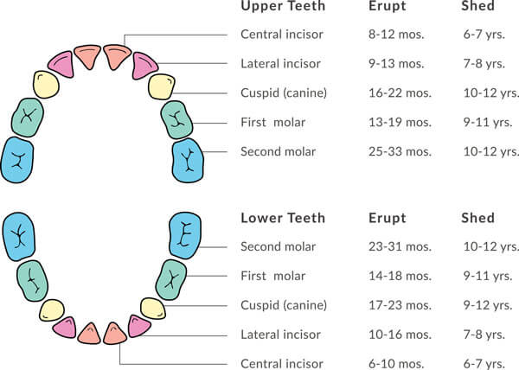
Eruption and shedding time

Slide 36
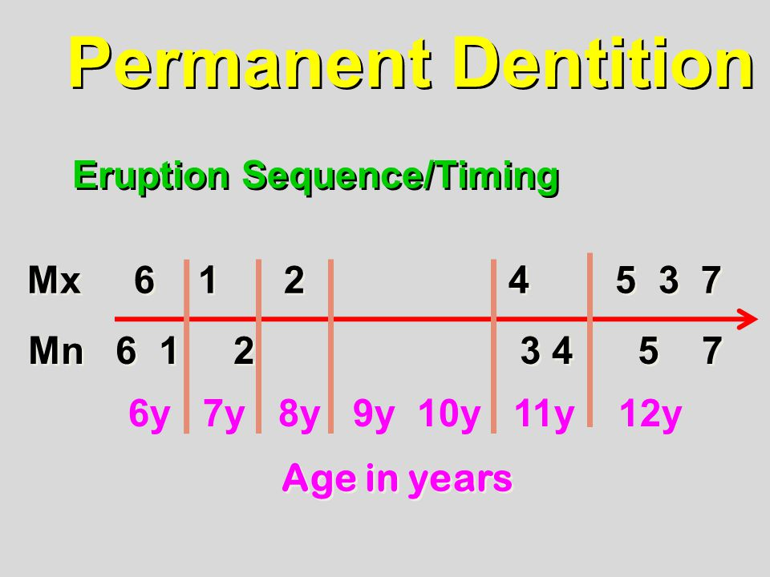
Eruption sequence

Slide 37
Prominence | Derivatives
Frontonasal | Forehead,bridge of nose, medial and lateral nasal prominences
Medial nasal | Philtrum, primary palate, upper 4 incisors and associated jaw
Lateral nasal | Sides of the nose
Maxillary (1st pharyngeal arch) | Cheeks, lateralupperlip, secondary palate, lateral upper jaw
Mandibular (1st pharyngeal arch) | Lower lip and jaw

Slide 38
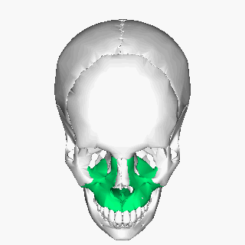
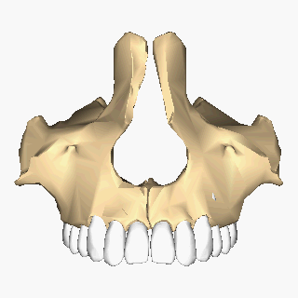
Postnatal growth of maxilla

Slide 39
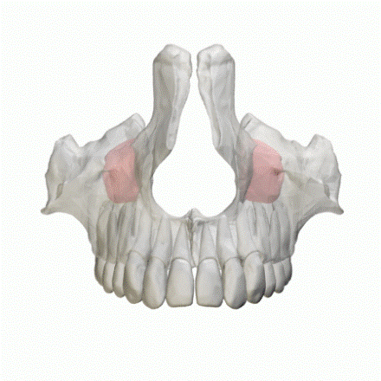
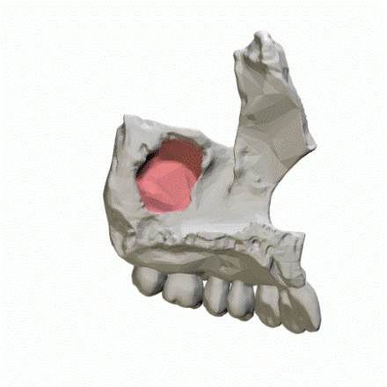
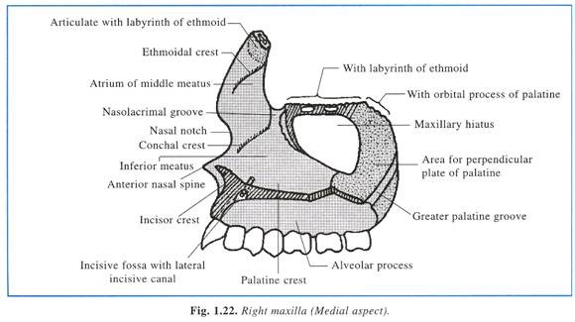
Medial aspect

Slide 40
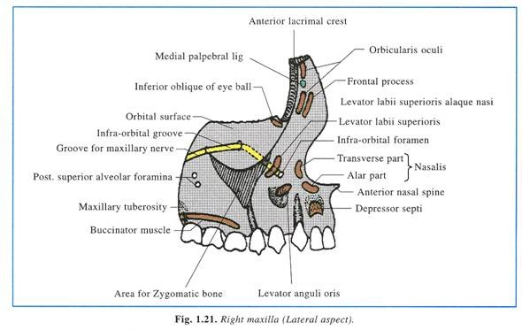
Lateral aspect

Slide 41
Primary ossification center
At the termination of infraorbital nerve
Secondary ossification center
Zygomatic
Orbitonasal,
Nasopalatine,
intermaxllary

Slide 42
PREMAXILLA two centers of ossification
• The palato-facial center: Appear at the end of 6 W IU.
It starts close to the external surface of the nasal capsule, in front
of the anterior superior dental nerve and above the germ of the
lateral deciduous incisor.
From this center bone formation spreads:
• Above the teeth germ of the incisors.
• Then downward behind them, to form the inner wall of their
alveoli& palatalpart of the premaxilla.

Slide 43
The pre vomerine center ( paraseptal center ):
It begins at about 8-9 W IU
Spread along the outer alveolar wall. It is situated beneath the
anterior part of the vomer bone.

Slide 44
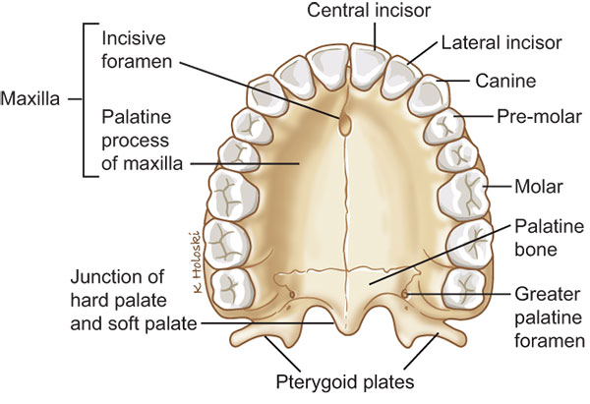
Parts of palate

Slide 45
Post natal growth
Postnatal growth of maxilla is a multifactorial process
According to Moss-
Translation (displacement)
Transposition (surface remodeling)

Slide 46
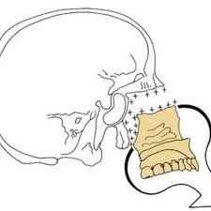
Translation

Slide 47
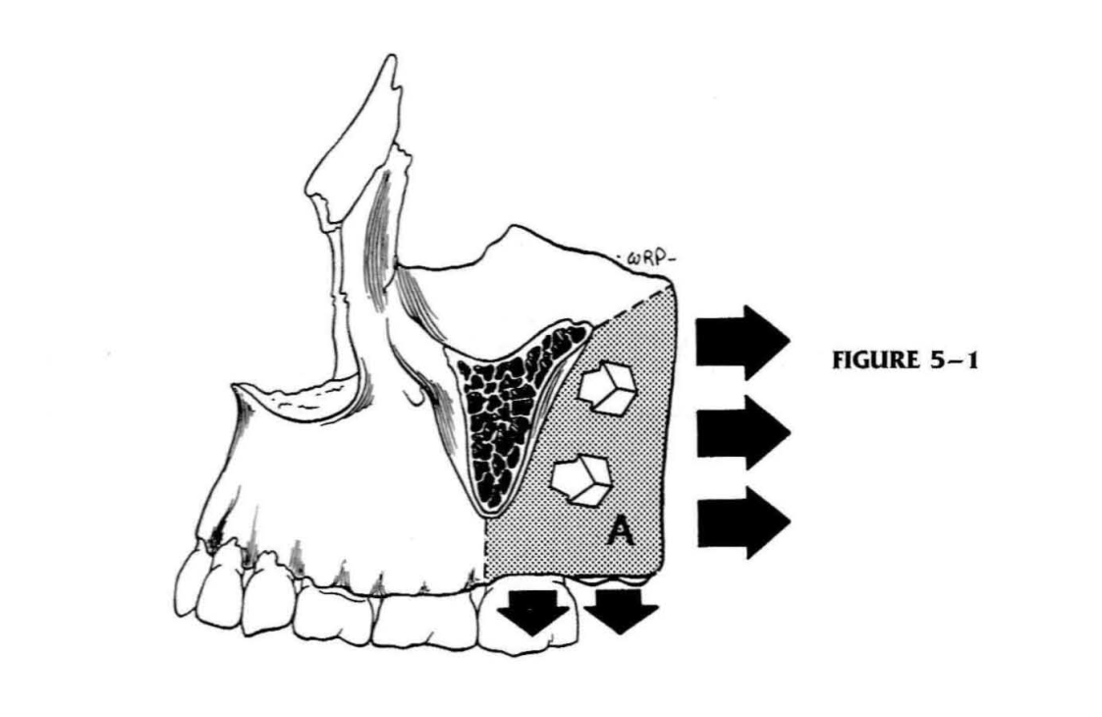
Primary displacement

Slide 48
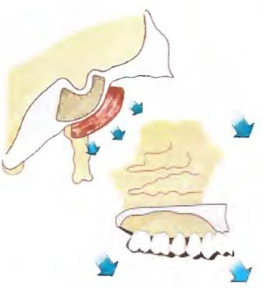
Secondary displacement

Slide 49
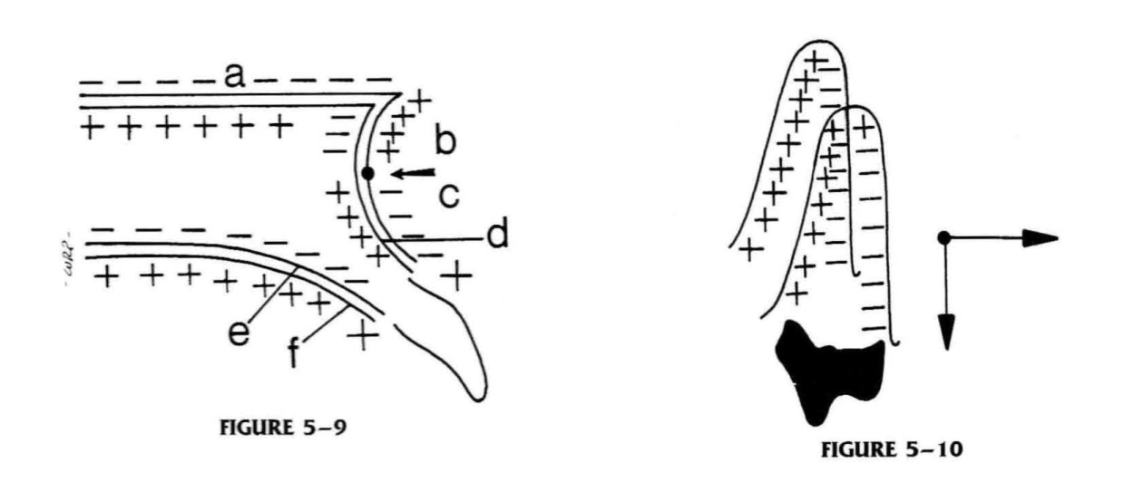
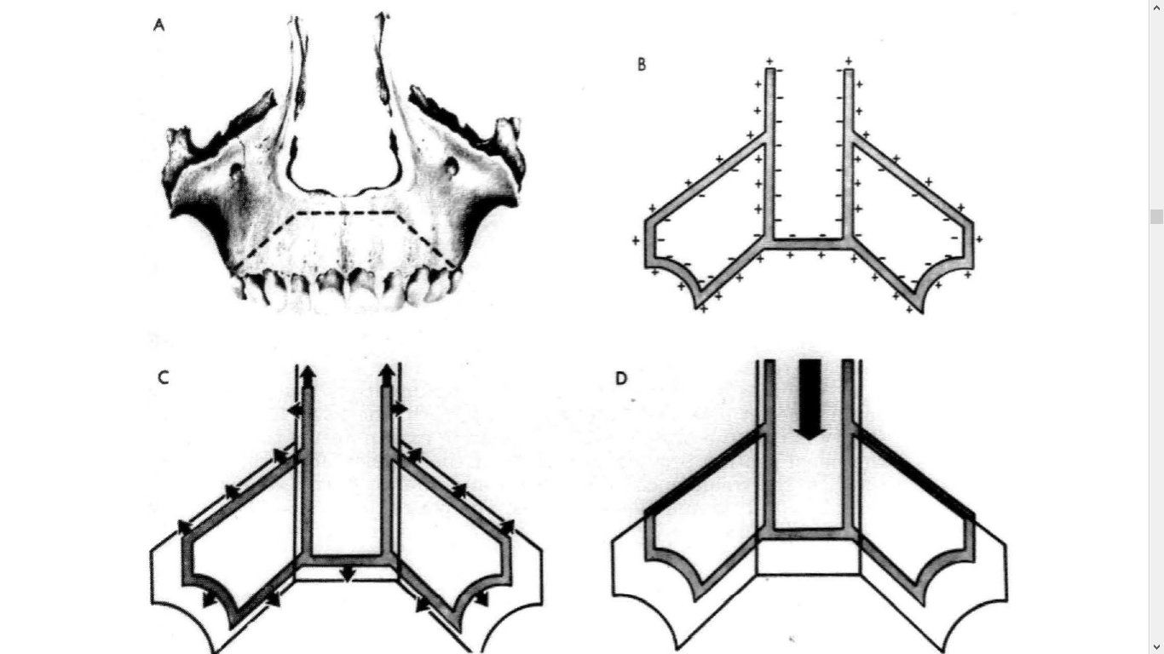

Slide 50
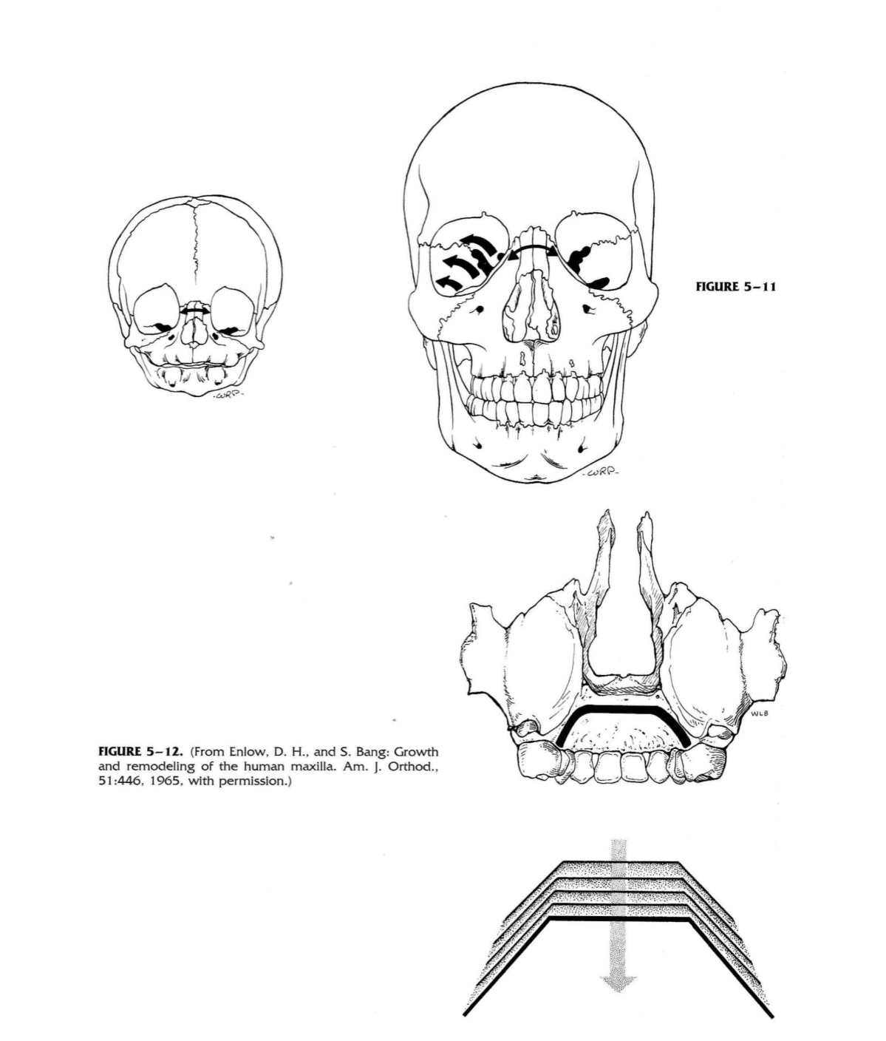

Slide 51
Sicher sutural theory
Growth at sutures
Frontonasal suture,
Frontomaxillary suture
Zygomatico temporal suture,
zygomatico maxillary suture,
Pterygo-palatine suture.

Slide 52
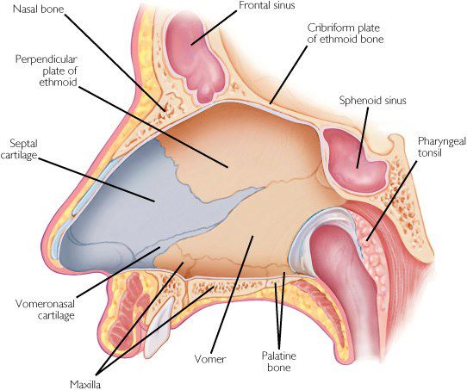
Scotts cartilagenous theory

Slide 53
Develomental disturbences

Slide 54
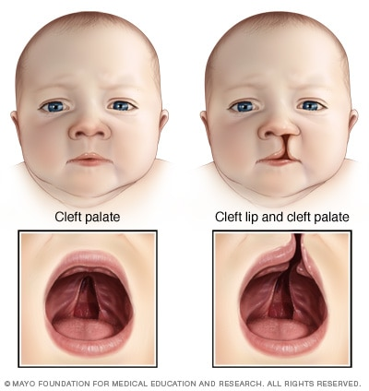
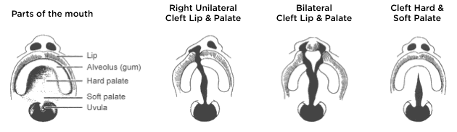
Cleft lip and palate

Slide 55
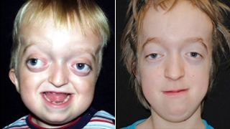
Crouzon syndrome

Slide 56
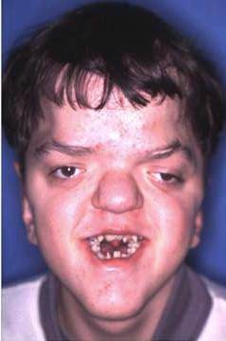
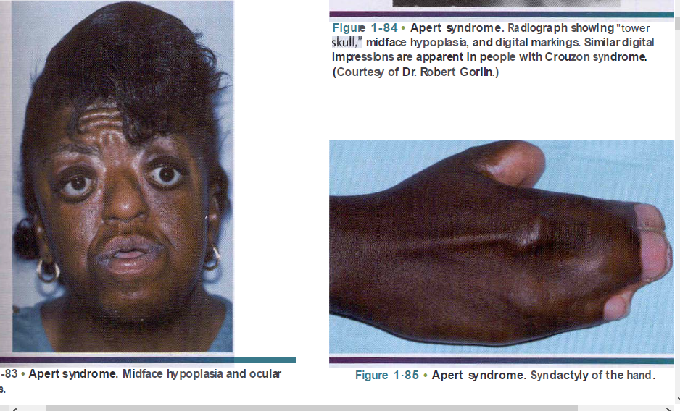
Apert syndrome

Slide 57
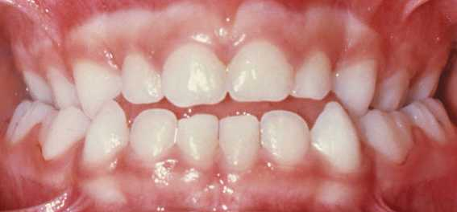





Slide 58





Slide 59


Slide 60
Orthodontic considerations

Slide 61






Expansion

Slide 62

Facemask

Slide 63

NAM

Slide 64

Orthodontic and Dentofacial Orthopedic Considerations in
Apert’s Syndrome-
R. David Rynearson, (Angle Orthod 2000;70:247–252.)

Slide 65


Slide 66
Treatment Plan
1. Pre-orthodontic restorative and periodontal therapy to enhance her oral health.
2. An orthognathic surgical consult due to her severe dentoskeletal discrepancies.
3. Extract maxillary second molars and mandibular left first molar due to nonrestorable caries;
extract the lower right first premolar due to arch length deficiency;
Extract the lower third molars due to horizontal bony impaction.

Slide 67
4. Band and bond both arches using .0180 .0250 edgewise appliances; distalizing the maxillary first molars to create space for the second premolars; create space for mandibular canines and maxillary incisors; level and align both arches.
5. After leveling and aligning, a multisegmental LeFort I maxillary osteotomy to address the transverse, sagittal and coronal skeletal discrepancies.
6. Following orthognathic surgery; continued orthodontics to harmonize the occlusion.
7. Retain using maxillary and mandibular Hawley-type retainers.

Slide 68



Slide 69




Orthodontic treatment of the transposition of a maxillary canine and a first premolar: a case report
Dinoi Maria Teresa, Mummolo Stefano, Monaco Annalisa, Marchetti Enrico, Campanella Vincenzoand Marzo Giuseppe

Slide 70




Slide 71
Conclusion
It is important for the clinician to know the normal and the abnormal ranges of growth for proper diagnosis, treatment planning and selecting appropriate clinicalprocedures.
Orthodontic treatment irrespective of appliance depends to a great extent on adaptive capacity of alveolar process, growth and remodelling.

Slide 72
Reference
1.Enlow’s; Essentials of Facial Growth, 4th Edition.
2. Inderbeer singh; human embryology, seventh edition
3.Langmans medical embryology
4.Orbans oral histology and embryology
5.Oral and maxillofacial pathology Neville-3 edition
6.Craniofacial development -Sperber

Slide 73
7. Illustrated Review of the Embryology and Development of theFacial Region, Part 2: Late Development of the Fetal Face andChanges in the Face from the Newborn to Adulthood
P.M. Som and T.P. Naidich
8.Case Report: Orthodontic and Dentofacial Orthopedic
Considerations in Apert’s Syndrome -R. David Rynearson

Slide 74
Questions
1.Development of palate
2.Prenatal &post natal growth of maxilla
3.Cranifacial anomalies and its treatment
4.Developmental disturbance of palate
5.Developmental disturbance of upperlip
6.Transposition
7.Intrinsic and extrinsic factors influencing growth of jaws
8.Derivatives of brachial arches

