Slide 1
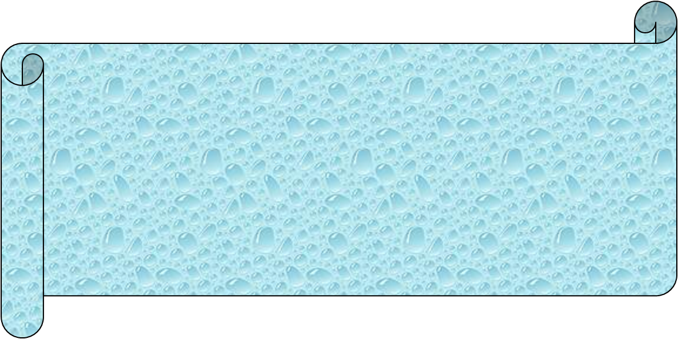
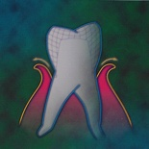
GINGIVAL TISSUE
MANAGEMENT IN RESTORATIVE DENTISTRY

Slide 2
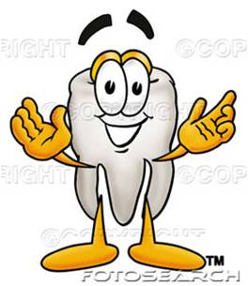
CONTENTS
Introduction
History
Definition
Indications
Contraindications
Classification
Methods of gingival tissue management
Recent advances
Conclusion
References

Slide 3
INTRODUCTION
The success of any restoration depends mainly on healthy gingival tissue surrounding it.
Undulated gingival pathology compromises the marginal fit of a restoration & causes further gingival irritation and recurrent caries.
Complete control of the soft tissues surrounding the operative site creates adequate visibility & improves the working field
A sound periodontium is the foundation for good restorative treatment.

Slide 4
HISTORY
3000 BC BABYLONIANS,SUMERIANS & CHINESE : used herbs with astringent effect to treat inflammed gingiva.
25BC AULUS CORNELIUS CELSUS : used a red hot iron over inflammed gingiva and then smeared them with honey.
1560 AMBROISE PARE : developed surgical gingivectomy for hyperplastic gingival tissue.
1942 ORBAN : introduced 5%paraformaldehyde to remove gingiva.
1960: electrosurgical gingivectomy was introduced .
1980: CO₂ Laser gingivectomy was introduced.

Slide 5
DEFINITION
Gingival displacement is deflection of the marginal gingiva away from a tooth.
Gingival displacement is a process of exposing margins when making impression of prepared teeth.
- Herbert T. Shillinburg

Slide 6
INDICATIONS
1.subgingival extensions of cavity margins.
2.Control of gingiva hemorrhage or fluid flow.
3.Esthetics.
4.Enhancing retention.
5.Recording preparation margins during impression making.
6.Removal of gingival overgrowth.

Slide 7
CONTRAINDICATIONS
Poor oral hygiene
Presence of gingival disease
Gingival recession
Bone loss

Slide 8
CLASSIFICATION
I. According to B.W. Benson (1986):
    1. Mechanical methods.
    2. Mechanico-chemical methods.
    3. Rotary gingival curettage.
    4. Electrosurgical method.
- J Dent 70(11):Nov, 1991
II. According to Rosenteil, Land, Fujimoto:
1.Mechanical,
2.Chemical
3.Surgical
  Electrosurgery
  LASERS

Slide 9
According to Marzouk
1.Physico-mechanical
2.Chemical
3.Electrosurgery
4.Surgery
IV. According to DCNA
1.Mechanical
2.Chemical
3.Surgical
    Rotary gingival curettage.
    Electrosurgical method.
4.Combination of three
- DCNA 2004

Slide 10
V. According toTylman
1.Mechanical
2.Mechanical – chemical
3.surgical
  Electrosurgery
  gingitage

Slide 11
METHODS OF GINGIVAL TISSUE MANAGEMENT
MECHANICAL RETRACTION METHODS:
Mechanically forces the gingiva away from the tooth surface in lateral & apical directions.
Used only when gingiva is healthy, good vascular supply, definite zone of attached gingiva & sufficient bone support.

Slide 12
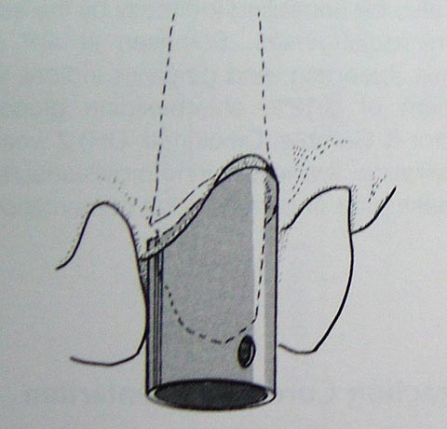
PHYSICO -MECHANICAL METHODS:
  1.COPPER BANDS
  Carry impression material & displace gingiva
INDICATION:
  Used when 1 or 2 preparation margins are not captured in a full arch impression
PLACEMENT TECHNIQUE:
PAGENKOPPS METHOD:
    One end → festooned/trimmed to follow contours of gingiva
    tube is filled with modelling compound/ elastomeric impression & placed along the path of insertion of the tooth preparation
    Occlusal portion closed with temporary stopping & patient is asked to bite on the band for 10 mins.
DISADVANTAGES:
    causes incisional injuries of gingiva
    recession of gingiva: 0.1 to 0.3 mm
    time consuming

Slide 13
2. RUBBER DAM
Developed by SC BARNUM in 1864.
INDICATION:
- Isolation of limited number of teeth prepared (margins not extending sub-gingivally) in one quadrant
CONTRAINDICATIONS:
-Severe cervical extensions
-Inflamed gingiva

Slide 14
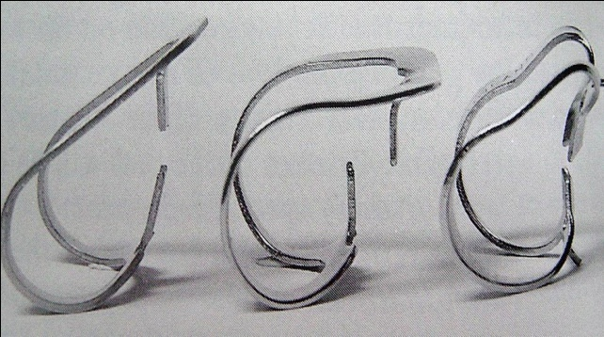
GINGIVAL RETRACTION FEATURES OF RUBBER DAM
  RUBBER DAM SHEET:
    Heavy (0.010 inch), extra heavy (0.012 inch) & special heavy (0.014 inch).
  RETAINERS:
    Gingivally directed prongs (retraction in partially erupted teeth)
    No 212 cervical retainer → MARKLEY (called as Ferrier W.I.CLAMP)
    Position facial jaw gingival to lesion by displacing the soft tissue & Stabilize the retainer with impression compound.
  HOLE SIZE & POSITION:
    Should be punched slightly facial to the arch form for the extension of dam in cervical area in Class V lesions.

Slide 15
Harmful Effects Of Rubber Dam On Gingiva
Movement of retainer on anchor tooth → injures gingiva
Extension of jaws beyond mesial & distal line angles → gingival trauma
Allergic reactions on gingiva
Stabilizing rubber cords → may cause gingival ischemia

Slide 16
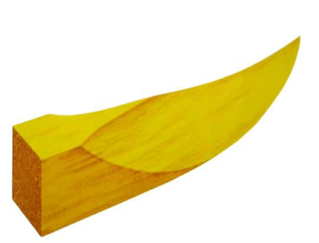
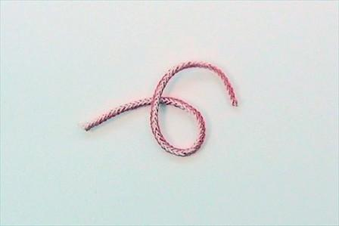
3. WOODEN WEDGES
Depresses inter dental gingiva .
4. NON – IMPREGNATED CORDS
Left for sufficiently long time to obtain sulcus enlargement
> 20 mins → permanent soft tissue changes can occur.
Eg:Sulpak Plain (T) (Aseptico Inc)
Gingi - plain (T,W) (Belport Co)
Retrax (W) (Pascal dental mfg)
Ultrapak (W) (Ultradent)

Slide 17
CHEMICO -MECHANICAL METHODS:
COTTON TWILLS WITH FAST SETTING ZOE:
by Charbeneau
mixing ZnOE into thin consistency & rolling cotton about the diameter of dental floss along with cement
rolls are dried with paper towel to remove excess liquid
→ compactness
place it laterally & not apically
should remain in gingival sulcus for 48hrs
if left for more than 7 days → loss of PDL attachment

Slide 18
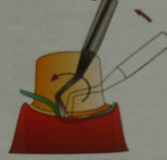
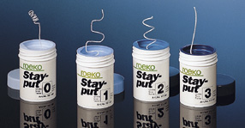
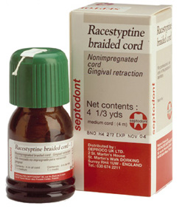
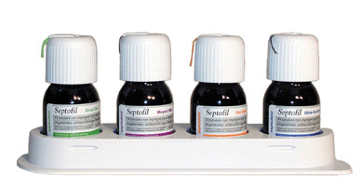
2.RETRACTION CORDS
Readymade cotton/synthetic fibres woven in form of cords
Combines chemical action with pressure packing when impregnated
Enlarges the gingival sulcus, controls fluid seeping from the walls
Displace 0.2 to 0.5 mm of marginal gingiva

Slide 19
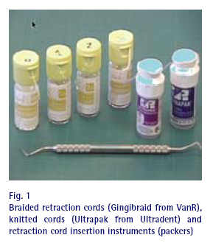
TYPES OF RETRACTION CORDS
i) surface finish: – waxed
– unwaxed
ii) configuration: – braided
– knitted
– plain
iii) thickness: (colour coded)
– black 000 (extra small)
– yellow 00 (small)
– purple 0
– blue 1
– green 2
– red 3 (extra large)
iv) chemical treatment: – non impregnated
– impregnated
v) surface texture: – wet
– dry

Slide 20
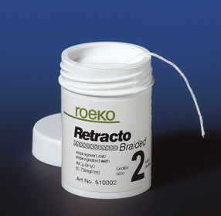
IDEAL REQUIREMENTS OF RETRACTION CORDS
- Dark in color
Safe locally & systemically
Effects should be spontaneously reversible
Absorbent in nature
Available in different diameters
Should not stick to soft tissues
Provide hemostasis
Medicament used should aid in displacement & cause tissue shrinkage.

Slide 21
IMPREGNATED CORDS
Used with chemicals before/after insertion
Earlier caustic chemicals → sulphuric acid, trichloroacetic acid,
45% negatol (metacreolsulfonic acid + formaldehyde)
Disadv: undesirable effects on gingiva
Current chemicals used:
VASOCONSTRICTORS: 8% racemic epinephrine [ 0.04 to 0.2 mg/inch of cord]
ASTRINGENTS/BIOLOGIC FLIUID COAGULANTS:
100% alum solution
aluminium chloride/sulphate
13.3% ferric sulphate
20-60% tannic acid solution
Sympathomimetic amines
TISSUE COAGULANTS: 8% Zinc chloride, silver nitrate

Slide 22
ROLE OF EPINEPHRINE IN IMPREGNATED CORDS
Hemostasis → local vasoconstriction → gingival shrinkage
Buchanan W.T. et.al 1982:
- epinephrine controversy → ↑ Blood Pressure & Heart Rate
Houston JB et.al 1970:
- minimal changes
- worsens in lacerated gingiva
Maximal dose: for healthy adults:0.2mg
for cardiac patients:0.04mg
Eg: Sulpak epinephrine vasoconstrictor (aseptico inc)
Gingipak (belport co inc)

Slide 23
CONTRAINDICATIONS OF EPINEPHRINE IMPREGNATED CORDS
Cardiac patients
Patients taking following drugs:
-Ganglionic blockers
-Epinephrine potentiating drugs
-Rauwolfia compounds
Hyperthyroidism
H/O epinephrine allergy
Diabetics

Slide 24
EPINEPHRINE SYNDROME
Tachycardia
Rapid respiration
Elevated B.P
Anxiety
Post operative depression
Nervousness

Slide 25
ASTRINGENTS/BIOLOGIC FLUID COAGULANTS
1.ALUM(POTASSIUM ALUMINIUM SULPHATE)
Produces similar gingival retraction like epinephrine and it can be left for 20 min. It produces 0.49mm of gingival retraction when compared to 0.51 mm with epinephrine
Mech. of action: precipitates proteins , coagulates blood and tissue fluids .
Eg:sulpak –k - alum

Slide 26
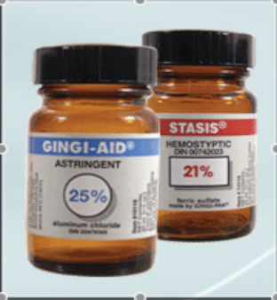
2.ALUMINIUM CHLORIDE / SULPHATE:
Mech.of action: - precipitates proteins , coagulates blood and tissue fluids
Disadv:-gingival irritation
Eg: Aluminium Chloride :
GingiAid (Belport Co.Inc)
Hemodent (Primer)
Gingigel (Van R)
Aluminium Sulphate:
Cutter cord (Miles Dental prod)
Pascord (Pascal Dental Prod)

Slide 27
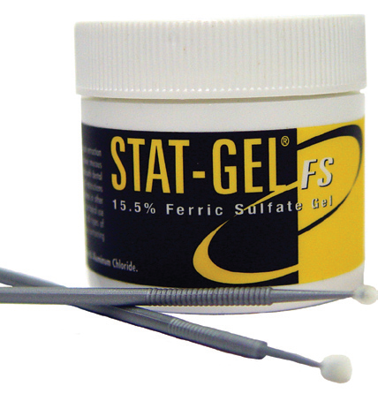
3.FERRIC SULPHATE:
Mech.of action
-agglutinates proteins &forms plug on capillary orifices
13-15% solution
Hemostasis in 15 sec.
Eg. of retraction cords with Fe₂(So₄)₃ :
Ultra pak & Astringedent ( Ultradent)
Disadv: blue–black appearance of gingiva.

Slide 28
4.SYMPATHOMIMETIC AMINES:
Phenylephrine HCl 0.25% ( Neosynephrine Winthrop prod)
Similar effect as alum & epinephrine
Oxymetazoline HCl 0.05% (Afrin, Schering-plough)
Tetrahydrozoline HCl 0.05% (Visine, Pfizer)

Slide 29
TISSUE COAGULANTS
Zinc chloride 8% and silver nitrate act by coagulating the surface layer of sulcular and free gingival epithelium along with any fluid present in sulcus.
Causes ulceration , necrosis and changes in position and contour of free gingiva when applied for prolonged period of time.
Not popularly used.

Slide 30
RETRACTION CORD PLACEMENT TECHNIQUES
Single cord technique
Deknatel technique / double cord technique
Infusion technique
Every other tooth technique
- current concepts in gingival displacement
DCNA 2004

Slide 31
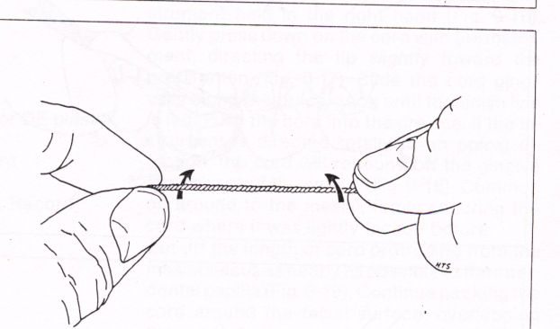
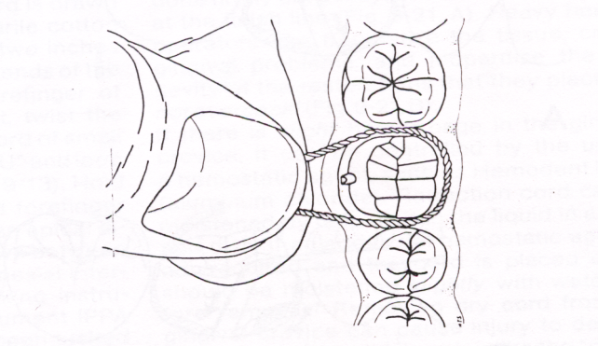
SINGLE CORD TECHNIQUE
Simplest & least traumatic
Indication→ when gingival tissue are healthy & do not bleed.
→ For making impressions for 1 to 3 prepared teeth.
Procedure:
Isolate the quadrant
Grasp the ends of the cord between thumb & forefinger, form a ‘U’ & loop it around the tooth.
Diameter of cord chosen.
Use a size slightly larger.
Suitable length of cord selected

Slide 32
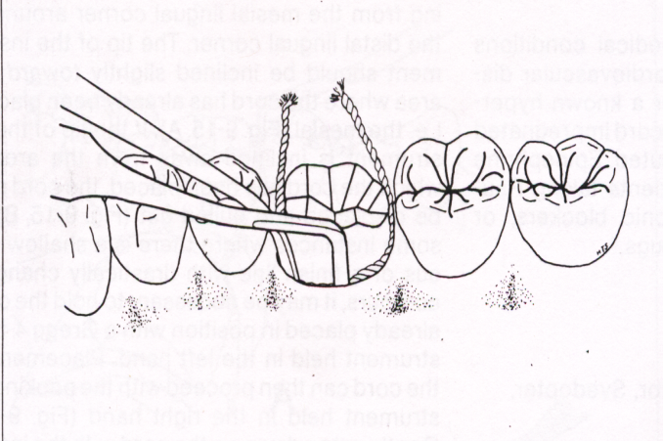
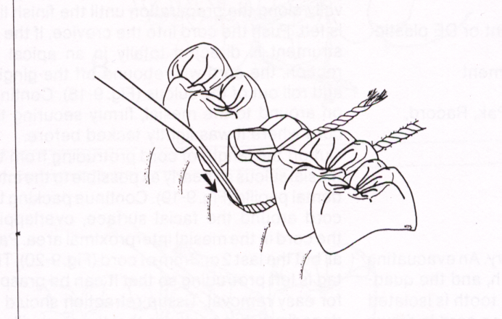
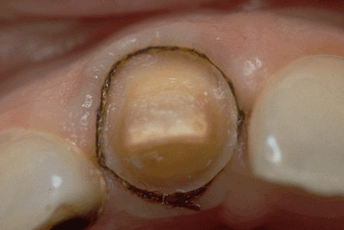
Push cord between tooth & gingiva on mesial aspect with a cord packing instrument
Continue packing on lingual, distal & buccal aspects. Inline tip of instrument towards area where cord has already been placed until it overlaps mesial aspect.
Cut-off the excess cord
Leave 2-3 mm of cord in excess
Kept in place 10min

Slide 33
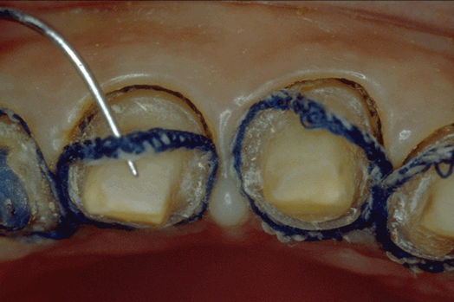
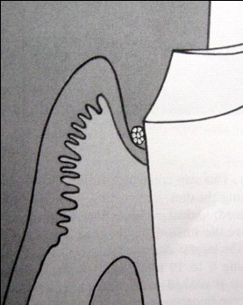
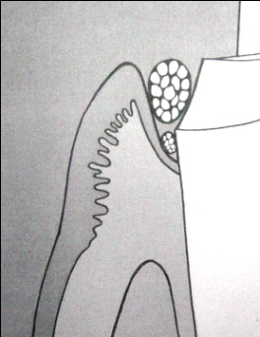
DOUBLE CORD TECHNIQUE
(DEKNATEL TECHNIQUE)
Indication→ gingival inflammation, increased hemorrhage.
Disadv. → gingival healing & re-attachment → unpredictable.
Procedure:
An extra thin esp. # 00 size (0.3 mm diameter) → placed 0.5 mm below finish line for 5 min; reflects marginal gingiva
2nd larger diameter impregnated cord is placed above it for 8-10 mins for hemostasis.
The 2nd cord is removed just before the impression is injected.
1st cord→ removed after temporization & cementation→ to remove any residual impression material in sulcus.

Slide 34
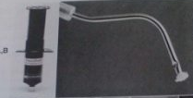
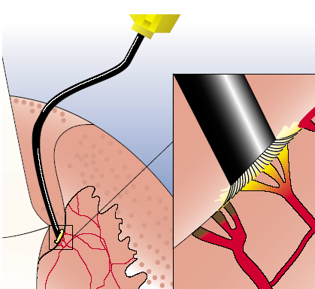
INFUSION TECHNIQUE
In this technique , after tooth preparation , hemorrhage is controlled using a specially designed dentoinfusor with a ferric sulphate medicament.

Slide 35
EVERY OTHER TOOTH TECHNIQUE
This can be used with the single or double cord technique . Retraction cord is placed around the most distal prepared tooth. No cord is placed around the prepared tooth medial to this tooth. Retraction procedures are completed on alternate teeth.

Slide 36
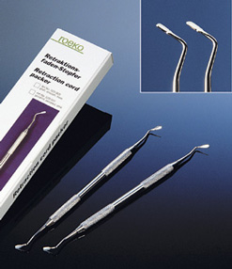
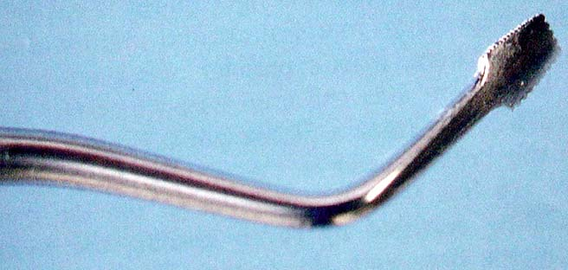
CORD PACKING INSTRUMENTS
Circlet, standard & angled styles
stainless steel thin tip → packs easily into sulcus.
45⁰ offset blade angle → decrease end to end flipping during packing
End of the tip Serrated /plain
Eg: - Ging-pak SS cord pakers
- Silicon-handled nemetz cord pakers
- The stark (GTX coated) cord placer
- Fischer’s ultra pak packers.

Slide 37
ADVANTAGES OF RETRACTION CORDS
Easy to use
Cost effective
Less chairside time
No costly equipment required
Less traumatic

Slide 38
PRECAUTIONS FOR RETRACTION CORDS
Tissue displacement done gently → excess force causes gingival ischemia.
Soak cord slightly in water before removing dry cord can injure epithelial lining
Avoid repeated use of displacement cord in the sulcus → gingival recession.

Slide 39
ROTARY CURETTAGE / GINGETAGE/DENTTAGE
Described by Amsterdam in 1954
Dr. Fred Hansing in 1972 -75 originally developed the techniques for gingival tissue management during cast restoration fabrication by using high speed diamond instrument , which is refined later and was called gingitage.
Rotary curettage is a troughing technique used to produce minimal removal of gingival epithelium during subgingival placement of restoration margins.
Indications:
- Done only in healthy, inflammation free tissue, sulcus depth less than 3mm.

Slide 40
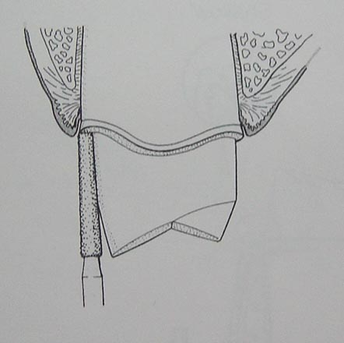
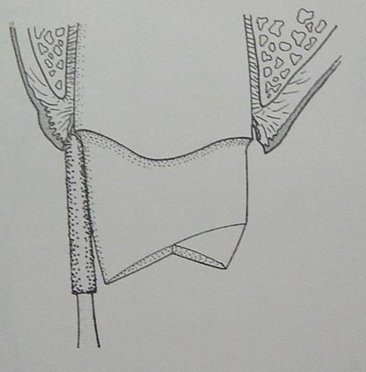
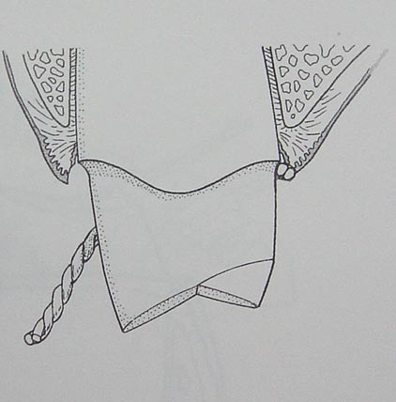
Procedure:
- 1st a flat end torpedo-nosed diamond bur of 150 to 180 grit used→ creates a shoulder finish line at gingival crest.
Next a chamfer bur is used into ½ to 1/3rd the depth of sulcus.
Retraction cord with Alum, Aluminium chloride placed for 4-8 mins → controls hemorrhage.
Adv: - - Used with reversible hydrochloride impressions
- less changes in gingiva height than with cords.
Disadv: - Poor tactile sensation → deepening of sulcus
- Destructs periodontium if used incorrectly.

Slide 41
SURGICAL TECHNIQUES
- Electrosurgery
- Chemosurgery
- Surgical gingivectomy
- Laser surgery

Slide 42
ELECTROSURGERY
  Experiments of D’Arsonvol (1891) demonstrated that electricity at high frequency will pass through a body without producing a shock (pain or muscle spasm), producing instead an increase in the internal temperature of the tissue.
  This discovery was used as the basis for eventual development of electrosurgery.
Used for removing inflamed gingiva & granulation tissue, which is
not near the bone.
Healing is complete within 72 hrs.
- Kalkwarf et al

Slide 43
Indications:
Used for exposure of finish line
Removal of irritated tissue that has proliferated over prepared finish lines
Gingival sulcus enlargement
Crown lengthening procedures
Contraindications:
Patients with cardiac pacemakers
Thin attached gingiva
Precautions
Don’t use in presence of inflammable gases, ethyl chloride etc.

Slide 44
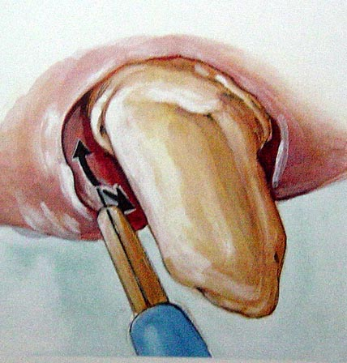
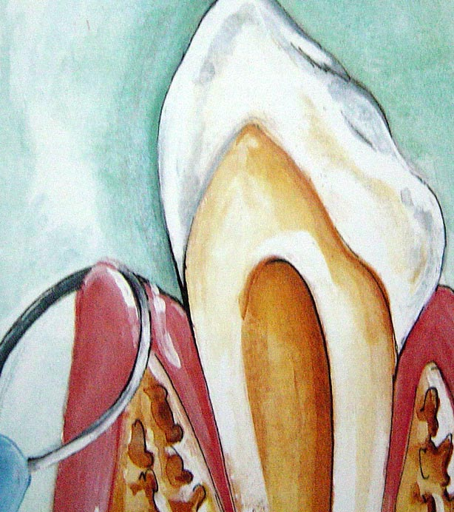
ELECTROSURGICAL TECHNIQUE
Administer LA
Use fully rectified wave form & straight wire or vari -tip to remove tissue
If tissue is close to bone→ use filtered waveform
Extremely hyperaemic tissue → use loop rather than straight wire
For gingivoplasty → loop with fully rectified waveform.

Slide 45
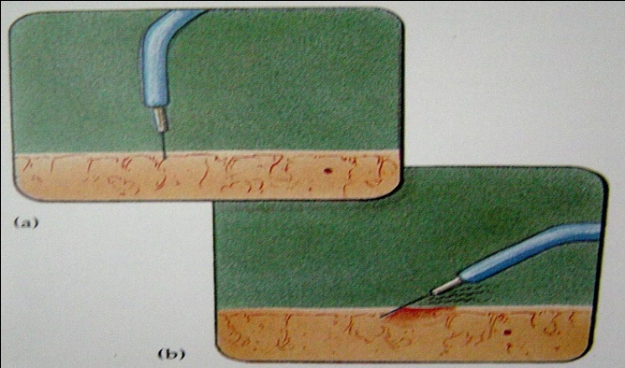
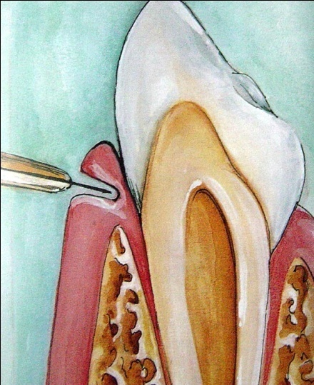
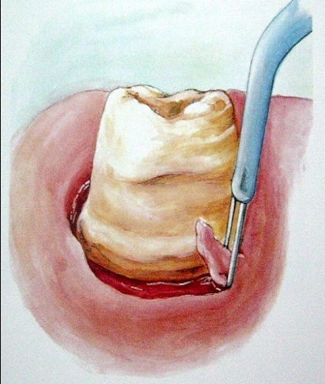
Gentle paint-brush stroke
Place electrode perpendicular to tissue to concentrate the signals
Never remain motion less→ increases lateral heat
Attempt 3 or 4 shallow cuts instead of one deep incision.
After tissue removal → use pencil point or ball –shaped electrode tip for hemostasis.

Slide 46
ADVANTAGES
Clear operating area without bleeding.
Healing by primary intention.
Lack of pressure to incise tissue.
less tissue loss after healing

Slide 47
DISADVANTAGES
Unpleasant odour.
Slight loss of crestal bone (Kamansky F.W. et al)
Not suitable for thin gingiva.

Slide 48
CHEMOSURGERY
5 % paraformaldehyde & potassium hydroxide
Disadv:
Uncontrolled depth of action
Gingival remodelling not effective
Slower re- epithelialization & healing.

Slide 49
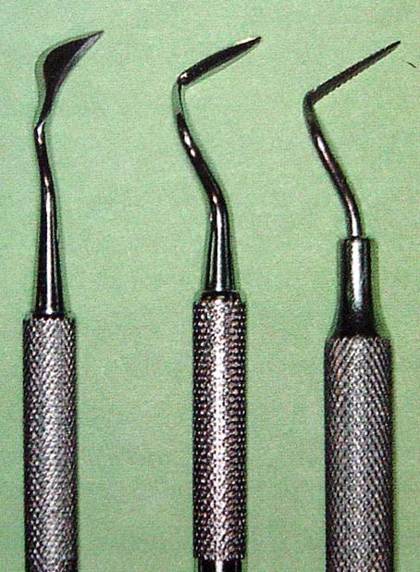
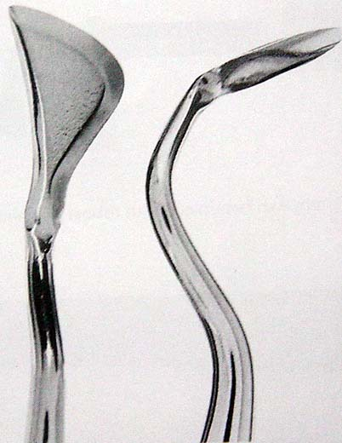
SURGICAL GINGIVECTOMY
Indications : - Gingival pockets, suprabony pockets & gingival enlargement
Contraindications: -Aesthetic considerations
-Bone loss
Instruments used:-Kirkland knives
-Orban periodontal knives
-# 11, & #12 BP blades
-Scissors

Slide 50
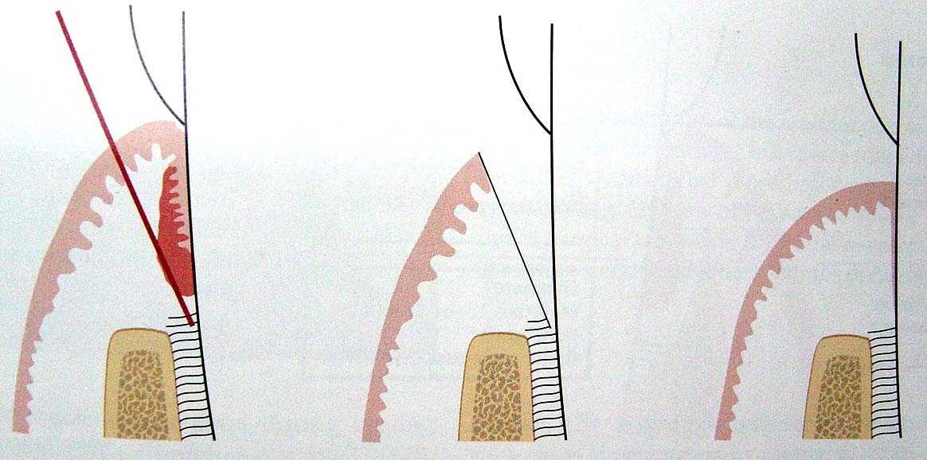
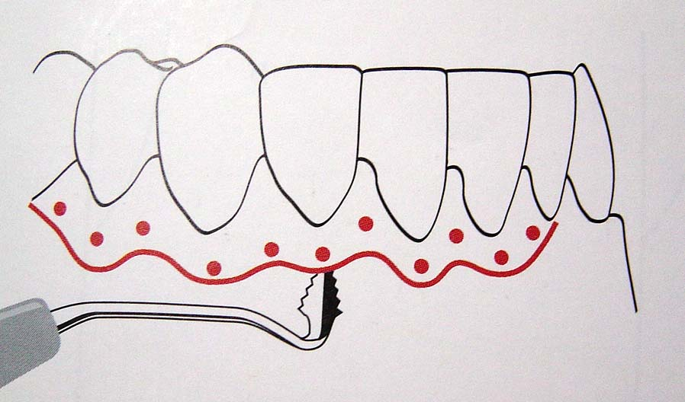
SURGICAL GINGIVECTOMY TECHNIQUE
Access & trace the outline of the area to be excised.
Kirkland knives→ incisions on facial & lingual aspects
Orban knives→ interdental incisions

Slide 51
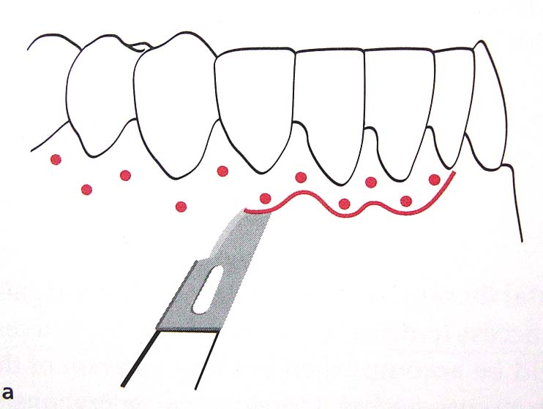
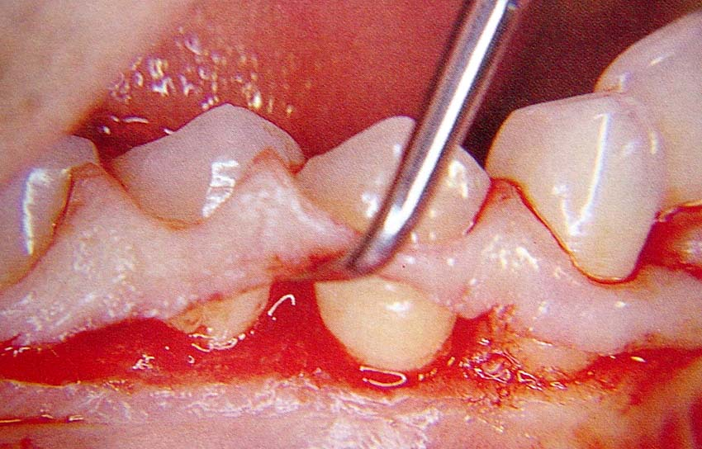
Incisions should not expose the bone, but close enough to remove soft tissue
Incisions (discontinuous / continuous) bevelled at 45⁰ to tooth surface.
Excise the tissue, currette the granulation tissue
Cover area with surgical pack.

Slide 52
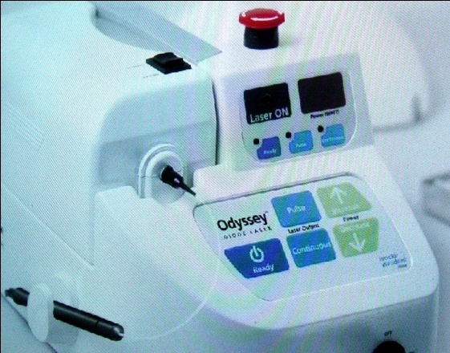
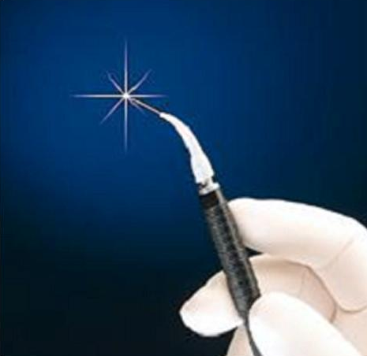
LASER SURGERY
Developed by Theodore H. Maiman in 1960 & improved by Townes 1964.
1st laser developed for dentistry → by Patel in 1964 ( CO₂ laser).
Types of lasers used in dentistry:
a) Carbondioxide
b) Argon
c) Neodymium : Yttrium –
Aluminium – Garnet

Slide 53
Pick in 1985 → used for gingival tissue management.
Indicated in gingival hyperplasia associated with systemic hemorragic disorder
Nd – YAG LASERS are recommended for gingival tissue retraction and excision .
LASERS work through photoablation and produce completely bloodless incision , controlled tissue removal and rapid , pain free healing. There is no need for anaesthesia.

Slide 54
ADVANTAGES & DISADVANTAGES OF LASERS
Adv:
-Seal small blood vessels & lymphatics < 0.5 mm diameter
-Precise incision
-Improved visibility
-Minimal tissue damage
-decreased swelling post operatively
Disadv:
-Delayed healing than with scalpel
- traumatizes bone & dentin
- if beam is reflected by operative instruments, neighbouring tissues are injured.
- very expensive.

Slide 55
RECENT ADVANCES

Slide 56
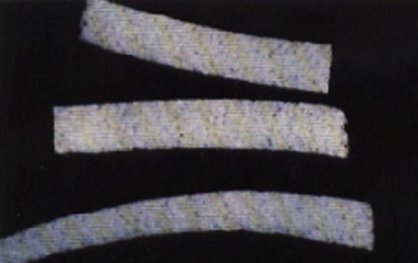
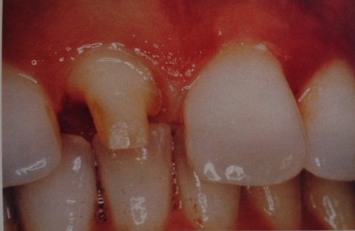
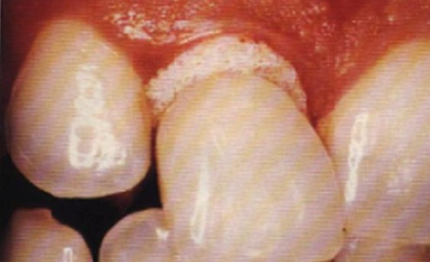
NEWER MATERIALS FOR RETRACTION
MEROCEL (MEROCEL CO):
- sponge like synthetic polymer (2mm thick)
- made of hydroxylate polyvinyl acetate
- expands on insertion
- minimal trauma & effective
Procedure:
- After tooth preparation make provisional restoration & remove it
- place Merocel into Gingival sulcus &
place provisional restoration.
- ask patient to bite on it for 10-15 mins
- Merocel exerts pressure on fluid absorption & retracts.
Tissue Management with a new gingival retraction material: A preliminary clinical report. J P D, March 1996 Vol 75, No.3, 242-247

Slide 57
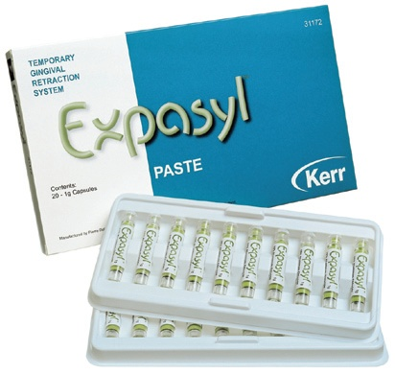
EXPASYL (KERR DENTAL):
- paste containing Aluminium Chloride(hemostat) & white clay
- injected into sulcus; deflects gingiva & causes hemostasis
- Material is dispensed directly into the sulcus, left for 2 minutes, and then rinsed, leaving behind a dry field and retracted gingival tissue
- rapid action (sulcus opening of 0.5mm in 2mins) & painless

Slide 58
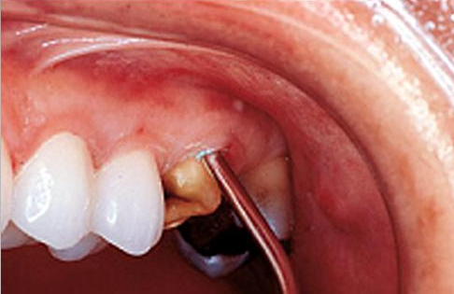
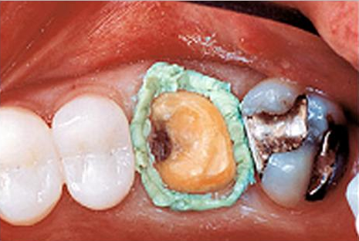
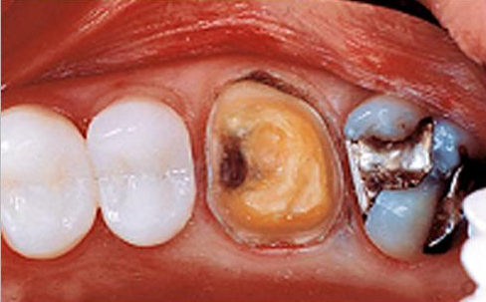

Slide 59


EXPANDING POLY VINYL SILOXANE GELS :
(MAGIC FOAM CORD)
Expanding vinyl polysiloxane material
Less traumatic to the tissues than retraction cord.

Slide 60






Syringed around the crown preparation margins and a cap (Comprecap) is placed to maintain pressure.

Slide 61


DRAWBACKS
Tips too large to adequately inject the material into the sulcus .
Hemostasis must be established prior to the use of Magic FoamCord, significantly reducing its clinical efficiency .

Slide 62

GINGITRAC
a hand-held 2.5 ml syringe.
The two-step procedure -patients bite pressure to push astringent GingiTrac into the sulcus without packing cord.

Slide 63
CONCLUSION
Gingival tissue management holds an aesthetic & functional role in restorative dentistry .
Thus the respectful maintenance of healthy biological relational conditions should always take precedence over aesthetic relationships for optimal efficiency of any restorative procedure.
Management of gingival tissues is very important for the long term success of restorative treatment. Sound periodontal condition enhances both the longevity and esthetics of restorative treatment.

Slide 64
REFERENCES
Text book of Operative Dentistry – Vimal.K.Sikri
Aesthetic Dentistry ---- Asccheim,Dale
Fundamentals of fixed Prosthodontics – Herbert T. Shillinburg
Clinical Periodontology – Fermin A Carranza
Marzouk
Charbeneau
Sturdvents
Summitt

Slide 65
REFERENCES
Clinical trial of gingival retraction cords J Prosthet Dent 1999:81:258
Current methods of finish line exposure by practicing prosthodontists J Prosthodont 1999:8:163
Tissue management with a new gingival retraction material: a preliminary clinical report . J Prosthet Dent: 1996;75:242
A clinical study on gingival retraction .J. Perio. 2003 vol 3
Current concepts in gingival displacement.DCNA 48(2004);433-444

Slide 66

THANK U

