Slide 1
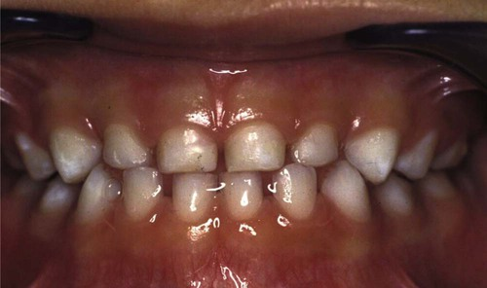
Gingival Disease in Childhood

Slide 2

Periodontium of the Primary Dentition
Periodontal Changes Associated with Normal Development
Gingival Diseases of Childhood
Periodontal Diseases of Childhood
Gingival Manifestation of Systemic Disease in Children
Oral Mucosa in Childhood Diseases
Therapeutic Considerations for Pediatric Patients
Conclusions

Slide 3
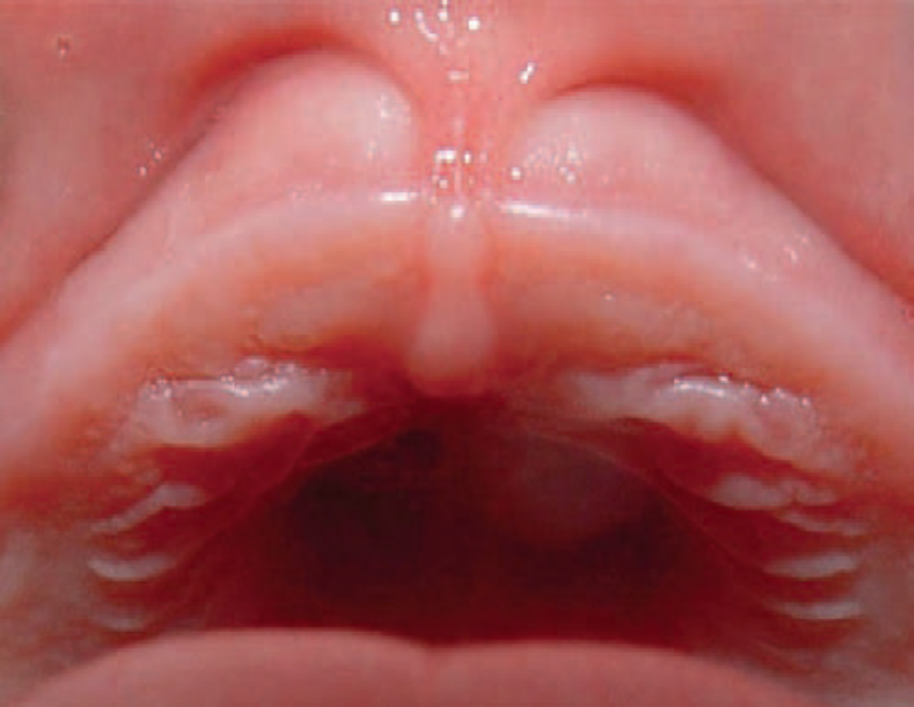
In the edentulous infant, the gingival tissues have thick gingival mucosa and segmentations that correspond with the primary buds.
A high labial frenum attachment is a normal finding in almost 85% of infants; it may diminish in size with normal development.
During the primary dentition stage, the normal gingiva continues to be somewhat different from that found in adults.
The tissues are pale pink, but they are pink to a lesser degree than the attached gingiva of adults because the thinness of the keratinized layer allows the underlying vessels in children to be more visible.
Stippling appears at about 3 years of age and has been reported for 56% of children between 3 and 10 years of age.
The interdental gingiva is broad buccolingually and narrow mesiodistally, which is consistent with the morphology of the primary dentition. Its structure and composition are similar to those of the adult gingiva

Slide 4
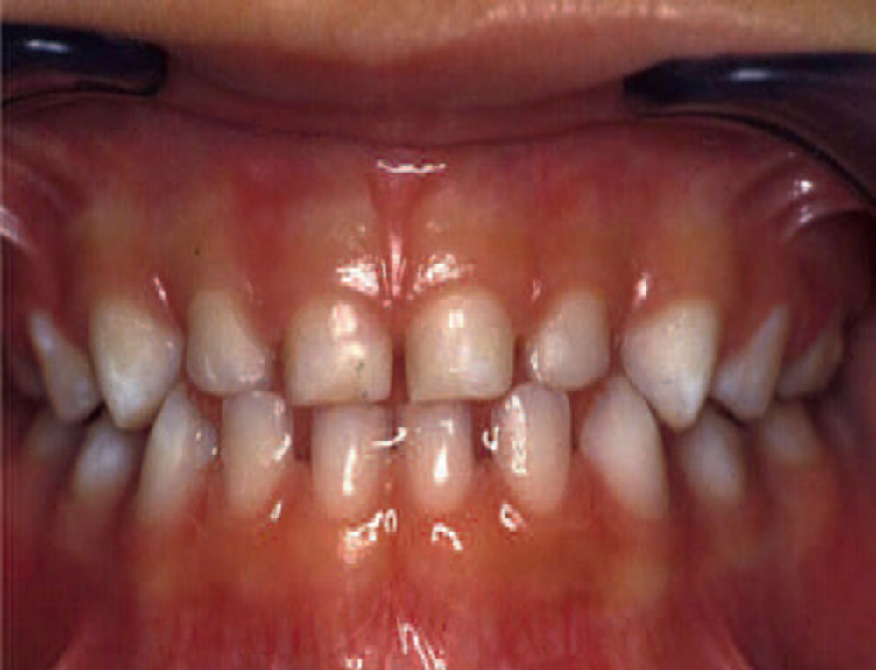
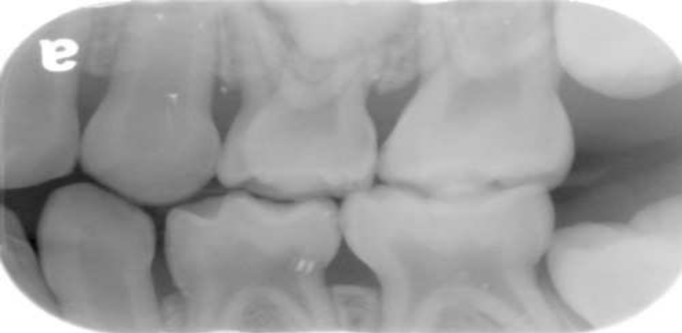
Gingival sulcular depth is shallower in the primary dentition than in the permanent dentition.
The attached gingiva varies in width antero posteriorly, with a range of 3 to 6 mm.
The lingual attached gingiva shows an inverse relationship, with an increase in width from anterior to posterior.
The gingival width normally increases with age as children transition from the primary to the permanent dentition.
The junctional epithelium is thicker in the primary dentition than in the permanent dentition, which is thought to reduce the permeability of the tissues to bacterial toxins.
Radiographically, the lamina dura is prominent in the primary dentition, with a wider periodontal space than in the permanent dentition.
The marrow spaces of the bone are larger, and the crests of the interdental bony septa are flat, with bony crests within 1 to 2 mm of the cementoenamel junction.

Slide 5
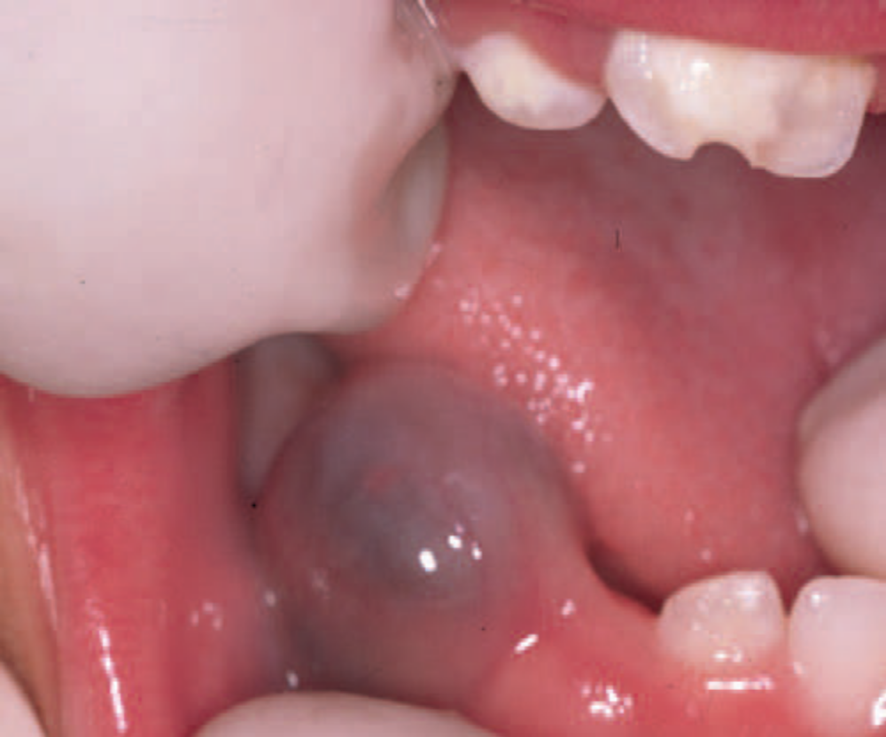
Periodontal Changes Associated With normal Development
Tooth Eruption
Before the eruption of a primary or permanent tooth, the gingiva reveals a bulge that is firm and pink or blanched as a result of the underlying tooth crown.
An eruption cyst occasionally is evident. This fluctuant mass can be filled with blood, as a bluish or deep red enlargement of the gingiva over the erupting tooth .
The most common sites of these cysts are the primary first molars and the permanent first molars.
During the period of active tooth eruption, it is normal for the marginal gingiva that surrounds partially erupted teeth to appear prominent; this is most evident in the maxillary anterior region. The prominence is caused by the height of the contour of the erupting tooth and mild inflammation from mastication.
Poor oral hygiene can contribute to the development of significant gingivitis in unprotected gingival areas

Slide 6

  Teething
The timing of primary incisor eruption (i.e., 5 to 12 months of age) coincides with the diminution of the passive humoral immunity conferred by the transfer of maternal antibodies through the placenta and establishment of the child’s own immunity.
Pain is a common feature of teething as reported by parents and some health care providers.
The tooth does not cause the pain; rather, the follicle, which is a rich source of eicosanoids, cytokines, and growth factors, stimulate a localized inflammatory response

Slide 7
Primary Tooth Exfoliation
As with tooth eruption, the process of tooth exfoliation involves changes in the periodontium.
The depth of the gingival sulcus increases as the junctional epithelium migrates down the resorbing root of an exfoliating tooth.
Changes in the permeability and integrity of the junctional epithelium can make the exfoliating tooth more susceptible to inflammation.
During the process of exfoliation, teeth can change position, leading to changes in occlusion.
Malalignment caused by spacing and changes in skeletal relationships related to erupting teeth can contribute to significant trauma of the periodontal structures.
In most patients, these injuries spontaneously resolve as the teeth exfoliate, erupt, and align through the normal growth and development processes.

Slide 8
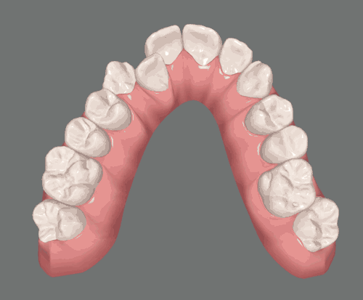
Other Developmental Issues
Relation of Periodontal Status to Malocclusion
Data indicate an association between abnormal tooth position and gingivitis.
Crowding in the mixed dentition can often make plaque and food removal more difficult, increasing the likelihood of gingivitis.
Severe changes include gingival enlargement, discoloration, occasional ulceration, and formation of deep pockets or pseudo pockets.
Gingival health usually can be restored with orthodontic correction.

Slide 9
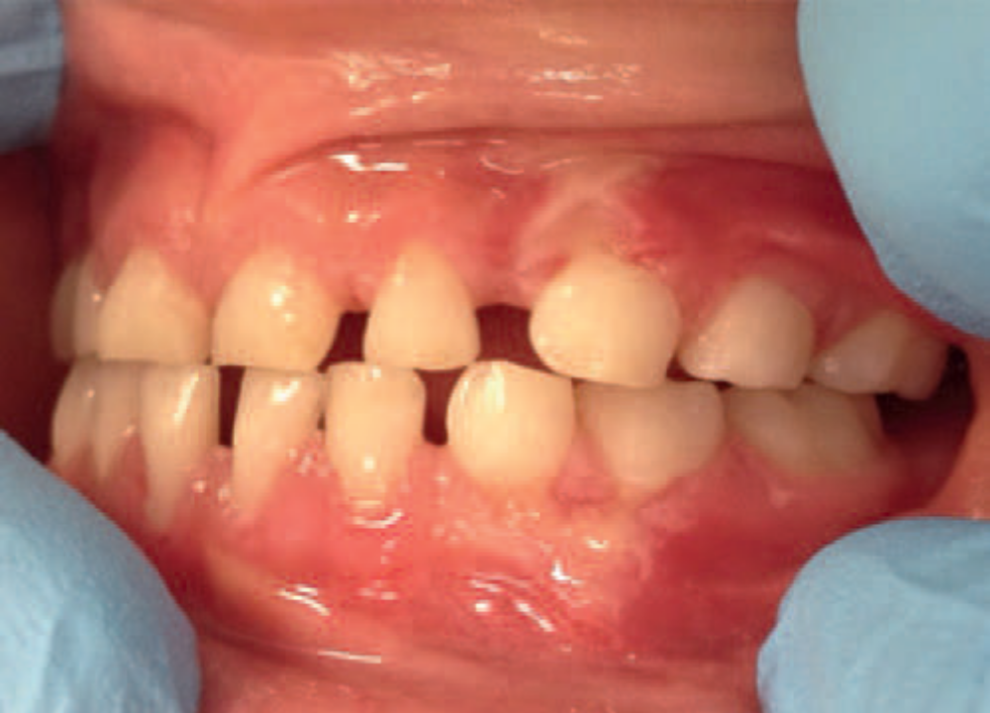
Mucogingival Problems
Evidence suggests that some mucogingival problems start during the primary dentition as a consequence of developmental aberrations in eruption and deficiencies in the thickness of the periodontium.
A high frenum attachment may also be a factor in the development of mucogingival problems if there is excess tension at the marginal tissues.
Orthodontic treatment and realignment may be necessary to protect the integrity of the attached gingiva.
Because the width of the attached gingiva increases with age, any of these problems may resolve spontaneously.
During the mixed dentition, recession is most often found on the facial aspect of mandibular permanent incisors due to rotations or labial positioning related to space problems.
The maxillary canine region is prone to localized gingival recession.
Recession also can be associated with an anterior open bite as a result of the labial inclination of the teeth

Slide 10
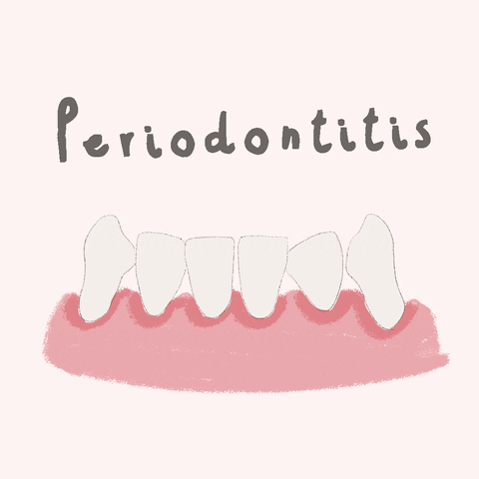
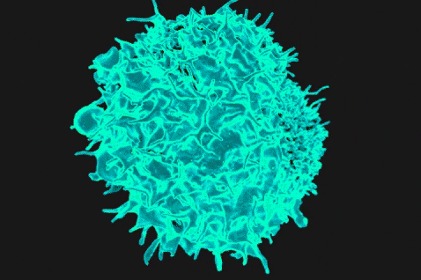
Gingival Diseases of Childhood
Plaque-Induced Gingival Disease
Clinical Features
The most prevalent type of gingival disease in childhood is chronic marginal gingivitis .
Red, linear inflammation is accompanied by underlying chronic changes, including swelling, increased vascularization, and hyperplasia.
Bleeding and increased pocket depth are not found as often in children as in adults, but they may be observed if severe gingival hypertrophy or hyperplasia occur.
Chronic gingivitis in children is characterized by a loss of collagen in the area around the junctional epithelium and an infiltrate that consists mostly of lymphocytes, with small numbers of polymorphonuclear leukocytes, plasma cells, monocytes, and mast cells.
Unlike the adult inflammatory response, gingivitis in children is dominated by T lymphocytes, with few B lymphocytes and plasma cells in the infiltrate. This difference may explain why gingivitis in
children rarely progresses to periodontitis

Slide 11
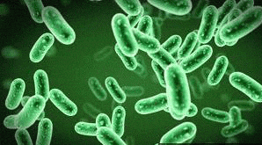
Microbiology of Disease
The composition of the oral microlora changes as the child matures.
Sixty-eight percent were infected with Porphyromonas gingivalis, and 20% had Tannerella forsythia (previously called Bacteroides forsythus).
In a similar study, 60% of children between the ages of 2 and 18 years had detectable levels of P. gingivalis in their plaque, and 75% showed similar levels of Actinobacillus actinomycetemcomitans.
P. gingivalis was most strongly associated with the progression of gingivitis and the onset of periodontitis in otherwise healthy children.
Pediatric gingivitis models have demonstrated increased subgingival levels of Actinomyces, Capnocytophaga, Leptotrichia, and Selenomonas—pathogens usually not seen in adult gingivitis— thereby raising interest in their potential role in the cause of childhood gingivitis.

Slide 12
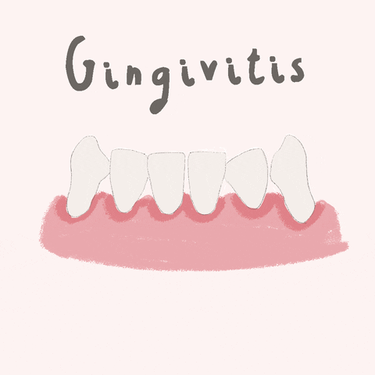
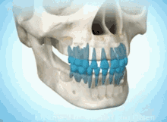
Eruption Gingivitis
Gingivitis associated with tooth eruption is so common that the term eruption gingivitis has come into frequent use.
Although tooth eruption does not directly cause gingivitis, inflammation associated with plaque accumulation around erupting teeth, perhaps due to discomfort caused by brushing these friable areas, may contribute to gingivitis.
The gingiva around erupting teeth can appear reddened because gingival margins have not yet keratinized fully and sulcus development is incomplete.
Exfoliating and severely carious primary teeth often contribute to gingivitis caused by plaque accumulation as a result of pain during brushing or food impaction in areas of cavitation.
As a normal part of exfoliation, the junctional epithelium migrates under the resorbing tooth, thereby increasing pocket depth and potentially creating a niche for pathogenic bacteria.

Slide 13
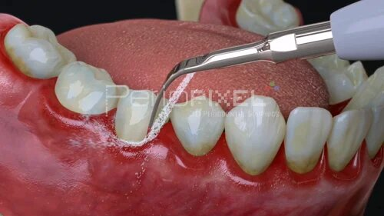
Puberty Gingivitis
The incidence of marginal gingivitis increases as a child matures, peaking when he or she is 9 to 14 years old and then decreasing
slightly after puberty.
Gingival disease that behaves in such a manner is often referred to as pubertal (or puberty) gingivitis.
The altered gingival response during this developmental stage is thought to be the result of hormonal changes that magnify the vascular and inflammatory response to dental plaque and that modify the reactions of dental plaque microbes
The most frequent manifestation of puberty gingivitis is bleeding
Inflammatory gingival enlargement may also occur in males and females, but it typically subsides after puberty.
and inflammation in interproximal areas.

Slide 14
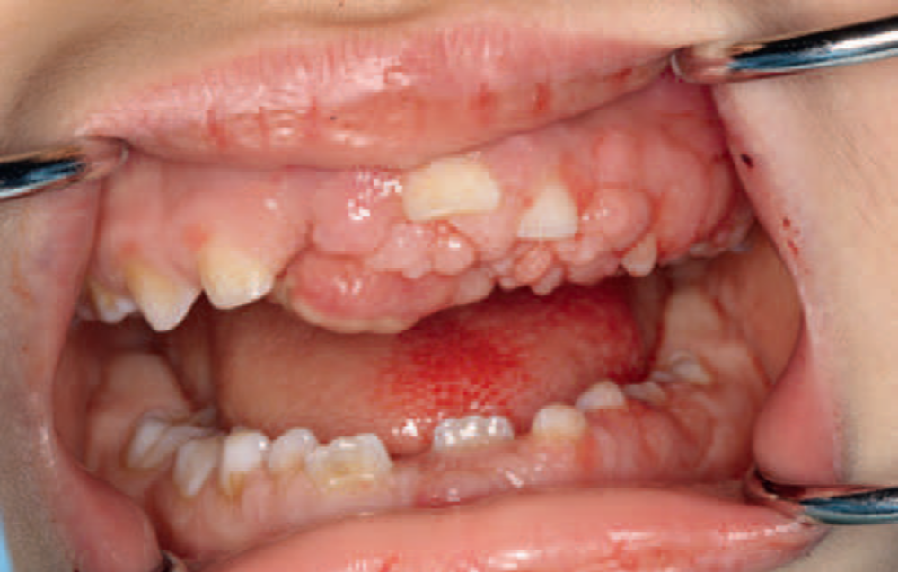
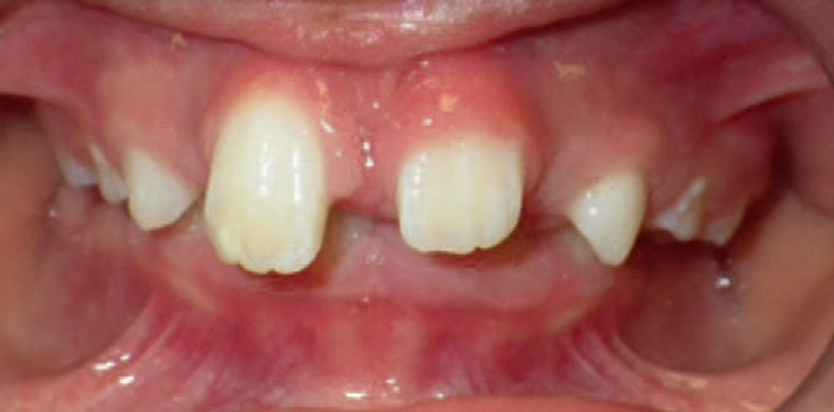
Drug-Induced Gingival Enlargement
Gingival enlargement can result from the use of certain drugs.
Cyclosporine, phenytoin, and calcium channel blockers,
which are used to treat conditions that are encountered during childhood (e.g., organ transplantation, epilepsy, cardiac anomalies), increase the prevalence of gingival enlargement .
A randomized clinical trial found an interesting and significant decrease in the incidence (21%) of phenytoin-induced gingival hyperplasia in children with epilepsy taking oral folic acid supplementation (0.5 mg/day) compared with the control group (88%).

Slide 15
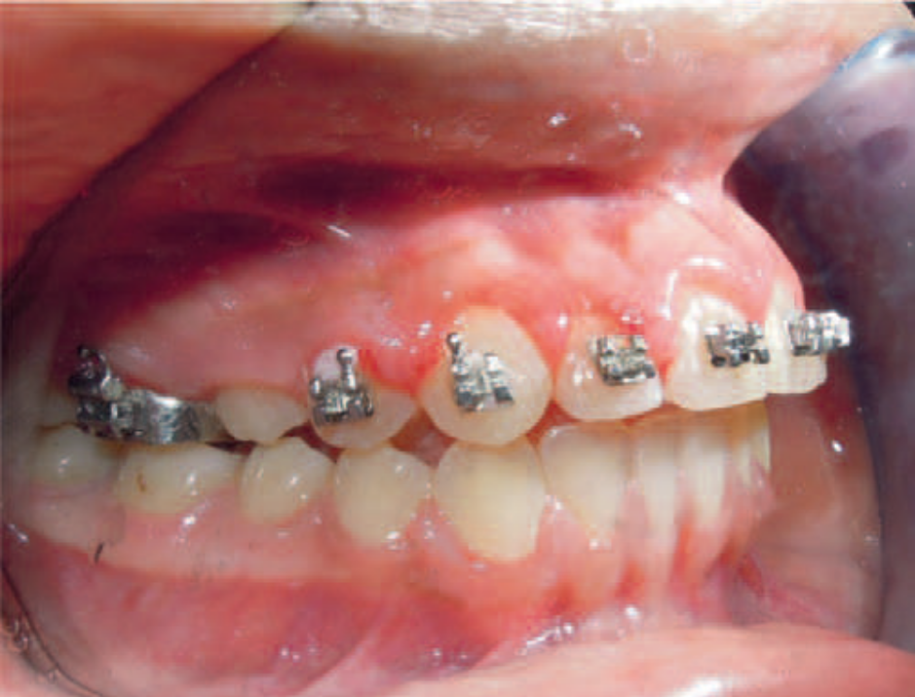
Gingival Changes Related to Orthodontic Appliances
Gingival enlargement can be related to the presence of fixed orthodontic appliances, which complicate plaque removal.
Gingival changes can occur within 1 to 2 months of appliance placement. They usually are transient, and they only rarely produce long-term damage to periodontal tissues.
The fact that most orthodontic treatment is provided to individuals during puberty, when they are subject to the inflammatory changes associated with puberty gingivitis, may exacerbate the observed effect.
Mouth Breathing
Mouth breathing and lip incompetence, which are together referred to as an open mouth posture, are often associated with increased plaque and gingival inflammation.
The area of inflammation is often limited to the gingiva of the maxillary incisors.

Slide 16
Non–Plaque-Induced Gingival Lesions
Primary Herpetic Gingivostomatitis
Primary herpetic gingivostomatitis is an acute-onset viral infection that occurs early during childhood, with a heightened incidence between the ages of 1 and 3 years .
Among children with primary herpetic infections, 99% are symptom free or have symptoms that are attributed to teething.
The remaining 1% can develop significant gingival inflammation and ulceration of the attached gingiva, tongue, palate, and lips.
The most important therapeutic measure is to control the child’s
hydration with bland, fluids.
Candidiasis
Candidiasis results from an overgrowth of Candida albicans, usually after a course of antibiotics or as a result of congenital or acquired immunodeficiency.
It is far less common in children than in adults, and it rarely occurs in a healthy child.
The six most common pediatric intraoral lesions are primary herpetic gingivostomatitis, recurrent herpes simplex, recurrent aphthous stomatitis, candidiasis, angular cheilitis, and geographic tongue.

Slide 17
Localized Juvenile Spongiotic Gingival Hyperplasia
Another condition that appears to be unrelated to plaque accumulation is localized juvenile spongiotic gingival hyperplasia.
This condition was identified only recently, and its pathogenesis is not well defined.
Most of the patients with this condition are between 8 and 14 years of age
The lesions are localized patches on the attached gingiva that manifest as bright red, raised overgrowths;
they are usually painless and associated with easy bleeding.
These lesions are most commonly seen on the anterior labial maxillary and mandibular gingiva.

Slide 18
Gingival Manifestation of Systemic Disease in Children
Endocrine Disorders and Hormonal Changes
Diabetes Mellitus
Type 1 or insulin-dependent diabetes mellitus occurs more frequently in children and young adults than type 2 or non–insulin-dependent diabetes mellitus.
As with diabetic adults, gingival inflammation and periodontitis are more prevalent in affected children than in unaffected individuals.
Clinical consequences include premature tooth loss and impaired immune response to the oral flora.
The severity of periodontal disease is worse in children with poor metabolic control.
Disease prevention and fastidious oral hygiene measures should be highly promoted

Slide 19
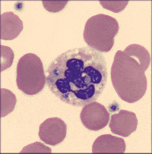
Hematologic Disorders and Immune Deficiencies
Leukemias
Leukemia is the most common type of cancer in children.
Acute lymphocytic leukemia accounts for most cases among children who are younger than 7 years of age
Leukemia must be considered as part of the differential diagnosis for children who present with the
hallmark features of acute gingival enlargement, ulceration, bleeding, and infection

Slide 20
Neutrophil Disorders
Neutrophil disorders impair defences against infections, making afflicted individuals susceptible to severe periodontal destruction.
The diagnosis of the systemic disorder usually occurs before any signs of periodontal destruction appear.
Because periodontal changes are dificult to reverse in children with neutrophil disorders, disease management includes oral hygiene measures, mechanical debridement, antimicrobial therapy, and supportive care for any resultant tissue destruction or tooth loss.
Treatment success is unpredictable because of the impact of systemic disease
Many neutrophil disorders are genetic, including some forms of neutropenia, such as familial and cyclic neutropenia, Chédiak–Higashi syndrome, leukocyte adhesion deiciency, Papillon– Lefèvre syndrome, and Cohen syndrome.

Slide 21
Congenital Anomalies
Down syndrome is another congenital condition that is diagnosed before the expression of periodontal disease
People with Down syndome experience a high prevalence of severe aggressive periodontitis during early adulthood
The disease process likely reflects a host susceptibility that results in an exaggerated immune and
inflammatory response rather than a reaction to a specific causative microbe.
Studies of people with Down syndrome uncovered defective neutrophil chemotaxis, which can lead to significant tissue loss and the progression of periodontitis.

Slide 22


