Slide 1
General principles and theories of growth and development

Slide 2
CONTENTS-
INTRODUCTION
KEY CONCEPTS
DIFFERENT THEORIES OF GROWTH
BONE REMODELING THEORY
GENETIC THEORY
SUTURAL THEORY
CARTILAGINOUS THEORY
VAN LIMBORGH’S THEORY
ENLOW’S EXPANDING ‘V’ PRINCIPLE
ENLOW’S COUNTERPART PRINCIPLE
HUNTER-ENLOW GROWTH EQUIVALENT THEORY
FUNCTIONAL MATRIX THEORY
FUNCTIONAL MATRIX THEORY REVISITED
SERVOSYSTEM THEORY OF GROWTH
NEUROTROPISM IN OROFACIAL GROWTH

Slide 3
INTRODUCTION
The practice of orthodontics has two basic requirements.
First- To possess an intimate knowledge of the anatomy and growth of the head.
Second- To master the techniques for regulating tooth position.
The knowledge of the oro-facial region is vitally important in planning the treatment procedure as well as for the success of the orthodontic treatment.

Slide 4
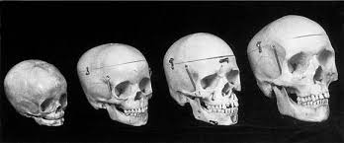
DEFINITION OF GROWTH:-
An increase in size – TODD
An increase in size, change in proportion and progressive complexity – KROGMAN
Change in any morphological parameter, which is measurable – MOSS
Quantitative aspect of biologic development per unit of time – MOYERS

Slide 5
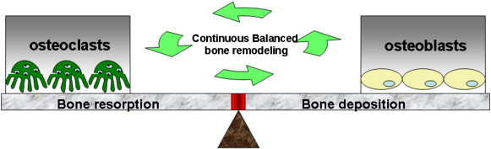
Key Concepts-
Bone Remodelling is characterized by deposition and resorption of bone at different sites of a bone in the body. This usually leads to change in size or shape of the body.
Bone Modelling is known as formation of new bone from either cartilage or by direct deposition.
Notes:
Cartilage-bone:endochondral oss
Bone is laid down directly in a fibrous membrane-intramembranous oss

Slide 6
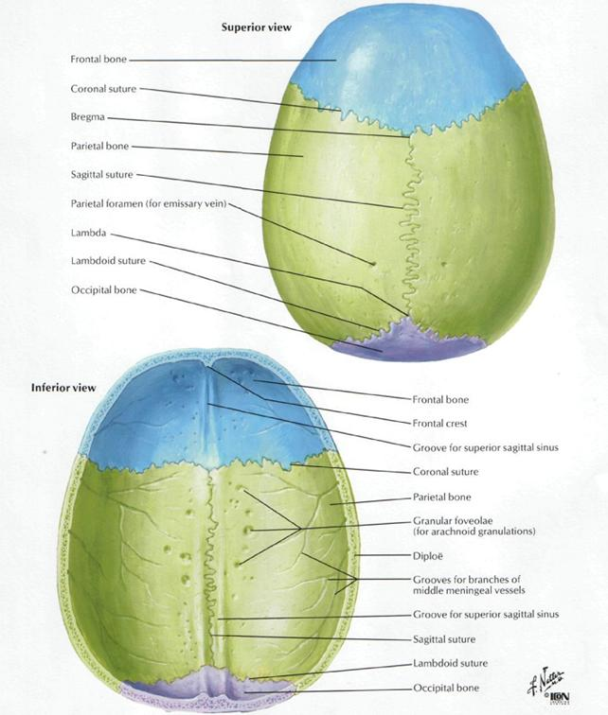
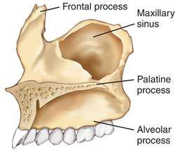
Growth Sites is a term proposed by Baume.
Growth Sites serve as a location in the bone where the actual growth occurs.
Fields that have some special significance/noteworthy role in the growth process.
Show response to external influences.
Growth sites are dependent on the growth centers for growth.
Some examples include sutures of cranial vault, lateral cranial base and maxillary tuberosity, lingual tuberosity., mandibular condyle., suture of face and cranium, synchondroses of all cranial base , alveolar bone housing teeth
Notes:
It shows marked response to external influences-do not control the overall growth of bone-exaggerated growth occurs

Slide 7
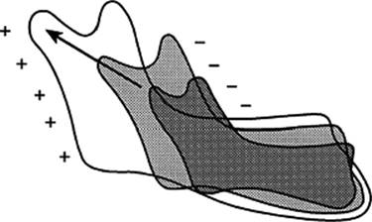
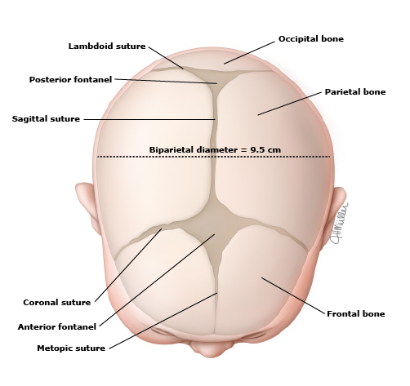
Growth Center is an area in the bone that controls the overall growth of the bone from its locations through different signalling mechanisms.
A center with the ability to generate tissue separating forces.
Not affected by external influences.
All growth centres can be growth sites but not all growth sites can be growth centers.
Some examples include membranous bones of cranium., nasal septal cartilage, Epiphyseal plate.
Notes:
Innate growth potential-little response to external influences

Slide 8
DEFINITION OF DEVELOPMENT:
“Progress towards maturity” - Todd
“All the naturally occurring unidirectional changes in the life of an individual from it’s existence as a single cell to it’s elaboration as a multifunctional unit terminating in death” -Moyers

Slide 9
Correlation between growth and development
According to PROFFIT ,
Growth is basically anatomic phenomenon and quantitative in nature .
Development is basically physiologic phenomenon and qualitative in nature .

Slide 10
GROWTH CHARTS
growth charts are visible display of child’s physical growth and development .
Aka road to health chart.
It was first designed by David morley and was later modified by WHO.
The chart is visible display of a graph , showing horizontal X axis and longitudnal Y axis.
Baby clinics , PHC, utilize growth charts.
The weight measurement of child over a period of time are plotted on the growth chart and any deviation from the normal pattern can be visualisedand interpreted.
An upward curve in the road to health is ideal .
A flat and downward curves are not desirable.

Slide 11
USES –
It is a diagnostic tool to identify high risk children .
Planning and policy making
Tool for educating mothers.
Tools for action helps in type of intervention that is needed .
Evaluation of effectivness of corrective measures and impact of a programmme of special interventions for improving childs growth and development .

Slide 12
WHO GROWTH CHARTS
MULTICENTRIC GROWTH REFERENCE STUDY (MGRS)
Participating countries include brazil, ghana , india , norway, oman , and USA .
Data collected by trained staff using a common protocol
Sample selected from communities where there were no enviornmental constratints to growth .
The new growth reference is based on breastfeeding as the biological norm .
Measurements include weight/age , height/age and weight/height .
Data on BMI was generated for children under 5 for the 1st time.

Slide 13
BASICS OF GROWTH CHART
consists of X axis which is usually in years or months and y axis that changes according to the reference eg – cm ,inches , kg
The x axis usually divided into 12 equal parts (months ) for each year. Standard growth chart has a 7 percentile lines and includes 3,10,25,50,75,97 percentiles.

Slide 14
Method of studying growth
ACCORDING TO MOYERS –
1 . Types of growth data
2 methods of gathering growth data
3 evaluation of growth data

Slide 15
TYPES OF GROWTH DATA –
OPINION – it is a clever guess based on experience .
2 . OBSERVATION – limited use when more quantitative data are not possible .
3 . RATING AND RANKINGS – data are compared to conventional rating scales which may be based on developmemtsal stages on typical stages or pateerns or on standard coloured charts.

Slide 16
4. QUANTITIVATIVE MEASUREMENTS-
DIRECT DATA – measurement taken on living person / cadavers by calipers or scales eg – measuring size of teeth in the mouth
INDIRECT DATA – measuremnts taken from images or reproduction of actual person eg – from photos casts cephalograms
DERIVED DATA – obtained by comparing two measurments , eg – between 7 and 8 years growth is 2 mm

Slide 17
Methods of gathering growth data
Longitudinal studies
Cross sectional study
Overlapping / semi longitudnal

Slide 18
Longitudinal studies
Involves examination of a group of children repeatedly over a long period during active growth .
Produces valuable data for study of growth rates and the variability of individual growth .
Measurement made of the same person or group at regular intervals through time .
Advantages-
As the same subjects are followed up over a long period , the specific developmental pattern of an individual can be studied and compared .
Variation in development among individuals within sample can be studied.
Problems in sampling are easily smoothened out since an unusual event in measuring is easily seen.

Slide 19
Disadvantages –
TIME – takes a lifetime to gather data .
EXPENSE – necessitates maintenance of laboratories , research personnel and data storage for a long time .
ATTRITION – sample size becomes smaller because of migration / death eg- attrition rate reaches 50% in 15 years .
Textbook of orthodontics – BISHARA

Slide 20
Cross sectional studies
A large number of individuals of different ages are examined on one occasion to develop information on growth attained at particular age .
Carried out by observation and measurement made of different samples and studied at different period .
This study provides best data for establishing national standards .
Eg – measure a group of 7 year old boys on the same day , 8 year old boys on the same day and same venue and the changes between 7 and 8 year groups are noted and assessed .

Slide 21
ADVANTAGE –
Short duration
Less expensive
Possible to get Large sample as duration of study is short
Possible to repeat the study if any flaw is there.
Used for cadaver , skeleton and archeologic data
DISADVANTAGE-
In cross sectional study individual variations cant be noted completely. Eg – studies of timing of developmental events like onset of puberty or adolescent growth spurt

Slide 22
Mixed longitudinal study / overlapping / semi longitudnal :
combination of cross-sectional and longitudnal studies .
Subjects at different age levels are seen longitudnally for shorter periods (6 years )
3) Evaluation of growth data –
Done by using statistical method on data obtained .
Eg – evaluation of growth data using cephalometrics for research and day to day practice .

Slide 23
Method of studying physical growth (PROFFIT)
The data collection for evaluation of physical growth is done by –
Measurement approach : based on technique for measuring living animals , animal is not harmed in this approach.
Experimental approach :includes experiment sin which growth is manipulated in some way. This implies that subject will be available for detailed study that may be destructive . So these are restricted for human species.

Slide 24
Measurement approach :
Craniometry
Anthropometry
Cephalometric radiography
4. Three dimensional imaging

Slide 25
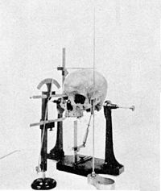
Craniometry
The first measurement approach of studying growth .
Based on measurement of dry skulls found in human skeletal remains .
Advantage :precise measurement can be made on skull
Disadvantage : all growth data are cross sectional . i.e although different ages are represented in population, the same individual can be measured at only one point in time .
No longitudnal studies can be done.

Slide 26
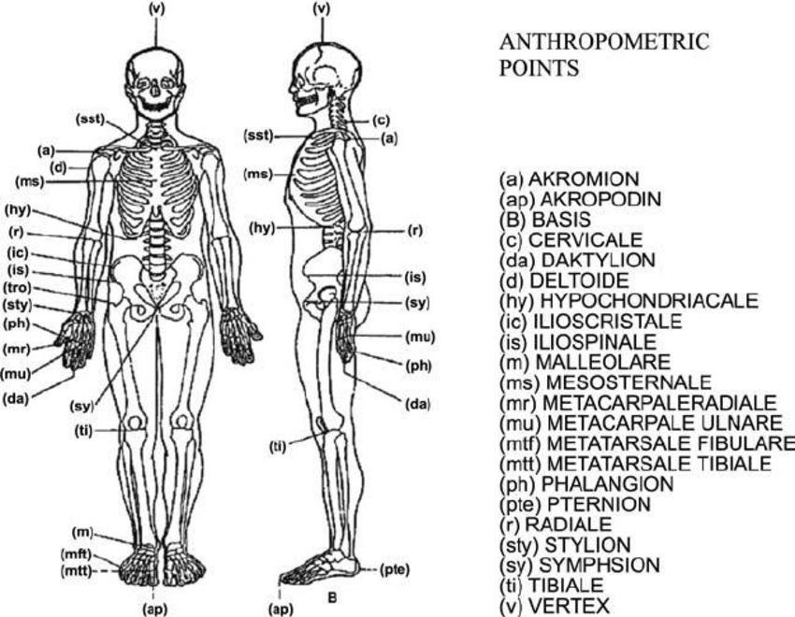
Anthropometry
Used to measure skeletal dimension on living individuals .
Various landmarks measured using soft tissue points .
Makes it possible to follow the growth of an individual directly , making same measurement repeatedly at different times.
This produces longitudinal data – repeated measures of same individual .
Important study done by FURKAS have provided valuable new data for human facial proportions and their changes over time .

Slide 27
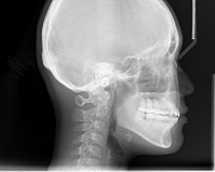
Cephalometric radiography
Technique depends on precisely orienting the head before taking radiographs , with equally precise control of magnification .
Allows a direct measurement of bony skeleton dimensions.
Combines advantages of craniometry and anthropometry.
Growth studies are done by superimposing a tracing of later cephalogram on an earlier one .
Hand wrist xrays –used to study biological/skeletal age .
Hand wrist has number of spongy bones called carpels that have a definite schedule of appearance and ossification.
Disadvantage – produces two dimensional representation of a 3d structure , so not all measurements are possible .

Slide 28
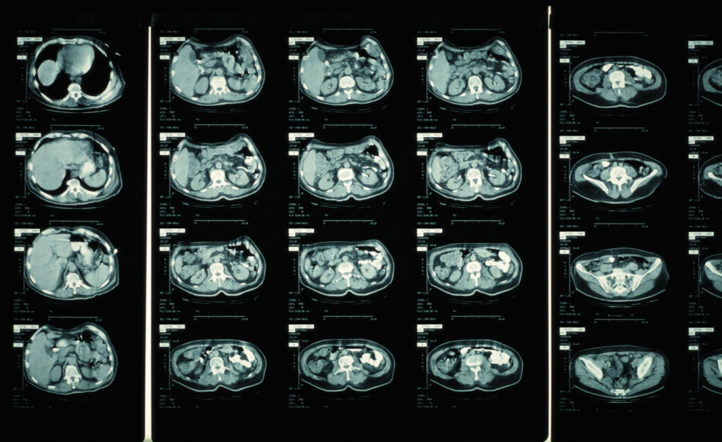
3D imaging
Computed axial tomography or CT allows 3D reconstructions of cranium and face .
Recently CBCT is been used .
MRI is also used which doesn’t cause any raditation exposure to patient .

Slide 29
BIOMETRIC STUDIES –
Physical characterstics such as weight height skeletal maturation and ossification are measured and compared in standards based on data from healthy subjects .

Slide 30
Biologic maturity indicators
MORPHOLOGIC AGE | DENTAL AGE | SEXUAL AGE | SKELETAL AGE
Based on height . A child’s height can be compared with those of his same age group. Useful as a maturity indicator from late infancy to early adulthood . | Observation of age at primary and permanent teeth eruption. Rating of tooth development form crown calcification to root completion . Useful from birth to early adolescence. | Development of secondary sex characterstics , breast development and menarche in female . penis and testes growth in males . Only for adolescent growth | Assessing the development of bone in hand and wrist . Development of bones from appearance of calcification centers to epiphyseal plate closure occurs in hand and wrist throughout entire post natal growth period . Total 51 separate centers of bone growth are located in hand and wrist . Atlas of handwrist development has been developed , useful in rating maturity status of individual child .

Slide 31
Experimental approach
1.Vital staining
2. Autoradiography
3. Radioisotopes
4. Implant radiography

Slide 32
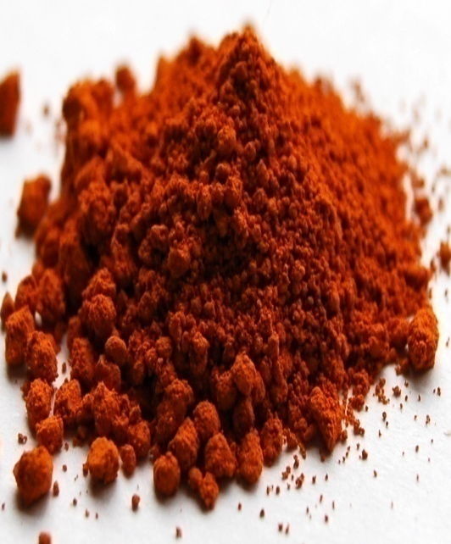
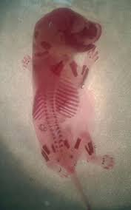
Vital staining
Introduced first by john hunter in 18th century.
Growth is studied by observing pattern of stained mineralized tissues after injection of dyes to animal.
Alizarin was found to be the active agent and still used for staining purposes. It reacts strongly with calcium at sites of where bone calcification is occuring .
Stain indicates active skeletal growth .
The gamma emitting isotopes can be used to detect area of rapid bone growth .
Useful for localised area problems.
Cant be used for humans since to study vital stained tissue sacrifice was necessary.
Other dyes used –
AKIZARIN RED 5
ACID ALIZARIN BLUE
TRYPON BLUE , TETRACYCLINE ,LEAD ACETATE.

Slide 33
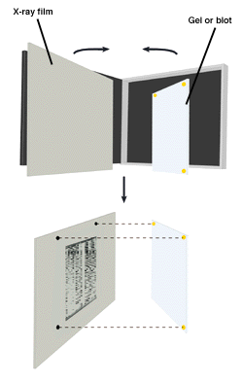
Autoradiography
Technique in which film emulsion is placed over a thin section of tissue containing radioactive isotope and then is exposed in dark by radiation .
After the film is developed , the location of radiation indicates where the growth is occuring .

Slide 34
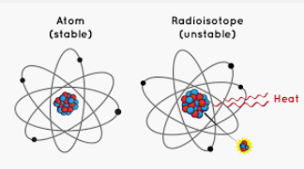
Radioisotopes
These elements when injected into tissues get incorporated in developing bone and act as in vivo markers and can then be located by means of radioactivity they emit. Eg – calcium 45 , potassium 32., gamma emitting isotope Tc tecnicium 99

Slide 35
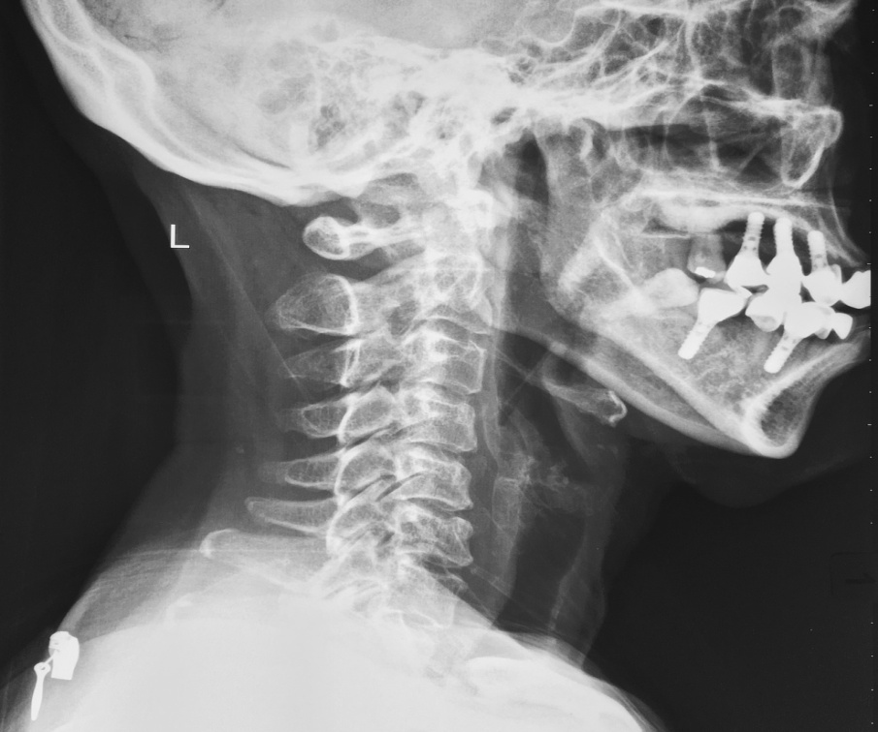
Implant radiography
Used extensively by ARNE BJORK AND CO WORKERS. 1969 .
Can be used in human subjects .
Inert metal pins (made of titanium)are inserted anywhere in the bony skeleton including face and jaws
The implants are about 1.5 mm in length and 0.5 mm in diameter .
These pins are biocompatible.

Slide 36
Superimposing radiographs on the implants allow precise observation of both changes in position of one bone relative to another and changes in external contour of individual bone.
They serve as radiographic reference points for serial radiographic analysis .
These metals are embedded into certain areas of maxilla and mandible in order to study growth of skull.

Slide 37
In maxilla
Hard palate behind the maxillary deciduous canine (prior to eruption of maxillary permanent incisors )
Below the anterior nasal spine (after eruption of maxillary incisors )
Two implants on either side of zygomatic process of maxilla
Border between hard palate and alveolar process medial to first molar
In mandible –
Anterior aspect of symphysis in the midline below the root tips .
Two pins of the right side of the mandibular body .( one pin under first premolar and other below second premolar or first molar )
One pin on the external aspect of the right ramus in level with the occlusal surface of molars.

Slide 38
Factors affecting physical growth
Heredity –
There is genetic control of the size of parts to the rate of growth and to the onset of growth events.
Eg-menarche , dental classification, eruption of teeth , ossification of bones and start of adolescent growth spurt
There is a considerable degree of independence between growth before and growth during adolescence.
2) Nutrition –
Malnutrition may delay growth and affect size of parts , body proportions , body chemistry and the quality and texture of some tissues ef –teeth and bones .
Malnutrtion may also affect adolescent growth spurt but children recover well provided adverse conditions have not been too extreme or prolonged .
“Catch up” growth is seen in both sexes , girls seem to be better buffered against the effects of malnutrition and illness.

Slide 39
3) Illness –
Systemic disease has a effect on child growth .
Minor childhood diseases normally do not cause adverse growth.
Serious prolonged and deblitating illness have a marked negative effect on growth.
4) RACE –
North american blacks are ahead of their white counterparts in skeletal maturity at birth and for atleast first two years of life.
Their teeth also erupt one year earlier than whites .
5) CLIMATE AND SEASONAL EFFETCS-
Climate has a little effect on rate of growth
There are seasonal variations in the growth rates of children and in the weight of the new born babies .

Slide 40
6) ADULT PHYSIQUE –
There are correlation between adult physique and earlier development events
Eg – tall women tend to mature later
7) SOCIOECONOMIC FACTORS –
Children living in good socioeconomic conditions tend to be larger , display different types of growth and show variation in the timing of growth when compared to under priviliged children .
8) EXERCISE –
Those children who exercise regularly and strenously don’t grow favourably .

Slide 41
9) FAMILY SIZE AND BIRTH ORDER –
First born children tend to weight less at birth and ultimately achieve lesser stature and higher IQ
Smaller the family size better would be the nutrition and other favourable conditions .
10) SECULAR TRENDS –
15 year old boys are approximately 5 inches taller than 15 year old boys that were 50 years ago .
Average age of menarche has steadily become earlier throughout the entire world .
11) Psychologic disturbances –
Children experiencing stressful conditions display an inhibition of growth hormone .

Slide 42
Concepts of growth
Concept Of Normality
Rhythm Of Growth
Differential Growth
Timing Of Growth : Growth Spurts

Slide 43
pattern , variability and timing
PATTERN – is defined as a set of constraints operating to preserve the integration of parts under varying conditions or through time.
The term pattern applied to developmental changes is defined by brodie as –
The term pattern embraces every characterstic of the individual . In addition to those which mark the human species are those which make a particular human being .
Pattern means not only shape and size , and the shape and size of parts but in addition the rate time and manner in which these are attained .
Eg – the shape of bony skeleton with its soft tissue covering, the muscular and neuromuscular systems that control the skeleton individual metabolism , mental gifts and limitations and psychological responses.
Practice of orthodontics by J.A Salzmann

Slide 44
NORMALITY AND VARIABILITY
according to cohen’s (1955) the theory of organic form is based on the principle of “optimal design for economy and simplicity”
Normality may not necessarily be ideal .
Deviation from usual pattern can be used to express quantitative variability .
This can be done using growth charts .
Variability is Law of nature .
Because of infinite number of genetic possibilities.

Slide 45
Concepts of normality -
Normal – which is usually expected .
Statistical – specific mathematics ways to portray –
Mean – average of values
Median –value midway between greatest and smallest measurement (average of position)
Mode – most frequent measurement
Standard deviation – mathematic expression of the distribution of individuals around the mean .
b) Evolutionary –
All forms of life pass critical test of survival , i.e survival of the fittest .
Bizzare and abnormal forms unable to cope and have been lost .
c) Functional – normal for most biologic forms to establish effective homeostasis with the enviornment inorder to adapt and survive .

Slide 46
d) Esthetic – culture determines what is normal within a group .
e) Clinical – normal is not equal to ideal .
Normal is the central tendency of the group.

Slide 47
Variability may be demonstrated in number of ways –
In physical growth – by statistics which expresses quantitatively the range of differences found in a large population of individuals of similar age , sex socio-economic status.
Gross variation from central tendency is indicative of pathologic condition or a grossly abnormal pattern of growth that will markedly affect the treatment .

Slide 48
However , the law of variation of structure , form and function is inherent in human race .
Adaptive variability of tissues and organs is necessary according to age, sex , diet , occupation , climate etc. on which survival of organism depends .
Orthodontic treatment is done due to morphologic, spatial and functional deviations of the teeth and jaws beyond the limits of normality.
Normal implies absence of diseases or deficiency of growth or development .
Normal growth has a range of variability for individuals .

Slide 49
various individuals may all be normal and still differ from one another.
Normal growth of child should fall within the range of variability of childs potentitalities of growth .
Normal growth is not the average of a number of individuals but a wide range in which healthy individuals vary in specific characteristics but maintiain their common identity.
Structure form and function are within the range of normal if they reflect no diseases .

Slide 50
Rhythm of growth
According to hooton , “ human growth is not a steady and uniform process of acceration wherein all parts of the body enlarge at the same rate and the increments of one year are equal to that of the preceding or succeeding year .
This growth rhythm is seen in body height .
The maintenance of of an adequate rate of growth is more important than the actual height or weight attained or the degree of correlation to so called norms.
Occurs in both sexes from birth to the fifth or sixth year .
It is most intense and rapid during first two years.
Then it follows a slow increase , terminating in boys at about 10 – 12 years .
And in girls – not more than 10years . Then both sexes enter adolescence (girls – 14-16 years) and boys – 16-18years.
Then final period of slow growth ends in girls at 18-20 years and boys – till 25 years.

Slide 51
Differential growth
The human body does not grow at the same rate throughout life. Different organs grow at different rates to a different amount and at different times . This is called as differential growth .
The two main concepts of differential growth are :
Scammons curve of growth
Cephalocaudal gradient of growth

Slide 52
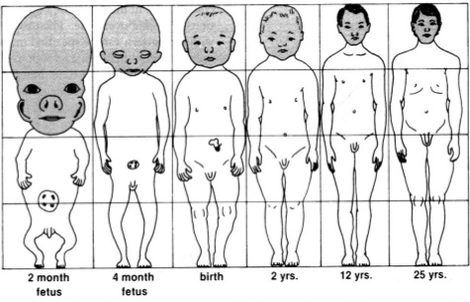
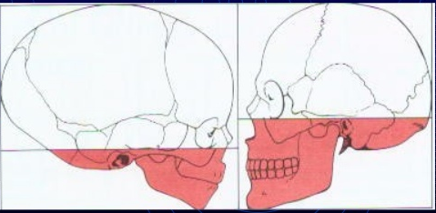
Cephalocaudal gradient of growth
Cephalocaudal gradient of growth simply means that there is an axis of increased growth extending from head towards the feet.
IN FOETAL LIFE -
The head takes upto 50%of total body length around the third month of IUL.
Limbs are rudimentary
Trunk is underdeveloped
AT THE TIME OF BIRTH -
the trunk and the limbs have grown more than the head and face
thereby reducing the head to about 30% of body length .
.

Slide 53
AT ADULTHOOD –
reduction in the relative size of the head to about 12% .
Relative size of limbs is about 50% of total body length .
There is increased gradient of growth evidence even within the head and face .
At birth , cranium is proportionally larger than face .
Post natally the face grows more than cranium.
Mandiblle shows more growth than maxilla post natally.
Structures away form the head grow later and also more than structures closer to head .

Slide 54
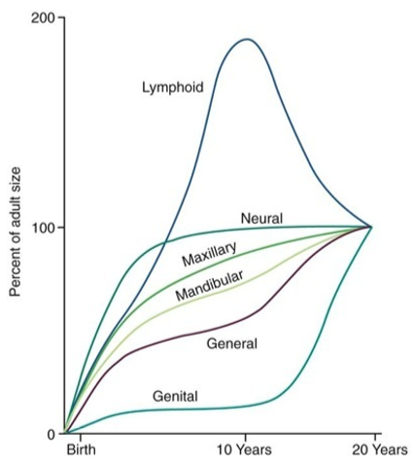
Scammon’s growth curve
Given by RICHARD SCAMMON in 1930.
It shows growth of various tissues expressed as percentage of total gain from birth to maturity . It shows growth of various tissues expressed as percentage of total gain from birth to maturity .
The curves cover the post natal period of 20 years and assume that during that span of time adult dimensions have been achieved and have 100% of their value starting at birth with 0%.
1. The “general curve” – exemplifies height growth , includes external dimensions of the body , respiratory and digestive organs , kidney , aorta , muscles , skeleton .this curve rises steadily from birth to 5 years of age and then reaches a plateau from 5 – 10 years , folllowed by an upsweep during adolesence and finally a slowdown in adulthood .
Textbook of facial growth - Enlow

Slide 55
2. The “genital curve “ – represents reproductive organ , primary sex apparatus and secondary sex traits . This curve has a small upturn in first year of life and then is quiescent until after 10 years of age , at which time growth of these tissues increases during the time of puberty .
This curve shows very slow prepubertal growth , whereas during puberty the growth rate is quite dramatic.
3. The “neural curve” – it includes the brain , spinal cord , optic apparatus and skull, upper face and vertebral column , the curve rises strongly during childhood , at the age of 8 years the brain in nearly 95% of its adult size . It has a very characteristic post natal shape because the brain develops earlier than any other part of body .
Between birth and 18 years of age the head circumference has an average increase of 20cm . However, half of this is achieved around 8-9 months .and 75%of the total increase has been gained at age of 2 years .

Slide 56
4. The “lymphoid curve “ –
Represents lymphoid tissue .
These are tissues that support the immune response , ie they protect us from infection.
Two type of lymphoid tissues are there –
Primary and secondary .
Primary includes bone marrow and thymus .
Secondary include lymph nodes , spleen and tonsils .
Reaches its maximum before puberty , where after it continually regresses until maturity .it includes thymus , pharyngeal and tonsillar adenoids , lymph nodes and interstitial lymphatic masses.. These tissue rise to a point nearly 200% between 10 -15 years .the reduction from 200% to 100% is mainly achieved by involution of thymus , which reverts to connective tissue .

Slide 57
Significance of scammons growth curve -
Björk and Palling found that during the earlier teenage years, growth of the mandible exceeds that of the maxilla resulting in straightening of the profile and retroclination of the lower incisors which may be one of the reasons for the increase in lower arch crowding at that time.
Maxilla shows neural growth pattern because neural growth tissue consists of brain, cranium and upper face . Hence , it is related to cranial base and the maxilla .
Mandible growth pattern shows somatic / general growth pattern . So longtime growth is seen in mandible upto 18 – 20 years .as general tissue show growth of body as whole and not as specific tissue .
So skeletal problems are treated first in maxilla than mandible .

Slide 58
The growth of the calvarium (which surrounds the developing brain), should follow a similar growth pattern as neural tissues.
The Cranial base (the interface between the brain and the Viscerocranium (Midface and Lower face) should follow a combined growth pattern to Neural and General growth.
SOMATIC / GENERAL GROWTH SIGNIFICANCE IN ORTHODONTICS-
Children with reduced somatic growth may present with various endocrinal diseases , especially growth hormone deficiency , idiopathic short stature, genetic disorders.
So these children show similar craniofacial features , such as short length of cranial base and mandible increased facial height , retropositional mandible and obtuse gonial angle .

Slide 59
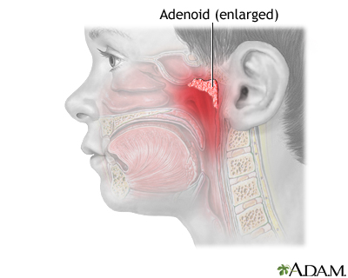
Significance of lymphoid tissue in orthodontics
As the lymphoid tissue consists of lymph nodes , adenoids, tonsillar tissue and thymus gland .
Any alterations in the adenoids can be seen in a patient with habits such as mouth breathing which would lead to malocclusion.
The upper airway obstruction caused by hypertrophic adenoid and possibilities of subsequent malocclusion.
Upper respiratory obstruction often leads to obstructive sleep apnea .
Habitual mouth breathing may result in dentoskeletal malocclusions .

Slide 60
Lymphoid tissue is normally present as a part of waldeyer’s tonsillar ring in the form of nasopharyngeal tonsil .
( linder Annson 1970)
Adenoid system development are most common in childhood at age range of 2 -12 years .During adolescence a decrease in adenoid size is noted as current with growth of nasopharynx .
Rarely adenoid tissue is present in adult .
The tongue displaced downwards during airway obstruction can also lead to retrognathic mandible and anterior occlusal anomalies .
Thus orthodontic treatment should be carefully carried out in these patients .

Slide 61
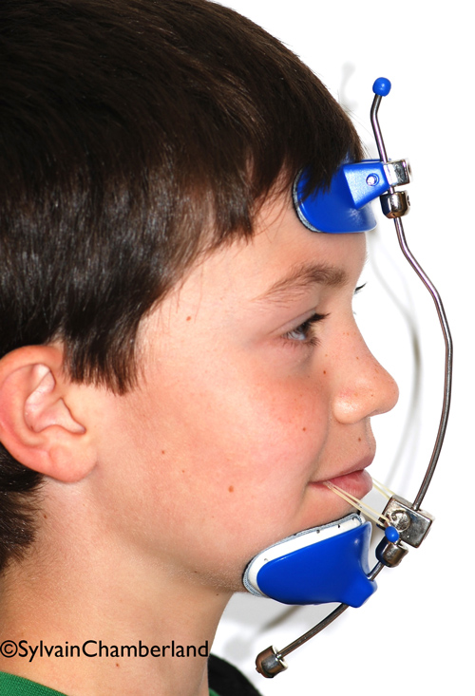
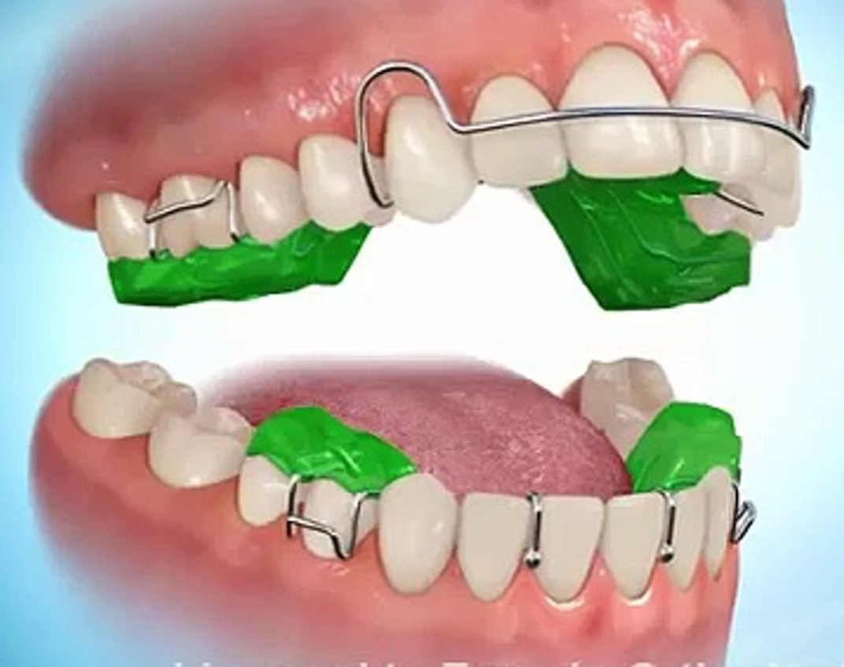
Twin block or maxillary protracting appliance (MPA) ie facemask / modified protraction headgear can be used for patients with skeletal retrognathia or maxillary hypoplasia, who are in there peak of growth period.
Twin block and MPA showed a significant improvement in airway problems.
Enlarged adenoids and tonsills can lead to long face syndrome due to mouth breathing habits .
Long face syndrome (skeletal open bite) is characterized by excessive vertical facial development . There is excess lower facial height with lower occlusal and mandibular plane angles .
There is vertical maxillary excess with mandibular hypoplasia .
Treatment for long face syndrome in young patients is to halt and control descent of lower jaw and to prevent eruption of posterior teeth .

Slide 62
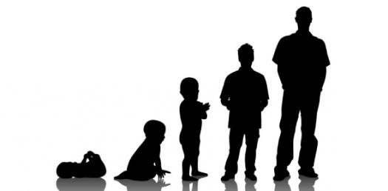
Growth spurts
Growth does not take place uniformly at all times. There are times where sudden acceleration of growth takes place . This sudden increase in growth is called growth spurt.
These are period of sudden rapid increase .
There is a period of rapid increase of growth just before birth and another just before , and at beginning of puberty .
The rate of growth is more rapid at the beginning of cellular differentiation, increases until birth and decreases thereafter this is termed as ”spurts”.
Believed to be due to physiological changes in hormonal
secretion.

Slide 63
Puberty
Puberty is a combination of morphologic and physiologic changes that occur in children during the time of the maturation of testes in boys and ovaries in females.
Puberty is characterized by an acceleration and then deceleration in skeletal growth.
The initiation, duration and amount of growth vary considerably during the growth spurt.
Pubertal growth and biological maturation are dynamic processes regulated by a variety of genetic and environmental factors.
Genetic, endocrine and nutritional factors and ethnicity contribute variably to the amount of growth gained during this important period of rapid changes.

Slide 64
During puberty the growth velocity curve rises to a maximum and then quickly begins to fall again .
The maximum speed (at the height of curve ) is called peak height velocity (PHV).
According to TANNER AND DAVIS (1985) PHV it is 9.5cm / year for boys and 8.3cm /year for girls.
AGE OF PHV - BOYS – 13.5 +/- 0.9 YEARS
GIRLS – 11.5 +/- 0.9YEARS
The pubertal growth spurt occurs 2 years earlier in girls than in boys.
The main somatic indicators of puberty are –
The adolescent growth spurt .
The development of gonads .
The development of secondary sex characteristics .
Changes in body composition (muscle mass and fat).
An increase in circulatory and respiratory capacities , especially in boys (Marshall and Tanner ,1986).

Slide 65
Pubertal growth spurt occurs , 2 years earlier in girls than in boys .
That is 13.5 years for boys
11.5 years for girls .
Thus , many girls will begin to grow rapidly whereas most of the boys of same age are still growing at their prepubertal rate .
In 95% of normal girls breast development start at 9-13 years.(11.5 years mean)(marshall and tanner in 1965).
In 95% normal boys genital development begins at 9.5 – 13.5 years (11.64 year mean)(marshall and tanner 1970)
In over 70% girls menarche ,it occurs in late stages of breast development (marshall and tanner 1969)
Thus during menarche one can conclude that girl has passed her highest growth velocity and her growth is slowing down .
Tanner and Davis 1985

Slide 66
Timing of growth spurt
WOODSIDE (1968) – in his study of burlington study group torrento showed,
Name of growth spurt
BOYS GIRLS
Infantile/childhood growth spurt 3 years 3 years
Juvenile /mixed dentition growth spurt 6-7 years 7-9 years
Prepubertal /adolescent growth spurt 11-12 years 14-15 years

Slide 67
Modified by BJORK (1975)
PRENATAL – just before birth
POSTNATAL - one year after birth
3. MIXED DENTITION GROWTH SPURT : females : 7-9 years
males : 8-11 years
4. PREPUBERTAL GROWTH SPURT -
females : 11-13 years
males : 14-16 years.

Slide 68
Significance of growth spurt in orthodontics
Functional jaw orthodontic therapy takes advantage of redirection of remaining growth of craniofacial region.
Functional appliances like twin block , bionator , frankel appliances are given for class II skeletal correction .
Effectiveness of these appliances to modify skeletal growth is minimal after pubertal growth spurt .
Orthopaedic appliances like headgear are also advantageous to correct maxillary prognathism during growing stage of patient .

Slide 69
Maxillary sagittal growth is completed much earlier than mandible and so use of headgear to restrict or redirect the growth should be started much before pubertal growth spurt in mixed dentition period .
Maxillary expansion procedure in cases of jaw constriction should be carried out during early mixed dentition . Growth in width of maxilla occurs by sutural growth in interpalatine and intermaxillary sutures. Maximum growth occurs in first 5 years.
The skeletal expansion procedures should be carried out before the fusion of palatal suture that is by 15 years.
Orthopaedic appliances like facemask and chin cup are used for the treatment of skeletal class III malocclusions early during the mixed dentition period . Thus , continuing growth of mandible and its pubertal growth spurt can lead to development of malocclusion after early intervention .
Active growth cessation is prerequisite for orthognathic surgery particularly in cases with mandible prognathism .

Slide 70
Advantages of growth spurt
To differentiate whether growth changes are normal/abnormal .
Treatment of skeletal discrepancies is more advantageous if carried out in mixed dentition period(during growth spurt).
Orthognathic surgery should be carried out only when growth ceases.
Arch expansion is carried out during maximum growth period .

Slide 71
BASIS FOR DEVELOPMENT OF THEORIES
It is believed that growth is strongly influenced by genetic factors, but it also can be significantly affected by the environment, in the form of nutritional status, degree of physical activity, health or illness and a number of similar factors.
Major part of the need for orthodontic treatment is created by disproportionate growth of the jaws, it is necessary to learn how skeletal growth is influenced and controlled to understand the etiologic process of malocclusion and dentofacial deformity.

Slide 72
DIFFERENT THEORIES OF GROWTH -
Bone Remodeling theory by Brash
Genetic theory by Allan Brodie
Sutural theory by Sicher and Weinmann
Cartilaginous theory by Scott
Van limborgh’s theory
Expanding “v” principle by Enlow
Enlow’s counterpart principle/Growth equivalent concept
Hunter-Enlow growth equivalent theory
Functional matrix hypothesis by Melvin Moss
Servosystem theory of growth by Petrovic
Neurotropism in orofacial growth

Slide 73
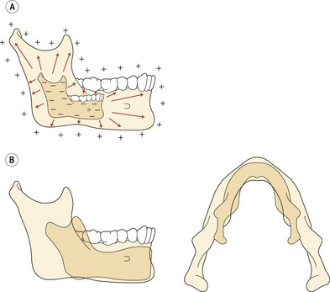
BONE REMODELLING THEORY-
This theory was given by BRASH in 1939.
It was the first general theory of craniofacial growth.
Brash proposed that bone grows only by surface remodelling-selective addition at one surface and resorption on the other.
He further stated that growth of the jaws is characterised by the deposition of bone at the posterior surface of maxilla and mandible.
SHORTCOMING- Could not explain the role of sutures and cartilages in the growth of craniofacial skeleton.

Slide 74
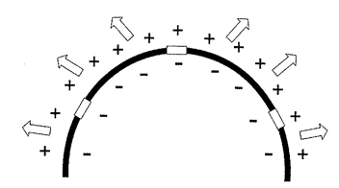
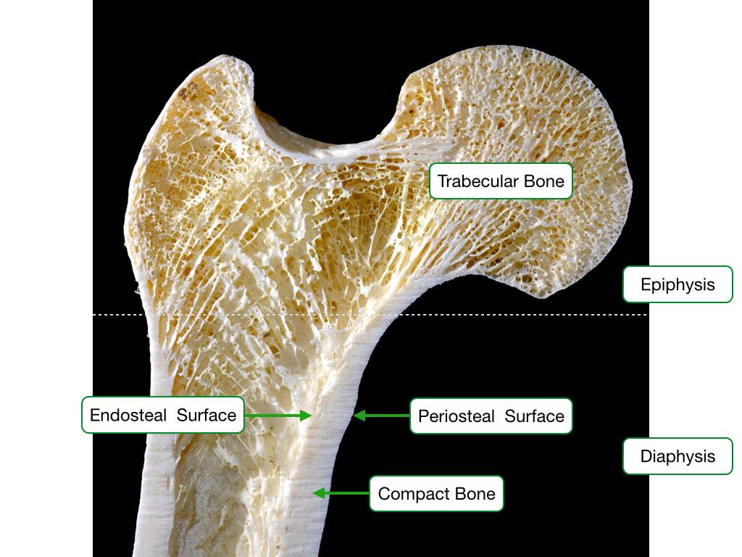
Diagram showing remodelling theory of craniofacial growth using cranial vault as a model . Increase in size of cranial vault occurs by adding bone via periosteal deposition on the outer , ectocranial surface and resorption of bone on the inner , endocranial surface of the vault . Growth of the jaws takes place principally via deposition of bone on the posterior surface of the maxillary complex and mandibular ramus . Sutures and cartilages play no role in the growth of craniofacial complex.

Slide 75
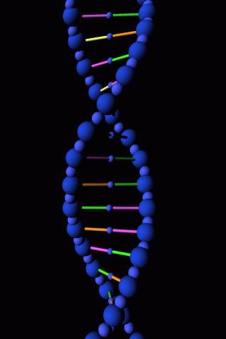
GENETIC THEORY-
This theory was given by BRODIE in 1941.
This was the earliest theory which proposed that skull growth was controlled by genetic factors and was pre-planned.
The mechanism by which the traits were transmitted were not initially understood until the beginning of 20th century.

Slide 76
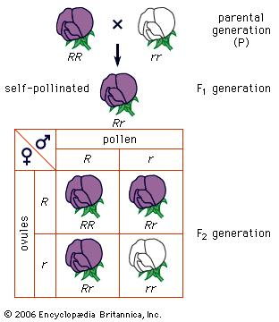
Mendel is credited with performing benchmark research for much of genetics especially regarding the mechanisms of inheritance and transmission of traits by demonstrating that specific traits were passed between generations in a particulate, discrete manner from both parents (MENDEL’S LAW).
Johannsen then used the term gene to refer to the presumed unit of heredity, which provided the developmental ‘potentiality’ of the organism -CARLSON EA

Slide 77
Analysis of the role of gene in development began in the earnest with the publication of Morgan’s classic book ‘The Theory Of The Gene’ in 1926.
-MORGAN TH,YALE UNIVERSITY PRESS ,1926.
Gene has a major role in establishing basic facial pattern.
According to Brodie, genes determine the overall craniofacial growth control.
This theory was opposed by Moss and other investigators.
Although called a theory it was more assumed than proven.

Slide 78
DRAWBACKS-
Primary genetic control determines only certain features and does not have complete influence on growth.
After the general assumptions were found to be flawed, some said "perhaps this part is genetically controlled while that is not," or "this part is more controlled by heredity than that." Such statements showed uneasiness with the all-embracing aspects of the theory.

Slide 79

SUTURAL THEORY
This concept was given by SICHER in 1952.
Sicher’s theory came from the evidence he gathered by observing the staining of bones of animals fed on ‘madder’ and observations of pathological states.
Madder contains ‘Alizarin’ which gets incorporated in developing bones and causes intrinsic staining.

Slide 80
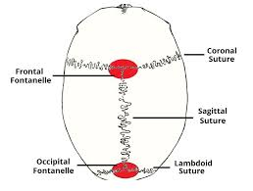
Sicher concluded that sutures were causing the growth since they were the sites of active staining in experiments.
The primary event in craniofacial growth was the proliferation of the connective tissue between bones which caused them to grow and elongate.

Slide 81
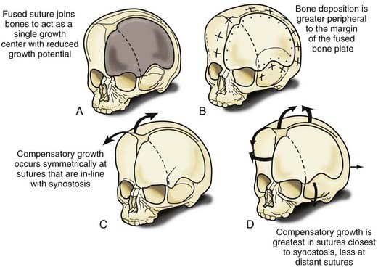
The replacement of the proliferating connective tissue by bone was necessary for the development of functionally adequate bones.
Sicher thought that growth of the cranium occurred due to the apposition at the sutures which determined the adult facial form.

Slide 82
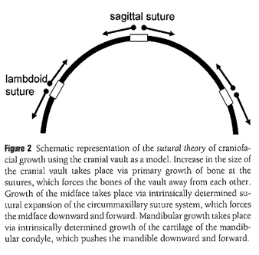
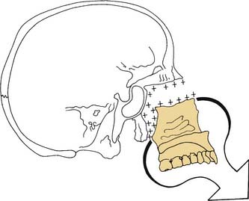
Sicher stressed that growth at the sutures and cartilages was under strong genetic control with a minor contribution from the local environmental factors.
Diagram showing sutural theory . Increase in cranial vault takes place via primary growth of bone at the sutures,which forces the bones of the vault away from each other .
Growth of midface takes place via intrinsically detremined sutural expansion , which forces the midface downward and forward .

Slide 83
Points raised against this theory-
When an area of the suture is transplanted to another location, the tissue does not continue to grow. This clearly indicates a lack of innate growth potential of the sutures.
Growth takes place in untreated cases of cleft palate even in the absence of sutures.
Extirpation of facial sutures has no appreciation effects on the dimensional growth of the skeleton - Sarnat, 1963.
Microcephaly and hydrocephaly raised doubts about the intrinsic genetic stimulus of sutures
Notes:
Microcephaly-small head-downpatau Edward
Hydrocephalus is a condition in which there is an accumulation of cerebrospinal fluid (CSF) within the brain.^{[1]}This typically causes increased pressure inside the skullf CNS infections, meningitis, brain tumors, head trauma, toxoplasmosis, intracranial hemorrhage Arnold-Chiari malformation

Slide 84
EVIDENCES SUPPORTING THE THEORY-
First the role of local environment in causing periosteal remodeling was accepted and the role of genetic factors was laid to be secondary, as was observed experimentally.
Due importance was given to the growth of bones at the cartilaginous union.

Slide 85
SHORTCOMINGS-
Could not explain the massive craniofacial structural alterations that were observed in subjects with soft tissue deformities of CNS and the craniofacial tissues.
Experiments by Scott and colleagues revealed that cranial sutures grew by direct ossification of connective tissue without any cartilaginous precursor while Sicher believed them to be similar to synchondroses.
Notes:
Where the connecting medium is hyaline cartilage, a cartilaginous joint is termed a synchondrosis occipital and the sphenoid,

Slide 86
CARTILAGINOUS THEORY
Put forward by James H . Scott in 1950.
SYNONYMS-Nasal septum theory, Scott hypothesis, Nasocapsular theory.
Scott recognized that during prenatal development, cartilaginous parts of the craniofacial skeleton played a major role in the establishment of nasal capsule, mandible and cranial base.

Slide 87
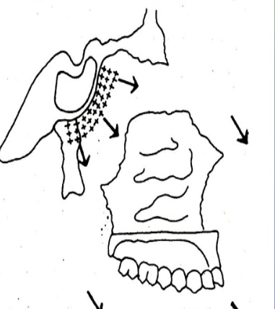
Scott believed that much of the control of facial growth exerted by the cartilage in utero is carried over into postnatal life.
He argued that growth of the nasal cartilage was the primary factor determining the growth and displacement of the midface forward, and that it was under strong genetic control.
Scott considered sutures to be only secondary in their contribution to craniofacial growth and merely making an adjustment to the separation of bones brought about by cartilaginuous growth.

Slide 88
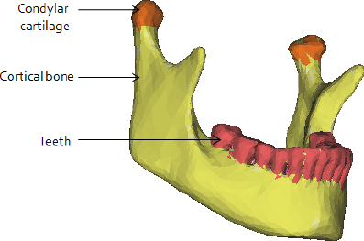
Scott believed that early growth was under strong genetic control while the later growth was controlled more by the functional forces.
Nasal septum is considered to influence the downward and forward growth of the maxilla.
In mandible, condylar cartilage is considered to be the growth centre present bilaterally with the U-shaped mandible in between.
The chief site of growth of mandible is at the condyle and condylar cartilage contribute to increase in the ramal height and total mandibular length (Brodie 1964).

Slide 89
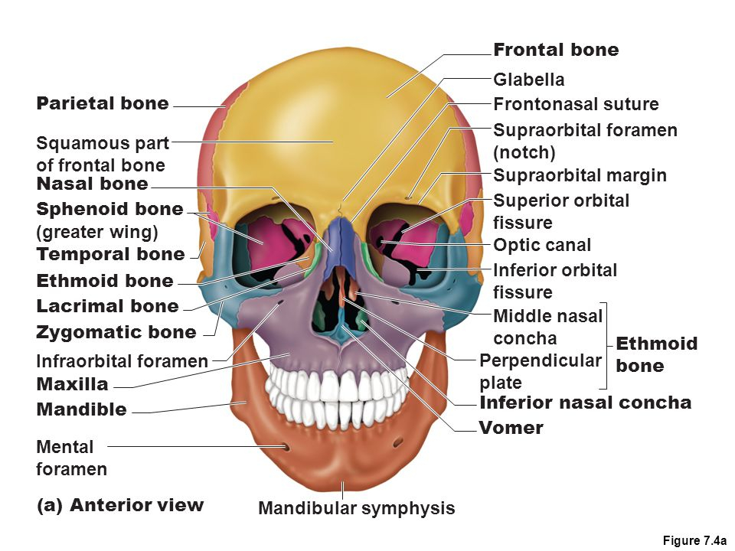
Scott is of the opinion that there are two suture system:-
Posterior suture system lies behind the maxilla and separates it from palatine ,lateral mass of ethmoid , lacrimal , zygomatic and vomer bones.
Anterior suture system separates premaxilla, nasal and vomer bone.

Slide 90
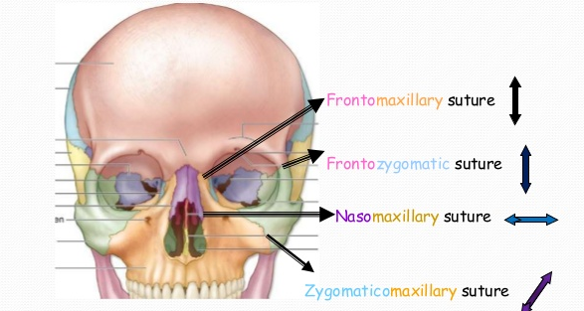
Scott said that the nasal cartilage is an extension of the cranial base cartilage and as it grows further, it separates the facial bones from one another and also from the cranial portion .
Thus it allows bone growth to take place at the sutures (frontomaxillary , frontonasal , frontozygomatic and frontozygomaticomaxillary) by surface deposition.

Slide 91
EVIDENCE SUPPORTING CARTILAGINUOUS THEORY-
Experimental studies on rats and rabbits showed retarded mid-face development when nasal septal cartilage was removed.
Many bones grow by cartilaginuous growth in which a precursor cartilage is removed by bone.
Transplantation of epiphyseal plate and synchondroses results in continued growth on transplanted area indicating intrinsic growth potential of the cartilage.

Slide 92
Experiments have been carried out to test the idea that cartilage can serve as a true growth centre (COPRAY JC).
It involves an analysis of the results of transplanting cartilage and an evaluation of the effect on growth of removing cartilage at an early age.
It demonstrated that not all skeletal cartilage acts the same when transplanted.
If a piece of epiphyseal plate of a long bone is transplanted, it will continue to grow in a new location or in culture, indicating that these cartilages do have innate growth potential.
Cartilage from the spheno-occipital synchondrosis of the cranial base also grows when transplanted, but not as well.

Slide 93
It is difficult to obtain cartilage from the cranial base to transplant, particularly at an early age when the cartilage is actively growing under normal conditions.
Perhaps this explains why it does not grow in vitro as much as epiphyseal cartilage.
In early experiments, transplanting cartilage from nasal septum gave equivocal results: sometimes it grew, sometimes it did not.
However, in more recent experiments it was found that the nasal cartilage grew nearly as well in culture as epiphyseal plate cartilage-COPRAY JC
Little or no growth was observed when the mandibular condyle was transplanted, and cartilage from the mandibular condyle showed significantly less growth in culture than the other cartilages- DELATTE M, VONDEN HOFF JW et al.

Slide 94
Early experimental studies on midfacial growth in
Rabbits-
SELMAN AND SARNAT reported that extirpation of the frontonasal suture in rabbits, a site of rapid growth, failed to produce a growth arrest of the snout-Selman AJ, Sarnat BG, Am J Anat. 1957
Sarnat and his co-workers designed and performed several experiments in young growing rabbits. They could demonstrate that resection of the “anterior portion” of the nasal septum (including cartilage and mucosa) resulted in a greatly underdeveloped snout, relative mandibular prognathism and malocclusion of the incisors-Sarnat BG, Wexler MR.
It was concluded that the cartilaginous nasal septum is important in growth and development of the “upper face” of the rabbit - J Craniofac Surg

Slide 95
Evidence against the theory:-
Moss and Bloonberg(1968), Brigit Thilander(1970) found only slight deformity after extirpation of septal cartilage.
They concluded that septal cartilage provides only mechanical support for the nasal bones and is not a primary growth center.
Two studies were carried out by Gilhus-Moe et al in Scandinavia in 1960’s showed that -There are excellent chances that condylar process would regenerate to approximately its original size after trauma. In a few there was even a overgrowth of condyle. In a few children there is a reduction in growth after injury maybe due to the trauma to the soft tissues / scarring. Therefore Scott’s hypothesis does not hold true completely.

Slide 96
CONCLUSION-
It appears that epiphyseal cartilages and (probably) the cranial base synchondroses can do act as independently growing centres, as can the nasal septal cartilage(perhaps to a lesser extent). -COPRAY JC.
At present, nasal septum theory is still accepted as a reasonable explanation for craniofacial growth.
Nasal septum may be important for anterioposterior growth of face because of endochondral growth process occurring at its posterior border.

Slide 97
It is not considered to be an active contributor for vertical development of face.

Slide 98
VAN LIMBORGH’S THEORY
This theory was put forward by VAN LIMBORGH in 1970.
According to Van limborgh, the three popular theories of growth were not satisfactory, yet each contains elements of significance which cannot be defined.
He supported the functional matrix theory of Moss acknowledged some aspects of Sicher’s theory and at the same time does not rule out genetic theory.

Slide 99
Van limborgh explained the process of growth and development in a view that combines all the three theories.
Van limborgh proposed the following five controlling factors of growth:-
  INTRINSIC GENETIC FACTORS- They are the genetic factors inherent to the craniofacial skeletal tissues.
  LOCAL EPIGENETIC FACTORS(capsular matrix)- Bone growth is determined by genetic control originating from adjacent spaces structures like brain,eyes,etc.
  GENERAL EPIGENETIC FACTORS-They are genetic factors determining growth from distant structures.eg-sex hormones,growth hormones.

Slide 100
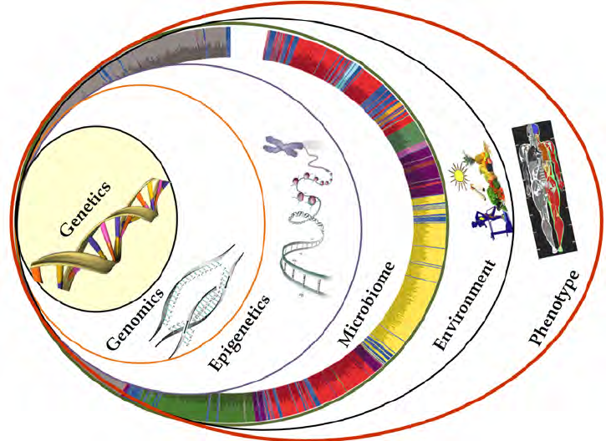
LOCAL ENVIRONMENTAL FACTORS(PERIOSTEAL MATRIX): They are non-genetic factors from local external environment. E.g.-habits, muscle force, etc.
GENERAL ENVIRONMENTAL FACTORS: They are general non-genetic influences such as nutrition, oxygen, etc.

Slide 101
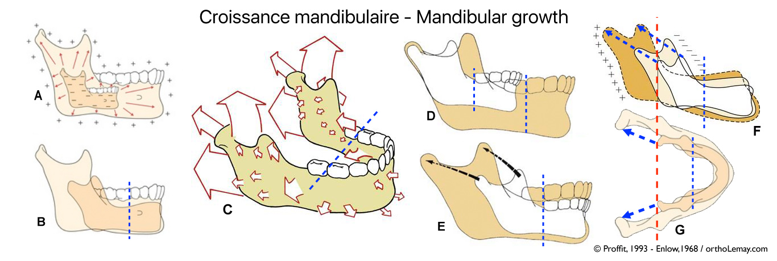
ENLOW’S EXPANDING ‘V’ PRINCIPLE-
This theory was put forward by DONALD ENLOW.
Many facial bones or parts of bone have a ‘v’ shaped pattern of growth.
The growth movements and enlargement of these bones occur towards the wide ends of the ‘v’ as a result of differential deposition and selective resorption of bone.

Slide 102
Bone deposition occurs on the inner side of the wide end of the ‘v’ and bone resorption on the outer surface.
Deposition also takes place at the ends of the two arms of the ‘v’ resulting in growth movement towards the ends.
As the remodeling continues, the ‘v’ moves away from its tip and enlarges simultaneously.

Slide 103
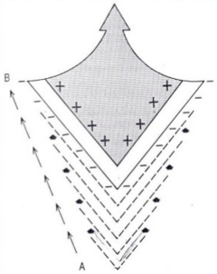
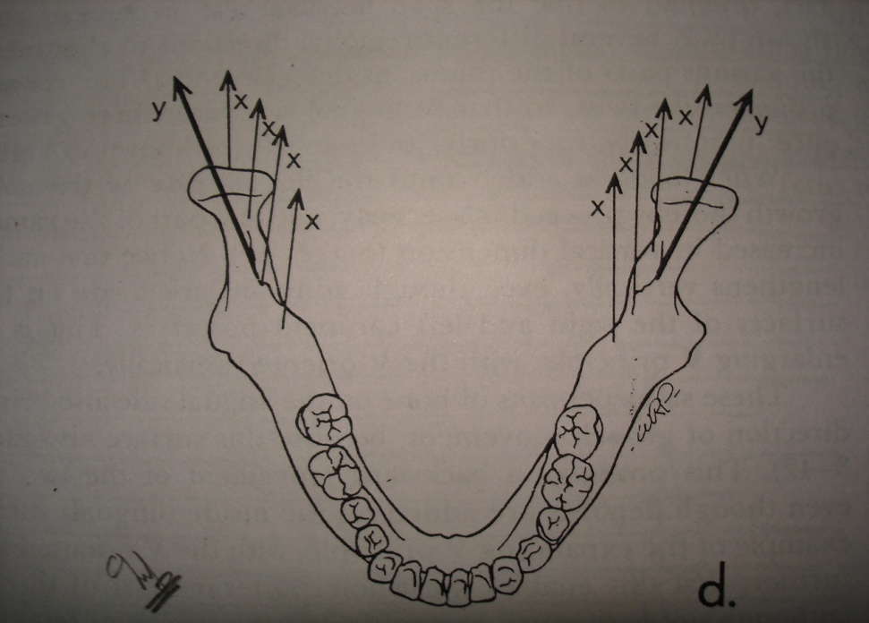
In this way, growth as well as movement of bone occurs simultaneously.
Such an increase in size and the simultaneous movement of the bone in the shape of ‘v’ is called as the expanding ‘v’ principle.

Slide 104
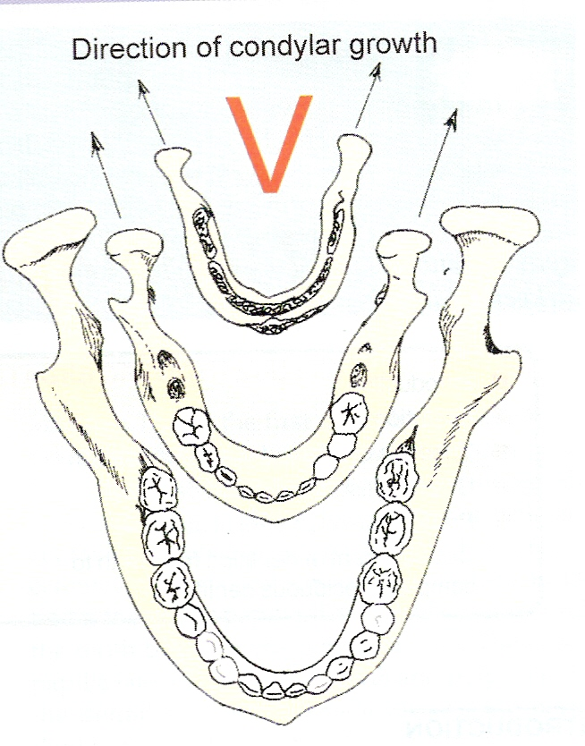
Such a growth process results in-
  Enlargement in overall size of the ‘v’ shaped area.
  Movement of the entire ‘v’ structure towards its own wider end.
  Continuous relocation(progressive
  sequential movement of component parts as a bone enlarges).

Slide 105
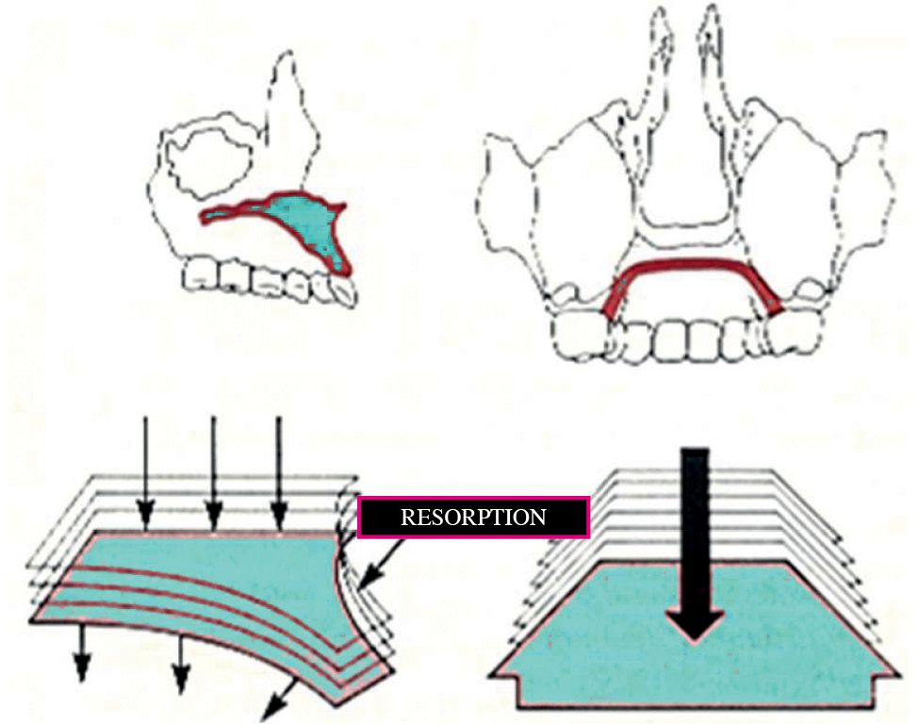
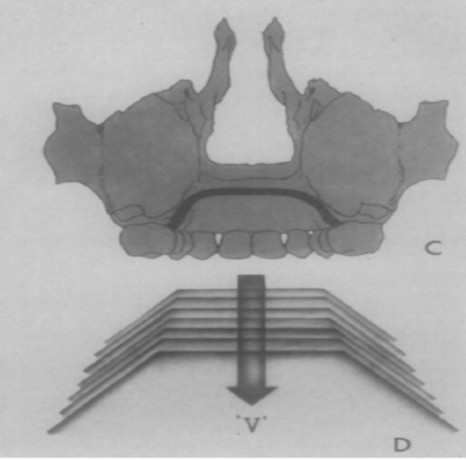
Most of the craniofacial bones including maxilla, mandible and palate grow on an expanding ‘v’.
  Growth of the palate is one of the best example of expanding ‘v’ principle.
  Deposition occurs on the palatal periosteal surface and resorption occurs on the side of nasal floor.
  In this way, palate expands on lateral direction and also moves downward.

Slide 106
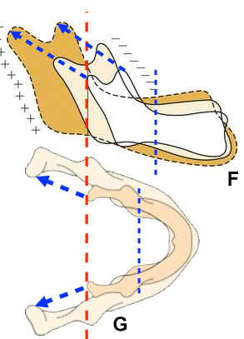
Ramus of the mandible grows on an expanding ‘v’ principle and the interramal width of the mandible also increases by expanding ‘v’ principle.
The condyle remodels according to this principle and the neck of the condyle gets lengthened.

Slide 107
ENLOW’S COUNTERPART PRINCIPLE-
This theory was given by ENLOW et al in 1969.
The counterpart principle of craniofacial growth states that the growth of any given facial or cranial part relates specifically to other structural and geometric counterparts in face and cranium.
There are regional relationships throughout the whole face and cranium.
If each regional part and its particular counterpart enlarge to the same extent, balanced growth occurs.

Slide 108
Imbalances in the regional relationships are produced by differences in-
  Amounts of growth between the counterparts.
  Directions of growth between the counterparts.
  Time of growth between the counterparts.

Slide 109
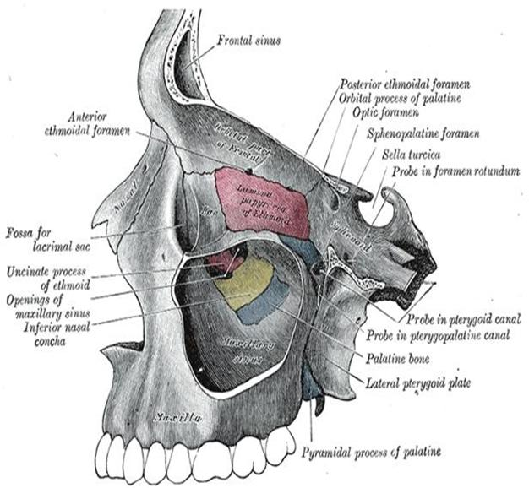
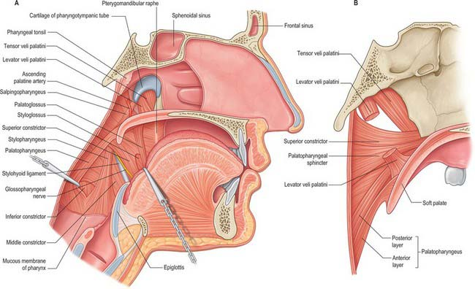
The different parts and their counterparts are-
  Nasomaxillary complex relates to the anterior cranial fossa.
  Horizontal dimension of the pharyngeal space relates to the middle cranial fossa.

Slide 110
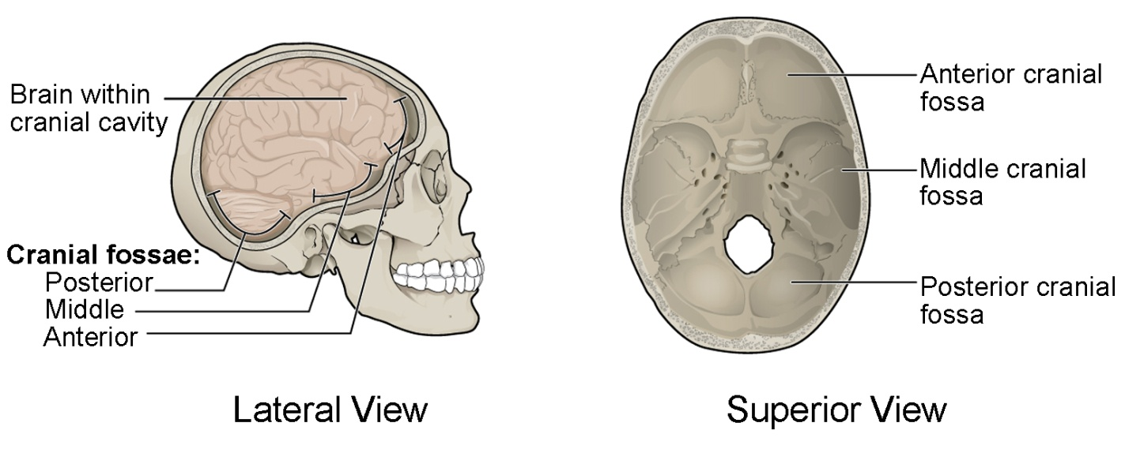
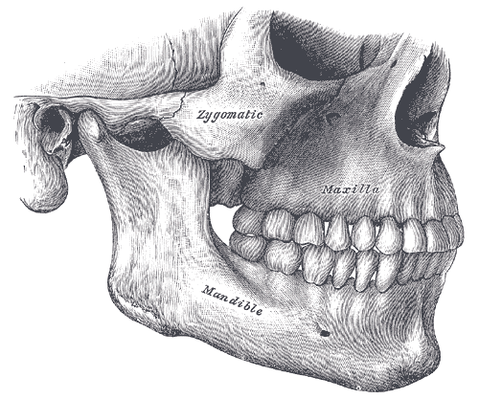
  Middle cranial fossa and breadth of ramus are counterparts.
  Maxillary and mandibular arches are mutual counterparts.

Slide 111
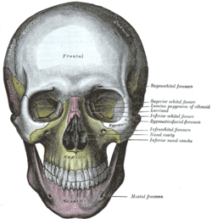
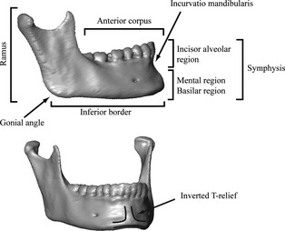
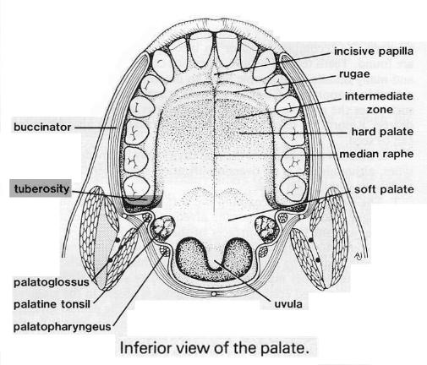


  Bony maxilla and corpus of mandible are mutual counterparts.
  Maxillary tuberosity and lingual tuberosity are counterparts.
Notes:
Growth at maxillary tuberosity-pushing maxilla against the cranial base-f and d

Slide 112
Drawbacks-
Enlow’s counterpart analysis (Enlow et al. 1969; Enlow, 1990; Enlow & Hans, 1996) can be regarded as an example of modularity: the growth counterparts are hypothesized to subdivide the skull into various relatively independent modules, both sagittally and vertically.
It is important to note that modularity is not limited to a single developmental organizational level: what appears as a single module at a given level of complexity can represent multiple modules seen from the next, lower level of complexity (Bastir, 2008) (e.g. when inspecting specific substructures at a higher resolution).
To shed some light on specific craniofacial mechanisms of morphological integration, it is essential to first identify and delimit modules (Klingenberg et al. 2003).
Notes:
J of anatomy

Slide 113

HUNTER-ENLOW GROWTH EQUIVALENT THEORY
This theory was put forward in 1968 by Hunter and Enlow.
This theory states that ‘there are four morpho-genetically distinct regions in the human skull- mandible, middle face, upper face, calvaria. The middle face, cranial base and the mandible are directly contiguous with each other, and the growth events that occur in one necessarily affects the nature of reciprocal, complementary growth processes in portions of the other two’.

Slide 114

Growth occurs at sutures, periosteal and endosteal surfaces and synchondroses.
Growth is a combination of complex remodeling at periosteal and endosteal surfaces as well as translation of whole bones in space.
The cartilaginous nasal septum and cranial base displace the other cranial and facial bones during growth and sutures respond secondarily to maintain the contact with adjacent bones.
Sutures and periosteal growth are controlled primarily by growth of adjacent structures and function.
Notes:
Translation-displacement-primary displacement-secondary displacementmaxilla atthached to vranial base
Cortical drift-deposition surface

Slide 115

The face, according to Hunter-Enlow, can be seen as consisting of specific horizontal and vertical ‘equivalents’ which match each other in general size or position if a harmonious face is to exist.
For example- The anterior cranial base, maxilla and the body of the mandible represent growth equivalents in the horizontal direction.
The forward displacement of the nasomaxillary complex occurs by the elongation of the spheno-occipital segment.

Slide 116
Different regions of the face and cranium are directly interdependent and mutually inter-related in respective growth activities.
This theory was supported by Petrovic’s servosystem theory and McNamara, in which he altered the muscle function in primates to evaluate the alterations in facial form.

Slide 117

FUNCTIONAL MATRIX HYPOTHESIS
This theory was put forward by Melvin Moss in 1962. Later updated
in 1990.
Moss theory was influenced by the ideas of Vander Klaauw(1946)-He asserted that the skull was made up of units whose size,shape,and position were determined by their functions. He called these units as functional cranial components.
The theory stated that- ‘the origin,growth and maintenance of all skeletal tissues and organs are secondary and compensatory responses to events and processes, occurring in related non skeletal tissues, organs and functioning spaces, called the functional matrices’.

Slide 118
A number of relatively independent functions are carried out in the cranio-facial region of the human body.eg-mastication, digestion , etc.
Each of these functions is carried out by a functional cranial component.
Each functional cranial component consists of all of the tissues, organs, spaces, and skeletal parts necessary to carry out a given function.

Slide 119
The functional cranial component is divided into:-
  Functional matrix
  Skeletal unit
All the tissues, organs and functioning spaces – Functional matrix
Skeletal tissues related to specific functional matrix-Skeletal unit
All the skeletal tissues originate, grow, and function completely embedded in their several matrices.
Changes in size, shape and spatial position of all skeletal units including their maintenance is due to the operational activity of their related functional matrices.

Slide 120

THE SKELETAL UNIT-
All skeletal tissues associated with a single function are called as ‘the skeletal unit’.
The skeletal unit comprises of bone, cartilage
and tendinous tissue.
Skeletal unit is composed of-microskeletal and macroskeletal units.
When a bone is composed of several contiguous skeletal units known as ‘microskeletal units’.
For ex-
    microskeletal units of mandible are alveolar, angular, condylar, gonial, mental, coronoid and basal units.

Slide 121

  Micro-skeletal unit of maxilla-orbital, pneumatic, palatal and basal units.
When adjoining portions of a number of neighboring bones are united to function as a single cranial component, it is called as ‘macro-skeletal unit’.Ex- endocranial surface of the calvarium is an example of macro-skeletal unit.

Slide 122
THE FUNCTIONAL MATRIX-
The functional matrix consists of muscles, glands, nerves, vessels, fat, teeth and the functioning spaces.
The functional matrix is divided into-
  Periosteal matrix
  Capsular matrix
Notes:
Temporal line of parietal bone
Neurocranium-case around the brain facial skeleton

Slide 123
PERIOSTEAL MATRIX-
The periosteal matrix include the muscles, blood vessels, nerves, glands, etc.
The periosteal matrices act directly and actively upon their related skeletal units.
Alterations in their functional demands produce a secondary compensatory transformation of the size and/or shape of their skeletal units.
Such transformation is brought about by the inter-related processes of bone deposition and resorption.

Slide 124

For example-
Consider the matrix of temporalis muscle and the coronoid process.
Research has shown that removal or denervation of the temporalis muscle results in the reduction in the size of the coronoid process also, sometimes leading to its total degeneration.
Conversely, hypertrophy or hyperactivity of the temporalis muscle increases the size of the coronoid process.

Slide 125

CRANIAL CAPSULE-
The craniofacial region can be divided into a number of matrix systems called as cranial capsules.
The cranial components comprising the neural region exist within the neurocranial capsules.
Those forming the facial region lie within the orofacial capsule.
The various cranial and orofacial skeletal units act to surround and protect their respective capsular functional matrices.

Slide 126

For example-
Let us consider the neural capsule.
    It consists of brain, leptomeninges and cerebrospinal fluid.
    In the neural capsular functional matrix model, during growth of the brain, the calvarial skeletal tissues are passively translated in space in response to the expanding neural mass.

Slide 127
Hydrocephaly is a situation in which there is raised intracranial pressure. This raised intracranial pressure causes the expansion of the neurocranial capsule.
But increased intracranial pressure also effectively decreases the blood flow within the capsule and so prevents periosteal deposition of bone at sutural areas thus producing characteristically excessively large fontanelles.

Slide 128
FUNCTIONAL CRANIAL COMPONENT
SKELETAL UNIT
FUNCTIONAL MATRIX
MICROSKELETAL UNITS
MACROSKELETAL
UNITS
CAPSULAR
MATRIX
PERIOSTEAL
MATRIX

Slide 129
SKELETAL UNIT
MICROSKELETAL UNIT
MACROSKELETAL UNIT
ALVEOLAR, GONIAL, CONDYLAR, ANGULAR AND BASAL UNIT OF MANDIBLE
MANDIBLE
MAXILLA

Slide 130
FUNCTIONAL MATRIX
CAPSULAR MATRIX
PERIOSTEAL MATRIX
ACT DIRECTLY ON MACROSKELETAL UNIT
ACT DIRECTLY ON MICROSKELETAL UNITS
EXPANSION OF CAPSULES CAUSES CHANGES IN SPATIAL POSITION OF THE SKELETAL UNITS
CAUSE CHANGES IN SIZE AND SHAPE OF BONE BY APPOSITION AND RESORPTION
EFFECT PASSIVE GROWTH OR TRANSLATION
EFFECTS ACTIVE GROWTH/TRANSFORMATION

Slide 131

STUDY IN SUPPORT OF THE THEORY-
In the cranial vault, the stimulus arises primarily from the expanding brain (Baer, 1954; Moss, 1954), sending signals by means of the dura mater (Kokich, 1986; Cohen, 2000).
As the brain expands and the cranial base synchondroses (cartilaginous bone growth plates) lengthen, the sutures respond by adding intramembranous bone at the edges of the bone fronts, such that the sutures remain approximately the same width and the cranial vault increases in size to accommodate the enlarging brain.

Slide 132
Clinical application of functional matrix theory
Application of force by orthodontic appliances tend to alter the functional matrix .
Alteration of periosteal matrix produces changes in microskeletal unit (alveolar bone).
Alteration of capsular matrix (dentofacial orthopedics) produce changes in macroskeletal unit (jaws).
Rapid platatal expansion by widening of palatal sutures is a form of orofacial orthopedics.
Repositioning of maxillary segment in cleft patient.

Slide 133
SHORTCOMING OF FUNCTIONAL MATRIX:-
The functional matrix theory had a principal shortcoming-
It failed to explain the sequence of events through which the extrinsic stimuli caused the adaptive responses in the skeletal structures,i.e.,the flow of the signals that generated the required response.
This issue has been addressed in newer researches which focused on intercellular signaling, communication and signal transduction from macromolecular matrix to micromolecular matrix.

Slide 134
FUNCTIONAL MATRIX HYPOTHESIS REVISTED-
It included four concepts-
CONCEPT OF MECHANOTRANSDUCTION
BONE AS AN OSSEOUS CONNECTED CELLULAR NETWORK
GENOMIC THESIS
EPIGENETIC ANTITHESIS AND THE RESOLVING SYNTHESIS
Notes:
Epigenetic-casual interaction between the gene and their products which bring the phenotype into being.

Slide 135
CONCEPT OF MECHANOTRANSDUCTION-
Mechanotransduction signifies cellular signal transduction.
It is the process by which macrocellular extrinsic stimuli are converted into cellular signals, which can be internalized by a cell and processed so that a suitable adaptive response can be generated.

Slide 136
There are several mechanotransductive processes, for example, mechanoelectrical and mechanochemical.
Whichever are used, bone adaptation requires the subsequent intercellular transmission of the transduced signals.

Slide 137
All vital cells respond to alterations in their external environment.
Mechanosensing processes enable a cell to sense and to respond to extrinsic loadings.
Mechanosensing process involves mechanoreception and mechanotransduction.
Mechanoreception transmits an extracellular physical stimulus into a receptor cell.
Mechanotransduction transduces or transforms the stimulus's energetic and/or informational content into an intracellular signal.
- Lewontin RC, Holland JH.

Slide 138
Osseous Mechanotransduction
Static(Waldrop MM) and dynamic(Liebovitch JS, West B) loadings are continuously applied to bone tissues, tending to deform both extracellular matrix and bone cells.
When an appropriate stimulus parameter exceeds threshold values, the loaded tissue responds by bone cell adaptation processes.
Osteoblasts directly regulate bone deposition and maintenance and indirectly regulate osteoclastic resorption- Grande L, Rieppel O.
Notes:
Afferent- sensory

Slide 139
Osseous mechanotransduction is unique in four ways-
  Most sensory cells are cytologically specialized but bone cells are not.
  Bone loading stimulus evokes three adaptational responses, non-osseous processes generally evoke one.
  Osseous signal transmission is aneural, other mechanosensory signals use afferent neural pathways(Mitchell M).
  The evoked bone adaptational responses are confined within each ‘bone organ’ independently. eg- within the femur.
Notes:
Afferent - sensory

Slide 140
Mechanotransduction translates the information content of a periosteal functional matrix stimulus into a skeletal unit cell signal, for example, it moves information hierarchically downward to the osteocytes.
There are two skeletal cellular mechanotransducive processes: ionic and mechanical.
Ionic or electrical processes:
Ionic transport occurs through the osteocytic plasma membrane.
This results in intercellular transmission of electric signals.
It is computed by the osseous connected cell network.
This network’s output regulates the multicellular bone cell responses. (Moss M)

Slide 141
Stretch activated channels:
Several types of deformation may occur in strained bone tissue.
One of these involves the plasma membrane stretch-activated ion channels, a structure found in bone cells(Salmivirata K, Gullberg D) and also in fibroblasts (Slavkin H).
When activated in strained osteocytes, they permit passage of a certain sized ion or set of ions, including K +, Ca2+, Na +.causing generation of action potential.
Such ionic flow may, in turn, initiate intracellular electrical events, for example, bone cell S-A channels may modulate membrane potential as well as Ca 2+ ion flux.

Slide 142
Electrical processes:
These include several, non exclusive mechanotransducive processes (e.g.- electromechanical and electrokinetic), involving the plasma membrane and extracellular fluids.
Electromechanical-
As in most cells, the osteocytic plasma membrane contains voltage - activated ion channels, and transmembrane ion flow may be a significant osseous mechanotransductive process. (Mayr E, Provine WB)
It is also possible that such ionic flows generate osteocytic action potentials capable of transmission through gap junctions -Bouchard TJ
Notes:
Permits transpoet of specific substances- transmemebrane

Slide 143
Electrokinetic:
Bound and unbound electric charges exist in bone tissue, many associated with the bone fluid(s) in the several osseous spaces or compartments - Crabbe JC, Belknap JK
It is generally agreed that electrical effects in fluid-filled bone are not piezoelectric, but rather of electrokinetic, that is, streaming potential (SP) origin. (Myers MP, Wager-Smith )
The SP is a measure of the strain-generated potential (SGP) of connected electric charges in the fluid flow of deformed bone.
The usually observed SPG of +2 mV can initiate both osteogenesis and osteocytic action potentials. (Herrnstein RJ, Murray C)
Notes:
Produce electricalcharges accord to mechanical stress-piezoelectric

Slide 144
Electric field strength:
Bone responds to exogenous electrical fields. (Reddi AH)
Although the extrinsic electrical parameter is unclear, field strength may play an important role (Atchley W).
A significant parallel exists between the parameters of these exogenous electrical fields and the endogenous fields produced by muscle activity.

Slide 145
Mechanical processes:
Although it is probable that the intracellular, transductive process does not initiate action potentials, it is an alternative means by which periosteal functional matrix activity may regulate hierarchically lower level bone cell genomic functions.
The mechanical properties of the extracellular matrix influence cell behavior. (Ishiguro K)
Loaded mineralized bone matrix tissue is deformed or strained.

Slide 146
Recent data indicate that a series of extracellular macromolecular mechanical levers exist, capable of transmitting information from the strained matrix to the bone cell nuclear membrane.
The basis of this mechanism is the physical continuity of the transmembrane molecule integrin. (cell signaling molecule)
This molecule is connected extracellularly with the macromolecular collagen of the organic matrix and intracellularly with the cytoskekeletal actin.

Slide 147
The molecules of actin, in turn, are connected to the nuclear membrane, at which site the action of the mechanical lever chain initiates a subsequent series of intranuclear processes regulatory of genomic activity. (Lovell DP, Johnson FM)
It is suggested that such a cytoskeletal lever chain, connecting to the nuclear membrane, can provide a physical stimulus able to activate the osteocytic genome (Balme DM, 1992 )
It is by such an interconnected physical chain of molecular levers that periosteal functional matrix activity may regulate the genomic activity of its strained skeletal unit bone cells, including their phenotypic expression.

Slide 148
FORCE(MUSCULAR OR EXOGENOUS SUCH AS ORTHODONTIC APPLIANCE – HEADGEAR)
TISSUE STRAIN
INTERSTITIAL FLUID FLOW
CELL MEMBRANE STRAIN CAUSES DEFORMATION OF THE MEMBRANE AND CYTOSKELETAL STRUCTURES
EXPRESSION OF REGULATOR GENES
REGULATION OF MARKER GENES
CELL DIFFERENTIATION,PROLIFERATION AND MATRIX SYNTHESIS
GROWTH AND DEVELOPMENT
MACROSCOPIC CHANGE IN SHAPE
Notes:
A regulator gene, regulator, or regulatory gene is a gene involved in controlling the expression of one or more other genes
a marker gene is a gene used to determine if a nucleic acid sequence has been successfully inserted into an organism's DNA

Slide 149
BONE AS AN OSSEOUS CONNECTED CELLULAR NETWORK ‘CCN’ –
The term ‘CCN’ implies that a network exists between the adjacent cells of a tissue through specialized structures in the cell membrane.
The specialized structures are-tight junctions and the gap junctions in the cell membrane.
These junctions serve to rapidly spread the stimuli across the connected cells.

Slide 150
It has been proven that extensive CCN exists in bone and that the principle component of it is the gap junction.-SCHIRRMACHER K,SCHMITZ ET AL.
Connexin 43, a cytoskeleton protein, is the major constituent of this network- MINKOFF R, RUNDUS VR ET AL.
Gap junctions not only connect the osteocyte to the neighbouring osteocyte but also the superficial osteocytes to periosteal and endosteal osteoblasts.
This network is so well established that it may be said that the bone tissue is ‘hard-wired’- MOSS ML,NOWAK R.
Connected cellular network's output regulates the multicellular bone cell responses-Langton CG.

Slide 151

Gap junctions allow passage of the ionic currents and biochemical molecules, and allow bidirectional flow of signals, in contrast to chemical synapses.

Slide 152

GENOMIC THESIS-
Genomic thesis claims that the genome contains all the information needed for the growth and development of an organism from intrauterine life till death.
It holds the necessary information to ‘regulate’-
  The intranuclear formation and transcription of mRNA.
  And without mRNA the morphogenesis of tissues, cells and organs is not possible.

Slide 153
The proponents of this theory argue that ‘all (phenotype) features are ultimately determined by the DNA sequence of genome’-HILL PA,REYNOLDS JJ ET AL.

Slide 154
In this thesis, morphogenesis is but the predetermined reading-out of an intrinsic and inherited genomic organismal blueprint where, in addition to molecular synthesis, the genome also regulates the geometric attributes of cell, tissue, organ, and organismal size, shape, and location.
For example, "specific patterns of gene regulation (cause, control, regulate, determine) the mechanisms by which a fertilized egg divides and progresses through the various decision points to yield groups of cells that are first determined to become and then actually differentiate to become specialized tissues of the right dimension and in the proper location. ‘’-Lodish H, Baltimore D

Slide 155
EPIGENETIC ANTITHESIS AND THE RESOLVING SYNTHESIS-
Epigenetic factors include-
All of the extrinsic, extraorganismal, macroenvironmental factors important for vitality such as food, light, temperature, also including electromagnetic field.
All of the intrinsic, intraorganismal, biophysical events occurring on, in, and between individual cells, extracellular materials, and cells and extracellular substances.
Thus, according to Moss, even orthodontic stimuli may be considered to be an epigenetic stimuli which regulate or alter the craniofacial growth.

Slide 156
The genomic thesis is denied because it is both reductionist and molecular; that is, descriptions of the causation (control, regulation) of all hierarchically higher and structurally more complex morphogenetic processes are reduced to explanations of mechanisms at the molecular (DNA) level.
For example, the genomic thesis of craniofacial odontogenesis passes directly from molecules to morphogenesis: directly from DNA molecules to adult gross morphology, ignoring the role(s) of the many epigenetic processes and mechanisms competent to control (regulate, cause) the large number of intervening, and increasingly more structurally complex, developmental stages13318 particularly, and there are additional similarly reductionist views of odontogenesis- Harold FM, Holliday R.
The epigenetic antithesis, detailing both processes and mechanisms, is integrative(Civitelli R) seeking to clarify the causal chain between genome and phenotype.

Slide 157
"intrauterine environment" can regulate fetal mandibular growth -Sasaki Y, Nonaka K
Loading -Many different epigenetic processes can evoke mechanisms capable of modifying DNA- Jorgensen R, Solter D.
"Among the numerous epigenetic factors influencing the vertebrate face is mechanical loading. ‘’- Herring SW
While clinical observations usually are macroscopic, the loadings act microscopically, at molecular and/or cellular levels- Davies PF, Brand RA
Closely similar epigenetic mechanisms and processes are observed in the adaptational responses of all connective tissues, including cartilage, to loading. -Biewener AA, Bertram JE
Mechanical loading is known to influence gene expression- Sandy JR, Farndale R
Of clinical (and FMH) interest, extrinsic musculoskeletal loading can rapidly change (1) both articular cartilage intercellular molecular syntheses and mineralization(van't Veen SJ, Hagen JW) and (2) osteoblastic (skeletal unit) gene expression- Raab-Cullen DM, Thiede DN.
Notes:
Loading – dymaic – muscle contraction static - gravity

Slide 158
SERVOSYSTEM THEORY AND CYBERNETICS-
Servosystem theory was given by Petrovic and Stutzman in 1980.
Servosystem theory is based on “cybernetic concept”.
Weiner defined cybernetics as ‘the science of control and communication in the animal and machine’.
Petrovic using the language of cybernetics explained the growth of various craniofacial regions is the result of interaction of a series of casual change and feedback mechanisms.

Slide 159

Cybernetics theory postulates that everything affects everything and, therefore, organized living systems never operate in an open-loop manner.
In an open loop mechanism, the input/stimulus leads to a response and there is no feedback or regulation.

Slide 160
Closed loop system can be of two types-
  Regulator system in which the main input is constant.
  Servosystem/follow-up system in which the main input varies rather than being constant.
Closed loop system can be expressed as follows-
INPUT/STIMULUS
REGULATION
MEASURE OF INPUT
MODIFIED INFORMATION

Slide 161
COMPONENTS OF A SERVOSYSTEM-
COMMAND
REFERENCE INPUT ELEMENTS
REFERENCE INPUT
COMPARATOR
ACTUATING SIGNAL
CONTROLLED SYSTEM
CONTROLLED VARIABLE
ATTRACTOR
REPELLER

Slide 162
COMPONENTS OF A SERVOSYSTEM
COMMAND: It is a signal established independently of the feedback system scrutiny.
It affects the controlled system without being affected by the consequences of this behavior.eg.-growth hormone, testosterone.
2. REFERENCE INPUT: It is the signal established as a standard of comparison such as the sagittal position of maxilla.

Slide 163
3. REFERENCE INPUT ELEMENTS: Establish the relationship between the command and reference input.
It includes the septal cartilage, septopremaxillary ligament,etc.
4. COMPARATOR: The configuration between the position of the upper and lower dental arch is the comparartor of the servosystem.
5. ACTUATING SIGNAL: Activity of the retrodiscal pad and lateral pterygoid constitutes the actuating signal.
Eg-the elastic menisco-temporal and menisco-mandibular frenums of the condylar disc form the retrodiscal pad.

Slide 164
6. CONTROLLED VARIABLE: It is the output signal of the servosystem.
Best example is the sagittal position of the mandible.
7. CONTROLLED SYSTEM: It is between the actuator and controlled variable.
E.g.-growth of condylar cartilage through the retrodiscal pad stimulation.
8. ATTRACTOR- It is the final structurally stable state in a dynamic system.E.G.- cusp to fossa relation.
9.REPELLER- It includes all unstable equilibrium states.eg- cusp to cusp relation.
Notes:
Centric relation- mand jaw position –head of condyle- ant and sup as it possibly can within the mand fossa

Slide 165
DEVELOPMENT OF FACE AS SERVOSYSTEM-
According to the servosystem theory(CARLSON DS), the midface grows downward and forward under the primary influence of the cartilaginous cranial base and nasal septum, influenced principally by the intrinsic cell tissue related properties common to all primary cartilages and mediated by the endocrine system.
The influence of somatotropic hormone on the growth of cartilages of nasal septum,spheno-occipital synchondroses and other synchondroses follows that of a cybernetic form of command pattern.
Related to this event, the maxillary dental arch is carried into a slightly more anterior position.
This is the first and primary event.

Slide 166
This causes a miniscule variation between the upper and lower arches which Petrovic(GRABER TM, RAKOSI T) referred to as ‘comparator’,ie, constantly changing reference point between the positions of upper and lower jaws.
The upper dental arch is the constantly changing reference input.
Second, within the periodontium and TMJ, the proprioceptors recognize even a tiny occlusal variation and activate the muscles for mandibular protrusion tonically.
PETROVIC said that the functional appliances will work in the same way when given to stimulate mandibular growth in class 2 malocclusions.
Third, activation of retrodiscal pads and lateral pterygoid muscles act on the condylar cartilage directly and through the vascular supply to the TMJ indirectly, thereby stimulating the growth of the condyle.
Growth in the secondary cartilages, like the condyle,corresponds to local and environmental factors(epigenetic control).
Lower arch constitutes the controlled variable.
Notes:
Primary –synchondrose
Symphysis- secondary – fibrocartilaginous joint-intervertebral

Slide 167

At last, hormonal factors acting principally on the condylar cartilage and the musculature get directly and indirectly influenced by the effect of the muscle function and receptivity of the condylar cartilage.
As long as the midface-upper dental arch portion grows and matures with proper extrinsic, functional and hormonal factors being supportive, this complete cycle is activated incessantly as a servomotor.
This affects the output signal.
The output signal is the final sagittal position of mandible.
The final sagittal position of the mandible depends on the modification of condylar growth by the activity of retrodiscal pad and lateral pterygoid muscle stimulation.

Slide 168
HORMONAL FACTORS
IN ORDER TO REPOSITION THE MANDIBLE ANTERIORLY THE MUSCLE ACTIVITY AND THE PROTRUSION IN THE PRESENCE OF APPROPRIATE HORMONAL FACTORS
REFERENCE INPUT
MAXILLARY GROWTH
COMMAND
ANTERIOR GROWTH OF THE MIDFACE
CONTROLLED SYSTEM
MUSCLE FUNCTION
OCCLUSAL DEVIATION
COMPARATOR
CONDYLAR GROWTH
STIMULATE GROWTH AT THE MANDIBULAR CONDYLE
OUTPUT
ACTUATING SIGNAL
IT TRIGGERS THE PROTRUDED MUSCLES OF THE MANDIBLE TO BECOME MORE ACTIVE TONICALLY
RESULTS IN A SLIGHT OCCLUSAL DEVIATION BY PROPRIOCEPTORS
SENSORY ENGRAM
PROPRIOCEPTORS:
PERIODONTIUM-TMJ
PERCEPTION OF THIS OCCLUSAL DEVIATION BY PROPRIOCEPTORS
CNS
SERVOSYSTEM THEORY OF CRANIOFACIAL GROWTH WITH EMPHASIS ON THE GROWTH OF THE MANDIBLE

Slide 169
COMMAND(RELEASE OF GROWTH RELATED HORMONES)
REFERENCE INPUT ELEMENTS(Eg.-SEPTAL CARTILAGE)
CONSTANTLY CHANGING REFERENCE INPUT(SAGITTAL POSITION OF MAXILLA)
DISTURBANCES
COMPARATOR(CONFRONTATION BETWEEN UPPER AND LOWER ARCHES)
COUPLING SYSTEM
(AMPLIFIER)
COUPLING SYSTEM(GROWTH AT CONDYLAR CARTILAGE)
CONTROLLED VARIABLE
(SAGITTAL POSITION OF MANDIBLE)
ACTUATOR (TEETH,
PERIODONTIUM,MUSCULATURE)
CONTROLLER
PERFORMANCE ANALYZING ELEMENTS
PERFORMANCE

Slide 170
CLINICAL SIGNIFICANCE
It is difficult to explain the growth of most parts of the body with servosystem theory.
It is used to explain the growth of mandible following functional appliance therapy.
It is more useful as a research and experimental tool.

Slide 171
EVIDENCES AGAINST THE THEORY
Goret-Nicaise, Awn (1983) found that the resection of lateral pterygoid muscle fails to diminish condylar growth.
Das, Meyer, Sicher (1965) found that the occlusion remained unaffected in condylectomy studies.

Slide 172
NEUROTROPISM IN OROFACIAL GROWTH-
This theory was given by Moss ML in 1971.
According to the functional matrix theory by Moss, the soft tissues regulate the skeletal growth through functional stimuli.
The process by which the functional stimulus is transmitted to the skeletal unit interface involves neurotropism.

Slide 173

Neurotropism is a non-impulse transmitting neural function that involves axoplasmic transport and provides for long term interaction between neurons and innervated tissues that homeostatically regulates the morphological, compositional and functional integrity of those tissues.
Notes:
Axoplasm- cytoplasm of nerve axon homeostatically- maintain internal stability

Slide 174
Neurotropism mechanisms are of three types-
  Neuro-epithelial tropism
  Neuro-visceral tropism
  Neuro-muscular tropism

Slide 175
NEURO-EPITHELIAL TROPISM-
Epithelial growth regeneration is controlled by neurotropism.
The normal epithelial growth is controlled by certain neurotropic substances by the nerve synapses.
When neurotropic process is deficient orofacial hypoplasia and malformation may occur, eg, few patients with facial hypoplasia, cleft palate exhibit concurrent sensory deficits which show neuroepithelial tropism.

Slide 176

Another example explaining neuro-epithelial tropism-
The presence of taste buds is dependent upon an intact innervation.
The nerves are not only important for the sensation of taste but they also have a neurotrophic effect in sustaining healthy growth of the taste buds and nearby epithelial tissue.
If the taste buds are de-innervated, they become atropic and also the nearby epithelial cells.

Slide 177
NEUROMUSCULAR TROPHISM-
According to Moss, neural innervations influence the gene expressions of the cell.
The periosteal muscular functional matrices regulate the size and shape of the microskeletal units through neuromuscular trophism.
Embryonic myogenesis is independent of neural innervation and trophic control.
Approximately at the myoblast stage of differentiation, neural innervation is established without which further myogenesis usually cannot continue.
Notes:
Myoblast- myotubes

Slide 178
NEURO-VISCERAL TROPHISM-
The salivary gland, fat tissues and other organs are also regulated by neurotrophism, at least in parts.
Salivary hyperplasia and hypertrophy is thought to be partially under neurotrophic control.

Slide 179
CONCLUSION
With increased understanding of craniofacial growth and development we can develop better mechanotherapies.

Slide 180
REFERENCES-
Contemporary orthodontics—William.R.Profit
Handbook of orthodontics-Rorert.E.Moyers
Orthodontics Principles & practice-T.M.Graber
New vistas in orthodontics-Lysle.E.Johnston
The functional matrix hypothesis revisited – role of mechanotransduction -. (Am J Orthod Dentofac Orthop 1997;112:8-11)
The functional matrix hypothesis revisited –The role of an osseous connected cellular network- (Am J Orthod DentofacOrthop 1997;112:221-6.)
The functional matrix hypothesis revisited –The genomic thesis (Am J Orthod Dentofac Orthop 1997;112:338-42.)
The functional matrix hypothesis revisited -The epigenetic antithesis and the resolving synthesis - (Am J Orthod DentofacOrthop 1997; 112:410-7.)
Craniofacial Growth Series – Monograph 23 (Craniofacial Growth Theory and Orthodontic Treatment – Edited by Carlson)
Treatment objectives and case retention: Cybernetic and myometric considerations R.M. Jacobs Am J Orthod, 58:552-564, 1970
Grant’s Atlas of Anatomy

Slide 181
THANKYOU

