Slide 1

Good morning

Slide 2
INTRODUCTION

Slide 3
The caries preventive effect of fluoride has been known since the 1930’s, when the differences in caries prevalence between communities were attributed to naturally occurring fluoride levels in the drinking water.
The cariostatic efficiency of fluorides has been convincingly demonstrated & the recent decline in caries prevalence is primarily attributed to the increased use of various fluoride agents.
Due to its safety, efficacy and cost effectiveness in preventing caries, the use of fluorides in various forms thus remains cornerstone of most caries prevention programs.

Slide 4
OCCURRENCE AND CHEMISTRY OF FLUORIDE

Slide 5
Fluorine as element
Fluorine is the first member of Halogen Family with Atomic No:9 & Atomic Wt: 19
Fluorine in Latin means “To Flow”
Is a pale, yellow- green gas at the room temperature
Is the most electronegative element reacts with all the elements except oxygen and nitrogen

Slide 6
From biological viewpoint, fluoride is usually grouped with trace elements.
The Federal Register of United States (FDA) describes Fluoride as an essential micro nutrient.
The WHO Expert Committee on Trace Elements has included Fluorine as one among the 14 physiologically essential elements for the normal growth and development of human beings.

Slide 7
Fluoride in environment
  Lithosphere
  Hydrosphere
  Biosphere
  Atmosphere

Slide 8
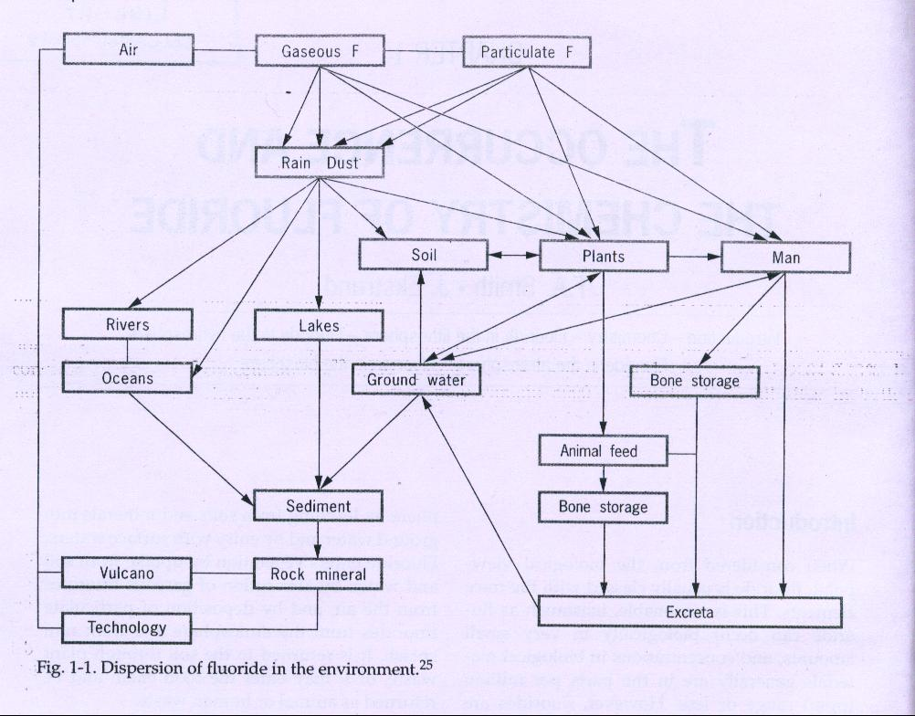
Fluoride in environment

Slide 9
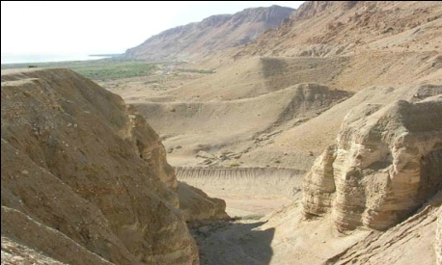
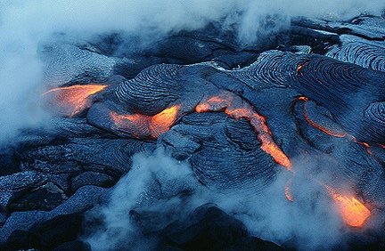
Fluoride in lithosphere
Fluoride is found mostly as inorganic fluoride.
Concentrations are increased in silicaceous igneous rocks, alkalic rocks in geothermal waters, hot springs and in volcanic gases.
About 150 fluoride containing minerals are known among them fluorspar, fluorapatite and cryolite are most important.
Fluoride is widely distributed in Earth’s crust where it averages 300ppm & about 0.087%.
Fluoride concentrations varies in different types of rocks.

Slide 10
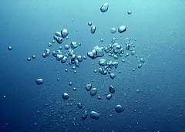
Fluoride in hydrosphere
Due to universal presence of fluorides in Earth’s crust, all water contains fluoride in varying concentrations.
The concentration of fluoride in water varies not only from place to place but also within the same locality.
Water with high fluoride content are usually found at the foot of high mountains and in areas with geographical deposits of marine origin.
The fluoride content of water from rivers, lakes or wells is for the most part below 0.5mg/kg even though concentration as high as 95mg/kg is reported in Tanzania.

Slide 11

Fluoride in atmosphere
Fluoride is found in the air of both rural as well as cities.
Sources are volcanoes, dust generating by weathering of fluoride soils, outcropping of minerals, ocean spray, smoke from burning coal & industrial waste release.
Person normally inhales up to 0.8mg fluoride per day.

Slide 12

Fluoride in biosphere
The normal level of fluoride in plants is about 2-20mg/g of dry weight.
Virtually all foodstuffs contain at least trace amounts of fluoride.

Slide 13
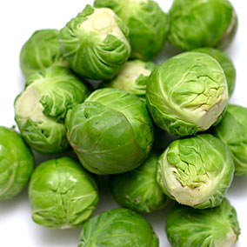
Leafy vegetables such as cabbages, lettuce,& Brussels sprouts contain 11-26 mg F on dry weight basis.
About 90% of weight of vegetables is water
Washing leafy vegetables reduces intake of fluoride by 1/3 -1/2.
Plants grown in acidic soil have more fluoride than grown in lime containing basic soil.
Uptake varies among plant species, being influenced by age of the leaf, soil, use of fertilizers, irrigation etc.

Slide 14
SOURCES
RICH SOURCES:
  Water – ground water, sea water (1-1.5 ppm)
Food
  Sorghum (3-3.5 ppm)
  Barley and rice (2 ppm)
  Meat (0.2-1ppm)
  Veg –green salad, potato etc (6.5 ppm)
  Canned fish such as salmon and sardines (0.21- 4.5ppm)
Beverages
  Tea leaves (40 – 70 ppm)
  Wine (6-8 ppm)

Slide 15
Dental products
  Toothpaste (1000 – 1500 ppm)
  Solution and gels for topical treatment (4000-19000ppm)
  Fluoride tablets (0.25,0.5 or 1 mg/tablet)
Atmosphere
  volcanic and industrial activity,
  burning of coal
POOR SOURCES
Milk (0.02-0.05 ppm)
Coconut water (0.43 – 0.6 ppm)

Slide 16
FLUORIDE INTAKE

Slide 17
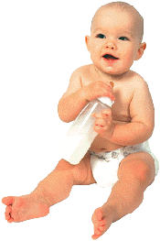
Infants
Much of the infants diet consists of human milk or milk of other mammals.
Fluoride is poorly transported from plasma to milk, and concentration of fluoride in milk remain low even when the intake of fluoride by the woman is high.
Fluoride concentration of human milk ranges from 5-10ug/L
Cow’s milk has 0.04ppmF

Slide 18
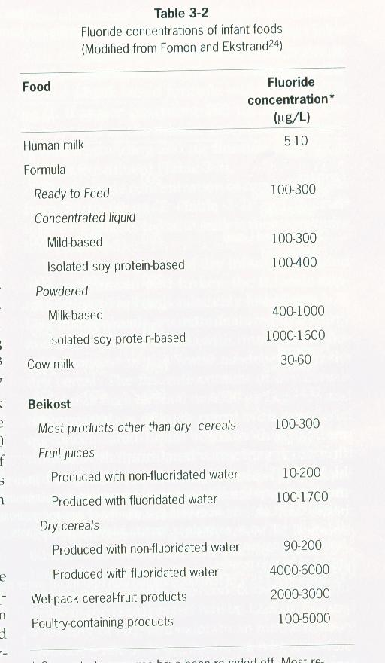

Slide 19
Pre school children
Predominantly from beverages rather than food.
Intake of fluoride is likely to be quite low when the predominant beverage is cow milk, but will be considerably greater when consumption if fruit juices, fruit flavored drinks and carbonated beverages is high.

Slide 20
Fluoride concentrations varies within same type, brand, flavor.
Cranberry,redberry,cherry,apple - > 0.6ppm
Orange,pineapple,lemonade - < 0.6ppm
Jowar, banana and potatoes also contain substantial quantities of fluoride.

Slide 21
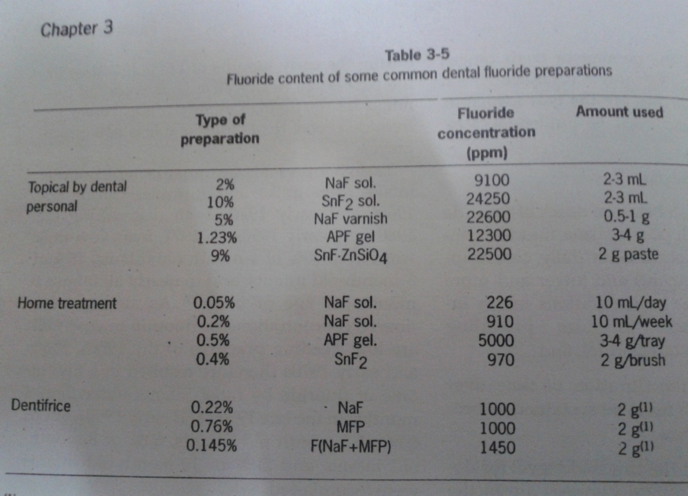
Fluoride exposure from dental products

Slide 22
Miscellaneous sources of exposures
The vessel used for cooking may also influence the fluoride content of the food. Teflon coated pans release fluoride whereas aluminum absorb fluoride during cooking.
Use of fluoride containing tranquiliers (benzothiazines, fluorosteroids, phenothaizines), fluoride containig ANAESTHETICS (Enflurane, Isoflurane & Sevoflurane) or other drugs rarely contributed substantially to fluoride intake.

Slide 23
FLUORIDE METABOLISM

Slide 24
A thorough knowledge of fluoride metabolism can be obtained by dividing it into -
ABSORPTION
DISTRIBUTION
ELIMINATION

Slide 25
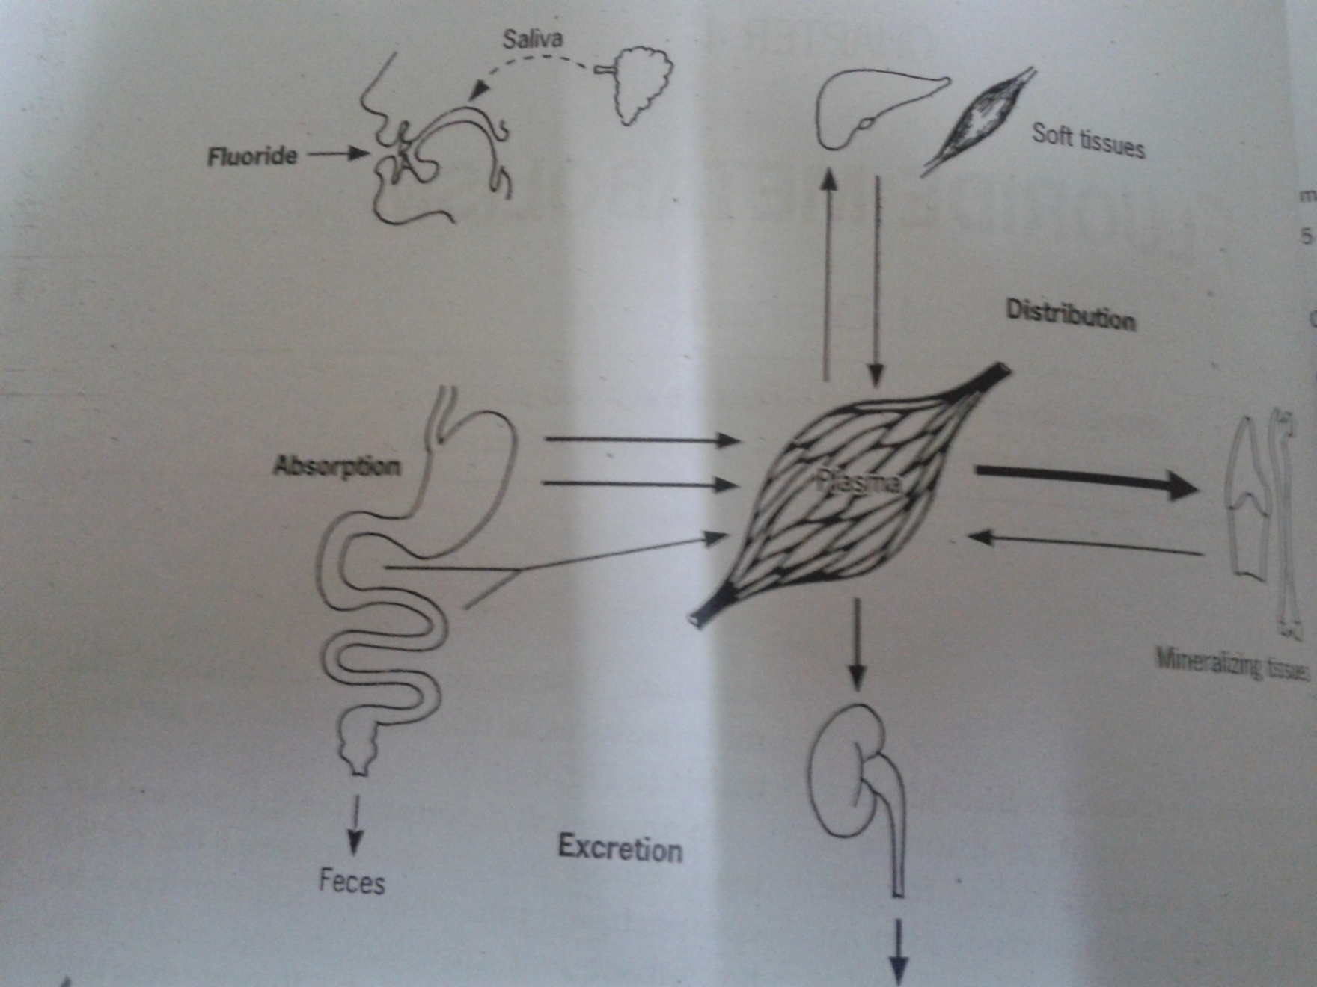

Slide 26
Absorption
STOMACH AND INTESTINE
(MAXIMUM)
ORAL TISSUES
LUNGS
SKIN

Slide 27
Plasma peak usually occurs in 30 minutes.
Height of the plasma peak depends on the following factors –
Fluoride dose ingested.
Rate of absorption.
Body weight.

Slide 28
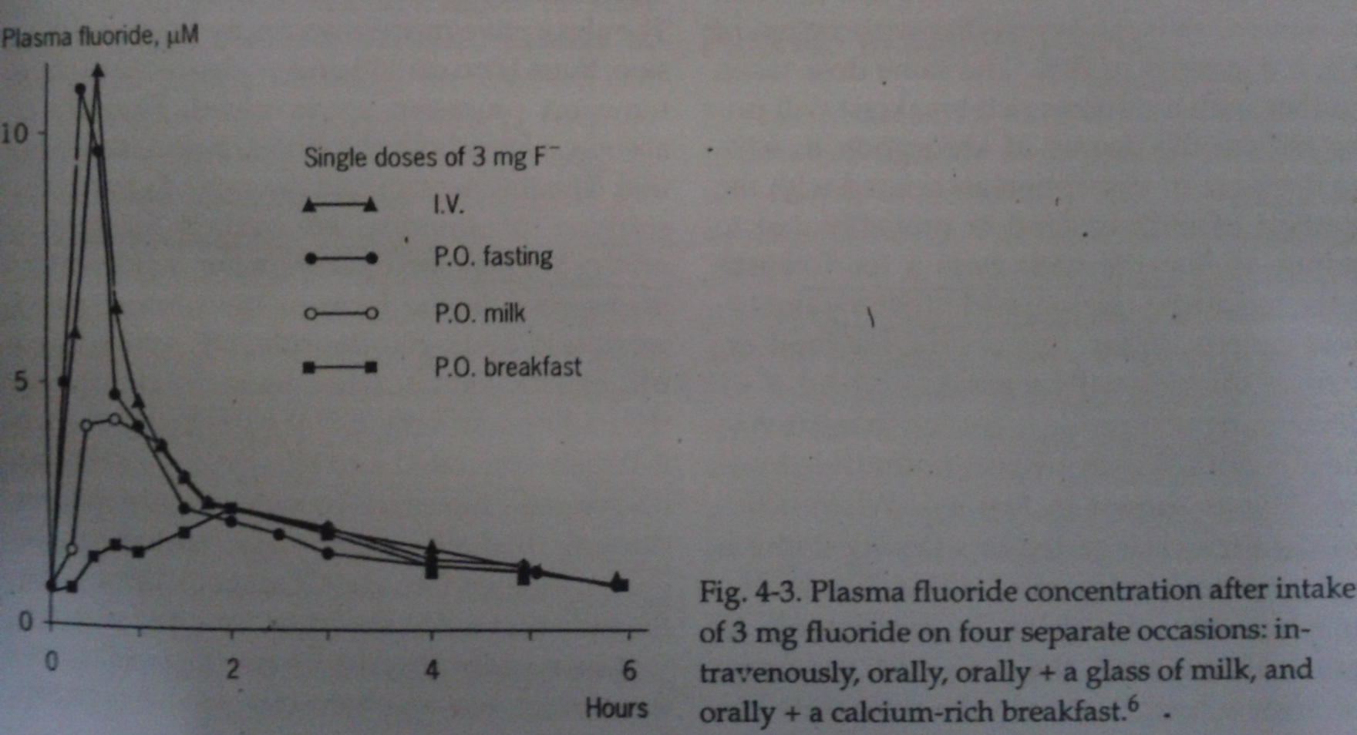

Slide 29
The ingestion of fluoride with food also retards its absorption.
When NaF tablets are taken on a fasting stomach –degree of absorption is 100%.
With a glass of milk – 70%
With calcium rich breakfast – 60%

Slide 30
The timing of fluoride ingestion in relation to a meal is critical with respect to fluoride bioavailability.
The clinical implication is that if tooth brushing occurs soon after a meal, fluoride absorption will be reduced to some extent, and high plasma fluoride peaks will not occur. This might be important for small children, who tend to retain and ingest more of the toothpaste applied to the brush.

Slide 31
Factors influencing absorption
Solubility of the compound
Physical form of the ingested fluoride
Dosage of fluoride.
Diffusion area of the intestinal wall.
Organic constituents of diet.
Body weight of the subject
Influence of inorganic elements in the diet.

Slide 32
FLUORIDE IN BLOOD PLASMA
TOTAL PLASMA FLUORIDE 0.7 – 2.4 uM/L.
Plasma fluoride values greater than 4 mcmol/L indicate excessive exposure and are associated with periostitis.
Plasma concentration is twice as high as that associated with the cells.
Ionic (inorganic or free fluoride)
Non-ionic or bound

Slide 33
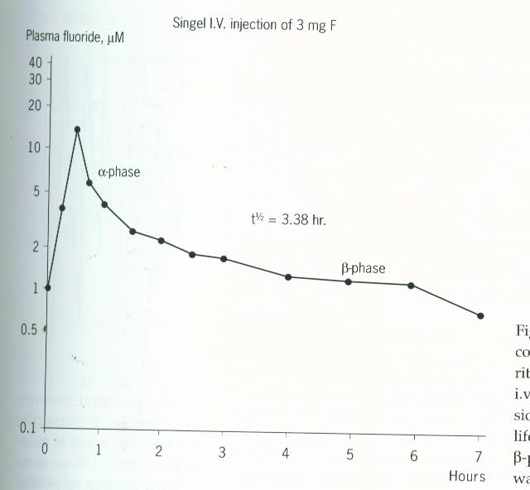
Pharmacokinetics of fluoride
Plasma fluoride concentration versus time

Slide 34
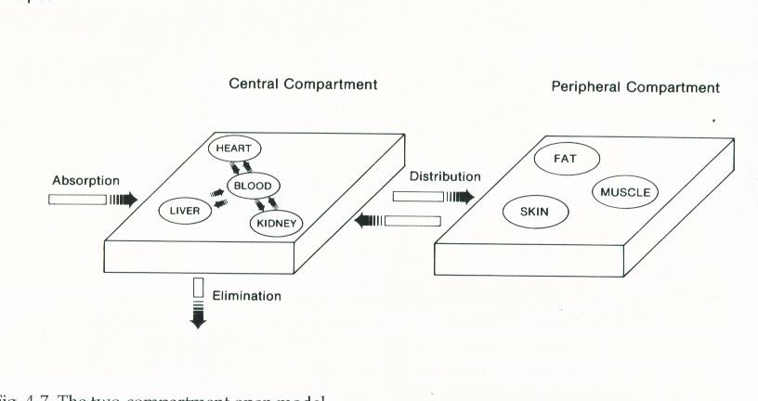
Two compartment model

Slide 35
The plasma half life for fluoride in human adults ranges from 4 to 10 hours.
The rate of elimination is proportional to the plasma concentration ; the higher the plasma concentration of fluoride the faster elimination and vice - versa.
Thus , the fluctuation of the plasma fluoride concentration depends on the fluoride dose ingested, dose frequency and the plasma half life of fluoride.

Slide 36
DISTRIBUTION

Slide 37
DISTRIBUTION IN SOFT TISSUES
Depends on the rate of blood flow to the tissues.
Steady state tissue to plasma fluoride concentration ratios fall between 0.4 and 0.9( achieved more rapidly for well perfused tissues).
Notable exceptions to this range include the brain and adipose tissue in which it is less than 0.2.
Kidney tubules accumulate a higher concentration than that of plasma.

Slide 38
DISTRIBUTION IN MILK
Ranges from 0.01 ppm to 0.05 ppm
Peak concentration reaches within one hour (slow absorption).
Has to be released from the bound forms before digestion.
Milk will raise the ph of the gastric juice by its powerful buffering action.
Bottle fed babies have a higher fluorosis index than do breast fed babies.

Slide 39
Distribution in saliva
Ranges from 0.01 ppm to 0.05 ppm
Peak concentration within one hour.
Unstimulated saliva contains more fluoride than stimulated
Type of fluoride compound ingested also alters the extent of salivary response.

Slide 40
DISTRIBUTION IN BONE TISSUE
It is reversibly bound to bone (if intake is markedly reduced some of the fluoride accumulated is gradually lost).
Distribution is not uniform – highest in areas of most active growth (endosteal and periosteal surfaces usually have a high fluoride content).

Slide 41
Distribution in dental tissues
Dentin and bone appear to have similar fluoride concentrations which increase with age, while that of enamel is markedly lower.
Dentin fluoride levels decline progressively from the pulpal surface to the dentin-enamel junction (DEJ).
Enamel fluoride concentrations are highest at the surface and decline progressively toward the DEJ.
Bulk enamel (all the enamel from a tooth) fluoride concentrations mainly reflect the level of fluoride exposure during tooth formation, while dentin and bone fluoride concentrations are generally proportional to the long-term level of intake (Weatherell, 1969).

Slide 42
Distribution in the fetus
Placenta acts as a total barrier to the fluoride; others have suggested that it is only partial.
Recent studies have shown that placenta is not in any sense a barrier to the passage of fluoride.
Direct relationship between serum fluoride concentration of mother and fetus.

Slide 43
EXCRETION

Slide 44
Excretion
It depends on several factors
The total intake
The form in which fluoride is taken into the body.
Whether the individual is regularly exposed to the fluoride
The health status of the individual.

Slide 45
Major route of removal is by kidneys
Determinant of amount of fluoride excreted in urine. (best index of fluoride intake)
Glomerular filtration rate
Renal clearance of fluoride
Percentage of filtered fluoride reabsorbed.

Slide 46
EXCRETION VIA BREAST MILK
Breast milk represents a reference point for the natural daily fluoride Intake during the first six months of life.
Fluoride concentration of colostrum and mature breast milk – 0.4 M.
There is limited transfer of fluoride from plasma to breast milk but fluoride content is increased if the amount ingested is increased.

Slide 47
Excretion via feces
Less quantitative importance - 10% of daily excretion can be accounted for in feces.
When diet contains insoluble fluoride compounds, larger amounts are excreted through feces.

Slide 48
EXCRETION IN SWEAT AND SALIVA
At ambient temperatures and humidity up to 25% of fluoride excreted appeared in sweat.
During excessive perspiring appreciable amounts are lost through sweat.
A negligible fraction can be accounted for in the saliva.
Fluoride is completely diffusible in saliva and it may be incorporated into dental calculus.

Slide 49
EFFECT OF FLUORIDE INTAKE IN HUMANS

Slide 50
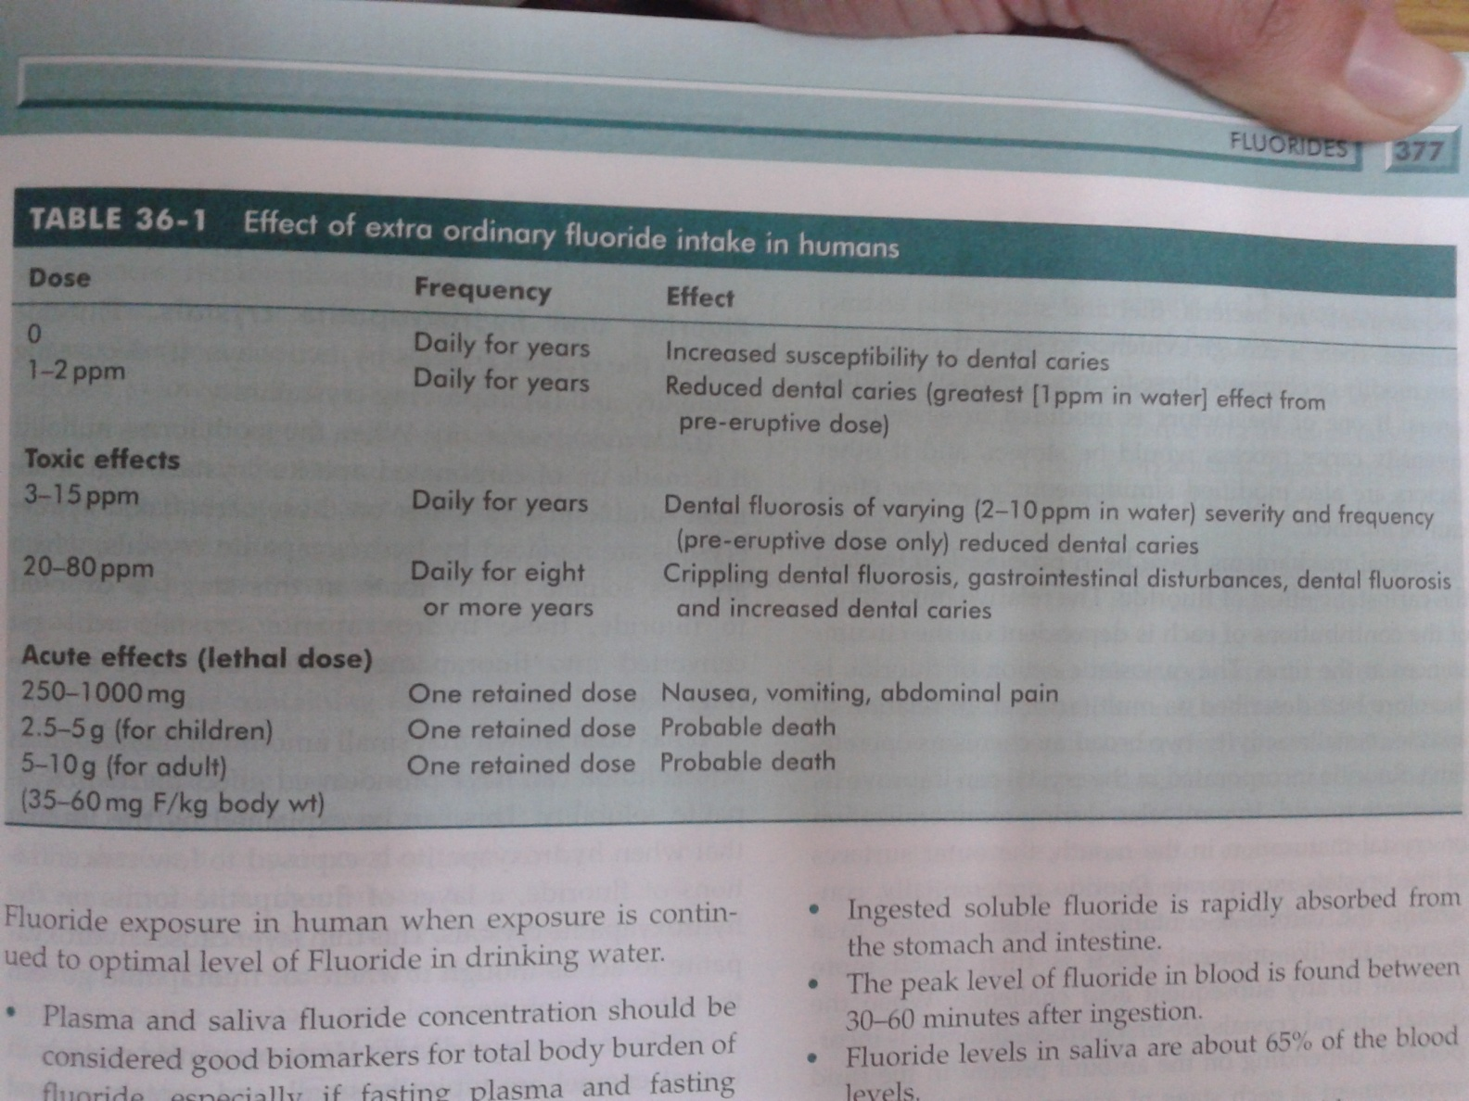
EFFECT OF FLUORIDE INTAKE IN HUMANS

Slide 51
MECHANISM OF ACTION OF FLUORIDE

Slide 52
By the early 1990’s it was well understood that fluoride is most effective in caries prevention.
It is accepted that fluoride action in preventing caries is multi factorial.
It is seen that anti caries effect is most pronounced when a low level fluoride is constantly maintained in the oral cavity, though the respective roles of pre eruptive and post eruptive fluoride continues to be debated.

Slide 53
- Mechanism by which fluoride increases caries resistance Proposed mechanisms assumed to work simultaneously are:
Increased enamel resistance/ reduction in enamel solubility
Increased rate of post eruptive maturation
Remineralization of incipient lesions
Interference with plaque microorganisms
Modification in tooth morphology

Slide 54
1. INCREASED ENAMEL RESISTANCE
This theory explains:
The action of fluoride on caries being due to stabilization of the apatite lattice.
Stabilization is a result of hydroxyapatite having inherent voids due to missing hydroxyl groups.
Fluoride ions fill these voids and add their hydrogen bonding tendencies to the forces which hold the crystals together.

Slide 55
Improving crystallinity
HA in dental enamel is typically small and contains impurities. [Possner, 1985]
Radiographic analysis= F ion even in low conc. Effectively increases crystallinity= Void Theory
Fluoroapatite
Hydroxyapatite

Slide 56
(the solubility hypothesis)
Enamel structure
Carbonated apatite = highly soluble in acids
Newly erupted tooth
Hydroxyapatite = less soluble in acids
Matured tooth
Fluoride uptake
Fluorapatite = least soluble in acids
Matured tooth with fluoride

Slide 57
Hypothesis: [murray]
it is not the fluoride itself that protects the enamel, but the indirect effect of F in reducing the carbonate conc. with its attendant effects on solubility and crystal form.

Slide 58
2. INCREASED RATE OF POST ERUPTIVE MATURATION
Newly erupted teeth often have hypomineralized areas that are prone to dental caries.
In addition, the entire enamel surface is at its maximum degree of susceptibility to caries as soon as it appears in the mouth.
Fluoride increases the rate of mineralization, or post eruptive maturation of these areas.

Slide 59
Post eruptive maturation and remineralization are similar but they differ in at least one way.
Post eruptive maturation involves deposition of minerals into hypomineralized areas, while remineralization involves deposition of minerals into demineralized areas.
Remineralization does not occur without demineralization

Slide 60
3. REMINERALIZATION
The partially dissolved crystals acts as ‘nucleators’ for remineralization.
Fluoride speeds up this process by adsorbing to the surface and attracting Ca.
Newly formed veneer will have composition in between HA and FA= HFA

Slide 61
Saliva is natural remineralizing solution.
Reversal of early carious lesions is accounted to F use.
White spots are more rapidly remineralized by calcium phosphate containing F by 0.5% F solution alone.
(Myers, Hamilton and Becks (1952)
Hallsworth and Weatherrell (1969)
Koulourides et al (1980))

Slide 62
It reduces carbonate of enamel so decreases the solubility
After dissolution by acid, provides F from plaque, saliva and favors remineralization
F accumulates in early lesions in higher conc.
Solubility-Remineralization concept

Slide 63
4. INTERFERENCE WITH MICRO ORGANISMS
Fluoride interferes with oral bacteria in two ways.
In high concentrations, fluoride is bactericidal. This is probably how fluoride helps reduce plaque.
In lower concentrations, fluoride is bacteriostatic. It helps control the growth of bacteria without destroying them.
Fluoride has been known to inhibit bacterial enzymatic processes involved in carbohydrate metabolism (glycolysis).
Also inhibits the production of extracellular polysaccharides.

Slide 64
Fluoride is concentrated with in the plaque.
Fluoride normally present in plaque is largely bound (thus unavailable for antibacterial action), only 2-5% being in ionic form.
When the ph of plaque decreases, acid is produced by plaque organism, the bound fluoride dissociate to ionic fluoride
Thus, when caries process starts and acids are formed, plaque fluoride in ionic form may serve to interfere with further acid production by plaque microorganism

Slide 65
When the ph in the plaque falls as the bacteria produce acids, a portion of the fluoride present in the plaque fluid then combines with hydrogen ions to form HF and rapidly diffuses into the cell, effectively drawing more HF from the outside.

Slide 66
Modification in tooth morphology:
There is a direct relationship between the amount of fluoride ingested during tooth development and the incidence of dental caries.
If fluoride is ingested during tooth development, there is some evidence to suggest the formation of a more caries resistant tooth slightly smaller with shallow fissures.

Slide 67
The size and morphology of teeth in humans can be influenced by ingestion of fluorides.
Most reports indicate that diameters and cusp depths of teeth are smaller if fluoride is present during tooth development.
Such changes in morphology would tend to decrease the caries susceptibility of teeth by making them more self cleansing.
The reduced level of occlusal caries found in fluoridated areas may be partly attributed to the improved morphology of the occlusal surface.

Slide 68
Current concept
Regardless of the fluoride modality used, there is a clear consensus that the method of action of fluoride in preventing caries is primarily the topical effect of the fluoride ion on the enamel surface (Brambilla, 2001).
In addition to enhancing remineralisation of the hard tissue surface, fluoride has an inhibitory effect on the enolase enzyme of oral bacteria found in dental plaque and improves the chemical structure of enamel, making it more resistant to dental caries (Jones et al., 2005).

Slide 69
CLASSIFICATION OF FLUORIDES

Slide 70
Classification
Systemic fluorides:
Community water fluoridation
School water fluoridation
Salt fluoridation
Milk fluoridation
Fluoride supplements
Topical fluorides:
Professionally applied:
Sodium fluoride preparation
Stannous fluoride preparation
Acidulated phosphate fluoride preparation
Fluoride varnish
Fluoride impregnated floss and prophylactic paste
Fluoride containing devices and dental materials
Self applied
Fluoridated dentifrices
Fluoride mouth rinse

Slide 71
SYSTEMIC FLUORIDES

Slide 72
Systemic fluorides
Historically, it is of interest that the empirical use of fluorides for the prevention of dental caries can be tracked back to the last quarter of the 19TH century.
The origin of today’s concept of fluoridation as a preventive measure, however, is directly attributable to observations made in connection with another dental disease, mottled enamel

Slide 73
Community Water fluoridation
Fluoridation can also be thought of as a form of nutritional supplementation in which F is added through drinking water
Great advances in public health “ four horseman of PH” along with chlorination, pasteurization and immunization. [Dr. Luther Jerry, 1961-1965]
Fluoridation is the single most important commitment that a community can make to the oral health of its children and to future generation [ Dr, C Everett Koop, 1981-1989]

Slide 74
Water fluoridation can be defined as the upward adjustment of the concentration of fluoride ion in public water supply in such a way that concentration of fluoride ion in water may be consistently maintained at 1 parts per million by weight to prevent dental caries with minimum possibility of causing dental fluorosis.
The term fluoridation has been given to the process of supplementing the natural fluoride content of potable water to the point of optimum conc.

Slide 75
Water fluoridation is purest public health use of fluoride, not a targeted approach reaches everyone in community.
Same time it is the source of greatest problems in terms of social policy.

Slide 76
Fluoridation: an ideal public health intervention
Socially equitable
Continuous protection with no effort on participation.
Works without requiring individuals to gather in central location
Do not require costly health services
No daily dosages to remember
No bad tasting oral medications to be taken
No painful inoculations.

Slide 77
History of community water fluoridation

Slide 78
The history of community water fluoridation can be traced back to the early years of the 20th century and may be categorized into 4 phases:
Clinical discovery phase [1901-1933]
Epidemiological phase [1933-1945]
Demonstration phase [1945-1954]
Technology transfer phase [1954 onwards]

Slide 79
Clinical discovery phase [1901-1933]

Slide 80
1901= Dr. Fredrick McKay “Colorado Stains” (Mottled enamel” )
1905= He moved to St Louis for continuing his practice
1909= GV Black = an endemic imperfection of the enamel of the teeth unknown in the literature of dentistry
1912 = McKay came across article written Dr. J.M Eager in 1902 where he observed the ‘Ugly brown Stains’ known as ‘Denti di chiaie’
1916= McKay and Black examined 6,873 children and put forward the “Water Hypothesis”
1918= Dr. O.E Martin asked McKay to visit Britton where they observed that in 1898 Britton changed their drinking water supply from shallow waters to deep drilled artesian wells

Slide 81
1920= etiologic agent as water supply
1925= Oakley Idaho [deep water hypothesis]
1928= chicago society = decreased dental caries
1930= spectrographic analysis
Jan 20th 1931 H.V Churchill, AlCoA found the excessive amounts of F in water samples from Bauxite at 13.7 ppm. [also Smiths in Arizona and Velu in France]

Slide 82
1931 = Dr. Trendley H. Dean [1St dentist in newly established National Institute of Health] was appointed by Dr. Clinton Messener U.S Public Health Services as one-person Dental Unit to investigate mottled enamel
Tasks:
To map out the prevalence of mottled enamel
To develop a scale to classfiy full range of mottlenamel
.

Slide 83
Epidemiological phase [1933-1945]

Slide 84
Dean’s 21 city study was conducted by Trendly dean
They examined the teeth of children who lived in 21 different communities with different levels of fluoride. (7527 children aged 12-14 years, fluoride concentration varies from 0-2.6ppm)
Findings: More fluoride in water, less is the decay and more enamel fluorosis.

Slide 85
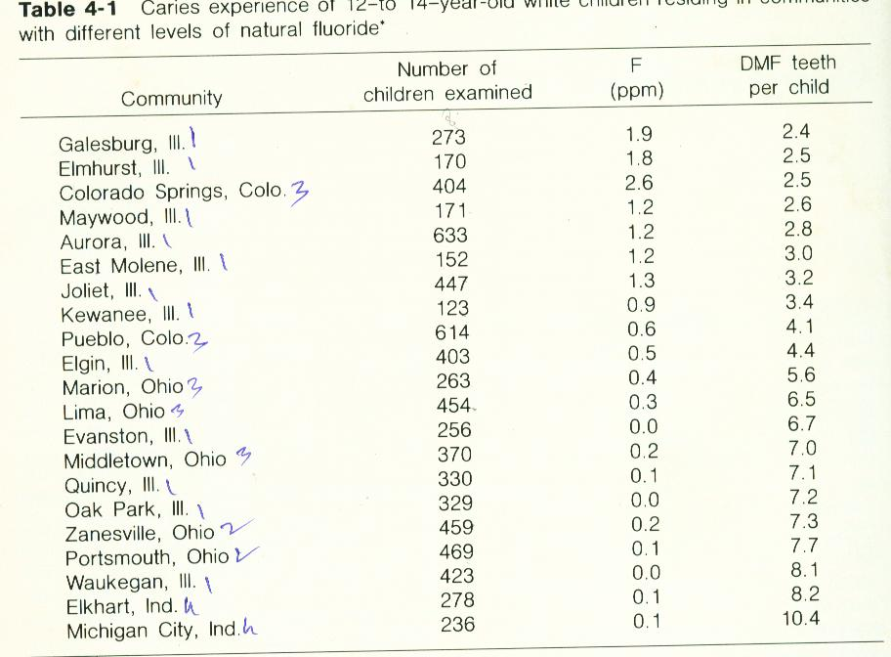
21 study map

Slide 86
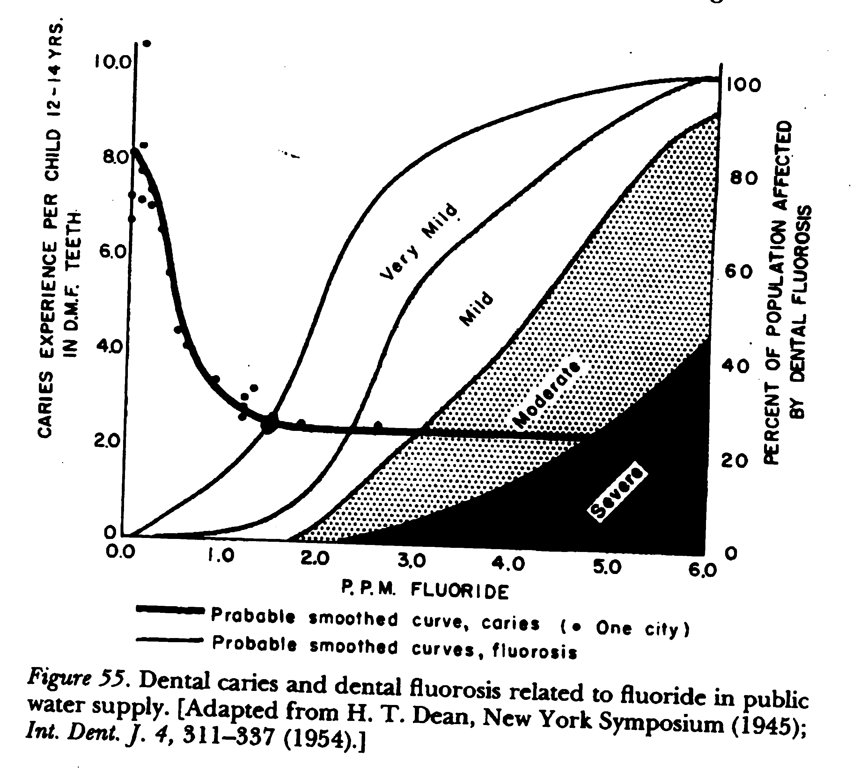
21 city survey/ ecological study

Slide 87
Dean’s results showed that both decreased risk of caries & fluorosis were attained with water fluoride level of ~ 1ppm.
At this level ~ 60% decrease in caries in ~10% population of exhibiting very mild fluorosis which investigators considered to be acceptable and cosmetically inconsequential.
So 1ppm became benchmark level to reduce caries.

Slide 88
1934= T.H Dean introduced “Dean’s index for Fluorosis” [7-point ordinal scale]
1938= Dean Modified the index to 6-point scale
1942= Milestone discovery given by Deans et al that 1 ppm showed that 60% reduction in caries incidence
1942= dean and Dixon gave the Community Fluorosis Index

Slide 89
Demonstration phase [1945-1954]

Slide 90
The results of 21 cites study by Dean were strong presumptive evidence of cause and effect, though because the data were cross sectional they could not by themselves establish cause and effect between fluoridated water and reduced dental caries experience.
They did however, set the stage for a prospective test of the fluoridation-caries hypothesis, first suggested in 1943
Clinical trials that compared the dental and medical results following the deliberate addition of fluoride to drinking water in 4 cities with control town in which communities with negligible level of F were taken.

Slide 91
GRANDS RAPIDS-MUSKEGON STUDY
This study began on 25th Jan 1945 when sodium fluoride was added to Grand Rapids water supply, with near by Muskegon as the control city.
The results after six and half years of fluoridation showed that caries experience of 6 year old Grand Rapids children was almost half that of Muskegon children. (Arnold, Dean and Knutson 1953)

Slide 92
NEWBURGH-KINGSTON STUDY
On May 2nd 1945, sodium fluoride was added to drinking water of Newburg. Kingston town was the control.
After 10 years of fluoridation, DMFT had fallen from 23.5% to 13.9%, thus confirming the caries inhibitory property of fluoride in drinking water. (Ast et al 1956)

Slide 93
EVANSTON-OAK PARK STUDY:
This experiment, conducted in January 1946, kept Evanston as the experimental town and Oak park as the control. A reduction of 49% was seen in the caries prevalence.
Presented the most detailed data of all the fluoridation studies.

Slide 94
Canadian study (Brantford,Sarnia,& Stratford)
In Canada in Brantford, Ontario where fluoride was added to the water supply in June 1945.
Sarnia was control town in addition, the community of Stratford where fluoride was present in 1.3 ppm was used in auxiliary control.
After 17 years of fluoridation in Brantford, Caries experience was similar to Stratford & was 55% lower than in control town of Sarnia. (Hutton et al 1951, Brown and Poplove,1965)

Slide 95
DUTCH STUDY (TIEL-CULEMBORG):
Among the earlier studies, the only true longitudinal study of fluoridation’s effects was the Tiel culemberg study in the Netherlands.
Tiel was the experimental town and Culemborg was the control. The experiment was conducted in March1953.
Successive cohorts of children were examined longitudinally every 2 years from the ages of 7 through 18 years until 1971.

Slide 96
This study has proved to be a valuable resource in the study of the effects of fluoride in general, and fluoridated water in particular.
The property of fluoride inhibiting smooth surface caries more effectively than pit and fissure caries was discovered in this study.
Examinations in 1969 on 15 year old children showed an overall 56% reduction in caries prevalence with the highest reduction in smooth surface caries (86%).

Slide 97
The demonstration phase lasted until about 1954 when the benefits of the optimal adjustment of fluoride levels in drinking water became apparent in many US cities.
Thus the demonstration phase overlapped slightly with the fourth period.

Slide 98
Technology Transfer phase [1954 onwards..]
Began about 1950 when planning for implementation of fluoridation began in earnest in many large US cities.
Continuing to this day, this phase is characterized by the establishment of a set of National Health goals which includes fluoridation. (75% of population should live with fluoridated water by the year 2010)
This phase extended fluoridation worldwide. Singapore (1958) serving 100% of the population.
The republic of Ireland- first country to actually legislate mandatory nationwide fluoridation in 1960.

Slide 99
Safety of Water fluoridation

Slide 100
The issue of safety relative to adding fluoride in water has often been attributed by the opponents to every disease known to mankind.
It is a common practice for fluoridation opponents to distribute pictures of children alleged to have crippling skeletal fluorosis and attribute the malady to fluoridation.
Safety concerns about fluoridation relate to the number of factors, including: toxicity of fluoride, the impact on human health, the effect on the environment, water quality, and the engineering aspects

Slide 101
Fluoridation have been linked with a wide range of diseases, eg. Cancer, Alzeimer diseases, patients with impaired kidney funtion, Osteoporosis, fractures, Down’s syndrome, heart disease or it interferes with immune function.
But there is overwhelming agreement between the scientific, medical and dental community worldwide that fluoridation of water is safe and effective public health measure. (Mc donagh 2000).
The WHO recommended that only one form of systemic fluoride measure should be used at any one time (Petersen and Lennon, 2004)

Slide 102
Engineering aspects of Water fluoridation

Slide 103
Fluoridation is not necessary
Where caries prevalence is low
Drinking water already contains fluoride which is present naturally at or near the optimal concentration.
Where endemic fluorosis is seen

Slide 104
Compounds used in Water Fluoridation :
Fluorspar
Sodium fluoride (It is the most expensive of fluorides)
Silicofluorides
Sodium silicofluoride -It is the most popular and cheapest form of fluoride solutions. This is corrosive and the materials used for piping, valves, pumps should be chosen with this in mind.
Hydrofluosilicic acid - cost of transporting liquids more.
Ammonium silicofluoride

Slide 105
Equipments
The 3 types of fluoridation equipment commonly used are
Saturator system
Dry feeder system
Solution feeder system

Slide 106
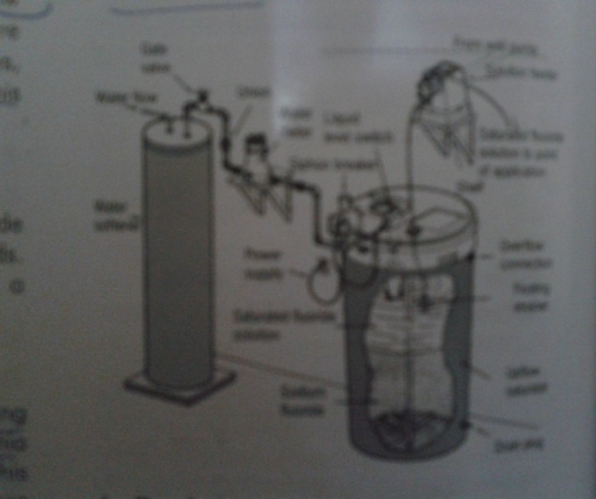
Saturator System
Principle : A 4% saturated solution of sodium fluoride is produced and injected at the desired concentration at the water distribution source with the aid of a pump.
Factors limiting utilization :
A high hard water level (>75 mg/lit).
The need to clean the gravel bed used for water
filtration
Recommendation : It is suitable for small towns with a total requirement of less than 3.8 million lit/day.

Slide 107
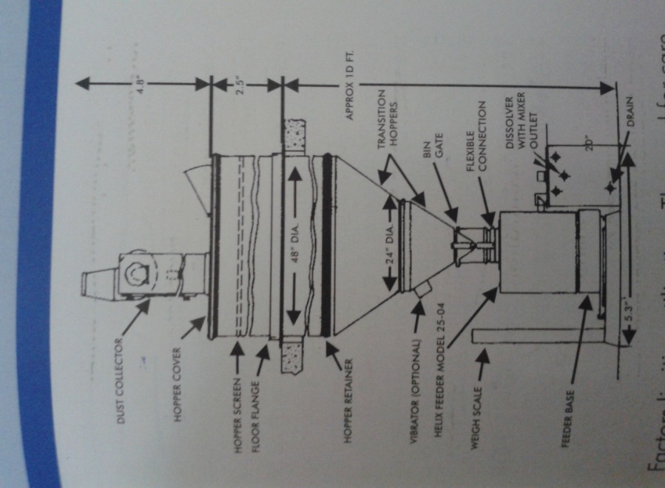
Dry Feeder
Principle : Sodium fluoride or silico fluoride in the form of powder is introduced into a dissolving tank with the aid of an automatic mechanism to ensure maintenance of the correct supply of fluoride according to the amount of water to be delivered.
Factors limiting utilization :
The need for care in the handling of fluoride.
Obstruction of pipes
Compacting of fluoride while stocked in a humid
atmosphere.
Recommendation:
It is suitable for medium sized towns
Capacity is 19 million lit/day.

Slide 108
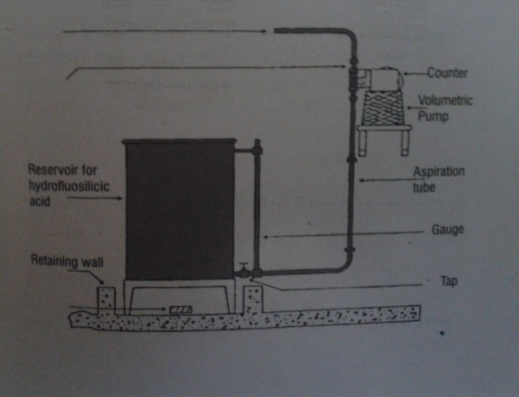
Solution Feeder System
Principle : Volumetric pump permitting the addition of a given quantity of hydrofluoric acid in proportion to the amount of water treated.
Factors limiting utilization :
All the equipment must be resistant to acid attack necessitating construction in polyvinyl chloride or another plastic.
Recommendation:
It is suitable for medium sized and large towns with a total requirement of more than 7.6 millions litres per day

Slide 109
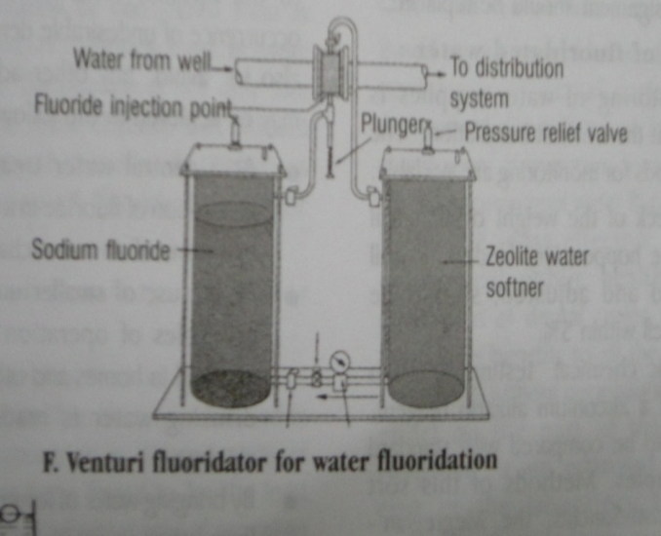
Venturifluoridator System
It is a non electrical system developed by J.N.Leo. It is activated by the flow of water in the main line . The tank containing the fluoride is made of a clear acrylic thermoplastic and this enables the operator to make a visual inspection of the level of chemical, in order to replenish it.
Advantages:
It is simpler to install and the cost of this is approximately 2/3rd of the cost of the conventional equipment's .
No possibility of accidental overdosage

Slide 110
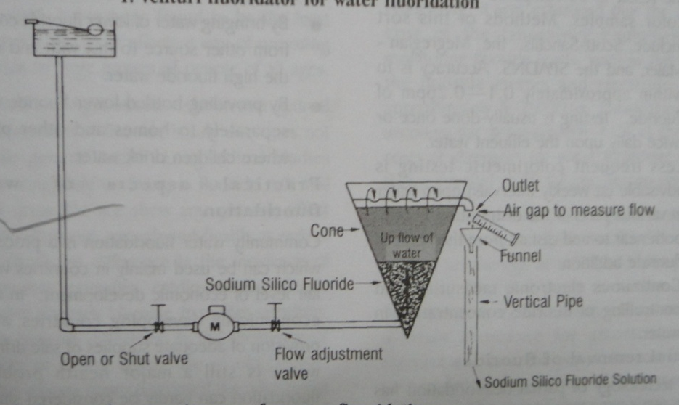
Saturation Suspension cone System
Notes:
This system was developed in Brazil. It consists of an upside down cone charged with a bag of sodium silicofluoride through which a constant flow of water percolates. The solution is collected at the top by a horizontal perforated plastic pipe which forms the outlet.

Slide 111
KEY ATTRIBUTES OF WATER FLUORIDATION
Effective
safe
Equitable
Requires no co-operation
Water fluoridation
Benefits for a lifetime
Independent of Professional services
Reduces costs for dental treatment

Slide 112
Disadvantages
Communities with community water supply
Interferes with personal choice
People may think of over-protection
Initial cost for installing fluoridation plant is more
Extra manpower will be required

Slide 113
School water fluoridation

Slide 114

School water fluoridation
1954 –Virginia island, 2.3ppm at 2 schools
1962 - 7-13 year old children were examined and showed that 21.9% caries reduction. (Horowitz , Law and pritzker , 1965)
Heifetz et al 1983 –12yr study (6.3ppm) –47% reduction
Results of these several studies -Effective public health measure

Slide 115
Recommended where water fluoridation is not feasible.
Primary effect is systemic but also topical
Reduces dental caries by 25-47%
Recommended concentration is 4.5 ppm.

Slide 116
Criteria:
F level of particular area should be low
School should have its own water supply
Children should not consume water from outside source
Fluoridation should be done by trained personnel
It should be under strict vigilance
Parents should not object their child to take water from it
Clearly disinfected and cleaned periodically

Slide 117
Advantages
Target population—school children
Quite economical
Dental fluorosis lesslikely to occur
Disadvantages
Limited pre eruptive contact (5-6yr)
Intermittent exposure of F to children (5-6hrs 4.5ppm
All children may not attend the school all days.
Lack of co-operation from school authorities and parents.
The cost per child per year including equipment and labour has been estimated at $ 1.5 (Newbrun 1978)

Slide 118

Requirements & feasibility in india
Baseline data among school going children.
Assessment of availability of potable water and source with level of fluoride.
We need to monitor, train technical personnel and school teacher.
When all these things are met it will be feasible.
Biggest problem in our country, is getting potable water for school especially rural area.
Minimal utilization of water among the children from school.

Slide 119
Salt fluoridation

Slide 120
Salt fluoridation
Is the controlled addition of F⁻ usually Na⁺ or K⁺ fluoride during the manufacturing of the salt for human consumption
Introduced by Wespi et al in 1955
First adopted in Switzerland in The Canton of Zurich
Initially 90mgF/Kg but was raised upto 250mgF/Kg by 1982
Mode of Action → Marthaler et al Only Post-eruptive
  TOPICAL + SYSTEMIC

Slide 121
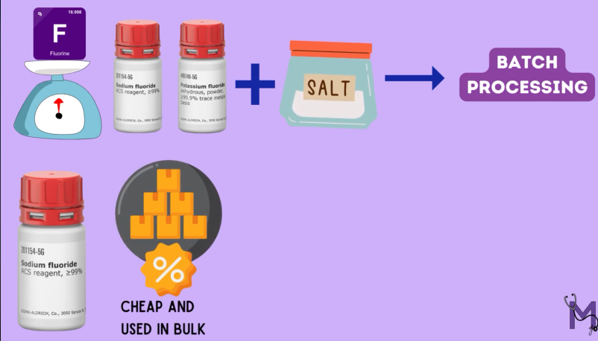

Slide 122
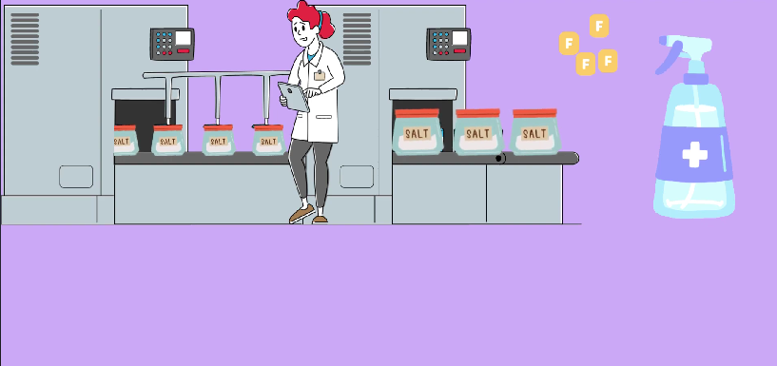
Continuous processing

Slide 123
Advantages of salt fluoridation
Wide coverage
Needs little conscious action by the individual
Safe
Consumer free choice
Lifelong daily compliance
Low cost
Favourable cost-effective and benefits.
Socially equitable.
No supervised water distribution systems
Minimum possibility of fluorosis as children use very little salt

Slide 124

Limitations
Related to the extent of public acceptance
Variation in salt intake. no precise control on individual consumption
Difficulty in controlling the distribution of various concentrations
Multiple sources of water
High salt intake may contribute to Hypertension
  F⁻ consumption is the lowest when the need is highest → Early Years.
  Supplement to water fluoridation, not replacement [Mather, 1959]

Slide 125
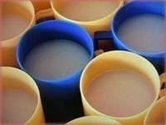

Milk fluoridation
It is the addition of a measured quantity of fluoride to bottled or packaged milk to be drunk by children.
Because milk is recommended as a good nutrition for infants and children and is widely available both at home and in school in many countries, it was considered, to be a suitable vehicle for supplementing children's fluoride intake.

Slide 126
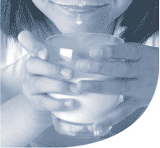
Milk fluoride as a possible dental caries prevention medium was first proposed by a Swiss pediatrician ---Zielger in 1953
Bovine & human milk contains low levels of fluoride i,e.,0.03ppmF, it is Considered as suitable vehicle over for fluoride intake [By Zielger in 1956]
The interest of the UK-based Borrow Dental Milk Foundation has been a major factor in the continuing research into fluoridated milk as a caries-preventive agent

Slide 127
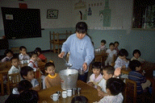
Advantages
Staple food
Target children directly
Consumers choice
Limitations
Children who do not drink milk
Consumption declines with age
High level of technical expertise
Slow absorption means no topical effect
Low socioeconomic children tend to drink less milk and no milk
Costly and needs parent co-operation

Slide 128
Fluoride supplements

Slide 129
Fluoride dietary supplements were first introduced in the late 1940’s and were intended as a substitute for fluoridated water for children in non fluoridated areas.
They are also called as fluoride supplements because they are manufactured as tablets or drops for swallowing.
Tablets for chewing or lozenges are intended to be sucked slowly in the mouth before swallowing to get both systemic and topical effects
Lozenges
Fluoride drops
Fluoride tablets

Slide 130
Commercially available
NaF tablets
fluoritab tymafluor, luride (U.K)
2.2mg (1mgF), 1.1m g(0.5mgF), 0.55mg (0.25mg F)
Drops 0.125,0.25,0.50mg/ml Luride ,Flura drops, Pediaflor (10 drops equal 1mg of fluoride, using plastic dropper bottle)
10 drops are placed in litre of water with no fluoride, there is resultant conc. Of 1ppm of F
APF tablets/ KF/CaF
Phos-flur (1 mg APF)

Slide 131
APF tablets are more expensive than NaF tablets (Driskoll et al 1989) and greater salivary flow caused by the low Ph of the APF tablets is likely to reduce the concentration of fluoride around the teeth and hasten its clearance from the mouth.
It is desirable that fluoride tablets dissolve slowly so that teeth are bathed in high levels of fluoride for along time.

Slide 132
Fluoride released from a tablet tends to remain highly concentrated at the site of tablet dissolution (Weatherell et al 1984)
There was very little mixing between the sides of the mouth or between vestibules of upper and lower arches.
It would seem important, therefore, that the position of tablets in the mouth is changed regularly. (Dawes and Weatherell,1990)

Slide 133
It is also believed that if fluoride tablets are taken at night, a higher fluoride saliva level is possible than if taken during the day.
Reasons
Fluoride saliva concentrations are higher in unstimulated saliva
Glomerular filtration is reduced during sleep, resulting in higher blood levels

Slide 134
Important considerations when using dosage schedule
Drinking water should be tested for fluoride content before supplements are prescribed.
All sources of fluoride should be evaluated with a thorough fluoride history.
Patient exposure to multiple water sources can make proper prescribing complex.

Slide 135
Ingestion of higher than recommended levels of fluoride in children is associated with an increase in mild dental fluorosis in developing unerupted teeth.
There is convincing evidence, however, that supplements are sometimes prescribed at the wrong dosage as well as in areas where the water is adequately fluoridated (Margolis et aL, 1980; Levy and Muchow, 1992)

Slide 136
Practicality
Fluoride tablets in school settings is an excellent example to use where the water is fluoride deficient.
Procedure can be supervised by a classroom teacher or volunteer with minimal training.
Takes only a few minutes of classroom time and it is highly accepted by students ,faculty and parents.
Major drawback- it’s a daily procedure and Only children with parental consent can participate

Slide 137
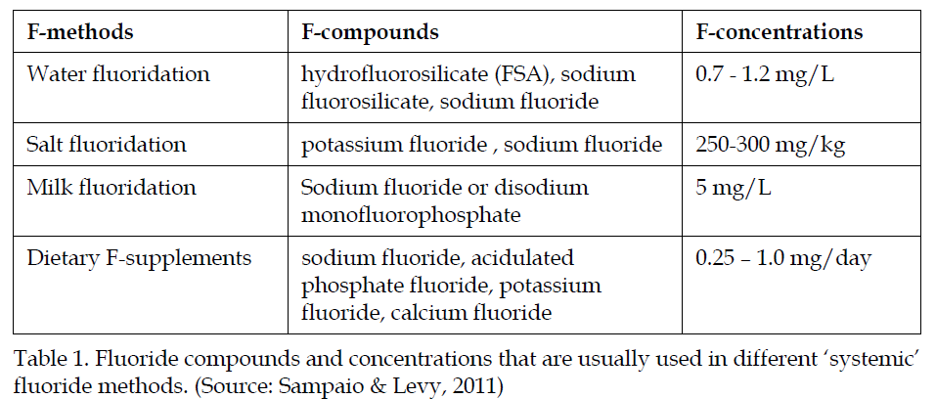

Slide 138
Guidelines to implement fluoridation programs
PHASE I- feasibility and program implementation
Several preliminary studies are essential prior to determining whether a national fluoridation program may be appropriate in a given country.
Also, under economic constraints and market-oriented economies, cost-benefit analysis is one of the best ways to justify the implementation of preventive fluoridation programs.

Slide 139
PHASE II- first evaluation
First evaluation of the country fluoridation program be done seven to ten years after its implementation in the country.
PHASE III- long-term evaluation and consolidation
These activities provide information on program progress, effectiveness, side-effects and sustainability, which are important for generating continued support for the program.

Slide 140
Topical fluorides

Slide 141
Topical fluorides
Are delivery systems which provide fluoride for local chemical reaction to exposed surfaces of erupted dentition

Slide 142
TOPICAL FLUORIDES
Topical fluorides
Fluoride solutions
- Fluoride gels
- Dental Varnishes
- Prophylactic paste
Self applied
Professionally applied
Dentifrices
- Mouth rinses

Slide 143
Professionally applied Topical Fluorides
Bibby in 1942 – repeated application of sodium & potassium fluoride reduced caries
NaF
-Aqueous solution
-Gel
-Prophylaxis paste
-Dental varnish
SnF2
APF

Slide 144
Method of preparation of 2% NaF:-
20grams of NaF powder in 1 litre of water
storage- Plastic container.

Slide 145
Technique of topical F application
Knutson’s technique :-
After
prophylaxis
Thoroughly
wetted with soln
Allowed to dry
for 3-4 min
Three further applications
With one week intervals
Recommended ages – 3,7,11 &13yrs

Slide 146
NaF application
NaF is applied once because once a layer of CaF2 is formed it interferes with further diffusion of F – to react with hydroxyapatitie. This is called as choking off phenomenon
Repeated on other quadrants
Instructed not to eat, drink or rinse for 30 min

Slide 147
Na fluoride
Advantages :
Chemically stable
Acceptable taste
Non-irritant to gingiva
Does not discolor teeth
Inexpensive
Disadvantages :
4 visits within a short time

Slide 148
Stannous fluoride
Method of Preparation :
To prepare 8% SnF – 0.8 gms is dissolved in 10 ml of distilled water in a plastic container and shaken.

Slide 149
Stannous fluoride
Muhler’s single application technique
Through prophylaxis
Including stripping of
inter proximal surfaces
Teeth isolated &
dried with Air
Kept moist with
soln for 4min
Repeat application
every 6 months

Slide 150
Stannous fluoride
Solution is applied continuously keeping the teeth moist for 4 min
Instructed not to eat, drink or rinse for 30 min
No. of application :
6mts or 12 mts.

Slide 151
Mechanism of action :
Low concentration
Ca5(PO4)3OH + 2SnF2 2CaF2 + Sn2(OH)PO4 + Ca3(PO4)2
[hydroxyapatite]
High concentration
Ca5(PO4)3OH + 16SnF2 CaF2 + 2Sn3F3PO4 + Sn2(OH)PO4
[hydroxyapatite] + 4CaF2(SnF3)2
2Ca5(PO4)3OH + CaF2 2Ca5(PO4)3F + Ca(OH)2
[fluorapatite]

Slide 152
Stannous fluoride
Disadvantages :
Unstable
Metallic taste
May cause gingival irritation
Causes brown pigmentation of teeth particularly in hypocalcified area
Causes staining on margins of restorations

Slide 153
ACIDULATED PHOSPHATE FLUORIDE
Brudevold et al developed APF formula in 1960s
APF solution :
Method of preparation :
20 gms of NaF is dissolved in 1 litter of 0.1 molar phosphoric acid
To this 50% hydro fluoride acid is added to adjust the pH at 3 & fluoride conc at 1.23%
Solution
Gel

Slide 154
APF solution (Brudevold technique)
Prophylaxis
APF solution is continuously and repeatedly applied with cotton applicators
Teeth are kept moist for 4 min
Floss is passed through interproximal embrasures to ensure wetting of these surfaces
Repeated for remaining quadrant
Instructed not to drink, eat or rinse for 30 min

Slide 155
APF Solution
No. of application :
1 or 2 per year
Advantages :
Stable
Cheap
50% more effective than NaF
Disadvantages :
Teeth must be kept wet for 4 min
Acidic, sour and bitter to taste

Slide 156
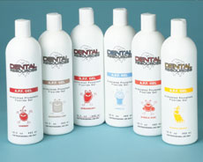
APF Gel
Method of preparation :
A gelling agent methylcellulose or hydrox-ethyl cellulose is to be added to the solution and pH is adjusted between 4 – 5

Slide 157
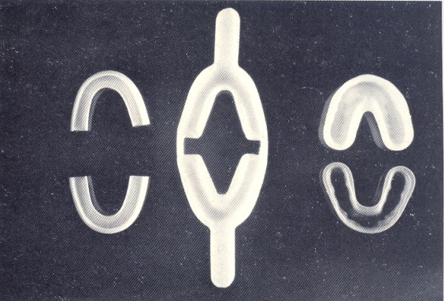
Technique of application (APF Gel)
Prophylaxis
Application of APF gel is done using trays that fit pts U/L dental arches
A disposable foam-lined tray is preferred
Pt is seated upright in chair
Minimum amt of APF gel should be dispensed in tray – 5 ml, custom fitted trays –1 ml

Slide 158
APF Gel
U/L trays are inserted into the mouth and pt is asked to exert slight pressure using light biting forces in order to cause the gel to flow interproximally
The gel is kept in mouth for 4 min
Instructed not to drink, eat or rinse for 30 min

Slide 159
APF Gel
In rare instances :
Small amt of APF gel may be painted directly onto tooth surface
Advantages :
Acceptable taste due to flavoring
Easy to apply
Can be self applied
Disadvantages :
Irritation to gingiva and to open carious lesion

Slide 160
Mechanism of action :
Ca(PO4)3OH + 4H⁺ 5Ca⁺⁺ + 3HPO4⁻⁻ + H2O
[hydroxyapatite] [dehydration & shrinkage]
Ca⁺⁺ + 3HPO4⁻⁻ Ca.HPO4.2H2O (DCPD)
[hydrolysis] [ Di calcium phosphate dihydrate]
(intermediate product)
5Ca.HPO4.2H2O + F⁻ Ca5(PO4)3F + 3HPO4⁻⁻ + H⁺ + H2O
(DCPD) [fluorapatite]

Slide 161
Comparison of Topical Fluoride agents
 | NaF | SnF2 | APF
Percent F | 2% | 8% | 1.23%
ppm F | 9,200 | 19,500 | 12,300
Frequency of application | 4 weekly intervals at 3,7,11,&13yrs | 1or 2/yr | 1 or 2/yr
Taste | Bland | Disagreeable | Acidic
Stability | Stable | Unstable | Stable in plastic container
Tooth pigmentation | No | Yes | No
Gingival irritation | No | Occasional transient | No
Average effectiveness | 29% | 30% | 28%

Slide 162
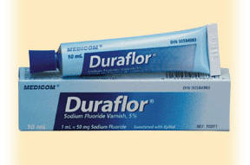
Fluoride varnish
Discovered by Schmidt in 1964
Method of preparation :
Commercially available
Duraphat, fluorprotector, fluoritop, duraflor

Slide 163
Fluoride varnishes
1) Duraphat :
  1st Fluoride varnish in Germany
  Viscous yellow material containing 22600ppmF as NaF in a neutral colophonium base (NaF varnish containing 2.26% F in organic lacquer)
2) Fluorprotector
  Clear polyurethane based product containing 7000 ppm F from an organic compound difluorosilane (silane fluoride with 0.7% F in a polyurethane based lacquer)
3) Carex
  Contains lower fluoride concentration than Duraphat (1.8% F )

Slide 164
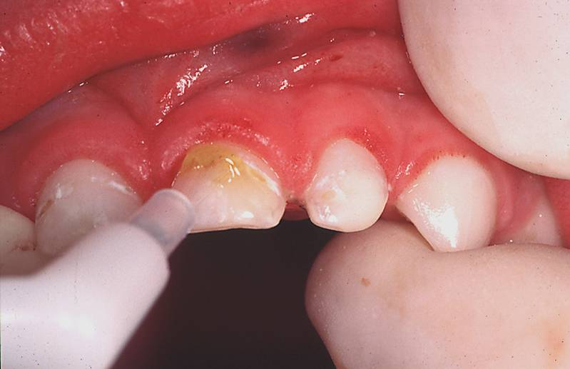
Technique of application :
Prophylaxis
Teeth are dried
A drop of varnish is taken on brush and painted thin on the teeth
Painted first on lower arch & then on upper arch
Patient is made to sit with mouth open for 4 min
Patient is instructed not to rinse or drink or brush teeth for 1 hour
Patient is instructed to take liquids or semisolid food and avoid eating solid food

Slide 165
No. of application :
Semiannual application
Advantages :
Forms a water tight protective film insulating against thermal and chemical influences
Varnish remains on tooth for several days
Disadvantages :
Pt co-operation is required
Expensive

Slide 166
Self applied fluoride agents

Slide 167
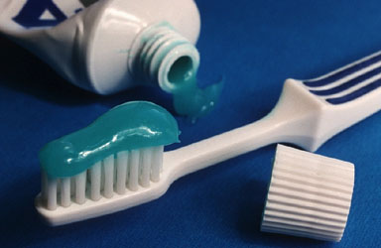
FLUORIDE DENTIFRICE
The development of fluoride dentifrice began around 1945
Effective means of providing partial protection against dental caries
Fluoride compounds which have been incorporated into tooth paste include – NaF, SnF, APF, sodium monofluorophosphate, and amine fluoride

Slide 168
Dentifrice composition :
Composition Range in formulation %
Abrasive 40 – 50 %
Humectant 20 – 40 %
Detergent 1 – 2 %
Binding agent 0.5 – 2 %
Flavor, color 1 – 4 %
Fluoride 0.1%
Water 20 – 30 %

Slide 169
Fluoride source :
Major source --- Sodium fluoride, stannous fluoride, and sodium monofluorophosphate
Std fluoride conc in U.S is 1% ( 1000 ppm ) --- equivalent to 0.22% NaF, 0.76% sodium monofluorophosphate and 0.4% SnF

Slide 170
Recommendations for use of Fluoridated tooth paste in children:
For children below 4 years ------ not recommended
For children 4 -6 years------ brushing once daily with F tooth paste & other 2 times without paste
For children 6 - 10 years ------- brushing twice daily with F tooth paste & once without paste
For children above 10 years ------- brushing three times with F tooth paste

Slide 171
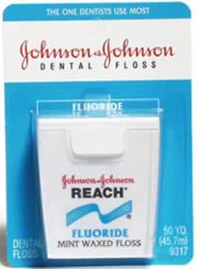
Fluoride Impregnated Dental Floss
For deposition of F on interproximal tooth surface
Gillings --- developed dental floss containing NaF and SnF
Notes:
B’coz of the lack of detailed data , no definative conclusions about its cariostatic effectiveness could be made

Slide 172
Fluoride Chewing Gum
Mean F conc in whole saliva following the ingestion of chewing gum is markedly
Peak F conc for a 0.25 mg preparation --- 15 – 25 ppm and 0.5 mg --- 25 – 40 ppm
Most F release occurs during first 5 mim
At 30 min after ingestion, conc of saliva is 1 ppm
Not recommended in preschool children

Slide 173
Fluoride mouth rinses
  Bibby et al in 1946
  In mid 1960’s – scandinavial researches – showed that biweekly rinse for 1 min with 0.2% NaF (1900 ppmF) was effective in reducing caries
  Furthermore – daily – 0.05% NaF (230 ppmF) – gave – more caries protection
  Effectiveness – 20-50% reduction

Slide 174
Alternative fluoride agents

Slide 175
Fluoride containing Alginates
Commercial available alginates --- De trey’s, Zelgan, Kerr contain 1.9% & 1.5% F
They do furnish topical F exposure to pts who require prosthodontic or orthodontic Rx
They provide limited additional caries benefits of a very short duration

Slide 176
Fluoride containing restorative materials
Silicate
zinc phosphate
Zinc polycarboxylate
glass ionomer cement
Pit and fiisure sealant

Slide 177
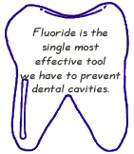
Summary & conclusion
The fluoridation of public water supplies has been one of the most successful public health preventive measures undertaken in advanced countries.
Community water fluoridation is safe and cost-effective and should be introduced and maintained wherever it is socially acceptable and feasible.

Slide 178
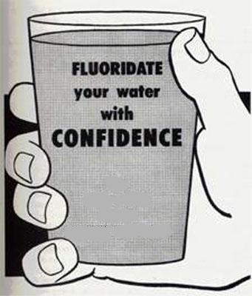
Salt fluoridation, at a minimum concentration of 250 mg F-/kg, should be considered as a practical alternative to water fluoridation and best vehicle.
Only one systemic fluoride measure should be used at anyone time.

Slide 179
In a country like ours, maintaining the status of dental caries or limiting the increase in prevalence will be a step further in this direction.
Unfortunately we don’t have baseline data regarding caries prevalence especially among school going children.
Our first problem is to know which areas are deficient in fluoride and whether there are arrangements for potable and community drinking water supply.

Slide 180
There is a need to carry out detailed fluoride mapping for existing water sources.
Governments in the affected areas should establish clear guidelines on exploitation of groundwater so that sinking boreholes in high fluoride zones can be avoided.
Continuing education to the public and to health professionals is essential.
Until and unless we have answer to these problems fluoridation in this country is not likely to be taken up systematically.

Slide 181
REFERENCES
Text book of Fluorides in caries prevention -JJ Murry A.T.Rugg-Gunn,G.N.Jenkins
Text book of The prevention of oral diseases -JJ Murray
Text book of fluorides -Fejereskov
Text book of Dentistry, Dental practice & the community -Brain A. Burt
Text book of Primary Preventive Dentistry- Norman O Harris
Fluorides and oral health. WHO technical report series:1994
Fluorides and dental caries- Amrit Tewari

Slide 182
D.M. O’Mullane (1994) systemic fluorides. Adv Dent Res 8(2);181-184
H. Chen et al (2006) Effects of Systemic Fluoride and in vitro Fluoride Treatment on Enamel Crystals J Dent Res 85(11):1042-1045
Fluoride nature’s cavity fighter. JADA, Vol. 136 December 2005
Michael W et al (2008) Ameican academy of peadiatrics vol 101;No.1
Benefits and risks of water fluoridation An Update of the 1996 Federal-Provincial Sub-committee Report by Dr. David Locker
T. M. Marthaler et al.(2005) Salt fluoridation – an alternative in automatic prevention of dental caries International Dental Journal 55, 351-358
Burt, B A (1992) The changing patterns of systemic fluoride intake. J-Dent-Res. 71(5): 1228-37

Slide 183
Horowitz HS: Decision-making for national programs of community fluoride use.Community Dent Oral Epidemiol 2000; 28: 321–9.
Development of a milk fluoridation scheme for prevention scheme for prevention of dental caries. WHO 2001
Is Water Fluoridation Still Necessary? J.V. Kumar. Adv. Dent. Res. 2008; 20; 8.
Water Fluoridation:a Review of Recent Research and Actions. Joel M. Kauffman,; Journal of American Physicians and Surgeons Volume 10 (2) 2005.
A systematic review of the efficacy and safety of fluoridation. Australian National Health and Medical Research Council.Canberra: Australian Government; 2007

Slide 184
Harding MA. Water fluoridation and oral health. Acta Medica Academica 2013;42(2):131-139
Marthaler TM. Salt fluoridation and oral health. Acta Medica Academica 2013;42(2)140-155
Banoczy J et al. Milk fluoridation for the prevention of dental caries. Acta Medica Academica 2013;42(2):156-167
Pizzo et al. Community water fluoridation and caries prevention: a critical review. Clin Oral Invest 2007 Sep;11(3):189-93.

Slide 185
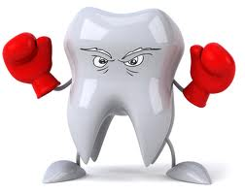
Thank you

