Slide 1

FINANCE IN DENTAL CARE

Slide 2


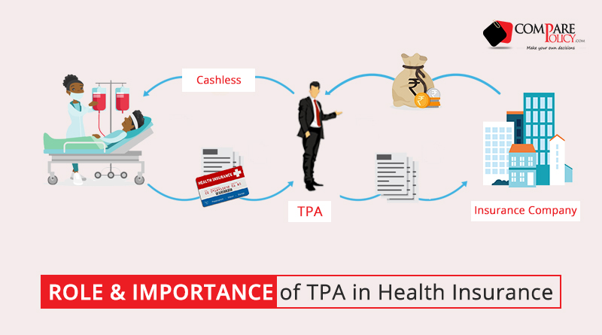
INTRODUCTION

Slide 3
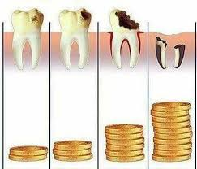
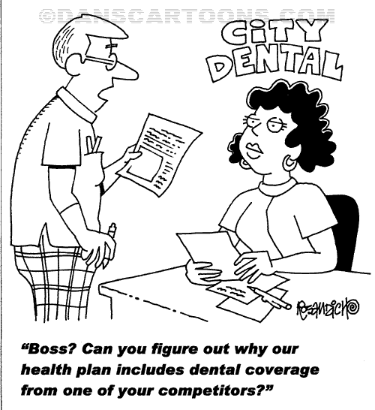
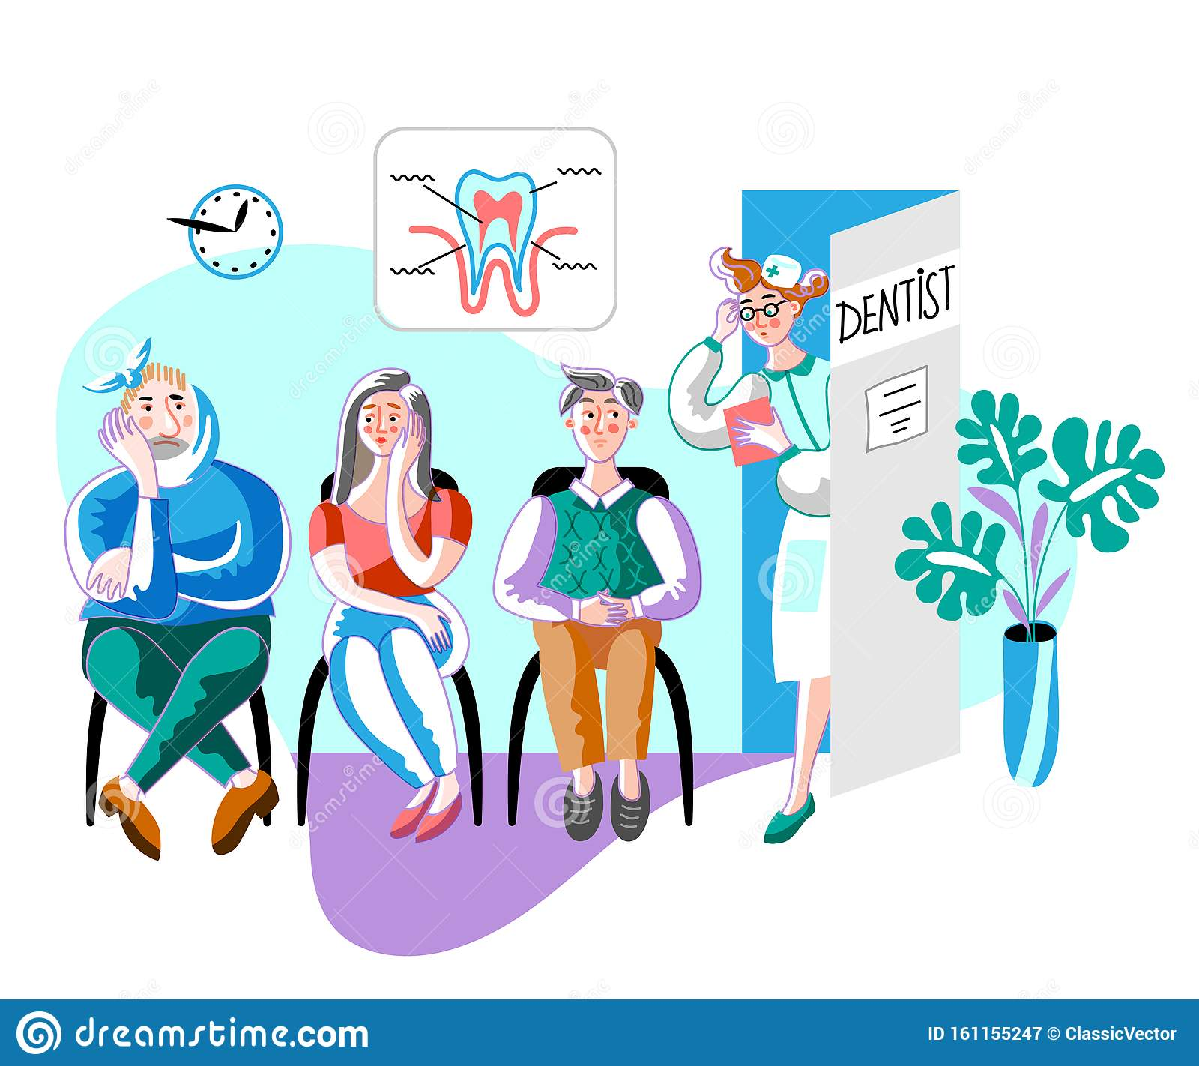
Notes:
Oral health: An integral part of general health, As the costs of dental care continues to rise, the majority of the people cannot afford dental treatment, especially when it is being provided on a fee-for-service. In the developing countries like India, Very few people can afford to utilize oral health care services regularly. Most of the people will visit dentist only for curative services occasionally, not for preventive measures.

Slide 4
Mechanisms of payment for Dental Care
Private fee for service
Salary
Post payment plans
Private third party prepayment plans
Public Programs

Slide 5
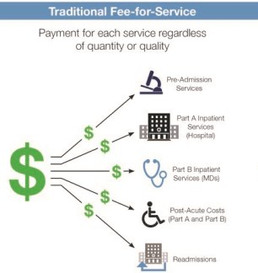
PRIVATE FEE FOR SERVICE
ADVANTAGES:
Culturally acceptable
Flexible
Administratively simple
DISADVANTAGES:
Some potential patients who cannot afford dental care offered.

Slide 6
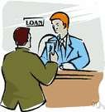
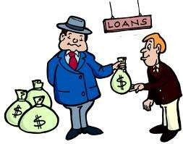
POST PAYMENT PLANS/BUDGET PAYMENT PLAN
Introduced in late 1930’s by local dental societies in Pennsylvania & Michigan..

Slide 7
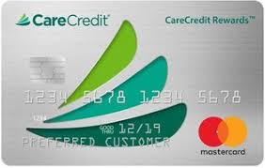
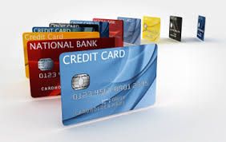
By the late 1970’s many dentists were accepting credit cards in the developed countries

Slide 8
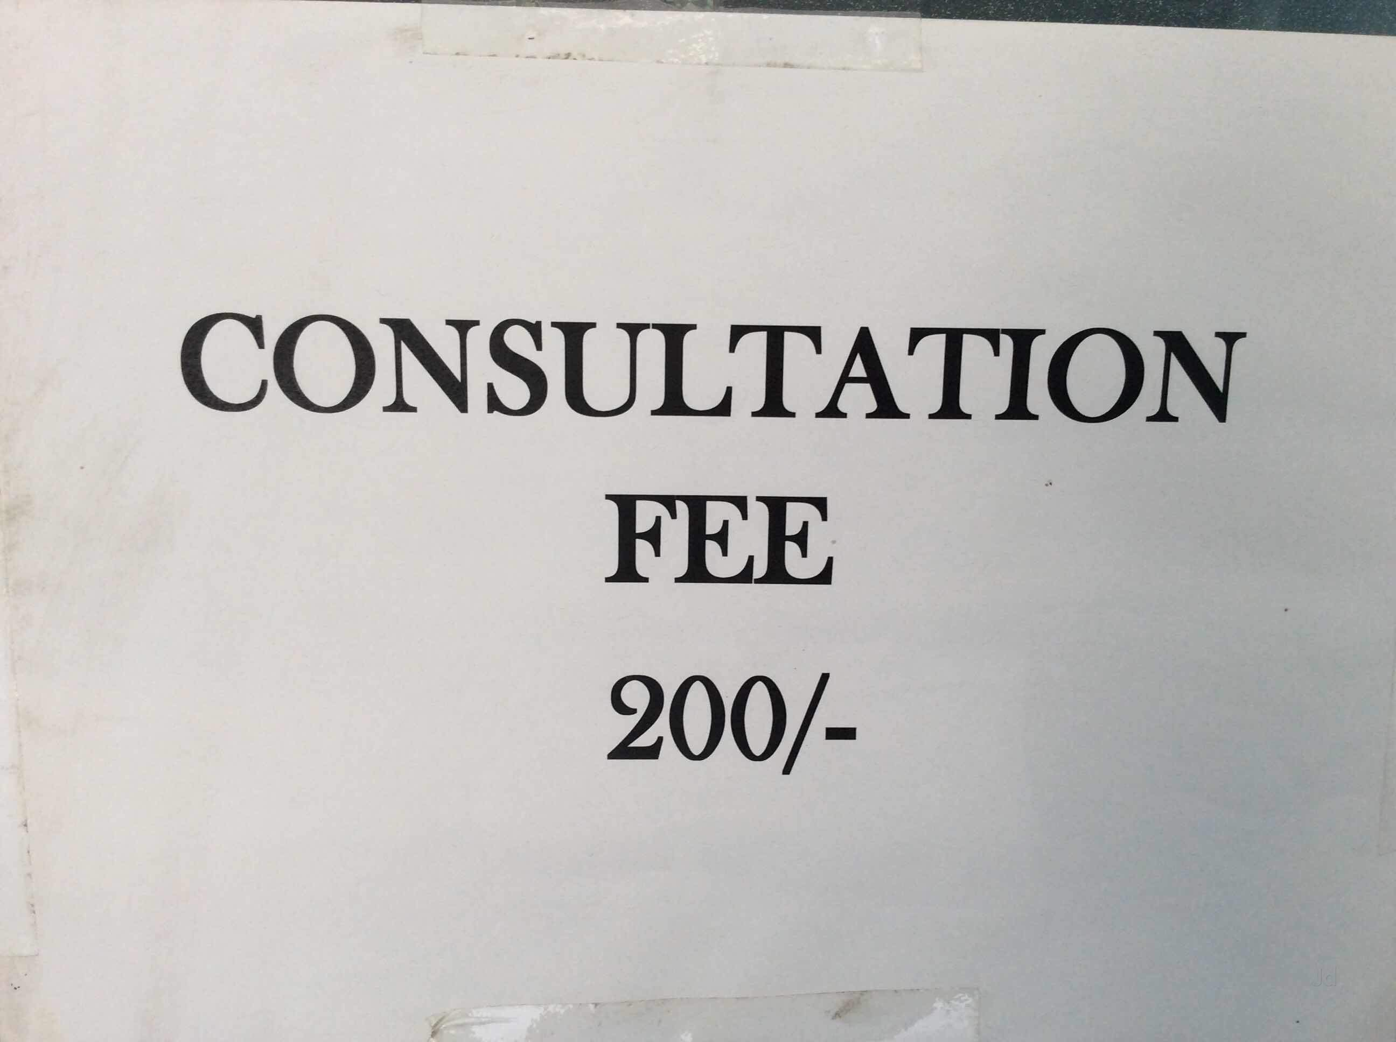
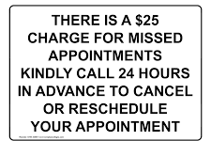
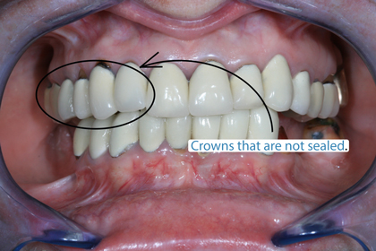
PRINCIPLES

Slide 9
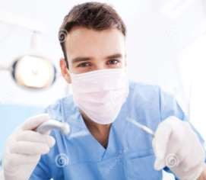
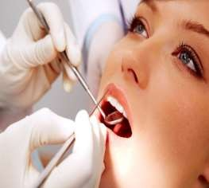

PRIVATE THIRD PARTY PREPAYMENT PLANS
It is defined as ‘’payment for services by some agency rather than directly by the beneficiary of those services’’.
1st PARTY - DENTIST
2nd PARTY - PATIENT
3rd PARTY – FINANCE ADMINISTRATOR

Slide 10
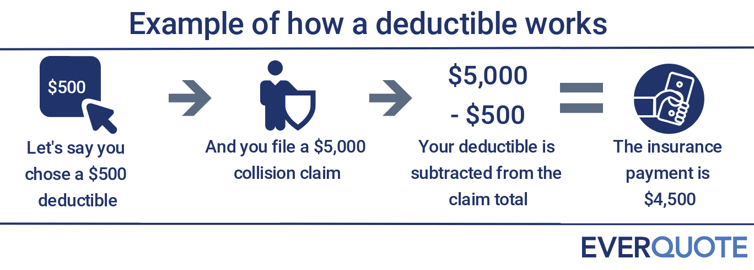
DEDUCTIBLE:
Notes:
It is sometime called a front-end-payment.

Slide 11

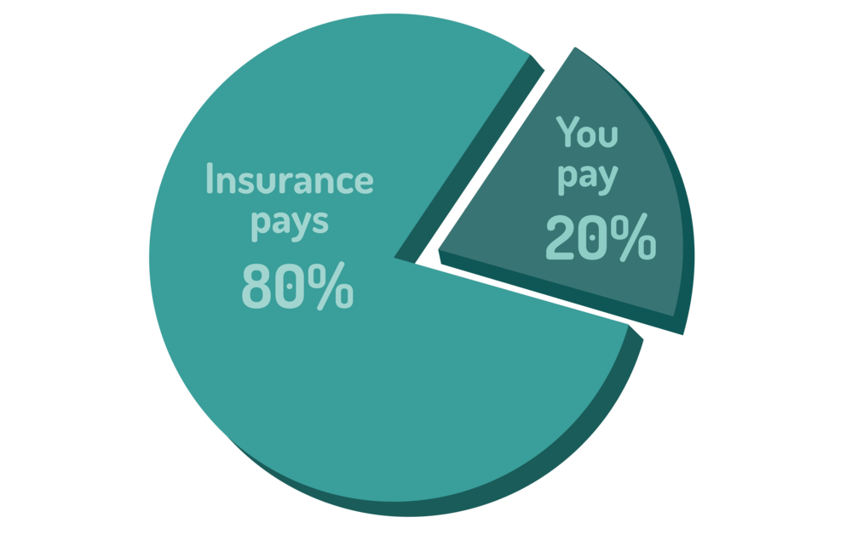
CO-INSURANCE

Slide 12
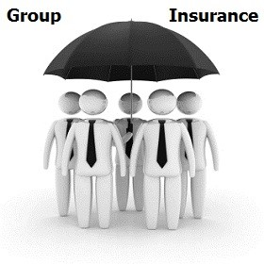
GROUP INSURANCE

Slide 13
REIMBURSEMENT OF DENTISTS IN PREPAYMENT PLANS
The major forms of third-party reimbursement currently in use are
  Usual, customary, and reasonable fee (UCR) .
  Table of allowances.
  Fee schedules
  Direct Reimbursement

Slide 14
USUAL, CUSTOMARY, AND REASONABLE (UCR) FEE.
ADA preferred method for reimbursement for dentists in prepayment plans. defines-
Usual
Fee that an individual dentist most frequently charges for a given dental service
Customary
Fee level determined by the administrator of a dental benefit plan from actual submitted fees for a specific dental procedure to establish the maximum benefit payable under a given plan for that specific procedure
Reasonable
Fee charged by a dentist for a specific dental procedure that has been modified by the nature and severity of the condition being treated and by unusual circumstances

Slide 15
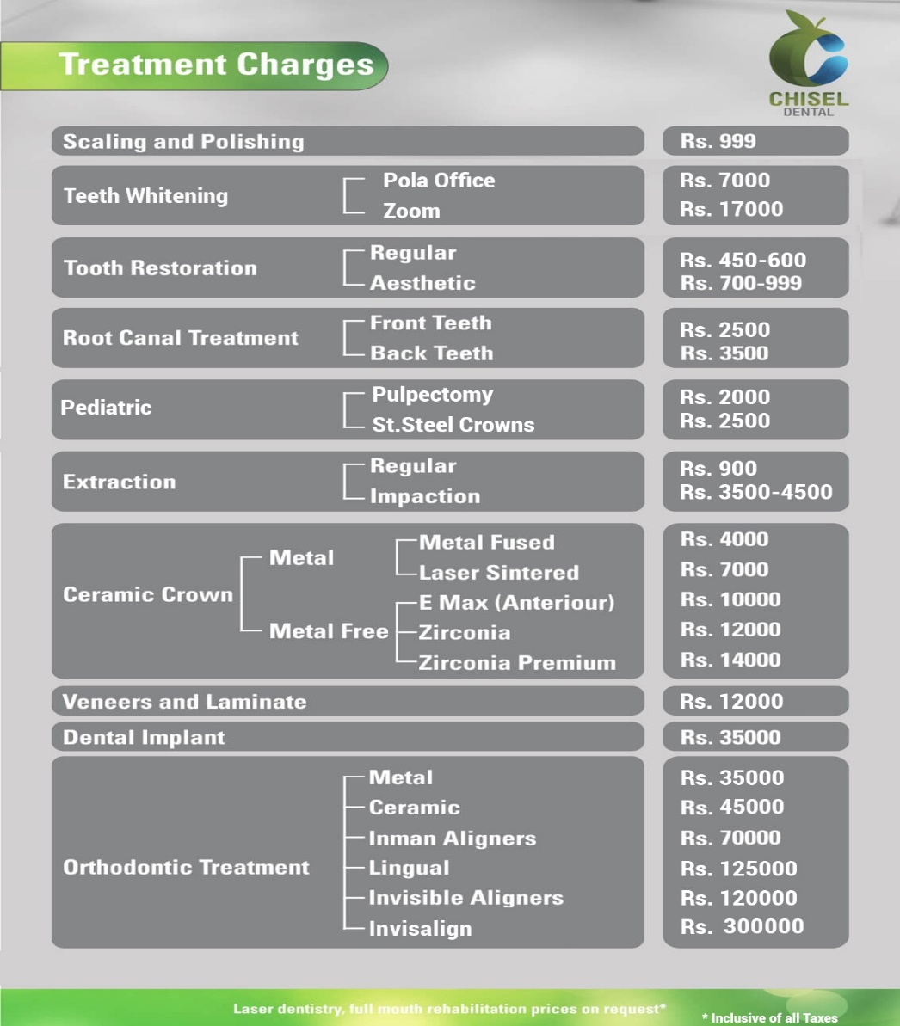
TABLE OF ALLOWANCES
A table of allowances is defined as a list of covered services that assigns to each service a sum that represents the total obligation of the plan with respect to payment for such service but that does not necessarily represent a dentist’s full fee for that service.
Notes:
The dentist’s fee becomes more than that assigned to that service by the carrier, the remainder will be collected by the dentist from the patient.This method of reimbursement is not entirely satisfactory because the patients are often unaware that the plan may not cover them in full for dental care.

Slide 16
Fee schedules/ service plan:-
Defined as a list of the charges established or agreed by a dentist for specific dental services .

Slide 17
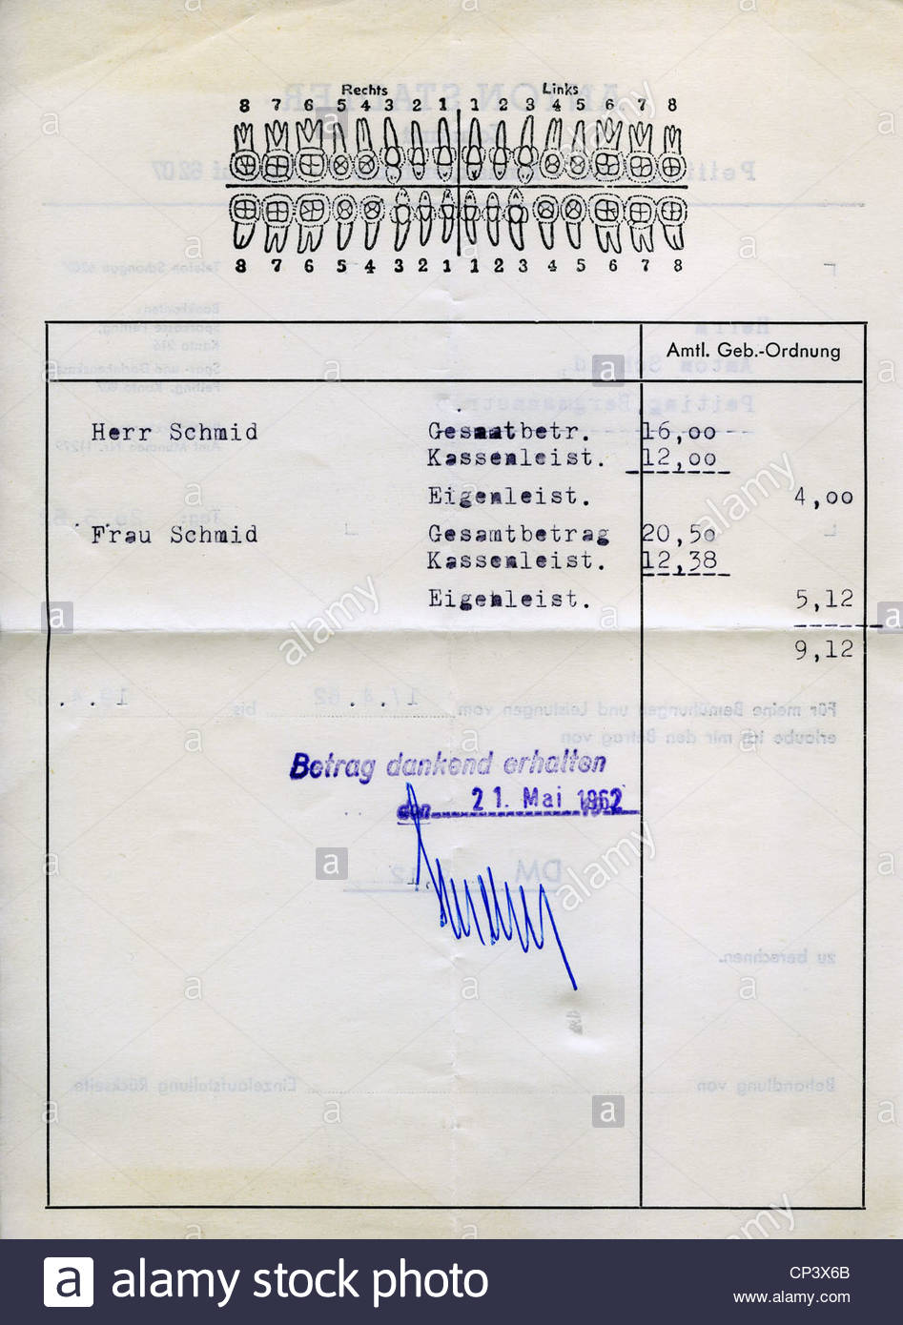

DIRECT REIMBURSEMENT

Slide 18
PRIVATE THIRD Party prepayment plans
  Commercial insurance companies
  Non profit health service corporations
  (delta dental plans & blue cross/blue shield).
  Prepaid group practice
  (health maintenance organizations and independent practice association)
  Capitation plans

Slide 19
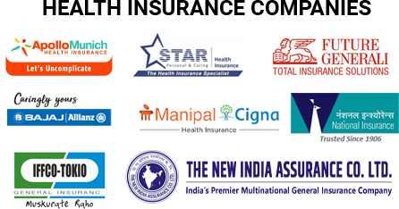
COMMERCIAL INSURANCE COMPANIES

Slide 20
COMMERCIAL INSURANCE COMPANIES
ADVANTAGES
Payment is quicker & hassle free.
No fee audits & post treatment dental examination to assess the quality of care delivered.
DISADVANTAGES
Do not encourage utilization of services
Charge higher premiums.

Slide 21
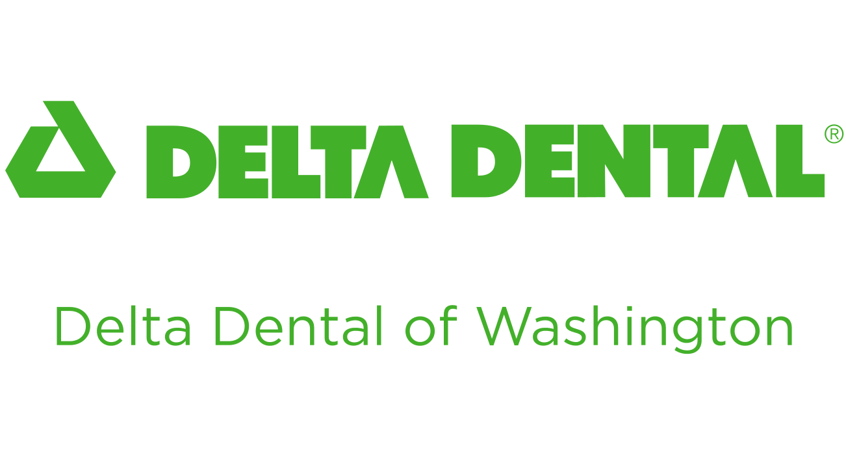
NON-PROFIT HEALTH SERVICE CORPORATIONS
, - DELTA DENTAL PLANS
June 1954, the Seattle District Dental Society
Comprehensive dental health care program for children upto 14 years.
The National Association of Dental Service Plans (NADSP) - june1966
The NADSP changed its name to Delta Dental Plans Association in April 1969.
.

Slide 22
Characteristics of a dental service corporation as per Mitchell and Hoggard are
Professional sponsorship
Non-profit operation
Participation permitted by all licensed dentists with the state
Benefits provided on a service basis
Freedom of choice is allowed for both patient and dentist.

Slide 23
REIMBURSEMENT OF DENTISTS IN DELTA PLANS
PARTICIPATING DENTIST Conditions for participating dentists:
Pre filing of usual & customary fee
Acceptance of payment at 90th percentile.
Fee audits by auditors from delta
Post treatment assessment of randomly chosen patients..
NON PARTICIPATING DENTIST: no fee audit, lower percentile, 50th percentile, or median

Slide 24
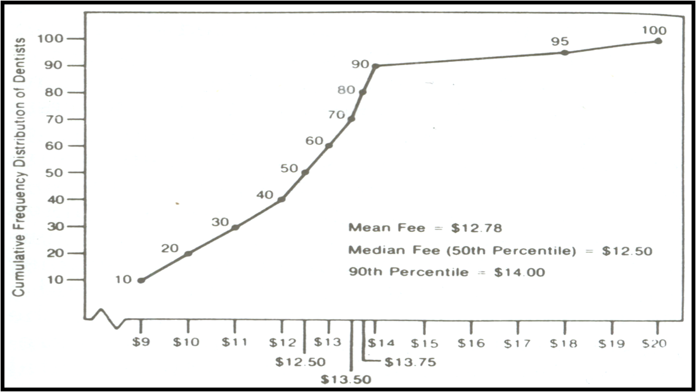
90th percentile

Slide 25
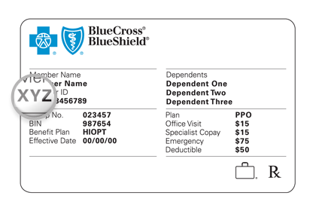
Blue Cross/ Blue Shield Dental Plans
Blue shield offers affordable and comprehensive dental plans available to clients with and without a blue shield plan.
Notes:
They offered only limited dental coverage for longer periods of -time as a part of their hospital –surgical-medical policies.

Slide 26
3. PREPAID GROUP PRACTICE
It is a group practice that provides dental services on a prepaid basis. Such groups are often regarded as open panels.
According to ADA (1969) Group practice is that type of dental practice in which dentists, sometimes in association with the members of other health professions agree formally between themselves on certain central arrangements designed to provide efficient dental health service.

Slide 27
Code of Ethics of the Dental Society of state of New York states “type of dental practice in which ethical, licensed dentists sometimes in association with members of other health professions agree formally among themselves on certain central arrangements designed to advance the economical and efficient conduct of a dental practice in order to render an improved health service to the patient”

Slide 28
According to U.S. Public Health Service (1971) A group practice is defined as a practice formally organized to provide dental care through the services of three or more dentists, using office space, equipment and or personnel jointly.

Slide 29
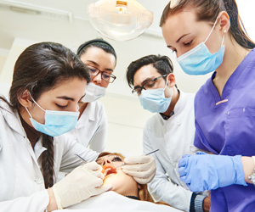
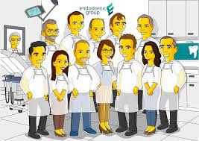
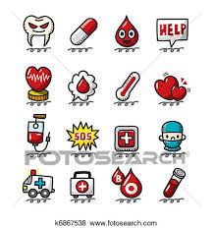
It can be of different types
General Group practice
Single specialty group
Multi-specialty groups

Slide 30

HEALTH MAINTENANCE ORGANIZATION
HMO is defined as a legal entity which provides a prescribed range of services to each individual who has enrolled in the organization in return for prepaid, fixed and uniform payment.

Slide 31
It Started essentially as a method to provide health care services to workers, Served 13 states with a total enrollment of close to 5 million.
The main advantages of HMO’s lies in their claim to reduce costs of care for those enrolled.

Slide 32
Models of HMO
STAFF MODEL
GROUP MODEL
INDEPENDENT PRACTICE ASSOCIATION
PREFERRED PROVIDER ORGANISATION

Slide 33
Staff model:-Dentists dental hygienists and dental assistants are salaried employees of HMO
Group model:-HMO contracts directly with a group practice, partnership or corporation for the provision of dental services. The individual dentists usually receive the income as in group practice , it is not affected by HMO contract.
Independent practice association:- independent dentists that develops its own management and fiscal structure for the treatment of patients enrolled in HMO.
PREFERRED PROVIDER ORGANISATION (PPO’S):- Involve contracts between insurance companies and number of practitioners who agree to provide specific services for fees that are lower then average for that area.

Slide 34

CAPITATION PLANS
A capitation fee is defined as affixed monthly or early payment paid by a carrier to a dentist in a closed panel, based on the number of patients assigned to the dentist for treatment.
ADA defines capitation as dental benefit program in which a dentist contract with the program sponsor or administrator to provide all or most of the services covered under the program to subscribers in return for a payment on per capita basis.

Slide 35
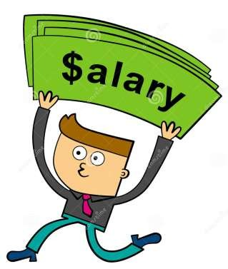
SALARY
Advantages:-Predetermined amount of money is paid by the plan to each participating dentist
It allows a dentist to be largely free of the business concerns of running a practice thereby allowing the dentist to concentrate on clinical matters.
Disadvantages:-There could be a lack of financial incentive that some dentists, need to be highly productive.

Slide 36
PUBLIC PROGRAMS
MEDICARE
MEDICAID
NATIONAL HEALTH INSURANCE

Slide 37
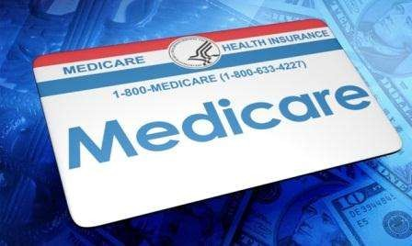
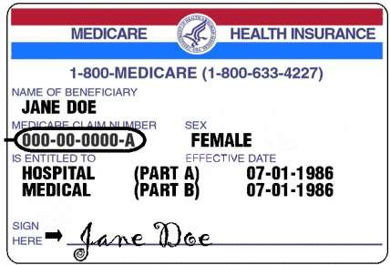
MEDICARE
Title xviii of the social security amendments of 1965 is the program known as ‘’Medicare’’. This program removed all financial barriers for hospital and physician services for all persons aged 65 and over, regardless of their financial means.
2 parts-1970
Hospital Insurance
voluntary supplemental medical Insurance.

Slide 38
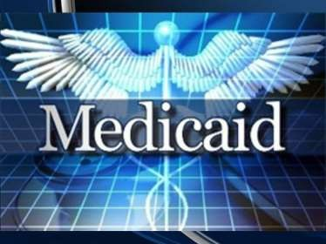
MEDICAID
It is the name given to title xix of the social security amendments of 1965.
The original intent of the program was to provide funds to meet the health care needs of all indigent and medically indigent persons.

Slide 39

Basic services ,
In patient hospital care
Outpatient hospital care
Laboratory and x-ray services
Skilled nursing facility services

Slide 40
Home health services for individuals aged 21 years and older.
Early and periodic screening ,diagnosis and treatment (EPDST) program for individuals under 21 years
Family planning services
Physician services

Slide 41
Early and periodic screening, diagnosis and treatment services {EPSDT}
Enacted into law in the year 1967,amended in the year1989 .
Provides for periodic screening,vision,dental, hearing and necessary and follow-up services for Medicaid recipients under age of 21.

Slide 42

﻿STATE CHILDREN'S HEALTH INSURANCE PROGRAM (SCHIP)
This program was developed in USA to provide coverage for children in low to moderate-income families who do not qualify for Medicaid.

Slide 43
National Health Insurance
Introduced by
    Bismarck in Germany in 1880’s
    Lloyd George in Britain in 1910
NHI is primarily a financing mechanism by which health care services are paid for from a publicly organized fund

Slide 44
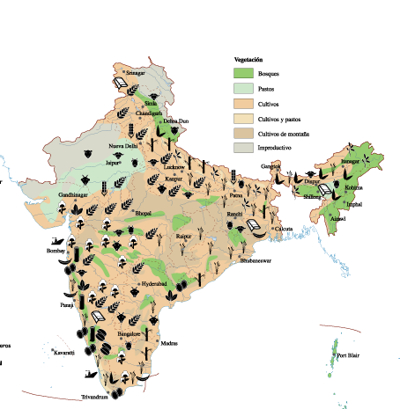
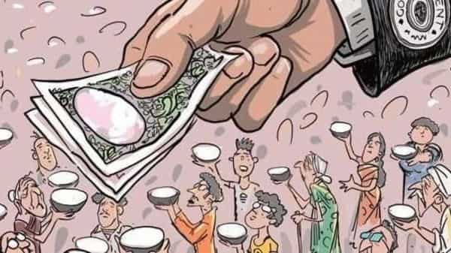
INDIAN SCENARIO
2%

Slide 45

EMPLOYEES STATE INSURANCE SCHEME(ESI)
It was introduced by an act of parliament in 1948 amended in 1975,1984 and 1989.

Slide 46
SCOPE OF ESI
Small power using factories employing 10-19 persons, and
Non power using factories employing 20 or more persons.
Shops
Hotels and restaurants
Cinemas and theaters
Road motor transport establishments
News paper establishments

Slide 47
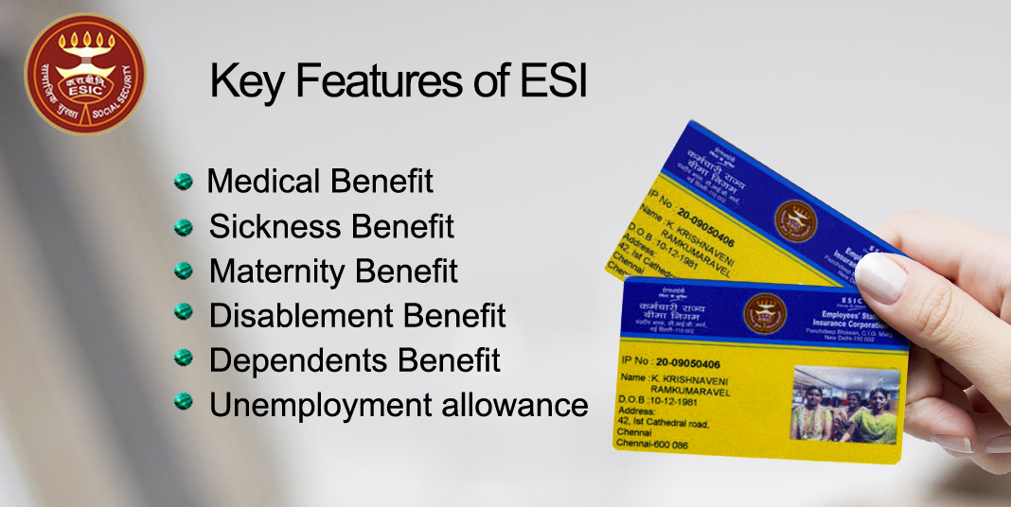
BENEFITS TO THE EMPLOYEES in ESI scheme
Medical benefit
Sickness benefit
Maternity benefits
Disablement benefit
Dependant's benefit
Funeral expenses
Rehabilitation allowance.

Slide 48

CENTRAL GOVERNMENT HEALTH SCHEME(CGHS)
It was introduced in 1954 for comprehensive medical care of central government employees.
The dental health aspect is covered through the dental welfare facilities available in dispensaries.

Slide 49

DEFENCE MEDICAL SERVICES
Defence services have their own organization for medical care to their personnel under the banner "Armed Medical and Dental Service.”

Slide 50
HEALTH CARE OF RAILWAY EMPLOYEES
The railways provide comprehensive health services including dental treatment through the agency of railway hospitals, health unit and clinics.

Slide 51
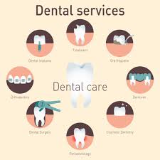

Dental Insurance Schemes in India
The first dental insurance scheme in India was launched through oral care brand, Pepsodent in 2002.
The scheme, launched through a partnership with the New India Assurance offered a dental insurance of Rs 1,000 on purchase of any pack of Pepsodent..

Slide 52
Insurance cover against expenses for the extraction of teeth due to caries and periodontitis was provided.
Dental rehabilitation was not covered.
The dental insurance plan provided by ICICI Lombard and Bajaj Allianz are not comprehensive plans and are clubbed with the general health insurance scheme

Slide 53
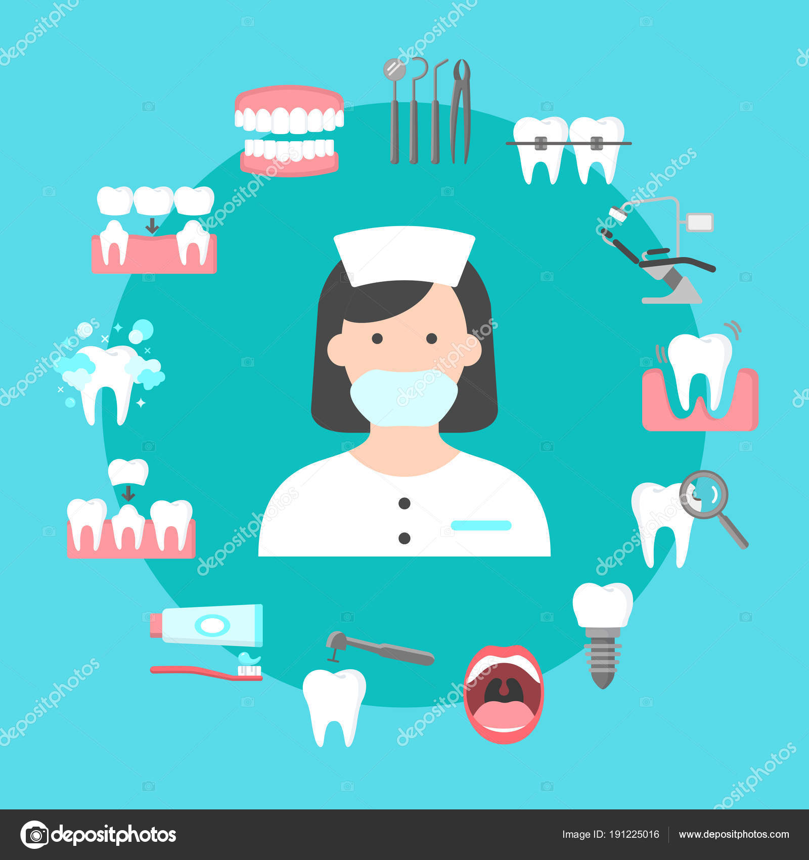
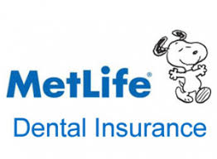
Metlife dental insurance plan

Slide 54
HEALTH INSURANCE SCHEMES IN INDIA
Ayushman Bharat
Awaz Health Insurance Scheme---kerala
Aam Aadmi Bima Yojana
Bhamashah Swasthya Bima Yojana---Rajasthan
Central Government Health Scheme (CGHS)
Chief Minister's Comprehensive Insurance Scheme--Ttamil nadu
Employees' State Insurance Scheme
Karunya Health Scheme---kerala
Mahatma Jyotiba Phule Jan Arogya Yojana-----maharashtra

Slide 55
Mukhyamantri Amrutum Yojana---Gujarat
Pradhan Mantri Suraksha Bima Yojana
Dr YSR Aarogyasri
Employees and Journalists Health Scheme---Telangana
Rashtriya Swasthya Bima Yojana
Universal Health Insurance Scheme
Yeshasvini Health Insurance Scheme----Karnataka
West Bengal Health Scheme--- West bengal

Slide 56
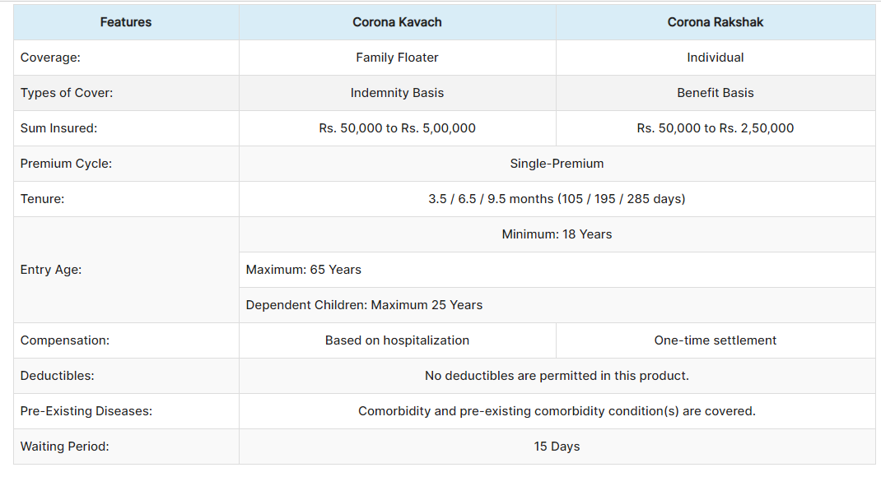

Slide 57
Third parties in India
Life Insurance
Corporation
(LIC)
General Insurance
Corporation
(GIC)
Government
Employees’
State
Insurance
Scheme
(ESIS)
Central
Government
Health
Scheme
(CGHS)
United Indian
Insurance
Corporation
(UIIC),
National
Insurance
Corporation
(NIC)
Oriental
Insurance
Company
(OIC).
New India
Assurance
(NIA)

Slide 58


Slide 59


