Slide 1
FILMS,INTENSIFYING
SCREENS
AND
GRIDS
Dr.M.SWATHI
READER
DEPT OF ORAL MEDICINE & RADIOLOGY

Slide 2
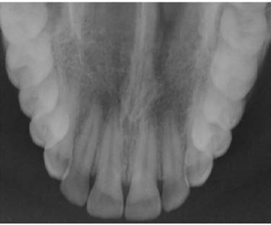
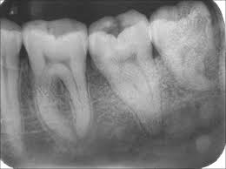
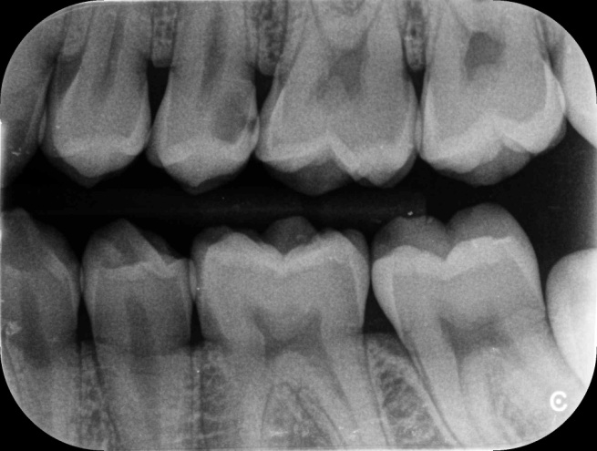
Intraoral films-
IOPAR
OCCLUSAL
BITEWING

Slide 3
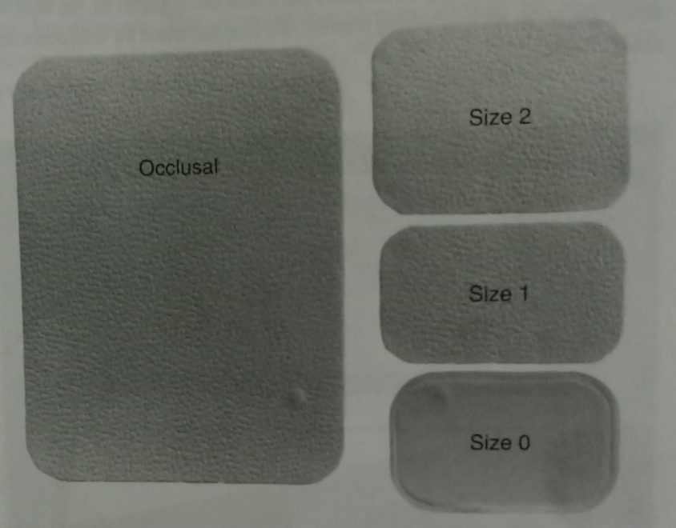
FILM SIZES :
SIZE 0- Small children,22 ×35mm
SIZE 1 – Narrow , anterior teeth, 24 × 40 mm
SIZE 2 –Adults ,30.5 × 40.5 mm
OCCLUSAL - 57 × 76 mm

Slide 4
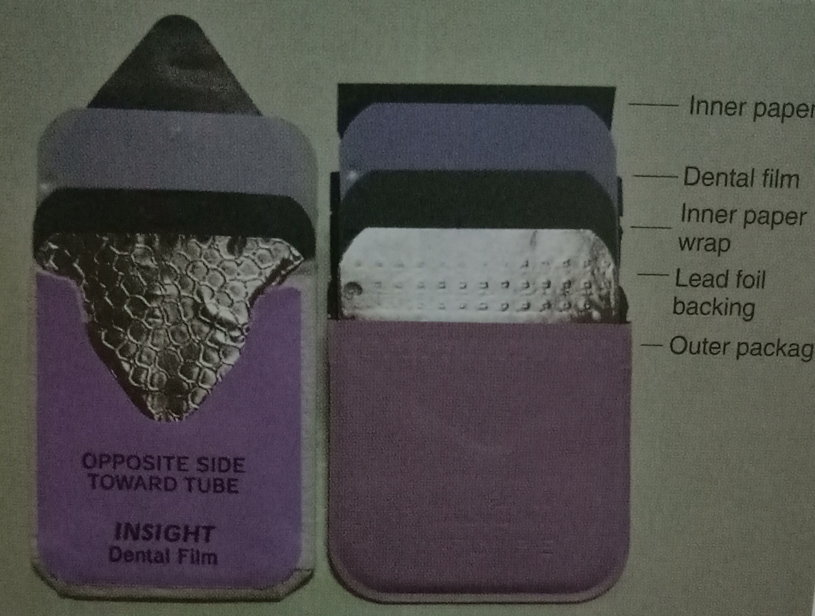
CONTENTS OF FILM PACKET

Slide 5
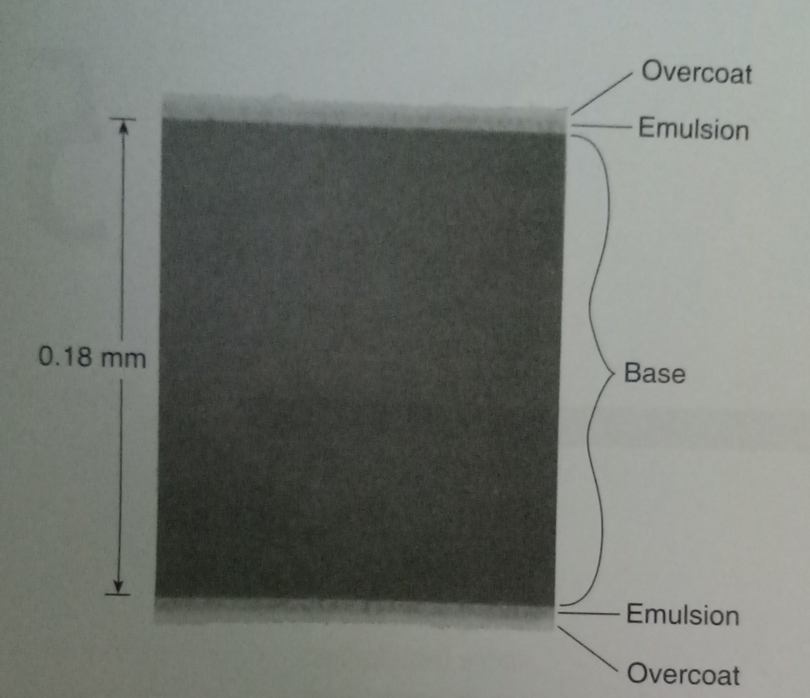
FILM COMPOSITION :
1. Emulsion
2. Base
Emulsion records radiographic image
Base is a supporting material onto which emulsion is coated.

Slide 6
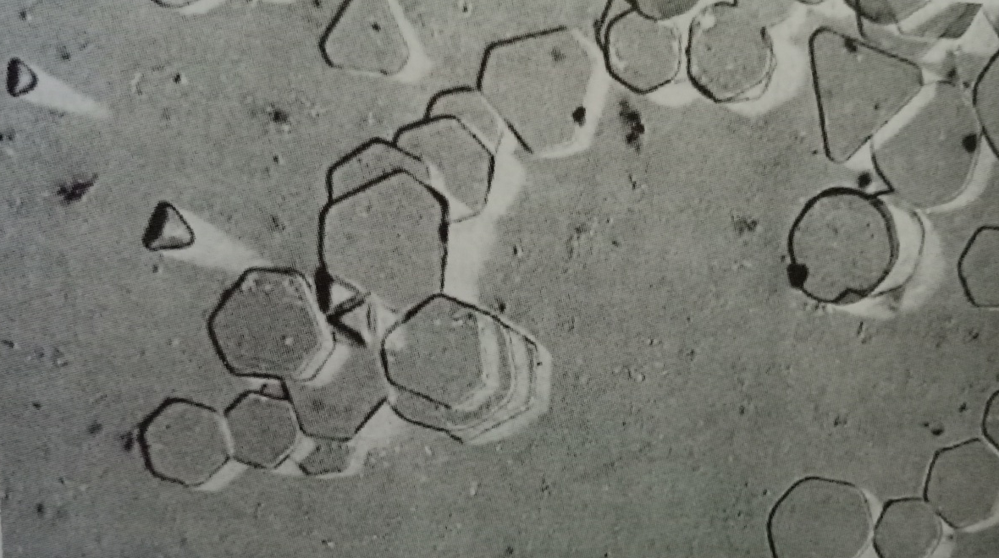
Emulsion contains :
Silver halide grains and vehicle matrix
Silver bromide are sensitive to x radiation and visible light and vehicle matrix in which crystals are suspended.
During film processing vehicle helps in absorbing the processing solutions ,allowing chemicals to reach and react with the silver halide crystals.

Slide 7
Base (polyester polyethylene terapthalate )
Supports the emulsion
Flexibility to allow easy handling of the film
To withstand processing solutions
Prevents distortion

Slide 8
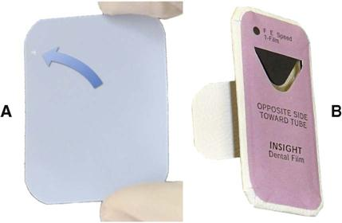
Intra oral x ray film :
Corner has a small , raised dot which should face the x ray tube head during exposure.
Depressed side is faced towards the patient’s palate or tongue.
After exposure the raised dot also helps in identification right and left side of the image.
It helps in mounting the radiographs ,each film is oriented with the convex side toward the viewer.

Slide 9
Film is encased in black paper and plastic wraping so as to be resistant to moisture.
Lead foil serves by reduced scaterred radiation and reduces film fog and increases subject contrast also reduces patient exposure by reducing the residual x ray beam.

Slide 10
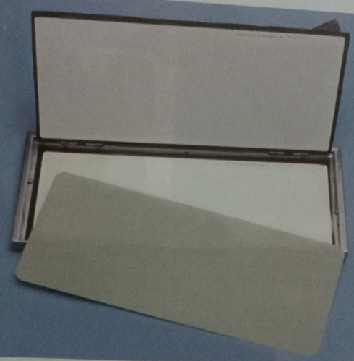
Intensifying screens
They are used in extraoral projections along with cassette.
Intensifying screen absorb x rays and emit visible light which exposes the film.
Silver bromide crystals are sensitive to UV and blue light so these are sensitive to screens that emit UV and blue light.

Slide 11
FUNCTION OF SCREENS :
Intensifying screens are 10 to 60 times more sensitive to the x ray than the film alone.
It also helps in reducing raiation to the patient.
They are not used intraorally,because when used reduces the resolution of the image.

Slide 12
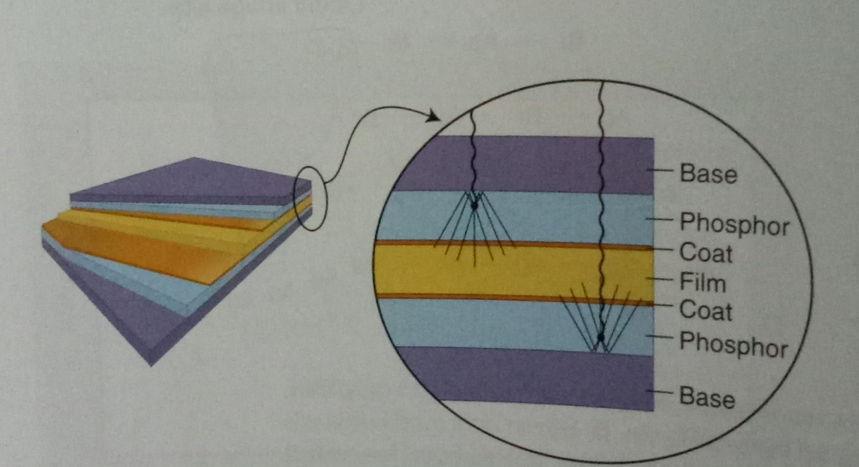
Composition :
Base
Phosphor layer
Protective polymeric coat

Slide 13
Intensifying screens are used in pairs and are held close to the film so as to increase the sharpness of the image.
Casette is purposed to hold the screens and film together.

Slide 14
Base
Polyester plastic
O.25mm thick
Provides mechanical support

Slide 15
Phosphor layer :
Contains phosphorescent crystals suspended in polymeric binder.
When these crystals absorb x-ray photons they fluoresce.
Crystals contain rare earth elements like lanthanum, gadolinum.
Other elements like thulium, niobium or terbium can be added to increases the fluorescence capacity.
These rare earth elements absorb x-ray photons and convert them into visible light and exposes the film.

Slide 16
Fast screens have large phosphor crystals but produces images of lower resolution.
Rare earth elements used in intensifying screens :
Emission | Phosphor
Green | Gadolinium oxysulfide , terbium activated
Blue and UV | Yttrium tantalite, niobium activated

Slide 17
Protective coat
<15µm thick protective polymer coat is placed over the phosphor layer to protect the phosphor.
Screens should be routinely cleaned because any debris, spots may cause light leaks on the resultant image.

Slide 18
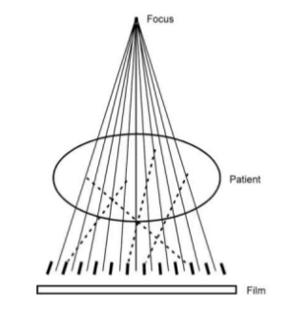
GRIDS
Grids reduce the amount of scattered radiation reaching the patient and helps in improving image contrast.
Grids are placed between patient the film .

Slide 19
Grid ratio : height of lead strip divided by distance between the lead strip.
G= h/d
Bucky factor : Incident radiation/transmitted radiation.
Higher grid ratio higher bucky factor.

Slide 20
Types of grids
focused grids - strips are slightly angled
parallel grid: used for short fields
moving grids (also known as Potter-Bucky or reciprocating grids): eliminates the fine grid lines or shadows of the lead foil .

Slide 21
SUMMARY
Various types of films
Sizes of the films
Composition of intraoral film
Intensifying screens and their composition
Grids

Slide 22


