Slide 1


FAULTY
RADIOGRAPHS
Dr. B. MRUDULA
READER
DEPT OF ORAL MEDICINE & RADIOLOGY

Slide 2
Good quality radiographs should have:
Image with optimum density & contrast.
Image with minimum distortion.
Image with sharp borders & maximum details.

Slide 3
Various reasons for faulty radiographs
1)Errors in operating the machine. 2)Errors in techniques.
3)Errors in processing & mounting.

Slide 4
Kvp – speed, penetration power, energy of Xray photons .
mA – amount , intensity of current .
S - time of current flow.

Slide 5
Errors in operating the machine
Lighter radiographs (underexposed/ underdeveloped radiographs).
Exposure time less
< KVp
underdeveloped

Slide 6
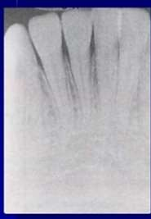
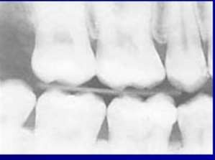

Slide 7
Darker films (overexposed /overdeveloped /high density)
Exposure time >.
Higher Kilovoltage peak. (burn out effect)
Over developed.

Slide 8
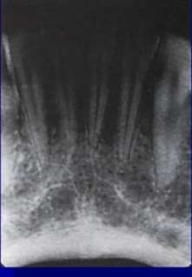
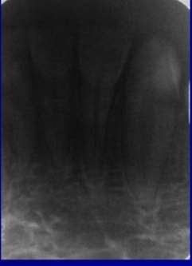

Slide 9
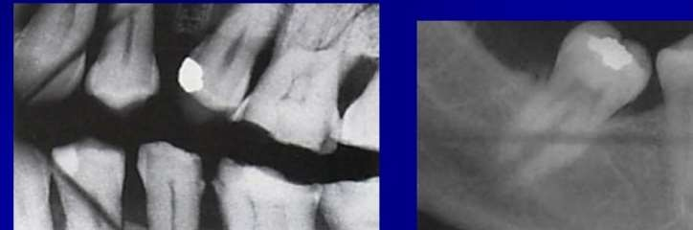
Errors in technique
Improper manipulation /bending of film .

Slide 10
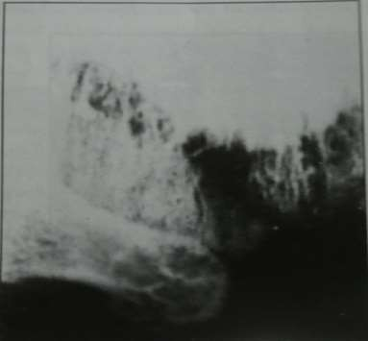
Phalangioma.

Slide 11
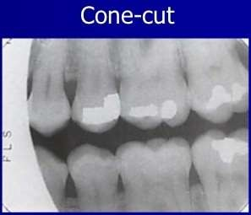
Cone cut/partial image.

Slide 12
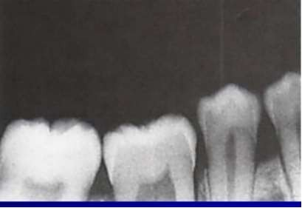
Apical ends cut off.

Slide 13
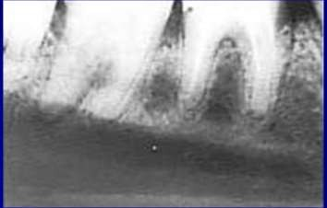
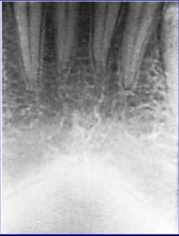
Crown cut off

Slide 14
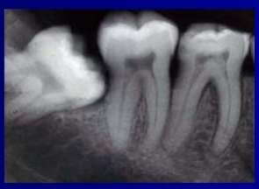
Region of interest not shown

Slide 15
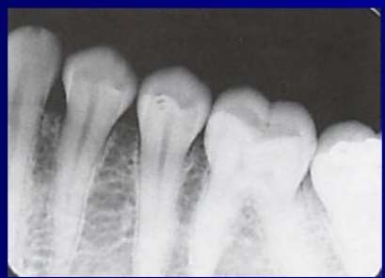
Tipping/tilting of occlusal plane

Slide 16
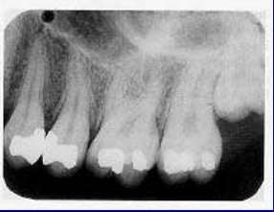
Dot artifact

Slide 17
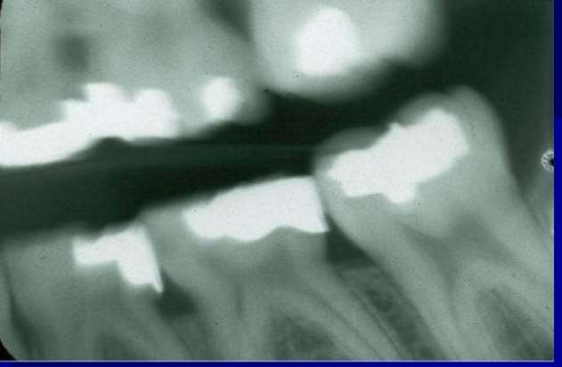
Blurring

Slide 18
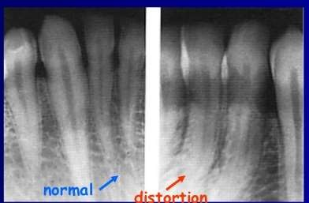
Image shape distortion.

Slide 19
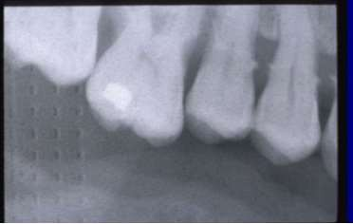
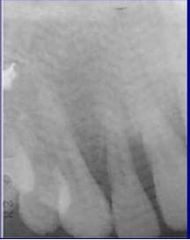
Tyre track/herring bone pattern

Slide 20
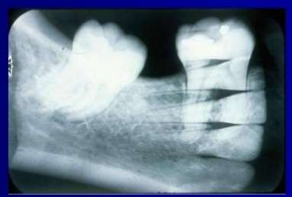
Double image

Slide 21
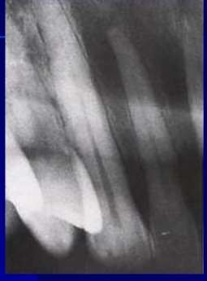
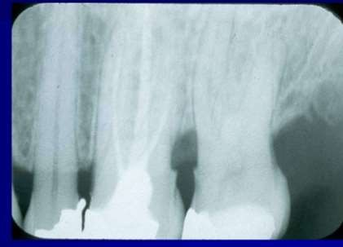
Size distortion/less vertical angulation/ elongation

Slide 22
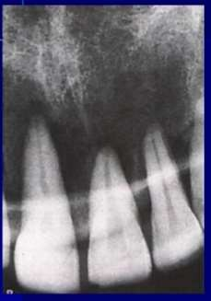
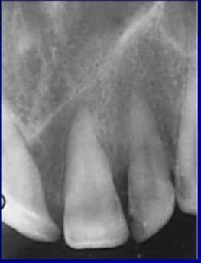
More vertical angulation shortening

Slide 23
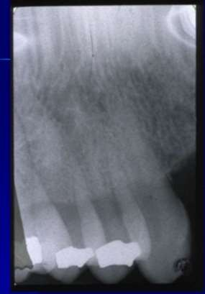
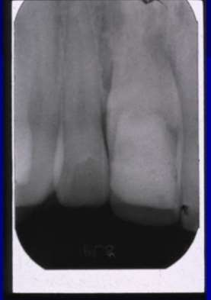
Improper horizontal angulation.

Slide 24
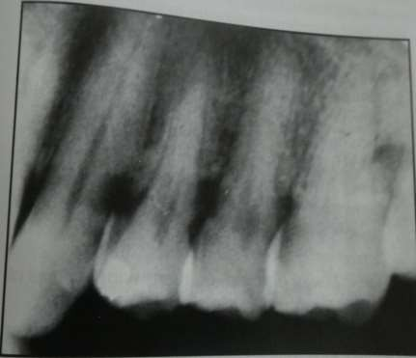
Cervical burn out/adumbration:

Slide 25
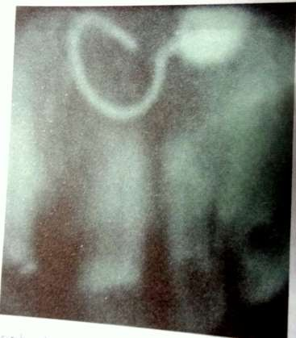
Ornamental artifact

Slide 26
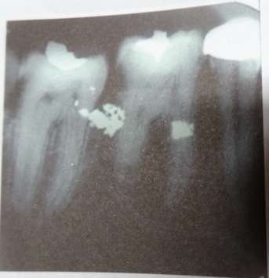
Foreign body/restorative material

Slide 27
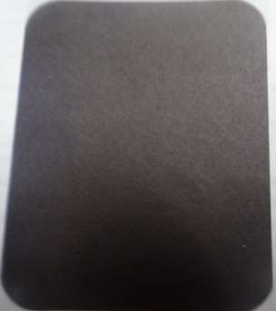
Errors in processing
Exposure of film in day light.

Slide 28
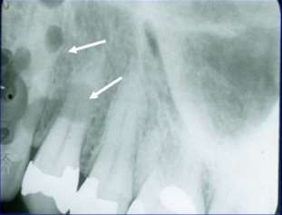
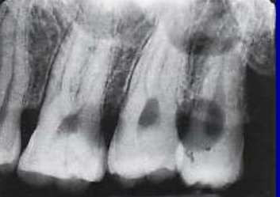
Contaminated film with developer before processing/developer spots.

Slide 29
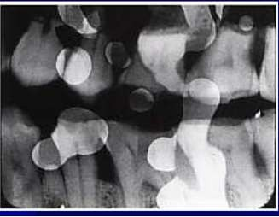
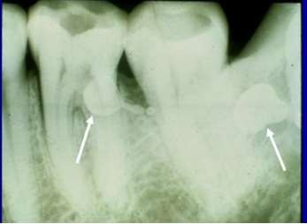
Contaminated film with fixer before processing/fixer spots.

Slide 30
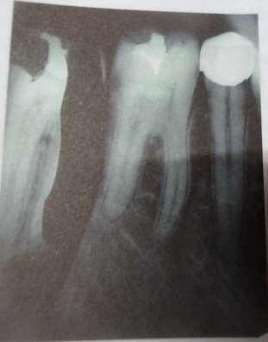
Film dropped into developer

Slide 31
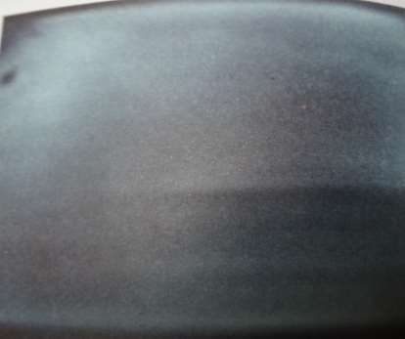
Film dropped into fixer

Slide 32
Standard dark room principle
Developer solution - left
Water - middle
Fixer solution - right

Slide 33
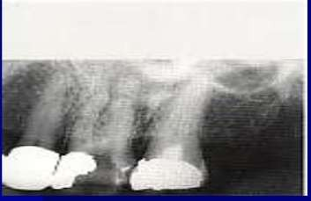
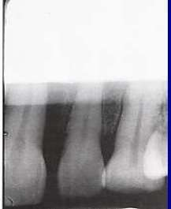
Film incompletely immersed in developer solution /developer cut off

Slide 34
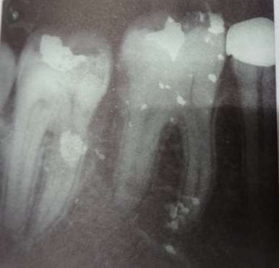
Dust in developer solution

Slide 35
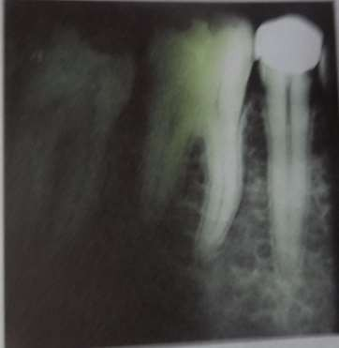
Film incompletely immersed in fixer solution/fixer cut off

Slide 36
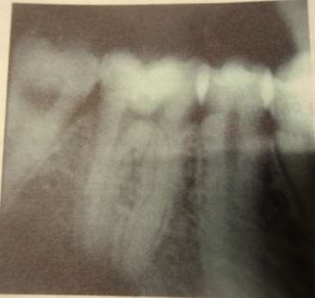
Dust in fixer

Slide 37
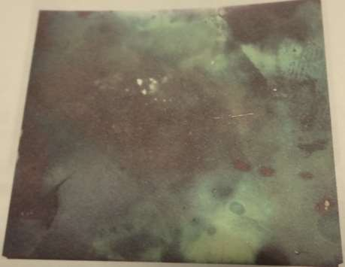
Use of expired film

Slide 38
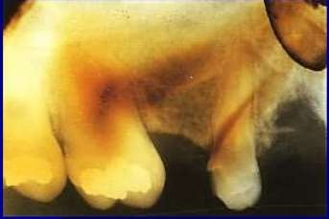
Improper washing of films

Slide 39
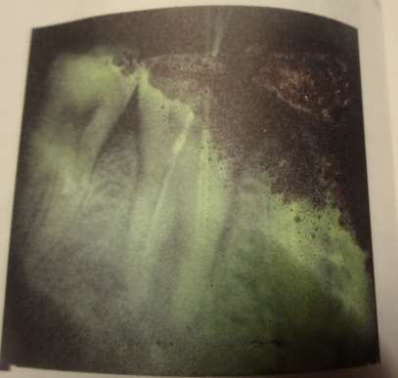
Warping of film

Slide 40
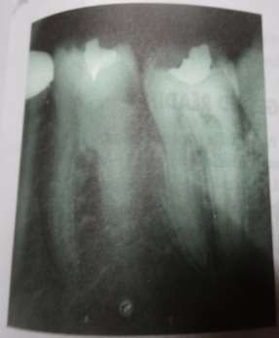
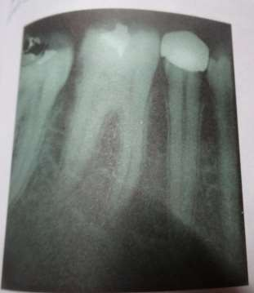
Improper position of hanger

Slide 41
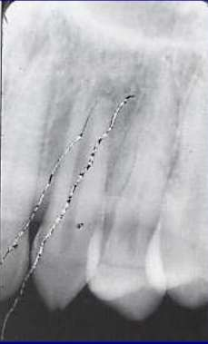
Scratches on film

Slide 42
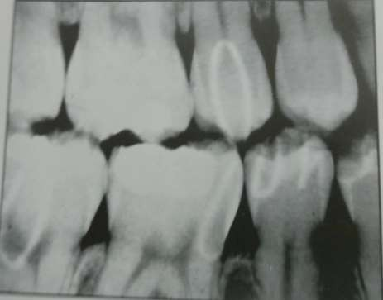
Writing on film

Slide 43
Film fog light fog radiation fog chemical fog
deterioration of film

Slide 44
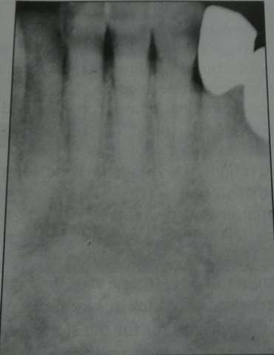

Slide 45
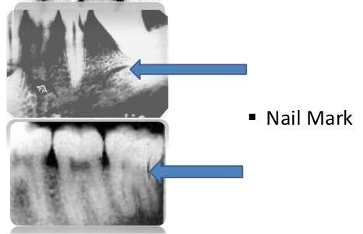
Finger nail artifact - dark cresent shaped

Slide 46
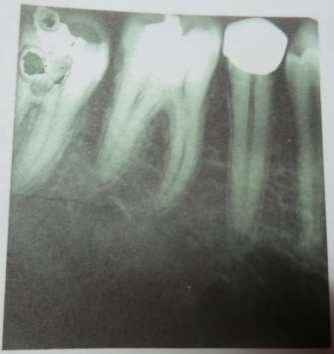
Improper drying

Slide 47
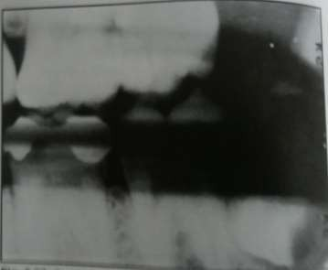

Black streaks

Slide 48

Smuge/finger prints
touched by fingers contaminated by developer/fluoride.

Slide 49


Over lapped films

Slide 50

Air bells

Slide 51

Reticulation/orange peel appearance

Slide 52

Static electricity/grass root/tree like/lightening marks

Slide 53
Frilling
hot processing solution
Dark flow marks
vigorous agitation.
Crimping artifact
remove from film holder.

Slide 54

Errors in OPG
1)Ghost image
is a radiopaque
artifact produced
when radiodense object is penetrated twice.

Slide 55

2)Lead apron artifact
cone shaped artifact

Slide 56

Thyroid collar

Slide 57
3)Lips not closed
dark radiolucent anterior teeth.
shadow that obscures

Slide 58

4)Tongue not in contact with palate/palatoglossal air space

Slide 59




5)Frankfort plane upward
R L

Slide 60


6)Frankfort plane downwards

Slide 61

7)Teeth position anterior to focal trough

Slide 62

8)Teeth position posterior to focal trough

Slide 63

9)Midsagittal plane not centered
R L

Slide 64

10)Position of spine/spine shadow ghost

Slide 65

11)Blurring – due to patient movement
R

Slide 66
Bibliography
1)Diagnostic imaging of jaws Langland & Langlais. 2)Oral radiology White & Pharoah .
3) Essentials of dental radiology Eric Whaites. 4)Manuel of dental & oral radiology john wright.
Fundamental of dental radiology Manson & Hing.
Radiology for dental professionals Stabulus Savage.
Radiogra phic imaging for dental auxillaries Miles
,Dis & Jensen.

Slide 67


