Slide 1


Slide 2

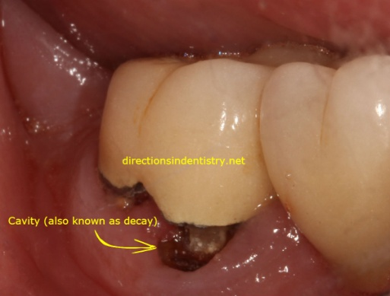
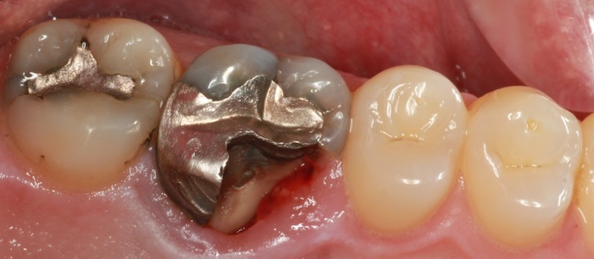
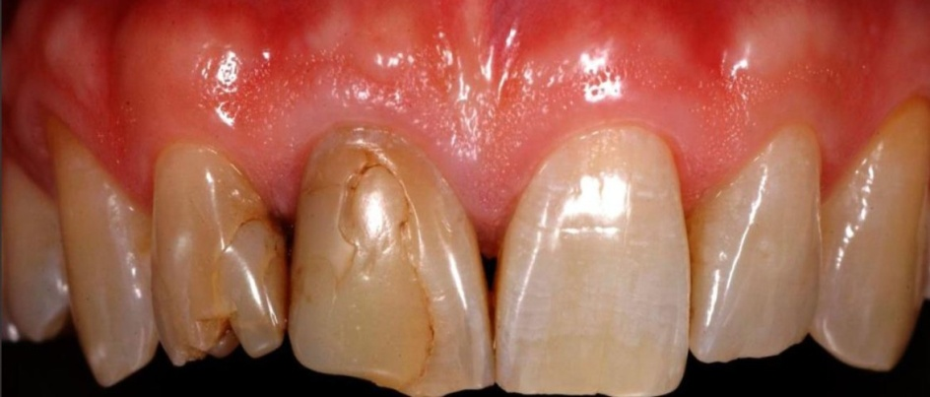
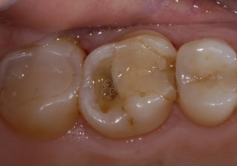
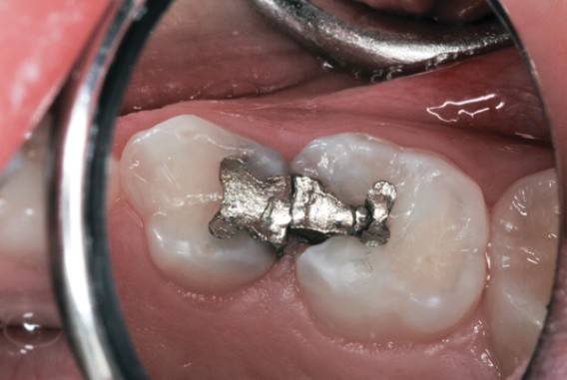
FAILURES OF RESTORATIONS
Causes and Prevention

Slide 3
CONTENTS
Introduction
Importance and objectives of a restoration
Criteria for selection of restorative materials
Forces acting on a restoration
Evaluation criteria for dental restorations
Ways in which restorations fail
Factors affecting failures
Failures of direct restorations
  Amalgam
  Composite
  Direct filling Gold
Failures of Indirect restorations
  Intracoronal
    Inlays / Onlays
  Extracoronal
    Full crowns
Conclusion
References

Slide 4
INTRODUCTION
Failure may be defined as the inability to meet the desired outcome.
Majority of restorative failures in dentistry can be attributed to the hindrances of the operator himself.
Everything done from the time of cavity preparation, until the restoration is polished has a definite affect on the success and failure of a restoration.
Combined efforts of meticulously done work, and maintenance by the patient is bound to yield fruitful results.

Slide 5
INTRODUCTION
The longevity of a restoration depends on many factors including anatomical position of the tooth in the oral cavity, type of restoration, age of the patient, the materials and techniques used and the operators' efficiency.
The quality evaluation of a dental restoration is an extremely difficult parameter to define.

Slide 6
INTRODUCTION
Its definition can be derived from many evaluating factors like function, marginal integrity, esthetics, tissue compatibility, absence or evidence of caries, pulp status and patient symptoms.
To achieve and maintain acceptable levels of success, deviation from any of these categories can be considered as a failure, thereby necessitating the replacement of a restoration.

Slide 7
CRITERIA FOR SELECTION OF RESTORATIVE MATERIAL
Because no restorative material is ideal and all materials display a potential lifespan of no more than 20 years, a considerable amount of restorative work undertaken in clinical practice consists of replacement of old restorations.
Generally replacement is indicated because of recurrent caries, failure of the previous restorative material or fracture of remaining tooth structure, these factors will dictate the choice of the replacement material and this material must always offer the greatest longevity possible.

Slide 8
CRITERIA FOR SELECTION OF RESTORATIVE MATERIAL
Requirements of an ideal restorative material
It should stop further progression of the present lesion such as caries, erosion, abrasion, attrition or fracture.
It should protect and maintain pulp vitality.
It should restore normal function of the affected tooth, which maybe cutting, tearing or mastication of food.
It should restore normal esthetics.
It should sustain the normal physiologic occlusal load without fracture and it should protect the remaining sound tooth structure from fracture.
It should restore and maintain the integrity of the dental arch and its surrounding periodontium.
It should restore any speech defects created due to missing parts of the hard tooth structures.

Slide 9
CRITERIA FOR SELECTION OF RESTORATIVE MATERIAL
Factors influencing selection of the suitable restorative material can be grouped as:
Patient related factors
Age
Physical status of patient
oral hygiene
Mental status of a patient
Economical status
esthetic appearance
Tooth related factors
Types of forces falling on tooth and character of bite
Size of carious lesion
Prognosis / status of tooth
Endodontically treated tooth
Site of lesion
Depth of lesion
Types of restoration in adjacent or opposing tooth
Position of tooth in arch
Friability of enamel
Sensitivity of dentin
Condition of pulp
Material related factors
Primary factors
Solubility resistance
Adapatability
Dimensional stability
Strength
Abrasion resistance
Application of rubber dam/ Isolation
Esthetics
Secondary factors
Low thermal conductivity
Resistance to corrosion
Ductility

Slide 10
FORCES ACTING ON A RESTORATION
The forces acting on a restoration and the restored tooth are predominantly
  Vertical forces
  Horizontal/ lateral forces
  Compressive forces
  Tensile stresses
  Oblique forces
During mastication, all kinds of forces are in action.
Therefore, the restoration should be placed such that the forces acting are in equilibrium and not exceeding the limits of the restoration.
If excessive forces act on the restoration, it may fail.

Slide 11
EVALUATION CRITERIA FOR DENTAL RESTORATIONS
Modified Ryge USPHS Clinical Criteria
Category | Assessment | Criteria
Colour | Alfa | The restoration matches in colour and translucency to adjacent tooth structure.
 | Bravo | The mismatch in colour and translucency is within the acceptable range of tooth color and translucency
 | Charlie | The mismatch is outside the acceptable range of colour and translucency
Marginal adapation | Alfa | Explorer does not catch or has one way catch when drawn across the restoration and tooth interface.
 | Bravo | Explorer falls into crevice when drawn across the restoration and tooth interface.
 | Charlie | Dentin or base is exposed along the margin
Anatomic form | Alfa | The general contour of the restoration follows the contour of the tooth
 | Bravo | The general contour of the restoration does not follow the contour of the tooth
 | Charlie | The restoration has an overhang
Surface roughness | Alfa | The surface of the restoration has no surface defects
 | Bravo | The surface of the restoration has minimal surface defects
 | Charlie | The surface of the restoration has severe surface defects

Slide 12
EVALUATION CRITERIA FOR DENTAL RESTORATIONS
Marginal staining | Alfa | There is no discoloration between restoration and tooth
 | Bravo | There is discoloration on less than half of the circumferential margin
 | Charlie | There is discoloration on more than half of the circumferential margin
Interfacial staining | Alfa | There is no stain on the restoration or the stain is equal on both the tooth and restoration
 | Bravo | There is more stain on the tooth than the surrounding tooth structure
 | Charlie | The stain cannot be polished off the restoration (body discoloration)
Pulpal complication | Alfa | No dentinal hypersensitivity or pulp pain
 | Bravo | Transient hypersensitivity or pulp pain of minor intensity
 | Charlie | Frequent or sustained hypersensitivity or moderate intense pulp pain
CONTACT Occlusal | Alfa | Excellent occlusal contact is present
 | Bravo | Occlusal contact is within clinically acceptable range
 | Charlie | Occlusal contact is absent

Slide 13
EVALUATION CRITERIA FOR DENTAL RESTORATIONS
Proximal | Alfa | Excellent proximal contact is present
 | Bravo | Proximal contact is within clinically acceptable range
 | Charlie | Proximal contact is absent
Post-operative sensitivity | Alfa | No sensitivity when an air syringe is activated for 2 sec at a distance of 0.5 inch from the restoration with the facial surface of the proximal tooth covered with gauze.
 | Bravo | Sensitivity is present when an air syringe is activated for 2 sec at a distance of 0.5 inch from the restoration with the facial surface of the proximal tooth covered with gauze and ceases when the stimulus is removed.
 | Charlie | Sensitivity is present when an air syringe is activated for 2 sec at a distance of 0.5 inch from the restoration with the facial surface of the proximal tooth covered with gauze and does not cease even after the stimulus is removed.
Secondary caries | Alfa | There is no clinical diagnosis of caries
 | Bravo | No abnormality detected
 | Charlie | There is clinical diagnosis of caries
Luster of restoration | Alfa | The restoration surface is shiny and has enamel like translucency
 | Bravo | The restoration surface is dull and somewhat opaque
 | Charlie | The restoration surface is distinctly dull and opaque and is esthetically displeasing.

Slide 14
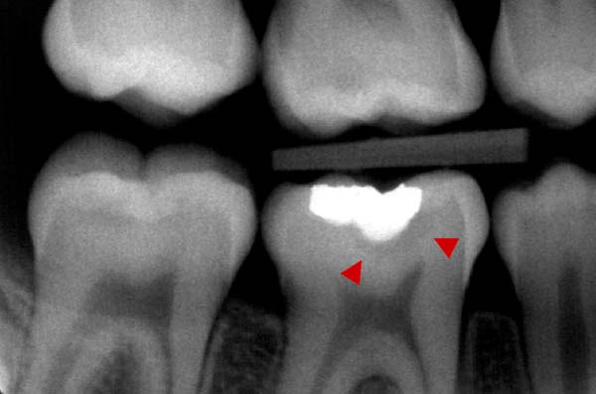
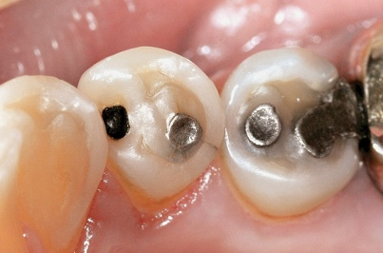
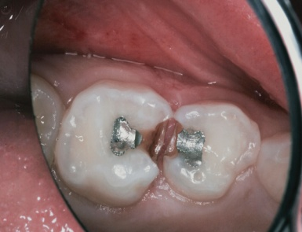
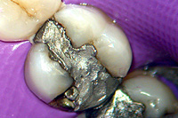
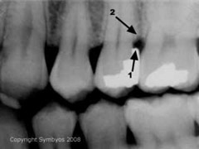
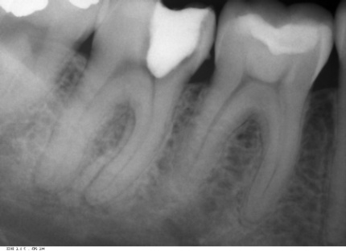
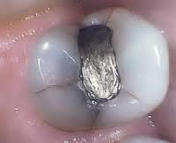
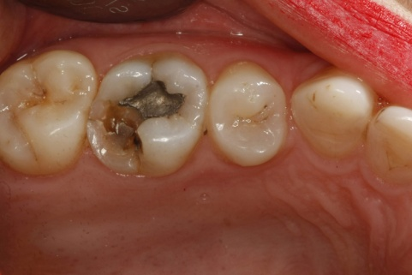
WAYS IN WHICH RESTORATIONS FAIL
Failure
New Disease Technical Failure
➢ Caries & Tooth wear ➢ Fractured restoration
➢ Periodontal disease ➢ Marginal breakdown
➢ Pulpal problems ➢ Tooth fracture
➢ Trauma ➢ Defective contours
➢ Failure of retention

Slide 15
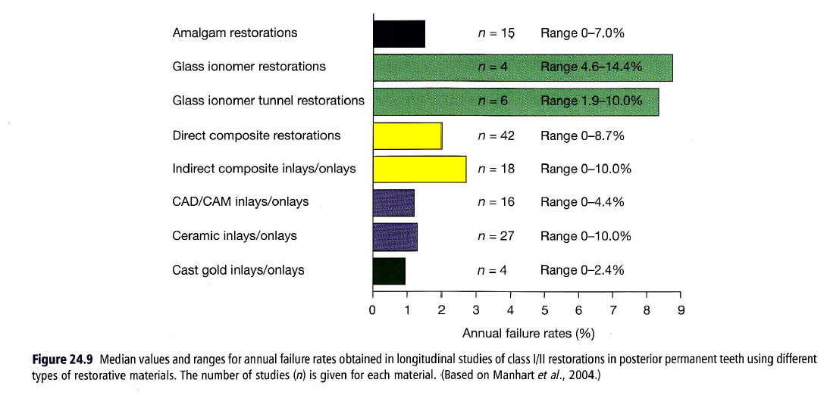
Manhart J, Chen HY, Hamm G, Hickel R. Buonocore memorial lecture. Review of the clinical survival of direct and indirect restorations in posterior teeth of the permanent dentition. Oper Dent 2004; 29: 481-508.

Slide 16
FACTORS AFFECTING FAILURES
Material selection
Inferior products
Improper storing and handling, packaging.
Impurities incorporated
Technique sensitivity
Operator factors
Improper diagnosis and wrong treatment modality suggested
Improper case selection and material selection
Lack of knowledge of about use of restorative material
lack of skill
negligent attitude
Patient factors
Not following post-operative instructions & maintenance
Improper Oral hygiene protocol
Deleterious habits

Slide 17
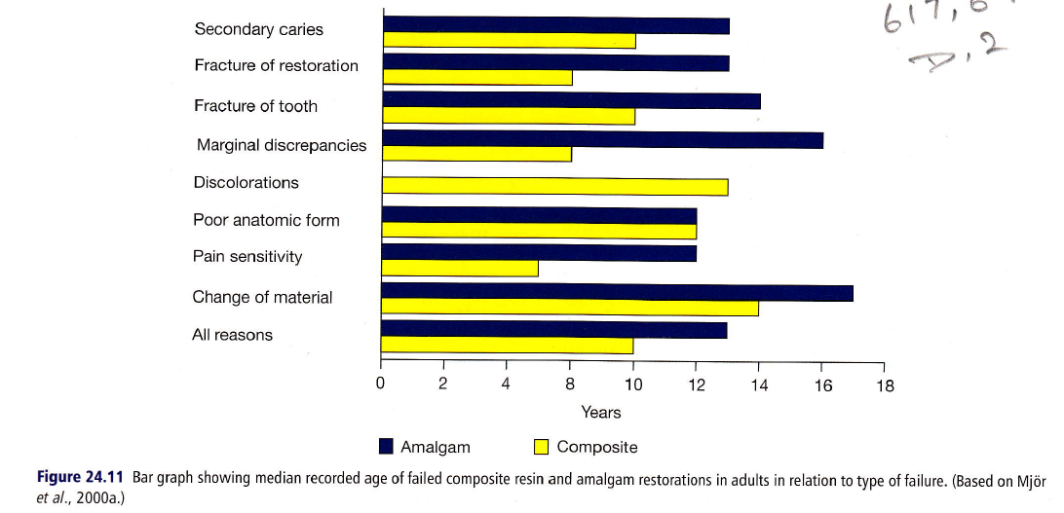
CAUSES OF FAILURES
Bar graph showing median recorded age of failed composite resin and amalgam restorations in adults in relation to type of failure.
Mjor IA, Moorhead JE, Dahl JE. Reasons for replacement of restorations in permanent teeth in general dental practice. Int Dent J 2000; 50: 360-6.

Slide 18
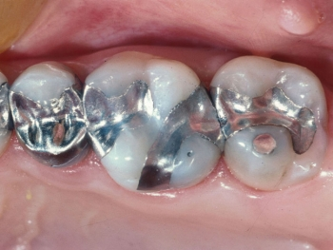
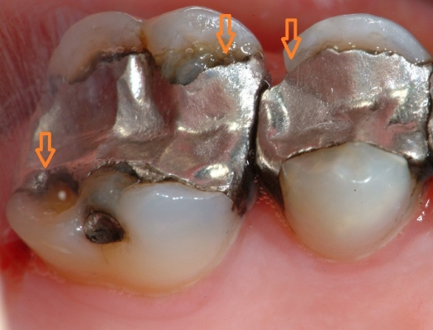
FAILURES OF DIRECT RESTORATIONS
FAILURE OF AMALGAM RESTORATIONS
The average life span of an amalgam restoration is upto 8-10 yrs if manipulated correctly.
Though failures occur, they are mostly due to faulty cavity preparation or faulty manipulation.

Slide 19
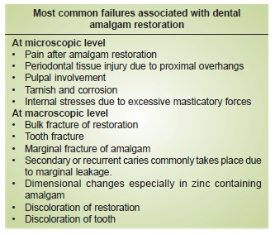
FAILURES OF DIRECT RESTORATIONS
FAILURE OF AMALGAM RESTORATIONS

Slide 20
FAILURES OF DIRECT RESTORATIONS
FAILURE OF AMALGAM RESTORATIONS
Amalgam Failures Can Be Attributed To following Causes
Failures due to faulty cavity preparation.
Failures due to poor matrix adaptation.
Due to faulty amalgam manipulation.
Due to improper condensation.
Failures due to contamination.
Improper finishing and polishing procedures.
Post-operative pain.
Micro leakage of amalgam.
Tarnish and corrosion
Role of creep
Role of faulty contacts
Effects of bleaching.

Slide 21
FAILURES OF DIRECT RESTORATIONS
FAILURE OF AMALGAM RESTORATIONS
1. Faulty Cavity Preparation :
Different causes that can occur at various steps while preparing cavities are:-
  a) Inadequate occlusal extension:-
    Inadequate extensions into pits and fissures increases the chances of recurrent caries particularly in patients with high caries index.
    Thus all susceptible pits and fissures should be included while terminating margins in areas that can be finished.

Slide 22
FAILURES OF DIRECT RESTORATIONS
FAILURE OF AMALGAM RESTORATIONS
1. Faulty Cavity Preparation :
  b) Inadequate extension of proximal box:-
    Embrasures if not involved adequately are not amenable to brushing and cleaning. These result in secondary caries affecting the life of the restoration.
    However radical extension of the proximal box will weaken the tooth structure leading to fracture of restoration.
    Special attention in this category should be given to lower bicuspid and distal embrasures of maxillary and mandibular 1st molars where frail walls can be formed easily.

Slide 23
FAILURES OF DIRECT RESTORATIONS
FAILURE OF AMALGAM RESTORATIONS
1. Faulty Cavity Preparation :
  c) Over extensions of cavity prepared walls:-
  One fourth of inter-cuspal distance facio-lingually is the ideal requirement for amalgam restoration to possess adequate strength for functioning.
Caries Involvement | Suggested protocol
1/4th of Facio-lingual distance | Simple preparation
½ of facio-lingual distance | Considering cuspal capping
2/3rd of facio-lingual distance | Cuspal capping mandatory

Slide 24
FAILURES OF DIRECT RESTORATIONS
FAILURE OF AMALGAM RESTORATIONS
1. Faulty Cavity Preparation :
  This is because amalgam acts as a wedge between the opposite cusps and tries to split them apart.
  Thickness of amalgam required for capping :
    Functional cusps-2 mm
    Non-Functional cusps-1.5mm
  If thickness required is not provided fractures result inadverently.
  It has been calculated that 1.5mm of minimal amalgam bulk is necessary to resist fractures.

Slide 25
FAILURES OF DIRECT RESTORATIONS
FAILURE OF AMALGAM RESTORATIONS
1. Faulty Cavity Preparation :
If pulpal floor is not smooth or is curved the restoration causes a wedging effect and increases chances of fracture of tooth.
Butt joints especially where occlusal stresses are to be encountered are essential.
Thus the cavo-surface angle has been suggested to be 90º or preferably 110º.

Slide 26
FAILURES OF DIRECT RESTORATIONS
FAILURE OF AMALGAM RESTORATIONS
1. Faulty Cavity Preparation :
Cavosurface angle
  More acute:- Fractures of tooth margins
  More obtuse :- Marginal amalgam fracture under occlusal stresses.
Cavity margins are to be finished so as to remove unsupported enamel rods susceptible to fractures and resulting secondary caries failure to round off axio-pulpal line angle as well as internal line-angles and point angles results in concentration of forces at these places resulting in fractures of the material or worse the tooth itself.

Slide 27
FAILURES OF DIRECT RESTORATIONS
FAILURE OF AMALGAM RESTORATIONS
1. Faulty Cavity Preparation :
By rounding axio-pulpal line angle increase bulk of amalgam for strength is also obtained.
Very narrow isthmus related to rest of the cavity preparation and co-positioning of the isthmus and axio-pulpal line angle results in fracture of proximo-occlusal restoration due vulnerability of these areas to be the weakest points of cavity preparation.
Such phenomenon can also occur due to inadequate proximal retention form.

Slide 28
FAILURES OF DIRECT RESTORATIONS
FAILURE OF AMALGAM RESTORATIONS
1. Faulty Cavity Preparation :
d) Incomplete caries removal:-
  Incomplete caries removal can lead to failures either by:-
  Further involvement and pulpal insult.
  Fracture of restoration due to unsupported material.
  If pulpal floor is not flat there will be inability of the restoration to resist forces directed along long axis of tooth.
  This leads to stress concentration and as a result fracture of restoration.

Slide 29
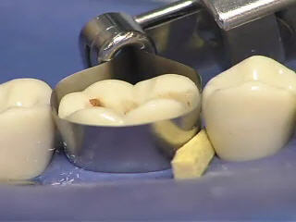
FAILURES OF DIRECT RESTORATIONS
FAILURE OF AMALGAM RESTORATIONS
2. Poor Matrix Adaptation
Minimal thickness of 0.03-0.05mm is required for a matrix to be burnishable and allow condensation of amalgam without deformation.
Also an extension of 0.5-1mm beyond cavo-gingival line angle of cavity and similarly above level of marginal ridge is required for proper condensation of amalgam.
The band should also be stable after application because if not so it can lead to distorted restoration, gross marginal excess, uncondensed mass of amalgam, leading to failure.

Slide 30
FAILURES OF DIRECT RESTORATIONS
FAILURE OF AMALGAM RESTORATIONS
2. Poor Matrix Adaptation
The use of a wedge is mandatory.
Also, if band width is too large it will lead to creations of an open contact or a contact too occlusally.
If band width is less it will allow amalgam to escape and form an overhang resulting in tissue irritation & destruction or incorporation of amalgam in tissues.

Slide 31
FAILURES OF DIRECT RESTORATIONS
FAILURE OF AMALGAM RESTORATIONS
3. Faulty Amalgam Manipulation:-
Mercury – Alloy Ratio :-
  Serious loss of structure was reported when residual mercury is in an excess of 55% in a restoration.
  Higher mercury content used during mixing results in higher residual mercury which cannot be effectively removed by squeezing or condensation.
  This high mercury results in :-
  Decrease in crushing strength.
  increase in flow and increased susceptibility to tarnish and corrosion .
  One should prefer minimal mercury technique which gives proper mixes with use of dispensers for correct proportioning or amalgamation.

Slide 32
FAILURES OF DIRECT RESTORATIONS
FAILURE OF AMALGAM RESTORATIONS
3. Faulty Amalgam Manipulation:-
Mercury – Alloy Ratio :-
  Mulling with bare hands causes incorporation of contaminants like moisture into the mix which is deleterious especially in zinc containing alloys.
  Hardened set amalgam if not removed from the mortars will act as points of weakness in the matrix of the mix, rendering the restoration prone to failure as stress concentration occurs at these points.

Slide 33
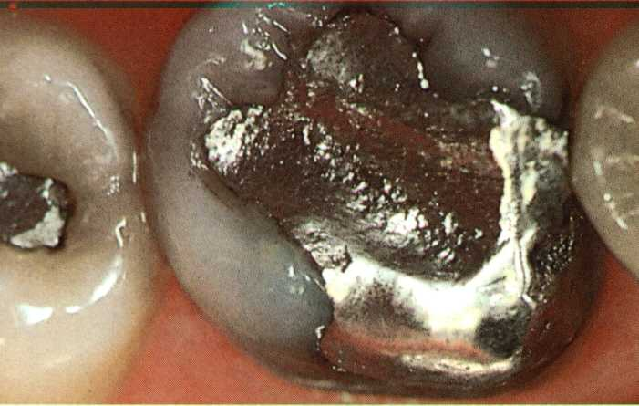
FAILURES OF DIRECT RESTORATIONS
FAILURE OF AMALGAM RESTORATIONS
3. Faulty Amalgam Manipulation:-
Mercury – Alloy Ratio :-
  Under triturated and over triturated mixes and their effects:-
    Under triturated - Soft-Powdery, Non-coherent mass
    Over triturated Mix - May break already forming matrix
  Effective removal of residual mercury is possible only within 4 mins of triturating.
  Re plasticising mix by adding mercury seriously decreases strength and rendering the restoration weak.

Slide 34
FAILURES OF DIRECT RESTORATIONS
FAILURE OF AMALGAM RESTORATIONS
4. Improper Condensation :-
Condensation reduces the residual mercury contents, and ensures amalgam reaches to all parts of preparation to obtain a homogenous mix.
Due to improper condensation if voids occur these serve as areas of least strength in the restoration very susceptible to fracture.
Thus proper condensation is a “Stepping” motion to drive away any voids is advised.

Slide 35
FAILURES OF DIRECT RESTORATIONS
FAILURE OF AMALGAM RESTORATIONS
5. Contamination:-
By Moisture :-
  Moisture contamination in oral cavity by saliva and blood leads to delayed expansion, resulting in marginal flaws, tarnish, pitting corrosion and pain.
By Materials :-
  Any impurities incorporated during the procedure e.g. Bare hand manipulation of material add impurities
  Using mix kept on unclean apparatus leads to incorporation of flaws into the matrix rendering the mix weak and susceptible to degradation.

Slide 36
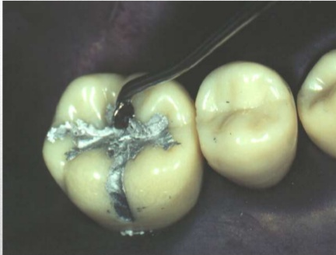
FAILURES OF DIRECT RESTORATIONS
FAILURE OF AMALGAM RESTORATIONS
6. Improper carving, finishing & polishing:-
Caries may recur in stagnation areas forming marginal gaps, excess of amalgam, or in crevices resulting from fracture of excess amalgam.
The main carving should be delayed until the surface offers resistance to instrumentation.
The correct time is indicated by a particular “Squeaking” sound deviated from surface “Cry of tin”.

Slide 37
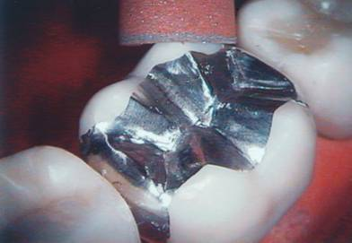
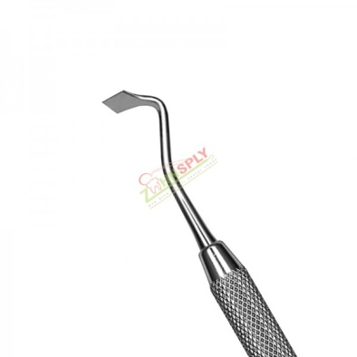
FAILURES OF DIRECT RESTORATIONS
FAILURE OF AMALGAM RESTORATIONS
6. Improper carving, finishing & polishing:-
The instruments used should be sharp and proper otherwise defects can be produced in the carvings
Excess amalgam at margins is dressed down to thin flakes or “SPUR” like overhangs resulting in areas susceptible to secondary caries.
A rough pitted and corroded surface leads to increased susceptibility for tarnish and corrosion and increased failure rate.

Slide 38
FAILURES OF DIRECT RESTORATIONS
FAILURE OF AMALGAM RESTORATIONS
6. Improper carving, finishing & polishing:-
Overcarving :-
Leads to decreased thickness of restoration with increased chances of fracture.
Undercarving :-
Leads to production of high points causing increased forces on tooth resulting in post operative pain and potential source for fractures.
When carving marginal ridges the instrument should be directed into bulk of restoration, otherwise the ridge amalgam remains relatively unsupported & may fracture.

Slide 39
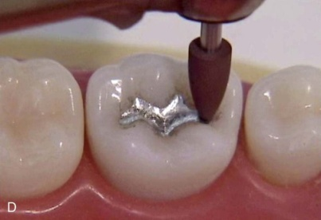
FAILURES OF DIRECT RESTORATIONS
FAILURE OF AMALGAM RESTORATIONS
6. Improper carving, finishing & polishing:-
Polishing :-
Should not be initiated less than 24 hrs after condensation and carving and should be done adequately and sufficiently.
If rough surfaces exist they act as sources of plaque adhesion and subsequent caries progression.
These spots also promote corrosion of the material.
If polishing temperature increases more than 65% mercury is released from amalgam leading to failure by rendering the matrix weak.
Inadvertently this heat may also irritate the pulp and cause deleterious effects.

Slide 40
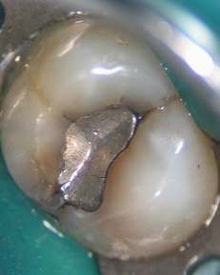
FAILURES OF DIRECT RESTORATIONS
FAILURE OF AMALGAM RESTORATIONS
7. Marginal degradation (Ditching)
The “Ditching” around amalgam restorations misthought to be due to amalgam contraction is mainly due to stress/corrosion dependent defect occuring in areas subjected to occlusal loading.
Magnitude of extent of ditching is directly related to creep properties so
Increased Creep --------> Increased Ditching

Slide 41
FAILURES OF DIRECT RESTORATIONS
FAILURE OF AMALGAM RESTORATIONS
8. Role of Creep :-
Time dependent plastic deformation of a material under a static load or constant stress is called Creep. (Anusavice)
Creep is a critical factor leading to fracture of restoration or teeth e.g. The mere fact that incidence of fracture of lingual cusps in mandibular teeth and buccal cusps in maxilla explains the phenomenon of creep.
High copper alloys have low creep rates and are thus more stable.

Slide 42
FAILURES OF DIRECT RESTORATIONS
FAILURE OF AMALGAM RESTORATIONS
Other Factors Responsible for Marginal Deterioration :-
  Improper Marginal preparation
    Poorly supported enamel rods may fracture resulting in crevice formation.
  Improper Carving and finishing
    “Flashes” around margins may fracture.
  Excess Mercury
    Excess mercury induces weak gamma – 2 phase resulting in weaker amalgam.
  Low copper amalgams
    Low copper alloys have high corrosion rates, making margins porous and # prone.
  Amalgam Expansion
    Material expands – Protrudes- Margins unsupported.

Slide 43
FAILURES OF DIRECT RESTORATIONS
FAILURE OF AMALGAM RESTORATIONS
9. Post – operative pain
Caused due to :-
  Hyperocclusion due to undercarving
  Cracks in teeth
  Galvanism
  Delayed expansion
  Zinc containing alloys on contamination with water.

Slide 44
FAILURES OF DIRECT RESTORATIONS
FAILURE OF AMALGAM RESTORATIONS
10. Microleakage in amalgam :-
Amalgam when freshly condensed does not adapt closely to walls of prepared cavity.
Generally a gap of 10-15 μm exists around a restoration and is justified.
Though amalgam later becomes a self-sealing material by virtue of products of corrosion e.g., different oxides and chlorides, but if spherical particles of alloy are used or faulty manipulation done chances of increased microleakage.

Slide 45
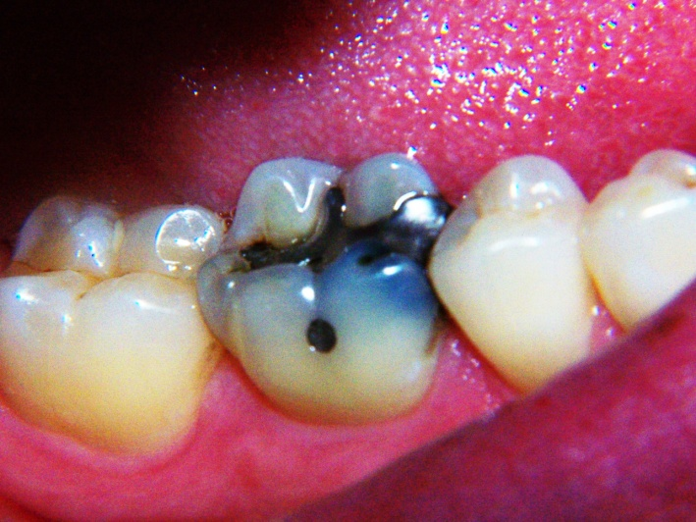
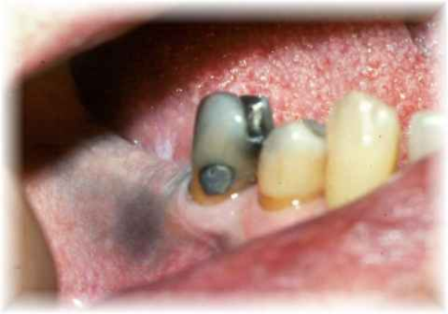
FAILURES OF DIRECT RESTORATIONS
FAILURE OF AMALGAM RESTORATIONS
11. Amalgam “Blues” and “Tattoo” :-
Penetration of amalgam products into dentinal tubules leads to very unaesthetic condition called “Amalgam Blues” needing re-restoration as desired by the patient caused by not adhering to proper lining systems.
Penetration of amalgam residuals during restoration in marginal gingiva and when not removed results in “Tattooing” of gingiva which discolors the mucosa and irritates the attachment apparatus.

Slide 46
FAILURES OF DIRECT RESTORATIONS
FAILURE OF AMALGAM RESTORATIONS
12. Effects of bleaching :-
These can also have deleterious effects on amalgam
6 % H₂O₂ Gels – Do not alter surface texture
10-16% carbamide Peroxide - On non-polished surfaces causes corrosion and increases corrosion susceptibility on polished amalgams too.
Caused due to active oxidation.
Bleaching also greens the tooth – amalgam interface.

Slide 47
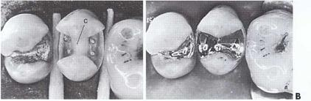
FAILURES OF DIRECT RESTORATIONS
FAILURES OF PIN RETAINED RESTORATIONS
Failures may occur in 5 areas :-
Within Restoration
At Interface B/W Pin & Restorative Material
Within pin (Pin Fracture)
At interface B/W pin & dentin (Pin-dentin separation)
Within dentin (Dentin Fracture)

Slide 48
FAILURES OF DIRECT RESTORATIONS
FAILURE OF PIN-RETAINED RESTORATIONS
1) Within Restoration -
Due to :-
Improperly retained matrix
Movement of matrix
Improper condensation
Premature removal of matrix
High points in restoration
Solution :- Repair or Re-restoration

Slide 49
FAILURES OF DIRECT RESTORATIONS
FAILURE OF PIN-RETAINED RESTORATIONS
2) At Pin –Restoration Interface
Due to :- Corrosion products at interface resulting in # of restoration
Solution :- Use of titanium pins or Re-restoration
3) Within Pin (Pin #)
Due to :- Wrongs placement, leading to inadvertent force concentration on body of pin
Solution :- Removal of restoration & pin drilling another hole 1.5-2 mm away from original site and re-restoration

Slide 50
FAILURES OF DIRECT RESTORATIONS
FAILURE OF PIN-RETAINED RESTORATIONS
4) At pin –Dentin Interface
Due to :- Loose pins that do not properly engage dentin, as hole size too large.
Solution :- Preparing pin hole for next pin size or drilling hole at another site.
5) Within Dentin
Due to :- Preparation kept rough on floor uneven direction of forces stress concentration dentin fracture
Solution :- Reduce to that surface & redrill pin hole

Slide 51
FAILURES OF DIRECT RESTORATIONS
FAILURE OF PIN-RETAINED RESTORATIONS
Pulpal damage or exposure, biologic space invasion
Heat generation while drilling
Solution :- Pulp capping with calcium hydroxide, redrilling hole 1.5-2 mm away.
As most of teeth receiving such restoration have/had extensive restorations /caries health of pulp already compromised so ideal treatment is Endodontic Therapy

Slide 52
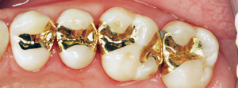
FAILURES OF DIRECT RESTORATIONS
FAILURE OF DIRECT FILLING GOLD
1. Due to material
Impurities in material added during production- even small amounts of impurities in material have pronounced effects on mechanical properties e.g. 0.2% lead makes gold brittle and thus creation of a non-uniform restoration.
Other Contaminants :- Bismuth
Mercury

Slide 53
FAILURES OF DIRECT RESTORATIONS
FAILURE OF DIRECT FILLING GOLD
1. Due to material
Impurities incorporated during procedures :-
Contaminated gases like SO_{2 ,} Ammonia and water vapours during annealing.
If flame used is not of Methanol or Ethanol without additives, contaminants are bound to be incorporated.
Overheating done during annealing leads to carbon contamination by flame, tray or instrument making physical properties inferior.

Slide 54
FAILURES OF DIRECT RESTORATIONS
FAILURE OF DIRECT FILLING GOLD
2. Due to faulty procedures :-
Improper caries removal
  Large cavities :- Inability to take masticatory stress, role of creep and thus leading to # of tooth though malleable and ductile.
  Contamination :- A totally dry cavity is mandatory for cohesive condensation, contamination by blood, saliva etc lead to lack of strength of restoration.

Slide 55
FAILURES OF DIRECT RESTORATIONS
FAILURE OF DIRECT FILLING GOLD
2. Due to faulty procedures :-
Improper Annealing :-
  Improper removal of surface contaminants.
  Overheating makes gold stiffer, difficult to condense and ductility.
  Contaminants may get incorporated by over heating, use of faulty flame etc.
Temp below 315^{O} (600^{O}F) were inadequate to attain optimum hardness of gold during annealing.

Slide 56
FAILURES OF DIRECT RESTORATIONS
FAILURE OF DIRECT FILLING GOLD
3. Improper condensation:-
If restoration not condensed in a proper “Stepping” motion VOIDS can be incorporated - decreasing cohesive form when in the bulk .
When on surface → called “Pits”
These lead to Corrosion, marginal leakage, secondary caries due to plaque accumulation.
High force concentration by hand can damage tooth and insult pulp.
High thermal conductivity of gold causes thermal insult to pulp.
Galvanism.

Slide 57
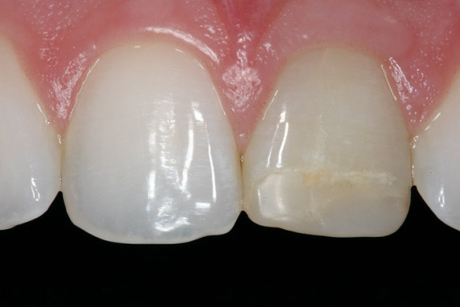

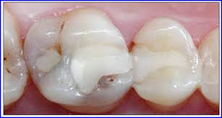
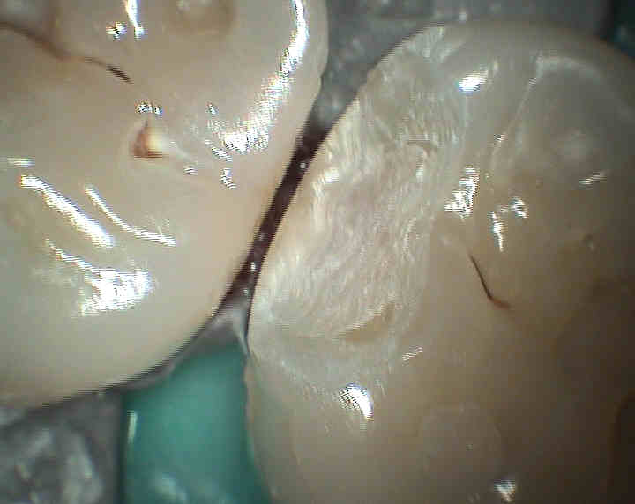
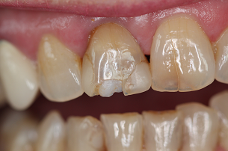
FAILURES OF DIRECT RESTORATIONS
FAILURE OF COMPOSITE RESTORATIONS
Failures that can be seen in a composite restoration are as follows :-
Discolorations especially at margins
Marginal fractures
Recurrent Caries
Gross fractures of restorations
Lack of contact maintenance
Post-operative sensitivity
Pulpal irritation or damage
Microleakage around composites

Slide 58
FAILURES OF DIRECT RESTORATIONS
FAILURE OF COMPOSITE RESTORATIONS
Failures caused by the following factors :-
Limitations of operator and process:-
Improper caries removal
Faulty preparation
Faulty handling, manipulation of material
Improper isolation
Contamination
Improper Etching and bonding
Inadequate curing
Bulk placements
Improper finishing & polishing

Slide 59
FAILURES OF DIRECT RESTORATIONS
FAILURE OF COMPOSITE RESTORATIONS
Limitations of material composite:-
Polymerization shrinkage
Weak bond strength when cavosurface margin in dentin
Water sorption
Penetration in tissues to irritate pulp
Inadequate polymerization in deep inter proximal areas

Slide 60
FAILURES OF DIRECT RESTORATIONS
FAILURE OF COMPOSITE RESTORATIONS
1. Incomplete caries excavation :-
If incomplete caries excavation is done, the left over caries hinders the bonding mechanism.
Also if Zinc Oxide Eugenol is not removed fully in any case it hinders the methacrylate group of resins making the bonding weaker .
Incomplete etching or failure to remove residual acid from enamel tags.

Slide 61
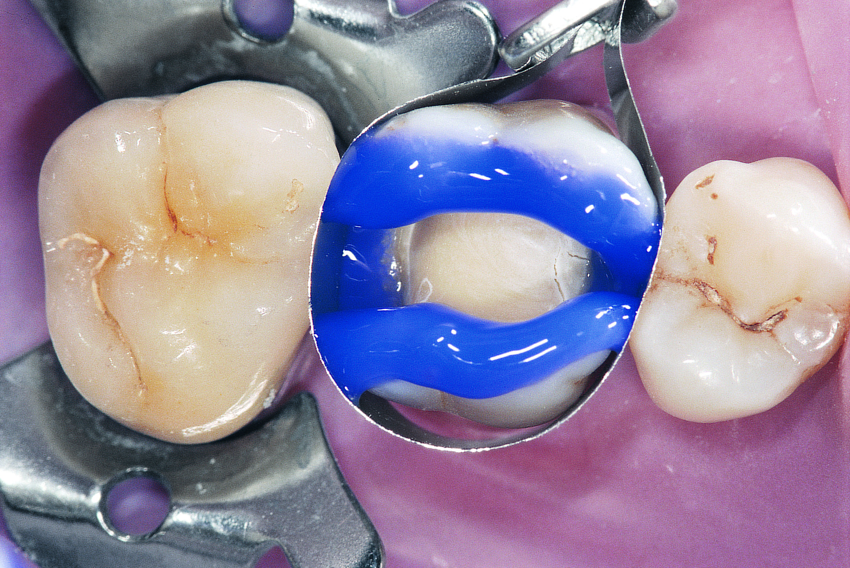
FAILURES OF DIRECT RESTORATIONS
FAILURE OF COMPOSITE RESTORATIONS
Proper concentration of etchant and etching time has to be adhered to -total etching time should not be more than 60 secs (30-60 Secs range).
Though 15 Secs etching sufficient for enamel, washing 20-30 Secs (Gels) 10-15 Secs (Liquids)
Avoid 3-way syringe for drying – Contamination by machine oils etc.

Slide 62
FAILURES OF DIRECT RESTORATIONS
FAILURE OF COMPOSITE RESTORATIONS
2. Role of cavosurface margins :-
90 degree - Conservative - Doesn’t expose ends of rods
45 degree - Most common - Superior seal –decreased Microleakage exposes rods
Concave exit - Most retentive - Least conservative (used in cl IV cases)

Slide 63
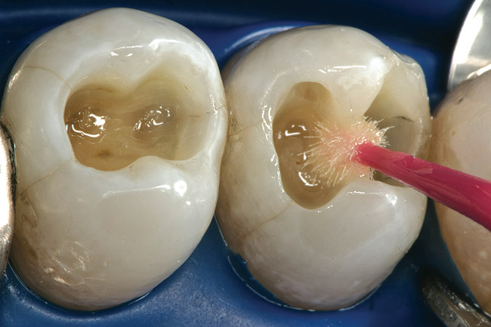
FAILURES OF DIRECT RESTORATIONS
FAILURE OF COMPOSITE RESTORATIONS
3. Improper bonding :-
Bonding agent is to be applied gently and uniformly all around cavity walls.
Double coats are to be avoided as these lead to marginal leakage and non-uniform bonding hinders the bond strength to bonding agent.

Slide 64
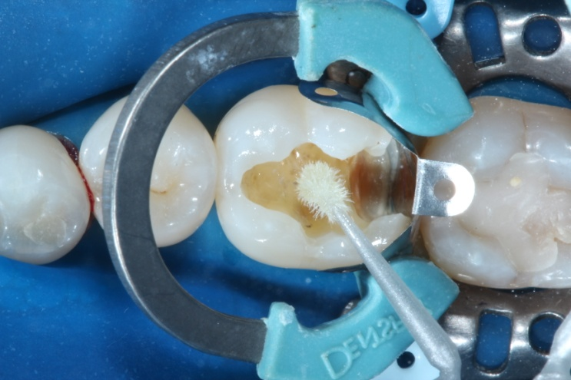
FAILURES OF DIRECT RESTORATIONS
FAILURE OF COMPOSITE RESTORATIONS
4. Lack of isolation
Isolation is mandatory in a composite restoration ideally rubber dam should be used, otherwise cotton rolls should be kept ready and changed evenly.
Any contact with gingival fluid, saliva or blood
  Potential source of contamination
  reduces resin to resin bond strength.
Sol – Etching and bonding to be repeated.

Slide 65
FAILURES OF DIRECT RESTORATIONS
FAILURE OF COMPOSITE RESTORATIONS
Other contaminants :-
  Touching the material with hands or fingers
  Picking material from tongue etc and placing back
  Using unclean instruments
These add impurities to the material rendering it weak and less colour stable, changing shade characteristics.
Always teflon coated instruments to be used.

Slide 66
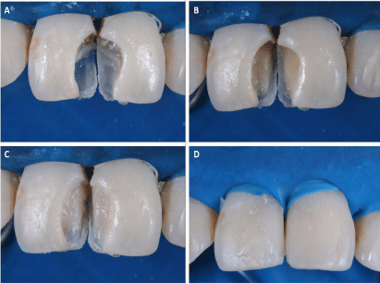
FAILURES OF DIRECT RESTORATIONS
FAILURE OF COMPOSITE RESTORATIONS
5. Bulk placements
Material is to be cured in increments and each increment should be as small as possible as gaps may occur after shrinkage of material at tooth restoration interface.
These lead to post-operative sensitivity, marginal leakage & secondary caries.
Also due to gaps and voids, material is rendered weak and stress points – source of #

Slide 67
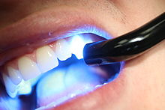
FAILURES OF DIRECT RESTORATIONS
FAILURE OF COMPOSITE RESTORATIONS
6. Improper curing
Curing if not done from all sides and for a stipulated period results in a restoration with marked decreased strength and prone to marginal leakage.
If first curing should be done gingivally or else the material due to its property to shrink towards source of light creates a gap between pulpal floor and bulk of material in occlusal cavities and also leads to gap formation in gingival seat area in proximal restorations which are prone to leakage’s and fractures.

Slide 68
FAILURES OF DIRECT RESTORATIONS
FAILURE OF COMPOSITE RESTORATIONS
7. Improper angle & Path of light
As angle deviates from perpendicular, the penetration and intensity of light is afflicted & reduced. e.g. Marginal ridge of adjacent tooth blocks light placed at an angle.
8. Thickness of resin
Optimum polymerization occurs at depth of just 0.5-1mm owing to air inhibition at surface and difficulty of light penetration.

Slide 69
FAILURES OF DIRECT RESTORATIONS
FAILURE OF COMPOSITE RESTORATIONS
9. Air Inhibition
Oxygen in air competes with polymerization and inhibits setting of resin.
Extent of surface inhibition is inversely related to filler loading.
Undercured layer can vary from 50-500mm or more, depending on reactivity of photoinitiator used.
Unfilled resins should be cured, covered with air inhibiting gel (Oxyguard-Commercial Preparation ) Petroleum jelly glycerin & then recured.

Slide 70
FAILURES OF DIRECT RESTORATIONS
FAILURE OF COMPOSITE RESTORATIONS
10. Improper light intensity
Optimum curing intensity – 468 + 20nm
Blue light – 400mv/cm²
Causes of decreased intensity :-
  Age of bulb
    Increased Age – Decreased Intensity
  Voltage
    Voltage drops decrease intensity
  Sterilization of curing tips reduces light transmission
  Filters to increase blue light transmission degrades intensity.
  Curing distance :-
    Distance of 1 mm from occlusal surface - ideal increase in distance -->Decreased intensity --> Decreased strength

Slide 71
FAILURES OF DIRECT RESTORATIONS
FAILURE OF COMPOSITE RESTORATIONS
11. Exposure :-
Minimum exposure of 20-40 secs under continuous light is mandatory.
Any deviations in lesser range results in partially cured, inferior restorations.
12. Temperature :-
Light cure composites cure less effectively if they are cold during application (Freshly taken out of refrigerator )
They cure more rapidly & completely at room temp.
Also most curing lamps produce heat which speeds curing process.
However excess heat by undue application can result in pulpal irritation and inflammation.

Slide 72
FAILURES OF DIRECT RESTORATIONS
FAILURE OF COMPOSITE RESTORATIONS
13. Improper finishing & polishing :
Meticulous finishing and polishing is to be done, as all rough surfaces act as a nidus for microorganisms (Plaque accumulation)
Special attention in interproximal area as sharp projections – irritate & inflame gingiva by impingement
Dry Polishing & Finishing is detrimental as it can open dentin margins at dentin – restoration interface.
Effect of number of flutes of finishing & polishing bur – more the number of flutes lesser the damage

Slide 73
FAILURES OF DIRECT RESTORATIONS
FAILURE OF COMPOSITE RESTORATIONS
14. Pulp irritation or damage :-
It is difficult to differentiate the effect of components of composite resin itself, the trauma of cavity preparation, and sequelae such as microleakage at margins.
Cytotoxicity Studies show that :-
Cured polymerized resin as far as possible causes minimum irritation, but incompletely cured resin because of presence of uncured resins or surface active complexes formed b/w low molecular wt. components of light initiator systems.

Slide 74
FAILURES OF DIRECT RESTORATIONS
FAILURE OF COMPOSITE RESTORATIONS
One potent component is HEMA (Hydroxlethyl Methacrylate ) an essential component of light cured composites,
  Highly Hydrophillic
  Allergenic
  Studies show that it can transverse in tubules appear in pulp & cause deleterious effects.

Slide 75
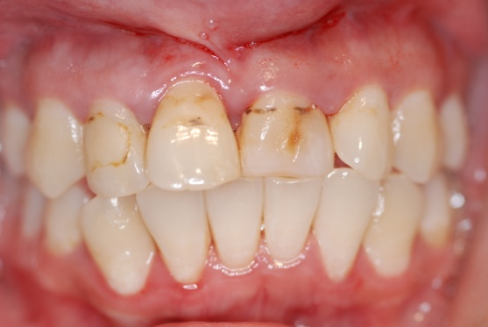
FAILURES OF DIRECT RESTORATIONS
FAILURE OF COMPOSITE RESTORATIONS
15. Composite Discoloration :-
Composite may undergo extensive surface staining, intrinsic colour change or both.
Extrinsic surface staining
Max. water sorption in first 7-10 days
Strong staining agents (Tea, Coffee, cola) penetrate to depth of 3.0-5.0 mm (Mount & Hume)
Problems accentuate with wear and incomplete curing .

Slide 76
FAILURES OF DIRECT RESTORATIONS
FAILURE OF COMPOSITE RESTORATIONS
Intrinsic discoloration
Seen in both chemically activated & light activated
Chemically activated – Substantial yellowing in 1-3 yrs due to oxidation of excess amine from initiator system
Visible light cured systems :-
Lighten in colour & become more translucent during curing and cure further in 24-48 hrs. by decomposition of camphoroquinone.

Slide 77
FAILURES OF DIRECT RESTORATIONS
FAILURE OF COMPOSITE RESTORATIONS
16. Role of Water sorption
Limited amount may be beneficial
More sorption – Restoration dimensionally unstable
Aesthetically unpleasant
More Water sorption – More Creep rate
  Microfilled Resin – 1.5-2.0 mg/cm²
  Hybrid & Macrofilled – 0.61-1 mg/cm²

Slide 78
FAILURES OF DIRECT RESTORATIONS
FAILURE OF COMPOSITE RESTORATIONS
16. Role of Water sorption
Water sorption increases when
  Filler content less, resin content more
  reduced curing time (e.g. 25% reduction in curing time) –> Increased Water sorption
  2 fold increase in sorption → 6 fold increase in solubility
  Seriously affects durability & colour stability.

Slide 79
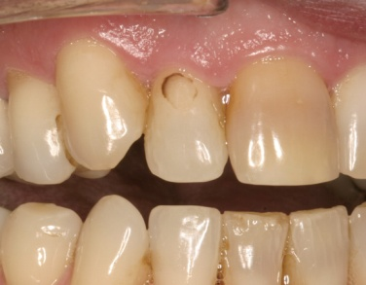
FAILURES OF DIRECT RESTORATIONS
FAILURE OF COMPOSITE RESTORATIONS
17. Microleakage of composites :-
Considerable evidence - Etching itself not a culprit of pulpal
inflammation as acids get buffered in dentin
Should marginal leakage occur & presence of partially or uncured monomers occurs – Pathway to pulp open.
Advised – not to etch dentin in vital teeth or a strong GIC base should be placed completely covering all dentine before etching enamel walls.

Slide 80
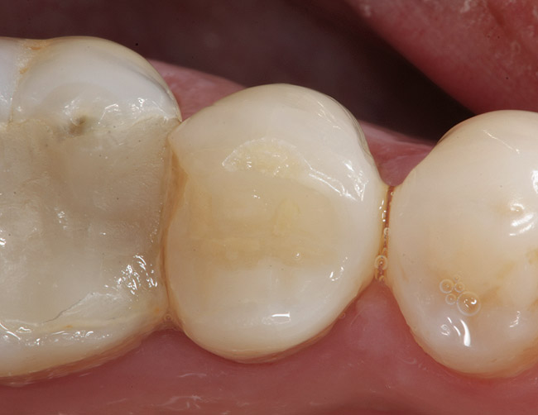
FAILURES OF DIRECT RESTORATIONS
FAILURE OF COMPOSITE RESTORATIONS
18. Marginal Defects :-
Surface fracture of excess material.
Marginal Porosity or void (incorporation of air b/w restoration & Tooth during placement)
Wear of restoration (Progressive exposure of axially directed cavity wall)
Role of type of composite used :-
Macrofilled – More of wearing type of defects
Hybrids – Tend to chip (Crevice formation) & wear
Microfilled – Chipping & Surface fractures

Slide 81
FAILURES OF DIRECT RESTORATIONS
FAILURE OF COMPOSITE RESTORATIONS
19. Role of composite fatigue :-
Under certain loading conditions, composites begin to tire, losing strength over a period of time.
Results in cohesive microcracks & external chipping.
20. Role of bleaching :-
Results in colour instability by changing shade.
10-16% carbamide peroxide, may lead to slight deterioration by statistically causing surface roughness & amount of parasites especially in microfilled & hybrid resins result in increased plaque adhesion & staining .

Slide 82
FAILURES OF DIRECT RESTORATIONS
FAILURE OF COMPOSITE RESTORATIONS
20. Role of bleaching :-
25-35% hydrogen peroxide uniformly showed decrease in shear-bond & tensile bond strength of all composites.
37% carbide peroxide or pastes with 30% H₂O₂ and Na perborate, lead to microleakage.
These concentrations after affecting marginal seal may penetrate to pulp and cause deleterious effects.

Slide 83
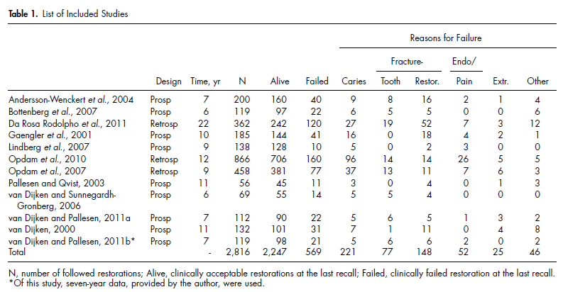
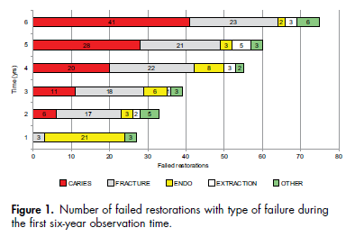
FAILURES OF DIRECT RESTORATIONS
FAILURE OF COMPOSITE RESTORATIONS
Opdam et al (2014) conducted a systematic review on longevity of posterior composite restorations found that the main reasons for failure were caries and fracture.
They showed a significantly higher risk of failure for restorations in high-caries-risk individuals and those with a higher number of restored surfaces.

Slide 84
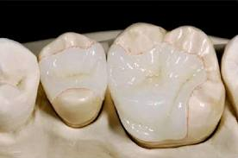
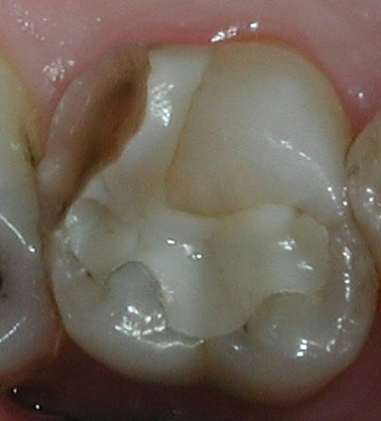
FAILURES OF INDIRECT RESTORATIONS
FAILURE OF INLAYS / ONLAYS
Important failures include :-
Secondary caries
Surface discoloration
Marginal fractures (Especially porcelain inlays)
Restoration dislodgements
Marginal leakage
Tooth fractures

Slide 85
FAILURES OF INDIRECT RESTORATIONS
FAILURE OF INLAYS / ONLAYS
Failures caused due to
1. Faulty preparation :
Angle of divergence of walls :-
Buccal and lingual walls divergence should be at an angle b/w 5º & 10 ⁰
If Angle < 5º – Remaining structure under undue stresses during cementing & force loading in function
If Angle > 10º – Compromised retention

Slide 86
FAILURES OF INDIRECT RESTORATIONS
FAILURE OF INLAYS / ONLAYS
2. Structure of walls :-
After inlay seated in mouth, maintenance of retention depends on strength and integrity of both lingual & buccal walls.
It is virtually impossible to gain strength and retention from opposite remaining cusp which is already weak (Extracoronal coverage)

Slide 87
FAILURES OF INDIRECT RESTORATIONS
FAILURE OF INLAYS / ONLAYS
3. Improper Margins :-
30-40º Marginal metal desirable
angle of 140-150º (Cavosurface angle) desirable while cutting
Cavosurface angle > 150º – Metal too thin and weak
< 140º – Metal too bulky and difficult to burnish
Gingival bevel of 30º desirable

Slide 88
FAILURES OF INDIRECT RESTORATIONS
FAILURE OF INLAYS / ONLAYS
4. Secondary flares :-
If not given results in proximal surfaces inaccessible to surface cleaning action – leading to plaque accumulation & periodontal problems.
5. Luting cement :
Luting cements are prone to dissolution in oral environment
More the gap in restoration- tooth interface → More cement exposed → More dissolution → more marginal leakage
Also in proximal areas any excess cement remaining after cementation, unchecked becomes an area of continuous periodontal irritation.

Slide 89
FAILURES OF INDIRECT RESTORATIONS
FAILURE OF INLAYS / ONLAYS
6. Post-insertion sensitivity :-
Seen with both GIC and Zinc phosphate
Occurs mostly due to removal of smear layer
7. Marginal leakage & percolation
Leakage occurs when teeth are subjected to alternative cooling and warming.
The difference in coefficient of thermal expansion of tooth and material.
Results in ingress & egress of fluids leading to percolation.
As a result bacteria can gain access & cause deleterious effects.
Another cause is when there is increased taper, continuing loads fall upon the restoration and it gives away by rotating on walls causing fractured thin metal margins.

Slide 90
FAILURES OF INDIRECT RESTORATIONS
FAILURE OF INLAYS / ONLAYS
8. Considerations in porcelain inlays :-
If bevels are given, thin sections of porcelain at cavosurface are highly brittle and prone to fracture.
Fractures
A strain of only 8-10 mm/cm in dental porcelain is required before it fractures.
Most fractures start from inner surfaces especially at or near gingival margins.

Slide 91
FAILURES OF INDIRECT RESTORATIONS
FAILURE OF INLAYS / ONLAYS
9. Role of surface flaws :-
Porcelains are brittle materials but not synonymous with weakness. Because of structure of Si-O2 bonds & absence of grain boundaries, the vitreous matrices of porcelain have intrinsic strength.
As material perfectly elastic – Measured strength strongly dependent on presence or absence of surface flaws.

Slide 92
FAILURES OF INDIRECT RESTORATIONS
FAILURE OF INLAYS / ONLAYS
10. Fracture Propagation :-
Caused by stress concentration at tip of surface.
Once initiated , the extension of crack is ensured by applied stresses & increasing stress concentration factor of growing crack.
Exposure to water strength of porcelain attributed to stress enhanced B/w glass & H₂O occurs primarily at tips of such cracks water reacts with glass – destruction of Si-O network –hydroxyl ions attack siloxane bonds.

Slide 93
FAILURES OF INDIRECT RESTORATIONS
FAILURE OF FULL/PARTIAL VENEERS
1. Discomfort
The various causes leading to patient discomfort can be :
  a. Premature contact / malocclusion
  b. Oversized or poorly positioned food table
  c. The contact area may lack adequate area and strength
  d. The gingival tissues can be over protected or underprotected
  e. The sensitivity at the cervical area
  f. Torque generated during placement of restoration

Slide 94
FAILURES OF INDIRECT RESTORATIONS
FAILURE OF FULL/PARTIAL VENEERS
2. Looseness of the restoration
The looseness of crowns and bridges is due to:
a. Deformation of the metal castings leads to loosening of the restoration. Such deformation can result :
  When the casting is too thin because of insufficient tooth reduction.
  Excessive wear because of the abnormal occlusal forces.
  The sharp cusp of the opposing tooth putting abnormal stresses.
  When the opposing restoration is of harder metal or unglazed porcelain
  When the yield point of the alloy is low.

Slide 95
FAILURES OF INDIRECT RESTORATIONS
FAILURE OF FULL/PARTIAL VENEERS
b. Torque movement or abnormal stresses lead to loosening of the cement at the tooth restoration interface, subsequently lead to failure.
Different types of restorations in a bridge such as full crown at one end and inlay at another, lead to such torque movements.
The torque is minimized by equilibrium of the occlusion and by recontouring the occlusal table.

Slide 96
FAILURES OF INDIRECT RESTORATIONS
FAILURE OF FULL/PARTIAL VENEERS
c. Technique of cementation and the solubility of cement in oral fluids: cements not mixed properly or tooth surfaces not cleaned, the cementation is ineffective.
Dissolution of the cement is mainly because of gap at the margins or creation of hole occlusally during equilibration of the occlusion.
Recurrent caries can lead to loosening of the crown/bridge: Caries can develop because of gaps, gingival recession and/or exposed tooth surfaces.
In case the caries has undermined the restoration, the restoration is to be removed, caries treated and the tooth is to be prepared again for fresh fabrication of the restoration.

Slide 97
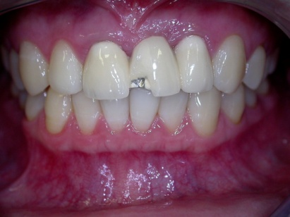
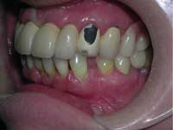
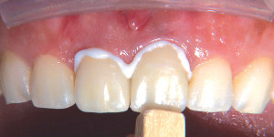
FAILURES OF INDIRECT RESTORATIONS
FAILURE OF FULL/PARTIAL VENEERS
Wear of luting agent on occlusal surface may lead to submargination of
the restoration.
f. In case of bridge, if one retainer is inlay without covering the cusps, this leads to stresses onto the tooth thereby loosening of the restoration.

Slide 98
FAILURES OF INDIRECT RESTORATIONS
FAILURE OF FULL/PARTIAL VENEERS
3. Recurrence of caries
This happens due to:
Short castings
Open margins
Loose restorations
Overcontoured restorations filling the embrasures
Wear of the the restoration occlusally
Prolonged temporary restorations leading to ginigval recession
Use of metal which cannot be burnished
Poor oral hygiene
More the surfaces involved in restoration, more the recurrent caries.

Slide 99
FAILURES OF INDIRECT RESTORATIONS
FAILURE OF FULL/PARTIAL VENEERS
4. Loss of supporting structures
The health of supporting alveolar bone is important for better prognosis of the crowns and bridges.
Already existing periodontal problem may aggravate by poor contouring of the restoration or by inability of the patient to thoroughly clean the area.
Other features which lead to loss of supporting structures, are:
  Overextension of the margins
  Size of the food table
  Contours and embrasures
  Length of the span of the bridge.

Slide 100
FAILURES OF INDIRECT RESTORATIONS
FAILURE OF FULL/PARTIAL VENEERS
4. Loss of supporting structures
The overextended margins and the contours can be corrected during try-in of the restoration.
In case the contouring is not adjustable, re-fabrication is indicated.
Long span bridges should only be constructed if the abutment teeth are suitable both in numbers and in periodontal health.
The occlusal table should be should be shortened in order to decrease the load during mastication.
Periodic treatment of the periodontal problem should be encouraged so as to minimize loss of support to these restorations.

Slide 101
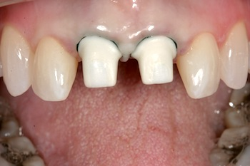
FAILURES OF INDIRECT RESTORATIONS
FAILURE OF FULL/PARTIAL VENEERS
5. Degeneration of the pulp
The preparation of the tooth should be carried out slowly along with lubricant and coolants so as to avoid damage to the pulp.
In metal ceramic crowns, where labial or occlusal clearance is required in excess, the chances of pulpal exposure are more.
In such cases, immediate attention is mandatory.
The cutting/finishing is stopped and the bleeding point is covered with a small gauze soaked in calcium hydroxide.

Slide 102
FAILURES OF INDIRECT RESTORATIONS
FAILURE OF FULL/PARTIAL VENEERS
5. Degeneration of the pulp
Temporary crown is fabricated or prefabricated polycarbonate crown is selected and fitted using zinc oxide eugenol as sealer.
Otherwise the temporary covering along with zinc oxide eugenol cement is indicated since the time gap between the preparation and the final restoration is deleterious to the pulpal health.
Premature contacts and the minor occlusal interferences, if not corrected, lead to pulpal involvement.
The root canal treatment becomes mandatory if the pulpitis is established

Slide 103
FAILURES OF INDIRECT RESTORATIONS
FAILURE OF FULL/PARTIAL VENEERS
6. Fracture of the restoration and/or tooth
Fracture of the porcelain over the metal is quite common.
Similarly acrylic facings can also be separated.
In case of bridges, the components can also be fractured because of faulty joints and improper soldering.
Occlusal interferences are the major cause of the fracture.
Equilibration of the occlusion should be carried out prior to planning the tooth preparation as well as during temporary restorations.

Slide 104
FAILURES OF INDIRECT RESTORATIONS
FAILURE OF FULL/PARTIAL VENEERS
6. Fracture of the restoration and/or tooth
Small pieces of separated acrylic/porcelain, especially in posterior teeth, can be repaired with composites; however large pieces of separated coverings require to be re-fabricated.
The ceramic restored teeth are susceptible to bulk fracture, maybe of tooth or restoration.
The inherent presence of microporosities develops during sintering accounts of the fracture.
These microporosities can predispose to crack initiation and propagation, which in turn can lead to fracture of the restoration.

Slide 105
CONCLUSION
Failures of restorations is a frequent concern to dentists in routine dental practice.
Proper techniques and care should be exercised to minimise failure and prolong the life of a restoration.
Operator skill and knowledge of materials and proper case selection play an important role.
Thus, it should be considered vital to know what all aspects of a restoration could possibly go wrong.

Slide 106
REFERENCES
Studervant – Textbook of operative dentistry
Marzouk – Textbook of operative dentistry
Vimal sikri – Textbook of operative dentistry
Mount- Preservation & restoration of tooth structure
Advanced operative dentistry - Wilson, fuzzi, Vol I, vol II
Pickards Manual of dentistry
Philips – dental material science
Quality evaluation of dental restorations- K.J. Anusavice
Indirect restorations - Vimal K Sikri
Textbook of Operative Dentistry – Nisha Garg
Manhart J, Chen HY, Hamm G, Hickel R. Buonocore memorial lecture. Review of the clinical survival of direct and indirect restorations in posterior teeth of the permanent dentition. Oper Dent 2004; 29: 481-508.
Opdam, N.J.M.; van de Sande, F.H.; Bronkhorst, E.; Cenci, M.S.; Bottenberg, P.; Pallesen, U.; Gaengler, P.; Lindberg, A.; Huysmans, M.C.D.N.J.M.; van Dijken, J.W. Journal of Dental Research.2014; 93(10): 943-949.
Mjor IA, Moorhead JE, Dahl JE. Reasons for replacement of restorations in permanent teeth in general dental practice. Int Dent J 2000; 50: 360-6.

