Slide 1


Slide 2
Ethiology of malocclusion
Introduction
Classification of etiology of malocclusion
General factors
Local factors
Conclusion.

Slide 3
Ethiology of malocclusion
Dr. Madhu Bhaskar MDS
St.Joseph dental college

Slide 4
Introduction
Malocclusion :
Malocclusion is a condition in which there is a departure from the
normal relation of teeth to the other teeth in the same arch and/or
to the teeth in the opposing arch (White TC, Gardiner JH and
Leighton B).
Etiology of malocclusion : study of its cause and causes

Slide 5
Necessity???
Identification
Prevention
Interception
Elimination

Slide 6

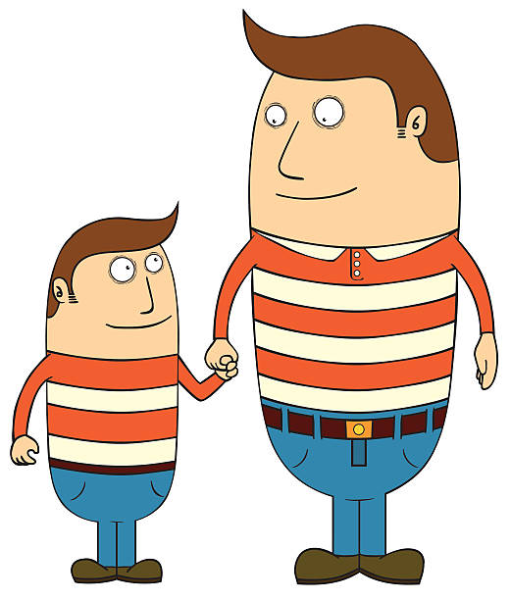

Slide 7

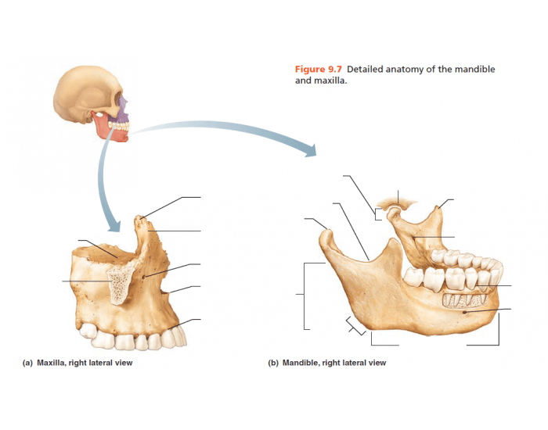
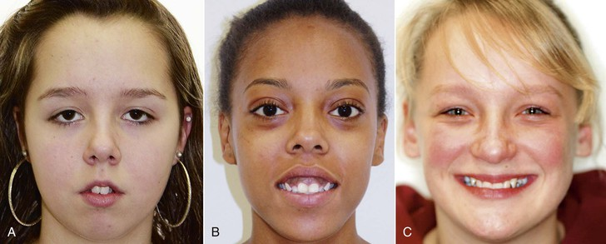
Classification
Moyers
Heredity
Heredity
Developmental
Trauma
Physical agents
Habits
Disease
Malnutrition

Slide 8
Lundstrom human traits
Tooth size
Arch dimensions
Crowding/spacing
Abnormality of tooth shape
Abnormality of tooth number
Overjet and inter arch variations
Frenum attachment.

Slide 9
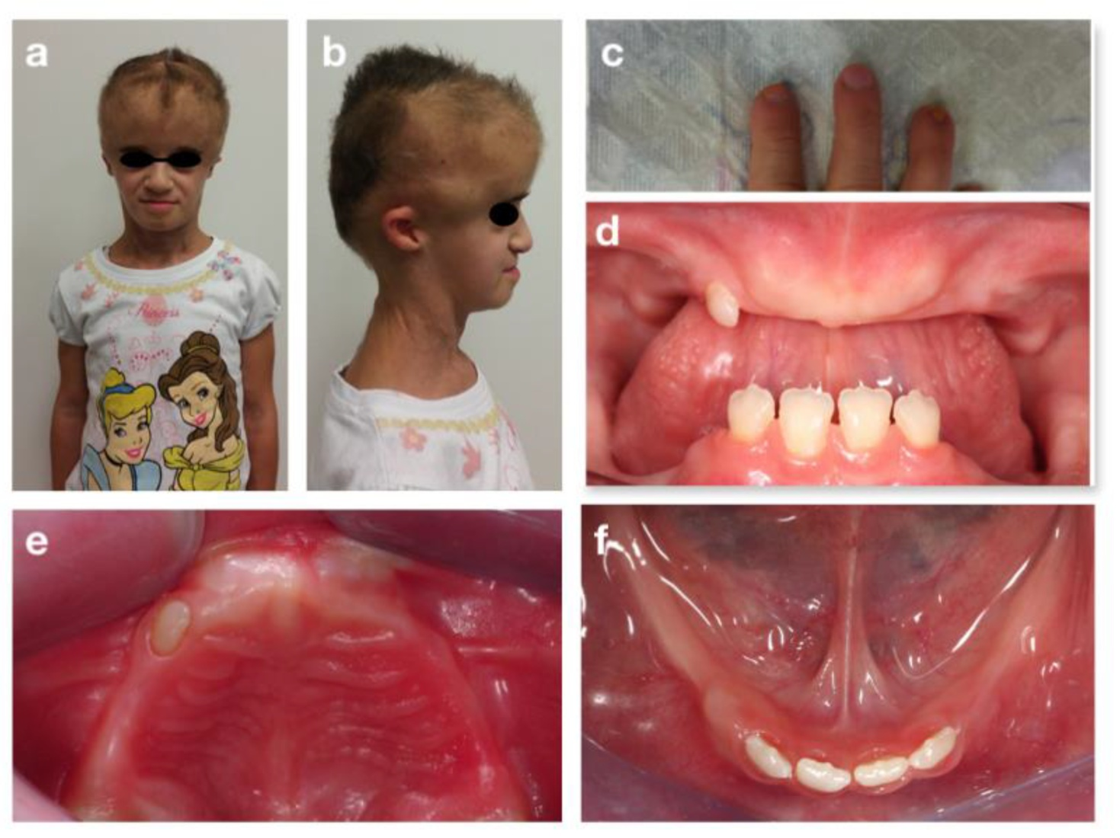
Developmental
Heredity
Developmental
Trauma
Physical agents
Habits
Disease
Malnutrition

Slide 10
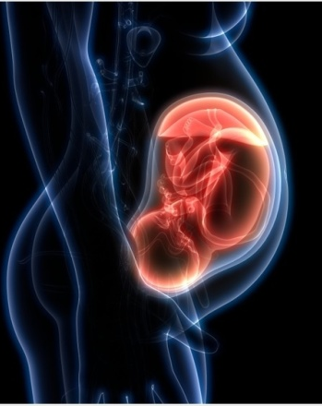
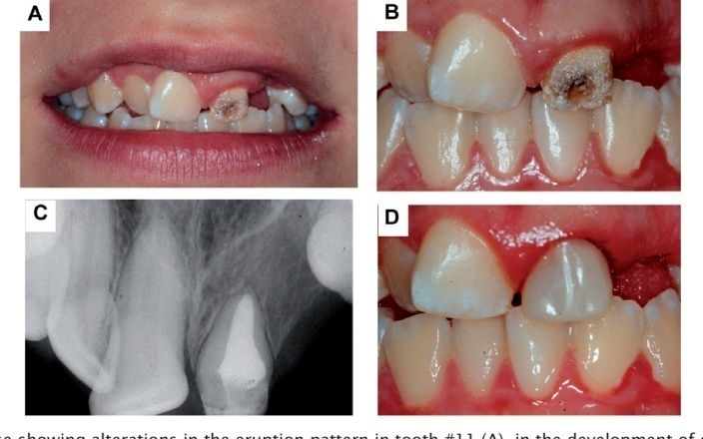
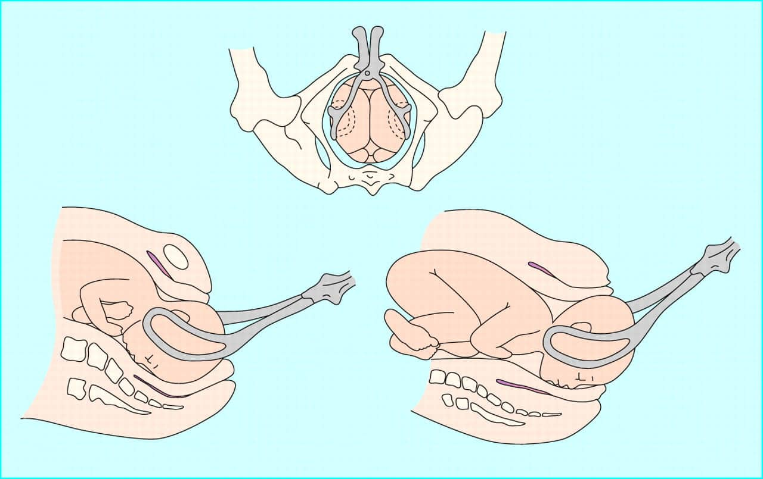
Trauma
Heredity
Developmental
Trauma
Physical agents
Habits
Disease
Malnutrition

Slide 11
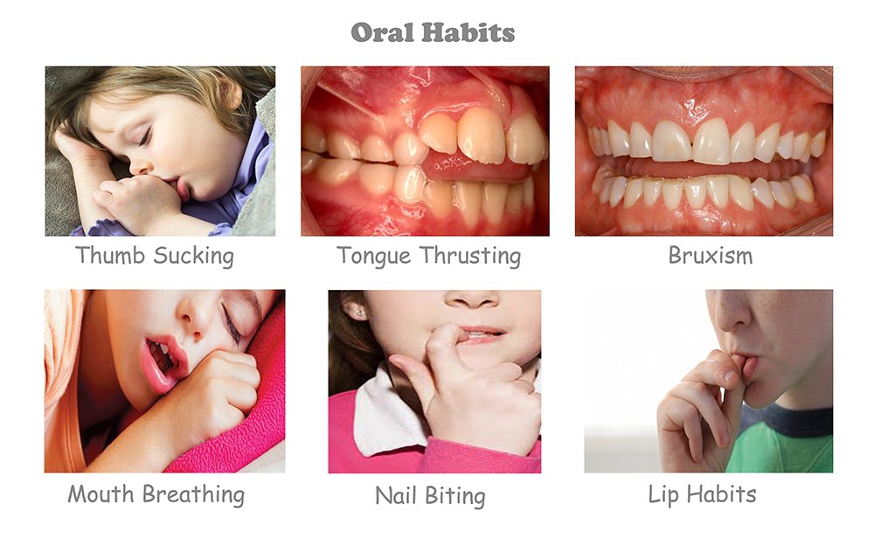
Habits
Heredity
Developmental
Trauma
Physical agents
Habits
Disease
Malnutrition

Slide 12
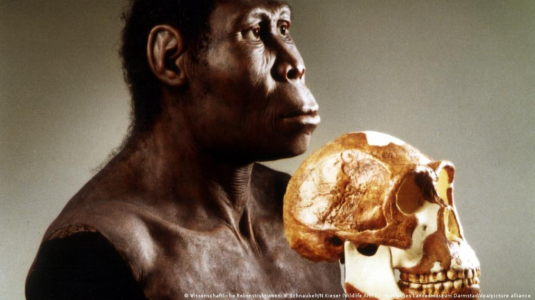
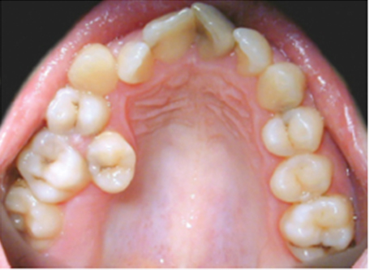
Physical agents
Heredity
Developmental
Trauma
Physical agents
Habits
Disease
Malnutrition

Slide 13
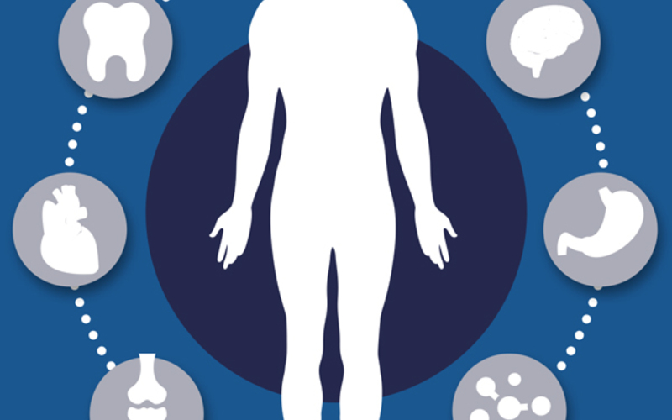
Diseases
Heredity
Developmental
Trauma
Physical agents
Habits
Disease
Malnutrition

Slide 14

Heredity
Developmental
Trauma
Physical agents
Habits
Disease
Malnutrition

Slide 15
White and Gardiners classification of etiology of malocclusion
Etiology
Dental base
Pre eruption
Post eruption

Slide 16
Graber classification of Etiology of Malocclusion
Graber divided the etiologic factors as general and local factors and presented a very comprehensive classification.
This helped in clubbing together of factors which make it easier to understand and associate a malocclusion with the etiologic factors.

Slide 17
General factors
G-genetic (heredity/congenital)
E-environmental(pre &post natal)
N-nutrition
E-endocrine imbalances/metabolic
R-rest of mandible /chin
A- abnormal habits
L- local trauma ,labour trauma

Slide 18
Local factors
LOCAL FACTORS
1. Anomalies of number:
a. Supernumerary teeth
b. Missing teeth (congenital absence or loss due to accidents, caries, etc.).
2. Anomalies of tooth size
3. Anomalies of tooth shape
4. Abnormal labial frenum: mucosal barriers
5. Premature loss
6. Prolonged retention
7. Delayed eruption of permanent teeth
8. Abnormal eruptive path
9. Ankylosis
10. Dental caries
11. Improper dental restorations.

Slide 19
Heredity
Skeletal structuresThe underlying basal bone and other associated cranial bone structures are partially inherited. The Class III skeletal pattern is most commonly associated with familial tendencies.

Slide 20
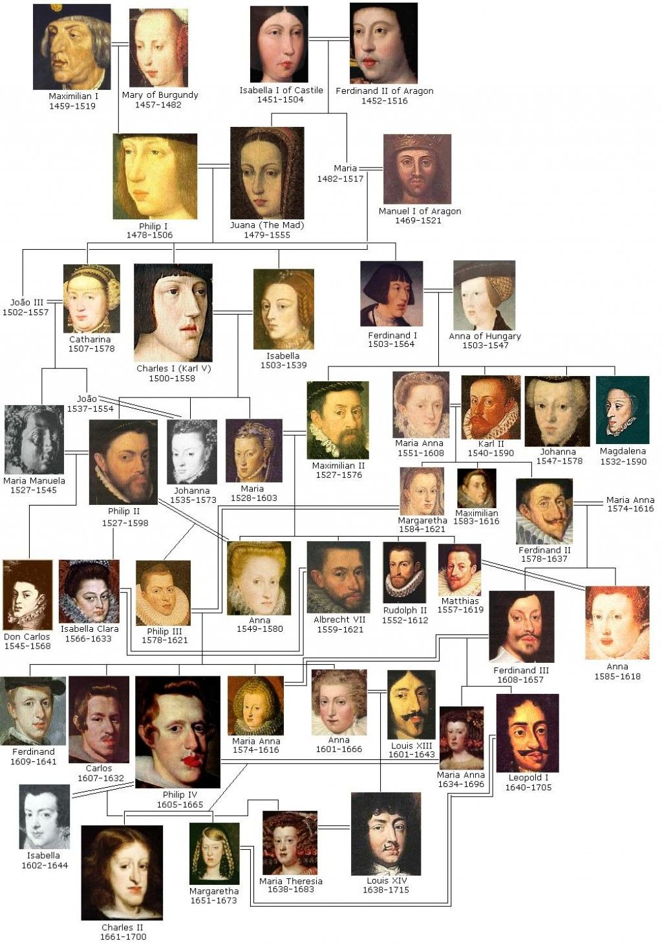
Habs burgs jaw.

Slide 21
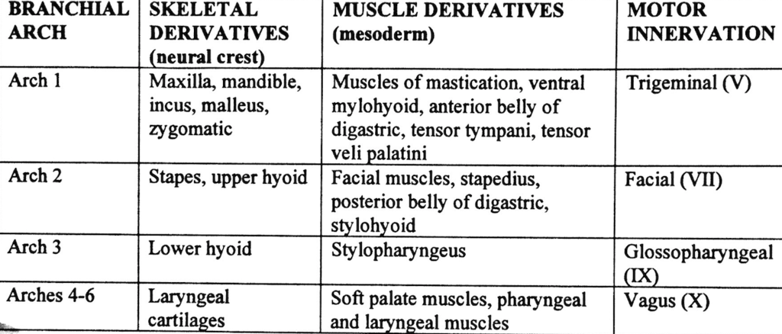
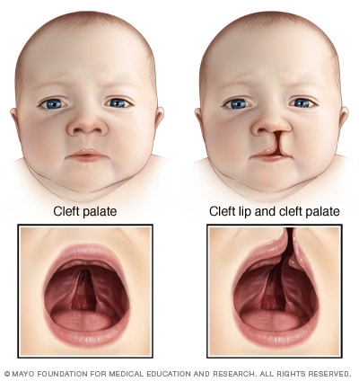
Congenital
Congenital factors Congenital defects include those malformations that are seen at the time of birth.
These are generally maldevelopments of the 1st and the 2nd branchial arches.

Slide 22
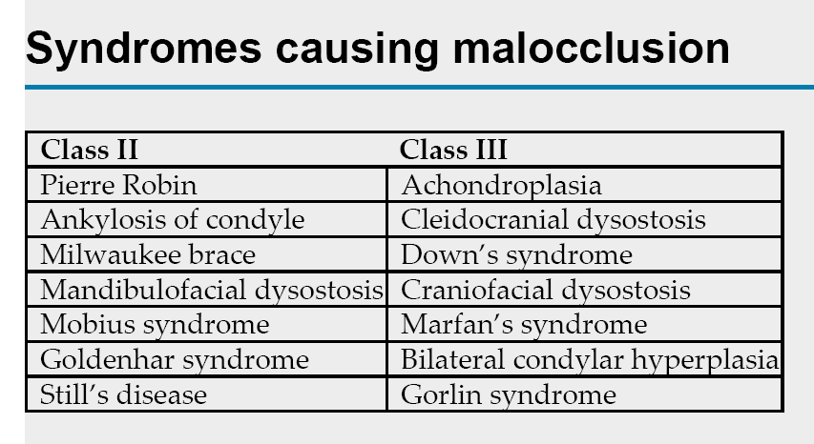

Slide 23
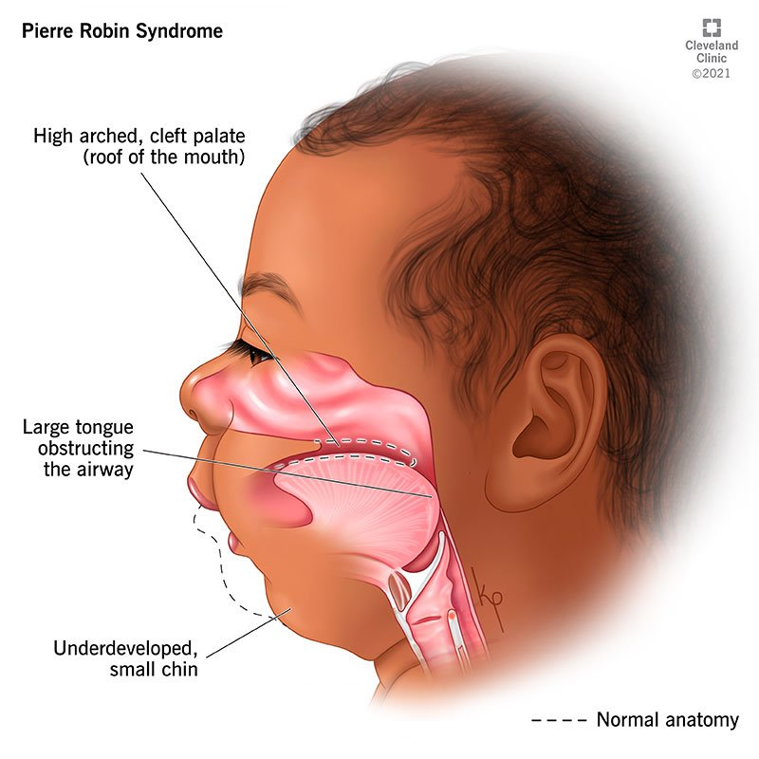
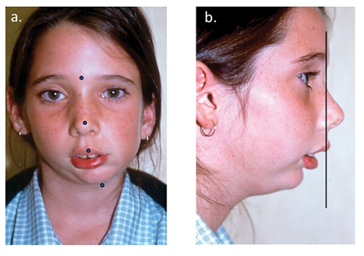
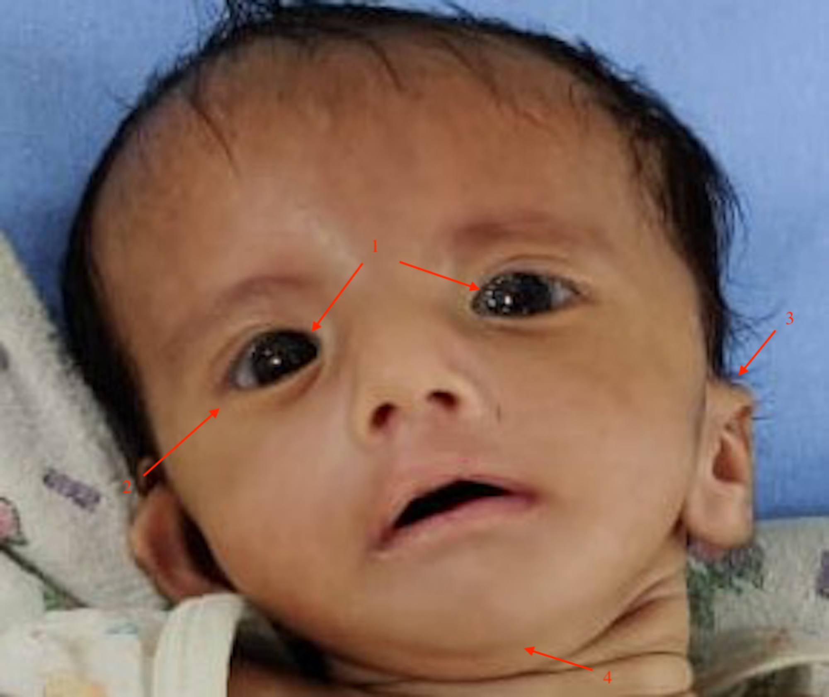
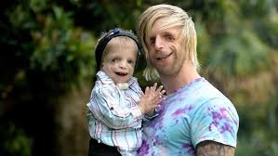
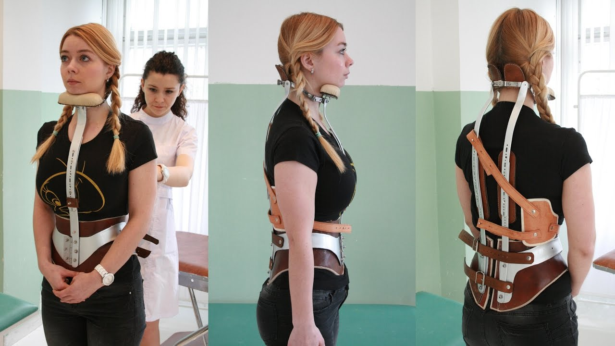

Slide 24
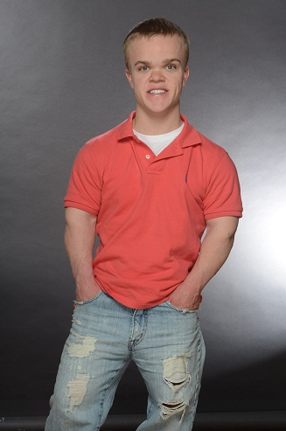
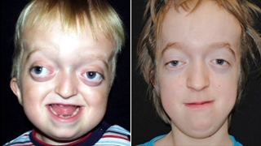
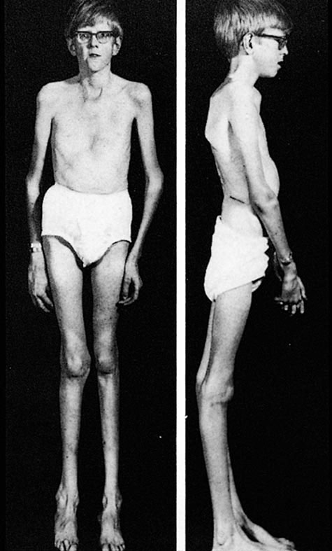
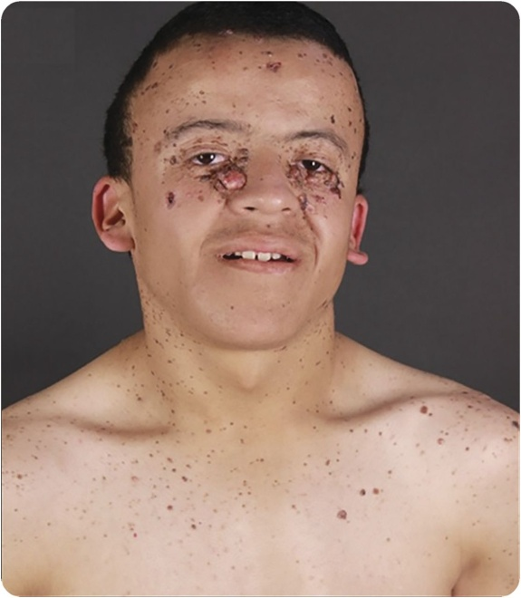
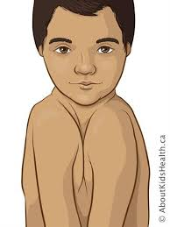
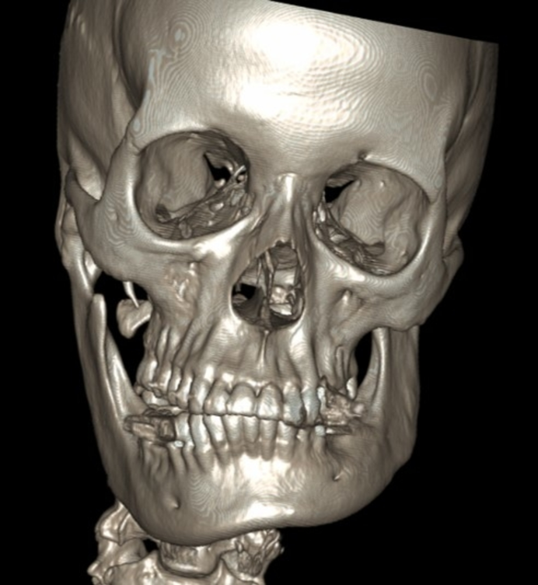

Slide 25
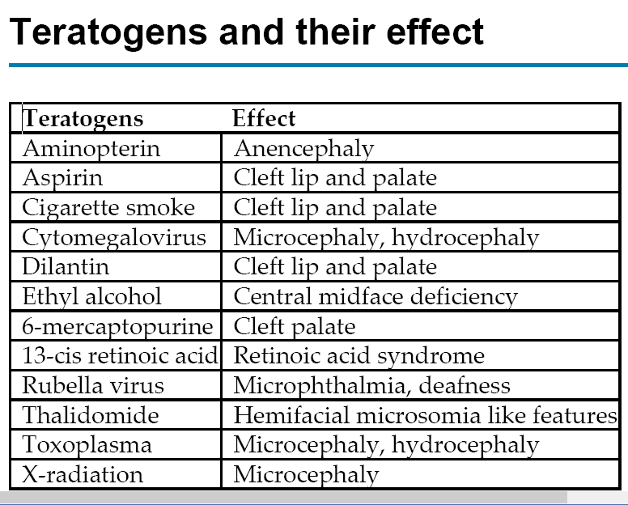

Slide 26
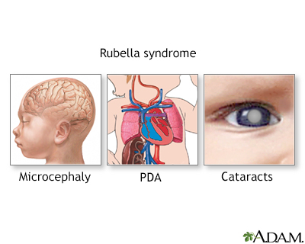
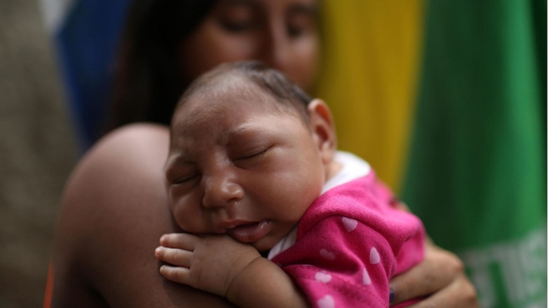
Predisposing metabolic climate and disease
Under this three separate conditions need to be stressed upon: a. Endocrine imbalance
b. Metabolic disturbances
c. Infectious diseases.

Slide 27
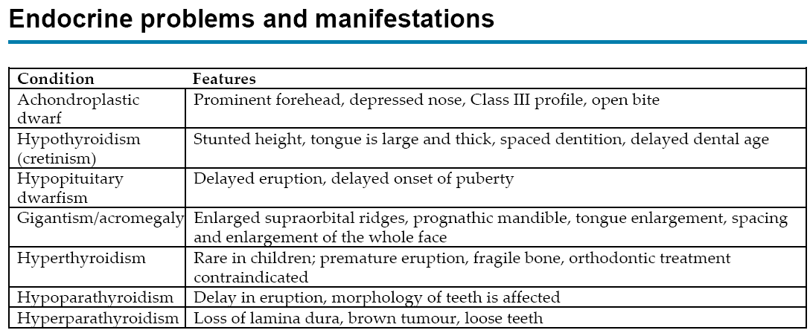

Slide 28
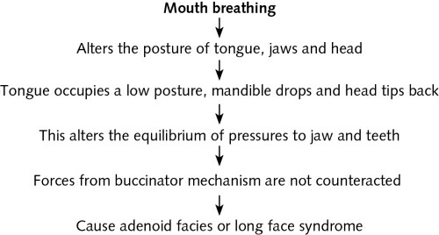
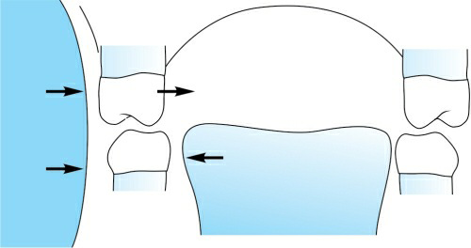
Habits

Slide 29
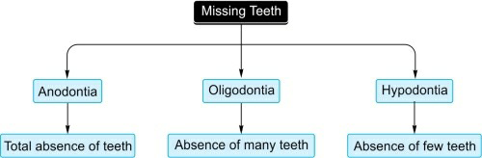
Local factors
Third molar > lower second premolar > upper lateral incisor > upper second premolar > lower central incisor

Slide 30
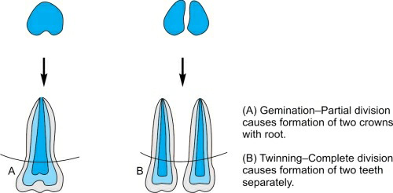
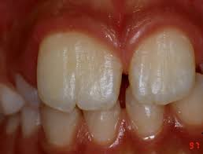
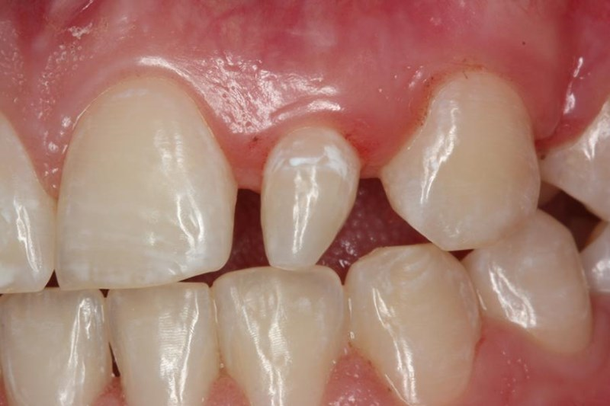
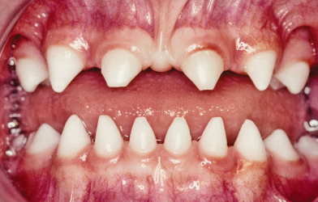
Size and shape

Slide 31
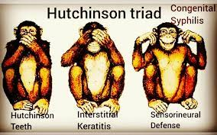
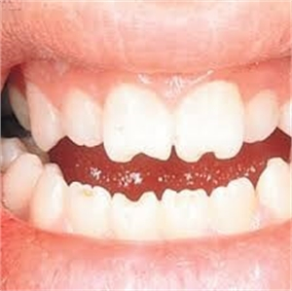
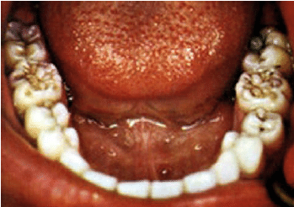

Slide 32
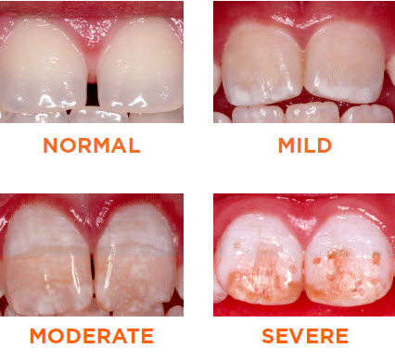
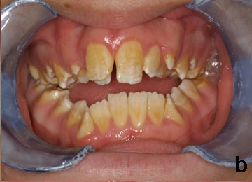
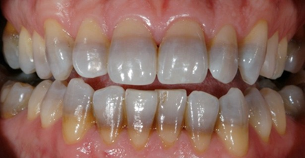
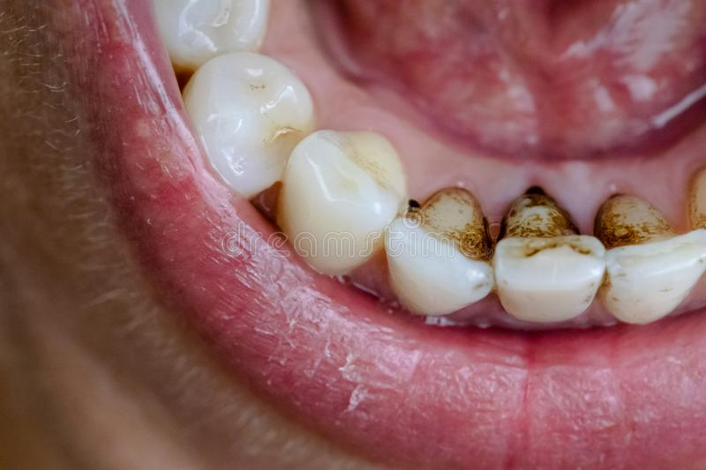

Slide 33
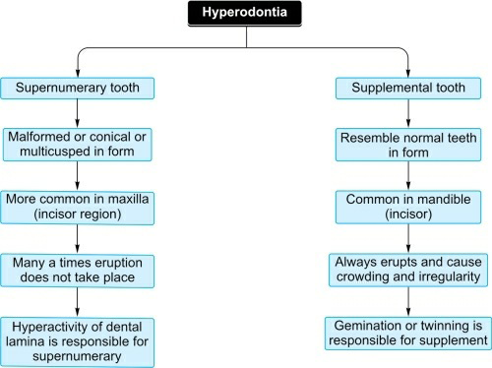

Slide 34
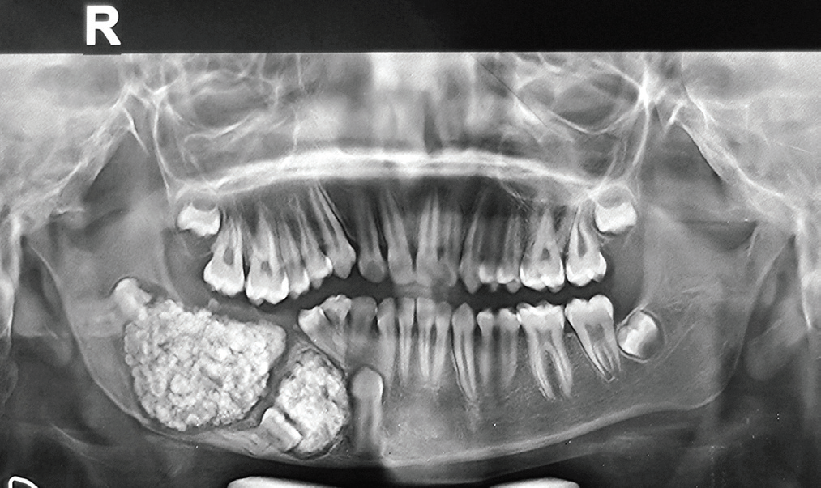
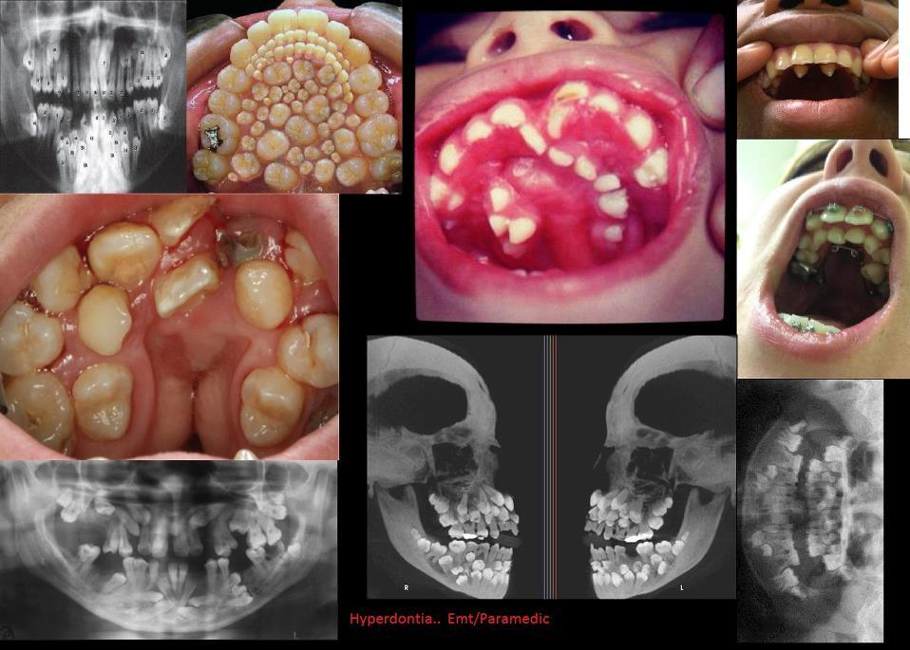
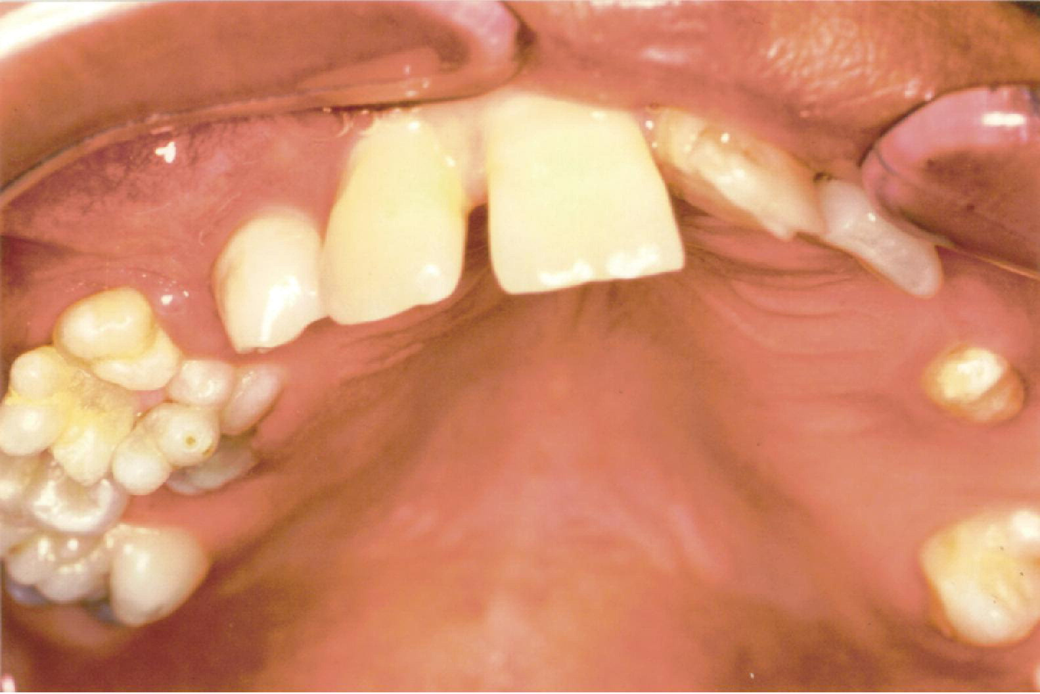

Slide 35
Delayed eruption/dentitiotarda
• There are two mechanisms involved in tooth eruption:
a. Resorption of the deciduous roots and overlying bone.
b. Guidance of the erupting tooth into the path created.
• Interference with any one mechanism can lead to delayed eruption of tooth.
• In cleidocranial dysostosis, delayed eruption occurs due to defective bone resorption.
• Presence of supernumerary tooth,
• Early loss of deciduous tooth ,
• Mucosal barrier ,
• hypothyroidism, hypopituitarism, cause delay in eruption.
• Ankylosis of the primary tooth .

Slide 36
Ectopic eruption/abnormal eruptive path
• Malposition of a tooth bud,
• Maxillary first permanent molar and mandibular incisors are the frequently affected teeth.
• Maxillary first molar erupts & resorption of roots of second primary molars.
• Ectopic eruption could be due to arch length deficiency.
• Transposition of the lateral incisor and canine.
• Retained root fragment of primary tooth.

Slide 37
Early loss of primary teeth.
• Two important functions of the primary teeth are:
a. To act as space maintainers for the successor.
b. To maintain the opposite tooth in the occlusal level.
• Premature loss of the primary tooth will result in loss of space and also derangement of occlusion.
• Loss of primary tooth in the anterior region does not cause significant change in arch relationship.

Slide 38
Retained deciduous teeth
• This is a condition where there is delay in eruption of permanent successor due to the presence of deciduous tooth beyond its chronological age.
• There are two types of retained deciduous teeth:
(i) those with permanent successor and
(ii) those with missing permanent successor.
• Most frequently retained primary teeth are the primary canines
and primary second molars.

Slide 39
Reasons for retention of primary teeth
• Absence of permanent successor
• Ectopic eruption of permanent successor
• Impacted permanent tooth
• Presence of odontome
• Ankylosis of primary tooth.
• Hypothyroidism

Slide 40
Trauma as aetiologic factor
Trauma can affect either the jaws or teeth or both.
Trauma to jaws:
➤ Any fracture to the condylar neck can retard the mandibular
growth.
➤ Trauma to TMJ also affects mandibular growth (e.g. forceps
delivery).
➤ Mechanism by which trauma causes retarded growth is that it
interferes with function.
➤ Loss of function either due to scar or immobilization retards the
growth of mandible.
➤ In children, conservative management of fracture with early
mobilization is advised

Slide 41
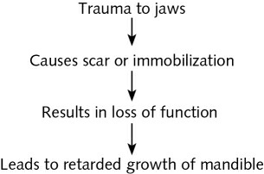

Slide 42
Trauma to teeth:
➤ Trauma to teeth causes malocclusion in three ways:
a. Damage to permanent tooth buds .
b. Drift of permanent teeth after premature loss of primary teeth
c. By direct injury to permanent teeth
➤ The effects of trauma to the tooth are as follows:
1. Trauma to primary teeth
2. Displacement of the crowns of permanent tooth
Defective enamel formation
Short stunted roots (or) dilacerated roots

Slide 43

Trauma

Slide 44
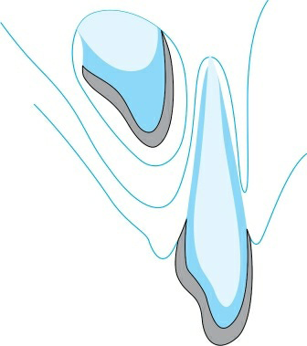

Slide 45
High-frenal attachment/persistent labial frenum
➤ In the newborn, the frenum is seen as a large, fleshy attachment which joins low down over the crest of the alveolus into the incisor papilla.
➤ With time, it recedes up the labial surface of the alveolar process.
➤ Recession is because of the vertical growth of this portion ofmaxilla.
➤ Persistence of the labial frenum breaks the continuity of transseptal fibres between the central incisors.
➤ In the presence of invaginated labial frenum, the direction of transseptal fibres is horizontal for a very short distance away from midpalatal suture

Slide 46


Slide 47


Conclusion

